Slide 1
A new R package statTarget
Hemi Luan hemi.luan@gmail.com; hm-luan@msn.com
Hong Kong Baptist University

Slide 2
statTarget An easy to use tool provide a graphical user interface for quality control based signal correction, integration of metabolomic data from multiple batches, and the comprehensive statistic analysis for non-targeted and targeted approaches.

Slide 3
Work flow of large scale metabolomcis
Samples and QC samples
Aliquot 1 (LC-MS-ESI+)
Aliquot 2 (LC-MS-ESI-)
Aliquot 3 (GC-MS-EI)
Sample preparation
(proteins precipitation with methanol)
Sample preparation
(proteins precipitation with methanol)
Methyl chloroformate (MCF) derivatization
Samples preparation
LC-MS-ESI+ analysis
Batch1
LC-MS-ESI+-analysis
Batch1
GC-MS-EI
analysis
Batch1
Batch2
Batch2
Batch2
Batch3
Batch3
Batch3
Batch4
Batch4
Batch4
Batch5
Batch5
Batch5
Signal correction
(QC-RLSC algorithm )
Signal correction
(QC-RLSC algorithm )
Signal correction
(QC-RLSC algorithm )
Quality control and quality assurance strategy
Data analysis
Data analysis

Slide 4
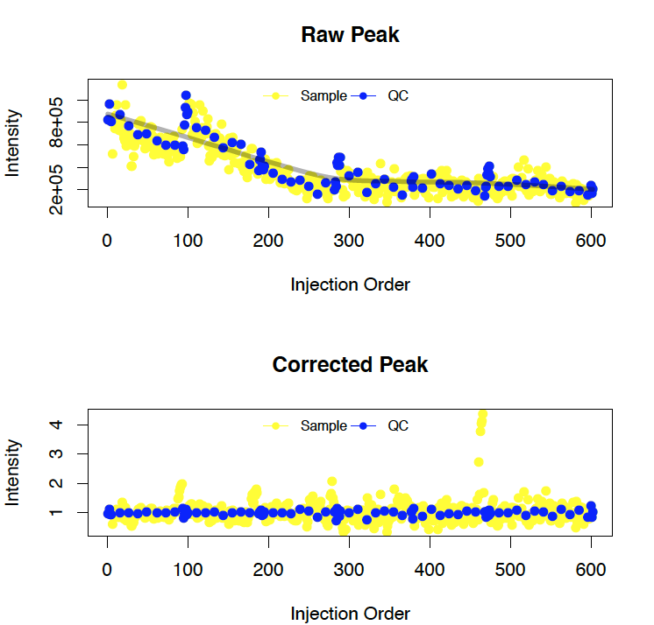
The robust QC based quality control procedures
Bank (5) QC(5) True samples (5~10) QC True samples (5~10) QC QC
Repeat
(n)
Experimental design
QC-RLSC algorithm: The measured data of QC samples is smoothed by the Loess method. The coefficient values between QC samples are interpolated by the cubic-spline. the entire datasets is aligned to the spline result.
*QC: Quality samples
Loplot

Slide 5
The pipeline of statTarget
Meta info.
Metabolite Profile
Metabolite Profile
80% rule
No
No
Nosie
80% rule
Multiple imputations
Multiple imputations
Missing value
Missing value
QC-RLSC
QC based Signal Correction
Variance stabilization and normalization
Comprehensive statistic analysis
PCA
ROC & AUC
PLS-DA
P- value
Box plot
Random Forest
Volcano plot
Fold changes
Descriptive statistics
Odd. ratio

Slide 6
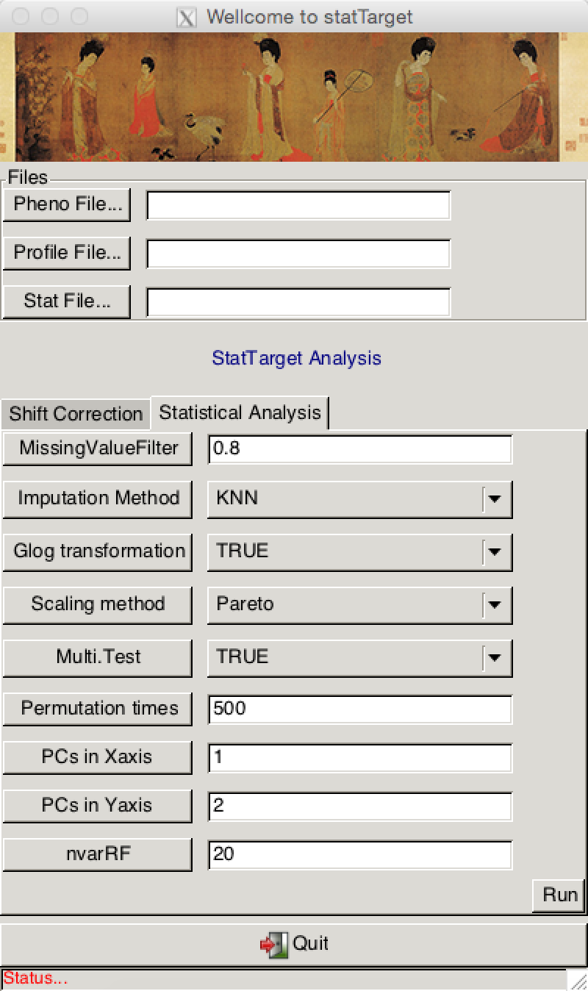
Main - GUI
Component 1 – Shift Correction
statTarget
A graphical user interface, easy to use tool provide quality control based signal correction, integration of metabolomic data from multiple batches, and the comprehensive statistic analysis for non-targeted and targeted approaches.
Component 2 Statistical Analysis

Slide 7

Parameters of Shift Correction
Meta info. with CSV format
Expression data with CSV format
Removing peaks with more than 80% missing values (NA or 0) in each group. (Default: 0.8)
The smoothing parameter which controls the bias-variance tradeoff. if the QCspan (0.20~0.75) is set at '0', the generalised cross-validation will be performed to avoid overfitting the observed data. (Default: 0)
The parameter for imputation method.(i.e., nearest neighbor averaging, "KNN"; minimum values for imputed variables, "min", median values for imputed variables (Group dependent) "median” (Default: KNN)
Lets you specify local constant regression (i.e., the Nadaraya-Watson estimator, degree=0), local linear regression (degree=1), or local polynomial fits (degree=2). (Default: 2)

Slide 8
Parameters for Statistical Analysis
Expression data with CSV format
Removing peaks with more than 80% missing values (NA or 0) in each group. (Default: 0)
The parameter for imputation method.(i.e., nearest neighbor averaging, "KNN"; minimum values for imputed variables, "min", median values for imputed variables (Group dependent) "median” (Default: KNN)
Generalised logarithm (glog) transformation for Variance stabilization (Default: TRUE)
Scaling method before statistic analysis (PCA or PLS). Pareto can be used for specifying the Pareto scaling. Auto can be used for specifying the Auto scaling (or unit variance scaling). Vast can be used for specifying the vast scaling. Range can be used for specifying the Range scaling. (Default: Pareto)
The number of permutation times for PLS-DA model (Default: 20)
Multiple statistical analysis and univariate analysis (Default: TRUE)
Principal components in PCA-PLS model for the x or y-axis (Default: 1 and 2)
The number of variables in Gini plot of Randomforest model (=< 100). (Default: 20)

Slide 9
Data inputs for statTarget
transX() is to generate statTarget inputs from Mass Spectrometry Data software, like XCMS.
transX() directly read the .tsv file from diffreport function in XCMS software.
datpath <- system.file("extdata",package = "statTarget")
data <- paste(datpath,"xcmsOutput.tsv", sep="/")
transX(data,"xcms")
transCode(data,"xcms")
#statTarget Version >= 1.5.6

Slide 10
Data input for shift correction
Saved as .csv
Meta information (Pheno File)
sample | batch | class | order
batch01_QC01 | 1 | NA | 1
batch01_QC02 | 1 | NA | 2
batch01_QC03 | 1 | NA | 3
batch01_C05 | 1 | 1 | 4
batch01_S07 | 1 | 2 | 5
batch01_C10 | 1 | 1 | 6
batch01_QC04 | 1 | NA | 7
Do not change the column name
Class: The QC should be labeled as NA. Order : Injection sequence
Batch: the analysis blocks or batches.
Sample name should be consistent in Pheno file and Profile file.
Metabolites ID Sample name
Expression data (Profile File)
name | batch01_QC03 | batch01_QC01 | batch01_QC02 | batch01_C05
78.02055 | 14023 | 13071 | 15270 | 0
452.00345 | 22455 | 10737 | 27397 | 16898
138.96337 | 6635.4 | 8062.3 | 6294.6 | 6380.5
73.53838 | 26493 | 26141 | 25944 | 14949
385.12885 | 57625 | 56964 | 59045 | 78490
237.02815 | 105490 | 90166 | 92315 | 90442
222.02744 | 34676 | 34025 | 30253 | 30470
399.33298 | 42457 | 44250 | 41942 | 209710
394.23541 | 36120 | 29848 | 36707 | 14463
446.13947 | 7789.3 | 9748.6 | 8932.4 | 0

Slide 11
Data input for statistical analysis
Saved as .csv --Stat File
Sample name Class Factor
The sample class or group should be matched with ordinal number, e.g., 1,2,3,4,5…
Metabolites ID
Name | Group | 1 | 2 | 3 | 4 | 5
21 | 1 | 0.0269394 | 0.212481308 | 0.421938647 | 0.072731082 | 0.476999498
71 | 1 | 0.004056653 | 0.104999071 | 0.014279731 | 0.024105957 | 0.167094773
50 | 1 | 0.004056653 | 0.570556469 | 0.171406702 | 0.02019163 | 0.061832702
14 | 2 | 0.014602305 | 4.650099858 | 0.022114445 | 0.007105695 | 0.156819962
74 | 1 | 0.045739012 | 0.36876884 | 0.019088228 | 0.006108264 | 0.278668387
9 | 2 | 0.008098186 | 0.235025541 | 0.182280343 | 0.025622084 | 0.046807751
32 | 1 | 0.019498917 | 0.683527006 | 0.035527196 | 0.014959372 | 0.430006029
20 | 2 | 0.004056653 | 0.060402839 | 0.015232417 | 0.007500019 | 0.149098523
168 | 1 | 0.015402529 | 1.036678761 | 0.155572884 | 0.022977097 | 0.152309431
28 | 2 | 0.036884932 | 6.041892945 | 0.103977726 | 0.017530557 | 0.299275534
62 | 2 | 0.031621389 | 6.028034401 | 0.352036582 | 0.086246923 | 0.935893131
Concentration

Slide 12
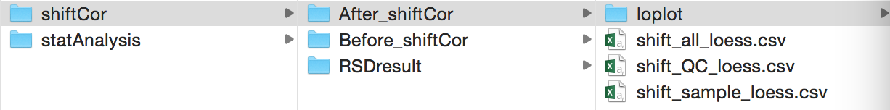
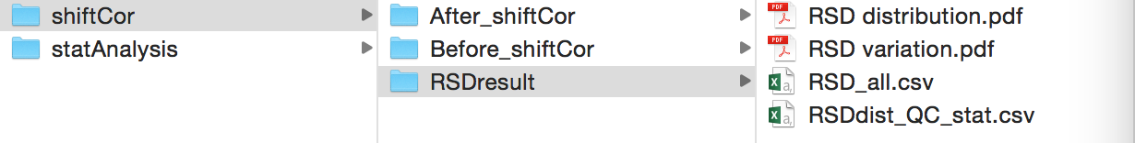
Output for Shift Correction

Slide 13
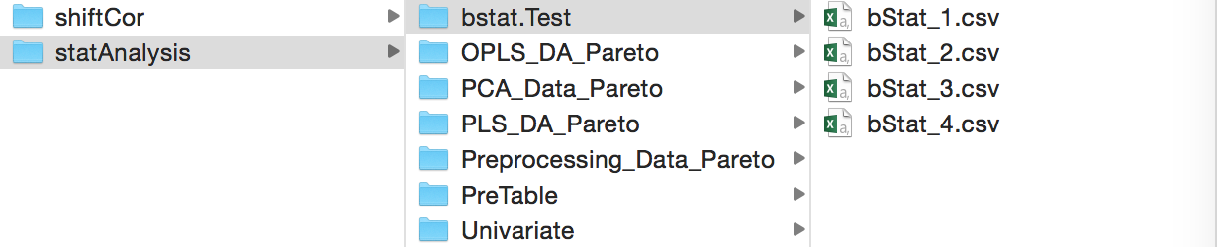
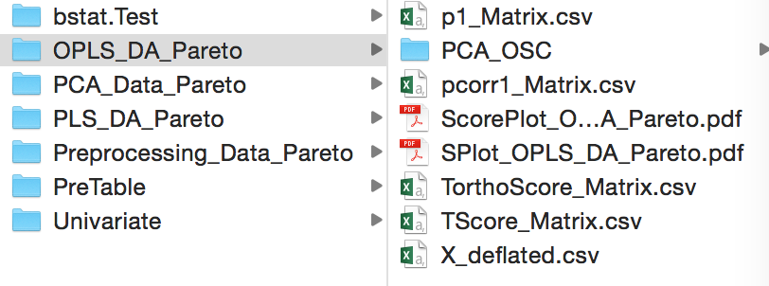
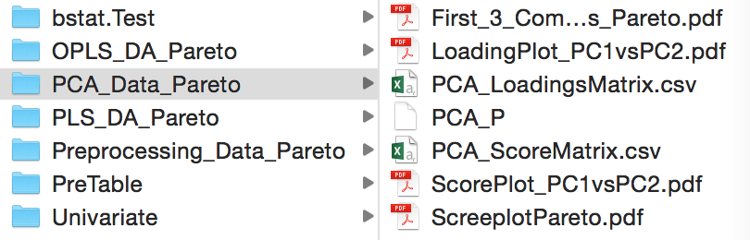
Output for Statistical Analysis

Slide 14

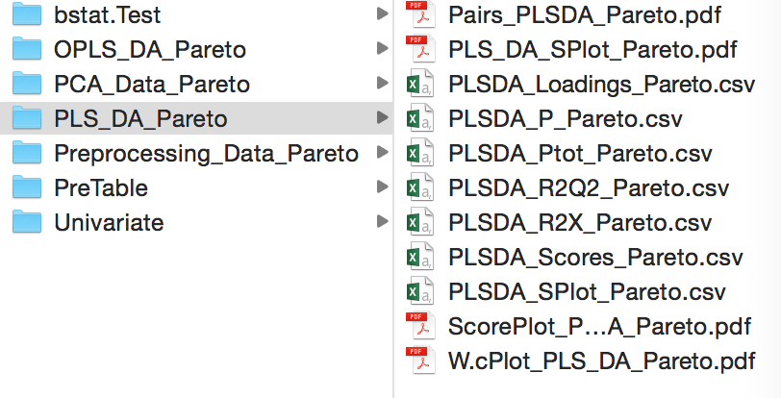
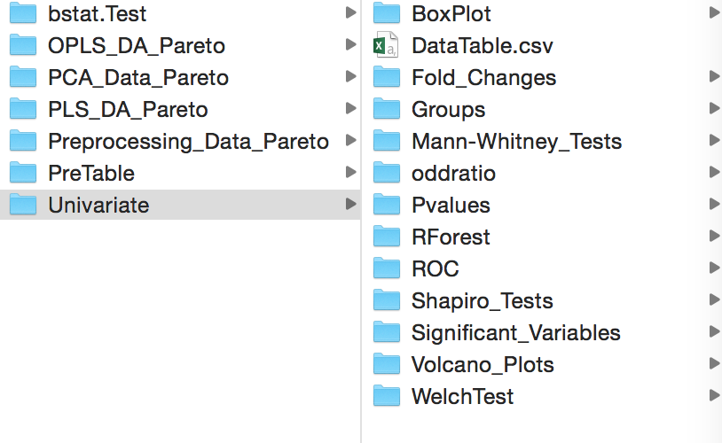

Slide 15
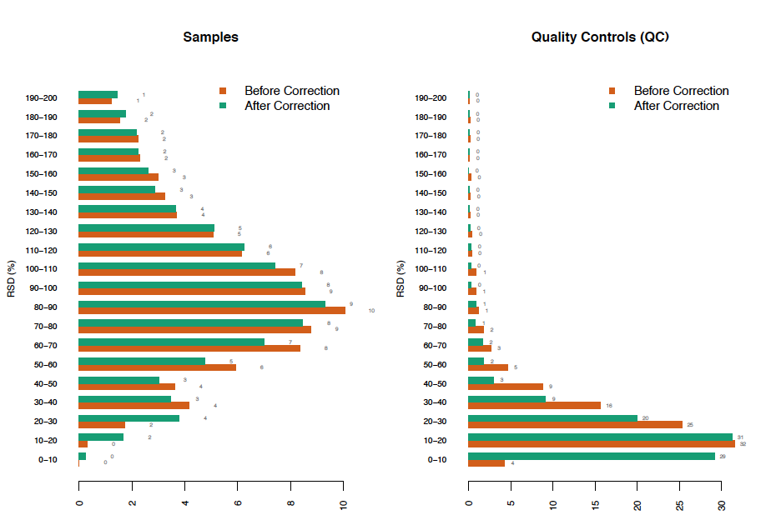
Typical plot in for Shift Correction function
loplot
Distribution of RSD

Slide 16
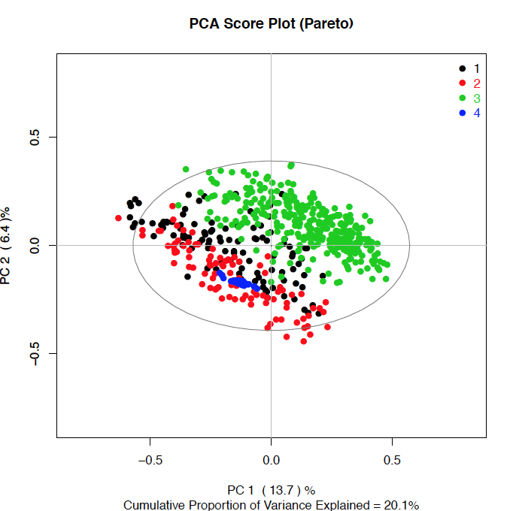
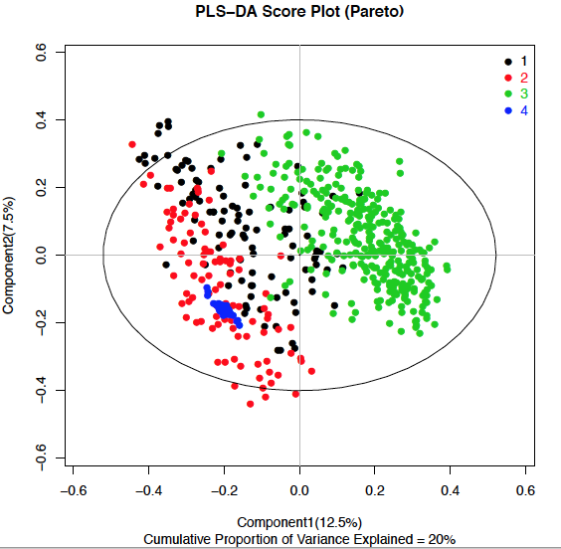
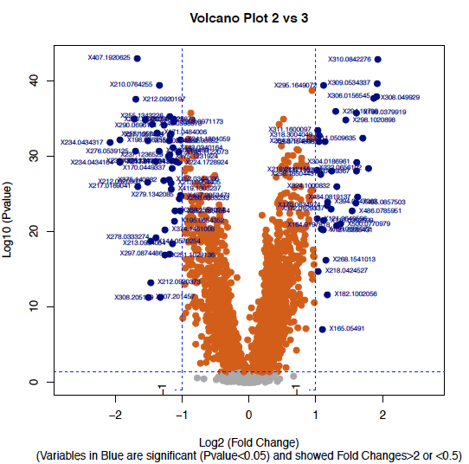
Typical plot in for Statistical Analysis
PCA score plot PLS-DA score plot Volcano plot

Slide 17
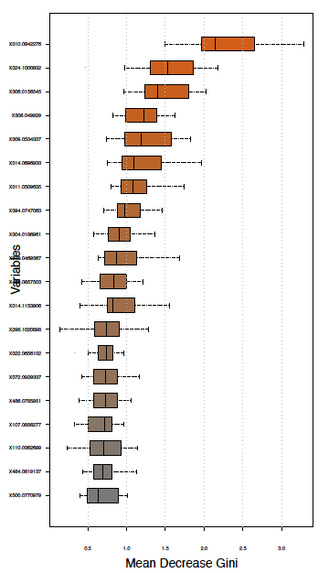
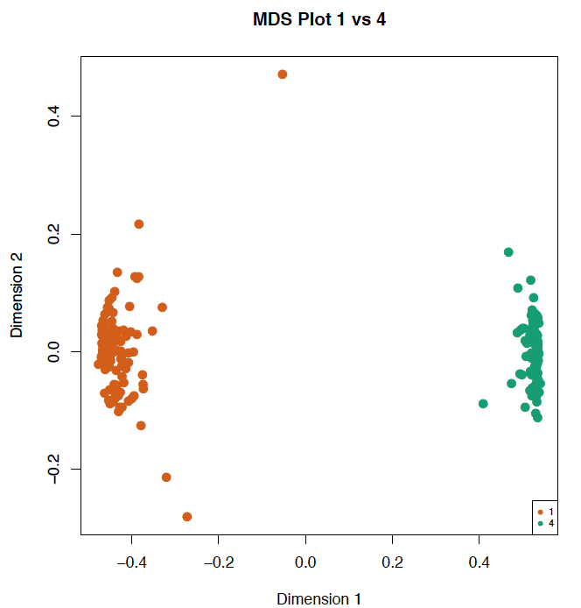
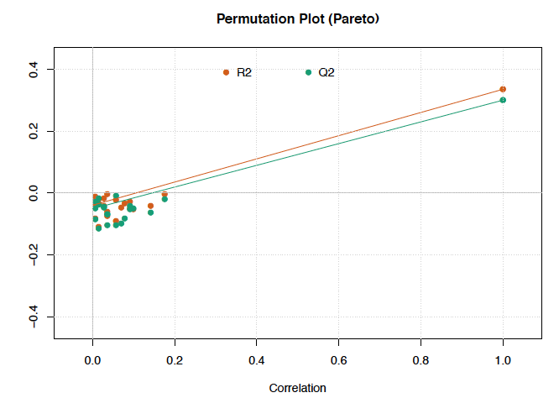
Permutation for PLS-DA Random Forest MDSplot Random Forest Gini index plot

