Slide 1

Transforming Illiteracy into Empowerment
Prepared By: Muhammad Khalid Haq

Slide 2
Nation’s Strengths
&
Religion
Population
Notes:
5% visit mosques and out of these 50% have issues in Namaz. Also, 50% population is female gender and almost have less than 2% contribution in national growth in living in remote town and villages.

Slide 3
Mission & Vision
Unite Namaz-inspired spiritual knowledge with academics, social awareness, and skill development.
A literate, morally strong Pakistan where opportunity empowers communities for sustainable growth.
Notes:
Allama Iqbal’s vision of the Two‑Nation Theory provided the philosophical basis, which Quaid‑e‑Azam Jinnah turned into the political reality of Pakistan.

Slide 4
Goals & Objectives
Revisiting Iqbal’s dream and Jinnah’s vision to find lost destiny
Transform religion and population from perceived weaknesses into its greatest nation’s strengths
Established a role‑model setup designed for communities replication
Endeavour expanding welfare program to millions of schools across Pakistan

Slide 5



Slide 6
Where We Stand Today
Progress
  Registered 100 Schools with 1000+ Students.
  Mobilized donors to acquire funds for a sustainable role-model operation (fund utilized > 9.0M PKR).
Performance
  250+ Proper Namaz Practices Recorded via FSSS Schools.
  Sustainable Community Jobs 120 (60% staff female).
  Empowering 54 staff with Hifz allowance — most of them female.
  Monthly ration and meal support of approx. 400,000 PKR, benefiting around 200 families.

Slide 7
Virtual Schools
Education at the Doorstep
No civil structure, furniture, utility bills, or supporting staff required.
No uniform, no time rules, and no stationery. Minimum 01 hour anytime in day. School going students are also encouraged for religious part.
Any citizen who has space for 10 students, can lead proper Namaz, recite the Quran, and teach up to Grade 5 is eligible to qualify as an FSSS franchise.
Operates without computers or internet, making it accessible and replicable in resource‑limited areas.

Slide 8
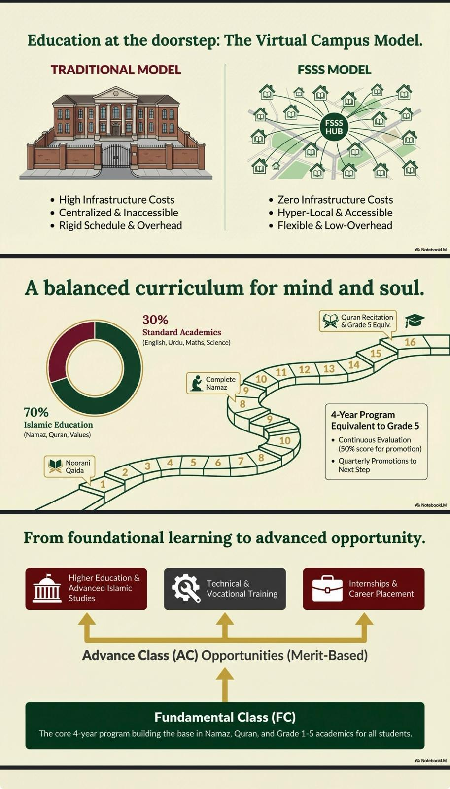

Proper Tajweed
Understanding Msg
Offering
Understanding
Purpose & Benefits

Slide 9

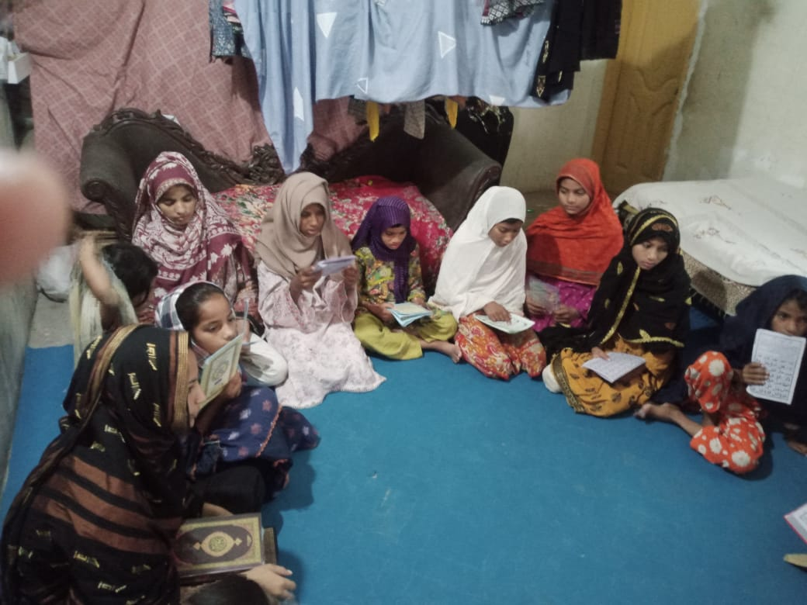
FSSS School: A Snapshot
A Physical Snapshot, FSSS School

Slide 10
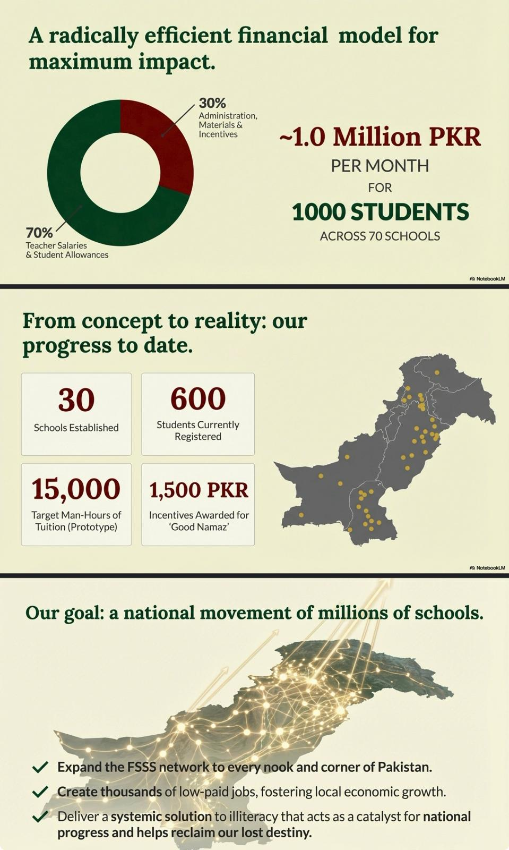

Slide 11
Governance & Regulations
QMS compliance.
QA/QC monitoring.
Incentives (Hifz allowance, merit recognition).
Penalties for non-compliance and poor performance.

Slide 12
Transparency & Control
A hybrid software solution with control points for manual data computerization.
Regular reporting provide support for decision making into operations, compliance, and outcomes.

Slide 13
Every Moment,
Tangible Digital Progress
From 100 schools, 50 proper Namaz are added to the tally every month.
Access to structured learning up to Grade 4 with %promotion report on monthly basis.
Creating respectable and sustainable employment opportunities in resource‑limited communities — especially for women.
Hifz allowance and reading Glasses in 30 mosques/month to support strengthening spiritual development.

Slide 14
Implementation Plan
Public a role-model comprehensive package with all SOPs for adoption by private sector industries, NGOs, government institutes, and community welfare setups.
Partner with large and effective welfare organizations such as Al‑Khidmat to drive widespread implementation and maximize community impact.

Slide 15
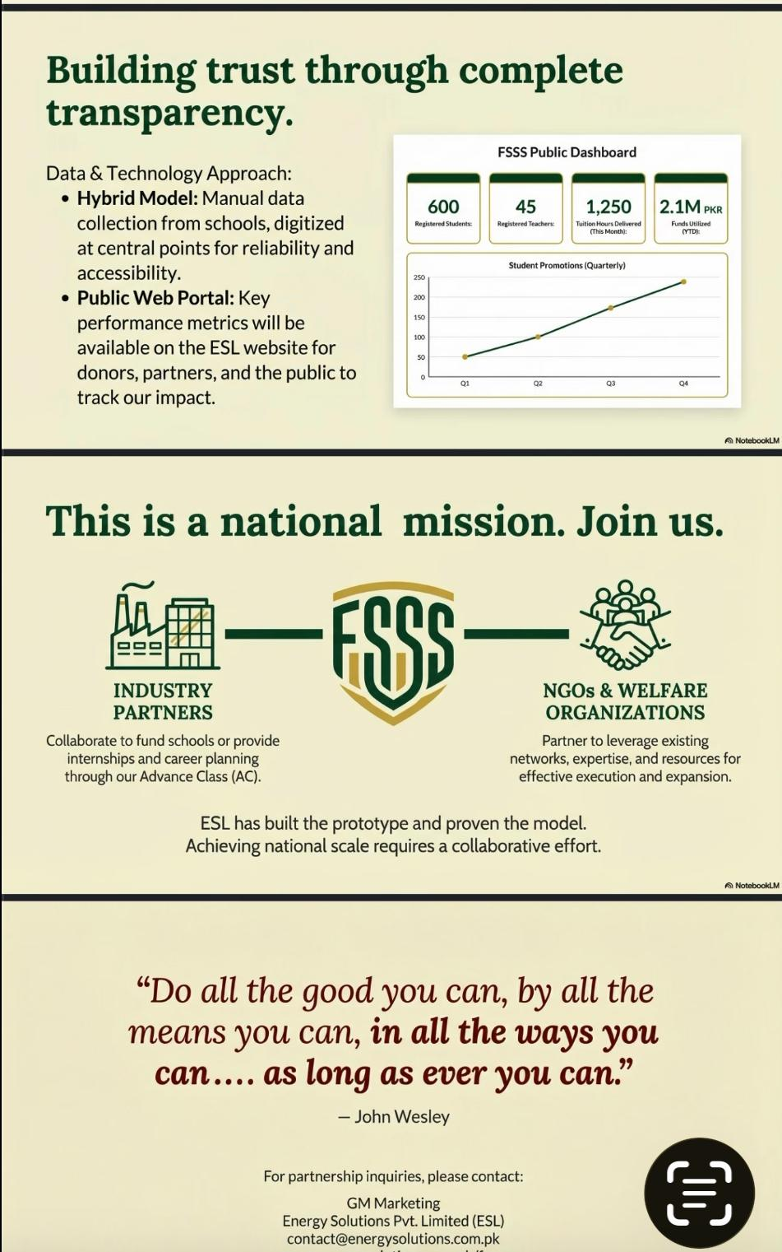
Hope: 100% access to schools for all, creating millions of jobs for women in remote towns, integrated with core religious activity (Namaz).

Slide 16
Other Key Features
Generic Schools: Small setups with fewer than 10 students, requiring only 01 proper Namaz every 02 months.
FSSS Advance Category: Offers scholarships, sponsorships, internships, career planning, and short‑term loans to support daily earning opportunities.
Stand‑Alone Setups: Provides life‑cycle support for individuals already running welfare schools.
Quran Promotion: Ankhen Project places reading glasses in mosques across remote towns to encourage and facilitate Quran recitation.

Slide 17
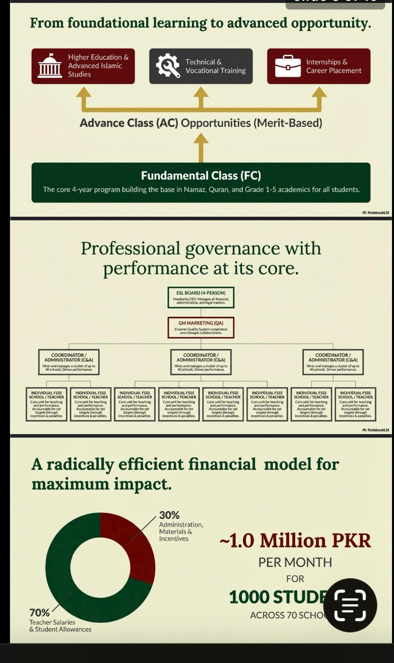

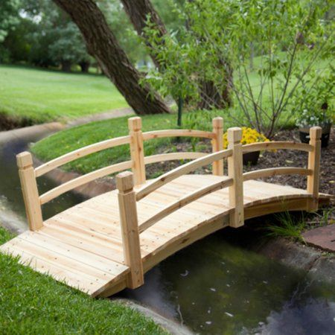
Seminaries
Standard Schools
FSSS School
1000 Students & 100 Schools

Slide 18
Funding Framework
Basic Setup: Energy Solutions Private Ltd. (ESL) provides the initial setup, covering expenses on stationery and other essentials.
Donor Support: With 90% of funds contributed by donors, the model is firmly positioned for sustainability and scalability.

Slide 19
Knowledge Categories
Physical / Material (1%):
  Relates to what can be measured, observed, and interacted with using human senses and scientific instruments.
  Focused on tangible facts, processes, and material progress.
  Unfortunately, most of our attention has been limited to this small fraction of knowledge.
Spiritual (99%):
  Concerns meaning, consciousness, ethics, and the divine — knowledge beyond physical measurement.
  Provides guidance, purpose, and values that shape human life.
  Begins with Namaz, which serves as the foundation for accessing and nurturing this vast dimension of knowledge.

Slide 20

Namaz Importance
Every child should learn Namaz, recite the Qur’an with tajweed, and gradually understand its teachings so that the words of Allah guide their daily life and lead them towards success in this world and the Hereafter.
Cash Prizes at 03 Levels
L-01 Proper Offering
L-02 Understanding
L-03 Purpose & Benefits
💰

Slide 21
Spiritual(99%)→Begins with Namaz
Spiritual(99%)→Begins with Namaz
Spiritual(99%)→Begins with Namaz
Spiritual(99%)→Begins with Namaz
Spiritual(99%)→Begins with Namaz
Spiritual(99%)→Begins with Namaz
Spiritual(99%)→Begins with Namaz
Spiritual(99%)→Begins with Namaz
Together, we can transform illiteracy into empowerment, InshaAllah.
Thank-You

