Slide 1

Fireside Chat with
AEA Data Editor
Demystifying Reproducibility
Lars Vilhuber
Cornell University
The opinions expressed in this talk are solely the authors, and do not represent the views of the U.S. Census Bureau, the American Economic Association, or any of the funding agencies.
You may, however, find these opinions quite useful.
© Lars Vilhuber .

Slide 2
Data and Code Availability Policy

Slide 3

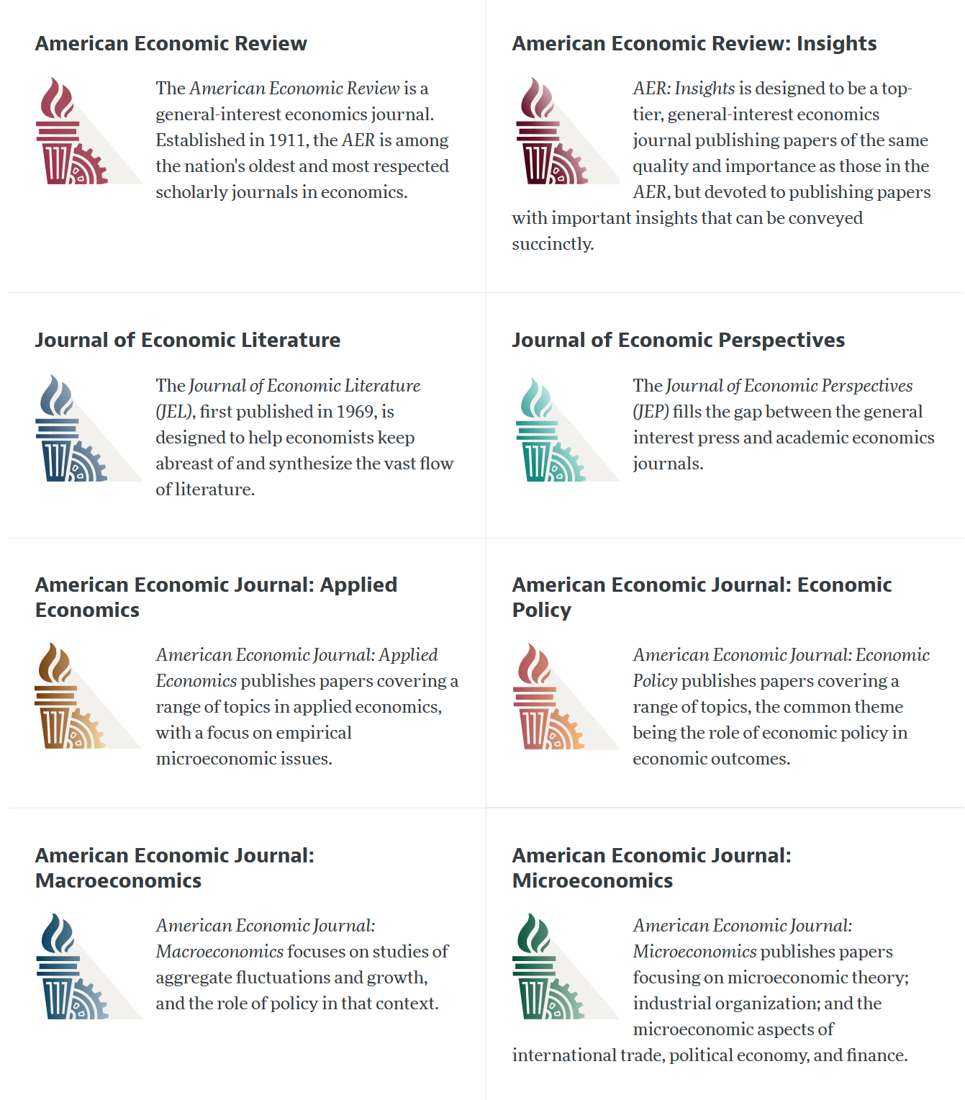

Slide 4
AEA Data & Code Availability Policy (2019)
It is the policy of the American Economic Association to publish papers only if the data used in the analysis are clearly and precisely documented and access to the data and code is clearly and precisely documented and is non-exclusive to the authors.
Authors of accepted papers that contain empirical work, simulations, or experimental work must provide, prior to acceptance, the data, programs, and other details of the computations sufficient to permit replication, as well as information about access to data and programs.
https://www.aeaweb.org/journals/data/data-code-policy

Slide 5
Current efforts at the AEA
Pre-emptively improve code archives
  By conducting reproducibility checks when we can
  By working with groups that conduct reproducibility checks
  when we cannot
Better archives
  Greater transparency of the code and data archives
Better provenance tracking
    Leave code where it is when appropriate
    Leave data where it is almost always
    Display that information
Notes:
Add logo from AEA

Slide 6
Reproduciblity checks:
The Process

Slide 7
Data citation and provenance analysis
Report on
provenance and data citations
Request for evaluation

Slide 8
Data citation and provenance analysis
Report on
provenance and data citations
Request for evaluation
Report on
computational reproducibility
Yes
Conduct reproducibility check
Can we access all the data?

Slide 9
Data citation and provenance analysis
Report on
provenance and data citations
Request for evaluation
Report on
computational reproducibility
Yes
Conduct reproducibility check
Can we access all the data?
No
Do we know how/
somebody who can?
Yes
Contact
third party
Conducts reproducibility check
No
Conduct
Code
check
Report on
potential reproducibility

Slide 10
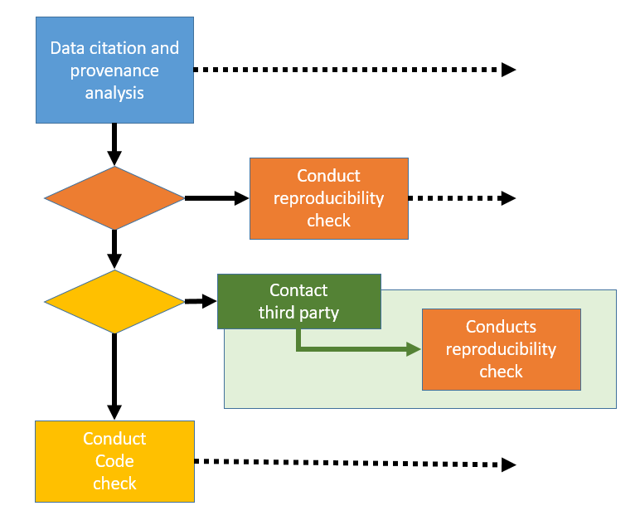
Request for evaluation
Report on
provenance and data citations
Report on
computational reproducibility
Report on
potential reproducibility
Summary indicator of reproducibility

Slide 11
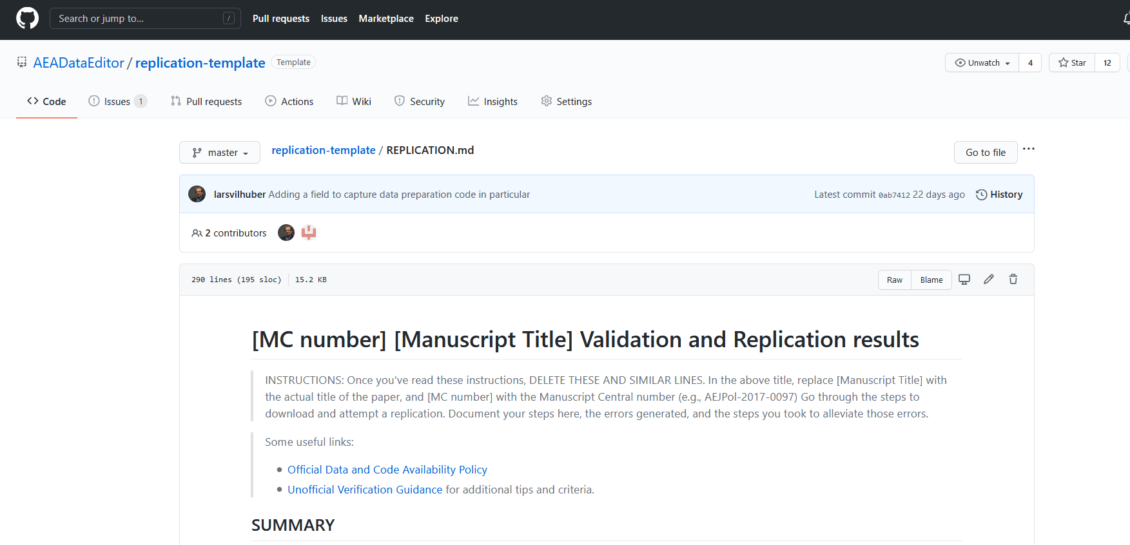
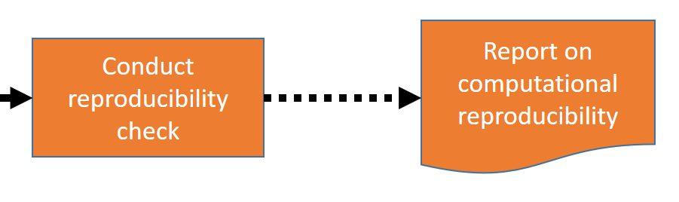
What is the reproducibility check?
Template report available at github.com/AEADataEditor/replication-template/

Slide 12
What is the reproducibility check?
Data checks
Code description
Requirements
  As stated by author
  As encountered by replicator
Verbose description of steps to replicate
Findings
  Compare tables
  Compare figures
  Compare in-text numbers

Slide 13
Where/how to start

Slide 14
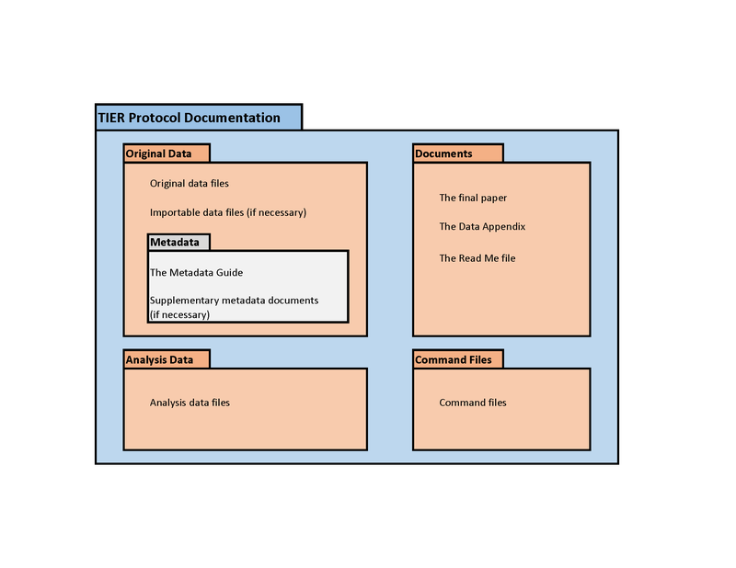
Basic project setup
Structure your project
  Data inputs
  Data outputs
  Code
  Paper/text/etc.
Version your project (git)
Track metadata
  Cite articles you reference
  Cite data sources you use
https://www.projecttier.org/tier-protocol/specifications-3-0/

Slide 15
Computational empathy

Slide 16
Computational empathy
Consider how the next person will (be able) to compute
  You don’t know what they don’t know
  Assume some frequent characteristics
    Empirical background (2-3 yrs undergrad?)
    Likely to know about frequently used software, but not very specific software
    Have none of your add-on packages/ libraries/ etc. pre-installed
Don’t force them to do tedious things
More

Slide 17
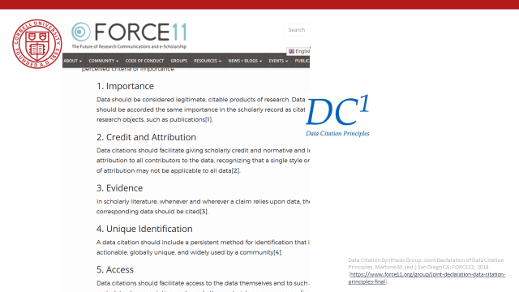
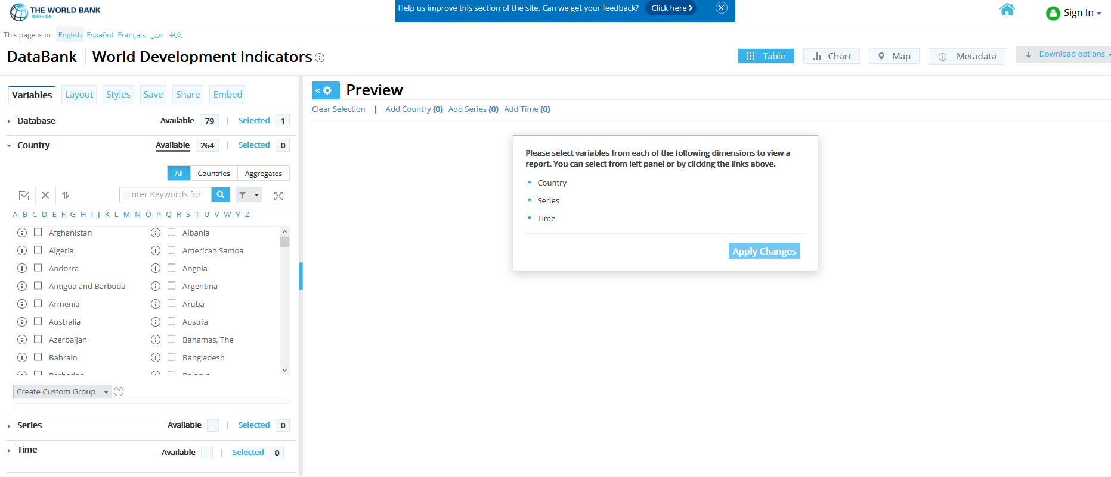
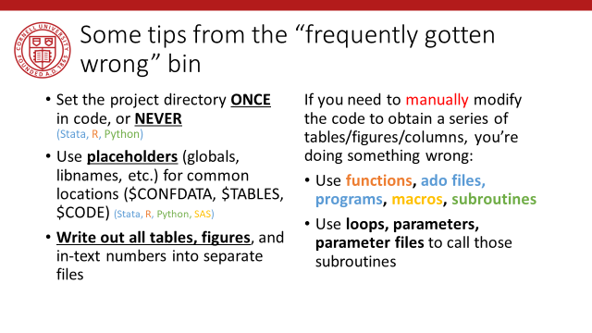
Details
Data provenance
Data citations
Good coding practices

Slide 18
Restricted-access data

Slide 19
Current efforts at the AEA
Restricted-access data
pose a challenge
Pre-emptively improve code archives
  By conducting reproducibility checks when we can
  By working with groups that conduct reproducibility checks
  when we cannot
Better archives
  Greater transparency of the code and data archives
Better provenance tracking
    Leave code where it is when appropriate
    Leave data where it is almost always
    Display that information
How do you check code when the data access is complex?
How do you improve archives when you do not control data management?
How do you document data provenance when you cannot provide the data?
Notes:
Add logo from AEA

Slide 20
AEA Data & Code Availability Policy (2019)
It is the policy of the American Economic Association to publish papers only if the data used in the analysis are clearly and precisely documented and access to the data and code is clearly and precisely documented and is non-exclusive to the authors.
Authors of accepted papers that contain empirical work, simulations, or experimental work must provide, prior to acceptance, the data, programs, and other details of the computations sufficient to permit replication, as well as information about access to data and programs.

Slide 21
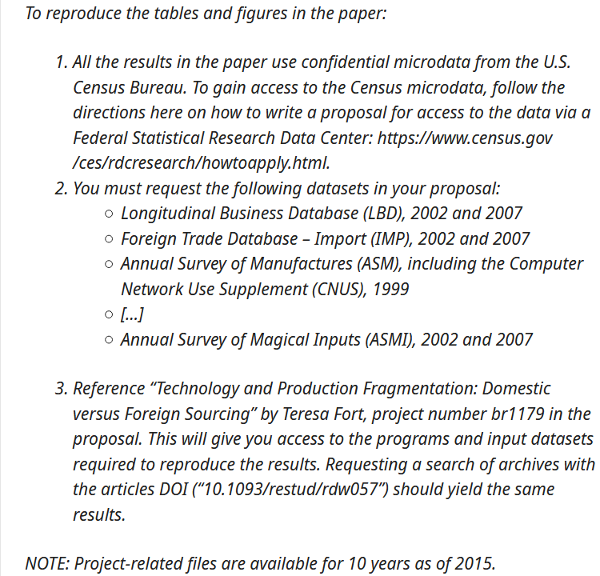
Example: FSRDC
Access can be clearly and precisely documented
Is non-exclusive to the authors
Intermediate files preserved
(example taken from Fort, Restud 2016)
NOTE: for AEA, you are required to provide all programs, but a copy may/should be available within the FSRDC as well.
https://social-science-data-editors.github.io/guidance/DCAS_Restricted_data.html#us-census-bureau-and-fsrdc

Slide 22
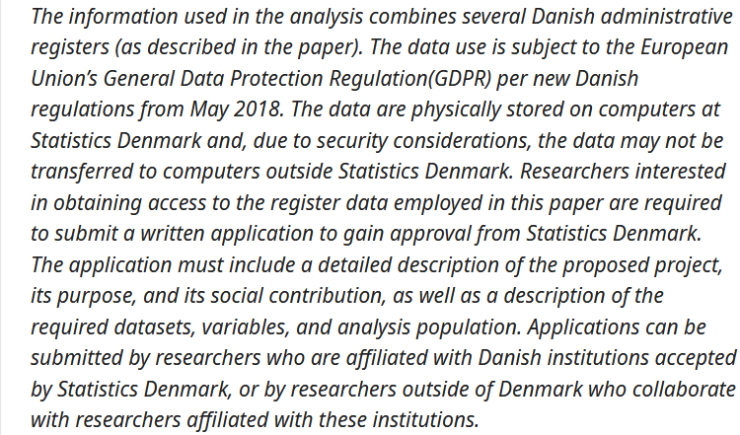
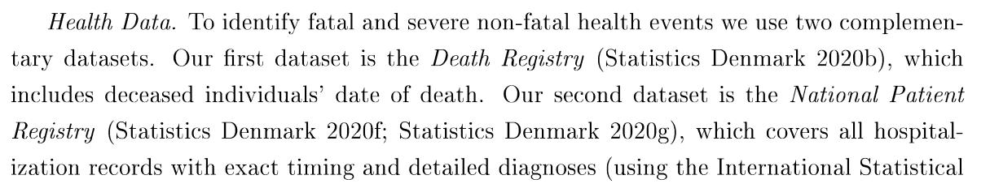
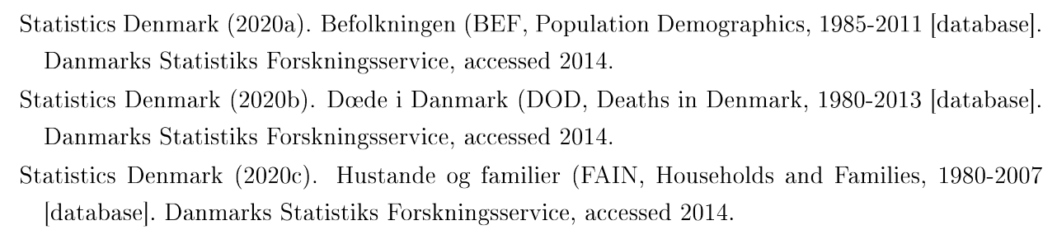
Example: Danish administrative data
Access can be clearly and precisely documented
Is non-exclusive to the authors
(example taken from Fadlon and Nielsen, AEJ:Applied 2021)
https://social-science-data-editors.github.io/guidance/Requested_information_dcas.html#example-for-government-registers
http://www.dst.dk/extranet/forskningvariabellister/Oversigt%20over%20registre.html

Slide 23
Details on the Reproducibilty Check

Slide 24
What is the reproducibility check?
Data checks
Code description
Requirements
  As stated by author
  As encountered by replicator
Verbose description of steps to replicate
Findings
  Compare tables
  Compare figures
  Compare in-text numbers
INSTRUCTIONS: When data are present, run checks:
Can data be read (using software indicated by author)?
Is data in archive-ready formats (CSV, TXT) or in custom formats (DTA, SAS7BDAT, Rdata)?
Does the dataset have variable labels?
Run check for PII. Apply judgement.

Slide 25
What is the reproducibility check?
Data checks
Code description
Requirements
  As stated by author
  As encountered by replicator
Verbose description of steps to replicate
Findings
  Compare tables
  Compare figures
  Compare in-text numbers
INSTRUCTIONS:
Review the code (but do not run it yet).
Identify programs that create "analysis files" ("data preparation code").
Identify programs that create tables and figures. Not every deposit will have separate programs for this.
  Identify all Figure, Table, and any in-text numbers.

Slide 26
What is the reproducibility check?
Data checks
Code description
Requirements
  As stated by author
  As encountered by replicator
Verbose description of steps to replicate
Findings
  Compare tables
  Compare figures
  Compare in-text numbers
Software Requirements
  Version of software (Stata 15, Matlab R2019b, etc.)
  Complete list and version of packages!
Computational Requirements
  Type, vintage, memory size, speed of computer
  Disk space!
Time Requirements
  Minutes, hours, days, weeks, months?

Slide 27
What is the reproducibility check?
Data checks
Code description
Requirements
  As stated by author
  As encountered by replicator
Verbose description of steps to replicate
Findings
  Compare tables
  Compare figures
  Compare in-text numbers
INSTRUCTIONS
Provide details about your process of accessing the code and data.
DO describe actions that you did as per instructions
DO describe any other actions you needed to do ("I had to make changes in multiple programs”)
Findings come later

Slide 28
What is the reproducibility check?
Data checks
Code description
Requirements
  As stated by author
  As encountered by replicator
Verbose description of steps to replicate
Findings
  Compare tables
  Compare figures
  Compare in-text numbers
INSTRUCTIONS:
Describe your findings both positive and negative in some detail, for each Data Preparation Code, Figure, Table, and any in-text numbers.
When errors happen, be as precise as possible.
  For differences in figures, provide screenshot of manuscript figure, as well as the figure produced by the code you ran.
  For differences in numbers, provide both the number as reported in the manuscript, as well as the number replicated.

Slide 29
Coding for Reproducibility

Slide 30

Streamlining replication packages
Master script preferred
  Least amount of manual effort
No manual manipulation
  “Change the parameter to 0.2, then run the code again”
No manual copying of results
  Write out/save tables and figures using packages
  Compute all numbers in package
No manual install of packages
  Use a script to create all directories, install all necessary packages/requirements/etc.
Clear instructions!

Slide 31
Some tips from the “frequently gotten wrong” bin
Set the project directory ONCE in code, or NEVER
(Stata, R, Python)
Use placeholders (globals, libnames, etc.) for common locations ($CONFDATA, $TABLES, $CODE) (Stata, R, Python, SAS)
Write out all tables, figures, and in-text numbers into separate files
If you need to manually modify the code to obtain a series of tables/figures/columns, you’re doing something wrong:
Use functions, ado files, programs, macros, subroutines
Use loops, parameters, parameter files to call those subroutines

Slide 32
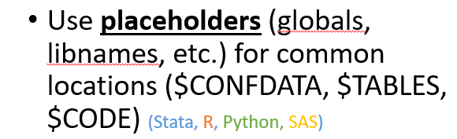
Some tips from the “frequently gotten wrong” bin
Cleanly separate
Confidential data and public use data
  You are going to have to provide copies of the public use data without compromising confidentiality
Confidential parameters and the rest of the code
  Reduces need to redact programs

Slide 33
Some tips from the “frequently gotten wrong” bin
Have “computational empathy”
Consider cross-platform programmng practices
Consider that the replicator can learn from the process
  They probably don’t have the same knowledge
Consider that the replicator might not have the same modules/packages/etc.
Path and filenames:
  Stata: always use forward slashes, even on Windows
  use “$data/path/data.dta”
  R: use “file.path()”
  x <- read(file.path(data,”data.dta”)
  SAS: use filename and libname to abstract
  data DATALIB.step1;
  set CONFLIB.slid_1996;

Slide 34
Extreme examples
Matlab-based simulation
Real example, 10 figures, 4 panels each
For Figure 5a, comment line 52, uncomment line 151, run the code, then copy the figure into your document.
For Figure 5b, comment line 151 again, leave line 52 commented, and change the parameter on line 75 to “3”
….

Slide 35
Extreme examples
Stata-based estimation
4 variants
Run the data creation programs, then copy the data to Folder A
Copy programs “b.do” and “c.do” from Folder A to Folder B, but modify “c.do” on line 20
Once done, convert the output from “d.do” to a Matlab file, and run the simulation in Folder B/C
….

Slide 36
Ideal setup
1 program to prepare the setup
  Installs all packages
  Creates all directories
1 program (or a very small number) that creates the rest
  Possibly with macros/ ado files/ subroutines
  Possibly with parameter files that might differ per directory
All tables and figures are output programmatically
Setting up can be done in all languages
  Matlab, Stata, R, Python, Fortran
Subroutines exist in all languages
  You might need to learn how!
Ability to output figures and tables (Excel, LaTeX) exist in all languages

Slide 37
Preparing Replication Package

Slide 38
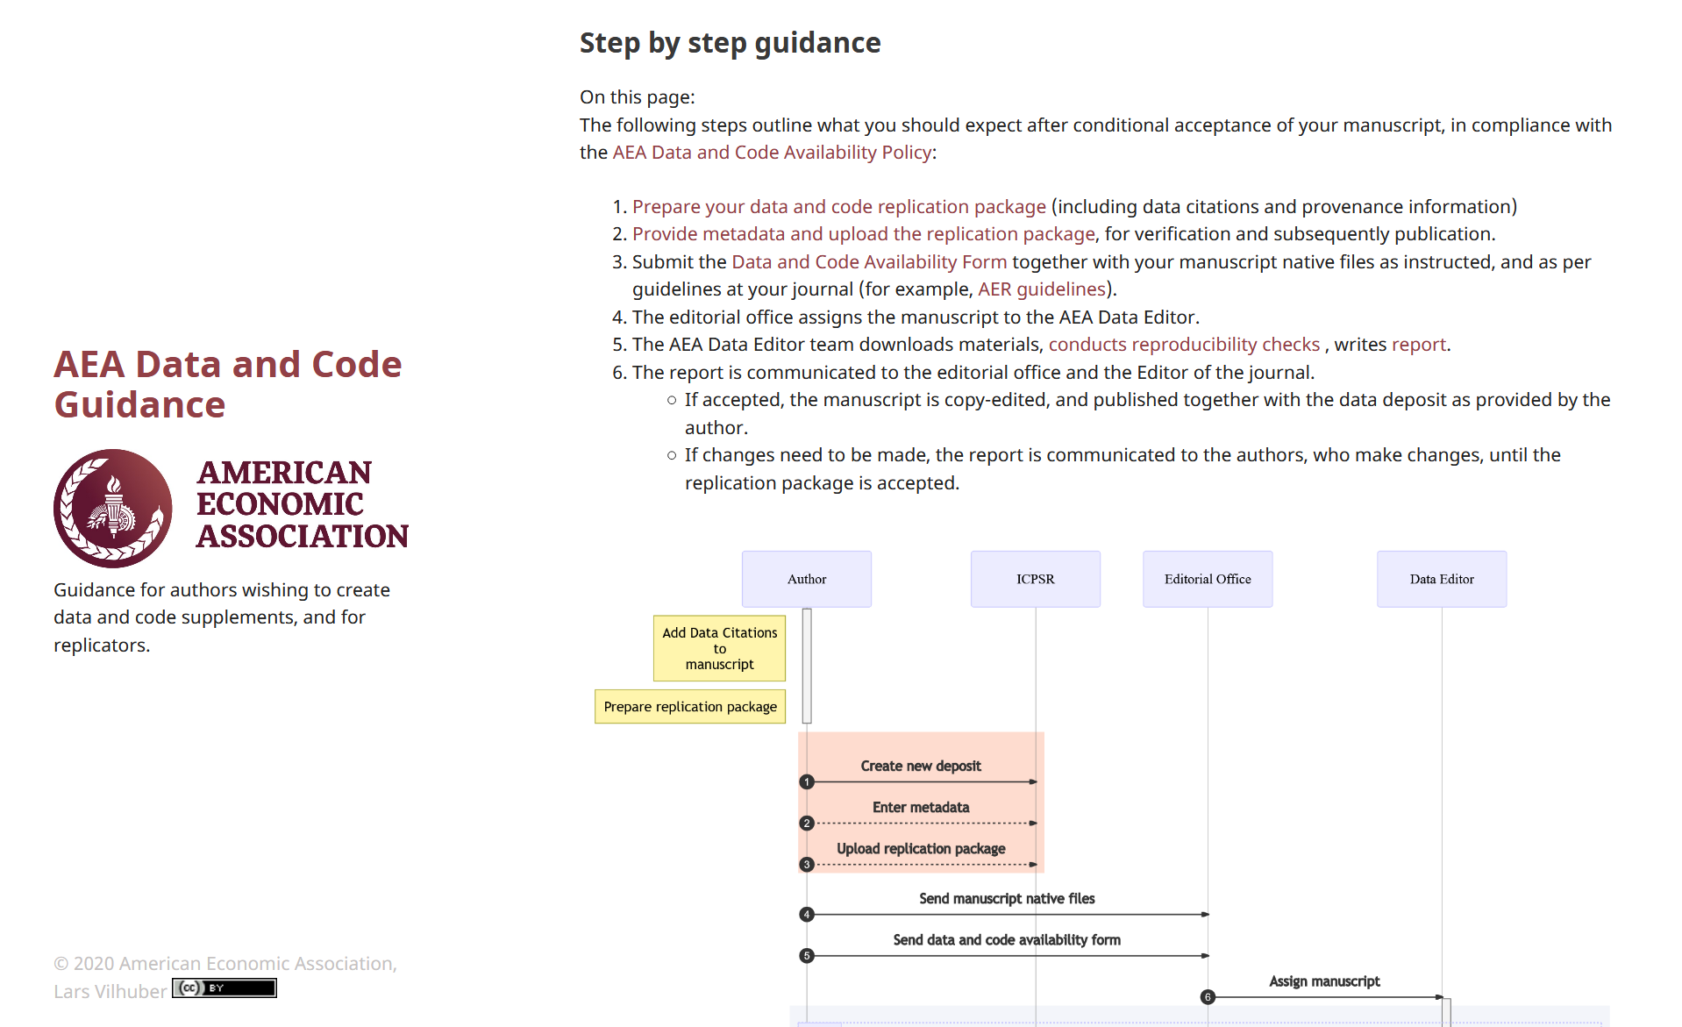
Follow the steps
https://aeadataeditor.github.io/aea-de-guidance/step-by-step.html

Slide 39
How to test the replication package
README
Full package of all programs, data you intend to provide
ZIP it up
Now ask an RA/ colleague/ friend/ grandma/ daughter not previously involved to
  Download the package
  Follow the instructions in the README without talking to you!
  Compare the results to the paper

Slide 40
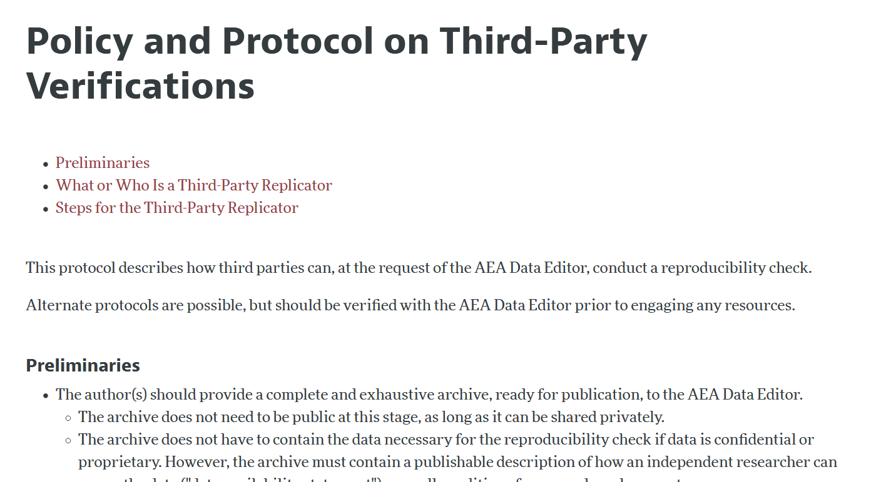
How to prepare the replication package
README
Full package of all programs, data you intend to provide
ZIP it up
Now ask an RA/ colleague/ friend/ grandma/ daughter not previously involved to
  Download the package
  Follow the instructions in the README without talking to you!
  Compare the results to the paper
https://www.aeaweb.org/journals/data/policy-third-party

Slide 41
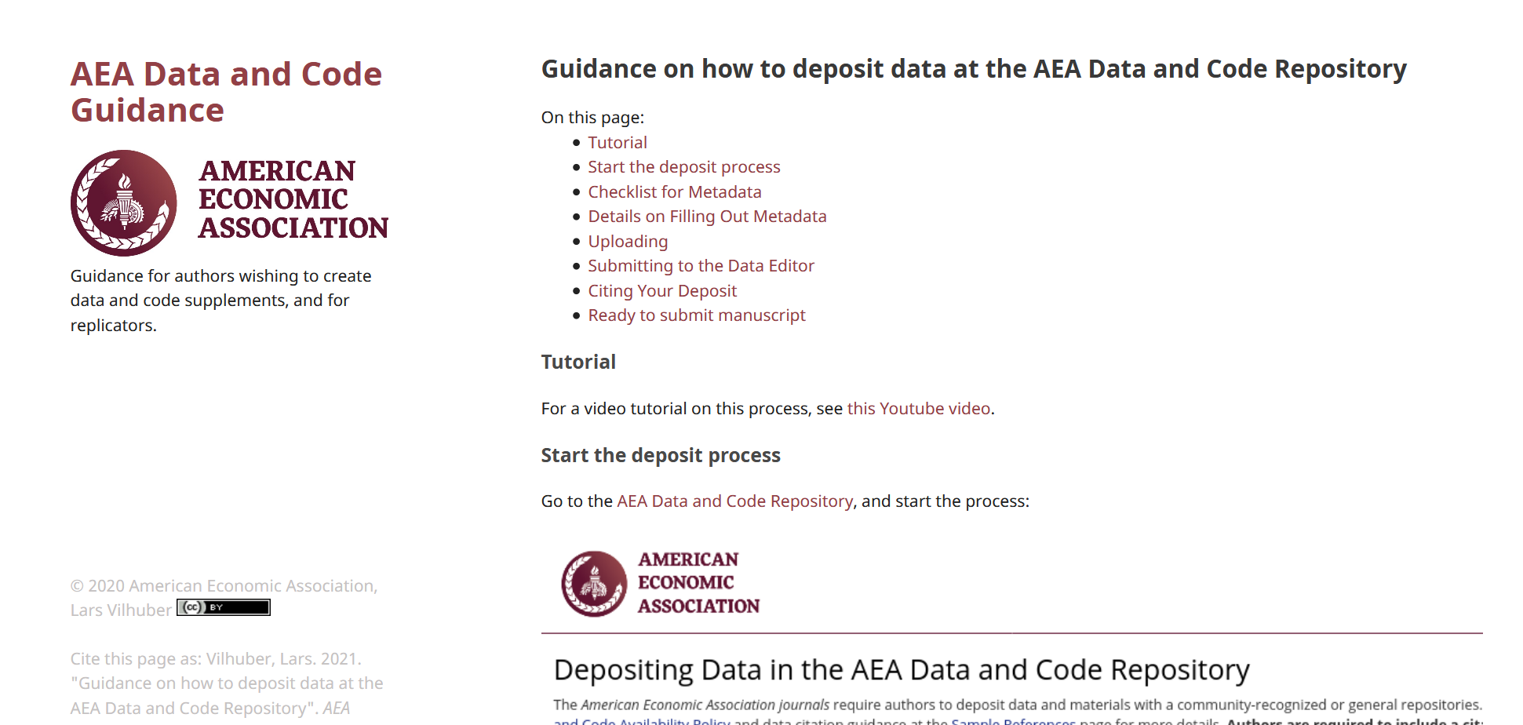
Then follow the steps to upload
No ZIP file *upload* - use the “Import from Zip.”
When revising, do not create new deposit – re-use existing project.
https://aeadataeditor.github.io/aea-de-guidance/data-deposit-aea.html

Slide 42
The role for journals

Slide 43
Goal: Transportability
Any standards, tools, methods: must be transportable across journals (no custom solutions)

Slide 44

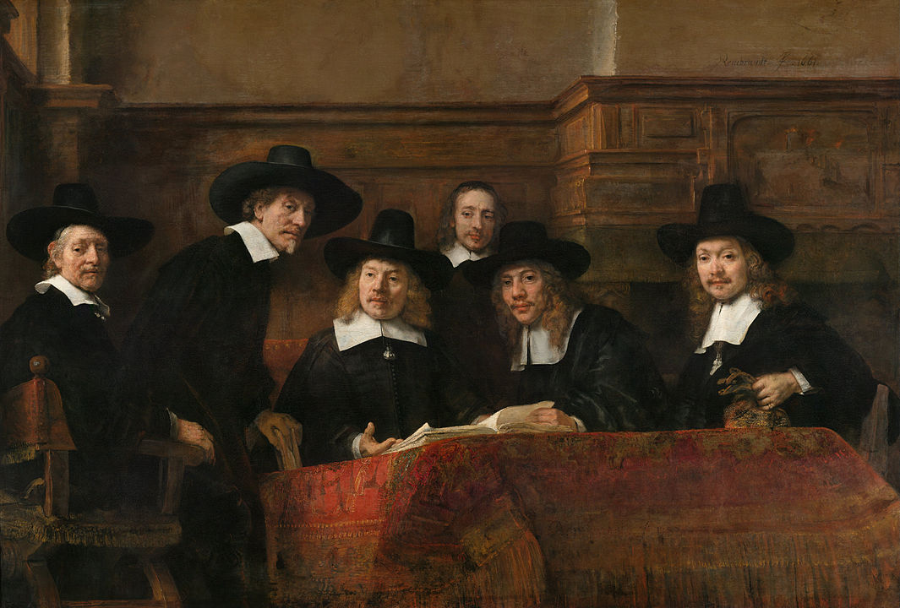
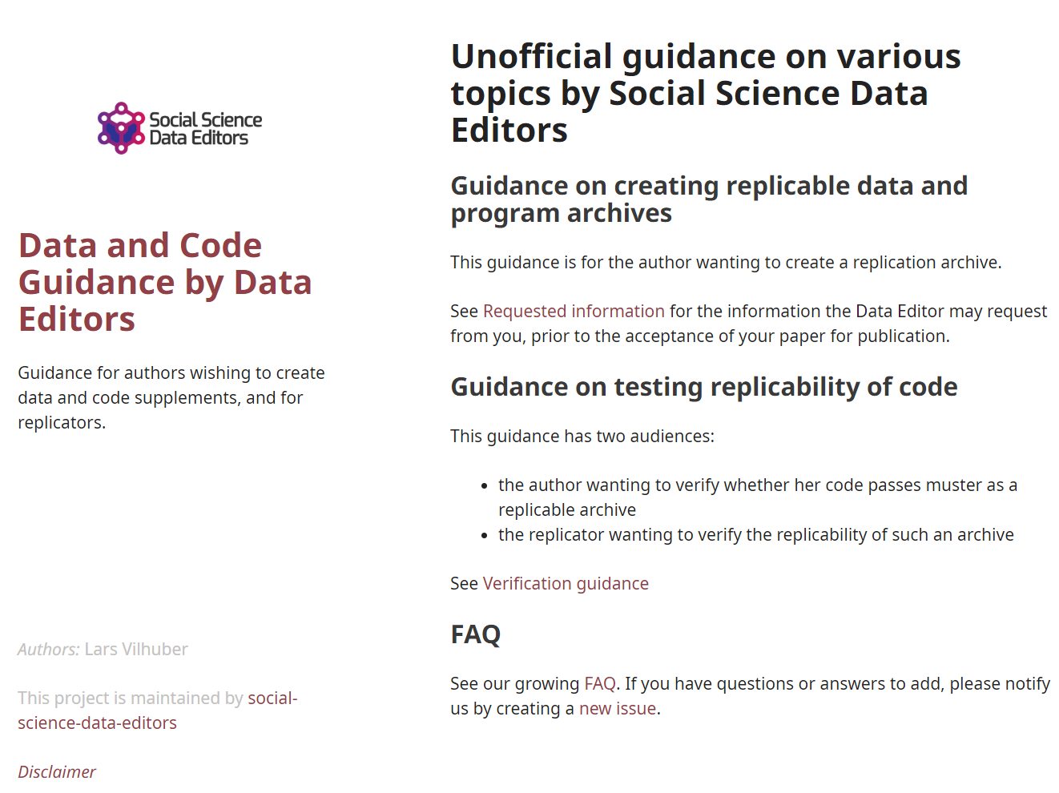
Social science “guild”
https://
social-science
-data-editors.
github.io/
guidance/

Slide 45
Some resources

Slide 46

Some resources
https://social-science-data-editors.github.io/guidance/
  General guidance
  Template README
  data citation guidance
  discussion of licensing
https://aeadataeditor.github.io/aea-de-guidance/
  Step-by-step guidance

