Slide 1


4. 1. Definition of organizational environment
An organization's environment is defined as all the factors and forces existing within and outside the organization that can directly or indirectly affect organizational performance& managerial decision- making.

Slide 2
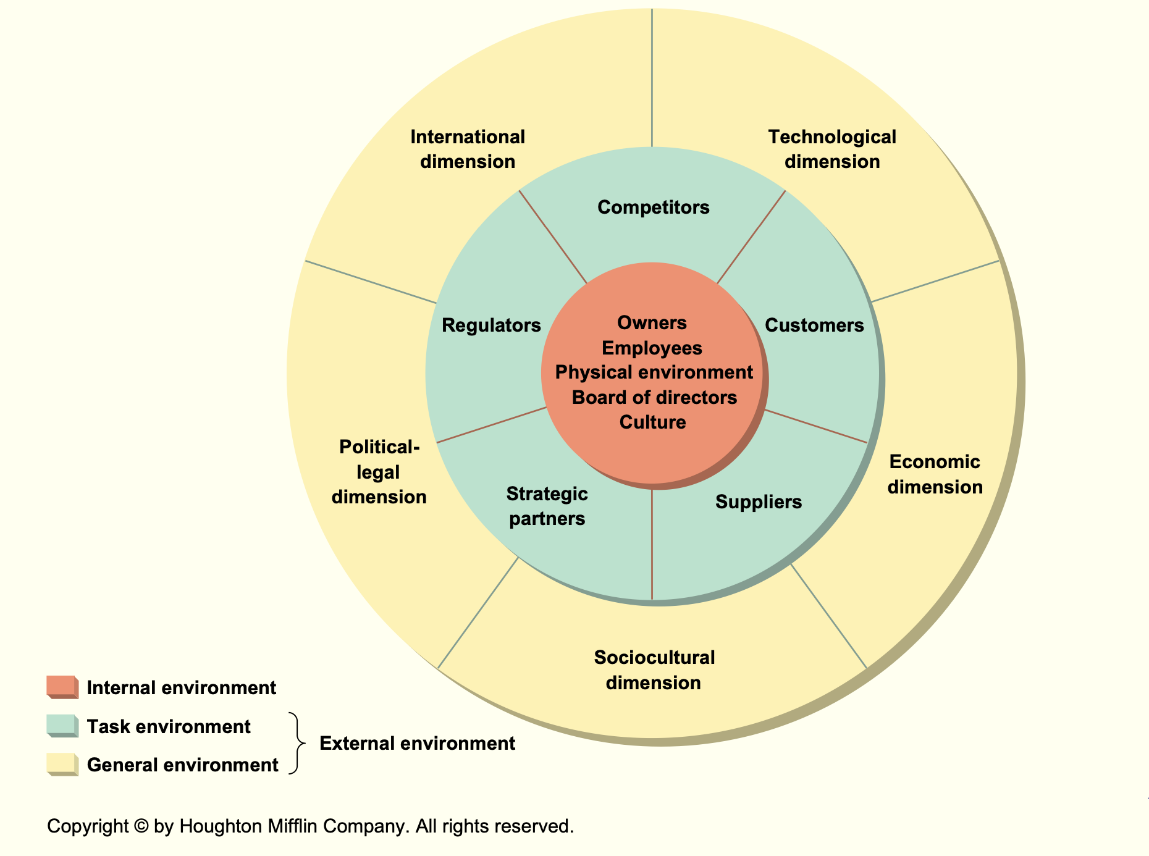
4. 2. Classification of organizational environment

Slide 3
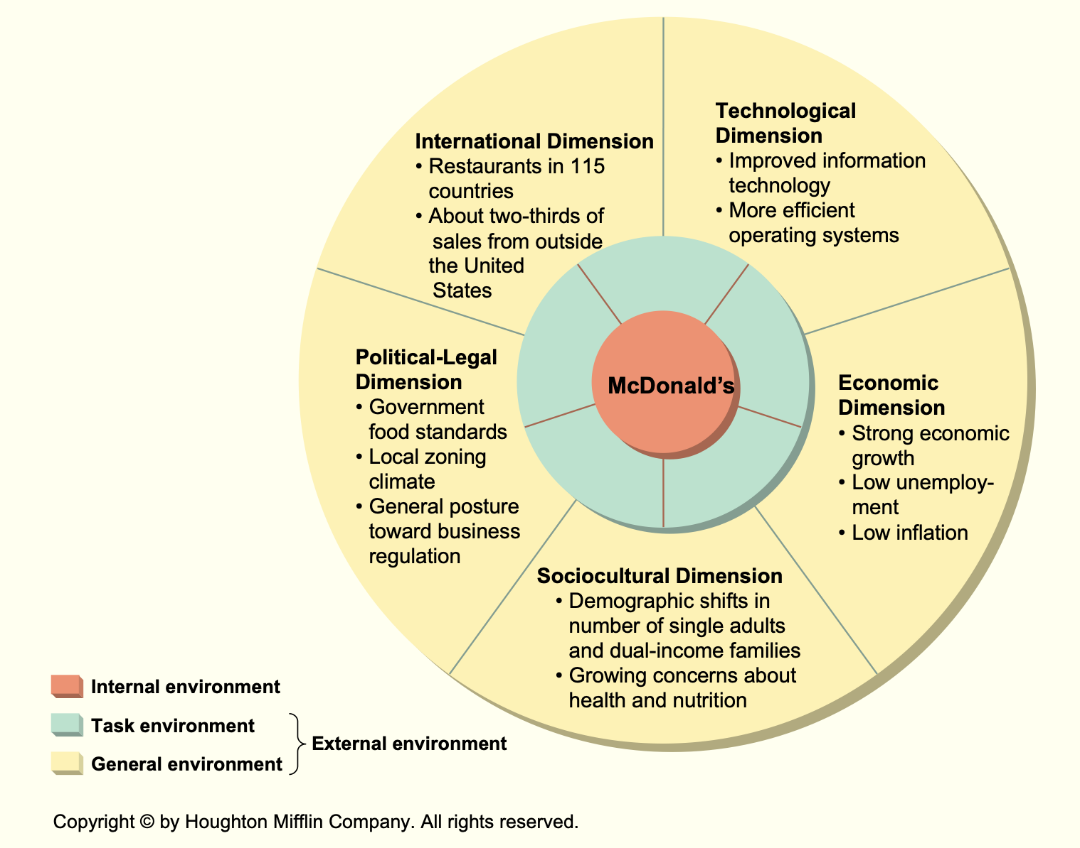
McDonald’s General Environment

Slide 4
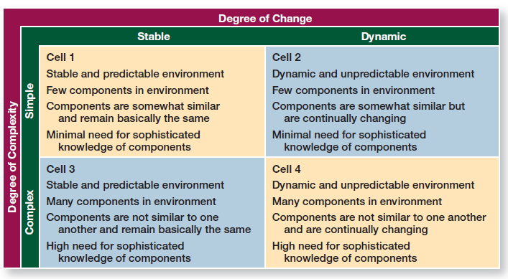
Assessing Environmental Uncertainty

Slide 5
Organizational Culture
4. 2. Classification of organizational environment
    A set of values, beliefs, behaviors, customs and traditions that affect organizational activities, feeling, thinking and behaviors of all members in pursuing organizational goals.
    Managers need to comprehend organizational culture to co-ordinate with others.

Slide 6
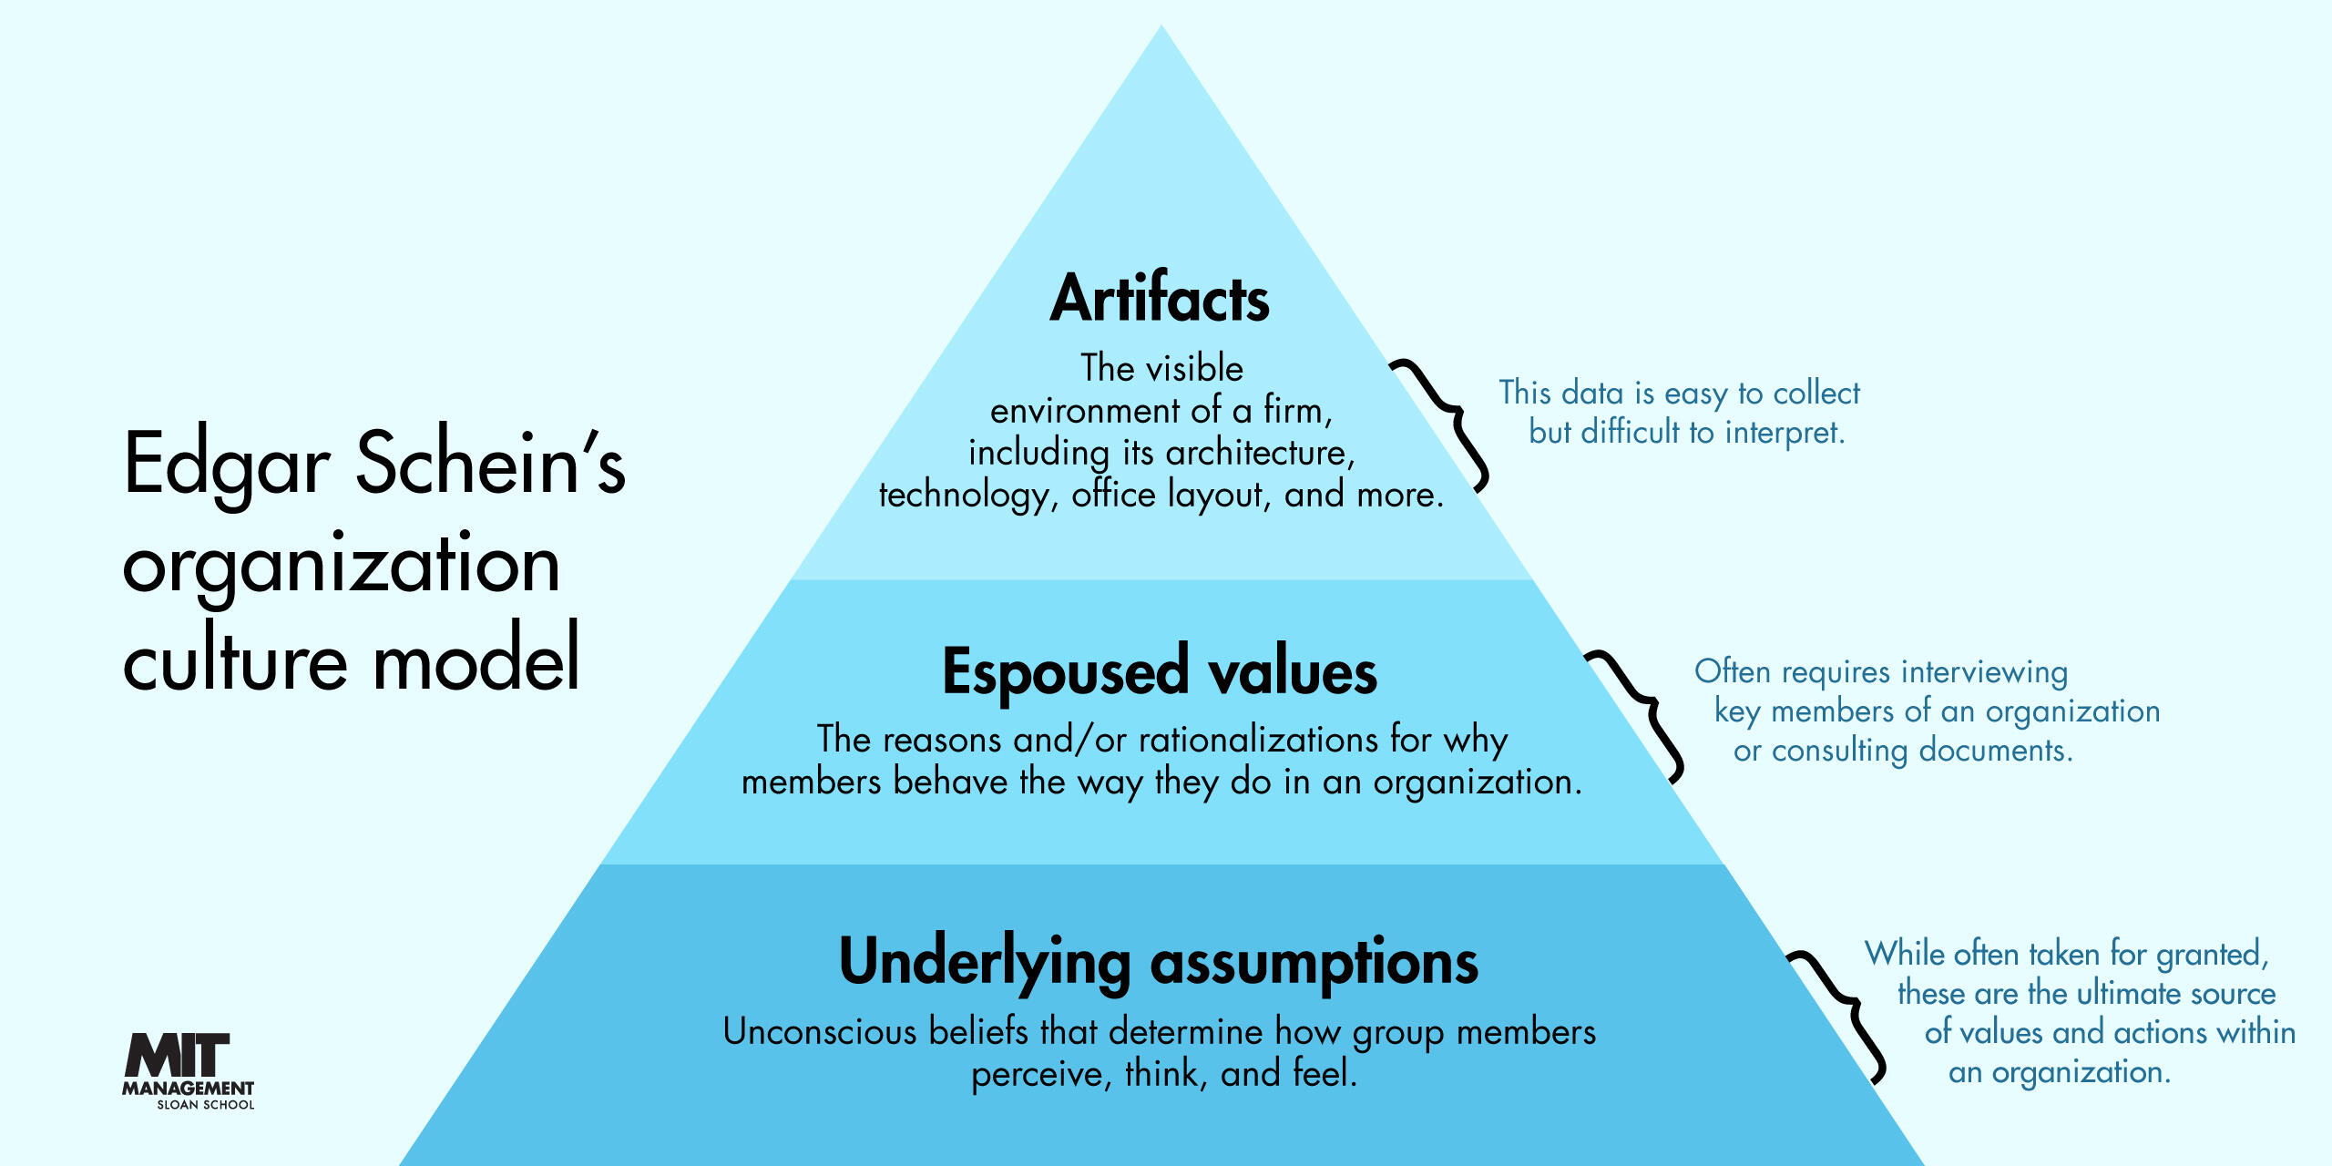

Slide 7
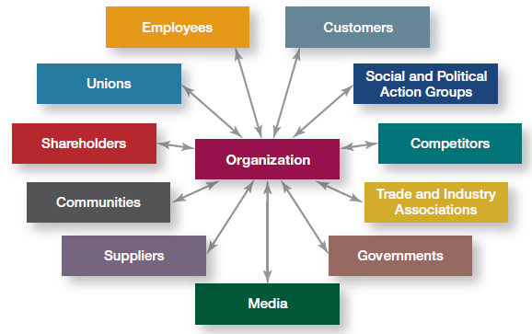
Organizational Stakeholders

Slide 8
Challenges and Opportunities for MANAGEMENT
Expansion or downsizing
Workforce diversity: transitioning from a "melting pot" approach to a "celebration of differences" approach
Trend towards empowering employees
Encouraging creativity
Decreasing employee loyalty towards organizations
CSR

Slide 9
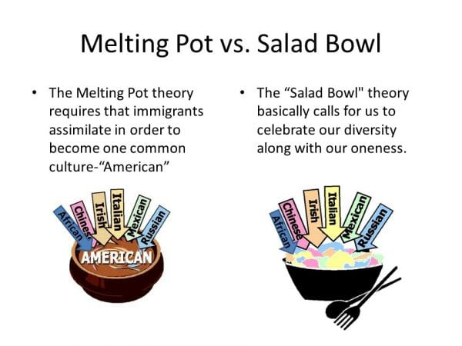
Challenges and Opportunity

