Slide 1

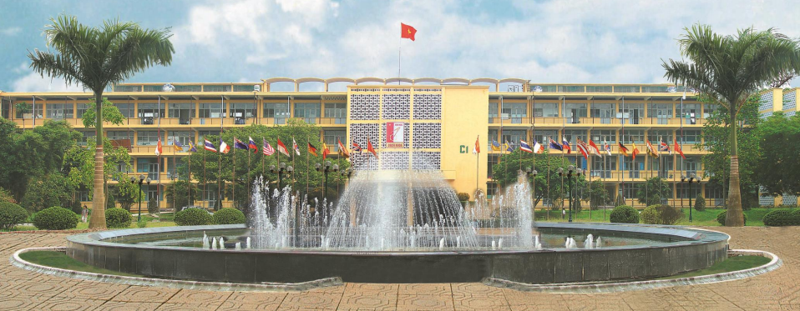
TRƯỜNG ĐẠI HỌC BÁCH KHOA HÀ NỘI
HANOI UNIVERSITY OF SCIENCE AND TECHNOLOGY
CHAPTER 1: OVERVIEW OF ORGANIZATIONAL MANAGEMENT
SCHOOL OF ECONOMICS AND MANAGEMENT– HUST
DR. NGUYEN THANH HUONG

Slide 2
BRIEF PROGRAM OVERVIEW
HANOI UNIVERSITY OF SCIENCE AND TECHNOLOGY
Chapter 1: Overview of Organizational Management
Chapter 2: Planning Function
Chapter 3: Organizing Function
Chapter 4: Leadership Function
Chapter 5: Controlling Function
Chapter 6: Information in Operational Management
Conclusion and Review

Slide 3
CLASS MATERIALS
HANOI UNIVERSITY OF SCIENCE AND TECHNOLOGY
[1] Textbook
Ricky W. Griffin, 2008. Fundamentals of Management, 5th Edition, South Western, Cengage Learning, ISBN-13: 978-1-4390-3790-4, ISBN-10: 1-4390-3790-6
[2] More books
Tài liệu tham khảo (References)
In Vietnamese
1. Nguyễn Quang Chương, Bài giảng Quản trị học đại cương, Nhà xuất bản Bách khoa, 2013
In English
Robbins, S.P. & Coulter, M. (2017), Management, 11th edition, Pearson Education Inc.
John R.Schermerhorn, Introduction to Management, 14th edition, John Wiley & Sons, Inc, 2020.
Kinicki/Williams, Management: A practical introduction, 9th edition, McGraw- Hill, 2020.
[3] Related papers

Slide 4
Course Evaluation Methods
HANOI UNIVERSITY OF SCIENCE AND TECHNOLOGY
Điểm thành phần Grade Breakdown | Phương pháp đánh giá Assessment Methods | Mô tả Description | Tỷ trọng %
A1. Điểm quá trình Mid-term (*) | Đánh giá quá trình Progress |  | 50%
 | A1.1. Chuyên cần/ Attendance | Kiểm tra (Test) | 10%
 | A1.2. Bài tập trên lớp nhóm In- class Exercises | Thảo luận (Discussion) | 5%
 | A1.3. Bài tập tiểu luận Group Essay Assignment | Tự luận / Bài tập lớn (Essay) | 15%
 | A1.4. Thi giữa kỳ Midterm Exam | Hỗn hợp (Mix) | 20%
A2. Điểm cuối kỳ Final | A2.1. Thi cuối kỳ Final exam | Trắc nghiệm (Multiple- choice exam) | 50%

Slide 5
Learning goals
HANOI UNIVERSITY OF SCIENCE AND TECHNOLOGY
After chapter 1, students may be able to understand:
The concept, essence and the roles of management in organizational efficiency
Levels of management and their functions in an organization
Principles of management
Managerial roles and skills
Orgnizational environronment

Slide 6
CONTENT
Level 1 | Level 2 | Level 3
1. The necessity and concept of management | 1) The social division of labor
 | 2)Why do we need management?
2. Definition and principles of management | 1) General definition of management
 | 2) Definition of organizational management | An organization and its characteristics
 |  | The systems approach to management
 |  | The process approach to management
 |  | Results and efficiency
 | 3) Principles of management
3. Definition of a manager, the managerial roles and skills | 1) Definition of a manager | Who are managers?
 |  | Levels of management
 | 2) The Managerial roles | Interpersonal roles
 |  | Informational roles
 |  | Decisional roles
 | 3) The Managerial skills | Technical skills
 |  | Human skills
 |  | Conceptual skills
4. Organizational environment

Slide 7
KEYWORDS
System | a set of connected things or parts forming a complex whole
Organization | An “open” system, includes or more people who work together in a structured way to achieve a specific goal or set of goals
Effectiveness | the final consequence of a sequence of actions or events
Efficiency | An input- output concept
Managerial roles | 03 categories: informational (managing by information), interpersonal (managing through people), and decisional (managing through action).
Managerial skills | 03 managerial skills essential to successful management: technical, human , and conceptual.
Organizational environment | All the factors and forces existing within and outside the organization that can directly or indirectly affect organizational performance and managerial decision- making.

Slide 8
1. The necessity and concept of management
1) The social division of labor
2)Why do we need management?
Notes:
Now, let’s go into the first part of our session, where we explore the importance of management. In this section, we'll address two key aspects:
Quản lý và quản trị
Quản lý là làm tốt việc được giao
quản trị là làm đúng việc, đúng người, đúng thời điểm và địa điểm.
Giáo sư Phan Văn Trường, chuyên gia cao cấp về đàm phán quốc tế, cố vấn cho Chính phủ Pháp
Có hai con thuyền cùng xuất phát từ Hải Phòng đến Kuala Lumpur. Con tàu thứ nhất của Việt Nam, thuyền trưởng và thuỷ thủ người Việt. Con tàu thứ hai của Malaysia, thuyền trưởng và thuỷ thủ đều là người Malaysia. Trước khi tàu rời bến, thời tiết rất đẹp nhưng cả hai đều biết được rằng sẽ có bão đổ bộ trên đường đi trong 6 tiếng nữa.
Thuyền trưởng Việt Nam vội vàng hô hào anh em lên đường may ra mới thoát bão
trong khi thuyền trưởng Malaysia quyết định chưa đi vội, chờ xác định được chính xác đường đi của bão rồi quyết định lên đường.
Sau 6 tiếng lênh đênh, thuyền Việt Nam gặp bão, thuỷ thủ phải đánh lộn với bão. Cuối cùng cũng tới được Kuala Lumpur mà không hề có tổn thất về người và tài sản nhưng ai cũng mệt nhoài.
Trong khi đó, thuyền của Malaysia do có sự tính toán kỹ nên trên đường không gặp bão, thuỷ thủ nghỉ ngơi thảnh thơi trên boong tàu và cũng chỉ tới muộn hơn nửa ngày.
Thủy thủ của Việt Nam kiểm soát được khủng hoảng, không để bị thiệt hại, đó là quản lý giỏi. Thế nhưng thuyền trưởng người Việt lại quản trị kém vô cùng do chọn sai việc nên trong bão táp đã gây nên vấn đề mà nhân viên phải quản lý một cách khó khăn. Sau khi đến nơi, thuỷ thủ ngủ 2 ngày 2 đêm vì quá mệt.
Ngược lại, tàu của Malaysia không gặp bão, thuỷ thủ không mất sức là do thuyền trưởng rất giỏi, chọn đúng việc, làm đúng việc và đúng thời điểm.
Người Malaysia chậm hiểu hơn mình nhiều lắm, giải thích tới 4 lần có khi có người cũng không hiểu trong khi người Việt nói nửa câu đã hiểu rồi nhưng hiểu xong lại lao đầu vào bão, đôi khi chỉ là muốn chứng tỏ rằng rất giỏi đấu tranh với bão”, ông Trường nói.
“Lấy ví dụ đó tôi mới thấy thương người Việt mình, vô cùng sắc sảo và giỏi nhưng lúc nào cũng hớt hải, vất vả trong khi người Malaysia nhẹ nhàng dù không chăm chỉ, là vì họ quản trị đúng”, ông nhận định thêm.
Theo ông Trường,
quản lý là làm tốt việc được giao
còn quản trị là làm đúng việc nhưng phải chọn đúng người, làm đúng thời điểm và địa điểm.
Tuy nhiên, rất khó để có thể quản trị tốt.
Nếu làm quản trị tốt, chọn đúng người, đúng việc, đúng thời điểm và địa điểm thì công ty vận hành trơn tru, nhân viên nhàn hạ. Trong khi đó, phần đông những công ty ông Trường quen biết đều có nhân viên làm việc rất vất vả, đấu đá nhau mọi nơi và toàn làm những việc không phải của mình.

Slide 9
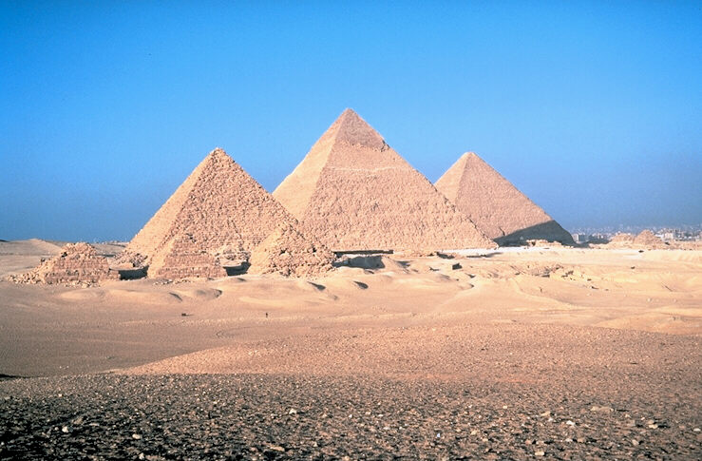
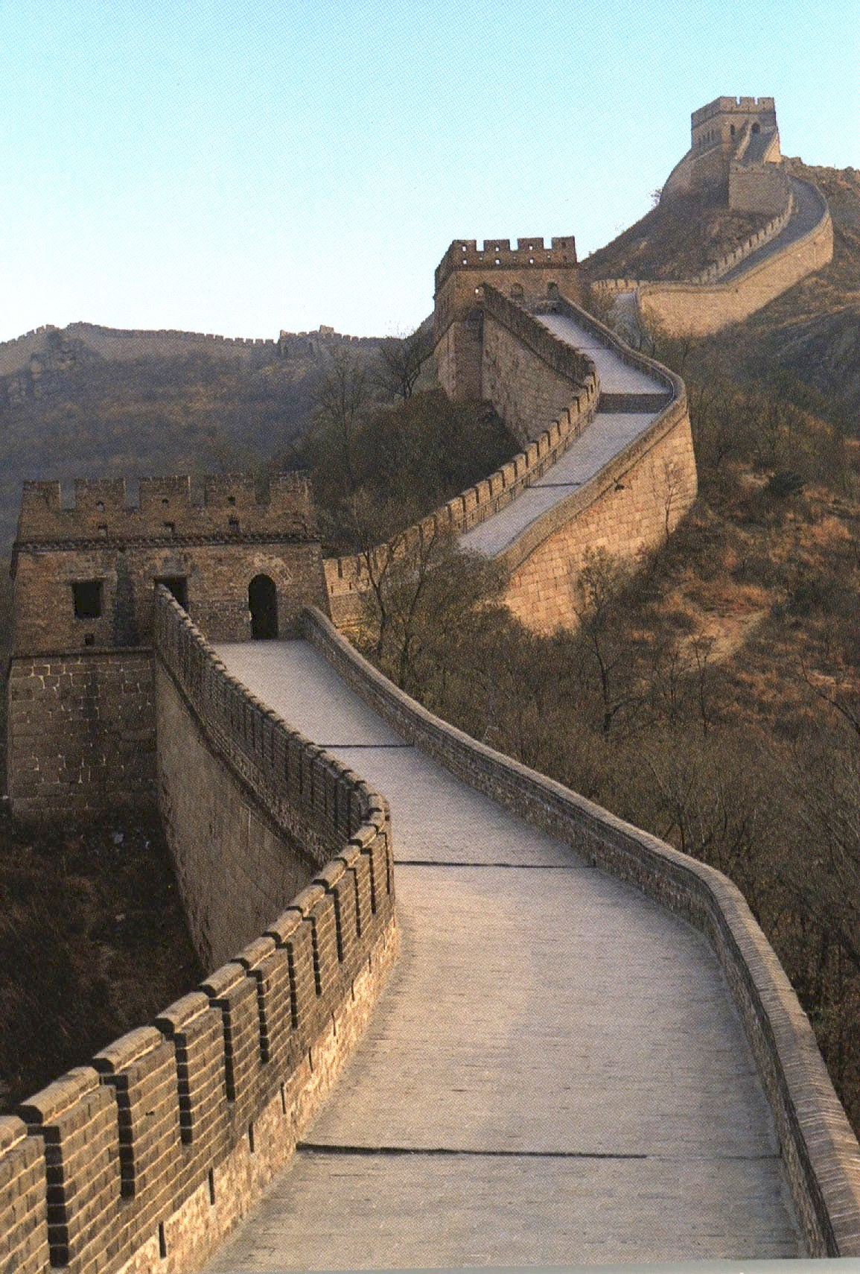

Slide 10
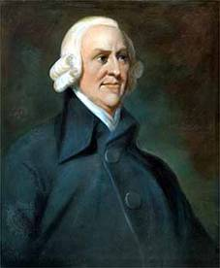
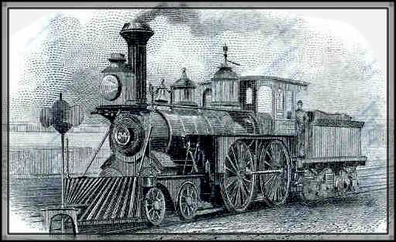
Adam Smith, (1776) author of the classical economics doctrine, The Wealth of Nations, argued about the economic advantages that division of labor
The Industrial Revolution: The introduction of machine powers, combined with the division of labor, made large, efficient factories possible. Planning, organizing, leading, and controlling became necessary.
The development of management theories has been characterized by differing beliefs about what managers do and how they should do it.

Slide 11
1.1. THE SOCIAL DIVISION OF LABOR
Eg: In order to finish a lesson
Learners
Lecturer
Infrastructure
Other factors
Co-operate individual activities with the overall aim of achieving common objectives efficiently
COMMON
OBJECTIVES

Slide 12
1.2. WHY DO WE NEED MANAGEMENT?
Due to work allocation and collaboration
Nowadays, management becomes more and more important:
  Randomness and other risk factors
  Resource exhaution because of increasing need.
  A good and creative management can make up for the shortage of resources and preferential natural conditions
  On the tendency of global economic integration, Vietnamese organizations need to improve managerial capacity, besides technology, labour…

Slide 13
2. DEFINTION AND PRINCIPLES OF MANAGEMENT
1) General definition of management
2) Definition of organizational management
3) Principles of management

Slide 14

2.1 General definition of management
  Management is the cooperation between activities of individuals with the overall aim of achieving common objectives efficiently

Slide 15
2.2 Definition of organizational management
2.2.1. An organization and its characteristics
An organization could be defined as two or more people who work together in a structured way to achieve a specific goal or set of goals
Organizations’ characteristics:
People
Specific goal/ set of goals
Structured way
Specific
goals
Structured
way
People

Slide 16
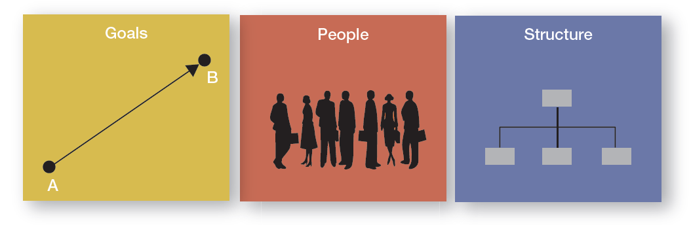
Three Characteristics of Organizations

Slide 17

2.2 Definition of organizational management
The systems approach to management
The process approach to management

Slide 18

2.2 Definition of organizational management
2.2.1. The systems approach to management
System is a set of connected things or parts forming a complex whole
Closed system is an isolated system that has no interaction with its external environment
Open system is a system which continuously interacts with its environment or surroundings

Slide 19
2.2 Definition of organizational management
2.2.1. The systems approach to management
Environment
Transformation process
Products/ Services
Employee work performance
Job satisfaction
Turnover
Input
Output
Raw materials
Human resource
Capital
Technology
Information
Management process
Activities of Employees
Management Activities
Methods, Technology, and Operations
Feedback
Environment

Slide 20
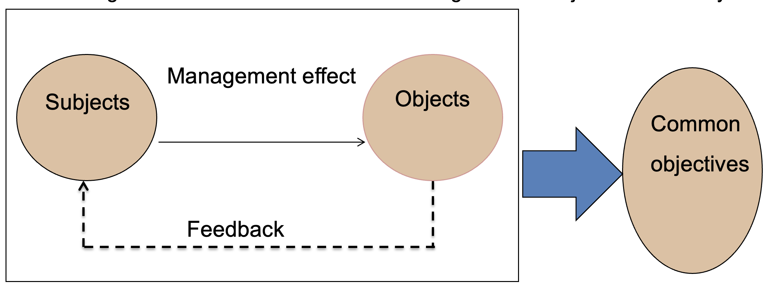
2.2 Definition of organizational management
2.2.2. The process approach to management
It is defined as the intentional impact of subjects of management on objects of management with the overall aim of achieving common objectives efficiently

Slide 21
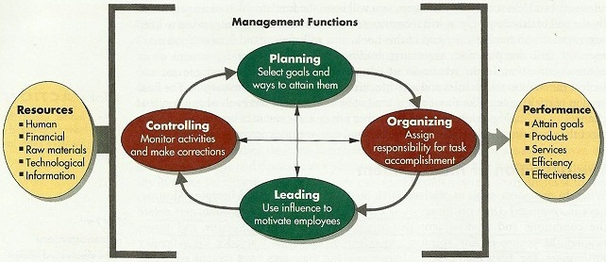
2.2 Definition of organizational management
2.2.2. The process approach to management

Slide 22
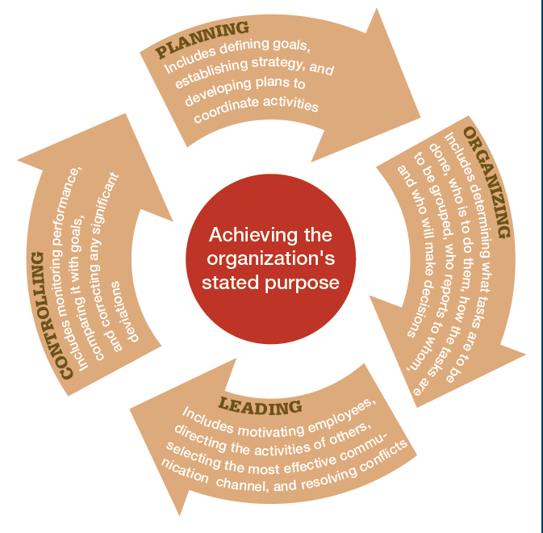
Four Functions Approach
Planning
Organizing
Leading
Controlling

Slide 23
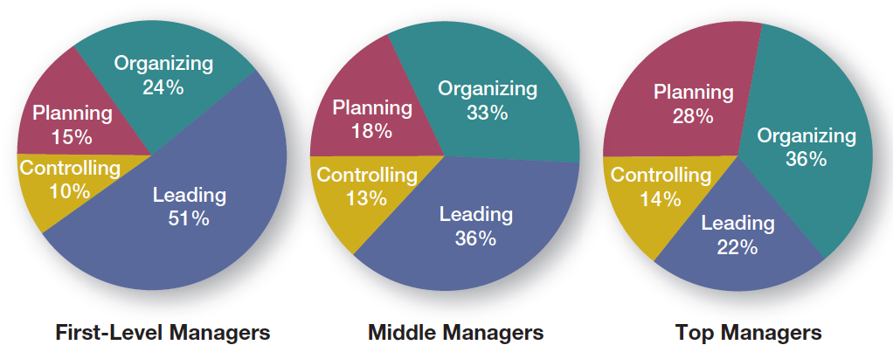
Is the Manager’s Job Universal?
1. Level in the Organization

Slide 24

2.2 Definition of organizational management
2.2.2. The process approach to management
Mary Parker Follett: “Management is defined as ”the art of getting things done through people”
Koontz & O' Donnel: “Management of an organization is the process of establishing objectives and goals of the organization periodically, designing the work system and the organization structure, and maintaining an environment in which individuals, working together in groups, accomplish their aims and objectives and goals of the organization effectively and efficiently”
James Stoner & Stephen Robbin: “Management is the process of planning, organizing, leading, and controlling the work of organization members and of using all available organizational resources to reach stated organizational goals”.

Slide 25
2.2.4. Efficiency and Effectiveness
Efficiency
Effectiveness
Doing things right
Doing the right things
The aims of management:
Waste minimization
Higher levels of objectives

Slide 26

2.2 Definition of organizational management
2.2.3. The process approach to management
Bateman & Snell:
“Management is the act of getting people together to accomplish desired goals and objectives using available resources efficiently and effectively”

Slide 27
2.3. Principles of management
Henri Fayol's 14 Principles of Management.
1/ Division of work
8/Centralization
2/Authority
9/Scalar chain
3/Discipline
10/Order
4/Unity of command
11/Equity
5/Unity of direction
12/Stability of Tenure
of Personnel
6/Subordination of individual interest to general interest
13/Initiative
7/Remuneration
14/Esprit de Corps

Slide 28

3. Definition of a manager, the managerial roles and skills
3.1. Definition of a manager
3.2. Levels of management
3.3. Managerial roles
3.4. Managerial skills

Slide 29

3.1. Definition of a manager
  Who are managers?
  Someone who works with and through other people by coordinating and integrating their work activities in order to accomplish organizational goals.

Slide 30
What Titles Do Managers Have?
Top Managers
  Make decisions about the direction of an organization
Middle Managers
  Manage other managers
First-line Managers
  Direct nonmanagerial employees

Slide 31
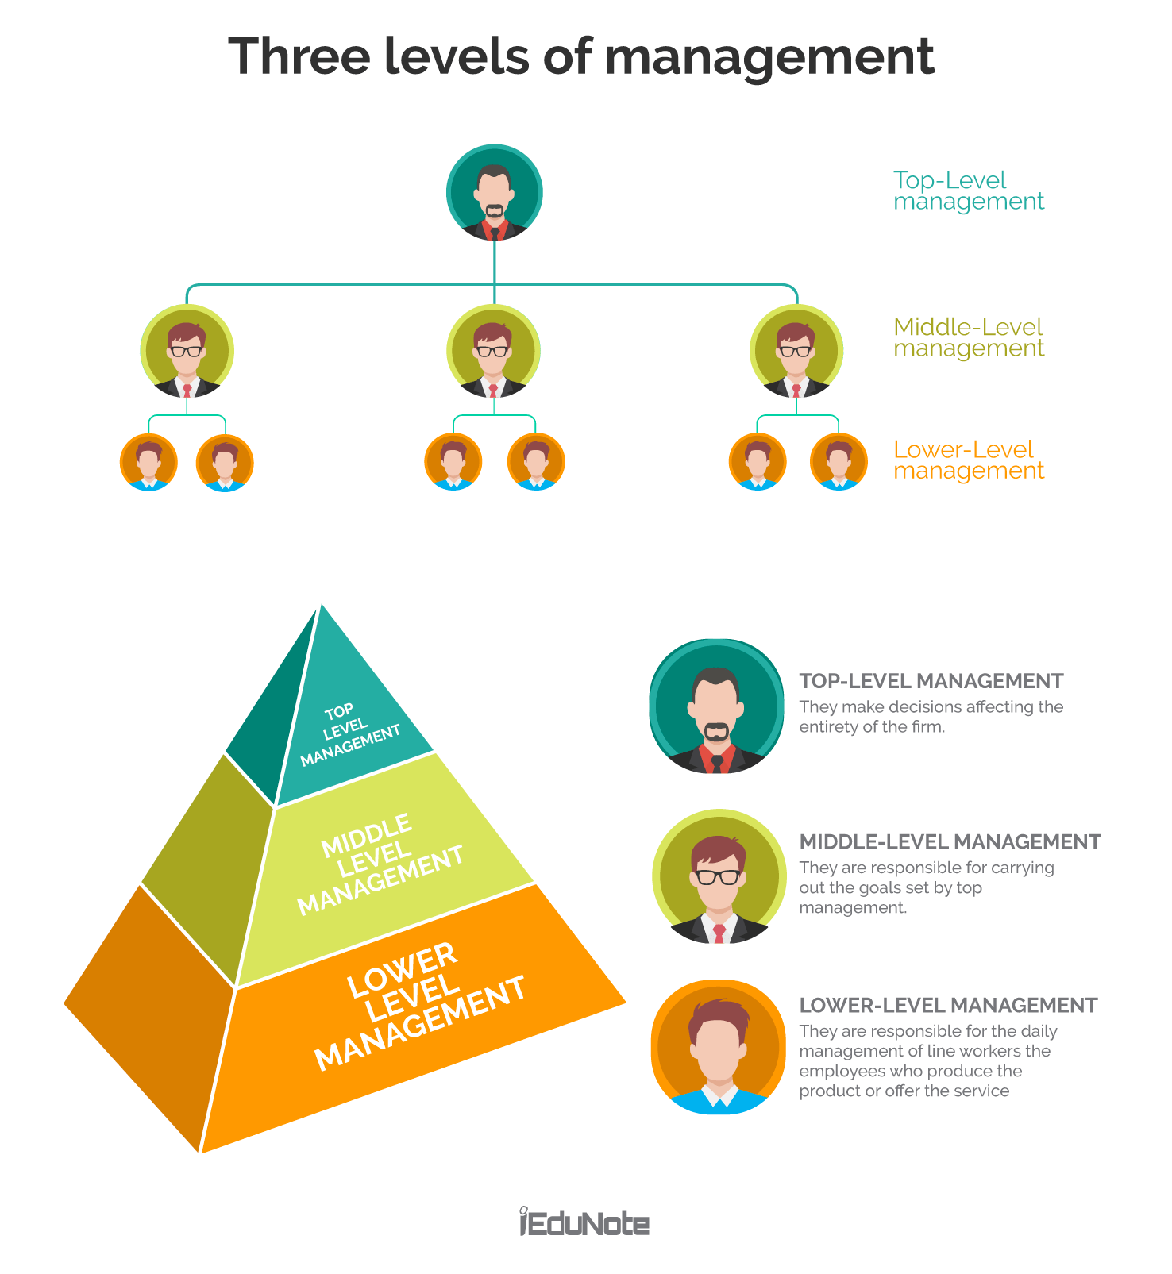
3.2. ORGANIZATIONAL HIERACHY

Slide 32
3.3. Managerial roles
Henry Mintzberg (1990):
Interpersonal Roles
Figurehead
Informational Roles
Monitor
Spokesperson
Decisional Roles
Entrepreneur
Negotiator
Liaison
Leader
Disseminator
Disturbance Handle
Resource Allocator

Slide 33
3.3. Managerial roles
When to use?
  Write a job description
  Develop training
  Assess your own weaknesses

Slide 34


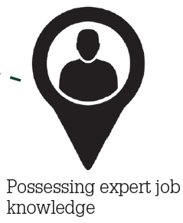

What Skills Do Managers Need?
Conceptual Skills
Interpersonal Skills
Technical Skills
Political Skills
Source: Simon/Fotolia

Slide 35
4. ORGANIZATIONAL ENVIRONMENT
1)Definition of organizational environment
2) Classification of organizational environment

Slide 36

4. 1. Definition of organizational environment
An organization's environment is defined as all the factors and forces existing within and outside the organization that can directly or indirectly affect organizational performance& managerial decision- making.

Slide 37
4. 2. Classification of organizational environment
Natural
Macroeconomic
Competitors
Owners (shareholders)
HR
Finance
Organizational Culture
Workplace’s Physical Environment
Relevant organizations
Socio-cultural
Global
Suppliers
Customers
Technological
Political and Legal

Slide 38
4. 2. Classification of organizational environment
Macro environmental factors
Political and legal factors
Macroeconomic factors
Socio -cultural factors
Technological factors
Global factors
Natural factors

Slide 39
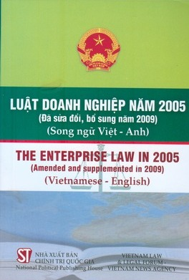
Political and legal factors
4. 2. Classification of organizational environment
- State policies
  Make it convenient for businesses and create equal opportunities for citizens to join business activities.
  Play an important role in economic regulation through fiscal policy, monetary policy, tax policy and national expenditure programs, etc.
-Political conditions
  Political stability is essential to create a favourable environment for organizations ; create a climate of confidence to welcome domestic and foreign investment.
- Legal system
  The legal system partially defines what members of a society must do and cannot do ; the legal basis of sanctions
  Codes, decrees, circulars and decisions , such as Labour code, Trade law, corporate law, Investment law, Law on export and import duties, environmental law…issued to regulate relevant activities.

Slide 40

Macroeconomic factors
4. 2. Classification of organizational environment
GDP, GNP
Economic growth rate
Inflation rate
Unemployment rate
Exchange rate
Interest rate
Salary and Income
State Budget Deficit and Surplus
Balance of Payments (BoP)
Infrastructure systems
=> Opportunities and Threats

Slide 41
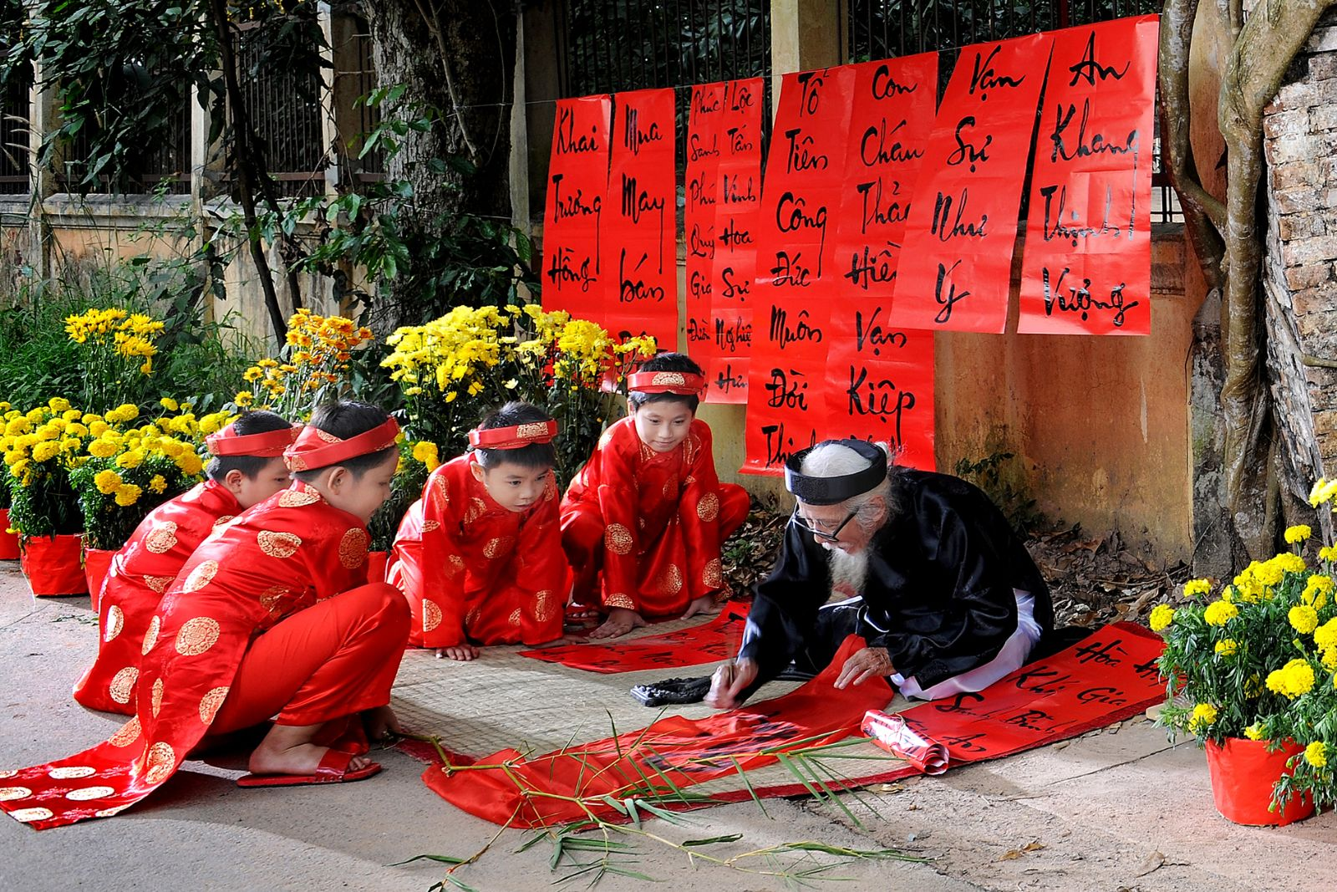
Socio cultural factors
4. 2. Classification of organizational environment
Population and demographics
National culture
Styles and Lifestyles
Religions

Slide 42

Technological factors
4. 2. Classification of organizational environment
Technological innovation results in increasingly short technology & product life cycles.
Changes in working methods due to boom in information and communications technology (ICT) revolution

Slide 43

Global factors
4. 2. Classification of organizational environment
The increasing economic integration of countries around the world.
Managers have to work under the increasing pressure of global competition

Slide 44

Natural factors
4. 2. Classification of organizational environment
  The natural environment encompasses all living and non-living things occurring naturally on Earth or some region thereof.
  Abuse of natural resources results in serious environmental problems
  Managers need to have sense of environmental responsibility

Slide 45
4. 2. Classification of organizational environment
Micro environmental factors
External microenvironment
Internal microenvironment

Slide 46
4. 2. Classification of organizational environment
External microenvironment
Customers
Suppliers
Competitors
Partners
Relevant organizations

Slide 47
Customers
4. 2. Classification of organizational environment
Customers are individuals/ groups that buy goods/services produced by an organization.
Customers tend to change needs and tastes; switch brands due to goods/services diversification
The bargaining power of customers depends on the ratio of volume of purchased goods/services to total amount of goods/services that organization put up for sale; availability of existing substitute products, cost of storage, etc.

Slide 48
Suppliers
4. 2. Classification of organizational environment
Suppliers: are the organizations/individuals providing the input resources that an organization needs to produce goods and services
The input resources include: raw materials, equipment, labour, capital, information, etc.
The bargaining power of suppliers depends on degree of importance of inputs; supplier competition; degree of differentiation of inputs
It is supposed to choose stable and reliable supply or diversify suppliers

Slide 49
Competitors
4. 2. Classification of organizational environment
  Competitors : are organizations / individuals that have the ability to satisfy target customers‘ needs by offering the similar products/services or substitutes .
  Direct competitors: are organizations / individuals that offer products and services that are functionally the same
    Managers need to identify competitors‘ strengths, weaknesses; forecast their actions and respones to changes
  Potential competitors (potential entrants)
    Managers need to estimate the threat of new entrants in future.
    Some advantages that help in creating entry barriers: economies of scale, product/service diversification, capital, distribution agreement, cost price...
  Substitutes
    Virtually result from advances in technology
    Adoption of advanced technology and concentration in R&D help improve competitive advantage.

Slide 50
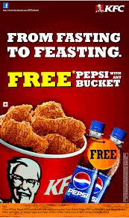

Partners
4. 2. Classification of organizational environment
Many organizations choose cooperative strategy to develop together
Cooperative forms: joint- venture; business cooperation contract…in order to take advantage of mutual strengths, share risk, expand into a new market, etc.

Slide 51
Relevant organizations
4. 2. Classification of organizational environment
-Relevant organizations are entities that have the ability to control or influence organizational activities.
- Government agencies: keep control on relevant activities of organizations
- Pressure groups: organized by their members to attempt to influence organizations indirectly . However, they have no official power, but use the media to call attention to their positions
PRESSURE

Slide 52
4. 2. Classification of organizational environment
Internal microenvironment
Owners (shareholders)
Humman resources
Finance
Organizational culture
Workplace’s Physical environment
Other internal factors

Slide 53

Owners (shareholders)
4. 2. Classification of organizational environment
owner
Owners are individuals /organizations have partial or total ownership of an organization (with the legal protection)
Managers have responsibility for informing owners sufficiently and exactly about the utilization of organizational resources and its performance.
Information rights help owners (shareholders) make sound investment decisions.

Slide 54
Human resources
4. 2. Classification of organizational environment
Managers (at all levels):
  Technical skills, human skills, conceptual skills
  Professional ethics
  Managerial performance
Employees (operatives):
  Besides similar criteria (mentioned above), organizations attach increasing importance to training and incentives

Slide 55

Finance
4. 2. Classification of organizational environment
Consist of sources of funds and capacity to mobilize funds; fund utilization and allocation; cost control capacity; financial relation between relevant parties, etc.
The basis of future investment, materials purchase, employee payments, etc.

Slide 56
Organizational Culture
4. 2. Classification of organizational environment
    A set of values, beliefs, behaviors, customs and traditions that affect organizational activities, feeling, thinking and behaviors of all members in pursuing organizational goals.
    Managers need to comprehend organizational culture to co-ordinate with others.

Slide 57
Workplace’s Physical environment
4. 2. Classification of organizational environment
Consist of working spaces, working conditions, etc.
A tendency towards “Open” working space → facilitate efficient teamwork.

Slide 58
Other internal factors
4. 2. Classification of organizational environment
  Production operations management:
    2 main functions:
      Design production system
      Operate production system
Research and development (R&D)
  Product R&D
  Process R&D
Other factors: Marketing , infrastructure, information system, organizational structure, etc.

Slide 59
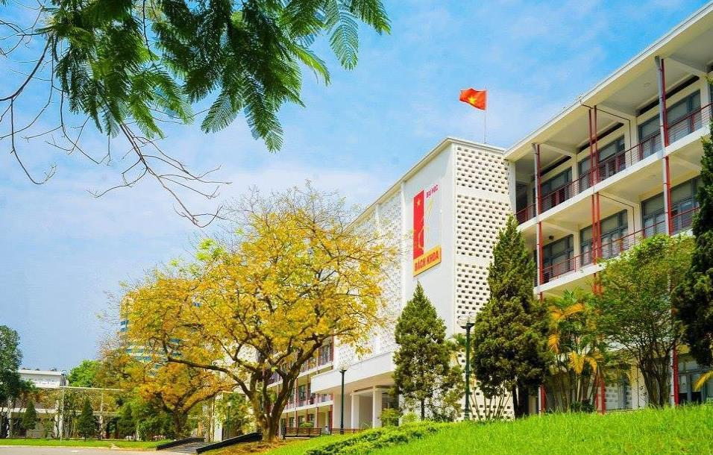
HANOI UNIVERSITY OF SCIENCE AND TECHNOLOGY

