Slide 1


HANOI UNIVERSITY OF SCIENCE AND TECHNOLOGY
Chapter 4: LEADING function
School of economics and management
DR. Nguyen Thanh huong

Slide 2

PROCESS OF MANAGEMENT

Slide 3
OBJECTIVES
HANOI UNIVERSITY OF SCIENCE AND TECHNOLOGY
1. Present the definition and role of leading function
2. Acquire knowledge of theories related to needs, motives, and motivation.
3. Describe leadership styles
4. Gain insight into different leadership methods.

Slide 4
CONTENT
HANOI UNIVERSITY OF SCIENCE AND TECHNOLOGY
4.1. Definition and role of leading function
4.2. Theories of needs, motive and motivation
4.3. Leadership styles
4.4. Leadership methods

Slide 5
Leaders and Leadership
Leader:
someone who can influence others and who has managerial authority.
Leadership:
the process of leading a group and influencing that group to achieve its goals.

Slide 6
4.1.Definition and role of leading function
- Leading function is defined “ as the activity of influencing people to strive willingly for group activities” (George R. Tery)
- Leading function is defined as “influence, the art or process of influencing people so that they will strive willingly and enthusiastically toward the achievement of group goals. ” (Harold Koontz, Cyril O’ Donnell, & Heinz Weihrich)
- Leading function refers to process in which a manager influences employees so that they are enthusiastic, initiative and creative in achieving common objectives in the organization.

Slide 7
The difference between a manager and a leader
While every leader may not be a manager, should every manager be a leader?

Slide 8
4.1.Definition and role of leading function
The role of leading function
Maintain discipline and order to stabilize the organization.
Guide, persuade, and encourage employees during task execution.
Maximize the capabilities and potential of employees to develop the organization.
Coordinate individual efforts into collective efforts for the entire organization.
Contribute to building the organizational culture.

Slide 9
MOTIVE & MOTIVATION
Motive
Motivation
Originates from within the individual worker.
-
-
-Heavily influenced by the individual worker, family, and the surrounding social environment.
-
-Influenced significantly by the individual worker and the organizational environment where the worker is employed.
- Labor motivation refers to the variations in intensity: high or low, existence or non-existence.
-

Slide 10
4.2. Theories of needs, motive and motivation
4.2.1 Theory of needs
4.2.2 Theory of motive

Slide 11
4.2.1 Theory of needs
4.2.1.1. Concept of needs
4.2.1.2. Maslow's Hierarchy Of Needs

Slide 12

4.2.1 Theory of needs
4.2.1.1. Concept of needs
- Need can be defined as a psychological state of feeling of lack and desire to be satisfied
There are different needs based on awareness, psychological and physiological characteristics.

Slide 13
4.2.1 Theory of needs
4.2.1.2. Maslow's Hierarchy Of Needs
- Assumptions in Maslow's hierarchy of needs
- Content of Maslow's hierarchy of needs
- Application of Maslow's hierarchy of needs in management

Slide 14
4.2.1.2. Maslow's Hierarchy Of Needs
Some fundamental assumptions
1- A satisfied need does not act as a motivator, and another replaces it.
2- Most of people have a diverse system of needs. There always exists different needs affecting people’s behaviour
3- It is common accepted that One must satisfy lower level basic needs before progressing on to meet higher level growth needs.

Slide 15
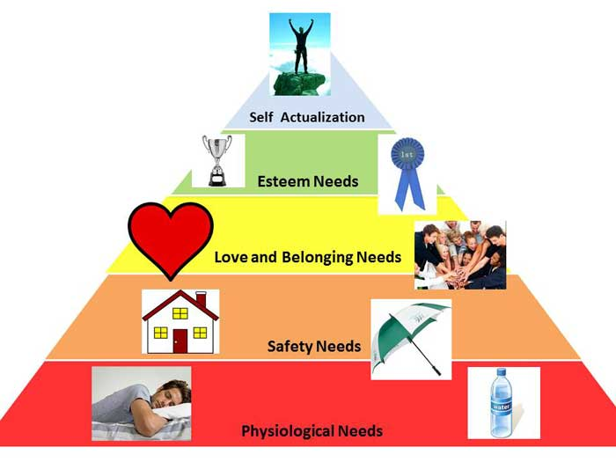
4.2.1.2. Maslow's Hierarchy Of Needs
Content of Maslow's hierarchy of needs

Slide 16
4.2.1.2. Maslow's Hierarchy Of Needs
Application of Maslow's hierarchy of needs in management
-It is supposed to grasp the stage of needs of employees. By this way, managers are able to propose appropriate solutions for employee satisfaction, ensuring objective achievement in an organization.
- Basic needs (physiological needs)
- Safety needs
- Love and belonging needs
- Esteem needs
- Self actualization
-Rewards need personalizing in different stages.

Slide 17
4.2.2 Theory of motive
4.2.2.1. Concept of motive
4.2.2.2. Herzberg's two-factor theory

Slide 18
4.2.2 Theory of motive
4.2.2.1. Concept of motive
- Motive is a subjective goal of people’s activities to meet the given demands
- It is a reflection of wants and demands and the reason for people’s actions

Slide 19
4.2.2 Theory of motive
Concept of motive (illustration)
Wants
Demand
Reality
Motive
Action
Environment

Slide 20
4.2.2 Theory of motive
4.2.2.2. Herzberg's two-factor theory
Content of Herzberg's two-factor theory
Application of Herzberg's two-factor theory in management

Slide 21
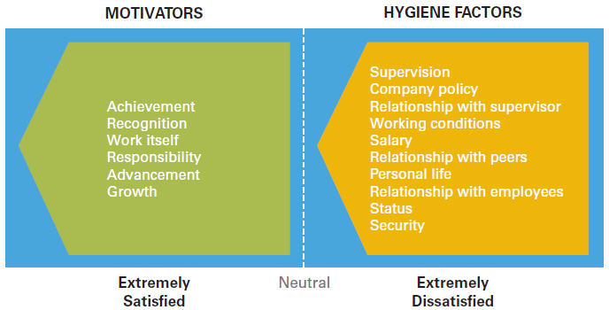
4.2.2 Theory of motive
Content of Herzberg's two-factor theory

Slide 22
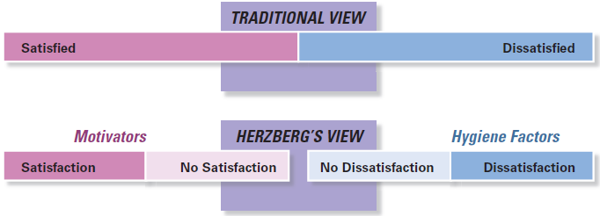
4.2.2 Theory of motive
Content of Herzberg's two-factor theory
Copyright ©2017 Pearson Education, Inc.

Slide 23
4.2.2 Theory of motive
2) Application of Herzberg's two-factor theory in management
The majority of managers believe that money (referring specifically to “pay” in the study) is both hygiene factor and motivation factor.
In case of high paying , most employees feel satisfactory and strive for fulfilment.
However, uninspired work is likely to make pay cease to be motivating factors

Slide 24
4.3. Leadership styles
4.3.1 Lewin‘s leadership theory
4.3.2 MBO

Slide 25

Leadership styles
- A leadership style refers to a leader's methods and behaviors when directing, motivating, and managing others.
- A person's leadership style also determines how they strategize and implement plans while accounting for the expectations of stakeholders and the well-being of their team.

Slide 26
4.3.1. Lewin‘s leadership theory
Significant research on leadership styles was first conducted by Kurt Lewin, who led a team of researchers exploring different leadership styles based on authority (Lewin, Lippit, White, 1939).
Autocratic (authoritarian)
Democratic (participative)
Laissez-faire (delegative) leadership

Slide 27
4.3.1. Lewin‘s leadership theory
Autocratic (authoritarian)
Democratic (participative)
Laissez-faire (delegative) leadership
Motivates through threats & punishments
Prefers giving orders
Expects obedience
Decisive
Lack trust in subordinates
Seeks inputs from subordinates
Collaborative decision-making
Limited use of authority
High degree of freedom for subordinates

Slide 28
Autocratic (authoritarian) leadership
Trait:
  Centralizes all power in the leader, managing through their own will, suppressing the ideas and initiatives of all members in the group.
  Authoritarian leaders prefer giving orders, making decisive decisions, and have little trust in those at lower levels.
  They motivate employees through coercion and punishment primarily
  Advantages:
  The leader quickly, decisively, and uniformly resolves tasks, seizing business opportunities.
  Ensures the leader's authority.
  Disadvantages:
  Does not harness the creativity of subordinates, creates tension and pressure on employees, leading to resistance.
  Employees may dislike the leadership, and work efficiency may be low when the leader is not present. The organizational atmosphere may be less friendly.

Slide 29
Democratic leadership
Trait:
  The leader delegates their management authority, seeks input from subordinates, and involves them in decision-making.
  This leadership style creates favorable conditions for subordinates to express their creativity, participate in planning and implementing plans, and fosters a positive psychological atmosphere in the management process.
  The leader refrains from action without the consensus of subordinates or decides independently but considers the opinions of their subordinates.
Advantages:
  Employees are likely to appreciate the leader more, creating a friendly organizational atmosphere with clear team orientation and task orientation.
  Each member feels the need to bond with each other to work together for common results, ensuring high work efficiency even in the absence of the leader.
  This style helps the leader leverage the capabilities and intelligence of the team, tapping into the creativity of subordinates, and decisions made by the leader are trusted and followed by subordinates.
  Disadvantages: The leader may take longer to make decisions, and sometimes it can be challenging to reach a consensus on specific issues without a manager who is sufficiently specialized, knowledgeable, and decisive.

Slide 30
Laissez- faire leadership
Trait:
  Leaders rarely use power to influence subordinates, sometimes not influencing them at all.
  The leader allows employees the right to make decisions, but the leader still takes responsibility for those decisions.
  Their role is to assist subordinates' activities by providing information and acting as a liaison with the external environment.
  The leader decentralizes decision-making authority to subordinates and grants them a high level of autonomy.
Advantages:
  Creates an "open" working environment within the group and the organization.
  Each member tends to become a contributor, providing ideas and opinions to solve important issues posed by reality.
Disadvantages:
  May create a dull atmosphere for the leader, leading to arbitrary or negligent work.
  It can result in employees having less trust in the leader, and the leader may be absent frequently

Slide 31
4.3.2. MBO
MBO (Management by Objectives) : Management through the establishment of goals for each employee, directing their activities towards achieving the set objectives.
Purpose: To increase the organization's performance by achieving organizational goals through the individual goals of employees; encourage the expanded participation of all members in the organization in the goal-setting process, thereby understanding the organization's goals, direction, and recognizing their role and responsibility in achieving the organization's goals.
MBO is a powerful tool for aligning employee actions with the organization's objectives.
-

Slide 32
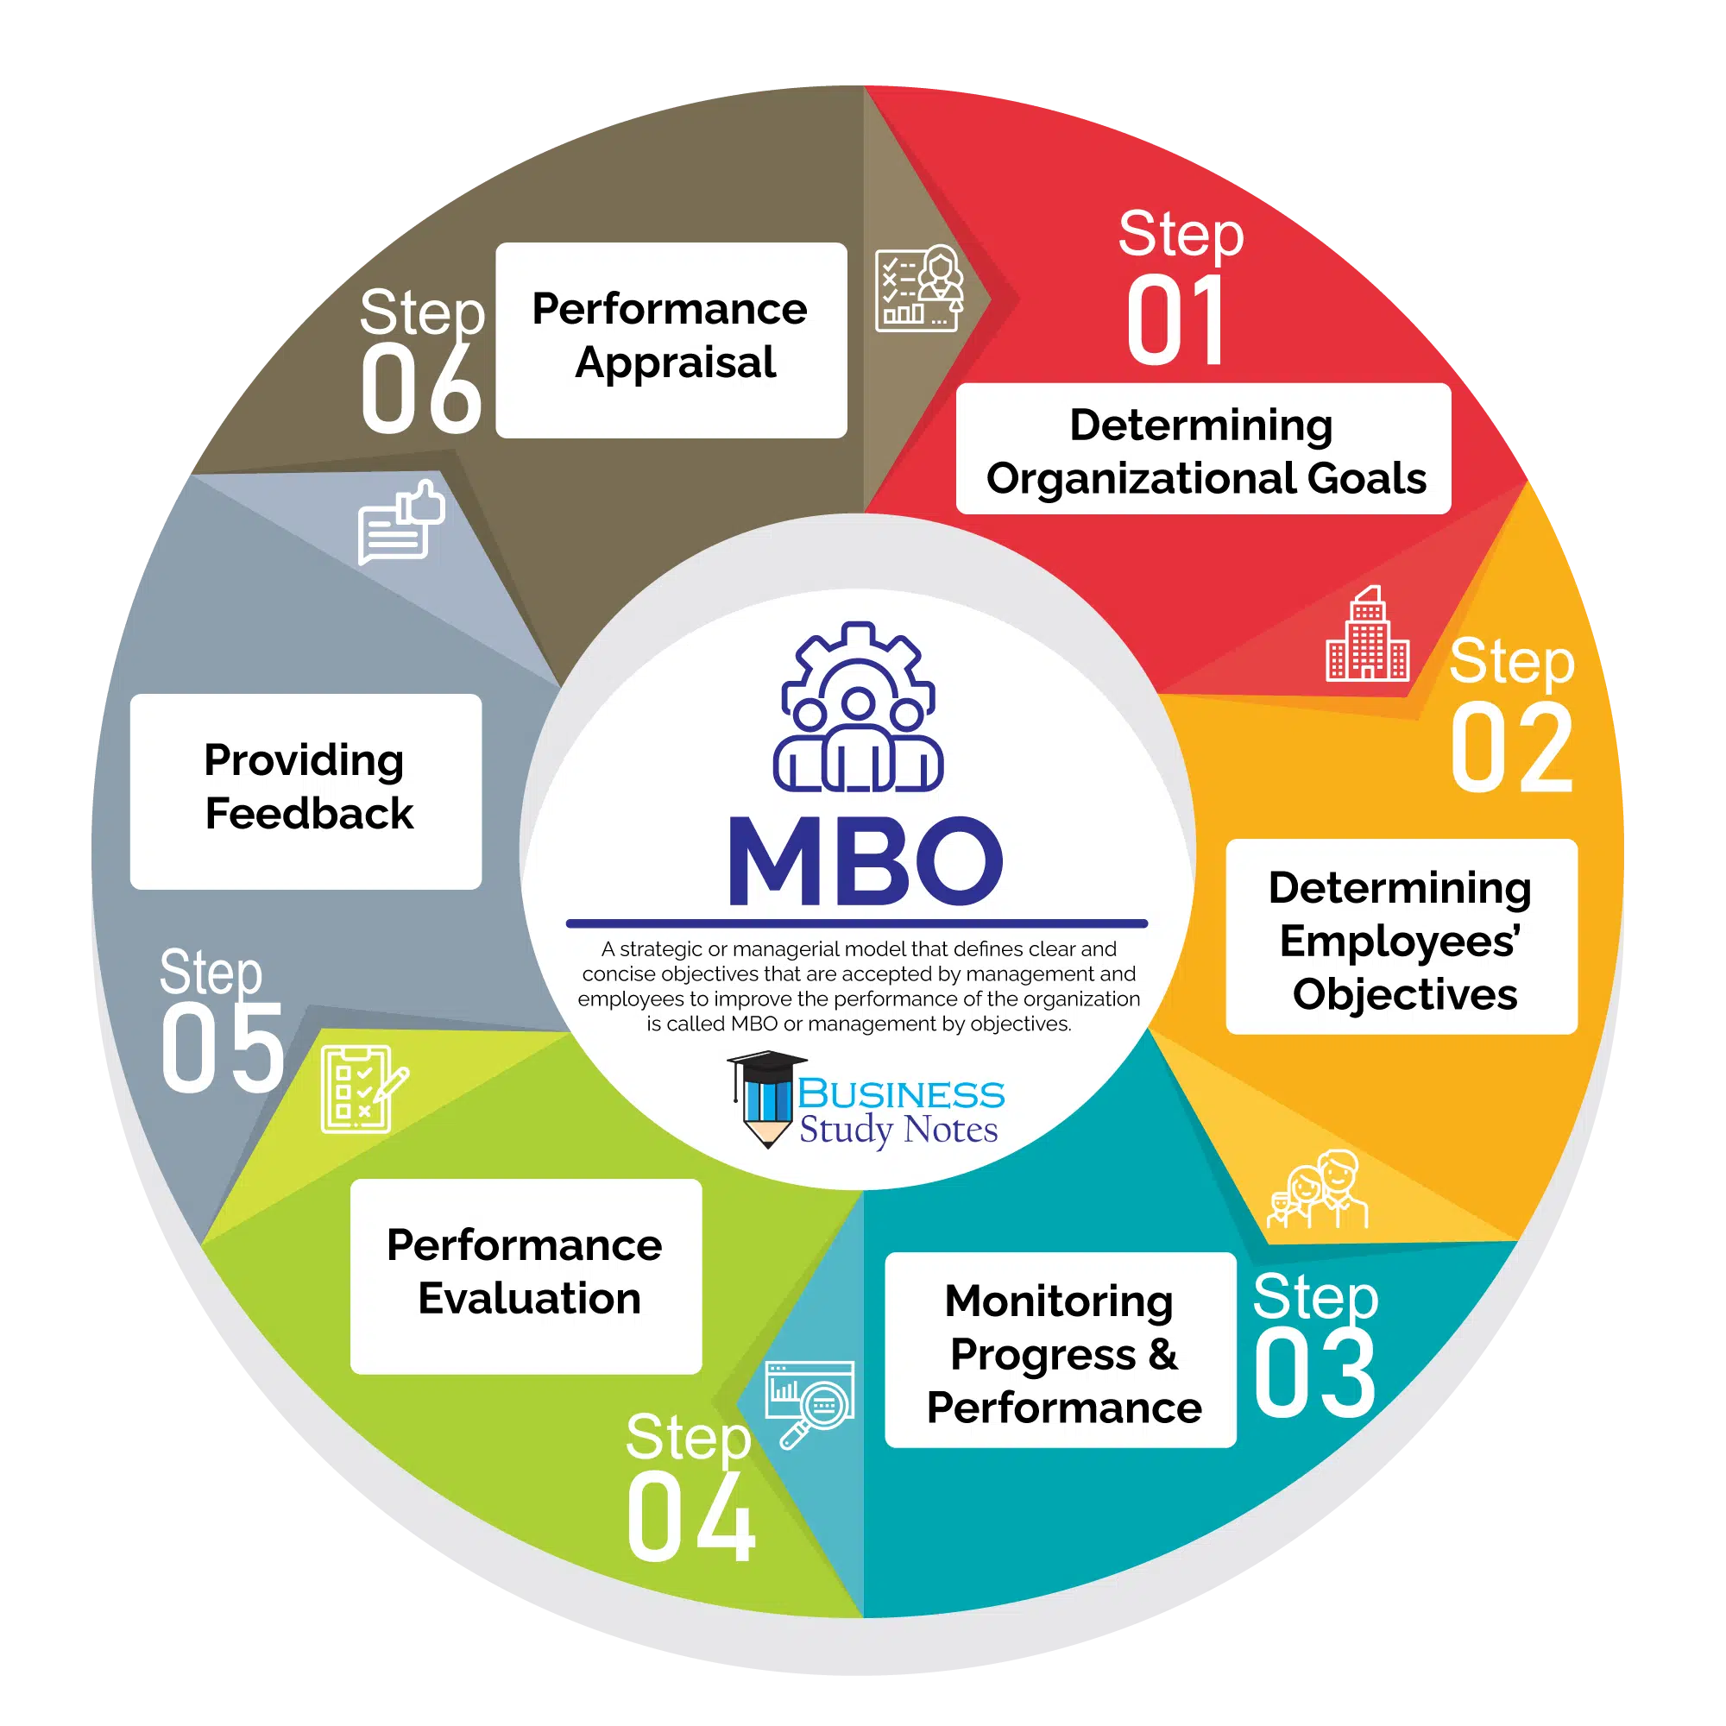
4.3.2. MBO
MBO PROCESS
-

Slide 33
4.3.2. MBO
ADVANTAGES:
Creating work motivation for employees
Providing conditions for employees to understand their tasks and have a higher sense of job responsibility
Facilitating accurate assessment of job effectiveness
Efficient utilization of organizational resources
Creating a more transparent and open work environment
Contributing to improving the company's organizational structure
Aiding in organizational control Supporting employees in developing their capabilities
-

Slide 34
4.3.2. MBO
DISADVANTAGES:
Environmental changes can render established goals inappropriate, requiring continuous adaptation.
Implementing MBO can be challenging and time-consuming.
At the organizational level, MBO necessitates full commitment from the organization and a fundamental system to monitor goals and performance.
-

Slide 35
4.4. Leading methods
4.4.1 Economic methods
4.4.2 Administrative methods
4.4.3 Educational methods

Slide 36
4.4.1. Economic methods
- Economic methods include pay and personal life…with the aim of basic-level needs satisfaction (Maslow's hierarchy of needs) and motivation (Herzberg's two-factor theory)
- These methods influence employees by economic benefits . As a result, employees willingly choose the most efficient way within their scope of activities.
-

Slide 37
4.4.2. Administrative methods
- Administrative methods uses hygiene factors (Herzberg's two-factor theory ): Managerial policy and supervision, work condition, etc.
- These methods influence employees by irrevocable and obligatory decisions
-

Slide 38
4.4.3. Educational methods
- Educational methods have impact on higher-level needs (Maslow's hierarchy such as: Esteem needs, self-actualization needs)… or mental motivation such as achievement , responsibility, challenges; opportunities for personal growth; recognition (Herzberg's two-factor theory )
- These methods influence employees in terms of awareness and sentiment in order to develop their self- consciousness and enthusiasm .
-

Slide 39

HANOI UNIVERSITY OF SCIENCE AND TECHNOLOGY

