Slide 1

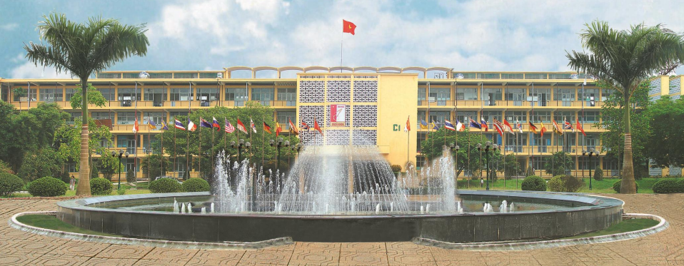
HANOI UNIVERSITY OF SCIENCE AND TECHNOLOGY
Chapter 5: Controlling function
School of economics and management
DR. Nguyen Thanh huong

Slide 2
objectives
HANOI UNIVERSITY OF SCIENCE AND TECHNOLOGY
Present the concept and role of controlling activities.
Identify types of control.
Describe the control process.
Explain the principles of effective control for organizations

Slide 3
Content
HANOI UNIVERSITY OF SCIENCE AND TECHNOLOGY
5.1. Concept of controlling activities
5.2. The role of controlling activities
5.3. Types of control
5.4. The controlling process
5.5. Principles of control”

Slide 4

5.1. CONCEPT OF CONTROLLING FUNCTION
Control is understood as the process of measuring the actual performance based on set objectives in order to identify errors and propose corrective measures to achieve the stated goals

Slide 5
5.1. CONCEPT OF CONTROLLING FUNCTION
Purpose:
  Identify shortcomings in the organizational system
  → make timely adjustments.
  Ensure the existence and maintain the effectiveness of each individual, each team, each department, and the organization

Slide 6
5.2. THE ROLE OF CONTROLLING FUNCTION
  Refine decisions in management.
  Control to encourage the effective implementation of plans
  Ensure the exercise of the organization's power
  Help the organization monitor and respond to environmental changes.
  Creates conditions for improvement and innovation processes

Slide 7
5.3. TYPES OF CONTROL
Feedforward control: aims to reduce errors, with the impact of decreasing the need for corrective activities.
Concurrent control: Control that takes place while a work activity is in progress and helps to foresee problem ahead of occurrence.
Feedback control: post-assessment is conducted after the activity has taken place to provide valuable information for planning and improving motivational factors to drive employee performance.

Slide 8
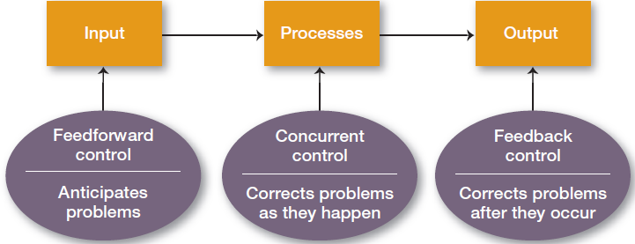
5.3. TYPES OF CONTROL

Slide 9
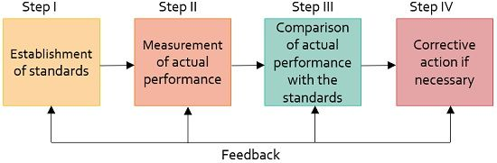
5.4. CONTROL PROCESS

Slide 10
5.4. CONTROL PROCESS
(1) Establishing standards:
  These are the criteria of tasks that need to be implemented or the criteria for implementing plans.
  A business can have multiple standard systems.
  Control standards are categorized as quantitative and qualitative standards.
  Requirement: the set standards must be reasonable and achievable in practice.

Slide 11
5.4. CONTROL PROCESS
(2) Measurement of actual performance & comparison with the standard
  If the standards are reasonably set and there are accurate means of measurement, measuring actual performance will be easy.
  If the standards are not clearly defined, the use of vague standards, such as customer trust, respect for business partners..

Slide 12
5.4. CONTROL PROCESS
(3) Taking corrective actions:
  Analyze the causes of deviations.
  Making adjustments by restructuring the factory's machinery, reallocating departments, providing training for employees, hiring additional labor, and modifying goals.

Slide 13
5.5. PRINCIPLES OF CONTROL
Control should be designed based on the organization's operational plan and tailored to the level of the entity being examined.
Tasks should be designed according to the individual characteristics of managers.
Control should be conducted at critical points.
Control must be objective.
The control system must align with the business's atmosphere.
Control activities should be cost-effective and ensure economic efficiency.
Control should lead to action.

Slide 14
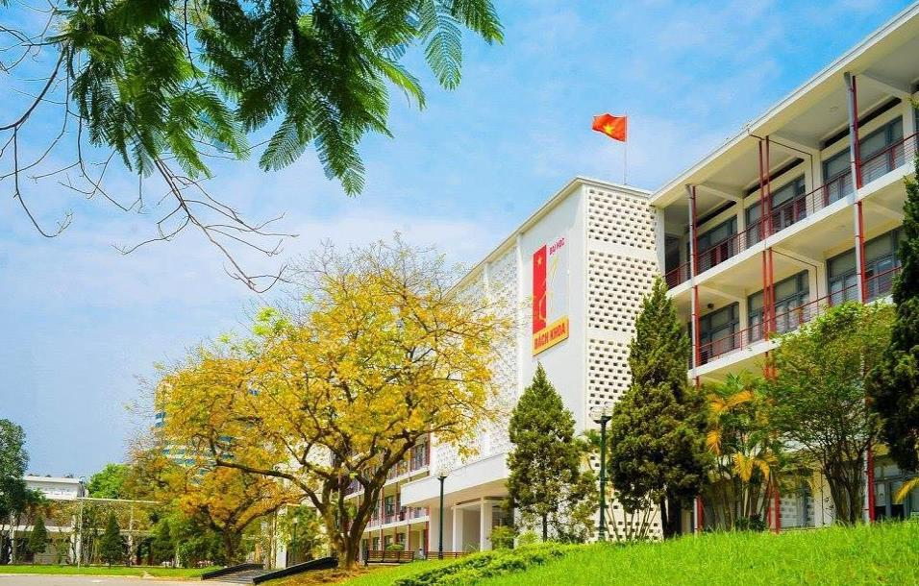
HANOI UNIVERSITY OF SCIENCE AND TECHNOLOGY

