Slide 1


INTRODUCTION TO MARKETING
Lecturer: Dr. Nguyen Quynh Hoa
PhD in Marketing
University of Canterbury (New Zealand)
Zalo: 0936110108
Email: hoa.nguyenquynh@hust.edu.vn

Slide 2
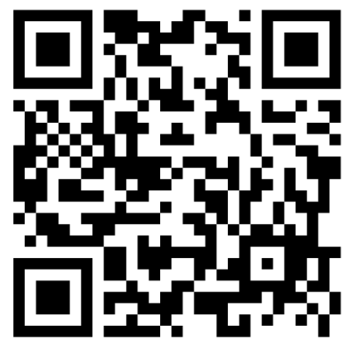
Course details
(Please see the syllabus for more information)
Assessment
What we do?
Lecture
  Tuesday & Thurday
  8.30am – 12.05 pm, 15-min break
  See the detailed schedule
Grading
  90-100% = A
  80 – 89% = B
  70 – 79% = C
  60 – 69% = D
  Under 60% = F
Attendance 10% →
Group Project & Presentation 20%
Mid-term test 30%
Final exam 40%
Discussion in class → Plus points

Slide 3
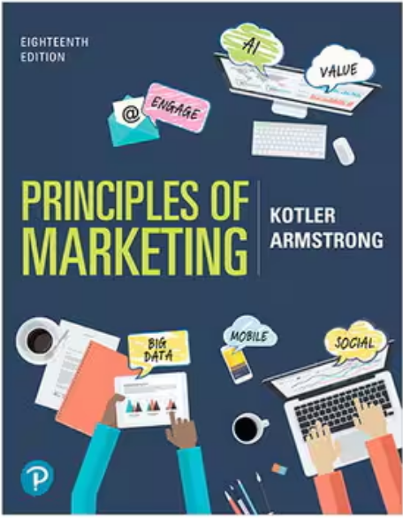
Textbook and other documents
Main textbook:
Kotler, P., & Armstrong, G. (2021). Principles of Marketing, 18th Edition. Pearson Education Limited.
E-book: https://drive.google.com/file/d/12nuBRl2G0biy-jvpXQyfILC_nz6_1abQ/view?usp=sharing
Case studies: Will be provided in class

Slide 4
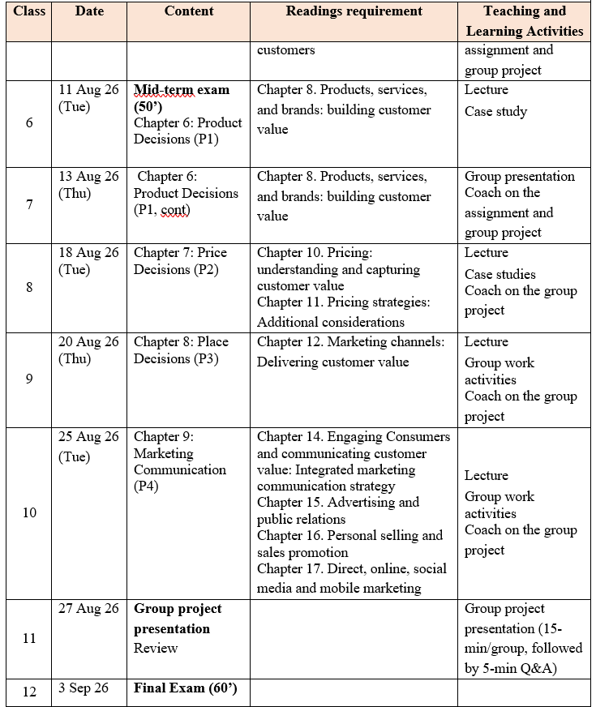
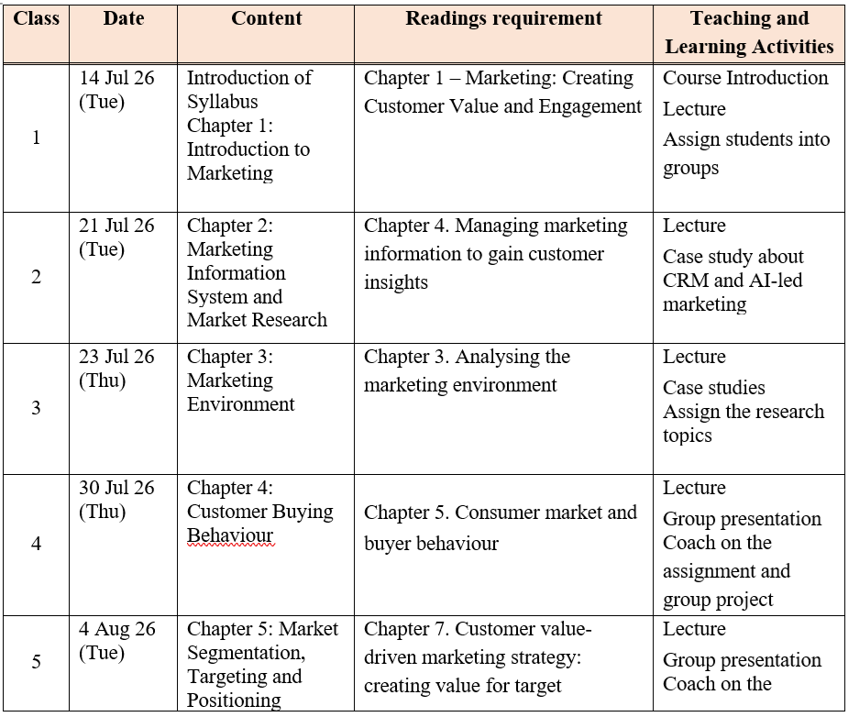
What will we cover?

Slide 5
MKT361 – Course aims
To enable students to understand the fundamental concepts and theories of marketing and how they may be applied to the marketplace in a modern and dynamic environment.
After the course, successful students should be able to:
  • Understand and explain the four components of the marketing mix
  • Recognise the role of marketing in the strategic planning process of a firm.
  • Link the marketing mix elements to a firm’s marketing strategy.
  • Apply marketing concepts to specific business cases and situations.

Slide 6
Group project
Group assignments:
Requirement
Group 1
Group 2
Group 3
Group 4
Group 5
Each group will be assigned a marketing-related case study to analyse throughout the course alongside the topics covered in class.
Each group is expected to discuss and present the following aspects of the assigned case study:
  How do the macro-environmental and micro-environmental factors influence the company's marketing activities?
  Who are the company's target customer segments? What are the key characteristics of these target segments?
  What are the consumer behaviour patterns of customers within these target segments?
  What product, pricing, distribution (place), and integrated marketing communication (IMC) strategies would be most appropriate for the target segments?
  What Customer Relationship Management (CRM) and Corporate Social Responsibility (CSR) initiatives should the company implement?
  What marketing performance metrics (KPIs) are most appropriate for evaluating the effectiveness of the company's marketing activities in relation to its business objectives?

Slide 7

What is marketing?

Slide 8
Aims
By the end of the lecture, students should be able to:
Define marketing, and outline the steps in the marketing process.
Explain the importance of understanding the marketplace and customers, and identify the five core marketplace concepts.
Identify the key elements of a customer-driven marketing strategy, and discuss the marketing management orientations that guide marketing strategy.
Discuss customer relationship management, and identify strategies for creating value for customers and capturing value from customers in return.
Describe the major trends and forces that are changing the marketing landscape in this age of relationships.

Slide 9
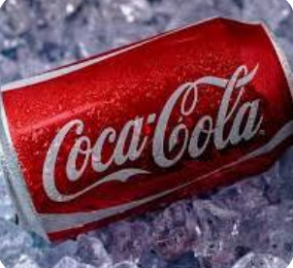

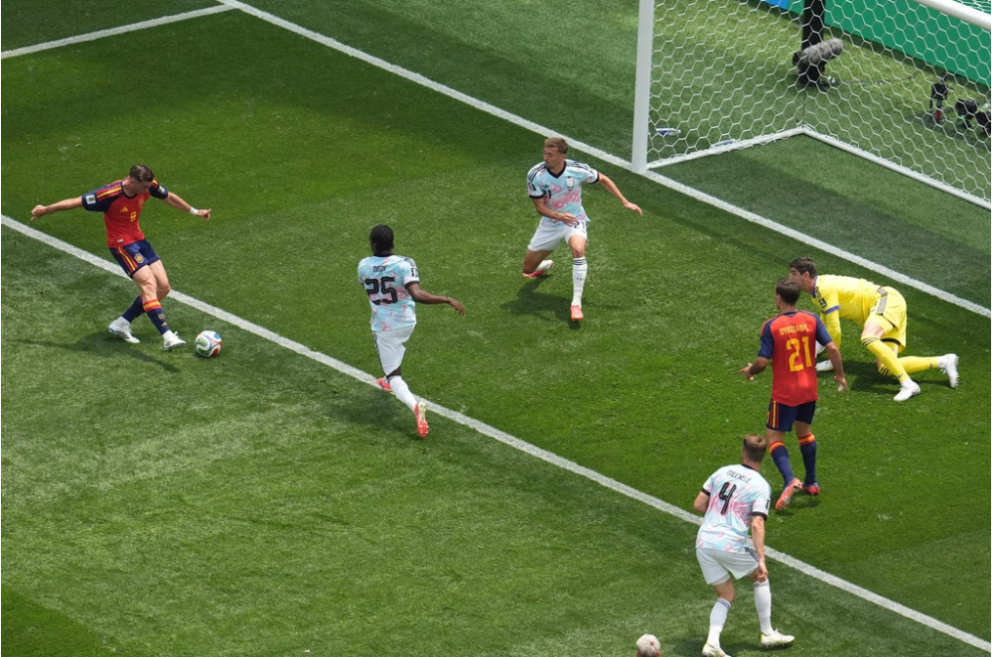
Markets
A market
  set of actual and potential buyers of a product
  these buyers share a particular need or want
  that can be satisfied through exchange relationships
The main elements of a marketing system are:
  suppliers
  company
  competitors
  marketing intermediaries
  consumers

Slide 10
MARKET-ING
The process of maximising returns to stakeholders by developing exchanges with valued customers and creating an advantage for them.’ (Pride 3e, p. 6)
‘The activity, set of institutions, and processes for creating, communicating, delivering, and exchanging offerings that have value for customers, clients, partners, and society at large’. (AMA)
The process by which marketing organisations engage customers, build strong customer relationships and create customer value in order to capture value from customers in return.

Slide 11
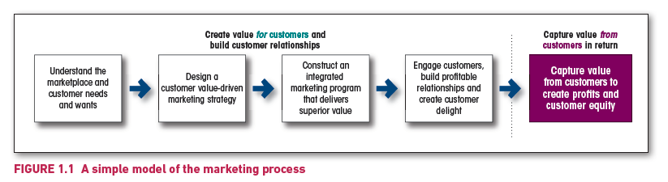
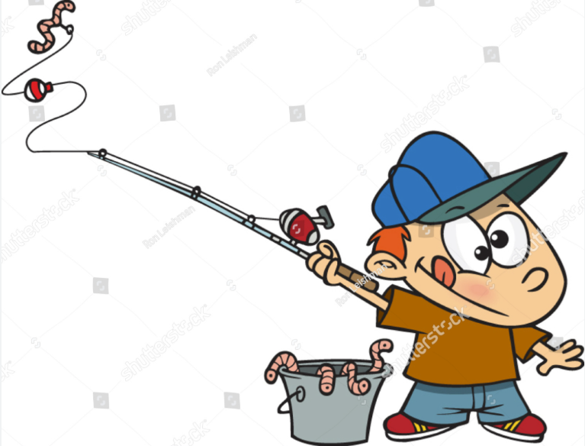
“Personally, I am very fond of strawberries and cream, but I have found that for some strange reason, fish prefer worms. So, when I went fishing, I didn’t bait the hook with strawberries and cream.” (Dale Carnegie)

Slide 12

Understand the marketplace and customer needs

Slide 13
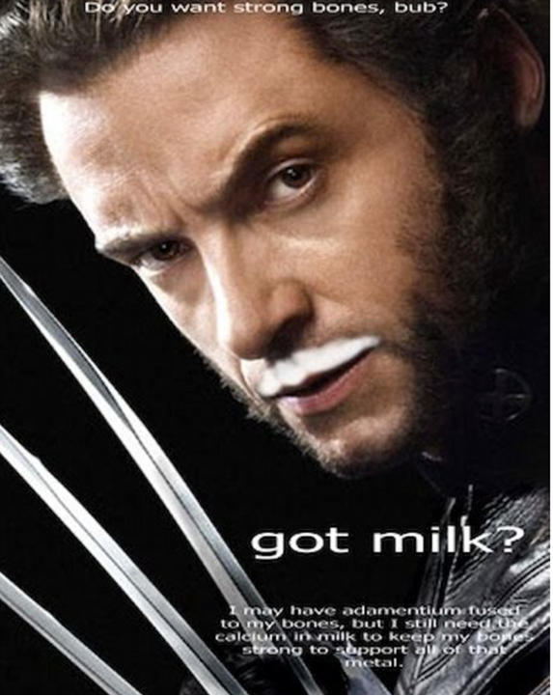
Needs
Needs are states of felt deprivation arising from basic physical, social, or individual requirements.
  Eg: hunger reflects a need for food, loneliness reflects a need for belonging, and uncertainty may create a need for information or security
These needs are a fundamental part of human nature; marketers do not create them.
  Eg: a smartphone company does not create the basic need for communication
Instead, marketing seeks to understand how people experience these needs and how they may be satisfied through suitable market offerings
Customer need | Possible market offering
Transportation | Bus service, bicycle, car, ride-hailing app
Belonging | Social network, club membership, community event
Education | University course, textbook, online programme
Relaxation | Spa service, holiday, music platform
Recognition | Luxury product, professional award, premium membership

Slide 14
Type of need | Meaning | Examples
Physical needs | Basic requirements for survival and physical wellbeing | Food, clothing, warmth, shelter, safety
Social needs | Needs connected with relationships and interaction with others | Belonging, affection, friendship, acceptance
Individual needs | Needs related to personal development and identity | Knowledge, self-expression, achievement
Joining a fitness club could satisfy:
a physical need for health;
a social need for belonging;
an individual need for confidence or achievement.

Slide 15
Marketing myopia: when a business pays too much attention to its products and too little attention to the needs and benefits underlying those products.
A railway company is not merely selling train tickets; it is satisfying a transportation need.
A hotel is not merely selling rooms; it may satisfy needs for rest, safety, convenience, status, escape, or cultural experience.
A university is not simply selling courses; it may satisfy needs for knowledge, qualifications, career development, identity, and belonging.
A latent need is a need that consumers may experience but cannot yet clearly express, or for which they do not know that a solution exists.

Slide 16
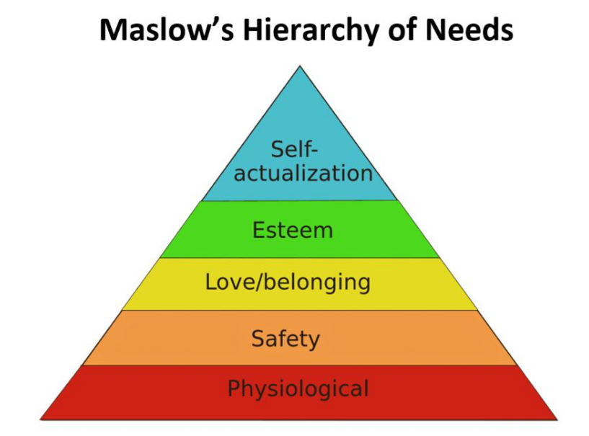
Maslow's Hierarchy of Needs
(Theory of Human Motivation)
Theory of Human Motivation: “human needs can be arranged in a hierarchy, where lower-level needs generally require sufficient satisfaction before higher-level needs become important motivators.”
The hierarchy is not rigid—people may pursue multiple levels simultaneously, and the order can vary depending on circumstances and culture.

Slide 17
The Five Levels of Needs
Physiological Needs: Basic Human Survival
Eg: Need for food, water, air, sleep, shelter
Mkt offers: restaurants, bottled water, hotels
→ A hungry customer is unlikely to care about luxury branding until the basic need for food is met.
2. Safety Needs: Once physiological needs are reasonably satisfied, people seek safety and stability.
Eg: personal security, financial security, health
Mkt offers: insurance, banks, hospitals
3. Love and Belonging Needs: Humans naturally seek meaningful relationships and social acceptance.
Eg: friendship, family, romantic relationships, community, team membership, sense of belonging
Mkt offers: social media platforms, dating apps, sport clubs, community events, travel experiences
→ Many successful brands create communities rather than simply selling products.

Slide 18
4. Esteem Needs: People want to feel respected, competent, and valued.
Internal esteem: the desire for self-respect.
  Achievement
  Confidence
  Independence
  Mastery
  Autonomy
  Eg: A researcher completes a difficult paper and feels proud because she knows she produced high-quality work—even before anyone else reads it. The satisfaction comes from within.
External esteem: the desire for recognition from others
  Recognition
  Reputation
  Status
  Prestige
  Appreciation
  Reputation
  Admiration
Eg: The same researcher receives a Best Paper Award or promotion. Now the esteem comes from other people's recognition.
Become the best version of yourself
Personal Growth not to impress others
Luxury watches
Show your success
Self-esteem: a person's overall evaluation of their own worth, competence, and value. It is how positively or negatively people feel about themselves.
→ It is an outcome or psychological state, not a type of need: “I believe I am capable”; “I feel worthy of respect”; “I accept myself despite my weaknesses”.
Luxury cars
Executive clubs
Likes on FB
Designed fashion

Slide 19

5. Self-Actualisation Needs: This is the desire to realise one's full potential.
Eg: Creativity; Personal growth; Learning; Meaning; Purpose; Self-development
Someone pursuing a second Bachelor may be motivated largely by intellectual growth and personal fulfilment rather than financial reward alone.
→ Mkt offers: Higher education Professional development courses Adventure travel Artistic workshops Coaching
Later Addition: 6. Self-Transcendence Needs: going beyond one's own interests to contribute to others or to a cause greater than oneself. → Contributing to society
Eg: Volunteering Mentoring Environmental protection Religious or spiritual devotion Scientific discovery for society
Two-time Oscar-winning actor and composer, Sir Anthony Hopkins released his debut single, "Bracken Road," at the age of 88.

Slide 20
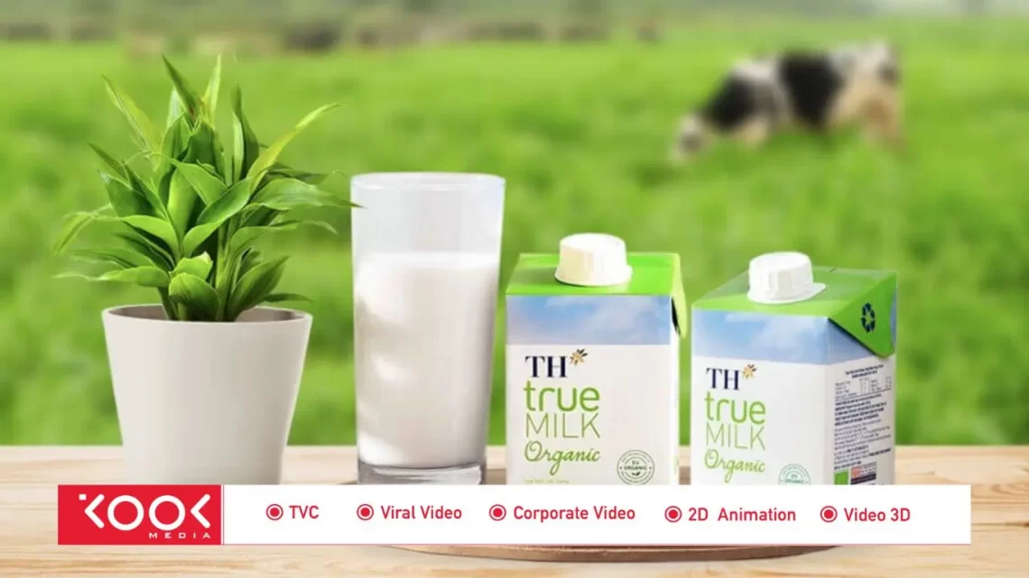
Wants
Wants are the forms that human needs take when they are shaped by culture and individual personality
Eg: A hungry person in Hanoi may want phở, while individuals in other cultural contexts may want pasta (Rome), curry (Tokyo), or a sandwich (U.S).
The need is similar—food—but the preferred solution varies according to culture, lifestyle, personality, experience, social influence, and context
While needs don’t change, wants are changing and satisfaction with existing offerings gradually declines.
What should marketers do?

Slide 21
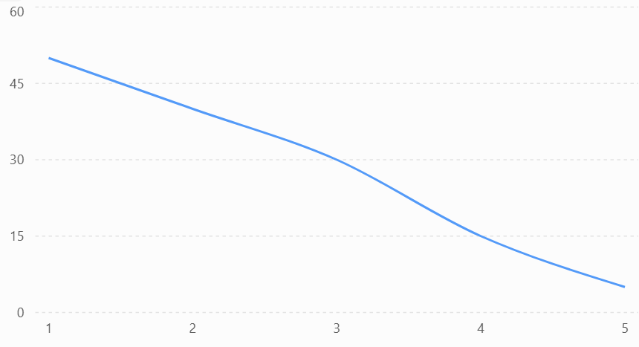
Law of Diminishing Marginal Utility (DMU)
Utility: the satisfaction or benefit that a consumer derives from consuming a product or service.
Eg: Imagine you are extremely thirsty.
  The first glass of water gives you tremendous satisfaction. 😍😍😍😍😍
  The second glass is still enjoyable. 😍😍😍😍
  The third glass is less satisfying. 😍😍😍
  The fourth glass provides little additional pleasure. 😐
  The fifth glass may even make you feel uncomfortable. 🤢
The product has not changed.
What changes is the level of satisfaction received from each additional unit.
Marginal Utility (MU) is the additional satisfaction gained from consuming one more unit of a product.

Slide 22
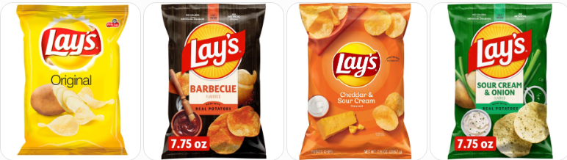
Why consumers constantly seek novelty?
Consumers eventually become bored with consuming the same product repeatedly.
→ Therefore, marketers introduce:
new flavours,
new colours,
limited editions,
seasonal collections,
product extensions.
Eg: Snack: Original → Barbecue → Cheese → Sour Cream & Onion → Seaweed
Consumers do not need different types of potato chips to satisfy hunger. Rather, new varieties increase perceived satisfaction.
What would happen if only Original taste is provided?

Slide 23
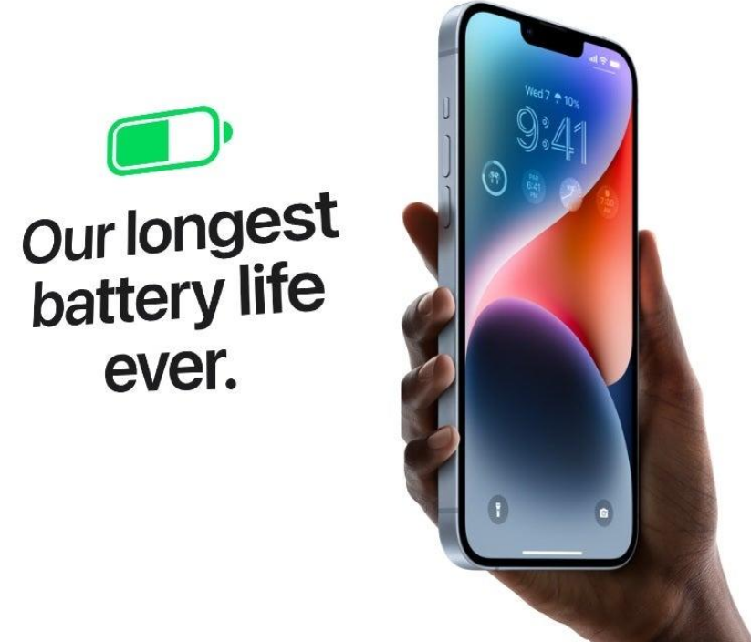
Why firms must continue creating value?
Product Innovation: As consumers become accustomed to existing products, their marginal utility declines → why companies continuously innovate.
Example: Apple releases new iPhone models with:
  improved cameras,
  AI features,
  faster processors,
  longer battery life.
The basic need for communication remains
unchanged, but innovation increases
the perceived utility of upgrading.
Customer Loyalty: create additional sources
of value beyond the core product
Help maintain high levels of customer satisfaction
and encourage repeat visits.

Slide 24
Demands
Wants become demands when they are supported by buying power.
Eg: A consumer may want an electric car, but that want becomes effective market demand only when the consumer is willing and financially able to purchase it.
Eg: Need (Hunger) → Want (Desire for sushi) → Demand (Ability and willingness to buy sushi)
Demand = Want + Ability to Pay + Willingness to Buy

Slide 25
How marketers can increase demand?
Customer Value = Perceived Benefits − Perceived Costs
Marketers can increase demand by: improving product quality; adding new features; offering better service; providing warranties; creating emotional benefits; enhancing customer experience
Marketers can reduce perceived cost: time; effort; risk; psychological cost.
→ free delivery; one-click purchasing; easy returns; money-back guarantees; simple installation

Slide 26
Improve Affordability: purchasing power
Make products easier to afford:
  installment payments
  financing
  subscriptions
  student discounts
  trade-in programmes
Eg: Instead of paying $1,200 upfront, customers can pay $50 per month, making the purchase more accessible.

Slide 27
Encourage Re-purchases
Demand is not only about attracting new customers but also about encouraging existing customers to buy again.
  CRM programmes
  Eg: Starbucks records customers' purchase history and sends personalised offers (e.g., "Buy your favourite latte this week and earn double Stars"). This encourages repeat purchases and strengthens customer relationships.
  Loyalty cards
  Eg: Sephora Beauty Insider: Customers earn points for every purchase, which can be redeemed for products or experiences. The more they buy, the more rewards they receive, increasing purchase frequency.
  Membership benefits
  Eg: Amazon Prime: Members enjoy free shipping, Prime Video, Prime Music, exclusive deals, and early access to sales.
  Personalised recommendations
  Eg: Netflix analyses users' viewing history and recommends movies and TV shows tailored to their preferences. Personalisation increases engagement and reduces search effort.
  Subscription services
  Eg: YouTube Premium: Customers pay a monthly subscription for ad-free listening, offline downloads, and unlimited skips.

Slide 28
Market offerings
Goods
Services
Tangible, physical objects
Ownership is transferred to the buyer
Usually produced before consumption
Can be inventoried and stored
Standardised; quality is relatively consistent
Don’t require customer involvement during manufacturing
Eg: Shoes, iPhone, furniture, salt
Intangible performances or experiences
No ownership; customers receive access, benefits, or experiences
Usually produced and consumed simultaneously
Cannot be stored (perishable)
More variable because people often deliver the service
customers often participate in service delivery
Eg: haircut, hotel stay, airline flight, education, medical treatment

Slide 29
Customer value
a customer’s overall assessment of the utility of an offering based on perceptions of what is received and what is given.
  Value refers to the ‘total offering’. It evolves continually and is unique for each individual.
  Value = Benefits - Costs
Utility: the benefits or value gained by users of a product/service.
  Form Utility - creation of product
  Place Utility - accessibility
  Time Utility - availability when needed
  Possession Utility - transfer of ownership, use
  Image Utility - emotional or psychological

Slide 30
Exchanges, transaction and relationships
Exchange
  the act of obtaining a desired object from someone by offering something in return
  A successful marketing exchange involves:
    two or more parties, each with something of value desired by the other party
    all parties must benefit from the transaction
    the exchange must meet both parties’ expectations (e.g. quality, price)
    Free to accept or reject the offer.
A transaction
  a trade between two parties that involves at least two things of value, agreed-upon conditions, and a time and place of agreement
Marketing consists of actions
  taken to build and maintain desirable exchange relationships
  with target audiences
  involving a product, service, idea or other object

Slide 31
Marketing Myopia
What benefits do we provide?
What business are we in?
  Shell - a petroleum company vs. an energy company vs. kiwi energy company
  Revlon – makeup vs. “hope”
  Kodak – cameras vs. preserving memories
“In our factory we make perfume; in our advertising we sell hope.”

Slide 32
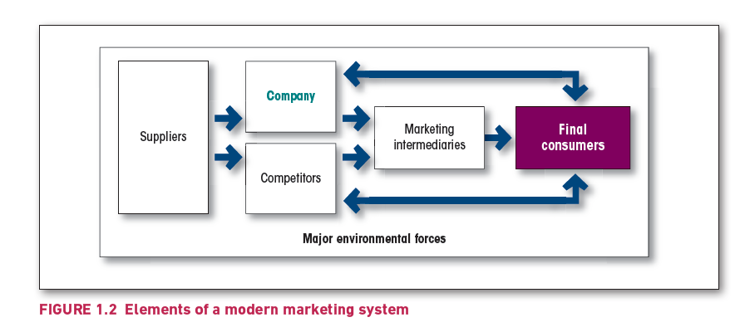

Slide 33
Table 1.1 Demand management ready-reckoner
Demand management ready reckoner
1 Negative demand A market is in a state of negative demand if a major part of the market dislikes the product and may even pay a price to avoid it. Examples: health insurance and dental work.
2 No demand Target consumers may be unaware of or uninterested in the product. The marketing task is to find ways to connect the benefits of the product with the person’s natural needs and interests.
3 Latent demand Many consumers may share a strong need that cannot be satisfied by any existing product. Examples: safer communities and more environmentally friendly cars. The marketing task is to measure the size of the potential market and develop effective products and services that would satisfy the demand.

Slide 34
Demand management ready reckoner
4 Declining demand Every organisation, sooner or later, faces declining demand for one or more of its products. The marketing task is to reverse the declining demand through creative remarketing of the product.
5 Irregular demand Many organisations face demand that varies on a seasonal, daily or even hourly basis, causing problems of idle or overworked capacity. Examples: holiday resorts and restaurants. The marketing task is to find ways to alter the same pattern of demand through flexible pricing (e.g. early-bird specials), promotion and other incentives.

Slide 35
Demand management ready reckoner
6 Full demand Organisations face full demand when they are satisfied with their volume of business. The marketing task is to maintain the current level of demand in the face of changing consumer preferences and increasing competition.
7 Overfull demand Some organisations face a demand level that is higher than they can, or want to, handle. Examples include a national park that is carrying more tourists than the facilities can handle. The marketing task, called demarketing, requires finding ways to reduce the demand temporarily or permanently. Demarketing aims not to destroy demand but only to reduce its level, temporarily or permanently.
8 Unwholesome demand Unwholesome products, such as cigarettes and wines, will attract organised efforts to discourage their consumption. The marketing task is to get people who like something to give it up, using such tools as fear messages, price hikes and reduced availability.

Slide 36
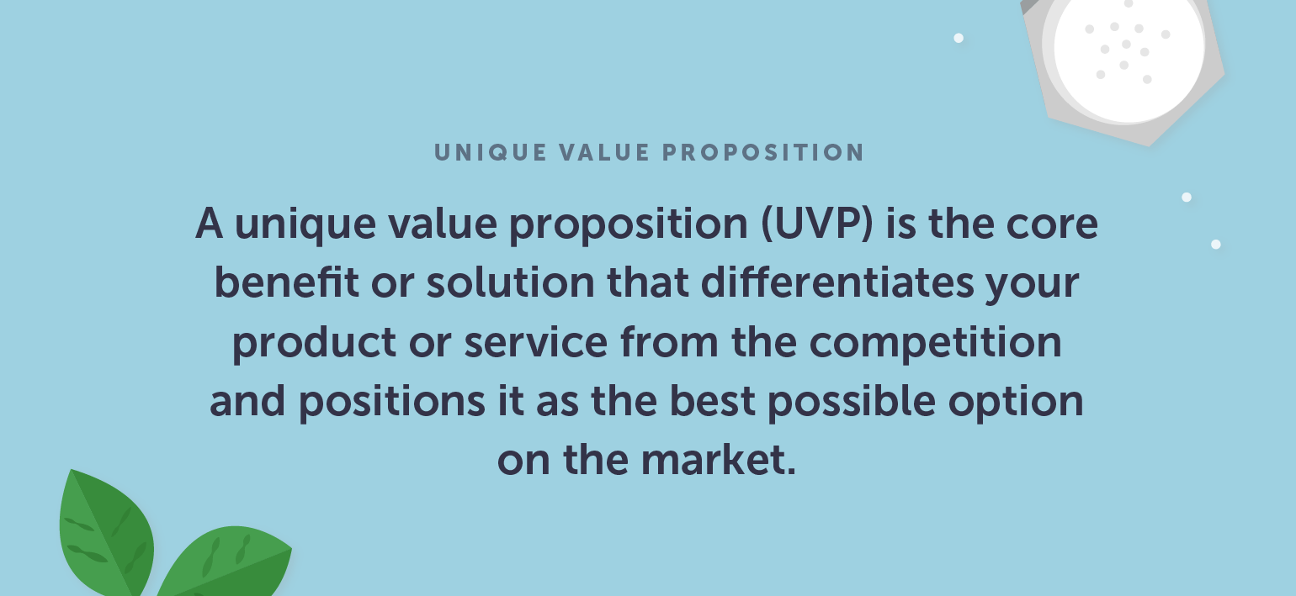
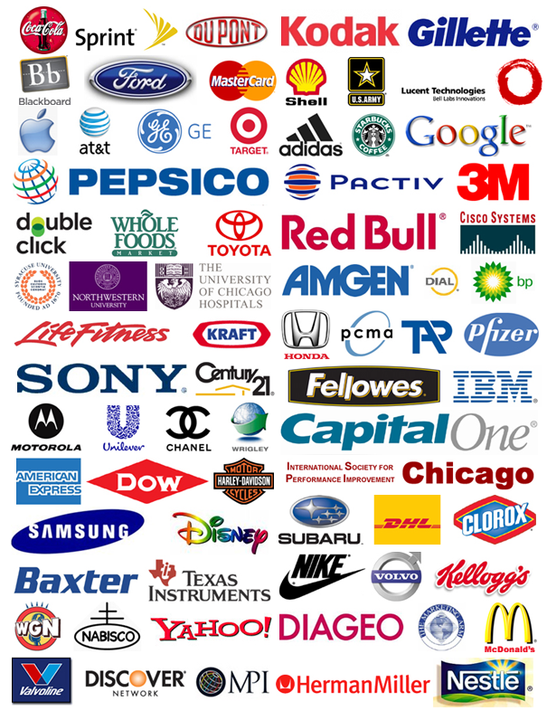
Choosing a value proposition
value proposition is the set of benefits or values it promises to deliver to consumers to satisfy their needs.
Such value propositions differentiate one brand from another.

Slide 37

Marketing management orientations
Marketing pathway

Slide 38
Marketing Management
The analysis, planning, implementation and control of programs designed to create, build, and maintain beneficial exchanges with target buyers for the purpose of achieving organisational objectives.

Slide 39
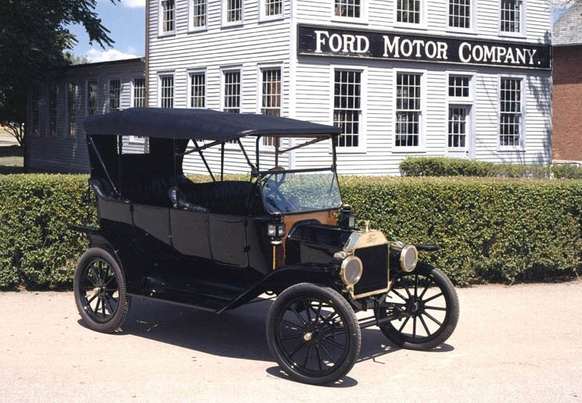
Production concept
If we make it, they will buy it…
Management focus is on:
  Improving production efficiency and distribution efficiency
  Improving product features
"Customers can have any colour they want, as long as it's black.“ (Henry Ford)

Slide 40
Product concept
Consumers will favour products that offer the highest quality, the best performance, or the most innovative features.
→ Company focuses on:
  improving product quality;
  adding advanced features;
  enhancing technical performance;
  investing in research and development;
  continuously upgrading the product.
Build a better product, and customers will buy it.
Eg: A smartphone company may believe customers will choose its phone because it has: a more powerful processor; a higher-resolution camera; a sharper screen; longer battery life; more advanced AI functions.
Its marketing strategy therefore concentrates heavily on product innovation and technical superiority.
However, this assumption is not always correct. Customers may care more about price, ease of use, convenience, design, brand image, after-sales service, and emotional value.

Slide 41
Discussion
Company A
Company B
“Our laptop has the fastest processor, the highest screen resolution, and the most advanced graphics card.”
Begin with the product
Mkt myopia: too focused on the product itself and loses sight of the customer’s underlying need.
“Our target customers are university students. They need a lightweight, affordable laptop with long battery life and reliable after-sales support.”
Begin with customers’ need.

Slide 42
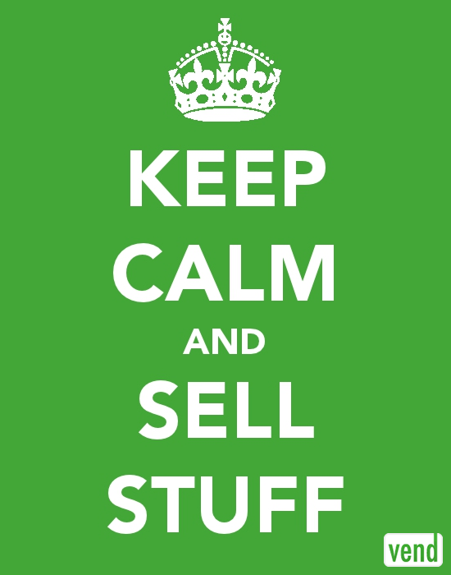
Selling concept
“If we SELL it right, they will buy it…”
Companies focus on selling what they have produced, rather than producing what customers actually want.
Instead of asking what customers need, a company try to convince customers to buy its products.
Management focus is on
  Improving sales techniques
  Increasing spending on promotion
  Relatively short-term view
  Unsought goods
Problems: unsatisfied customers, short-term relationships, high promotion costs, brand reputation damage
Eg: Imagine a gym with a selling concept: "Join today! 50% discount! Only three days left!“ → Discuss what happened? Why?

Slide 43
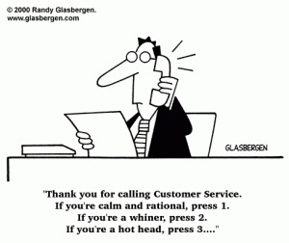
Marketing concept
If we make what they want, they will buy it…
The key to achieving organisational goals is to identify the needs and wants of target markets and deliver superior customer value more effectively and efficiently than competitors.
the marketing concept starts with the customer, not the product.
"What do customers need, and how can we satisfy those needs better than our competitors?"
Management focus is on…
  Customer needs and wants
  Functional integration
  Long-term success, profits come from need satisfaction

Slide 44
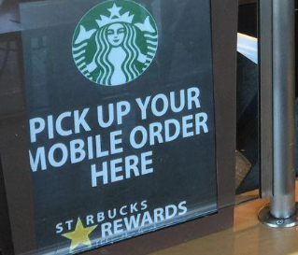
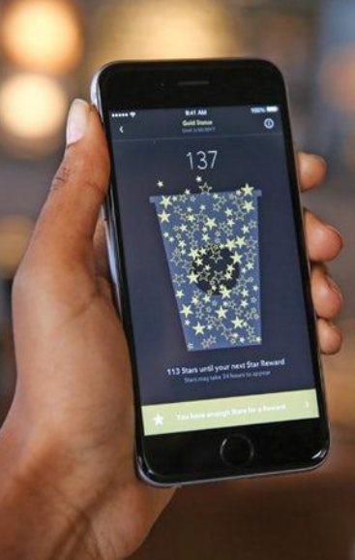
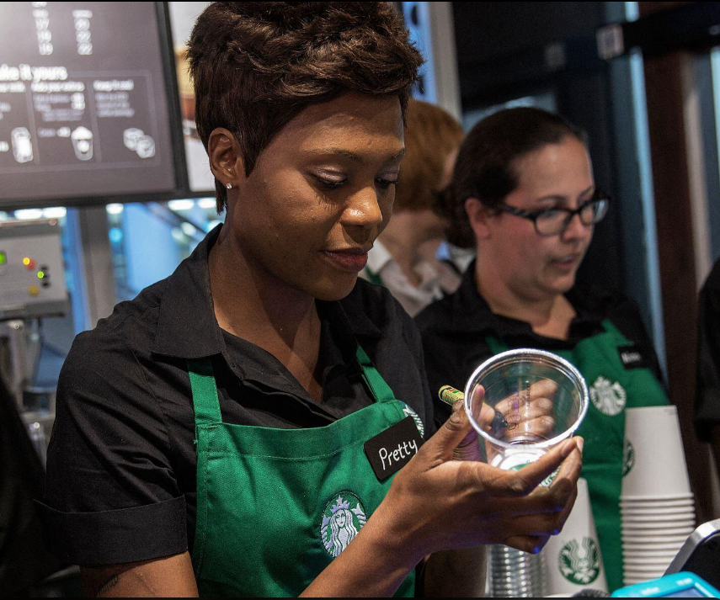
Starbucks
Starbucks does not merely sell coffee. It creates value through:
  personalised drinks: Customers can customise size, milk, syrup, temperature, toppings, and even have their name written on the cup.
  mobile ordering: The Starbucks app allows customers to order, pay, and skip the queue.
  loyalty rewards: Starbucks Rewards lets customers earn Stars, redeem free drinks, and receive personalised offers
  comfortable store environments: Cozy seating, free Wi-Fi, music, and ambience encourage customers to stay longer and socialise or work
  customer relationships:Personalised service, seasonal promotions, and CRM strengthen long-term loyalty
The experience is as important as the coffee itself.
Customers do not simply buy coffee; they buy convenience, personalisation, belonging, and an enjoyable experience.

Slide 45
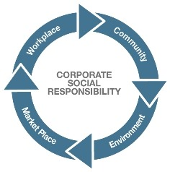
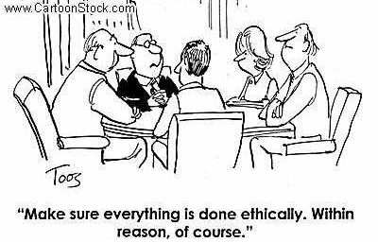
Societal marketing concept
If we make what they want in a socially responsible manner, they will buy it…
Management focus is on
  Satisfying customer needs and wants
  Achieving the organisation’s goals
  While also trying to maintain and improve society

Slide 46
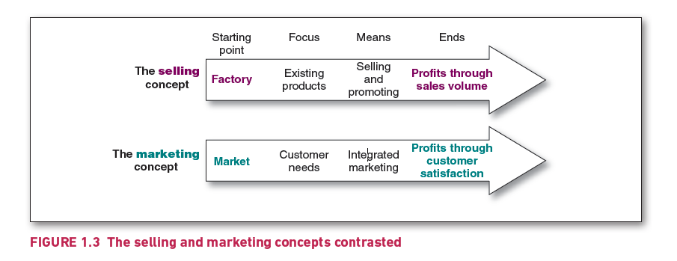
The selling and marketing concepts contrasted

Slide 47

The changing marketing landscape

Slide 48
The digital age: Big Data and AI era
Online, mobile and social media marketing: The consumer love affair with digital and mobile technology makes it fertile ground for marketers trying to engage customers.
Digital and social media marketing
  involves using digital marketing tools, such as websites, social media, mobile ads and apps, online video, email, blogs and other digital platforms
  engage consumers anywhere, anytime via their computers, smartphones, tablets, Smart TVs and other digital devices.
Social media marketing: Big Data and AI platforms
Most brand websites, and even traditional media ads, feature links to the brand’s Facebook, Instagram, Twitter, LinkedIn, YouTube, Snapchat or other social media sites.
Online social media offer an ideal platform for real-time marketing by which marketers can engage consumers in the moment by linking brands to
  important trending topics
  real-world events, causes, personal occasions
  other important happenings in consumers’ lives

Slide 49
Digital vs. Traditional Marketing Communications
Digital Mkt
Traditional Mkt
Tools: Search, social media, websites, email, apps
Interactive communication
Precise audience targeting
High personalization
Real-time and measurable data
Flexible and easy to optimise
Tools: TV, radio, newspapers, billboards
Mainly one-way communication
Broad audience targeting
Limited personalization
Difficult to track individual responses
High cost of modification
Key advantages:
Measurable
Targetable
Interactive
Flexible
Scalable
Key limitations:
Data privacy concerns
information overload and ad fatigue
Dependence on platforms and algorithms
Require continuous monitoring and optimisation
Digital mkt does not replace traditional mkt:
Our consumers still live in both digital and physical worlds

Slide 50
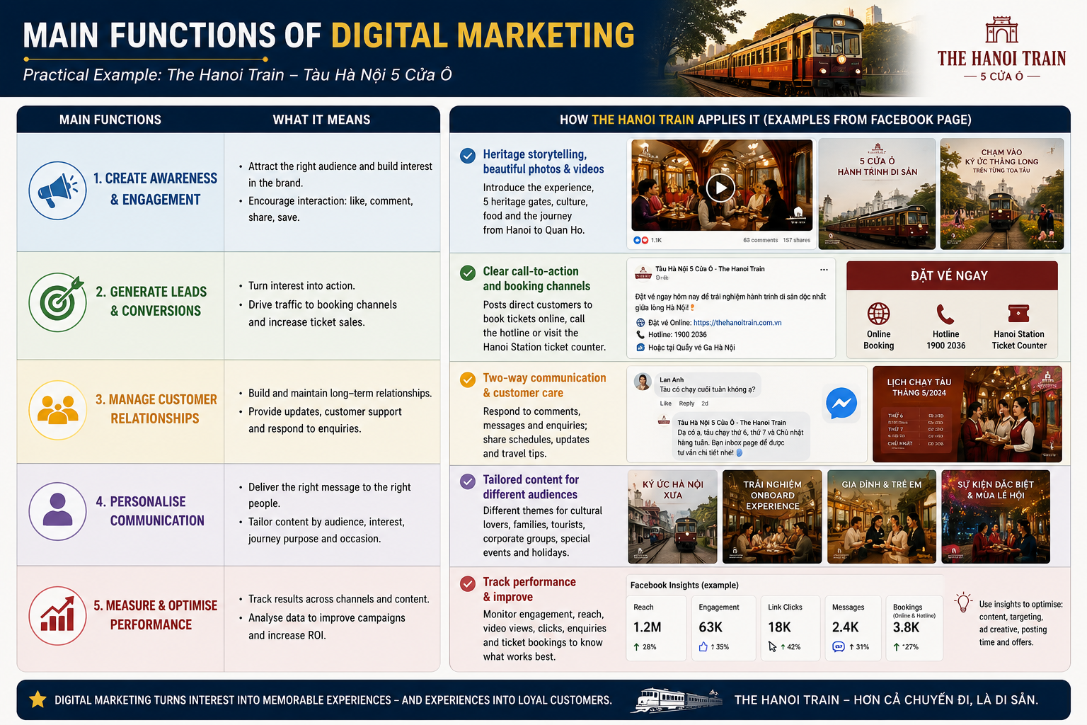

Slide 51
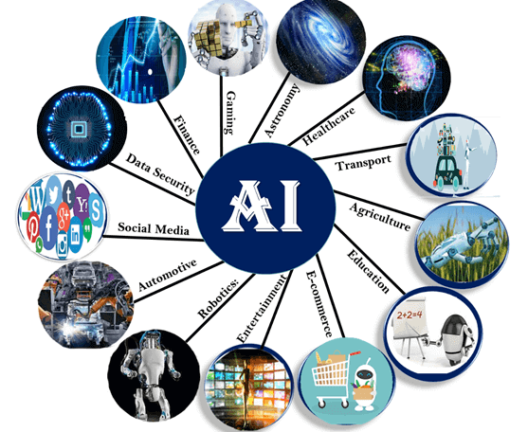
Big data and artificial intelligence (AI)
The explosion in digital technologies means we now have ready access to more data than ever before.
Companies can use this big data to gain deep consumer insights, personalise marketing offers, and improve communication, engagement and service with consumers.
To make sense of big data and to be able to use it effectively, marketers are turning to even more-advanced marketing analytics.
Artificial intelligence (AI) involves machines thinking and learning in a way that looks and feels human, but with much greater analytical capacity.
Marketers use AI to analyse data at lightning speed and apply marketing insights to engage customers in real time and help them through the buying process.

Slide 52
The Digital Mkt Management Tool Stack
Digital Marketing Task | Example Tools / Software | Management Aim
Analytics and Tracking | Google Analytics 4 | Understand customer behaviour and measure campaign performance
Digital Advertising | Google Ads, Meta Ad Manager, TikTok Ads Manager | Reach target audiences and generate traffic, leads, or sales
Social Media Management | Meta Business Suite | Plan, publish, monitor, and manage social media communication
CRM | HubSpot, Salesforce, Zoho CRM | Manage customer data, relationships, and interactions
Marketing Automation | HubSpot, Salesforce Marketing Cloud | Automate repetitive communication and personalise customer journeys
Email and Direct Marketing | Zalo, Mailchimp | Nurture leads, retain customers, and encourage repeat purchase
SEO and Search Management | Google Search | Improve visibility in search engines and attract organic traffic
Content Creation | Canva, Adobe Express, ChatGPT | Create visual, video, and written marketing content
Dashboard and Reporting | Power BI | Integrate data and support marketing decision-making

Slide 53
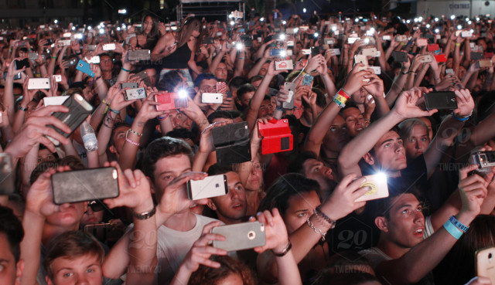
Mobile marketing
Mobile marketing is perhaps the fastest-growing digital marketing platform.
Four out of five smartphone users use their phones to:
  access their bank account for online transfers and payments
  browse product information through apps or the mobile web
  make in-store price comparisons
  read online product reviews
  find and redeem coupons
Smartphones
  ever-present; always on; finely targeted; highly personal
  ideal for engaging customers anytime, anywhere, as they move through the buying process

Slide 54
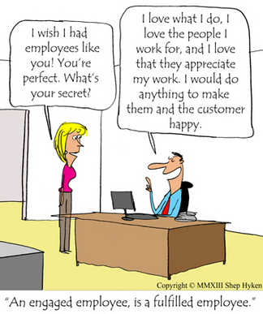
The growth of not-for-profit marketing
Not-for-profit marketing is a type of marketing practised by a variety of organisations whose aim is to make surpluses so as to continue their operations, but that do not seek to make profits for shareholders.

Slide 55
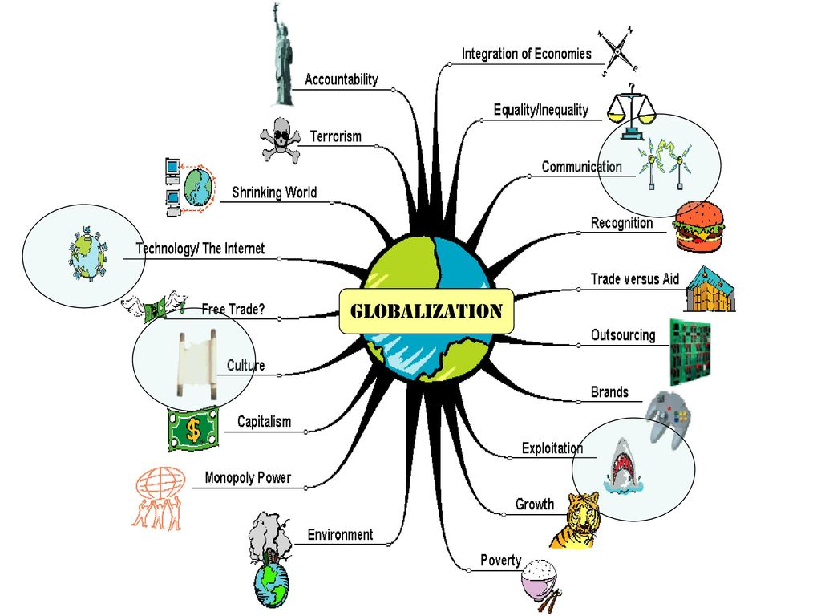
Rapid globalisation
Geographical and cultural distances have shrunk as a result of burgeoning air travel, telephone links, digital communication, social networking and other technical advances.
These technological advances have allowed companies to significantly expand their geographical market coverage, purchasing and manufacturing.
  The result is a vastly more complex marketing environment for both companies and consumers.
Q: Rapid globalisation brings with it both marketing opportunities and marketing challenges. Give some examples of each.

Slide 56
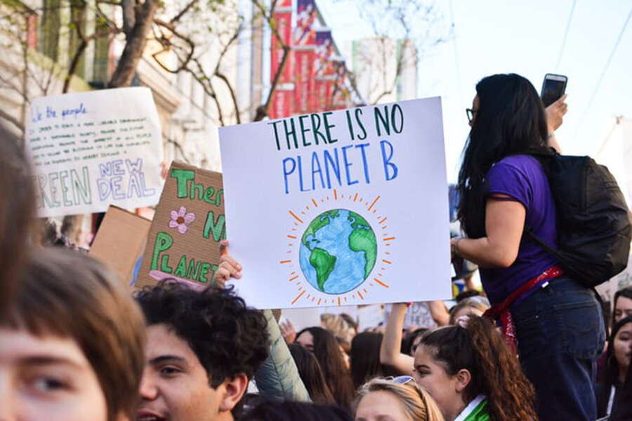
Sustainable marketing
call for more environmental and social responsibility
increased call for companies to take responsibility for the social and environmental impact of their actions
Corporate ethics
  have become an important matter in almost every business arena, from the corporate boardroom to the business-school classroom.
Q: Global companies sometimes move operations from one country to another in search of lower labour costs. Should they be responsible for problems that arise as a result?

Slide 57
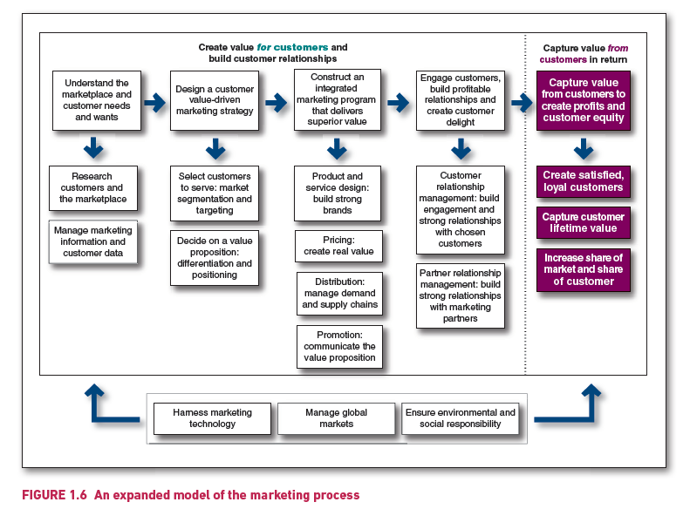
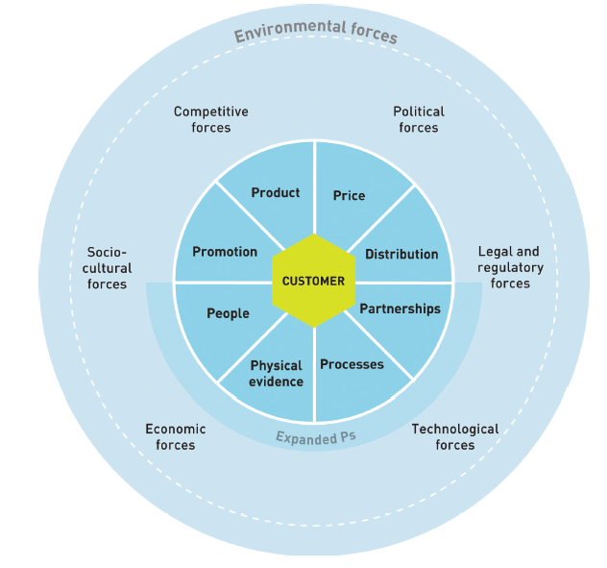
So, what is marketing? Pulling it all together

