Slide 1

Marketing Environment
Lecturer: Hoa Nguyen Quynh, PhD
SEM, HUST

Slide 2
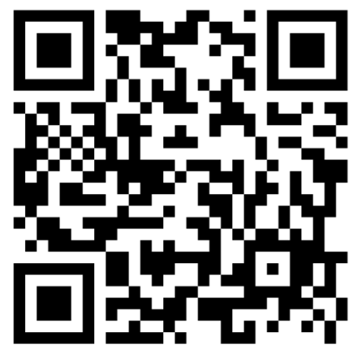
Course details
(Please see the syllabus for more information)
Assessment
What we do?
Lecture
  Tuesday & Thurday
  8.30am – 12.05 pm, 15-min break
  See the detailed schedule
Grading
  90-100% = A
  80 – 89% = B
  70 – 79% = C
  60 – 69% = D
  Under 60% = F
Attendance 10% →
Group Project & Presentation 20%
Mid-term test 30%
Final exam 40%
Discussion in class → Plus points

Slide 3
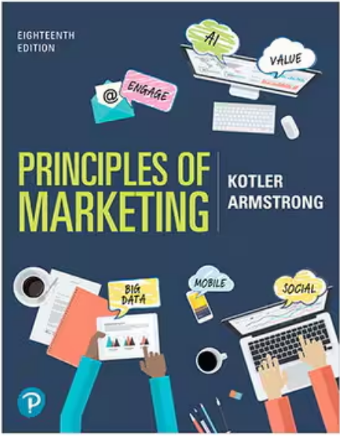
Textbook and other documents
Main textbook:
Kotler, P., & Armstrong, G. (2021). Principles of Marketing, 18th Edition. Pearson Education Limited.
E-book: https://drive.google.com/file/d/12nuBRl2G0biy-jvpXQyfILC_nz6_1abQ/view?usp=sharing
Case studies: Will be provided in class

Slide 4
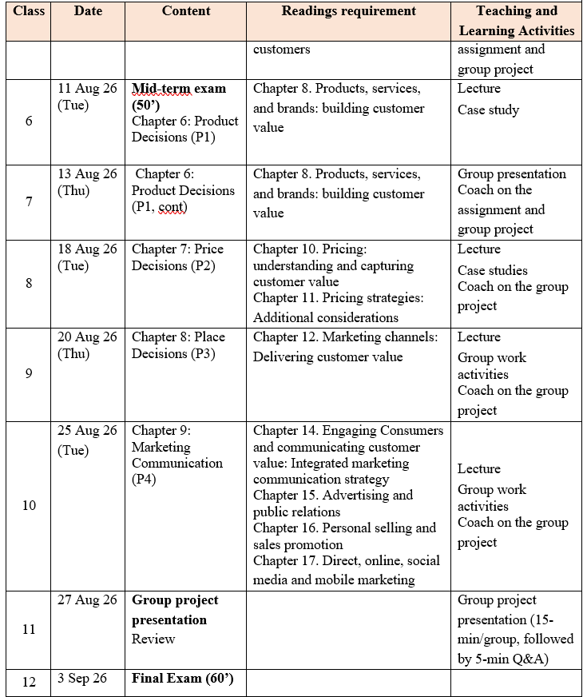
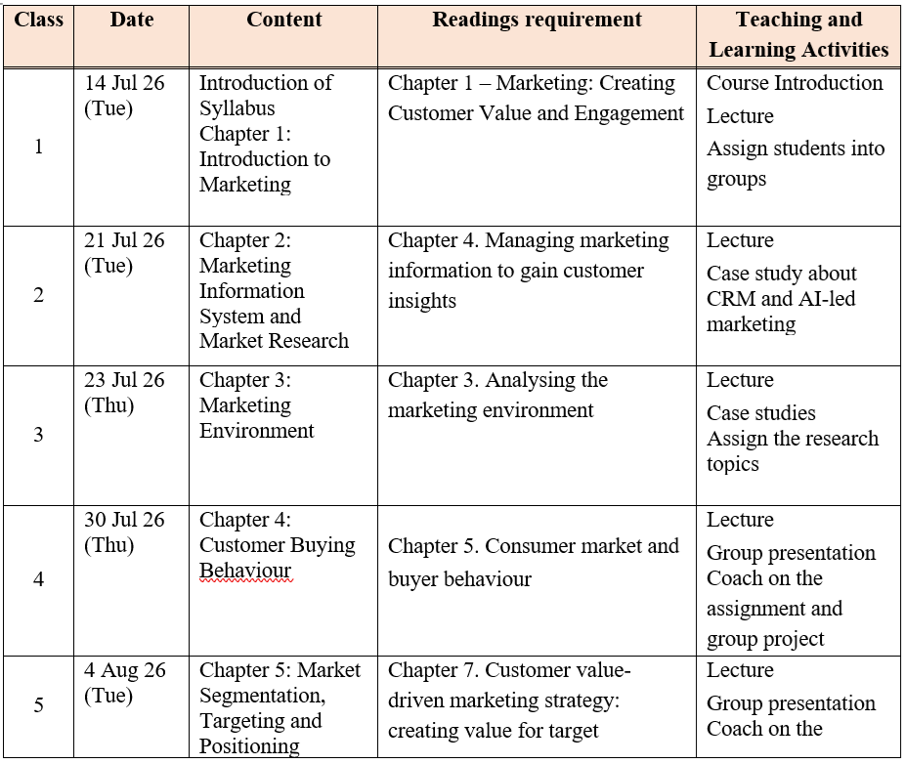
What will we cover?

Slide 5
MKT361 – Course aims
To enable students to understand the fundamental concepts and theories of marketing and how they may be applied to the marketplace in a modern and dynamic environment.
After the course, successful students should be able to:
  • Understand and explain the four components of the marketing mix
  • Recognise the role of marketing in the strategic planning process of a firm.
  • Link the marketing mix elements to a firm’s marketing strategy.
  • Apply marketing concepts to specific business cases and situations.

Slide 6
Group project
Group assignments:
Requirement
Group 1: Tiến Đạt
Group 2: Hà Anh group
Group 3: Hoàng Anh
Group 4: Đỗ Quang Huy
Group 5: Duy Tuân
Group 6: Trần Minh
Each group will be assigned a marketing-related case study to analyse throughout the course alongside the topics covered in class.
Each group is expected to discuss and present the following aspects of the assigned case study:
  How do the macro-environmental and micro-environmental factors influence the company's marketing activities?
  Who are the company's target customer segments? What are the key characteristics of these target segments?
  What are the consumer behaviour patterns of customers within these target segments?
  What product, pricing, distribution (place), and integrated marketing communication (IMC) strategies would be most appropriate for the target segments?
  What Customer Relationship Management (CRM) and Corporate Social Responsibility (CSR) initiatives should the company implement?
  What marketing performance metrics (KPIs) are most appropriate for evaluating the effectiveness of the company's marketing activities in relation to its business objectives?

Slide 7

The changing marketing landscape

Slide 8
The digital age: Big Data and AI era
Online, mobile and social media marketing: The consumer love affair with digital and mobile technology makes it fertile ground for marketers trying to engage customers.
Digital and social media marketing
  involves using digital marketing tools, such as websites, social media, mobile ads and apps, online video, email, blogs and other digital platforms
  engage consumers anywhere, anytime via their computers, smartphones, tablets, Smart TVs and other digital devices.
Social media marketing: Big Data and AI platforms
Most brand websites, and even traditional media ads, feature links to the brand’s Facebook, Instagram, Twitter, LinkedIn, YouTube, Snapchat or other social media sites.
Online social media offer an ideal platform for real-time marketing by which marketers can engage consumers in the moment by linking brands to
  important trending topics
  real-world events, causes, personal occasions
  other important happenings in consumers’ lives

Slide 9
Digital vs. Traditional Marketing Communications
Digital Mkt
Traditional Mkt
Tools: Search, social media, websites, email, apps
Interactive communication
Precise audience targeting
High personalization
Real-time and measurable data
Flexible and easy to optimise
Tools: TV, radio, newspapers, billboards
Mainly one-way communication
Broad audience targeting
Limited personalization
Difficult to track individual responses
High cost of modification
Key advantages:
Measurable
Targetable
Interactive
Flexible
Scalable
Key limitations:
Data privacy concerns
information overload and ad fatigue
Dependence on platforms and algorithms
Require continuous monitoring and optimisation
Digital mkt does not replace traditional mkt:
Our consumers still live in both digital and physical worlds

Slide 10
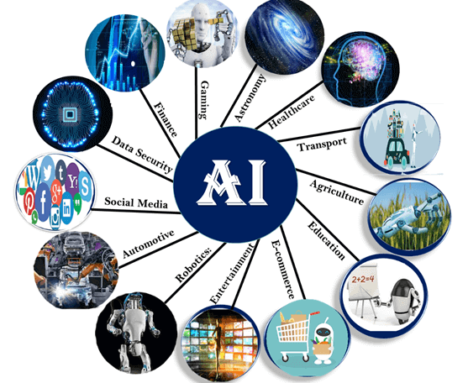
Big data and artificial intelligence (AI) – AI Marketing
The explosion in digital technologies means we now have ready access to more data than ever before.
Companies can use this big data to gain deep consumer insights, personalise marketing offers, and improve communication, engagement and service with consumers.
To make sense of big data and to be able to use it effectively, marketers are turning to even more-advanced marketing analytics.
Artificial intelligence (AI) involves machines thinking and learning in a way that looks and feels human, but with much greater analytical capacity.
Marketers use AI to analyse data at lightning speed and apply marketing insights to engage customers in real time and help them through the buying process.

Slide 11
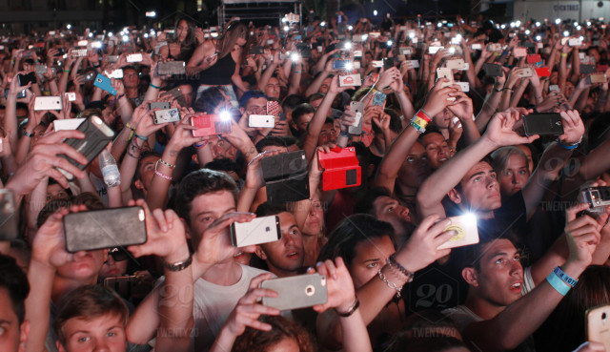
Mobile marketing
Mobile marketing is perhaps the fastest-growing digital marketing platform.
Four out of five smartphone users use their phones to:
  access their bank account for online transfers and payments
  browse product information through apps or the mobile web
  make in-store price comparisons
  read online product reviews
  find and redeem coupons
Smartphones
  ever-present; always on; finely targeted; highly personal
  ideal for engaging customers anytime, anywhere, as they move through the buying process

Slide 12
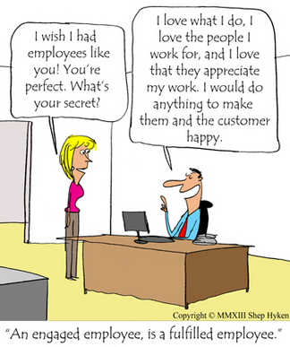
The growth of not-for-profit marketing
Not-for-profit marketing is a type of marketing practised by a variety of organisations whose aim is to make surpluses so as to continue their operations, but that do not seek to make profits for shareholders.

Slide 13
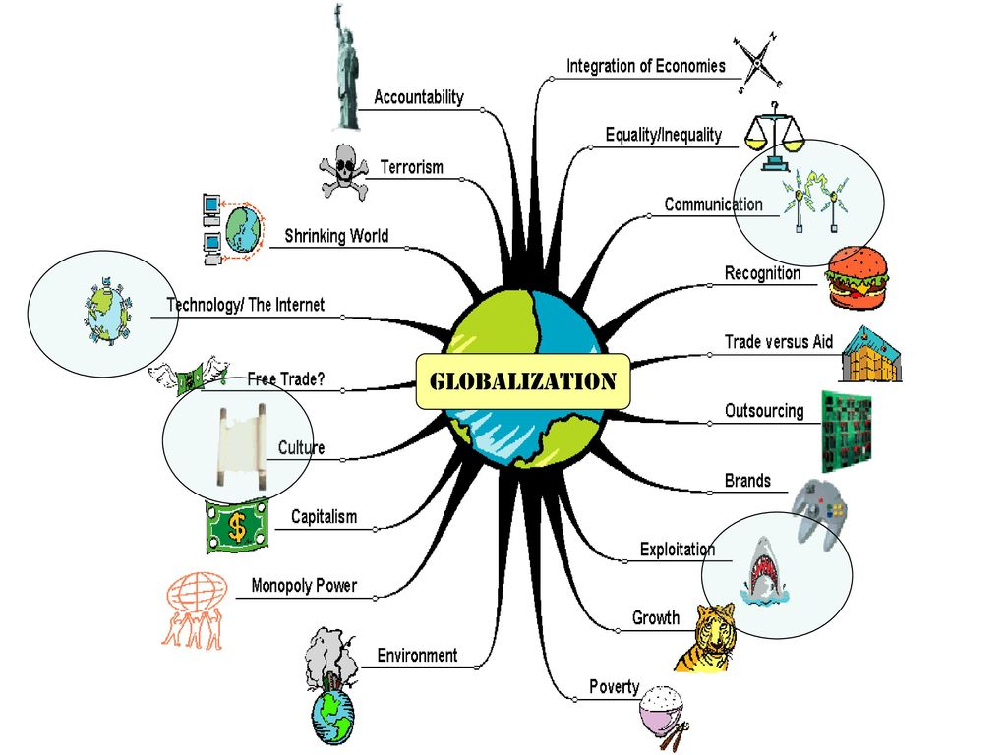
Rapid globalisation
Geographical and cultural distances have shrunk as a result of burgeoning air travel, telephone links, digital communication, social networking and other technical advances.
These technological advances have allowed companies to significantly expand their geographical market coverage, purchasing and manufacturing.
  The result is a vastly more complex marketing environment for both companies and consumers.
Q: Rapid globalisation brings with it both marketing opportunities and marketing challenges. Give some examples of each.

Slide 14
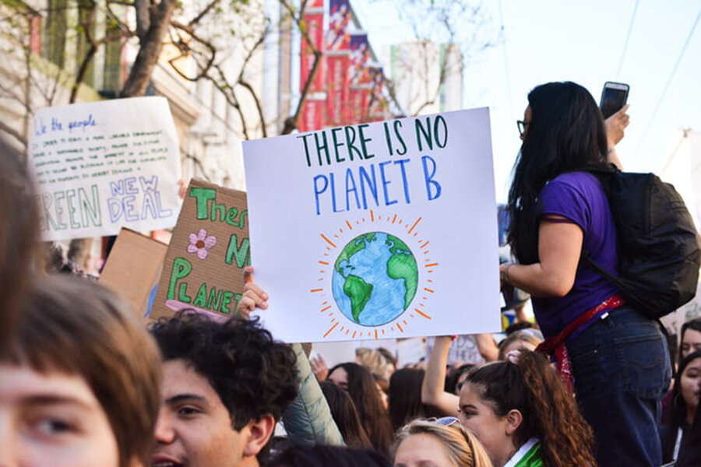
Sustainable marketing
call for more environmental and social responsibility
increased call for companies to take responsibility for the social and environmental impact of their actions
Corporate ethics
  have become an important matter in almost every business arena, from the corporate boardroom to the business-school classroom.
Q: Global companies sometimes move operations from one country to another in search of lower labour costs. Should they be responsible for problems that arise as a result?

Slide 15
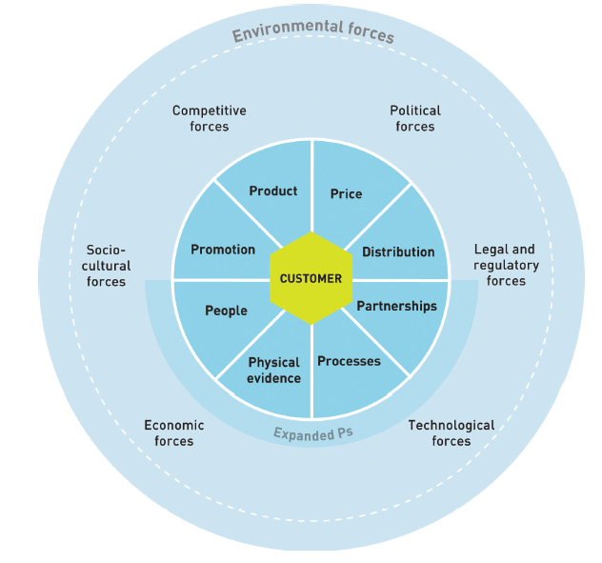
Marketing Environment

Slide 16
Macro-environments

Slide 17
Demographic environment: changes in the size, structure, location, and characteristics of a population.
Key factors
Why it matters?
Population growth or decline
Age structure
Family size and household composition
Education and occupation
Migration and urbanisation
Ethnic and cultural diversity
who customers are,
what they need,
where they live,
how much they buy, and
how firms segment their markets.

Slide 18
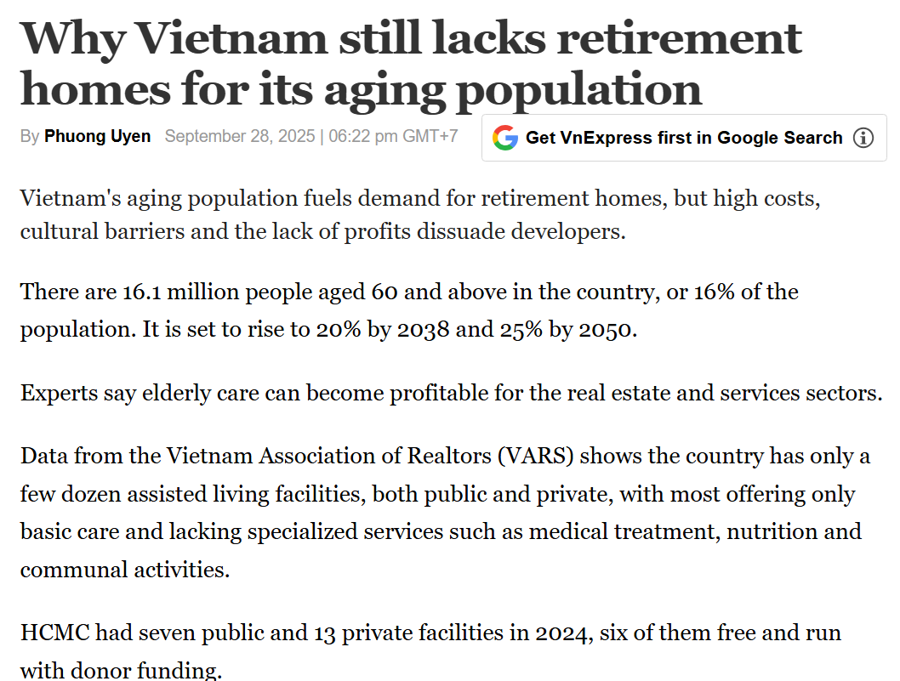
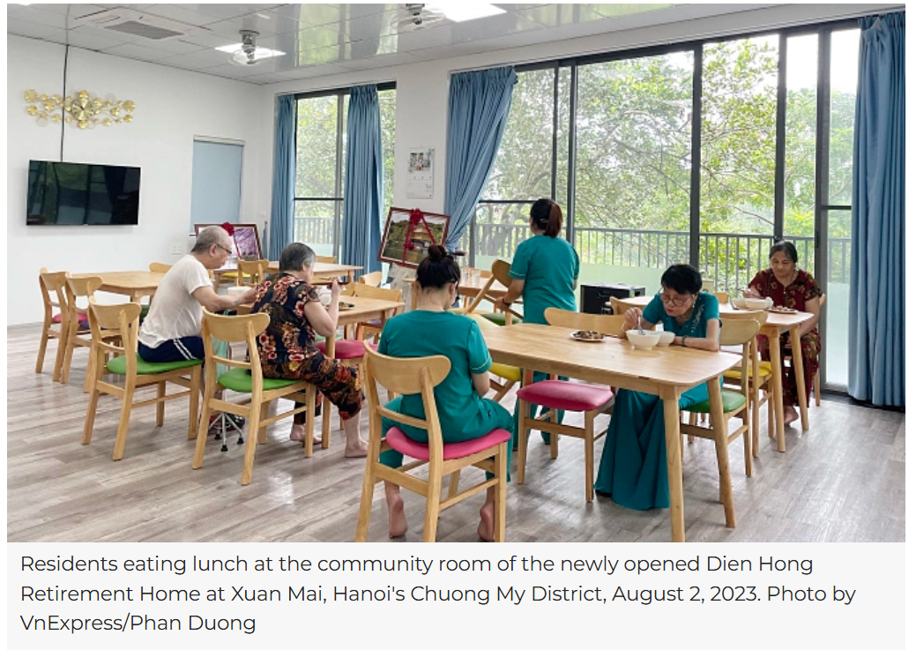
Q: How might Vietnam’s ageing population affect the marketing strategies of banks, hospitals, and tourism companies?
An ageing population creates greater demand for:
  healthcare services,
  retirement products,
  convenient packaging,
  accessible transport, and
  products designed for older consumers.

Slide 19
Economic environment: factors that influence consumers’ purchasing power and spending patterns
Key factors
Why it matters?
Economic growth
Inflation
Interest rates
Exchange rates
Employment and income levels
Income distribution
Consumer confidence
how much consumers can spend,
which products they prioritise,
their sensitivity to price, and
their willingness to borrow or save.

Slide 20
Q: Rising fuel prices push up the prices of goods and services across the economy, leading to higher inflation. How are consumers likely to change their behaviour in response?
Companies may introduce:
economy product lines,
flexible payment options,
discounts,
value bundles,
or smaller, more affordable packages.
Should premium brands reduce their prices during an economic downturn?
switch to cheaper products and services
buy smaller package sizes,
reduce non-essential spending,
compare prices more carefully,
respond more strongly to promotions.

Slide 21
Natural environment: natural resources, ecological conditions, climate issues, and environmental pressures affecting businesses and consumers
Key factors
Why it matters?
Climate change
Natural disasters
Resource scarcity
Pollution
Waste management
Energy use
Environmental regulations
Consumers, governments, and investors increasingly expect companies to reduce their negative environmental impact.
  reduce plastic packaging,
  use recyclable materials,
  lower carbon emissions,
  manage water consumption, and
  source ingredients responsibly.

Slide 22
Marketing implications
Businesses may adopt:
  sustainable product design,
  green packaging,
  circular economy practices,
  environmental certification,
  and transparent sustainability communication.
Q: Is sustainable marketing mainly an ethical responsibility or a competitive strategy?

Slide 23
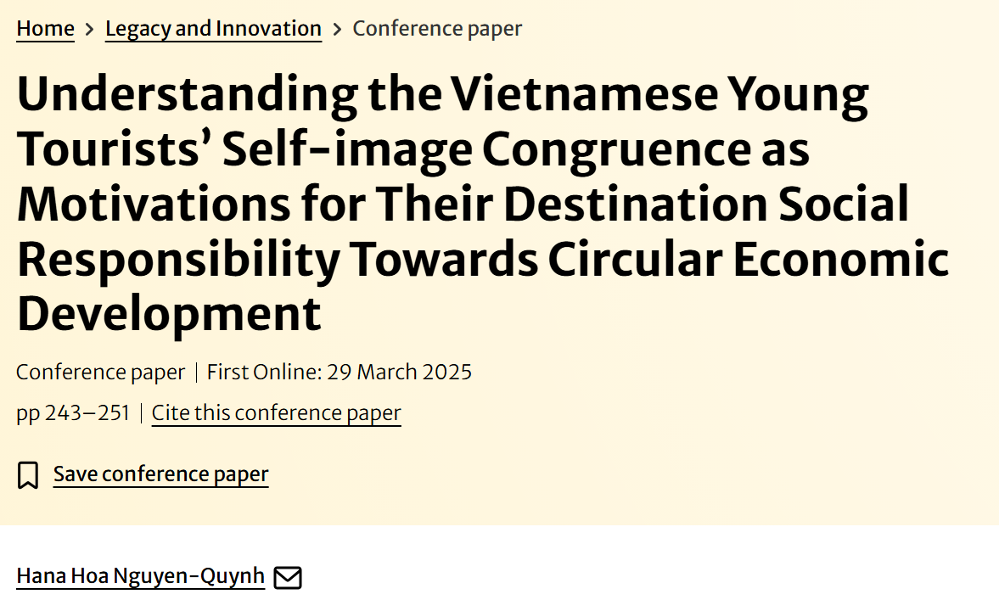
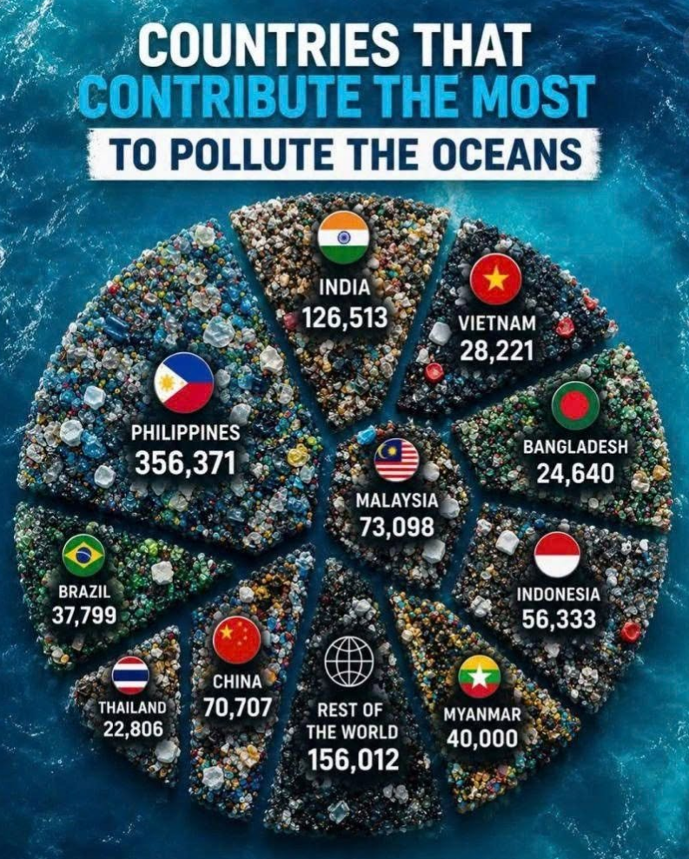
According to Zorpas et al. (2021), the amount of solid generated by tourists could be doubled by what was from tourism businesses and residents.
Schumann (2020) further mentioned that 5.3% of total greenhouse gases from human activities may be generated from transport-related emissions from the tourism industry by 2030. These tourism eco-footprints contribute to climate change (Hall, 2009; Hall & Saarinen, 2021).
In Vietnam, according to Jambeck et al. (2015), it is estimated that approximately 730,000 tons of plastic made on land would go to the ocean each year as garbage.
If there is no necessary control, this plastic litter will continue to damage the marine environment, threaten marine biodiversity and contaminate marine life, which in turn will ruin the people’s health and the country’s economy, especially the fishing and tourism industry.
It is not an easy job as the plastic waste leaks from Vietnam to the ocean every year mainly from the Red River and Mekong River which are running through several countries like China and some other Association of Southeast Asian Nations (ASEAN) countries before coming through Vietnam to the ocean.
As Vietnam has a long coastal line from North to South, its economy and many local communities depend heavily on the ocean.

Slide 24
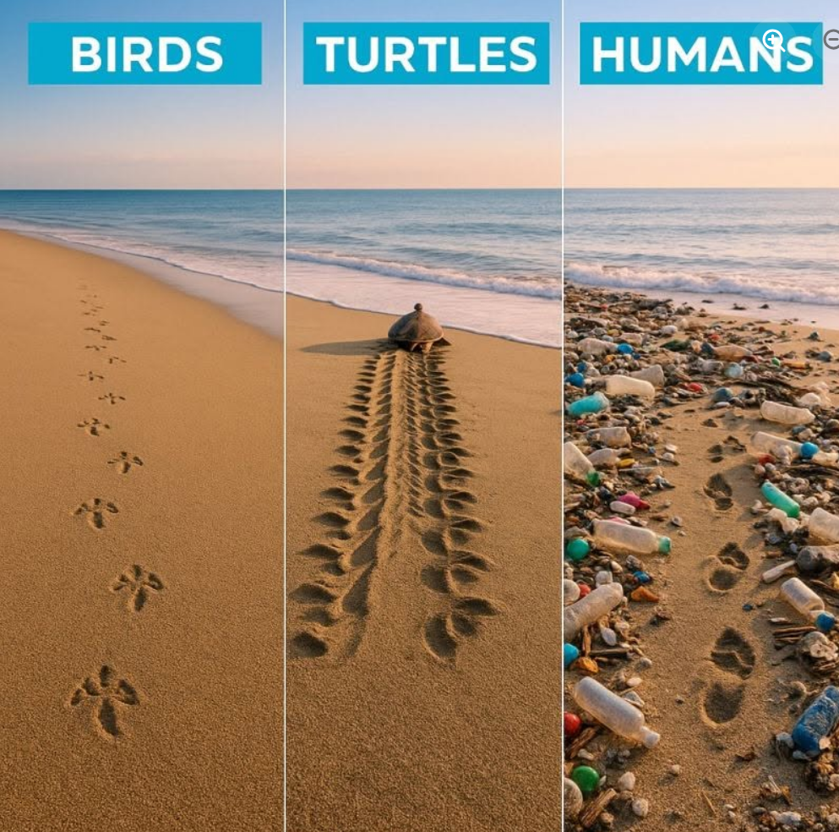
Environmental claims must be supported by evidence. Misleading claims may be regarded as greenwashing.
A plastic bottle is labelled “100% recyclable”, but its cap, label, and adhesive cannot be recycled through most local recycling systems.
A company advertises a product as “made from recycled materials”, but recycled material accounts for only 5% of the product, and this limitation is not disclosed prominently.
A paper cup is promoted as “plastic-free”, but its production uses large amounts of water, energy, or chemicals. → The company highlights one environmental benefit while ignoring other significant impacts.
A cosmetics company promotes a product as “natural and eco-friendly” because it contains botanical ingredients, while downplaying the use of persistent synthetic ingredients (silicone) and tests on animals.
A company calls an electric car “zero-emission” or “completely green”, although emissions and environmental impacts still arise from battery production, electricity generation, mining, manufacturing, and disposal.

Slide 25
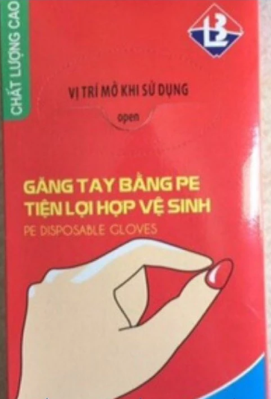
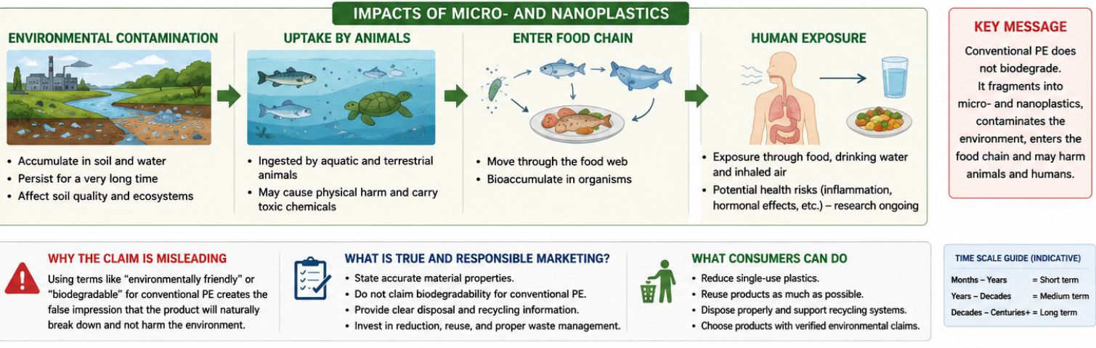
A company markets conventional PE packaging as “environmentally friendly” or “biodegradable,” even though the material does not naturally biodegrade.
This false claim may lead consumers to believe that the packaging will safely decompose in the environment. PE packaging may remain in the environment for a very long time.
Research shows that conventional plastic persists and progressively breaks into micro- and nanoplastics. They can accumulate in soil and water, be ingested by animals, move through food webs, and carry chemical additives or other pollutants. Humans can be exposed through food, drinking water and inhaled air.

Slide 26
Technological Environment: innovations that change products, services, communication, distribution, and customer behaviour.
Key factors
Why it matters?
Artificial intelligence
Automation
Big data
Social media
Mobile technology
E-commerce
Virtual and augmented reality
Digital payment systems
create new products,
make existing products obsolete,
improve customer experience,
reduce costs, and
change how customers search, compare, purchase, and review products.

Slide 27
AI Marketing
AI allows business and marketers to provide:
  personalised recommendations,
  automated customer service,
  predictive analytics,
  dynamic pricing, and
  targeted advertising
Q: When does personalised marketing become an invasion of privacy?

Slide 28
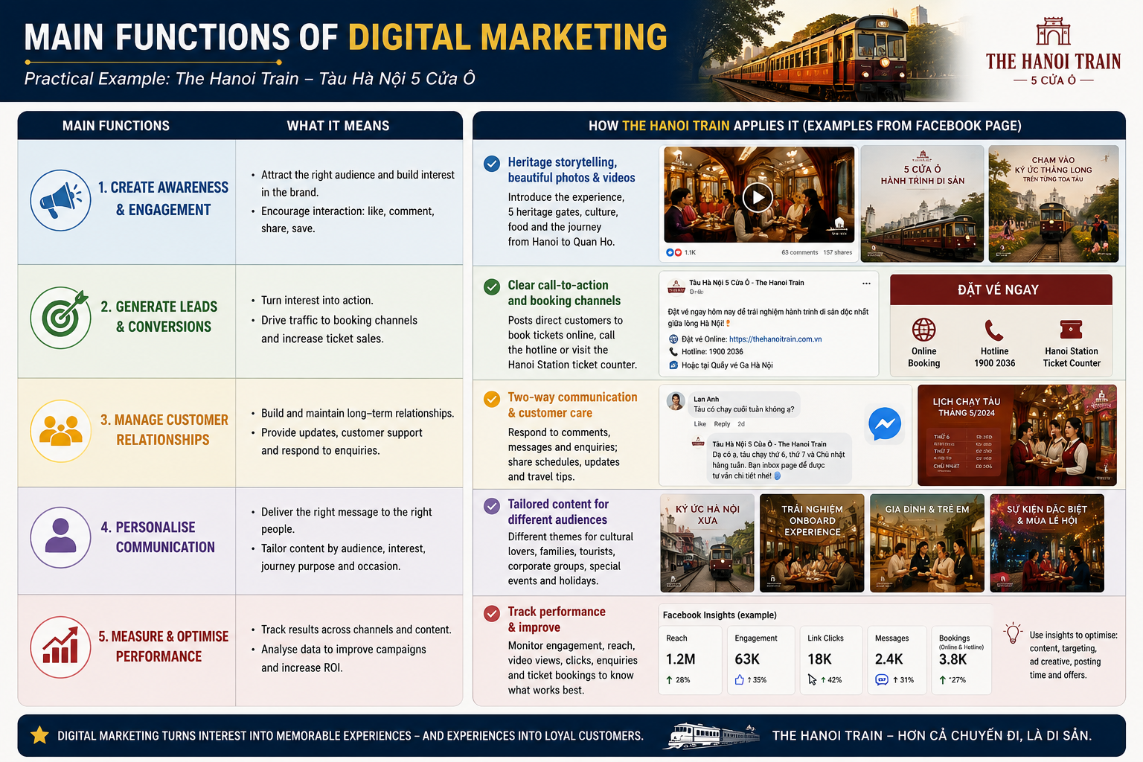

Slide 29
Political and Legal Environment: laws, regulations, government policies, and political conditions that influence marketing decisions.
Key factors
Why it matters?
Consumer protection laws
Competition regulations
Advertising standards
Data protection rules
Product safety requirements
Taxation and trade policies
Labour and environmental laws
Political stability
Companies must ensure that their:
  products are safe,
  advertisements are truthful,
  customer data are protected,
  prices are fair,
  and business practices comply with the law.

Slide 30
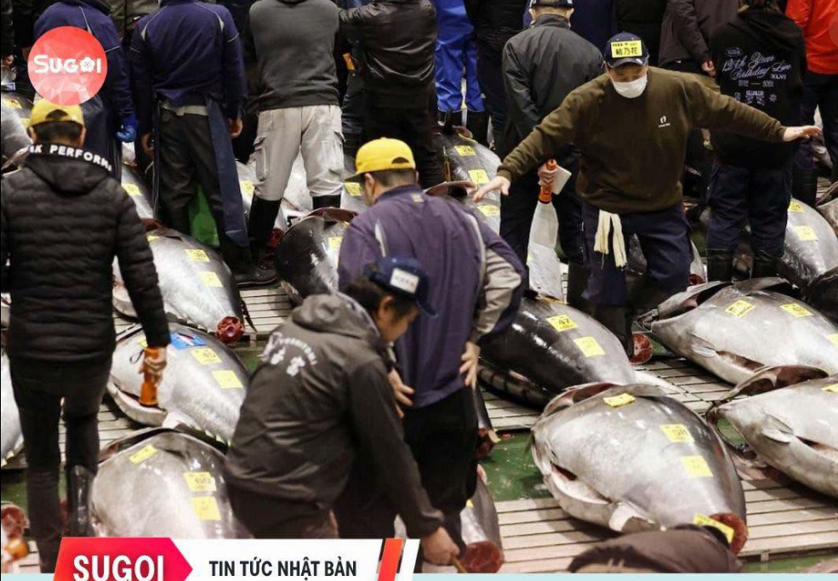
Japan’s Bluefin Tuna Dilemma
In July 2026, Japanese fishermen faced a strange situation. Pacific bluefin tuna had recovered strongly after years of strict conservation measures. Large tuna were now appearing in great numbers in Japanese waters, and fishing nets were often full.
However, fishermen could not simply bring all the tuna to market. International fishing quotas still strictly limited how much each region could catch and sell. In some areas, fishing cooperatives had already used 70–80% of their annual quota within the first few months of the year.
For example, fishermen around Sado Island in Niigata had an annual quota of 66 tonnes, but they caught 42 tonnes in April alone. To preserve part of the quota for winter—when bluefin tuna are fattier and more valuable—they sometimes had to remove live tuna from their nets and release them back into the sea.
Japan proposed increasing the quota for large tuna by 25% from 2027. Although the United States supported the proposal, Mexico opposed it because of conflicting national fishing interests. The international meeting ended without agreement, so Japan had to keep the existing quota.
The situation created several business concerns. Domestic tuna supply could become limited during winter, potentially increasing prices for sushi restaurants and consumers. Some businesses might need to use imported or frozen tuna. Fishermen could also lose income despite the abundance of fish.
At the same time, the recovery of bluefin tuna may affect the wider marine ecosystem because tuna consume commercially important species such as mackerel and sardines.

Slide 31
Socio-Cultural Environment: society’s values, beliefs, norms, lifestyles, traditions, and attitudes.
Cultural values
Social norms
Religion and traditions
Lifestyle changes
Attitudes towards family and work
Gender roles
Health consciousness
Social responsibility
Consumers do not buy products only for functional benefits. Products may also represent:
  identity,
  social status,
  belonging,
  values,
  lifestyle,
  and cultural meaning.

Slide 32

A campaign that succeeds in one country may fail elsewhere because symbols, humour, values, and social norms differ.
In 2018, Italian luxury brand Dolce & Gabbana launched a social-media campaign to promote a major fashion show in Shanghai.
The videos showed a Chinese woman attempting to eat Italian foods, including pizza and spaghetti, with chopsticks. The campaign appeared intended to be humorous and to combine Italian and Chinese culture.
However, many Chinese consumers interpreted the advertisements very differently. The woman’s exaggerated behaviour, the traditional music and the presenter’s tone were viewed as stereotypical, patronising and disrespectful to Chinese culture.
The reaction spread rapidly across Chinese social media. Celebrities withdrew from the Shanghai fashion show, the event was cancelled, and major Chinese e-commerce platforms removed Dolce & Gabbana products. The controversy later contributed to weaker sales for the brand in China.
The campaign demonstrated that humour and cultural symbols do not carry the same meanings in every market. What a company intends as playful cultural interaction may be perceived by local consumers as mockery or disrespect.

Slide 33

Micro-environments

Slide 34
The company
Why it matters?
Key internal groups
Top management
Finance
Research and development
Purchasing
Operations
Human resources
Accounting
Customer service
Mkt cannot work independently. It needs cooperation across the organization:
  Mkt budget
  Product quality and delivery
  New products
  Skilled mkt staff
  Satisfied and loyal customers

Slide 35
Suppliers/ Contractors: provide the resources a company needs to produce its goods and services.
What they provide?
Why they matters?
Raw materials
Components
Equipment
Technology
Energy
Labour services
Information
Supplier performance affects:
  Product quality
  Production costs
  Availability
  Delivery speed
  Pricing
  Customer satisfaction
Competitive ability

Slide 36
A construction company wins a contract to build a shopping centre within 12 months. To complete the project, it depends on a supplier for steel beams.
If the supplier delivers late, raises prices unexpectedly, or provides steel that does not meet quality standards, the construction company may:
  delay the project,
  exceed its budget,
  fail to meet the contract deadline,
  pay financial penalties,
  damage its reputation,
  and lose future business opportunities.
Suppliers do more than provide materials and components; they directly affect the value a company can offer customers and its ability to compete.
If a company fails to manage its supplier relationships effectively, it may face delays, rising costs, inconsisten quality, or shortages.
As a result, the company may miss business opportunities, fail to fulfil customer orders, or be unable to complete contracts on time.

Slide 37
Marketing Intermediaries: help a company promote, sell, distribute, and deliver its products to final customers.
Who are they?
Why they matters?
Resellers
  Wholesalers
  Retailers
  Distributors
  Online marketplaces
Physical distribution firms
  Warehouses
  Transport companies
  Delivery services
Marketing service agencies
  Advertising agencies
  Market research firms
  Media companies
  Digital marketing agencies
Financial intermediaries
  Banks
  Payment providers
  Insurance companies
Intermediaries help companies:
  Reach customers
  Reduce distribution costs
  Provide convenient purchasing
  Manage logistics
  Process payments
  Communicate with the market

Slide 38
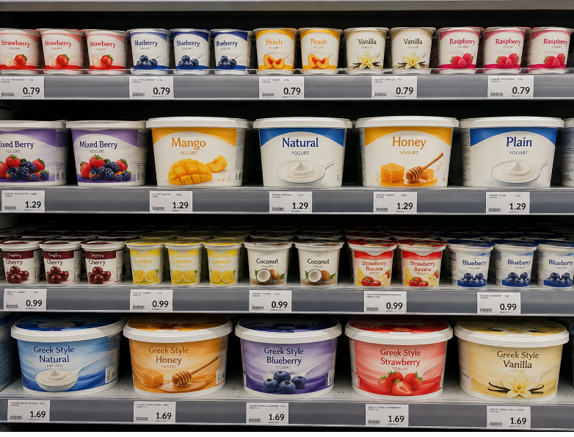
Supermarkets: powerful mkt intermediaries
A small food manufacturer develops a popular yoghurt product and wants to sell it through a major supermarket chain. Although the manufacturer owns the brand, the supermarket controls access to a large number of customers.
  The supermarket may require the manufacturer to:
  offer a lower wholesale price,
  pay listing or shelf-placement fees,
  provide frequent discounts,
  participate in supermarket promotions,
  accept long payment periods,
  meet strict delivery and packaging requirements,
  and take back unsold or expired products.
The supermarket may also decide:
  where the product is placed: A product displayed at eye level or at the end of an aisle is more visible, while one placed on a low shelf may sell less.
  How long the product can be displayed on the shelf
  If the manufacturer refuses the supermarket’s conditions, the retailer may reduce its shelf space, replace it with another brand, or promote its own private-label yoghurt.
A manufacturer may produce a good product, but without access to powerful retailers, it may struggle to reach customers and compete effectively.

Slide 39
How a bank-issued Letter of Credit (LC) helps two unfamiliar overseas businesses trade
A Vietnamese furniture importer wants to buy USD 200,000 worth of timber from a supplier in Brazil. The two companies have never worked together before. The Vietnamese importer is worried that it may pay in advance but never receive the goods. The Brazilian supplier is worried that it may ship the timber but not receive payment.
To reduce this risk, the importer asks its bank to issue a Letter of Credit (LC) in favour of the Brazilian supplier. The process is:
  The importer and supplier sign a sales contract.
  The importer’s bank issues the LC.
  The supplier ships the timber and submits the required documents, such as the bill of lading, invoice, packing list, and certificate of origin.
  If the documents comply with the LC terms, the bank pays the supplier.
  The importer receives the documents and collects the goods.
The bank acts as a trusted intermediary between two businesses that do not yet trust each other.
Banks and other financial intermediaries can make international trade possible by reducing risk, building trust, and enabling unfamiliar businesses in different countries to cooperate.

Slide 40
Competitors: offer similar products or satisfy the same customer need.
Different levels of competition
  Brand competition: Coca-Cola versus Pepsi
  Product-category competition: Soft drinks versus bottled juice
  Need-based competition: A soft drink versus coffee, tea, or water
  Budget competition: Buying a drink versus spending the money on another product
Q1: Does a lady who sells sticky rice compete with another lady who sells noodles in the same lane? Why?
Q2: Does a cinema compete with other cinemas?
Yes. It also competes with Netflix, YouTube, Social media, Restaurants, and other form of entertainment. Why?
Q3: Who are the main competitors of a university: other universities, online courses, employers, or all of them?

Slide 41
Publics: any group that has an actual or potential interest in, or impact on, a company’s ability to achieve its objectives.
Companies must manage relationships not only with customers, but also with groups that can influence public trust and business operations.
Financial publics: Banks, investors, and shareholders influence access to funding.
Media publics: News organisations, bloggers, and social-media creators influence reputation.
Government publics: Regulators affect advertising, product safety, competition, and data use.
Citizen-action groups: Environmental organisations and consumer groups may challenge company practices.
Local communities: Residents may support or oppose company operations.
General public
Internal publics: Employees and managers affect organisational culture and brand reputation.

Slide 42
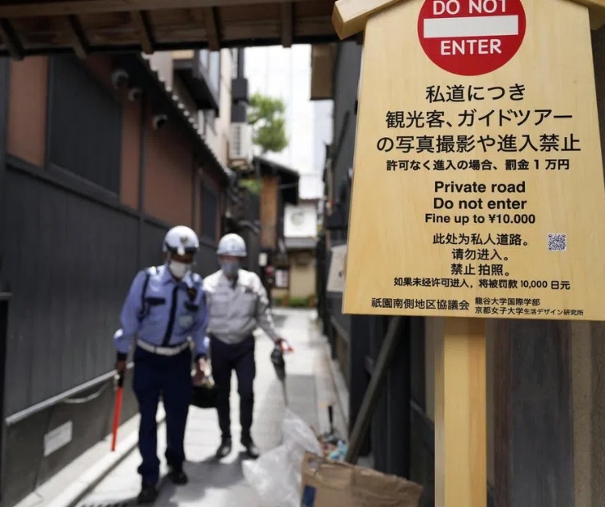
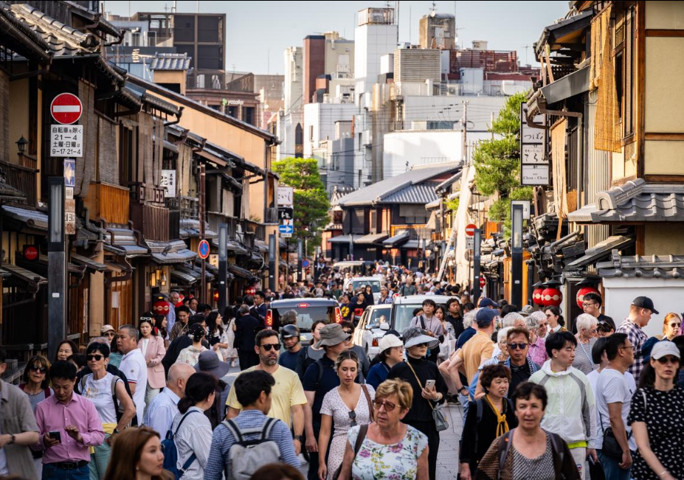
Residents’ opposition to overtourism in Kyoto
Kyoto receives large numbers of visitors, but tourism is concentrated in famous locations such as Gion, Kiyomizu-dera and Fushimi Inari. In Gion, residents complained that some tourists entered private streets, blocked narrow roads, photographed geiko and maiko without permission, and disturbed people living and working in the neighbourhood.
As a result, residents in parts of Gion installed signs banning tourists from entering or photographing on private roads, with warnings of fines of up to ¥10,000. Public streets remain open, but access to some private alleys has been restricted.
The residents’ opposition has influenced tourism. Kyoto had to manage visitor behaviour, disperse tourists to less crowded areas and protect public transport and residential life.
Residents are an important public in the tourism micro-environment. When local people feel that tourism is damaging their quality of life, their opposition can lead to access restrictions, new regulations and changes in destination marketing.

Slide 43
Customers
Consumer markets
Individuals and households buying for personal use.
Business markets
Organisations buying goods and services for production or operations.
Reseller markets
Organisations buying products to resell at a profit.
Government markets
Public agencies purchasing goods and services.
International markets
Buyers in other countries.
Different customer groups require different value propositions and marketing strategies.

Slide 44
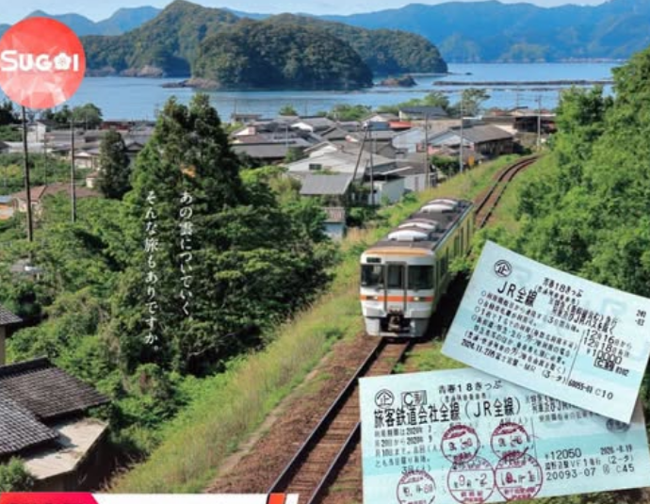
The Seishun 18 Kippu
If you live in Japan—or simply love slow, exploratory travel—you have probably heard of the Seishun 18 Kippu (青春18きっぷ), commonly shortened to the Seishun Pass or the “18 Ticket.”
The name Seishun, meaning “youth,” was not chosen by accident. Although the ticket has no age restriction and can be purchased by anyone, it was created for people who are young at heart: travellers with limited money, plenty of time, and enough courage to take the long way around.
If you travel from Tokyo to Osaka by Shinkansen, the journey takes only a few hours, with the scenery flashing past the window. With the Seishun 18 Ticket, however, you must travel on ordinary local trains. You have to get off, wait, and change trains at quiet, ageing stations in rural areas.
Yet this enforced slowness is precisely what makes the experience special. Young Japanese travellers have long used the ticket to discover a more authentic side of Japan: golden rice fields, deserted coastlines, and small towns they would never notice from a high-speed train.
For decades, the advertising campaigns for the Seishun 18 Ticket have also been considered artistic masterpieces by JR and classic examples of effective marketing.
However, JR Kyushu, one of the companies within the JR Group, recently released some shocking figures: ticket sales have fallen dramatically. From a peak of more than 620,000 tickets, sales dropped to 420,000 in 2024 and then to only 240,000 in 2025.
In just two years, nearly 60% of customers turned away from a ticket that had once symbolised youth and adventure. Why was such an iconic national product pushed towards a slow decline? The answer may lie in what many customers regard as one of JR management’s worst decisions.
First, travellers are now required to use the ticket on consecutive days. In the past, someone could travel on one Saturday and save the remaining days for the following weekend. Under the new rules, a three-day or five-day ticket must be used continuously—for example, on Friday, Saturday, and Sunday without a break. A leisurely journey has therefore been turned into an exhausting race against time.
Second, group sharing is no longer allowed. Previously, a five-day ticket could be used by a group of five people travelling together for one day, with each person using one day of the pass. The ticket has now been converted into an individual magnetic ticket that can be used by only one person. Families or groups of friends who want to travel together must each purchase a separate ticket.
The fall from 620,000 to 240,000 tickets offers a costly lesson for any business:
When a company prioritises administrative convenience over the customer experience and the product’s core value, the market may respond by walking away.

Slide 45
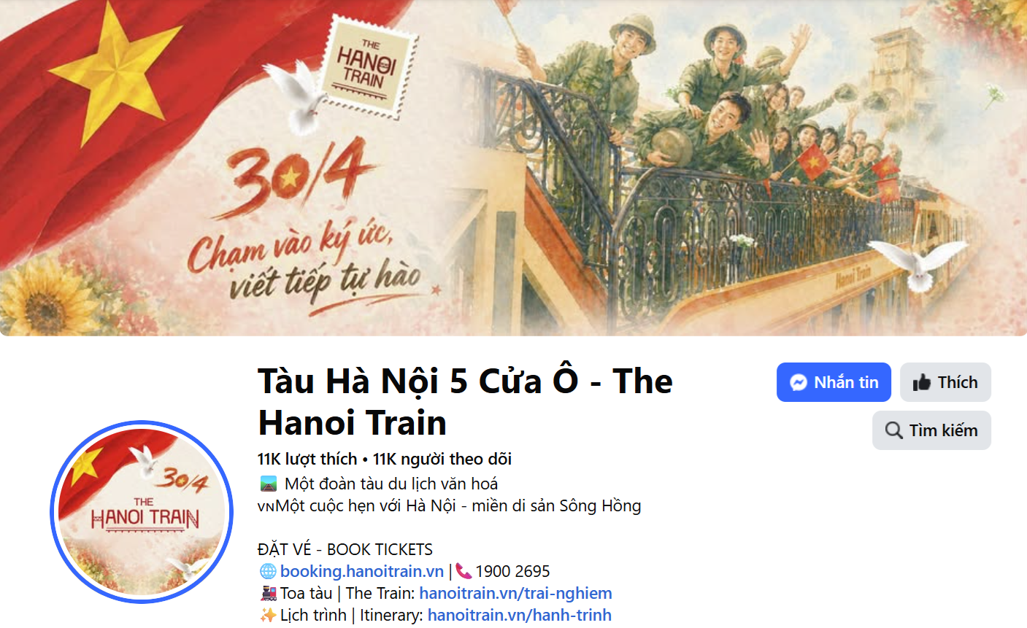
Group 1: The Hanoi 5 Gates Train
Launched in September 2025, The Hanoi Train – Five Gates is a cultural-tourism railway product connecting Hanoi Station with Từ Sơn in Bắc Ninh. It is operated by BHL Tourism Service Trading Joint Stock Company in collaboration with Vietnam Railways. Rather than selling transportation alone, the business transforms a short railway journey into an experience built around the history, culture and visual identity of Hanoi and the Red River Delta.
The train’s passenger carriages are named after five historic gates of Thăng Long–Hanoi: Ô Cầu Dền, Ô Quan Chưởng, Ô Cầu Giấy, Ô Chợ Dừa and Ô Đống Mác. Its double-decker carriages use different historical and cultural themes, while additional spaces are designed for photography and social-media “check-ins.”
The Hanoi Train does not compete primarily with ordinary trains. Its competitors include city tours, museums, cultural performances, day trips and other leisure activities.
During the journey, passengers may experience traditional forms of performance such as quan họ, ca trù, chèo and xẩm, together with regional food, lotus tea, storytelling and craft-related activities. The visit to Từ Sơn can also connect the journey with Đô Temple and the heritage of the Lý dynasty
Many customers may travel once to experience the new train, take photographs, and share them online, but they won’t come back.
Customers may not clearly understand whether the product is a sightseeing train, a cultural performance, a heritage tour, a family excursion, or a premium tourist experience.
Information about schedules, packages, prices, activities, and booking channels may appear across several websites, agents, and social-media pages, but inconsistent, and with limited accessibility for international tourists.
The total experience depends on railway operations, performers, tour guides, food providers, booking agents, and local attractions. One weak part of the service can damage the entire customer experience.

Slide 46
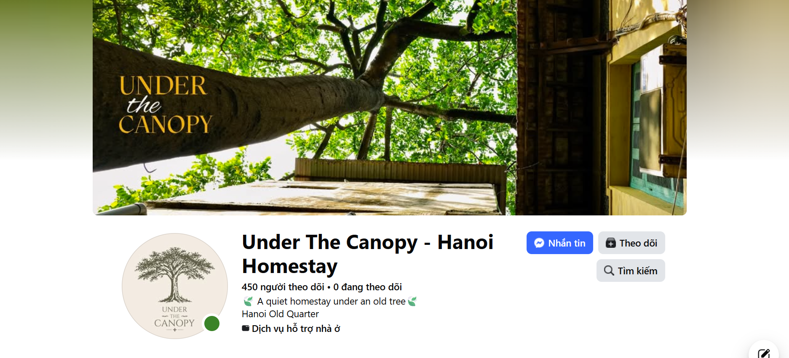

Group 2: Under the Canopy Homestay
A small Airbnb in Hanoi is located inside an old villa in the heart of the city. It offers only two private rooms. The walls are old, some paint is peeling, and many traces of time are still visible. The owner has deliberately kept these imperfections. The aim is not to create a polished hotel, but to preserve the spirit and memories of an old Hanoi home while adding just enough comfort for modern guests. Visitors can wake up to green views and birdsong, make tea, read, listen to music, and enjoy a slower rhythm of life. The property is also within walking distance of cafés, the train street, Tống Duy Tân, and the Hanoi Flag Tower.
However, this special experience is not easy to market. Many travellers have never heard of the property, and its charm is difficult to communicate through a simple list of facilities. At the same time, people who are already searching online for a unique stay in central Hanoi may never find it.
However, the business faces a marketing problem. Its Facebook page has some attractive photos and stories, but only a small number of people see the posts (https://www.facebook.com/profile.php?id=61589432002124). Many potential guests have never heard of the property. At the same time, the owner believes that there are travellers actively searching online for unusual, authentic, or centrally located accommodation in Hanoi, but the property is difficult to find through search.
The owner has a limited advertising budget and wants to increase bookings without losing the distinctive identity of the property.

Slide 47
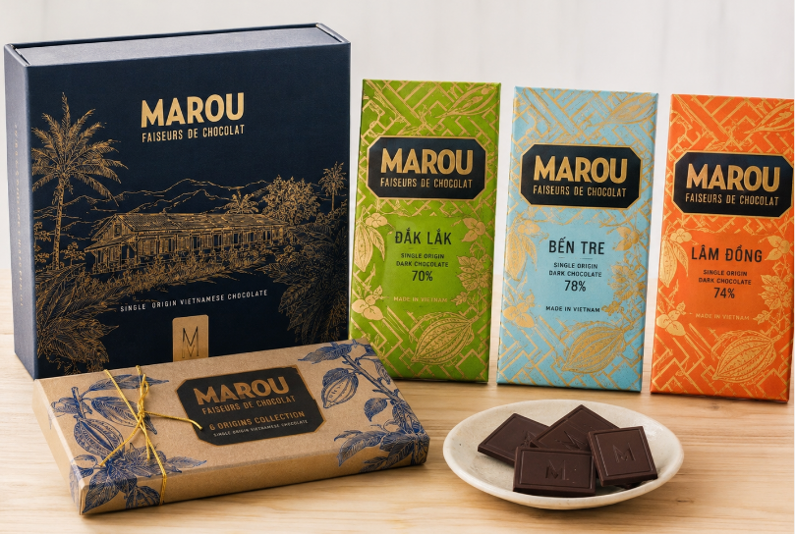
Group 3: Marou Chocolate: Turning Vietnamese Cacao into a Premium Cultural Product
This relationship can create value for several stakeholders:
  Farmers may receive better prices, technical knowledge and a more reliable market.
  Marou gains access to higher-quality and traceable cacao beans.
  Consumers receive distinctive chocolate with a clear geographical origin.
  Local communities benefit when more of the product’s value is created and retained in Vietnam.
However, Marou must ensure that its social-impact claims are transparent. Paying a premium price does not automatically prove that all farmers receive stable incomes or that every farming relationship is equitable. The company should therefore communicate measurable information about farmer income, purchasing volumes, training, long-term contracts and environmental outcomes.
Vietnam was traditionally better known for coffee and rice than for premium chocolate. Marou changed this perception by producing high-quality bean-to-bar chocolate from cacao grown in Vietnamese provinces such as Đắk Lắk, Lâm Đồng, Bến Tre and Tiền Giang.
Marou buys cacao directly from small farmers and fermenters rather than relying only on large international commodity suppliers. The company states that it pays premium prices and provides financial and technical support to more than 500 small-scale farmers and around 30 fermenters across Vietnam. It also encourages cacao agroforestry, in which cacao is grown alongside other trees and crops to support biodiversity.
In Đắk Lắk, cacao offers farmers an opportunity to diversify beyond familiar crops such as coffee, pepper and rubber. Marou’s Dak Lak single-origin chocolate connects the name of the farming region directly with the final premium product. Rather than selling anonymous cacao beans at a low commodity price, farmers become part of the story and value chain behind an internationally marketed Vietnamese chocolate brand.

Slide 48
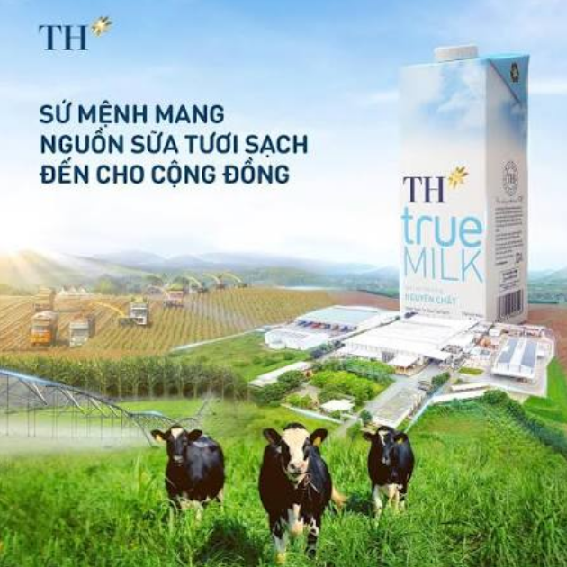
Group 4: TH True Milk and the fight for “Good milk”
For many years, Vinamilk was the dominant and most familiar dairy brand in Vietnam. Its wide distribution, long history, broad product portfolio and strong association with children’s nutrition made it a trusted household name.
When TH true MILK entered the market in 2010, it did not try to compete only through lower prices or a larger product range. Instead, it focused on a changing concern among Vietnamese consumers: growing interest in food safety, product origin, natural ingredients and healthier lifestyles.
TH positioned its products around the ideas of “true,” “fresh,” “clean” and “from nature.” Its communication emphasised fresh milk from its own farms, modern technology, traceability and internationally managed dairy herds. TH also developed the TH true mart retail chain, allowing it to present its products in a controlled environment associated with freshness, safety and healthy living.
This positioning helped redefine competition in Vietnam’s dairy market. Consumers were encouraged to think not only about whether milk was nutritious, but also where it came from, how the cows were raised, how the milk was processed and whether the product was “natural” or “clean.”
Vinamilk remained the larger and more established competitor, but it increasingly highlighted its farms, product quality, clean-label credentials, sustainable production and Green Farm fresh-milk range.
The two companies therefore competed not simply by selling milk, but by offering different meanings of “good milk”.
However, the word “clean” also creates a marketing challenge. By describing one brand as “clean milk,” consumers may infer that competing products are less clean, even when they meet legal safety and quality standards. Marketers must therefore distinguish strong positioning from claims that may confuse or unfairly influence consumers.

Slide 49
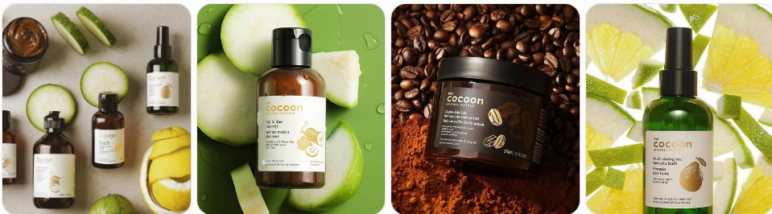
Group 5: Cocoon Vietnam: When Beauty Reflects Changing Social Values
The company extended this positioning through social and environmental initiatives. These included packaging-collection points, refill packaging and partnerships supporting animal welfare, such as campaigns against elephant riding and projects to protect moon bears.
Cocoon therefore sells more than functional skincare. It offers consumers a way to express several values at once:
  concern for animals;
  interest in environmentally responsible consumption;
  preference for plant-based ingredients;
  and pride in a modern Vietnamese brand.
However, this positioning also creates challenges. Ethical consumers may closely examine whether Cocoon’s packaging, sourcing and environmental activities are consistent with its brand promises. The company must also convince customers that vegan and locally sourced products are not only morally attractive, but also safe and effective.
Vietnam’s cosmetics market was traditionally dominated by international brands, while locally made products were sometimes perceived as less sophisticated or less trustworthy. However, younger Vietnamese consumers have gradually become more interested in ethical consumption, animal welfare, environmental responsibility, transparent ingredients and pride in local products.
Cocoon entered this changing market with a distinctive proposition: cosmetics that are made in Vietnam, use familiar Vietnamese plant-based ingredients and are positioned as 100% vegan and cruelty-free.
Instead of relying only on globally fashionable ingredients, Cocoon built product stories around local materials such as Đắk Lắk coffee, Hậu Giang lotus, Bến Tre coconut, turmeric, grapefruit and winter melon. This helped the brand connect skincare with Vietnamese places, agriculture and cultural identity. Cocoon states that it does not use animal-derived ingredients such as honey, beeswax, lanolin or snail secretion.
To make its ethical claims more credible, Cocoon joined international certification programmes. It became the first Vietnamese cosmetics brand accepted into Cruelty Free International’s Leaping Bunny programme, and its cruelty-free status is also listed by PETA. Its products are registered as vegan with The Vegan Society.

Slide 50
Classroom activity
Each group identify:
  one important supplier,
  one intermediary,
  two major competitors,
  one influential public, and
  its main customer market
for your assigned case study. Then answer:
Which micro-environmental actor creates the greatest opportunity or threat for this company?

