Slide 1

Marketing Information System (MIS) & Marketing Research
Lecturer: Hoa Nguyen Quynh, PhD
SEM, HUST

Slide 2

The MIS

Slide 3
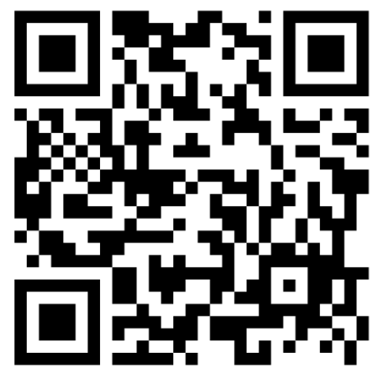
What is Mkt Information System (MIS)?
MIS is not simply about software or database.
MIS is an organized system of:
  people,
  technologies,
  data sources,
  analytical methods,
  procedures,
  Reports
  Dashboards
MIS is used to collect, integrate, analyse and distribute marketing information to decision-makers
Raw data → meaningful information → customer insights → marketing decisions → market actions → performance feedback

Slide 4
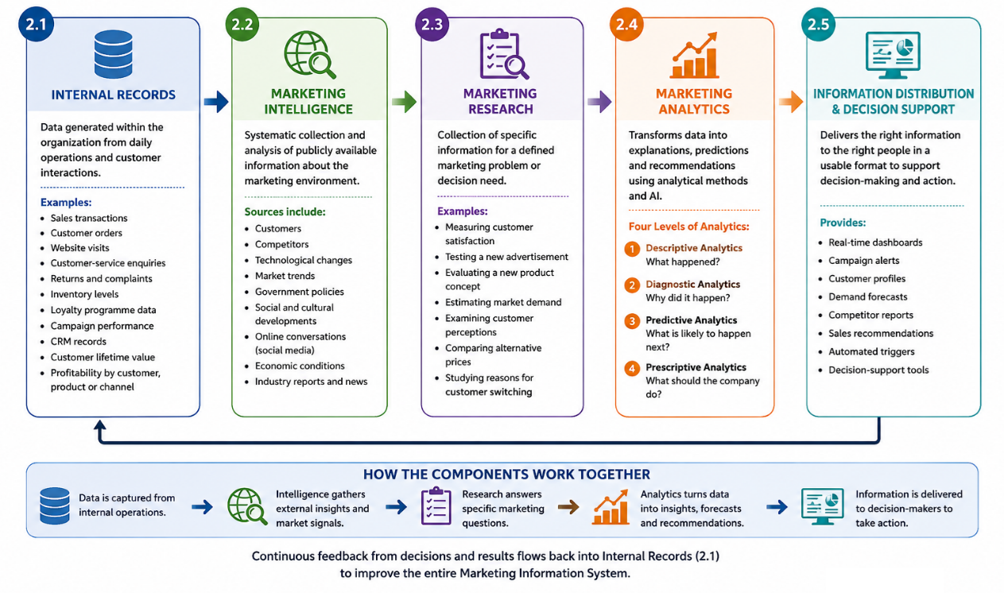
Main components

Slide 5
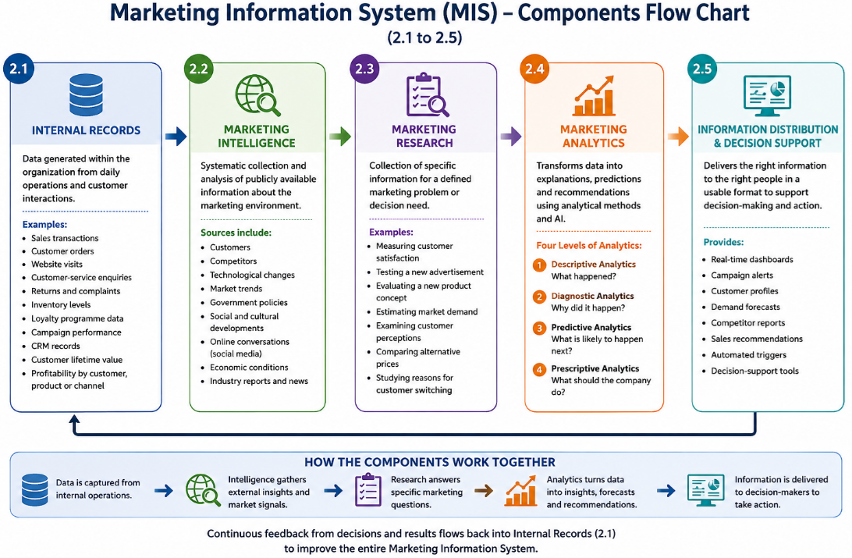

Slide 6
The digital age: Big Data and AI era
Online, mobile and social media marketing: The consumer love affair with digital and mobile technology makes it fertile ground for marketers trying to engage customers.
Digital and social media marketing
  involves using digital marketing tools, such as websites, social media, mobile ads and apps, online video, email, blogs and other digital platforms
  engage consumers anywhere, anytime via their computers, smartphones, tablets, Smart TVs and other digital devices.
Social media marketing: Big Data and AI platforms
Most brand websites, and even traditional media ads, feature links to the brand’s Facebook, Instagram, Twitter, LinkedIn, YouTube, Snapchat or other social media sites.
Online social media offer an ideal platform for real-time marketing by which marketers can engage consumers in the moment by linking brands to
  important trending topics
  real-world events, causes, personal occasions
  other important happenings in consumers’ lives
Marketers can understand the customer journey rather than evaluating each channel separately: what the customer searched for; what content they viewed; how long they stayed; what they clicked; where they abandoned the process; what they purchased; what they reviewed; what they shared.

Slide 7

Big data and artificial intelligence (AI) – AI Marketing
The explosion in digital technologies means we now have ready access to more data than ever before.
Companies can use this big data to gain deep consumer insights, personalise marketing offers, and improve communication, engagement and service with consumers.
To make sense of big data and to be able to use it effectively, marketers are turning to even more-advanced marketing analytics.
Artificial intelligence (AI) involves machines thinking and learning in a way that looks and feels human, but with much greater analytical capacity.
Marketers use AI to analyse data at lightning speed and apply marketing insights to engage customers in real time and help them through the buying process.

Slide 8
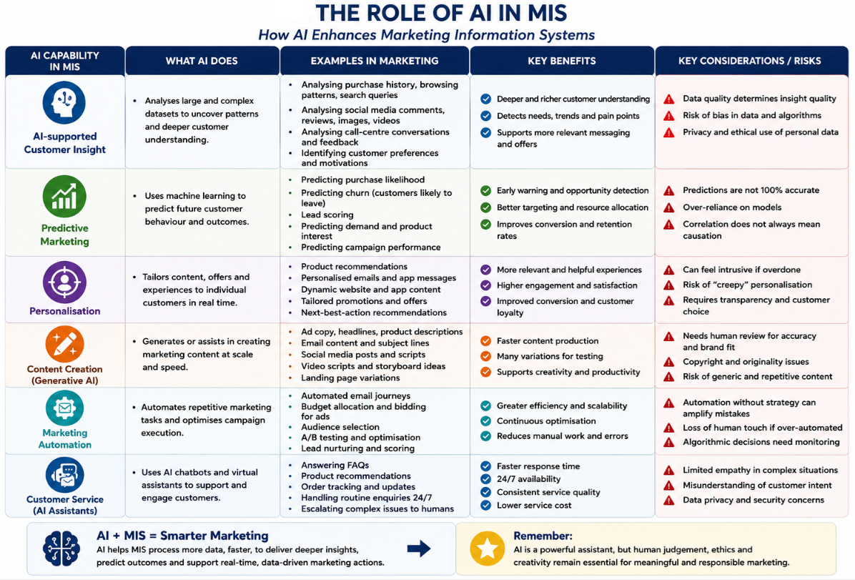

Slide 9
How AI change MIS and Mkt jobs?
Product: from periodic development to continuous adaptation
Price: from standard pricing to algorithmic pricing
Promotion: from campaign delivery to continuous optimization
Place: Place: from channel selection to journey orchestration
Customer behaviour: discover a product on TikTok → read reviews on Google → compare it on a marketplace → inspect it in a store → order through an app → contact customer service through messaging → post a review afterwards.
→ MIS must connect these touchpoints.

Slide 10
Mkt Strategies
Start with the marketing problem, not the technology:
→ Business objective → customer problem → information requirement → data → analysis or AI → action → evaluation
  Which customer problem are we trying to solve?
  Which decision needs better information?
  Which process is inefficient?
  Which outcome should improve?
  How will success be measured?
Combine AI with human judgement
  AI: recognising patterns; processing large datasets; automating repetitive activities; generating alternatives; predicting likely outcomes
  Human: strategic direction; ethical judgement; cultural interpretation; empathy; brand leadership; creativity; accountability

Slide 11
Marketing
Research

Slide 12
What Is Marketing Research?
Mkt research provides evidence that improves the decision
A restaurant studies why customers do not return.
A university investigates how students choose degree programmes.
A hotel measures guest satisfaction.
A retailer tests two advertising messages.
A technology company explores customer reactions to a new app feature.
defining a marketing problem or opportunity;
collecting relevant information;
analysing and interpreting the information;
reporting findings;
using the findings to support marketing decisions under uncertainty.
  customer needs and preferences;
  market size and demand;
  competitors;
  brand perceptions;
  product ideas;
  pricing decisions;
  advertising effectiveness;
  customer satisfaction;
  distribution channels;
  changing market trends.

Slide 13
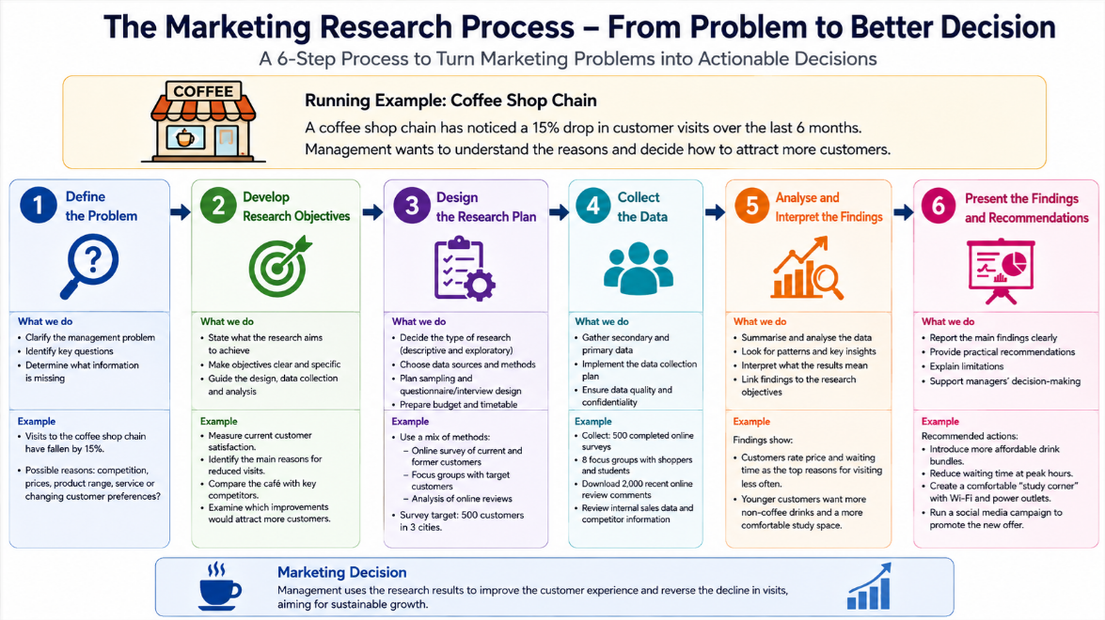

Slide 14
Define the Research Problem
A management problem: Eg: Sales are declining.
A marketing research problem: Eg: Investigate the factors influencing booking cancellation.
Defining the right problem helps: save time, money and efforts, good decision, productivity improvement.
Management problem: Applications to a university programme have declined.
  Weak RQ: Why do students dislike our programme? (The marketer already assumes that students dislike the programme.
  Better RQ: What are the factors influencing prospective students’ awareness, evaluation and choice of the programme?
What is the research problem for the case of your group?
  The Hanoi 5 Gates Train
  Under the canopy
  Marou Chocolate
  TH True milk
  Cocoon cosmetic
  Hanhsilk

Slide 15
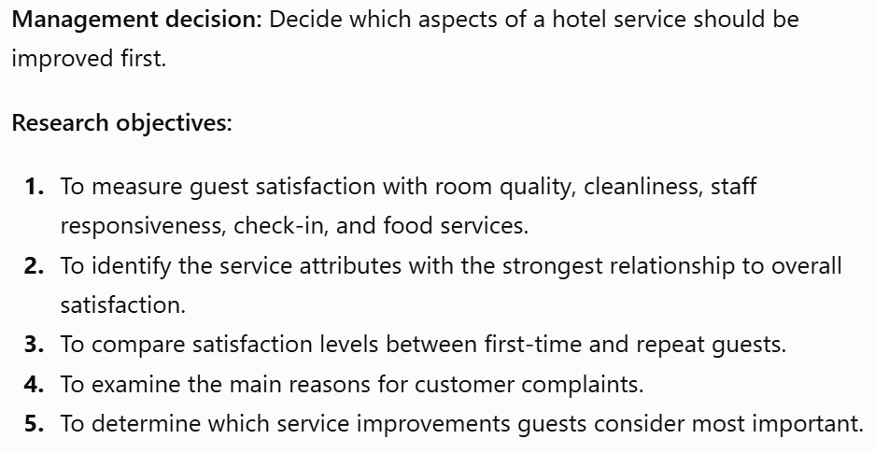
Developing Research Objectives
Research Objectives: clearly state what the study aims to discover, describe, compare or test.
  Research design
  Data collection
  Questionnaire development
  Data analysis
  Final conclusions/ report
Research Objectives:
  clear;
  specific;
  realistic;
  relevant to the management decision;
  measurable or answerable;
  neutral rather than biased.

Slide 16
Research Design:
Which type of Mkt Research best answers the research questions?
How much is the cost?
How long we need the research done?
Who will conduct the research?
What is the time plan to execute the research?
How we will analyse the data? By which software?
Who will write the report?

Slide 17
Types of Marketing Research
Exploratory research is used when the problem is unclear or insufficiently understood
Eg: The Hanoi 5 gates notices that younger customers visit once but rarely return
→ Exploratory research may investigate:
  perceptions of the atmosphere;
  service experiences;
  pricing concerns;
  product variety;
  competitor preferences;
  social media comments.
Common exploratory methods include: analysis of existing reports; expert interviews; customer interviews; focus groups; observation; social media analysis; case studies.

Slide 18
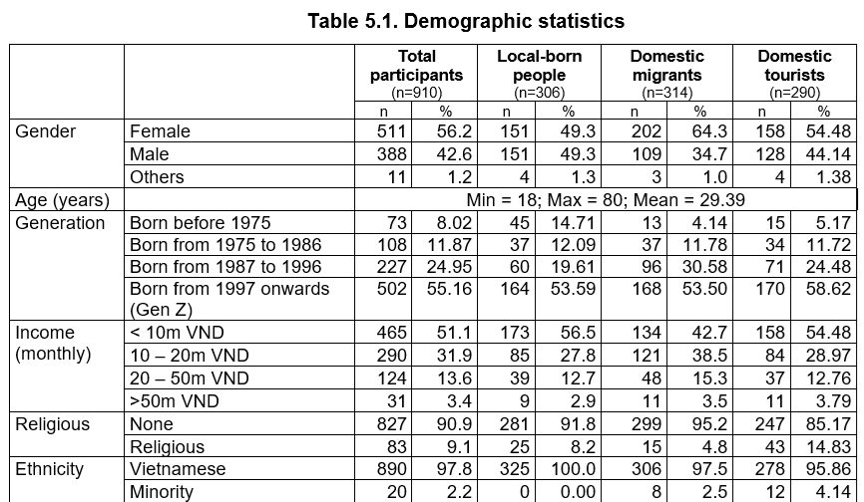
Types of Marketing Research
Descriptive research describes characteristics, behaviours or market conditions.
Help answer:
  Who buys the product? What do customers buy? How often do they purchase? Where do they purchase? How satisfied are they? Which brand do they prefer?
Eg:
  Estimating market size.
  Describing the demographic profile of buyers.
  Measuring brand awareness.
  Comparing preferences across age groups.

Slide 19
Types of Marketing Research
Causal research examines whether one variable causes a change in another variable.
Eg: If the company increase the price, will the sales reduce?
Does faster delivery improve customer satisfaction?

Slide 20
Types of Marketing Research
Experiments normally involve:
  changing one factor;
  controlling other factors where possible;
  comparing outcomes;
  using treatment and control groups.
Eg:
  Group A sees Advertisement A.
  Group B sees Advertisement B.
  Researchers compare purchase intention or brand recall.

Slide 21
Sources of Data
Secondary Data
Primary Data
Secondary data are information that already exists and was originally collected for another purpose.
Eg: How was the sales record of this company over the late 3 years?
Tools: company sales records; government statistics; academic articles; industry reports; websites; market databases; trade associations; social media platforms; competitor publications.
Primary data are collected specifically for the current research problem.
Eg: If we launch a new promotion, will sales increase in the next 3 months?
Tools: surveys; interviews; focus groups; observations; experiments; customer diaries; content analysis.

Slide 22
Advantages and Limitations
Secondary Data
Primary Data
Advantages
  directly relevant;
  current;
  designed for the research objectives;
  greater control over measurement.
Limitations
  can be expensive;
  may take considerable time;
  requires research expertise;
  may face low response rates;
  can contain sampling and measurement errors.
Advantage:
  less expensive;
  useful for understanding the market;
  helpful for defining the problem;
  valuable for comparing trends over time.
Limitations:
  outdated;
  incomplete;
  collected for a different purpose;
  based on unsuitable definitions;
  Unreliable & biased;
  too general;
  unavailable for the specific target market.
Q: Researchers should usually begin with secondary data. Why?

Slide 23
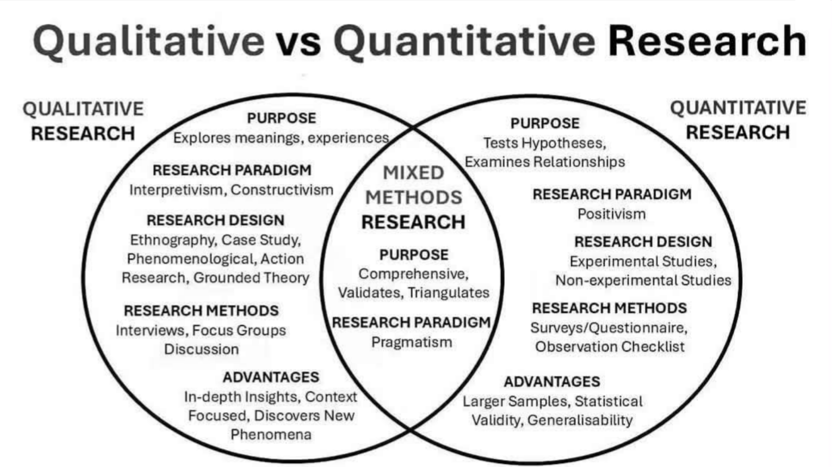

Slide 24
Aspect | Qualitative data | Quantitative data
Meaning | Non-numerical data: meanings, experiences, opinions, and motivations | Numerical data measure quantities, frequencies, differences, or relationships
Main purpose | To explore and understand | To measure, compare, and test
Typical questions | Why? How? What does it mean? | How many? How often? How much? Is there a relationship?
Data format | Words, images, videos, observations, narratives | Numbers, scores, percentages, frequencies
Sample size | Usually smaller | Usually larger
Sampling approach | Often purposive or judgement-based | Often probability sampling
Research design | Flexible and exploratory | Structured and standardised
Analysis | Coding, categorising, identifying themes and meanings | Statistical analysis, tables, graphs, comparisons, hypothesis testing
Typical output | Themes, explanations, quotations, customer stories | Averages, percentages, correlations, differences, predictions
Strengths | Provides depth, context, and detailed understanding | Supports measurement, comparison, and generalisation

Slide 25

Primary Research Methods

Slide 26
Surveys

Slide 27
Observation
Observation involves watching and recording actual behaviour.
Researchers may observe:
  movement through a store;
  product selection;
  website navigation;
  waiting times;
  service interactions;
  product use;
  customer reactions.

Slide 28

Focus Groups
A focus group is a guided discussion involving a small group of participants.
A moderator encourages discussion about:
  products;
  brands;
  advertisements;
  customer experiences;
  new ideas;
  market trends.

Slide 29
In-depth interviews
Interviews involve direct conversations between a researcher and a participant
Interviews can be
  Structured interview: Uses the same predetermined questions, in the same order, for every participant. It supports consistency and easy comparison.
  Semi-structured interview: Uses a prepared interview guide but allows the interviewer to ask follow-up questions and explore unexpected issues.
  Unstructured interview: Uses few or no fixed questions. The conversation is flexible and led largely by the participant’s experiences and responses.

Slide 30
Content analysis
Content analysis is a systematic method for examining communication materials.
Quantitative content analysis: Measures the frequency of specific words, themes, images or categories.
Eg: How often homestay reviews mention green products?
Qualitative content analysis: Interprets the deeper meaning, context and patterns in the material.
Eg: How do guests describe feeling “at home” in homestay services?
Researchers may analyse:
  advertisements;
  websites;
  customer reviews;
  social media posts;
  videos;
  interview transcripts;
  news articles;
  competitor messages;
  customer complaints.
Content analysis may examine: frequently discussed topics; positive and negative sentiment; brand associations; emotional language; product complaints; recurring service problems; visual themes; competitor positioning; representations of social groups.

Slide 31
Content analysis
Process: Define the research question→Select the content to analyse → Decide the unit of analysis → Develop categories or codes → Code the material → Check coding consistency → Identify patterns → Interpret the findings.
Eg: Marou Chocolate Reviews:
The marketer team of Marou analyses 1,000 online reviews
Possible coding categories: products quality; tastes; staff friendliness; price; colour; shapes; location; intention to repurchase.
→ The findings may show that customers like the chocolate tastes but repeatedly complain about the staff.

Slide 32
Experiments
Experiments test causal relationships by changing one factor and measuring its effect.
Possible marketing experiments include:
  different prices;
  alternative website designs;
  different advertisements;
  promotional messages;
  product packaging;
  store layouts;
  delivery options.
Eg: Divide the sample into 2 group, A and B
  Group A tried the old version of a drink
  Group B tried the new version of that drink
  The company learns how the 2 groups react to what they try to figure out which one should be launch to the market.

Slide 33
Surveys:
Surveys collect structured responses from a sample of people, through:
  online questionnaires;
  mobile apps;
  email;
  telephone;
  face-to-face interviews;
  paper questionnaires.

Slide 34
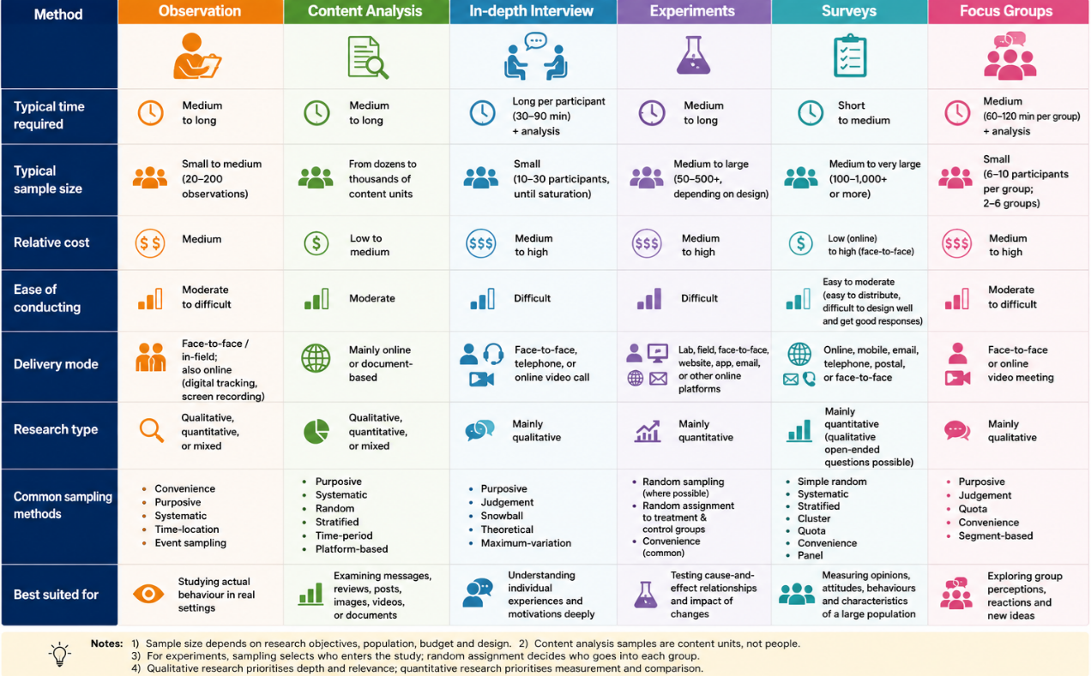

Slide 35
Sampling

Slide 36
Sampling
Population: The complete group relevant to the research.
Sample: A smaller group selected from the population.
Census: Data collected from every member of the population.
Example:
  Population: All students at a university.
  Sample: 500 selected students.
Sampling is normally used because studying the entire population may be:
  too expensive;
  too slow;
  impractical;
  unnecessary.
A well-selected sample can provide useful estimates of the wider population.

Slide 37
Sampling
Non-Probability Sampling
Probability Sampling
In probability sampling, each member of the population has a known chance of selection.
Examples:
  simple random sampling;
  systematic sampling;
  stratified sampling;
  cluster sampling.
In non-probability sampling, the chance of selection is unknown.
Examples:
  convenience sampling;
  judgement sampling;
  quota sampling;
  snowball sampling.
These methods are often faster and cheaper but may produce greater bias.

Slide 38
Sampling Error and Bias
Sampling error occurs because only part of the population is studied.
Sampling bias occurs when the sample systematically excludes or overrepresents particular groups.
Example:
A university satisfaction survey distributed only to the students at the library may underrepresent students who do not use the library.

Slide 39
Sample size
Sample size depends on:
  research objectives;
  population size;
  expected variation;
  sampling method;
  required precision;
  planned analysis;
  available time and budget.
A larger sample does not automatically produce better research. Why?

Slide 40
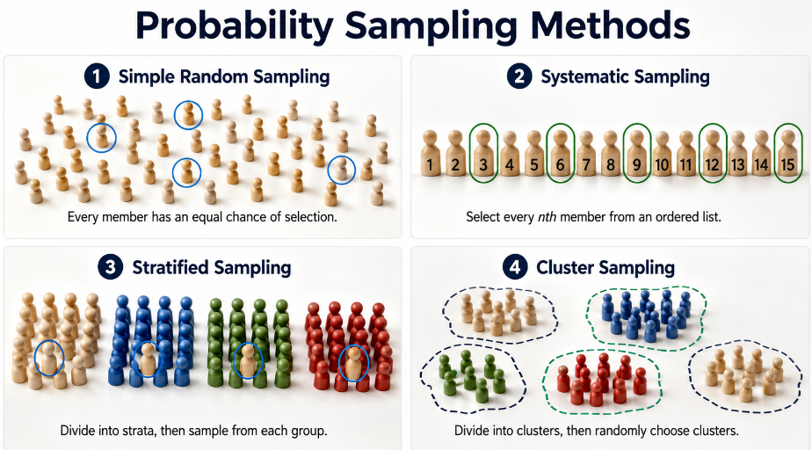

Slide 41
Method | Brief definition | Marketing research example
Convenience sampling | Selects participants who are easiest and most readily available to the researcher. | A researcher surveys students who are sitting in the university cafeteria because they are easy to approach.
Judgement sampling | The researcher deliberately selects participants believed to have relevant knowledge, experience, or characteristics. It is also called purposive sampling. | A company interviews experienced luxury-car owners to understand expectations of premium after-sales service.
Quota sampling | The researcher sets target numbers for important groups and selects available participants until each quota is filled. Selection within each group is not random. | A retailer surveys 200 customers, including 100 men and 100 women, to reflect its desired gender proportions.
Snowball sampling | Initial participants recommend or recruit other people who meet the study criteria. The sample grows through participant networks. | A researcher studying users of an invitation-only luxury resale platform asks each interviewee to refer other users.

Slide 42
Questionnaire

Slide 43
Questionnaire Design
A questionnaire translates research objectives into questions respondents can answer.
A good questionnaire should be:
  clear;
  relevant;
  concise;
  logically organised;
  easy to complete;
  neutral;
  suitable for the target respondents.

Slide 44
Avoid
Avoid Leading Questions:
Eg: How much did you enjoy our excellent customer service?
How would you rate the customer service you received?
Avoid Double-Barrelled Questions
Eg: How satisfied are you with our product quality and price?
A respondent may like the quality but dislike the price.
How satisfied are you with the product quality?
How satisfied are you with the price?
Avoid Ambiguous Questions
Eg: Do you regularly buy coffee?
“Regularly” may mean different things to different people.
→ During the past seven days, how many times did you purchase coffee outside your home?

Slide 45
Structure
Brief introduction.
Screening questions.
Simple and interesting questions.
Main research questions.
Sensitive or difficult questions.
Demographic questions.
Thank-you message.

Slide 46
Open and Closed Questions
Open question
Eg: What do you like most about this product?
→ Respondents answer in their own words.
Closed question
Eg: Are you satisfied with this product?
  Yes
  No

Slide 47
Multiple-choice questions
Single-answer: Which factor is most important when you choose a coffee shop?
  Price
  Product quality
  Location
  Service
  Atmosphere
Multiple-answer: Which features would you like the coffee shop to improve? Select all that apply.
  Product variety
  Service speed
  Seating
  Wi-Fi
  Prices
  Opening hours

Slide 48
Likert-scale questions: measures agreement with a statement
Please indicate your level of agreement with each statement.
Statement | Strongly disagree | Disagree | Neutral | Agree | Strongly agree
The staff are friendly. | 1 | 2 | 3 | 4 | 5
The service is fast. | 1 | 2 | 3 | 4 | 5
The prices are reasonable. | 1 | 2 | 3 | 4 | 5
I intend to visit again. | 1 | 2 | 3 | 4 | 5

Slide 49
100-point rating-scale questions
On a scale from 0 to 100, how likely are you to recommend this restaurant to a friend?
0: Not at all likely
100: Extremely likely
Note: respondents may find it difficult to distinguish precisely between close scores such as 72 and 73.

Slide 50

Group work

Slide 51

Group 1: The Hanoi 5 Gates Train
Launched in September 2025, The Hanoi Train – Five Gates is a cultural-tourism railway product connecting Hanoi Station with Từ Sơn in Bắc Ninh. It is operated by BHL Tourism Service Trading Joint Stock Company in collaboration with Vietnam Railways. Rather than selling transportation alone, the business transforms a short railway journey into an experience built around the history, culture and visual identity of Hanoi and the Red River Delta.
The train’s passenger carriages are named after five historic gates of Thăng Long–Hanoi: Ô Cầu Dền, Ô Quan Chưởng, Ô Cầu Giấy, Ô Chợ Dừa and Ô Đống Mác. Its double-decker carriages use different historical and cultural themes, while additional spaces are designed for photography and social-media “check-ins.”
The Hanoi Train does not compete primarily with ordinary trains. Its competitors include city tours, museums, cultural performances, day trips and other leisure activities.
During the journey, passengers may experience traditional forms of performance such as quan họ, ca trù, chèo and xẩm, together with regional food, lotus tea, storytelling and craft-related activities. The visit to Từ Sơn can also connect the journey with Đô Temple and the heritage of the Lý dynasty
Many customers may travel once to experience the new train, take photographs, and share them online, but they won’t come back.
Customers may not clearly understand whether the product is a sightseeing train, a cultural performance, a heritage tour, a family excursion, or a premium tourist experience.
Information about schedules, packages, prices, activities, and booking channels may appear across several websites, agents, and social-media pages, but inconsistent, and with limited accessibility for international tourists.
The total experience depends on railway operations, performers, tour guides, food providers, booking agents, and local attractions. One weak part of the service can damage the entire customer experience.

Slide 52
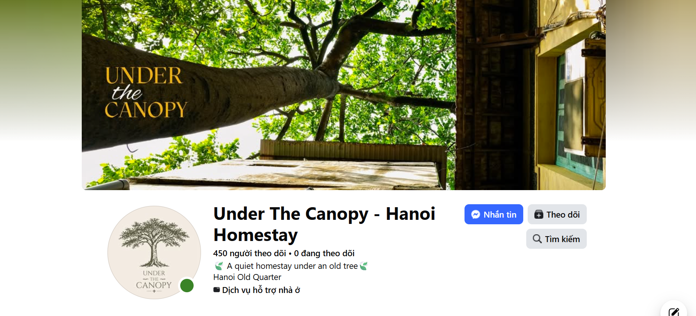
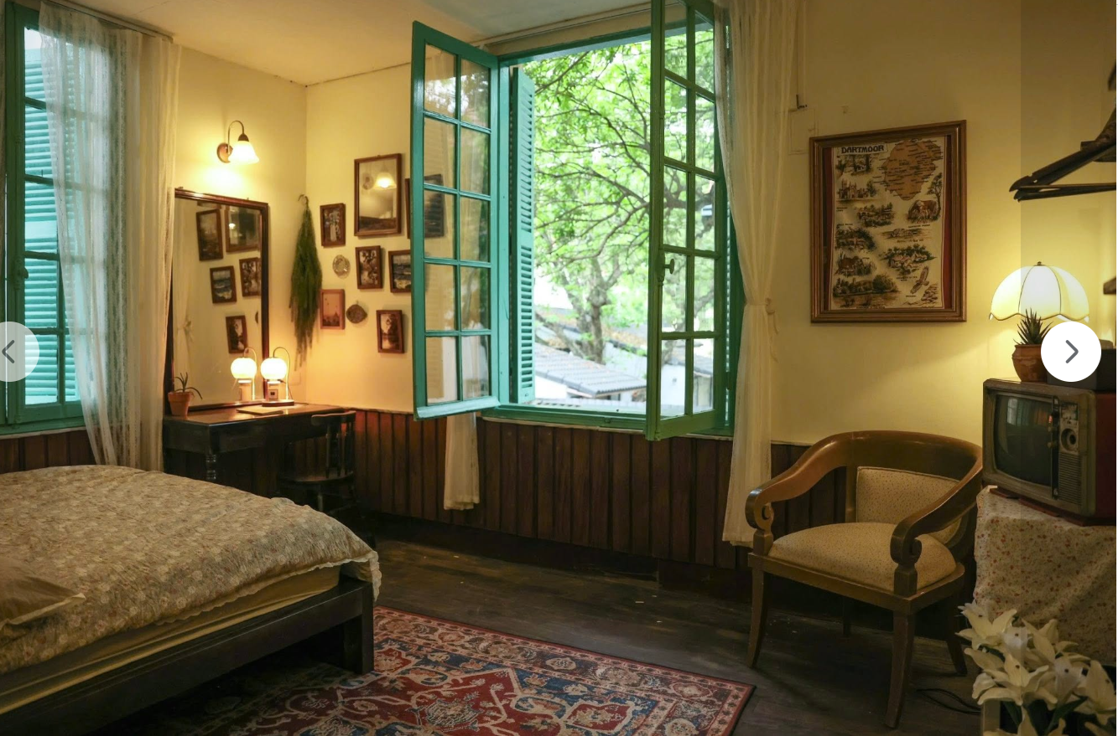
Group 2: Under the Canopy Homestay
A small Airbnb in Hanoi is located inside an old villa in the heart of the city. It offers only two private rooms. The walls are old, some paint is peeling, and many traces of time are still visible. The owner has deliberately kept these imperfections. The aim is not to create a polished hotel, but to preserve the spirit and memories of an old Hanoi home while adding just enough comfort for modern guests. Visitors can wake up to green views and birdsong, make tea, read, listen to music, and enjoy a slower rhythm of life. The property is also within walking distance of cafés, the train street, Tống Duy Tân, and the Hanoi Flag Tower.
However, this special experience is not easy to market. Many travellers have never heard of the property, and its charm is difficult to communicate through a simple list of facilities. At the same time, people who are already searching online for a unique stay in central Hanoi may never find it.
However, the business faces a marketing problem. Its Facebook page has some attractive photos and stories, but only a small number of people see the posts (https://www.facebook.com/profile.php?id=61589432002124). Many potential guests have never heard of the property. At the same time, the owner believes that there are travellers actively searching online for unusual, authentic, or centrally located accommodation in Hanoi, but the property is difficult to find through search.
The owner has a limited advertising budget and wants to increase bookings without losing the distinctive identity of the property.

Slide 53
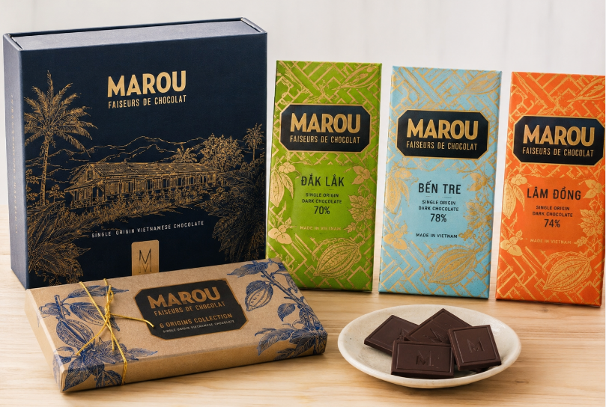
Group 3: Marou Chocolate: Turning Vietnamese Cacao into a Premium Cultural Product
This relationship can create value for several stakeholders:
  Farmers may receive better prices, technical knowledge and a more reliable market.
  Marou gains access to higher-quality and traceable cacao beans.
  Consumers receive distinctive chocolate with a clear geographical origin.
  Local communities benefit when more of the product’s value is created and retained in Vietnam.
However, Marou must ensure that its social-impact claims are transparent. Paying a premium price does not automatically prove that all farmers receive stable incomes or that every farming relationship is equitable. The company should therefore communicate measurable information about farmer income, purchasing volumes, training, long-term contracts and environmental outcomes.
Vietnam was traditionally better known for coffee and rice than for premium chocolate. Marou changed this perception by producing high-quality bean-to-bar chocolate from cacao grown in Vietnamese provinces such as Đắk Lắk, Lâm Đồng, Bến Tre and Tiền Giang.
Marou buys cacao directly from small farmers and fermenters rather than relying only on large international commodity suppliers. The company states that it pays premium prices and provides financial and technical support to more than 500 small-scale farmers and around 30 fermenters across Vietnam. It also encourages cacao agroforestry, in which cacao is grown alongside other trees and crops to support biodiversity.
In Đắk Lắk, cacao offers farmers an opportunity to diversify beyond familiar crops such as coffee, pepper and rubber. Marou’s Dak Lak single-origin chocolate connects the name of the farming region directly with the final premium product. Rather than selling anonymous cacao beans at a low commodity price, farmers become part of the story and value chain behind an internationally marketed Vietnamese chocolate brand.

Slide 54
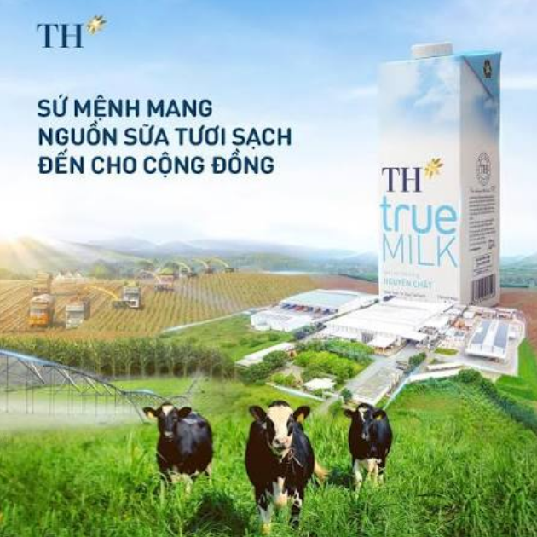
Group 4: TH True Milk and the fight for “Good milk”
For many years, Vinamilk was the dominant and most familiar dairy brand in Vietnam. Its wide distribution, long history, broad product portfolio and strong association with children’s nutrition made it a trusted household name.
When TH true MILK entered the market in 2010, it did not try to compete only through lower prices or a larger product range. Instead, it focused on a changing concern among Vietnamese consumers: growing interest in food safety, product origin, natural ingredients and healthier lifestyles.
TH positioned its products around the ideas of “true,” “fresh,” “clean” and “from nature.” Its communication emphasised fresh milk from its own farms, modern technology, traceability and internationally managed dairy herds. TH also developed the TH true mart retail chain, allowing it to present its products in a controlled environment associated with freshness, safety and healthy living.
This positioning helped redefine competition in Vietnam’s dairy market. Consumers were encouraged to think not only about whether milk was nutritious, but also where it came from, how the cows were raised, how the milk was processed and whether the product was “natural” or “clean.”
Vinamilk remained the larger and more established competitor, but it increasingly highlighted its farms, product quality, clean-label credentials, sustainable production and Green Farm fresh-milk range.
The two companies therefore competed not simply by selling milk, but by offering different meanings of “good milk”.
However, the word “clean” also creates a marketing challenge. By describing one brand as “clean milk,” consumers may infer that competing products are less clean, even when they meet legal safety and quality standards. Marketers must therefore distinguish strong positioning from claims that may confuse or unfairly influence consumers.

Slide 55
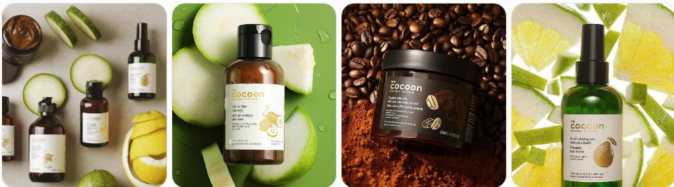
Group 5: Cocoon Vietnam: When Beauty Reflects Changing Social Values
The company extended this positioning through social and environmental initiatives. These included packaging-collection points, refill packaging and partnerships supporting animal welfare, such as campaigns against elephant riding and projects to protect moon bears.
Cocoon therefore sells more than functional skincare. It offers consumers a way to express several values at once:
  concern for animals;
  interest in environmentally responsible consumption;
  preference for plant-based ingredients;
  and pride in a modern Vietnamese brand.
However, this positioning also creates challenges. Ethical consumers may closely examine whether Cocoon’s packaging, sourcing and environmental activities are consistent with its brand promises. The company must also convince customers that vegan and locally sourced products are not only morally attractive, but also safe and effective.
Vietnam’s cosmetics market was traditionally dominated by international brands, while locally made products were sometimes perceived as less sophisticated or less trustworthy. However, younger Vietnamese consumers have gradually become more interested in ethical consumption, animal welfare, environmental responsibility, transparent ingredients and pride in local products.
Cocoon entered this changing market with a distinctive proposition: cosmetics that are made in Vietnam, use familiar Vietnamese plant-based ingredients and are positioned as 100% vegan and cruelty-free.
Instead of relying only on globally fashionable ingredients, Cocoon built product stories around local materials such as Đắk Lắk coffee, Hậu Giang lotus, Bến Tre coconut, turmeric, grapefruit and winter melon. This helped the brand connect skincare with Vietnamese places, agriculture and cultural identity. Cocoon states that it does not use animal-derived ingredients such as honey, beeswax, lanolin or snail secretion.
To make its ethical claims more credible, Cocoon joined international certification programmes. It became the first Vietnamese cosmetics brand accepted into Cruelty Free International’s Leaping Bunny programme, and its cruelty-free status is also listed by PETA. Its products are registered as vegan with The Vegan Society.

Slide 56
HanhSilk: Weaving Tradition into a Modern Brand
HanhSilk was founded in 2012 by Lương Thanh Hạnh after she discovered the traditional silk-making skills of Nam Cao village in northern Vietnam. She saw that local artisans, many of them women, produced high-quality silk but had limited access to wider markets.
The company works with the Nam Cao silk community across several stages of production, including silkworm farming, silk reeling, weaving, dyeing and embroidery. This helps create rural employment, preserve traditional knowledge and provide craftswomen with income closer to home.
HanhSilk sells fabrics, scarves, dresses, ties, pillowcases, towels, socks, beauty accessories and gift products. Some items are handmade, hand-painted or embroidered, while others are machine-woven. Prices range from affordable accessories to premium fashion products.
The brand sells through its Hanoi showroom, website, social media, Shopee, Etsy, trade fairs and international orders. Its products have reached customers in Vietnam and several overseas markets.
HanhSilk’s main strengths are its natural silk, cultural heritage and connection with local artisans. However, its wide product range and price levels may make its brand position unclear. Customers may also struggle to distinguish genuine silk from synthetic alternatives, especially when shopping online.
After more than a decade of development, HanhSilk must continue growing while protecting product authenticity, strengthening customer trust and maintaining meaningful benefits for the silk-making community.

Slide 57
Classroom activity
  Identify the mkt research problems

