Slide 1

Lecture 4:
Consumer Behaviour

Slide 2
Objectives
By the end of the lesson, students should be able to:
Define consumer buyer behaviour and the consumer market.
Explain the model of consumer buyer behaviour.
Identify the main factors influencing consumer decisions.
Distinguish among the four types of buying behaviour.
Explain the five stages of the buyer decision process.
Apply consumer behaviour concepts to marketing decisions.

Slide 3
What influences your choice of smartphone?
Why do people buy the same product for different reasons?
One student buys an iPhone for its camera.
Another buys it because friends use iPhones.
Another considers it a symbol of status.
Another values privacy and the Apple ecosystem.
Another buys it because of a promotional instalment plan.

Slide 4
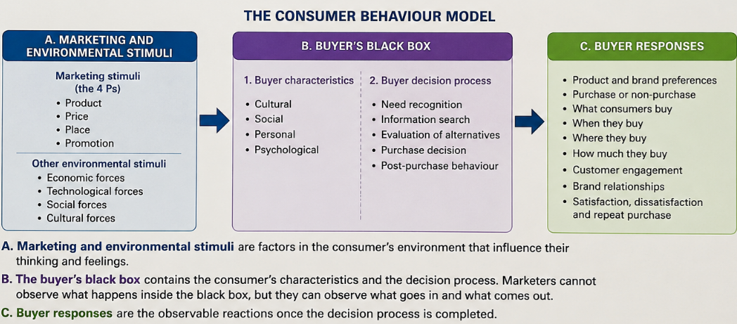
What is consumer behaviour?
Consumer buyer behaviour refers to the buying behaviour of final consumers who purchase goods and services for personal consumption.
It includes how consumers:
  Recognise needs
  Search for information
  Evaluate alternatives
  Select products and brands
  Purchase and use products
  Evaluate their experiences
  Dispose of products

Slide 5
Stimulus–Organism–Response Theory
The Stimulus–Organism–Response theory (Mehrabian and Russell, 1974) explains how features of an environment influence a person’s internal state, which then shapes their behaviour.
A stimulus is any external environmental factor that affects the consumer: Product features, price, advertising, store design, music, lighting, colour, scent, service quality, website design, online reviews, social-media content, brand reputation, interaction with employees or other customers.
Eg: In a coffee shop: the lighting, music, aroma, staff friendliness, seating arrangement and menu design are stimuli.
In an online shop: website attractiveness, information quality, navigation convenience, discounts, product recommendations, countdown timers, customer ratings, perceived security

Slide 6
Stimulus–Organism–Response Theory
The organism refers to the consumer’s internal cognitive and emotional state after encountering the stimulus.
Cognitive states: These concern what the consumer thinks or believes, such as: Perceived quality, perceived value, trust, perceived usefulness, perceived risk, brand image, service evaluation, perceived authenticity, perceived control.
Affective (Emotional) states: These concern what the consumer feels, such as: Pleasure, excitement, enjoyment, satisfaction, anxiety, irritation, fear, nostalgia, emotional attachment

Slide 7
Stimulus–Organism–Response Theory
The response is the behavioural outcome produced by the consumer’s internal state.
Responses can be divided broadly into approach and avoidance behaviour.
Approach responses: These reflect a desire to remain, explore, interact or engage: Entering a store, spending more time browsing, purchasing a product, spending more money, returning to a destination, recommending a brand, engaging with social-media content, developing brand loyalty
Avoidance responses: These reflect withdrawal or rejection: Leaving a store, closing a website, avoiding a destination, postponing a purchase, switching brands, writing a negative review, refusing to recommend the service

Slide 8
Starbucks
Stimulus
Coffee aroma
Organism
Pleasure
Response
Longer time spent in the store
Background music
Comfortable furniture
Warm lighting
Friendly employees
Attractive interior design
Relaxation
Perceived comfort
Sense of belonging
Positive store image
Higher spending
Repeat visits
Positive word of mouth
Brand loyalty

Slide 9

Major influencing factors on consumer behaviour
Cultural factors
Social factors
Personal factors
Psychological factors

Slide 10

Cultural Factors
Culture
Subculture
Social Class

Slide 11
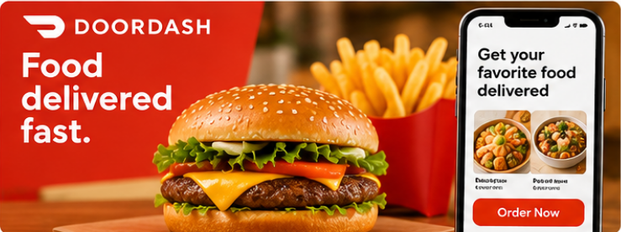

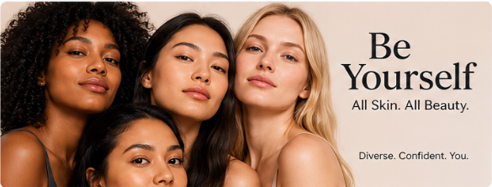

Culture
The collection of fundamental values, perceptions, preferences and behaviours learned from family and other important institutions.
Eg:
  Attitudes towards food:
    US: Convenience, speed, portion size and customization → Take away, delivery, meal kits and personalized choices.
    Japan: Presentation, seasonality, freshness, harmony, small portions and careful packaging → Attractive presentation, limited seasonal products and precise packaging
  Views of beauty
    US: emphasises individuality, confidence, diversity and self-expression
    S.Korea: clear skin, detailed skincare routines and carefully maintained appearance.

Slide 12
Culture and Cultural Values
Culture is the foundation for forming society and plays a key role in regulating behaviour and social development.
An individual makes choices about their behaviour based on how they perceive themselves in interaction with the outside world. When most people in a community make similar choices, those choices become the shared culture of that community (Phan, 1998).
Each choice has its own justifications and specific rituals to affirm it.
When communities interact, cultures may blend and merge, or whichever culture is more widely chosen may dominate and overshadow others. This selection is always evolving over time through human communication and community interactions, leading to the continuous change of culture.
Cultural values: remain constant → Roots of culture → Cultural identity → Shared beliefs that community celebrates, preserves, and takes pride in.

Slide 13
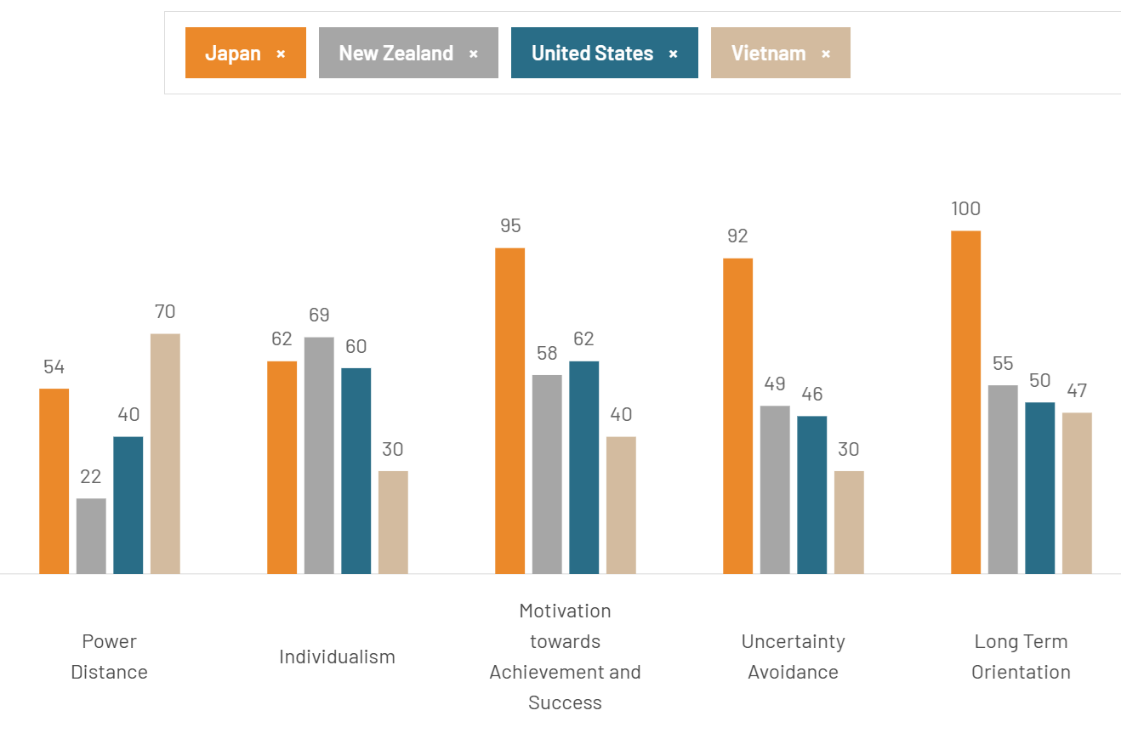
Cultural value dimensions
individualism-collectivism
power distance,
uncertainty avoidance,
femininity–masculinity (gender role differentiation)
long-term orientation.

Slide 14
Individualism-collectivism
In individualistic cultures, people behave according to self-interest and personal preferences and consider independence and self-sufficiency very important. → when someone fails to achieve a personal goal or accomplishment, they may feel guilty or ashamed.
in collectivist cultures, groups are of primary importance—individuals are secondary → a person may feel weak or inadequate if they cannot conform to social norms or expectations. When they "lose face", they lose their "honour and dignity," and vice versa.
Eg: Advertising a smartphone
  US: Ads focus on personal freedom, customization, individual achievement, self-expression, standing out from others → “Designed for your life. Create, connect and express yourself your way”.
  VN: Ads focus on staying connected with family, sharing experiences, group belonging, respect for parents, supporting family responsibilities → “Keep every generation connected, wherever life takes you”.

Slide 15
Power distance
The extent to which less powerful members of a society accept and expect power to be distributed unequally.
It examines whether unequal power, status and authority are viewed as normal and legitimate.
High power-distance cultures: Malaysia, the Philippines, China, Vietnam and India
  Hierarchies are accepted and respected.
  Seniority, titles and social status are important.
  Managers, teachers, doctors and other authority figures are expected to provide direction.
  Subordinates may hesitate to challenge people in authority.
  Status differences may be displayed through possessions, services and communication styles.
Low power-distance cultures: Denmark, Sweden, Norway, New Zealand and the Netherlands.
  Equality is valued.
  Authority figures are considered more approachable.
  Employees and students may openly question leaders.
  First names and informal communication are more common.
  Consumers may prefer brands that appear accessible, transparent and non-elitist.

Slide 16
Eg: A luxury watch
Low power-distance appeal
High power-distance culture
Advertisement “Made for those who define success their own way.”
An entrepreneur or creative professional
An informal work environment
Personal accomplishment
Craftsmanship and individuality
The watch represents personal taste and achievement rather than hierarchical rank.
Advertisement “Created for those who lead.”
A senior executive
A formal office
Symbols of rank and achievement
Exclusive access
Respect from subordinates
The watch represents status, authority and social distinction. → The consumer may view the watch not only as an accessory but also as a visible indication of rank, achievement and authority.

Slide 17
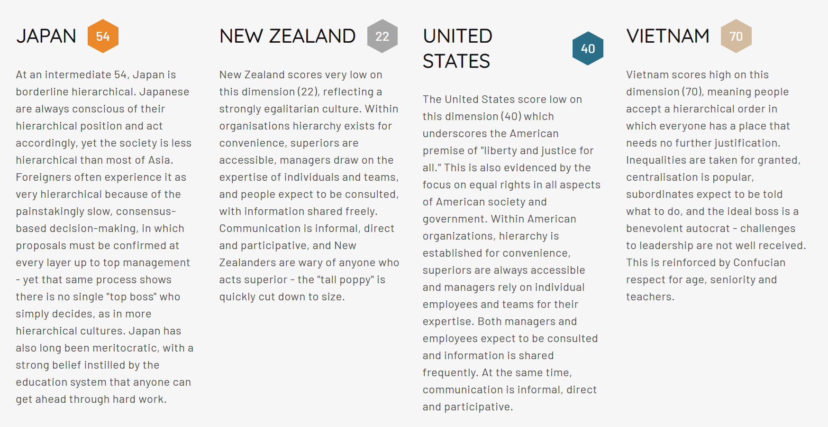
Power distance comparison

Slide 18
Uncertainty avoidance
The extent to which members of a culture feel uncomfortable with uncertainty, ambiguity and unpredictable situations.
It concerns how strongly people prefer:
  Clear rules
  Predictability
  Structure
  Detailed information
  Formal procedures
  Security and reassurance
In high uncertainty-avoidance markets, marketers should reduce perceived risk through evidence, guarantees, certifications and clear procedures.
In low uncertainty-avoidance markets, they can place greater emphasis on innovation, freedom, experimentation and novelty.

Slide 19
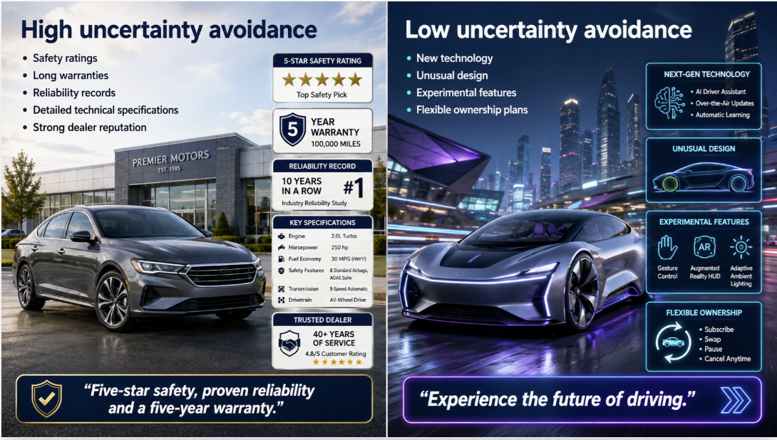

Slide 20
High uncertainty-avoidance cultures
Low uncertainty-avoidance cultures
Ambiguity may cause discomfort.
Consumers often prefer clear instructions and detailed information.
Rules, guarantees and expert advice are valued.
Familiar brands may be preferred over unknown alternatives.
Consumers may be more cautious about new products or unfamiliar technologies
Eg: Japan, Greece, Portugal, France and South Korea
Ads for a university program: “A clearly structured degree with accredited qualifications and strong graduate employment”
Ambiguity is more easily accepted.
Consumers may be more open to experimentation.
Flexible rules and informal processes may be acceptable.
New brands and unfamiliar products may attract interest.
Consumers may tolerate incomplete information if the experience appears interesting or convenient.
Eg: Singapore, Denmark, Sweden, the United Kingdom and New Zealand.
Ads for a university program: “Design your own pathway and explore where your interests lead.”

Slide 21
Femininity–masculinity
The extent to which a culture emphasises:
Competition, achievement, assertiveness and material success, or
Care, cooperation, quality of life and social relationships.
In Hofstede’s framework:
Masculine cultures tend to value achievement, ambition, status, competition, work and performance take priority over leisure, and clearly differentiated gender roles. Eg: Japan, Italy, Mexico, China, S. Korea, Vietnam
Feminine cultures tend to value quality of life, modesty, cooperation, wellbeing, balance, caring for others, and more flexible or overlapping gender roles. Eg.: Sweden, Norway, Denmark, New Zealand, and the Netherlands

Slide 22
Advertisement for cars
Feminine cultures
Masculine culture
“Engineered for those who refuse to come second.” → The car may be positioned as a symbol of achievement rather than simply transport.
Power
Performance
Winning
Professional success
Prestige
“Designed for safer journeys and a better everyday life.” → The car is positioned around wellbeing and usefulness rather than dominance or status.
Safety
Sustainability
Family comfort
Practicality
Environmental responsibility

Slide 23
Long-term orientation vs. Short-term orientation
The extent to which a culture encourages future-oriented values such as perseverance, thrift, adaptation and long-term rewards, rather than emphasising immediate results, established traditions and present obligations. <--> associated with Confucian cultural values
In relatively long-term-oriented cultures: China, Japan, South Korea and Singapore
  Consumers may be willing to delay immediate gratification.
  Saving and investment are often valued.
  Perseverance and gradual improvement are respected.
  Education may be viewed as a long-term investment.
  Consumers may accept short-term sacrifice for future benefits.
  Practical adaptation may be prioritised over maintaining tradition unchanged.
Eg: “Invest in the skills that will shape your future”, “Healthy choices today build a healthier future”
In relatively short-term-oriented cultures: the United States, Canada, Nigeria and some Latin American cultures
  Immediate outcomes may receive greater attention.
  Consumers may prefer benefits that can be experienced quickly.
  Traditions, social obligations and established norms may be important.
  Marketing success may depend on visible and immediate value.
  Promotional rewards and quick results can be especially persuasive.
Eg: “Save $50 today”, “Delicious, ready in three minutes”

Slide 24
Sub-culture
A subculture is a group of people who share value systems based on common experiences or situations.
Subcultures may be associated with:
  Nationality
  Region
  Religion
  Ethnicity
  Generation
  Lifestyle community
Generation Z consumers may share strong preferences for:
  Digital convenience
  Social-media communication
  Brand authenticity
  Personalisation
  Social and environmental responsibility

Slide 25
Social class
Social class refers to relatively enduring divisions in society whose members may share similar:
  Values
  Interests
  Lifestyles
  Consumption patterns
Social class is not determined only by income. It may also reflect:
  Occupation
  Education
  Wealth
  Social networks
  Cultural knowledge

Slide 26
Social class
Upper class: generally has substantial wealth, high social status or access to influential networks.
Value: Exclusivity, Heritage and craftsmanship, Privacy, Premium service, Investment value, Personalised experiences
Upper-middle class: highly educated professionals, senior managers, business owners and specialists.
→ Value: Quality, Professional success, Education, Health, Convenience, Long-term value
Middle class: office workers, teachers, technicians, small-business owners and mid-level employees.
→ Value: Quality and affordability, Family needs, Career development, Housing and education, Financial security, Occasional lifestyle spending
Eg: Education
Upper and upper-middle classes may consider international schools, overseas education, university prestige, personal development, international networks
Middle class: may consider employability, tuition affordability, scholarships, academic quality, career security

Slide 27
Social Class
Working class: skilled and semi-skilled workers, service employees, drivers, factory workers and manual workers.
Value: Price, Durability, Practicality, Familiar brands, Immediate usefulness, Low maintenance costs
Lower-income or economically vulnerable group: limited disposable income and may face unstable employment or financial insecurity.
Value: basic needs, immediate affordability, small package sizes, discount, access to credit, risk avoidance
Eg: Education
Lower-income class may consider education with low fees, financial support, practical skills, shorter programs, immediate employment opportunities.

Slide 28
Social class
People within the same class can have very different lifestyles and values.
Social class is not fixed or perfectly measurable. Consumers may move between classes → social mobility: moving upward, downward or between social groups
When consumers move into a higher social class, they may gradually change → consumers begin adopting the consumption patterns of a group they wish to join → symbolic value
  The products they consider appropriate
  The brands they trust
  The places where they shop
  The information sources they use
  The benefits they seek
  The way they display status
newly affluent consumers may display status more visibly than established wealthy consumers

Slide 29
Social class
When consumers experience reduced income, unemployment or financial pressure, they may:
  Switch to cheaper brands
  Delay large purchases
  Repair rather than replace
  Use promotions more actively
  Reduce discretionary spending
  Buy smaller quantities
  Choose second-hand products
They may protect purchases that are especially important to their identity. Eg: reduce restaurant visits and travel but continue paying for children’s education and health.
Consumers experiencing downward mobility may avoid making their changed financial situation visible → the desire to preserve social identity and avoid perceived loss of status. Eg: Purchase second-hand luxury goods

Slide 30
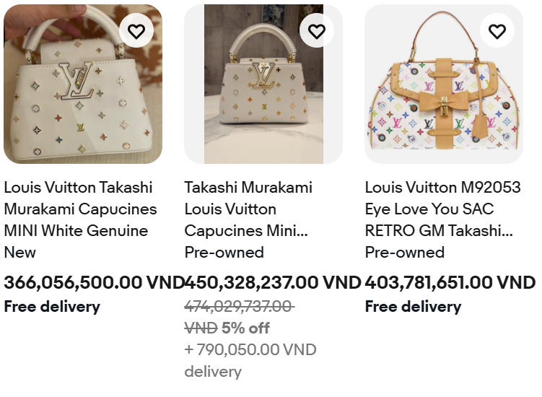
Case study: Louis Vuitton’s popularity problem in China
Background
China’s rapid economic growth created a large group of upwardly mobile consumers who wanted to demonstrate their new social status. For many, a Louis Vuitton monogram handbag became an immediately recognisable symbol of success. As the Chinese middle class expanded, millions of consumers aspired to own the brand, and Louis Vuitton increased its store presence across the country.
However, the brand’s success created an unexpected problem. As Louis Vuitton handbags became increasingly common, some wealthy Chinese consumers no longer considered them exclusive. Products that had once distinguished elite consumers were now being carried by a much broader social group. Affluent shoppers began turning towards scarcer and less visible brands such as Hermès, Chanel and Bottega Veneta.

Slide 31
The problem:
Luxury brands depend partly on scarcity and social distinction. Consumers often purchase luxury products not only for their functional quality but also because relatively few other people can own them.
As middle-class consumers increasingly purchased Louis Vuitton bags, the products lost some of their value as markers of exclusivity.
A wealthy consumer quoted by Reuters said that she owned two Louis Vuitton handbags but no longer carried them because the brand no longer suited her identity. Another industry observer argued that truly wealthy Chinese consumers were moving away from LV because it had become too common.
Louis Vuitton therefore faced a strategic dilemma. Expanding sales to the growing middle class produced strong revenue, but wider ownership weakened the brand’s exclusivity. To protect its prestige, the company placed greater emphasis on more expensive products, bespoke services, limited availability and cautious retail expansion.
Reuters reported that Louis Vuitton attempted to preserve its prestige by:
  Offering more expensive products
  Developing bespoke services
  Exercising greater care in opening new stores
  Creating products aimed at wealthier and more sophisticated customers
  Moving beyond products dominated by the highly visible monogram
Later analysis also shows that Louis Vuitton substantially reduced the proportion of relatively lower-priced handbags in its portfolio. Around half of its handbags were reportedly priced below €1,500 in 2014, compared with roughly one fifth in more recent years. This reflects an effort to move the brand upward and reduce dependence on entry-level products.

Slide 32
Discussion:
How did upward social mobility in China change the meaning of owning a Louis Vuitton bag for different consumer groups?
Which reference-group effects are visible in the case?
Identify how aspirational consumers were attracted to Louis Vuitton and why some affluent consumers later treated the brand as a dissociative symbol.
Why did greater brand popularity reduce Louis Vuitton’s appeal among some wealthy consumers, even though its sales and visibility increased?
Which consumer-behaviour concepts best explain the problem—social class, conspicuous consumption, symbolic consumption, need for distinction, or brand dilution—and how are they connected?

Slide 33

Social Factors

Slide 34

Social factors
Consumers are influenced not only by what they personally think, but also by the people and groups that matter to them.
Reference groups and social networks
Word of mouth
Opinion leaders and influencers
Family
Social roles
Status

Slide 35
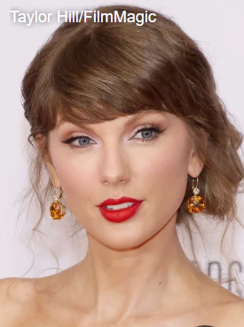
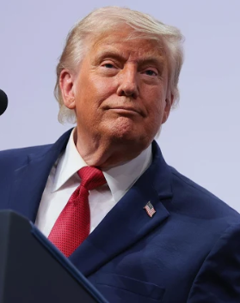
Reference groups and social influence
A reference group is any person or group that influences a consumer’s attitudes, values, self-image or behaviour.
Membership groups: groups the consumer belongs to.
Eg: Family and friends, Colleagues, Professional groups, Celebrities, Influencers, Sports teams, Social or lifestyle communities
Positive reference groups are groups that consumers admire, identify with or wish to join. Consumers may imitate their behaviour, adopt their values or purchase similar products. Eg.: successful entrepreneurs, celebrities, or luxury consumers
An aspirational group is a positive reference group to which the consumer does not currently belong but would like to belong.
Eg: A university student admires successful young entrepreneurs and follows their clothing styles, technology use and choice of professional courses. → help the student feel closer to the desired identity.
Negative reference groups are groups with which consumers do not want to be associated. Consumers may reject their behaviour, appearance or product choices to avoid being identified with them.
Eg: A young professional may avoid a clothing brand because it is strongly associated with an age group, lifestyle or social image that the consumer considers unfashionable or inappropriate.

Slide 36
Social Networks and Online Communities
Consumers are increasingly influenced by interactions on social media, review platforms, discussion forums, and online communities.
Influence may come from:
  friends and followers;
  influencers and content creators;
  customer reviews;
  online recommendations;
  electronic word of mouth.
Eg: A consumer may choose a restaurant after seeing positive TikTok videos and Google reviews.

Slide 37
Opinion leaders
Opinion leaders are individuals whose knowledge, expertise, credibility, or social visibility gives them influence over others’ purchasing decisions.
They may be celebrities, experts, bloggers, community leaders, or knowledgeable friends.
Eg: A skincare specialist recommending a sunscreen may influence consumers more strongly than a conventional advertisement.

Slide 38
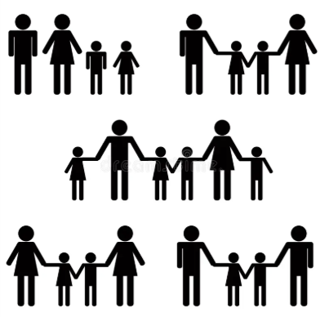
Family
Family is often one of the strongest social influences on consumption. Family members may influence:
  which products are considered;
  which brands are preferred;
  how much money is spent;
  who makes the final purchase decision.
Different family members may play different roles, including initiator, influencer, decision-maker, buyer, and user.

Slide 39
Social roles and Status
A person occupies different roles in society
Eg: A student can be a parent, manager, lecturer, or community member, depending on the context.
Each role carries expectations, while status reflects the social position attached to that role.
Consumers often choose products that express or support their roles and status.

Slide 40

Personal Factors

Slide 41
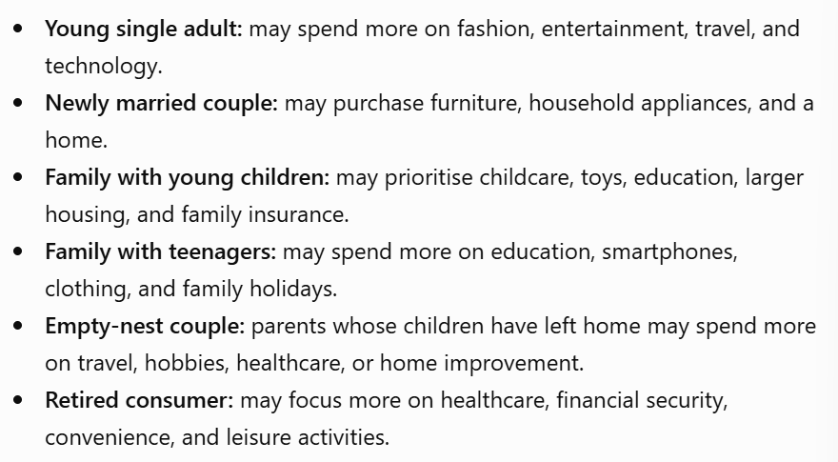
Age and Life-Cycle Stage
Consumers’ needs and preferences change as they grow older and move through different stages of life.
Eg: Teenagers may spend more on fashion and entertainment, while older consumers may prioritise healthcare, comfort, and financial security.
Life-cycle stage refers to the particular phase a person or family is experiencing at a given time. Each stage brings different needs, responsibilities, priorities, and spending patterns.
Consumers of the same age may be in different life-cycle stages and therefore behave differently.

Slide 42
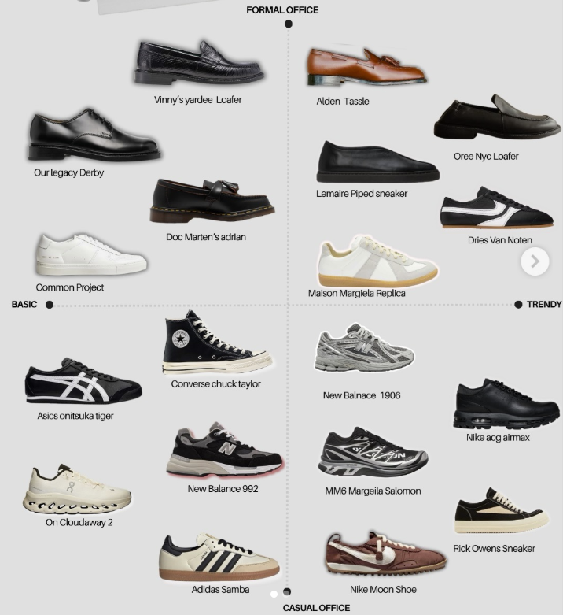
Occupation
A person’s job influences the products and services they need, as well as their purchasing habits.
Eg: An office worker may buy formal clothing and a laptop, while a construction worker may need protective equipment and durable footwear.

Slide 43
Economic situation
A consumer’s income, savings, debt, and access to credit affect what they can afford and how they spend.
Eg: When income falls, consumers may switch from premium brands to lower-priced alternatives.

Slide 44
Gender
Aspect | Male consumers | Female consumers
Shopping purpose | Often more task-oriented and focused on completing the purchase efficiently | Often more likely to view shopping as both a practical and social experience
Information search | May prefer fewer, more relevant pieces of information | May compare more alternatives and consider a wider range of information
Decision-making | Often focuses on key functional benefits, price, and performance | Often considers functional, emotional, social, and aesthetic benefits together
Shopping time | May spend less time browsing when the desired product is already known | May spend more time browsing, comparing, and evaluating alternatives
Brand loyalty | May remain loyal when a brand provides reliable performance and convenience | May remain loyal when a brand provides quality, trust, good service, and emotional connection
Response to advertising | May respond more strongly to direct messages about performance, efficiency, and achievement | May respond more strongly to detailed messages, relationships, experiences, and emotional meaning
Risk perception | May be more willing to accept risk in some product categories | May seek more information and reassurance before purchasing unfamiliar products
Social influence | May rely more on experts, technical reviews, or product specifications | May rely more on recommendations, reviews, friends, and social networks
Product evaluation | Often evaluates products using a smaller number of important criteria | Often evaluates products using multiple criteria and considers the overall experience
Service expectations | May prioritise speed, simplicity, and problem resolution | May place greater emphasis on communication, attentiveness, and relationship quality

Slide 45
Lifestyle
Lifestyle refers to how a person lives, including their activities, interests, and opinions.
Consumers with similar incomes or occupations may still make very different choices because they have different lifestyles.
Example: One consumer may spend heavily on travel and fitness, while another may prefer gaming and home entertainment.

Slide 46
Personality
Personality refers to the relatively consistent psychological characteristics that influence how a person thinks, feels, and behaves → explain why consumers respond differently to the same product, advertisement, or shopping situation.
Trait Theory: identifiable and relatively stable characteristics
  self-confidence;
  sociability;
  independence;
  impulsiveness;
  cautiousness;
  openness to new experiences;
  materialism;
  need for uniqueness;
  innovativeness.
Eg: A consumer with high innovativeness may be among the first to purchase a newly released smartphone, while a cautious consumer may wait for reviews and price reductions.
A highly open consumer may choose an adventurous holiday in a less familiar destination.
A highly conscientious consumer may choose a carefully planned tour with clear schedules, insurance, and verified reviews.

Slide 47
The Big Five Personality Model
Personality dimension | Meaning | Possible consumer behaviour
Openness to experience | Creative, curious, interested in novelty | More likely to try new products, unusual destinations, or innovative brands
Conscientiousness | Organised, careful, responsible | More likely to plan purchases, compare quality, and manage budgets
Extraversion | Sociable, energetic, outgoing | May prefer social activities, visible brands, events, and shared experiences
Agreeableness | Cooperative, caring, trusting | May respond positively to ethical brands, community messages, and recommendations
Neuroticism or emotional instability | Anxious, sensitive, emotionally reactive | May seek reassurance, guarantees, safety, and risk-reducing information

Slide 48
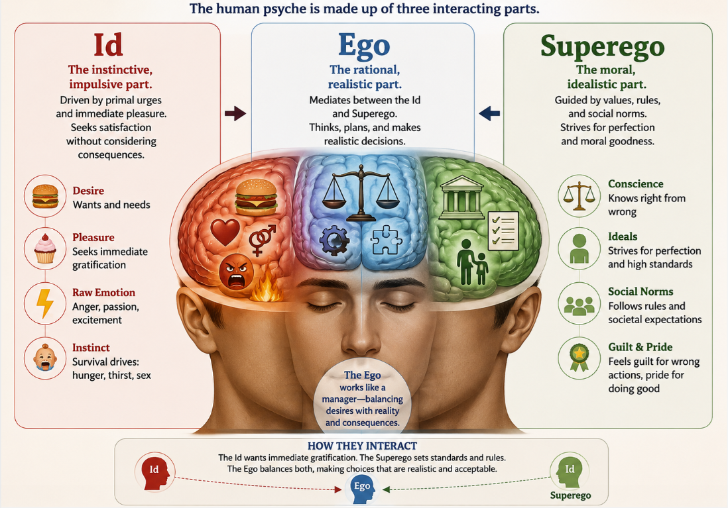
Psychoanalytic Theory
Psychoanalytic theory, associated with Sigmund Freud, suggests that behaviour is influenced partly by unconscious motives and internal psychological conflict.
Id: seeks immediate pleasure and satisfaction.
Consumer example: Buying an expensive dessert or luxury handbag because it provides immediate enjoyment.
Ego: makes realistic and rational decisions.
Consumer example: Comparing prices and deciding whether the product is affordable.
Superego: represents moral standards, social expectations, and personal values.
Consumer example: Rejecting a product because it is considered environmentally harmful or unethical.
A purchasing decision may involve conflict among all three.
For example, a consumer may want a luxury car because of desire and status, recognise that it is financially difficult, and also question whether such consumption is socially responsible.

Slide 49
Self-Concept
refers to how consumers perceive themselves and how they want to be perceived.
Actual self: how a person currently sees themselves.
Ideal self: how they would like to be.
Social self: how they believe others see them.
Ideal social self: how they want others to see them.
Eg: A consumer who sees themselves as healthy may purchase organic food and sportswear. Another consumer who wants to appear successful may purchase premium clothing or a luxury watch.
A consumer who sees themselves as environmentally responsible may prefer reusable products and sustainable brands.
Consumers often choose brands whose image matches their self-concept. This is known as self-congruity.

Slide 50
Life experience
Previous experiences with products, brands, services, and major life events can shape future behaviour.
Eg.: A customer who has had poor service from an airline may avoid that airline in the future.

Slide 51

Psychological Factors

Slide 52
Motivation
Motivation is an internal drive that encourages a consumer to satisfy a need or achieve a goal.
Consumer needs may include:
  basic needs, such as food and safety;
  social needs, such as belonging;
  esteem needs, such as status and recognition;
  self-development needs, such as learning and achievement.
Example: A consumer may buy a luxury watch not only to tell the time, but also to express success and social status.

Slide 53
The Marshmallow Experiment
A young child sat alone at a small table. In front of them was one soft, sweet marshmallow.
The researcher smiled and said, “You may eat this marshmallow now. But if you wait until I come back, you can have two.”
Then the researcher left the room.
The child stared at the marshmallow. It looked delicious. At first, the child touched it, smelled it, and almost took a bite. But then the child looked away, covered their eyes, sang quietly, and played with their hands to avoid temptation.
Some children ate the marshmallow immediately. Others waited and received a second one.
The experiment showed how children manage temptation and delay immediate pleasure for a larger future reward.

Slide 54
Edward Deci’s puzzle experiment
A group of university students were invited into a room and given a set of difficult puzzles.
At first, everyone worked without receiving any reward. Many students continued because they found the puzzles interesting and enjoyed the challenge.
Later, the students were divided into two groups. One group was paid for every puzzle they completed, while the other group received no payment.
The paid students worked hard while the reward was available. However, when the researcher later removed the payment and gave everyone some free time, something interesting happened. The students who had never been paid often continued solving the puzzles for enjoyment, while many of the previously paid students lost interest.
The experiment suggested that external rewards can sometimes reduce intrinsic motivation. Once students begin working mainly for money or another incentive, they may become less interested when the reward disappears.

Slide 55
Intrinsic vs. Extrinsic Motivations
Intrinsic motivation
Extrinsic motivation
Intrinsic motivation occurs when people do something because the activity itself is enjoyable, interesting, satisfying, or personally meaningful.
Eg:
  Reading because you enjoy learning.
  Exercising because it feels good.
  Visiting a museum because you are curious.
  Writing a product review because you enjoy helping others.
Marketers can make the product experience enjoyable, meaningful, or personally rewarding → build long-term engagement; brand communities; product involvement; emotional attachment
Eg:
  A fitness app that makes exercise enjoyable through progress tracking and personal challenges.
  A beauty brand that encourages creativity and self-expression.
Extrinsic motivation occurs when people do something to gain an external reward or avoid an unwanted consequence.
External rewards may include: money; discounts; points; prizes; grades; recognition; free gifts; avoiding penalties.
Eg:
  Buying a product to receive loyalty points.
  Completing a survey for a discount voucher.
  Exercising to win a competition.
  Writing a review to receive cashback.
Marketers can offer external incentives to encourage consumers to act → encourage trial, increase short-term sales, attract new customers, repeat purchases, promote referrals
Eg: A coffee shop gives customers one point for every drink and offers a free drink after ten purchases.

Slide 56
Perception
the process through which consumers select, organise, and interpret information.
Two consumers may see the same advertisement differently because of their experiences, needs, beliefs, and expectations.
Perception involves:
  selective attention: noticing only some information;
  selective distortion: interpreting information according to existing beliefs;
  selective retention: remembering information that supports existing attitudes.
Eg: A health-conscious consumer may notice the sugar content on a food package, while another consumer may focus mainly on taste and price.

Slide 57
Learning
Learning refers to changes in consumer behaviour resulting from experience, information, or repeated exposure.
Consumers learn through:
  personal experience;
  observation;
  advertising;
  rewards and incentives;
  positive or negative service encounters.
Example: A customer who receives good service from a hotel may learn to trust the brand and book it again.

Slide 58
Attitudes
An attitude is a relatively consistent evaluation, feeling, and behavioural tendency towards an object, brand, person, or idea.
Attitudes usually contain three components:
Attitudes are often difficult to change because they are connected to consumers’ beliefs, values, and emotions.
Component | Meaning | Example
Cognitive | What the consumer believes | “Electric cars reduce fuel costs.”
Affective | How the consumer feels | “I like environmentally friendly cars.”
Behavioural | What the consumer intends to do | “I plan to buy an electric car.”

Slide 59
Emotions
Common emotions used in marketing include:
  happiness;
  excitement;
  fear;
  nostalgia;
  pride;
  guilt;
  trust.
Example: A nostalgic advertisement may remind consumers of childhood and increase their emotional attachment to a brand.

Slide 60
Memory
Memory influences which brands consumers recognise, recall, and consider when making decisions.
Marketers use repetition, slogans, logos, packaging, music, and storytelling to strengthen brand memory.
Example: A memorable advertising jingle may help a brand come to mind when the consumer enters a shop.

Slide 61
Belief
A belief is a consumer’s opinion or understanding about a product, brand, or issue.
Beliefs may be based on facts, experience, advertising, word of mouth, or misunderstanding.
Example: A consumer may believe that Japanese cars are reliable and therefore prefer Japanese brands.

Slide 62
Type of beliefs
1. Descriptive beliefs
These beliefs concern the characteristics of a product.
Example:
“This phone has a long battery life.”
2. Evaluative beliefs
These beliefs include a judgement about whether a characteristic is good or bad.
Example:
“A long battery life makes this phone better than competing models.”
3. Normative beliefs
These beliefs concern what important people or society expect the consumer to do.
Example:
“My friends think I should buy an environmentally friendly car.”
4. Control beliefs
These beliefs concern whether the consumer feels able to perform a behaviour.
Example:
“I could buy an electric car, but there are not enough charging stations near my home.”

Slide 63
Halo effect
The halo effect occurs when one positive characteristic creates a favourable impression of the entire product, brand, or person.
Consumers may assume that because a product is good in one area, it must also be good in other areas.
Eg:
  Attractive packaging may make consumers believe the product is higher quality.
  A well-known celebrity endorsement may make a brand appear more trustworthy.
The halo effect can also be negative. One unfavourable characteristic may damage the consumer’s overall judgement. This is sometimes called the horn effect.
Eg: If a restaurant has an untidy entrance, customers may assume that the food and kitchen are also unhygienic.
Marketers try to create strong positive cues through:
  appealing design and packaging;
  prestigious country of origin;
  awards and certifications;
  respected endorsers;
  positive reviews;
  excellent customer service.
However, the halo effect can mislead consumers because the overall judgement may not be supported by actual product performance.

Slide 64
Social norms
Social norms are shared expectations about how people should behave in a particular group or society.
Eg:
  Wearing particular brands because they are popular among friends.
  Choosing environmentally friendly products because society increasingly approves of sustainable consumption.
  Leaving a tip because it is socially expected.
Consumers often choose products not only because they personally prefer them, but also because they want to fit in, gain approval, or avoid criticism.
Descriptive norms describe what most people actually do → This may encourage others to use it because the behaviour appears popular and normal.
  Eg: “Most students go to the library everyday.”
Injunctive norms describe what people approve or disapprove of → This encourages behaviour through social approval, responsibility, or possible guilt.
  Eg: “Responsible consumers should reduce plastic waste.”
Marketers use social norms through messages such as:
  “Nine out of ten customers recommend this product.”
  “Join millions of satisfied users.”
  “Most guests reuse their towels.”
  “People in your neighbourhood are saving energy.”

Slide 65

Group work

Slide 66
Classroom activity
  Discuss the consumer behaviour influences of your business case study
  What is the marketing strategy for such consumer behaviours?

