Slide 1

MARKET SEGMENTATION, TARGETING & POSITIONING
Lecturer: Hana Nguyen Quynh Hoa, PhD
Email: hoa.nguyenquynh@hust.edu.vn

Slide 2
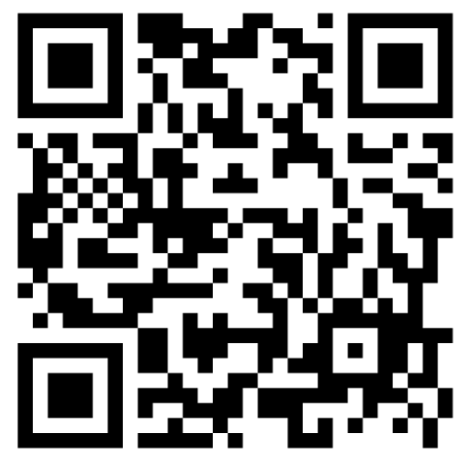
Learning Objectives
By the end of this topic, students should be able to
Explain why companies divide markets into segments.
Identify the major variables used to segment consumer markets.
Evaluate and select attractive target markets.
Compare different market-targeting strategies.
Explain differentiation and positioning.
Develop a simple positioning statement

Slide 3
Should a company serve all customers in exactly the same way?
Customers are different.
  needs and wants
  income
  age and lifestyle
  buying behaviour
  attitudes and preferences
  responses to marketing activities
Markets are different
  Density
  Demand
  Consumer power
  Value
  Resource
  Law

Slide 4
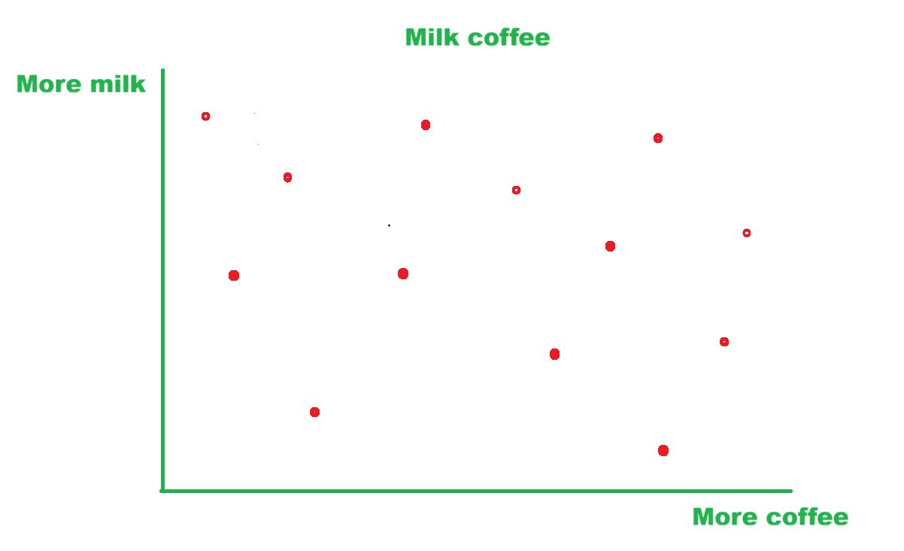

Slide 5
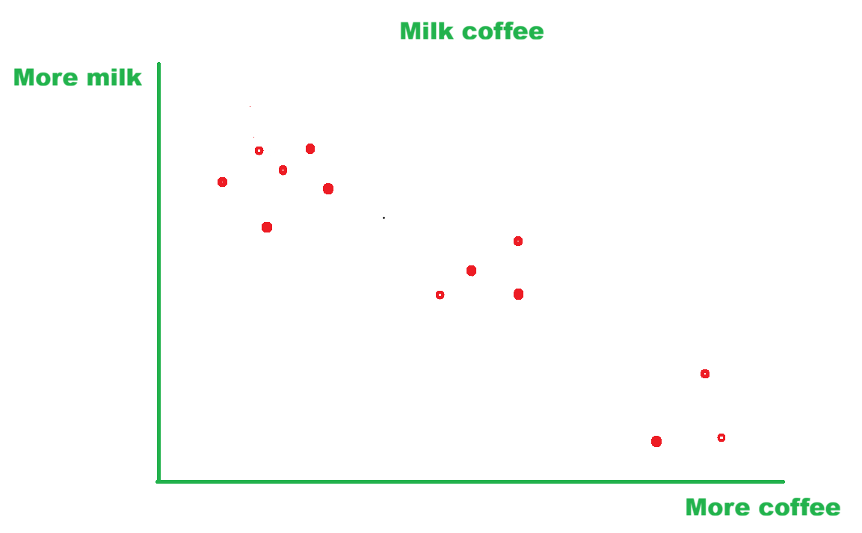
Latte
Cappuccino
Americano

Slide 6
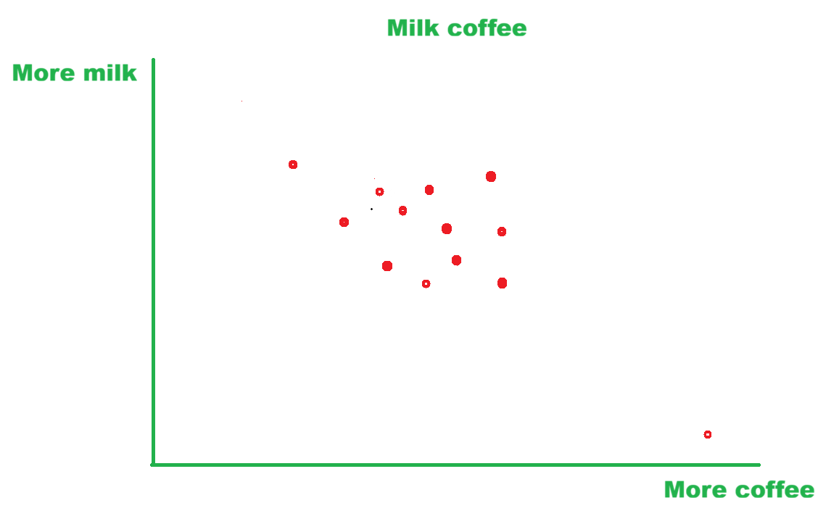
Nestle
G7
King Coffee

Slide 7
A customer-driven marketing strategy
Market Segmentation
Divide the market into distinct groups of buyers
Targeting
Select which segments to serve
Differentiation
Create superior customer value relative to competitors
Positioning
Create superior customer value relative to competitors

Slide 8

MARKET SGMENTATION

Slide 9
What Is Market Segmentation?
Market segmentation is the process of dividing a broad market into smaller groups of consumers who share similar needs, characteristics, or buying behaviours.
Consumers within the same segment are expected to respond similarly to a given marketing stimulus, while consumers in different segments are expected to respond differently to the same stimulus.
Because different segments respond differently, they may require different marketing strategies or marketing mixes.

Slide 10
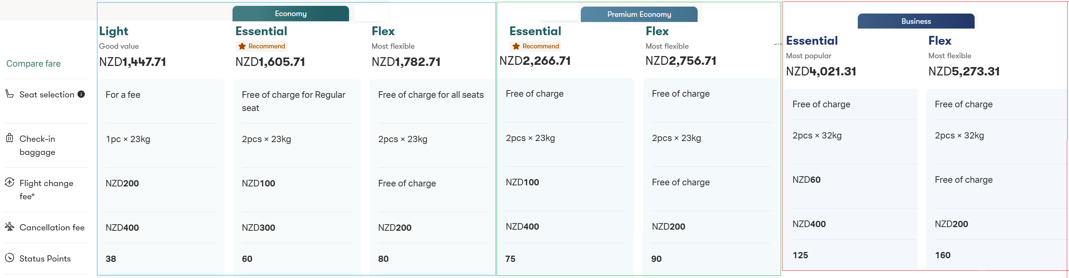
Flight Ticket (Cathay Pacific)
Same marketing stimulus: a $50 flexibility upgrade
Two market segments may respond differently:
Business travellers
Value flexibility because travel schedules may change.
Are relatively less price-sensitive.
Many may be willing to pay the extra $50.
Business segment: emphasise flexibility, convenience, and time saving.
Budget leisure travellers
Plan trips in advance.
Are more price-sensitive.
Many may prefer the cheapest non-refundable ticket.
Budget leisure segment: emphasise low fares and promotional discounts.

Slide 11
Why Segment Markets?
Segmentation helps companies:
  understand customers better
  identify attractive customer groups
  design more relevant products
  communicate more effectively
  allocate marketing resources efficiently
  compete more effectively
Eg: Hanoi 5 gates train. Instead of advertising the same travelling package to everyone, it may offer:
  family packages
  honeymoon packages
  school packages
  wellness retreats
Major Bases for Segmenting Consumer Markets: Geography, Demography, Psychology, Behaviour

Slide 12
GEOGRAPHIC SEGMENTATION
Dividing the market according to geographical units such as:
  nations
  regions
  cities
  neighbourhoods
  climate zones
  urban vs rural areas
  Topography
Eg: Clothing retailers sell: heavier winter clothing in cold regions, and lighter clothing in tropical regions.
McDonald’s: Menus can differ across countries (cultures)

Slide 13
DEMOGRAPHIC SEGMENTATION
Dividing the market based on characteristics such as:
  age
  life-cycle stage
  gender
  income
  occupation
  education
  religion
  generation
Eg: A bank may offer:
  student accounts → university students
  home loans → young families
  investment products → middle-aged customers
  retirement products → older consumers

Slide 14
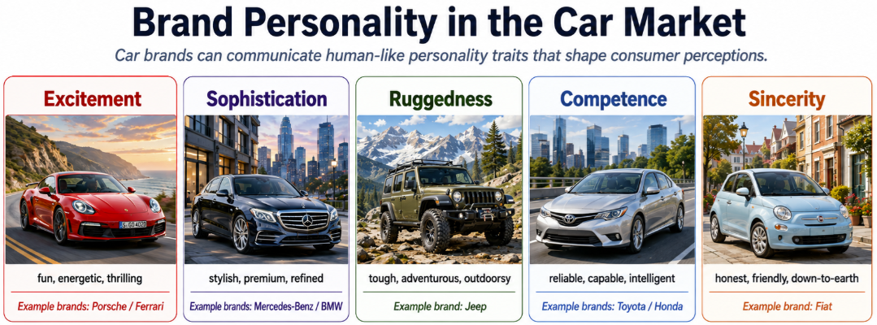
PSYCHOGRAPHIC SEGMENTATION
Consumers with similar demographics may have very different lifestyles → Dividing buyers based on:
  social class
  lifestyle
  personality characteristics
Eg: Two 30-year-old consumers with similar incomes may prefer:
  Consumer A → luxury shopping and fine dining
  Consumer B → hiking, minimalism and sustainable products.
Travellers may be:
  adventure seekers
  luxury travellers
  cultural explorers
  wellness travellers
  budget backpackers

Slide 15
BEHAVIOURAL SEGMENTATION
Dividing buyers according to their:
  knowledge
  attitudes
  uses
  responses to a product
Common variables include:
  occasions → Eg: Chocolate for Valentine’s Day, Mooncakes for Mid-Autumn Festival
  benefits sought → Eg: Toothpaste: cavity protection, whitening, sensitivity protection, fresh breath
  user status: non-users, potential users, first-time users, regular users
  usage rate → Eg: Coffee shops may particularly value customers who buy coffee every day rather than occasionally
  loyalty status → Eg: Airlines use frequent-flyer programmes to strengthen loyalty among frequent travellers.

Slide 16
EFFECTIVE SEGMENTATION
Measurable
Accessible
Substantial
Differentiable
Actionable
Eg: A business wants to target to customers who enjoy beautiful things
What is the problems?
  How large is this segment?
  How can we identify them?
  Can we reach them?
  Do they respond differently?
  Can we design a specific strategy for them?
"University students aged 18–24 who regularly purchase coffee near campus.“
easier to measure and reach

Slide 17

MARKET TARGETING

Slide 18
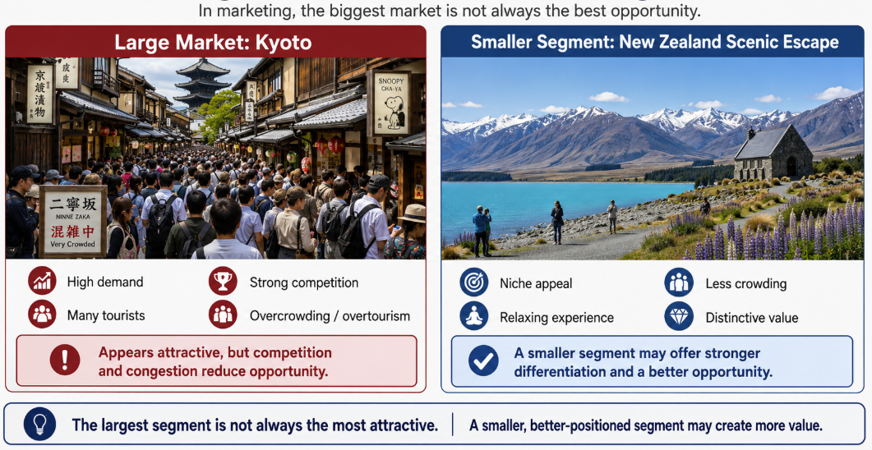
Why we need market targeting?
Which segment(s) should we serve?
Market targeting involves:
  Evaluating the attractiveness of market segments
    Segment size and growth: Is the segment large or growing?
    Structural attractiveness: How strong is competition? Are substitutes available? How powerful are buyers?
    Company objectives and resources: Does the segment fit the company's strengths and strategy?
  Selecting one or more segments to enter: The Largest Segment Is Not Always Best
A large market may appear attractive but may also have:
  intense competition
  high marketing costs
  strong existing brands
  low profitability
→ A smaller segment may offer a better opportunity.

Slide 19
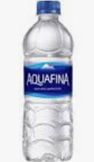
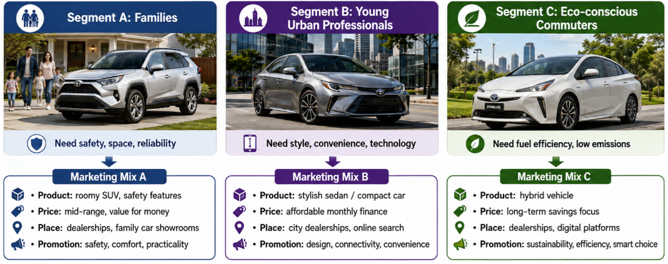
TARGET MARKET STRATEGIES
Undifferentiated marketing: The company targets the whole market with one offer.
  Advantage: lower cost
  Problem: difficult to satisfy diverse needs.
Differentiated marketing: The company targets several market segments and designs a separate offer for each.
  Example: Toyota

Slide 20
TARGET MARKET STRATEGIES
Concentrated marketing: The company focuses on a large share of one or a few smaller segments
→ niche marketing
→ useful when a company: has limited resources, has specialist expertise, serves highly specific customer needs

Slide 21
Cocoon Vietnam — Focusing on a Specific Beauty Segment
The Vietnamese cosmetics market includes many large international and domestic brands competing for mainstream consumers. Instead of trying to appeal to everyone, Cocoon focused on a more specific segment: consumers looking for vegan, cruelty-free and locally inspired beauty products.
Its products use recognisably Vietnamese ingredients such as coffee, winter melon and grapefruit, helping the brand combine ethical beauty with a distinctive Vietnamese identity.
rather than competing for every cosmetics buyer, Cocoon initially built strong relevance among consumers who particularly valued these attributes.
Cocoon did not need to serve the whole cosmetics market. By serving a smaller group with distinctive needs particularly well, it could build a strong and differentiated brand.
Limited resources → focus rather than mass competition
Specialist expertise → vegan, plant-based cosmetics
Specific customer needs → ethical, cruelty-free, locally rooted beauty

Slide 22
TARGET MARKET STRATEGIES
Micromarketing: Micromarketing adapts products and marketing programmes to specific:
individuals → Individual Marketing
  Eg.: Tailoring products to individual customers.
  Nike By You allows customers to personalise selected shoes.
local customer groups → Local Marketing
  Eg: Adapting brands and promotions to local customer groups.

Slide 23
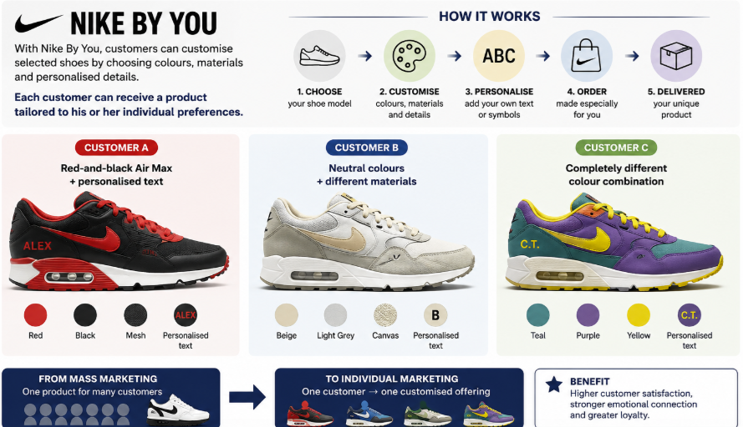

Slide 24

DIFFERENTIATION & POSITIONING

Slide 25
How will marketers create superior value for their target market?
Differentiation means making the market offering different from competing offerings in ways that create greater customer value.
Companies can differentiate through:
  products
  services
  channels
  people
  image

Slide 26
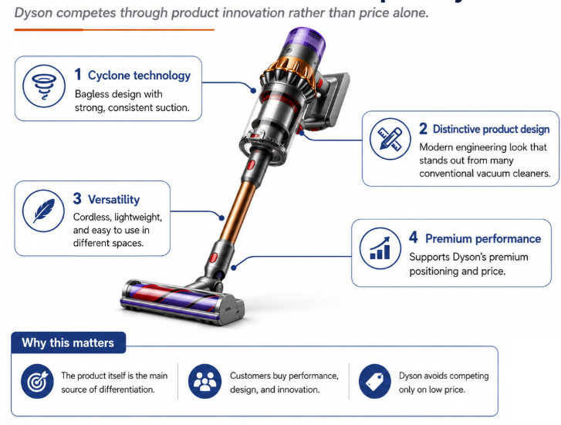
Dyson vacuum cleaner
Dyson entered highly competitive household appliance markets where many products performed similar basic functions.
Instead of competing mainly on price, Dyson differentiated through product technology and design. Its vacuum cleaners became known for bagless cyclone technology, strong suction, distinctive appearance, and engineering-focused innovation.
This allowed Dyson to position its products as high-performance, technologically advanced appliances and charge premium prices compared with many conventional competitors.
Question:
How product differentiation creates value?
By making the product itself meaningfully different in features, performance, design, or quality.

Slide 27
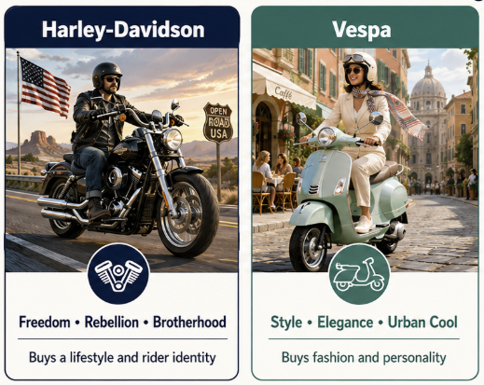
Image Differentiation
Harley-Davidson: customers are not simply buying a motorcycle - they may be buying freedom, identity, belonging, and a particular lifestyle.
Vespa: customers may buy stylish, youthful, urban and Italian rather than rugged, rebellious and American.

Slide 28
Choosing the Right Competitive Differences
Not every difference is worth promoting.
A difference should be:
  Important — delivers a highly valued benefit
  Distinctive — competitors do not offer it in the same way
  Superior — better than alternative ways of obtaining the benefit
  Communicable — easy for customers to understand
  Affordable — target customers can pay for it
  Profitable — financially worthwhile for the company

Slide 29
POSITIONING
Positioning means arranging for a product to occupy a clear, distinctive, and desirable place relative to competing products in the minds of target consumers.
Eg.: Vietjet Air – low-cost carrier
Volvo - safety

Slide 30
Value Proposition
Value Proposition | Meaning | Example
More for More | Superior benefits at a higher price | Rolex
More for the Same | More benefits at a similar price | Xiaomi
The Same for Less | Comparable benefits at a lower price | BigC
Less for Much Less | Fewer benefits at a substantially lower price | Vietjet Air
More for Less | More benefits at a lower price | New challenger brand

Slide 31
More for More: Rolex
Rolex competes in the luxury watch market. Its watches are priced far above ordinary watches, but customers are not paying only for timekeeping. They also receive prestige, craftsmanship, heritage, exclusivity, and strong symbolic value.
Customers pay more because they perceive that they receive more benefits, especially status and brand image.
More for the Same: Xiaomi
Xiaomi entered many smartphone markets by offering phones with high-resolution cameras, large batteries, strong processors, and attractive designs at prices similar to or lower than established mainstream brands.
Consumers may perceive that they receive more features and performance for roughly the same price.

Slide 32
The Same for Less: BigC
BigC sells many everyday grocery products that perform the same basic functions as products sold by larger supermarket chains. It keeps prices low through a limited product range, private-label products, simple store layouts, and cost-efficient operations.
Customers obtain similar basic benefits at a lower price.
Less for Much Less: Vietjet Air
Vietjet Air offers very low airfares but provides fewer included services than traditional full-service airlines. Passengers may pay separately for checked baggage, seat selection, food, and other extras.
Customers accept fewer services in exchange for a much lower price.

Slide 33
More for Less: New Market Entrant
Imagine a new fitness centre entering a university neighbourhood. Existing gyms charge 400.000 VND per month for basic equipment access. The new gym charges 300.000 VND while also including group classes, an app, extended opening hours, and free fitness assessments.
The company offers more benefits at a lower price.

Slide 34

Team work

Slide 35
Questions:
Discuss the possible segmentation of your business case study. How would you divide them? By which criteria?
What are the target segmentations? Why?
Which product/ service would be provided to make the business different to its competitors?
What positioning strategy do you recommend?

