Slide 1

Lecture 8: Place
Giảng viên: Nguyễn Quỳnh Hoa, PhD
SEM, HUST

Slide 2
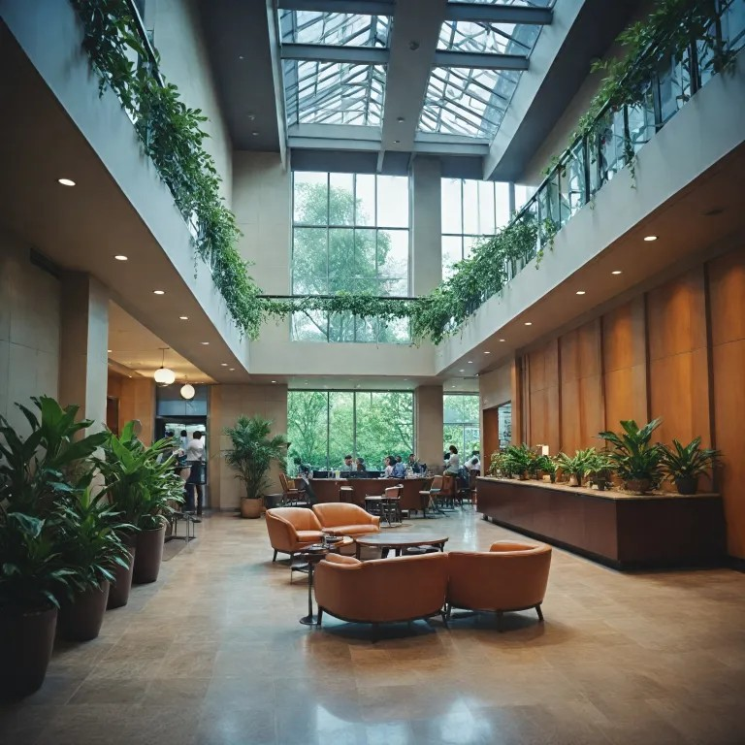
Place and Place-making
Place is not merely a location or a physical space
Place: when people give it meaning through their experiences, memories, emotions, activities, identities, and relationships (Chen et al., 2021)
Place making is the process through which a physical space is transformed into a meaningful place (Chen et al., 2021; Nguyen, 2021)
Marketers design servicescapes, events, communicate stories and build destination brands
→ Visitors and customers interpret these elements through their own experiences, emotions, and memories.

Slide 3
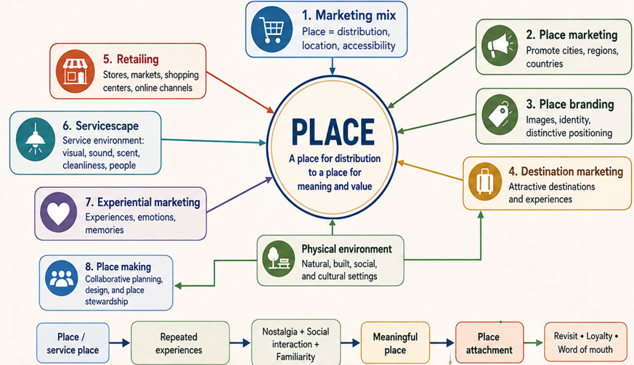

Slide 4

Market Coverage Decisions

Slide 5
Which geographic markets and customer areas should the company cover?
Firms need to decide where their products should be available, based on market potential, customer characteristics, competition, and distribution costs.
Typical market coverage decisions:
  National vs. local markets
  Urban vs. rural areas
  Residential vs. industrial/commercial areas
  Northern, Central, or Southern regions
  Selected cities, provinces, districts, or neighbourhoods
Factors to consider:
  Market size and growth potential
  Customer concentration and purchasing power
  Differences in consumer behaviour
  Competition
  Distribution and operating costs
Eg: TH true MILK - A dairy company may aim for national coverage, but distribution strategies can differ between:
  Hanoi and Ho Chi Minh City → supermarkets, convenience stores, online delivery
  Smaller towns/rural areas → traditional retailers and local distributors
→ A firm does not necessarily serve every market in the same way.

Slide 6
Through which channel should the product move from the producer to the customer?
Indirect distribution:
Producer → Intermediary → Customer
Direct distribution
Website
Brand-owned stores
Social commerce
Direct sales team
Wholesalers
Distributors
Retailers
Agents
E-commerce marketplaces
Eg: Customers may buy Cocoon through:
Official website → direct
Brand stores → direct
Guardian/Watsons → retail intermediary
Shopee/Lazada/TikTok Shop → e-commerce marketplace

Slide 7
How many intermediaries and selling points should carry the product?
This decision determines the availability and exclusivity of the product.
Intensive Distribution: Product is available in as many suitable outlets as possible.
Best for: Convenience products, Frequently purchased products, Products where easy availability matters
Eg: Coca-Cola, Bottled water, Snacks, Hảo Hảo noodle, Vinamilk
Selective Distribution
The company chooses a limited number of suitable retailers.
Best for: Shopping products; Brands requiring some service or brand control
Eg: Electronics, Cosmetics, TH Truemilk, Iphone, Lancome
Exclusive Distribution: Only one or very few authorised distributors/retailers operate in a market.
  Territorial exclusivity: A distributor is granted the exclusive right to sell a product within a specific geographic area.
  Eg: Carrier air conditioners are distributed exclusively in Northern Vietnam through CKĐA.
  Product exclusivity: A distributor is granted the exclusive right to distribute a specific product line or brand.
  Eg: Pierre Cardin products are exclusively distributed in Vietnam by An Phước Garment Embroidery Shoes Co., Ltd.

Slide 8
Direct and Indirect Distribution Channels
Direct
Indirect
Doanh nghiệp bán sản phẩm/dịch vụ trực tiếp cho khách hàng cuối cùng, không qua trung gian.
Doanh nghiệp kiểm soát tốt hơn về giá, hình ảnh thương hiệu, dịch vụ khách hàng và trải nghiệm mua hàng.
Chi phí có thể cao hơn vì doanh nghiệp tự đầu tư cửa hàng, website, nhân sự bán hàng, chăm sóc khách hàng, giao vận
Phù hợp khi doanh nghiệp muốn kiểm soát chặt và tiếp cận trực tiếp nhóm khách hàng mục tiêu
Doanh nghiệp có dữ liệu và tương tác trực tiếp với khách hàng → Thị trường nhỏ
Sản phẩm cao cấp, sản phẩm cần tư vấn chuyên sâu, dịch vụ, bán hàng online qua website/app riêng.
VD: Apple bán iPhone qua Apple Store
Doanh nghiệp bán sản phẩm/dịch vụ thông qua trung gian phân phối như đại lý, nhà bán buôn, nhà bán lẻ, siêu thị, sàn thương mại điện tử
Doanh nghiệp kiểm soát kém hơn vì phụ thuộc vào cách trung gian bán hàng, trưng bày, tư vấn và chăm sóc khách.
Có thể giảm gánh nặng vận hành vì trung gian hỗ trợ bán hàng, lưu kho, phân phối và tiếp cận khách hàng.
Phù hợp khi doanh nghiệp muốn mở rộng thị trường nhanh, phủ rộng nhiều khu vực
Dữ liệu khách hàng thường nằm một phần ở trung gian, doanh nghiệp khó hiểu khách hàng trực tiếp hơn.
Hàng tiêu dùng nhanh, sản phẩm phổ thông, sản phẩm cần độ phủ rộng.
VD: Unilever bán dầu gội, sữa tắm, bột giặt qua siêu thị, đại lý, cửa hàng tạp hoá và sàn thương mại điện tử

Slide 9
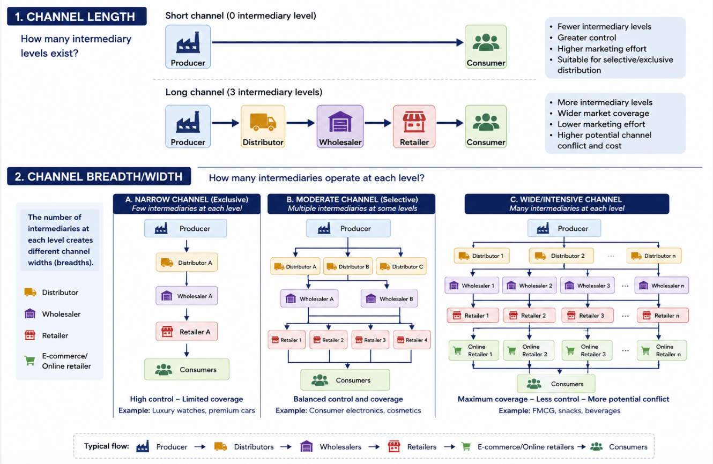
Channel structure

Slide 10
Retail Location Decisions
A good location should maximise customer accessibility and market potential while maintaining acceptable operating costs.
1. Customer traffic: How many potential customers pass the location?
2. Customer demand: Are target customers concentrated nearby?
3. Accessibility
  Public transport
  Parking
  Walking convenience
  Road access
4. Competition
5. Brand positioning: The location should reinforce the desired brand image.
6. Cost: rent, labour, utilities, logistics

Slide 11
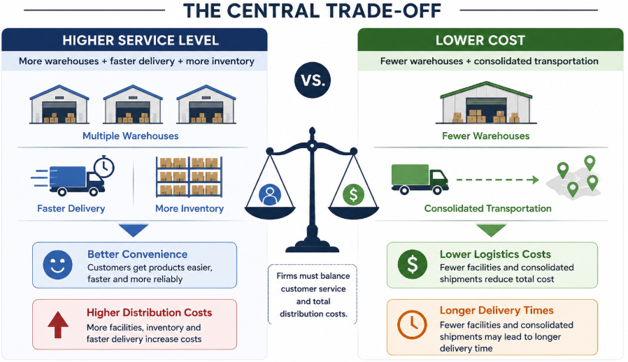
Warehousing & Transportation Decisions
Warehousing
  Number of warehouses
  Warehouse locations
  Inventory levels
  Centralised vs. decentralised storage
Transportation
  Road
  Rail
  Air
  Sea
  Courier/last-mile delivery
Three major considerations
  1. Transportation cost: Lower logistics costs can reduce the total distribution cost.
  2. Delivery time: Customers increasingly expect faster delivery.
  3. Customer convenience: Distribution should make buying and receiving the product easy.

Slide 12
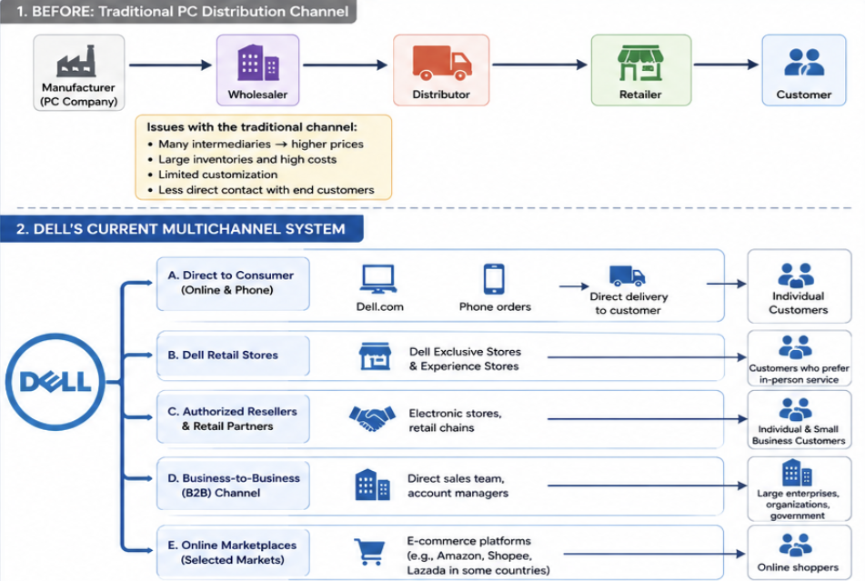
Dell’s distribution channel
In 1984, Michael Dell started selling personal computers from his university dorm room in Texas. At that time, most computer manufacturers sold through distributors, wholesalers and retail stores. Dell chose a different route. Customers ordered directly from the company, selected the specifications they wanted, and Dell assembled the computer after receiving the order. As the business grew, Dell continued to rely heavily on this direct model. Customers could first order by phone and later through Dell’s website. The company became well known for allowing buyers to customise their computers and have them delivered directly to their homes or offices. The model worked particularly well with business customers, who could order large numbers of computers with specific configurations. Dell also developed direct relationships with corporations, universities and government organisations.
By the mid-2000s, however, the consumer computer market was changing. Laptop sales were growing, and many customers wanted to visit stores, compare different brands, see the screen, try the keyboard and examine the size and weight of a laptop before making a decision. Competitors such as HP, Lenovo and Acer were widely available in electronics stores, while Dell products were much less visible there.
In 2007, Dell began placing selected computers in Walmart stores in the United States. It later expanded into other major retailers, including Best Buy. Customers who previously had to order a Dell computer directly could now see and buy selected models in physical stores. Dell continued to sell directly at the same time. As the company expanded its business beyond personal computers into servers, storage, networking and other technology products, it also increased its use of distributors and specialised partners. Distributors supplied Dell products to networks of smaller dealers and resellers. Some resellers sold Dell products together with installation, software or technical support. System integrators included Dell hardware as part of larger IT projects for companies and public organisations.
Dell therefore came to sell through several routes at the same time.
A small customer might buy a laptop from Dell’s website. Another might purchase one from a retail store. A small business might buy through a local reseller, while a multinational company could negotiate directly with Dell. In some markets, distributors supplied many smaller resellers that Dell did not serve directly.
This meant that the company founded on the idea of selling computers directly to customers eventually developed a distribution network involving direct sales, retailers, distributors, resellers and other business partners.

Slide 13

PLACE IN SERVICE

Slide 14
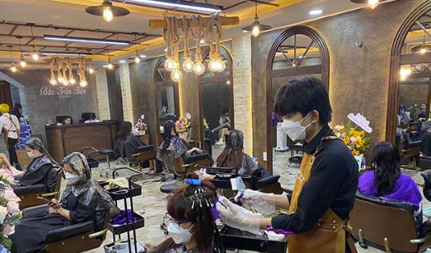
DISTRIBUTION IN SERVICE
Production and consumption occur simultaneously: Customers often participate in the service delivery process. Therefore, the place of distribution is also where the service experience takes place.
Services are intangible and cannot be stored: Unlike physical goods, unused service capacity cannot be inventoried for future sale.
Location and physical environment strongly influence the customer experience: The service setting can affect customers’ psychological responses, emotions, memories, physical comfort, and mood.
People are crucial: frontline employees, customers, and other customers all influence the service experience.
Service quality is difficult to standardise across different service locations.
Managing supply and demand: businesses must respond to seasonal fluctuations, service hours, peak and off-peak periods, and available capacity.
Convenience is an important source of competitive advantage.

Slide 15
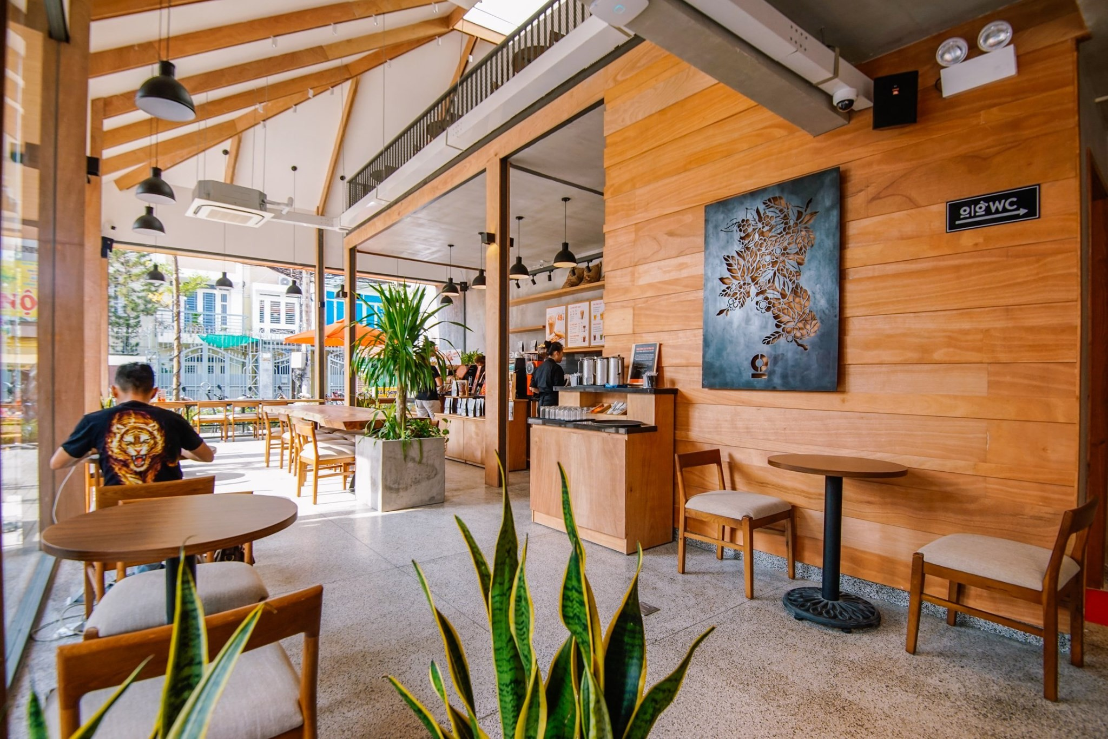
PLACE IS MORE THAN DISTRIBUTION IN SERVICE
The physical environment creates the first impression and communicates brand positioning.
It reduces customers’ perceived risk, especially because services are intangible.
It influences emotions, perceived waiting time, comfort, repeat purchase behaviour, and customer loyalty.
It helps manage interactions among customers, employees, and other customers.
A café does not simply sell drinks; it also sells a space for working, socialising, relaxing, and self-expression.
Sources: Lovelock & Wirtz; Zeithaml, Bitner & Gremler; Bitner (1992).

Slide 16
PLACE AS PART OF SERVICESCAPE AND EXPERIENCE
1. Facility exterior
2. Facility interior
3. Place = Meaning & Emotions
Exterior design: façade, signage, architecture, parking, and entrance.
These provide the first signals of the target market and expected service quality.
They can strongly influence whether customers choose to enter the service environment or walk away.
Interior environment: lighting, sound, scent, temperature, colour, layout, furnishings, equipment, and cleanliness. These elements shape the service experience and customers’ emotional and behavioural responses.
A well-designed layout helps to:
  Create a smooth customer flow
  Reduce congestion and crowding
  Save customers’ time
  Improve service efficiency
  Make the service easier to use
  Help employees work more efficiently
Hospital: clean, safe, reassuring
Café: relaxing, warm, inviting
Bank: trustworthy, professional, secure
Airline: safe, comfortable, relaxing
University: academic, open, supportive, professional
Sources: Lovelock & Wirtz; Zeithaml, Bitner & Gremler; Bitner (1992).

Slide 17
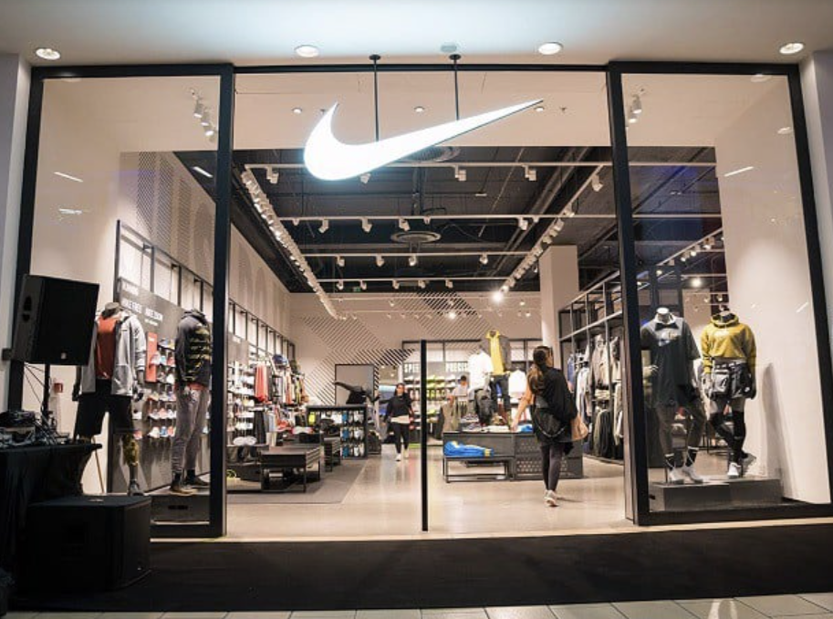
Study | Context | Findings
Spangenberg, Crowley, & Henderson (1996) | Simulated retail environment (Nike) | Pleasant scents can influence customers’ evaluations of both the store and its products. Retail environments with a pleasant scent are often evaluated more positively than otherwise similar scent-free environments.
Mattila & Wirtz (2001) | Retail | When scent and music are congruent in their level of arousal—for example, both are relaxing or both are energetic—customers tend to evaluate the environment more positively. This congruence can lead to more approach behaviours, greater impulse purchasing, and higher customer satisfaction.
Chebat & Michon (2003) | Malls | Scent influences customers’ perceptions of the shopping environment and of product/service quality, which can in turn affect their emotions and spending behaviour.
Scents

Slide 18
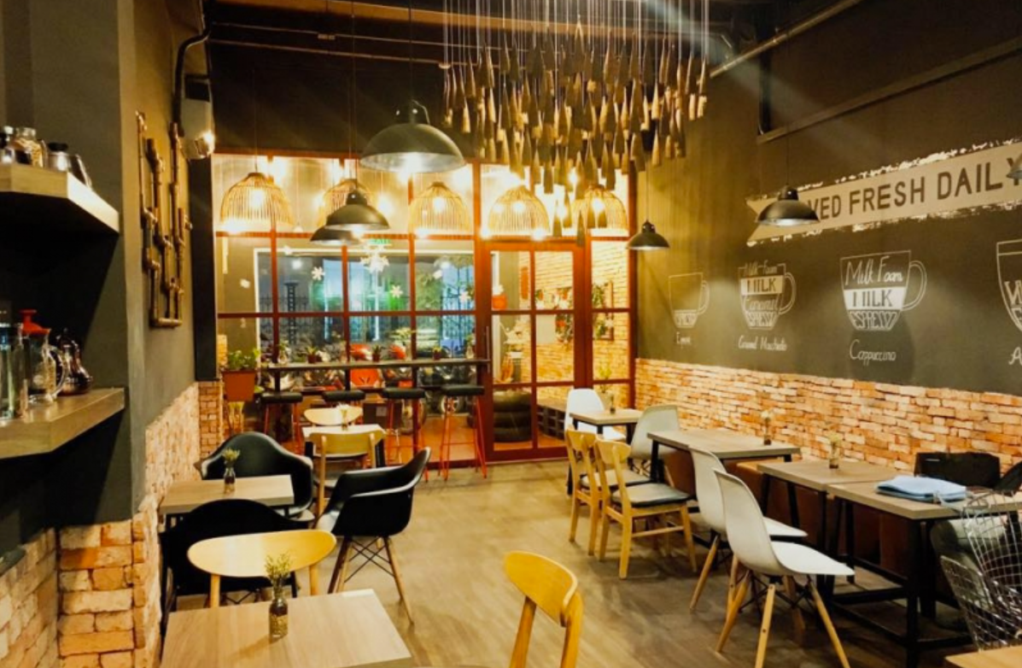
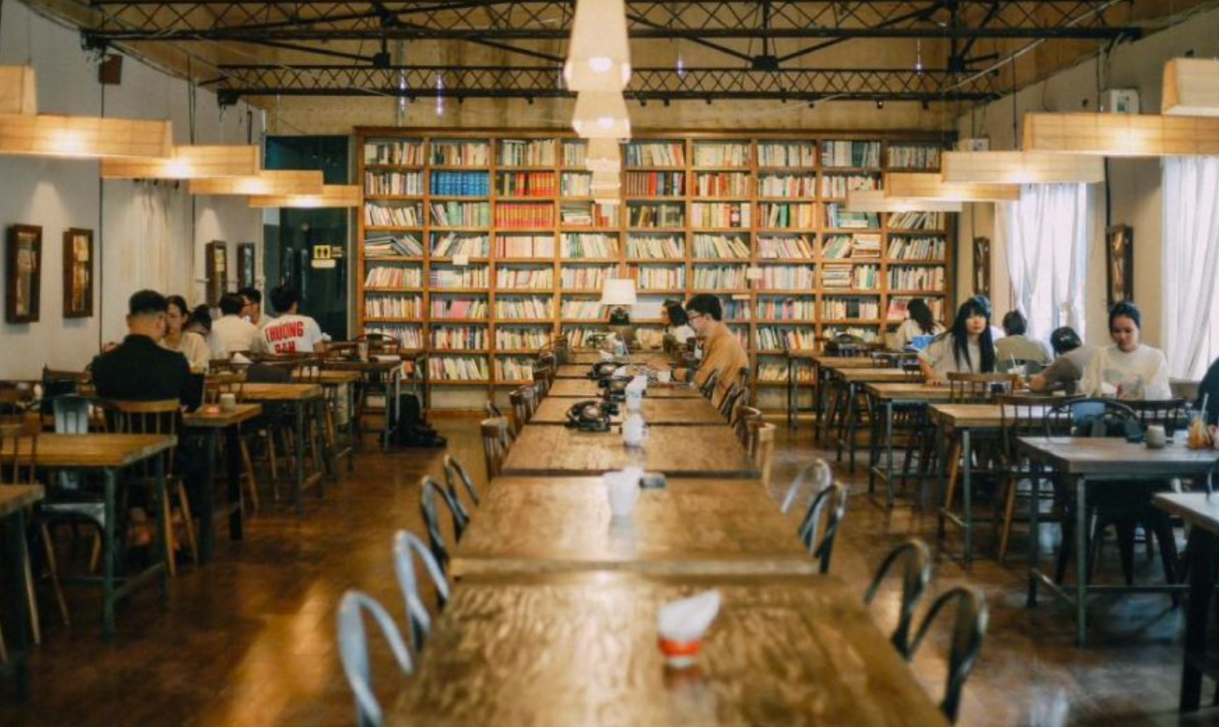
Lights
Lighting influences visibility, attention, perceived safety, perceived luxury, the warmth or coolness of the environment, and customers’ willingness to approach products.
Study | Context | Findings
Areni & Kim (1994) | Liquor shop | Research shows that in-store lighting can influence shopping behaviour and the way customers notice and pay attention to products.
Summers & Hebert (2001) | Retails | Increasing lighting at product displays can encourage approach behaviours, such as stopping at the display, touching products, and picking them up. This effect has been observed using video-based behavioural observation in real retail environments.
Babin, Hardesty, & Suter (2003) | Retails | Colour and lighting interact to shape customers’ perceptions of the retail environment, their judgments of price fairness, and their patronage intentions.

Slide 19
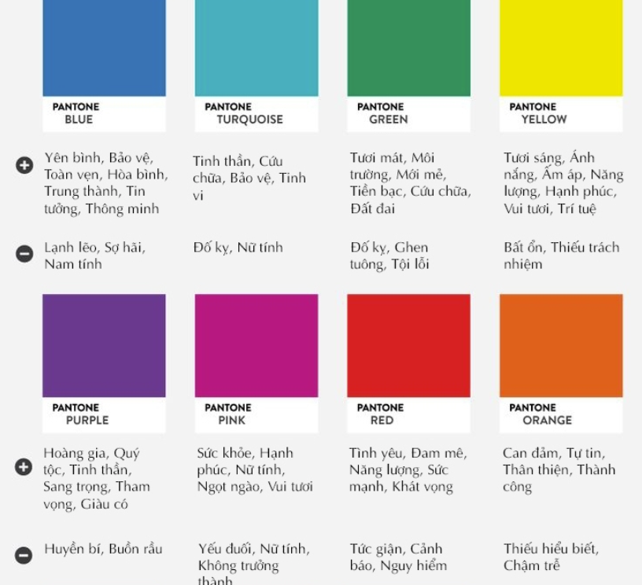
Colour does more than create visual appeal; it also communicates brand positioning. Its meaning can vary across cultures, service industries, and customer segments.
Colours
Study | Context | Findings
Bellizzi & Hite (1992) | Retails | Red and blue can trigger different responses: red is often associated with higher arousal and tension, while blue tends to evoke calmer and more positive feelings in service environments.
Crowley (1993) | Retails | Colour can influence shopping through two pathways: it shapes customers’ emotional responses and, at the same time, affects their cognitive evaluations of the store, products, prices, and overall shopping experience..
Babin, Hardesty, & Suter (2003) | Retails | Colour and lighting can influence shopping intentions through two mechanisms: customers’ perceptions of price fairness and their affective responses to the shopping environment.

Slide 20
Musics
Milliman (1982) | Malls | The tempo of background music can significantly influence customers’ movement through a store and sales performance. Slower music tends to make customers move more slowly, spend more time in the store, and potentially purchase more.
Areni & Kim (1993) | Liquor shop | Classical music can lead customers to choose more expensive wines than Top-40 music, suggesting that music can create associations with luxury, sophistication, and prestige.
North, Hargreaves, & McKendrick (1999) | Liquor shop | French music can increase sales of French wine, while German music can increase sales of German wine. Most customers are not consciously aware that the background music is influencing their product choice.
Caldwell & Hibbert (2002) | Restaurant | Music tempo and music preference can influence customers’ dining time, spending, enjoyment of the experience, and behavioural intentions in restaurants.
Biswas, Lund, & Szocs (2019) | Retails | Lower music volume or background noise can promote relaxation and may encourage healthier food choices. This effect has been examined in both field experiments and laboratory studies.

Slide 21

Lecture 9
Marketing
Communication

Slide 22
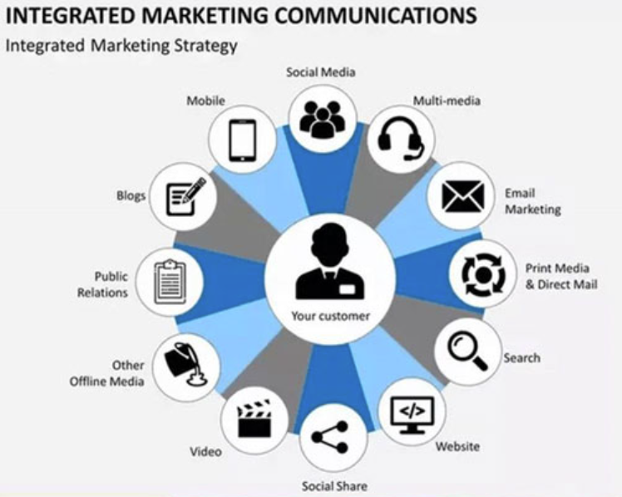
Integrated Marketing Communications
Integrated Marketing Communications (IMC) is the process of coordinating different communication tools—such as advertising, public relations, sales promotion, personal selling, direct marketing, digital media, and social media—to deliver a consistent, clear, and persuasive message to target customers (Belch & Belch, 2021; Kotler & Keller, 2016).
All communication tools should work towards a common objective.
Messages should remain consistent across different channels.
Communication should be target-customer centred.
IMC combines online and offline communication.
Its purpose is to build awareness, positive attitudes, and purchase or service-use behaviour.

Slide 23
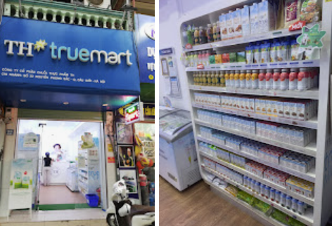
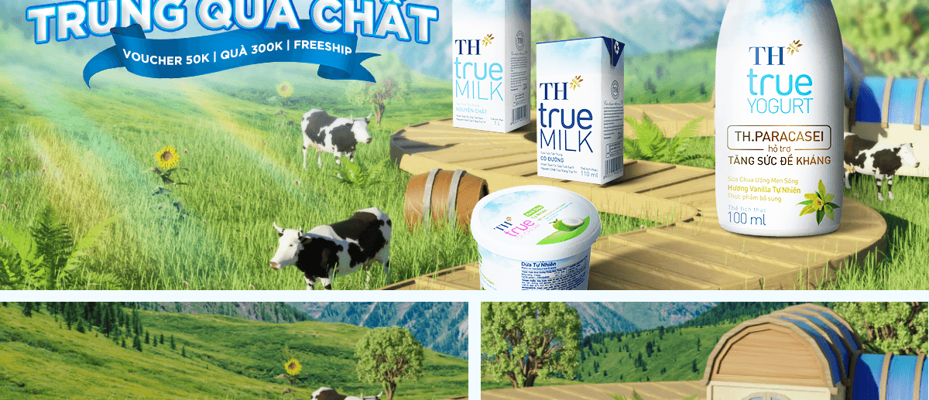
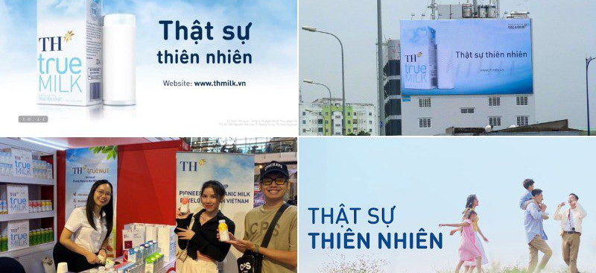

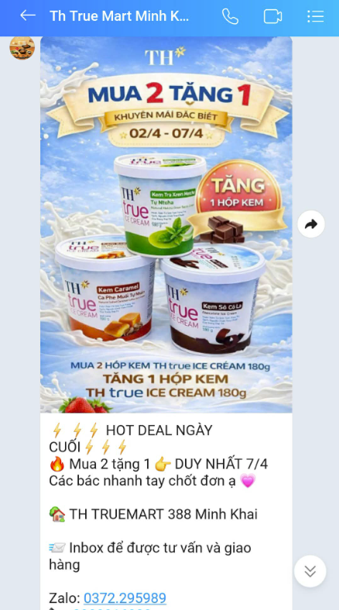
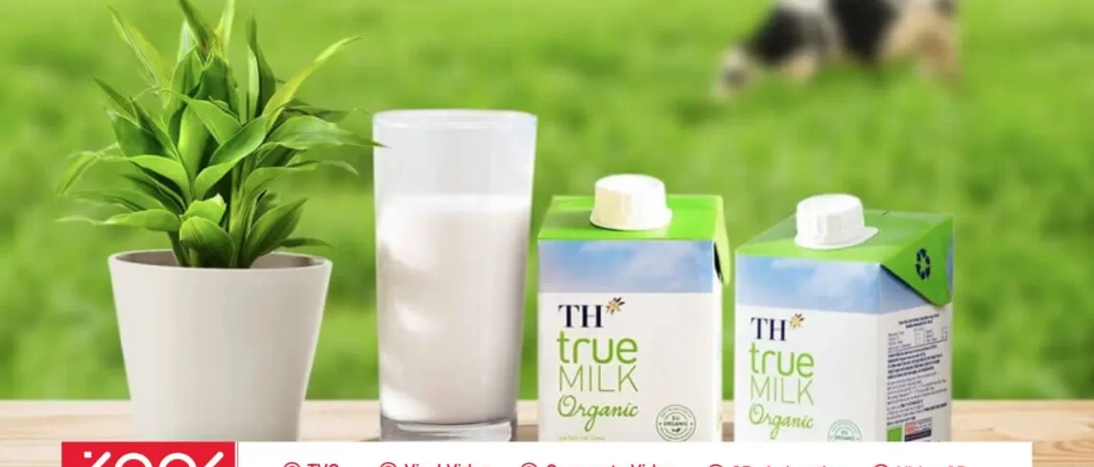
Consistent core message: “Fresh, pure milk / truly natural goodness.”
TH True MILK
Advertisement
Promotion/ digital
Brand awareness
Customer behaviour
Product and content
TH True MILK:
Story - telling
TH true MILK coordinates multiple customer touchpoints—including advertising, public relations, packaging, retail outlets, e-commerce, social media, and sales promotions. Together, these activities reinforce a consistent brand positioning: clean, natural products that support health and well-being.
Positioning
Belief

Slide 24
AIDA model
A – Attention: Capture attention
Customers become aware of the brand, product, or service.
Example: An advertisement with striking visuals, an eye-catching headline, or an intriguing message.
I – Interest: Generate interest
Customers begin to want to learn more because the message connects with their needs, wants, or problems.
Example: Content explaining product benefits, customer stories, or demonstration videos.
D – Desire: Create desire
Customers begin to feel that the product or service is relevant to them and want to own or experience it.
Example: Emphasising emotional benefits, distinctive value, or positive customer reviews.
A – Action: Encourage action
Customers take the desired action, such as purchasing, registering, downloading an app, providing contact details, or visiting a store.
Example: “Sign up now”, a limited-time offer, or a free consultation.

Slide 25
Steps in Designing a Marketing Communications Programme
Target Audience
Program target
Message
Schedule and media
Budget
Communication Structure
Evaluation

Slide 26
Audience: Who are you communicating with?
Existing or potential customers?
Buyer, user, or purchase influencer?
Example: Shampoo may be used by the whole family, but a woman in the household may make the purchase decision. Infant formula is consumed by the child, but purchased by the parents.
Demographic characteristics: age, gender, income, occupation, and place of residence.
Psychographic characteristics: lifestyle, personal values, interests, and motivations.
Consumer behaviour: purchase frequency, level of loyalty, and preferred information channels.
Customer problems, needs, or wants: What are they trying to solve, achieve, or experience?

Slide 27
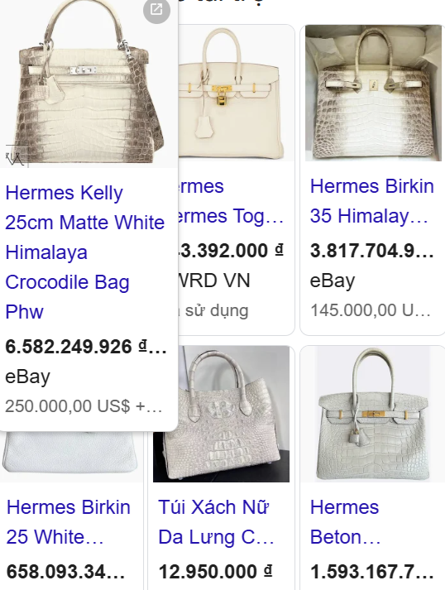
Luxury goods are sold to the rich, but their advertising is often intended to be seen by the less affluent. Why is that?
If a US$20,000 Hermès bag were valued only by wealthy buyers and the brand itself, it would be little more than a piece of high-quality leather. It becomes truly “powerful” when its owner walks down the street and everyone around them—even those who could never afford it—recognises how extraordinarily expensive it is.
This is why luxury brands need to be visible to a much wider, less affluent audience. Only then can the wealthy owner experience the admiration that comes from being seen with something that most people cannot attain.
The emotional value of luxury consumption, therefore, may come not only from the product itself but also from the perceived status distance it creates. The admiration, aspiration, and sometimes envy of others can reinforce the owner’s sense of prestige and social distinction.
This reflects both a basic logic of luxury marketing and an understanding of human behaviour. In the age of social media, consumers are increasingly surrounded by highly curated and often extravagant standards of living promoted through media and influencers.
Constant exposure to lifestyles and possessions that seem out of reach can contribute to feelings of inadequacy and status anxiety. In more extreme cases, it may encourage conspicuous consumption beyond one’s financial means—borrowing or overspending on luxury goods in exchange for temporary social recognition.

Slide 28
Communication Objectives: Specific and Measurable
Increase brand awareness
Example: Increase awareness of TH true MILK among customers aged 18–25 from 40% to 60% within three months.
Provide information about a new product or service
Example: Ensure that 60% of the target audience understands that the product contains natural ingredients and no preservatives.
Generate interest
Example: Increase the number of customers visiting the website to learn more about the product by 30% after the campaign.
Change customer attitudes or perceptions
Example: Increase the percentage of customers who perceive the brand as “trustworthy” from 50% to 70%.
Build brand preference
Example: Increase the percentage of customers who rank the brand among their top three favourite dairy brands.
Encourage purchase, registration, or trial
Example: Increase the number of orders by 20% during the campaign period.
Increase customer loyalty and encourage repeat purchases

Slide 29
Message Design
What is the core customer benefit?
  Apple: “Think Different” → creativity and innovation
  Biti’s: “Nâng niu bàn chân Việt” → care and comfort for Vietnamese consumers
Message structure
  Present a problem, then offer the solution
  Show before vs. after using the product
  Present rational benefits first, followed by emotional benefits
  Support the message with evidence, statistics, demonstrations, or customer reviews
Message format
  Visuals
  Colours
  Sound and music
  Language and tone
  Brand ambassadors or spokespersons
  Slogans
  Overall design style
Key requirements: The message should be clear, consistent, memorable, and relevant to the target audience.
https://www.youtube.com/watch?v=Dlx9Z0QcBds

Slide 30
Media Selection: Where Is Your Target Audience?
Mass Media
TV, radio, newspapers, magazines, billboards, and outdoor digital screens.
Best suited when a company wants to build broad market awareness.
Digital Media
Websites, email, social media, search engines, online advertising, and mobile apps.
Useful for personalisation, interaction, targeting, and performance measurement.
Direct Communication
Personal selling, consultations, seminars, events, and customer service.
Particularly suitable for products or services that require detailed explanation or involve high perceived risk.
Word-of-Mouth and Community Communication
Customer reviews, KOLs/KOCs, online communities, discussion groups, and user-generated content.
Useful for building credibility, social influence, and customer engagement.

Slide 31
Media schedule
Campaign start and end dates
Frequency of message exposure
Peak periods when communication intensity should be increased
Coordination of different channels across campaign stages
Consider seasonality, special events, holidays, and customers’ typical buying occasions.

Slide 32
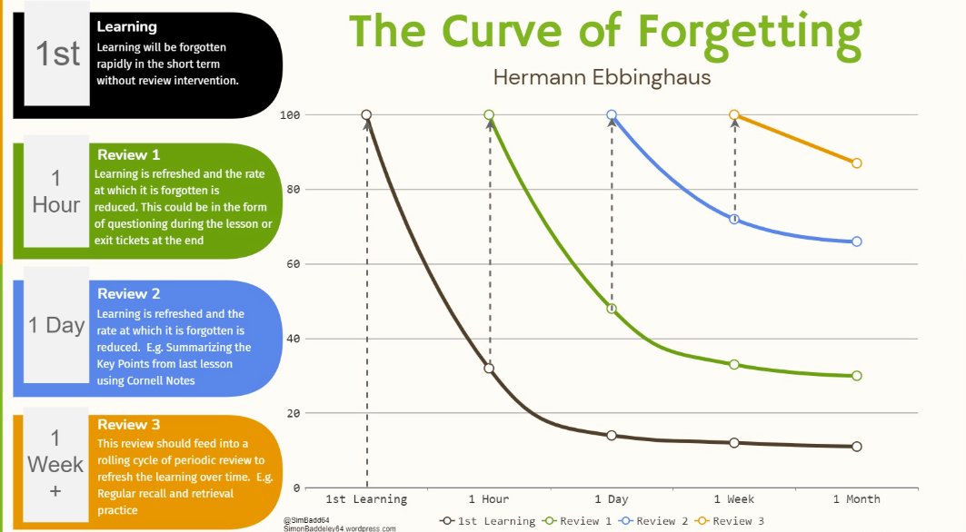

Slide 33
Budget
Affordable Method
The company spends what it believes it can afford on marketing communications.
The communication budget is therefore determined by available financial resources rather than by specific communication objectives.
Percentage-of-Sales Method: The communication budget is set as a percentage of current or forecast sales revenue.
Competitive-Parity Method
The budget is based on competitors’ communication spending, media presence, and the firm’s desired market share.
A common assumption is that market share is related to share of voice (SOV).
The firm therefore considers how frequently competing brands appear in the market and how much communication pressure is needed to remain competitive.
Objective-and-Task Method
Define specific objectives for awareness, trial, purchase, or market share.
Estimate the total level of media exposure required, often expressed in GRPs (Gross Rating Points).
Estimate the cost of achieving each GRP.
Calculate the total communication budget needed to achieve the objectives.
In short: Objectives → Required exposure → Cost per exposure → Communication budget.
Notes:
33

Slide 34
Structure
Budget allocation by product: Percentage of the communication budget allocated to each product, brand, or model.
Budget allocation by geographic area: Percentage of the budget allocated to each region, city, or market area.
Budget allocation by marketing communication tool: Percentage spent on advertising, sales promotion, public relations, direct marketing, and personal selling.
Budget allocation by media: Percentage spent on TV and radio, print advertising, out-of-home (OOH) media, online media, and other channels.
Budget allocation over time: Percentage of the budget allocated by quarter, month, or week throughout the year.

Slide 35
Communication tools
Advertising: builds broad awareness and gives the firm strong control over the message.
Public relations (PR): builds credibility, reputation, and trust.
Sales promotion: encourages short-term customer action and purchase.
Personal selling: provides consultation, persuasion, and handling of customer objections.
Direct marketing: delivers personalised messages to specific customers or customer segments.
Digital and social media: encourage interaction, sharing, rapid reach, and real-time measurement.
Events and experiential marketing: allow customers to interact directly with and experience the brand.

Slide 36
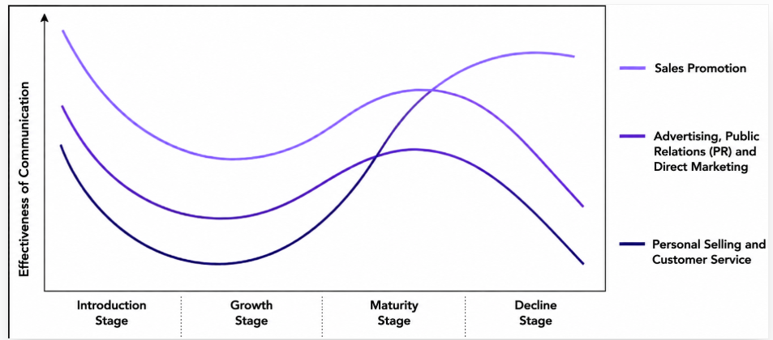
Mkt communication across the product life-cycle
Notes:
36

Slide 37
Teamwork

