Slide 1

Lecture 9
Marketing
Communication

Slide 2
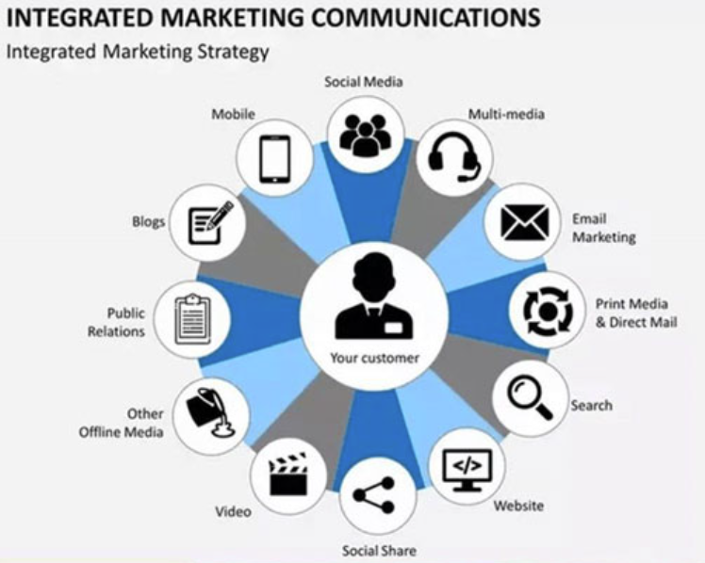
Integrated Marketing Communications
Integrated Marketing Communications (IMC) is the process of coordinating different communication tools—such as advertising, public relations, sales promotion, personal selling, direct marketing, digital media, and social media—to deliver a consistent, clear, and persuasive message to target customers (Belch & Belch, 2021; Kotler & Keller, 2016).
All communication tools should work towards a common objective.
Messages should remain consistent across different channels.
Communication should be target-customer centred.
IMC combines online and offline communication.
Its purpose is to build awareness, positive attitudes, and purchase or service-use behaviour.

Slide 3
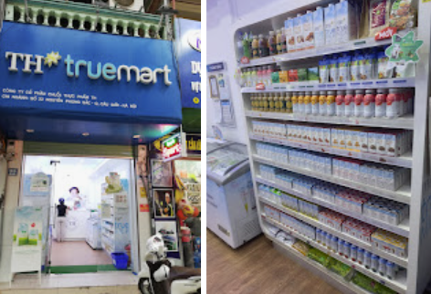
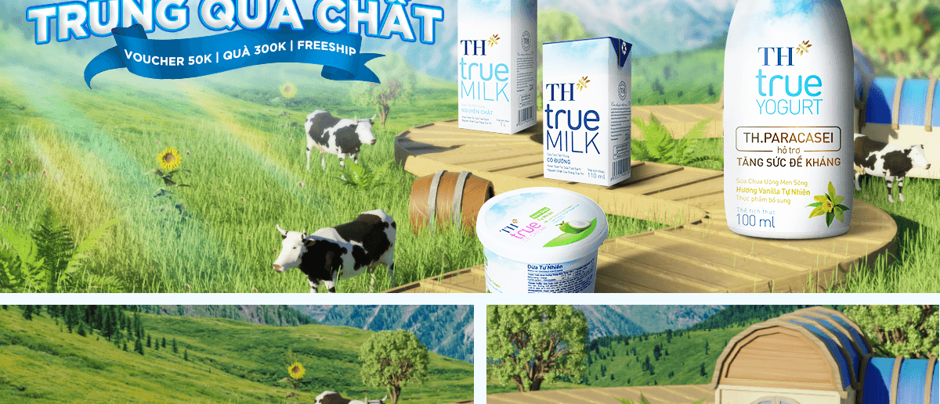
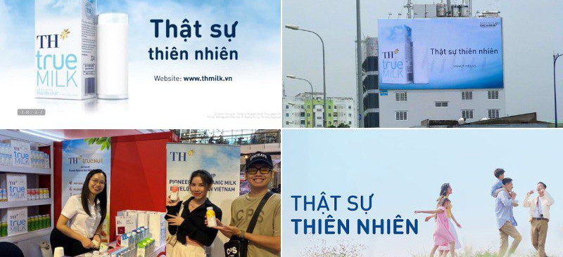

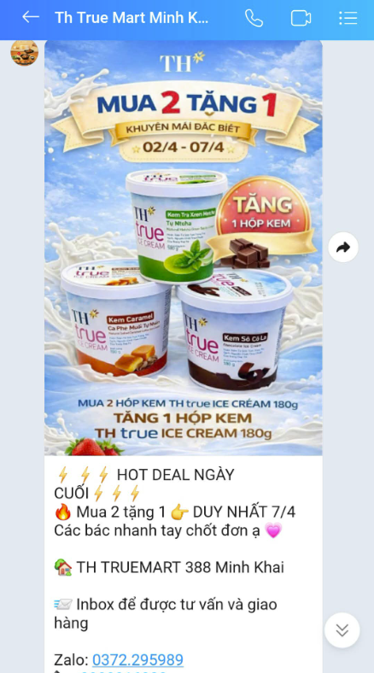
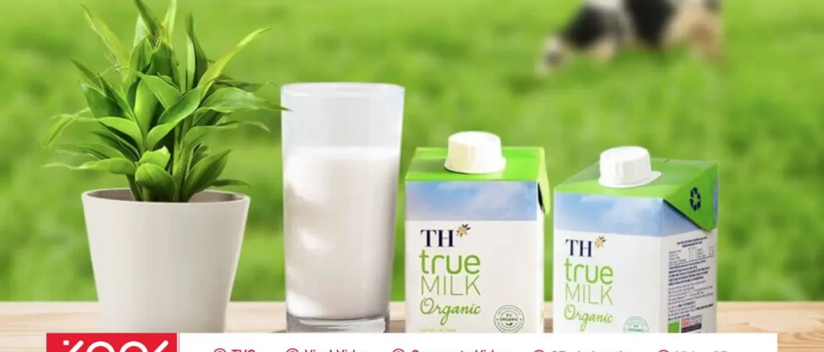
Consistent core message: “Fresh, pure milk / truly natural goodness.”
TH True MILK
Advertisement
Promotion/ digital
Brand awareness
Customer behaviour
Product and content
TH True MILK:
Story - telling
TH true MILK coordinates multiple customer touchpoints—including advertising, public relations, packaging, retail outlets, e-commerce, social media, and sales promotions. Together, these activities reinforce a consistent brand positioning: clean, natural products that support health and well-being.
Positioning
Belief

Slide 4
AIDA model
A – Attention: Capture attention
Customers become aware of the brand, product, or service.
Example: An advertisement with striking visuals, an eye-catching headline, or an intriguing message.
I – Interest: Generate interest
Customers begin to want to learn more because the message connects with their needs, wants, or problems.
Example: Content explaining product benefits, customer stories, or demonstration videos.
D – Desire: Create desire
Customers begin to feel that the product or service is relevant to them and want to own or experience it.
Example: Emphasising emotional benefits, distinctive value, or positive customer reviews.
A – Action: Encourage action
Customers take the desired action, such as purchasing, registering, downloading an app, providing contact details, or visiting a store.
Example: “Sign up now”, a limited-time offer, or a free consultation.

Slide 5
Steps in Designing a Marketing Communications Programme
Target Audience
Program target
Message
Schedule and media
Budget
Communication Structure
Evaluation

Slide 6
Audience: Who are you communicating with?
Existing or potential customers?
Buyer, user, or purchase influencer?
Example: Shampoo may be used by the whole family, but a woman in the household may make the purchase decision. Infant formula is consumed by the child, but purchased by the parents.
Demographic characteristics: age, gender, income, occupation, and place of residence.
Psychographic characteristics: lifestyle, personal values, interests, and motivations.
Consumer behaviour: purchase frequency, level of loyalty, and preferred information channels.
Customer problems, needs, or wants: What are they trying to solve, achieve, or experience?

Slide 7
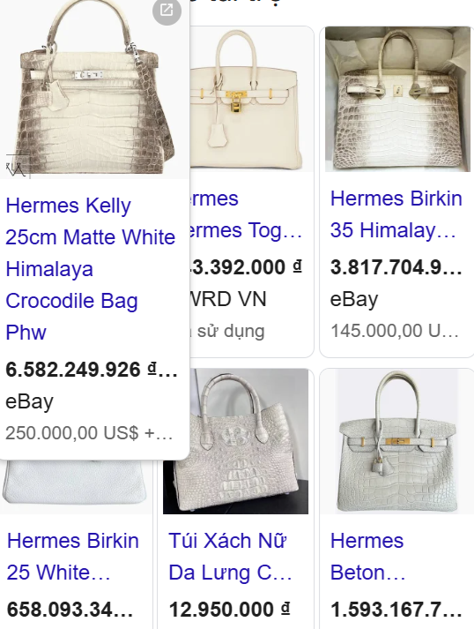
Luxury goods are sold to the rich, but their advertising is often intended to be seen by the less affluent. Why is that?
If a US$20,000 Hermès bag were valued only by wealthy buyers and the brand itself, it would be little more than a piece of high-quality leather. It becomes truly “powerful” when its owner walks down the street and everyone around them—even those who could never afford it—recognises how extraordinarily expensive it is.
This is why luxury brands need to be visible to a much wider, less affluent audience. Only then can the wealthy owner experience the admiration that comes from being seen with something that most people cannot attain.
The emotional value of luxury consumption, therefore, may come not only from the product itself but also from the perceived status distance it creates. The admiration, aspiration, and sometimes envy of others can reinforce the owner’s sense of prestige and social distinction.
This reflects both a basic logic of luxury marketing and an understanding of human behaviour. In the age of social media, consumers are increasingly surrounded by highly curated and often extravagant standards of living promoted through media and influencers.
Constant exposure to lifestyles and possessions that seem out of reach can contribute to feelings of inadequacy and status anxiety. In more extreme cases, it may encourage conspicuous consumption beyond one’s financial means—borrowing or overspending on luxury goods in exchange for temporary social recognition.

Slide 8
Communication Objectives: Specific and Measurable
Increase brand awareness
Example: Increase awareness of TH true MILK among customers aged 18–25 from 40% to 60% within three months.
Provide information about a new product or service
Example: Ensure that 60% of the target audience understands that the product contains natural ingredients and no preservatives.
Generate interest
Example: Increase the number of customers visiting the website to learn more about the product by 30% after the campaign.
Change customer attitudes or perceptions
Example: Increase the percentage of customers who perceive the brand as “trustworthy” from 50% to 70%.
Build brand preference
Example: Increase the percentage of customers who rank the brand among their top three favourite dairy brands.
Encourage purchase, registration, or trial
Example: Increase the number of orders by 20% during the campaign period.
Increase customer loyalty and encourage repeat purchases

Slide 9
Message Design
What is the core customer benefit?
  Apple: “Think Different” → creativity and innovation
  Biti’s: “Nâng niu bàn chân Việt” → care and comfort for Vietnamese consumers
Message structure
  Present a problem, then offer the solution
  Show before vs. after using the product
  Present rational benefits first, followed by emotional benefits
  Support the message with evidence, statistics, demonstrations, or customer reviews
Message format
  Visuals
  Colours
  Sound and music
  Language and tone
  Brand ambassadors or spokespersons
  Slogans
  Overall design style
Key requirements: The message should be clear, consistent, memorable, and relevant to the target audience.
https://www.youtube.com/watch?v=Dlx9Z0QcBds

Slide 10
Media Selection: Where Is Your Target Audience?
Mass Media
TV, radio, newspapers, magazines, billboards, and outdoor digital screens.
Best suited when a company wants to build broad market awareness.
Digital Media
Websites, email, social media, search engines, online advertising, and mobile apps.
Useful for personalisation, interaction, targeting, and performance measurement.
Direct Communication
Personal selling, consultations, seminars, events, and customer service.
Particularly suitable for products or services that require detailed explanation or involve high perceived risk.
Word-of-Mouth and Community Communication
Customer reviews, KOLs/KOCs, online communities, discussion groups, and user-generated content.
Useful for building credibility, social influence, and customer engagement.

Slide 11
Media schedule
Campaign start and end dates
Frequency of message exposure
Peak periods when communication intensity should be increased
Coordination of different channels across campaign stages
Consider seasonality, special events, holidays, and customers’ typical buying occasions.

Slide 12
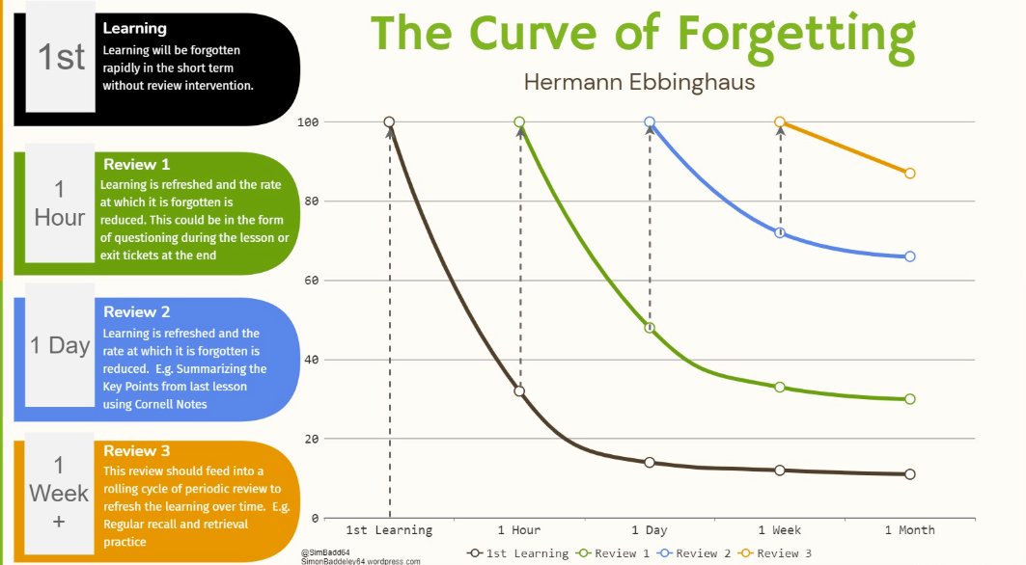

Slide 13
Budget
Affordable Method
The company spends what it believes it can afford on marketing communications.
The communication budget is therefore determined by available financial resources rather than by specific communication objectives.
Percentage-of-Sales Method: The communication budget is set as a percentage of current or forecast sales revenue.
Competitive-Parity Method
The budget is based on competitors’ communication spending, media presence, and the firm’s desired market share.
A common assumption is that market share is related to share of voice (SOV).
The firm therefore considers how frequently competing brands appear in the market and how much communication pressure is needed to remain competitive.
Objective-and-Task Method
Define specific objectives for awareness, trial, purchase, or market share.
Estimate the total level of media exposure required, often expressed in GRPs (Gross Rating Points).
Estimate the cost of achieving each GRP.
Calculate the total communication budget needed to achieve the objectives.
In short: Objectives → Required exposure → Cost per exposure → Communication budget.
Notes:
13

Slide 14
Structure
Budget allocation by product: Percentage of the communication budget allocated to each product, brand, or model.
Budget allocation by geographic area: Percentage of the budget allocated to each region, city, or market area.
Budget allocation by marketing communication tool: Percentage spent on advertising, sales promotion, public relations, direct marketing, and personal selling.
Budget allocation by media: Percentage spent on TV and radio, print advertising, out-of-home (OOH) media, online media, and other channels.
Budget allocation over time: Percentage of the budget allocated by quarter, month, or week throughout the year.

Slide 15
Communication tools
Advertising: builds broad awareness and gives the firm strong control over the message.
Public relations (PR): builds credibility, reputation, and trust.
Sales promotion: encourages short-term customer action and purchase.
Personal selling: provides consultation, persuasion, and handling of customer objections.
Direct marketing: delivers personalised messages to specific customers or customer segments.
Digital and social media: encourage interaction, sharing, rapid reach, and real-time measurement.
Events and experiential marketing: allow customers to interact directly with and experience the brand.

Slide 16
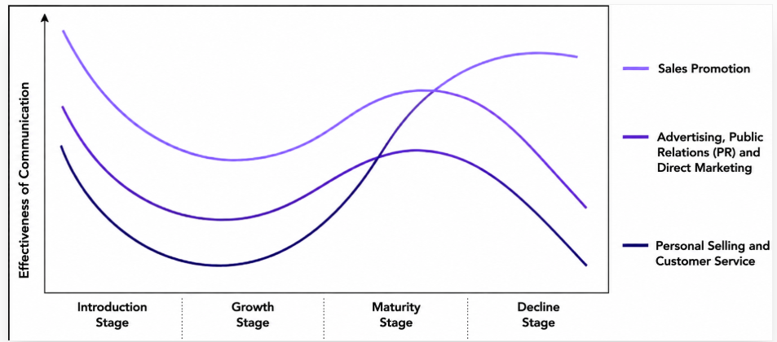
Mkt communication across the product life-cycle
Notes:
16

Slide 17

Advertisement

Slide 18
Advertisement
Advertising is a paid form of communication in which a company places a message or brand on a media channel to inform, persuade, or remind customers (American Marketing Association).
Applications:
  Launching a new product
  Building brand awareness
  Repositioning a brand
  Reminding customers
  Creating differentiation

Slide 19
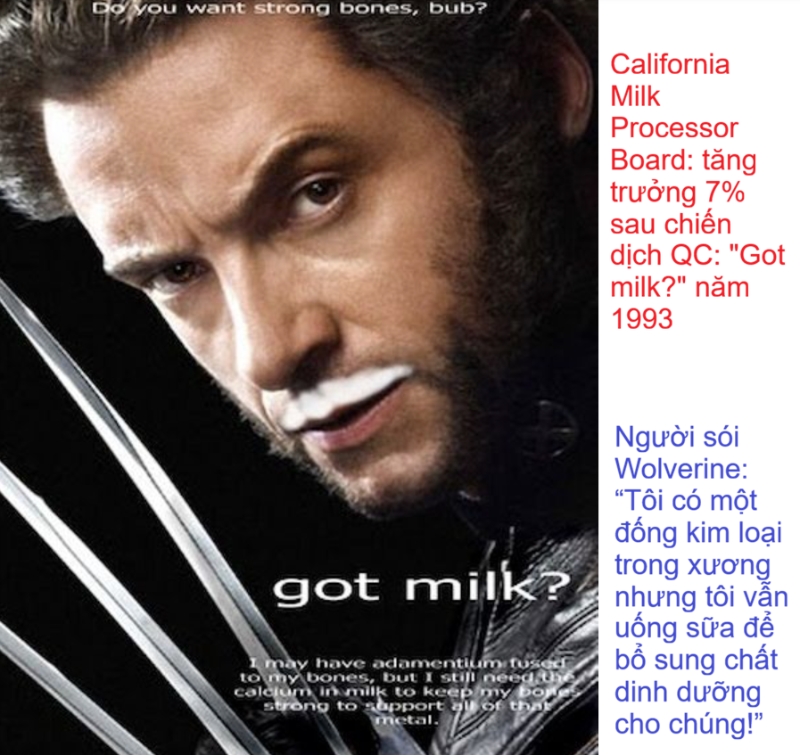
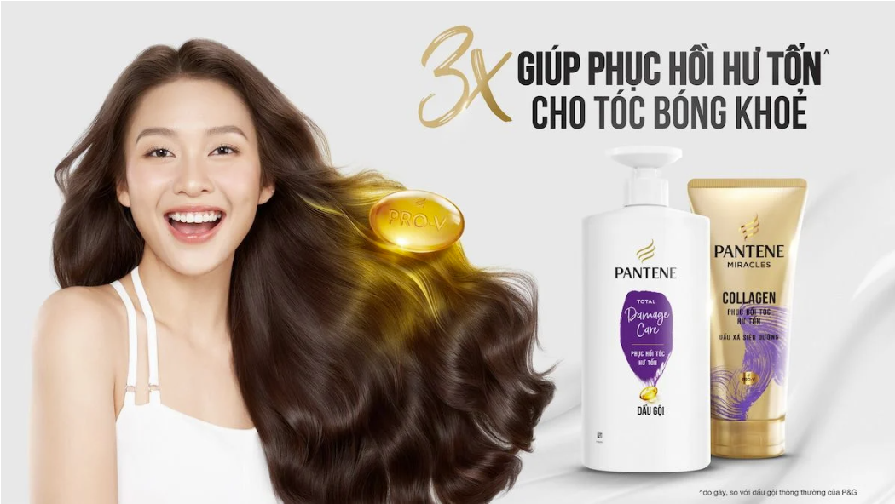
9.3.1 Đặc điểm
Ưu điểm
Tạo sự nhận biết thương hiệu
Xây dựng hình ảnh thương hiệu
Hạn chế
Tính chọn lọc khán giả thấp
Chi phí tuyệt đối là cao
Gây ấn tượng mạnh
Chi phí tương đối tính trên đầu khán giả (CPM) là thấp
Khả năng thuyết phục khách hàng hạn chế
Một số lĩnh vực không được phép quảng cáo

Slide 20
Advertisement design
Message
Measurement
Mission
Money
Media

Slide 21
Mission
Behavioural objectives: sales volume, revenue
Awareness and attitude objectives:
  Inform: unaware → aware
  Persuade: aware → interested → preference → convinced
  Remind: first purchase → repeat purchase

Slide 22
Money (Budget)
Top-down approach: Management first determines how much money is available for advertising, usually based on financial or competitive considerations. The budget is then allocated across advertising activities.
Affordable method: The company spends on advertising only what it believes it can afford after covering other expenses.
→ Limitation: Advertising is treated as a residual expense rather than an investment linked to objectives.
Percentage-of-sales method: The advertising budget is set as a fixed percentage of current or forecast sales revenue.
Eg: If forecast sales are $10 million and the company allocates 5% of sales to advertising, the advertising budget is $500,000.
→ Limitation: It assumes sales determine advertising expenditure, although advertising itself is intended to influence sales.
Competitive-parity method: The company sets its advertising expenditure based on competitors' spending or industry norms.
Share of Voice (SOV) → Share of Market (SOM)
  Share of Voice: the brand's advertising presence relative to total advertising in its market.
  Share of Market: the brand's sales as a percentage of total market sales.
Eg: If a brand accounts for 20% of total advertising expenditure in a category, its SOV is 20%. If it has 15% market share, then: SOV 20% > SOM 15%
→ This is sometimes called Excess Share of Voice (ESOV). The underlying idea is that maintaining SOV above current market share may help a brand grow over time.
Bottom-up approach: The advertising budget is built from specific communication objectives and the activities required to achieve them.
Objective-and-task method
  Define specific advertising objectives.
  Identify the tasks needed to achieve those objectives.
  Estimate the cost of performing those tasks.
  The total cost becomes the advertising budget.
Eg: A company wants to achieve 70% brand awareness among university students. It determines that it needs TikTok advertising, campus events, and influencer content. The estimated cost of these activities determines the budget.
Objectives → Tasks → Estimated costs → Budget
This is generally considered the most logical and strategically sound approach, because spending is directly linked to marketing objectives.

Slide 23
Bottom-up approach
Biti’s Hunter – “Đi để trở về” campaign
https://www.brandsvietnam.com/campaign/209-biti-s-di-de-tro-ve
The Biti’s Hunter campaign was built around an insight that resonated strongly with young Vietnamese consumers: young people want to travel, explore, and experience the world, but Tet is still the time when they want to return home to their families. The “Đi để trở về” (“Go to Return”) campaign connected the footwear product with the emotions of leaving and returning, exploration and family, and the spirit of Tet.
Music videos featuring celebrities.
Storytelling content centred on the journey of going away and coming home.
Social media communication, PR, and online community discussions.
Out-of-home advertising, including buses, taxis, and point-of-sale displays, to reinforce the message and encourage purchase.
Buzzmetrics noted that the campaign consistently applied the same consumer insight across multiple channels, while offline touchpoints such as retail stores, OOH advertising, buses, and taxis were used to remind consumers of the campaign message and keep the product highly visible.

Slide 24
• Under a bottom-up approach, the marketing team might begin by asking:
“If we want young consumers to love Biti’s Hunter during Tet, what activities do we need to carry out?”
• We need an emotional message.
• We need a music video with strong viral potential.
• We need to select a singer or celebrity who resonates with young consumers.
• We need social media activities to generate discussion and engagement.
• We need PR to amplify the campaign story.
• We need point-of-sale communication and out-of-home advertising (OOH) to move consumers from brand preference to actual purchase.

Slide 25
Top-down approach
The company starts with a large overall communications budget or target that has already been set at the corporate or regional level, and then allocates that budget to specific activities.
Shopee: major sales campaigns on special shopping dates such as 6.6, 7.7, 8.8, and 11.11.
These are platform-wide campaigns that are usually implemented simultaneously across multiple channels, including TV commercials, YouTube, Facebook, TikTok, KOLs/KOCs, in-app banners, vouchers, free-shipping offers, livestreaming, push notifications, and email, together with promotional incentives.
Under a top-down approach, senior management may first decide: “The company will allocate a budget of X to increase traffic, generate more orders, and strengthen brand awareness.”
The total budget is then allocated across specific activities, for example:
  how much for TV commercials and YouTube;
  how much for KOLs/KOCs;
  how much for social media advertising;
  how much for vouchers and free shipping;
  how much for in-app banners;
  how much for livestreaming and affiliate marketing.

Slide 26
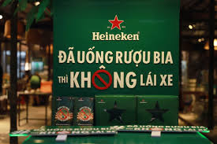
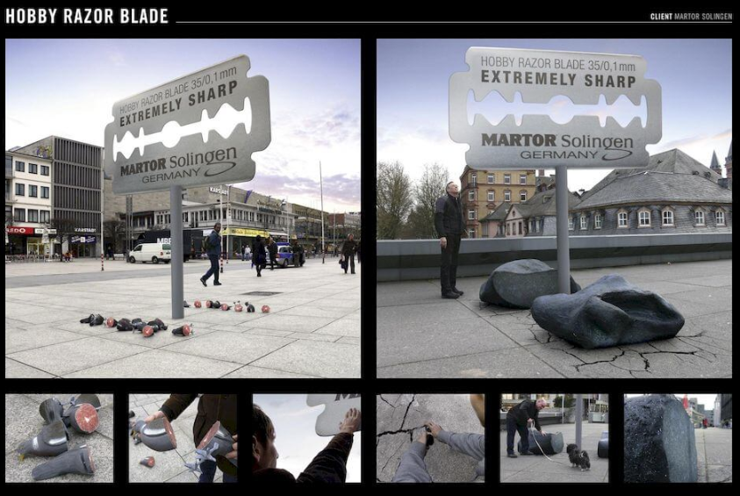
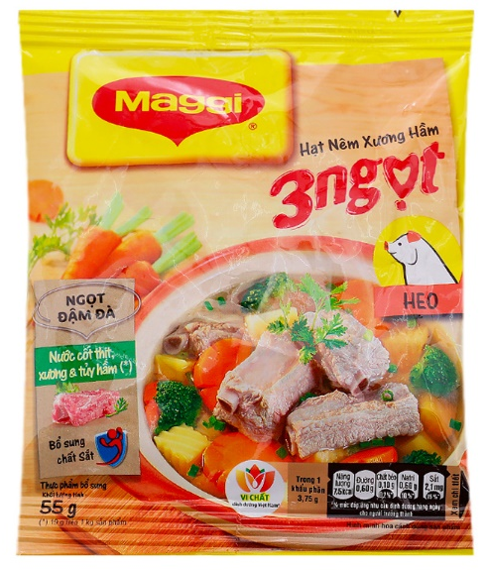
Message: appeal strategies
1. Start with a strong consumer insight: The message should connect with a real need, tension, desire, fear, aspiration, or experience of the target audience.
2. Choose the right advertising appeal: An advertising appeal is the basic approach used to attract attention and influence the audience.
3. Make the value proposition clear: The audience can quickly understand.
4. Make it relevant (meaningful to the target customer ) and distinctive (different enough to stand out from competitors)
5. Tell a story: Storytelling makes advertising more engaging because consumers can identify with: a character → a problem → an experience → a resolution.
6. Use strong creative execution: The same message can be communicated through different execution styles, such as lifestyle, fantasy, mood or image, music, celebrity endorsement, demonstration, testimonial, humour, storytelling
7. Create emotional and brand linkage
8. End with the desired response
Creative
Noticable
Relating
Memoriable
Responsive

Slide 27
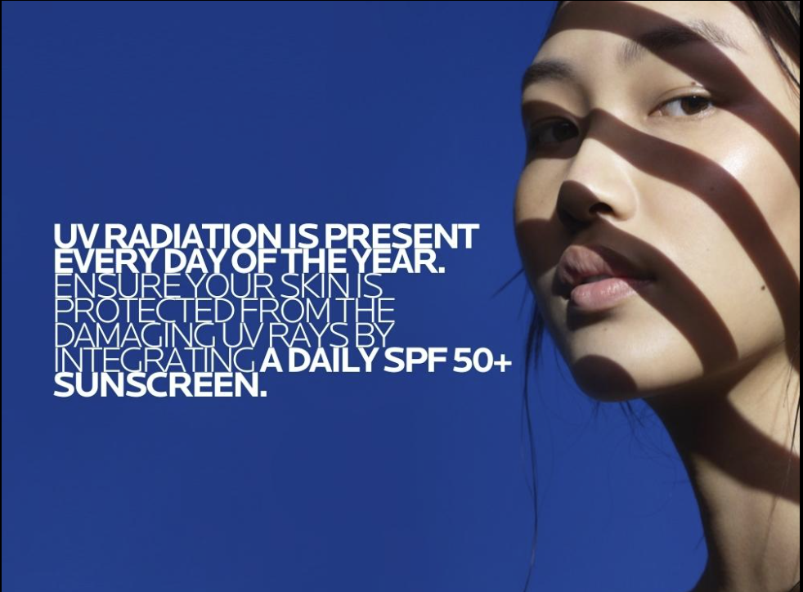
Message content example
Warning / Fear Appeal
(Problem–Agitation–Solution)
UV is there every day → UV damages your skin → protect yourself every day with SPF 50+
• Headline (Hook): [WARNING] This mistake is damaging your skin every day!
• Content: Clearly explain the negative consequences of the problem or bad habit → intensify the concern → introduce an urgent solution through the product or service.
• CTA (Call to Action): Message us now to receive a free personalised treatment plan!

Slide 28
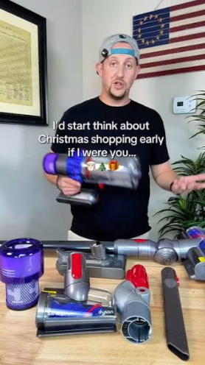
Message content example
Benefit-Focused Appeal
• Headline: Say goodbye to [problem] with just [X minutes] a day!
• Content: Use trending phrases or viral expressions from social media to make the message humorous, relatable, and engaging, then connect them back to the product’s core benefit.
• CTA: Click the link to get [X% off] today!
Dyson cordless vacuum
A cleaner home in less time.
Powerful cordless suction helps you move quickly from room to room without changing plugs or dealing with a cable.
Discover the Dyson cordless range today.

Slide 29
Message content example
Scarcity / Limited-Availability Appeal
Only 20 places left for our Digital Marketing Programme!
• Formula: Scarcity → Urgency → Action
• Headline / Hook:
Only [quantity/time] left to claim this offer!
• Content:
Emphasise that the quantity is limited, the offer is available for a limited time, or the benefit is reserved for the first group of customers.
Want to build practical skills in social media, content marketing, digital advertising, and marketing analytics?
Our Digital Marketing Programme is now accepting applications for the next intake, but places are limited.
Register before 15 September to receive:
10% early-bird tuition discount
Free access to an industry workshop
Personalised career consultation
After the deadline, the programme will return to the regular tuition fee.
Apply now to secure your place before the offer ends.

Slide 30
Chiến lược sáng tạo: 12 phong cách sáng tạo trong triển khai ý tưởng (execution styles)
Chào hàng trực tiếp (Straight sell)
Khoa học-Kỹ thuật (Scientific/Technical)
So sánh (Comparison)
Chứng thực (Testimonial)
Vấn đề thực tế trong cuộc sống
(Slice of life)
Trình diễn (Demonstration)
Hoạt hình (Animation)
Biểu tượng cá nhân (Personal symbol)
Hình ảnh chung (Imagery)
Diễn kịch (Dramatization)
Hài hước (humour)
Kết hợp (combination)

Slide 31
TV channels
Reach: High / broad
Audience selectivity: Low to moderate
Impact / attention-grabbing ability: High
Information retention: Limited
Ability to build credibility/trust: Limited to moderate
Timeliness: High
Viral potential: Low
Absolute cost: High
CPM (cost per thousand impressions): Relatively low
Typical target audience: More effective for middle-aged and older consumers, especially those who spend more time watching television.

Slide 32
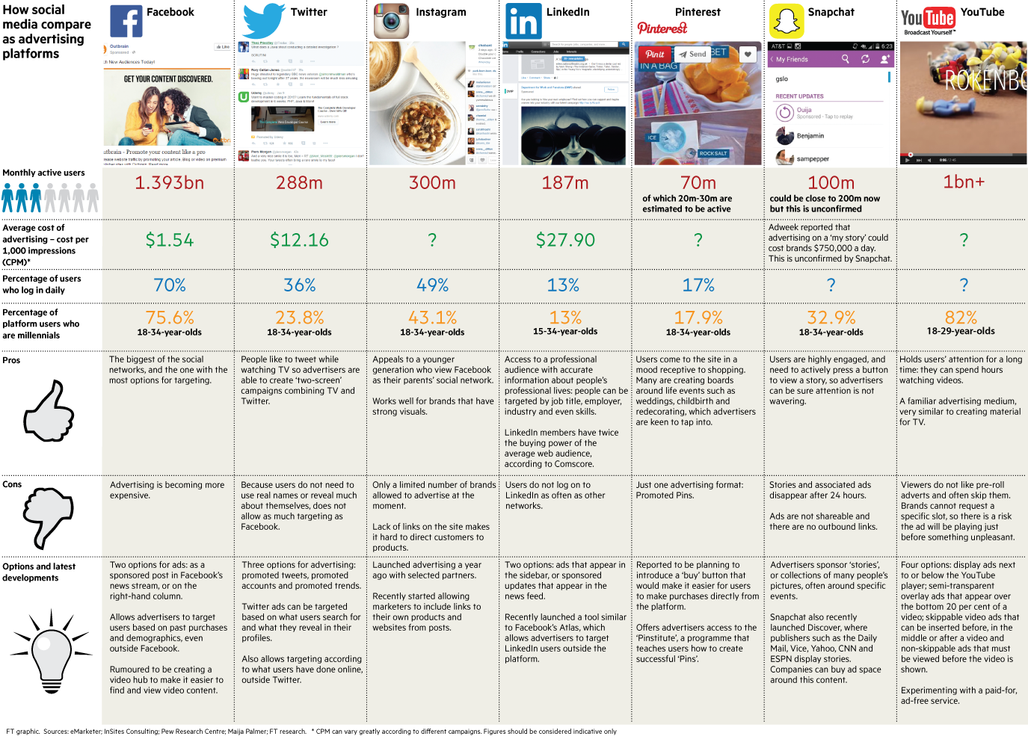

Slide 33
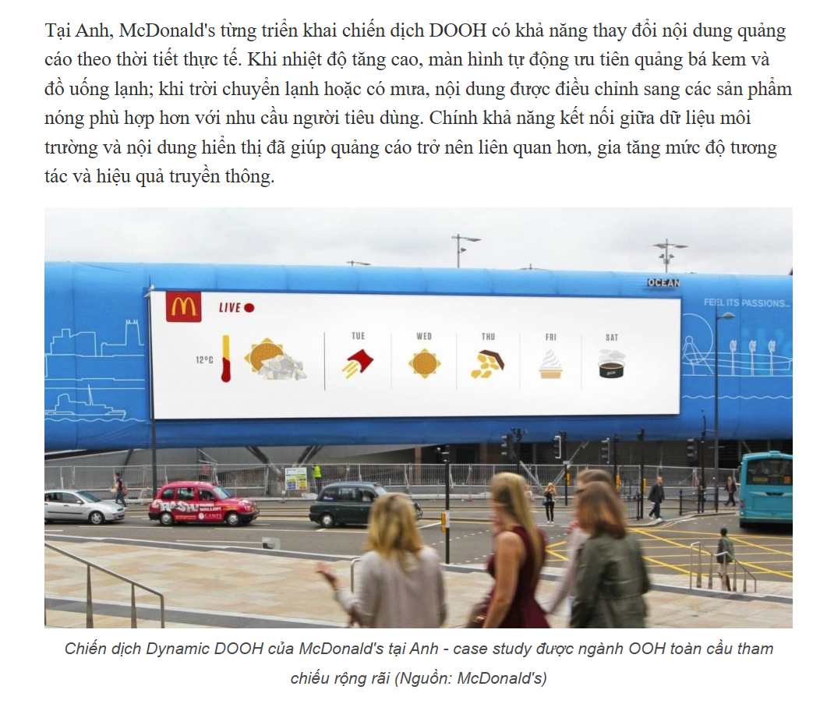
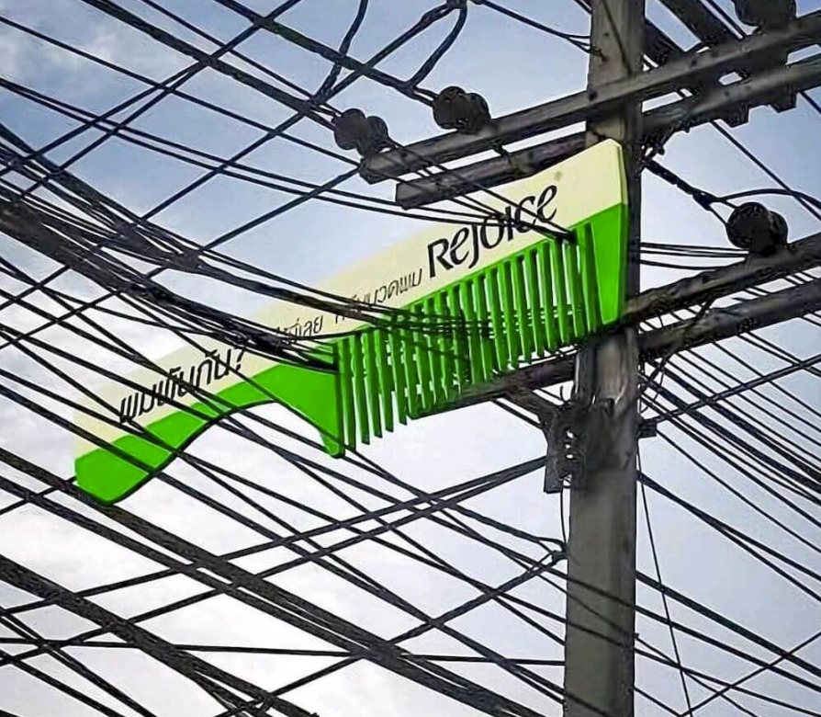
OOH (Out-of-Home) advertising
Advertising displayed in public spaces outside consumers’ homes.
The value of an OOH advertising location can be assessed based on the size of the advertising space, traffic volume, quality of audience-reach data, and the ability to optimise campaign performance in real time.
Key planning decisions include where the advertisement is placed, when and how often it is displayed, and how the advertising budget is allocated.

Slide 34
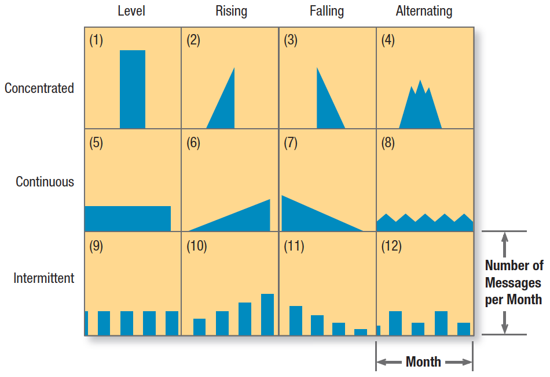
Ads schedule
Macro schedule: year and month
Micro schedule: week, day, hour
Schedule should match with type of target customers and their behaviours.

Slide 35
Media Selection: Factors to Consider
When selecting advertising media, marketers should consider:
Target audience: Who are we trying to reach, and which media do they use most?
Reach: How many people in the target market can the medium reach?
Frequency: How often will the target audience be exposed to the message?
Impact: How strongly can the medium attract attention and create an impression?
Audience selectivity: How precisely can the medium reach a specific customer segment?
Media habits: Where, when, and how does the target audience consume media?
Nature of the product: Some products need visual demonstration, detailed information, or repeated exposure.
Nature of the message: Complex messages may require media that allow more explanation, while simple messages may work well in short-form media.
Cost and CPM: What is the total cost, and how much does it cost to reach 1,000 people?
Timing and flexibility: How quickly can the advertisement be launched, changed, or updated?
Geographic coverage: Is the campaign local, regional, national, or international?
Engagement and interaction: Can consumers respond, click, share, comment, or purchase directly?
Measurability: How accurately can campaign performance be tracked and evaluated?

Slide 36
Measurement: Evaluation of Marketing Communication Effectiveness
1. Communication impact measures
Awareness rate: the percentage of the target audience who are aware of the brand, product, or campaign.
Comprehension rate: the percentage who correctly understand the intended message.
Liking: the extent to which consumers like the product, advertising message, or campaign.
Purchase intention: the degree to which consumers are willing or likely to purchase the product.
2. Sales performance measures
Sales volume: the number of units sold.
Sales revenue: revenue measured before, during, and after the campaign to identify possible changes associated with the marketing communication programme.
3. Evaluation methods: pre- and post-campaign surveys, brand-awareness and recall tests, message comprehension tests, attitude and purchase-intention surveys, sales analysis, web and social-media analytics, conversion tracking, and experimental/control-group comparisons.

Slide 37

Public Relations

Slide 38
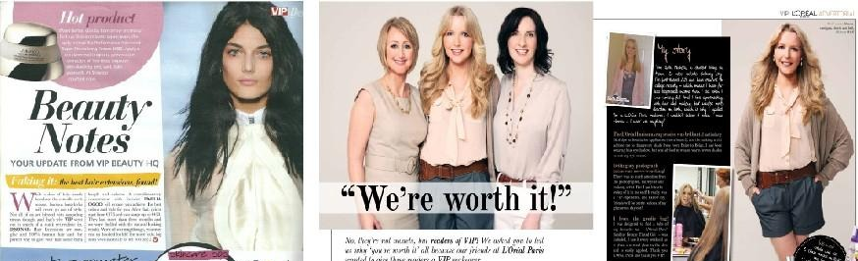
PR
Public Relations (PR) refers to activities aimed at building and maintaining a positive image, reputation, and trust between an organisation and its key publics, including customers, the media, local communities, government agencies, investors, and employees.
Common applications: brand launches, corporate social responsibility communication, crisis management, leadership reputation building, and internal communication.
Common PR tools and activities: press releases, events, CSR programmes, community sponsorships, media relations, crisis communication, and thought leadership.

Slide 39
LEGO Manufacturing Vietnam – Building Reputation
In April 2025, LEGO officially opened its US$1 billion manufacturing facility in Vietnam, its sixth factory globally and second in Asia. The opening ceremony involved senior Vietnamese government officials, LEGO executives, business partners, and community representatives, making the event not simply a factory launch but a major corporate PR occasion.
Instead of communicating only about production capacity, LEGO built the PR story around sustainability, responsible investment, employees, and local communities. The company described the Vietnam facility as its most environmentally sustainable factory at the time of opening. It installed around 12,400 rooftop solar panels, introduced paper-based packaging, obtained LEED Platinum and Gold certifications for its buildings, and developed renewable-energy infrastructure.
LEGO also linked the investment to its broader social purpose. Through partnerships with government agencies, NGOs and educational organisations, its programmes included LEGO Braille Bricks, Build the Change, and Girls Unstoppable. LEGO stated that these community initiatives were expected to benefit more than 60,000 children in Vietnam by the end of 2025.

Slide 40
Event sponsorship / sponsorship PR
Tiger Cup is probably the clearest example. Tiger Beer was the title sponsor of the ASEAN football championship from its launch in 1996 through the 2004 edition, which is why the tournament became widely known as the Tiger Cup. Asia Pacific Breweries explicitly described the purpose as associating Tiger Beer with football and increasing brand mindshare
Monsoon Music Festival is also an excellent Vietnam-based case, but here I would teach it as event sponsorship and cultural PR rather than saying “Monsoon itself is PR.” For example, Tuborg became the principal sponsor of Monsoon Music Festival from 2016, and the event was officially branded “Monsoon Music Festival by Tuborg.” Tuborg committed to a multi-year partnership and connected the brand with music, youth culture and social messages such as responsible drinking and traffic safety

Slide 41
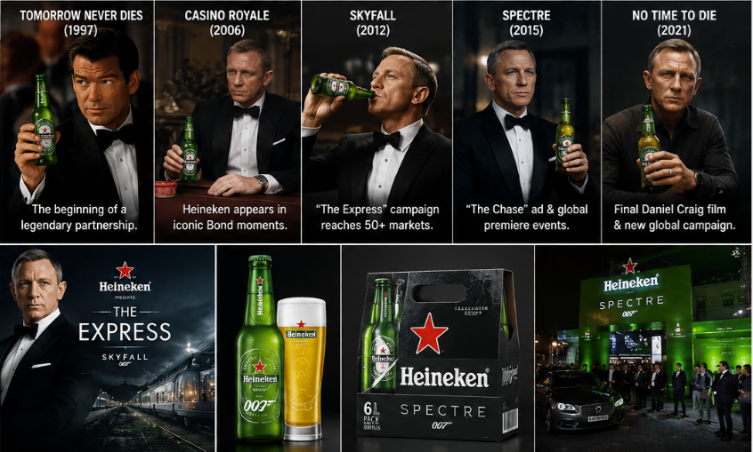
Heineken × James Bond 007
Heineken has partnered with the James Bond film franchise since 1997, beginning with Tomorrow Never Dies. By No Time to Die, the partnership had covered eight Bond films.
For Skyfall (2012), Heineken created the global campaign “The Express”, featuring Daniel Craig as James Bond. The campaign was activated through television, cinema, digital media and interactive consumer activities in more than 50 markets. Heineken reported more than 22 million online views of the campaign at the time.
For Spectre (2015), Heineken produced another Bond-themed commercial, “The Chase,” launched through Facebook before appearing on television and cinema screens. It also released special-edition packaging, exclusive Bond content and organised premiere events, including a Spectre premiere in Vietnam.
For No Time to Die, the campaign again featured Daniel Craig and included TV, online and social media communication, consumer promotions and limited-edition 007 packaging. In Vietnam, Heineken released Bond-themed bottles and cans and offered Bond-related consumer experiences and prizes
→ PR/Sponsorship objective: Strengthen Heineken's premium and international brand image by associating the brand with the iconic James Bond franchise. The 007 partnership gives Heineken access to an existing cultural property, story, celebrity, fan community, events and media attention, which can then generate PR and brand associations across many channels.

Slide 42
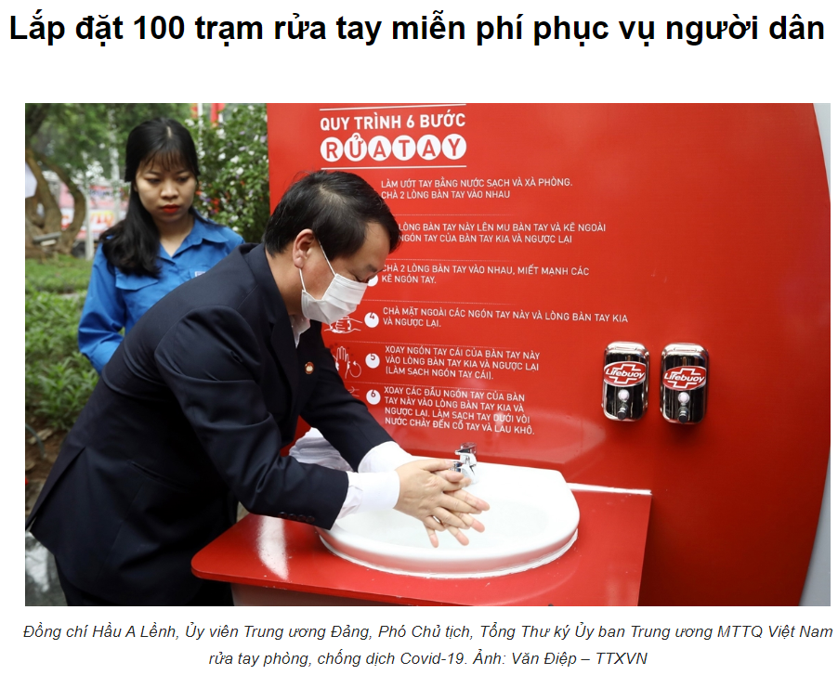
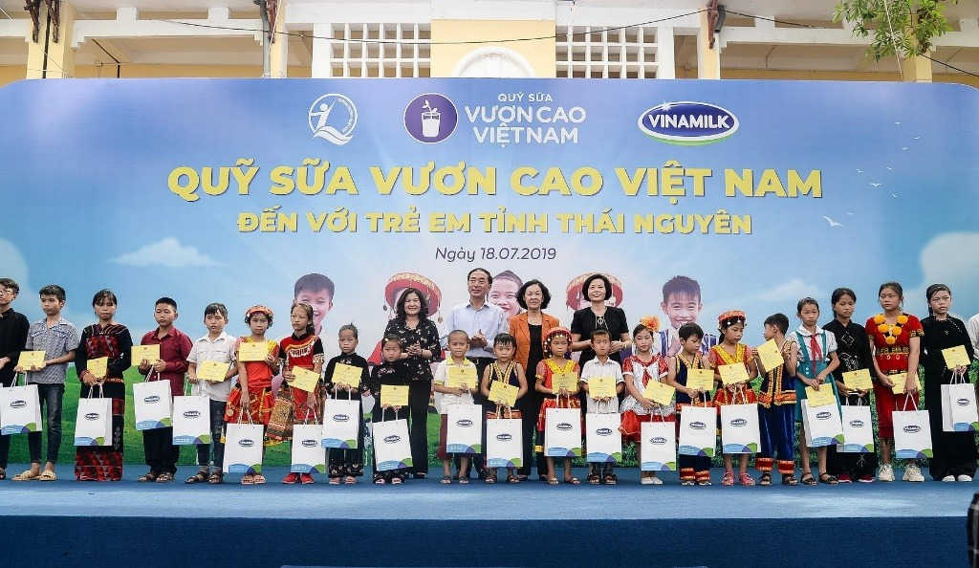
PR Objectives
Support the launch of a new product
Support the repositioning of an existing brand
Generate interest in a new product category
Influence specific target publics or stakeholder groups
Protect a product, brand, or corporate reputation during crises or negative incidents
Build a positive corporate brand image that, in turn, creates favourable attitudes toward the company’s products

Slide 43
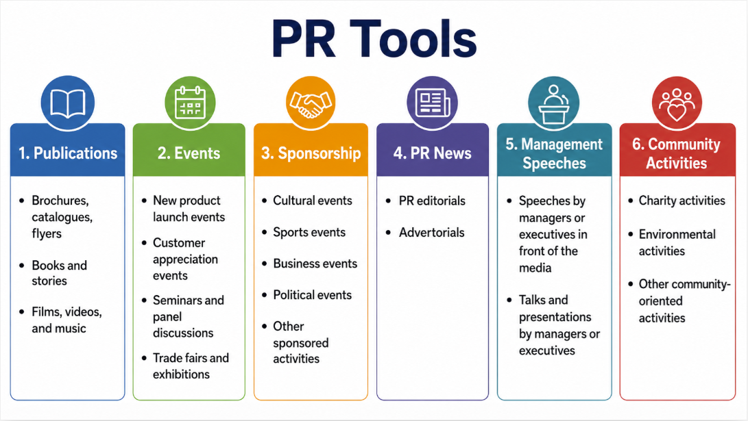

Slide 44
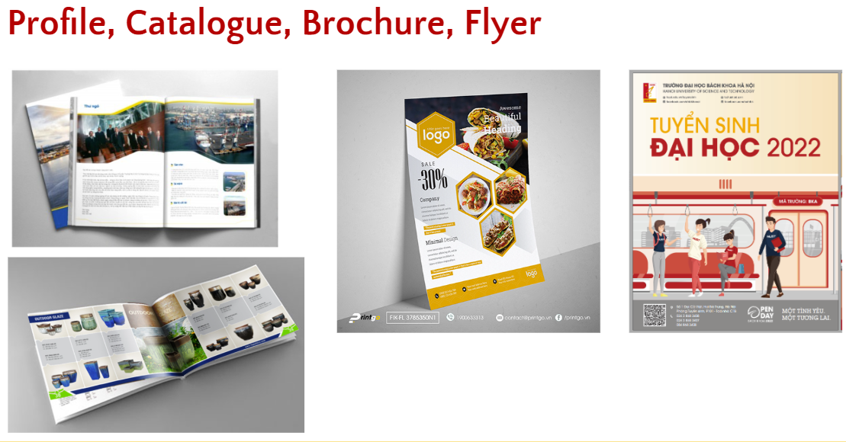

Slide 45
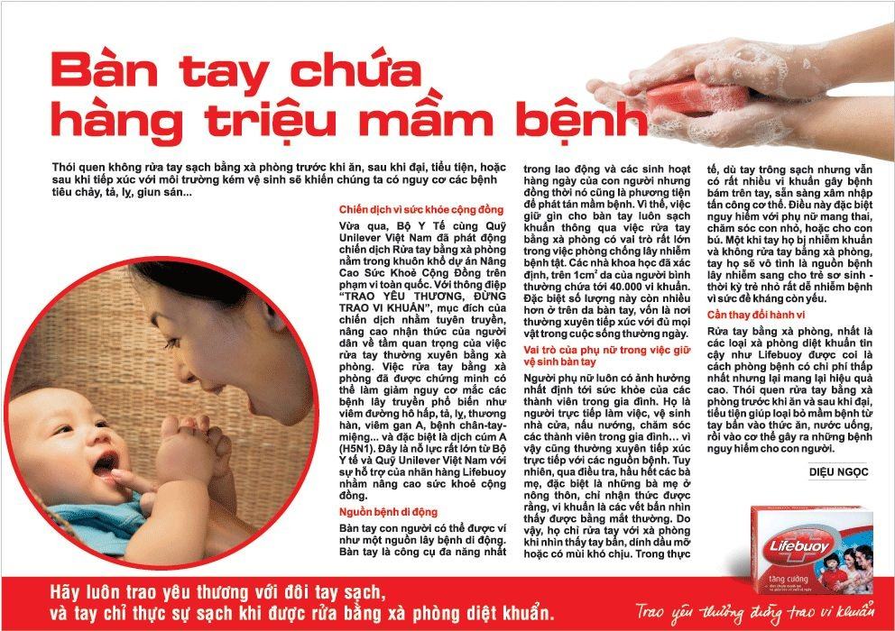
PR editorial
A PR article written in an editorial style, often using an inspiring story and providing more in-depth content.
Uses neutral language and an objective tone, rather than sounding like direct advertising.
Is integrated naturally with regular editorial content, rather than being placed in a separate advertising section.
The brand or product name is usually not prominently featured in the headline.

Slide 46
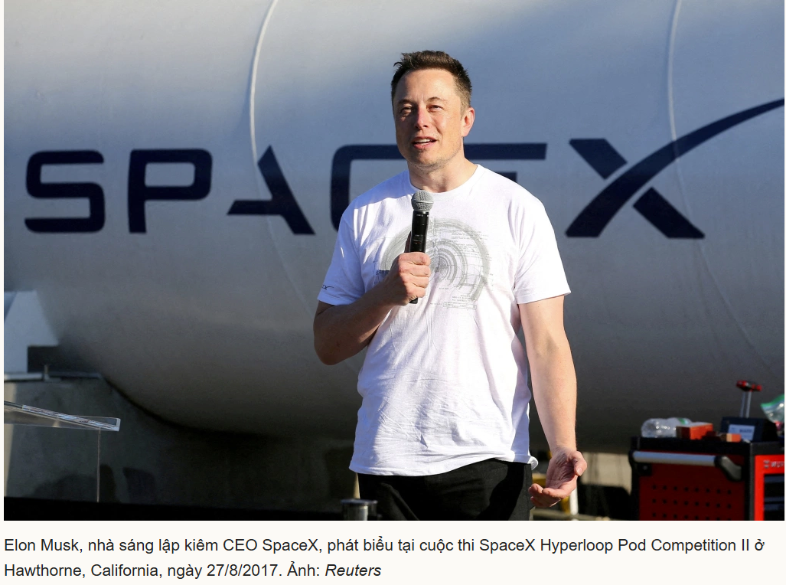
Endorsements and Statements by Influential Figures and Senior Leaders
The presence and public image of a manager or senior executive at an event can serve as an important form of endorsement and brand communication.
Short remarks to the media can also have strong PR value.
Such remarks may be either planned or spontaneous.
Even a brief comment can reveal the manager’s personality, opinions, perspective, and emotions at that moment.
Managers therefore need to be careful when speaking to the media, as unclear or inappropriate comments may create misunderstanding or negative impressions of the brand.
Formal speeches and presentations at events are another important PR tool.
These speeches should be carefully planned and prepared, both in content and delivery, to create the strongest possible positive impression of the brand.

Slide 47

Sales Promotion

Slide 48
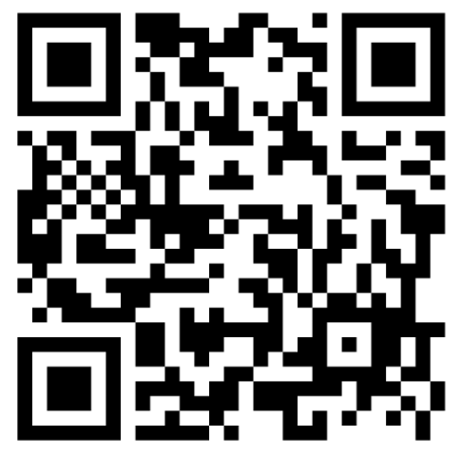
Sales Promotion
Promotional activities that provide short-term incentives or additional benefits to customers or channel intermediaries in order to encourage purchase, product trial, repeat purchase, or higher sales within a specific period.
Sales Promotion vs. Advertising
  Advertising: mainly aims to build awareness, brand/product preference, and reminder
  Sales promotion: gives customers an immediate reason to act
Sales promotion can encourage customers to:
  Buy now
  Try the product
  Switch brands/products
  Buy more
  Buy earlier than they otherwise would
Role in the AIDA Model: Sales promotion is particularly important in moving customers from: Attention / Interest → Desire / Action

Slide 49
Advantages
Disadvantages
Stimulate short-term demand
Increase seasonal sales or clear excess inventory
Encourage customers to try a new product, especially when they perceive some risk in switching or trying something unfamiliar
Increase purchase frequency or average order value, for example through bundles, package deals, or loyalty points
Support distribution channels by encouraging retailers to stock more products, provide better displays, or actively promote the brand
Easy to measure, because results such as redemption rates, sales uplift, trial rates, and repeat purchases can be tracked relatively quickly
Usually has only a short-term effect
If overused, customers may wait for discounts before buying
The company may simply bring future sales forward, rather than create genuinely new demand
Sales volume may increase, but profit may not necessarily increase
Frequent promotions can reduce the perceived value of the brand
Promotions may attract deal-prone, less loyal customers
Heavy discounting may create a perception of lower product quality

Slide 50
Objectives
A sales promotion programme should not be designed simply because the company “wants to sell more.” It should be linked to a specific marketing objective.
Increase awareness and trial of a new product
Example: free samples of laundry detergent, cosmetics, or instant coffee.
Increase short-term sales
Example: 20% discount during a grand opening, Tet holiday, or Black Friday.
Increase the quantity purchased per transaction
Example: buy three items and receive 15% off, or offer a bundle at a lower price than buying the items separately.
Encourage repeat purchase
Example: loyalty points, coupons for the next purchase, or membership programmes.
Retain existing customers
Example: birthday offers, appreciation gifts, or exclusive vouchers for loyal customers.
Support distributors and retailers
Example: trade discounts, sales incentives, or merchandising/display support.

Slide 51
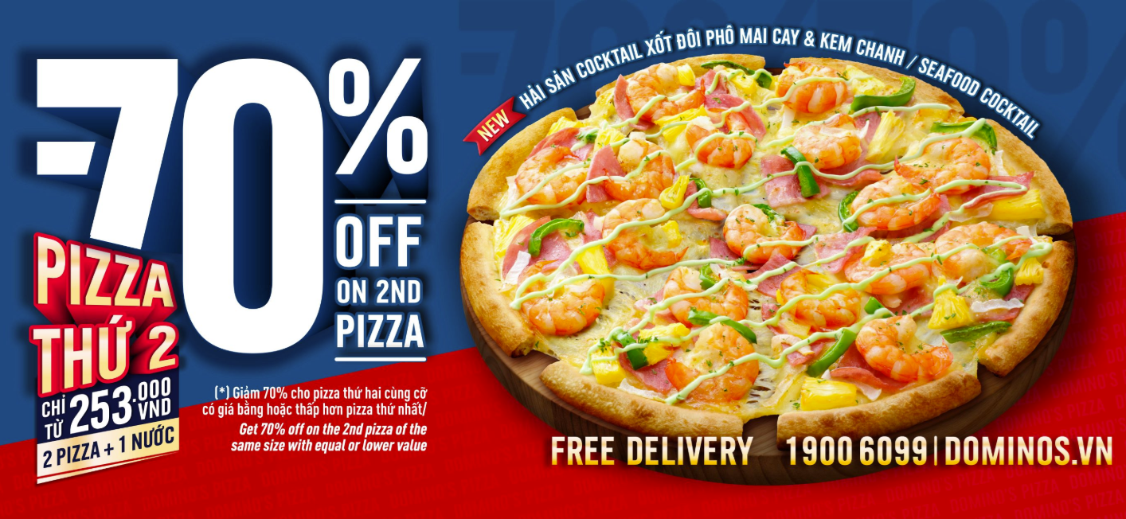
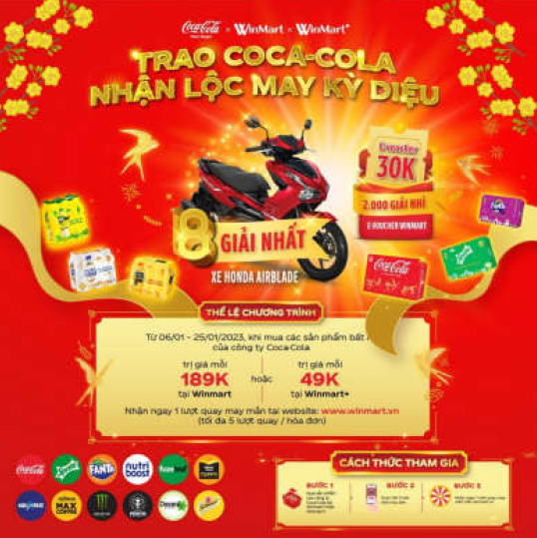
Pull strategy: focus on consumers
Direct price discounts
Example: 50% off selected products.
Coupons / vouchers / discount codes
Customers receive a price reduction on the current or a future purchase.
Example: Shopee — discount codes, free-shipping vouchers, flash sales, and double-date campaigns such as 8.8 and 11.11.
Buy-one-get-one / Multi-buy offers
Example: buy one get one free, buy two get one free, or buy a bundle at a lower total price.
Free samples / Product trials
Particularly suitable for cosmetics, food, beverages, and personal-care products.
Free gifts / Premiums
Example: Vinamilk — promotional gifts such as toys, cups, mugs, or water bottles.
Loyalty programmes and reward points
Example: collect points to redeem rewards, move up membership tiers, or receive exclusive benefits.
Contests, sweepstakes, lucky draws, and mini-games
Used to encourage participation, engagement, and social-media sharing.

Slide 52
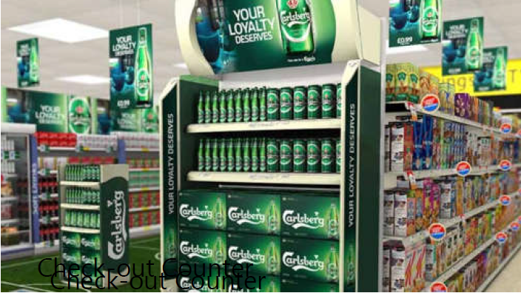
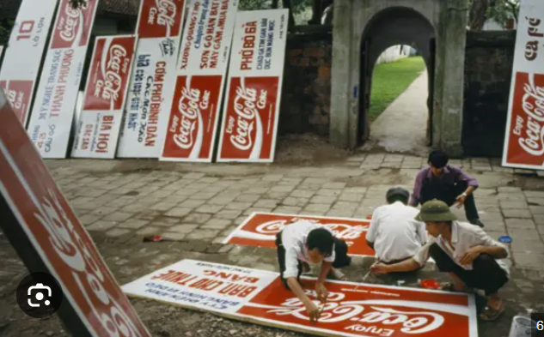
Push strategy: focus on intermediaries
The objective is to encourage distributors and retailers to stock more products, provide better in-store displays, and give the brand greater selling priority at the point of sale.
Trade discounts
The company offers distributors or retailers a lower purchase price when they order larger quantities.
Sales incentives / Sales bonuses
Dealers, retailers, or sales staff receive rewards for achieving specified sales targets.
In-store display support
Examples: sponsored shelves, posters, booths, standees, and other POSM materials.
Sales support
The company provides promotional staff such as PGs/PBs, organises product sampling, or conducts product demonstrations in supermarkets.
Sales contests
Dealers or retail stores compete to achieve the highest sales performance and receive rewards.

Slide 53
Discussion:
Programme A:
A 20% price discount lasting for 15 days.
Programme B:
A 30-day lucky draw promotion. For every purchase of VND 500,000, customers receive one entry into the prize draw.
There are 3,000 prizes with a total prize value of VND 2 billion. The top prize is a car worth VND 1 billion.
Discussion Question
Which programme is better? Discuss and justify your opinion.

Slide 54
Discussion
If the objective is to increase sales immediately in the short term, Programme A may be more effective.
If the objective is to protect the brand image and avoid price erosion, Programme B may be more suitable.
If the objective is to increase average order value, Programme B may perform better because customers need to spend at least VND 500,000 to receive an entry.
If the target customers are highly price-sensitive, Programme A is likely to be more attractive.
If the objective is to generate attention, excitement, and publicity, Programme B may be more effective.
If the objective is to control the promotion budget, Programme B has an advantage because the total prize value is capped at VND 2 billion, while the cost of Programme A’s 20% discount increases as sales volume rises.

Slide 55

Digital Marketing/ Direct Marketing
DIGITAL MARKETING

Slide 56
Digital/ Direct Marketing
Digital marketing refers to marketing activities that use digital devices, platforms, and channels—such as websites, search engines, social media, email, video platforms, and mobile apps—to reach, communicate with, and engage customers.
Direct marketing is a form of marketing in which a company communicates directly with specific target customers and enables them to respond or take immediate action.

Slide 57
Digital vs. Traditional Marketing Communications
Digital Mkt
Traditional Mkt
Tools: Search, social media, websites, email, apps
Interactive communication
Precise audience targeting
High personalization
Real-time and measurable data
Flexible and easy to optimise
Tools: TV, radio, newspapers, billboards
Mainly one-way communication
Broad audience targeting
Limited personalization
Difficult to track individual responses
High cost of modification
Key advantages:
Measurable
Targetable
Interactive
Flexible
Scalable
Key limitations:
Data privacy concerns
information overload and ad fatigue
Dependence on platforms and algorithms
Require continuous monitoring and optimisation
Digital mkt does not replace traditional mkt:
Our consumers still live in both digital and physical worlds

Slide 58
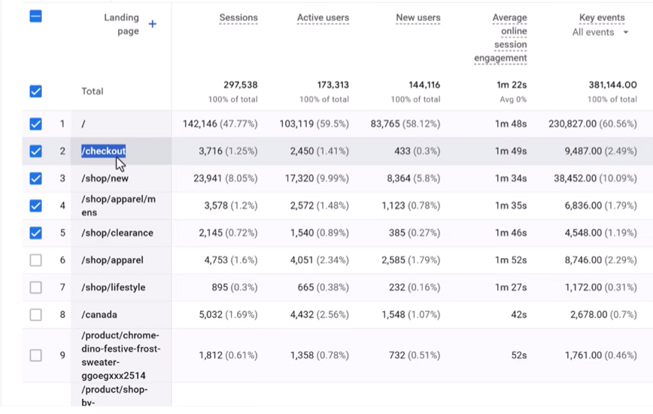
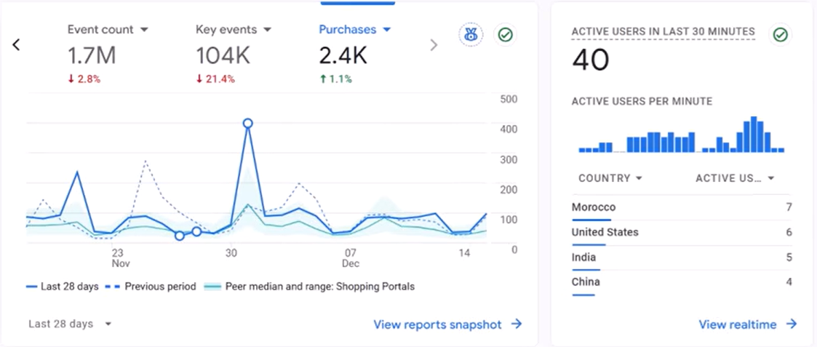
Digital Marketing channels
SEO (Search Engine Optimisation): tối ưu để khách hàng tìm thấy doanh nghiệp trên Google.
SEM (Search Engine Marketing): quảng cáo trả phí trên công cụ tìm kiếm

Slide 59
Social Search Optimisation means optimising content so that customers can find a brand more easily when searching on platforms such as TikTok, Instagram, Facebook, YouTube, and LinkedIn.
Example search: “Best sunscreen for sensitive skin review”
Businesses may optimise:
  captions
  hashtags
  keywords used in the video
  video titles
  review content
  comments and community discussion
  content formats such as how-to guides, reviews, comparisons, and real-user experiences
YouTube Search Optimisation (Video SEO) means optimising video content so that it appears more prominently when users search for tutorials, product reviews, real experiences, how-to content, or case studies.
Example search: “How to use sunscreen effectively”
Businesses should optimise:
  video title
  description
  thumbnail
  subtitles/captions
  keywords
  video content structure
Social Search Optimisation: Help customers discover the brand through social-platform search.
Video SEO: Help videos rank and get discovered through YouTube search.

Slide 60
Marketplace Search Optimisation means optimising product listings so that customers can find products more easily when searching directly on e-commerce marketplaces such as Shopee, Tiki, or Amazon.
Example search: “Acne facial cleanser”
Businesses should optimise:
  product titles
  product images
  keywords in product descriptions
  star ratings
  number of customer reviews
  chat response rate
  selling price
  vouchers and promotional offers
  store ranking and seller performance
  livestream content
  affiliate and KOC reviews

Slide 61
Affiliate / KOL / KOC Marketing: Selling or Building Trust Through Third Parties
This group of channels relies on other people talking about the brand rather than the company speaking about itself. Its main strength is that customers often trust the experiences, reviews, and recommendations of third parties more than direct advertising from the company.
KOL (Key Opinion Leader): a person who has influence or recognised expertise in a particular field.
Examples: a dermatologist recommending skincare products, a financial expert discussing banking services, a well-known lecturer talking about education, or a singer promoting a fashion product.
KOC (Key Opinion Consumer): an influential consumer who typically shares personal experiences of using a product or service.
Examples: someone reviewing a lipstick on TikTok after trying it themselves, a mother sharing her experience of using a particular milk product for her child, a student reviewing an English language centre, or a customer posting a video such as “I tried this restaurant on … Street.”
KOCs can create a sense of authenticity, relatability, and trust, helping other customers imagine the real-life product or service experience more easily.
Common KPIs:
  Reach / Impressions: level of audience exposure
  Engagement: likes, comments, shares, saves
  Clicks / Link clicks: number of clicks on a link
  Conversions / Sales: number of orders or registrations
  CPA / CPL: cost per acquisition / cost per lead
  Revenue / GMV: revenue or gross merchandise value generated
  ROAS / ROI: return on advertising spend / return on investment
  Sentiment: positive or negative attitudes expressed in comments
  Affiliate code usage: number of orders using each KOL/KOC’s code

Slide 62
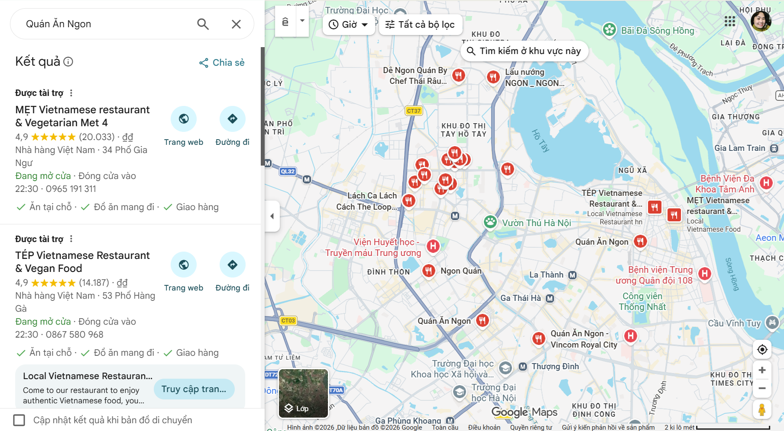
Local Search / Google Maps Optimisation: Location-Based Search
Examples: “Café near me,” “restaurants near HUST,” “English language centre in Bach Khoa.”
Businesses should optimise their Google Business Profile, including:
  address
  opening hours
  photos
  customer reviews
  frequently asked questions
  phone number
  website
  directions / map location

Slide 63
AI Search: Customers increasingly search through tools such as ChatGPT, Gemini, and AI Overviews.
  “Recommend five reputable IELTS centres in Hanoi.”
  “Compare banks that offer good credit cards for students.”
  “Which sunscreen is suitable for oily skin in a hot and humid climate?”
Businesses therefore need to make their online information clear, trustworthy, well-structured, and easy for AI systems to identify and cite. This approach is often referred to as GEO – Generative Engine Optimisation or AI Search Optimisation.
Content should include:
  consistent brand information
  clear product descriptions
  FAQs
  in-depth articles
  credible reviews
  structured data
  reputable cited sources
  up-to-date information

Slide 64
Email / SMS / Zalo Marketing: These channels are used to nurture, remind, and activate customers whose contact information is already available.
Their key strength is that the company does not simply wait for customers to search for or return to the brand. Instead, it can proactively:
  send reminders
  maintain customer relationships
  deliver personalised offers
  encourage immediate purchase or other actions
These channels can be highly effective, but they can also create a negative reaction if messages are sent too frequently, are irrelevant to the customer, or use customer data without sufficient transparency.

Slide 65
Content marketing: articles, videos, infographics, e-books, and podcasts.
Marketing analytics is the process of collecting, measuring, analysing, and interpreting marketing data to understand whether a campaign is effective, where customers come from, how they behave, and what needs to be optimised.
Customer sources: Do customers come from Google, Facebook, TikTok, email, Zalo, affiliates, or organic search?
Customer behaviour: Which pages do customers visit? How long do they stay? What do they click on? At which stage do they drop out?
Conversions: Do customers register, make a purchase, complete a form, call, or send a message?
Costs: How much does each click, lead, or order cost?
Customer value: Revenue, profit, customer lifetime value, and repeat-purchase rate.
Common Tools
Google Analytics 4: analyses website/app traffic, customer behaviour, and conversions.
Google Ads / Meta Ads / TikTok Ads Manager: measures the performance of paid advertising campaigns.
Meta Pixel / Conversions API: sends event data from websites, apps, or servers to Meta to support advertising measurement and optimisation. Meta describes the Conversions API as a way of creating a connection between an advertiser’s marketing data and Meta’s systems.
CRM systems: store customer information, consultation history, purchase history, and customer-service records.
Email / Zalo / SMS platforms: measure metrics such as open rate, click-through rate, and conversion rate.
Power BI: combines and visualises data from multiple sources for reporting and analysis.

Slide 66
A lead is a potential customer who has shown some level of interest in a product or service, but has not necessarily made a purchase yet.
Someone who sees an advertisement is not necessarily a lead.
Someone who likes a post is also not necessarily a lead.
A person is usually considered a lead when they take an action that shows clearer purchase interest, such as providing contact information, sending an enquiry, requesting a consultation, or registering for an offer.
Example:
An IELTS centre runs an advertisement. 500 people see the ad, and 60 people complete a form and leave their phone numbers to receive a consultation. In this case, the 60 people are leads.
Other examples of leads include:
A customer leaves a phone number to request a consultation.
A customer completes a form to request a quotation.
A customer sends a message on Facebook or Zalo to ask about the price.
A customer registers for a free trial class.
A customer downloads a report or e-book and provides an email address.
A customer adds a product to the shopping cart but does not complete the purchase.

Slide 67

Direct Sales

Slide 68
Direct sales refers to selling products or services directly to customers through personal interaction, without relying mainly on mass-media communication or independent retail intermediaries.
The salesperson identifies customer needs, explains the offer, answers questions, handles objections, and tries to close the sale.
Typical direct sales activities include:
  face-to-face selling
  sales calls
  product demonstrations
  consultation and needs assessment
  quotation and proposal
  negotiation
  follow-up
  closing the sale
  after-sales relationship management

Slide 69
Common KPIs for Direct Sales
Number of leads: potential customers generated
Number of qualified leads: leads with a realistic purchase potential
Contact rate: percentage of leads successfully contacted
Appointment rate: percentage of prospects who agree to a meeting or consultation
Conversion rate: percentage of prospects who become customers
Sales volume: number of units or contracts sold
Sales revenue: total revenue generated
Average order value: average value of each transaction
Sales per salesperson: revenue or units generated by each salesperson
Sales cycle length: average time from first contact to purchase
Customer acquisition cost (CAC): cost of acquiring one new customer
Repeat purchase rate: percentage of customers who buy again
Customer retention rate: percentage of customers retained over time

Slide 70
Role of direct sales:
Useful for high-value, complex, customised, or high-involvement products and services such as B2B solutions, banking, insurance, real estate, education, automobiles, and professional services.
Advantages: highly personalised communication, immediate feedback, easier objection handling, relationship building, and strong potential for closing complex sales.
Disadvantages: expensive per customer, difficult to scale, dependent on salesperson quality, and vulnerable to inconsistent service or aggressive selling.

Slide 71
Ethics selling
Helping customers make a decision that is in their interests as well as the company’s. Problems arise when the salesperson has more information than the customer and uses that advantage unfairly.
The main ethical risks include:
  Misleading claims: exaggerating product performance, hiding limitations, or making claims that cannot be supported.
  Example: telling a customer that a skincare product “will completely remove acne in seven days” without evidence.
  Pressure selling: creating excessive psychological pressure so that the customer feels unable to say no.
  Example: “You must sign today or you will lose this opportunity forever,” when the offer is not genuinely limited.
  Hidden conditions or fees: highlighting attractive benefits but not clearly explaining important restrictions, charges, contract terms, or cancellation conditions.
  Example: promoting a “0% instalment plan” without clearly explaining administrative fees or penalties.
  Selling unsuitable products: recommending what generates the highest commission rather than what actually fits the customer’s needs.
  Example: a bank employee encouraging a student to take an expensive financial product that is inappropriate for their situation.
  Misuse of customer data: collecting or using phone numbers, emails, purchase history, or personal information without proper consent or for purposes the customer did not expect.
  False scarcity: pretending that stock, places, or promotional time is limited when it is not.
  Example: “Only two places left!” when there is no real capacity limit.
  Manipulating vulnerable customers: taking advantage of customers who may have limited knowledge, financial difficulties, age-related vulnerability, or emotional distress.
  Conflicts of interest: failing to disclose that the salesperson receives a higher commission for recommending one product over another.

