Slide 1

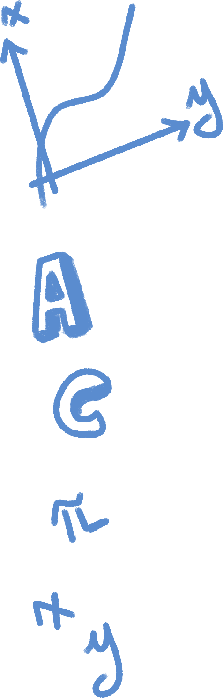





No Leash
By Team8
Teammates:
叶润莹, HUST
胡耘宁, SUST
陈慕涵, SJTU
@moonlab_studio
https://linktr.ee/moonlab_studio

Slide 2
Background
One day, the government issued a ban prohibiting humans from raising large dogs. The content of the ban was very unreasonable. Even some gentle and harmless dogs were clearly banned. Finally, a brave dog decided to escape from the city and return to nature.
However, things were not as simple as imagined. Heaven and hell were just a thought...

Slide 3




How to play
S
E/J
W/Space
P/Esc
Open the trash can
Terrain change
Jump
Pause
1, 2, 3, 4: dance

Slide 4
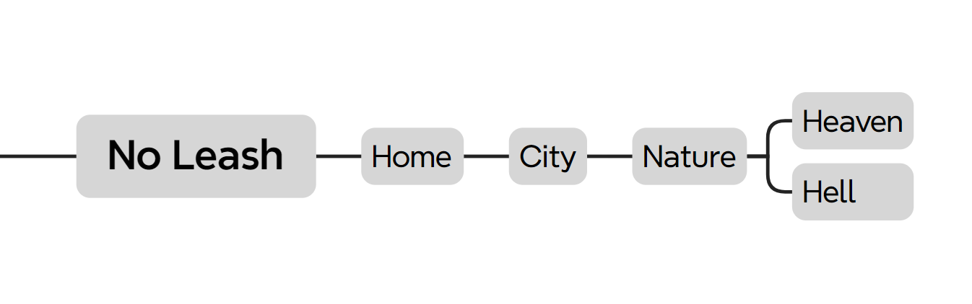
Levels

Slide 5








Instructions
W/Space:
Jump
E/J:
Terrain change
1, 2, 3, 4:
Dance!
P/Esc:
Pause
Swifter and higher
Be careful of rotten flesh!
Hearing for animals
Smell(distance)
“General turmoil”
(“鸡飞狗跳” in Chinese)
Be careful with the electrical appliances!
Snack for people, but for dogs…

