Slide 1
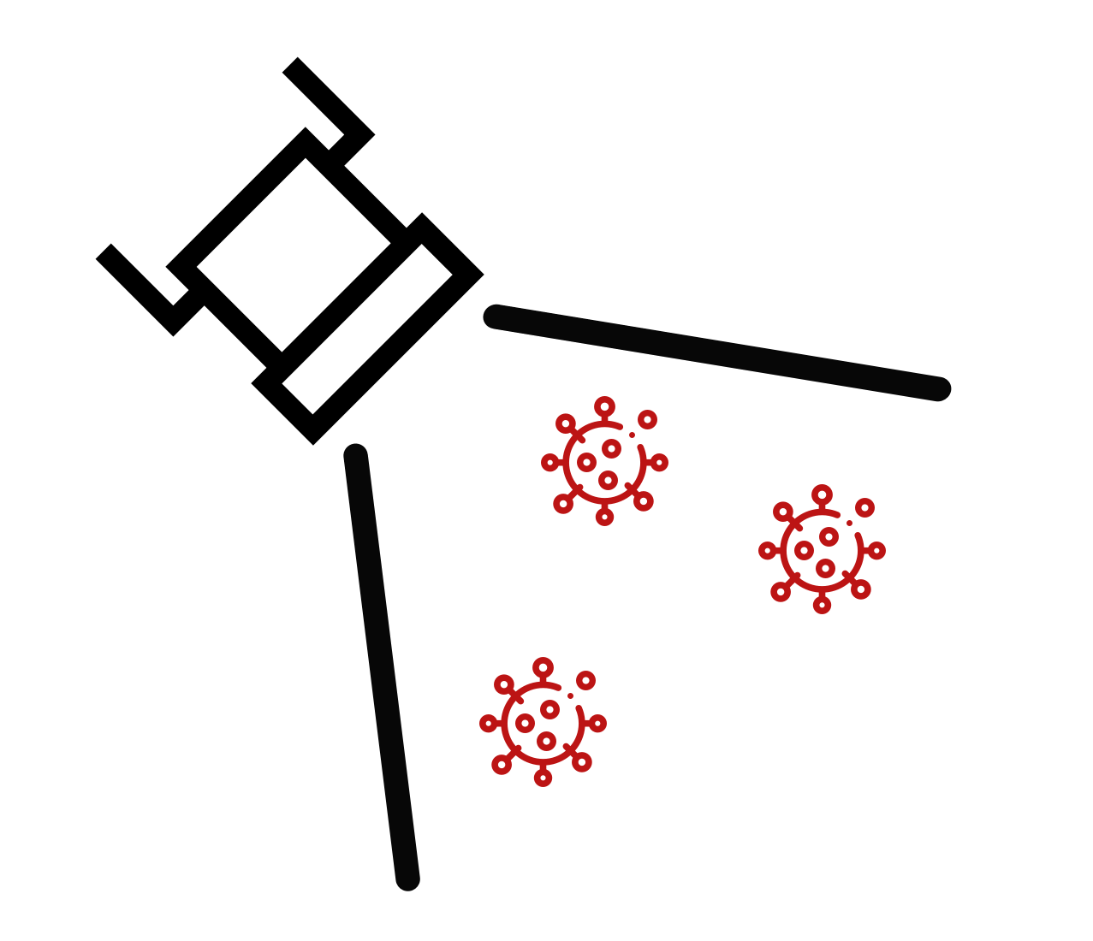
FloodLAMP
Biotechnologies, PBC
Extending the Reach of LAMP:
A platform for globally accessible disease screening
BARDA Market Research - March 7, 2022
Randy True, Founder and CEO | randy@floodlamp.bio

Slide 2

“FloodLAMP's mission is to improve global health and resiliency through universal access to rapid molecular testing.”
New testing technology
01
Turnkey screening programs
02
03
Disruptive open source strategy

Slide 3
2) Platform – Wraparound program components
Products
Applications
COVID Response
Emerging Threats
(Pandemic Prep)
TB
Zikka
Influenza
STD's
Cancer
All-in
Test Kits
Reagent
Test Kits
Collection Kits
Standard Consumables
Standard Equipment
PHYSICAL
Core
Modules
Sample Processing Sites (Labs)
App
Admin Portal
Training Program
Quality Management System
DIGITAL
Service, Support,
Consulting
Network
EMS & Municipalities
Schools and Businesses
U.S. Federal Agencies (BARDA, ASPR, CDC, DoD, FEMA)
International Governments
Testing Program Management

Slide 4
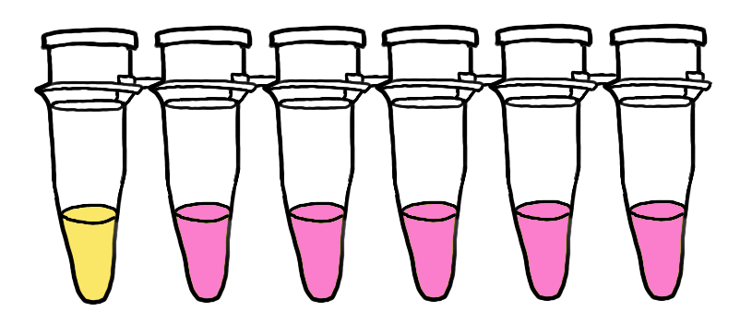

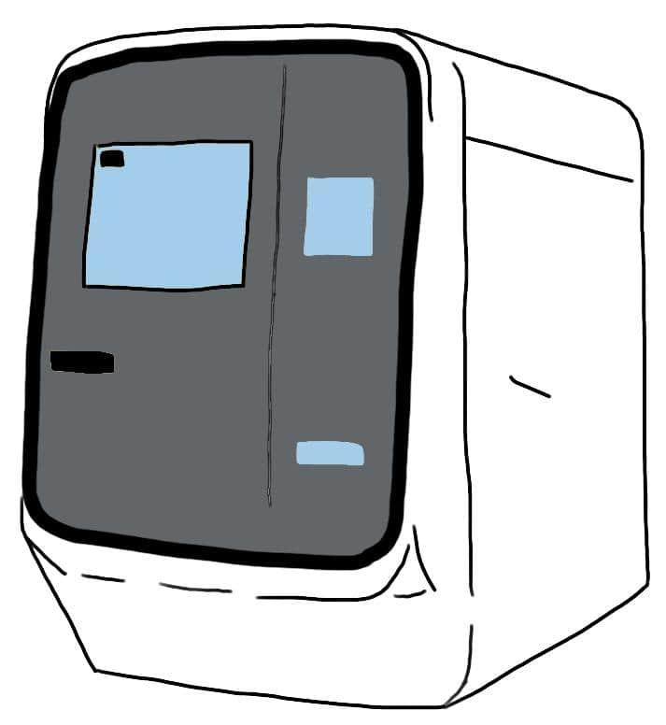
PCR and LAMP Sister Assays
visual readout
QuickColorTM LAMP Test
M1804 MM
Standard by-the-book 25µL reaction
3 primer sets mixed (AS1e, N2, E1)
25 minutes at 65°C
Streamlined Sample Prep
Same sample for both tests
2µL sample volume
Standard Rabe-Cepko TCEP/EDTA inactivation solution
Added directly to dry swabs
Same sample for both tests
Standard RT-qPCR instrument
EasyPCRTM Test
Luna E3006 kit
Standard by-the-book 20µL reaction
CDC primers in SalivaDirect config (N1, RNAseP)

Slide 5
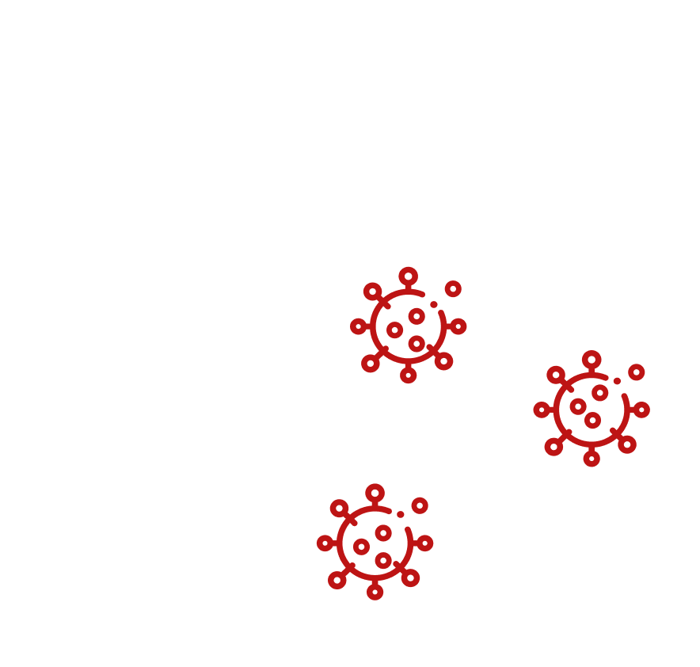
The Performance Sweet Spot
Supports at-home concierge diagnostics
Constrained by manufacturing
Too expensive for public health screening.
People want higher confidence in results.
RAPID TURNAROUND TIME
< 2 hrs sample to answer
Local
Fast
Cheap
Molecular
Flexible
Resilient
Antigen Test Strips
Rapid Molecular Cartridges
High upfront instrument costs
Limits replicability
Long turnaround period
Inefficient for large scale screening
Clinical Lab Purified PCR
LOW COST
FloodLAMP QuickColorTM
GOOD SENSITIVITY
SalivaDirectTM
< $5 / person
Detects Pre-Infectious Asymptomatics
FloodLAMP Pooled Swab PCR
These 2 tests have potential to drive down PCR costs.

Slide 6
Addressing Current Vulnerabilities
1
Antigen Tests are at Risk of Failure with New Variants
2
Multi-Gene Molecular Tests are Resilient to New Variants
Test combines primer sets for 3 genes
ORF1ab ; N2 ; E1
LAMP uses 6 primers and is highly tolerant to mismatches
(see recent NEB preprint analyzing our primers)
3
Reagent Based Molecular Tests are Adaptable and Scalable
4
FloodLAMP can deliver Prepositioned Assets
Vestibulum congue tempus
Primers swapped quickly and cheaply.
Other test components remain the same.
Primers produced in large volumes and distributed quickly.
10s of M of reactions / production run.
For rapid response, scaling & surge capability
Our systems comprise of ordinary, low-cost lab equipment
Offering best-in-class capacity per cost
We deliver custom-designed wraparound components
E.g: digital tools, QA, training

Slide 7

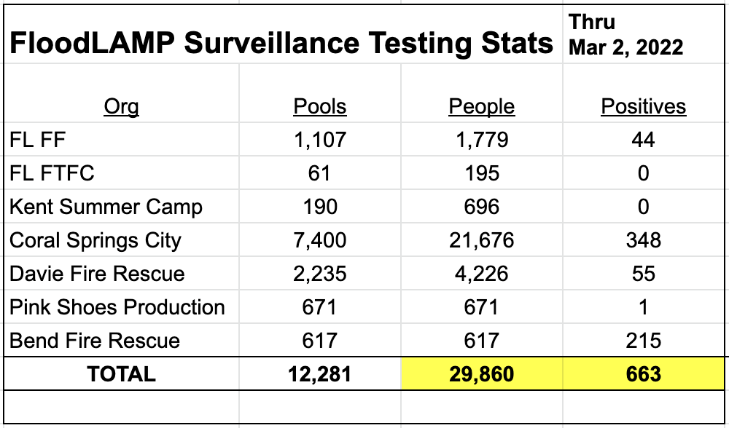
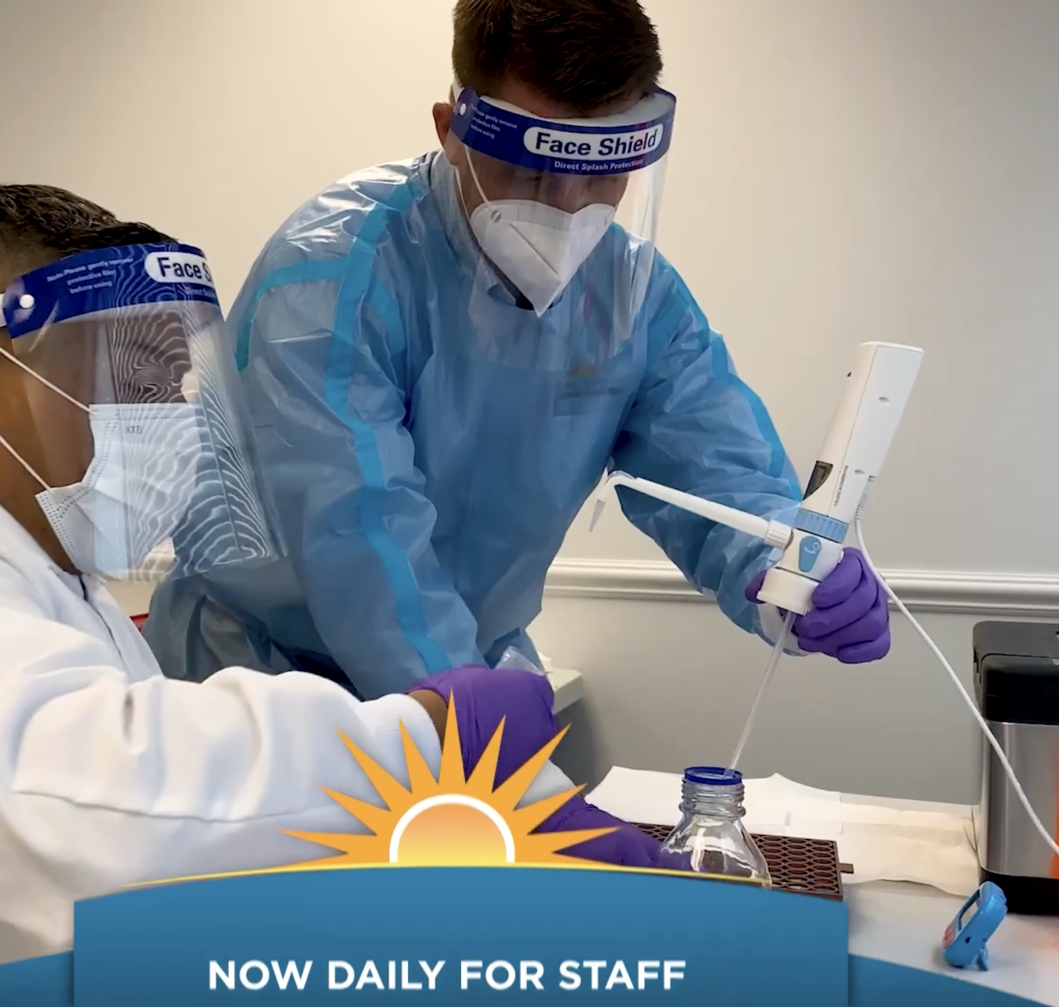
Operating Programs in the Real World
EMS Leadership Conference Screening
1,000 attendees
Municipal & EMS Deployments
Coral Springs, FL approx. 132,000
Davie, FL approx. 104,000
Bend, OR approx. 94,000
Preschool Screening with Family Pooling
Approx. 40 families
65-105 people per bi-weekly screening

Slide 8
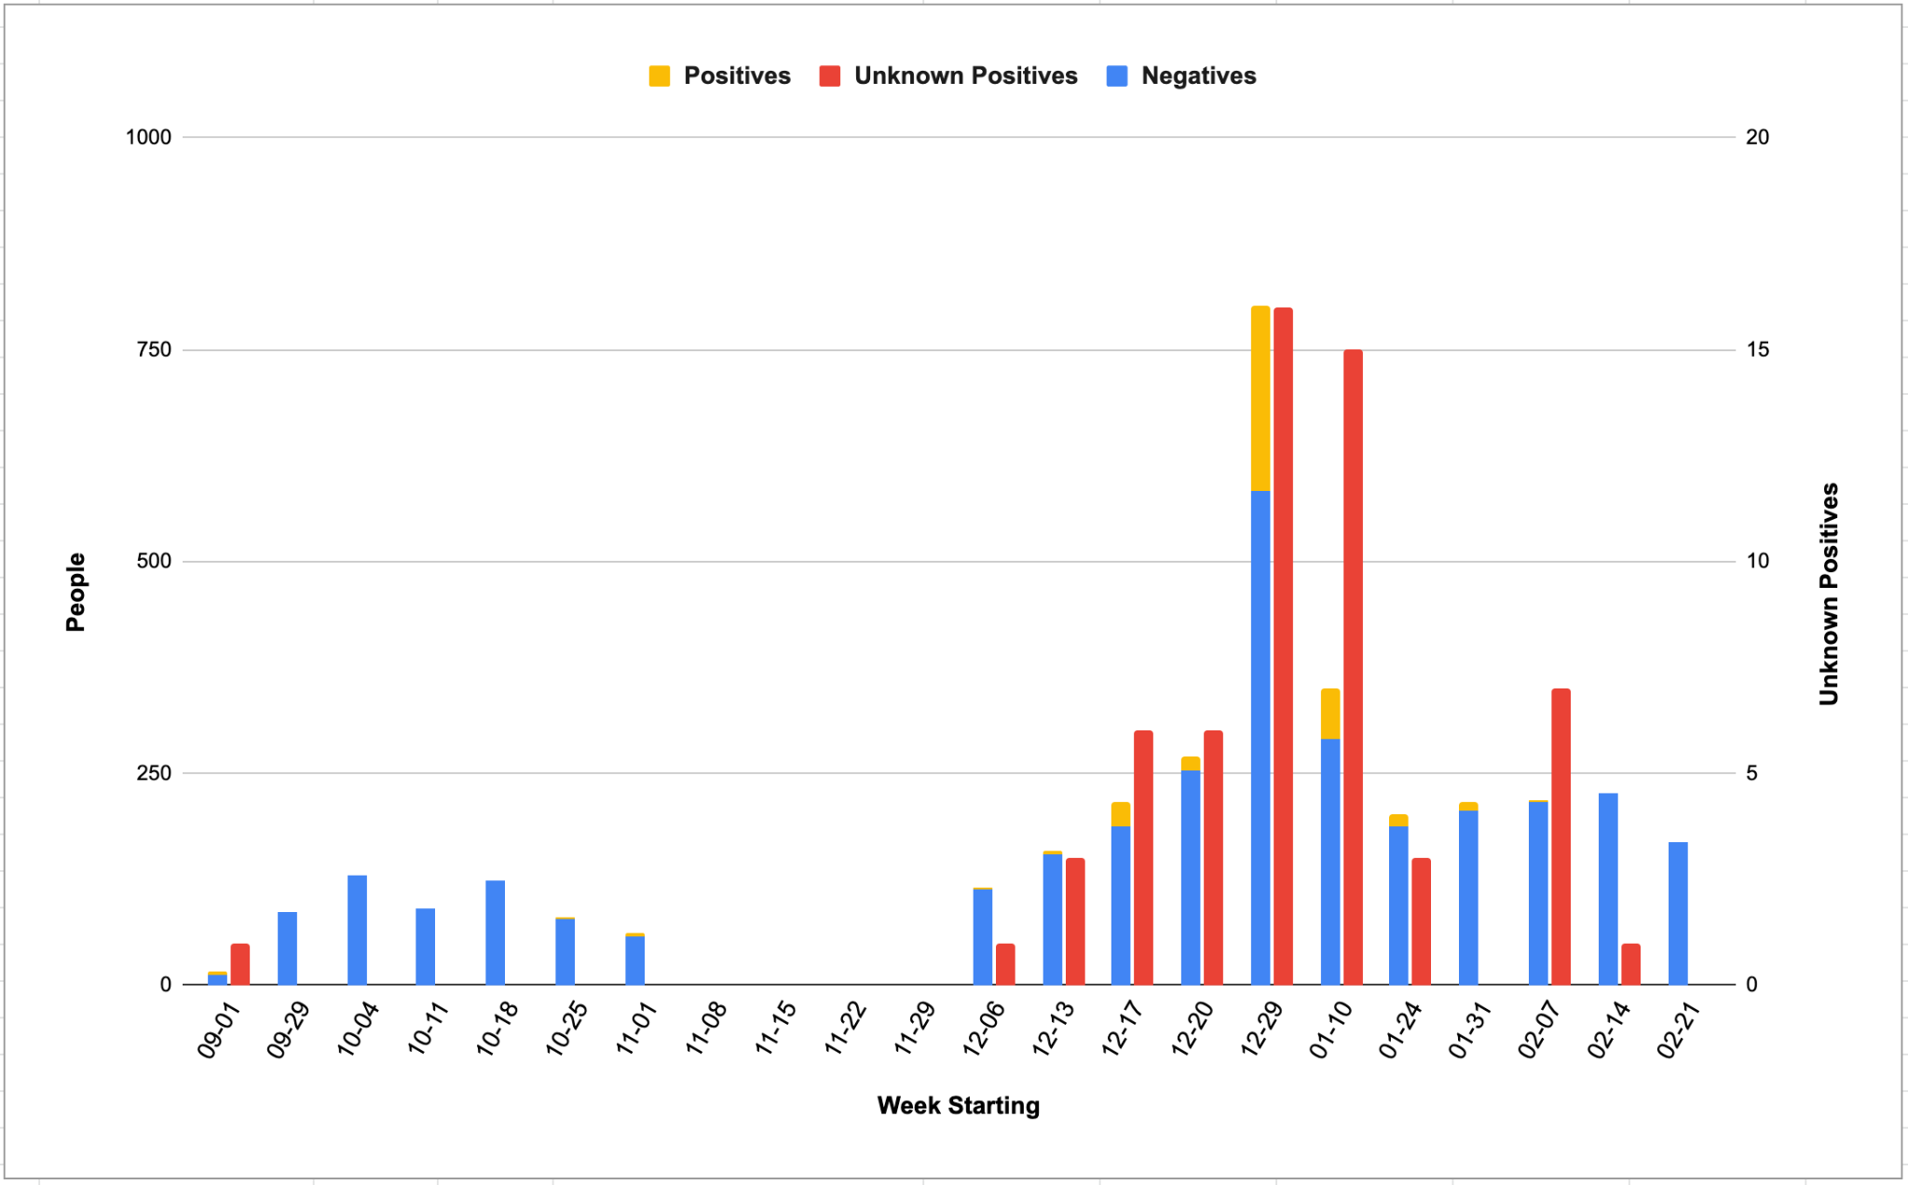
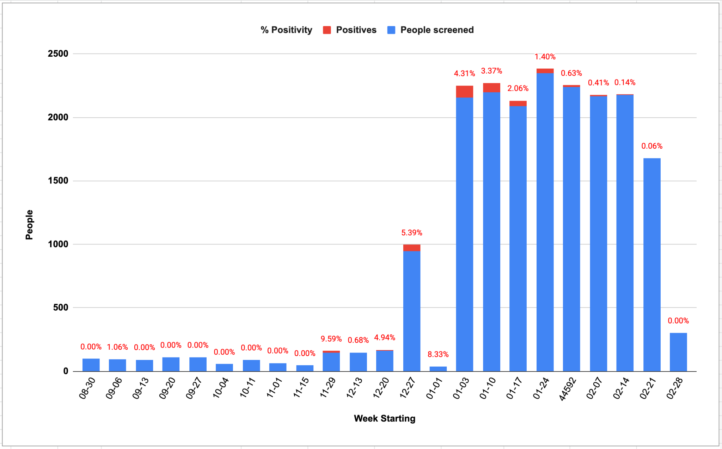
FloodLAMP’s successful response to surges
Town of Davie, FL
Coral Springs, FL

Slide 9
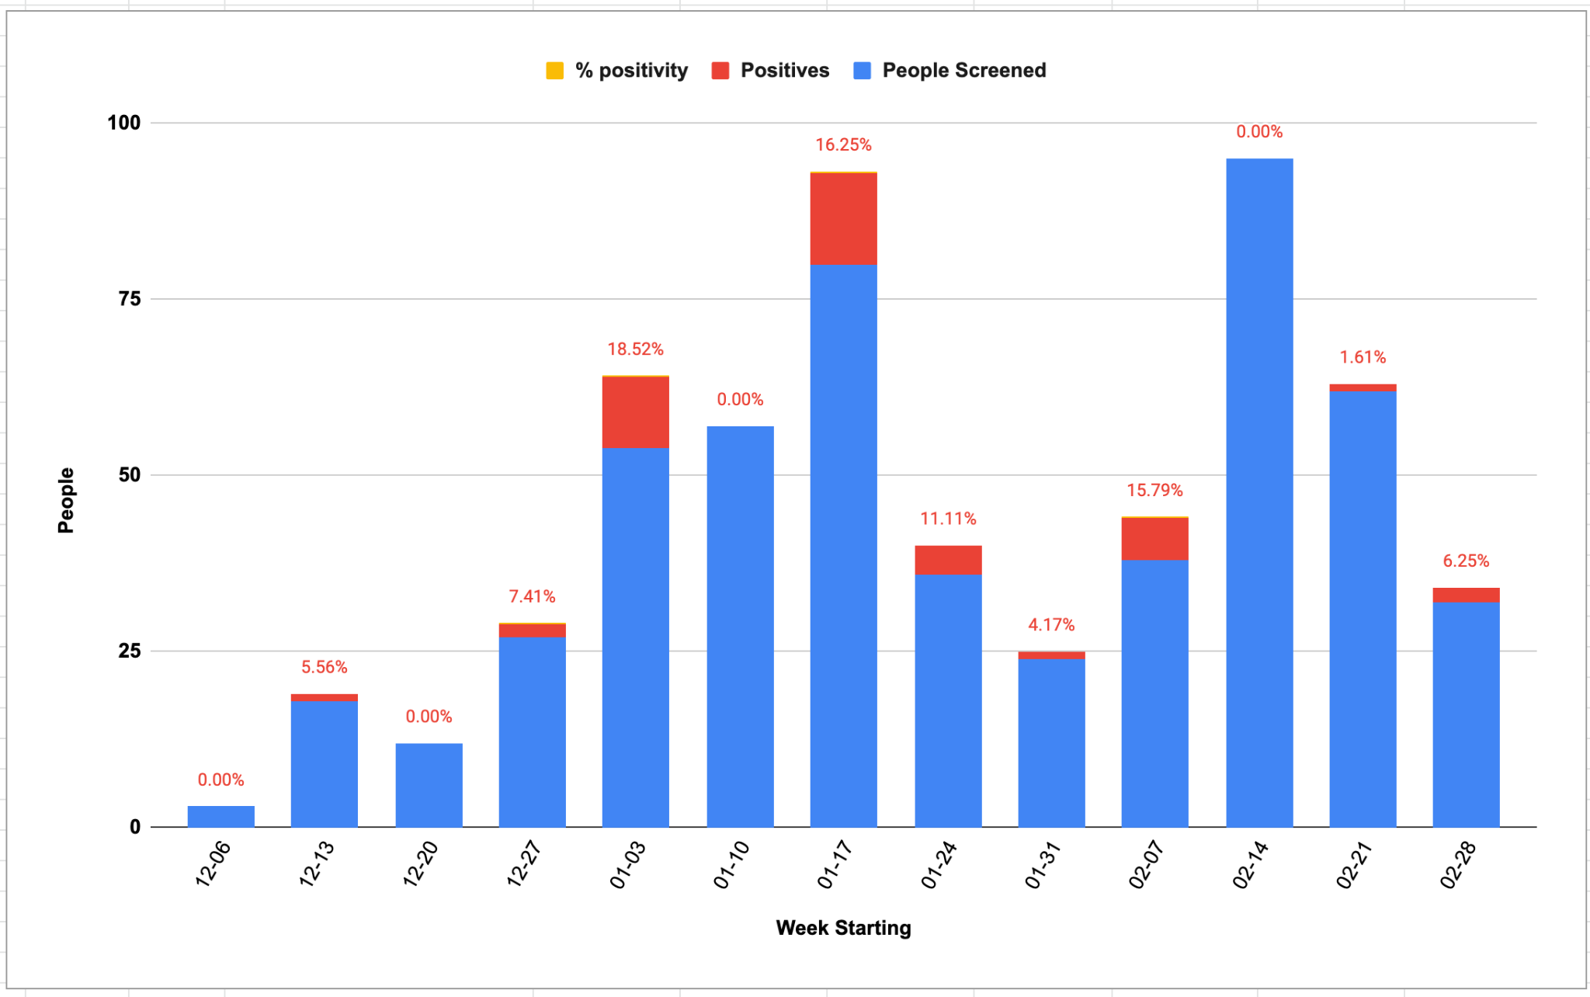
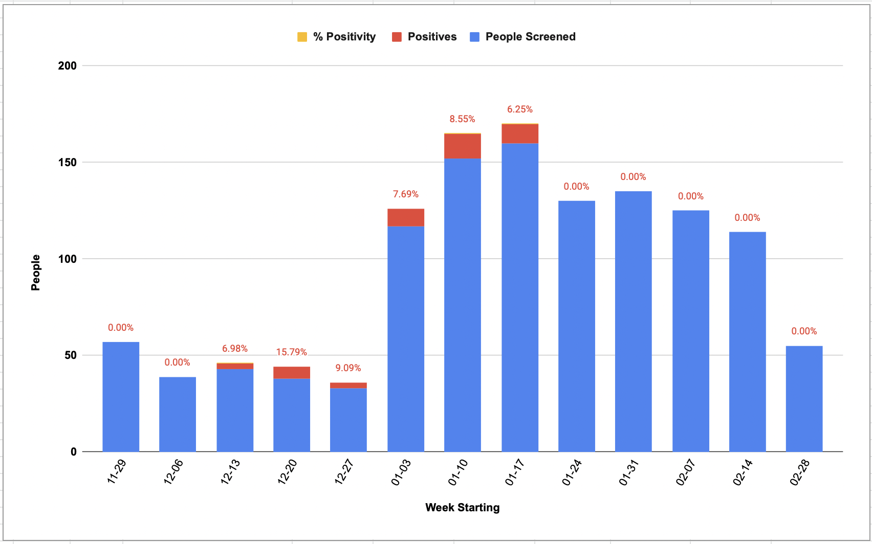
FloodLAMP’s successful response to surges
Bend, OR
Preschool, CA

Slide 10
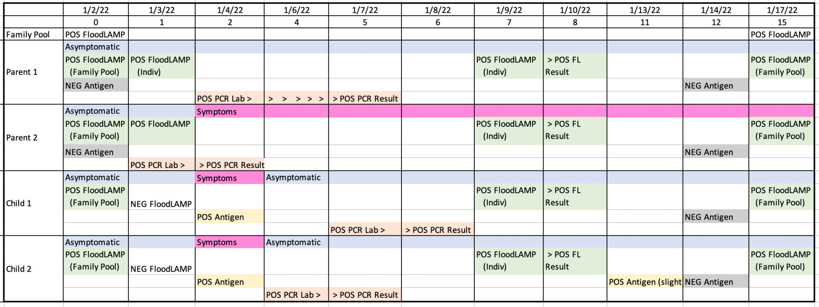
Case Report: Pre-School Screening
Several infections detected 1-2 days before symptoms or antigen tests
Family pooling, in 3 cases, detected infections among student family members and protected spread in the congregate setting (such as schools and workplaces).

Slide 11
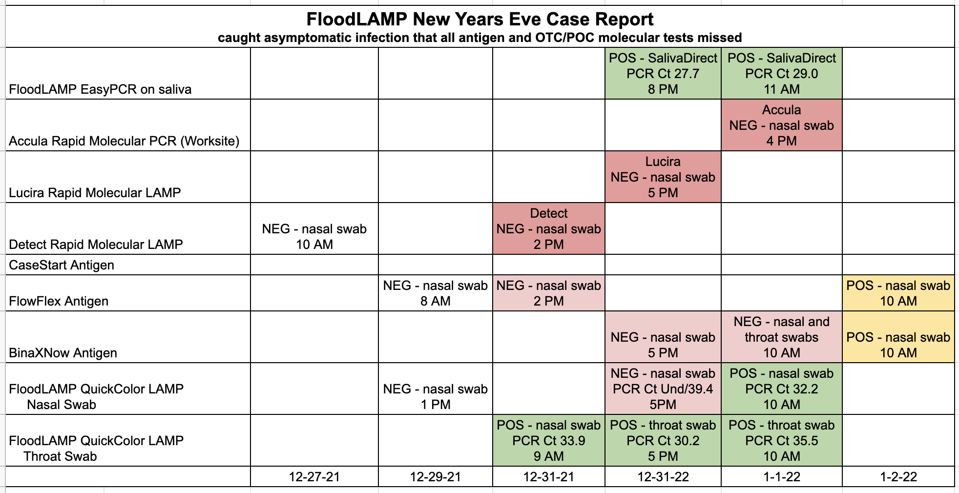
Case Report: New Year’s Eve
Detection of an asymptomatic infection that was missed by 3 expensive OTC/POC rapid molecular tests
Detect, Lucira, Mesa Accula were negative
BinaxNOW wasn't positive until 2 days later.
All FloodLAMP positive samples confirmed by PCR

Slide 12
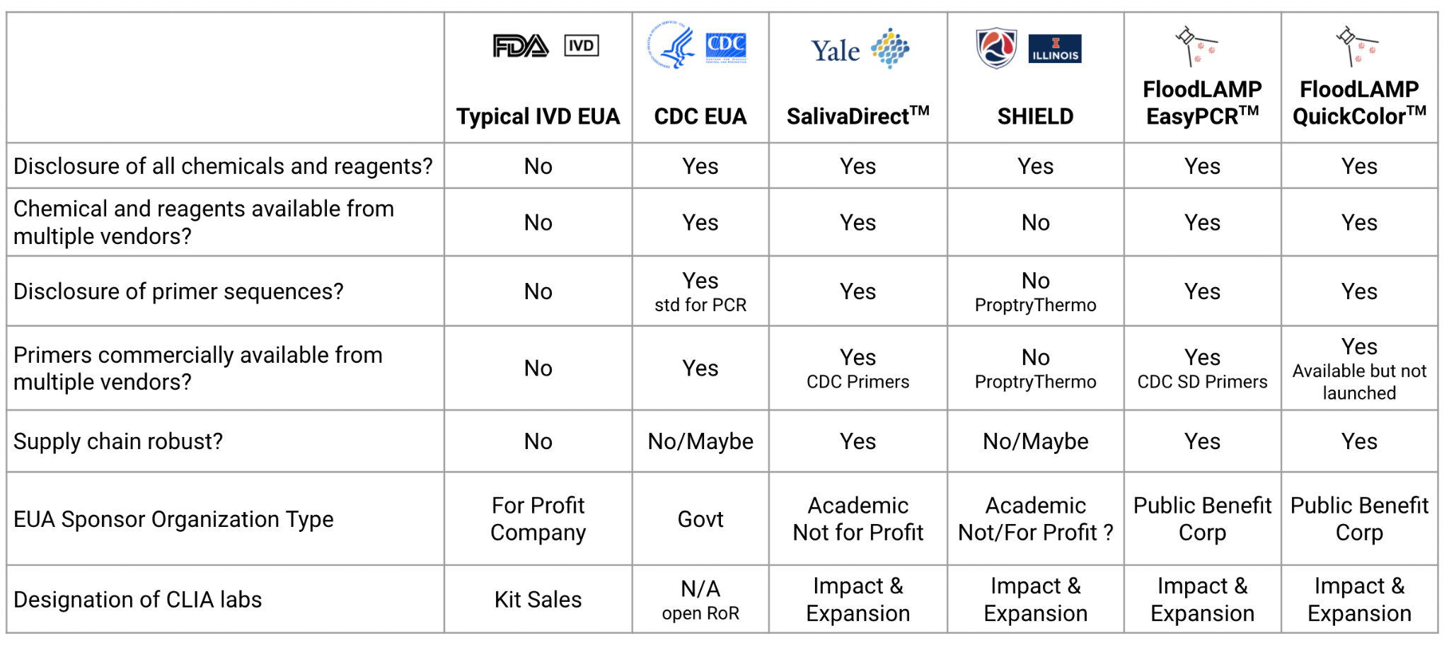
Open EUAs
Provide a path to establishing generics in diagnostics
(direct opposition to typical IVD EUA).
FloodLAMP has submitted 2 Full EUAs + pre-EUA as open protocol.

Slide 13
Support for Further Implementation
Federal support is required for rapid deployment to both a number of interested organizations (e.g. EMS, early child-care hospitals) and to the communities most in need.
Rapid Response Surge Screening
Sustained Community Assurance Screening
Multi-Site Study
Network of EMS Surveillance Screening Sites
Immediately deployable to hotspots
Highly replicable with low capital cost (unlike most PCR based mobile testing)
Partner with local community groups for building trust and driving adoption
Anchored in schools and workplaces
Expand to entire communities with flexible and convenient options
Marry with policies such as test-to-stay that drive adoption
Compare to antigen studies on key endpoints:
Additional reduction in Rt from Screening Program
% participation in program
Participant satisfaction in program
School/work days saved by program (test-to-stay)
High need for screening critical first-responders owing to the large degree of vaccine hesitancy in this population
FloodLAMP has established relationships with EMS leadership (facilitates rapid expansion)
Ideal group to expand screening to schools and businesses
(EMS has community trust)
‹#›

Slide 14
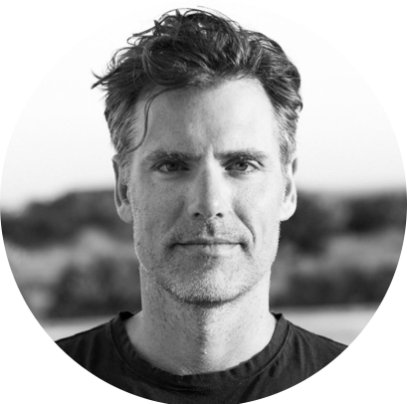
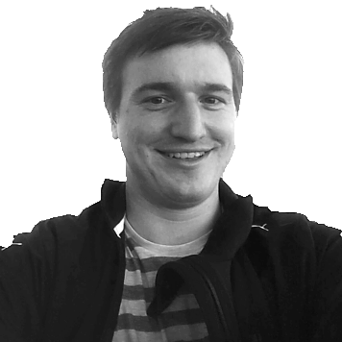
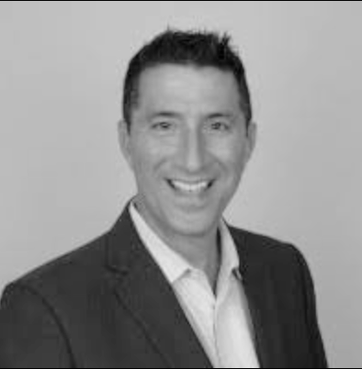
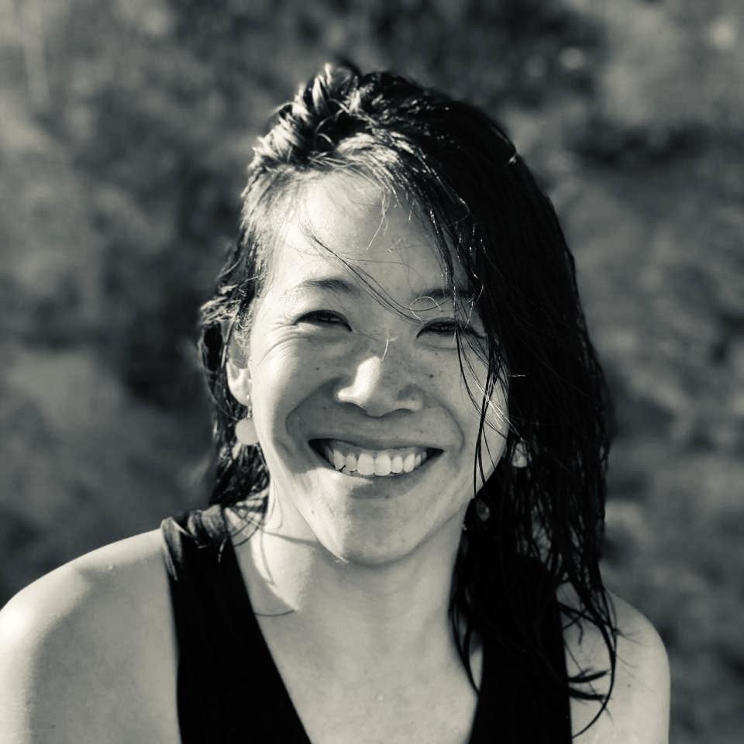
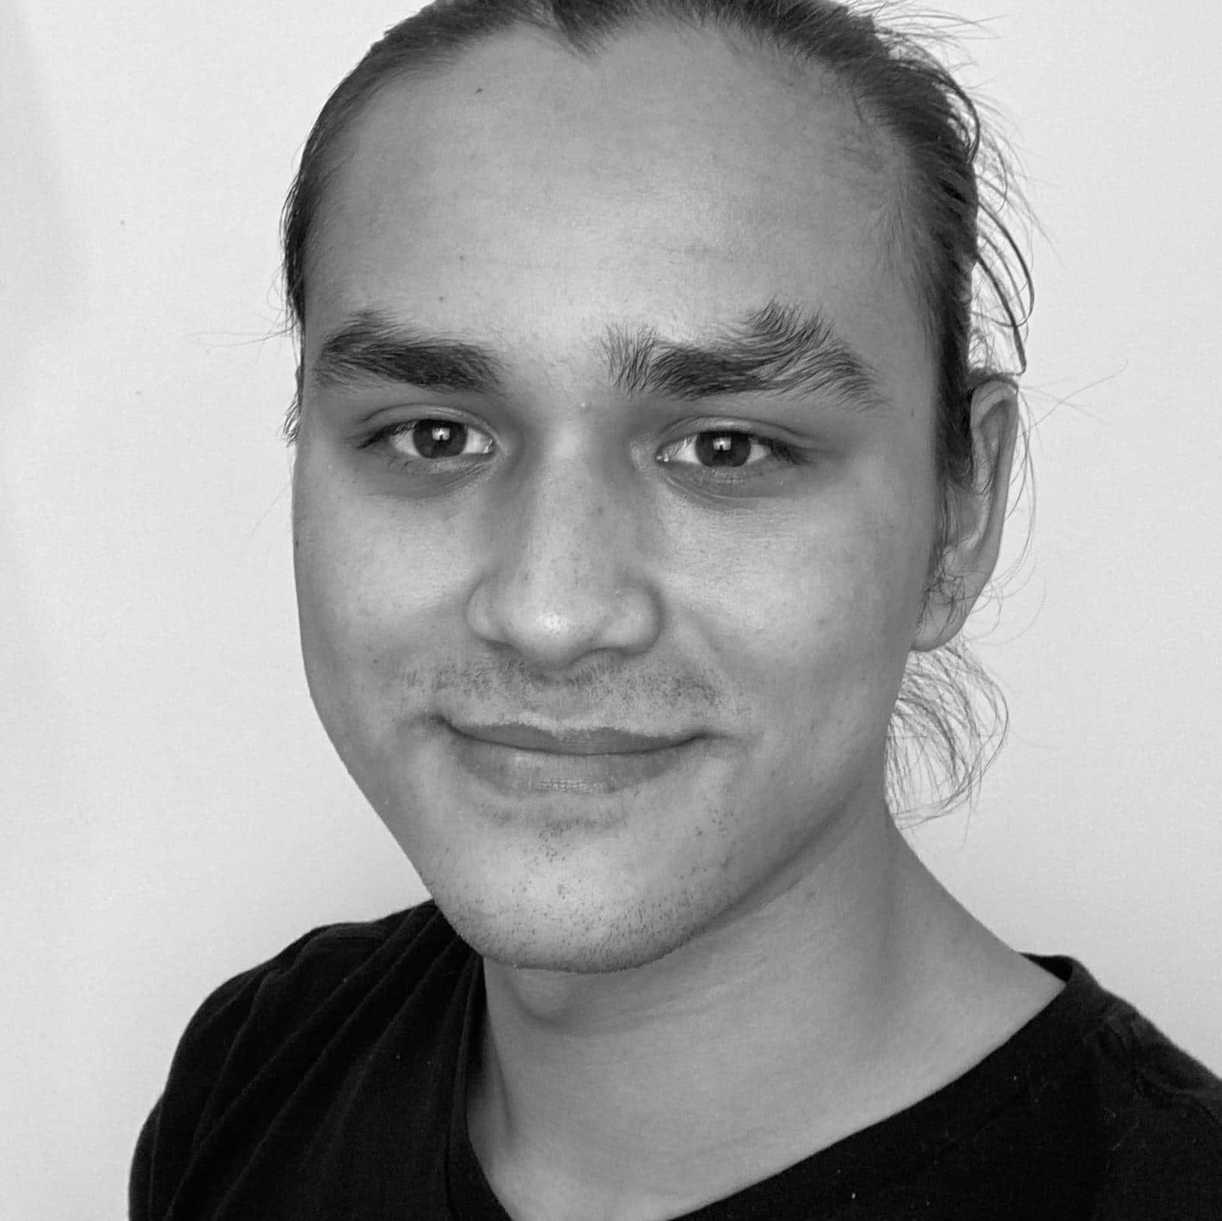
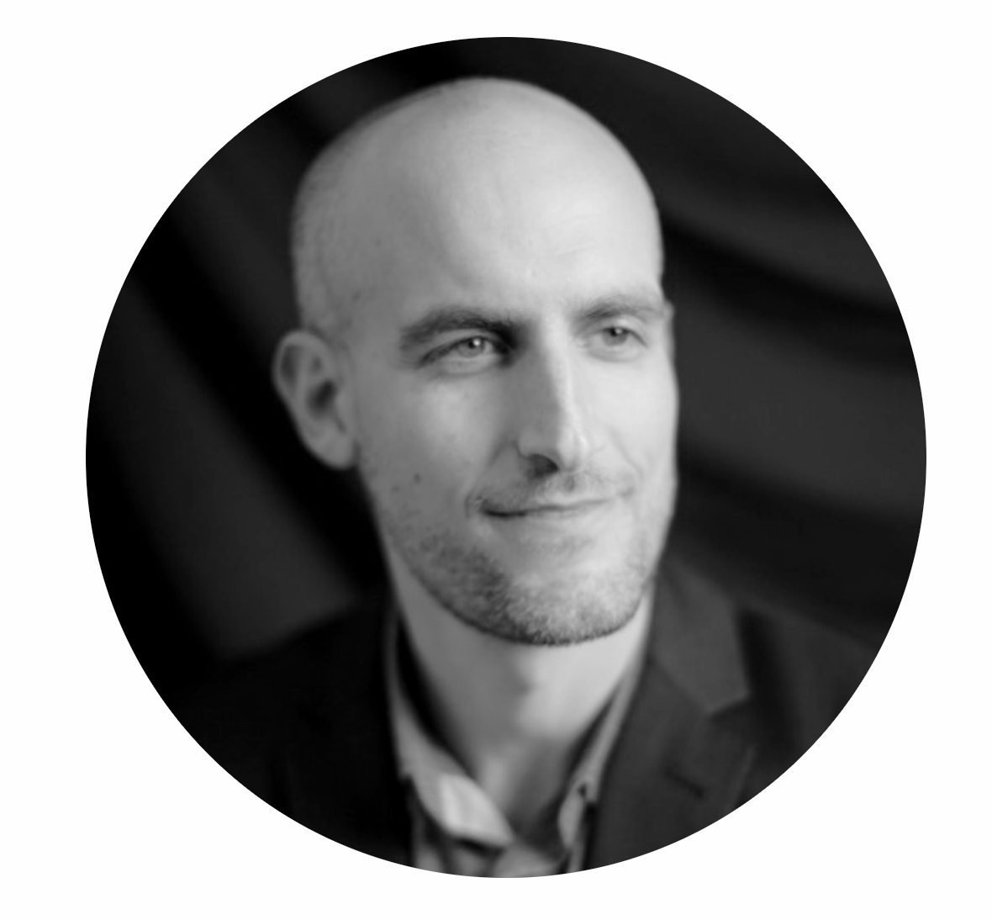

FloodLAMP Team
Scientific Advisory Board
Anne Wyllie
Yale, Lead Researcher – SalivaDirect
Bill Hyun
UC San Francisco, Genoa Ventures
Randy True
Founder & CEO
• Founder TMI Inc. - Acq. Affymetrix
• Former VP of R&D at Affymetrix
bit.ly/biosketch-randalltrue
co-author global LAMP consortium review: bit.ly/gLAMP-review
https://abrf.memberclicks.net/jbt-2021-september-issue
Industry Advisors
Tim Lugo
William Blair Biotechnology Group Head
Zarak Khurshid
Asymmetry Capital, Top MDx Analyst
John Edge
Oxford Internet Institute, Blue Field Labs, ID2020
Kevin Schallert
COO
• Co-Director covid19sci.org, National Volunteer Scientist DB
• Former Founder & COO of VineEye
Dr. Peter Antevy, MD
Program Medical Director
Acknowledgments
Antanas Sadunas, Sam Fogelberg, Carey Tan
Jeff Huber, Cliff Wang, Chris Mason, Simon Johnson, Brett Johnson, Mike Finney, Ron Cook
NSVD: Vincent Law, Michael Wells, Katrina Brandis, Gaby Hartley, Tim Earley, Nasreen Haque
Research-Aid Networks: Jeremy Rossman
EMS deployments: Adam, Danny, Alex, Petar, Dr. Paul Pepe
Thanks too to all of our advisors, volunteers & former employees!!
Theresa Ling
UX/Design Lead
Brandon Smith
Lab Assistant
Gary Withey, Ph.D.
Vice President of Research & Development
Esmé Thornhill-Davis
Communications Intern

Slide 15
APPENDIX

Slide 16
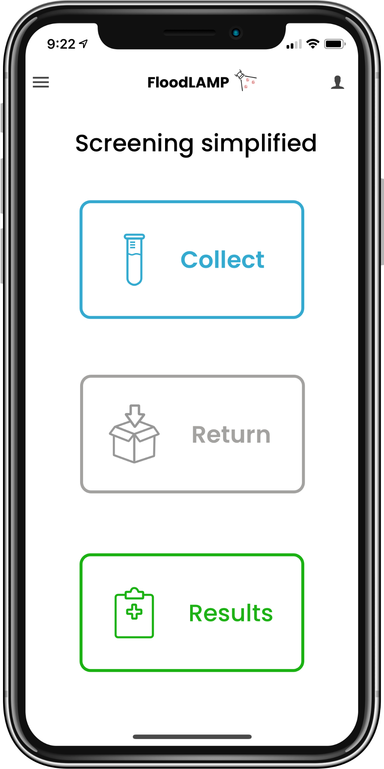
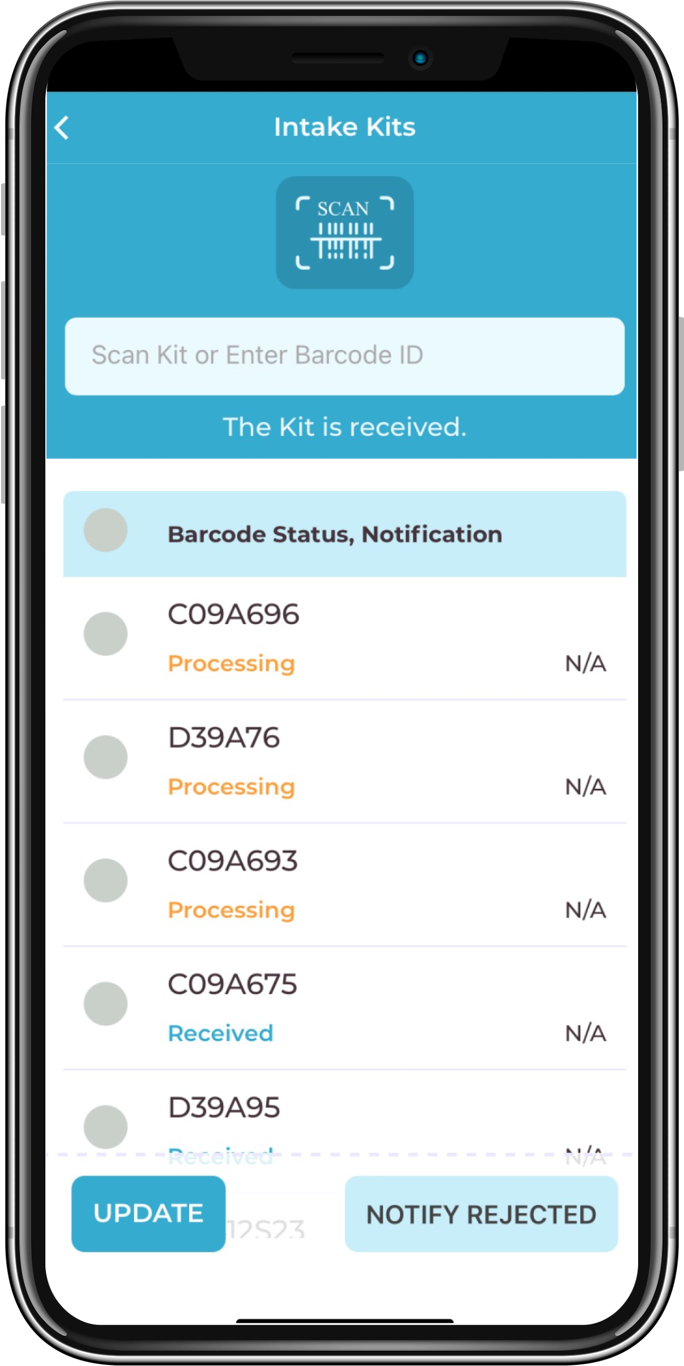
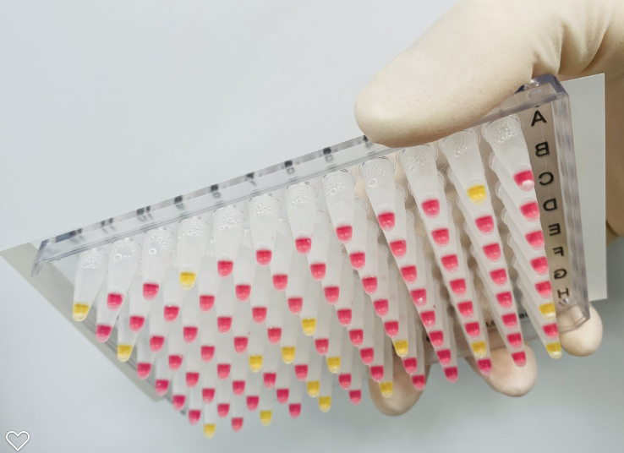
Quad Chart
Objective:
FloodLAMP's mission is to improve global health and resiliency through universal access to rapid molecular testing. We have developed a key capability that can help realize the enormous potential of the field of diagnostics in ending this pandemic, preparing for the next one, and improving human health globally. Our near term objective is to deploy hundreds of sites delivering easy to use, flexible, fast turnaround COVID surveillance screening to drive durable adoption in the communities most in need.
Description of effort:
Fully integrated turnkey surveillance programs comprising all equipment, consumables, test kits, pooled collection kits, digital tools, training, and support;
Systems cost of $2K gives 20K/day capacity, at low cost of <$2 pp (incl labor);
Currently 8 systems deployed with EMS departments in 3 states, 11 staff trained to run test (5 with no experience), 5,600 people screened, 36 unknown positive cases detected, 44 known confirmed (100%), no known FN;
Full FDA EUAs submitted for 2 tests, duplex PCR and colorimetric LAMP, as open source protocol EUAs, clinical evaluation by Stanford CLIA lab with 98% (PCR) and 90% (LAMP) sensitivity, and 100% specificity, pre-EUA sub for pooled home collection w/ FloodLAMP Mobile App, IRB approved.
Key advisors, collaborators and industry connections (Anne Wyllie of SalivaDirect, Robby Sikka's Sports & Society call, gLAMP consortium, NEB, LGC)
FloodLAMP Mobile App:
At home collection of family pools;
Lightweight LIMS for tracking and reporting;
Admin for mgmt, results, and metrics.
QuickColorTM COVID-19 Test and Turnkey Screening Program:
Instrument free rapid molecular test,
2 hrs to setup and validate site,
10K+/day throughput at <$5K cost.
FloodLAMP is addressing the practically unlimited demand for accessible, low cost, easy to implement COVID-19 testing and screening.
Benefits:
Scalable and replicable high quality molecular screening, deployable anywhere;
Rapid response to hot spots: 10K/day capacity bringup in 24hrs;
Outbreak risk reduction and disease suppression in high-need communities;
Acceleration of return-to-normal and economic activity;
Increased adoption over DIY antigen tests through convenience to end user;
Improved mitigation effectiveness of pooling at the family/household level;
Establishment of critical new regulatory paradigm – the generics of diagnostics through open source protocol FDA authorized tests, LAMP primer standards, and point-of-need flexible public health testing.
Challenges:
Regulatory barriers – access to FDA review as a startup;
Supply chain and staffing;
Educating the public and political leaders of the benefits of frequent screening.
Maturity of Technology:
Demonstrated real world success of full programs at multiple sites;
Test system clinical evaluation successful and FDA EUA validations completed;
Patent filings and licenses in place to secure control of key IP;
Pilot manufacturing of test reagents (40K reactions/day);
Reagent supply partners in place (LGC Biosearch and New England Biolabs);
Quality system and training program in development.
Major Milestones:
Milestone 1 - State level contract for all EMS sites screening first responders:
Hub and spoke model for smaller departments;
Pilot expansion to under served communities, schools and workplaces.
Milestone 2 - FDA open source protocol EUAs for pooled direct LAMP and PCR:
Complete asymptomatic clinical trial with enrichment strategy;
EUA for DTC pooled collection kit using FloodLAMP Mobile App;
Quality and training systems completed;
U.S. FDA EUA enables global distribution and copy cats.
Milestone 3 - Full suite of open source resources:
Modern website with all information, tools, products for various scales;
Includes quality and training systems.
Milestone 4 - 5M tests deployed:
Key reagents are in-hand, ready to kit and distribute.
Proposed Funding:
Phase 0: 1 week – deep dive due diligence;
Phase 1: 2-4 weeks – workplan incl Milestone 1 and TBD based on feedback;
Phase 2: 2-6 weeks – workplan incl Milestones 1, 2, 3 and TBD based on feedback.
‹#›

Slide 17
Filling a Gap in the Testing Landscape
At Home
OTC
Point of Care
Point of Need
CLIA Labs
Scaling a single test up to very high levels offers opportunities for innovation in sampling, test chemistry, and program configuration.
A "Point of Need" modality of testing is needed that combines the scalability and low cost of liquid reagent processing with the ease, flexibility and decentralized nature of POC/At-Home.
Public Health processing sites can fill the gap between CLIA labs and DIY at home tests.
Want this new capability to be additive and not cannibalize the clinical diagnostic infrastructure.
Current testing paradigms cannot stem a pandemic caused by an asymptomatically transmitted, aerosolized pathogen.

Slide 18
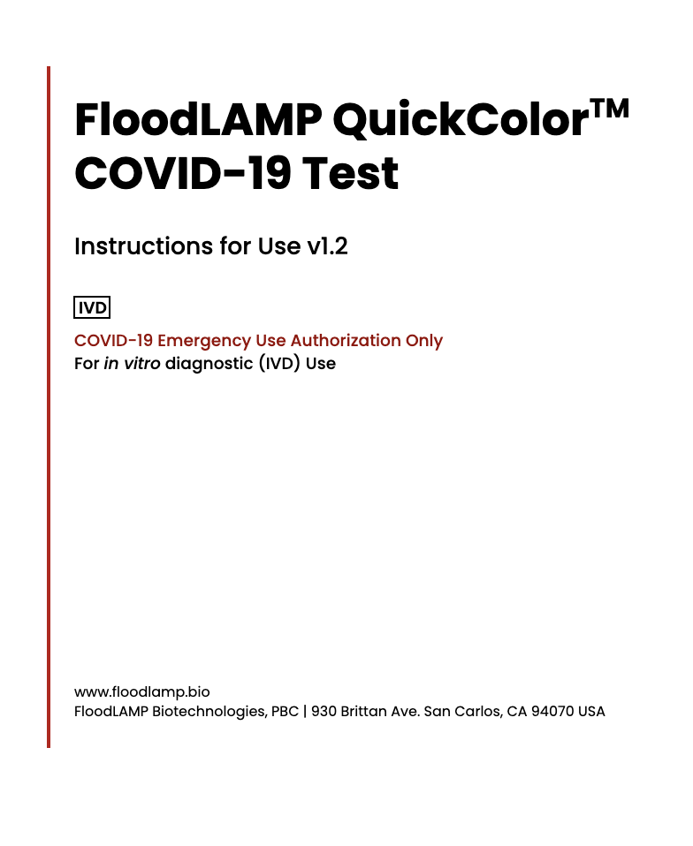
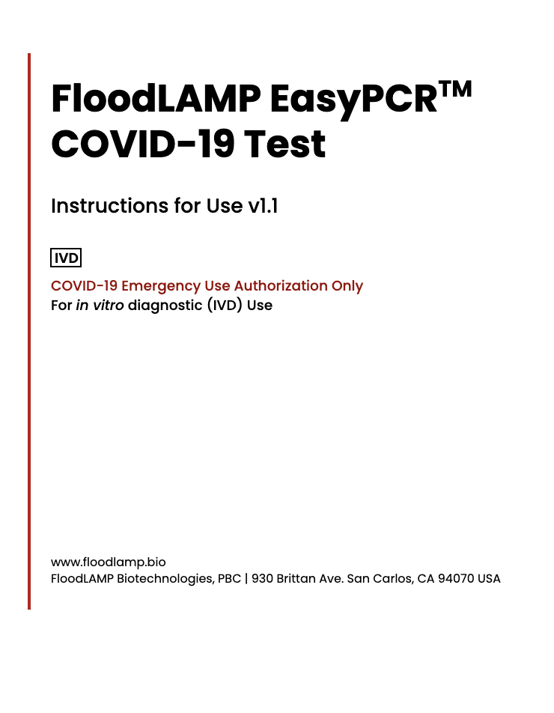
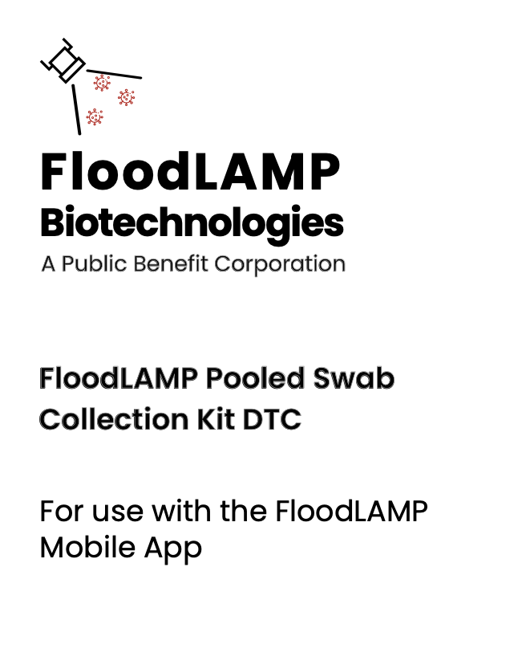
Open EUA's - 2 Full Submissions + Pre EUA

Slide 19
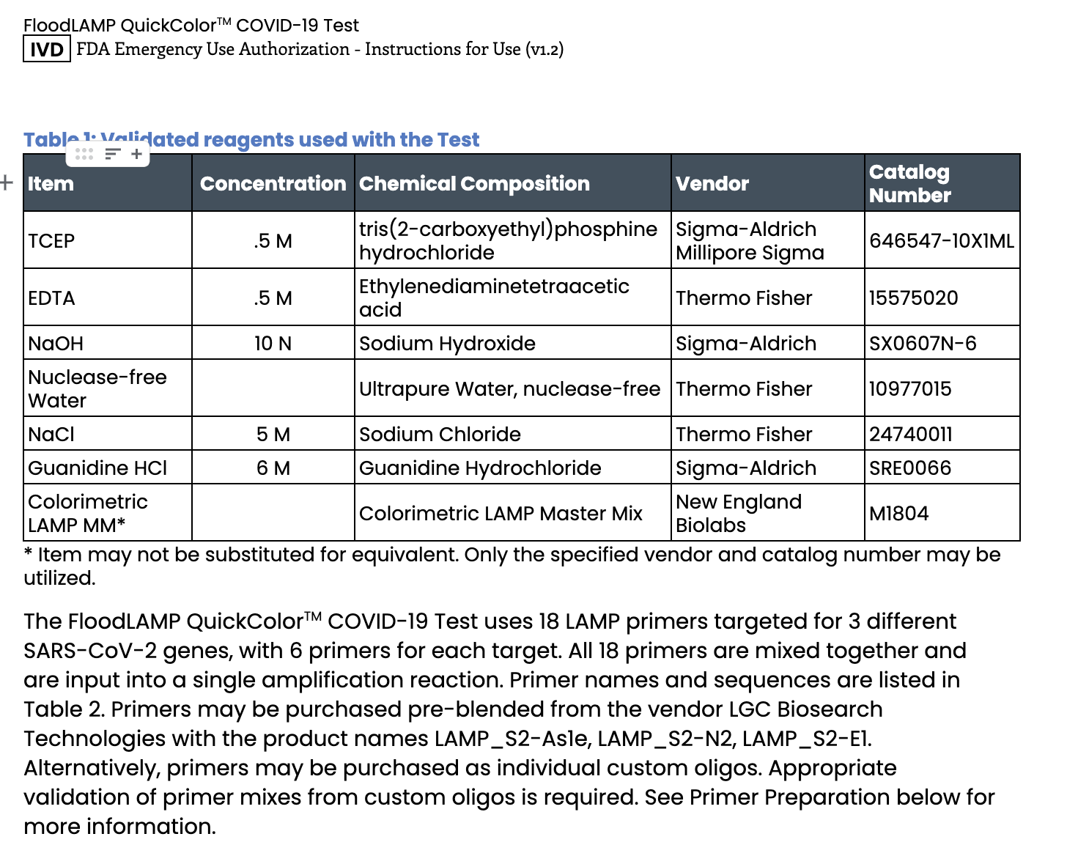
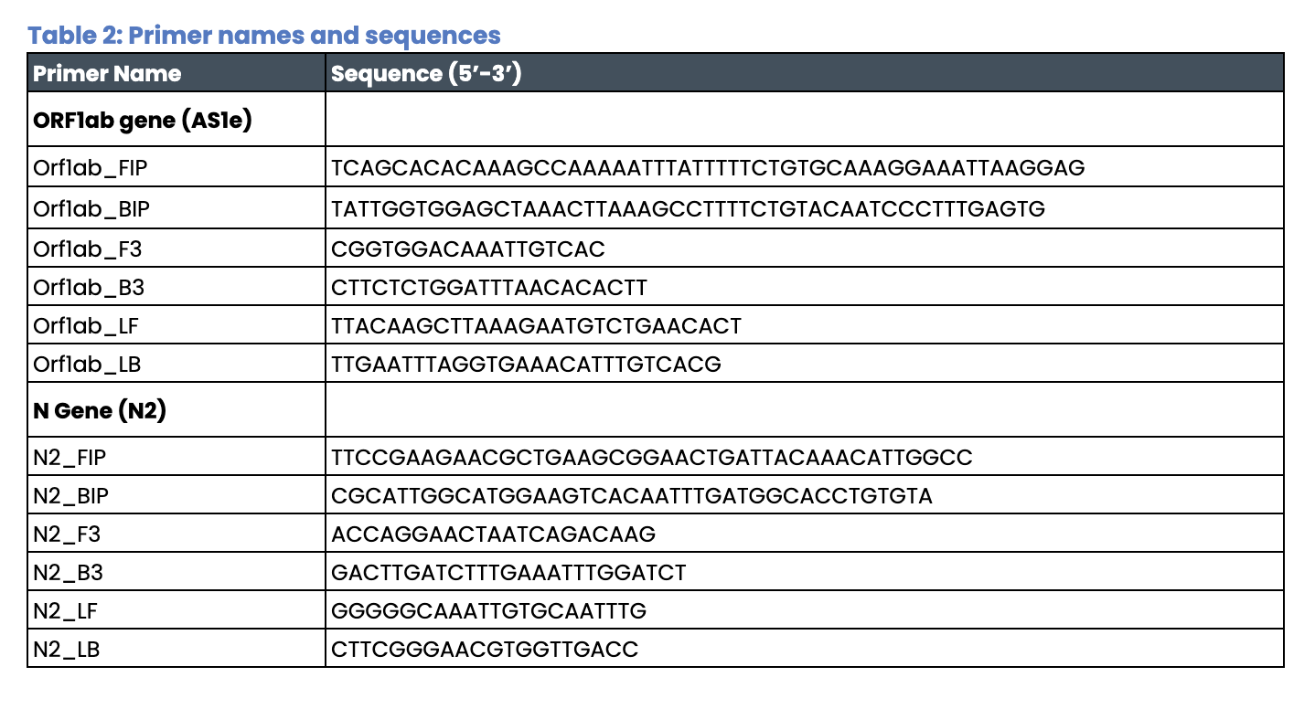
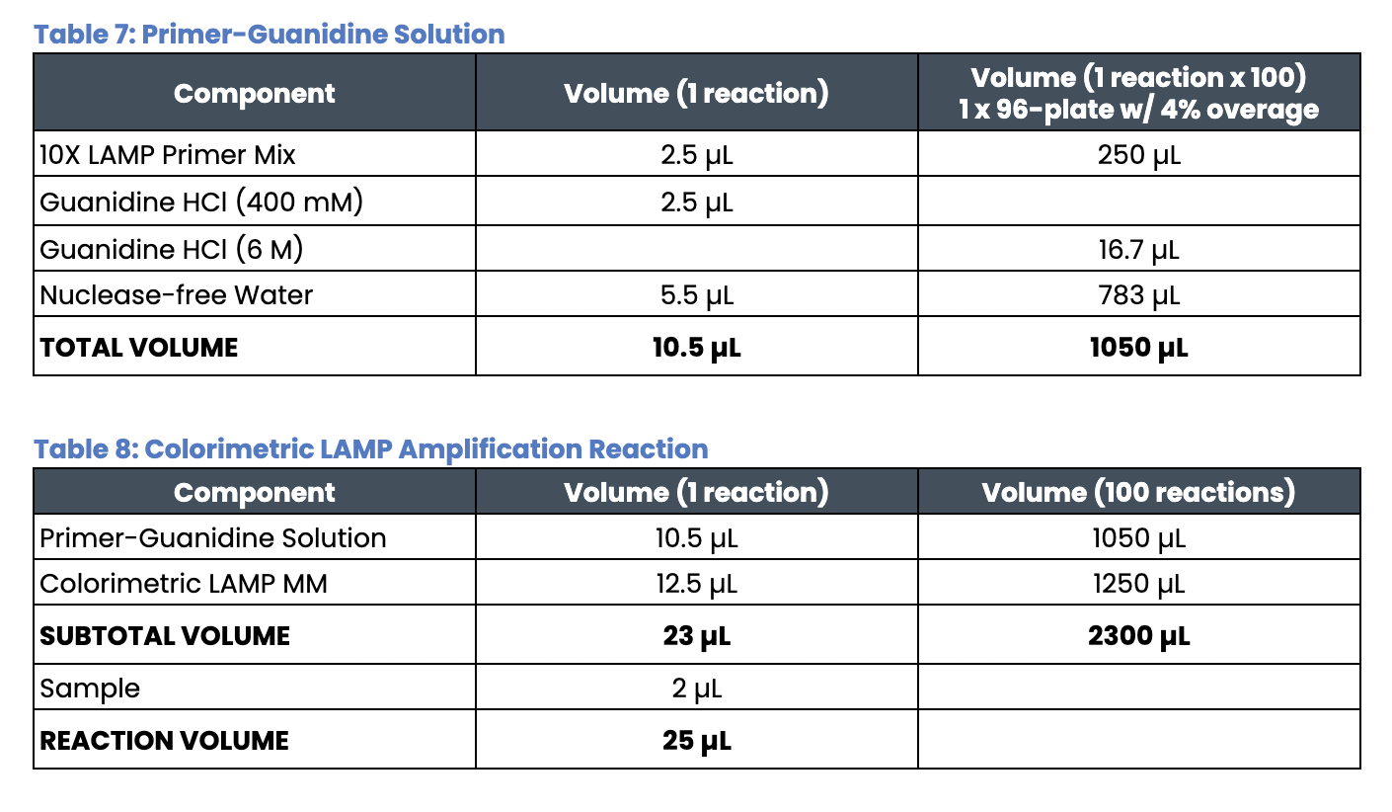
Open EUA - Disclosure of Components

Slide 20
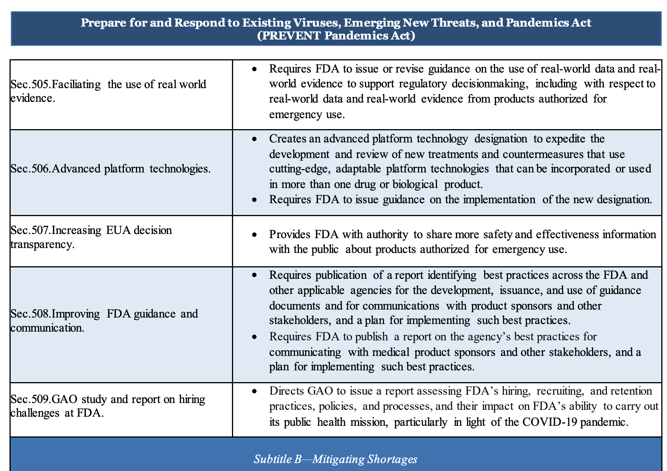



Push for Regulatory Progress
https://reaganudall.org/research-funding-opportunity
https://www.help.senate.gov/imo/media/doc/PREVENT%20Pandemics%20discussion%20draft%20sxs%20final.pdf

Slide 21
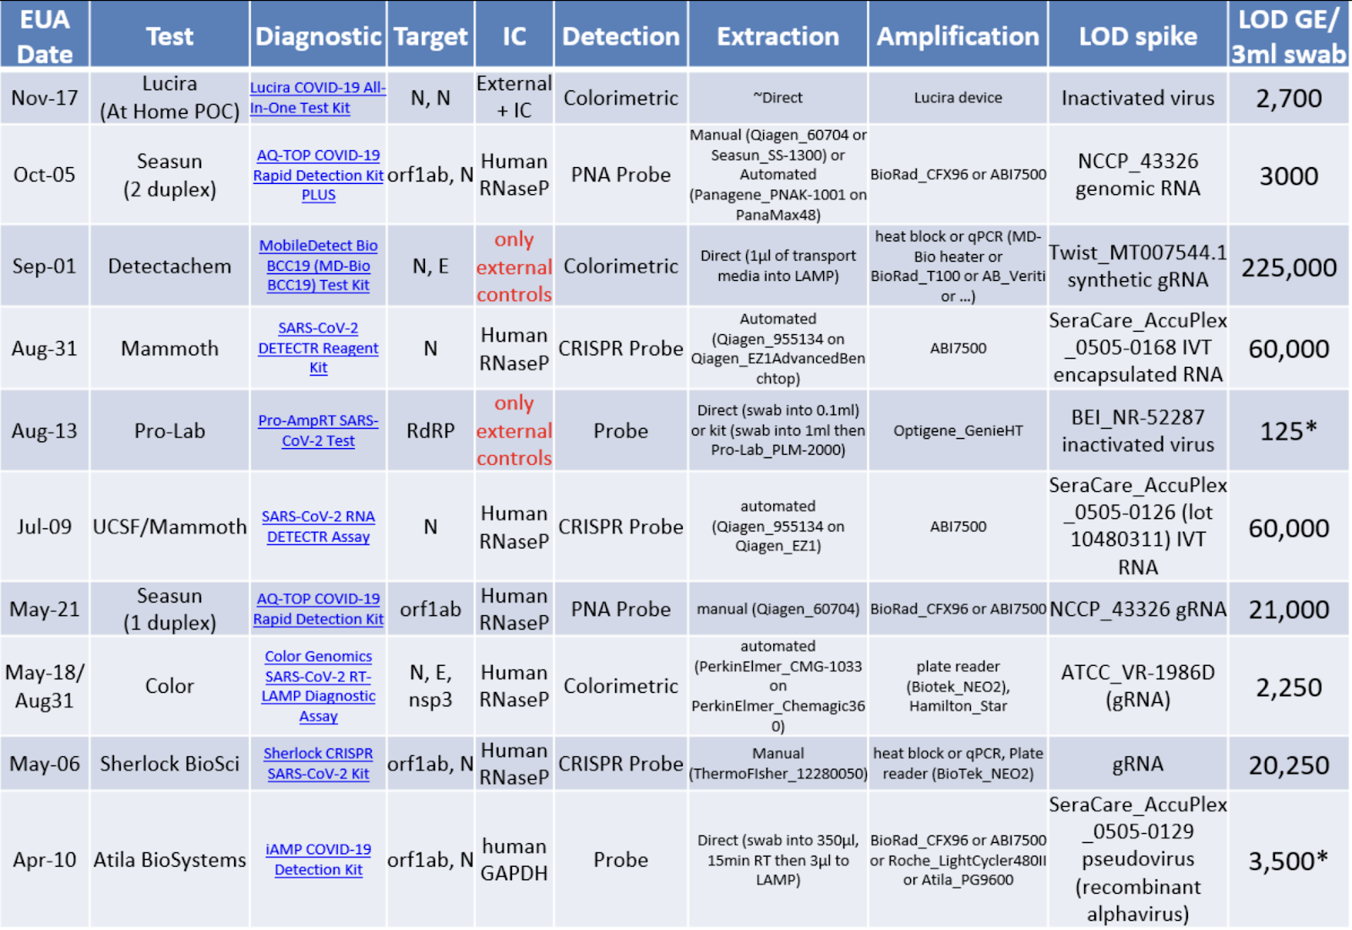
LAMP EUAs for SARS-CoV2
Just in 2020!
from Matt McFarlane
(twitter @mattmcfar)

Slide 22
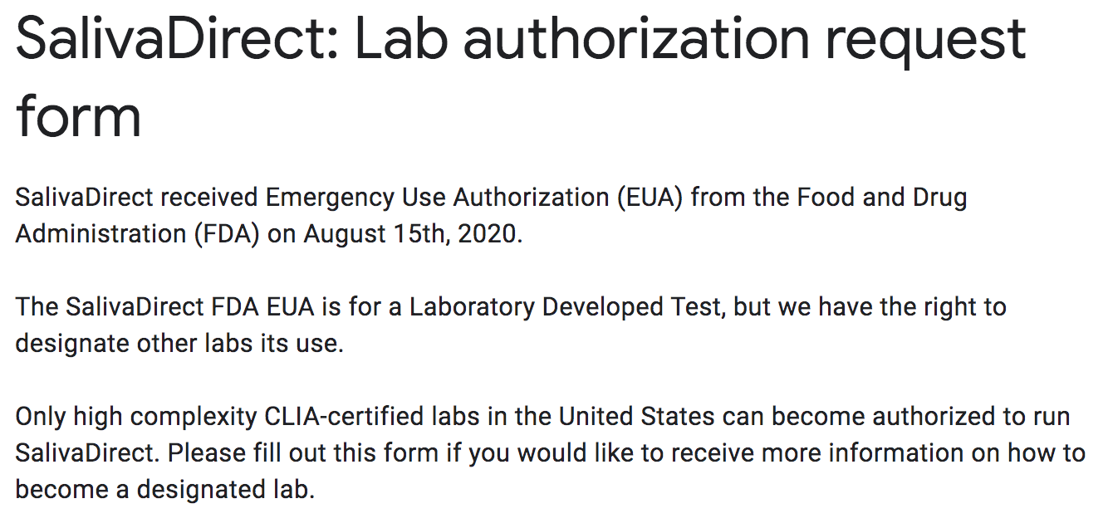
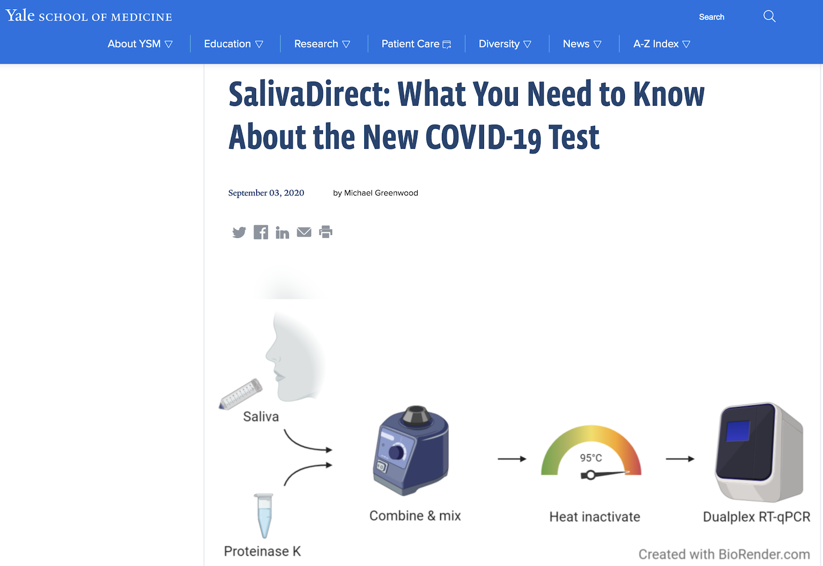
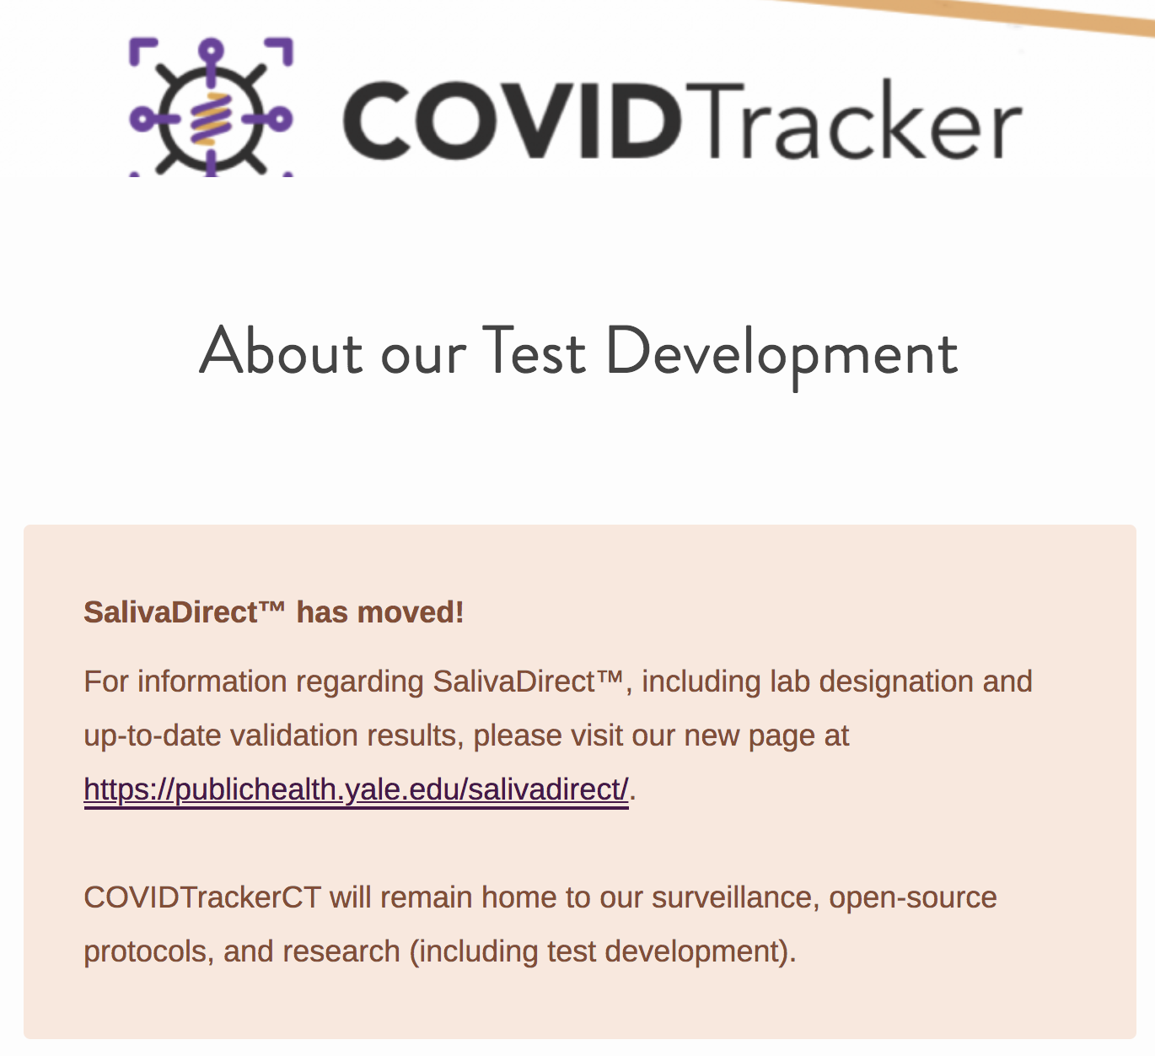
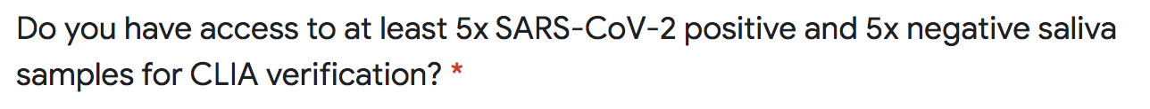
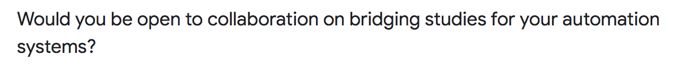
Saliva Direct "most unique EUA" - FDA
Is a protocol not a product
Open Access - any CLIA lab can use
Lots of clone assays being used
Yale can "designate" CLIA labs

Slide 23
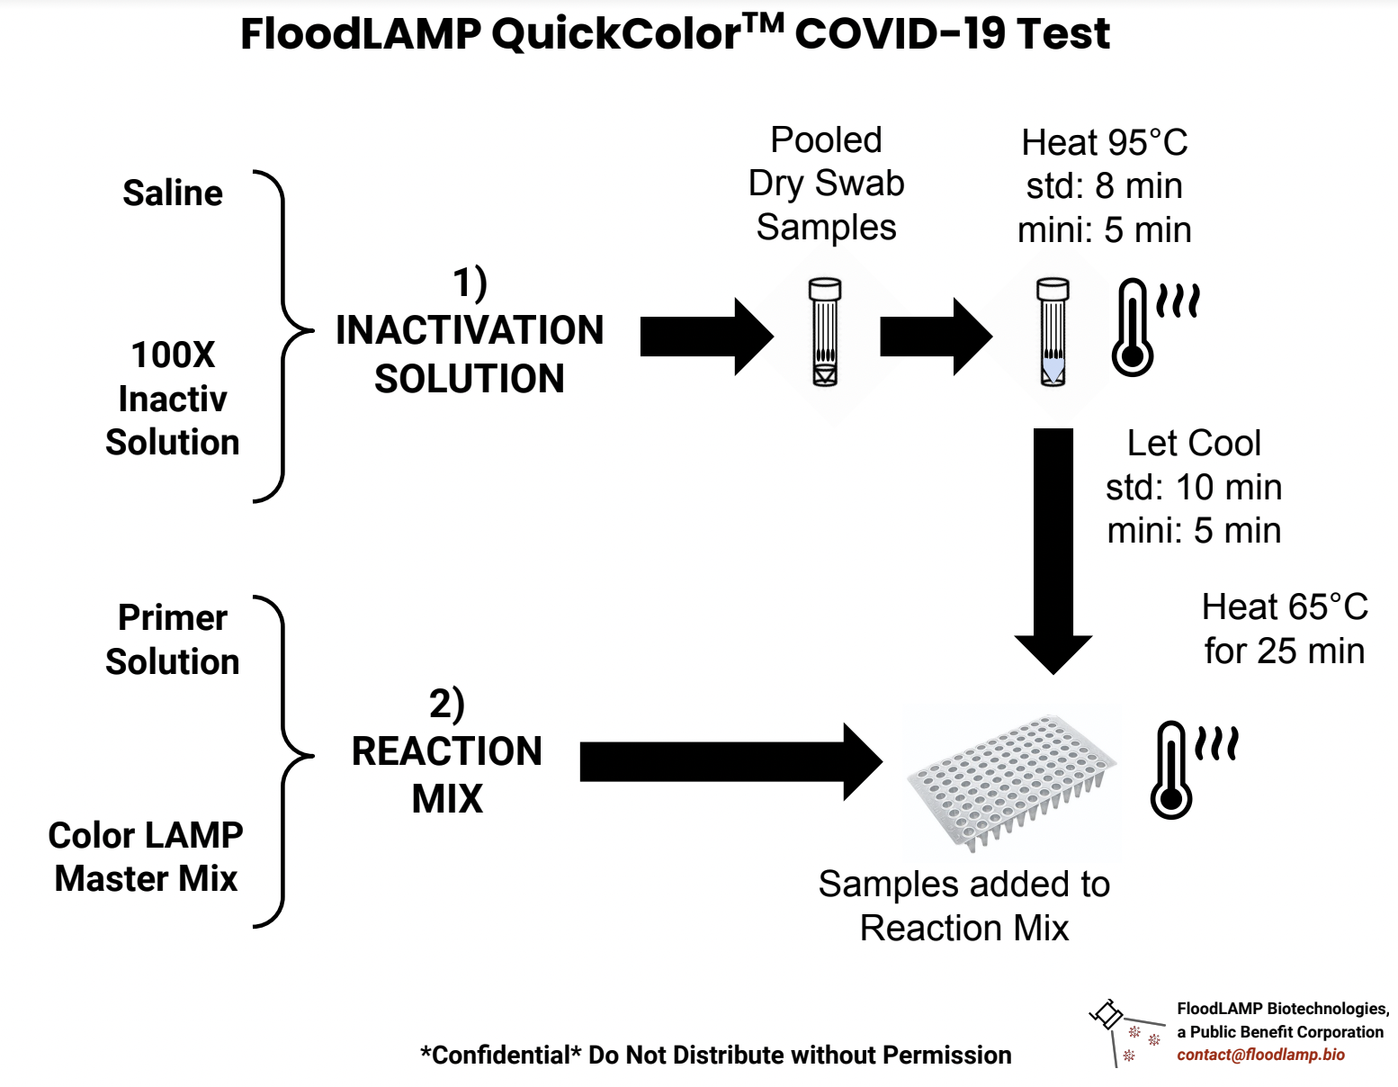
Test Diagrams
FloodLAMP is addressing the practically unlimited demand for accessible, low cost, easy to implement COVID-19 testing and screening.
TCEP/EDTA
(standard Rabe Cepko)
AS1e (ORF1ab)
N2
E1
NEB M1804

Slide 24
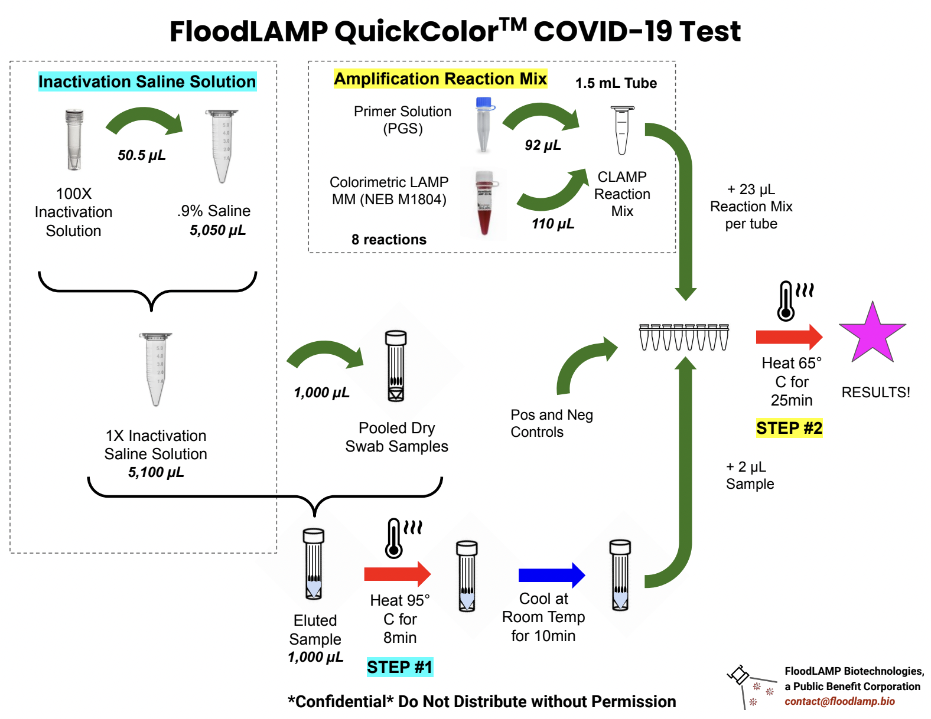
Test Diagrams
FloodLAMP is addressing the practically unlimited demand for accessible, low cost, easy to implement COVID-19 testing and screening.

Slide 25
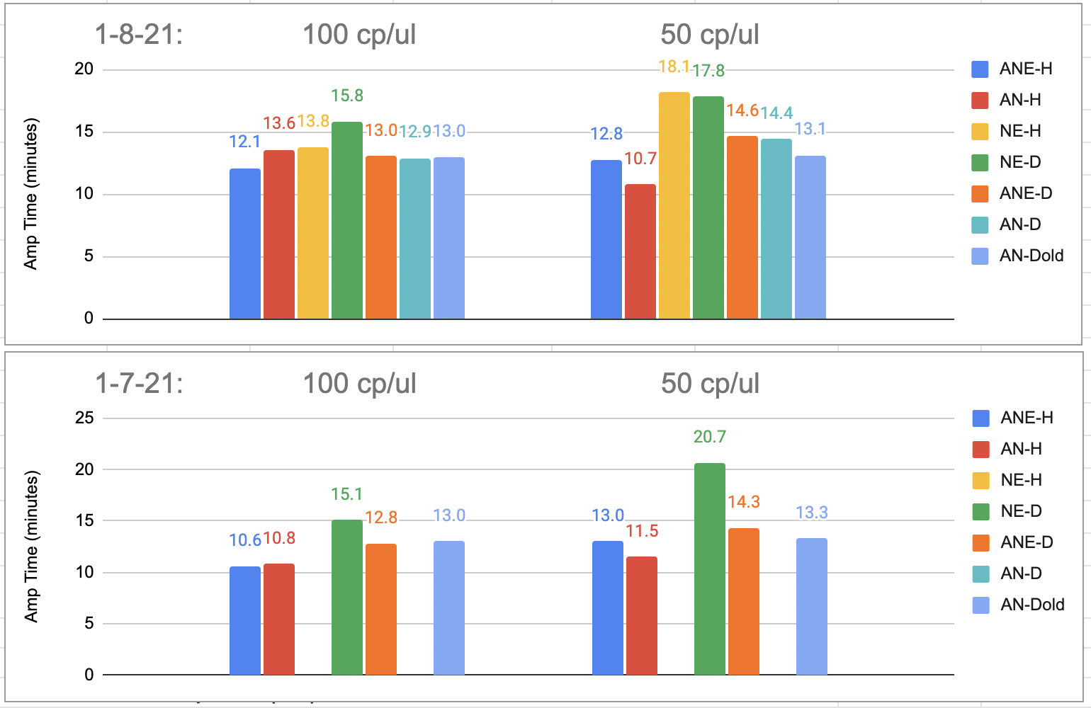
Primer Comparison
All 3 primer sets chosen by HPLC purification
Run with NEB E1700 Fluorimetric LAMP on QuantStudio7
Sample is contrived positive with Gamma BEI spiked into negative clinical sample
A = AS1e Rabe-Cepko primer set for ORF1ab
N = N2 primer set
E = E1 primer set
"H" = HPLC purified
"D" = Desalted

Slide 26

Successful Commercial Pilots
“FloodLAMP’s testing program is a total game-changer. I didn’t know this was possible. I’ve been blown away.”
– President of Production Company for FloodLAMP Pilot program “ROSA”
Commercial deployments in 3 states.
On-site, rapid mass molecular testing performed and operated by EMS staff.
"It's been a godsend!"
– EMS Training Director running the FloodLAMP program
2 cities have opted for mandatory FloodLAMP testing. Prioritizing it over antigen and PCR alternatives.

Slide 27
Town of Davie, FL

Slide 28
Coral Springs, FL

Slide 29
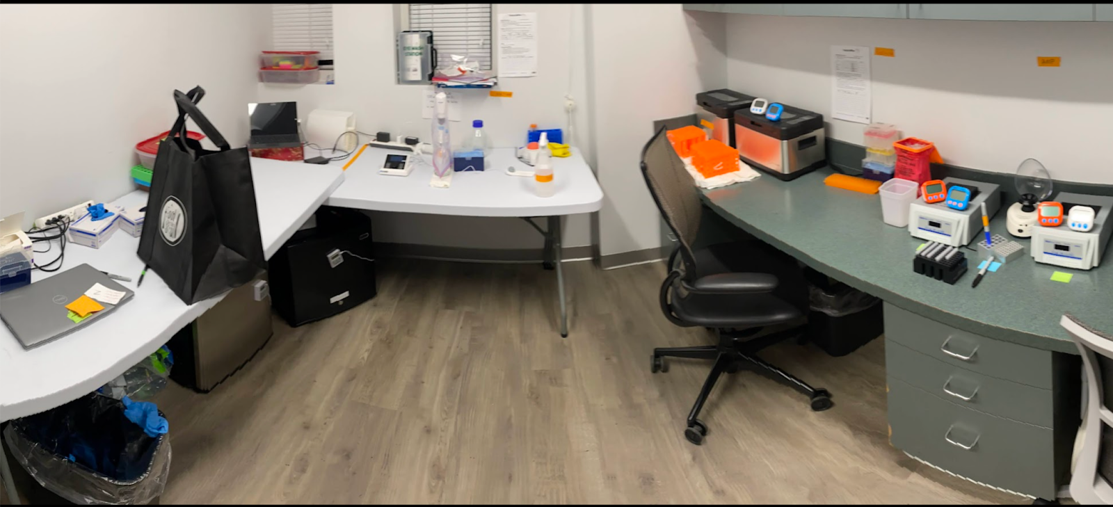
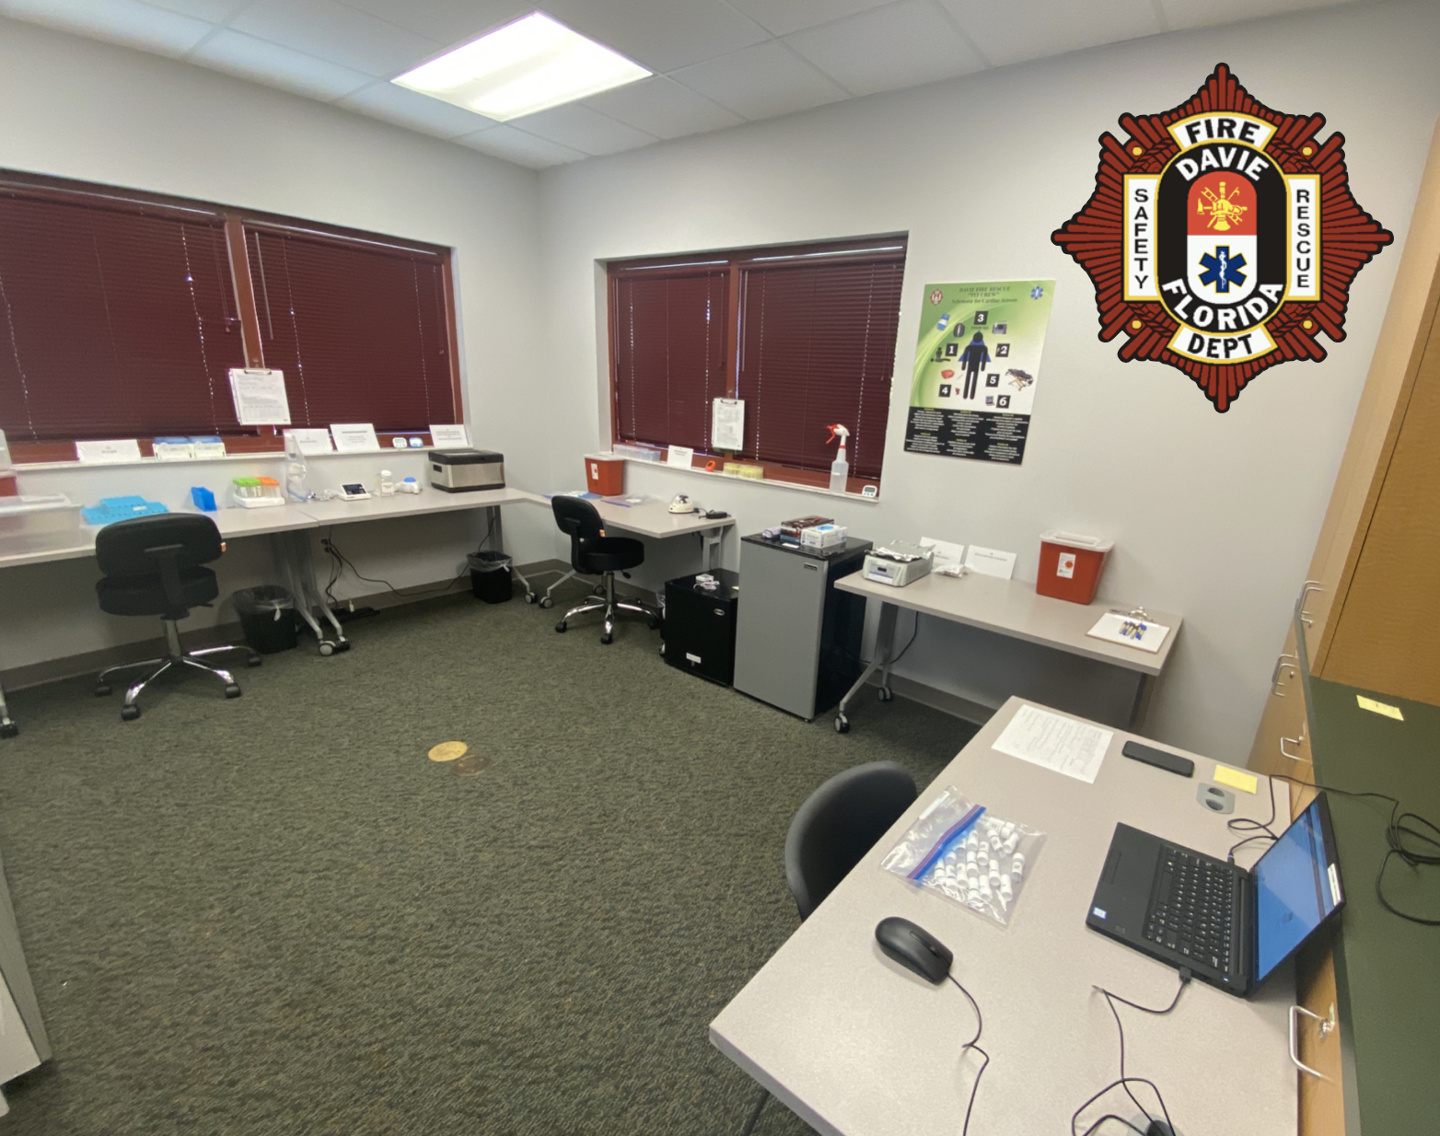
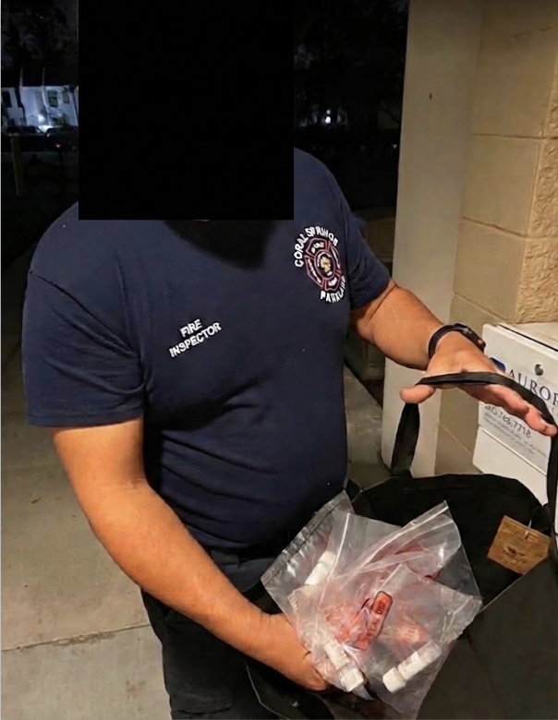
Coral Springs, FL
Davie, FL
A novice (but dedicated) tester is able to screen 1000 critical city employees.

Slide 30
Bend, OR

Slide 31
Preschool, CA

Slide 32
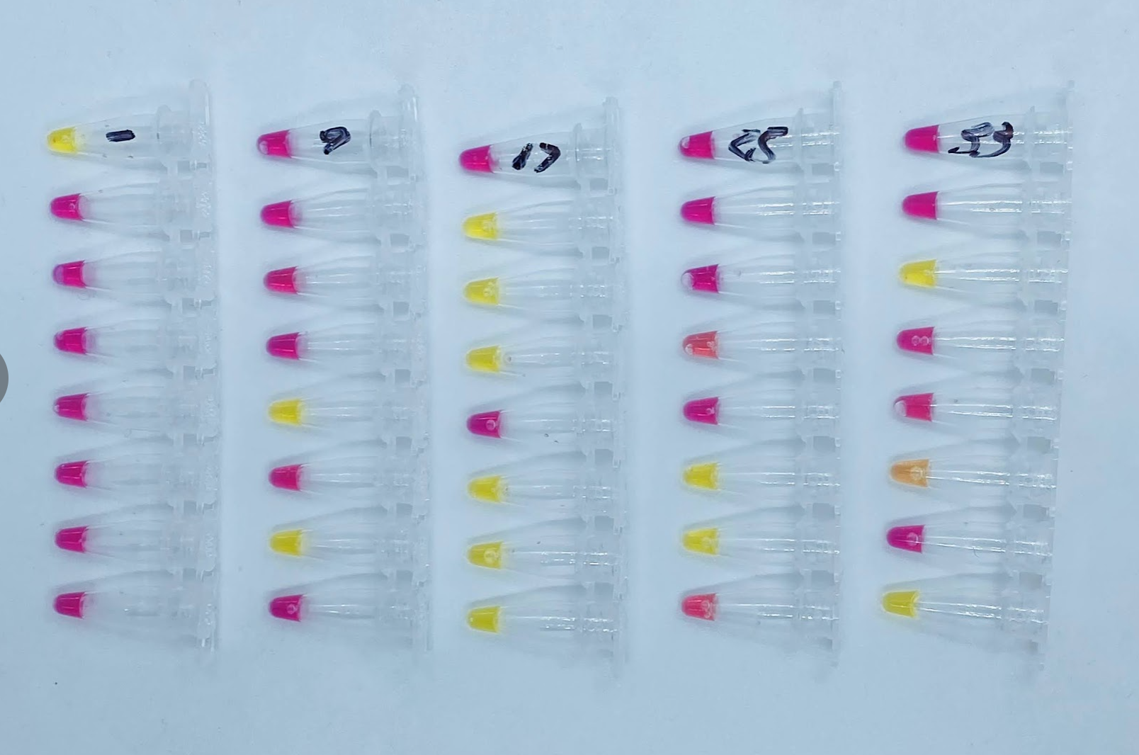
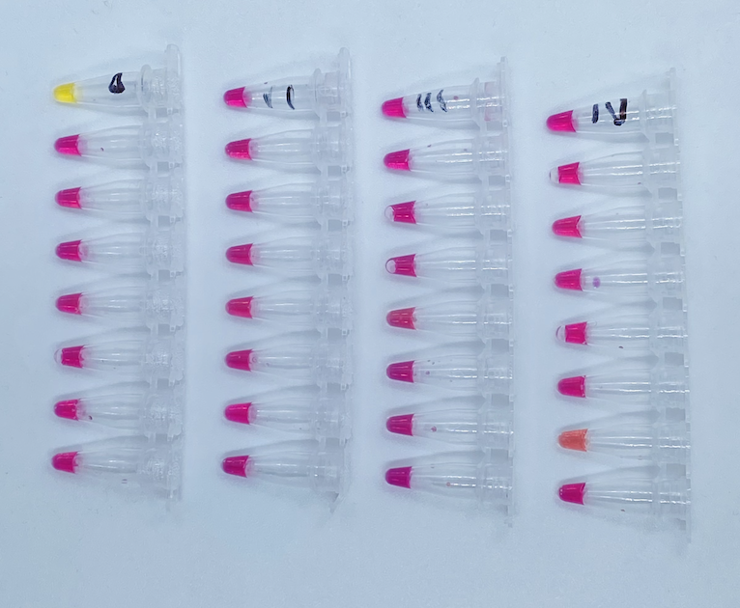
Pre-School Screening
Mon 1-10
Thurs 1-13
Mix of self collected individuals and family pools

Slide 33
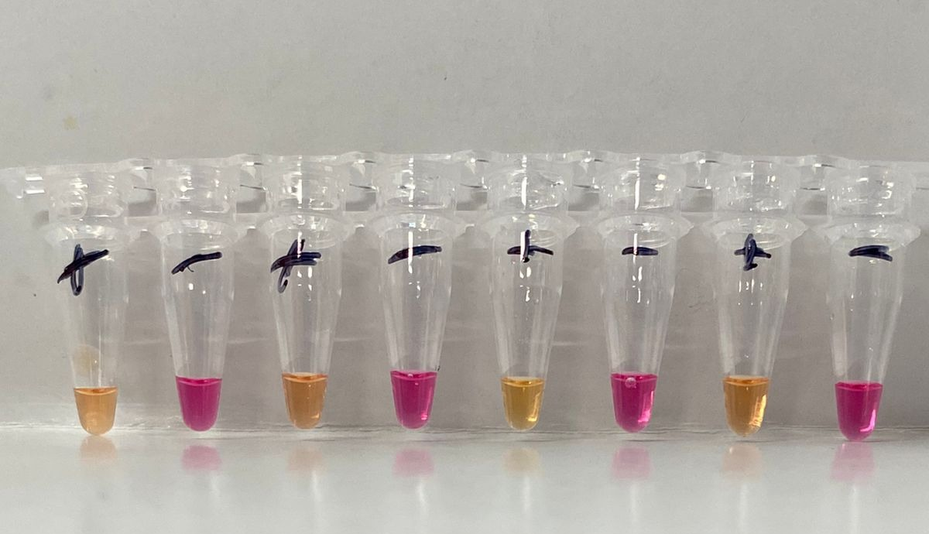
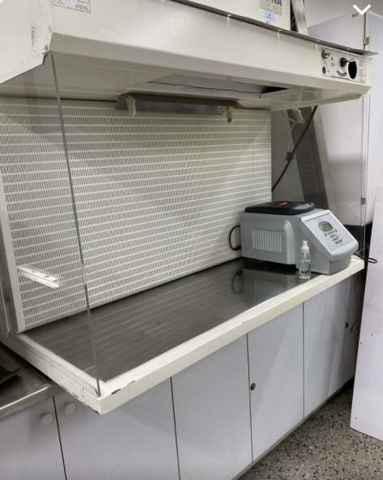
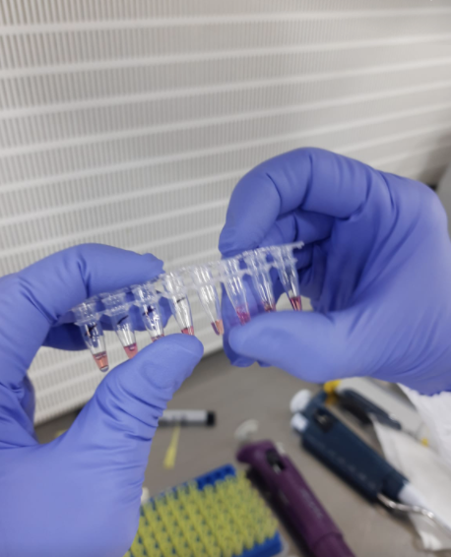
Collaboration with University of Antioquia (Medellin, Colombia)
Joint NEB / FloodLAMP project

Slide 34
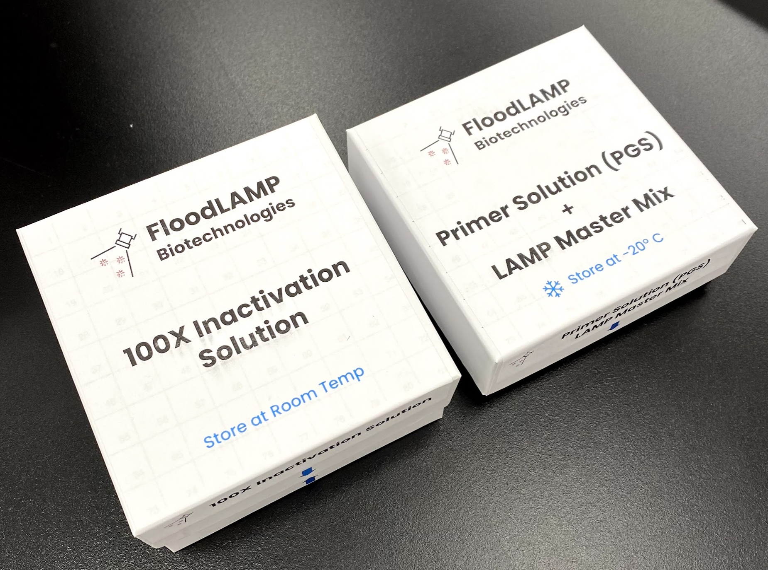
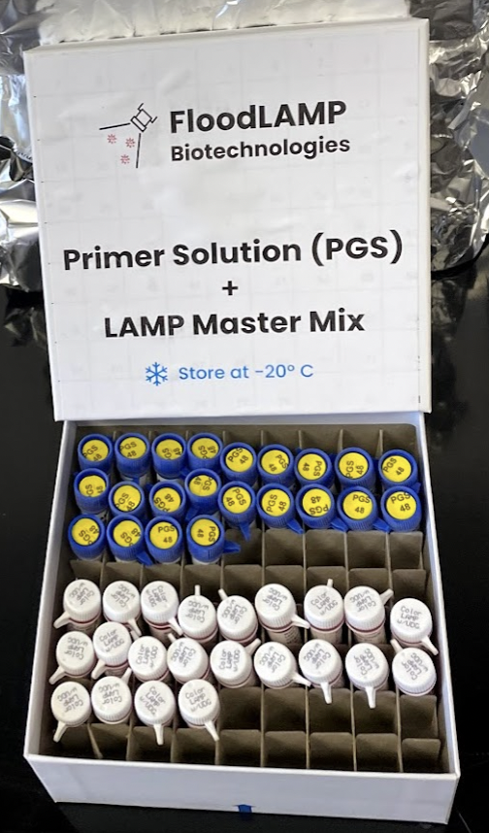
Reagent Kits
FloodLAMP is addressing the practically unlimited demand for accessible, low cost, easy to implement COVID-19 testing and screening.

Slide 35
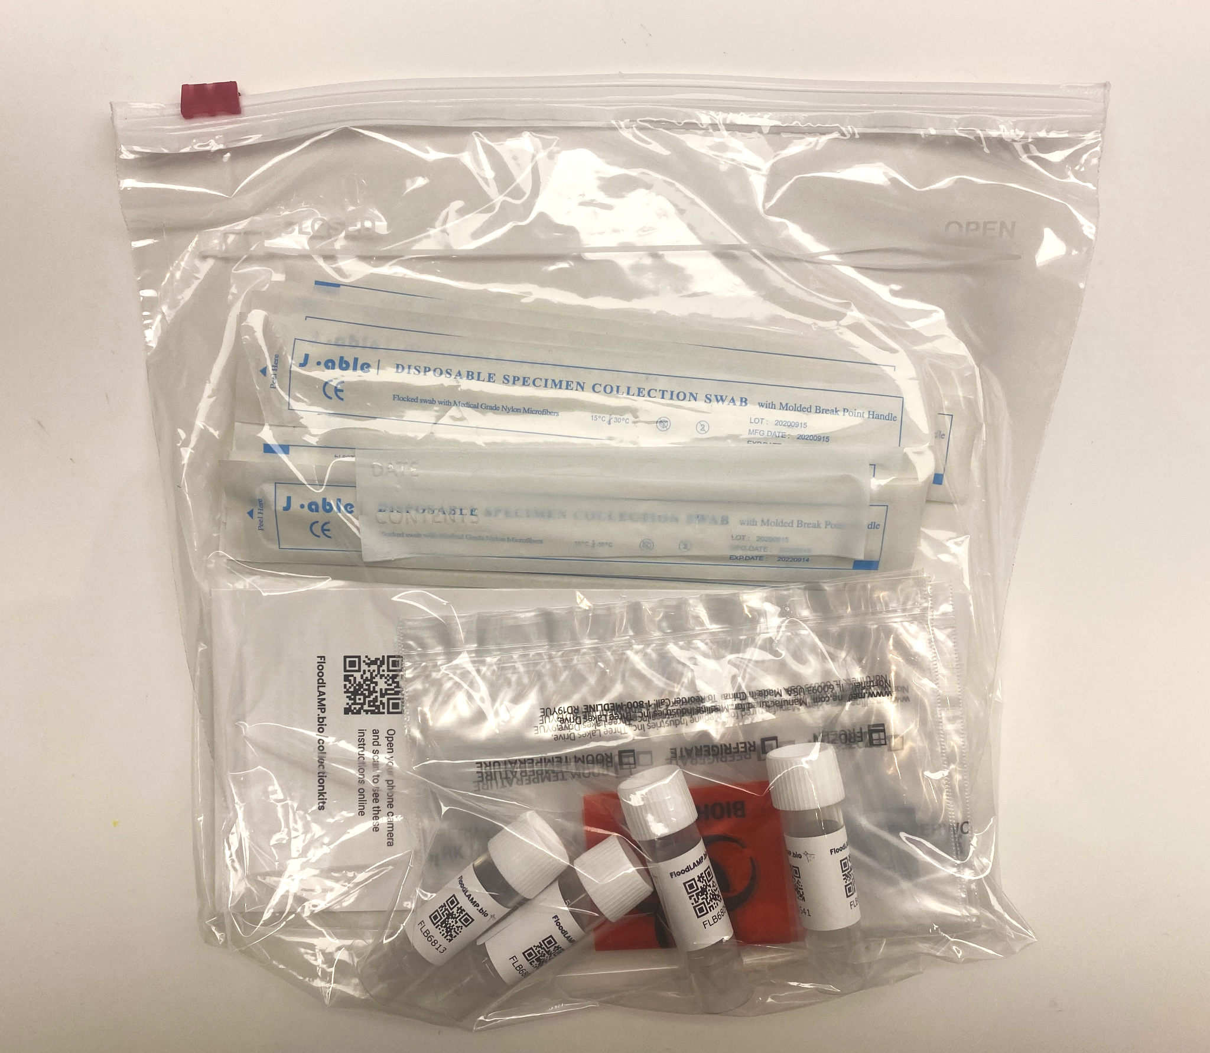
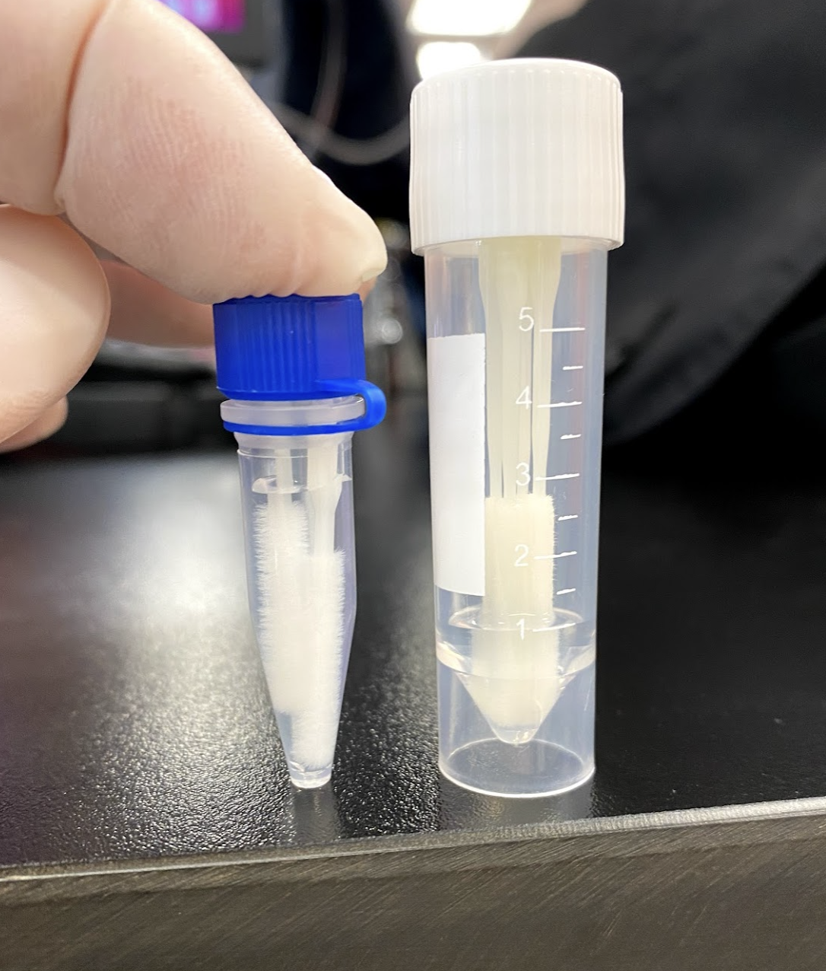
Collection Kits
FloodLAMP is addressing the practically unlimited demand for accessible, low cost, easy to implement COVID-19 testing and screening.

Slide 36

Collection Instructions
FloodLAMP is addressing the practically unlimited demand for accessible, low cost, easy to implement COVID-19 testing and screening.

Slide 37


Training Program - Interactive Video
FloodLAMP is addressing the practically unlimited demand for accessible, low cost, easy to implement COVID-19 testing and screening.

Slide 38

Training Program - Assessment for Certification
FloodLAMP is addressing the practically unlimited demand for accessible, low cost, easy to implement COVID-19 testing and screening.

Slide 39


Quality Management System
Implementing ISO 13485 QMS
QR Form Driven Logs
FloodLAMP is addressing the practically unlimited demand for accessible, low cost, easy to implement COVID-19 testing and screening.

Slide 40

New Site Validation Run
FloodLAMP is addressing the practically unlimited demand for accessible, low cost, easy to implement COVID-19 testing and screening.

Slide 41


Equipment and Supplies
FloodLAMP is addressing the practically unlimited demand for accessible, low cost, easy to implement COVID-19 testing and screening.

Slide 42


"Lab"
FloodLAMP is addressing the practically unlimited demand for accessible, low cost, easy to implement COVID-19 testing and screening.

Slide 43



Portable System
FloodLAMP is addressing the practically unlimited demand for accessible, low cost, easy to implement COVID-19 testing and screening.

Slide 44

Portable System - in action
FloodLAMP is addressing the practically unlimited demand for accessible, low cost, easy to implement COVID-19 testing and screening.

Slide 45





Prepared Cart
FloodLAMP is addressing the practically unlimited demand for accessible, low cost, easy to implement COVID-19 testing and screening.

Slide 46



Clinical Evaluation Data
Clinical evaluation performed by the Stanford CLIA Lab, with excellent results and praise on the "really straightforward" protocol.
EasyPCRTM Test
3 copies/µl LoD
98% sensitivity (PPA 39/40)
100% Specificity (40/40)
No false positives
Gamma inactivated cell lysate from BEI spiked into raw clinical negative sample
QuickColorTM LAMP Test
12 copies/µl LoD
90% Sensitivity (PPA 36/40)
Missed positives only high Ct (>36 with direct PCR)
100% Specificity (40/40)
No false positives
Source of Specimens: Stanford COVID-19 Clinical Testing Program
Specimen Type: Anterior Nares Swab in PBS, previously tested and frozen
Comparator Test: Hologic Panther Fusion SARS-CoV-2 Assay and Hologic Panther Aptima SARS-CoV-2 Assay

Slide 47

Clinical Evaluation by Stanford CLIA Lab

Slide 48


Clinical Evaluation by Stanford CLIA Lab
40 Clinical Positive Samples:
29 Positive by FloodLAMP QuickColorTM Test
7 Inconclusive (all high Ct, low viral load)
4 Negative (all > 36 Ct, very low viral load)
40 Clinical Negative Samples:
40 Negative by FloodLAMP QuickColorTM Test

Slide 49



Clinical Evaluation by Stanford CLIA Lab
One sample Undetermined (not detected) by FloodLAMPTM EasyPCR
Detected in FloodLAMP EasyPCRTM
Not detected by FloodLAMP QuickColorTM
(EasyPCRTM PPA 39/40 97.5%)
Detected in both FloodLAMP EasyPCRTM and QuickColorTM Colorimetric LAMP test
(QuickColorTM PPA 36/40 90%)
* includes initial inconclusive resolved by PCR
Both FloodLAMP EasyPCRTM and QuickColorTM had no false positives
(NPA 40/40 100%)

Slide 50

Clinical Evaluation by Stanford CLIA Lab
One sample not detected by FloodLAMPTM EasyPCR
(PPA 39/40 97.5%)
6 Positives Not Detected by FloodLAMP QuickFluorTM test
(PPA 34/40 85%)
Positives not detected by FloodLAMP QuickColorTM test
(PPA 36/40 90%)
* includes initial inconclusives resolved by PCR
All 3 Tests:
No false positives
FloodLAMP EasyPCRTM
QuickColorTM LAMP
QuickFluorTM LAMP
(NPA 40/40 100%)

Slide 51






Slide 52






App
For program participants
FloodLAMP is addressing the practically unlimited demand for accessible, low cost, easy to implement COVID-19 testing and screening.

Slide 53





App
For the lab
FloodLAMP is addressing the practically unlimited demand for accessible, low cost, easy to implement COVID-19 testing and screening.

Slide 54


Admin portal
Tools for program administrators
FloodLAMP is addressing the practically unlimited demand for accessible, low cost, easy to implement COVID-19 testing and screening.

Slide 55



Team Effort!

