Slide 1
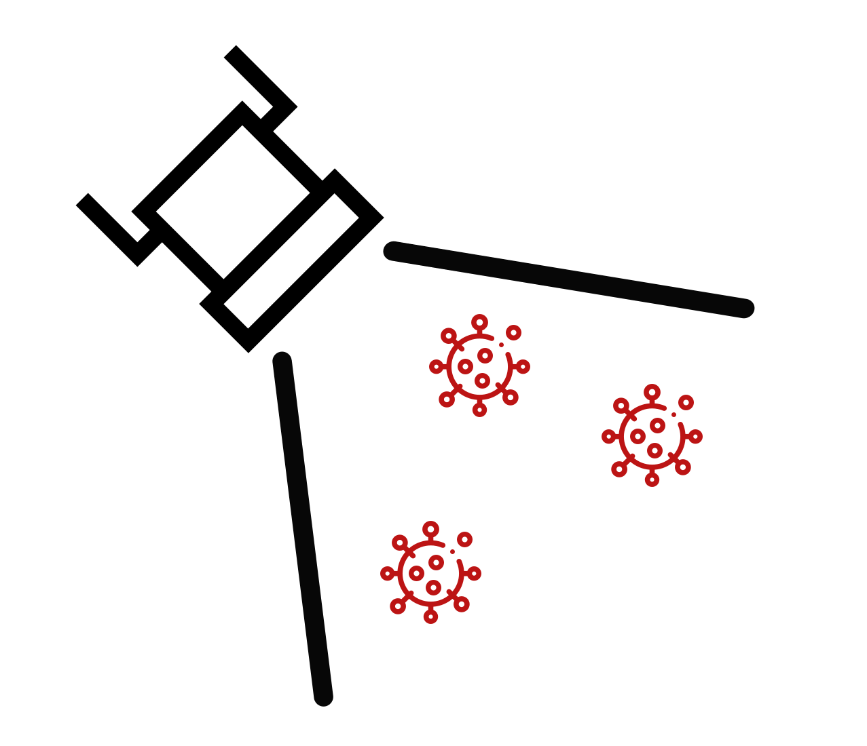



FloodLAMP
Biotechnologies, PBC
Delivering the testing our world needs (and people want)
For COVID-19 and beyond
Randy True, Founder and CEO | randy@floodlamp.bio | 415-269-2974
Bend Fire and Rescue - Site Bring Up
12-01-2021
Special Thanks to:
Katrina Brandis! Volunteer from Bend Science Station
Kevin Schallert! FloodLAMP COO and Founder NSVD

Slide 2
Today's Agenda
Intros 5 min 9:30 am start
FloodLAMP Overview 10 min
Safety Highlights 5 min
Contamination Procedures 10 min 10:00 am
Test System Overview 10 min
Validation Run 80 min 11:30 am
- Katrina
Training Kit Overview 20 min
Cleanup / Wrapup 10 min 12:00 noon

Slide 3
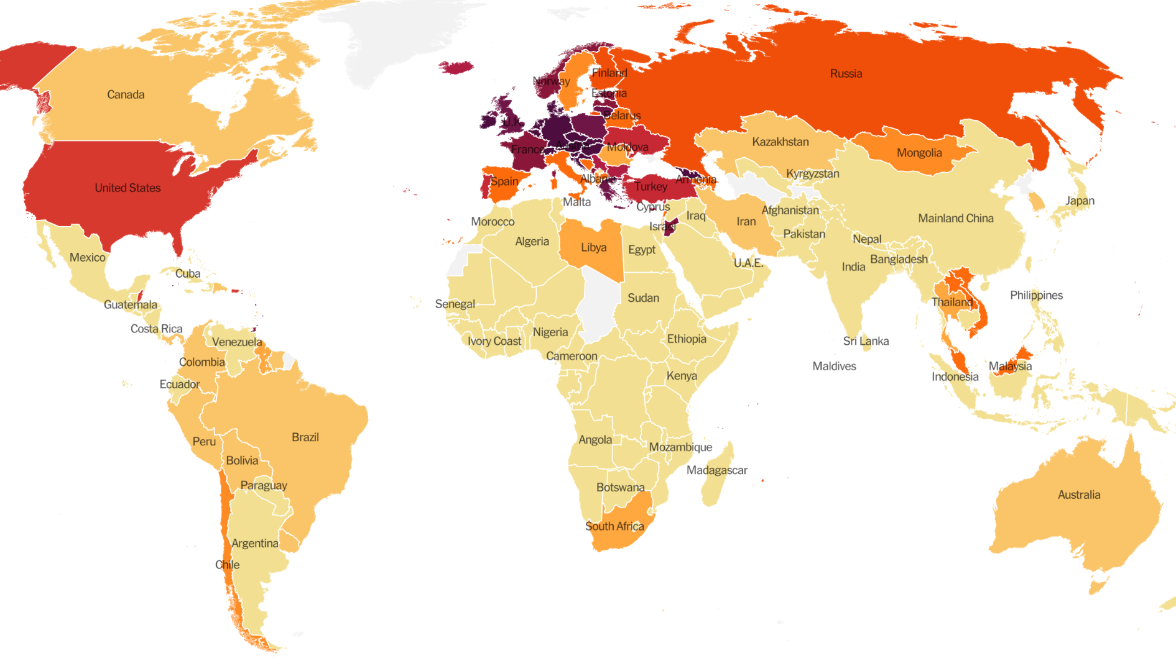
We still need better testing
FloodLAMP's mission is to improve global health and resiliency through universal access to rapid molecular testing.
FloodLAMP delivers
New testing technology that does not require any instrumentation or clinical lab overhead - it can be done at scale anywhere by anyone.
Turnkey screening programs with all of the wraparound components that give people and organizations what they want.
Disruptive open source strategy that unlocks molecular testing for our country and the world.

Slide 4

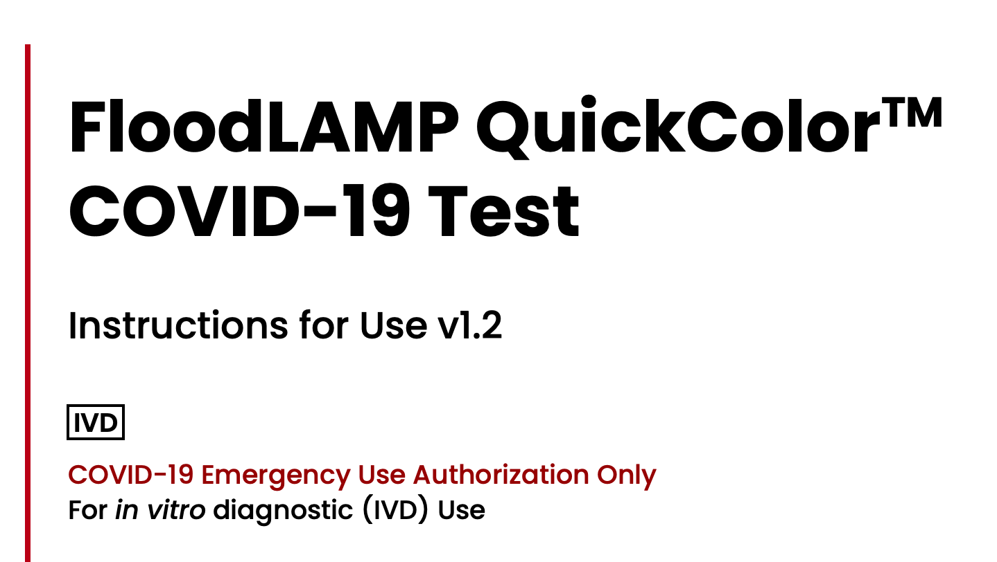

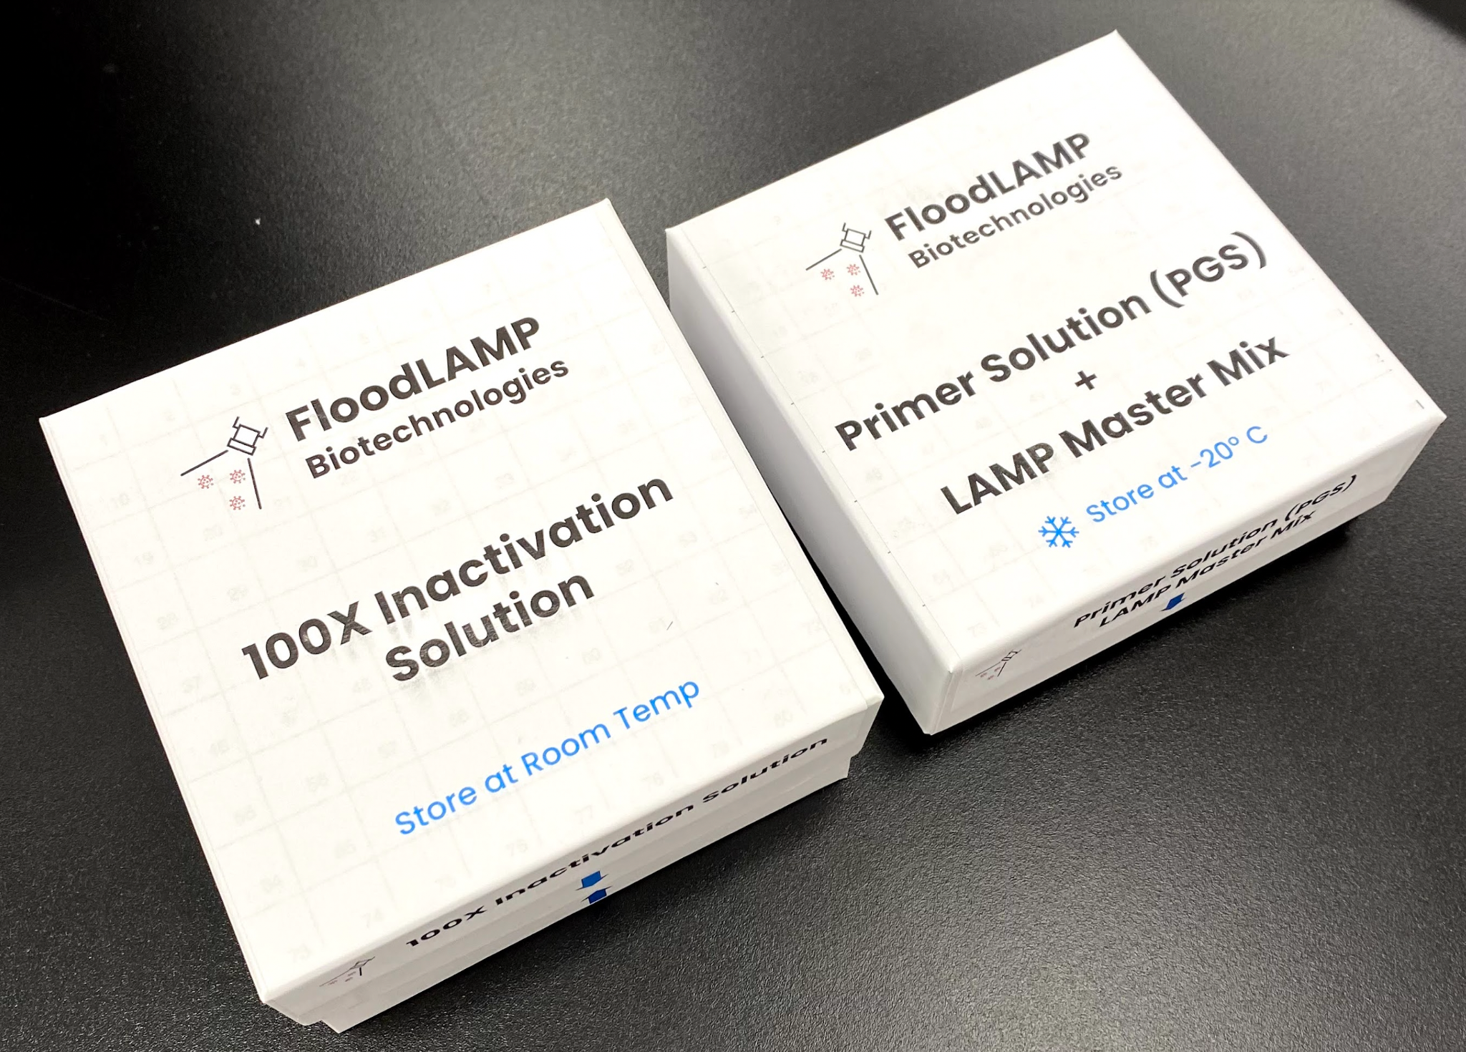
Technology Readiness - TRL 6/8
✓
Successful real world programs:
With EMS departments in 3 states, screening first responders and city employees;
Commercial contract screening TV production crew 3X per week with <2hr TAT;
Local community pre-school testing program with at-home family pooling enabled by the FloodLAMP Mobile App.
Regulatory progress and potential:
EMS programs green-lit as surveillance by top officials at FDA and CMS;
2 full FDA EUA submissions for open source protocol EUA's (direct PCR and LAMP);
Successful clinical evaluation from Stanford CLIA Lab;
Pre-EUA for Pooled Swab Collection Kit DTC with FloodLAMP Mobile App;
IRB approved for clinical study of pooling, home collection and App;
Experienced consultants and advisors on board, including Anne Wyllie (SalivaDirect).
Key IP protection:
Broad coverage of pooling and digital integration;
License to core assay chemistry from Harvard Medical School (Rabe-Cepko protocol);
New game-changing platform IP in development.
Pilot manufacturing:
Relationships with top reagent suppliers;
1.3M reactions of primers ready-to-go in freezers (for 5M people with 4X pooling).
✓
✓
✓

Slide 5
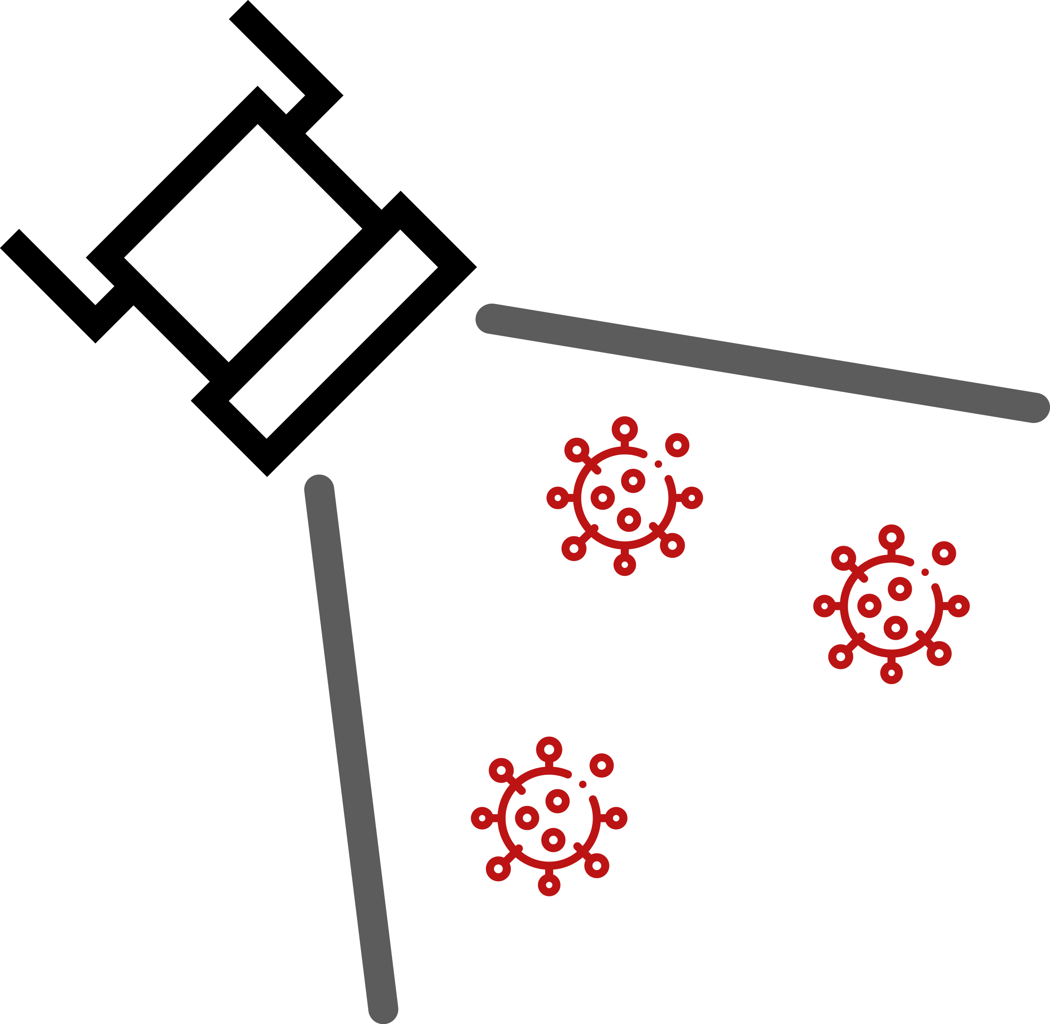
Performance in All Dimensions
People want higher confidence for both positive and negative results.
RAPID TURNAROUND TIME
< 2 hrs sample to answer
Local
Fast
Cheap
Molecular
Flexible
Resilient
Will help usher in era of at-home concierge diagnostics but simply too expensive for public health screening.
Antigen Test Strips
Rapid Molecular Cartridges
GOOD
SENSITIVITY
Detect
Pre-Infectious Asymptomatics
LOW COST
< $5 per person
FloodLAMP QuickColorTM
SalivaDirect & FloodLAMP Pooled Swab PCR
Long turnaround renders it unsuitable for large scale screening – schools and workplaces need to know quickly is someone is infected.
High upfront capital cost for PCR instruments – great potential to drive down PCR screening costs.
Clinical Lab Purified PCR

Slide 6
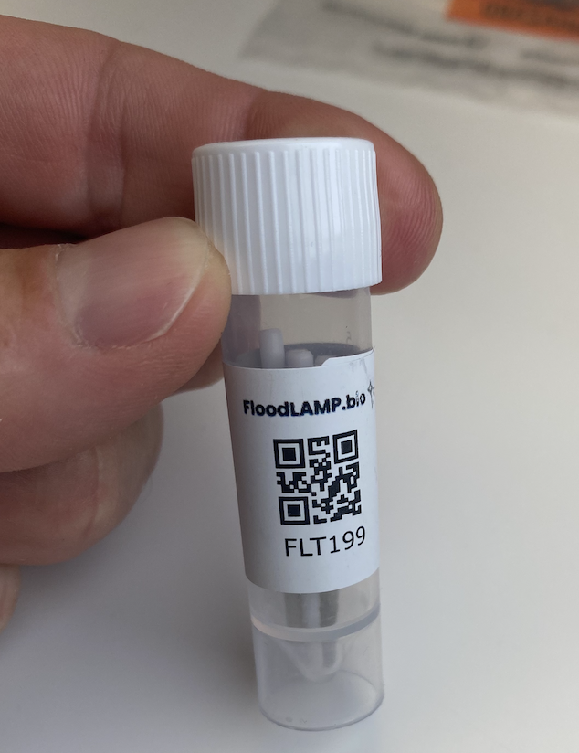
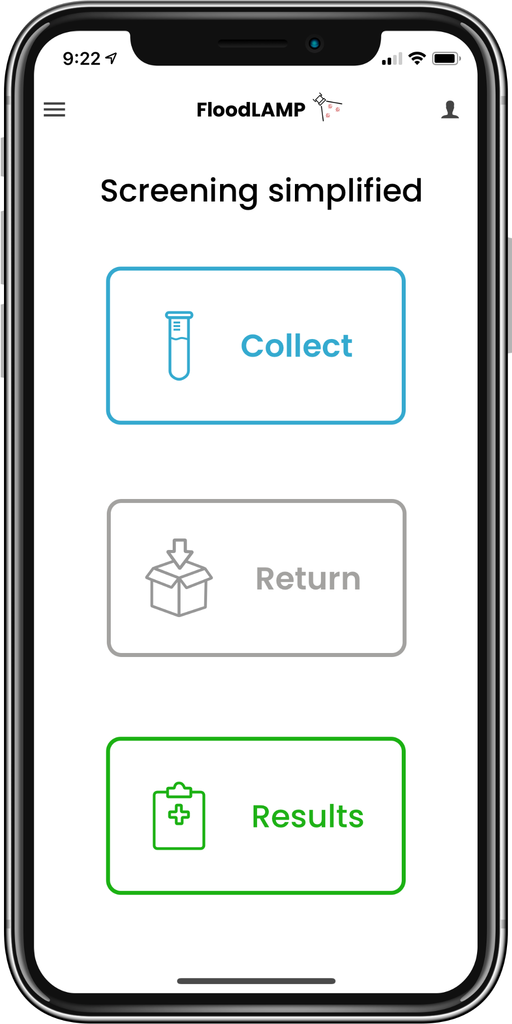
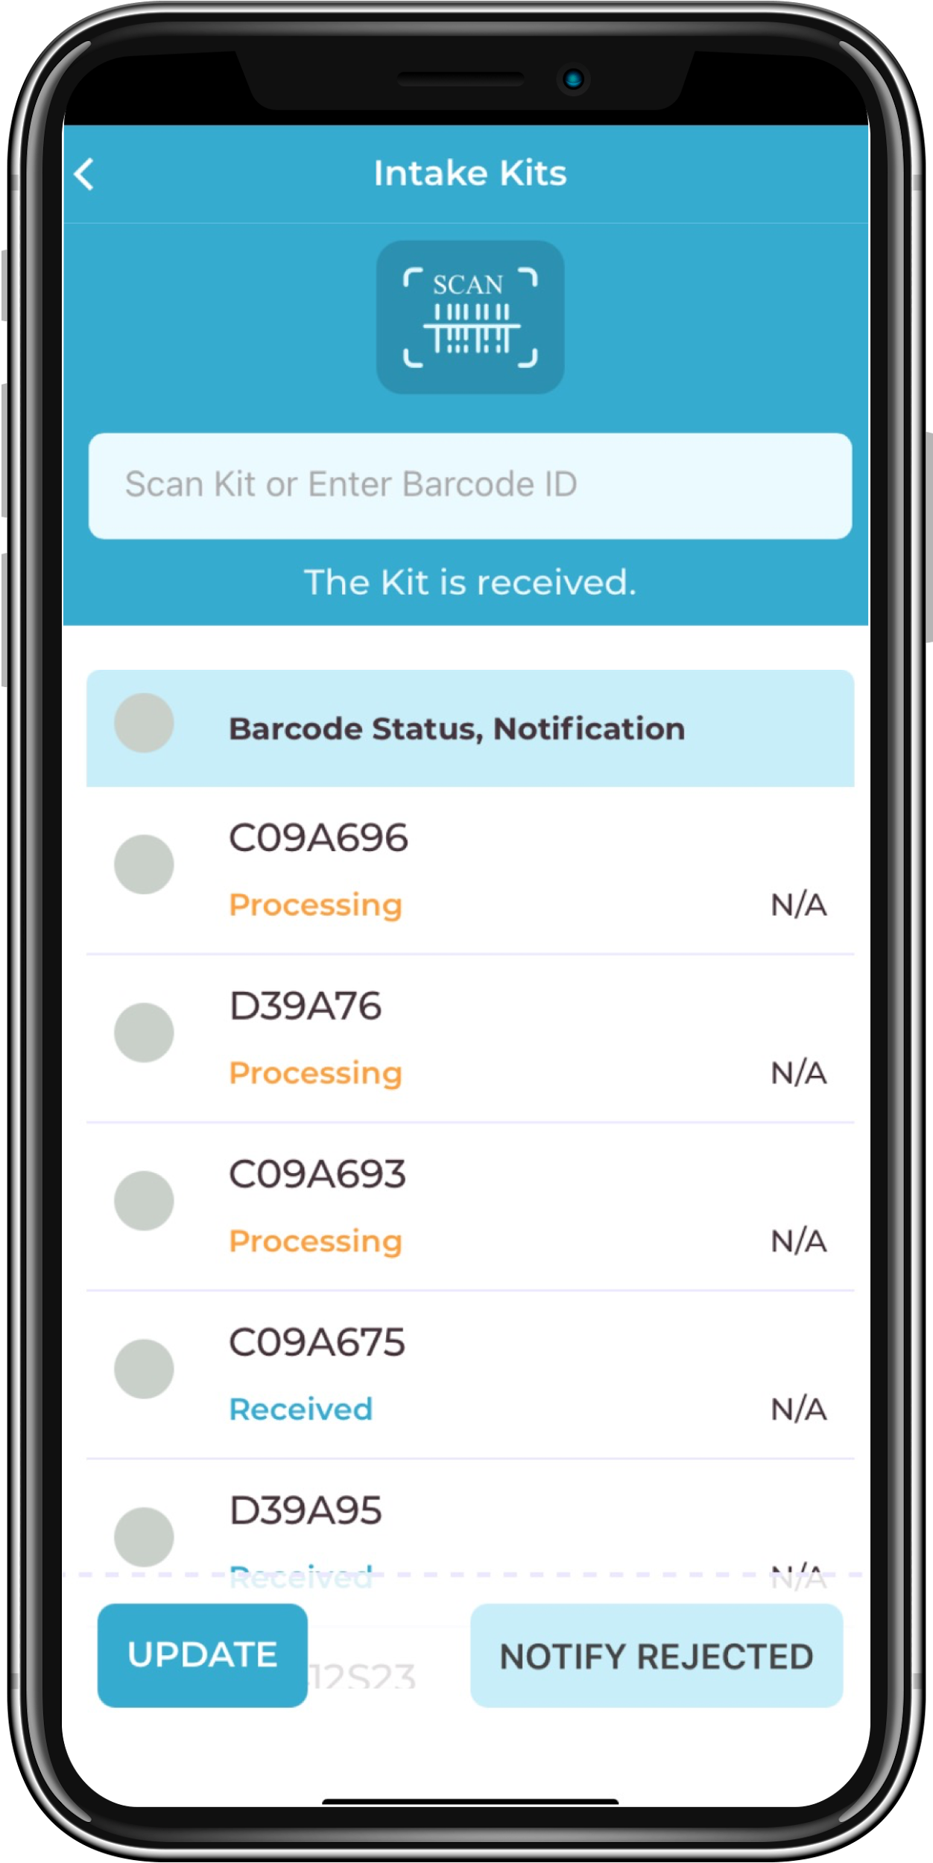
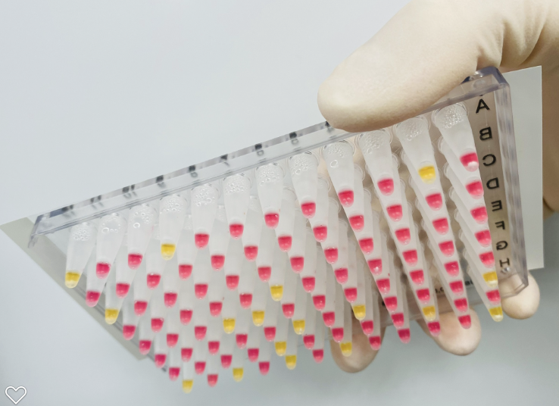
Our Solution
Unique Combination of Advantages in a Fully Integrated Program
FloodLAMP is addressing the practically unlimited demand for accessible, low cost, easy to implement COVID-19 testing and screening.
Pooled Swab Collection
Up to 4 nasal swabs per sample tube
FloodLAMP Mobile App
Custom app supports both self and sponsored collection
Results can be reported directly to participants and administrators
Lab staff interface for batch processing
FloodLAMP QuickColorTM Test
RT-LAMP "PCR-like" molecular amplification
No instruments required to run test or analyze results
Low cost and easy to run
Results in 45 minutes with only 15 minutes hands-on time

Slide 7

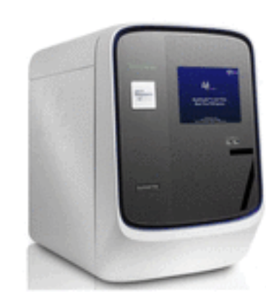
Core Assay Technology
FloodLAMP has fully validated 2 complementary tests that are best-of-breed with EUAs submitted to the FDA. Pooled home collection kit was also submitted for interactive review. The test workflow and collection kit has been designed to expand to non-COVID-19 targets in the future.
QuickColorTM LAMP Test
High sensitivity (90%)
Ultra-high throughput
Ideal for serial screening
Uniquely scales without capital intensive instruments
Licensed from Harvard Medical School (Rabe Cepko Protocol)
Visual Readout
EasyPCRTM Test
Very high sensitivity (98%)
Medium throughput (1.5 hrs/94)
Ideal for diagnostics/reflex/confirm
Streamlined Sample Prep
Upfront swab pooling
Highly scalable, integrated processing
Same sample for both tests
Standard RT-qPCR instrument

Slide 8
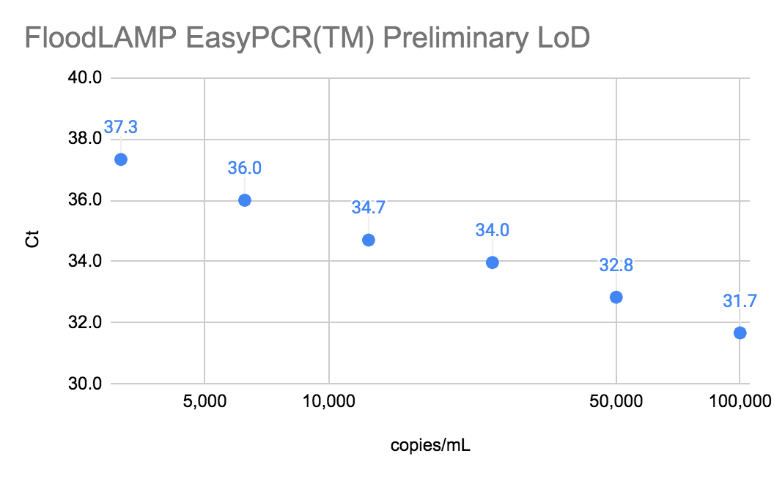
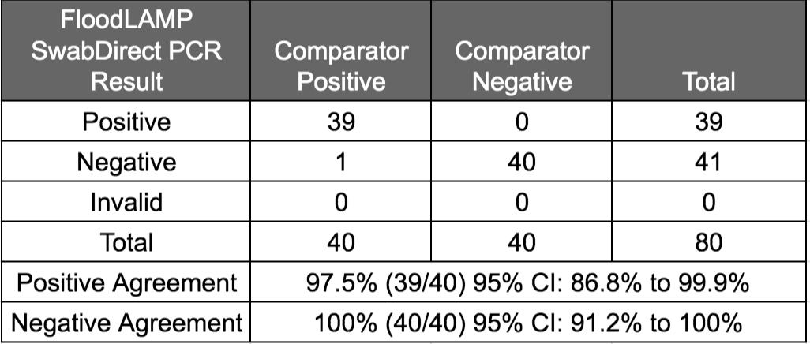
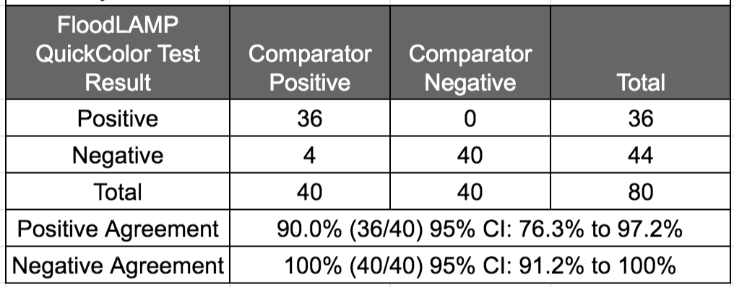
Clinical Evaluation Data
Clinical evaluation performed by the Stanford CLIA Lab, with excellent results and praise on the "really straightforward" protocol.
EasyPCRTM Test
3 copies/µl LoD
98% sensitivity (PPA 39/40)
100% Specificity (40/40)
No false positives
QuickColorTM LAMP Test
12 copies/µl LoD
90% Sensitivity (PPA 36/40)
Missed positives only high Ct (>36 with direct PCR)
100% Specificity (40/40)
No false positives
Source of Specimens: Stanford COVID-19 Clinical Testing Program
Specimen Type: Anterior Nares Swab in PBS, previously tested and frozen
Comparator Test: Hologic Panther Fusion SARS-CoV-2 Assay and Hologic Panther Aptima SARS-CoV-2 Assay

Slide 9
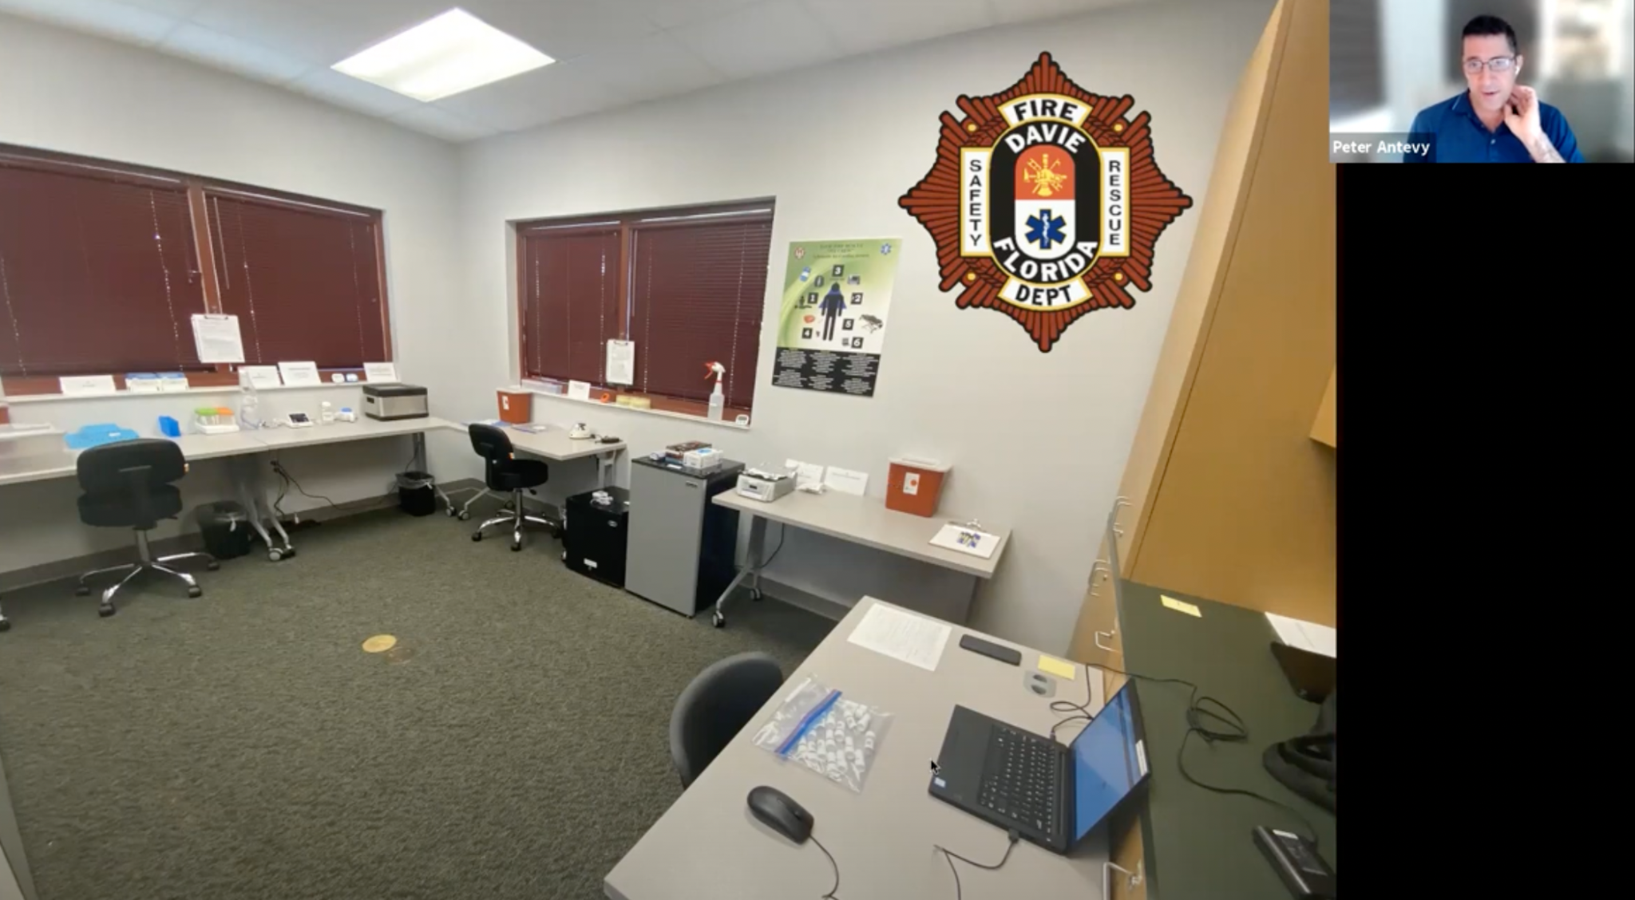
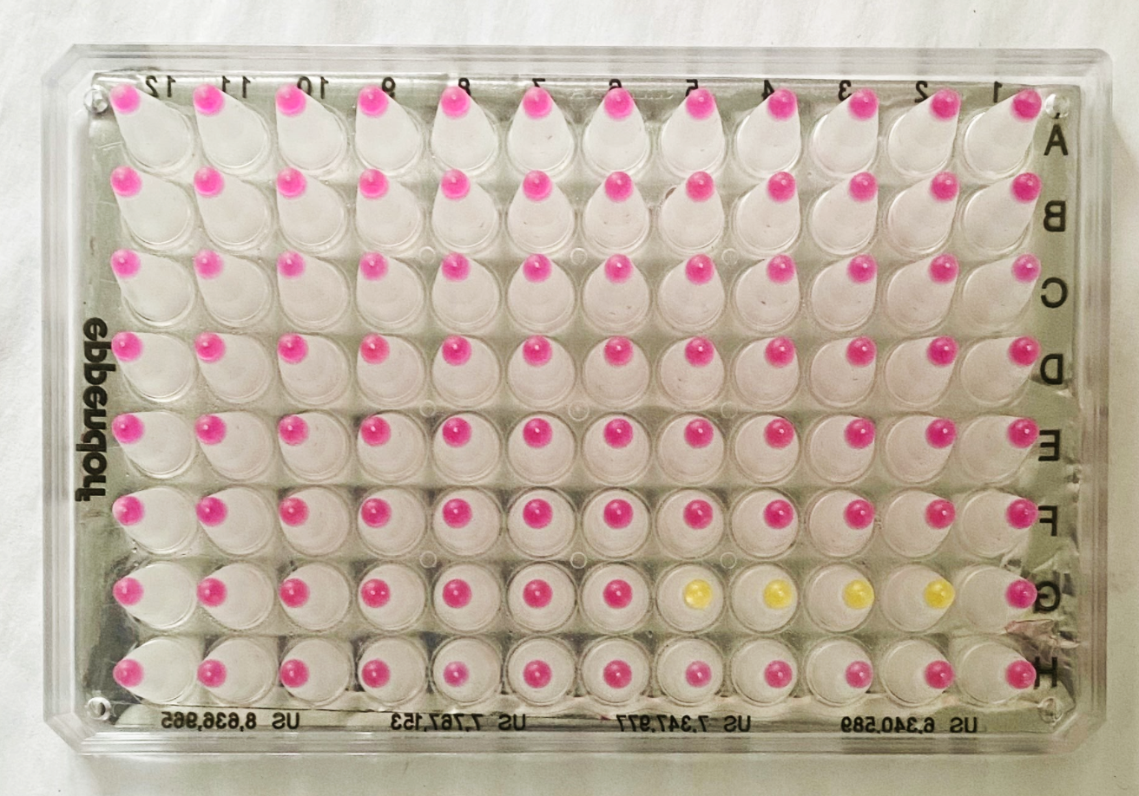
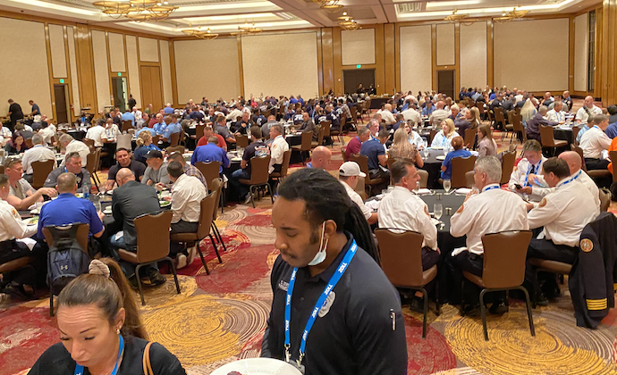
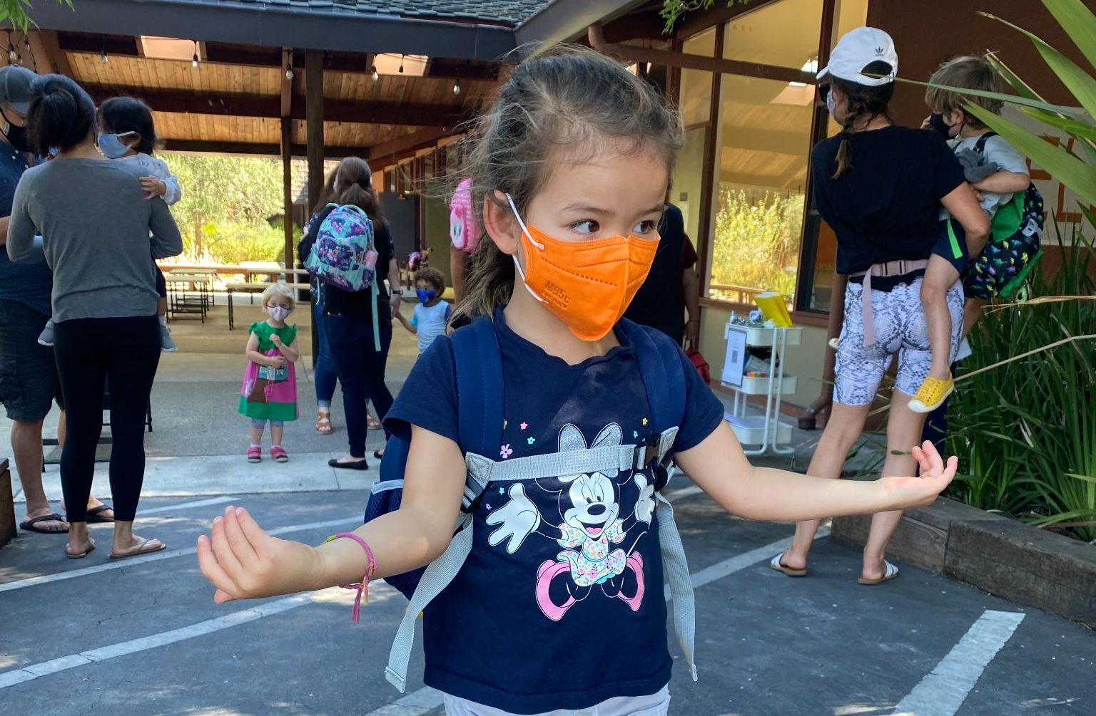
Case Studies
Florida Municipal & EMS Deployments
Davie and Coral Springs FL EMS Depts purchased systems to routinely screen first responders and city staff.
Full-time light duty firefighters dedicated to running FloodLAMP.
Unknown positive cases detected and many positives confirmed.
Clearance from CMS and FDA to operate non-diagnostic "surveillance" testing program
Reordered test kits and expanding programs.
Teen Summer Camp
Screened entire camp, 2 cohorts, 300 and 400 campers.
Remote bringup and processing by local academic volunteers.
FloodLAMP screening brought up early after 1 positive case identified on Day2.
Positive case confirmed by FloodLAMP.
Daily surveillance screened bunkmates and contacts post exposure.
EMS Leadership Conference Screening
Pop-up lab at conference venue - Hard Rock Hotel Ft. Lauderdale.
Setup and validation complete in 3 hrs.
Screened conference attendees on-site in pools of 2-4.
Same day training of volunteers to run test.
No positive or invalid results.
69 minute average turnaround time in lab
Preschool At-home Family Pooled Collection
Pilot underway with onboarding and first testing sessions successful.
Implementing "holy grail" of at-home self-collection of entire families.
Using FloodLAMP Mobile App for distributed collection and processing.
Convenient drop-off at school.
75min true turnaround-time from dropoff cutoff time to results.

Slide 10







Open EUAs
Path to establishing generics in Dx
 | Typical IVD EUA | CDC EUA | SalivaDirectTM | SHIELD | FloodLAMP EasyPCRTM | FloodLAMP QuickColorTM
Disclosure of all chemicals and reagents? | No | Yes | Yes | Yes | Yes | Yes
Chemical and reagents available from multiple vendors? | No | Yes | Yes | No | Yes | Yes, *except NEB LAMP MM
Disclosure of primer sequences? | No | Yes std for PCR | Yes | No ProptryThermo | Yes | Yes
Primers commercially available from multiple vendors? | No | Yes | Yes CDC Primers | No ProptryThermo | Yes CDC SD Primers | Yes Available but not launched
Supply chain robust? | No | No/Maybe | Yes | No/Maybe | Yes | Yes
EUA Sponsor Organization Type | For Profit Company | Govt | Academic Not for Profit | Academic Not/For Profit ? | Public Benefit Corp | Public Benefit Corp
Designation of CLIA labs | Kit Sales | N/A open RoR | Impact & Expansion | Impact & Expansion | Impact & Expansion | Impact & Expansion

Slide 11


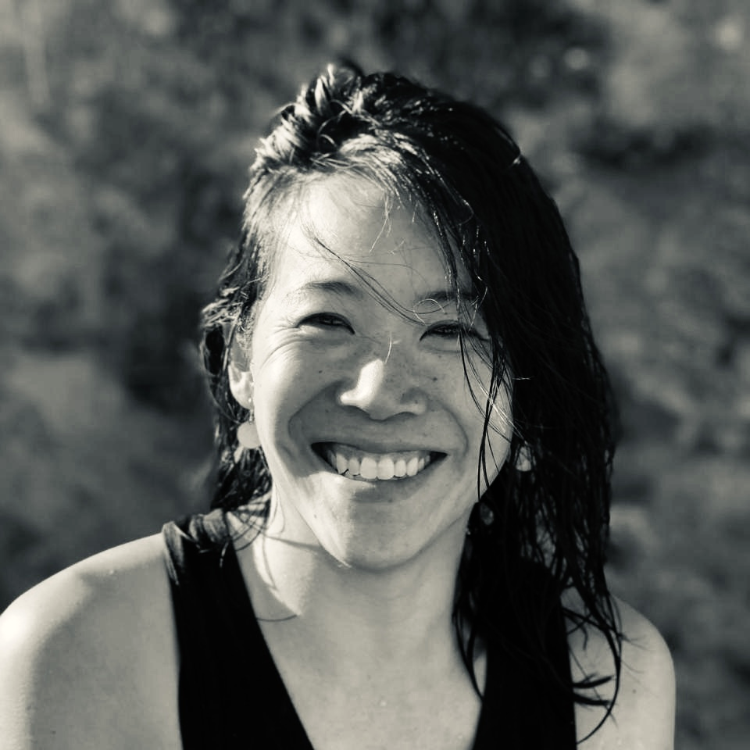
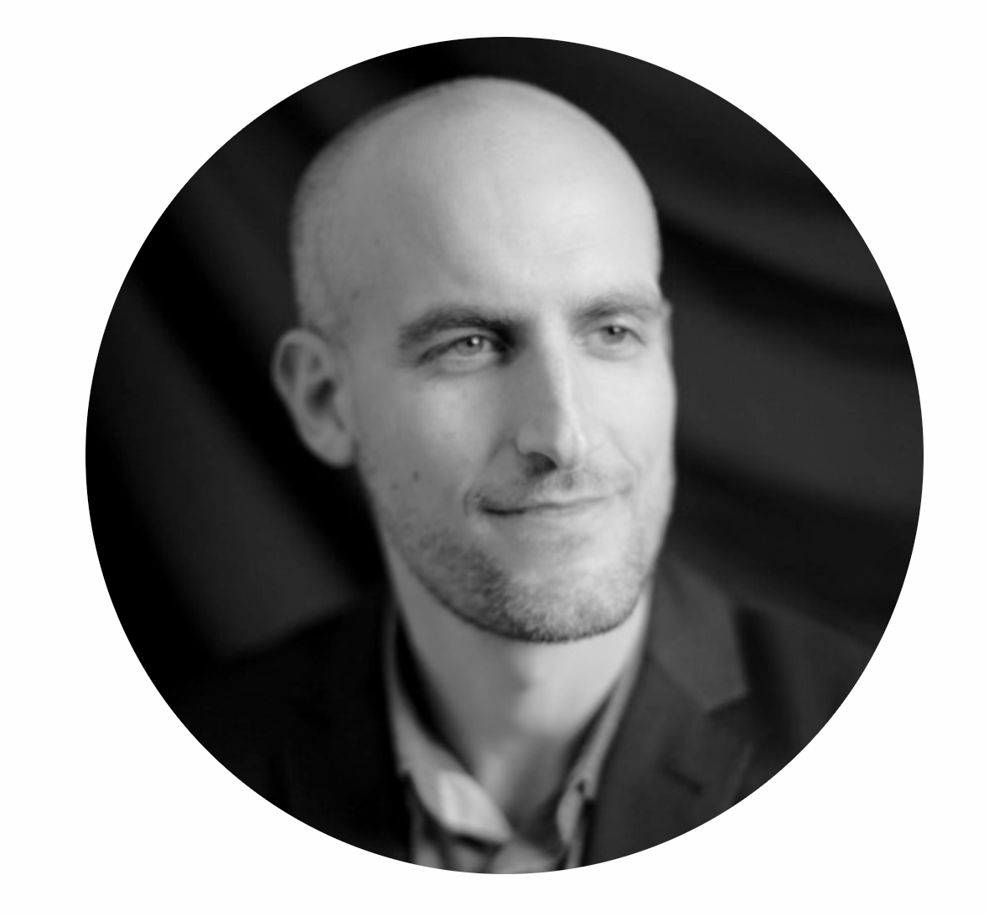
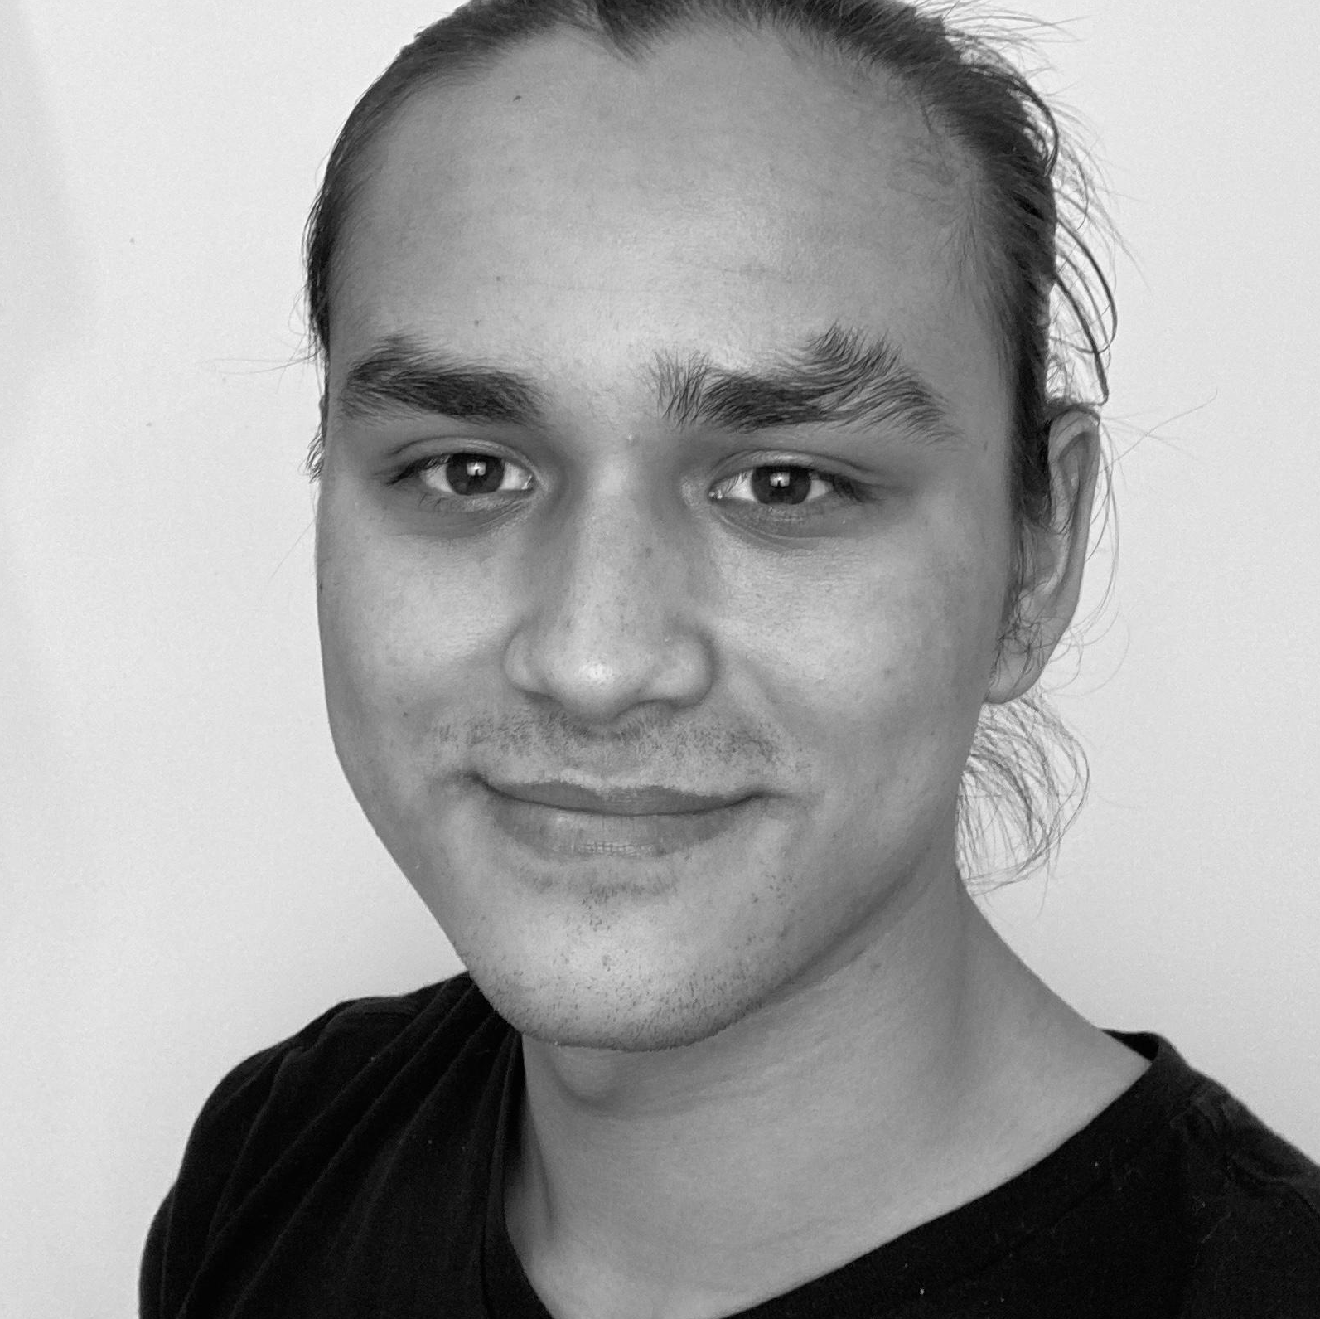
Team
Mission driven and execution experience, with a growing network of influential advisors and collaborators.
Randy True
Founder & CEO
• Founder TMI Inc. - Acq. Affymetrix 25MM
• VP of R&D at Affymetrix
Kevin Schallert
COO
• Co-Director covid19sci.org, National Volunteer Scientist DB
• Founder & COO of VineEye
Theresa Ling
UX/Design Lead
Former Uber, New Relic, R/GA
Gary Withey, Ph.D.
Director Process Development
• Current Associate Director, Atreca Inc.
• Former Pilot Production Manager, Affymetrix
Brandon Smith
Lab Assistant
• Silicon Valley CTE Graduate
Scientific Advisory Board
Industry Advisors
Collaborators
Anne Wyllie
Yale, Lead Researcher – SalivaDirect
Bill Hyun
UC San Francisco, Genoa Ventures
Prof. Connie Cepko (former)
Harvard, Harvard Medical School, Genetics Department, Co-Dir Trans Med Program, HHMI
Tim Lugo
William Blair Biotechnology Group Head
Zarak Khurshid
Asymmetry Capital, Top MDx Analyst
John Edge
Oxford Internet Institute, Blue Field Labs, ID2020
gLAMP Group
Global LAMP consortium of 200+ Academic and industry scientists
OpenCOVIDScreen
Jeff Huber (Google, Grail)

Slide 12
Safety Highlights
Protecting You!
Disclaimers:
This is not a substitute for formal Lab and Biosafety Training.
Site managers, site personnel, and volunteers are responsible for maintaining appropriate trainings and certifications, and for compliance with local, state, and federal regulations.
FloodLAMP's safety information is provided on a best-effort basis during this Public Health Emergency.
Resources:
UCLA Online Slides/PDFs - UCLA Root Site
Yale - Laboratory Chemical Training by Yale (40 min) - free video based
Yale - BioSafety Level 2 Training Part1 (25 min) Part2 (50min)
UC Davis Training ~1 hour online - must request access
OSHA Requirements on Hazardous Chemicals in the Workplace

Slide 13
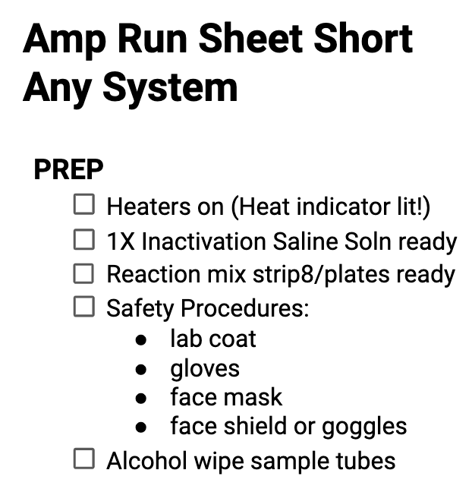
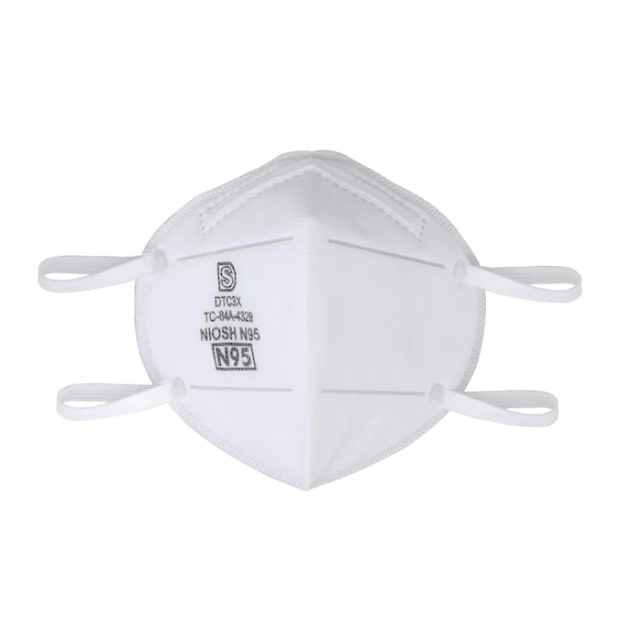
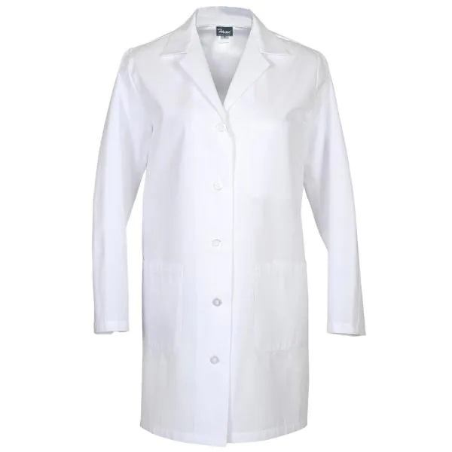
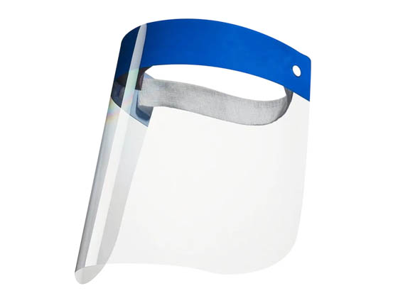
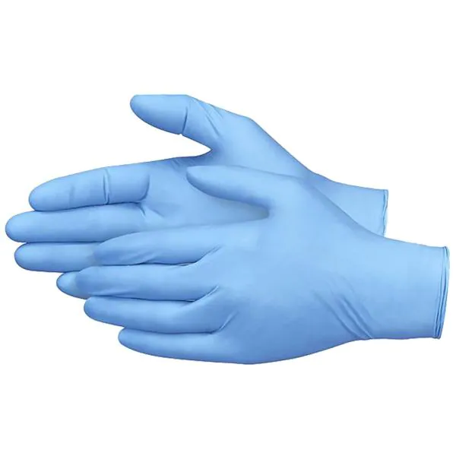
Safety Highlights
PPE

Slide 14
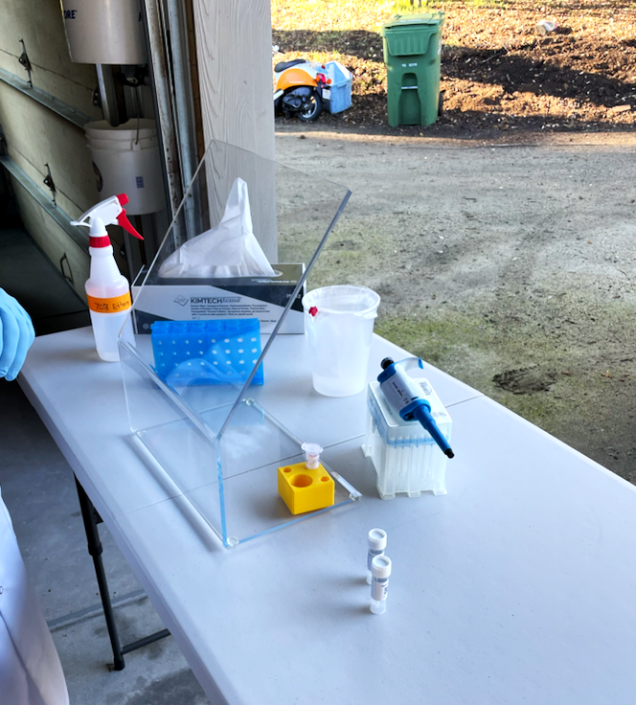
Safety Highlights
Sample Handling
Incoming Sample Tubes should be in biohazard bags or in a rack in a closed bin.
Samples tubes should be wiped with 70% alcohol or ethanol after debagging.
Step with the highest risk of infectious exposure is opening the tube with dry swab for addition of the 1X Inactivation Saline Solution (1st step of the Inactivation protocol).
  recommend performing this step in biosafety cabinet, chem hood, or well ventilated location.

Slide 15
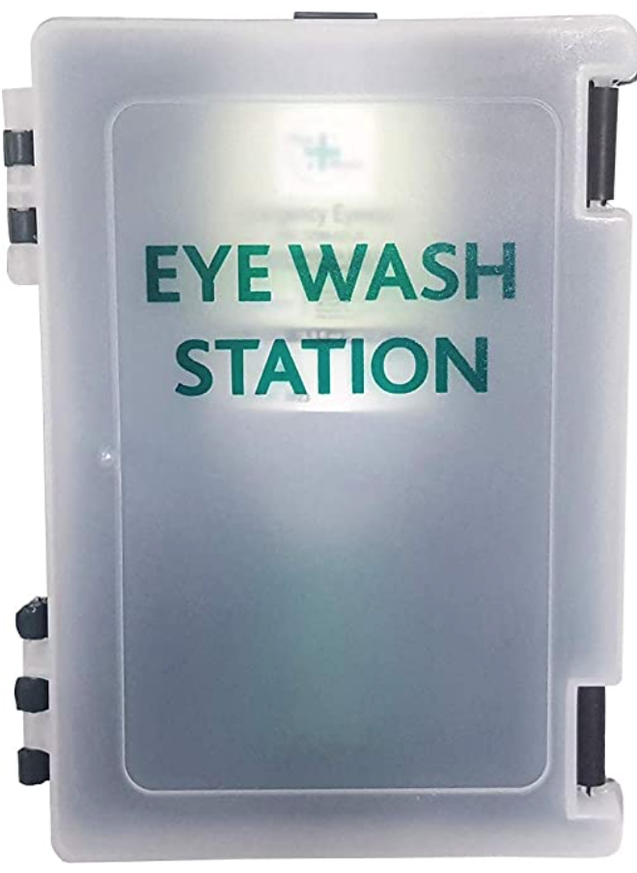
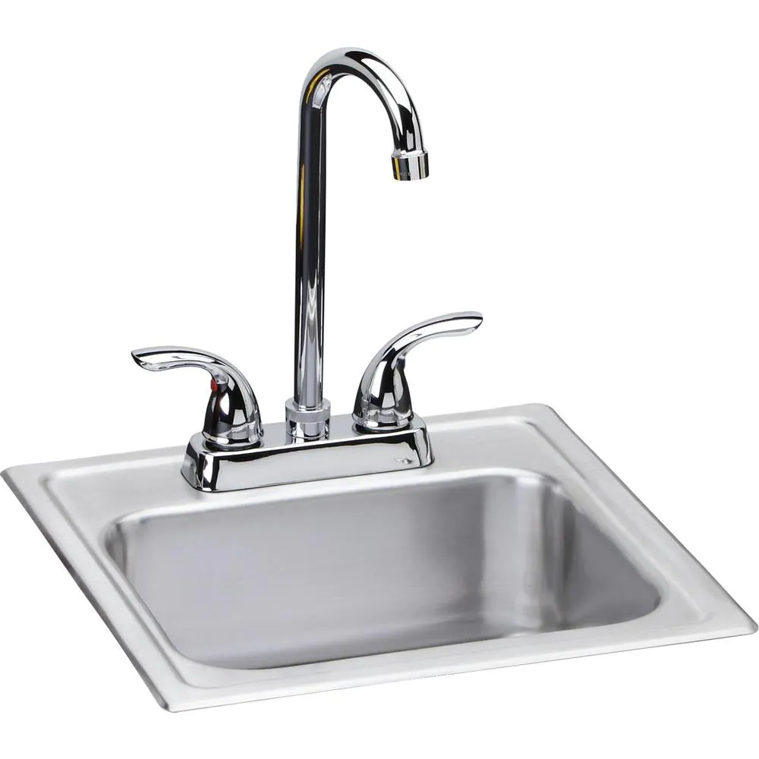
Safety Highlights
Chem Safety - TCEP Inactivation Solution
FloodLAMP Safety Data Sheets - bit.ly/floodlamp-sds
TCEP - Tris(2-carboxyethyl)phosphine hydrochloride
Causes severe skin burns / eye damage if contact
Ingestion / breathing in TCEP is dangerous
Use in well ventilated area with appropriate PPE
EDTA - Ethylenediamine Tetraacetic Acid
Causes serious eye irritation / Harmful if inhaled / May cause damage to organs through prolonged or repeated exposure
Use in well ventilated area with appropriate PPE
 | 100X IS | 1X ISS (Sample)
TCEP | 250 mM | 2.5 mM
EDTA | 100 mM | 1 mM
NaOH | 1.15 N | 11 mM
Give extra care when handling the 100X Inactivation Solution!
Eye Wash Station
Know location
Familiarize with use
Sink
Know location of nearest
Ensure stocked with soap

Slide 16
Contamination Procedures
Protecting the Tests!
Focus on 4 Types of Contamination
RNAse Contamination
Positive Control Contamination
Sample Cross Contamination
Amplicon Contamination = Death!
Notes:
Talked about how to protect you, Now we're going to cover how to protect the tests

Slide 17
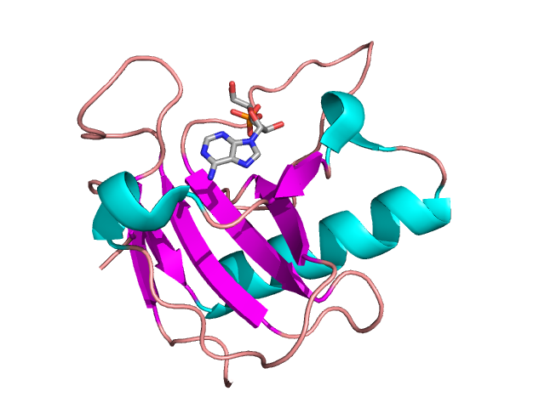
Contamination Procedures
RNAse Contamination https://www.neb.com/tools-and-resources/usage-guidelines/avoiding-ribonuclease-contamination
What is RNAse and why do we care?
Enzymes that destroy DNA and RNA, which is what our test detects
Produced by every living organism in every living cell
Creates unreliability in test results
When and where do we care?
Primarily in Amp Reaction
How do we know?
Positive Controls don't hit (pink or orange)
BUT this is usually degraded Positive Control - tricky!
RNAse is EVERYWHERE!!
What do we do about it?
Access Control - only people who know the rules can come in the room.
Gloves, Gloves, Gloves - don't touch anything except the desk station without gloves.
Always Wear Lab Coat - to avoid forearm slime from getting everywhere.
Clean then Keep Clean - use bins, bags and foil to keep things clean and you life easier.
Be Extra Careful w Reaction Plastics - clean gloves only, don't reach in bags, don't touch inside of caps when opening
Be Wary of Cross Contamination
Stage to Replace - avoid Matlock trap, keep stash clean and secure, and replace if problems

Slide 18
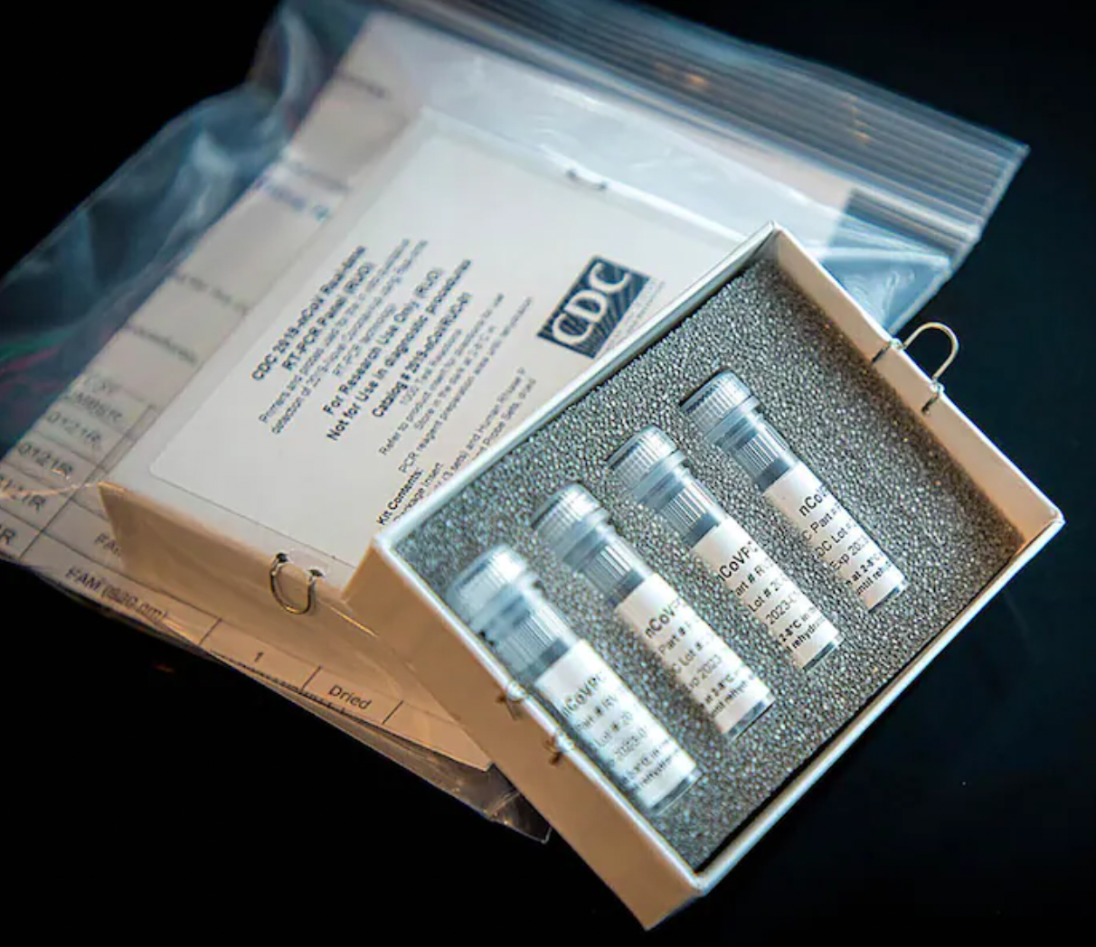
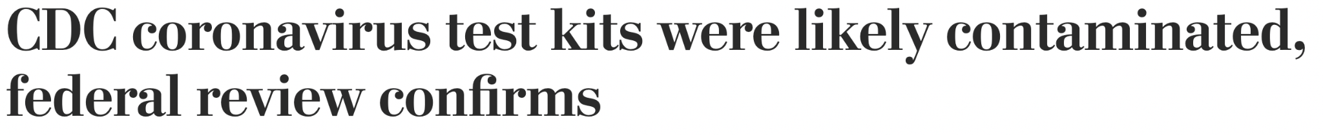
Contamination Procedures
Positive Control Contamination
“It was at this stage of the manufacture, when the bulk reagent materials for the test kits were processed and tested at [the respiratory virus lab], that they were most likely exposed to positive control material,’’
How do we know?
Negative control hit positive (yellow) or inconclusive (orange)
Suspiciously high number of positive or inconclusive samples
What do we do about it?
Follow Protocol - there are specific procedures and steps explicitly described in the protocol steps and shown in training to take extra care in the handling of the positive controls (TPC and Zeptos).
Handle tiny TPC tube carefully, open with left hand, keep right hand you pipet with clean.
Change gloves right after putting TPC back in it's baggie in the freezer.
Keep positive controls on bottom shelf in freezer, in bags.

Slide 19
Contamination Procedures
Sample Cross Contamination
Means transferring material from one sample tube to another.
For example, a drop from the cap gets on your glove and then you touch the inside of another cap.
How do we know?
You won't if all samples in batch are negative, which is usually the case!
Get multiple positives in a batch, especially neighbor tubes. You always confirm positives so if some aren't confirmed but some are, that would indicate sample cross contamination.
What do we do about it?
Follow Protocol - there are specific procedures and steps explicitly described in the protocol steps and shown in training to take extra care to avoid sample cross contamination.
Do initial wipe of sample tubes with alcohol/ethanol.
Be careful with caps when opening inactivated samples - we are not spinning them down in a centrifuge so there can be liquid on the cap.
If you get sample drip/drop, stop and wipe it up carefully, change gloves, clean spot/area with bleach+alcohol. Note sample ID in "notes" on run sheet.

Slide 20
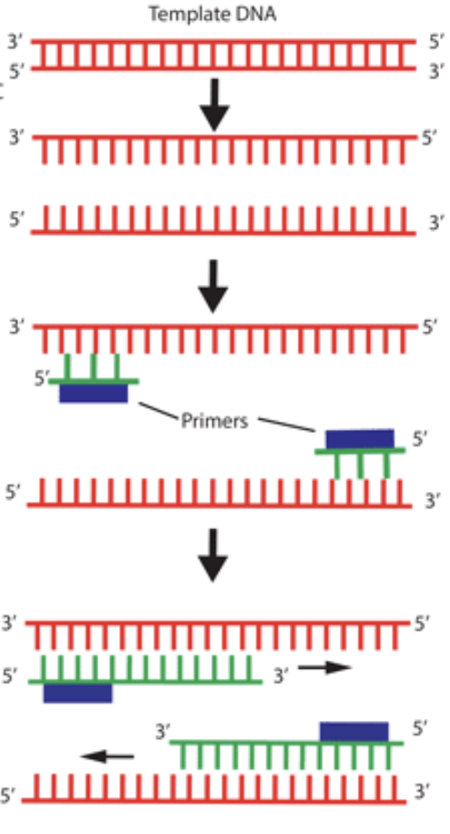
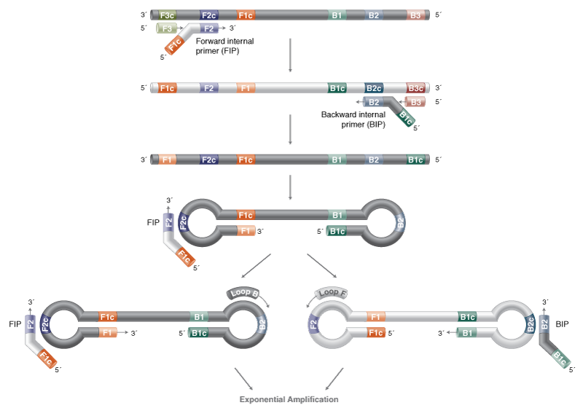
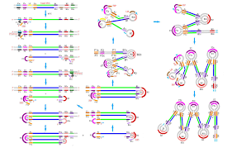
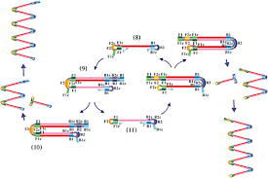
Contamination Procedures
PCR LAMP
Amplicon Contamination
What are amplicons?
Amplicons refer to the large amount of DNA produced in a positive amplification reactions. AKA "products".
Why Death?
Can contaminate entire lab and require start from scratch, sometimes in new building!
How do we avoid Death?
NEVER OPEN THE TUBES! - after amplification.
Treat the tubes, the heater, the lightbox (anything in the Amp area) as if it's radioactive.
Amp Area is a Black Hole - anything that goes in does not come out: pen, marker, post-it notes.
Change Gloves - after touching amp'd tubes and Amp area.
Follow these rules and you should be able to avoid amplicon death. Our NEB LAMP Master Mix uses a UDG thermolabile nucleotide (like an extra life, but don't want to use it!).

Slide 21
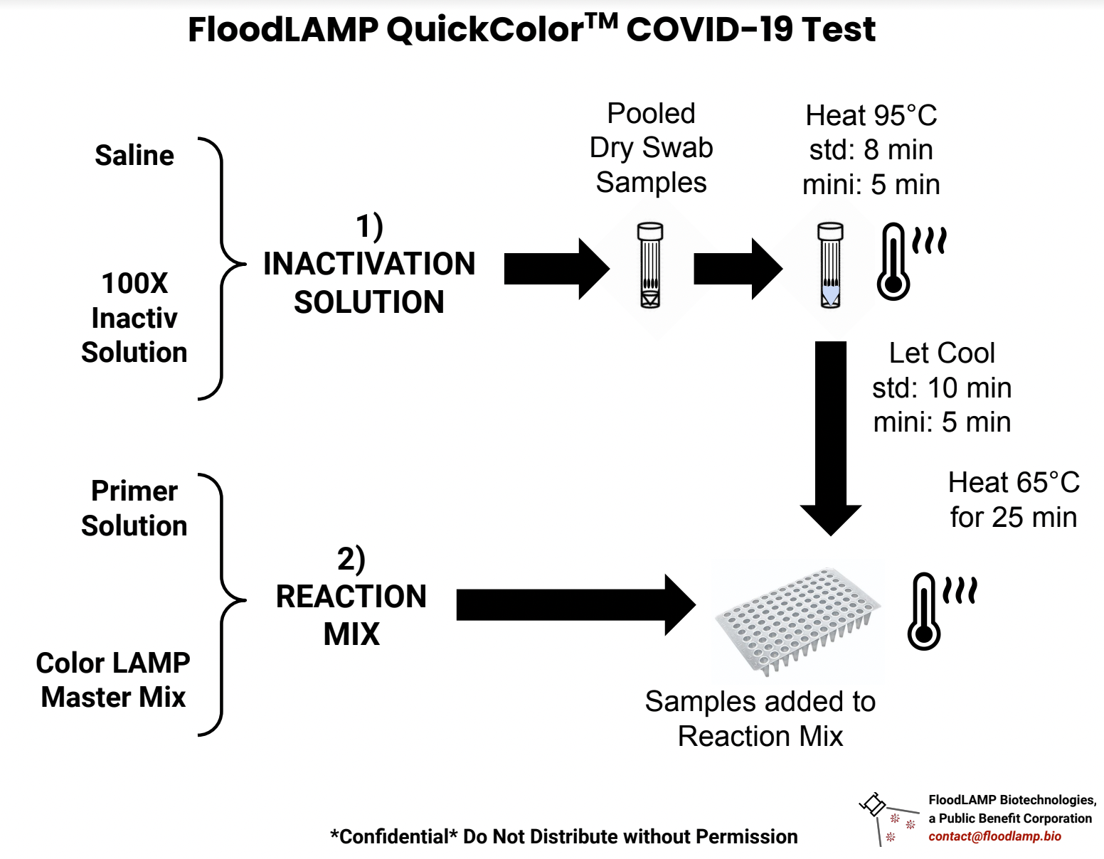
Test System Overview
2 x 2 x 2:
2 Solution Preps
2 Components Each
2 Heat Steps

Slide 22
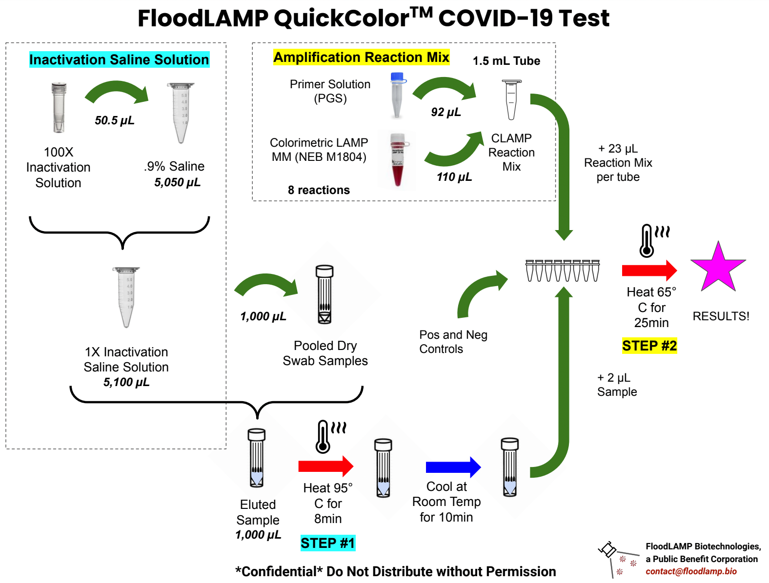
Test System Overview

Slide 23
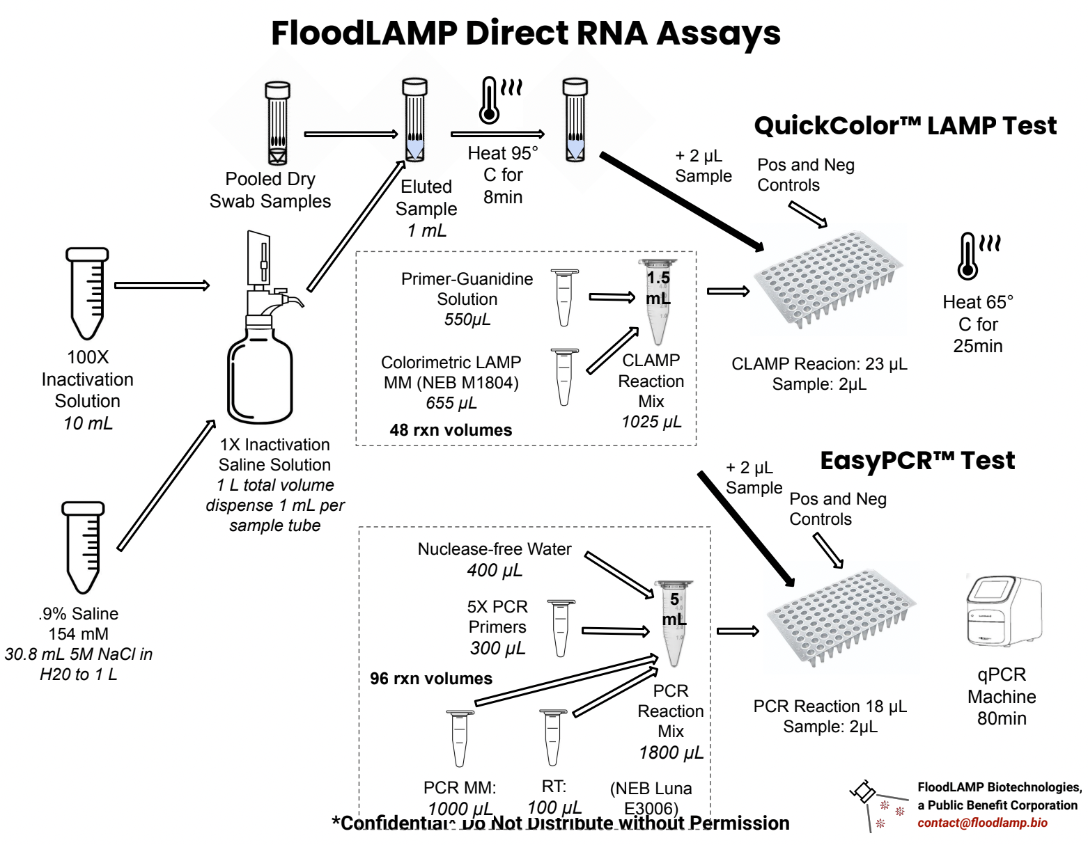
Test System Overview

Slide 24
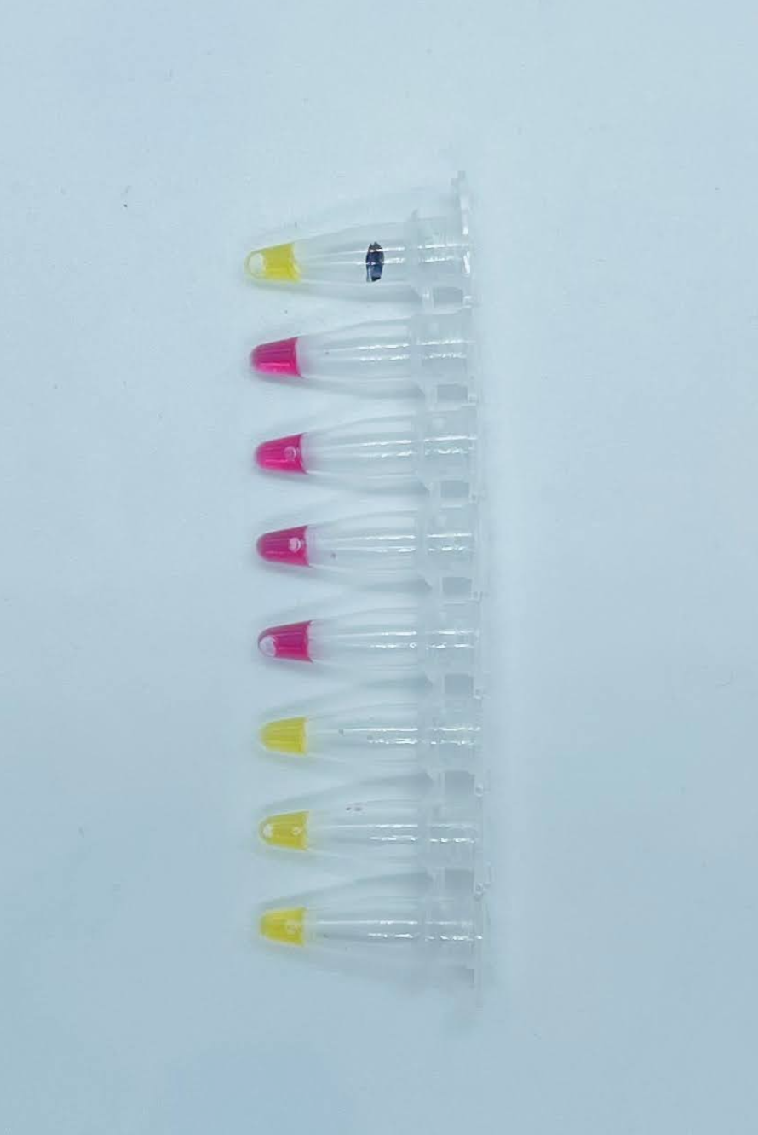
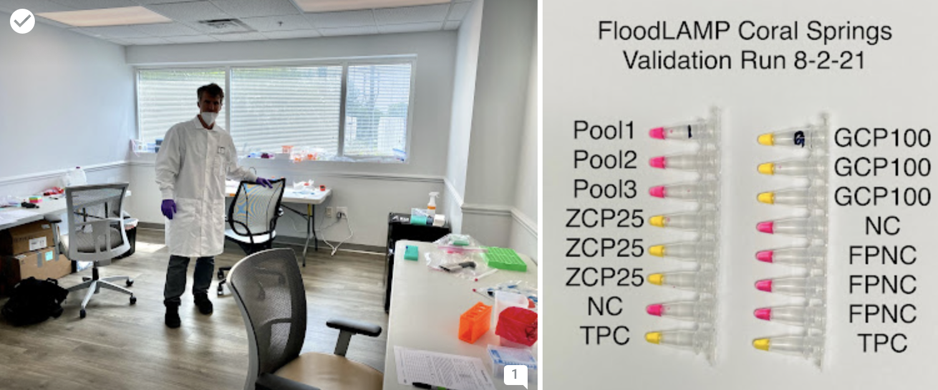
Validation Run
Will create "contrived positive" sample by spiking inactivated virus into the 1XISS
(Zeptos 50uL = 50 cp/uL in ZCP)
Run this in triplicate along with your pooled samples.
Have cold chain concern over reagent shipment - fingers crossed!
Single Strip8:
1) TPC
2) NC
3) ZCP50
4) ZCP50
5) ZCP50
6) Pool1
7) Pool2
8) Pool3

Slide 25
Training Kit
Learn and practice without burning or contaminating real reagents.
Line # | Item Description |  | Quantity
1 | Training 1.5mL Tubes |  | 30
2 | Training 30mL Chub Tubes |  | 2
3 | Training 5mL Snap Tubes |  | 2
4 | Mock PGS |  | 10
5 | Mock CLAMPMM |  | 5
6 | Mock 100XIS |  | 1
7 | Mock 50mL Saline |  | 2
8 | Mock TPC |  | 8

