Slide 1
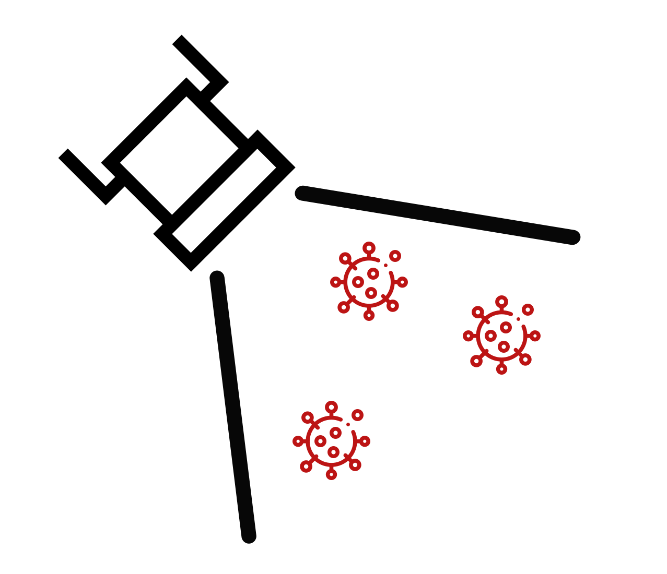


Deploying Mass Scale Molecular Testing
Randy True, CEO FloodLAMP Biotechnologies
randy@floodlamp.bio

Slide 2
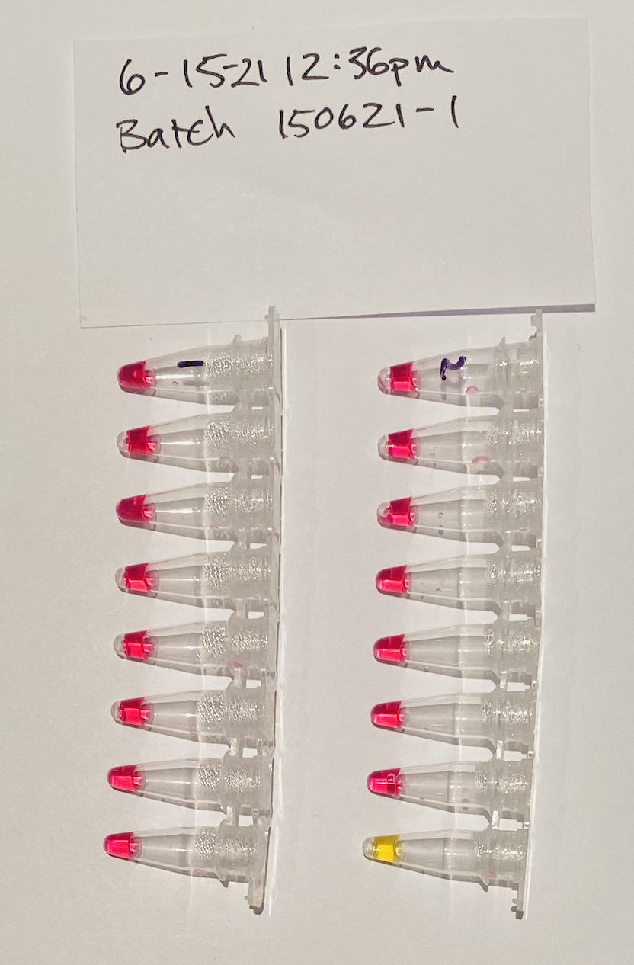
This is what you want to see!
Pink is not detected.
Last yellow is positive control.
Today's Results
Pooled collection of as AN swabs.
Surveillance testing in pop up FloodLAMP lab.

Slide 3
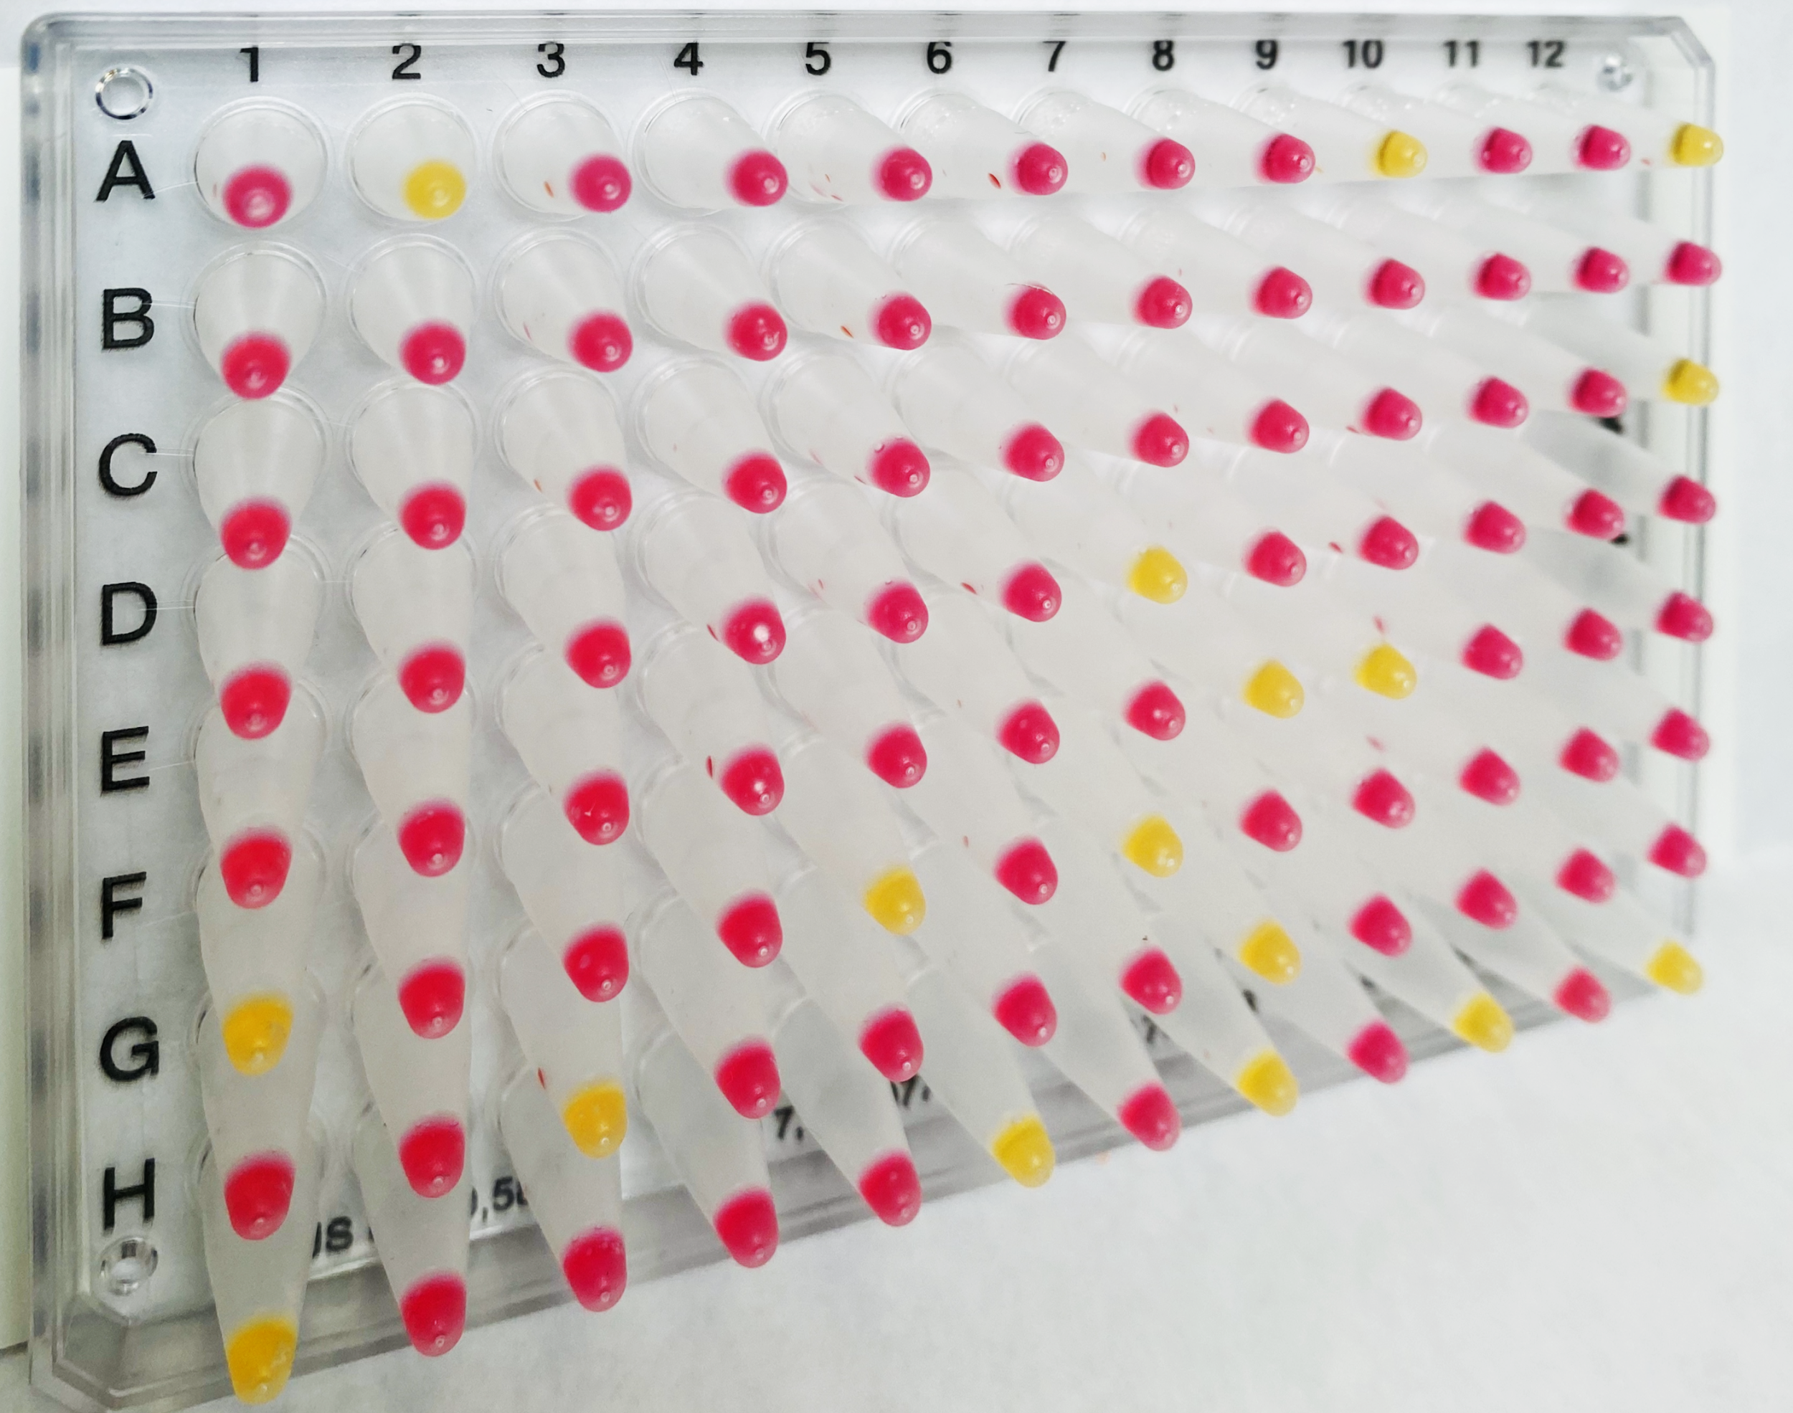

Slide 4
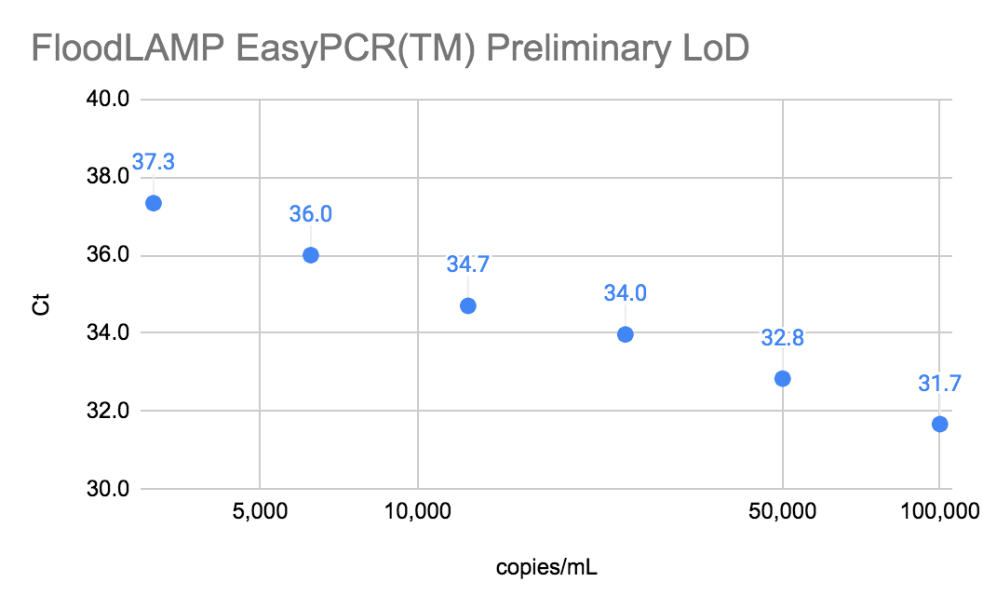
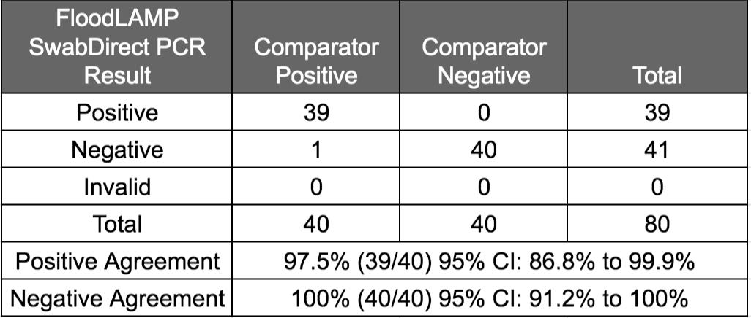
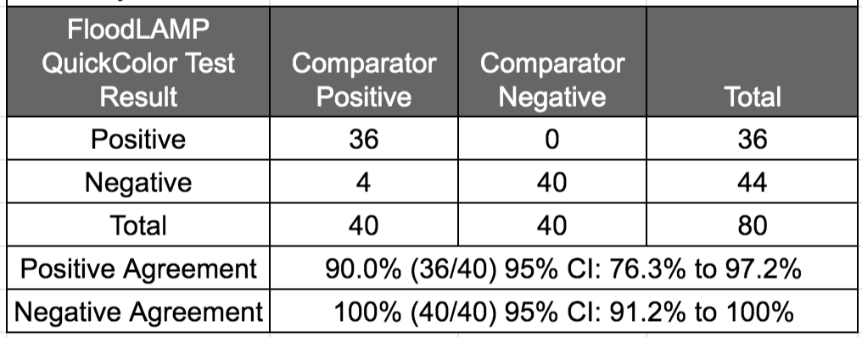
EasyPCRTM Test
3 copies/µl LoD
98% sensitivity (PPA 39/40)
100% Specificity (40/40)
No false positives
QuickColorTM LAMP Test
12 copies/µl LoD
90% Sensitivity (PPA 36/40)
Missed positives high Ct (>36 with direct PCR)
100% Specificity (40/40)
No false positives
Source of Specimens: Stanford COVID-19 Clinical Testing Program
Specimen Type: Anterior Nares Swab in PBS, previously tested and frozen
Comparator Test: Hologic Panther Fusion SARS-CoV-2 Assay and Hologic Panther Aptima SARS-CoV-2 Assay
Clinical Evaluation Successful
Clinical evaluation performed by the Stanford CLIA Lab, with excellent results and praise on the "really straightforward" protocol.

Slide 5
Thank You!
Peter Antevy, Eagles and FTFC
for invitation and your service.
FloodLAMP
Biotechnologies
Randy True
Founder and CEO
randy@floodlamp.bio

Slide 6
Accessible Testing for the Genomics Age
FloodLAMP
Biotechnologies
FloodLAMP helps people to take control of their health and lets labs grow into new public health markets by unlocking access to molecular testing. Our core product is a mass screening system built around a highly scalable, instrument-free LAMP test, a home collection kit, and a novel digital health app.

Slide 7
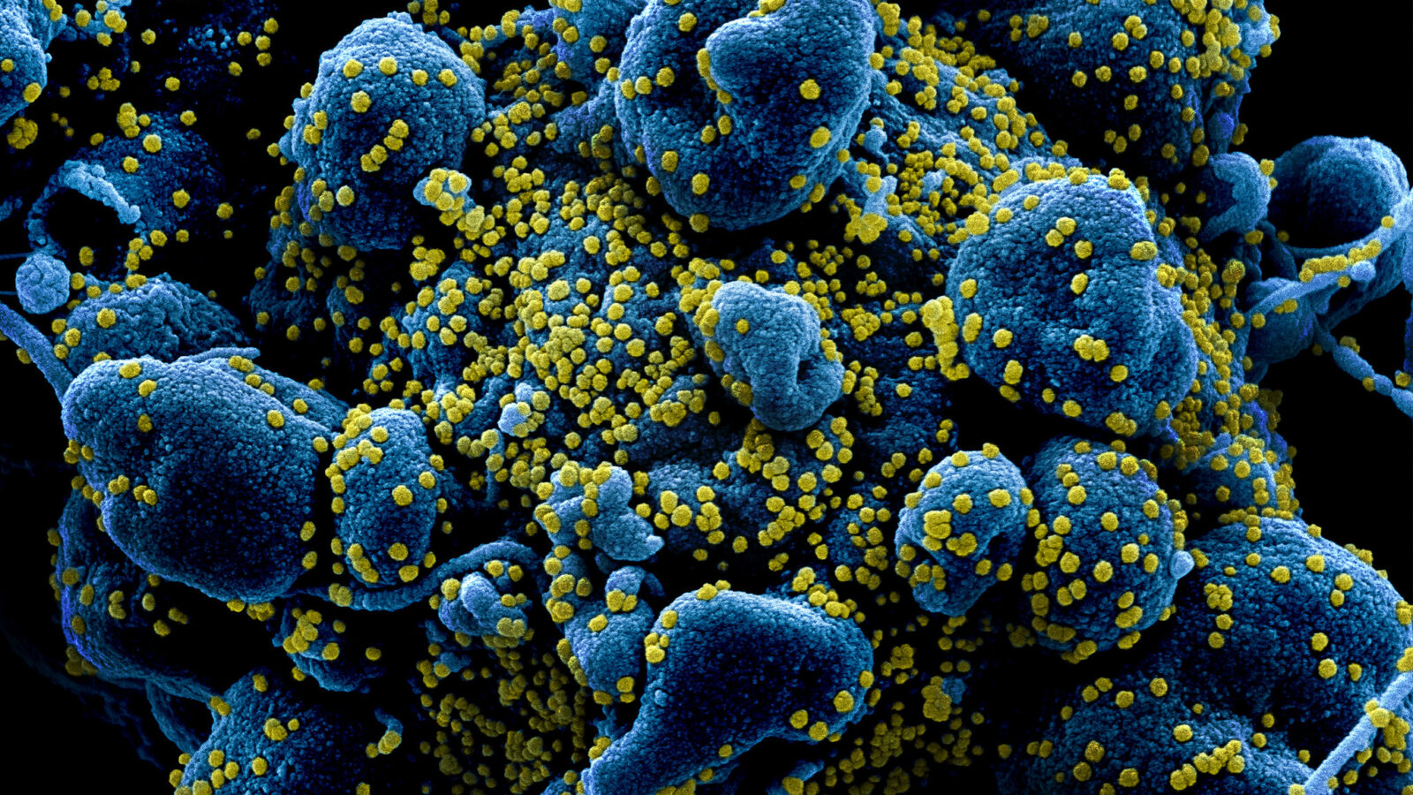
Molecular tests are so expensive and inaccessible that they are vastly underutilized to improve health and save lives.
Problem
The current diagnostics model is built around expensive, doctor prescribed, insurance reimbursable tests. This does not scale. The COVID crisis has exposed critical problems in testing, however they also have negative consequences far beyond the pandemic.

Slide 8


During COVID
Deploy FloodLAMP best-in-class mass screening program
Focus on COVID-19 school screening processed by independent labs
Grow lab network, sales channels and FloodLAMP adoption
Use volume to reduce FloodLAMP adoption friction
Post COVID
Key enabler for emerging multi-target molecular screening market
Apply digital, processing and sourcing infrastructure to high volume clinical and non-clinical molecular applications
Low prevalence, high consequence screening for public health intelligence, designed for the genomics age
Excel as an operator built for industry cost compression and commoditization via suite of enabling technologies
Opportunity
Huge govt investment in COVID-19 testing has created a once in a lifetime opportunity for rapid adoption of new modalities. FloodLAMP is using the opportunity for impact and growth in the short term, and as a beachhead to lead a future of accessible molecular testing using commodity chemistries.

Slide 9



How FloodLAMP Screening Works
1) Collect Samples
pooled swabs
at-home with family/household
on-site with pod
FloodLAMP app to register samples
fast and easy
2) Return Samples
pick up or courier to lab/processing site
low overhead and friction for organizations
3) Same Day Results
app for students and parents
web portal for school admins
Solution
FloodLAMP's COVID-19 screening program is an end-to-end solution that makes it easy and affordable to protect interacting groups such as schools, offices, or factories by providing sensitive and rapid turnaround testing.

Slide 10



FloodLAMP in the Lab
Distributed Lab/Sites
reach to underserved communities
almost all labs already have needed equipment
local control
same day turnaround times
expandable and replicable
Streamlined Workflow
simple direct assays
minimal hands-on time
modular design
instrument free
highly efficient operationally
Molecular Tests
high sensitivity and specificity
rapid results from LAMP
deconvolute with LAMP or PCR
target flexibility
Advantages
FloodLAMP has licensed best-in-class LAMP amplification chemistry and sample prep from Harvard Medical School. Our streamlined workflow is optimized for mass screening for COVID-19 and beyond.

Slide 11
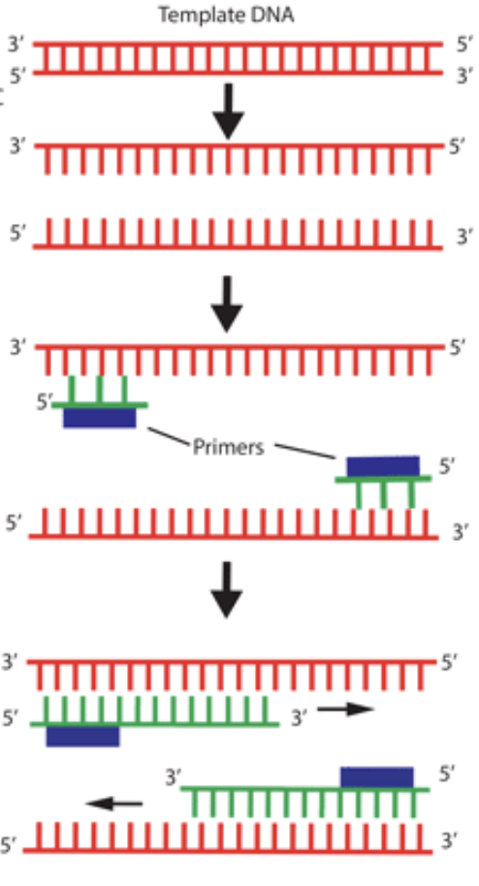
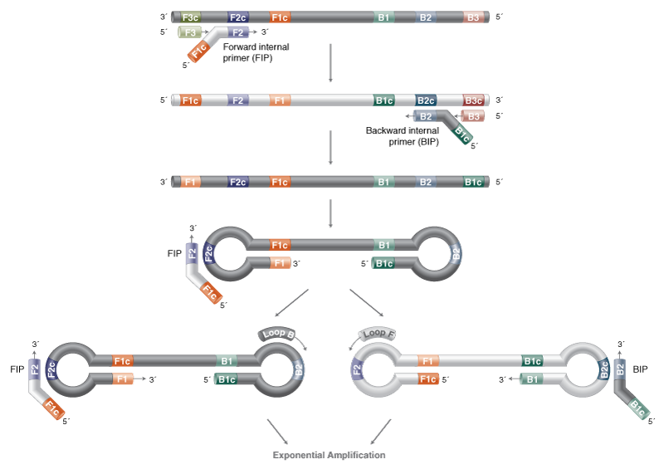
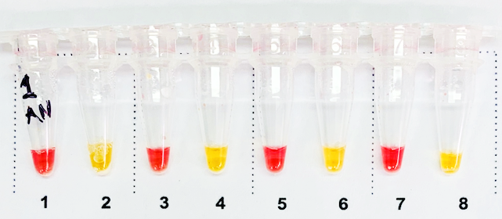
LAMP: Loop Mediated Isothermal Amplification
Detects viral RNA
LAMP generates 10X more DNA in 1/3 time compared to PCR
Easy visual / camera-based readout
 | qPCR | LAMP
Equipment | qPCR machine (thermal cycler & optics) | simple heat block or water bath (isothermal)
Time | 90 min | 30 min
Capital Cost | $30K-100K | $300

Slide 12
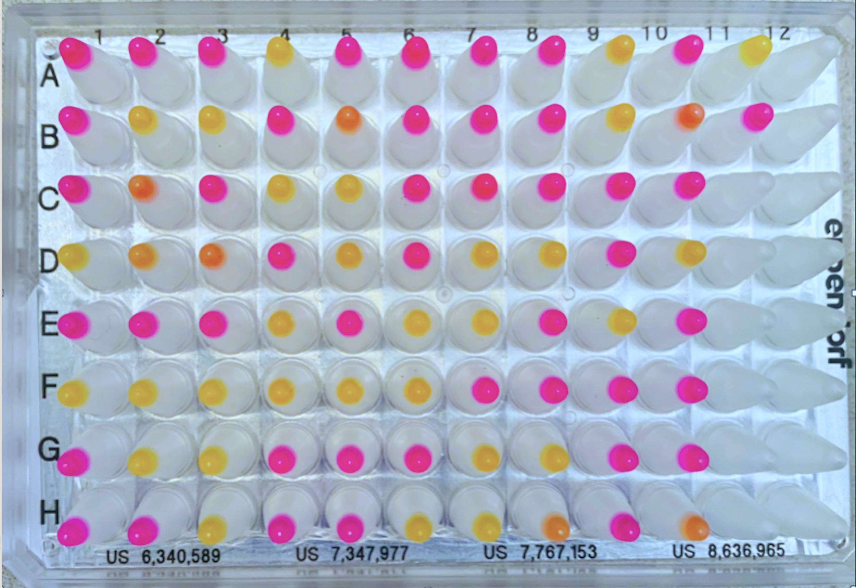
Clinical Sample Plate

Slide 13
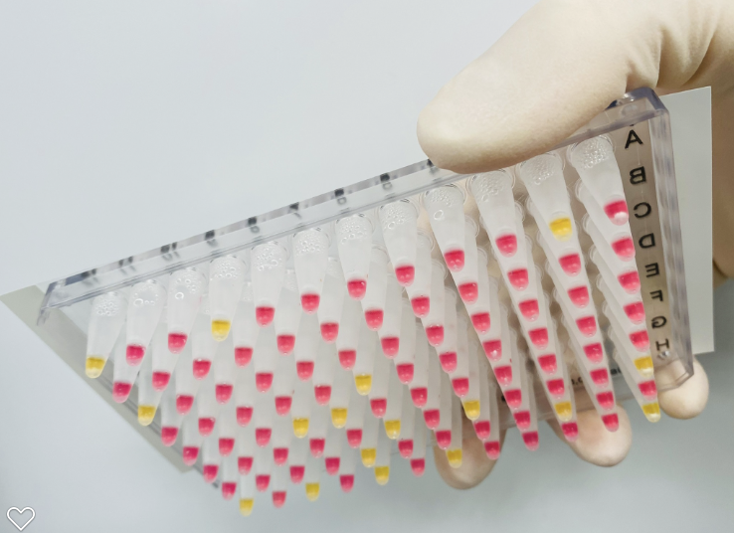

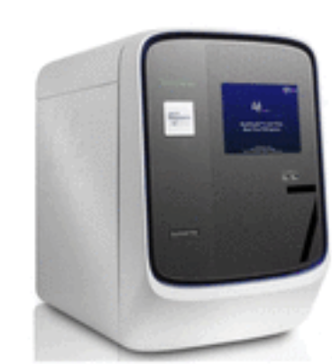
QuickColorTM LAMP Test
High sensitivity (90%)
Ultra-high throughput
Ideal for serial screening
Uniquely scales without capital intensive instruments
Visual Readout
Streamlined Sample Prep
Upfront swab pooling
Highly scalable, integrated processing
Same sample for both tests
EasyPCRTM Test
Very high sensitivity (98%)
Medium throughput (1.5 hrs/94)
Ideal for diagnostics/reflex/confirm
Standard RT-qPCR instrument
Core Assay Technology
FloodLAMP has fully validated 2 complementary tests that are best-of-breed. Emergency Use Authorizations for the tests have been submitted to the FDA, along with the game-changing FloodLAMP Pooled Swab Collection Kit DTC, for interactive review. The IRB for the clinical studies has been approved. The test workflow and collection kit has been designed to expand to non COVID-19 targets in the future.

Slide 14

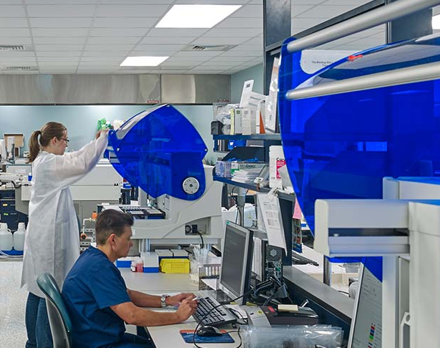
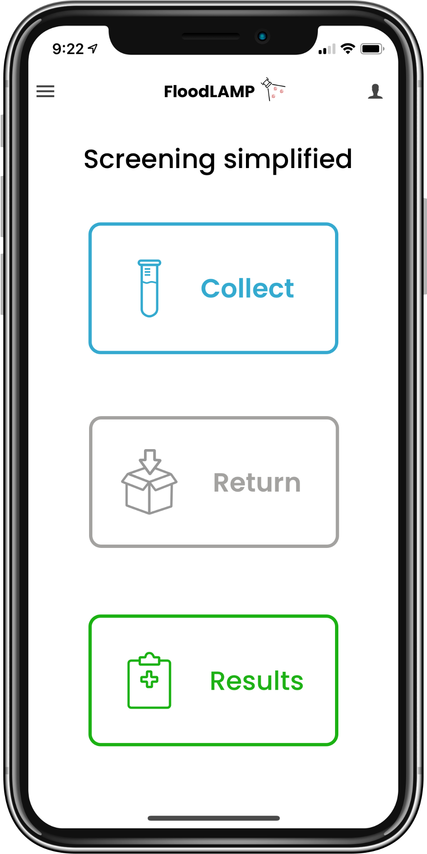
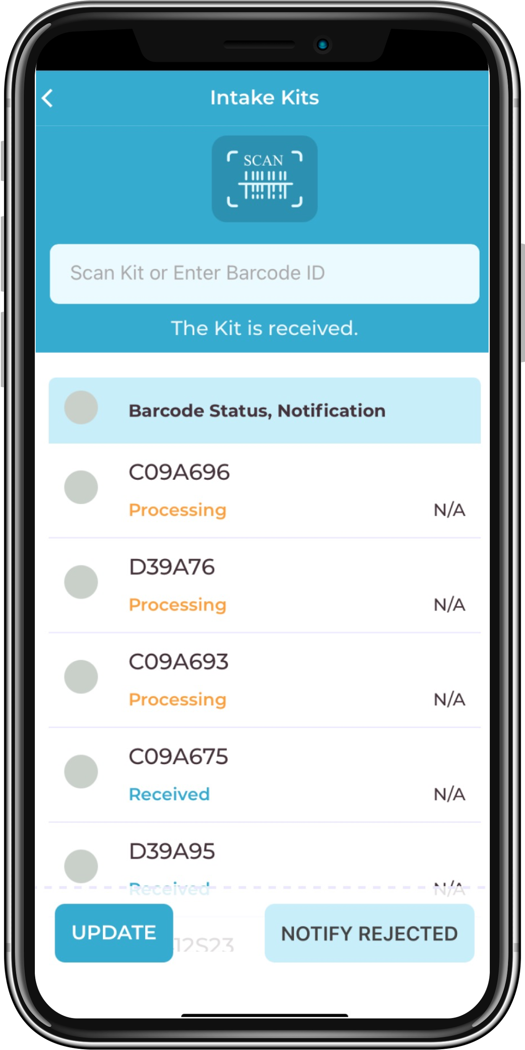
Easy, smooth UI for participants.
Powerful, lightweight
tool for the lab.
Rapid QR code scanning
Pre-accessioned, pre-pooled sample tubes
Batch flow control
Can replace LIS
Can interface w LIS thru API
Easy, shareable sign up
Electronic consent
Anywhere pooled collection
Results notifications and reporting
FloodLAMP’s digital suite is anchored on a powerful mobile tool for complete screening program management.
Core Digital Technology

Slide 15
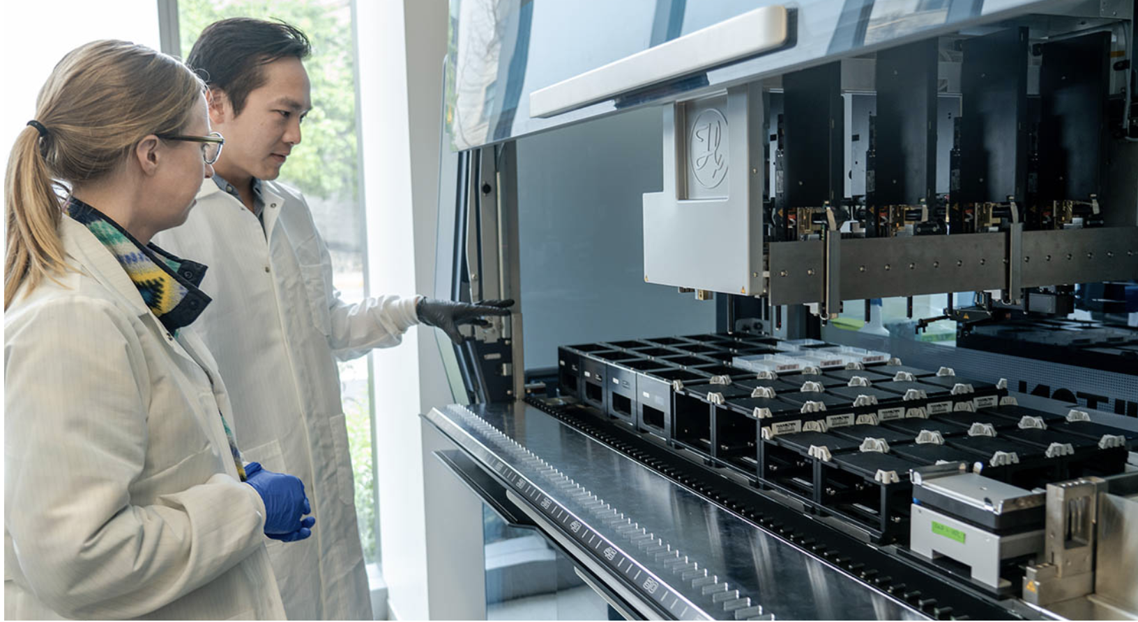










Antigen Test Suppliers
Time to Results
Prevent
Cases in School
FloodLAMP provides rapid, high sensitivity results with distributed local labs and processing sites.
Sensitivity
FloodLAMP
✓✓✓✓
✓✓✓✓
✓✓✓✓
✓✓
✓✓✓✓✓
✓✓
Poor sensitivity of antigen tests means they need to be run every day to protect a school, adding large cost and overhead.
Pooled Central PCR
Antigen
Centralized
Lab Processing
(pooled PCR)
✓✓✓✓✓
✓✓
✓✓
The > 24hr turnaround on a classroom PCR pool is a deal breaker for most schools.
"The key is it's all about turnaround time ... [instead of just the lab time] we're redefining turnaround time to be swab to results."
- Mara Aspinall, Advisor and lead author on Rockefeller Foundation National Testing Plan Report
Testing Landscape
FloodLAMP's solution hits the sweet spot for mass screening. Low-sensitivity antigen tests and long turnaround times for centralized lab tests mean more pre-symptomatic, infectious cases in schools. FloodLAMP brings high performance molecular tests to a much broader range of labs.

Slide 16
FloodLAMP Leadership Team
Randy True Founder & CEO
Founder TMI Inc. - Acq. Affymetrix 25MM
VP of R&D at Affymetrix
Kevin Schallert COO
Co-Director covid19sci.org, National Volunteer Scientist DB
Founder & COO of VineEye
Theresa Ling UX Design
Design Lead at Uber and New Relic
Research Aid Networks
Jeremy Rossman ED, Virologist
Volunteers
Vincent Law, Daria Tames, Amanda
Scientific Advisory Board
Anne Wyllie Yale, Lead Researcher - SalivaDirect
Prof. Connie Cepko Harvard, Harvard Medical School, Genetics Department,
Co-Dir Trans Med Program, HHMI
Bill Hyun UC San Francisco, Genoa Ventures
Industry Advisors
Tim Lugo William Blair Biotechnology Group Head
Zarak Khurshid Asymmetry Capital, Top MDx Analyst
Michael Hite Parachute Therapeutics, Founder
John Edge Oxford Internet Institute, Blue Field Labs, ID2020
Collaborators
gLAMP Group Global LAMP consortium of 200+ Academic and industry scientists
OpenCOVIDScreen Jeff Huber (Google, Grail), Cliff Wang (former Stanford)
Team
Proven biotech and software experience
Multiple startup exits
Large network of influential advisors and collaborators

Slide 17
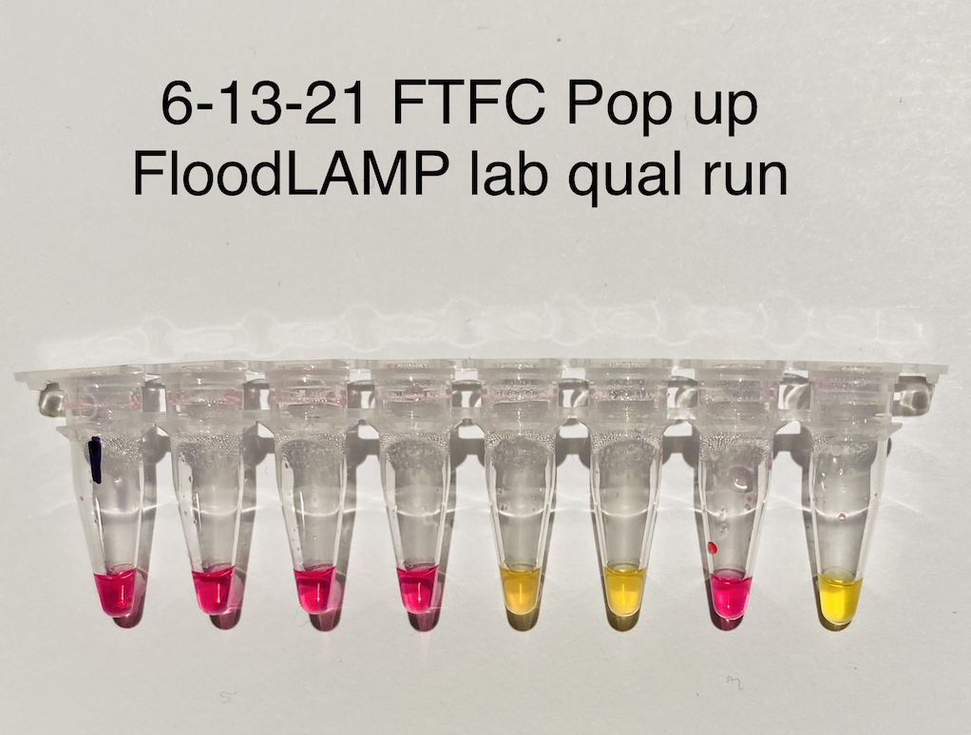
Yellow is positive (detected).
Pink is negative (not detected).
Full process controls with spiked inactivated virus.
Qualification Run
Pooled collection of as AN swabs.
Surveillance testing in pop up FloodLAMP lab.
3 hours from showing up with luggage to results.

Slide 18
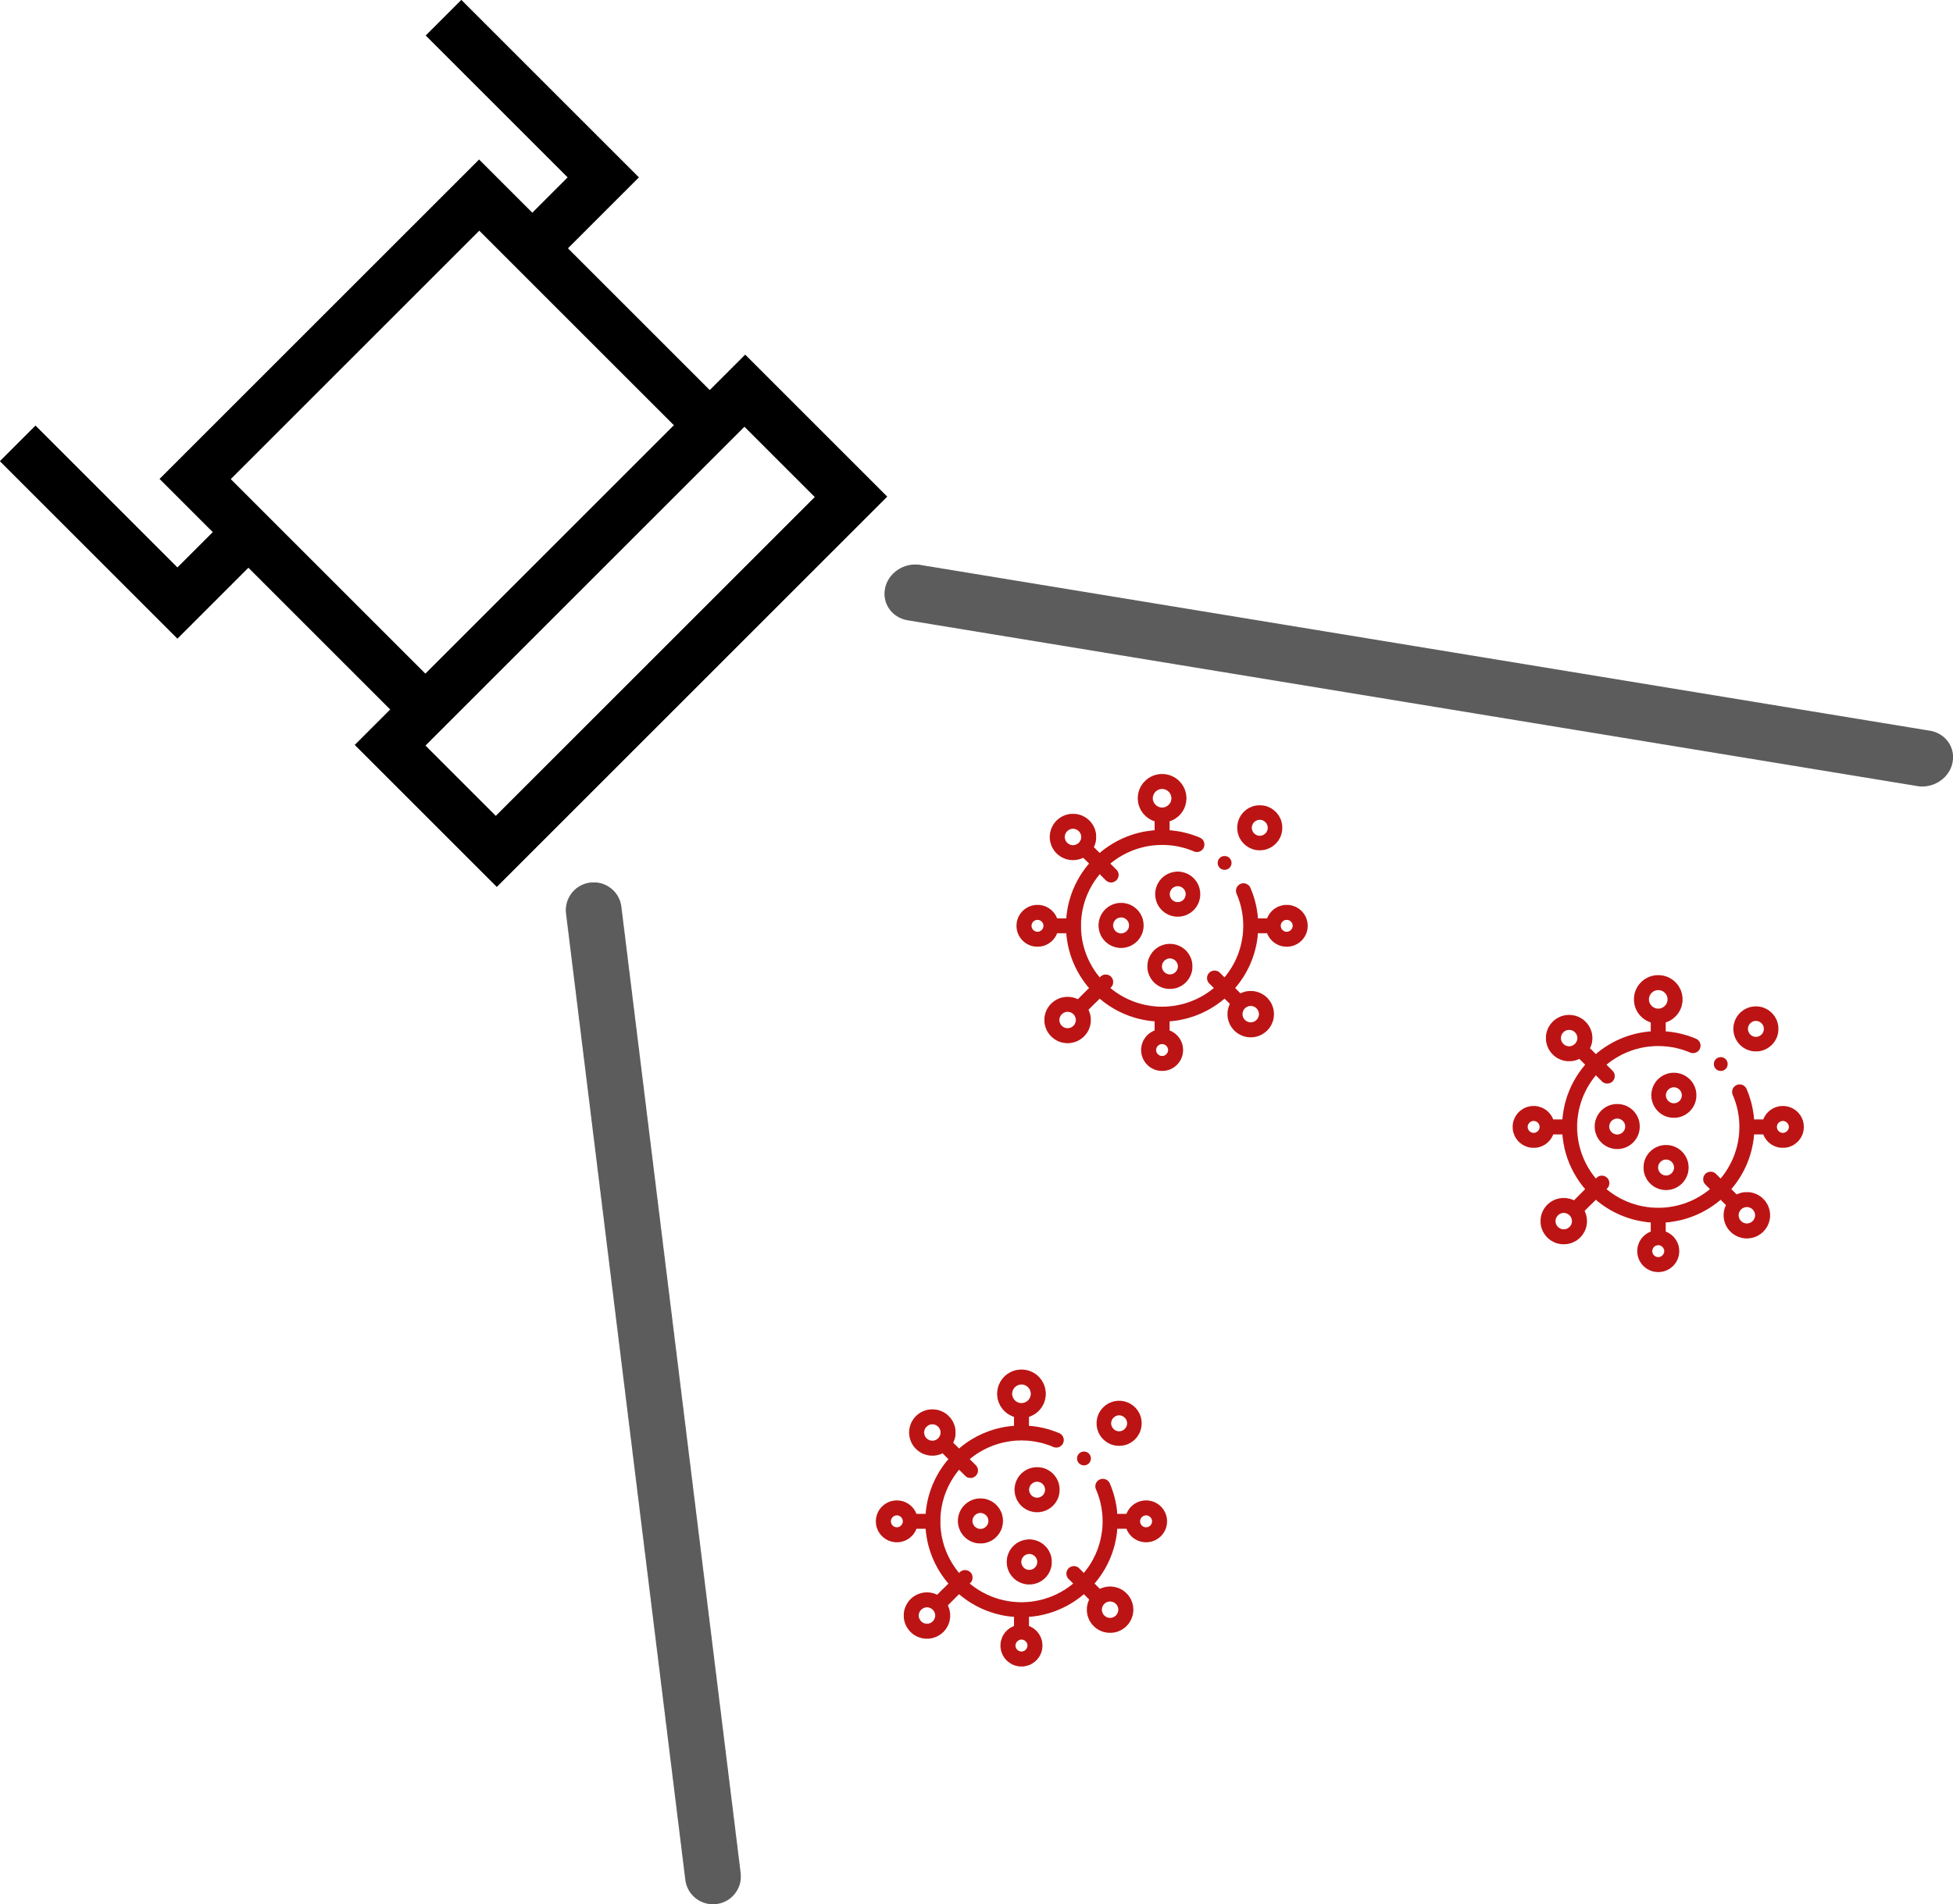

Molecular Assay Atlas
PEOPLE
SAMPLE
INACTIV
PURIFIC
AMPLIF
READOUT
Individual
Nasopharyngeal
Swab (NP)
TCEP (Chem)
+ Heat
Rabe Cepko, HUDSON
Glass Milk
Rabe Cepko
qPCR
qPCR Machine
Fluorescence
Cheek Swab
Proteinase K
(Enzyme) + Heat
Saliva Direct
Mag Beads
Kellner, Yu
LAMP
Colorimetric
Fluorimetric
Visual / Camera
Color Change
Pool: 5-10
Anterior Nares
Swab (AN)
Plate Reader
Absorbance
Color Genomics
Heat Only
Skip (Direct)
Misc
RPA, CRISPR, etc.
Saliva
Commercial
Zymo, Lucigen
Commercial
Thermo, Zymo, Kingfisher, Qiagen
Lateral Flow Strip
Pool of Pools: 20-100
FloodLAMP Biotechnologies,
a Public Benefit Corporation
contact@floodlamp.bio

Slide 19
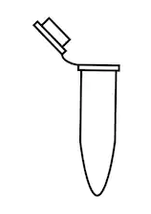
FloodLAMP Tests
SAMPLE
INACTIV
AMPLIF
READOUT
Colorimetric LAMP
FloodLAMP QuickColorTM
Visual / Camera
Fluorimetric LAMP
FloodLAMP QuickFluorTM
TCEP
FloodLAMP
EasyPCRTM
Sample
Indiv or Pooled
qPCR Machine
ProK
qPCR Amplification
SalivaDirectTM
FloodLAMP Biotechnologies,
a Public Benefit Corporation
contact@floodlamp.bio

Slide 20
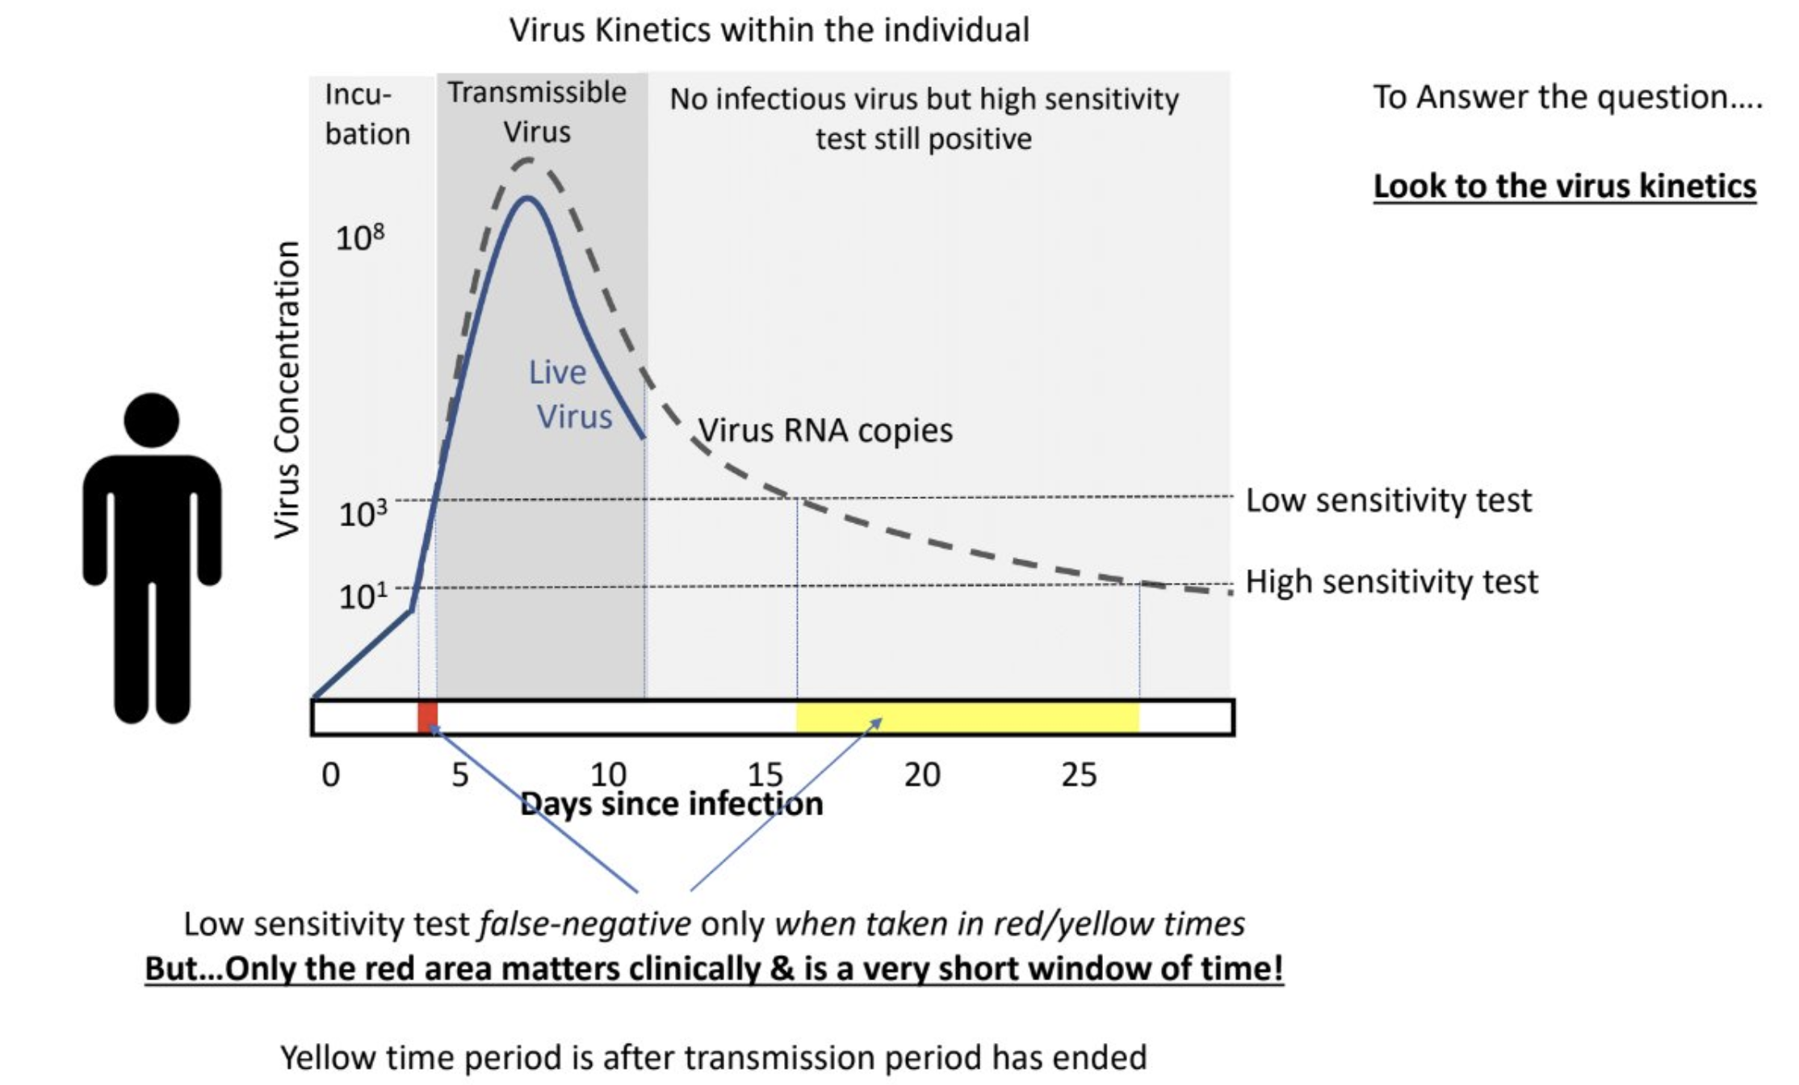
Viral Load and Infectious Detection
Threshold for "Capable to Infect Others" ~ 1e6/ml
Pooling uses assay sensitivity to scale up coverage - and detect unknown infectious people in interacting populations
Source: Michael Mina, UCSF Grand Rounds 8-13-20
https://youtu.be/Ew2MEF4XX8w?t=761

Slide 21
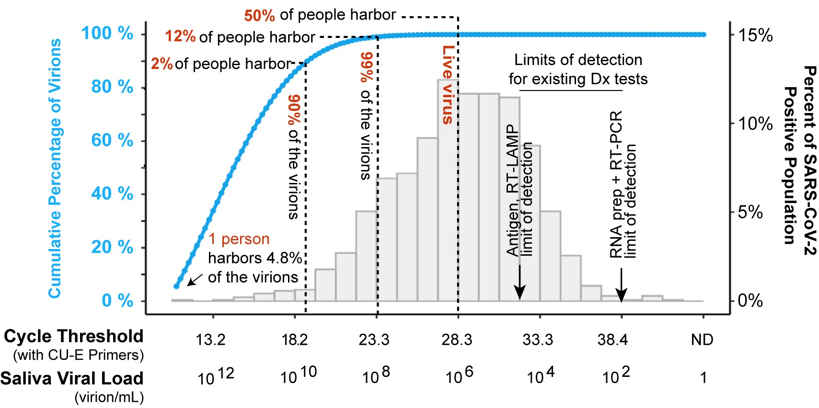
Viral Load and Infectious Detection
Best Purif RT-PCR (TaqPath, PE)
FL QuickColor LoD
FL SwabDirect PCR LoD
TaqPath Ct
FL Direct PCR
Source: Sara Sawyer Preprint https://doi.org/10.1101/2021.03.01.21252250
7 12 17 22 27 32
14 19 24 29 34 39

Slide 22
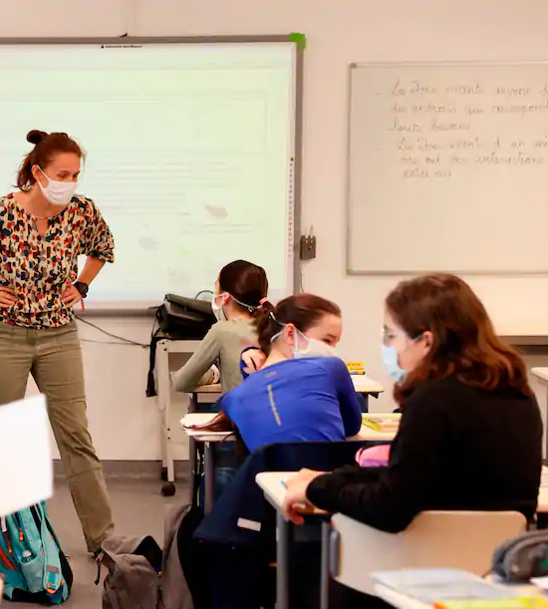


FL School Screening
At-Home Pooled Samples
Collected at Local Schools
Processed by FloodLAMP Network of Labs
Same Day Results
1
2
3

Slide 23
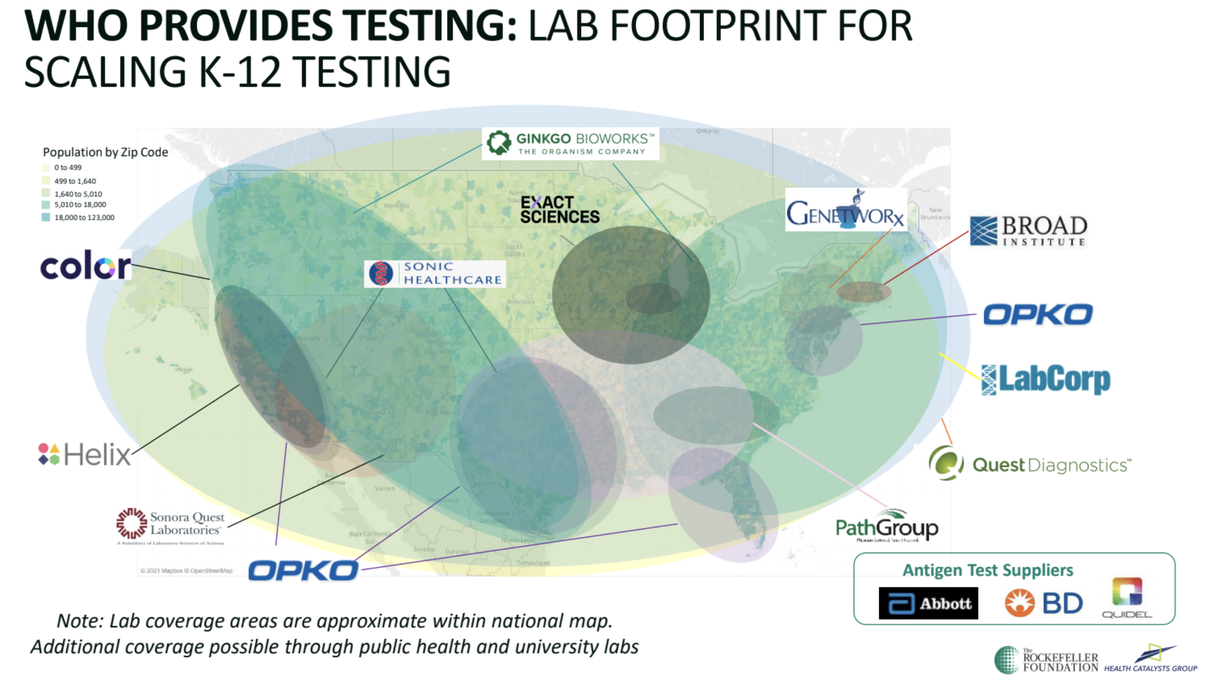
Current Screening Providers
Includes incumbent and upstart players. Products vary by sensitivity, level of integration and regional focus.

Slide 24
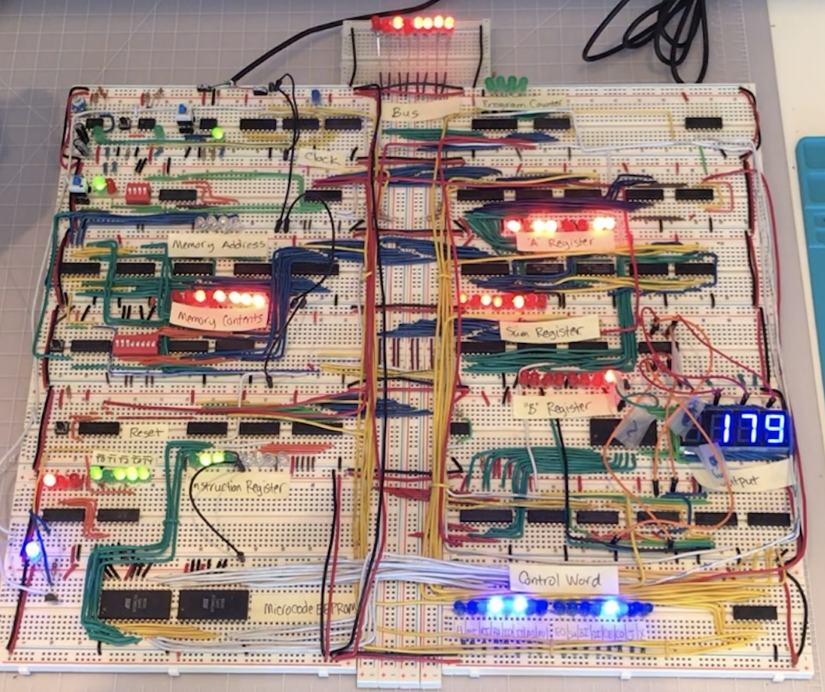
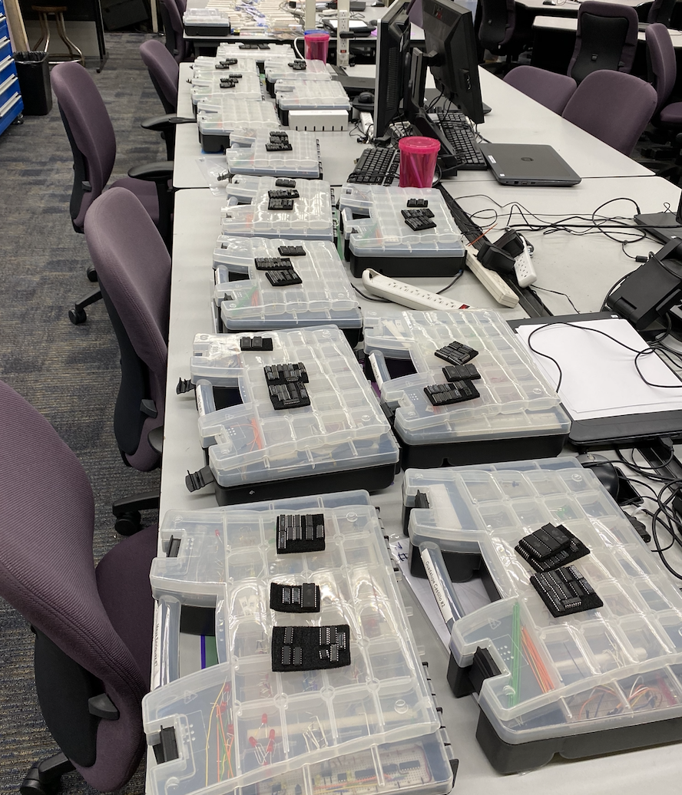
My CTE Classroom
FloodLAMP.bio

Slide 25
Regulatory Pathways
FDA EUA - Emergency Use Authorization (IVD)
LDT for labs and IVD for manufacturers
CLIA Lab LDT - Lab Developed Test
IRB - Internal Review Board
typically at universities
needed for EUAs
Non-Dx Surveillance
not under CLIA
no "individual diagnostic" results
reflex positives to CLIA test

Slide 26
Regulatory Challenges & Hurdles
Complexity of regulatory space
FDA approves test systems not protocols
Accessing clinical samples
Performing clinical studies
Submission paperwork
Changing priorities

Slide 27







Open EUAs
 | Typical IVD EUA | CDC EUA | SalivaDirectTM | SHIELD | FloodLAMP EasyPCRTM | FloodLAMP QuickColorTM
Disclosure of all chemicals and reagents? | No | Yes | Yes | Yes | Yes | Yes
Chemical and reagents available from multiple vendors? | No | Yes | Yes | No | Yes | Yes, *except NEB LAMP MM
Disclosure of primer sequences? | No | Yes std for PCR | Yes | No ProptryThermo | Yes | Yes
Primers commercially available from multiple vendors? | No | Yes | Yes CDC Primers | No ProptryThermo | Yes CDC SD Primers | Yes Available but not launched
Supply chain robust? | No | No/Maybe | Yes | No/Maybe | Yes | Yes
EUA Sponsor Organization Type | For Profit Company | Govt | Academic Not for Profit | Academic Not/For Profit ? | Public Benefit Corp | Public Benefit Corp
Designation of CLIA labs | Kit Sales | N/A open RoR | Impact & Expansion | Impact & Expansion | Impact & Expansion | Impact & Expansion

Slide 28
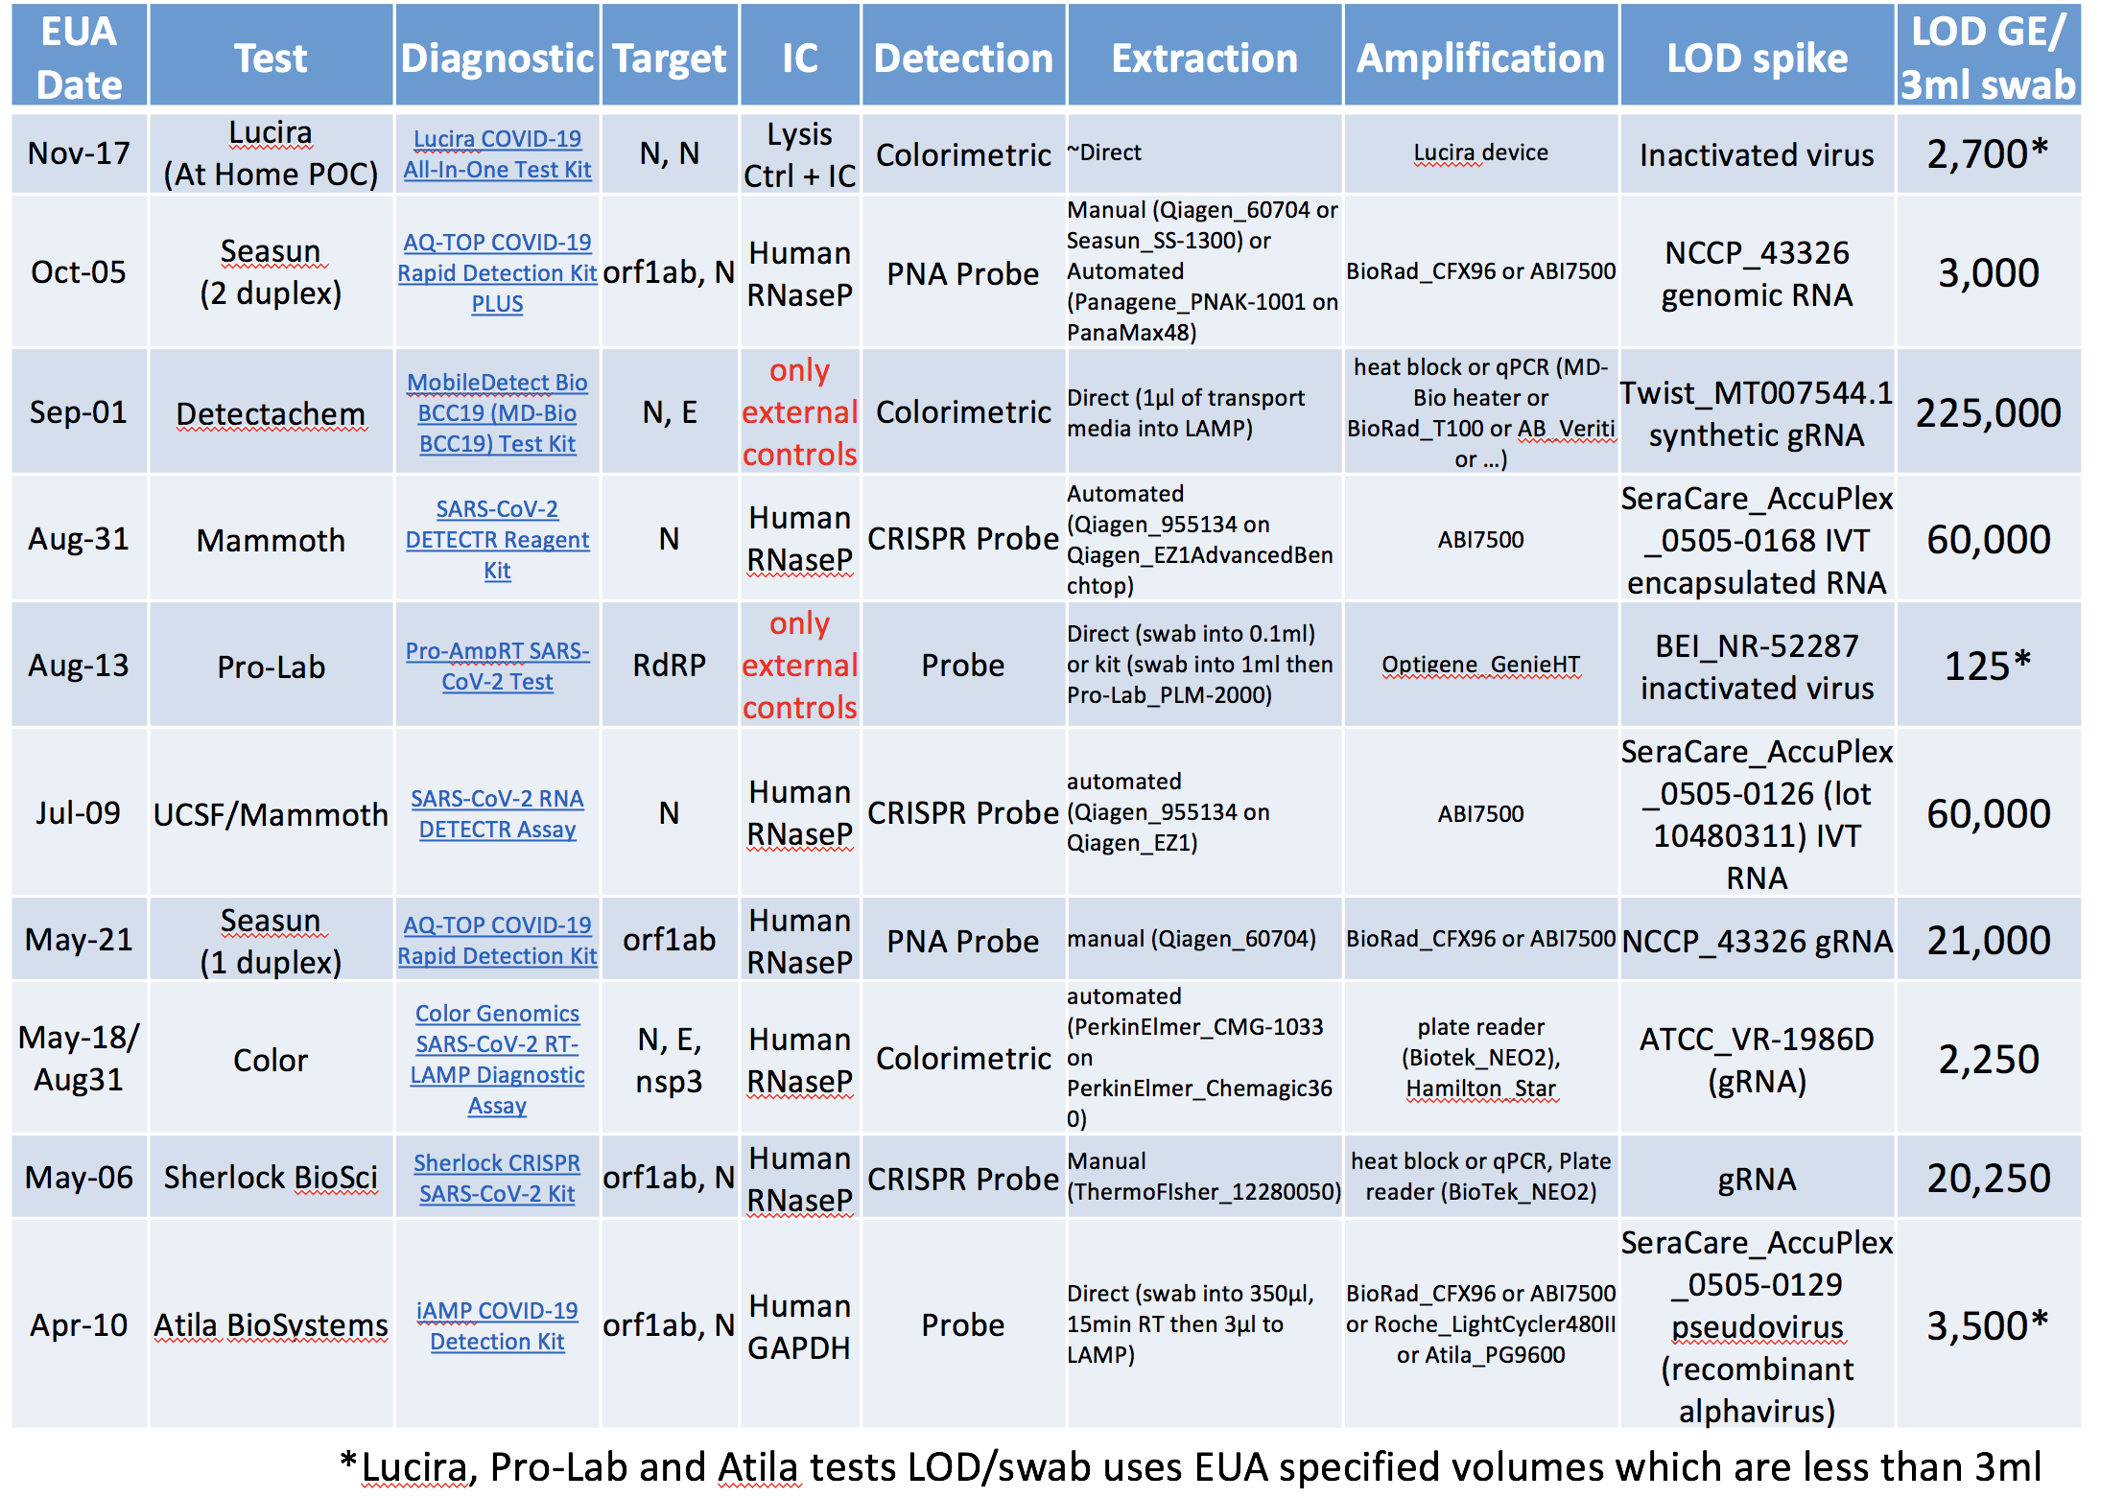

LAMP
EUAS
from Matt McFarlane mdmcfar@uvic.ca @mattmcfar

Slide 29

LAMP!

