Slide 1
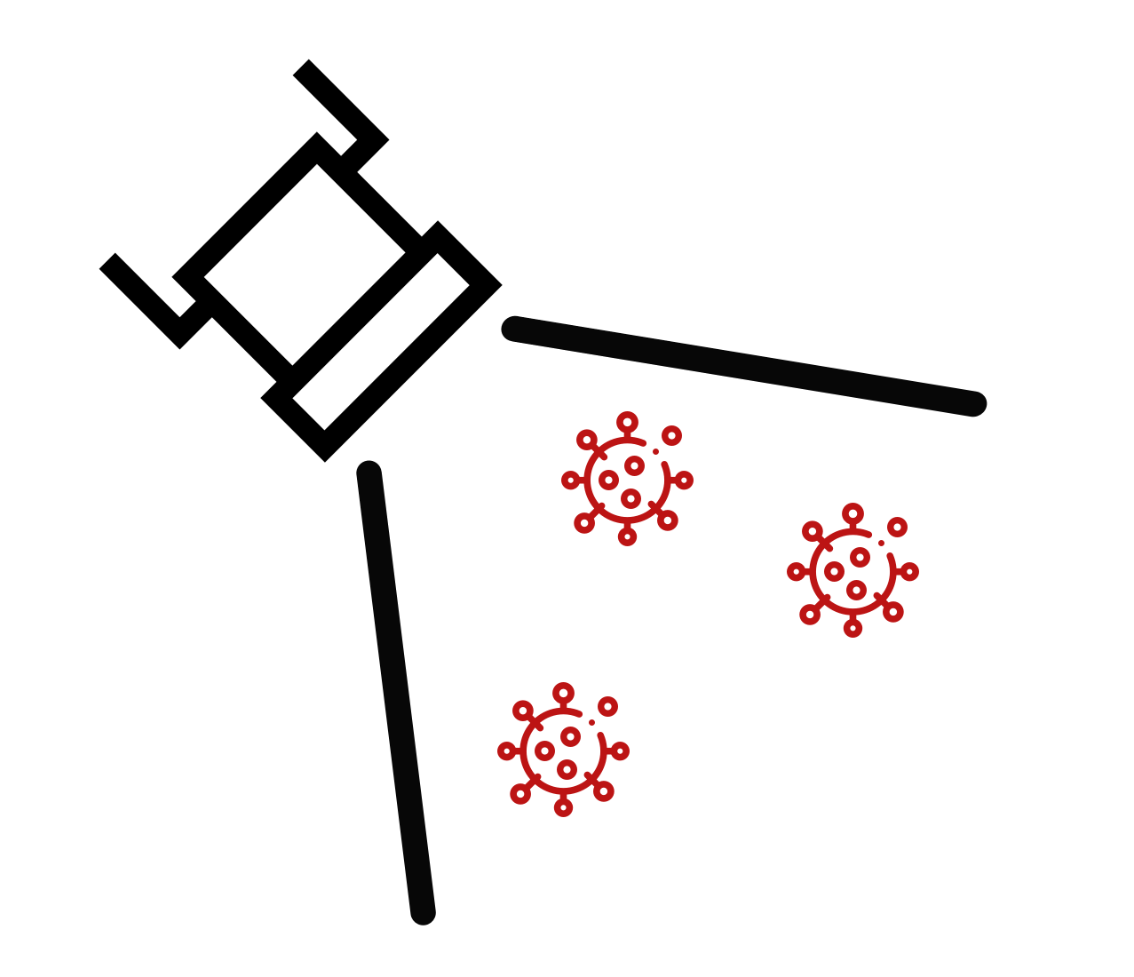
FloodLAMP
Biotechnologies, PBC
Extending the Reach of LAMP:
the FloodLAMP platform for globally accessible disease screening
New England Biolabs Seminar - March 3, 2022
Randy True, Founder and CEO | randy@floodlamp.bio

Slide 2
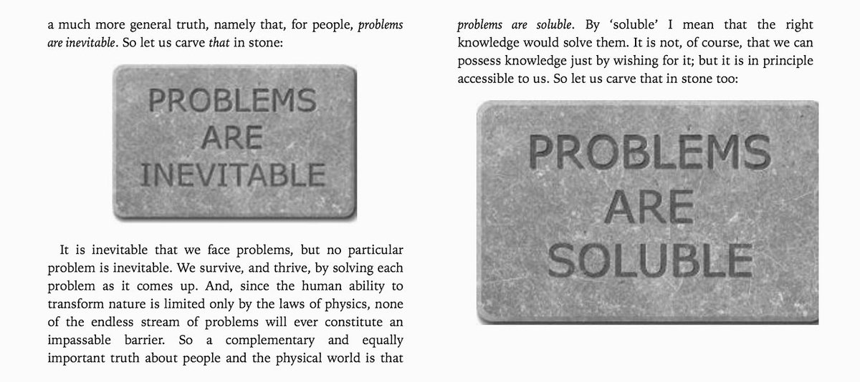

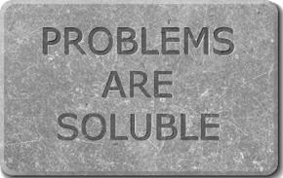
David Deutsch's Deep Optimism:

Slide 3
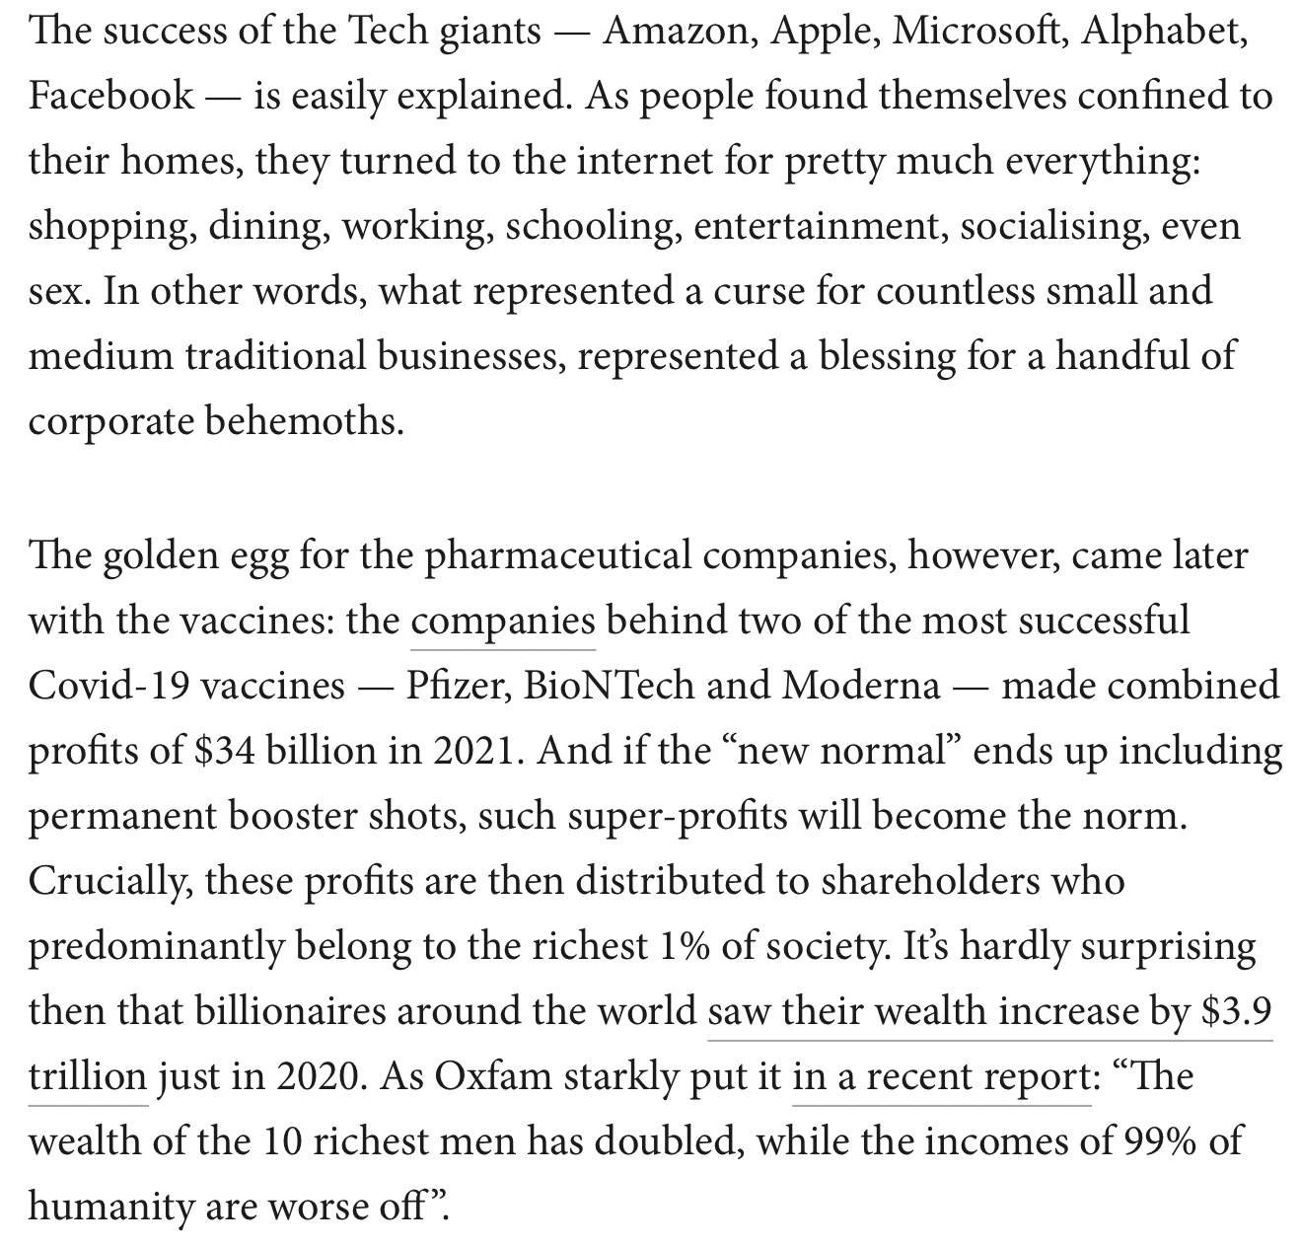

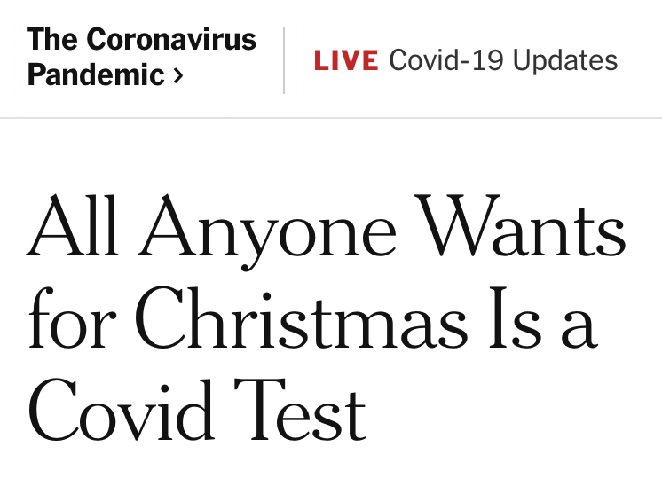
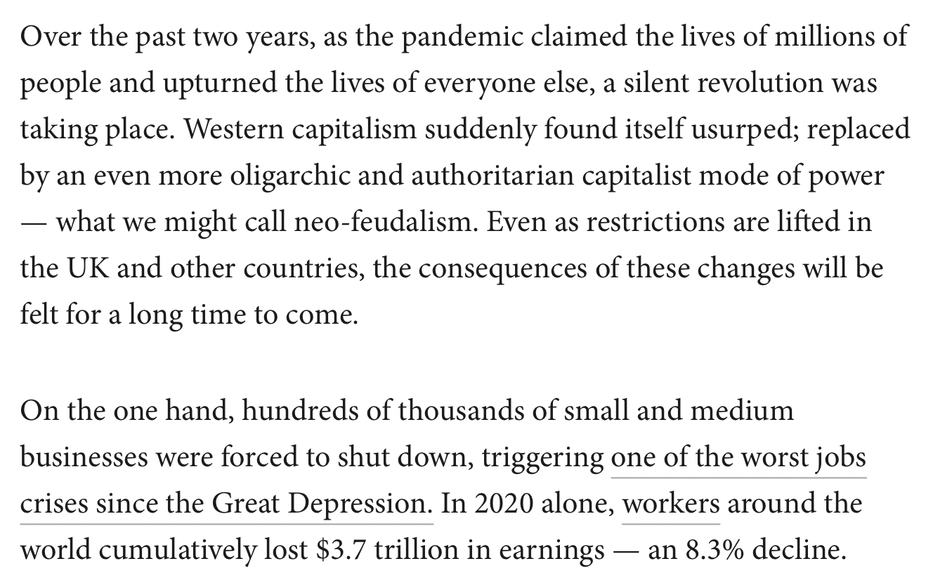


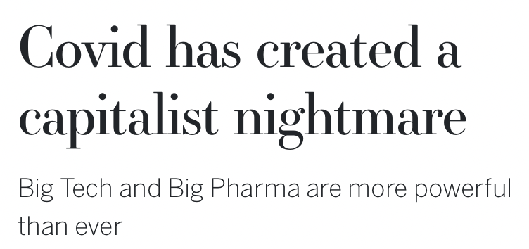
We still need better testing!

Slide 4

“FloodLAMP's mission is to improve global health and resiliency through universal access to rapid molecular testing.”
New testing technology
01
Turnkey screening programs
02
03
Disruptive open source strategy

Slide 5
Real World Programs

Slide 6
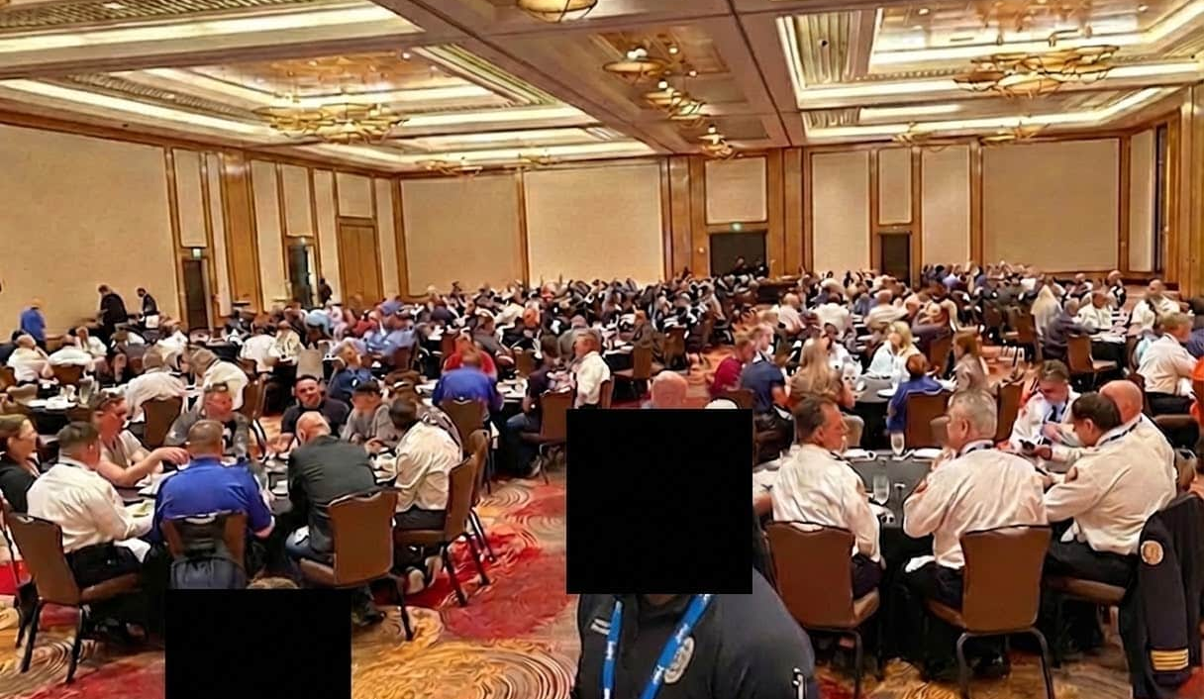
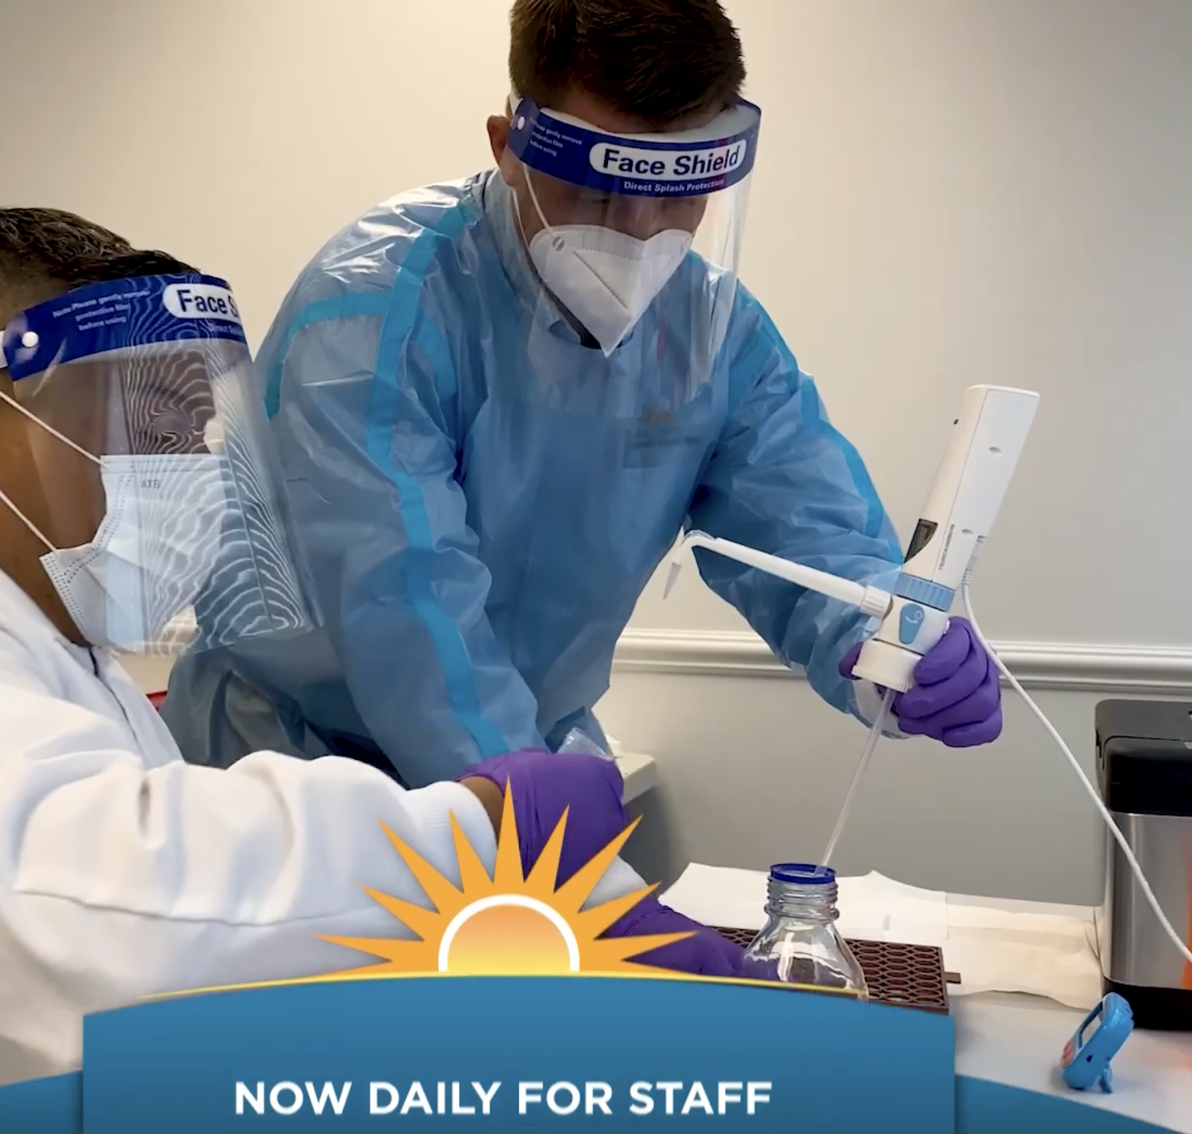
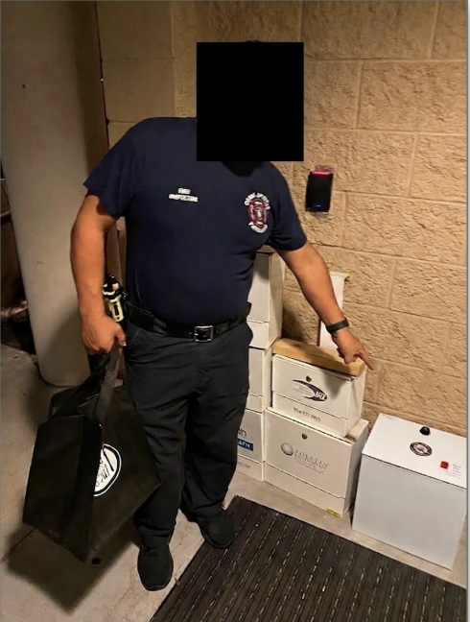
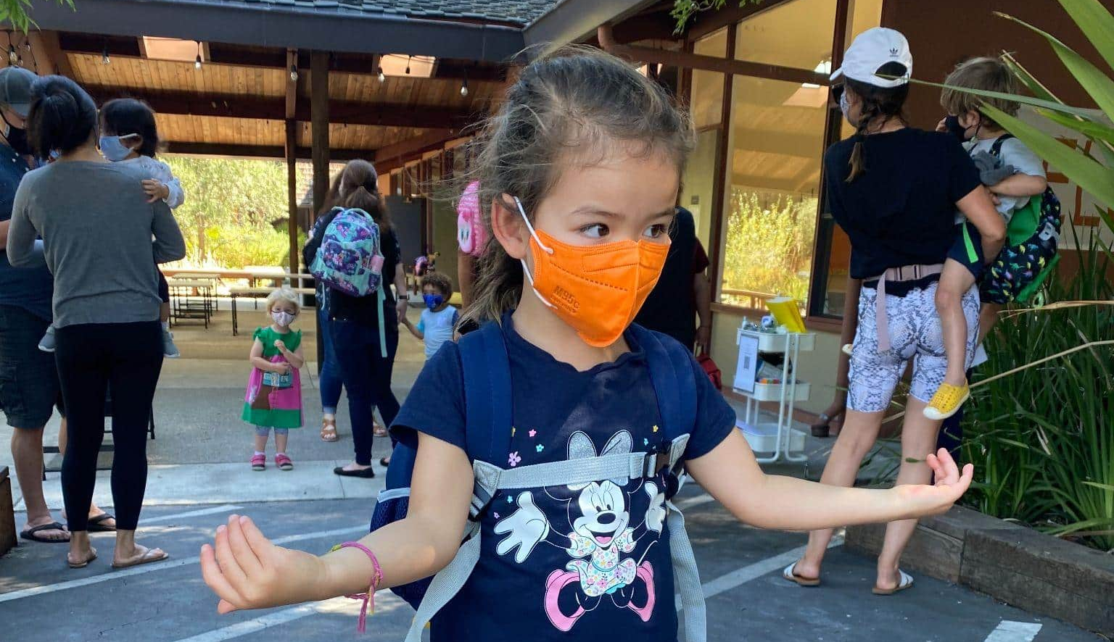
Operating Programs in the Real World
EMS Leadership Conference Screening
1,000 attendees
Municipal & EMS Deployments
Coral Springs, FL approx. 132,000
Davie, FL approx. 104,000
Bend, OR approx. 94,000
Preschool Screening with Family Pooling
Approx. 40 families
65-105 people per bi-weekly screening

Slide 7
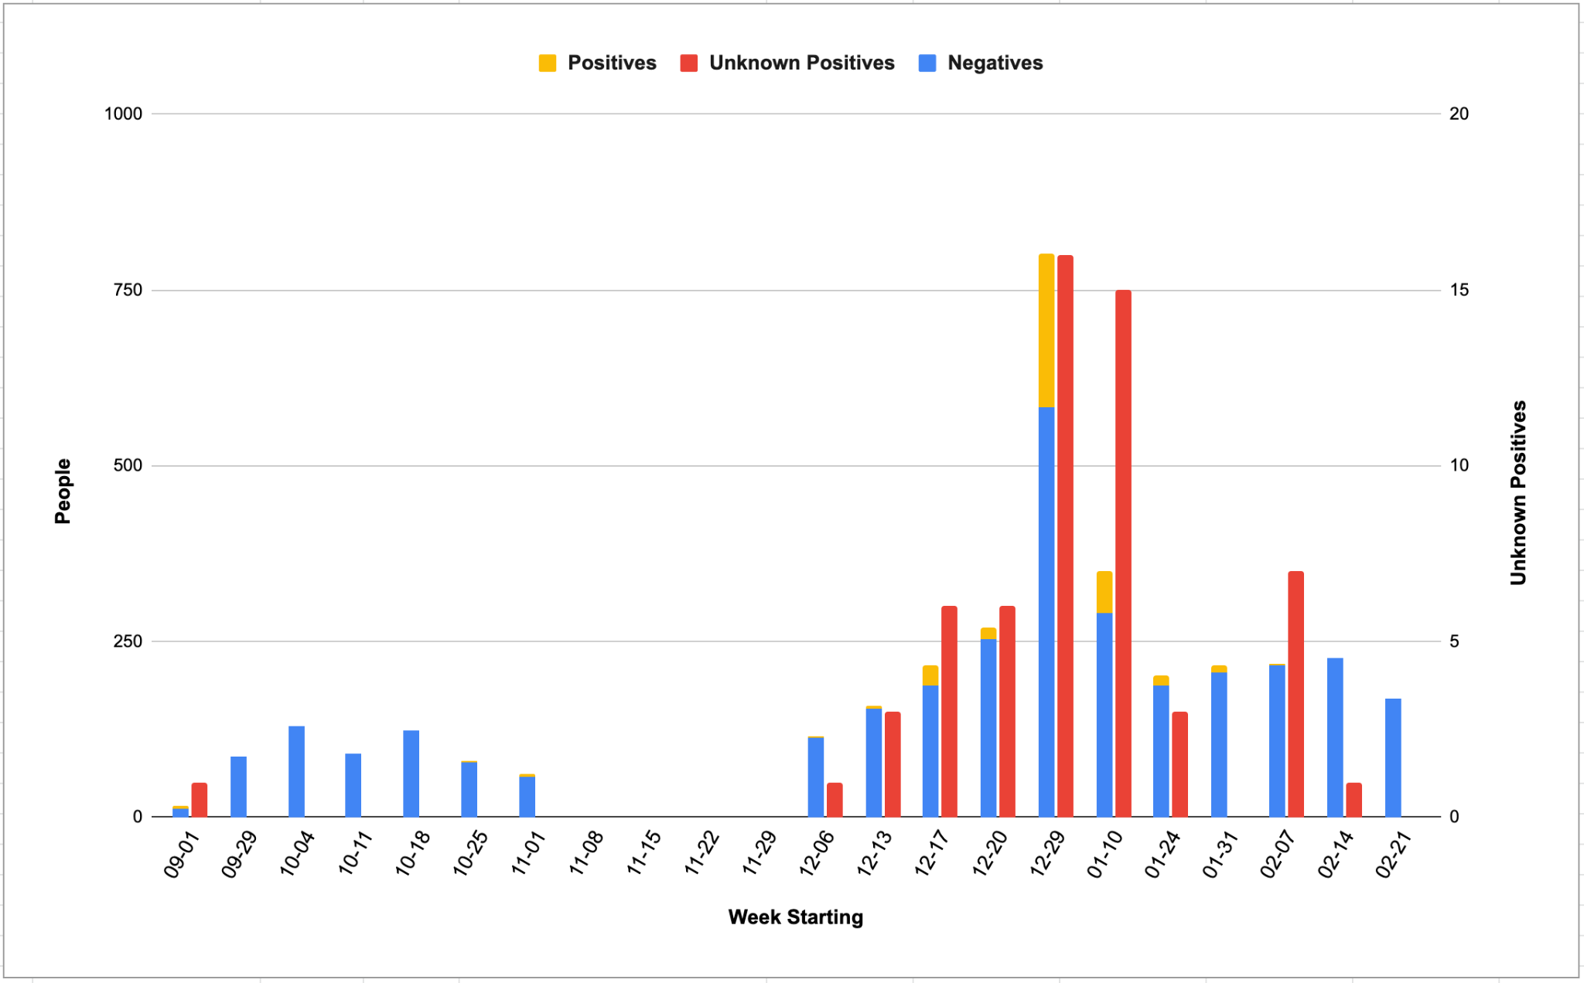
Town of Davie, FL

Slide 8
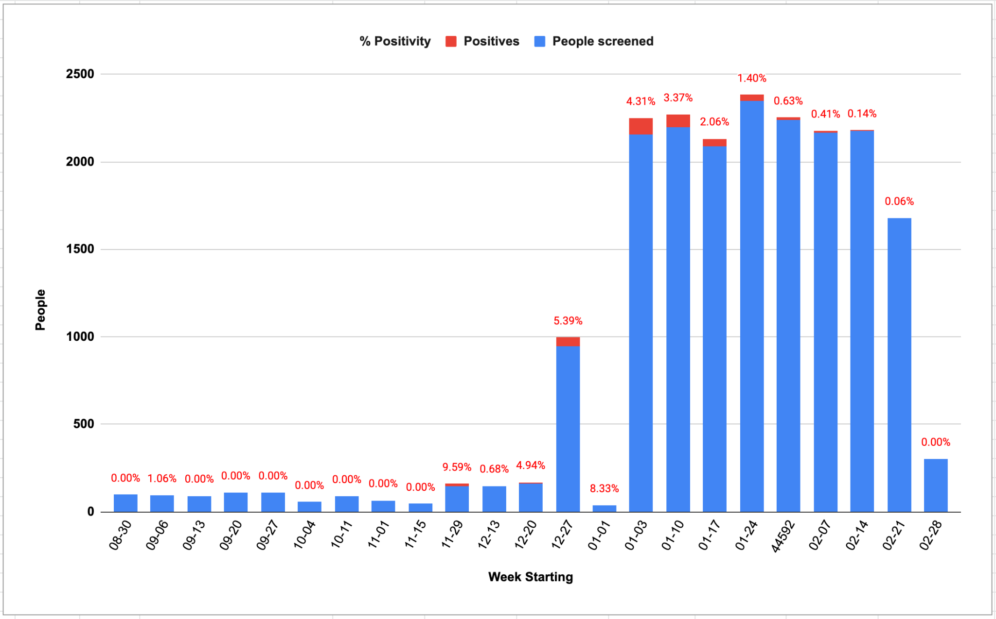
Coral Springs, FL

Slide 9
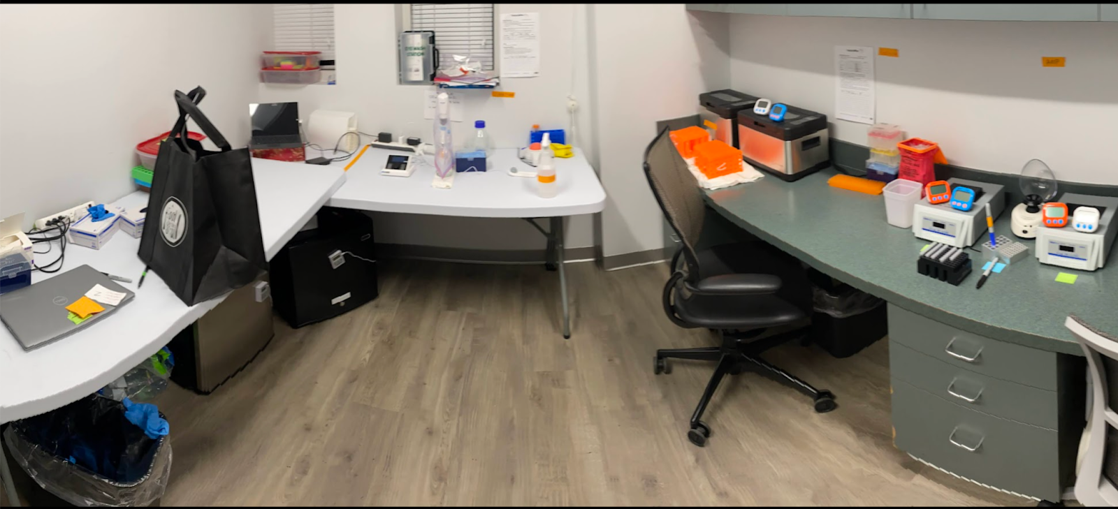
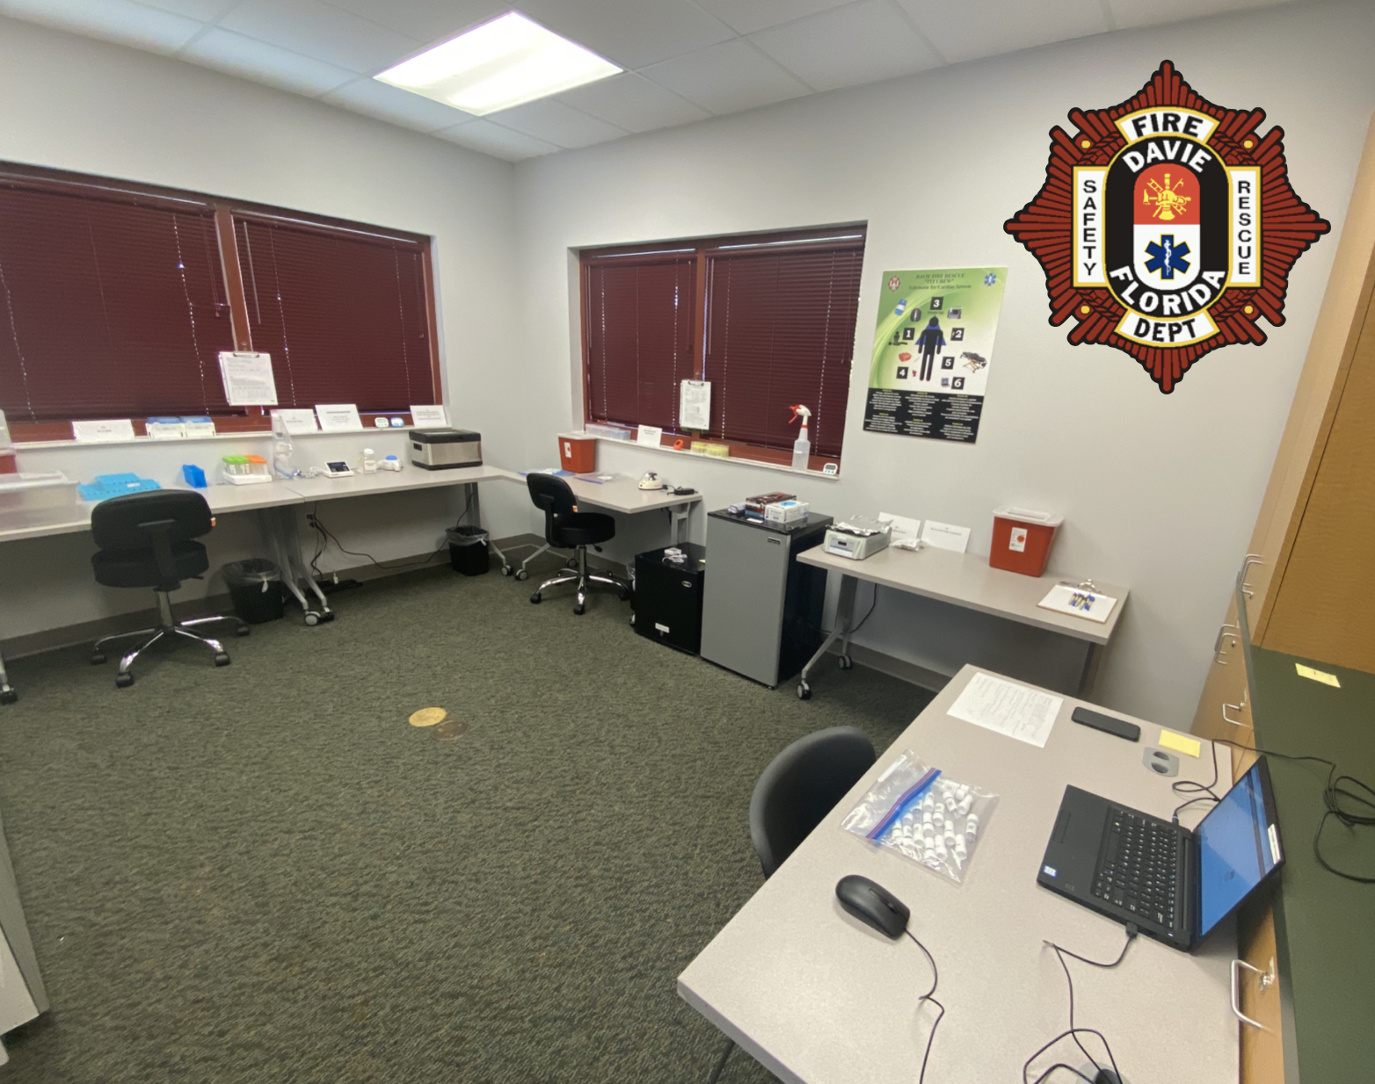
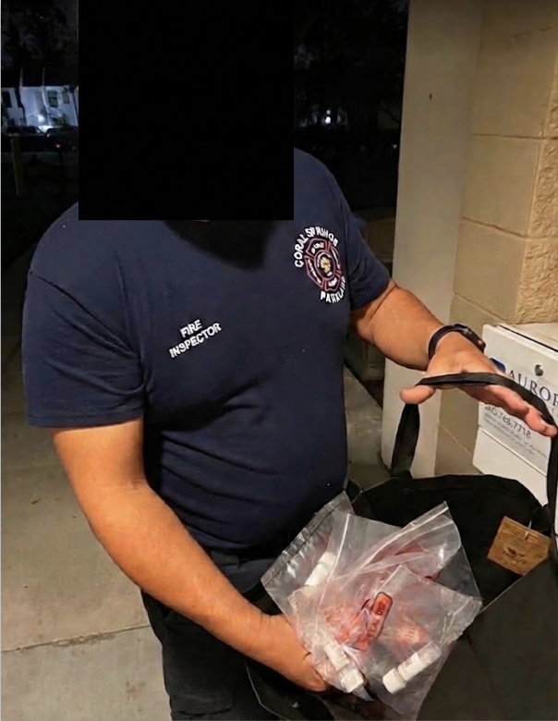
Coral Springs, FL
Davie, FL
This novice (but dedicated) tester is able to screen 1000 critical city employees.

Slide 10
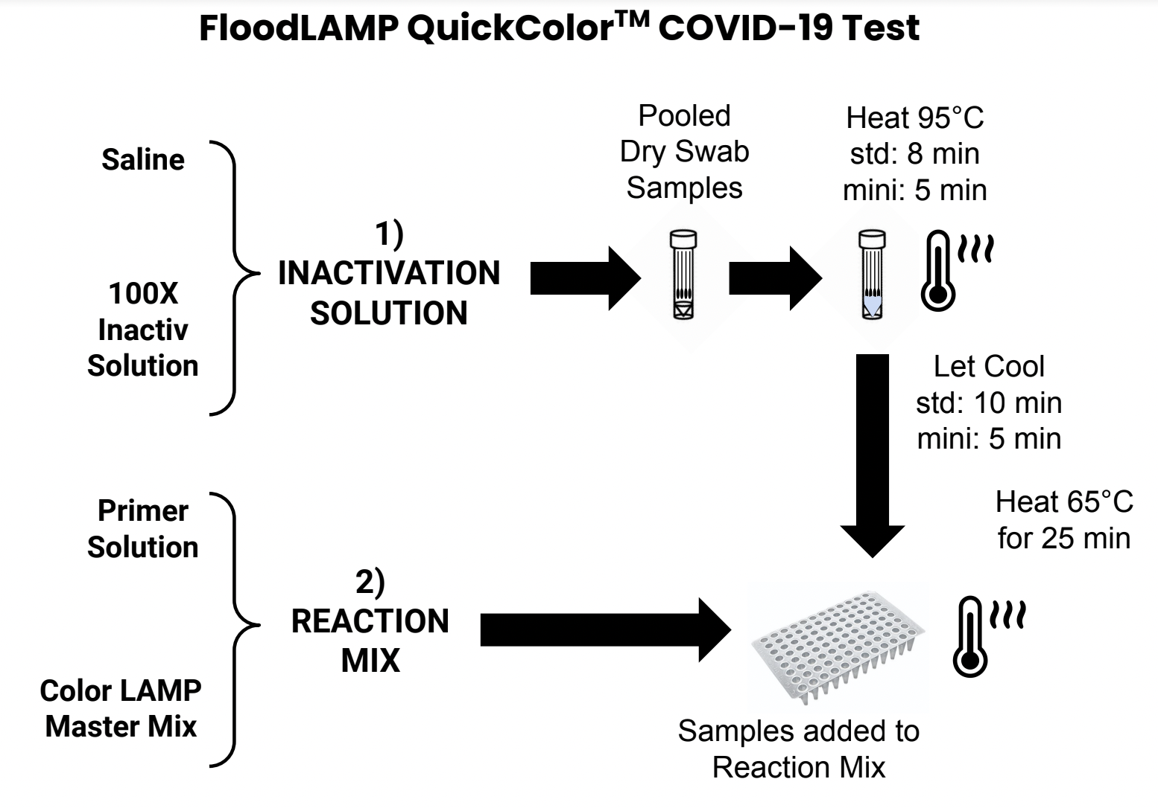
Test Diagrams
FloodLAMP is addressing the practically unlimited demand for accessible, low cost, easy to implement COVID-19 testing and screening.
TCEP/EDTA
(standard Rabe Cepko)
AS1e (ORF1ab)
N2
E1
NEB M1804

Slide 11
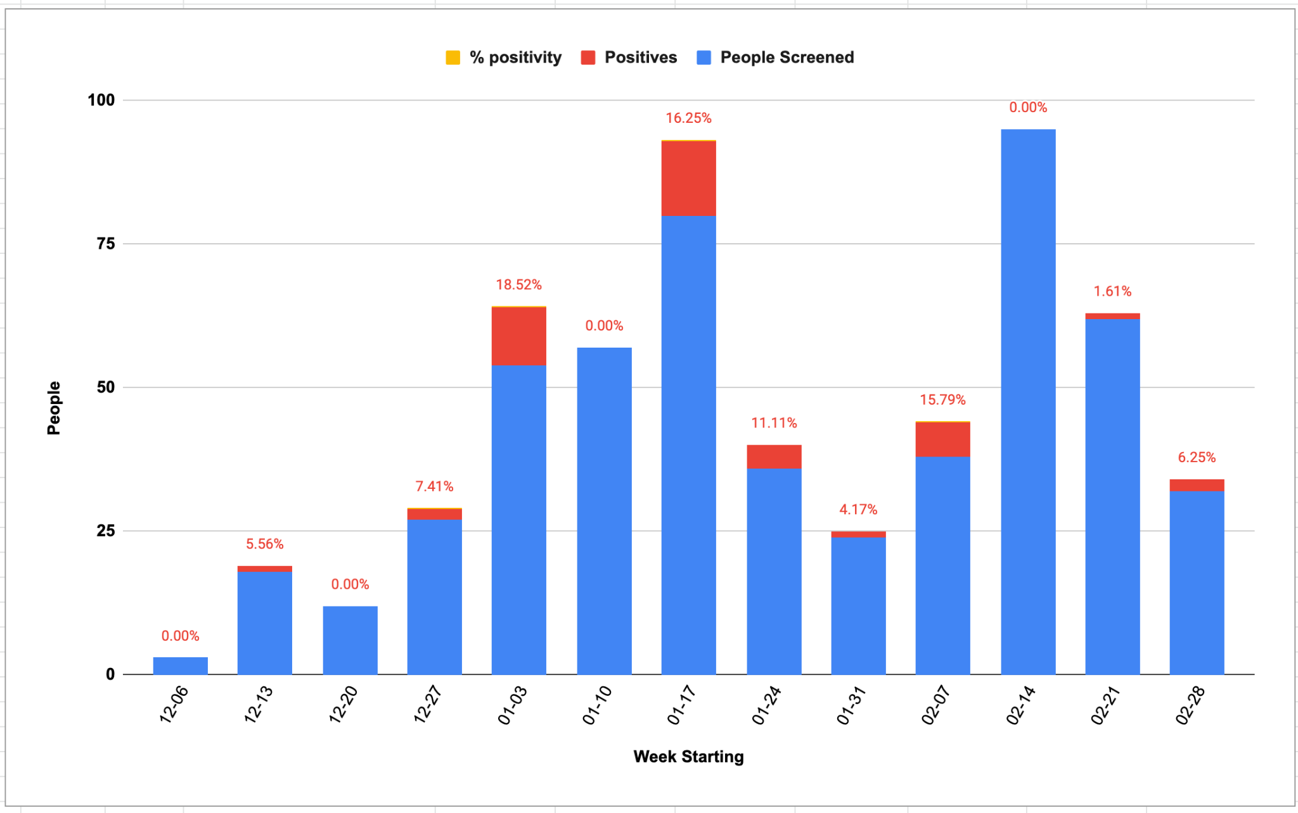
Bend, OR

Slide 12
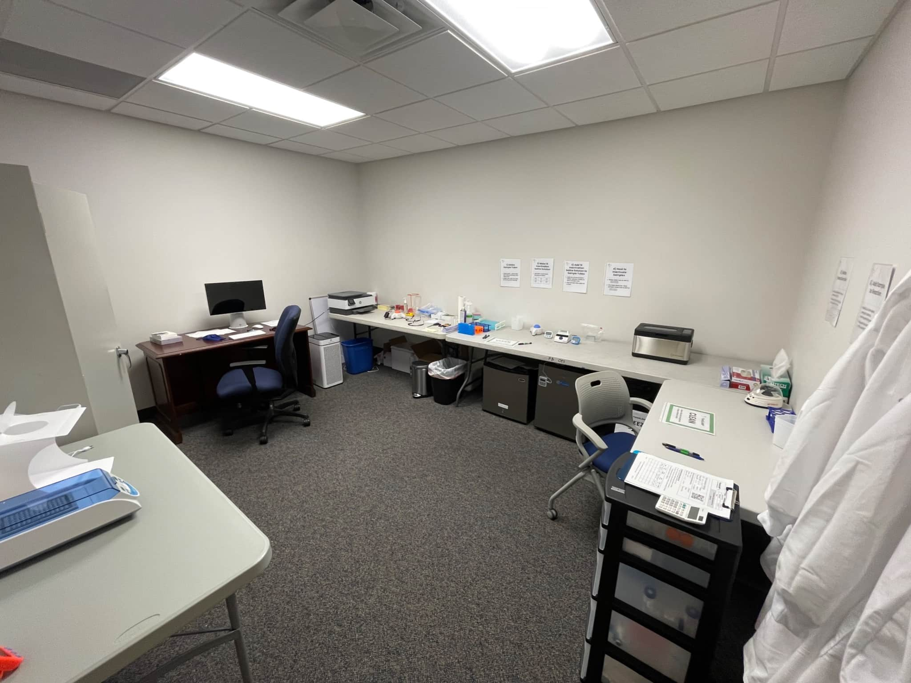
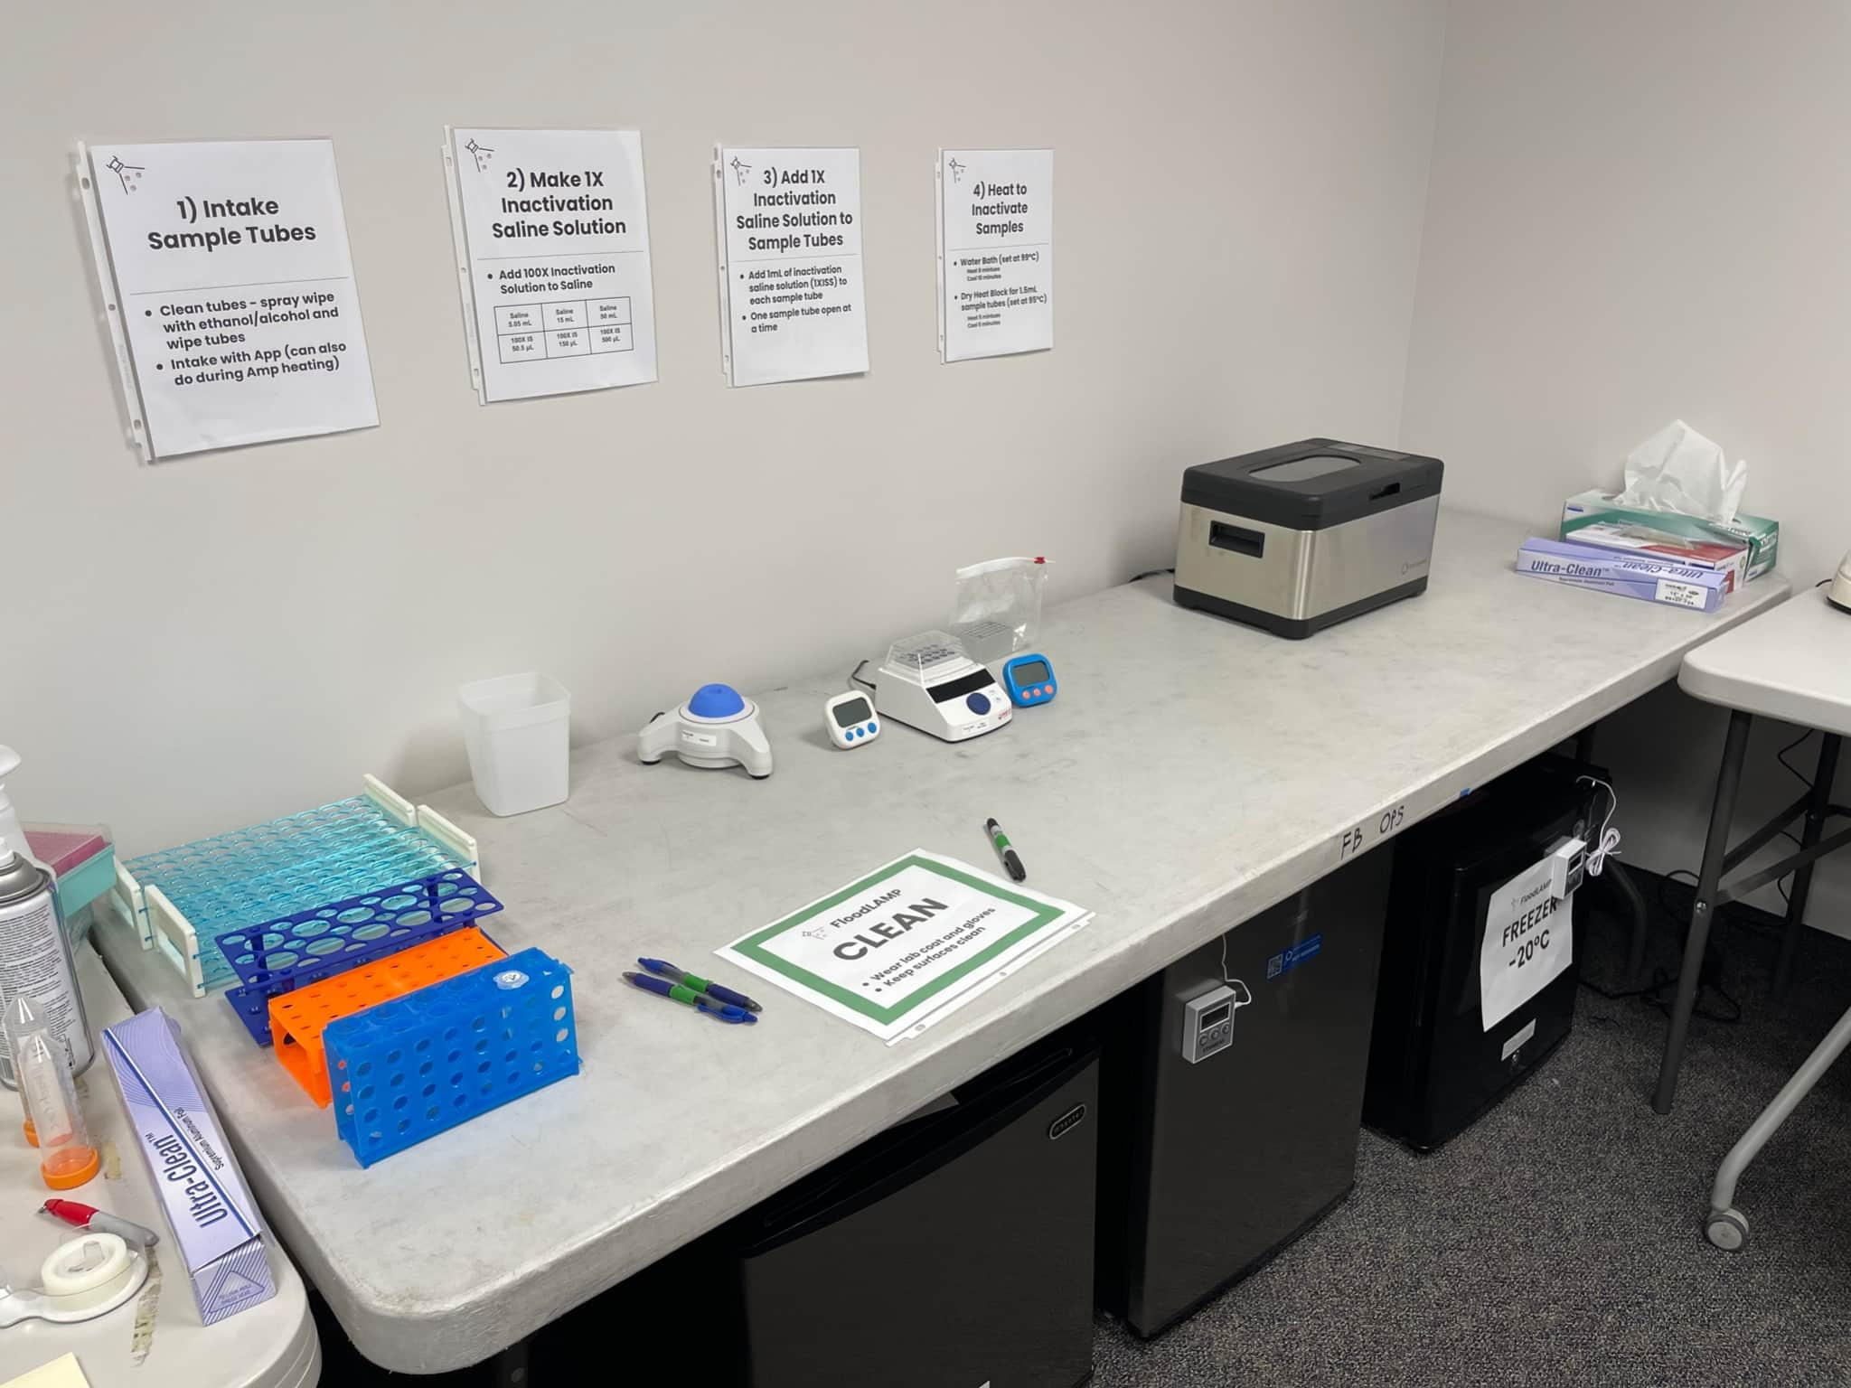
Nova, Southeastern University Lab
Lab setup (Jan 2022)

Slide 13
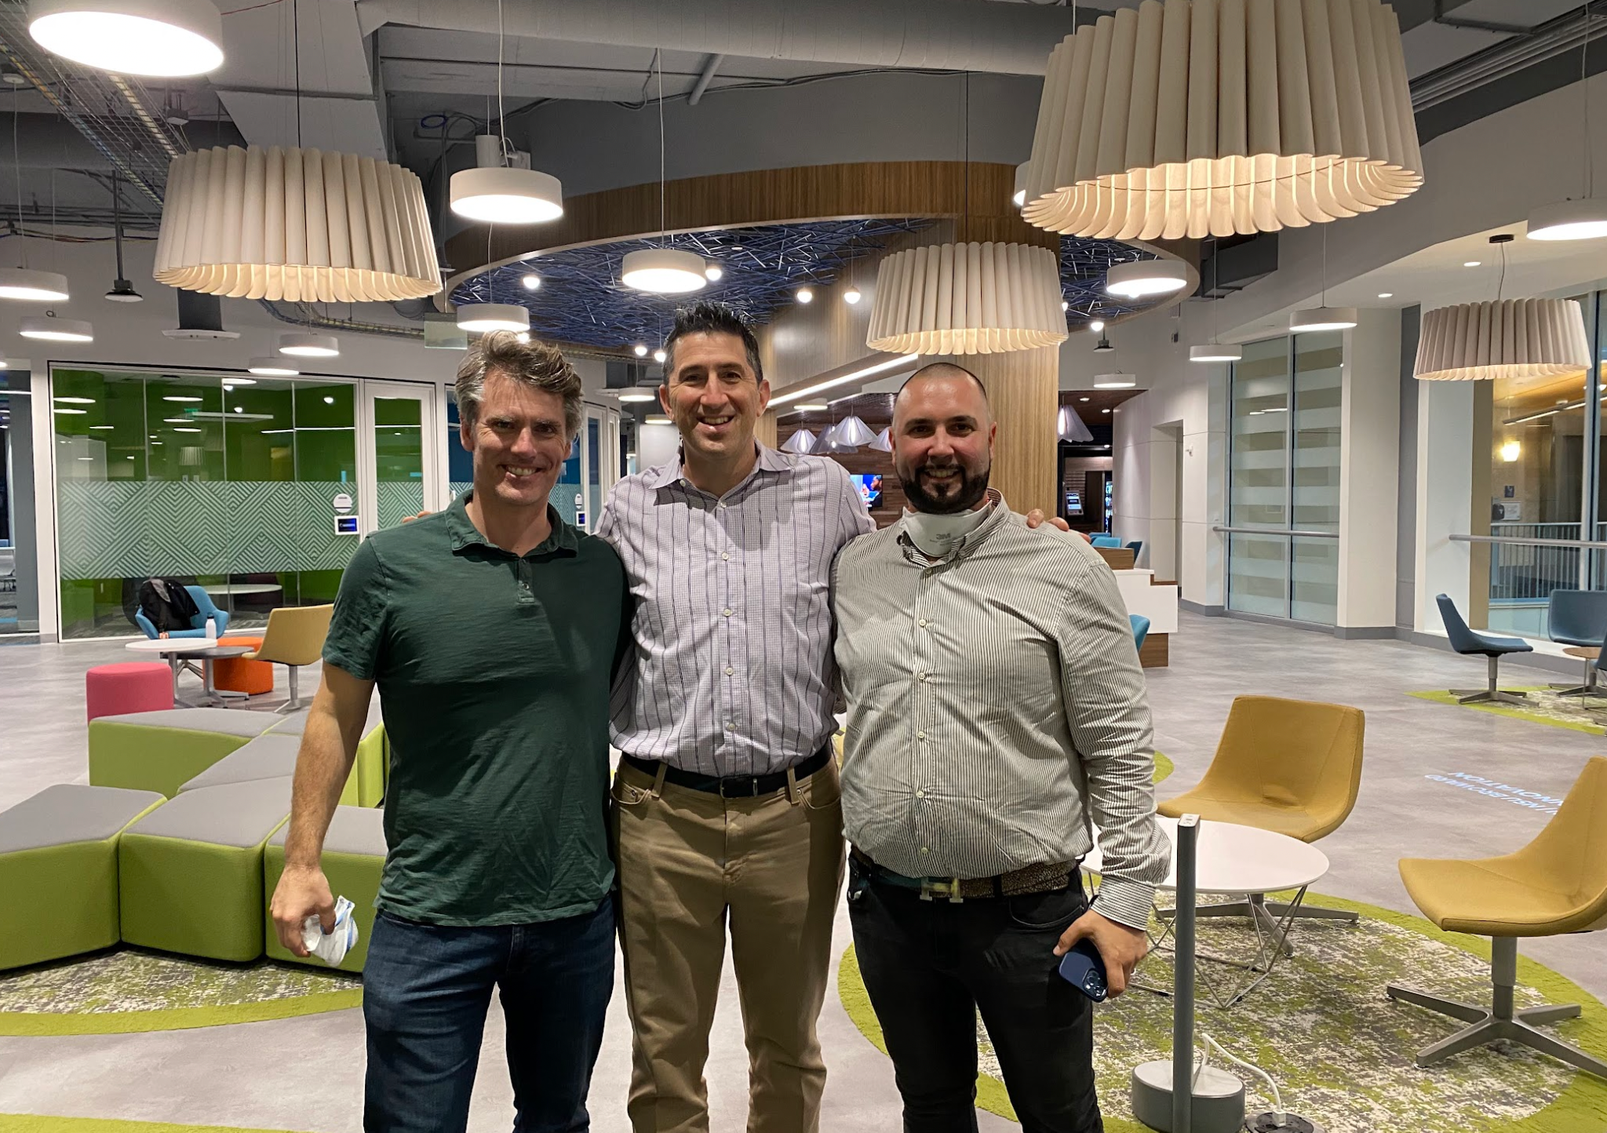
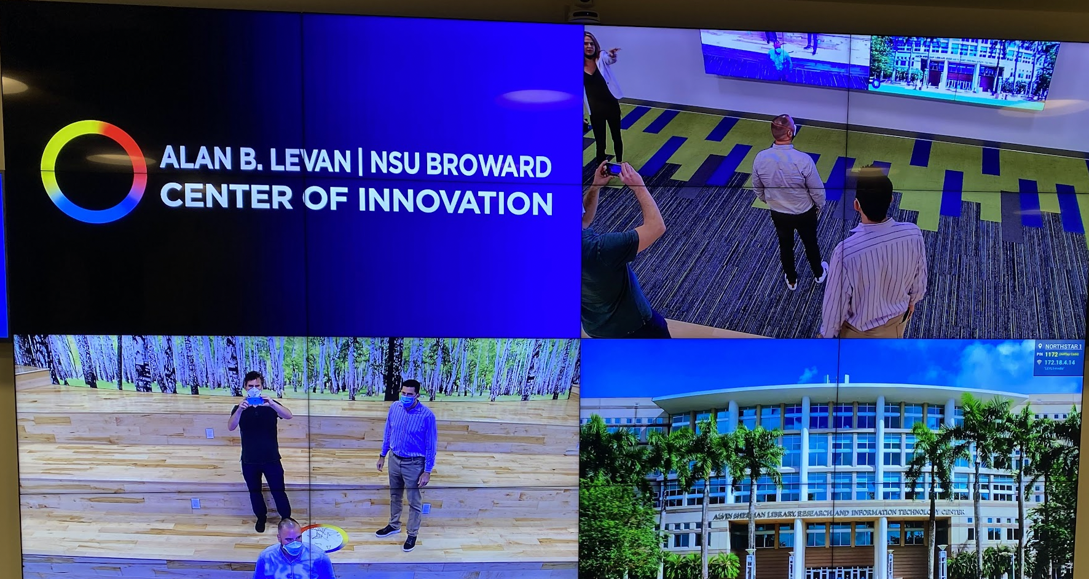
FloodLAMP accepted into Levan Innovation Center

Slide 14

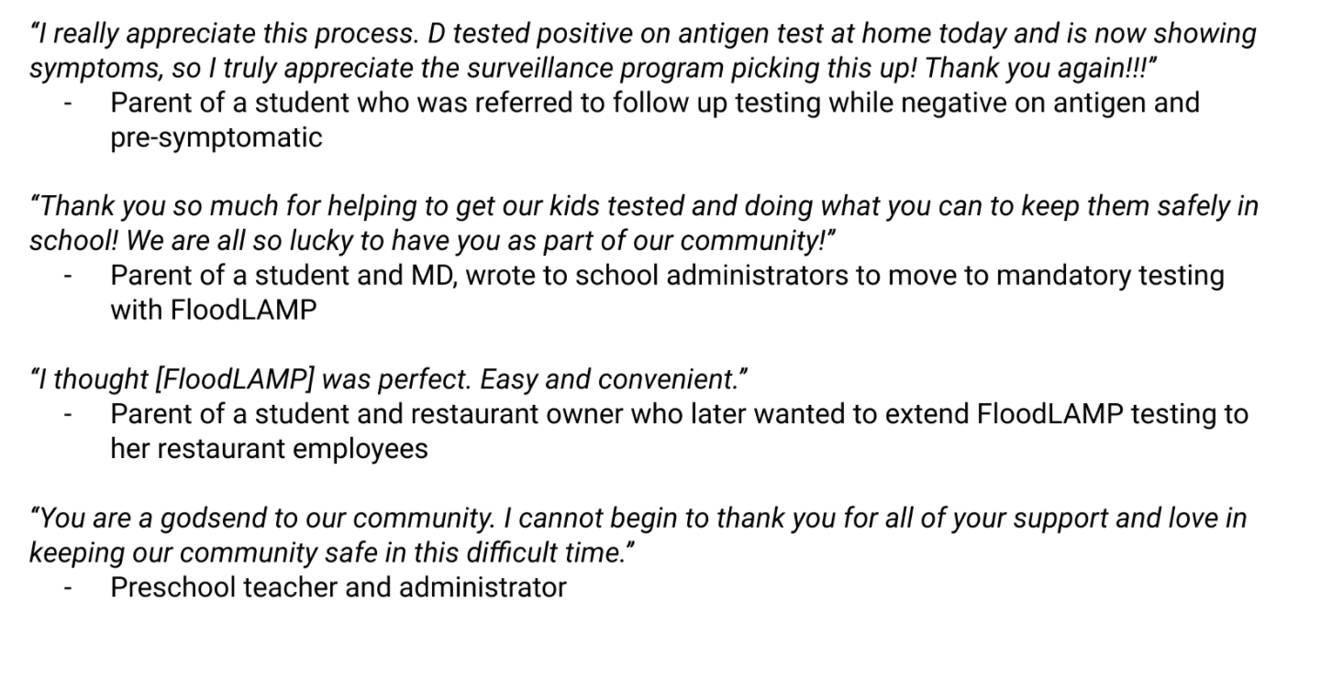
Link for Preschool Pilot Description
https://docs.google.com/document/d/1TOnklq-65XUX-v-li018rteK9jeL8NgqbNrtbndgD_o
FLOODLAMP ARCHIVE FILE PATH: various/fl-whitepapers/FloodLAMP Whitepaper - California Preschool Family Pooled Screening Pilot (June 2022).md

Slide 15
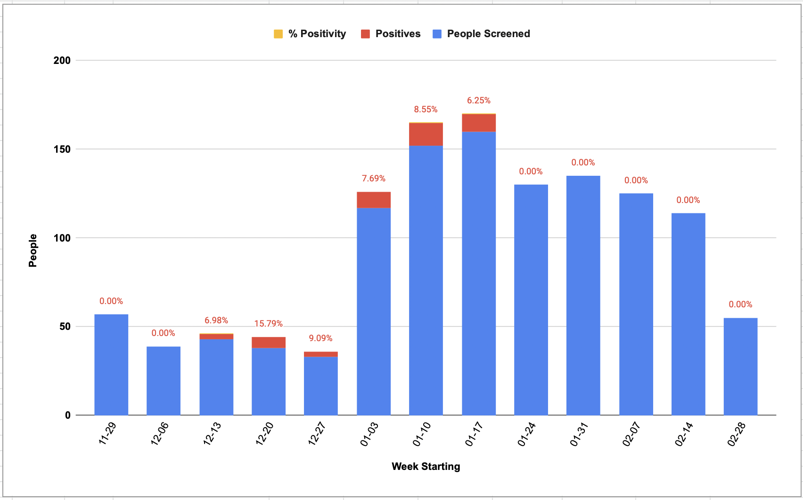
Preschool, CA

Slide 16
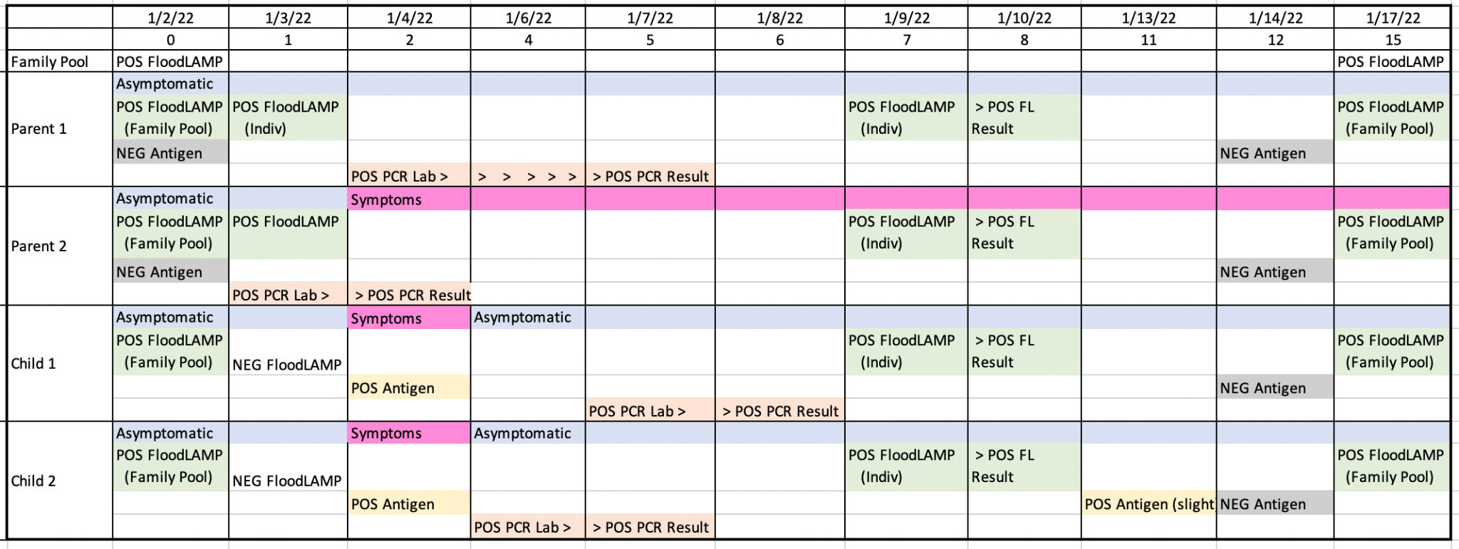
Pre-School Screening - Case Report
Several infections detected by FloodLAMP 1-2 days before symptoms or antigen tests
In 3 different cases, family members of the preschool student were detected, showing the advantage of family pooling in protecting spread in a congregate setting such as schools and workplaces.

Slide 17
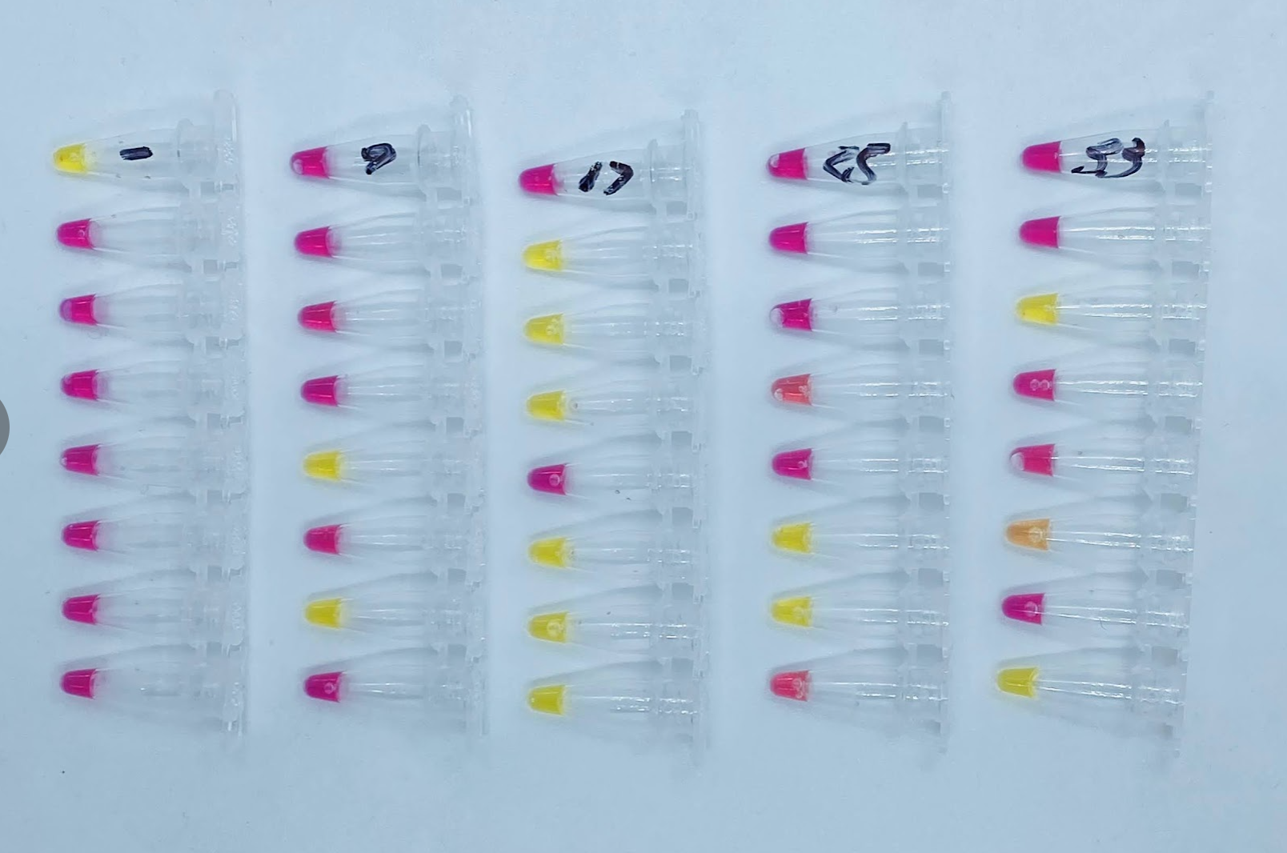
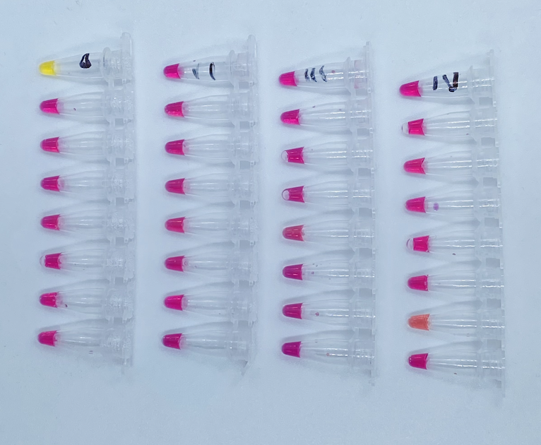
Pre-School Screening
Mon 1-10
Thurs 1-13
Mix of self collected individuals and family pools

Slide 18
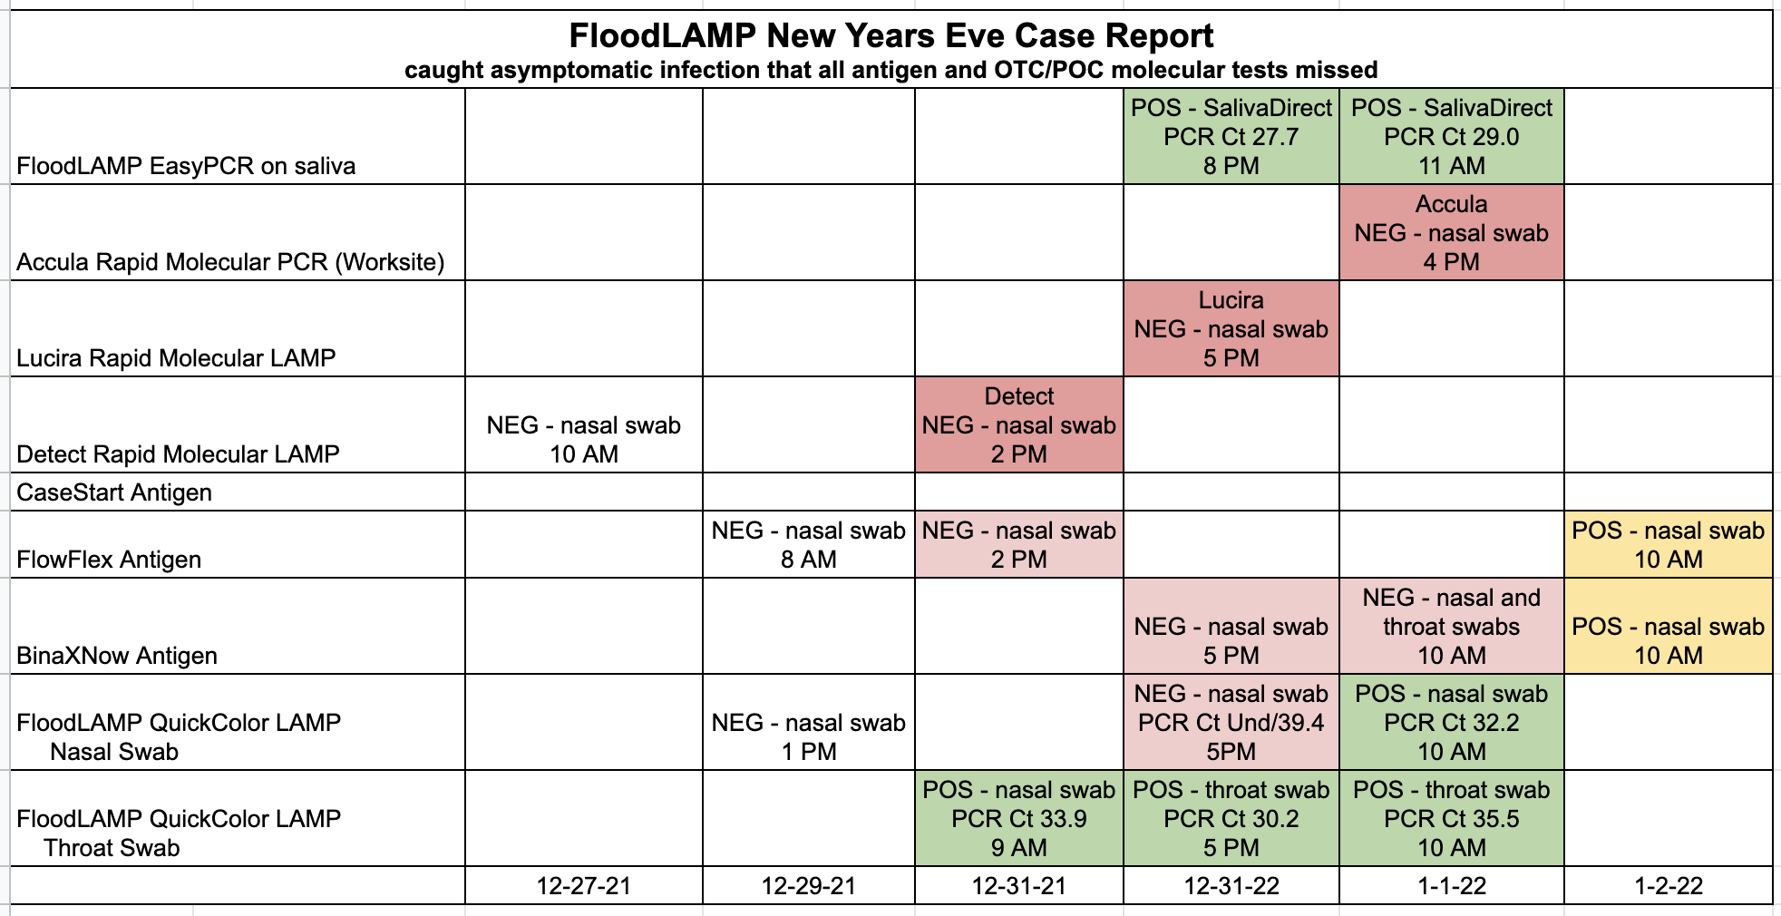
New Year’s Eve Case Report
FloodLAMP caught asymptomatic infection of advisor that 3 expensive OTC/POC rapid molecular tests missed (Detect, Lucira, and Mesa Accula)
BinaX now wasn't positive until 2 days later.
All FloodLAMP positive samples confirmed by PCR

Slide 19
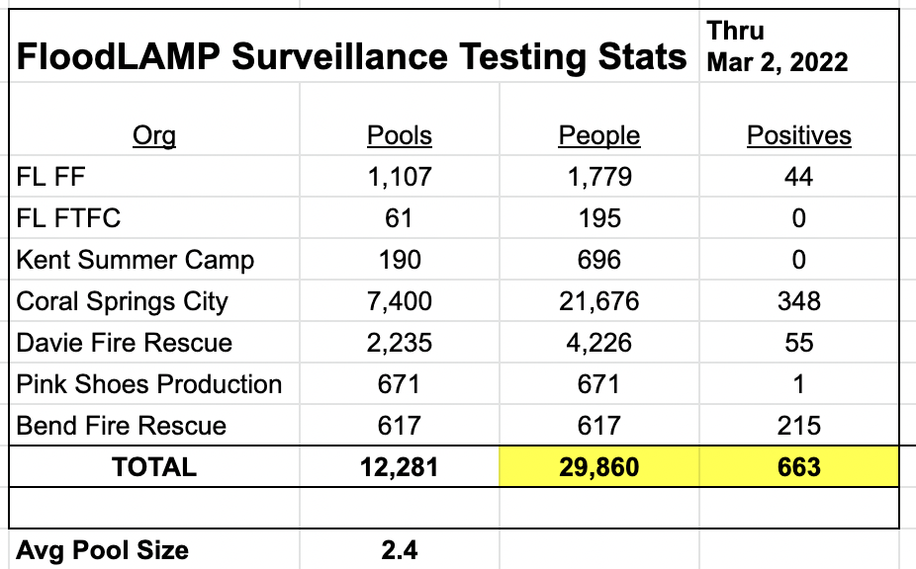
Surveillance Testing Stats

Slide 20
2) Platform - Wrap Around Components

Slide 21
2) Platform – Wraparound program components
Products
Applications
COVID Response
Emerging Threats
(Pandemic Prep)
TB
Zikka
Influenza
STD's
Cancer
All-in
Test Kits
Reagent
Test Kits
Collection Kits
Standard Consumables
Standard Equipment
PHYSICAL
Core
Modules
Sample Processing Sites (Labs)
App
Admin Portal
Training Program
Quality Management System
DIGITAL
Service, Support,
Consulting
Network
EMS & Municipalities
Schools and Businesses
U.S. Federal Agencies (BARDA, ASPR, CDC, DoD, FEMA)
International Governments
Testing Program Management

Slide 22
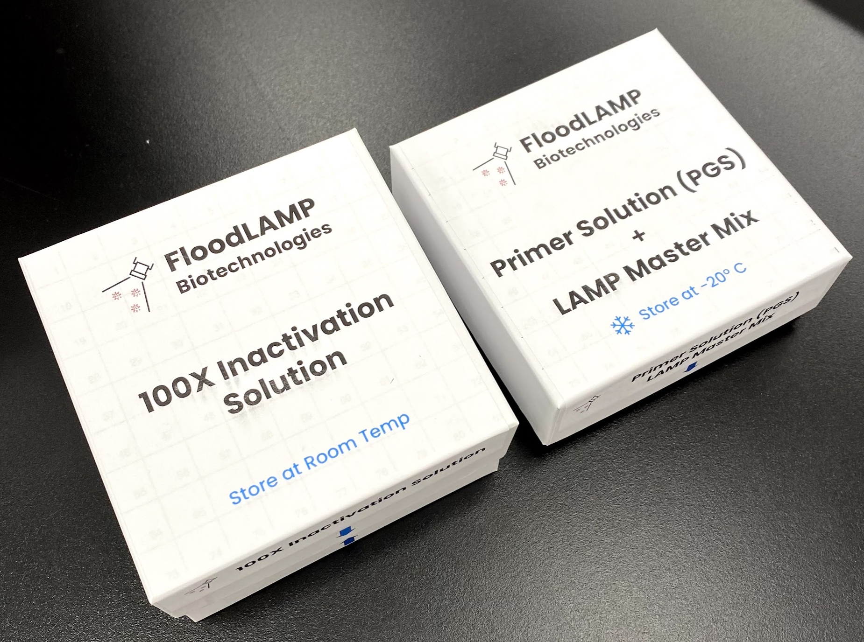
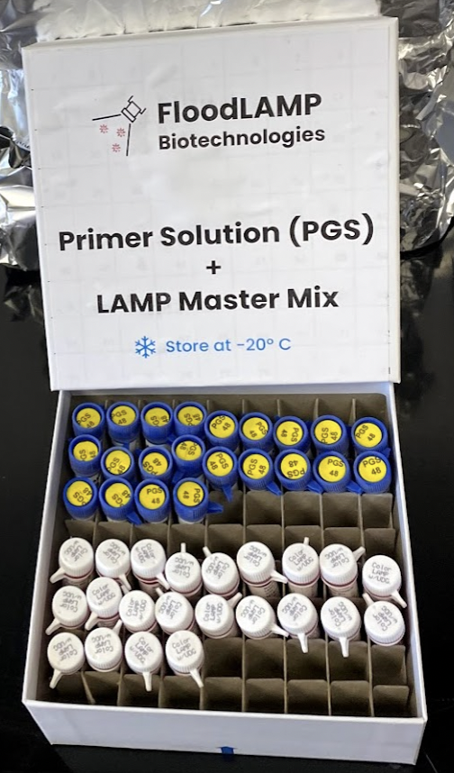
Reagent Kits
FloodLAMP is addressing the practically unlimited demand for accessible, low cost, easy to implement COVID-19 testing and screening.

Slide 23
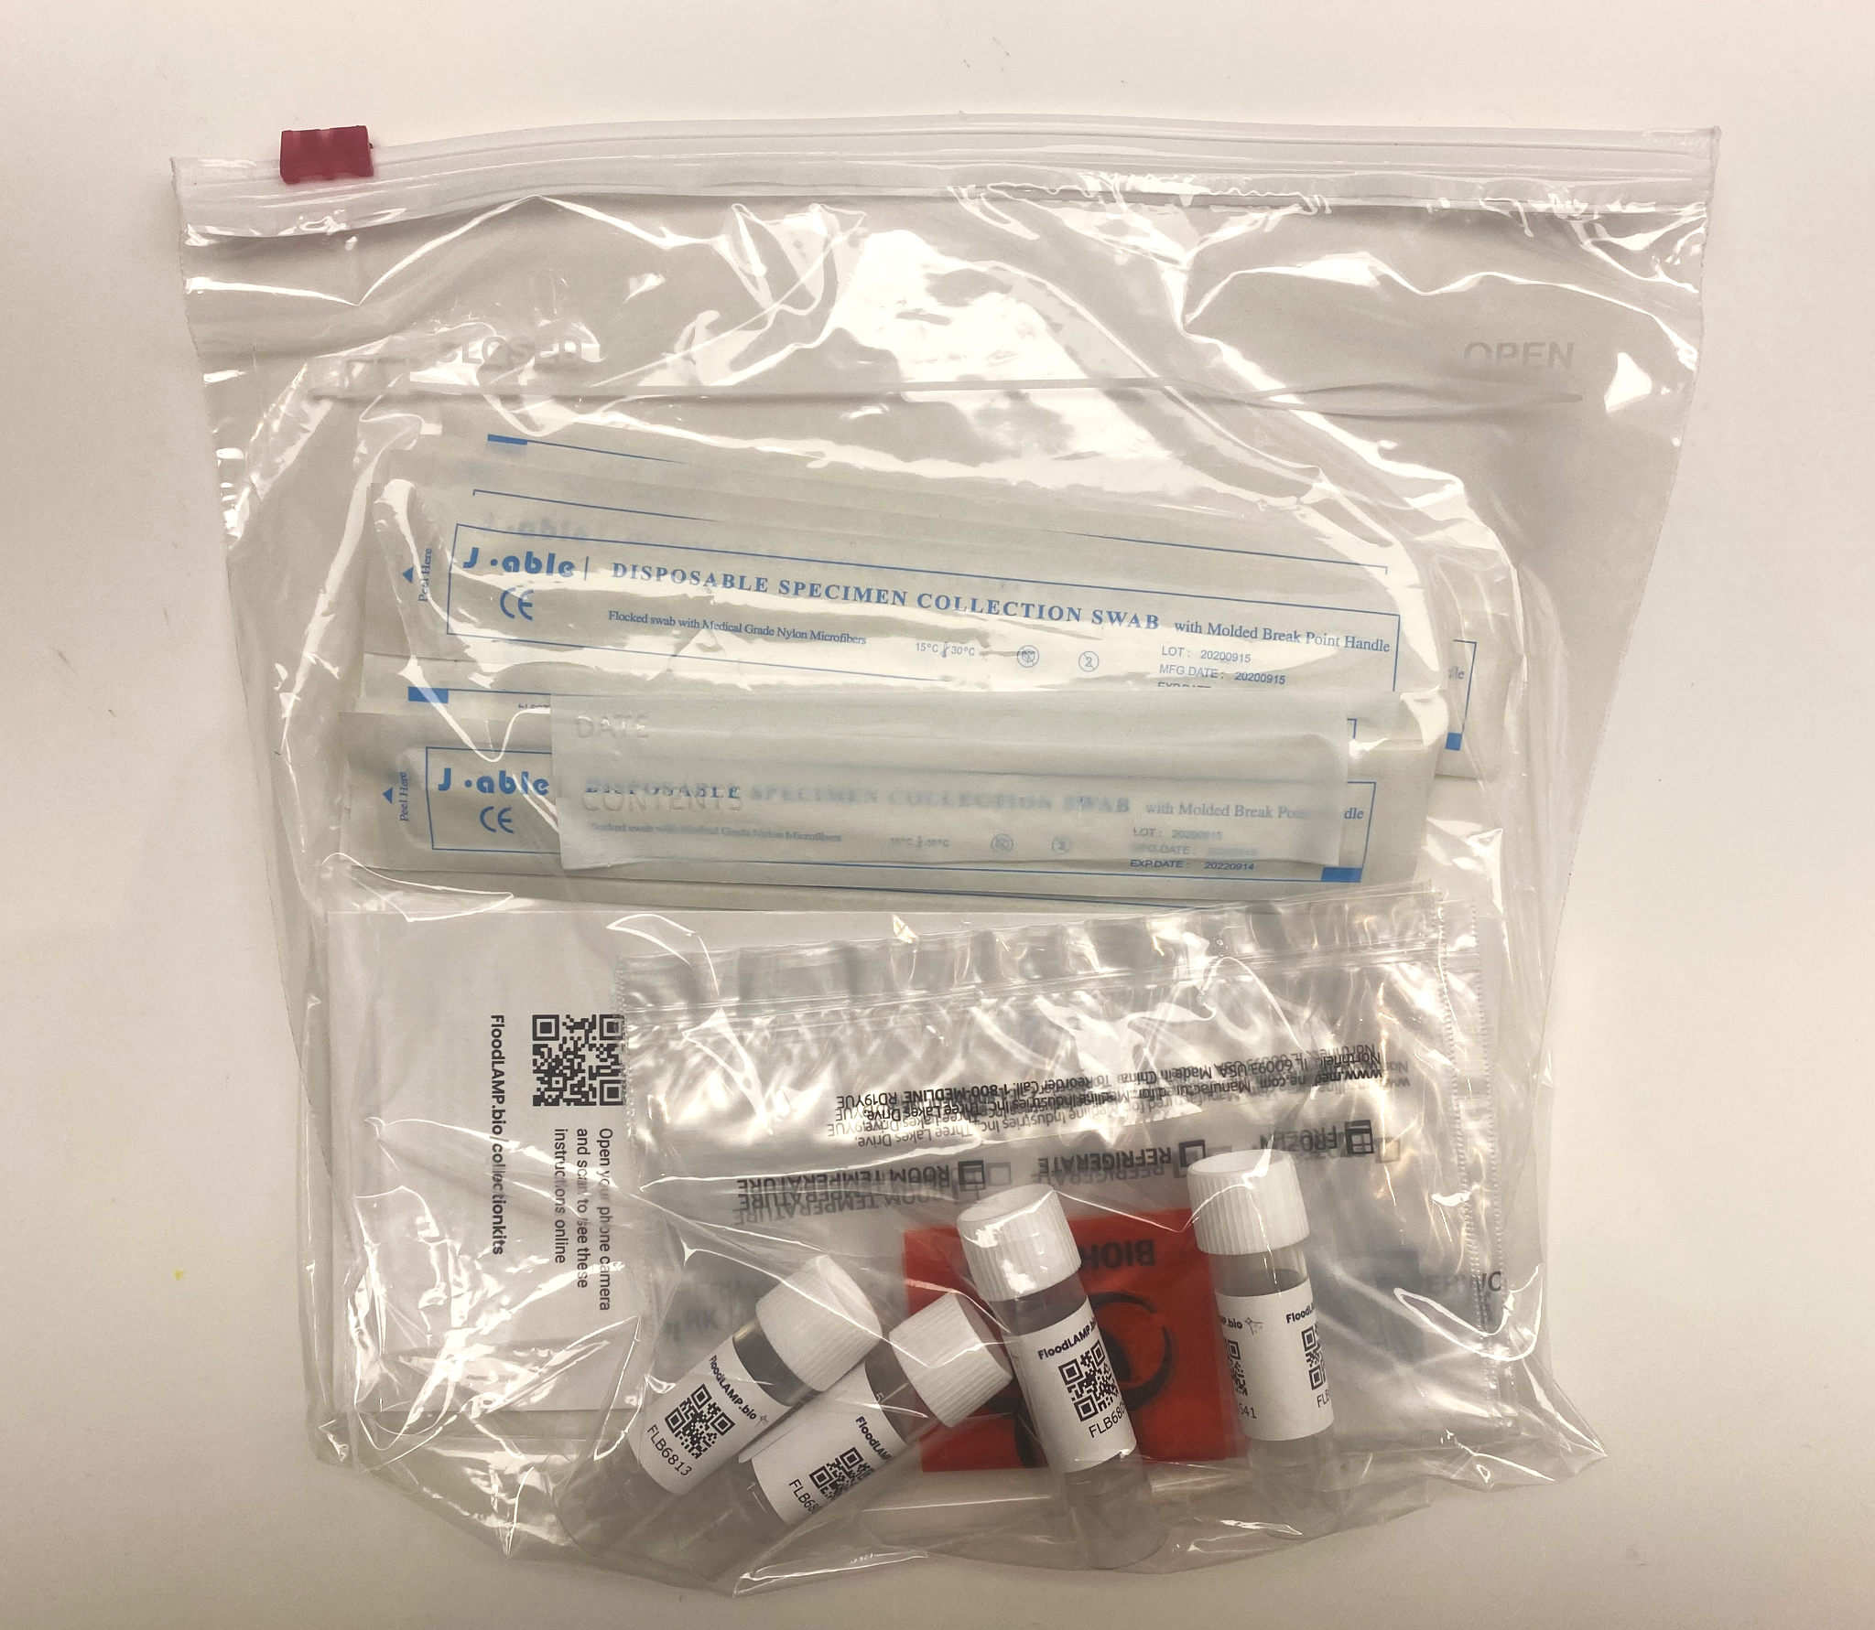
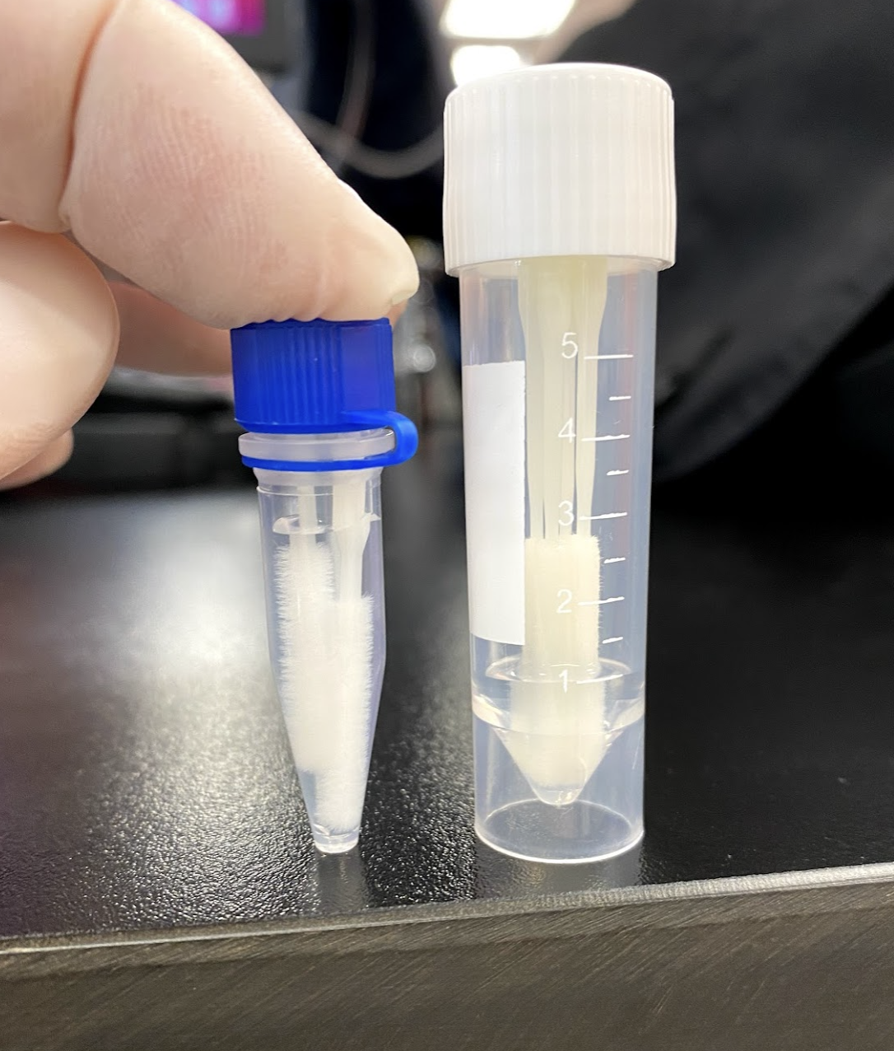
Collection Kits
FloodLAMP is addressing the practically unlimited demand for accessible, low cost, easy to implement COVID-19 testing and screening.

Slide 24
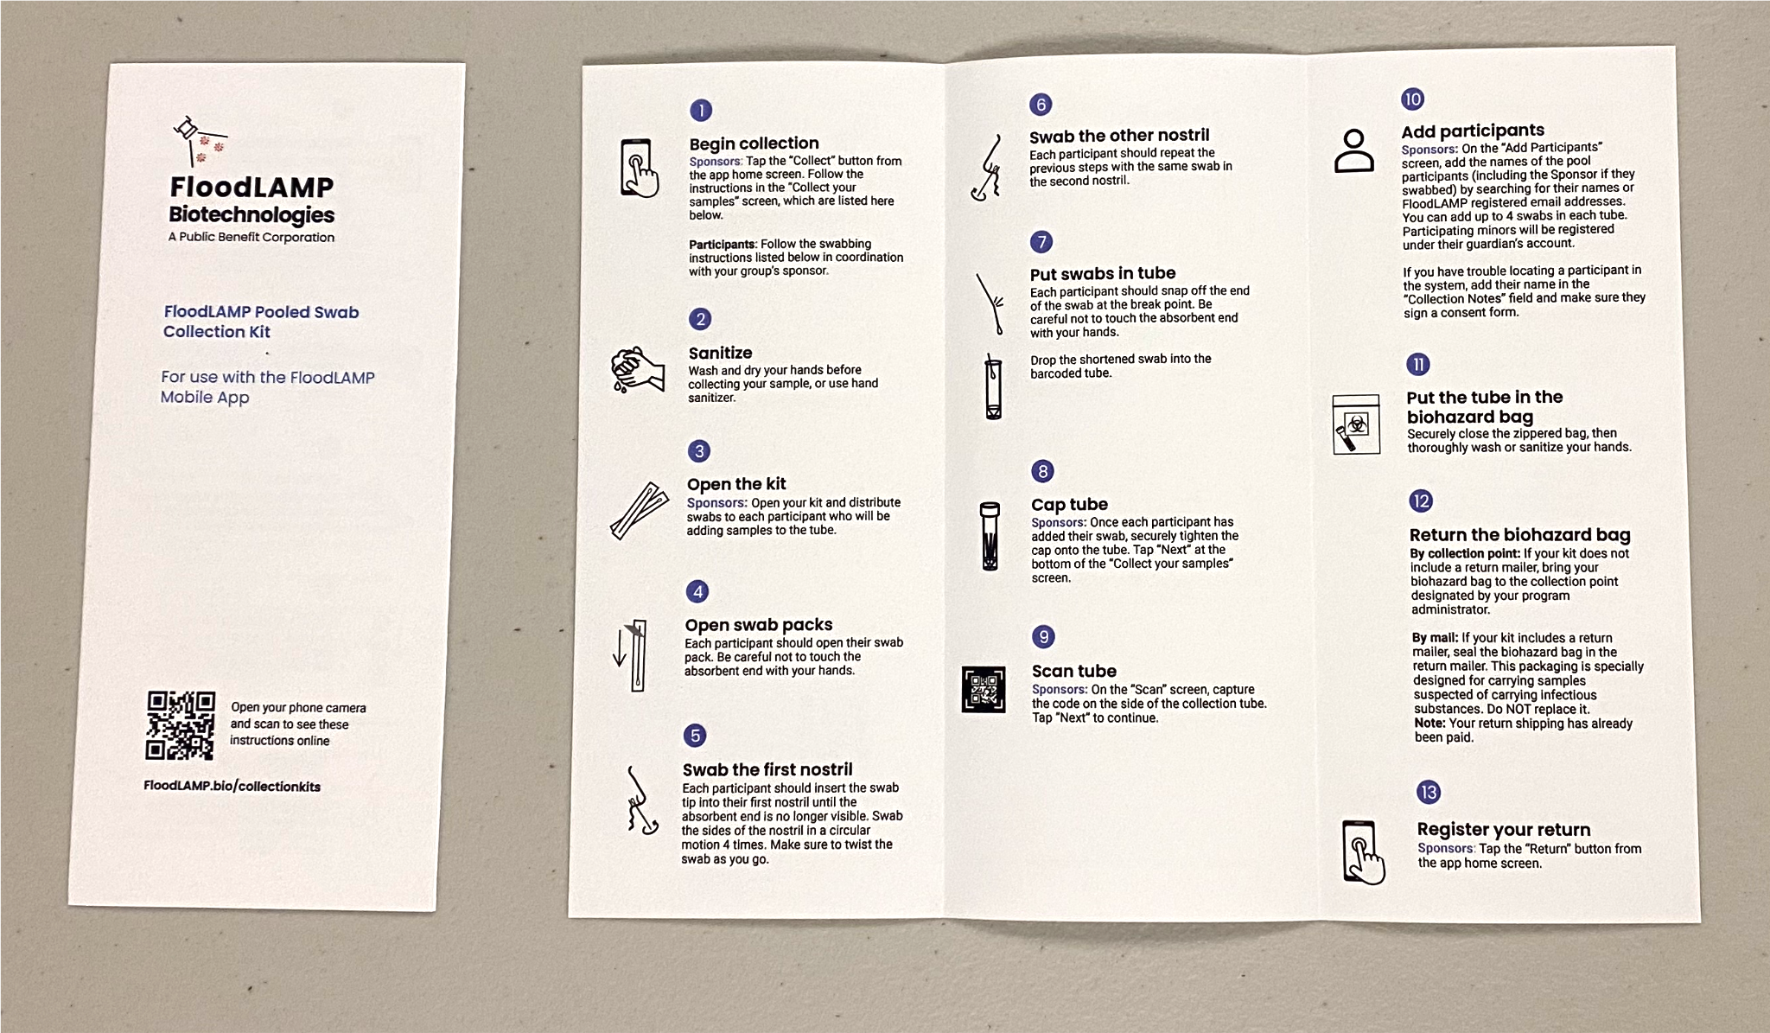
Collection Instructions
FloodLAMP is addressing the practically unlimited demand for accessible, low cost, easy to implement COVID-19 testing and screening.

Slide 25
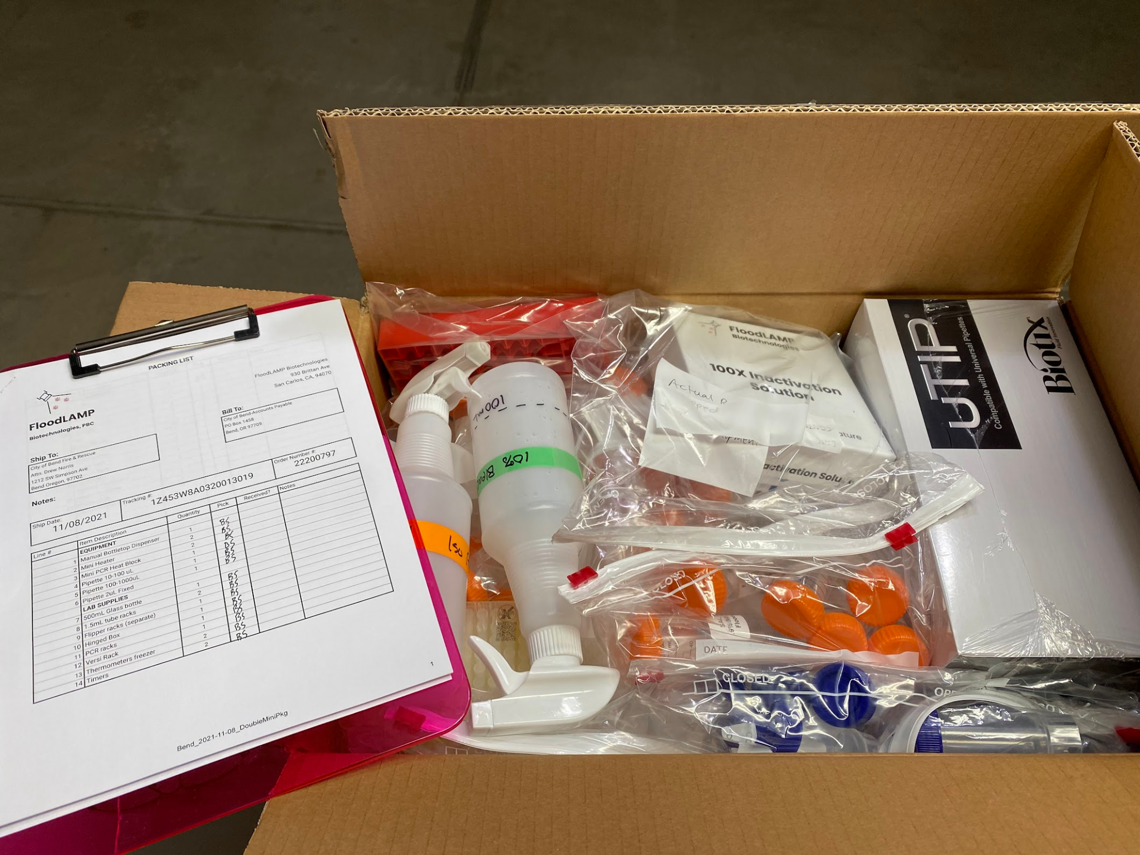
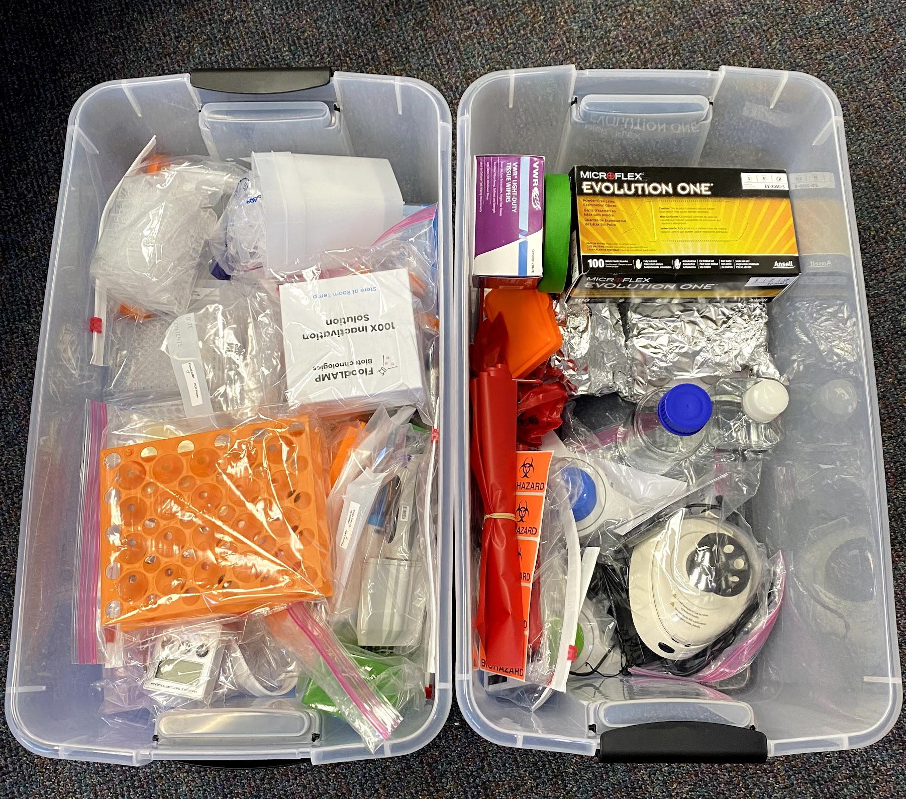
Equipment and Supplies
FloodLAMP is addressing the practically unlimited demand for accessible, low cost, easy to implement COVID-19 testing and screening.

Slide 26
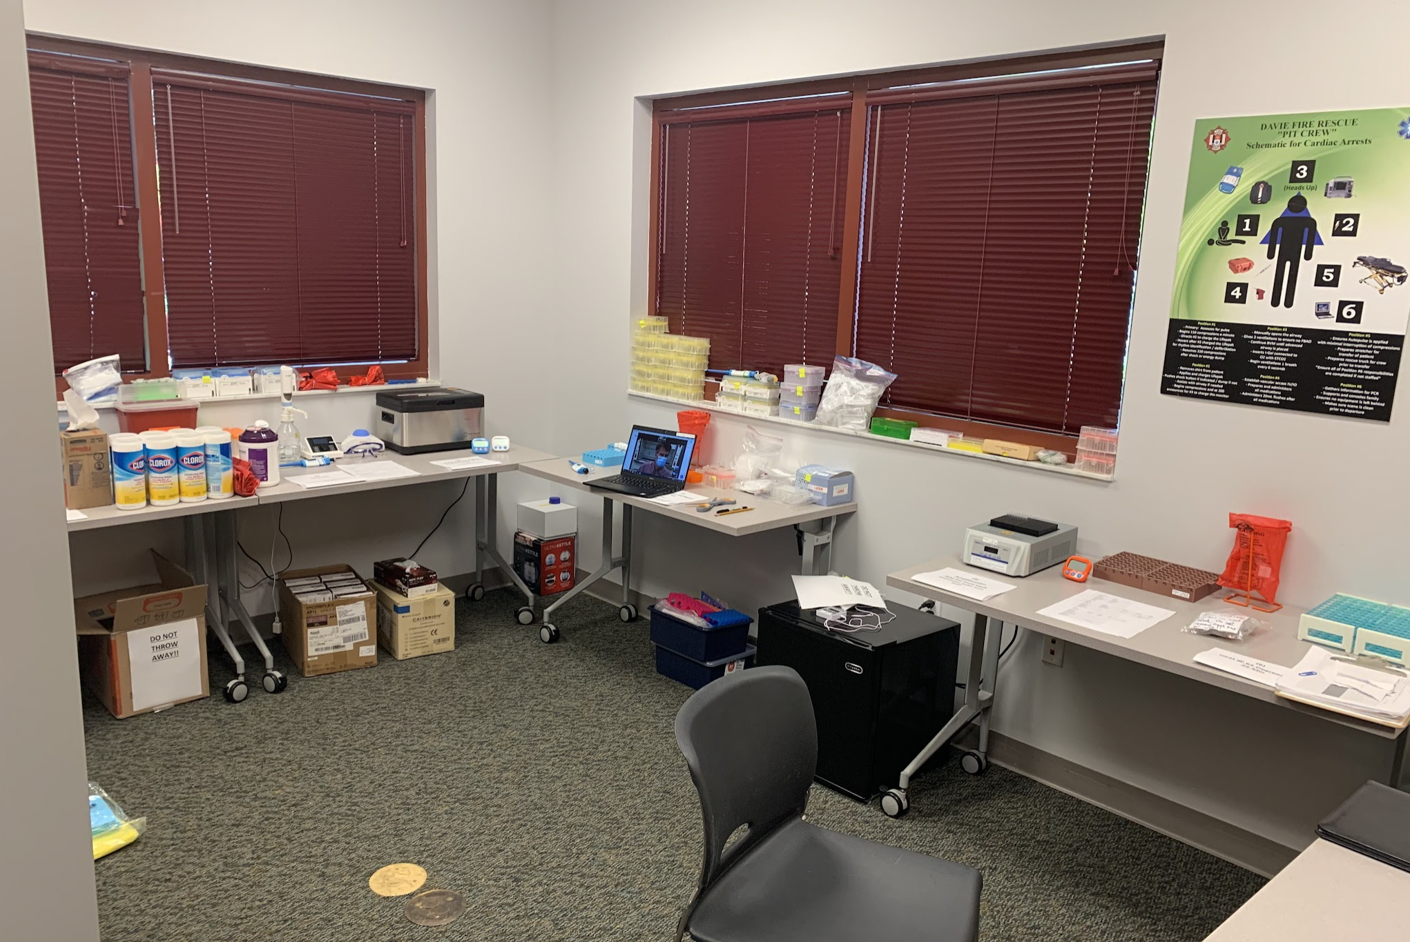
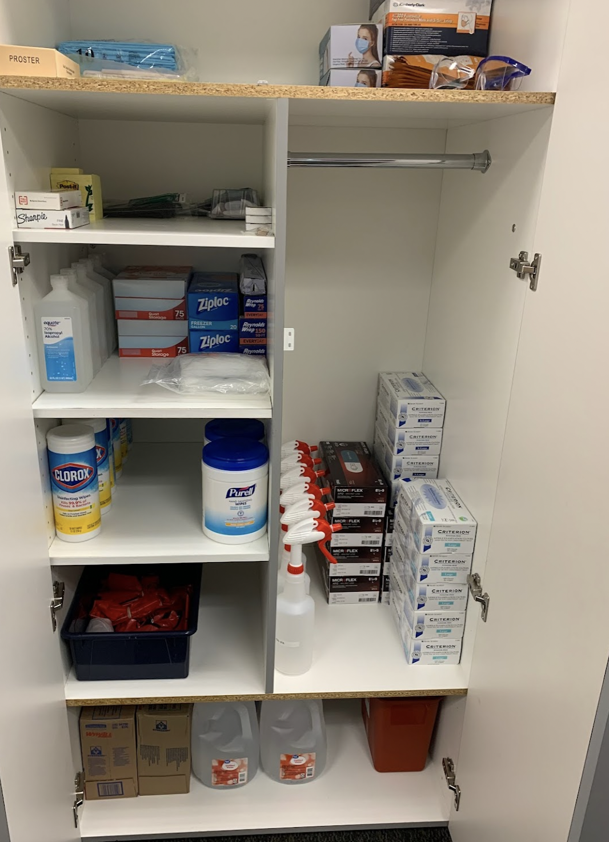
"Lab"
FloodLAMP is addressing the practically unlimited demand for accessible, low cost, easy to implement COVID-19 testing and screening.

Slide 27
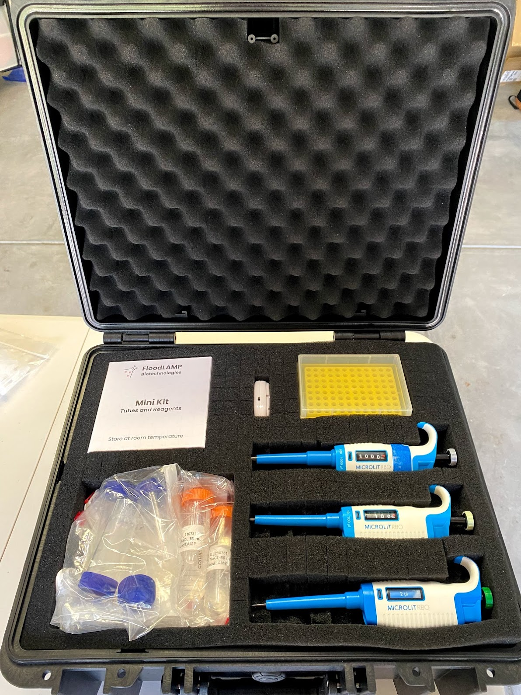
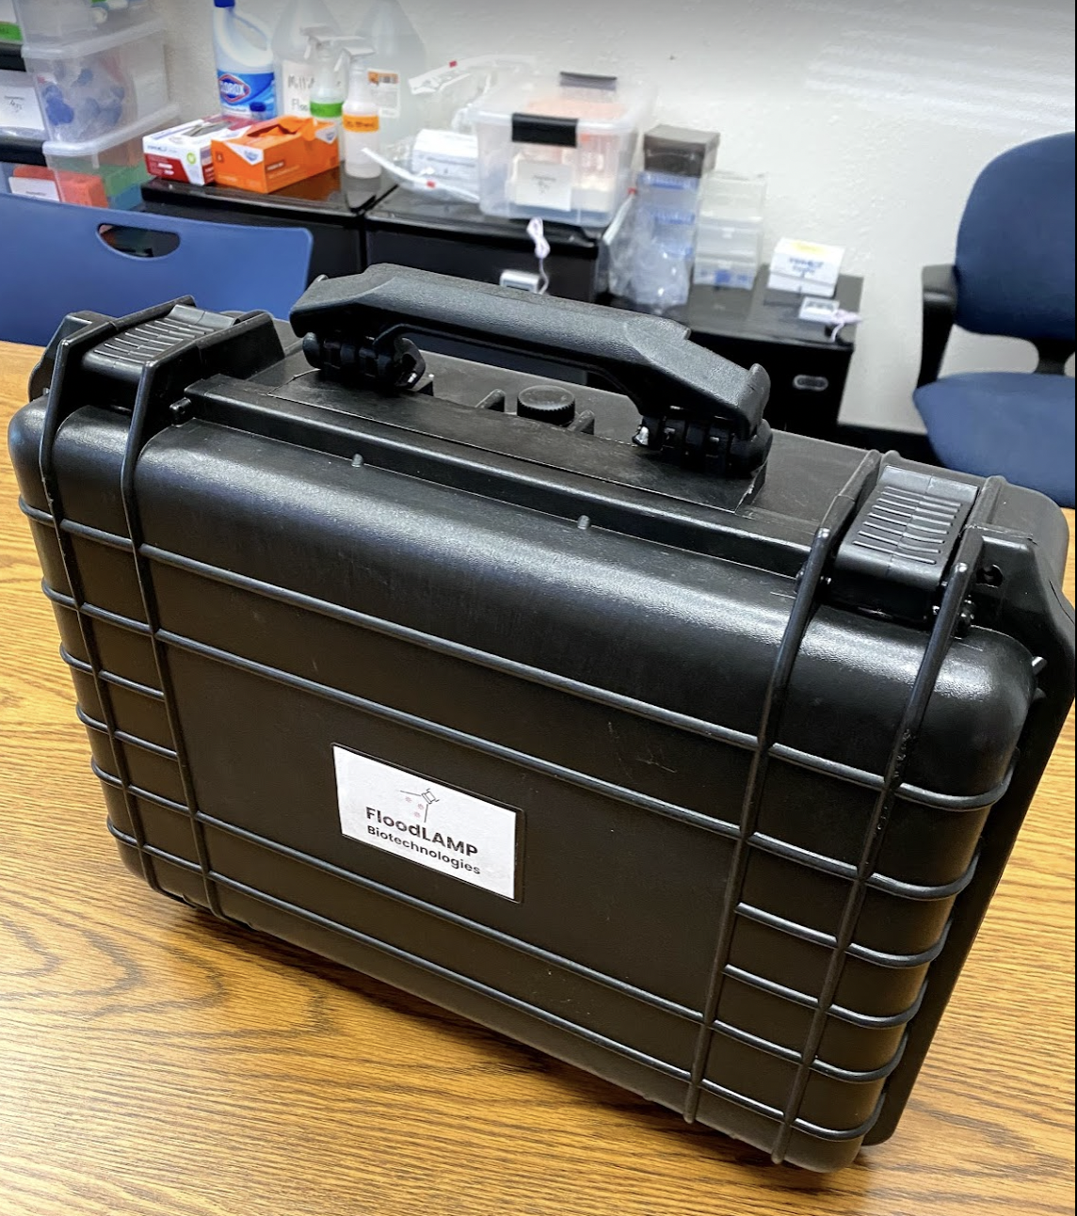
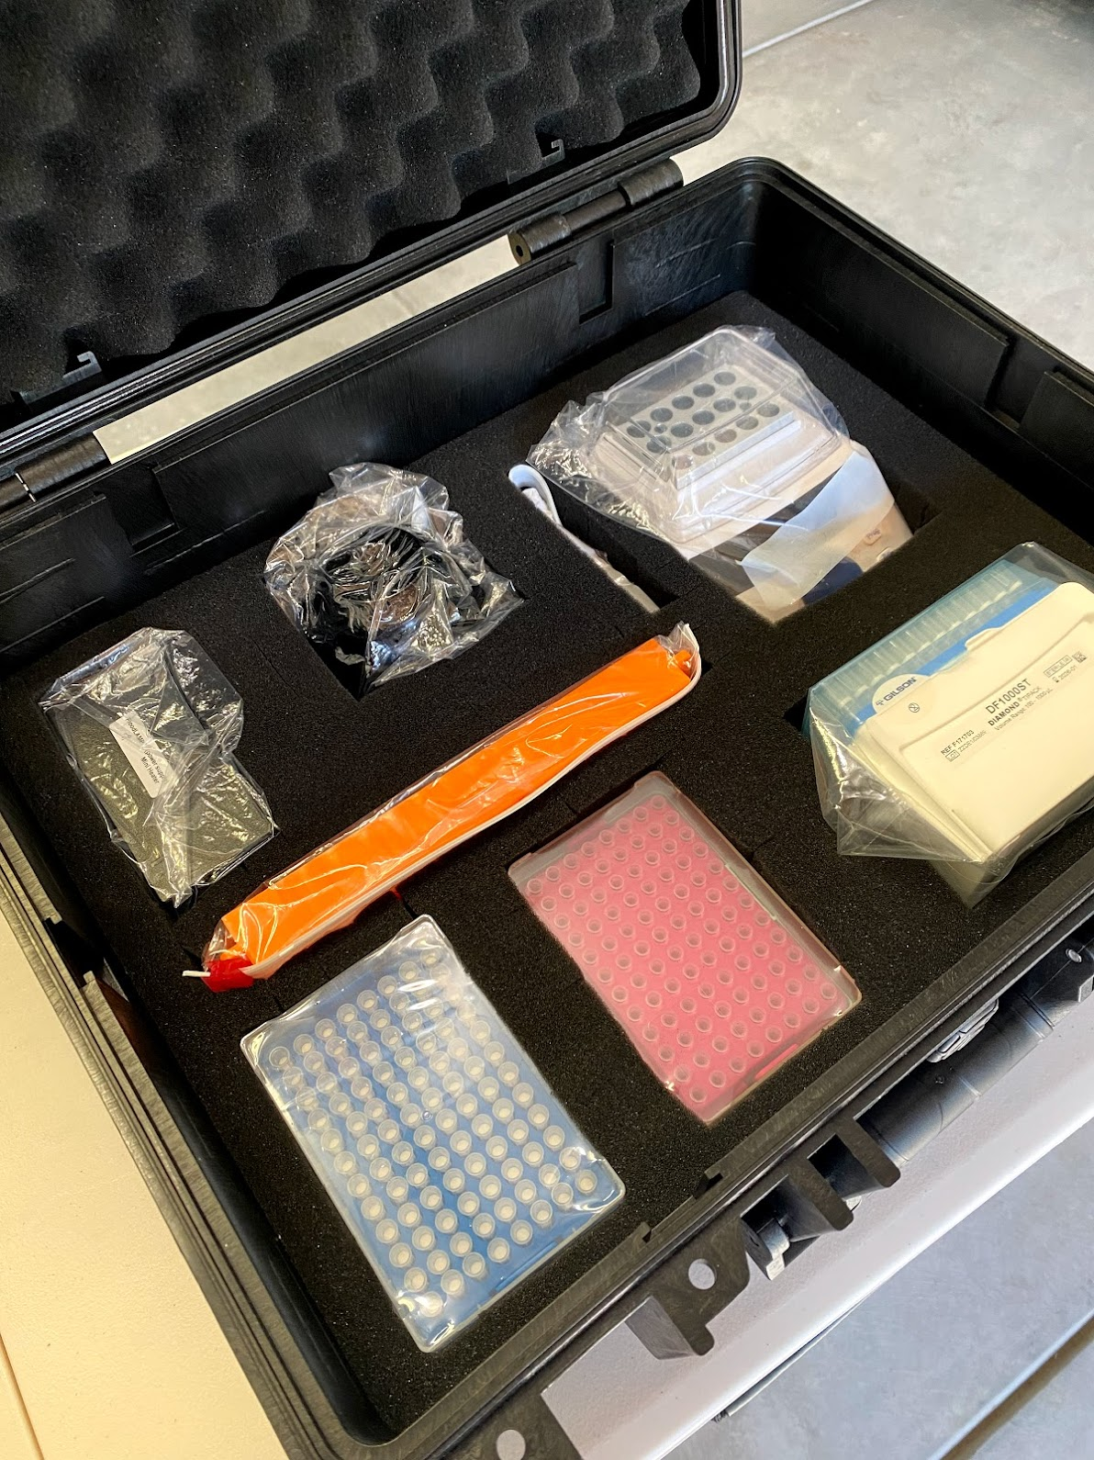
Portable System
FloodLAMP is addressing the practically unlimited demand for accessible, low cost, easy to implement COVID-19 testing and screening.

Slide 28
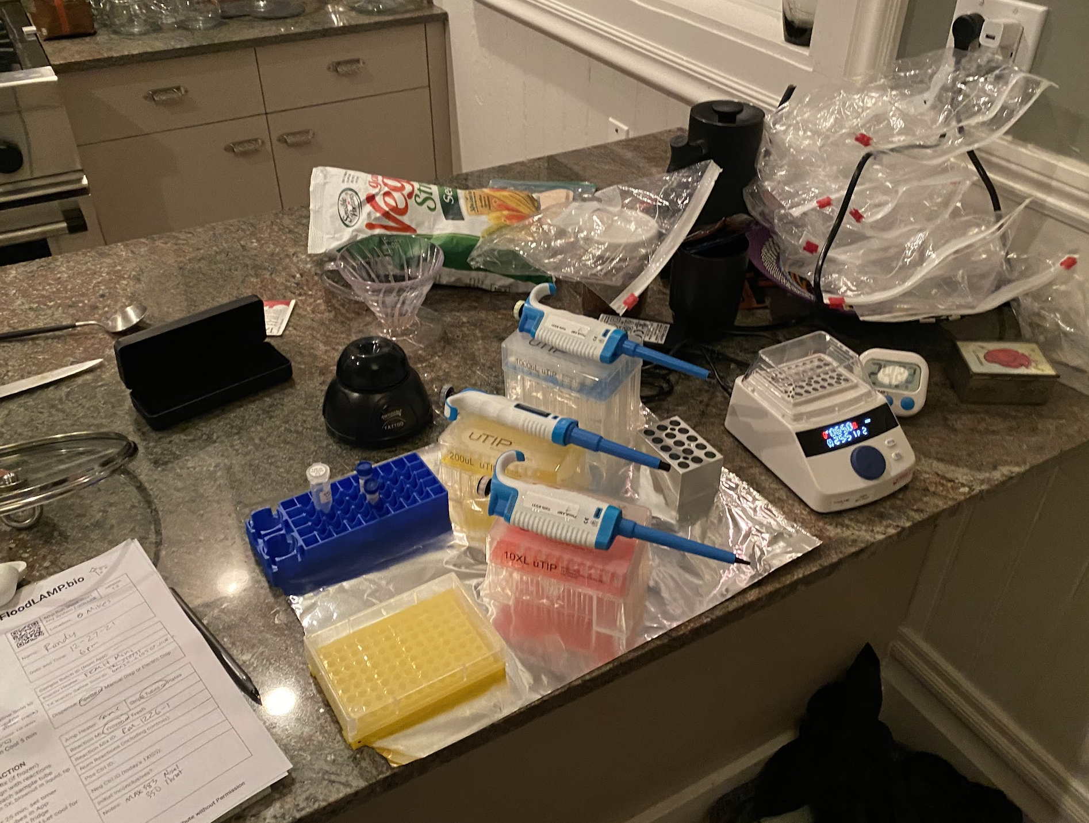
Portable System - in action
FloodLAMP is addressing the practically unlimited demand for accessible, low cost, easy to implement COVID-19 testing and screening.

Slide 29
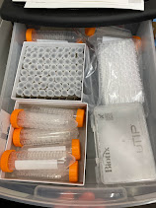
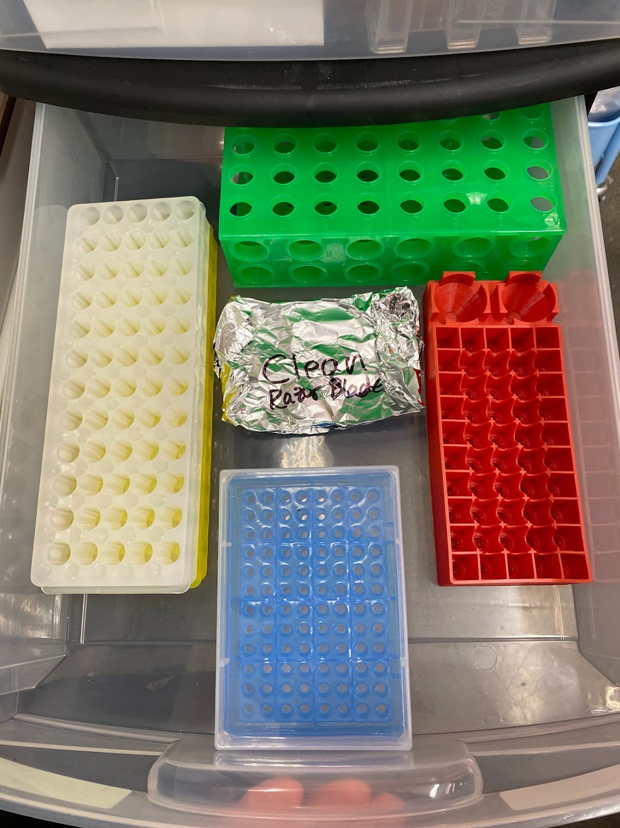
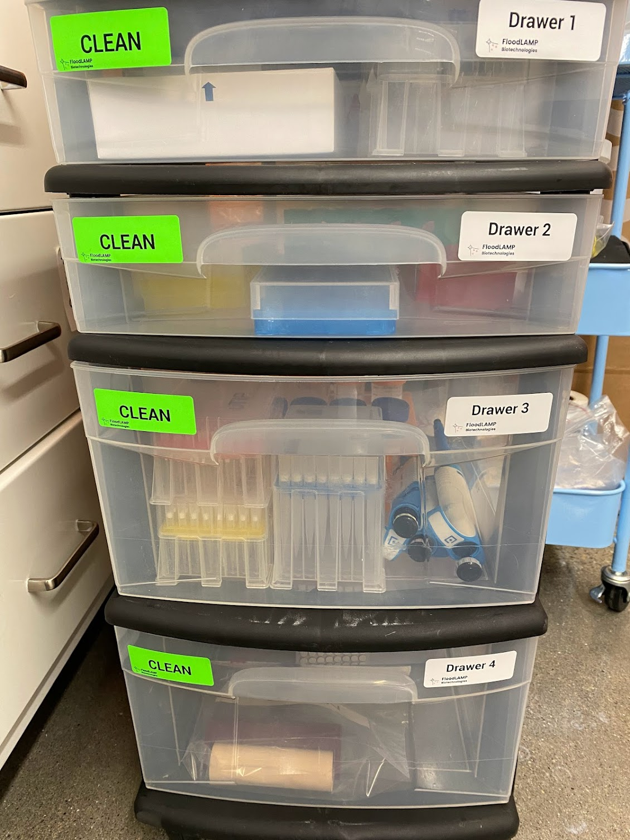
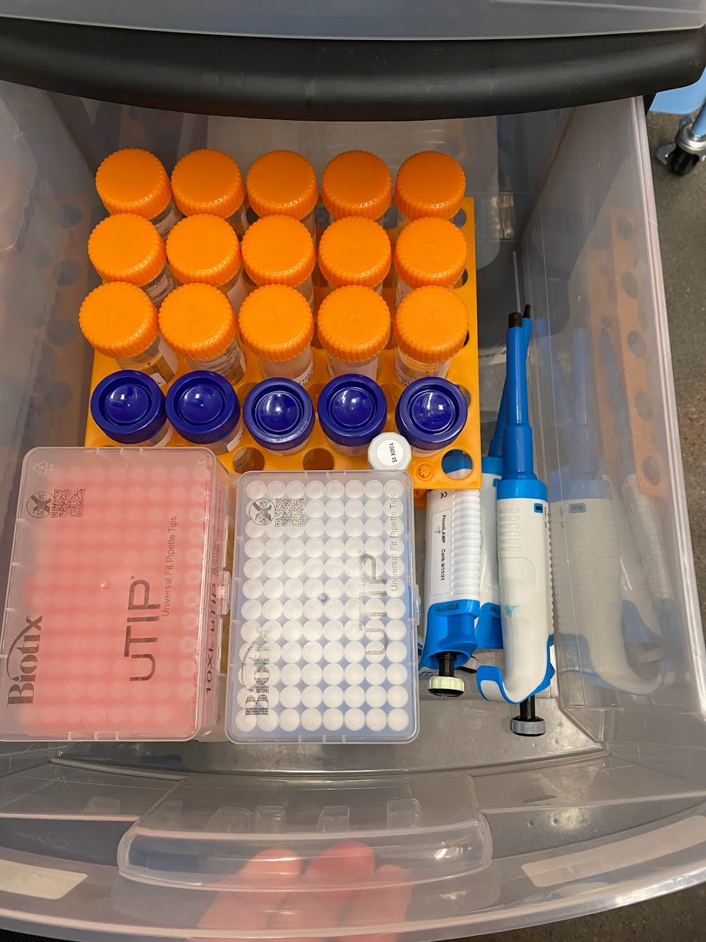
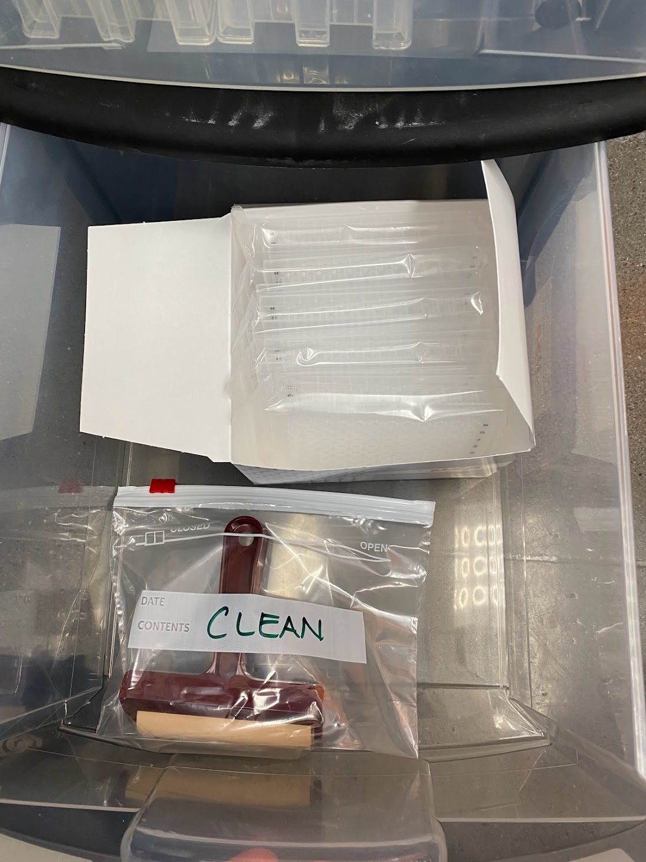
Prepared Cart
FloodLAMP is addressing the practically unlimited demand for accessible, low cost, easy to implement COVID-19 testing and screening.

Slide 30

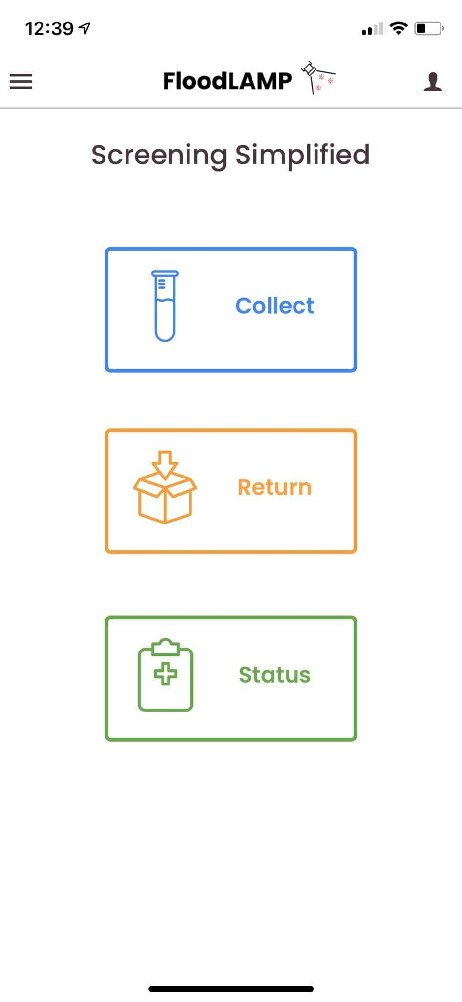
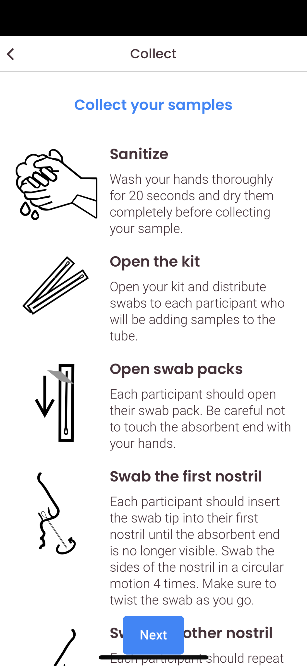
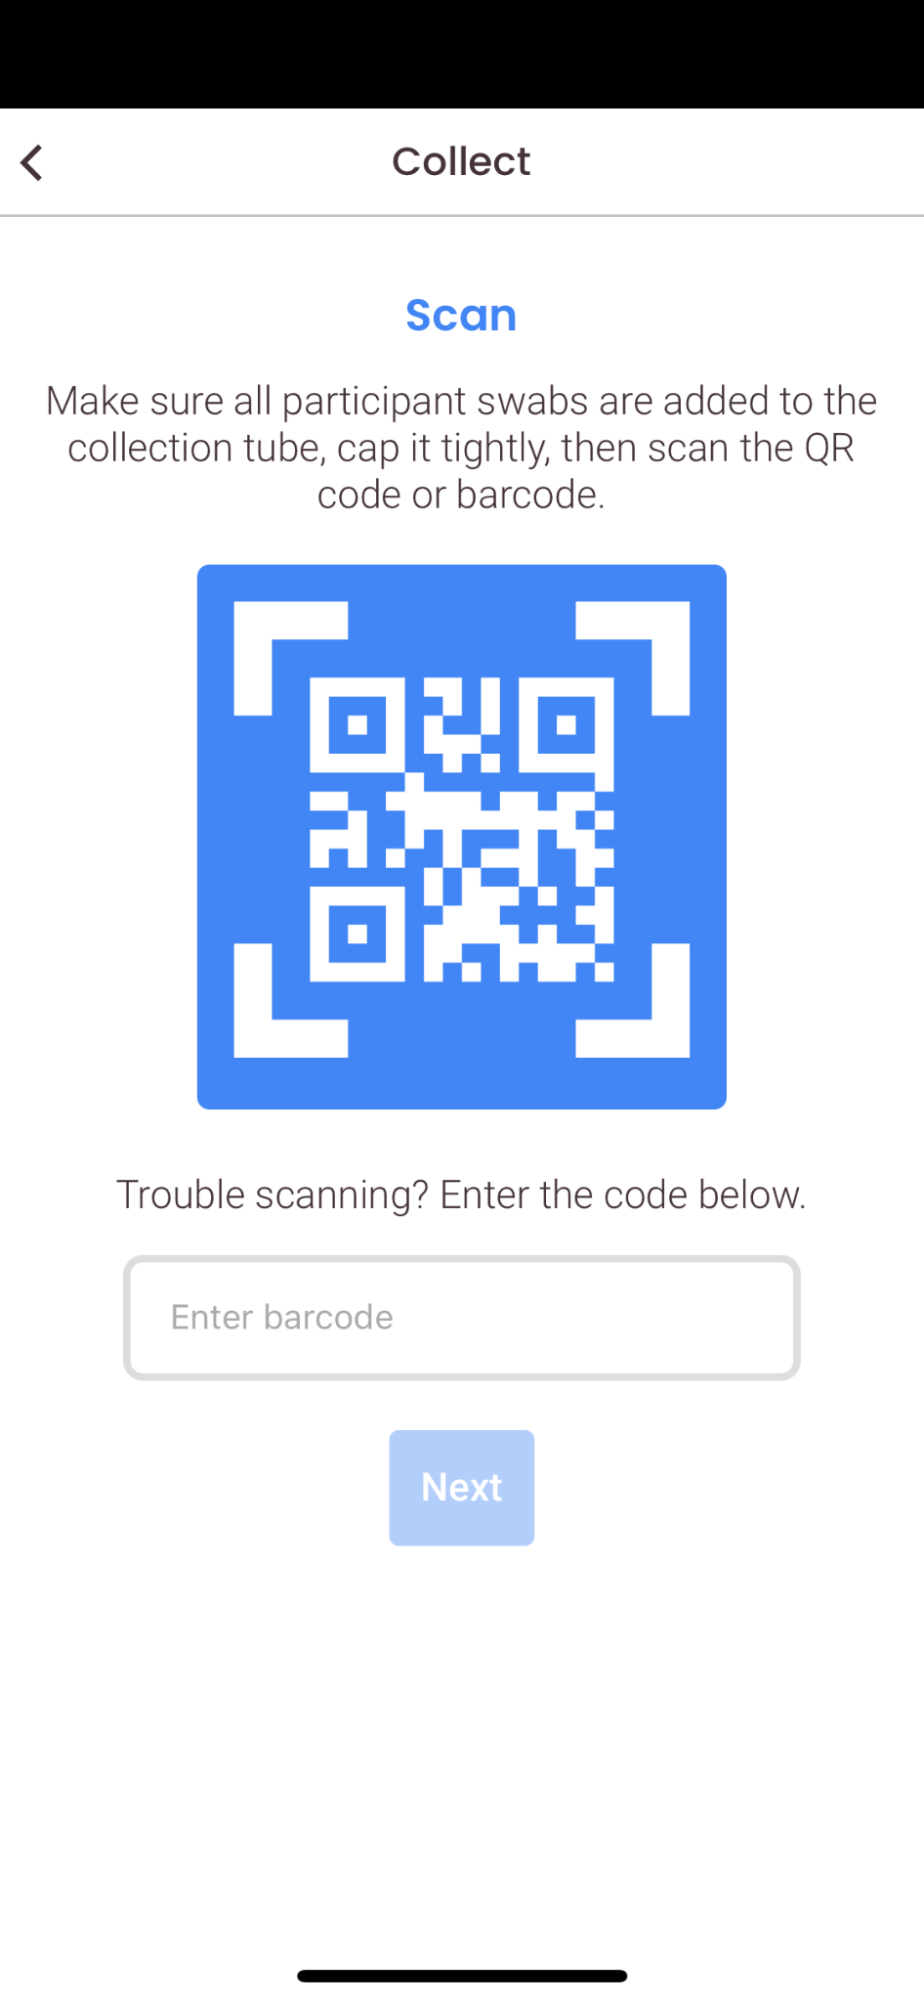


App
For program participants
FloodLAMP is addressing the practically unlimited demand for accessible, low cost, easy to implement COVID-19 testing and screening.

Slide 31





App
For the lab
FloodLAMP is addressing the practically unlimited demand for accessible, low cost, easy to implement COVID-19 testing and screening.

Slide 32


Admin portal
Tools for program administrators
FloodLAMP is addressing the practically unlimited demand for accessible, low cost, easy to implement COVID-19 testing and screening.

Slide 33

Test Diagrams
FloodLAMP is addressing the practically unlimited demand for accessible, low cost, easy to implement COVID-19 testing and screening.

Slide 34


Training Program - Interactive Video
FloodLAMP is addressing the practically unlimited demand for accessible, low cost, easy to implement COVID-19 testing and screening.

Slide 35

Training Program - Assessment for Certification
FloodLAMP is addressing the practically unlimited demand for accessible, low cost, easy to implement COVID-19 testing and screening.

Slide 36


Quality Management System
Implementing ISO 13485 QMS
QR Form Driven Logs
FloodLAMP is addressing the practically unlimited demand for accessible, low cost, easy to implement COVID-19 testing and screening.

Slide 37

New Site Validation Run
FloodLAMP is addressing the practically unlimited demand for accessible, low cost, easy to implement COVID-19 testing and screening.

Slide 38
3) Open Source “Generic” Tests

Slide 39

At Sweet Spot of Performance
Will help usher in era of at-home concierge diagnostics but simply too constrained by manufacturing and too expensive for public health screening.
People want higher confidence for both positive and negative results.
Rapid Turnaround Time
< 2 hrs sample to answer
High upfront capital cost for PCR instruments limit replicability. These 2 tests have potential to drive down PCR costs.
Antigen Test Strips
Rapid Molecular Cartridges
Improved performance
Good sensitivity
Fast turnaround
Cheap
Molecular
Flexible
Decentralised
Resilient
FloodLAMP QuickColorTM
Low Cost
< $5 per person
Good Sensitivity
Detects Pre-Infectious Asymptomatics
Long turnaround renders it unsuitable for large scale screening - schools and workplaces need to know quickly if someone is infected.
SalivaDirectTM & FloodLAMP Pooled Swab PCR
Clinical Lab Purified PCR

Slide 40
Filling a Gap in the Testing Landscape
At Home
OTC
Point of Care
Point of Need
CLIA Labs
Scaling a single test up to very high levels offers opportunities for innovation in sampling, test chemistry, and program configuration.
A "Point of Need" modality of testing is needed that combines the scalability and low cost of liquid reagent processing with the ease, flexibility and decentralized nature of POC/At-Home.
Public Health processing sites can fill the gap between CLIA labs and DIY at home tests.
Want this new capability to be additive and not cannibalize the clinical diagnostic infrastructure.
Current testing paradigms cannot stem a pandemic caused by an asymptomatically transmitted, aerosolized pathogen.

Slide 41

LAMP EUAs for SARS-CoV2
Just in 2020!
from Matt McFarlane
(twitter @mattmcfar)

Slide 42



PCR and LAMP Sister Assays
visual readout
QuickColorTM LAMP Test
M1804 MM
Standard by-the-book 25µL reaction
3 primer sets mixed (AS1e, N2, E1)
25 minutes at 65°C
Streamlined Sample Prep
Same sample for both tests
2µL sample volume
Standard Rabe-Cepko TCEP/EDTA inactivation solution
Added directly to dry swabs
Same sample for both tests
Standard RT-qPCR instrument
EasyPCRTM Test
Luna E3006 kit
Standard by-the-book 20µL reaction
CDC primers in SalivaDirect config (N1, RNAseP)

Slide 43



Clinical Evaluation Data
Clinical evaluation performed by the Stanford CLIA Lab, with excellent results and praise on the "really straightforward" protocol.
EasyPCRTM Test
3 copies/µl LoD
98% sensitivity (PPA 39/40)
100% Specificity (40/40)
No false positives
Gamma inactivated cell lysate from BEI spiked into raw clinical negative sample
QuickColorTM LAMP Test
12 copies/µl LoD
90% Sensitivity (PPA 36/40)
Missed positives only high Ct (>36 with direct PCR)
100% Specificity (40/40)
No false positives
Source of Specimens: Stanford COVID-19 Clinical Testing Program
Specimen Type: Anterior Nares Swab in PBS, previously tested and frozen
Comparator Test: Hologic Panther Fusion SARS-CoV-2 Assay and Hologic Panther Aptima SARS-CoV-2 Assay

Slide 44

Clinical Evaluation by Stanford CLIA Lab

Slide 45


Clinical Evaluation by Stanford CLIA Lab
40 Clinical Positive Samples:
29 Positive by FloodLAMP QuickColorTM Test
7 Inconclusive (all high Ct, low viral load)
4 Negative (all > 36 Ct, very low viral load)
40 Clinical Negative Samples:
40 Negative by FloodLAMP QuickColorTM Test

Slide 46



Clinical Evaluation by Stanford CLIA Lab
One sample Undetermined (not detected) by FloodLAMPTM EasyPCR
Detected in FloodLAMP EasyPCRTM
Not detected by FloodLAMP QuickColorTM
(EasyPCRTM PPA 39/40 97.5%)
Detected in both FloodLAMP EasyPCRTM and QuickColorTM Colorimetric LAMP test
(QuickColorTM PPA 36/40 90%)
* includes initial inconclusive resolved by PCR
Both FloodLAMP EasyPCRTM and QuickColorTM had no false positives
(NPA 40/40 100%)

Slide 47

Clinical Evaluation by Stanford CLIA Lab
One sample not detected by FloodLAMPTM EasyPCR
(PPA 39/40 97.5%)
6 Positives Not Detected by FloodLAMP QuickFluorTM test
(PPA 34/40 85%)
Positives not detected by FloodLAMP QuickColorTM test
(PPA 36/40 90%)
* includes initial inconclusives resolved by PCR
All 3 Tests:
FloodLAMP EasyPCRTM QuickColorTM LAMP
QuickFluorTM LAMP
had no false positives
(NPA 40/40 100%)

Slide 48





Saliva Direct "most unique EUA" - FDA
Is a protocol not a product
Open Access - any CLIA can use
Lots of clone assays being used
Yale can "designate" CLIA labs

Slide 49



Open EUA's - 2 Full Submissions + Pre EUA

Slide 50



Open EUA - Disclosure of Components

Slide 51

Open EUA's
Provides a path to establishing generics in diagnostics.

Slide 52




Push for Regulatory Progress
https://reaganudall.org/research-funding-opportunity
https://www.help.senate.gov/imo/media/doc/PREVENT%20Pandemics%20discussion%20draft%20sxs%20final.pdf

Slide 53



Team Effort!

Slide 54





FloodLAMP Team - Thank You!
Scientific Advisory Board
Anne Wyllie
Yale, Lead Researcher – SalivaDirect
Bill Hyun
UC San Francisco, Genoa Ventures
Randy True
Founder & CEO
• Founder TMI Inc. - Acq. Affymetrix
• Former VP of R&D at Affymetrix
bit.ly/biosketch-randalltrue
co-author global LAMP consortium review: bit.ly/gLAMP-review
https://abrf.memberclicks.net/jbt-2021-september-issue
Industry Advisors
Tim Lugo
William Blair Biotechnology Group Head
Zarak Khurshid
Asymmetry Capital, Top MDx Analyst
John Edge
Oxford Internet Institute, Blue Field Labs, ID2020
Theresa Ling
UX/Design Lead
Dr. Peter Antevy, MD
Program Medical Director
Acknowledgments
Antanas Sadunas, Sam Fogelberg, Carey Tan, Esmé Thornhill-Davis, Jeff Huber, Cliff Wang, Chris Mason, Simon Johnson, Brett Johnson, Mike Finney, Ron Cook
NSVD: Vincent Law, Michael Wells, Katrina Brandis, Gaby Hartley, Tim Earley, Nasreen Haque
Research-Aid Networks: Jeremy Rossman
EMS deployments: Adam, Danny, Alex, Petar, Dr. Paul Pepe
Thanks too to all of our advisors, volunteers & former employees!!
Gary Withey, Ph.D.
Vice President of Research & Development
Brandon Smith
Lab Assistant

Slide 55
APPENDIX

Slide 56


Successful Commercial Pilots
“FloodLAMP’s testing program is a total game-changer. I didn’t know this was possible. I’ve been blown away.”
– President of Production Company for FloodLAMP Pilot program “ROSA”
Commercial deployments in 3 states.
On-site, rapid mass molecular testing performed and operated by EMS staff.
"It's been a godsend!"
– EMS Training Director running the FloodLAMP program
2 cities have opted for mandatory FloodLAMP testing. Prioritizing it over antigen and PCR alternatives.

Slide 57



Collaboration with University of Antioquia (Medellin, Colombia)
Joint NEB / FloodLAMP project

Slide 58






Slide 59

Primer Comparison
All 3 primer sets chosen by HPLC purification
Run with NEB E1700 Fluorimetric LAMP on QuantStudio7
Sample is contrived positive with Gamma BEI spiked into negative clinical sample
A = AS1e Rabe-Cepko primer set for ORF1ab
N = N2 primer set
E = E1 primer set
"H" = HPLC purified
"D" = Desalted

