Slide 1
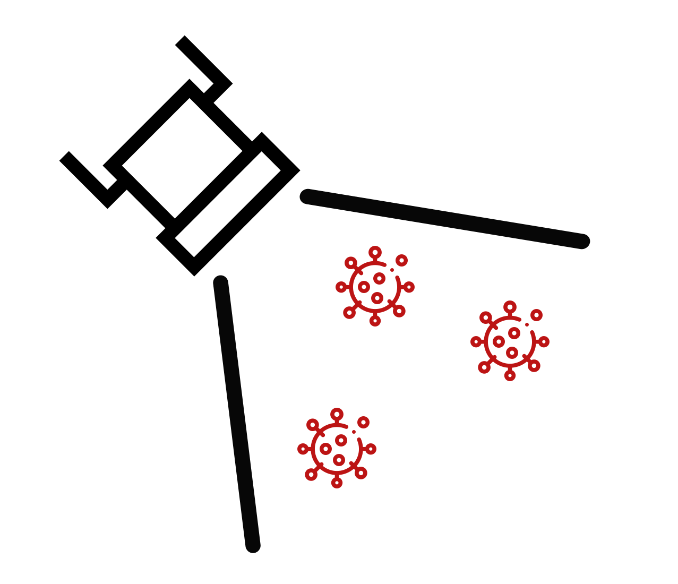
FloodLAMP
Biotechnologies
a Public Benefit Corporation
floodlamp.bio

Slide 2
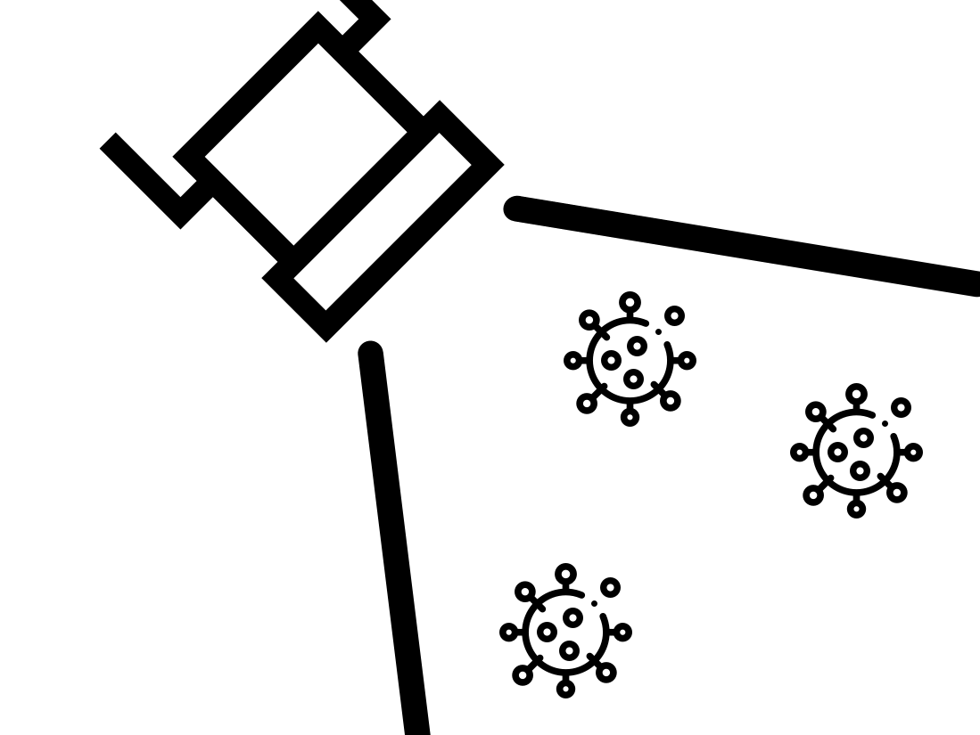
Our Mission is
to deploy mass screening to stop the spread of infectious disease

Slide 3
Overview of Technology Involved
Sample Collection
Coordinated by Custom App
Self pooling by household
Assay Chemistry - Rabe Cepko Protocol from Harvard Medical School:
Chemical Inactivation using TCEP/EDTA
Nucleic Acid Purification Protocol using ultra cheap Silica
Isothermal LAMP amplification with colorimetric readout

Slide 4
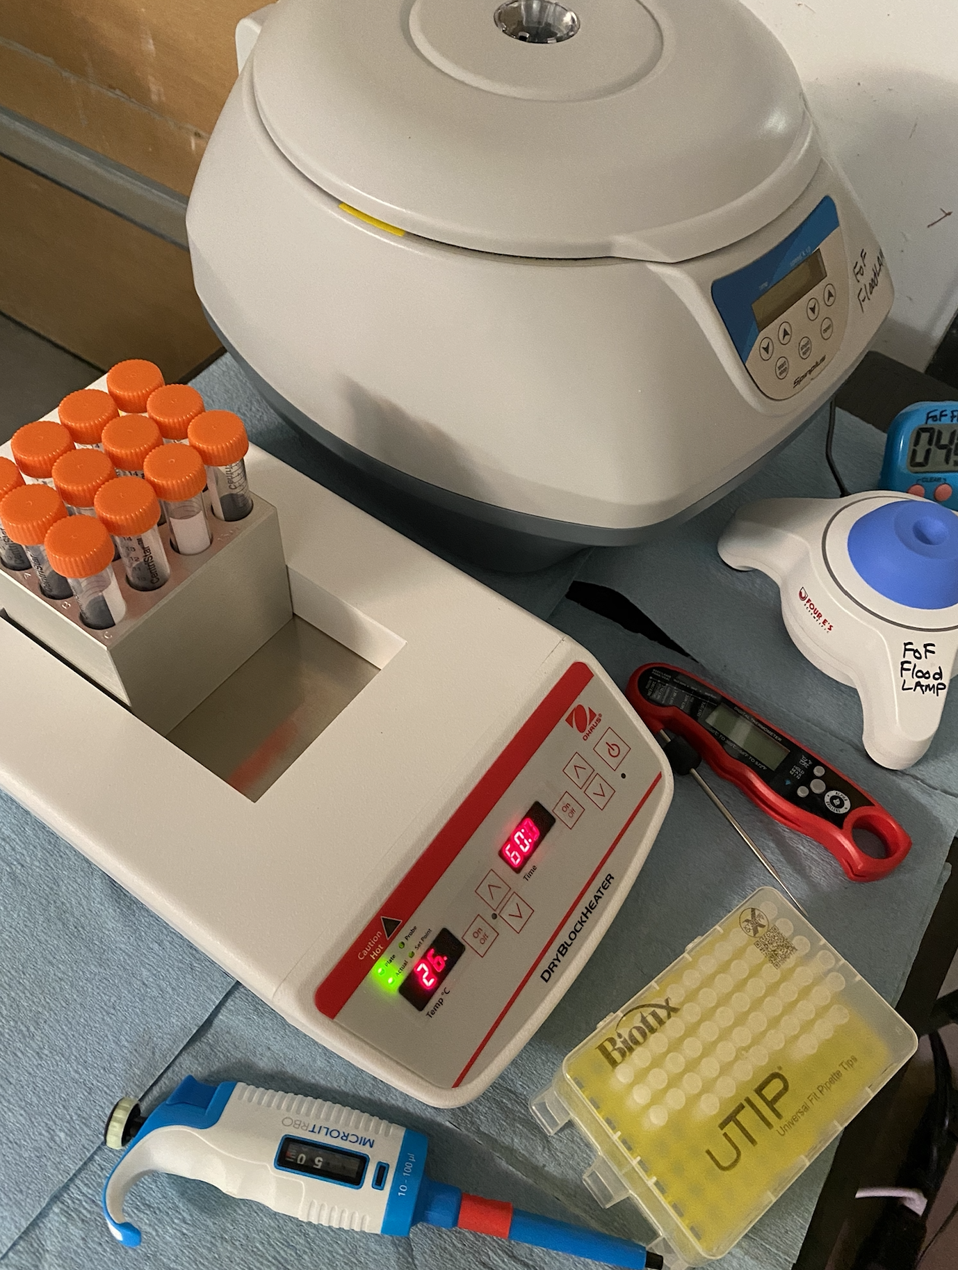
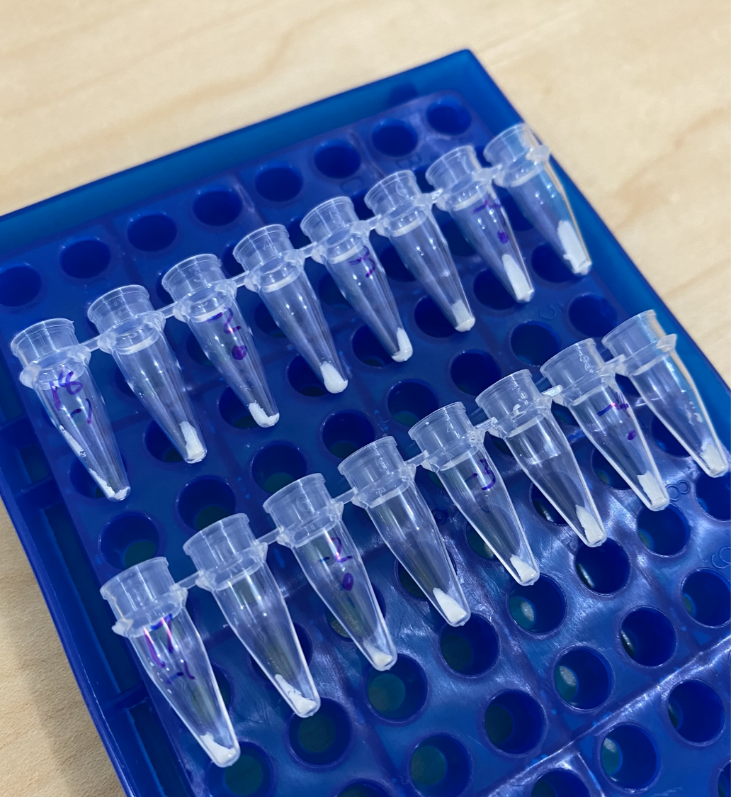
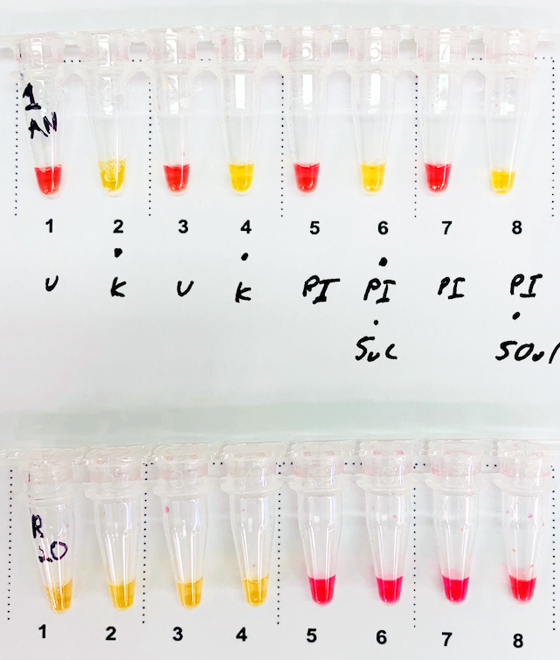
Rabe Cepko RT-LAMP Assay
Purification:
Bulk Silica
Allows larger volumes
Ultra cheap
Amplification:
Colorimetric LAMP
Isothermal
Instrument Free
Inactivation:
Chemical (TCEP) + Heat
Deployable outside a lab

Slide 5
Unique Positioning
Throughput
Scaling at our facility while also enabling many other labs to scale through openly sharing protocols and procedures
50K/day
Summer.bio
Amazon
Broad
10K/day
FloodLAMP
(non-pooled)
Color
Curative
LetsGetChecked
Medium Thruput Academic Labs: IGI, UCSF, Stanford
1-3K/day
FloodLAMP
(non-pooled)
10-200/day
Community Direct-LAMP
Upfront Lab
Setup Cost
$5-10K
$1-50M
$100-250M

Slide 6
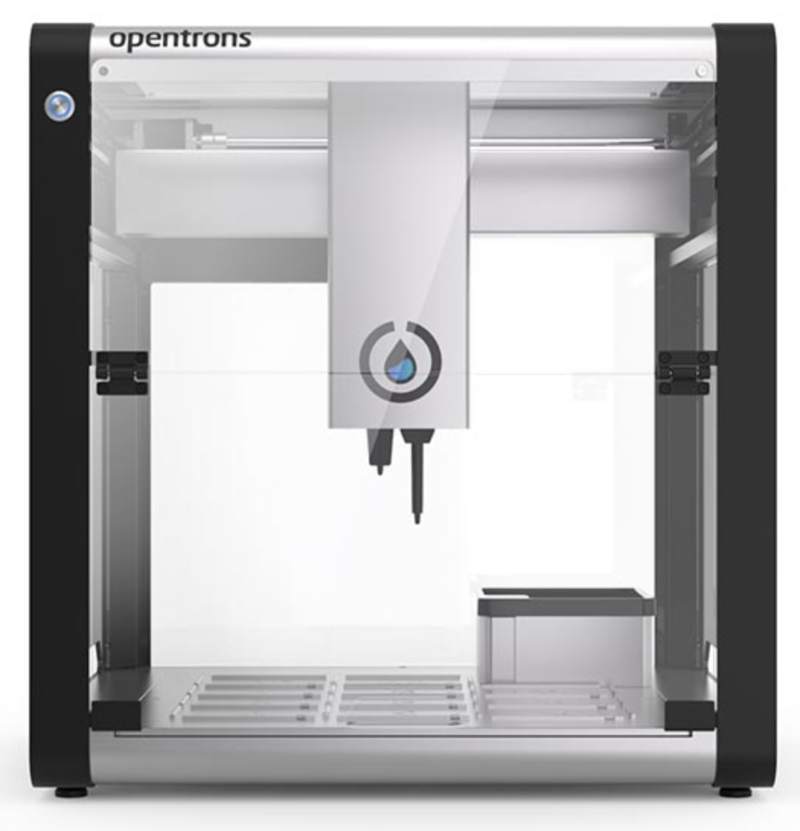

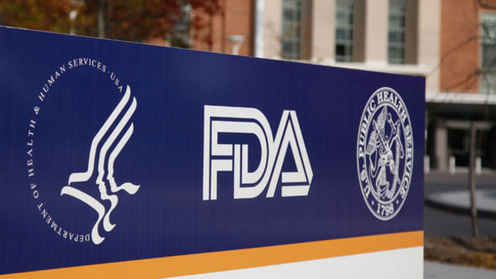
Scaling in Multiple Ways
Increase capacity at our facility with automation
2) Enable distributed
network of labs
through open
protocols
3) IVD EUA to
widely distribute
full assay kits

Slide 7
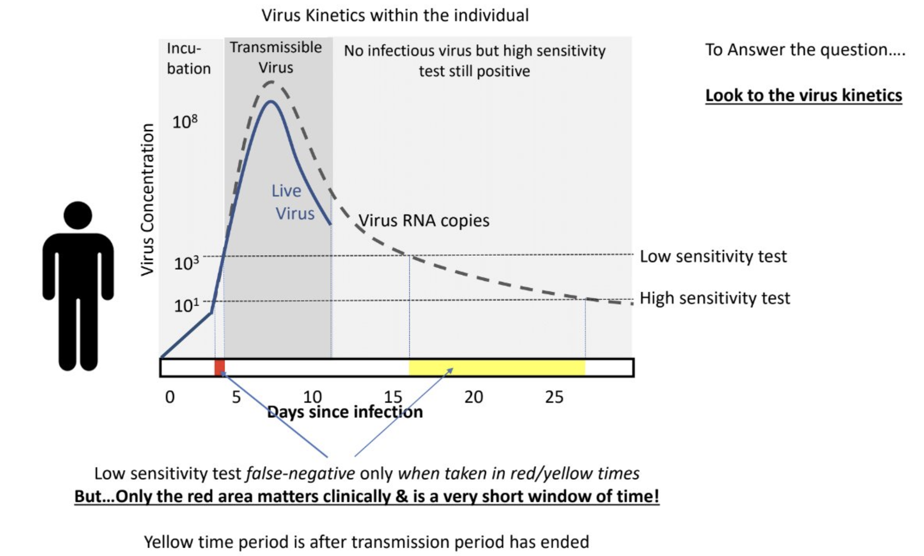
Pooling for Infectious Detection
Threshold for "Capable to Infect Others" ~ 1e6/ml
Pooling uses assay sensitivity to scale up coverage - and detect unknown infectious people in interacting populations

Slide 8
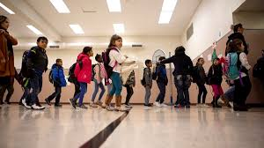
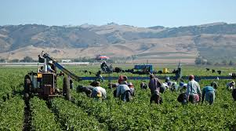
Benefitting Public Health
Our open protocol and scaling-friendly set up costs mean low overhead (training, cost, equipment) to better screen the populations that need it most.

Slide 9
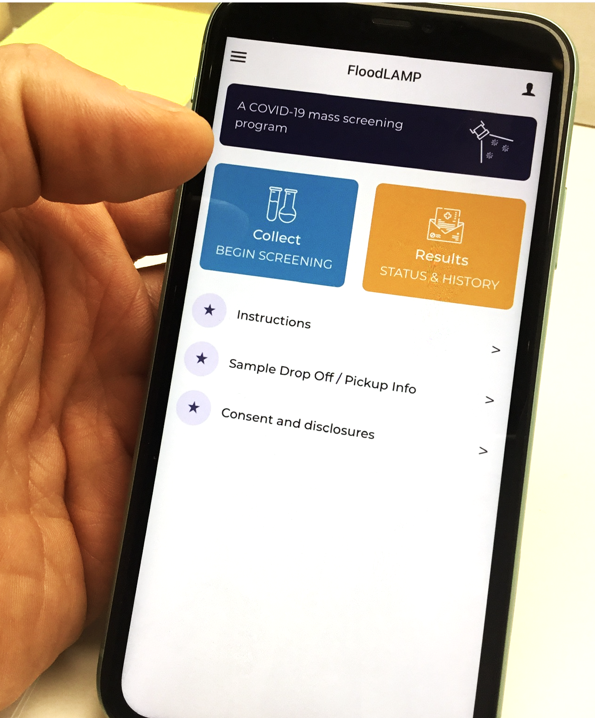
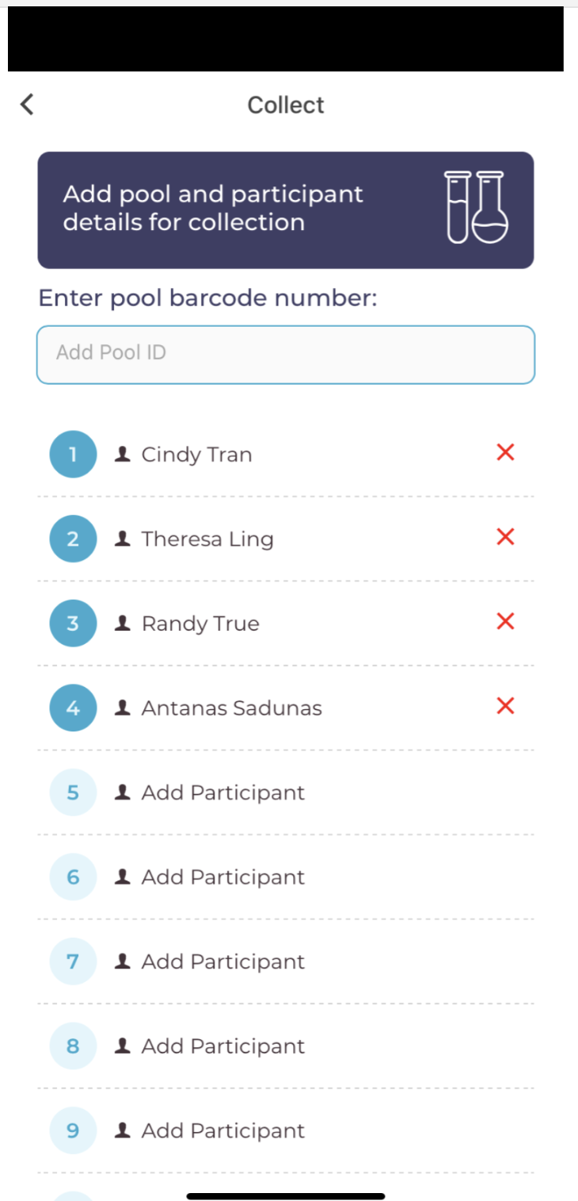
User-centered Screening
At-home collection
Pooling by household or pod
Custom software for recording samples and tracking results.
Prompts for repeat screens

Slide 10
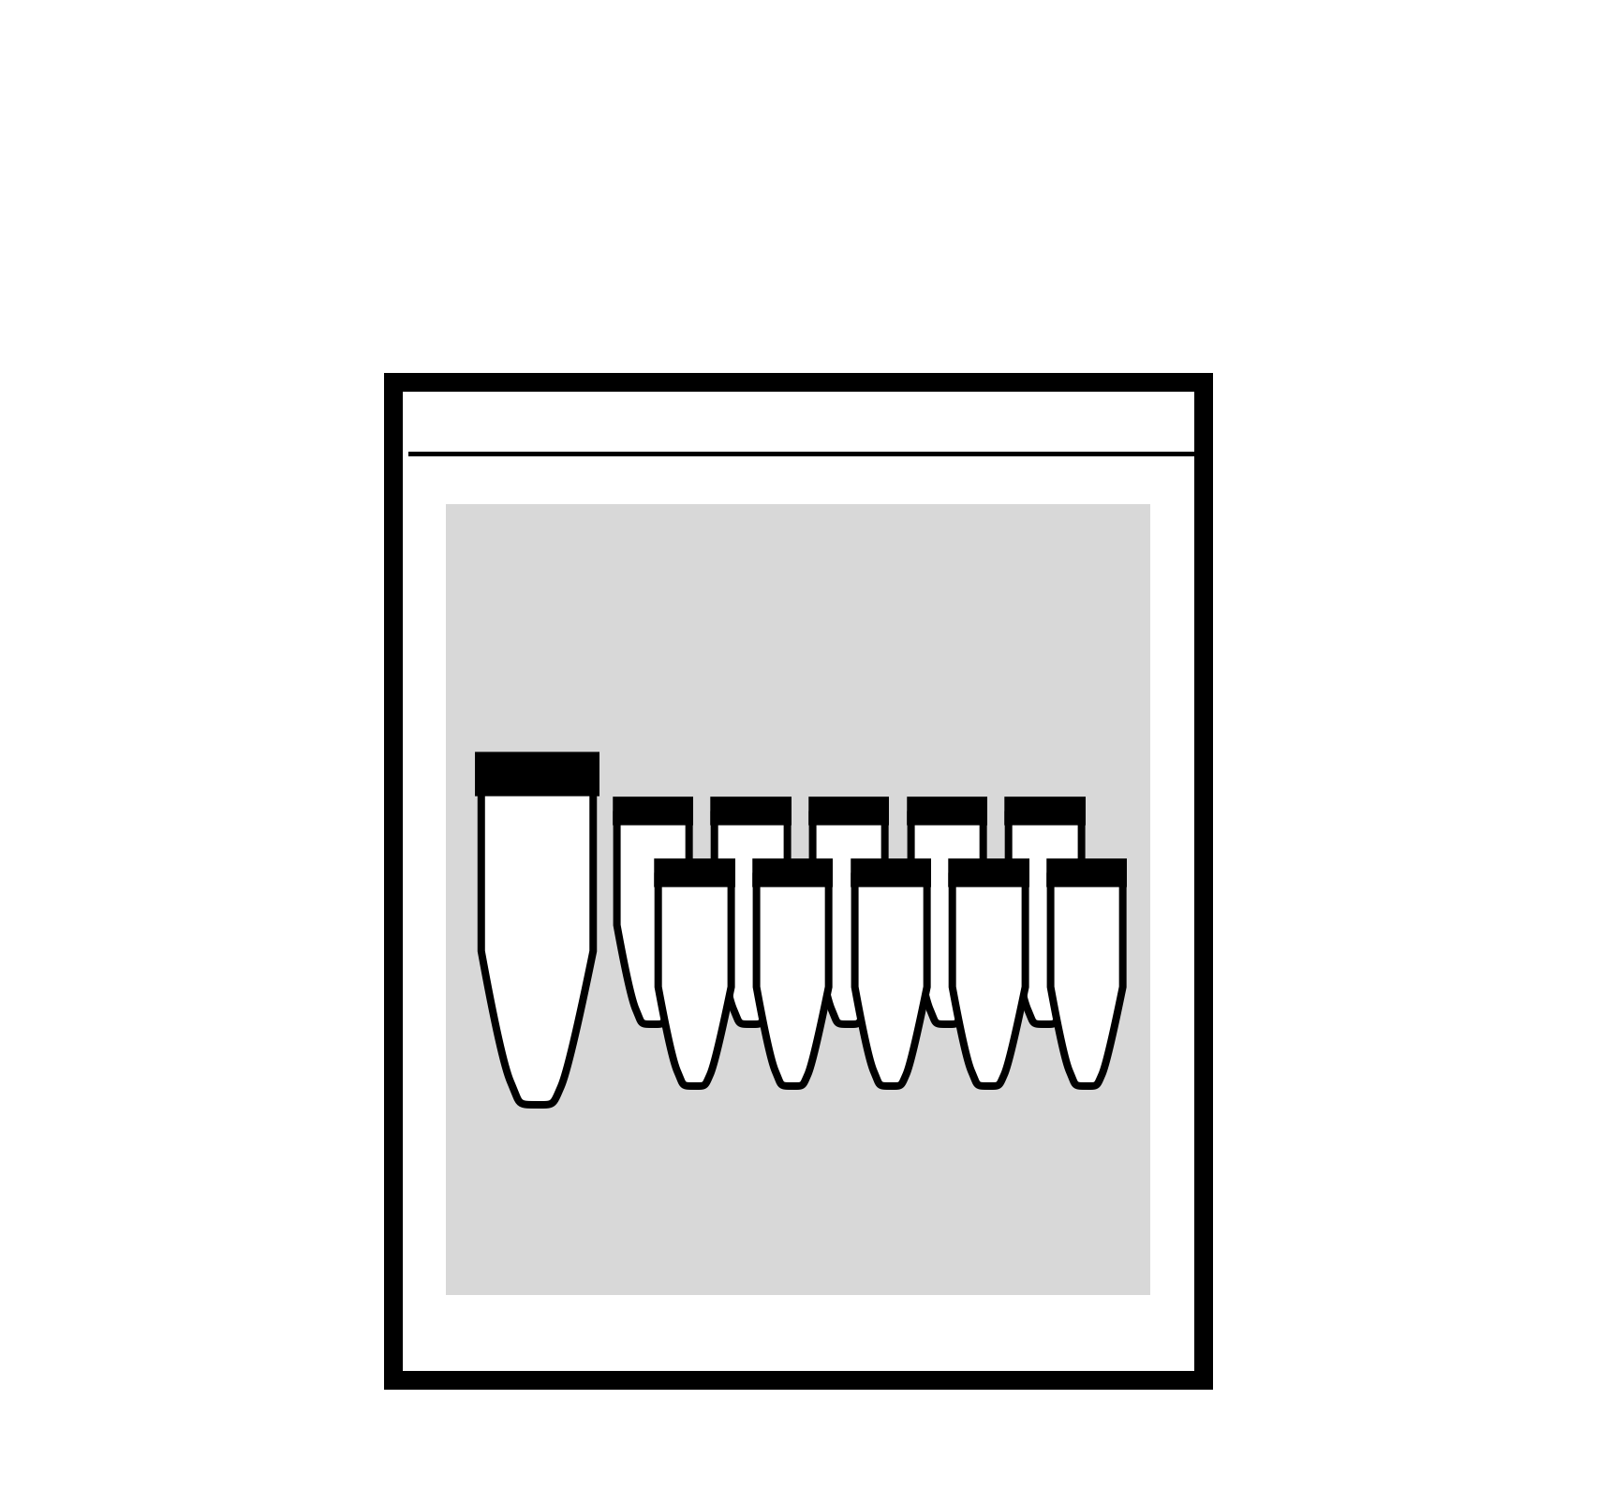


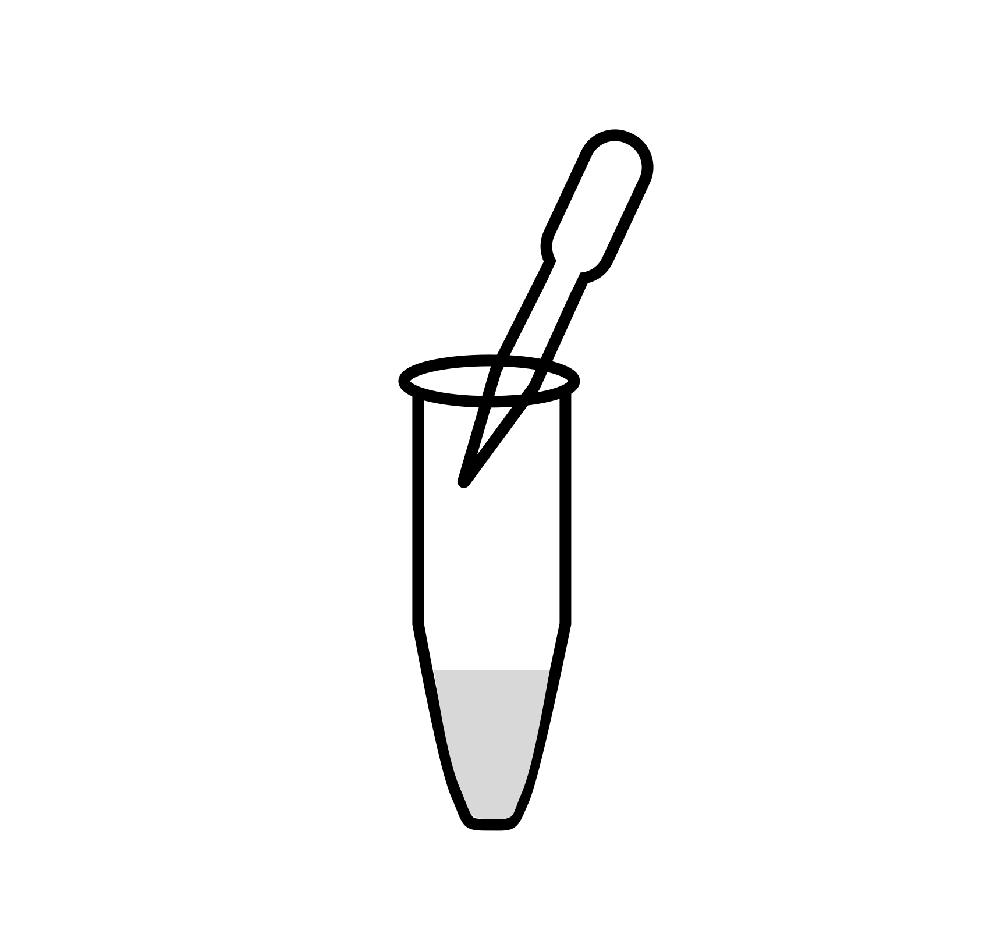
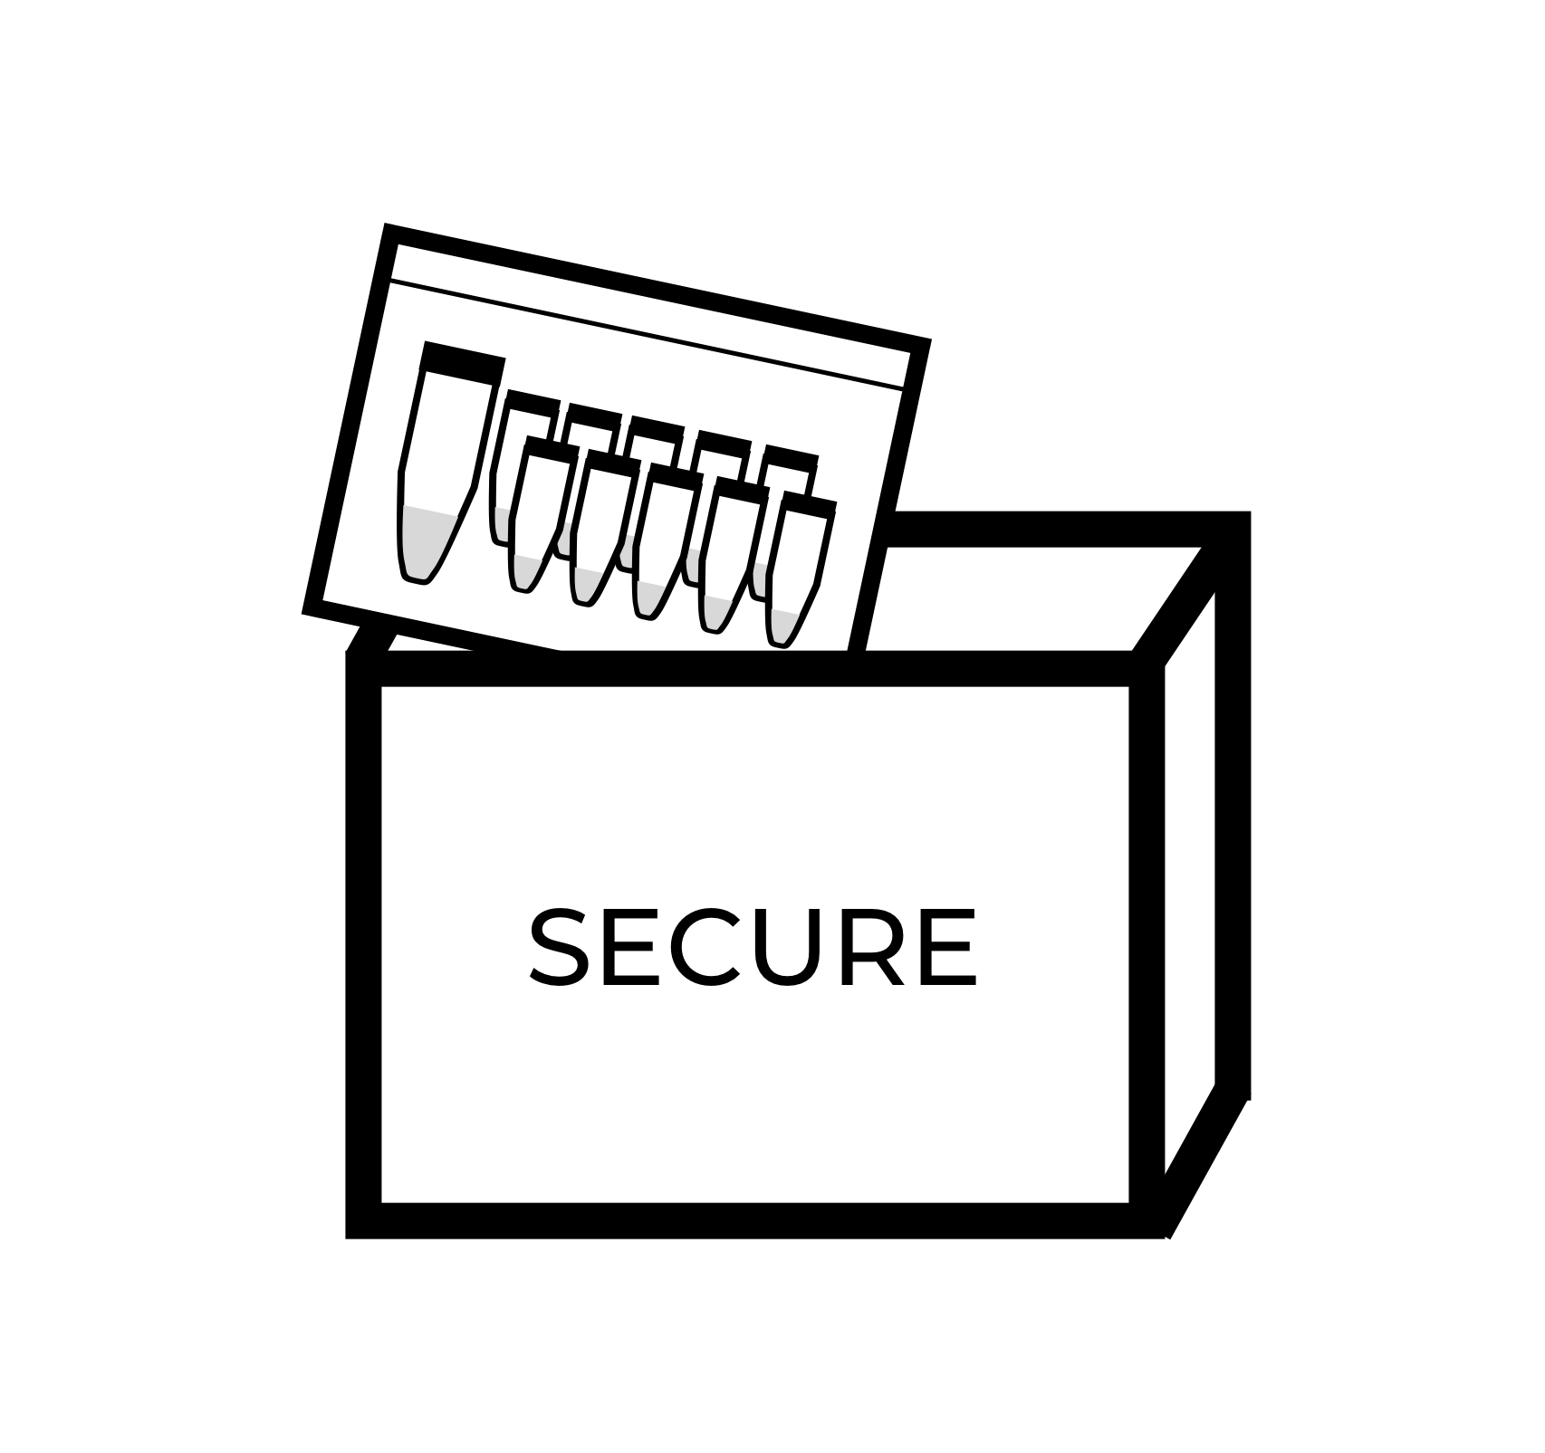
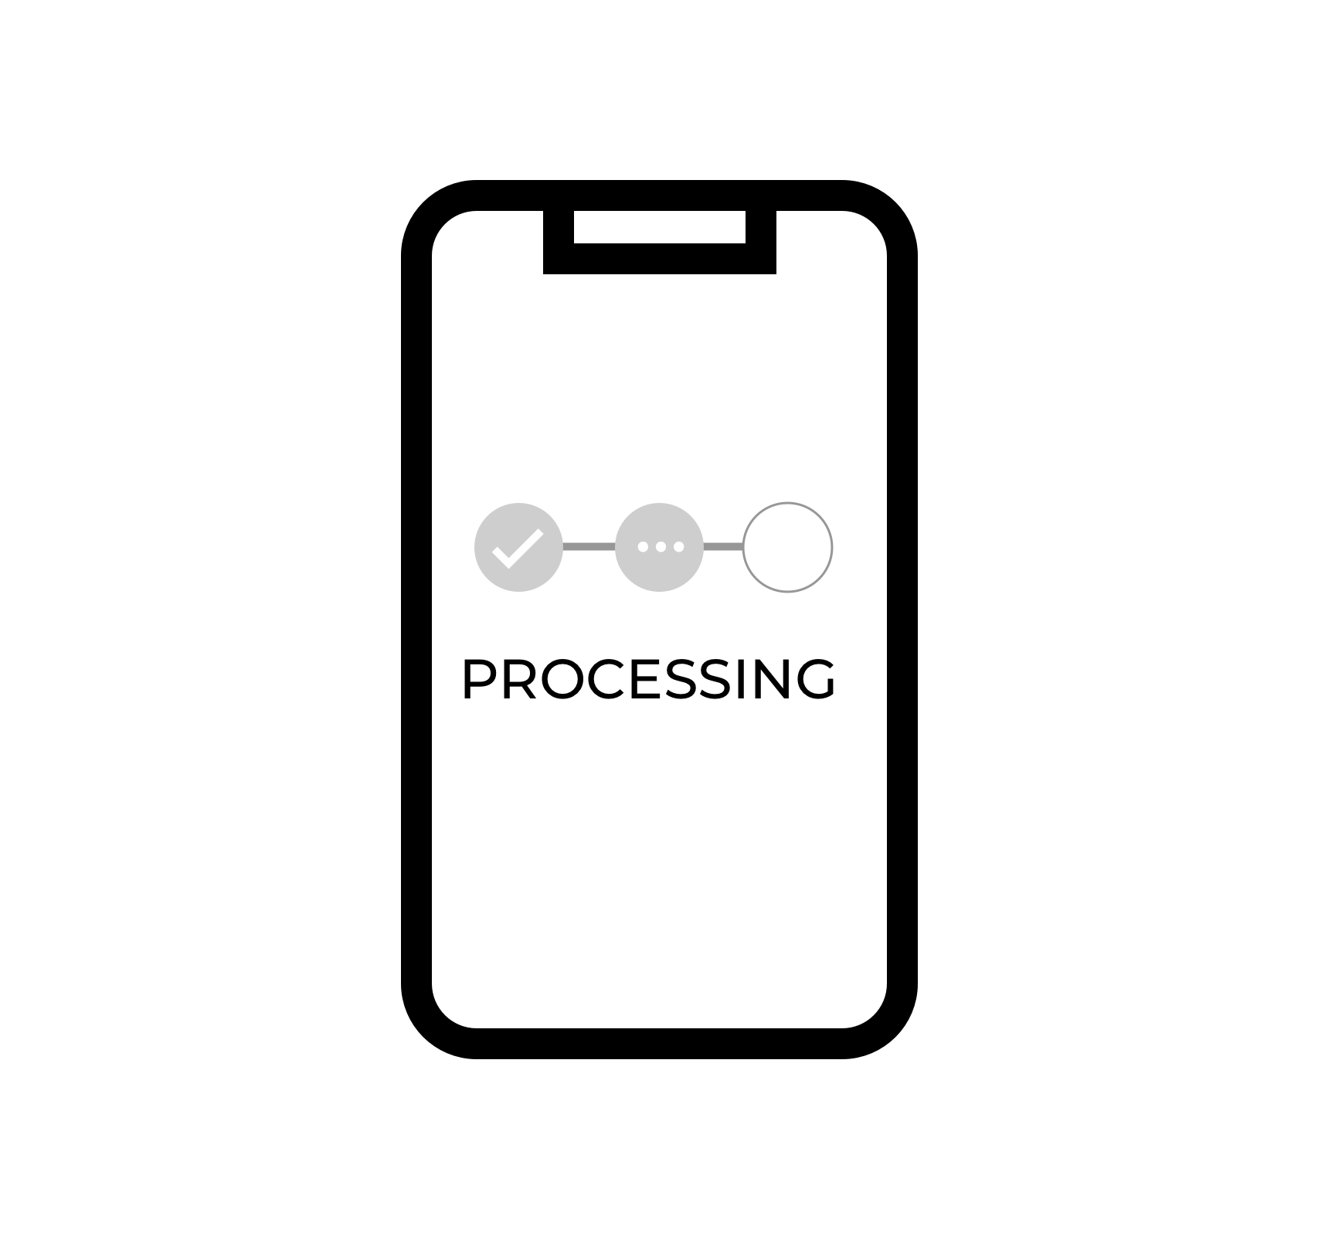
Sample Collection Workflow
1
Register
2
Get
3
Learn
• Visit app and register
• Your info added
• Your organization (if applicable)
• Receive your kit in the mail
• Review instructions
• Watch videos on collection techniques and process
• Prepare other participants if you’re a sponsor
4
Collect
5
Drop off
6
View status
• Identify who you’re collecting for in app
• Collect individual samples + record in app
• pool samples + record in app
• Drop samples in secure drop box and record in app OR
• Drop with staff member who records in system
• See state of your sample (in transit, processing, result, etc)
• See updates for next collection
• Sharing options for adoption spread

Slide 11
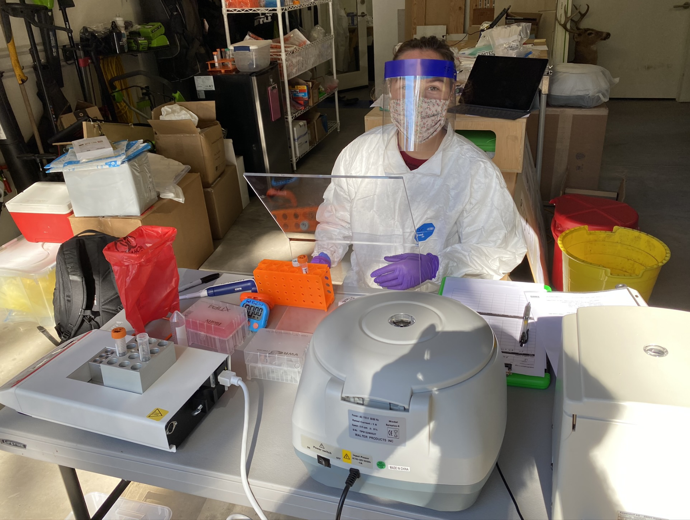
Field Inactivation Station

Slide 12
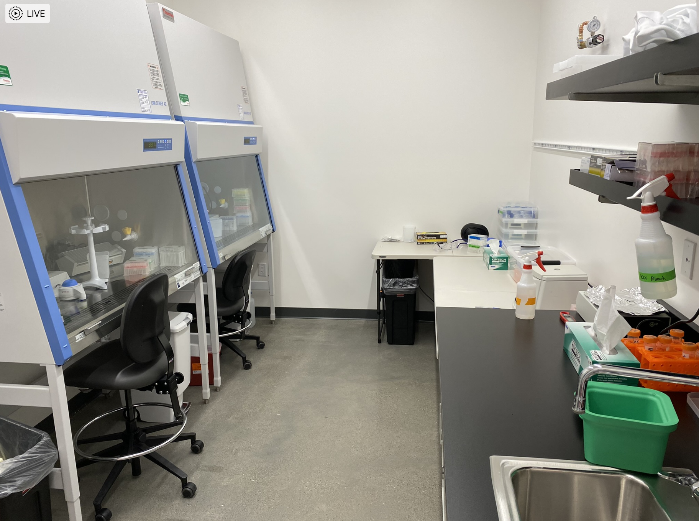
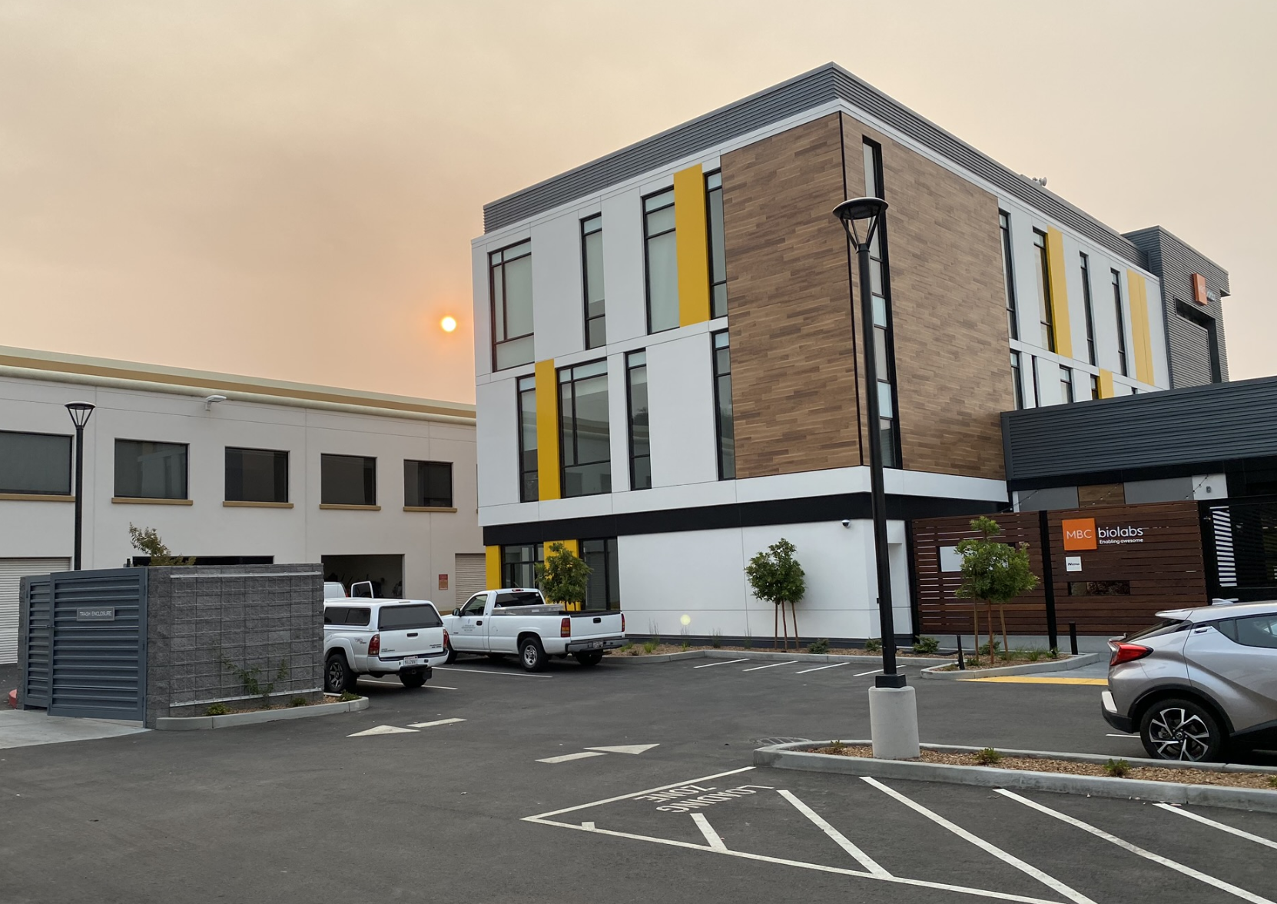
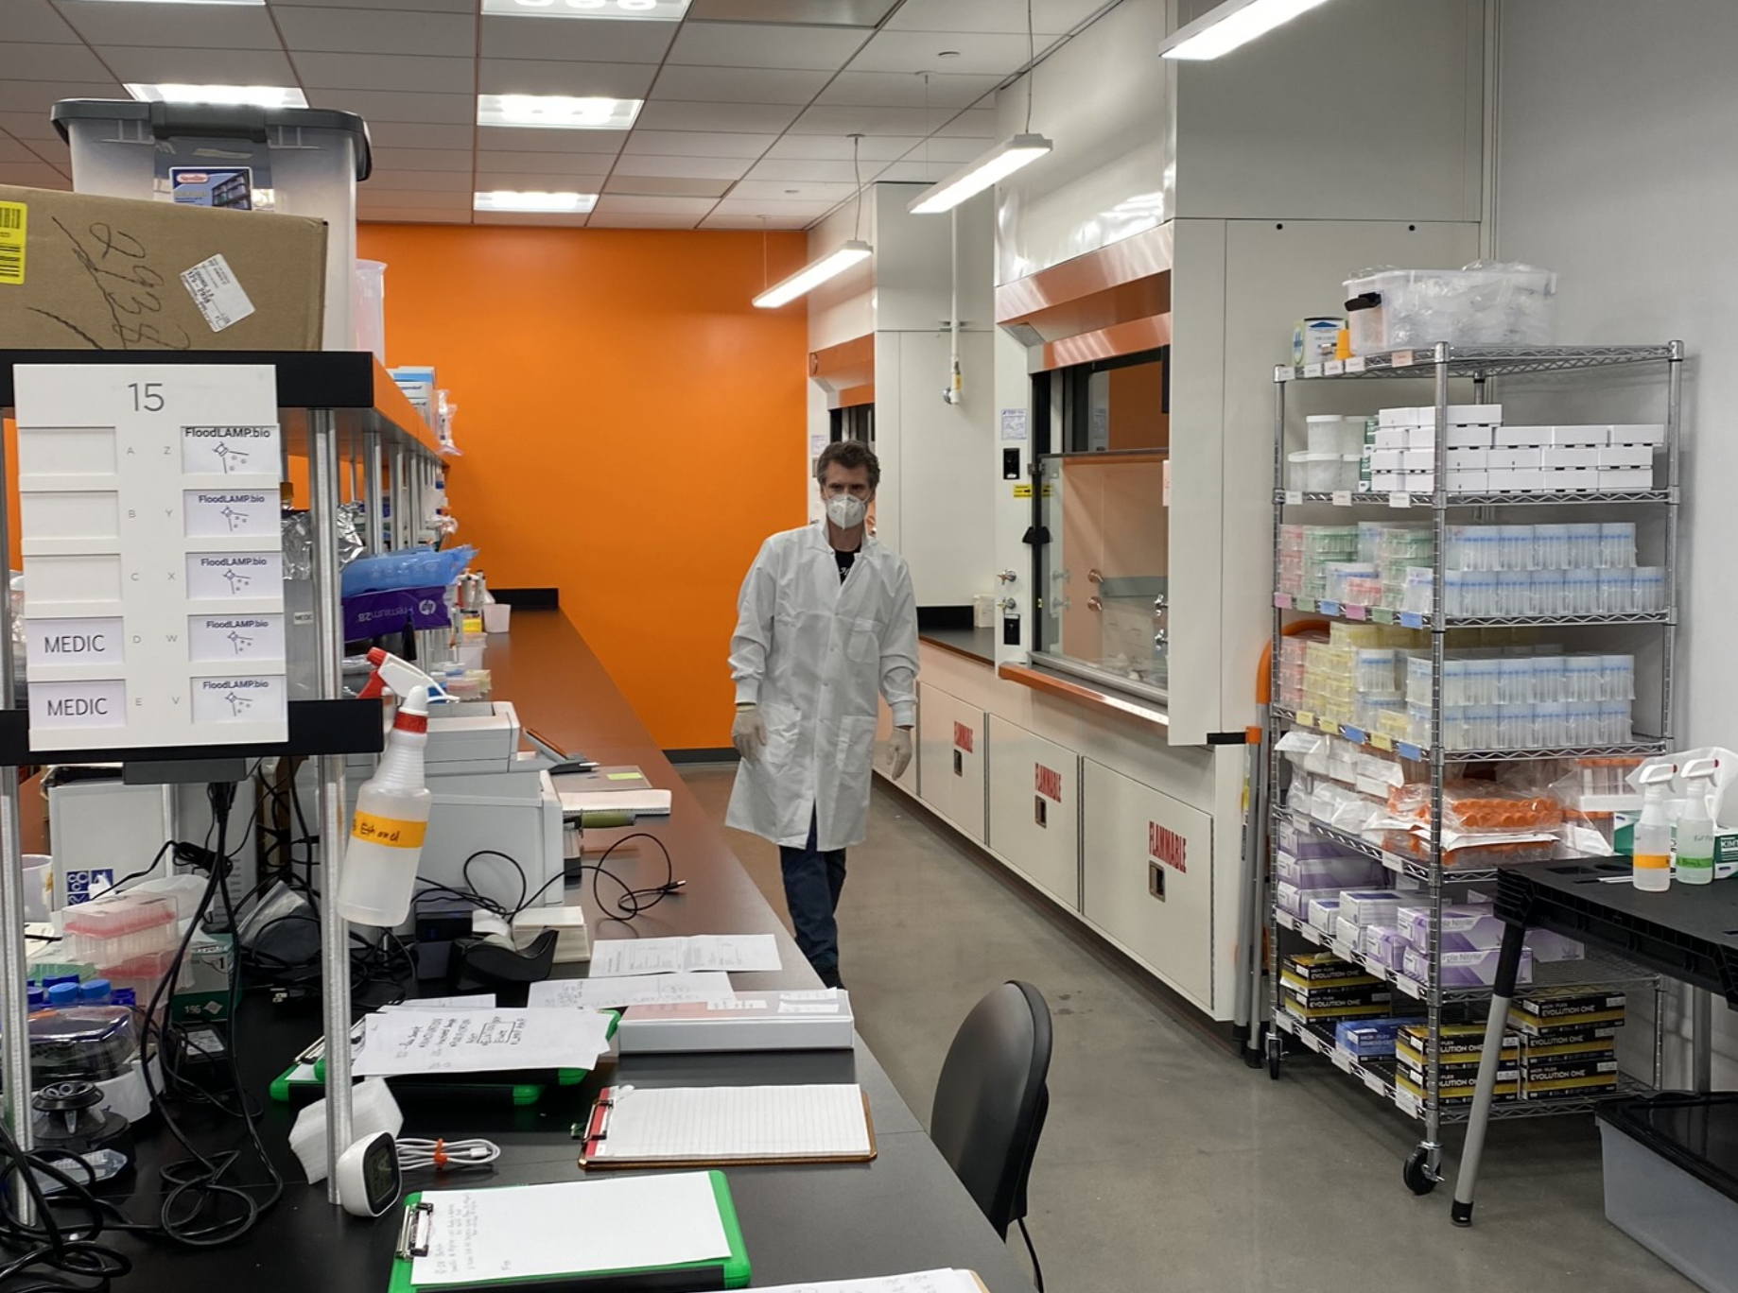
FloodLAMP Facilities at MBC Biolabs

