Slide 1



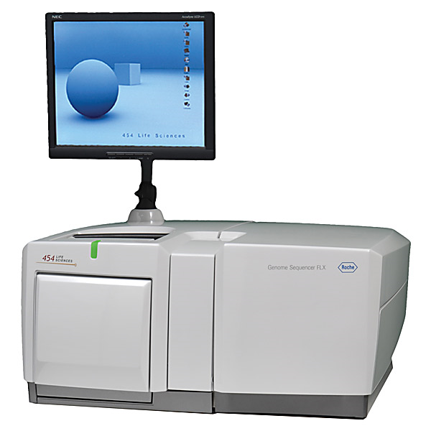
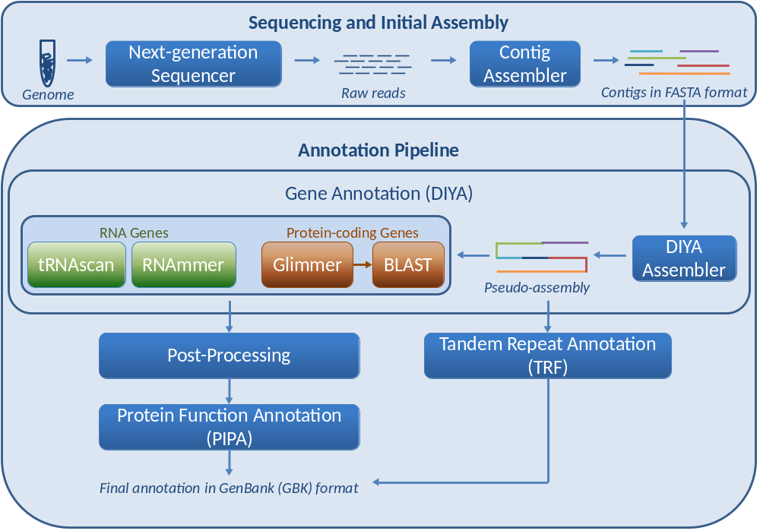
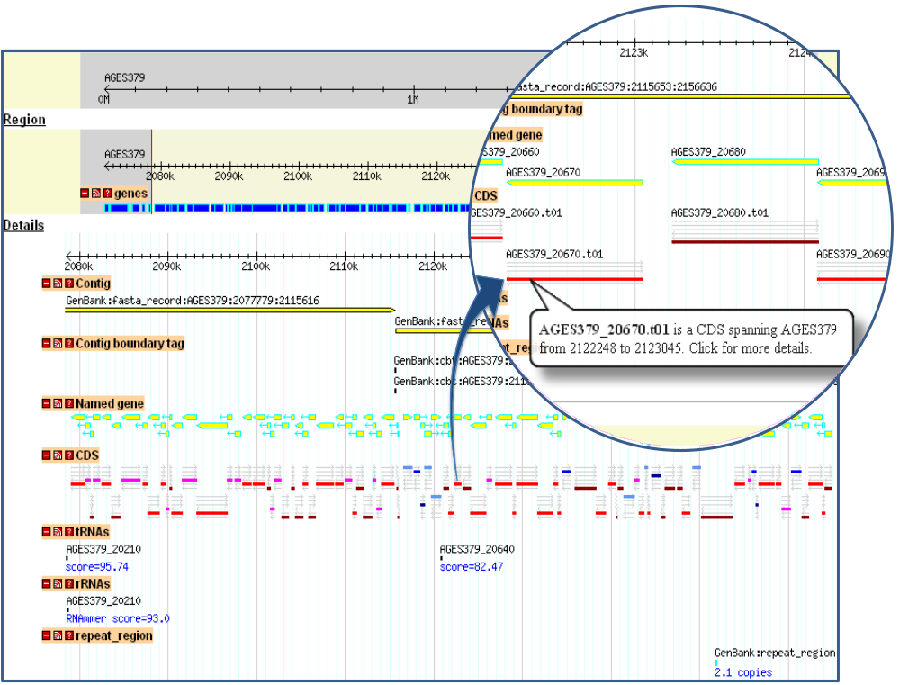
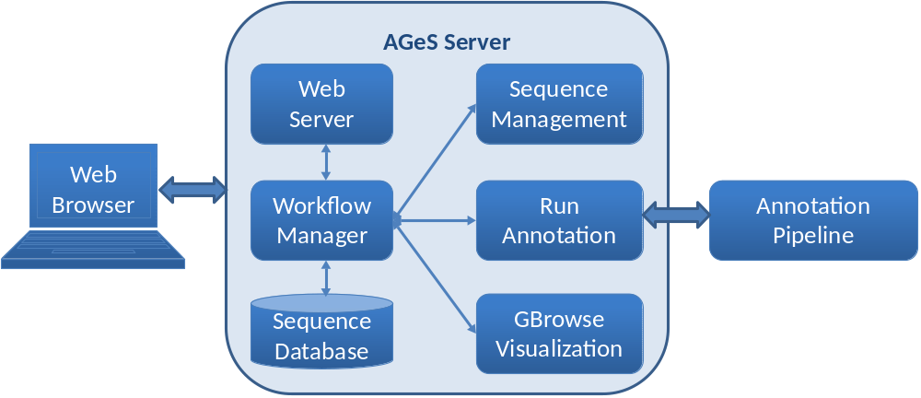
www.bhsai.org
AGeS: A Software System for Annotation and Analysis of Genome Sequences
Kamal Kumar, Valmik Desai, Li Cheng, Maxim Khitrov, Deepak Grover, Ravi Vijaya Satya, Chenggang Yu, Nela Zavaljevski, and Jaques Reifman*
DoD Biotechnology HPC Software Applications Institute, Telemedicine and Advanced Technology Research Center,
U.S. Army Medical Research and Materiel Command, Ft. Detrick, MD, USA
*jaques.reifman@us.army.mil (301) 619-7915
Problem
Salient Features
Analysis of next-generation sequencing data
Fully automated annotation of completed and draft bacterial genomes by combining the configurable annotation framework DIYA [1] with the protein function annotation pipeline PIPA [2]
Compliant with Minimum Information about a Genome Sequence [3] standard for genomic sequence information and Gene Ontology [4] for protein function annotations
Repeat identification based on Tandem Repeats Finder (TRF) [5]
User-friendly visualization based on the familiar open source genome browser GBrowse [6] with option to download annotated genomes in the GenBank format
High-throughput annotation accomplished through efficient utilization of high-performance computing
Pure culture or clinical/environmental sample
Visualization
Sequence contigs
Annotation
- gene locations
- gene/protein functions
Characterization
- drug-resistance
- pathogenicity
Next-generation sequencer
Sequence assembly
Diagnostics
- identification of pathogens
- differences with related genomes
Sequence reads
AGeS Architecture
Annotation Pipeline
Visualization
The Web server hosts the AGeS Web application. The workflow manager handles sequence management, annotation pipeline and GBrowse visualization. The sequence database stores all sequence and job-related data.
Given assembled contigs, the pipeline starts with DIYA gene annotation, followed by post-processing, tandem repeat annotation, and protein function annotation with PIPA.
The annotation of an 86.5 Kbp region of S. hominis SK119 genome, showing the locations of various features. The inset shows the zoomed-in view of a 2.2 Kbp.
Validation
Conclusions and Future Work
Genomes selected for comparison
AGeS is a fully integrated, user-friendly HPC system that:
  Provides a Web-based interface to store and retrieve sequence data
  Annotates genomic sequences
  Assigns functions to predicted protein-coding regions
  Provides a visualization of the annotation using GBrowse
  Currently compatible with bacterial genomes
Future work
  Annotation of viral genomes, clinical samples and metagenomic samples
  Addition of tools for diagnostics, characterization, and comparative genomics
Genome | Previous annotation source | Genome status | Size (No. of contigs)
Staphylococcus hominis SK119 | J. Craig Venter Institute (JCVI) | Draft | 2.2 Mbp (37 contigs)
Staphylococcus aureus subsp. aureus TCH60 | Baylor College of Medicine (BCM) | Draft | 2.8 Mbp (68 contigs)
Yersinia pestis CO92 | Sanger Institute | Complete | 4.6 Mbp
Summary of genomic features predicted by AGeS and the other three annotation methods
Detailed comparison of gene overlaps for the three genomes analyzed
 | S. hominis SK119 |  | S. aureus subsp. aureus TCH60 |  | Y. pestis CO92
Annotation Feature | AGeS | JCVI | AGeS | BCM | AGeS | Sanger
Genes | 2229 | 2244 | 2652 | 2805 | 4336 | 4103
CDS | 2172 | 2182 | 2591 | 2738 | 4249 | 3885
rRNA | 4 | 4 | 4 | 4 | 19 | 19
tRNA | 53 | 52 | 57 | 57 | 68 | 70
Tandem Repeats | 60 | NA* | 123 | NA* | 780 | NA*
 | S. hominis SK119 | S. aureus subsp. aureus TCH60 | Y. pestis CO92
Category | No. of genes (percentage) | No. of genes (percentage) | No. of genes (percentage)
Identical start and end | 1753 (78.7%) | 2037 (76.8%) | 2639 (60.9%)
Identical start only | 252 (11.3%) | 286 (10.8%) | 634 (14.6%)
Identical end only | 210 (9.4%) | 283 (10.7%) | 655 (15.1%)
Overlap | 10 (0.4%) | 20 (0.7%) | 201 (4.6%)
Unique to AGeS | 4 (0.2%) | 26 (1.0%) | 207 (4.8%)
Acknowledgments
This work was partially sponsored by the U.S. Department of Defense High Performance Computing Modernization Program office, under the High Performance Computing Software Applications Institutes Initiative.
Disclaimer
The opinions and assertions contained herein are the private views of the authors and are not to be construed as official or as reflecting the views of the U.S. Army or the U.S. Department of Defense. This poster has been approved for public release with unlimited distribution.
References
1. Stewart AC et al., Bioinformatics, 2009, 25:7.
2. Yu C et al., BMC Bioinformatics, 2008, 9:52.
3. Field D et al., Nat Biotechnol, 2008, 26:5
4. Ashburner M et al., Nat Genet, 2000, 25:1.
5. Benson G, Nucleic Acids Res, 1999, 27:2.
6. Donlin MJ, Curr Protoc Bioinformatics, 2009 9:9.
*Annotation was not available for this feature from the source
AGeS did not annotate 1% of S. hominis SK119 genes annotated by JCVI, 5.8% of S. aureus subsp. aureus TCH60 genes annotated by BCM, and 5.6% of Y. pestis CO92 genes annotated by the Sanger Institute.

