Slide 1


Network and pathway information for systems biology
Gary Bader
Oct.12.2011 – GMOD, Toronto

Slide 2
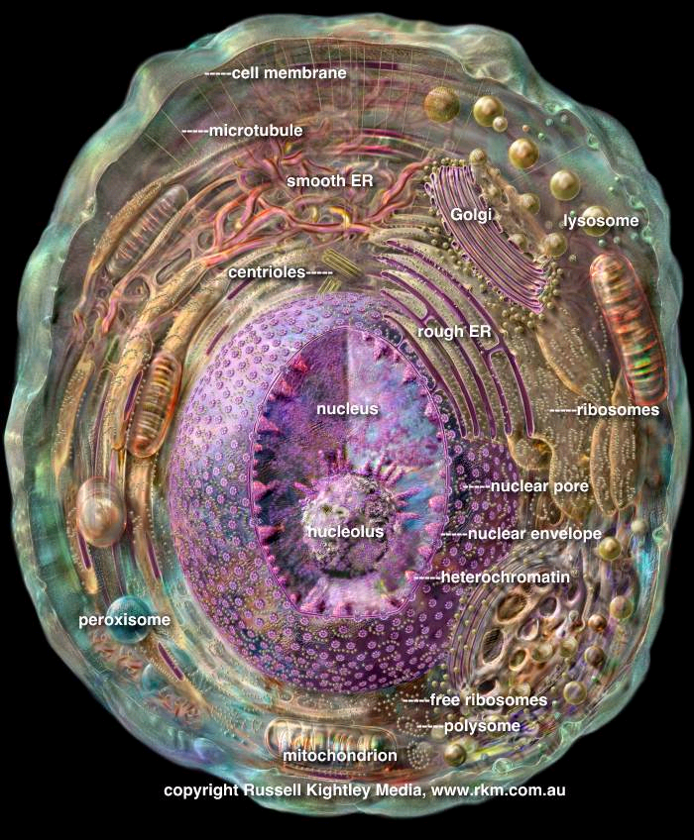
Computational Cell Map
Read map to understand
Cell processes
Gene function
Disease effects
Map evolution
Map the cell
Predict map from genome
Multiple perturbation mapping
Active cell map
Map visualization and analysis software
Cary MP et al. Pathway information… FEBS Lett. 2005
Bader GD et al. Functional genomics and proteomicsTrends Cell Biol. 2003

Slide 3
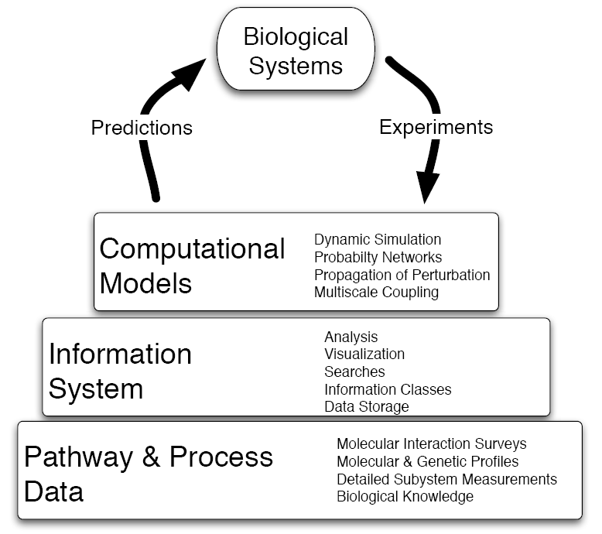
The Systems
Biology Pyramid
Cary, Bader, Sander, FEBS
Letters 579 (2005) 1815-20
Chris Sander, MSKCC

Slide 4
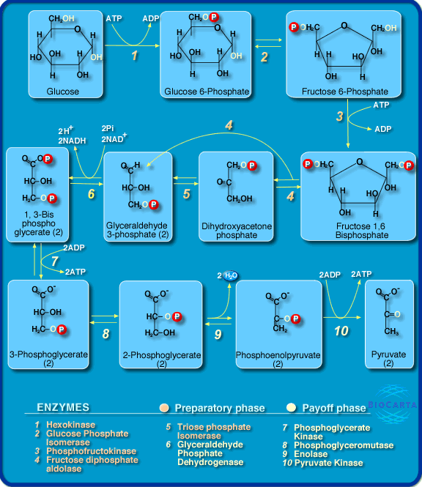

Slide 5
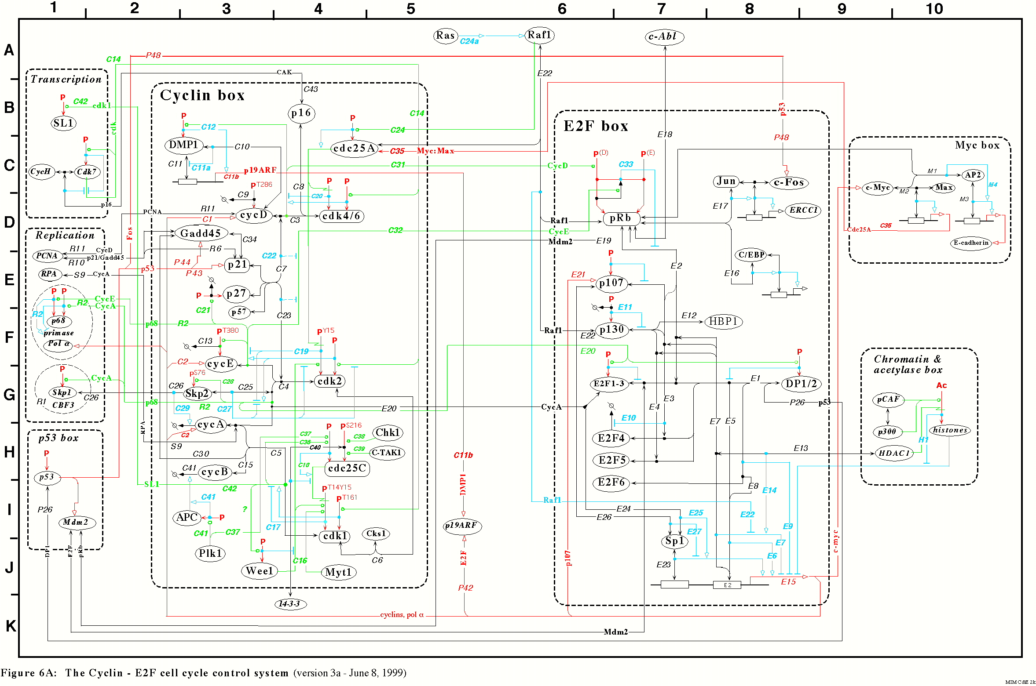
Signaling Pathway
http://discover.nci.nih.gov/kohnk/interaction_maps.html

Slide 6
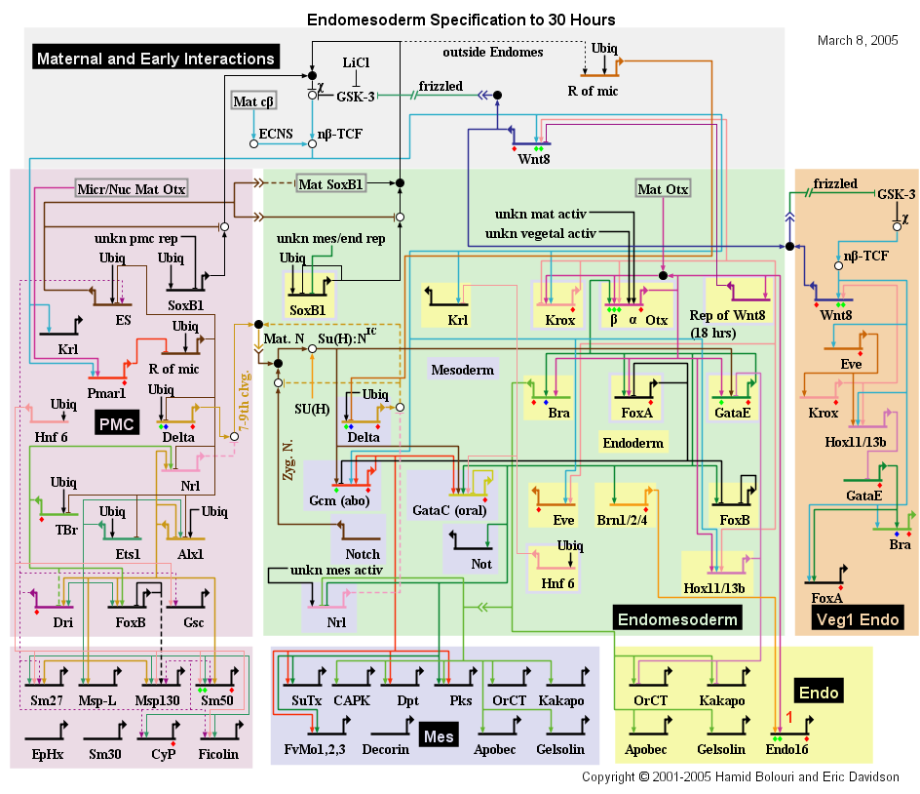

Slide 7
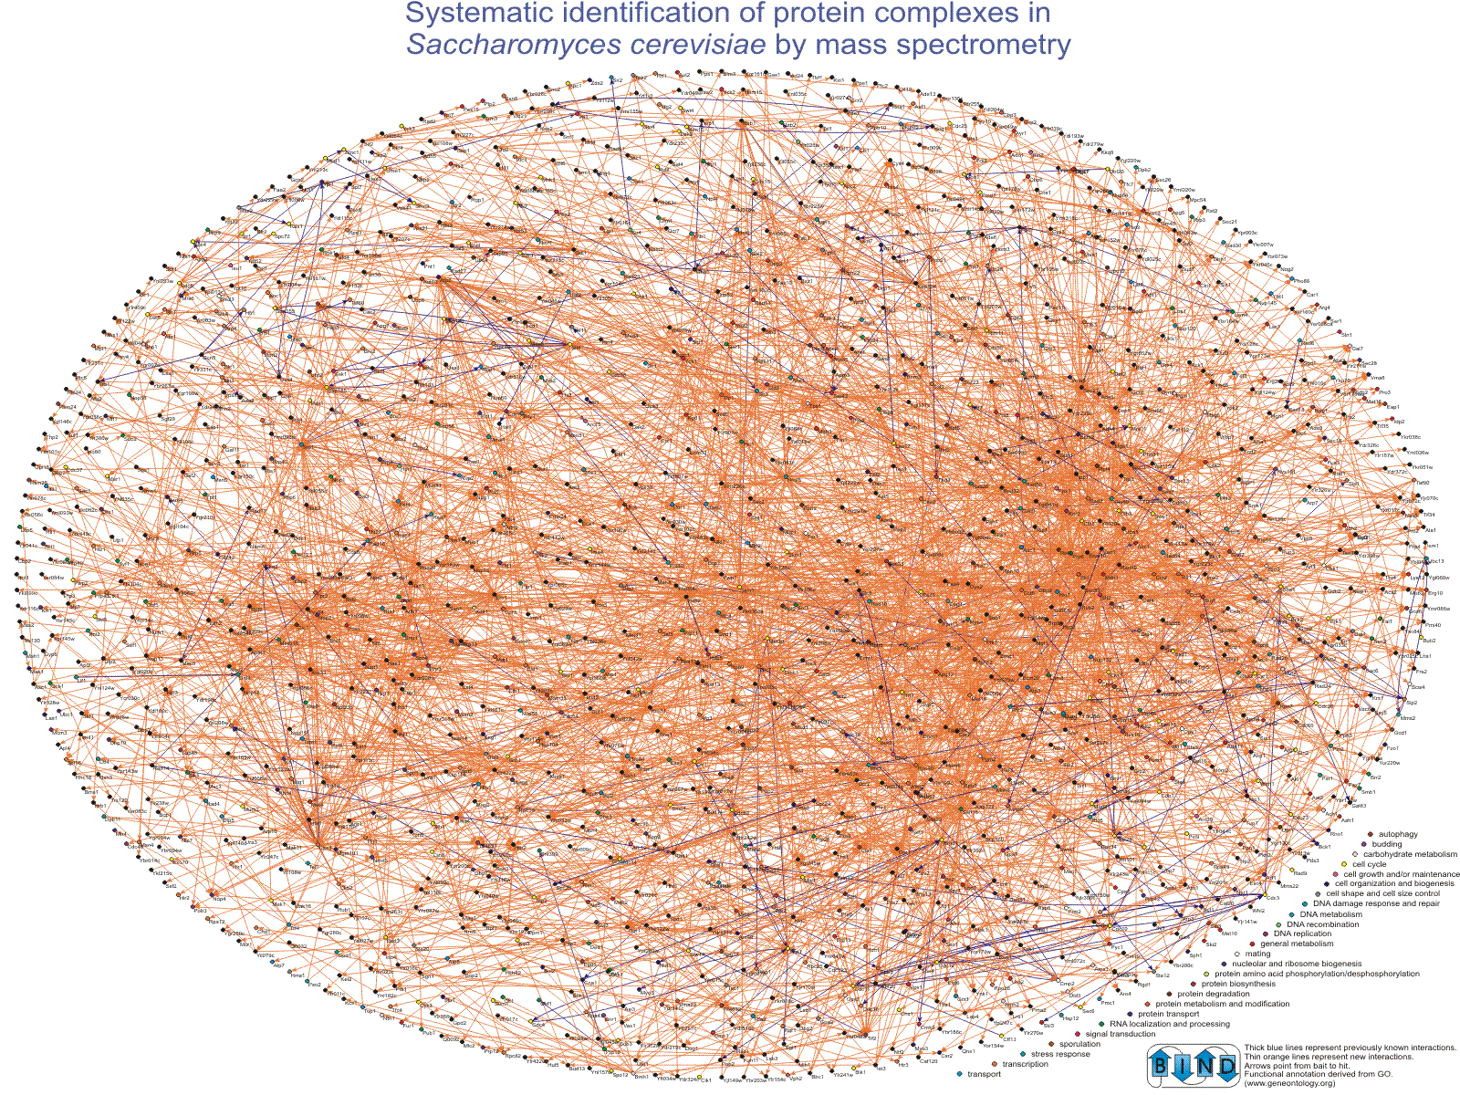
Ho et al. Nature
415(6868) 2002

Slide 8
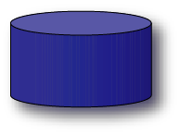

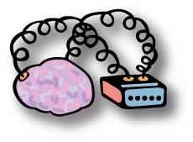
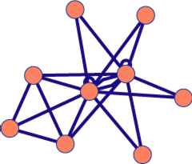
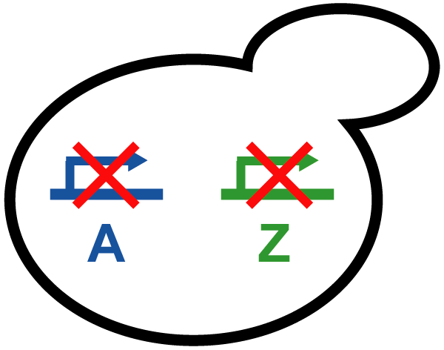
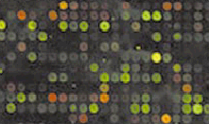
Pathway Information
Databases
  Fully electronic
  Easily computer readable
Literature
  Increasingly electronic
  Human readable
Biologist’s brains
  Richest data source
  Limited bandwidth access
Experiments
  Basis for models

Slide 9
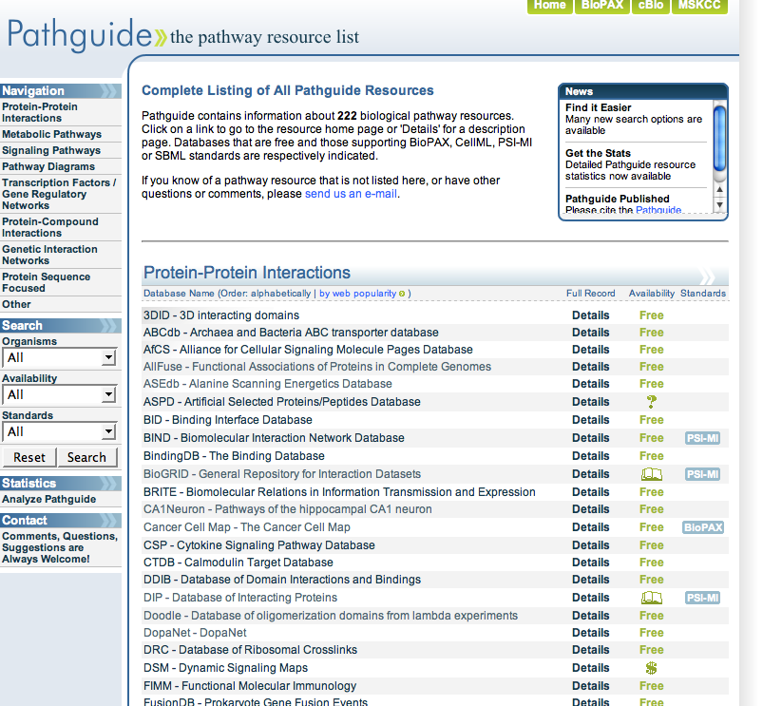
>320 Pathway
Databases!
http://pathguide.org
Varied formats, representation, coverage
Pathway data extremely difficult to combine and use
Vuk Pavlovic
Sylva Donaldson

Slide 10
Biological Pathway Exchange (BioPAX)
Software
Database
User
Before BioPAX
After BioPAX
Unifying language
>100 DBs and tools
Tower of Babel
Reduces work, promotes collaboration, increases accessibility

Slide 11
BioPAX Pathway Language
Represent:
  Metabolic pathways
  Signaling pathways
  Protein-protein, molecular interactions
  Gene regulatory pathways
  Genetic interactions
Community effort: pathway databases distribute pathway information in standard format
www.biopax.org

Slide 12

BioPAX Supporting Groups
Many Participants
Memorial Sloan-Kettering Cancer Center: E.Demir, M. Cary, C. Sander
University of Toronto: G. Bader
SRI Bioinformatics Research Group: P. Karp, S. Paley, J. Pick
Bilkent University: U. Dogrusoz
Université Libre de Bruxelles: C. Lemer
CBRC Japan: K. Fukuda
Dana Farber Cancer Institute: J. Zucker
Millennium: J. Rees, A. Ruttenberg
Cold Spring Harbor/EBI: G. Wu, M. Gillespie, P. D'Eustachio, I. Vastrik, L. Stein
BioPathways Consortium: J. Luciano, E. Neumann, A. Regev, V. Schachter
Argonne National Laboratory: N. Maltsev, E. Marland, M.Syed
CST: Peter Hornbeck, David Merberg (Vertex)
AstraZeneca: E. Pichler
BIOBASE: E. Wingender, F. Schacherer
NCI: M. Aladjem, C. Schaefer
Università di Milano Bicocca, Pasteur, Rennes: A. Splendiani
Vassar College: K. Dahlquist
Columbia: A. Rzhetsky
Collaborating Organizations
Proteomics Standards Initiative (PSI)
Systems Biology Markup Language (SBML)
CellML
Chemical Markup Language (CML)
Databases
BioCyc, WIT, KEGG, PharmGKB, aMAZE, INOH, Transpath, Reactome, PATIKA, eMIM, NCI PID, CellMap, NetPath
Wouldn’t be possible without
Gene Ontology
Protégé, U.Manchester, Stanford
Grants/Support
Department of Energy (Workshop)
caBIG
Notes:
Many other people have contributed in discussions in person and on the mailing list and we would like to thank them as well.

Slide 13
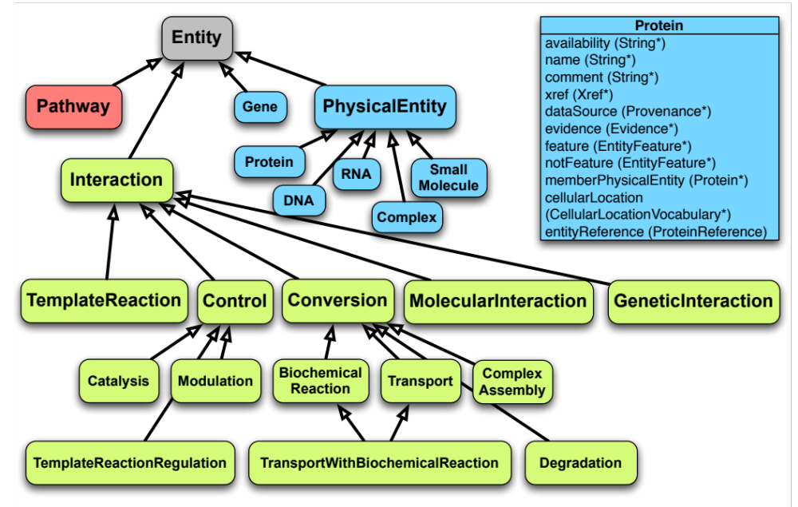

Slide 14
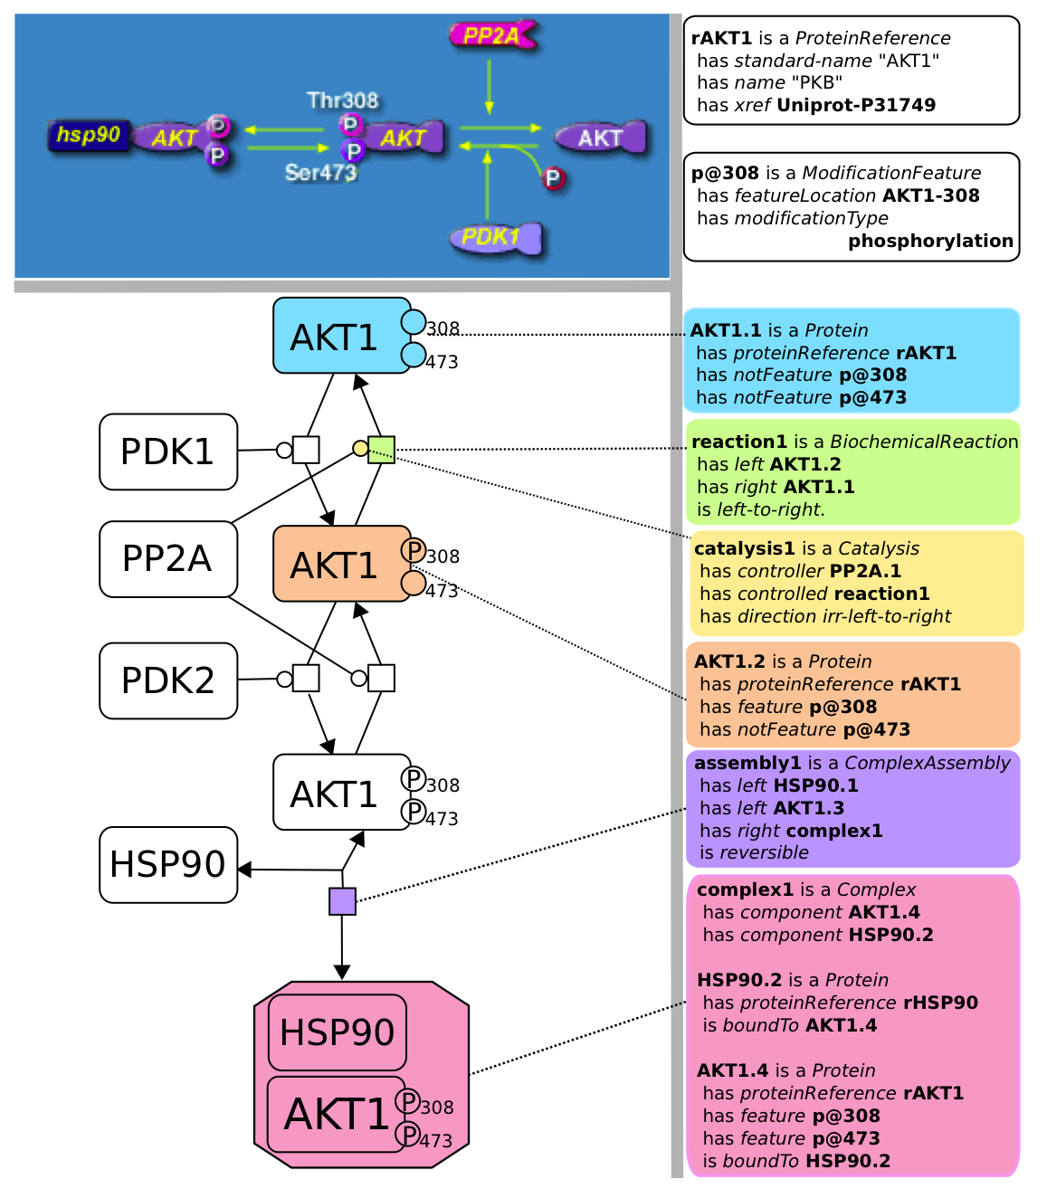
BioCarta
SBGN.org
BioPAX
Emek Demir

Slide 15
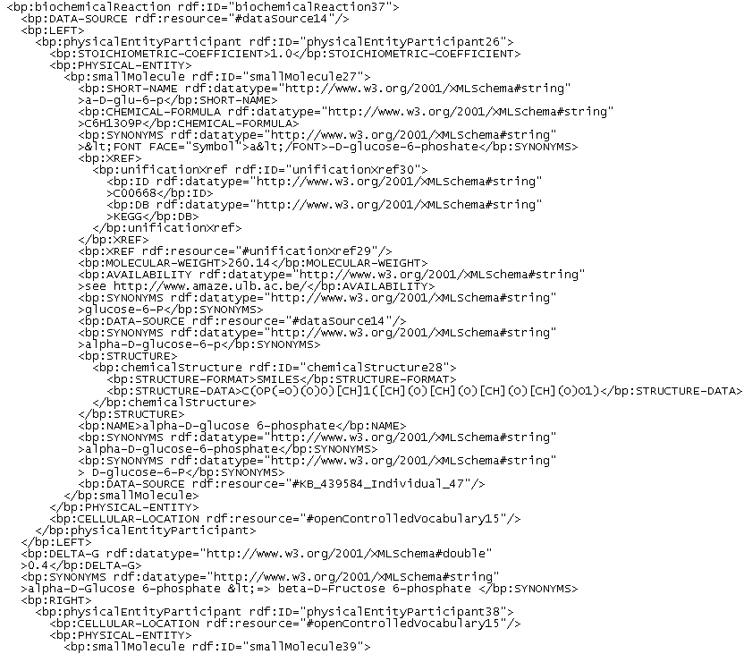
XML Snippet (OWL)

Slide 16
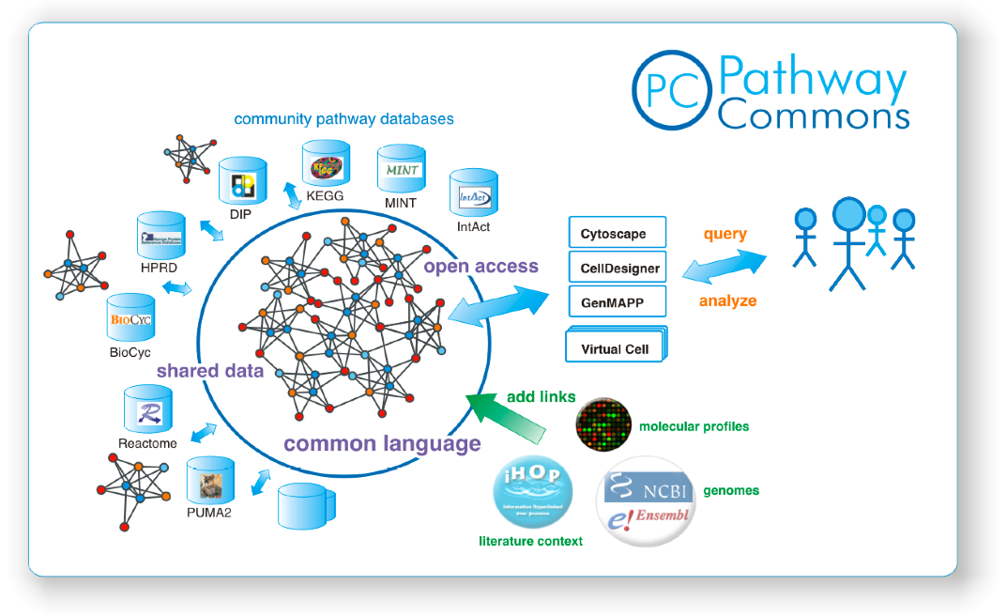
Aim: Convenient Access to Pathway Information
http://www.pathwaycommons.org
Facilitate creation and communication of pathway data
Aggregate pathway data in the public domain
Provide easy access for pathway analysis
Long term: Converge
to integrated cell map

Slide 17
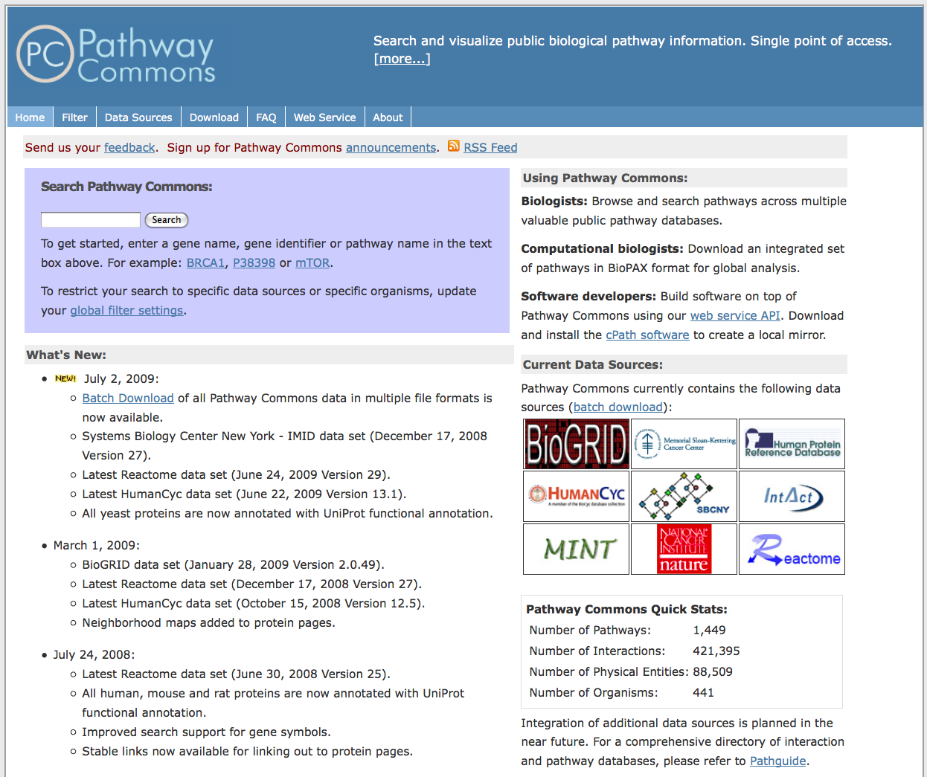
http://pathwaycommons.org

Slide 18
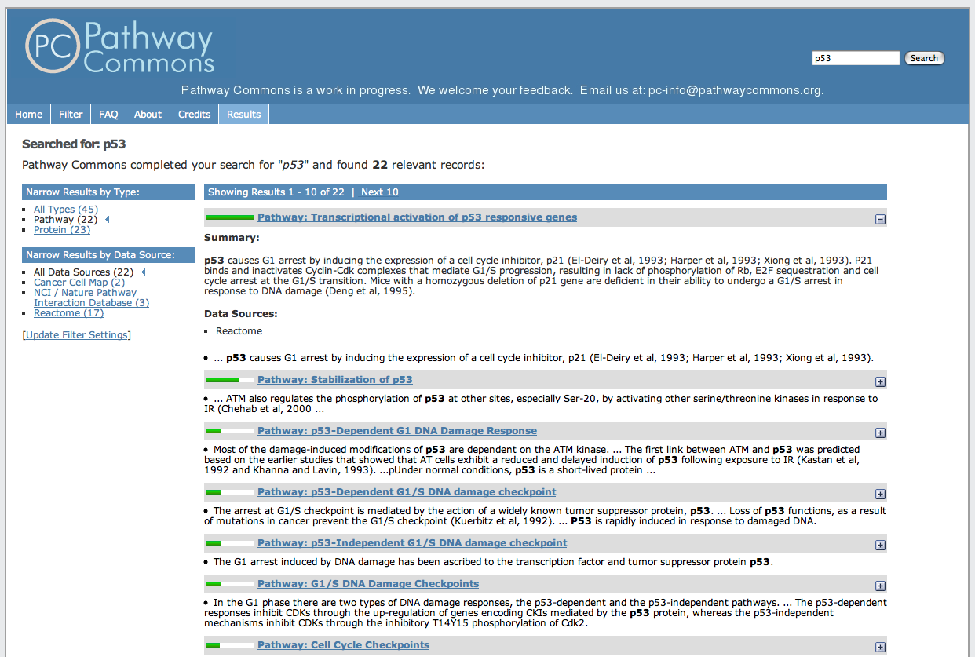
http://pathwaycommons.org

Slide 19
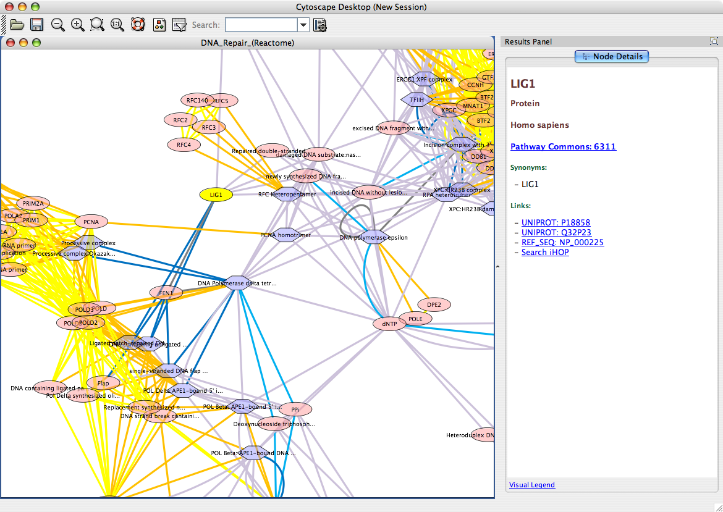
Access From Cytoscape

Slide 20
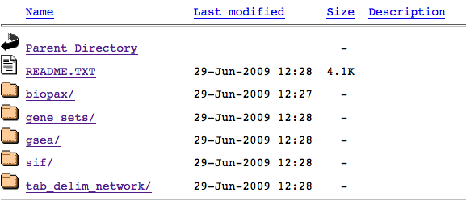
Download Service
http://www.pathwaycommons.org/pc-snapshot/

Slide 21
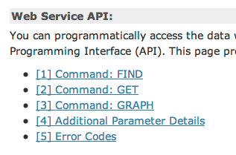
Pathway Commons: cPath²
http://www.pathwaycommons.org/pc2-demo/
Nadia Anwar, Ethan Cerami, Emek Demir, Ben Gross, Igor Rodchenkov
Chris Sander

Slide 22
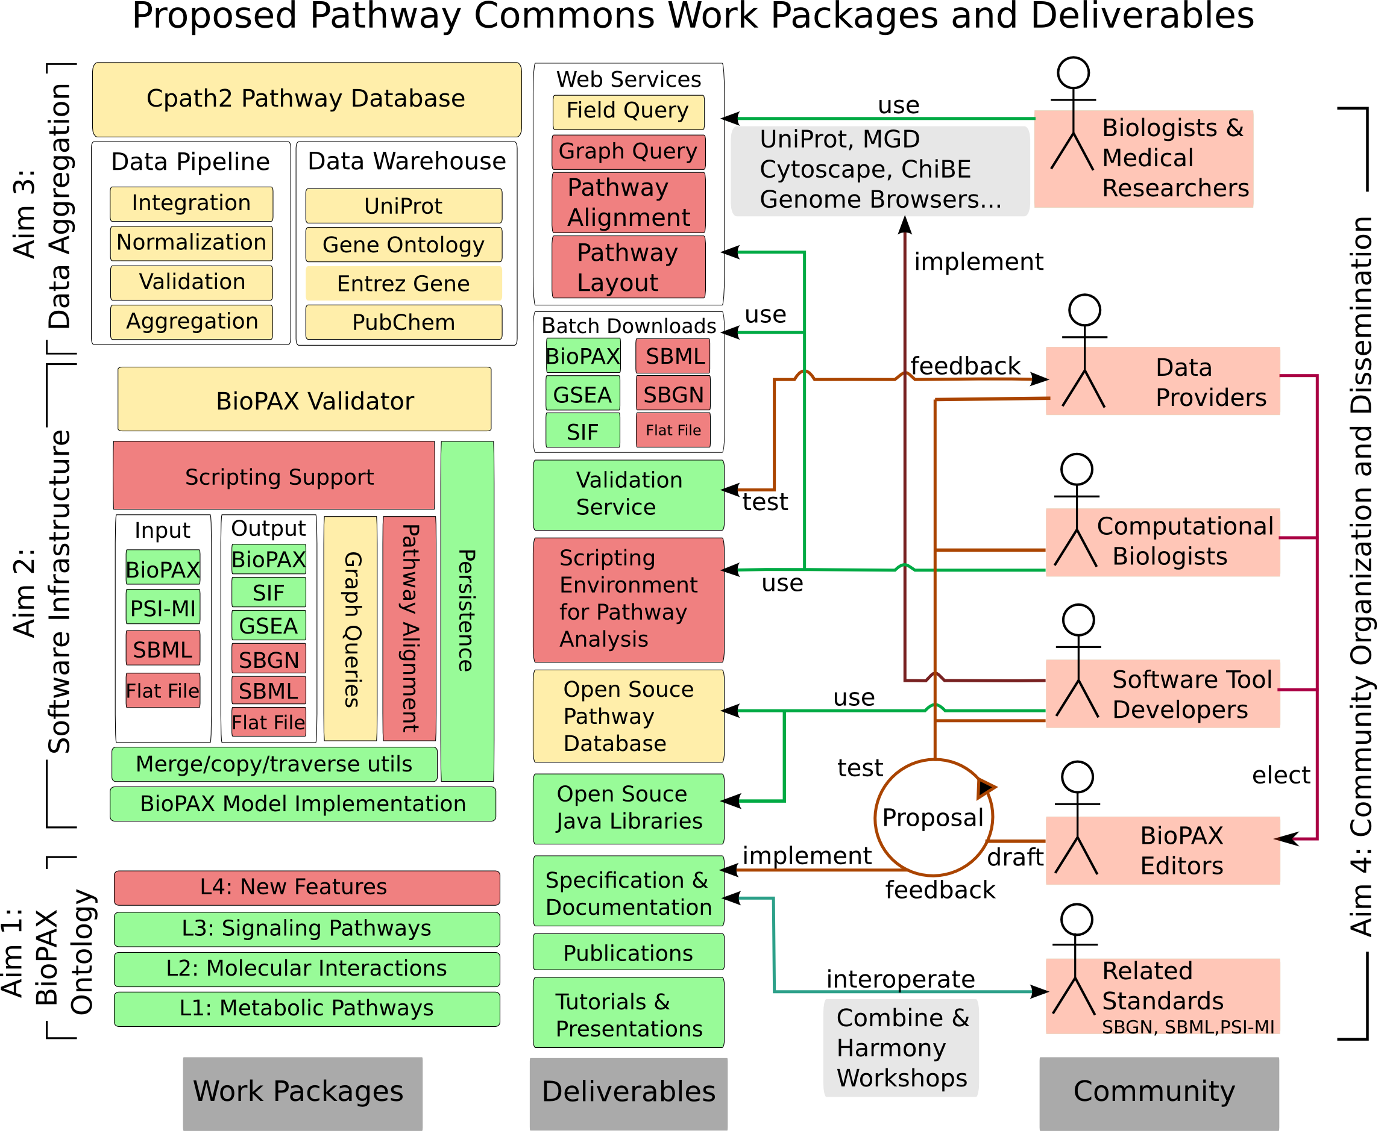

Slide 23
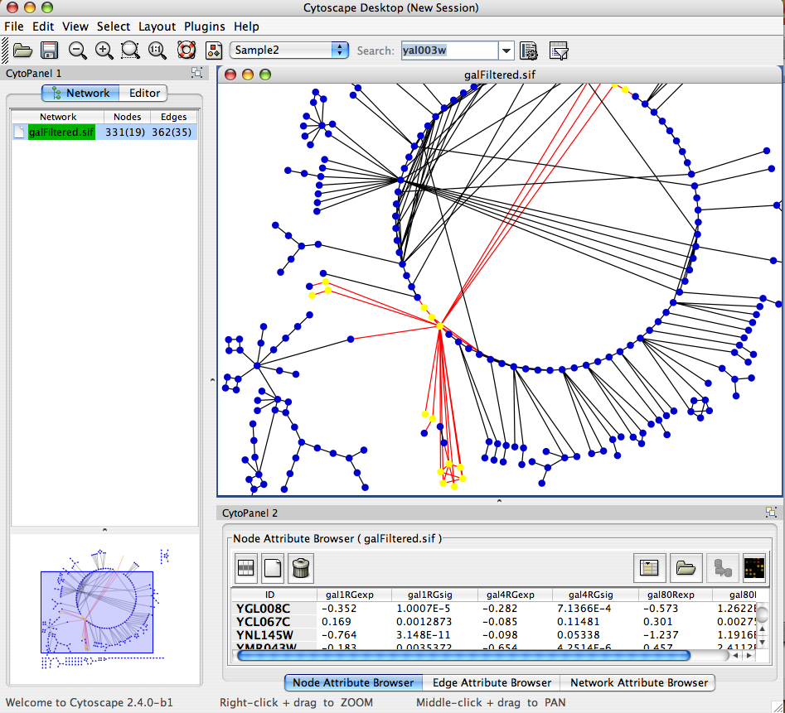
Network visualization and analysis
http://cytoscape.org
Pathway comparison
Literature mining
Gene Ontology analysis
Active modules
Complex detection
Network motif search
UCSD, ISB, Agilent, MSKCC, Pasteur, UCSF, Unilever, UToronto, U Texas

Slide 24
Cytoscape 3
Complete re-architecture: OSGi – everything is a plugin
Enables future features:
  More stable and powerful APIs
  Scripting, macros, recordable history, better undo/redo
  Command line mode, good for use on compute clusters
  Interactive control from other scripting languages e.g. R
Fixing bugs and porting plugins
3.0 developer pre-release now available
  Mirror functionality in 2.8.2
  Encourage plugin porting
  Documentation: http://wiki.cytoscape.org/Cytoscape_3
  Download: http://chianti.ucsd.edu/cytoscape-3.0.0-M3/

Slide 25
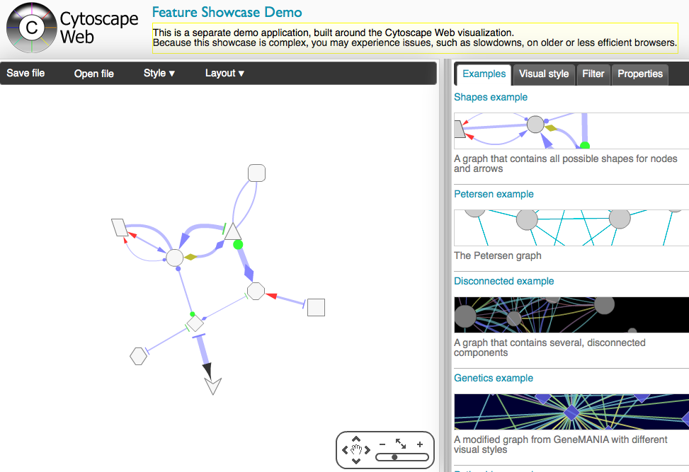
http://cytoscapeweb.cytoscape.org/

Slide 26
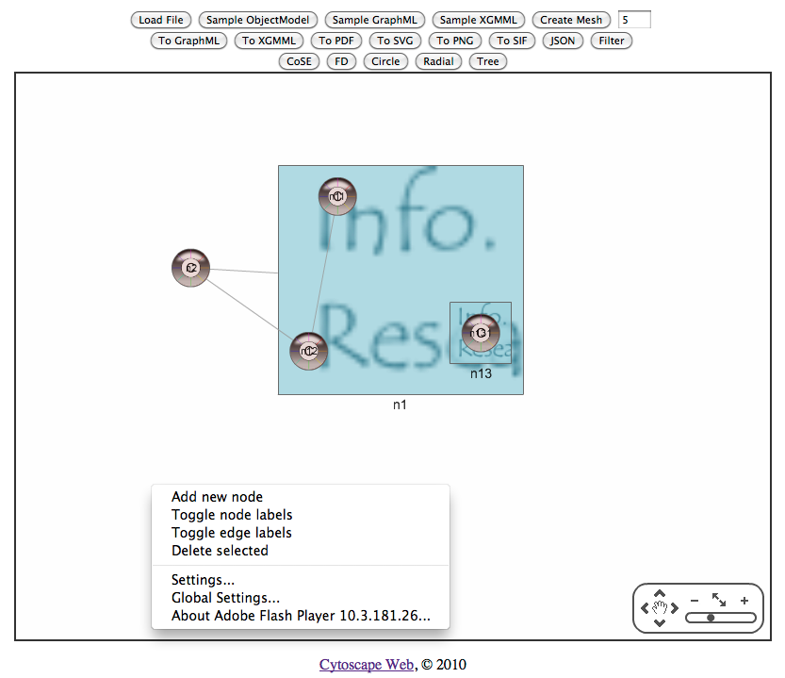
Compound Nodes
Onur Sumer
Ugur Dogrusoz
Bilkent, Ankara

Slide 27
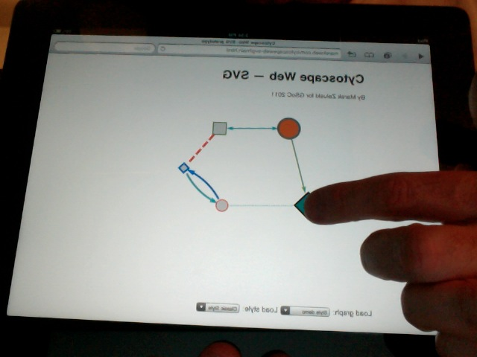
HTML5 SVG Prototype – iPad!
Marek Zaluski
GSoC 2011
http://marekweb.com/cytoscapeweb-svg/main.html

Slide 28
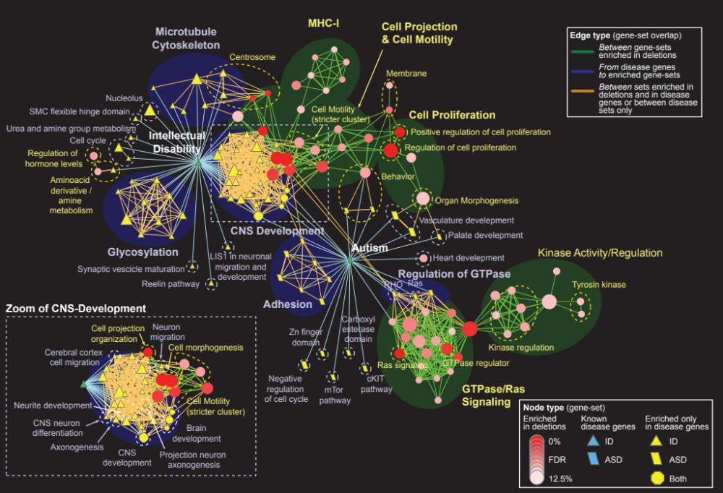
Pinto et al. Functional impact of global rare copy number variation in autism spectrum disorders. Nature. 2010 Jun 9.

Slide 29
GeneMANIA
http://www.genemania.org
Fast, fun gene function prediction
Work with Quaid Morris

Slide 30
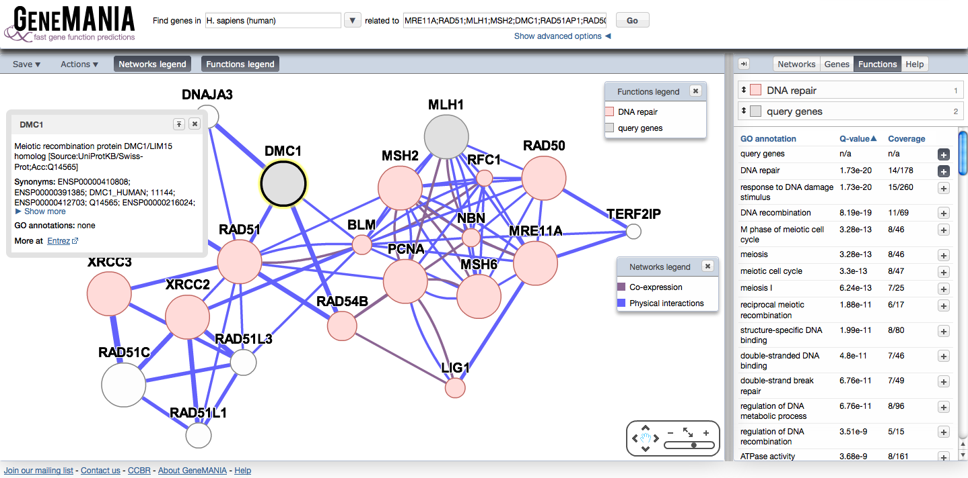
http://www.genemania.org
Mostafavi S et al. Genome Biol. 2008;9 Suppl 1:S4
Warde-Farley D et al. Nucleic Acids Res. 2010 Jul;8:W214-20.
Guilt-by-association principle
Biological networks are combined intelligently to optimize prediction accuracy
Algorithm is more fast and accurate than its peers
Gene Function Prediction
Quaid Morris (Donnelly), Sara Mostafavi
Rashad Badrawi, Ovi Comes, Sylva Donaldson,
Max Franz, Christian Lopes, Farzana Kazi,
Jason Montojo, Harold Rodriguez, Khalid Zuberi

Slide 31
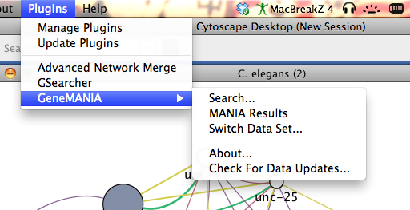
http://www.genemania.org/plugin/

Slide 32
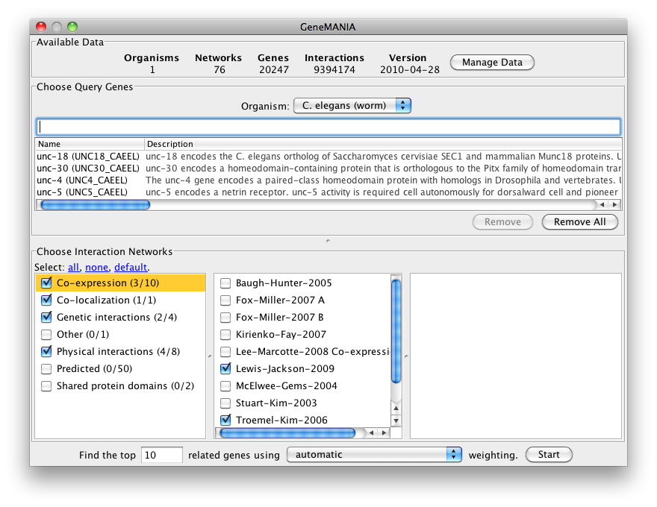

Slide 33
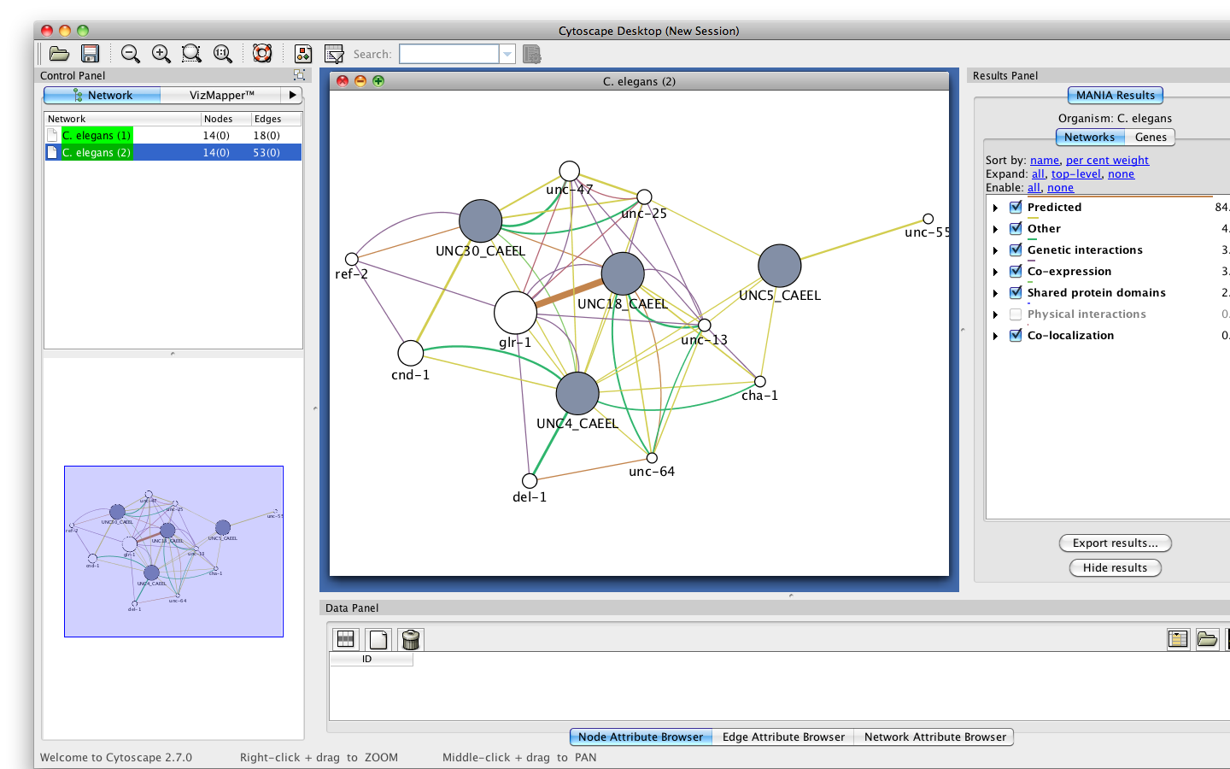
+Command line tools

Slide 34
Pathway Representation Tradeoff
Pathway Representation
Gene set
Network
Process model
Simulation model
Analysis methods need to keep up!
Depth
Coverage
Depth

Slide 35
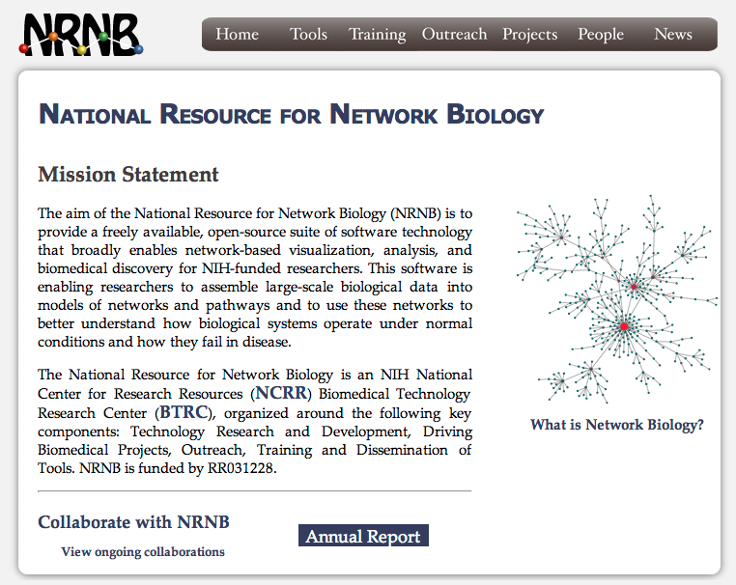

Slide 36
The Factoid Project
Publishing in science
  Highly inefficient
  Outdated technology, difficult to search and compute
http://www.elseviergrandchallenge.com/
  Winner: http://reflect.ws/
Pathway and network information database curation
  Highly inefficient
The factoid project
Max Franz, Igor Rodchenkov, Ozgun Babur, Emek Demir, Chris Sander

Slide 37
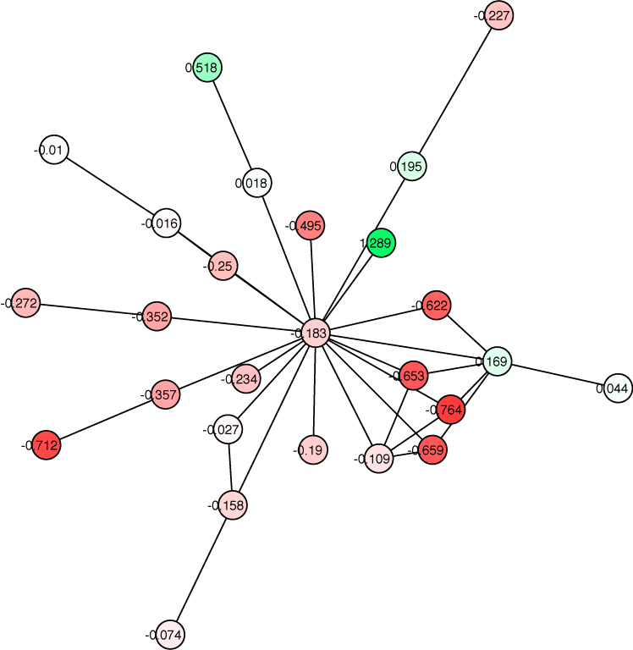







Acknowledgements
Bader Lab
Domain Interaction Team
Chris Tan
Shirley Hui
Shobhit Jain
Brian Law
Jüri Reimand
Former:
David Gfeller
Xiaojian Shao
Genetic Intx, Pathways:
Anastasia Baryshnikova
Iain Wallace
Magali Michaut
Ron Ammar
Daniele Merico
Ruth Isserlin
Vuk Pavlovic
Igor Rodchenkov
Pathway Commons
Chris Sander
Ethan Cerami
Ben Gross
Emek Demir
Igor Rodchenkov
Nadia Anwar
Ozgun Babur
www.GeneMANIA.org
Quaid Morris (Donnelly)
Rashad Badrawi, Ovi Comes, Sylva Donaldson,
Christian Lopes, Farzana Kazi, Jason Montojo, Sara Mostafavi,
Harold Rodriguez, Khalid Zuberi
Funding
http://baderlab.org

Slide 38


Acknowledgements
Cytoscape
Trey Ideker (UCSD)
Mike Smoot, Kei Ono, Peng Liang Wang (Ryan Kelley, Nerius Landys, Chris Workman, Mark Anderson, Nada Amin, Owen Ozier, Jonathan Wang)
Lee Hood, Ilya Schmulevich (ISB)
Sarah Killcoyne (Iliana Avila-Campillo, Rowan Christmas, Andrew Markiel, Larissa Kamenkovich, Paul Shannon)
Benno Schwikowski (Pasteur)
Mathieu Michaud (Melissa Cline, Tero Aittokallio, Andrea Splendiani)
Chris Sander (MSKCC)
Ethan Cerami, Ben Gross (Robert Sheridan)
Annette Adler (Agilent) Yeyejide Adeleye (Unilever)
Allan Kuchinsky, Mike Creech (Aditya Vailaya) Noel Ruddock
Bruce Conklin (UCSF) Scooter Morris (UCSF) David States (Texas)
Alex Pico, Kristina Hanspers
Pathway Commons
Chris Sander
Ethan Cerami
Ben Gross
Emek Demir
Igor Rodchenkov
Nadia Anwar
Ozgun Babur
NIGMS GM070743-01
http://baderlab.org

