Slide 1
Closing Remarks

Slide 2










VQA sponsors
Army Research
Office
Army Research
Lab
National Science
Foundation
Office of Naval Research

Slide 3
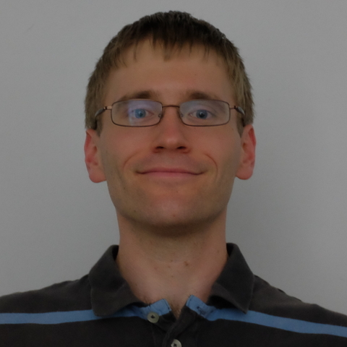
Dataset collection
Stan Antol

Slide 4


Workshop sponsors

Slide 5


Challenge host

Slide 6
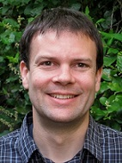
Larry Zitnick

Slide 7
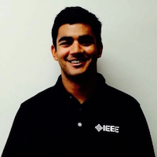
Webmaster
Akrit Mohapatra

Slide 8
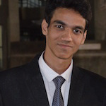
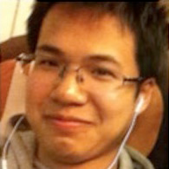
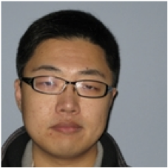
Student co-organizers
Yash Goyal
Jiasen Lu
Peng Zhang

Slide 9
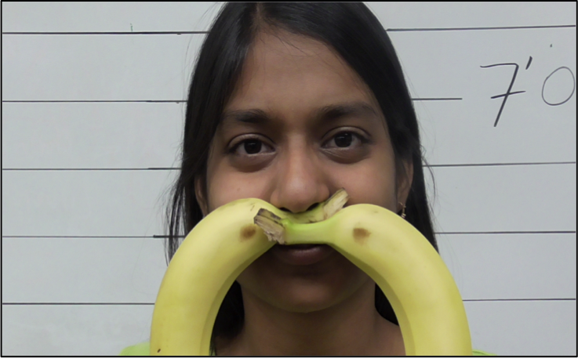
Student lead-organizer

Slide 10
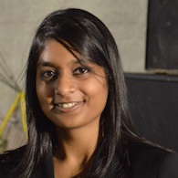
Student lead-organizer
Aishwarya Agrawal

Slide 11
Thoughts are very welcome.

Slide 12
Happy CVPR-ing!

