Slide 1

STOCKS FORECASTING AND VISUALIZATION USING DASH
PRESENTED BY TRIBE-L members
AMBRESH DESAI
HEENA NAWAZ
H ANJANA
GOURI POTDAR
VISHAKA RATHod
Shweta pawar

Slide 2
Table of contents
1. Abstract
2. Introduction
3. objective
4. requirements
5. APPROACH
6. PROJECT STAGES
7. PROJECT OUTCOMES
8. CONCLUSION

Slide 3
abstract
Stock price forecasting is a popular and important topic in financial and academic studies. Stock investments provide one of the highest returns in the market. Even though they are volatile in nature, one can visualize share prices and other statistical factors which help the keen investors to carefully decide on which company they want to spend their earnings on.
In this project we have created a single page web application using the Dash library (of Python), we have made dynamic plots of the financial data of a specific company by using the tabular data provided by yfinance python library. On top of it, we have used machine learning algorithm to predict the upcoming stock prices.

Slide 4
INTRODUCTION
Stock investments provide one of the highest returns in the market. Even though they are volatile in nature, one can visualize share prices and other statistical factors which helps the keen investors carefully decide on which company they want to spend their earnings on.
Stock prices are inﬂuenced by various factors ranging from the performance of the company itself to the conditions of the economy in general. Thus, to manage investment portfolios, stock market data has to be analyzed regularly to identify potential relationships between various stocks, hence to adjust investment based on related stocks trends.
A picture is worth a thousand words presenting data in visual form can assist humans in exploring deep insight of vast amounts of complex raw data, especially when people have limited knowledge of the data. Visual representation is one of the most eﬃcient ways to assist investors to have a clear overview of movements of the stock market, as well as providing a deeper understanding of each individual stock

Slide 5


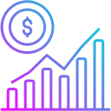
Data visualization is the graphical representation of information and data.
By using visual elements like charts, graphs, and maps, data visualization tools provide an accessible way to see and understand trends, outliers, and patterns in data.
The main goal of data visualization is effectively, efficiently, elegantly, accurately as well as meaningfully communicating information. It fulfills its objectives only if it encodes the given input in such a manner that our eyes can recognize and our brain can comprehend.
In stock market, Data visualization helps traders when making decisions quickly and enables them to easily synthesize large amounts of complex information.

Slide 6
OBJECTIVE
We will be creating a single-page web application using Dash (a python framework) and some machine learning models which will show company information (logo, registered name and description) and stock plots based on the stock code given by the user. Also the ML model will enable the user to get predicted stock prices for the dates inputted by the user.

Slide 7
OBJECTIVE
To create a single-page web application using Dash (a python framework) and some machine learning models which will show company information (logo, registered name and description) and stock plots based on the stock code given by the user. Also the ML model will enable the user to get predicted stock prices for the dates inputted by the user.
requirements
● Hardware Requirements:
○ RAM: 4 GB
○ Storage: 500 GB
○ CPU: 2 GHz or faster
○ Architecture: 32-bit or 64-bit
● Software Requirements:
○ Python 3.5 and above in Visual Studio code.
○ Operating System: windows 7 and above or Linux based OS or MAC OS

Slide 8
APPROACH
3
1
4
2
5
Generate plots of data using the plotly library of Python.
Make a main website’s structure using mainly Dash HTML Components and Dash Core Components.
Implement a Machine Learning model to predict the stock price for the dates requested by the users.
The data is fetched using yfinance Python library.
Enhance the site’s UI by styling using CSS.

Slide 9
PROJECT STAGES
Input stock code to get company information
STAGE 1
Select date range to get stock price and estimated moving average plots
STAGE 2
Input number of days to get forecast
STAGE 3

Slide 10
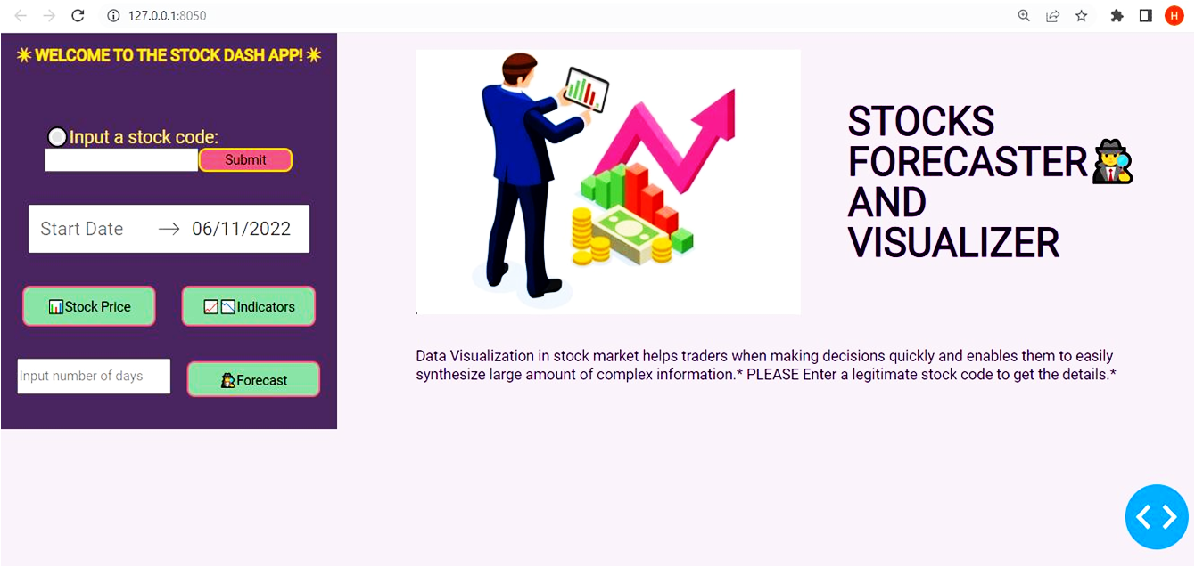
Our web app will look as shown below :

Slide 11
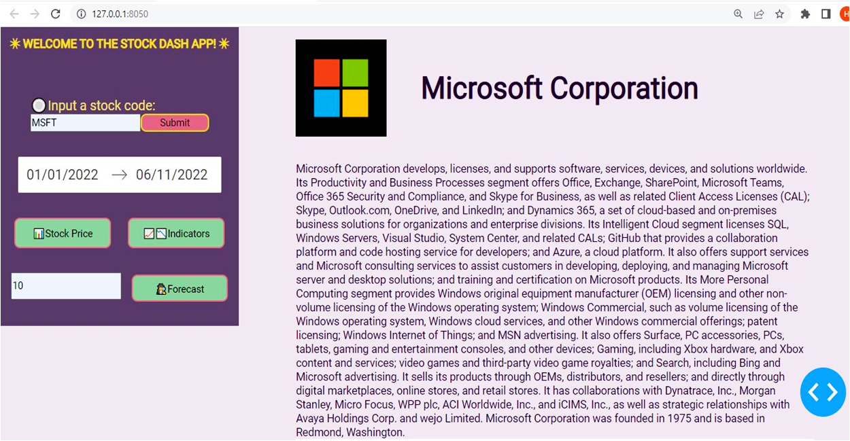
Input a stock code to get company’s information :

Slide 12
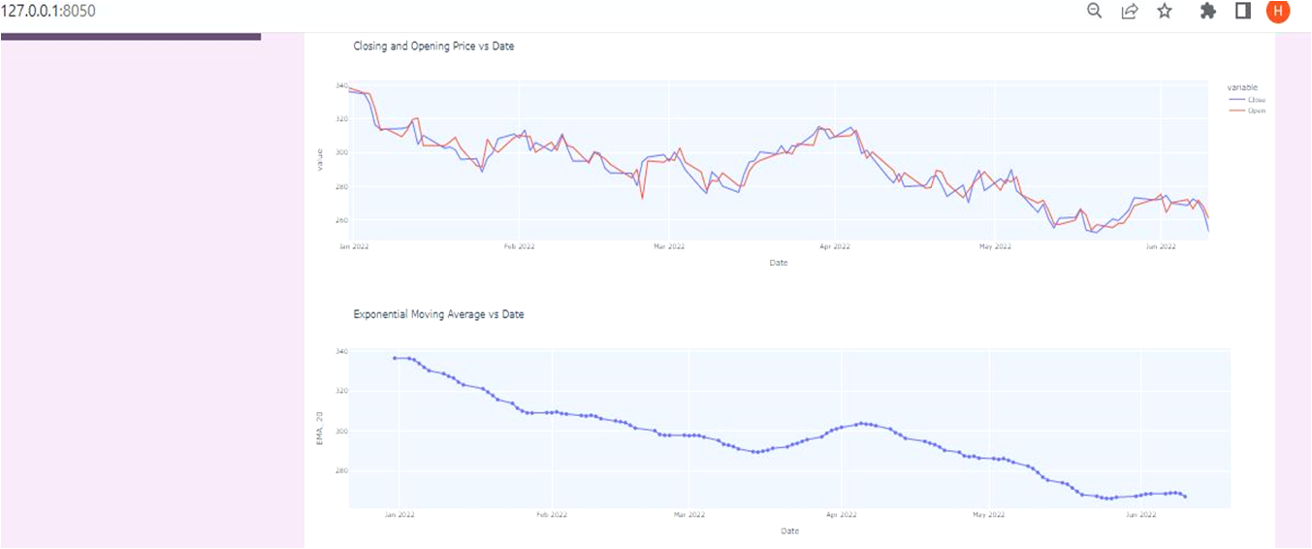
2. Select Date range to get a stock price and Estimated Moving Average

Slide 13
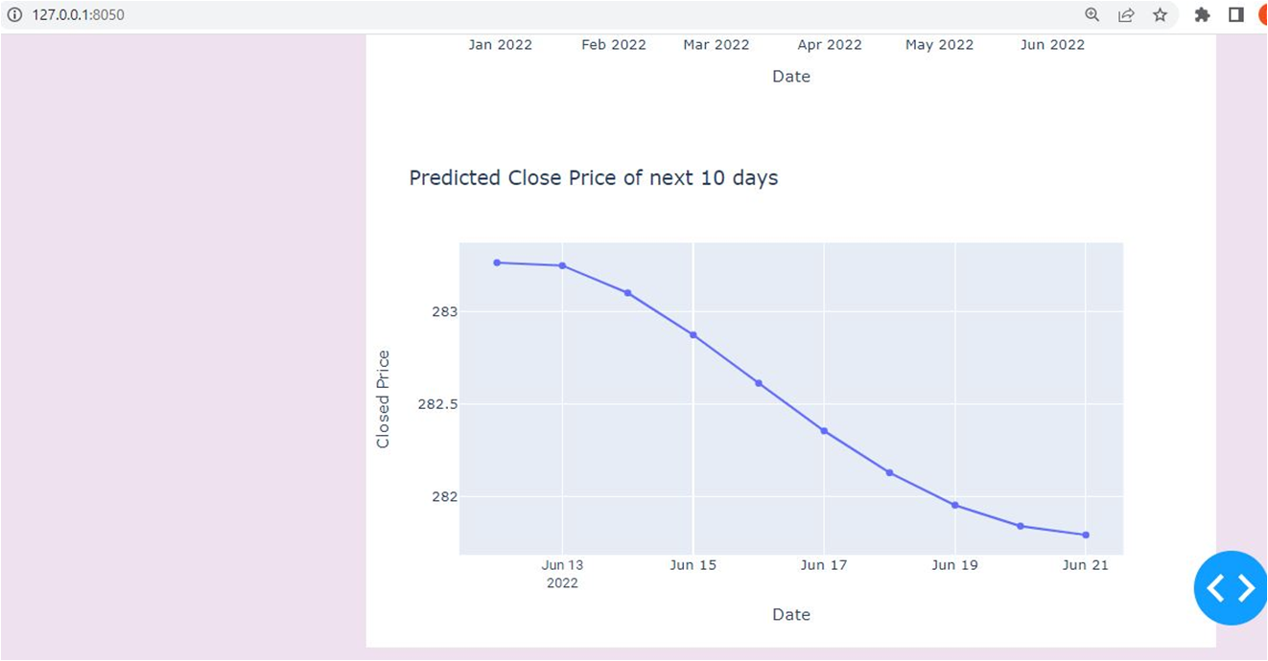
3. Input number of days to get forecast :

Slide 14
conclusion
Stocks forecasting and visualization using dash is a machine learning project we have built a single page web application using plotly dash python framework and using some machine models to get company’s information and plot graphs for visualization based on it. The stock market forecasting is done using machine learning model(SVR).
Dash provides a fast and quick way of creating beautiful and interactive dashboards without extensive knowledge of web development. It combines web development and analytics and provides a useful mechanism for serving dashboards for web response.In stock market, Data visualization helps traders when making decisions quickly and enables them to easily synthesize large amounts of complex information.

Slide 15
THANK YOU

