Slide 1
Detect Kernel-Mode Rootkits via
Real Time Logging & Controlling Memory Access
Igor Korkin, PhD |  | Satoshi Tanda
Independent Researcher |  | CrowdStrike, Inc
Moscow, Russia |  | Vancouver, Canada
2017 CDFSL
The slides are here – www.bit.ly/MemoryMonRWX
Notes:
Hi, I’m Igor, thanks for coming. The title is quite long, but actually it means just “We Protect the Computer Memory”.

Slide 2
We Protect the Computer Memory
Igor Korkin, PhD |  | Satoshi Tanda
Independent Researcher |  | CrowdStrike, Inc
Moscow, Russia |  | Vancouver, Canada
2017 CDFSL
The slides are here – www.bit.ly/MemoryMonRWX
Notes:
The ideas I’m going to present you are based not only on my work but also on the research made by Satoshi Tanda.

Slide 3


Igor Korkin, Ph.D.
His 5 recent papers are
double blind peer reviewed
He has spoken at the ADFSL conferences since 2014
Satoshi Tanda
He has 7 years of experience in reverse engineering & Windows internals
He spoke at the BlueHat v16,
REcon 2011 and 2016
Notes:
About a year-and-half ago I found his blog, where he carried out a huge research about how Patch Guard can be bypassed. He is really good at reverse engineering, hypervisors, and also he is a professional developer. I found his results very interesting and suggested him an idea of how to protect PatchGuard from being defeated.
And here is the result of our collaboration. Accesses to the computer memory can be illustrated as a road traffic and this traffic looks like the left picture.

Slide 4

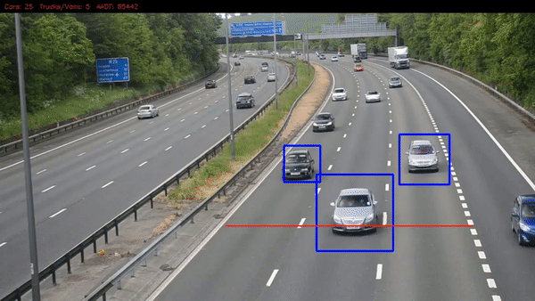
Memory accesses look like driving without rules
It is needed to control the memory accesses
Notes:
Here we can see no traffic lights, no traffic signs, no road marking. Actually in computer memory we have a similar situation.
My idea is to protect the memory by monitoring and controlling memory accesses. As a result, it will look like the right picture, where each car is counted and any
violations /ˌvaɪəˈleɪʃ(ə)n/ will be recorded.

Slide 5
Agenda
Malware avoids detection: trends & experts’ views
Intercepting memory access attempts: methods & projects
The new memory interceptor MemoryMonRWX: idea & prototype
Demos
Future plans with IoT & Digital Security
Notes:
I’d like to start with experts’ view on some new malware trends.
I’ll tell you about how to detect malware infections at early stages.
Next, I’ll demonstrate you how I managed it by controlling memory access.
I’ll show you the advantages of new memory monitoring tool.
Finally I’ll describe my ideas about applying The Internet of Things in digital security.

Slide 6


“... malware, or more specifically, a kernel rootkit, can often tamper with kernel memory data, putting the trustworthiness of memory analysis under question”¹
Prakash, A., Venkataramani, E., Yin, H., & Lin, Z. (2015, October 31). On the Trustworthiness of Memory Analysis - An Empirical Study from the Perspective of Binary Execution, IEEE Transactions on Dependable and Secure Computing (TDSC), 12(5), 1545-5971, http://dx.doi.org/10.1109/TDSC.2014.2366464
Notes:
The researchers from these two universities raise their concerns about modern malware rootkits. We can see that memory dump analysis is becoming useless.
What protection mechanisms do we have to solve this issue?

Slide 7
What do we have now?
Windows security features | What do we have now?
Driver Signature Enforcement
PatchGuard (Kernel Patch Protection)
McAfee. (2016, September). Threats Report. McAfee Labs. Retrieved from http://www.mcafee.com/us/resources/reports/rp-quarterly-threats-sep-2016.pdf
Singh, A. (2015, April 8). Dissecting Turla Rootkit Malware Using Dynamic Analysis. Retrieved from https://www.lastline.com/labsblog/dissecting-turla-rootkit-malware-using-dynamic-analysis
7
Notes:
Windows has several protection mechanisms to deal with these attacks. For example, a Driver Signature Enforcement prevents loading an unsigned driver. Another one is PatchGuard, which checks the integrity of the Windows kernel and in case of any modification PatchGuard crashes the system and we see a blue screen of death. Unfortunately, a new malware can avoid all these protection mechanisms.

Slide 8

What do we have now?
Windows security features | What do we have now?
Driver Signature Enforcement
PatchGuard (Kernel Patch Protection) | New malware is able to bypass PatchGuard: ‘Turla’ rootkit² TDL4/TDSS
3 million of signed malicious binaries¹
6 months
2016
McAfee. (2016, September). Threats Report. McAfee Labs. Retrieved from http://www.mcafee.com/us/resources/reports/rp-quarterly-threats-sep-2016.pdf
Singh, A. (2015, April 8). Dissecting Turla Rootkit Malware Using Dynamic Analysis. Retrieved from https://www.lastline.com/labsblog/dissecting-turla-rootkit-malware-using-dynamic-analysis
8
Notes:
3 million of new malware binaries with digital certificates show the weakness of the Driver Signature Enforcement. These two rootkits are able to defeat PatchGuard even on newest Windows. There are a lot of examples of defeating Windows PatchGuard. I’d like to show you one of them.

Slide 9
Defeat and Protect PatchGuard
№ | Pre-emptive Actions | Malware actions | Results & Comments
1
2
3
Rootkit is hiding the process
Exploit is disabling PatchGuard
Rootkit is hiding the process
Memory protector limits memory access
Exploit is disabling PatchGuard
Rootkit is hiding the process
9
Notes:
I’ll show you these three scenarios.
Firstly, I will load a rootkit, which hide a process and PatchGuard reacts on this manipulation via Blue Screen of Death (BSOD).
Secondly, I will load an exploit which disables PatchGuard and hides a process. In this case we won’t see a BSOD.
Finally, I’ll present you a new memory protector, which stops this exploit and protects the operating system.
Now we will see 3 videos. Let’s start.
Second video: This infection was the starting point for my research. I thought how to prevent this or similar exploit by monitoring memory access. Let’s see what I achieved.

Slide 10
Demo 1
The online version is here – https://www.youtube.com/embed/vi9TzLrO_pE?vq=hd1440
Demo 2
The online version is here –
https://youtu.be/vi9TzLrO_pE?t=70
10
Notes:
I’ll show you these three scenarios.
Firstly, I will load a rootkit, which hide a process and PatchGuard reacts on this manipulation via Blue Screen of Death (BSOD).
Secondly, I will load an exploit which disables PatchGuard and hides a process. In this case we won’t see a BSOD.
Finally, I’ll present you a new memory protector, which stops this exploit and protects the operating system.
Now we will see 3 videos. Let’s start.
Second video: This infection was the starting point for my research. I thought how to prevent this or similar exploit by monitoring memory access. Let’s see what I achieved.

Slide 11
Defeat and Protect PatchGuard
№ | Pre-emptive Actions | Malware actions | Results & Comments
1 |  |  | OS has crashed (PatchGuard has generated 0x109 BSOD)
2 |  |  | OS has been infected (PatchGuard has been disabled, no BSOD)
3 |  |  | OS has been protected (Exploit has failed)
✘
Rootkit is hiding the process
Exploit is disabling PatchGuard
✘
Rootkit is hiding the process
Memory protector limits memory access
Exploit is disabling PatchGuard
✔
Rootkit is hiding the process
11
Notes:
Here are the results of these 3 scenarios. We can see that only in the final video the operating system has been protected. The new memory interceptor blocks the exploit and prevents malware infection at early stage.

Slide 12
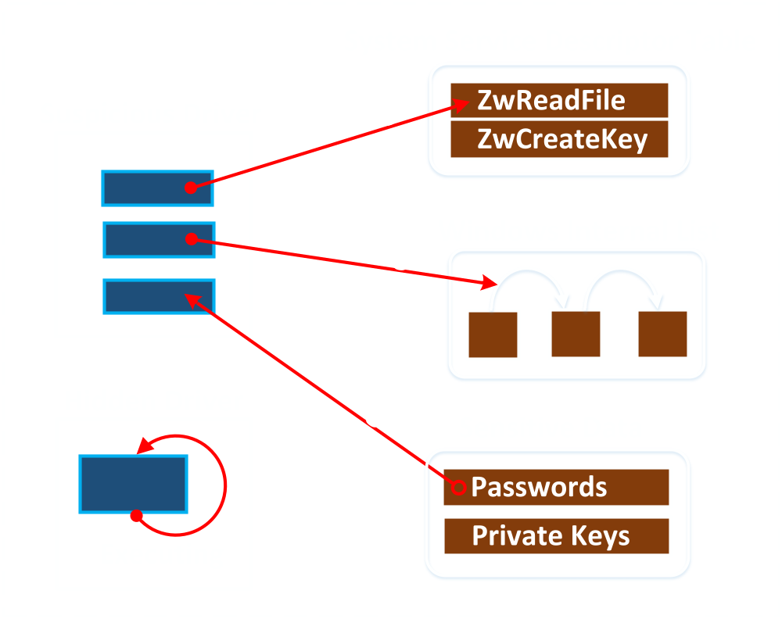
What malware attacks do we want to monitor & prevent?
Control memory accesses:
  Reading
  Writing
  Executing
12
Notes:
What sort of malware attacks can we prevent?
Let's think of some scenarios that this memory interceptor will face and try to specify its requirements. Modern malware can read sensitive data from the memory.
It can change the memory content, for example, by hooking, unlinking, or patching. And also the unknown code execution can create a new thread.

Slide 13
Memory Interceptor Requirements
1) All types of memory accesses: read, write, execute
2) Triples for each access:
Source Address
Type of access
Destination Address
13
Notes:
Well, we need to control all possible memory accesses: reading, writing, and executing.
So, for each memory access, we will log the following triple: source address, destination address, and the type of accessing.
It will be also good to filter all these accesses, for example to monitor memory access only from a suspicious driver or to limit access to the sensitive data in the memory.

Slide 14
Memory Interceptor Requirements
1) All types of memory accesses: read, write, execute
2) Triples for each access:
3) Access only from Source range → Destination range:
4) A kernel-mode driver, which supports Windows 10 x64 and multi-core CPUs
Source Address
Type of access
Destination Address
Source Address | Access Type | Destination Address
SourceAddr1 | read | DestinationAddr1
… | … | …
  Source range
Logs this access
  Destination range
  Others
Skips all other accesses
14
Notes:
I propose to divide memory into three parts: Source range, Destination range and others. Memory protector controls memory accesses only from the source range to the destination range and skips all the rest.
Source range can include, for example, the beginning and ending addresses of the entire driver in memory. Destination range can contain the range of addresses and can also include just one address to reveal a patching attack.
What else do we need? Compile and load this memory interceptor like any other driver. And keep it up to date. This tool has to support the newest Windows 10 64 bit and multi-core CPUs. That’s it. But how to achieve this?

Slide 15
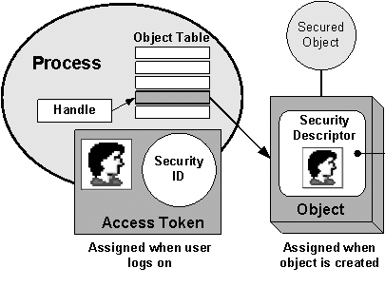
What can we use as a basis for the memory interceptor?
Windows security model protects only the
user-mode memory
Memory monitoring methods based on OS & hypervisor facilities
➔ There is no build-in tools for controlling kernel mode memory
15
Notes:
Let’s move on to the question – what tools and technologies are available at the moment? Windows protection mechanisms such as a process security and access rights regulate only the user-mode memory.
There are no built-in tools for controlling kernel-mode memory so far.
So what can help us to prevent unauthorized access in the kernel mode?

Slide 16

Intercepting memory access: methods & projects
16
Notes:
The most interesting memory mónitoring methods and projects are here.
All methods can be divided into two groups: based on operating system facilities and based on hardware virtualization technology. OS-based methods can be separated into two subgroups: based on hooking memory management functions, and based on handling page fault exceptions.
Hypervisor-based methods can also be divided into two groups. The first one handles page fault exceptions, while the second one applies a new virtualization extension – EPT to track all memory accesses.

Slide 17
Intercepting memory access: methods & projects
Project title, year | Read/ Write/ Execute
SPIDER, 2013 | +/+/–
SecVisor, 2007 | –/+/+
HyperSleuth, 2010 | +/–/–
CXPInspector, 2013 | –/–/+
HyperTap, 2014 | –/+/+
DRAKVUF, 2014 | –/–/+
MemoryMonRWX, 2017 (The proposed system) | + / + / +
17
Notes:
And here is the table of existing projects, which are based on the corresponding methods. We can see that none-of-them controls all three memory accesses at the same time. So, I decided to create a new memory mónitoring tool, which will meet all these requirements. I named it Memory Monitor of Read- Write- and eXecute access or just MemoryMonRWX. So what technology can be used as a basis for this new tool?

Slide 18
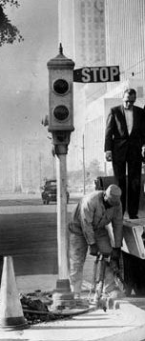
New Advanced Technology:
Intel VT-x with Extended Page Tables (EPT)
EPT Overview
EPT paging structures
Applying EPT to monitor & limit memory access
EPT plays the role of traffic lights for memory accesses
18
Notes:
The EPT technology, which has recently been integrated in Intel processors, seems very perspective. It is called VT-x with Extended Page Tables (EeePeeTee). I’ll give you a brief overview of this technology, its paging structures, and how to use EPT to monitor and control the memory access.

Slide 19
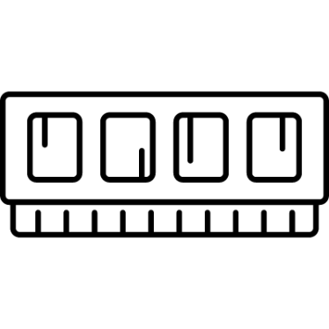
Processing memory access: VT-x vs. VT-x with EPT
VT-x without EPT
Access to virtual memory
Paging structures
Guest OS
Guest Physical address:
Hypervisor
Hardware
Host Physical address:
Host Memory
19
Notes:
Let’s look at the mechanism of address translation between the guest memory and the host memory. Without EPT once guest memory is accesséd, the translation between the guest virtual address and guest physical address starts happening. Then we receive the guest physical address. Without EPT this very guest physical address is used to access the host memory.

Slide 20

Processing memory access: VT-x vs. VT-x with EPT
VT-x without EPT
VT-x with EPT
Access to virtual memory
Access to virtual memory
Paging structures
Paging structures
Guest OS
Guest OS
Guest Physical address:
Guest physical address:
Hypervisor
EPT Paging structures
Hypervisor
Hardware
Host Physical address:
Host Physical address:
Host Memory
Host Memory
Hardware
20
Notes:
Using EPT we get an additional or a second level address translation. This case is on the right. EPT plays the role of an intermediary during address translation. The guest mapping is the same. But now, we receive the host physical address by traversing the EPT structures. These structures are very similar to the paging structures in the protected mode and determine the mapping between the guest memory and the host memory. Let’s zoom in on EPT paging structures.

Slide 21

Applying EPT features to trap and skip memory access
EPT Paging structures
EPT Page Directory
Entry
EPT Page Table
Entry
Access Bits | PFN
Access Bits | PFN
Access Bits | PFN
Intercept access:
Read Write Execute
Change mapping:
Substitute page
Change nothing
EPT violation
Hypervisor skips these accesses
21
Notes:
Now we are looking at the fourth EPT tables or leaves of EPT tree, which are called the EPT Page Tables. This table includes a lot of entries, which contain information about a single 4 Kilobyte memory page. Each EPT entry includes access bits and page frame number PFN. This PFN is a host physical address of the corresponding memory page. EPT access bits indicate whether read- write or execute-access is allowed for this page. Intel manual says that ‘any attempts at disallowed accesses will involve EPT violation and cause VeeM exits’. Also the hypervisor can limit access to this page by changing its PFN value. In order to intercept or skip each memory access, we configure the access bits in the corresponding EPT page table entries.

Slide 22
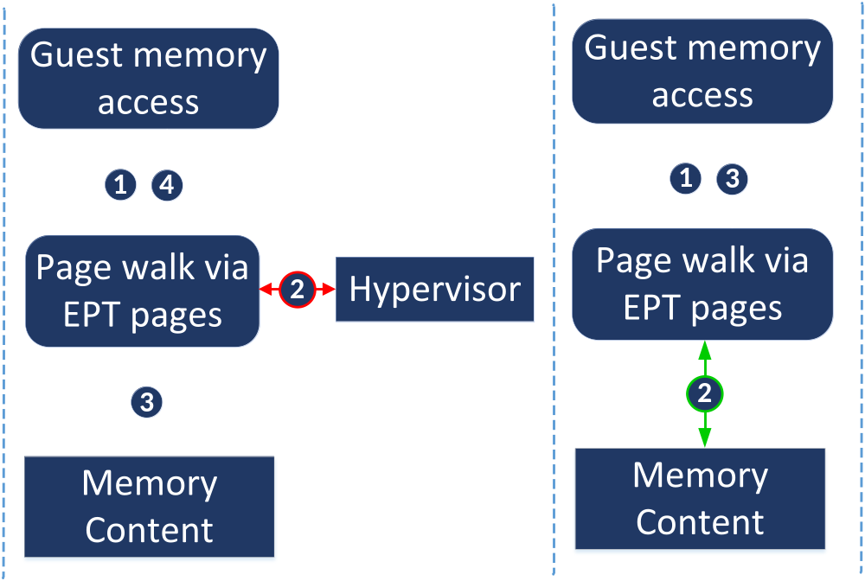
Applying EPT features to trap and skip memory access
EPT Paging structures
EPT Page Directory
Entry
EPT Page Table
Entry
Access Bits | PFN
Access Bits | PFN
Access Bits | PFN
Intercept access:
Read Write Execute
Change mapping:
Substitute page
Change nothing
EPT violation
EPT violation
Hypervisor skips these accesses
22
Notes:
There are two main scenarios of using EPT. If this memory access is not allowed, it involves EPT violation and causes VM exit. At this moment the hypervisor is able to log access to this memory page. After that control goes to physical memory and comes back to the guest, see central figure.
But, if this memory access is allowed according to the EPT bits, the hypervisor skips this access.
We can see, that by changing EPT setting a hypervisor can ímplement various algorithms. This is exactly what we’ve been looking for.

Slide 23
How to apply EPT to monitor access only
from Source range to Destination range
and skip all the rest?
We propose the following 5 steps
Source Address | Access Type | Destination Address
SourceAddr1 | read | DestinationAddr1
… | … | …
  Source range
Logs this access
  Destination range
  Others
Skips all other accesses
23
Notes:
Now let’s move on to the final question how to apply these EPT features to control access only from the source range to the destination range and skip all the rest.
We can combine skipping and trapping memory access in the following five steps.

Slide 24
Step 1. Trapping execution on Source range
Guest OS memory
  Source range
  Destination range
  Others
An access from the
source range ➔ destination range
An access from the destination range ➔ others
24
Notes:
First of all, let’s divide memory content into three sections: source range, destination range, and others memory addresses. The memory access attempts are shown by arrows. Here we have various accesses. For example, this is the access from the source range to the destination range, that one is from the destination range to others etc.

Slide 25
Step 1. Trapping execution on Source range
These are memory accesses from the source range
Guest OS memory
  Source range
  Destination range
  Others
25
Notes:
We are interested only in accesses from the source range, which are in red. We need to skip all other access, which are from the destination range and others. They are in green.

Slide 26
Step 1. Trapping execution on Source range
These are memory accesses from the source range
Guest OS memory
  Trap & go to Step 2
  Source range
  Destination range
  Others
EPT Normal View Structure
SRC.execute = false
SRC.read/write = true
Hypervisor
DST.execute = true
Memory Accesses
DST.read/write = true
Skip
OTH.execute = true
OTH.read/write = true
26
Notes:
To achieve this, we can use the following EPT structure as a trap. This is EPT normal view structure. In this structure only execution access bits on the source range are disallowed. All other accesses are allowed and will be skipped.
Now any code execution on the source range will involve EPT violation, which causes VM Exit. Hypervisor will trap it and we go to Step 2.

Slide 27
Step 2. Process VM-Exit to separate access to the Destination range
This is the memory access to the Destination range
Guest OS memory
  Source range
  Destination range
  Others
27
Notes:
Control goes to the hypervisor. At this point we have accesses only from the source range. We are focusing only on the accesses to the destination range. We are filtering out all other accesses.

Slide 28
Step 2. Process VM-Exit to separate access to the Destination range
This is the memory access to the Destination range
Guest OS memory
  Source range
  Destination range
  Others
  Trap, log & go to Step 3
EPT Monitor View Structure
SRC.execute = true
Skip
SRC.read/write = true
Hypervisor
DST.read/write = false
Memory Accesses
DST.execute = false
Trap & go to Step 5
OTH.execute = false
OTH.read/write = true
Skip
28
Notes:
In order to achieve it we use another EPT structure as a second trap. This is EPT monitor view structure. This structure disallows accesses to the destination range and skips all other accesses. Any access to the destination range generates a VM Exit again and we move on to Step 3.

Slide 29
Step 3. Process VM-Exit, because of access on Destination range
  Source range
  Destination range
  Others
Source Address | Access Type | Destination Address
SourceAddr1 | read | DestinationAddr1
… | … | …
Logs this access
29
Notes:
At this point the control goes to the hypervisor again. Now we can log all related information: the source address, the destination address, and the type of áccess.
Also we can optionally protect the destination data from being read {RED} or overwritten. In order to achieve it we apply the following 3 procedures:

Slide 30


Step 3. Process VM-Exit, because of access on Destination range
  Source range
  Destination range
  Others
EPT Monitor View Structure (Modified)
SRC.execute = true
PhysAddrA
SRC.read/write = true
PhysAddrB
Substitute Page
DST.read/write = true
PhysAddrNew
PhysAddrOriginal
Memory Accesses
  Trap & go to Step 4
Original Page
DST.execute = true
PhysAddrC
OTH.execute = false
PhysAddrD
OTH.read/write = true
PhysAddrE
MTF is set
30
Notes:
(1) We change PFN value of the secret page to the substitute one, for example, to the null page. This helps to protect the original data. (2) We allow read- and write- access to this page. (3) We set Monitor Trap Flag (MTF).
Setting MTF flag enables the system to generate VM Exit after executing each instruction. As a result, after the guest operating system reads the replaced page by executing just one instruction, the control goes automatically to the hypervisor again and we move on to Step 4.

Slide 31
Step 4 (Restore setting). Process VM-Exit, because of MTF
  Source range
  Destination range
  Others
EPT Monitor View Structure (Restored)
MTF is clear
SRC.execute = true
PhysAddrA
SRC.read/write = true
PhysAddrB
Original Page
DST.read/write = false
PhysAddrOriginal
PhysAddrNew
  Trap & go to Step 5
Trap & go to Step 3
Memory Accesses
DST.execute = false
PhysAddrC
Substitute Page
OTH.execute = false
PhysAddrD
OTH.read/write = true
PhysAddrE
31
Notes:
We’ve just avoided an access to the secret data. We need to restore the original settings.
We apply the following 3 procedures: (1) We set PFN value to the original page with secret data. (2) We block read- and write- access to this page. (3) We reset Monitor Trap Flag. This is the original EPT monitor view structure.
After that any access to the destination range will generate VM-Exit, and we move on to Step 3 again. Any execute access on other range will also generate VM-Exit, and we move on to Step 5. We’ve already considered Step 3. Now we go to the final Step 5.

Slide 32
Step 5. Process VM-Exit, because of execution on Destination range
Hypervisor traps these code executions, but we don’t need to control them
  Source range
  Destination range
  Others
EPT Normal View Structure
SRC.execute = false
Trap & go to Step 2
SRC.read/write = true
EPT Monitor View Structure
DST.execute = true
DST.read/write = true
Skip
OTH.execute = true
OTH.read/write = true
So, hypervisor changes EPT to normal view for trapping an execution on SRC range
32
Notes:
Now we trap an execution on destination range and others memory addresses.
We double check if this VM Exit address belongs to the source range. If it doesn’t, it means that this code is out of our control and we don’t need to control it.
So we change EPT from monitor view to normal view to be ready for trapping a new code execution on the source range. That’s it.

Slide 33
Five steps together
We are waiting for an execution on SRC range
Any access to destination range will be trapped and logged.
We protect the destination page via redirecting access to substitute page
EPT Normal View
Structure
EPT Monitor View Structure
EPT Monitor View with
Replaced EPT.DST.PFN
EPT.DST.read=true, EPT.DST.write=true
MTF is set
Step 2
Step 3
INIT
Step 1
Step 5
Step 4
We restore setting to the original page
Pointer to the current
EPT Paging Structure
33
Notes:
Here is the summary of the interaction between two EPT structures: normal view and monitor view. Firstly, we set EPT normal view to intercept any access from the source range. Secondly, after trapping an execution on the source range, we change EPT pointer to the EPT monitor view. It helps us to log accesses only to the destination range. Thirdly, we can optionally protect the page by redirecting access to another page. And after an access to the substituted page we restore setting, this is step 4 and go back to the EPT monitor view. If we trap the execution, which we don’t need to control, we change EPT to the normal view.

Slide 34
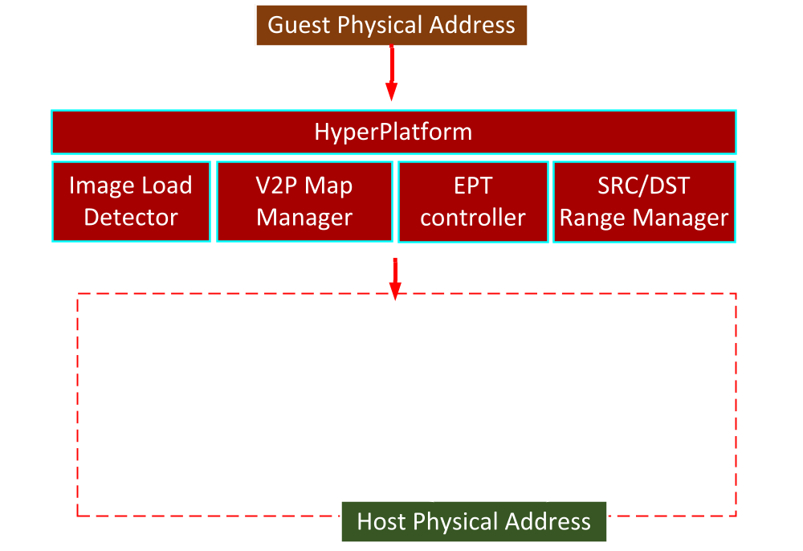
MemoryMonRWX architecture
The source code is here - http://bit.ly/MemoryMonRWX
34
Notes:
We checked all these ideas by developing a MemoryMonRWX hypervisor.
Now let’s look at its architecture. MemoryMonRWX includes the following five components: HyperPlatform, Image Load Detector, Virtual-to-Physical Map Manager, EPT controller, and Source/Destination Range Manager.

Slide 35
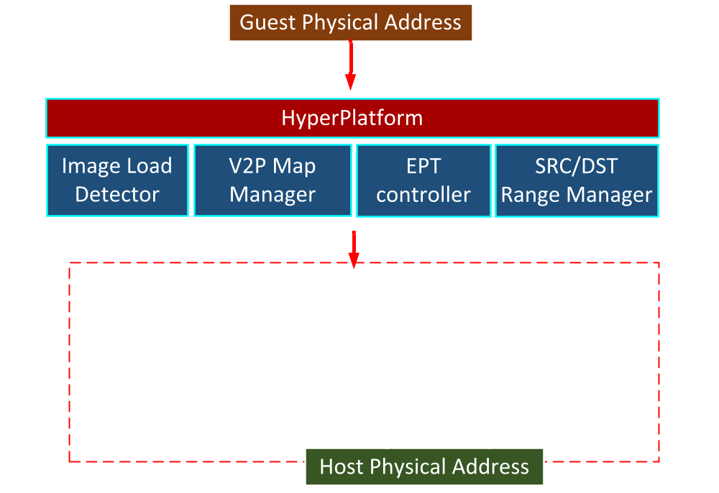
MemoryMonRWX architecture
The source code is here - http://bit.ly/MemoryMonRWX
35
Notes:
HyperPlatform is the main component of this system, which is a bare-metal hypervisor and it is designed for intercepting various events in the operating system.

Slide 36
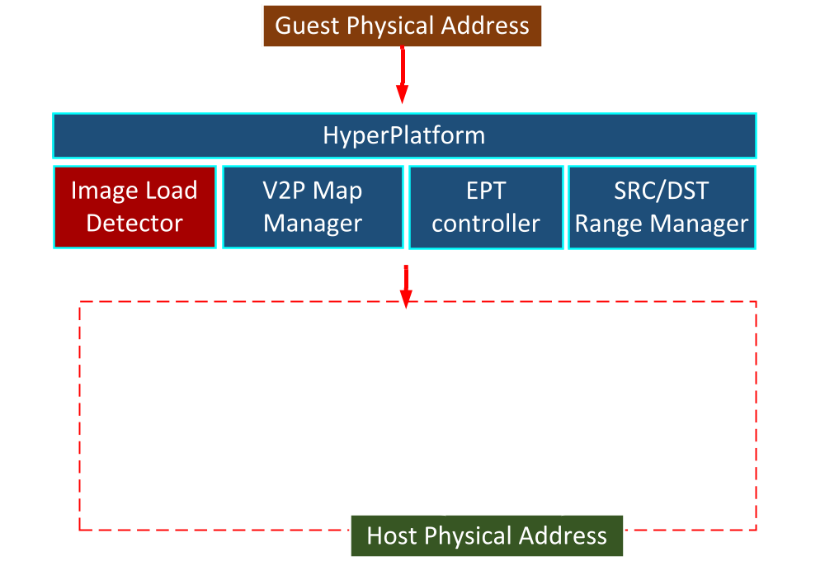
MemoryMonRWX architecture
The source code is here - http://bit.ly/MemoryMonRWX
36
Notes:
Source and destination address ranges are formed by Image Load Detector. We set the addresses of recently loaded drivers as a source range. Destination range includes, for example, address of PoolBigPageTableSize, which we’ve seen in the video at the beginning.

Slide 37
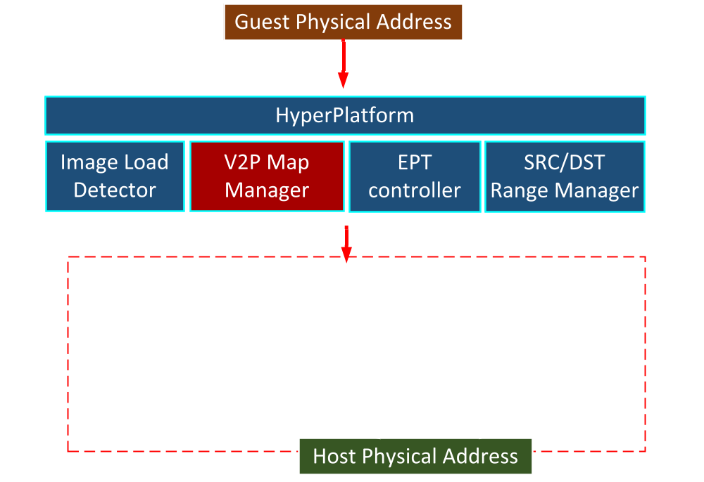
MemoryMonRWX architecture
The source code is here - http://bit.ly/MemoryMonRWX
37
Notes:
Virtual-to-Physical Map Manager maintains mapping between virtual and physical addresses. Actually it is a supplementary component.

Slide 38
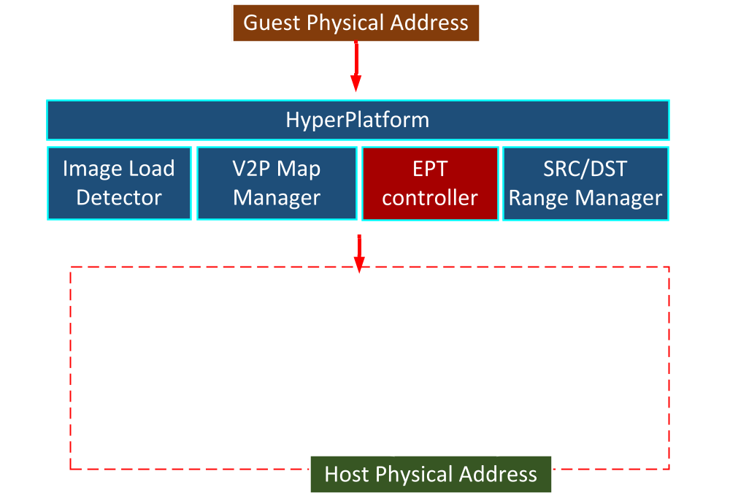
MemoryMonRWX architecture
The source code is here - http://bit.ly/MemoryMonRWX
38
Notes:
EPT controller is responsible for updating EPT Structures and handling EPT violations.

Slide 39
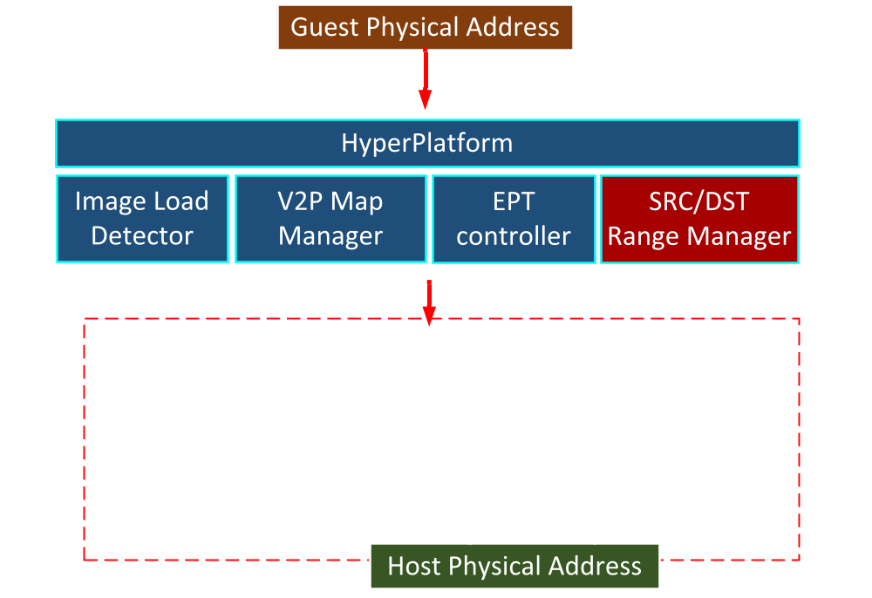
MemoryMonRWX architecture
The source code is here - http://bit.ly/MemoryMonRWX
39
Notes:
And the last one is the Source/Destination Range Manager. This manager asks the EPT controller to update EPT access bits for the source and destination ranges.

Slide 40
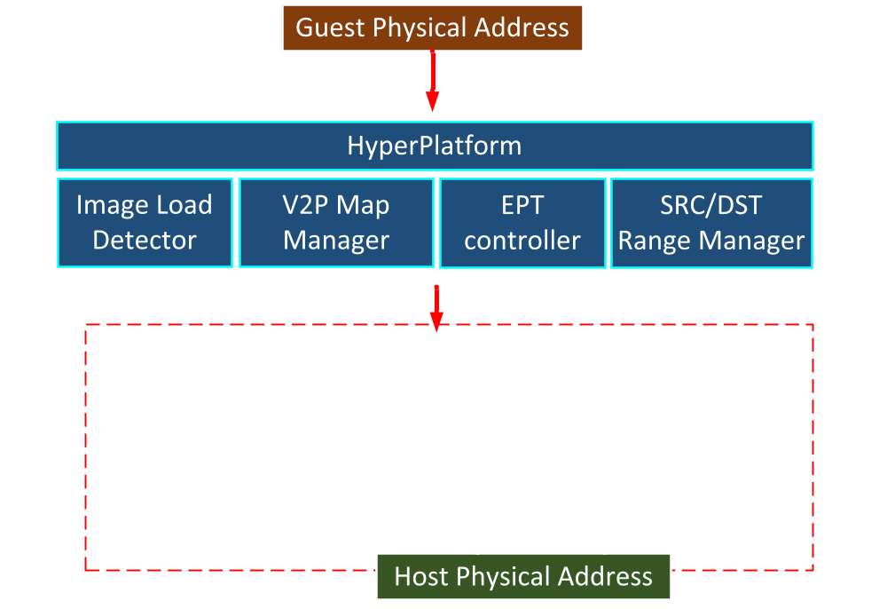
MemoryMonRWX architecture
The source code is here - http://bit.ly/MemoryMonRWX
40
Notes:
Architecture is quite simple, the source code is uploaded here.

Slide 41
Demo 3
The online version is here – https://youtu.be/vi9TzLrO_pE?t=157
41

Slide 42
MemoryMonRWX is small and fast
Comparison of hypervisors
(ines of code)
MemoryMonRWX overhead
Xen
QEMU
Virtual Box
MemoryMonRWX is made up of less than 12,000 lines of code, which is less than 3% of Xen
  0% - the system without hypervisor,
  100% – the full system overload
42
Notes:
MemoryMonRWX is designed to be small. It is made up of less than 12,000 lines of code, which is less than 3% of XEN, for example. Also, it can be compiled on Visual Studio without any problems. It can be debugged with WinDbg just like a common Windows driver.
MemoryMonRWX is very fast. The results showed that performance degradation was less than 10% in all tests except only one. It is quite positive.

Slide 43
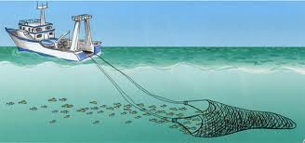






Conclusions
MemoryMonRWX logs & controls all memory accesses in a real time
It is a hypervisor, which supports newest Windows 10 x64
MemoryMonRWX can be used in various tasks:
  Trace malware activity
  Protect memory of 3rd party drivers
43
Notes:
MemoryMonRWX is a very promising project, it works in the newest Windows 10 and supports multi-core CPUs. It provides integrity and confidentiality for both code and data in memory. It can prevent data leakage attacks, unauthorized software copying, and protect PatchGuard from being disabled. MemoryMonRWX is just a fishing rod to catch memory disclosure attacks, I’m planning to develop a fast fishing boat to catch more and more. Also I’d like to show you my future plans.

Slide 44
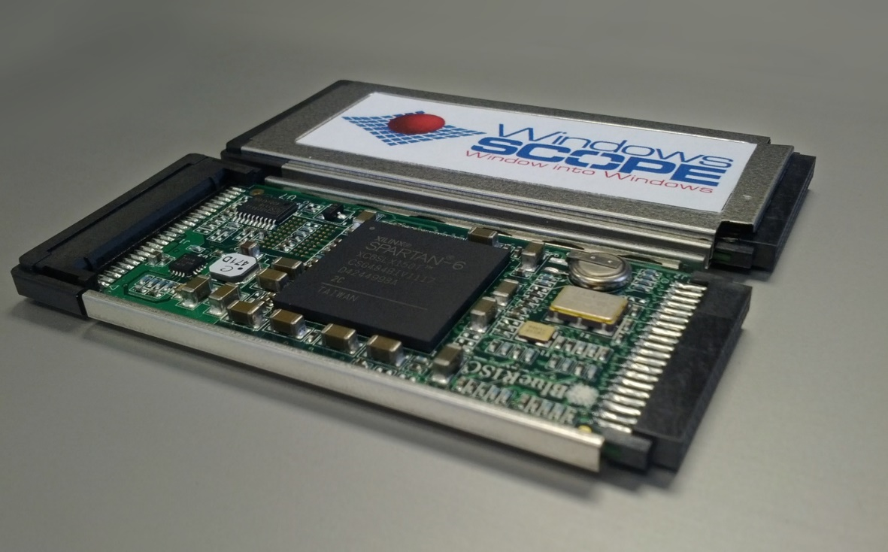
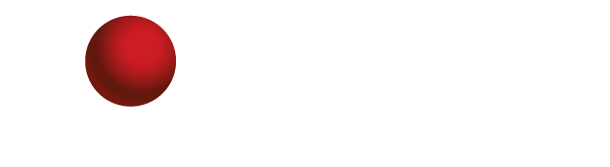
Acquire Physical Memory & Detect Hidden Software by Raspberry Pi
CaptureGUARD Physical Memory Acquisition Hardware
$7,799.00
“This is an ExpressCard device capable of imaging the physical memory of the computer it's connected to. Creates dump files in the standard WinDD format..”¹
44
1. CaptureGUARD Physical Memory Acquisition Hardware – ExpressCard. Windowsscope. http://www.windowsscope.com/product/captureguard-physical-memory-acquisition-hardware-expresscard/
2. Aumaitre, D., and Devine, C. Subverting Windows 7 x64 Kernel with DMA attacks. Sogeti ESEC Lab: http://esec-lab.sogeti.com/dotclear/public/ publications/10-hitbamsterdam-dmaattacks.pdf, July 2010.
Notes:
During my research I usually ignore hardware tools for digital forensics and incident response, but now look at this device.
This hardware can acquire physical memory dump by connecting to the ExpressCard slot. It’s produced by WindowsSCOPE company and it costs about $8000.
I suppose, that the device, which only dumps memory, can cost less.

Slide 45
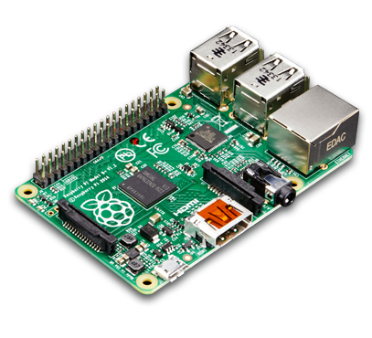
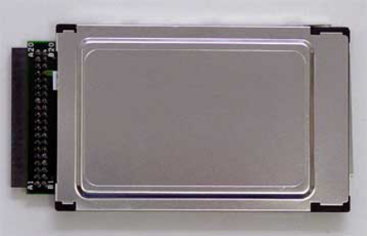
Acquire Physical Memory & Detect Hidden Software by Raspberry Pi
CardBus FPGA dev platform
Xilinx Spartan-3 400²
$295.00
Raspberry Pi 3
Model B
$35.00
CaptureGUARD Physical Memory Acquisition Hardware
$7,799.00
$330.00
“This is an ExpressCard device capable of imaging the physical memory of the computer it's connected to. Creates dump files in the standard WinDD format..”¹
Lower price with more features
45
1. CaptureGUARD Physical Memory Acquisition Hardware – ExpressCard. Windowsscope. http://www.windowsscope.com/product/captureguard-physical-memory-acquisition-hardware-expresscard/
2. Aumaitre, D., and Devine, C. Subverting Windows 7 x64 Kernel with DMA attacks. Sogeti ESEC Lab: http://esec-lab.sogeti.com/dotclear/public/ publications/10-hitbamsterdam-dmaattacks.pdf, July 2010.
Notes:
My idea is to apply IoT platform such as Raspberry Pi for the acquiring and processing memory dump. For example, it is possible to use FPGA devolvement platform Spartan-the-third to connect Raspberry Pi into ExpressCard slot. This Spartan platform has been successfully used in this project. Also after dumping we can apply Raspberry Pi to process the memory dump automatically as well as to send a dump via the Internet. All in all, it will cost about 10 times cheaper and have more features.

Slide 46
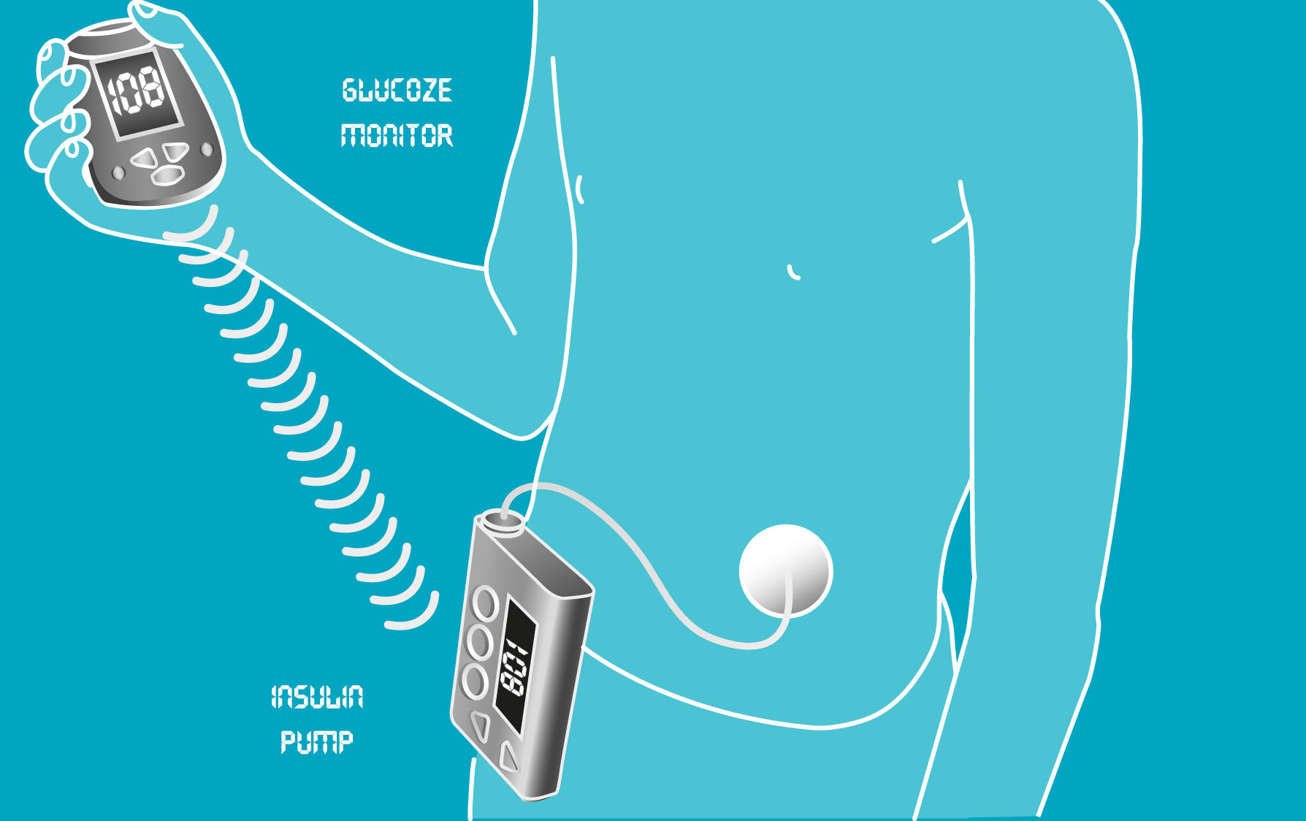
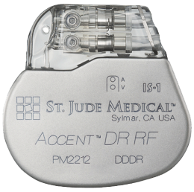
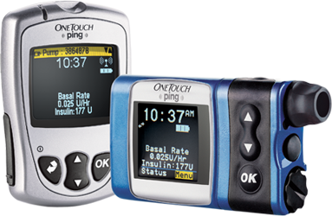
In the USA in upwards of 2.5 million people depend on wireless implantable medical devices, which all can be hijacked remotely¹
Consequences of attacks on implants:
1. Pacemakers by St. Jude Medical Inc.(2016)
  manipulation of beat rates
  battery drain
2. OneTouch Ping Insulin Pump by J&J (2016)
  unauthorized insulin injections
1. Ash, S. (2016). Cybersecurity of wireless implantable medical devices - http://pqdtopen.proquest.com/doc/1796055559.html?FMT=ABS
Notes:
Another idea is to protect medical devices from being hijacked.
A lot of people need wireless devices like insulin pumps, implantable cardioverter defibrillator ICDs and many others to survive and improve the quality of their life.
Patients and doctors use this wireless connection to control the devices and change their runtime parameters. Unfortunately, this wireless communication is vulnerable, here you can see some examples of resent cyber-attacks on implantable devices, performed through wireless connection. The idea is to protect this wireless communication.

Slide 47
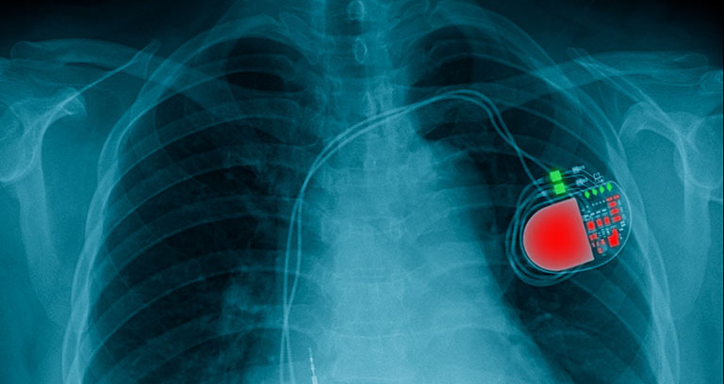


Protection of Wireless Implantable Medical Devices
Our Team:
Veronika Domova
Software developer, Sweden
IoT and Industrial Cyber Security
Igor Korkin, Ph.D.
Our Idea:
Input implant’s technical specifications
Choose the lightweight
crypto cipher
Verify the firmware
Vulnerable implant
Protected implant
Notes:
We are planning to provide complex security for these devices. We propose to choose for example length of crypto key according to the device specifications. We are thinking of a prevention system to reveal wireless denial-of-service attacks on these devices.

Slide 48
Thank you!
    Igor Korkin igor.korkin@gmail.com
    Satoshi Tanda tanda.sat@gmail.com
The slides, source code and all details are here – www.bit.ly/MemoryMonRWX
48
Notes:
Thank you!

