Slide 1

Kernel Hijacking Is Not an Option: MemoryRanger Comes to the Rescue Again
Igor Korkin
Independent Researcher
2020

Slide 2

WHOAMI
PhD, speaker at the ADFSL conference since 2014 and the BlackHat
Windows OS Kernel Security Researcher:
  Rootkits and anti-rootkits
  Bare-Metal Hypervisors vs. Attacks on Kernel Memory
Fan of cross-disciplinary research —
Love traveling and powerlifting —
igorkorkin.blogspot.com
igor.korkin

Slide 3
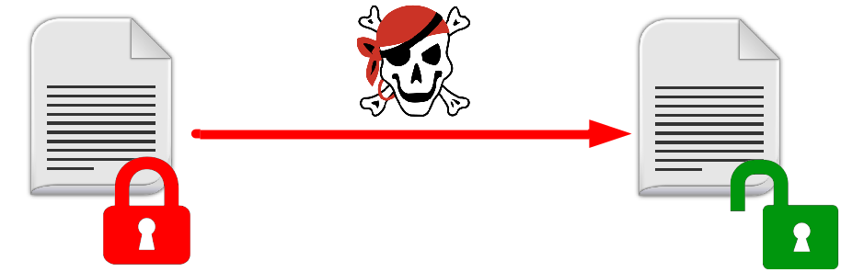
Agenda: Attacks on Files
Three attacks on kernel memory data:
Bypass file sharing access control:
    Handle Table Hijacking
    Hijacking NTFS structures

Slide 4
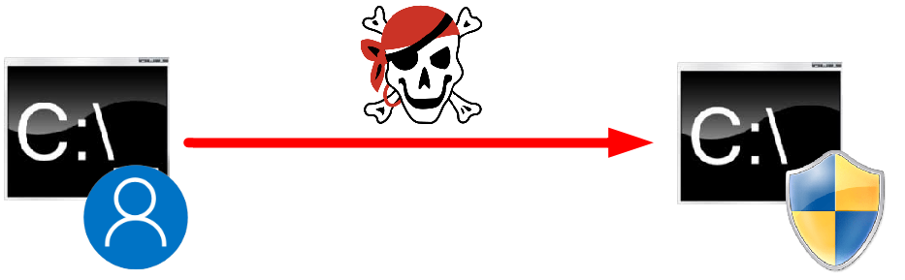
Agenda: Attacks on Files+Tokens
Three attacks on kernel memory data:
Bypass file sharing access control:
Process Privilege Escalation:
    Handle Table Hijacking
    Hijacking NTFS structures
    Token Hijacking

Slide 5
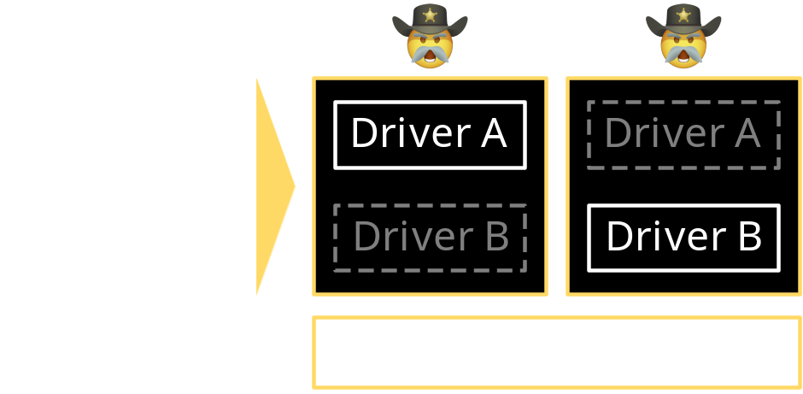
Agenda: Attacks on Files+Tokens & MemoryRanger
Three attacks on kernel memory data:
Bypass file sharing access control:
Process Privilege Escalation:
    Handle Table Hijacking
    Hijacking NTFS structures
    Token Hijacking
MemoryRanger blocks kernel attacks:
  It runs drivers in isolated kernel enclaves
  It includes a new feature: Data-Only Enclave

Slide 6

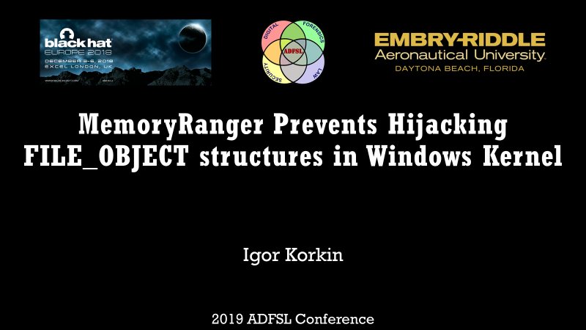
Previous research on MemoryRanger: papers+Slides+demos
(2018) Divide et Impera: MemoryRanger Runs Drivers in Isolated Kernel Spaces
https://igorkorkin.blogspot.com/2018/12/divide-et-impera-memoryranger-runs.html
(2019) MemoryRanger Prevents Hijacking FILE_OBJECT Structures in Windows Kernel
https://igorkorkin.blogspot.com/2019/04/memoryranger-prevents-hijacking.html

Slide 7
Kernel drivers can compromise the OS security

Slide 8
Kernel Drivers in recent malware attacks on Windows
RobbinHood Ransomware - 2020
  Exploits a legitimate buggy driver to load a malware driver
  Malware driver disables endpoint security products
Ransomware installs Gigabyte driver to kill antivirus products - https://www.zdnet.com/article/ransomware-installs-gigabyte-driver-to-kill-antivirus-products/
Nansh0u Miner Attack Infects 50K MS-SQL, PHPMyAdmin Servers - https://www.guardicore.com/2019/05/nansh0u-campaign-hackers-arsenal-grows-stronger/
Glupteba: Hidden Malware Delivery in Plain Sight - https://news.sophos.com/wp-content/uploads/2020/06/glupteba_final.pdf

Slide 9
Kernel Drivers in recent malware attacks on Windows
RobbinHood Ransomware - 2020
  Exploits a legitimate buggy driver to load a malware driver
  Malware driver disables endpoint security products
  Crypto-miner with a signed driver - 2019
  Infected more than 50,000 Windows machines in the world
  Uses a signed malware driver to protect itself from termination
Ransomware installs Gigabyte driver to kill antivirus products - https://www.zdnet.com/article/ransomware-installs-gigabyte-driver-to-kill-antivirus-products/
Nansh0u Miner Attack Infects 50K MS-SQL, PHPMyAdmin Servers - https://www.guardicore.com/2019/05/nansh0u-campaign-hackers-arsenal-grows-stronger/
Glupteba: Hidden Malware Delivery in Plain Sight - https://news.sophos.com/wp-content/uploads/2020/06/glupteba_final.pdf

Slide 10
Kernel Drivers in recent malware attacks on Windows
RobbinHood Ransomware - 2020
  Exploits a legitimate buggy driver to load a malware driver
  Malware driver disables endpoint security products
  Crypto-miner with a signed driver - 2019
  Infected more than 50,000 Windows machines in the world
  Uses a signed malware driver to protect itself from termination
Glupteba includes rootkit to hide files and processes - 2020
  Exploits a signed vulnerable driver to bypass the
  Kernel Patch Protection and Driver Signature Enforcement
Ransomware installs Gigabyte driver to kill antivirus products - https://www.zdnet.com/article/ransomware-installs-gigabyte-driver-to-kill-antivirus-products/
Nansh0u Miner Attack Infects 50K MS-SQL, PHPMyAdmin Servers - https://www.guardicore.com/2019/05/nansh0u-campaign-hackers-arsenal-grows-stronger/
Glupteba: Hidden Malware Delivery in Plain Sight - https://news.sophos.com/wp-content/uploads/2020/06/glupteba_final.pdf

Slide 11





Slide 12



Slide 13



Slide 14


Slide 15


Don’t mess with kernel data!
MemoryRanger

Slide 16
Episode 1
Bypass File Sharing Access Control via
Hijacking File Structures

Slide 17
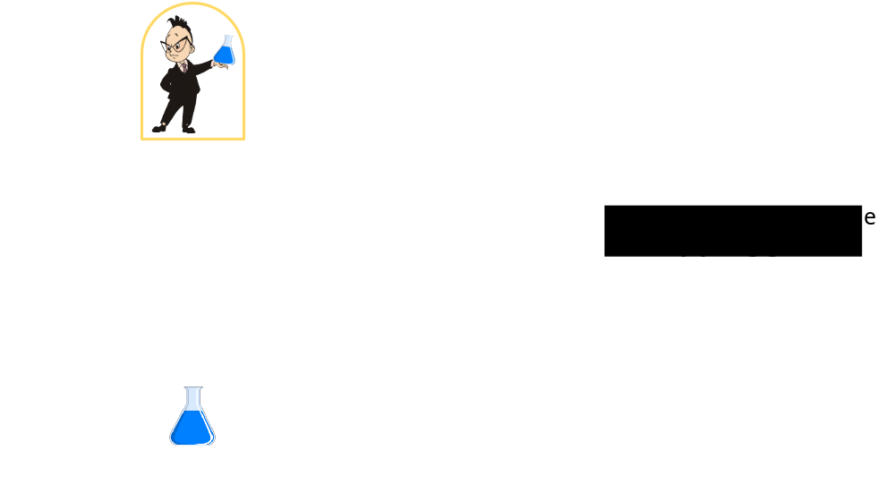
Scenario of attacks on files

Slide 18
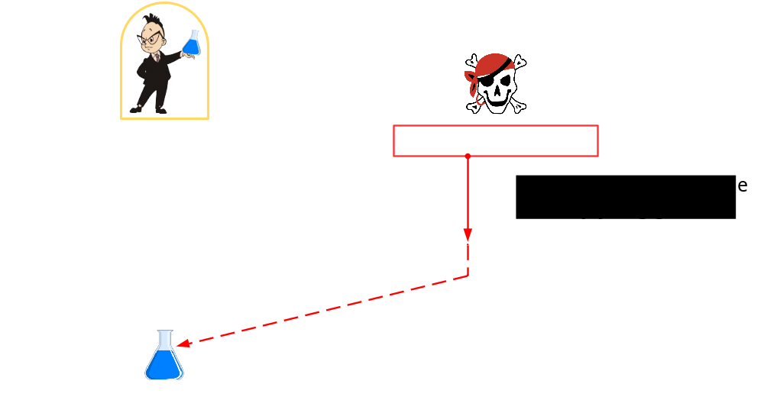
Scenario of attacks on files

Slide 19
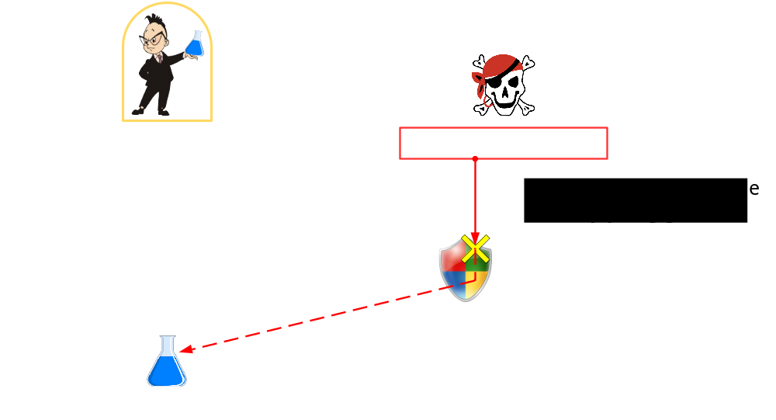
Scenario of attacks on files

Slide 20
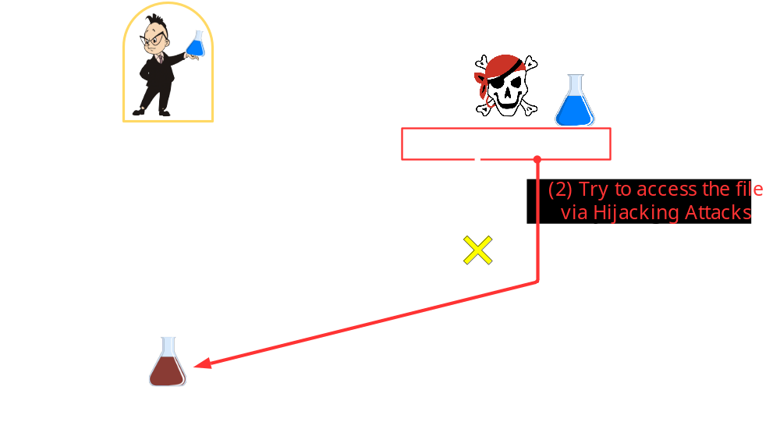

Scenario of attacks on files
Notes:
https://pixlr.com/ru/e/

Slide 21
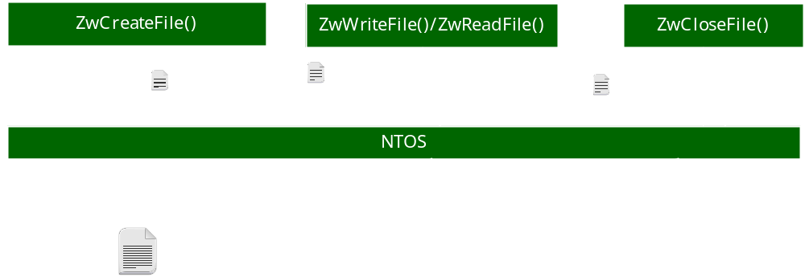
file system kernel API routines
NTSTATUS ZwCreateFile(..., ShareAccess, ...);
ShareAccess flag determines whether other drivers can access the opened file.

Slide 22
file system kernel API routines

Slide 23
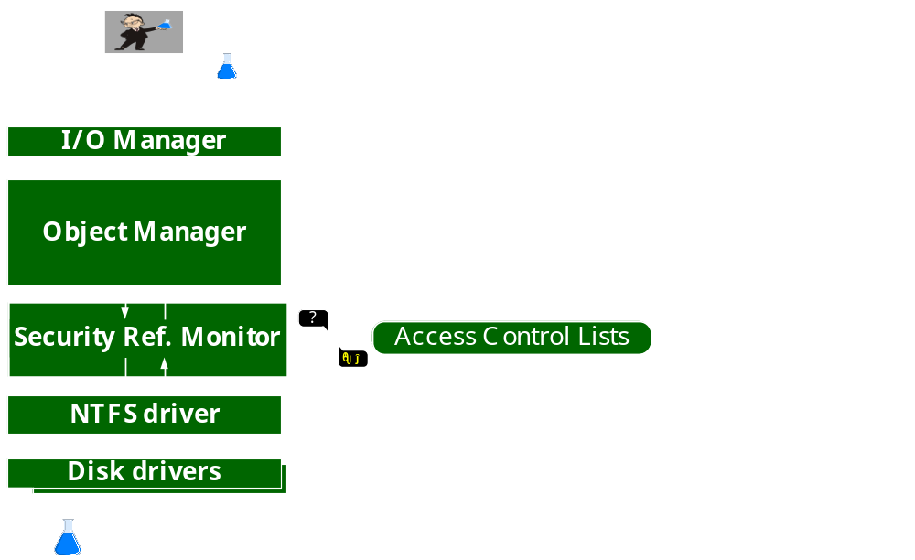
Internals of ZwCreateFile
Notes:
This function involves an Iee/Oou Manager,

Slide 24
Internals of ZwCreateFile
Notes:
This function involves an Iee/Oou Manager,

Slide 25
Internals of ZwCreateFile
Notes:
This function involves an Iee/Oou Manager,

Slide 26
Internals of ZwCreateFile
Notes:
This function involves an Iee/Oou Manager,

Slide 27
Internals of ZwCreateFile
Notes:
This function involves an Iee/Oou Manager,

Slide 28
Internals of ZwCreateFile
Notes:
This function involves an Iee/Oou Manager,

Slide 29
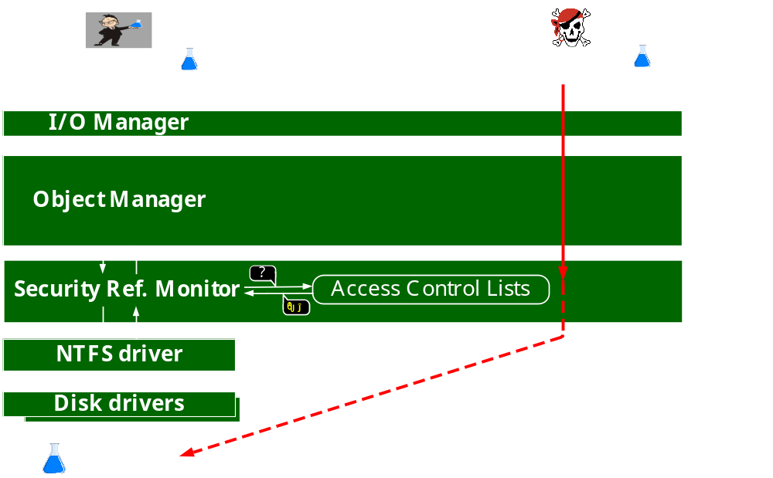
SECURITY REFERENCE MONITOR PREVENTS ILLEGAL ACCESS
Notes:
This function involves an Iee/Oou Manager,

Slide 30
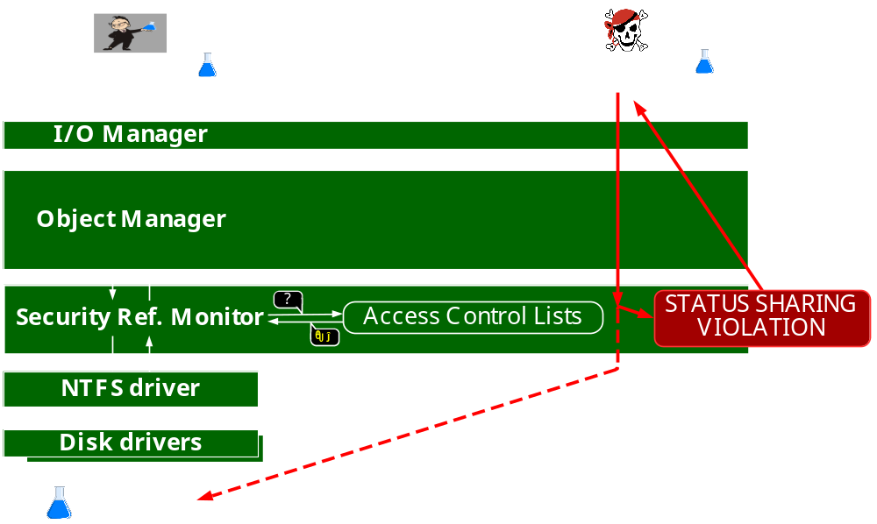
SECURITY REFERENCE MONITOR PREVENTS ILLEGAL ACCESS
Notes:
This function involves an Iee/Oou Manager,

Slide 31
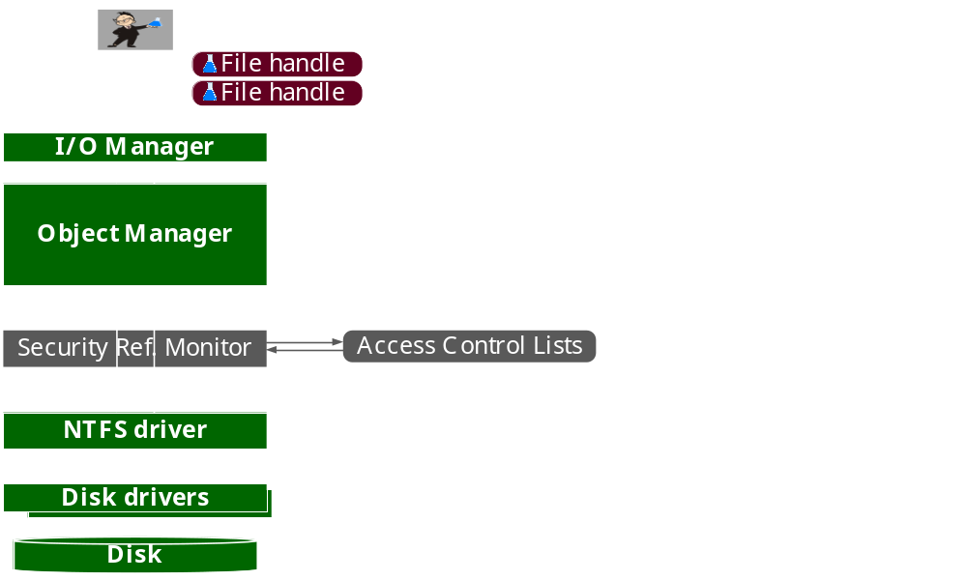
Internals of ZwReadFile/ZwWriteFile

Slide 32
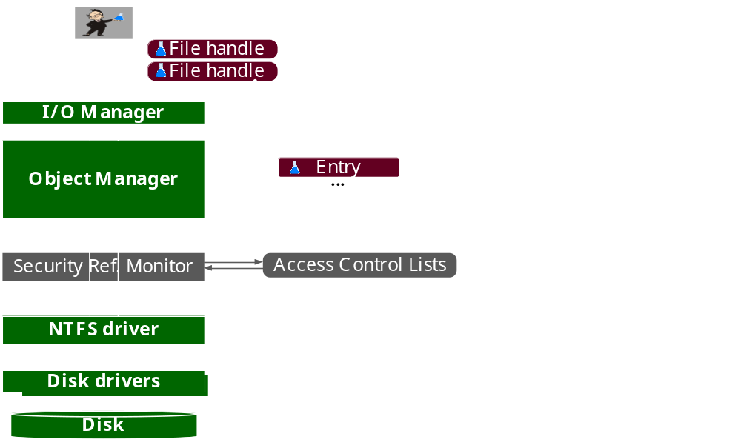
Internals of ZwReadFile/ZwWriteFile

Slide 33
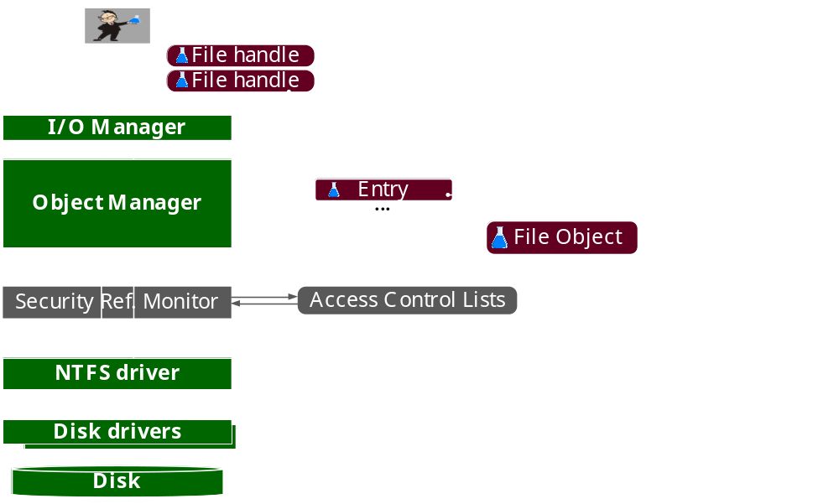
Internals of ZwReadFile/ZwWriteFile

Slide 34
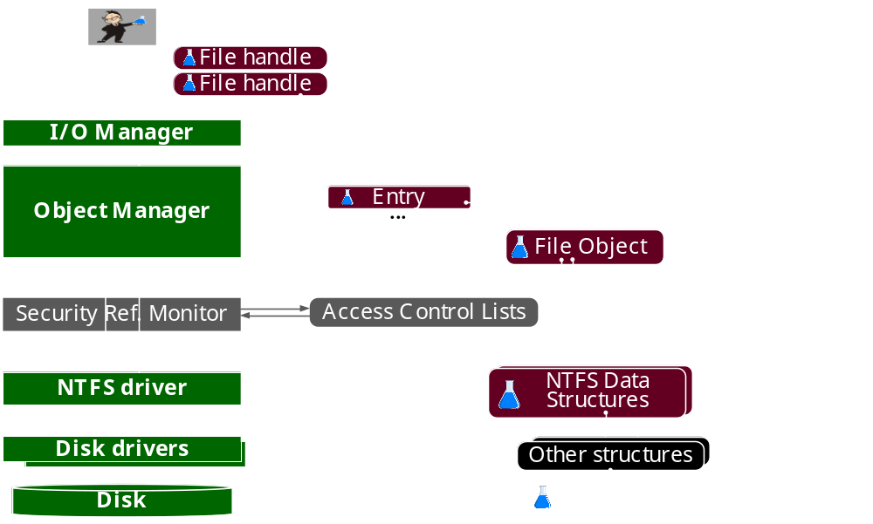
Internals of ZwReadFile/ZwWriteFile

Slide 35
Summary
ZwCreateFile checks shared access permissions
ZwWriteFile and ZwReadFile do not bother about access permissions

Slide 36
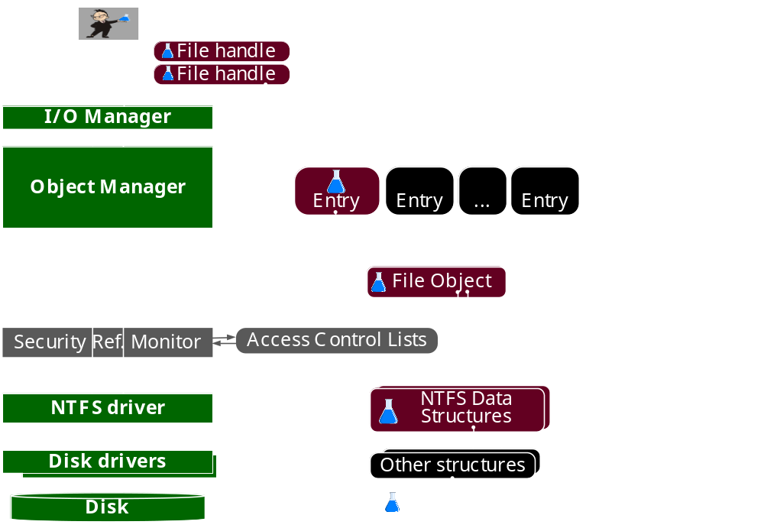
Idea of Hijacking: Create a File HIAJCKER

Slide 37
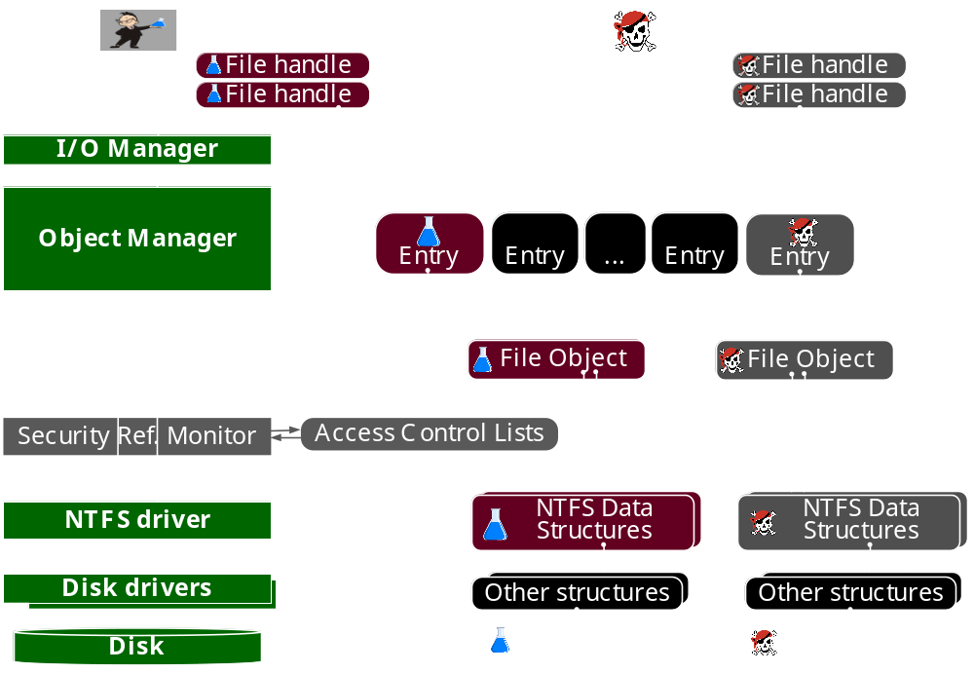
Idea of Hijacking: Create a File HIAJCKER and Copy structs

Slide 38
Idea of Hijacking: Create a File HIAJCKER and Copy structs

Slide 39
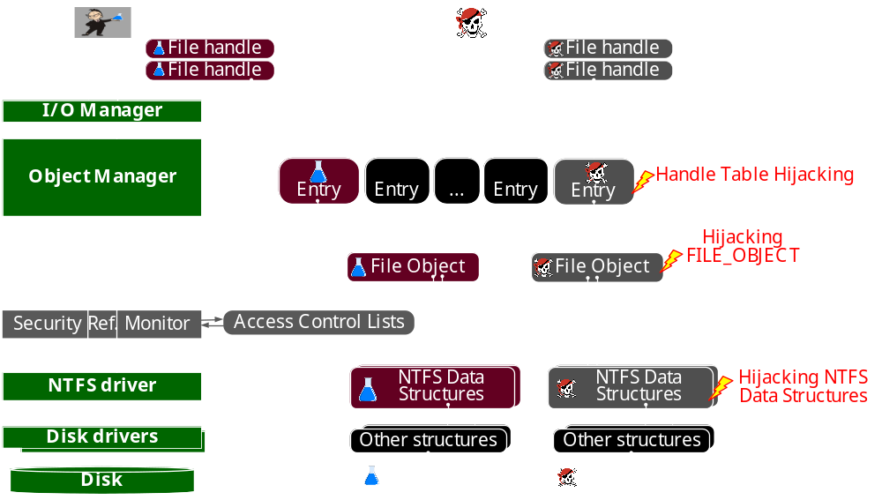

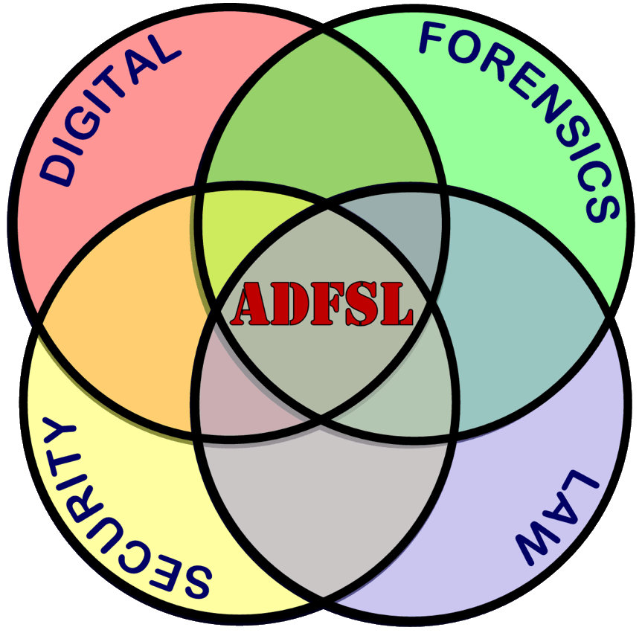
Hijacking Attacks on Files structures
2019

Slide 40
Hijacking Attacks on Files structures

Slide 41
Hijacking Attacks on Files structures
2019

Slide 42
Hijacking Attacks on Files structures

Slide 43
Hijacking Attacks on Files structures
Hijacking FILE_OBJECT → MemoryRanger Prevents Hijacking FILE_OBJECT Structures in Windows Kernel https://igorkorkin.blogspot.com/2019/04/memoryranger-prevents-hijacking.html

Slide 44
Handle hijacking Attack

Slide 45

Handle hijacking Attack

Slide 46
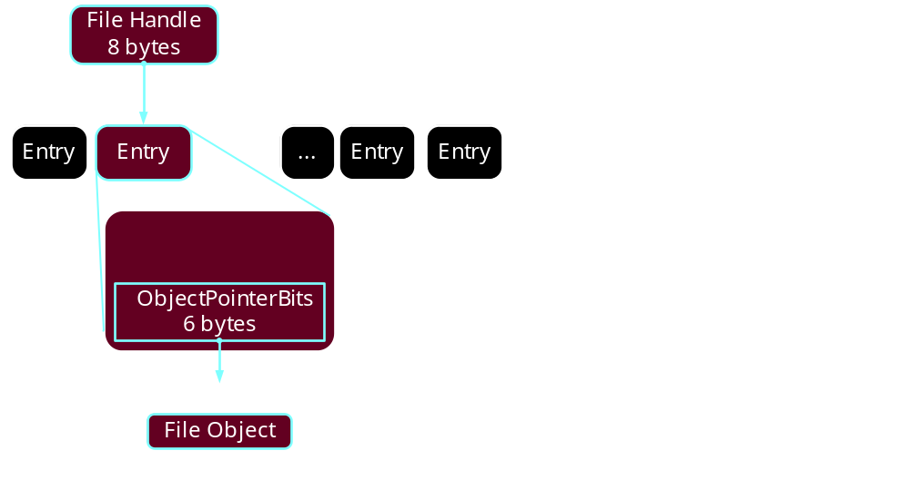
Kernel handle Table

Slide 47
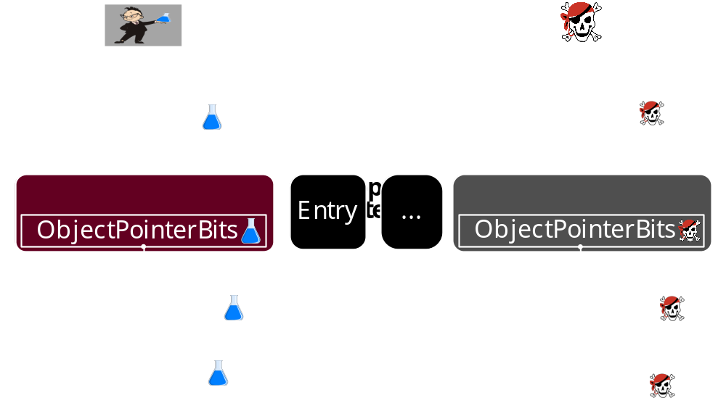
Handle Table hijacking

Slide 48
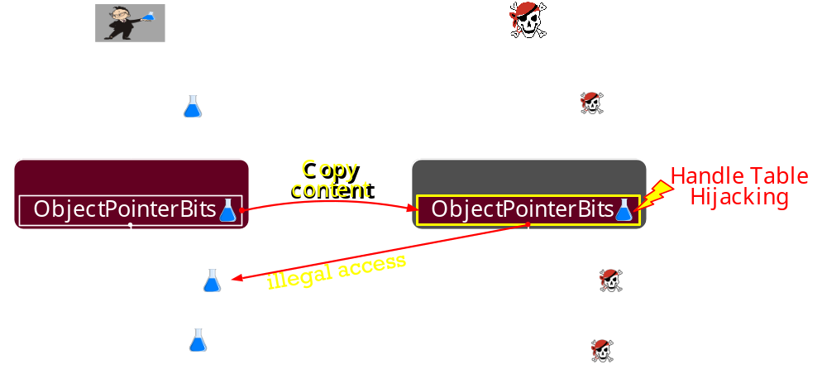
Handle Table hijacking

Slide 49
Handle Table hijacking

Slide 50
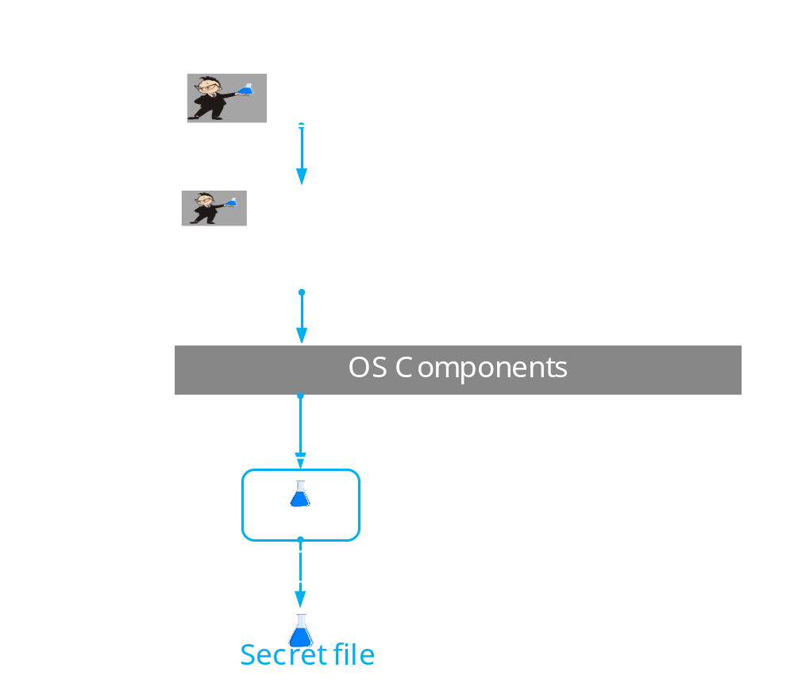
DEMO: Handle Table hijacking

Slide 51
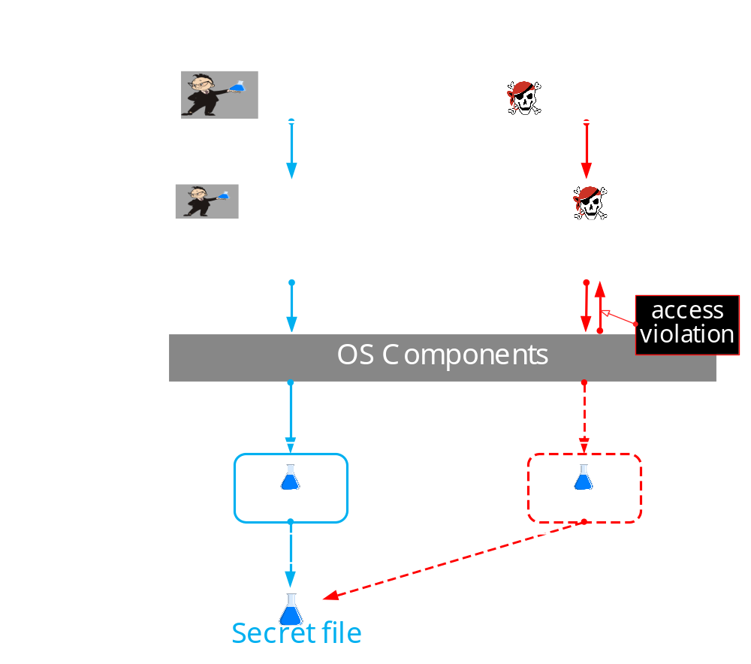
DEMO: Handle Table hijacking

Slide 52
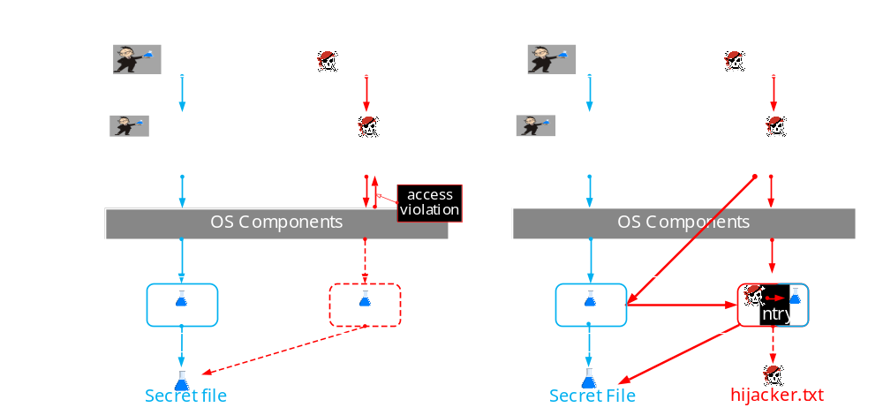
DEMO: Handle Table hijacking

Slide 53
Demo#1: Handle Table hijacking
The online version is here – https://www.youtube.com/embed/5NNSXfTRtiQ?vq=hd1440
Notes:
First of all, we are launching MemoryRanger console application.
It loads the hypervisor /ˈhaɪpə(r)ˌ vaɪzə(r)/ to protect kernel memory.
Then, the boss is launching his console, which loads a driver. The boss creates the budget file.
And we can see the created the file handle and the allocated FILE_OBJECT structure.
By using f_write the boss is setting up the budget.
Now, the boss is checking the budget. Done.
Now the boss receives a call and the budget file remains open.
At this moment, the attacker is getting a chance to snoop the budget.
He is launching its console. He is trying to open the budget using file system routine ZwCreateFile.
So, he fails to open the file, because Windows prevents illegal access to the budget file.
The attacker is willing to gain an access by hijacking.
He copies the address of the FILE_OBJECT. By using f_open_by_hijacking the attacker creates a file hijacker. Windows creates this file and returns the file handle and the FILE_OBJECT structure.
The attacker is trying to read the budget FILE_OBJECT, but he fails.
MemoryRanger prevents illegal memory access to the budget FILE_OBJECT.
Anyway, the attacker is still hoping to read the budget.
But instead of reading a real budget, the attacker can read only the deliberately foisted fake {pause} null data.
He fails again.
But anyway, he is trying to overwrite the budget file.
If the boss decides to check his budget he will see the originals data.
MemoryRanger prevents all illegal access attempts to the budget.
Finally, let’s compare these /ðiːz/ two files. We close the budget file and the file hijacker and both control consoles as well.
We can see that the budget file includes only the budget and all attackers input data is in his file.
The OS is protected.

Slide 54
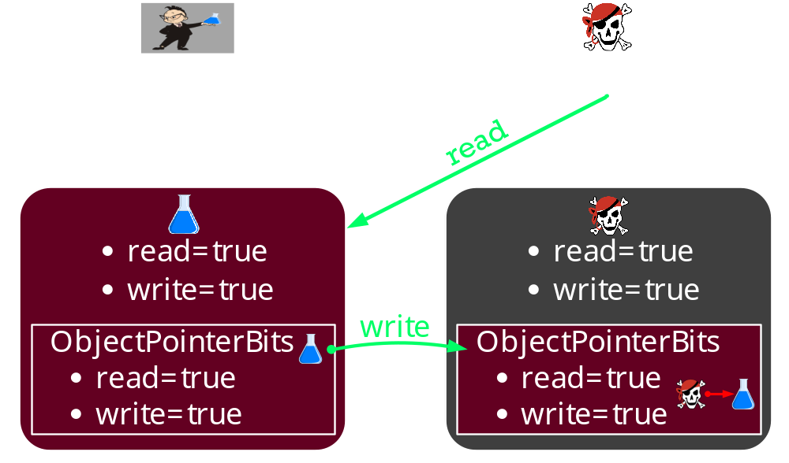
How to prevent the Handle hijacking?
We have to block WRITE access to the ObjectPointerBits
We have to grant READ access to the whole Handle Table for all drivers

Slide 55
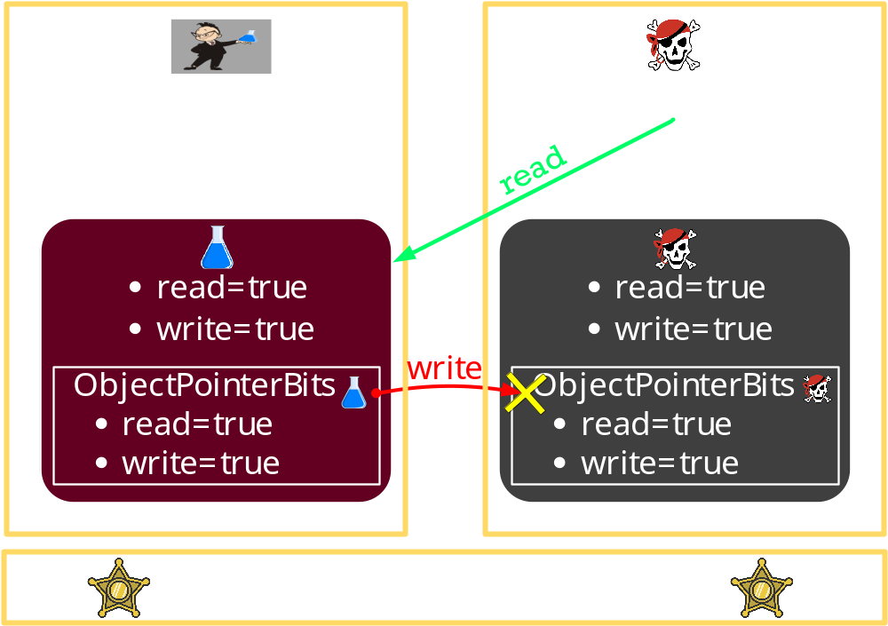
How to prevent the Handle hijacking?
We have to block WRITE access to the ObjectPointerBits
We have to grant READ access to the whole Handle Table for all drivers

Slide 56
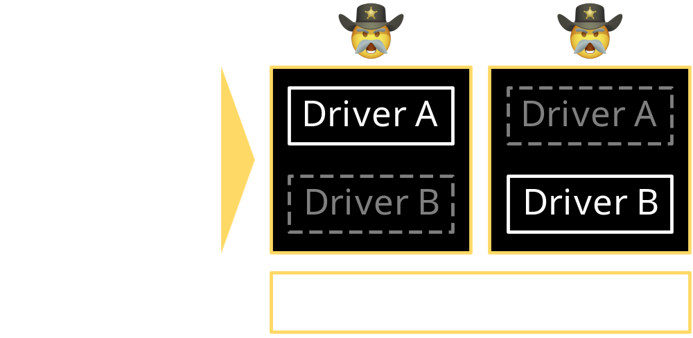
MemoryRanger isolates Drivers by running drivers in Separate Kernel Spaces
MemoryRanger and Enclaves details are here:
  (2019) https://igorkorkin.blogspot.com/2019/04/memoryranger-prevents-hijacking.html
  (2018) https://igorkorkin.blogspot.com/2018/12/divide-et-impera-memoryranger-runs.html

Slide 57
Memory Map: MemoryRanger Prevents Handle hijacking

Slide 58
Memory Map: MemoryRanger Prevents Handle hijacking

Slide 59
Memory Map: MemoryRanger Prevents Handle hijacking

Slide 60
Memory Map: MemoryRanger Prevents Handle hijacking

Slide 61
Demo#2: prevention OF Handle Table hijacking
The online version is here – https://www.youtube.com/embed/5Pz-IXvQDiY?vq=hd1440
Notes:
First of all, we are launching MemoryRanger console application.
It loads the hypervisor /ˈhaɪpə(r)ˌ vaɪzə(r)/ to protect kernel memory.
Then, the boss is launching his console, which loads a driver. The boss creates the budget file.
And we can see the created the file handle and the allocated FILE_OBJECT structure.
By using f_write the boss is setting up the budget.
Now, the boss is checking the budget. Done.
Now the boss receives a call and the budget file remains open.
At this moment, the attacker is getting a chance to snoop the budget.
He is launching its console. He is trying to open the budget using file system routine ZwCreateFile.
So, he fails to open the file, because Windows prevents illegal access to the budget file.
The attacker is willing to gain an access by hijacking.
He copies the address of the FILE_OBJECT. By using f_open_by_hijacking the attacker creates a file hijacker. Windows creates this file and returns the file handle and the FILE_OBJECT structure.
The attacker is trying to read the budget FILE_OBJECT, but he fails.
MemoryRanger prevents illegal memory access to the budget FILE_OBJECT.
Anyway, the attacker is still hoping to read the budget.
But instead of reading a real budget, the attacker can read only the deliberately foisted fake {pause} null data.
He fails again.
But anyway, he is trying to overwrite the budget file.
If the boss decides to check his budget he will see the originals data.
MemoryRanger prevents all illegal access attempts to the budget.
Finally, let’s compare these /ðiːz/ two files. We close the budget file and the file hijacker and both control consoles as well.
We can see that the budget file includes only the budget and all attackers input data is in his file.
The OS is protected.

Slide 62
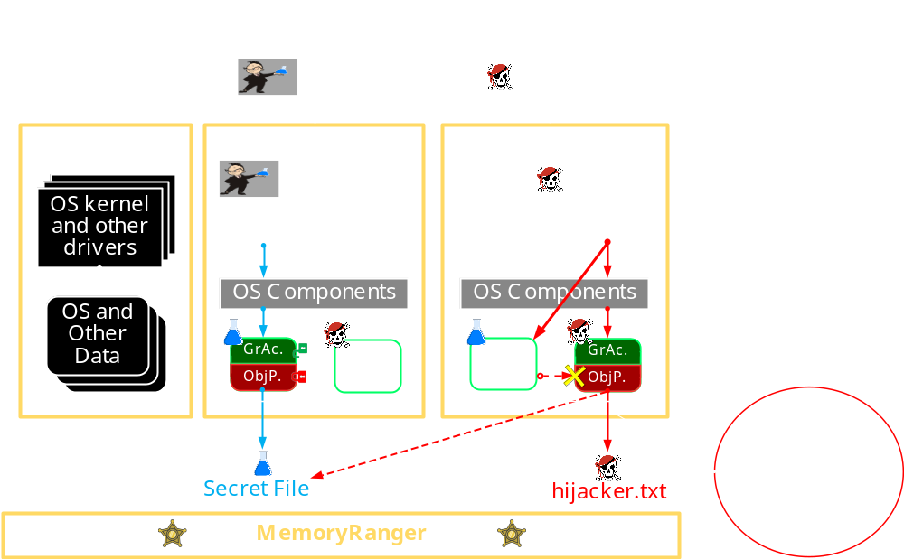

Slide 64
hijacking NTFS data structures

Slide 65
Hijacking Attacks on Files structures

Slide 66
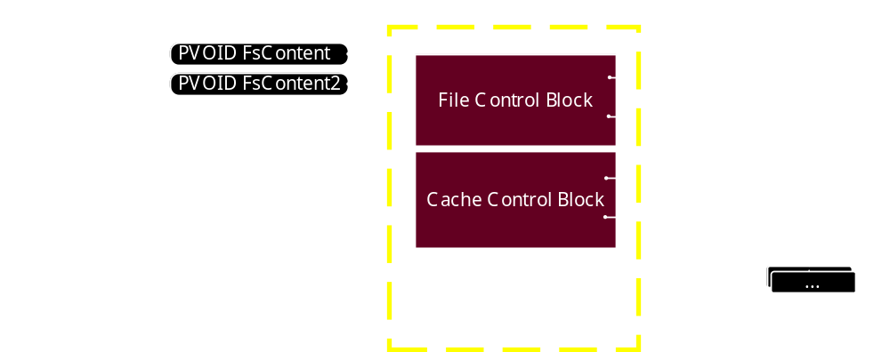
NTFS DATA STRUCTURES
Notes:
The fields FsContext and FsContext2 store file object specific context information:
FsContext field points to a structure which contains information about a file or a stream within the file.
FsContext2 field points to a cache control block, a data structure that used to store instance specific information about the file or stream.

Slide 67
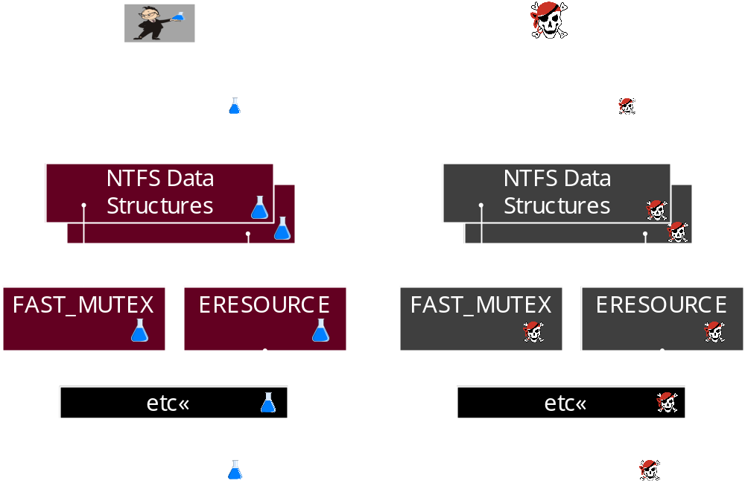
Hijacking NTFS structures

Slide 68
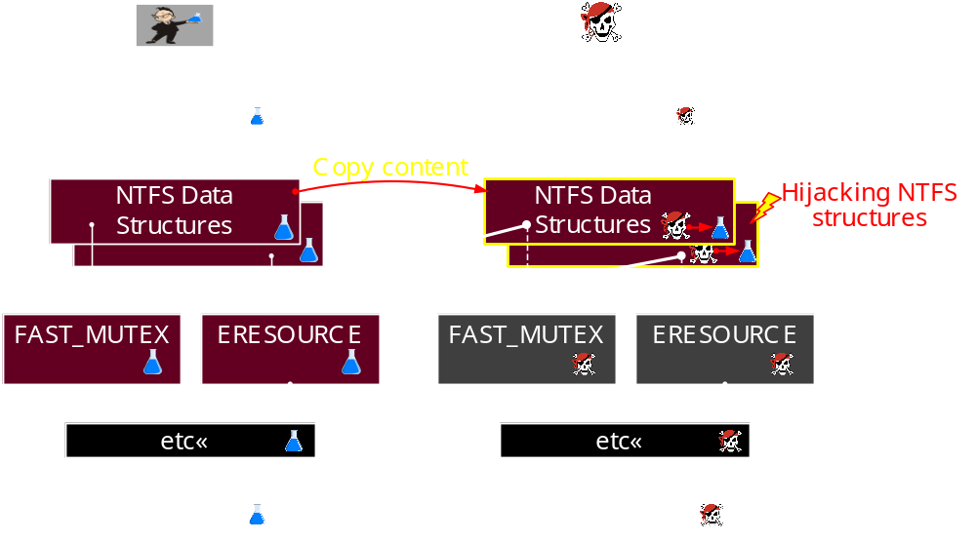
Hijacking NTFS structures

Slide 69
Hijacking NTFS structures

Slide 70
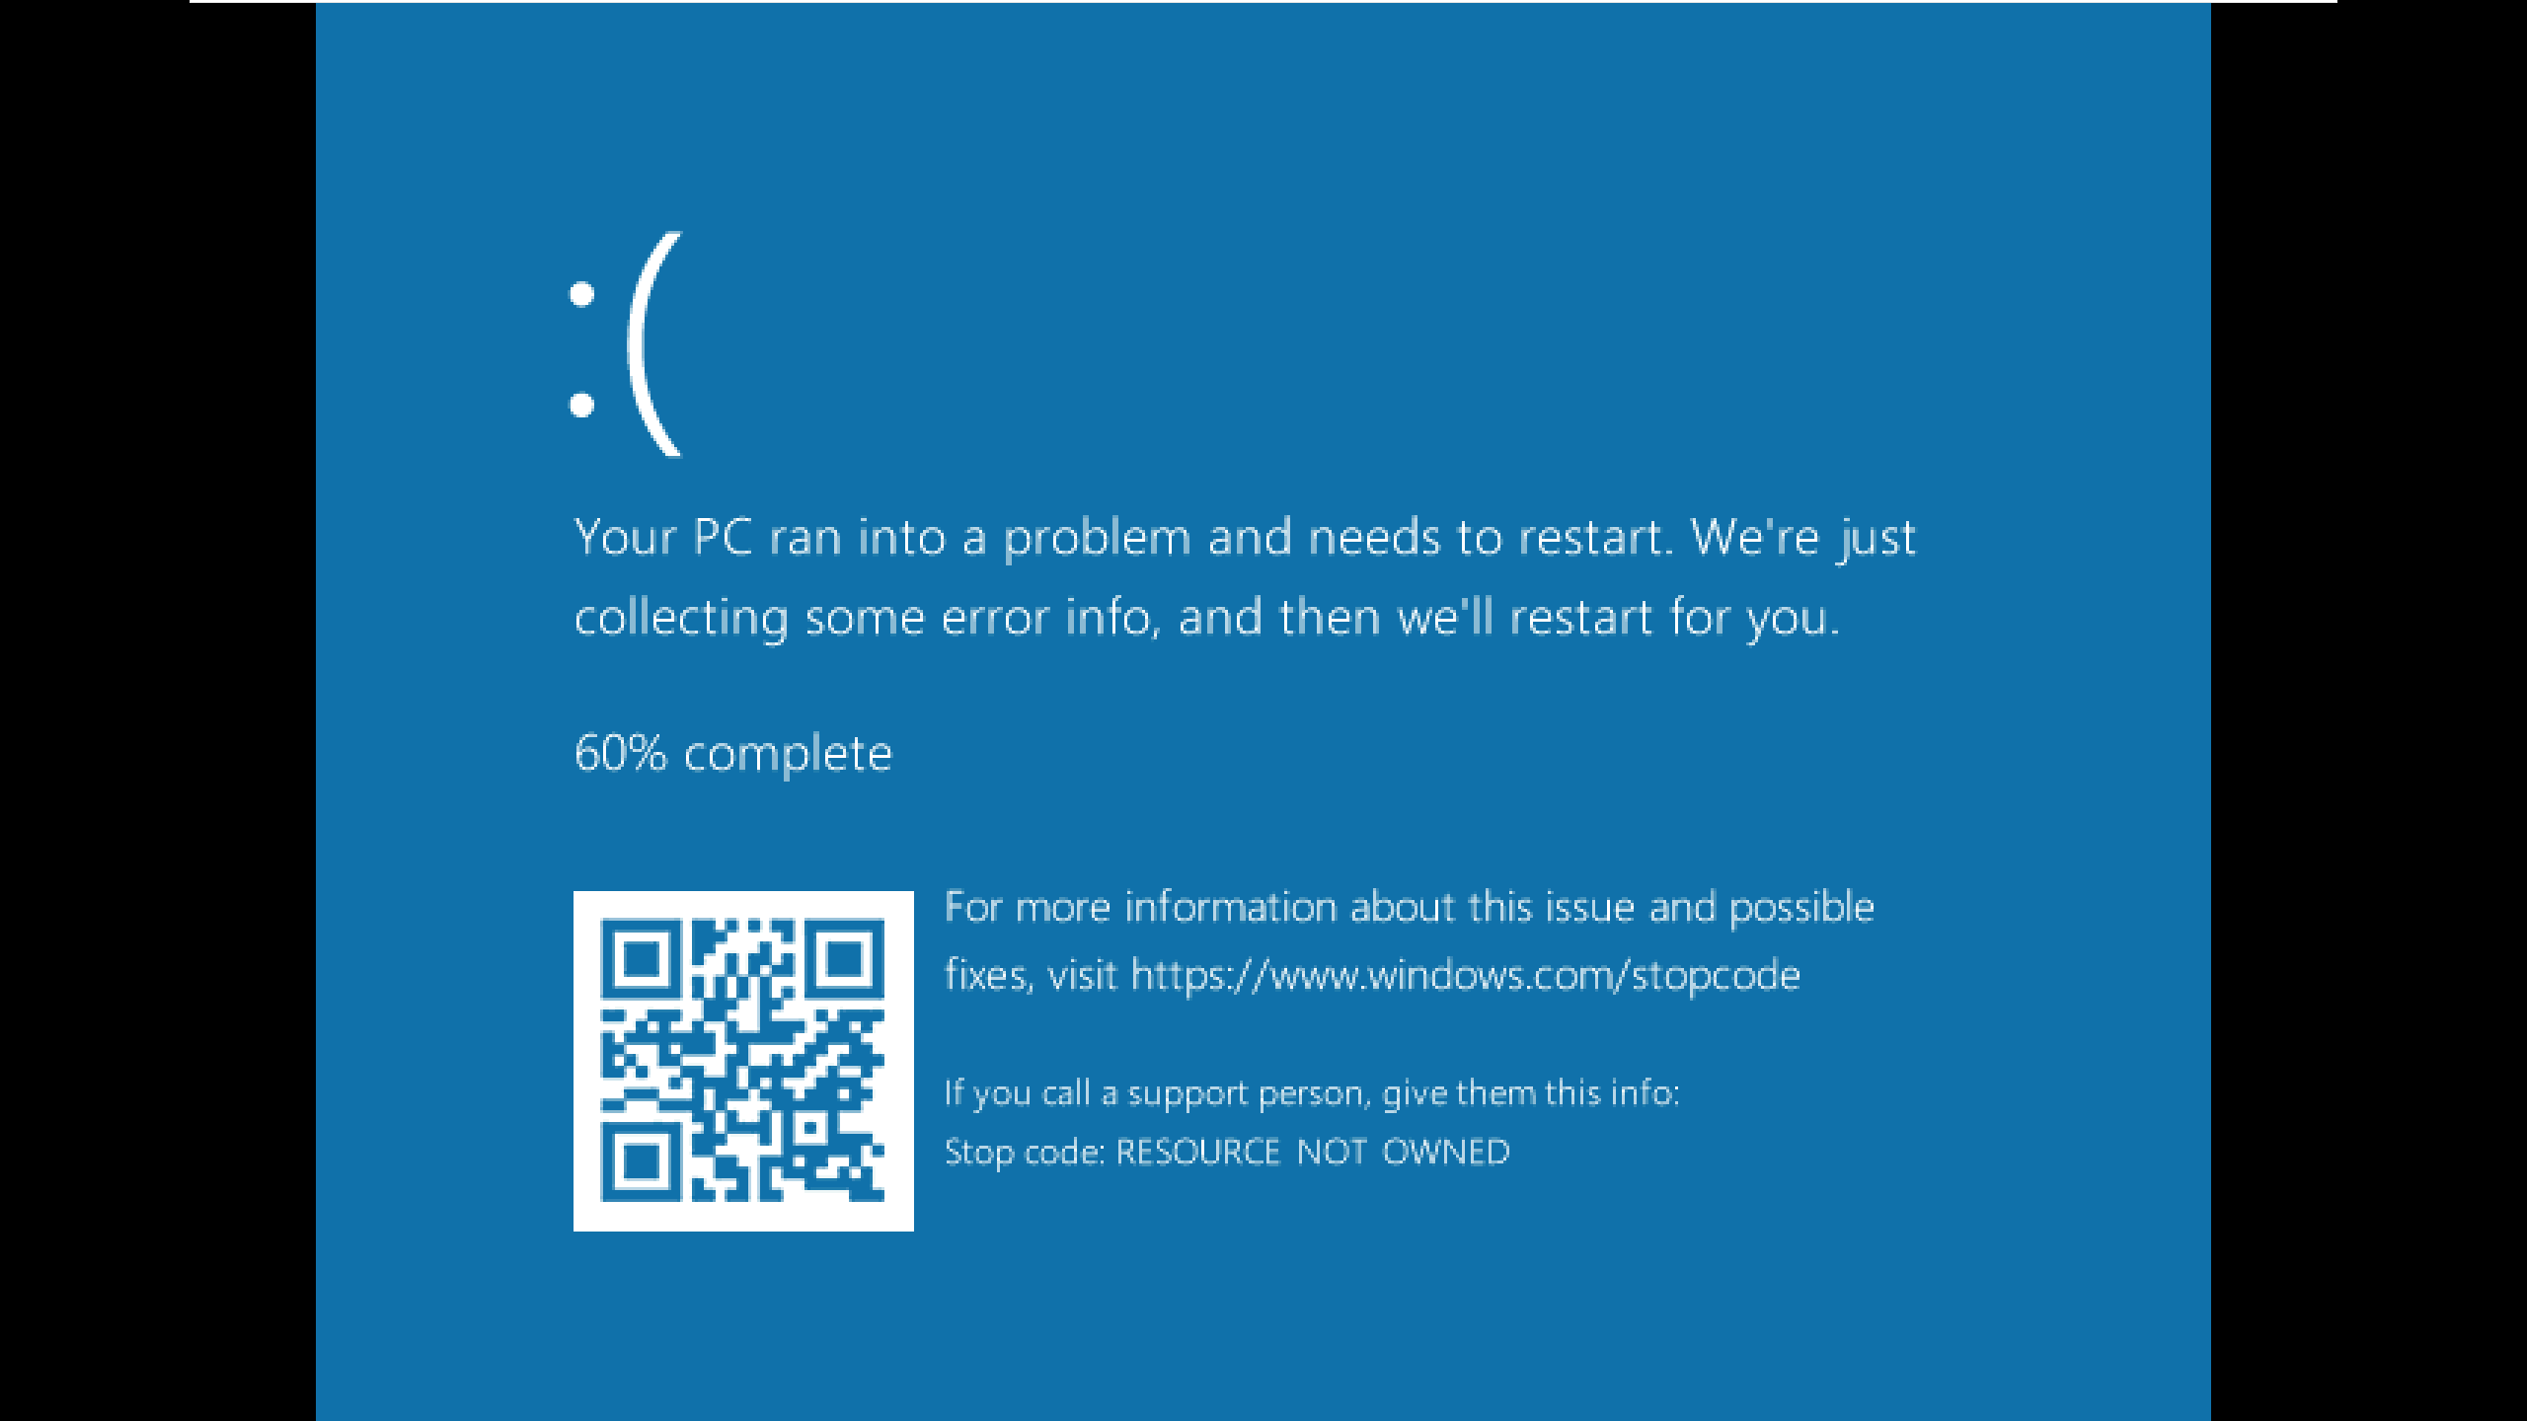
BSOD - RESOURCE_NOT_OWNED (0xe3)

Slide 71
BSOD: the Reason and the way to bypass
void ExReleaseResourceLite(PERESOURCE Resource){
…
CurrentThread = KeGetCurrentThread();
if (IsOwnedExclusive(Resource)) {
if (Resource->OwnerThreads[0].OwnerThread != CurrentThread) {
KeBugCheckEx(RESOURCE_NOT_OWNED, … )
}
}
}
*wrk-v1.2\base\ntos\ex\resource.c

Slide 72
BSOD: the Reason and the way to bypass
void ExReleaseResourceLite(PERESOURCE Resource){
…
CurrentThread = KeGetCurrentThread();
if (IsOwnedExclusive(Resource)) {
if (Resource->OwnerThreads[0].OwnerThread != CurrentThread) {
KeBugCheckEx(RESOURCE_NOT_OWNED, … )
}
}
}
*wrk-v1.2\base\ntos\ex\resource.c

Slide 73
BSOD: the way to bypass (for hackers only)
Overwrite control block structures
Patch ThreadID-related fields using attackers ThreadID:
    Resource->OwnerEntry.OwnerThread = PsGetCurrentThread();
    PagingIoResource->OwnerEntry.OwnerThread = PsGetCurrentThread()
Repeat steps 1 and 2 before each read and write call

Slide 74
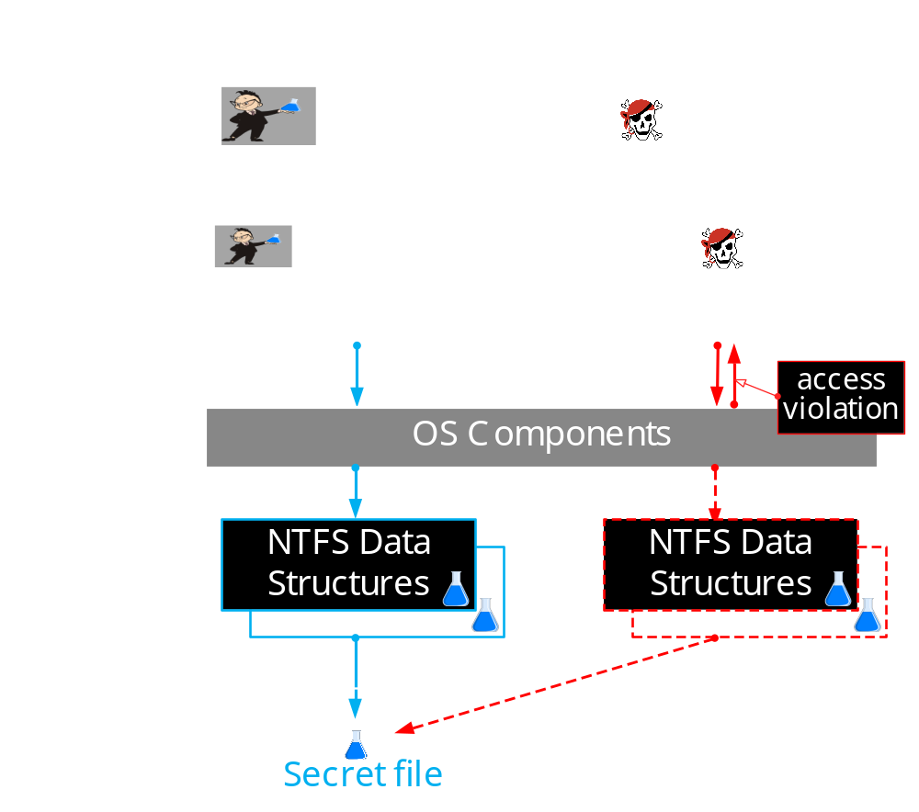
DEMO: Hijacking NTFS structures

Slide 75
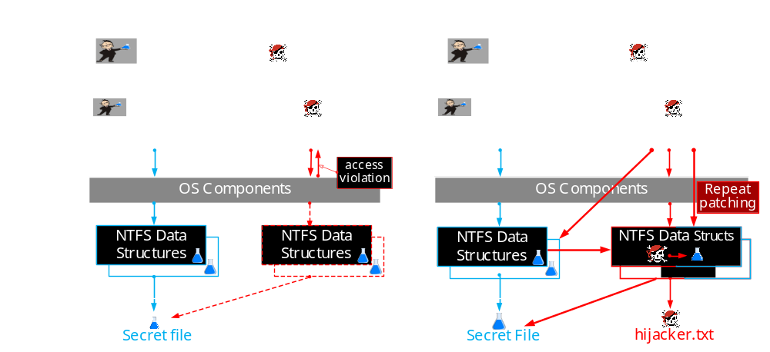
DEMO: Hijacking NTFS structures

Slide 76
Demo#3: Hijacking NTFS structures
The online version is here – https://www.youtube.com/embed/bHEf2fNkqbc?vq=hd1440
Notes:
First of all, we are launching MemoryRanger console application.
It loads the hypervisor /ˈhaɪpə(r)ˌ vaɪzə(r)/ to protect kernel memory.
Then, the boss is launching his console, which loads a driver. The boss creates the budget file.
And we can see the created the file handle and the allocated FILE_OBJECT structure.
By using f_write the boss is setting up the budget.
Now, the boss is checking the budget. Done.
Now the boss receives a call and the budget file remains open.
At this moment, the attacker is getting a chance to snoop the budget.
He is launching its console. He is trying to open the budget using file system routine ZwCreateFile.
So, he fails to open the file, because Windows prevents illegal access to the budget file.
The attacker is willing to gain an access by hijacking.
He copies the address of the FILE_OBJECT. By using f_open_by_hijacking the attacker creates a file hijacker. Windows creates this file and returns the file handle and the FILE_OBJECT structure.
The attacker is trying to read the budget FILE_OBJECT, but he fails.
MemoryRanger prevents illegal memory access to the budget FILE_OBJECT.
Anyway, the attacker is still hoping to read the budget.
But instead of reading a real budget, the attacker can read only the deliberately foisted fake {pause} null data.
He fails again.
But anyway, he is trying to overwrite the budget file.
If the boss decides to check his budget he will see the originals data.
MemoryRanger prevents all illegal access attempts to the budget.
Finally, let’s compare these /ðiːz/ two files. We close the budget file and the file hijacker and both control consoles as well.
We can see that the budget file includes only the budget and all attackers input data is in his file.
The OS is protected.

Slide 77
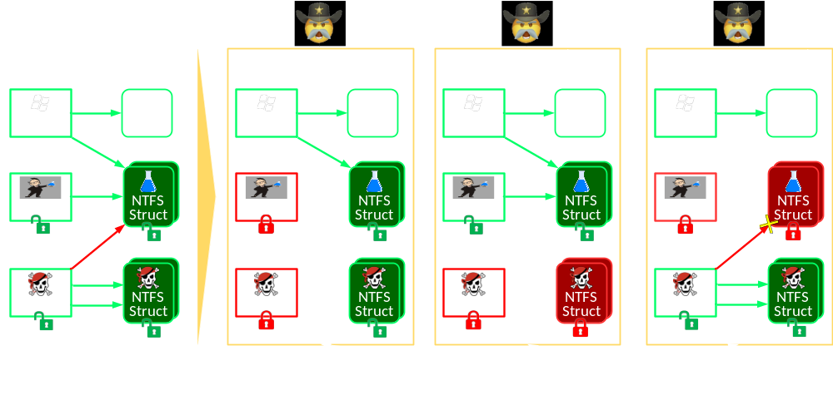
MemoryRanger Prevents Hijacking NTFS structs

Slide 78
MemoryRanger Prevents Hijacking NTFS structs

Slide 79
Demo#4: Prevention of Hijacking NTFS structs
The online version is here – https://www.youtube.com/embed/CSvq-VyxFH4?vq=hd1440
Notes:
First of all, we are launching MemoryRanger console application.
It loads the hypervisor /ˈhaɪpə(r)ˌ vaɪzə(r)/ to protect kernel memory.
Then, the boss is launching his console, which loads a driver. The boss creates the budget file.
And we can see the created the file handle and the allocated FILE_OBJECT structure.
By using f_write the boss is setting up the budget.
Now, the boss is checking the budget. Done.
Now the boss receives a call and the budget file remains open.
At this moment, the attacker is getting a chance to snoop the budget.
He is launching its console. He is trying to open the budget using file system routine ZwCreateFile.
So, he fails to open the file, because Windows prevents illegal access to the budget file.
The attacker is willing to gain an access by hijacking.
He copies the address of the FILE_OBJECT. By using f_open_by_hijacking the attacker creates a file hijacker. Windows creates this file and returns the file handle and the FILE_OBJECT structure.
The attacker is trying to read the budget FILE_OBJECT, but he fails.
MemoryRanger prevents illegal memory access to the budget FILE_OBJECT.
Anyway, the attacker is still hoping to read the budget.
But instead of reading a real budget, the attacker can read only the deliberately foisted fake {pause} null data.
He fails again.
But anyway, he is trying to overwrite the budget file.
If the boss decides to check his budget he will see the originals data.
MemoryRanger prevents all illegal access attempts to the budget.
Finally, let’s compare these /ðiːz/ two files. We close the budget file and the file hijacker and both control consoles as well.
We can see that the budget file includes only the budget and all attackers input data is in his file.
The OS is protected.

Slide 80
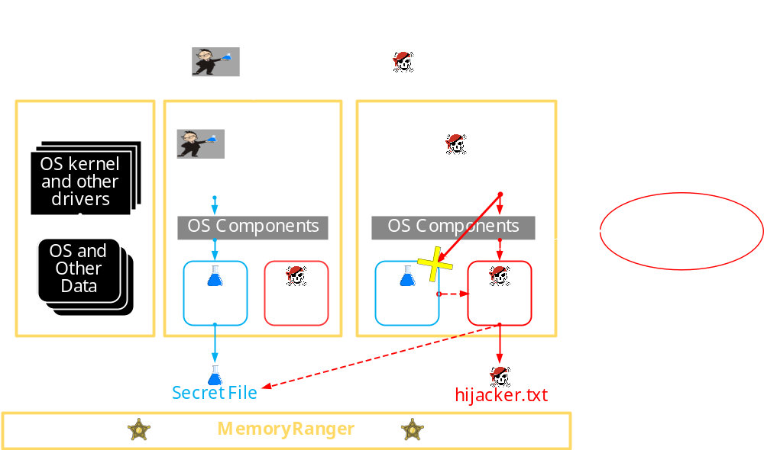

Slide 81
Episode 2
Privilege Escalation via Token Hijacking

Slide 82
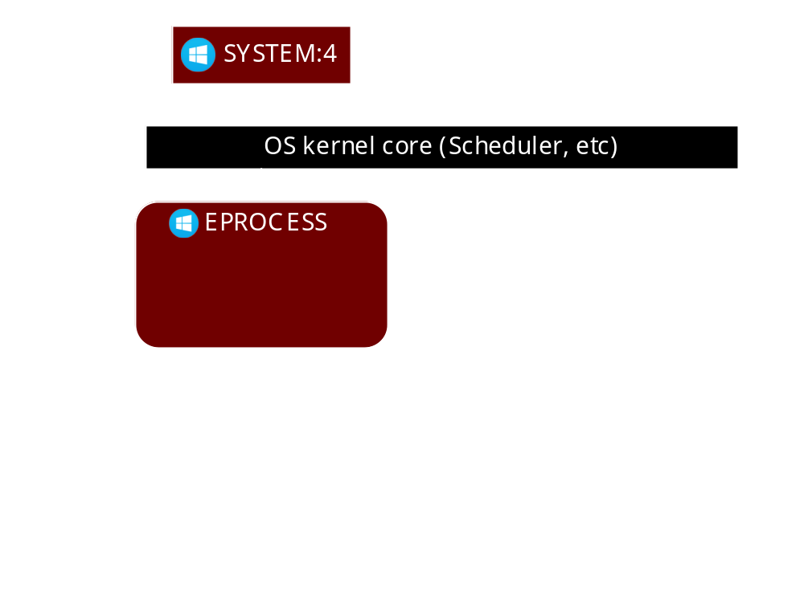
EPROCESS and TOKEN in Windows

Slide 83
EPROCESS and TOKEN in Windows

Slide 84
EPROCESS and TOKEN in Windows

Slide 85
EPROCESS and TOKEN in Windows: ADD MORE PRIVILEGES

Slide 86
EPROCESS and TOKEN in Windows: SidHash field

Slide 87
EPROCESS and TOKEN in Windows: token SWAPPING

Slide 88

EPROCESS and TOKEN in Windows: MSFT Defender

Slide 89
TOKEN INTERNALS

Slide 90
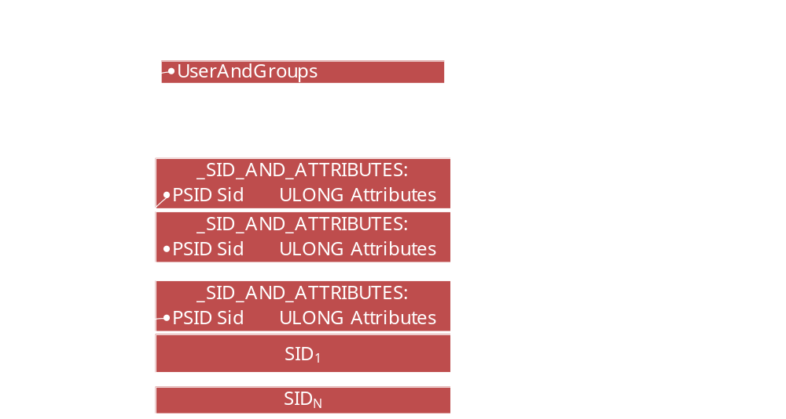
TOKEN INTERNALS

Slide 91
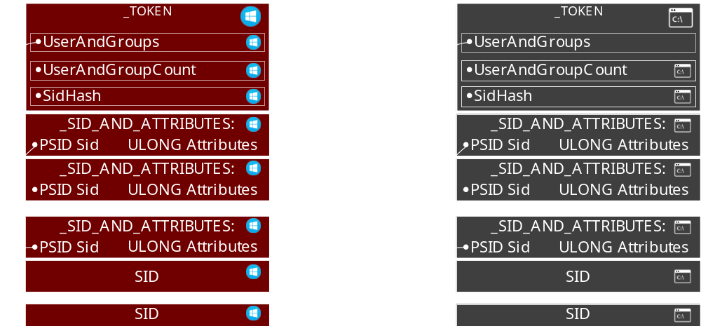
An idea of TOKEN HIJACKING Atack

Slide 92
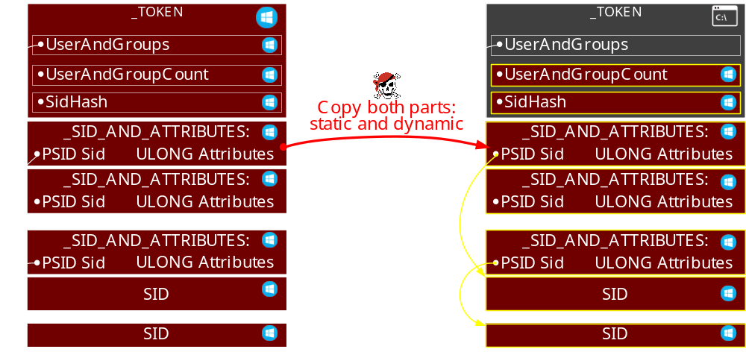
An idea of TOKEN HIJACKING Atack

Slide 93
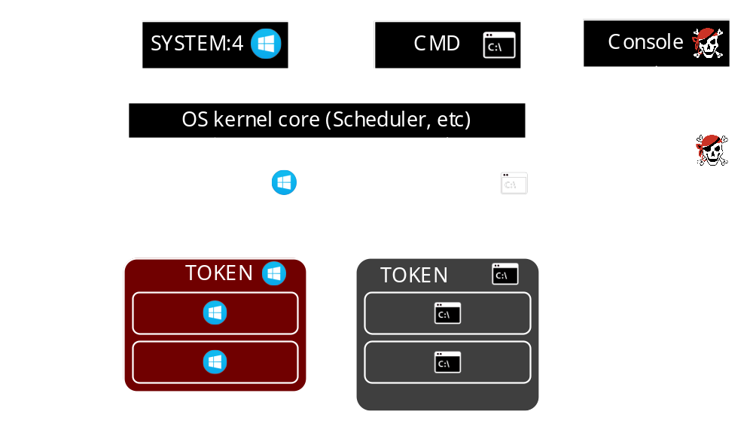
Token hijacking Attack

Slide 94
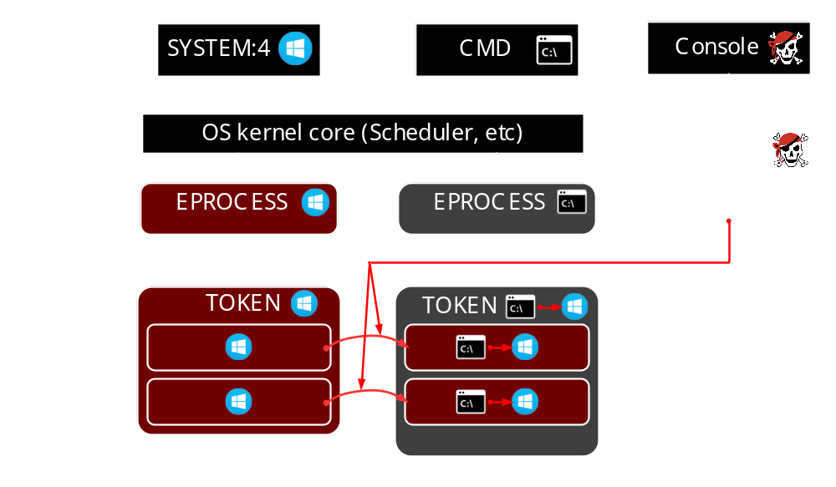
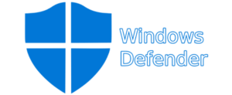
Token hijacking Attack
Commands to stop and disable Windows Defender —
https://www.carbonblack.com/2019/08/16/cb-tau-threat-intelligence-notification-trickbot-banking-trojan-continues-to-evolve/

Slide 95
Demo#5: TOKEN Hijacking
The online version is here – https://www.youtube.com/embed/7Dgtz_2oGJg?vq=hd1440
Notes:
First of all, we are launching MemoryRanger console application.
It loads the hypervisor /ˈhaɪpə(r)ˌ vaɪzə(r)/ to protect kernel memory.
Then, the boss is launching his console, which loads a driver. The boss creates the budget file.
And we can see the created the file handle and the allocated FILE_OBJECT structure.
By using f_write the boss is setting up the budget.
Now, the boss is checking the budget. Done.
Now the boss receives a call and the budget file remains open.
At this moment, the attacker is getting a chance to snoop the budget.
He is launching its console. He is trying to open the budget using file system routine ZwCreateFile.
So, he fails to open the file, because Windows prevents illegal access to the budget file.
The attacker is willing to gain an access by hijacking.
He copies the address of the FILE_OBJECT. By using f_open_by_hijacking the attacker creates a file hijacker. Windows creates this file and returns the file handle and the FILE_OBJECT structure.
The attacker is trying to read the budget FILE_OBJECT, but he fails.
MemoryRanger prevents illegal memory access to the budget FILE_OBJECT.
Anyway, the attacker is still hoping to read the budget.
But instead of reading a real budget, the attacker can read only the deliberately foisted fake {pause} null data.
He fails again.
But anyway, he is trying to overwrite the budget file.
If the boss decides to check his budget he will see the originals data.
MemoryRanger prevents all illegal access attempts to the budget.
Finally, let’s compare these /ðiːz/ two files. We close the budget file and the file hijacker and both control consoles as well.
We can see that the budget file includes only the budget and all attackers input data is in his file.
The OS is protected.

Slide 96
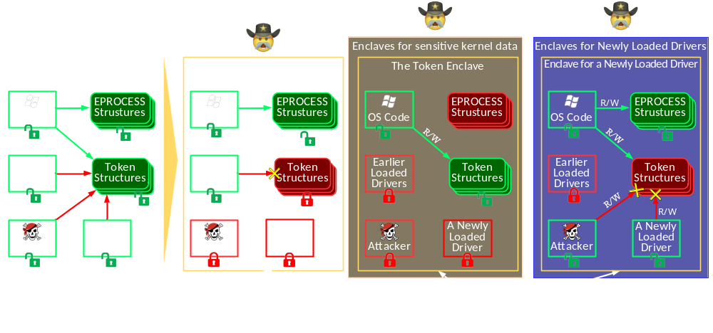
Memory Map: MemoryRanger Prevents token HIAJCKING

Slide 97
Memory Map: MemoryRanger Prevents token HIAJCKING

Slide 98
Memory Map: MemoryRanger Prevents token HIAJCKING

Slide 99
Memory Map: MemoryRanger Prevents token HIAJCKING

Slide 100
Demo#6: PREVENTION OF TOKEN Hijacking
The online version is here – https://www.youtube.com/embed/_zGAR7wvM4g?vq=hd1440
Notes:
First of all, we are launching MemoryRanger console application.
It loads the hypervisor /ˈhaɪpə(r)ˌ vaɪzə(r)/ to protect kernel memory.
Then, the boss is launching his console, which loads a driver. The boss creates the budget file.
And we can see the created the file handle and the allocated FILE_OBJECT structure.
By using f_write the boss is setting up the budget.
Now, the boss is checking the budget. Done.
Now the boss receives a call and the budget file remains open.
At this moment, the attacker is getting a chance to snoop the budget.
He is launching its console. He is trying to open the budget using file system routine ZwCreateFile.
So, he fails to open the file, because Windows prevents illegal access to the budget file.
The attacker is willing to gain an access by hijacking.
He copies the address of the FILE_OBJECT. By using f_open_by_hijacking the attacker creates a file hijacker. Windows creates this file and returns the file handle and the FILE_OBJECT structure.
The attacker is trying to read the budget FILE_OBJECT, but he fails.
MemoryRanger prevents illegal memory access to the budget FILE_OBJECT.
Anyway, the attacker is still hoping to read the budget.
But instead of reading a real budget, the attacker can read only the deliberately foisted fake {pause} null data.
He fails again.
But anyway, he is trying to overwrite the budget file.
If the boss decides to check his budget he will see the originals data.
MemoryRanger prevents all illegal access attempts to the budget.
Finally, let’s compare these /ðiːz/ two files. We close the budget file and the file hijacker and both control consoles as well.
We can see that the budget file includes only the budget and all attackers input data is in his file.
The OS is protected.

Slide 101
token hijacking ATTACK

Slide 102
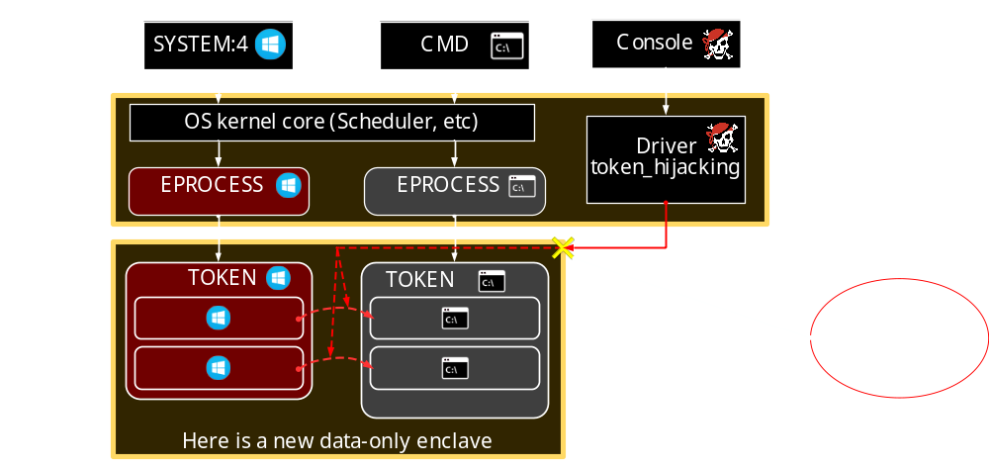
token hijacking is blocked by a new data-only enclave

Slide 103
Episode 3
MemoryRanger

Slide 104
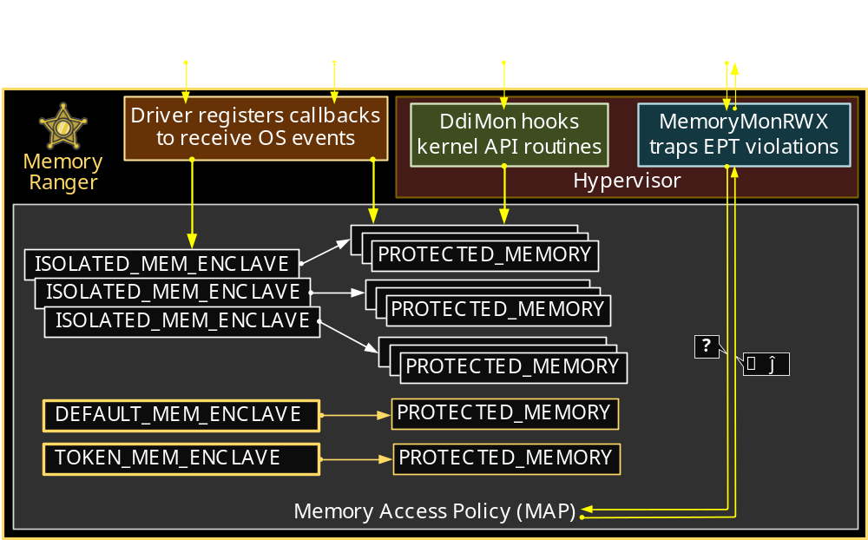
Memory Ranger architecture
(Further details in the paper)
https://github.com/IgorKorkin/MemoryRanger
Notes:
Memory Access Policy (MAP) plays a role of an intermediary during memory access to the protected data and decides whether to block or allow this access. Memory Access Policy relies on the ISOLATE_MEM_ENCLAVE structures and PROTECTED_MEMORY structures.
Now let’s move on to the benchmark assessment.

Slide 105
Conclusion
  Windows OS security features provide limited kernel memory protection
  Handle Hijacking = copy 6 bytes of structure
  Hijacking NTFS = copy data structures & Thread ID
  Token Hijacking = copy structures & their interconnections
  Updated MemoryRanger
  protects new data structures
  includes a new data-only enclave to isolate the secret data from all drivers
  works well on the recent Windows 1903

Slide 106


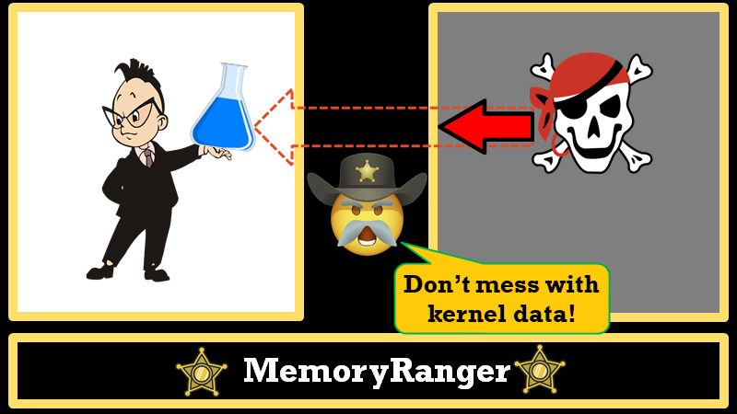

Slide 107
MemoryRanger protects the OS!

Slide 108

igorkorkin.blogspot.com
Igor Korkin * igor.korkin@gmail.com *

Slide 109
EXTRA SLIDES

Slide 110
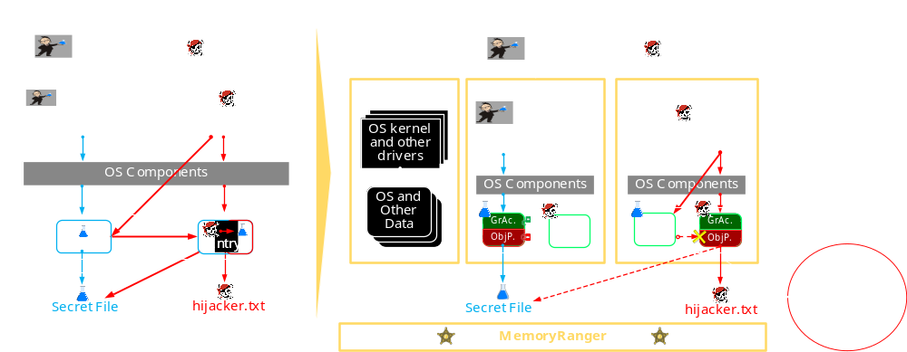
Demo: Preventing the HANDLE HIJACKING Attack

Slide 111

Demo: Preventing the Hijacking NTFS structures

