Slide 1


Protected Process Light will be Protected ‐
MemoryRanger Fills the Gap Again
Igor Korkin
Independent Researcher
2021

Slide 2

WHOAMI
PhD, speaker at the ADFSL, BlackHat, HITB, IEEE SPW
OS Security Researcher:
  Rootkits, Anti-rootkits and EDRs
  Memory Forensics for user- and kernel- modes
  Bare-Metal Hypervisors against Attacks on Kernel Memory
Fan of cross-disciplinary research —
Love traveling and powerlifting —
igorkorkin.blogspot.com
igor.korkin

Slide 3
Agenda
Protected Process Light (PPL) — Algorithm and Attacks

Slide 4
Agenda
Users secrets are stored in process memory

Slide 5
Agenda
PPL is enabled for the process to protect its memory

Slide 6
Agenda
Attackers are trying to steal the secrets, but PPL blocks their access

Slide 7


Thanks to PPL non-protected processes cannot do the following:
Access to the protected process memory
Inject code into the protected processes
Terminate protected processes
Attackers are trying to steal the secrets, but PPL blocks their access

Slide 8
Agenda
Attackers can disable PPL

Slide 9
Agenda
Attackers can steal users data easily

Slide 10
Agenda
Attackers want to protect their malware processes

Slide 11
Agenda
But PPL is enabled only for processes with a special signature

Slide 12
Agenda
Malware apps can illegally enable PPL to protect themselves

Slide 13
Agenda
Protected Process Light (PPL) — Algorithm and Attacks

Slide 14
Agenda
Protected Process Light (PPL) — Algorithm and Attacks
Changing kernel data can abuse PPL

Slide 15
Agenda
Protected Process Light (PPL) — Algorithm and Attacks

Slide 16
Agenda
Protected Process Light (PPL) — Algorithm and Attacks
MemoryRanger blocks attacks on PPL:

Slide 17


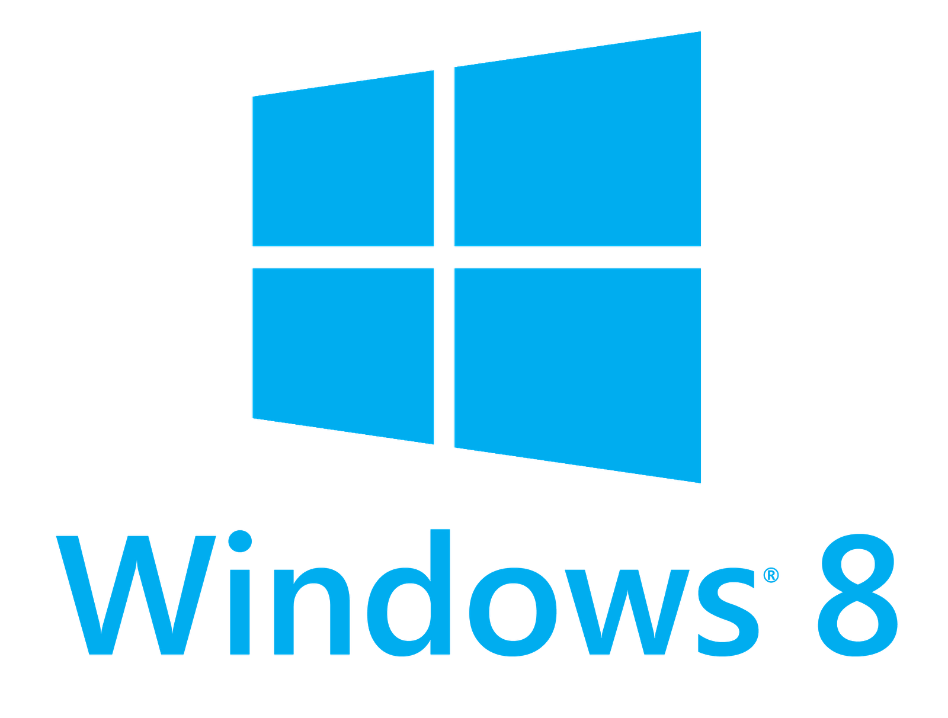
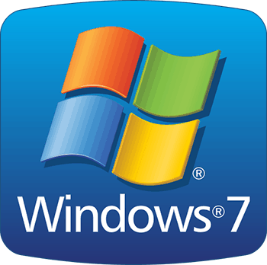




Microsoft Windows OSes

Slide 18


Episode 1
Does Windows provide any feature to Protect Process Memory?

Slide 19
Windows Features to Protect PROCESS Memory
  Security Reference Monitor (SRM)
  Protected Process Light (PPL)
  AppContainer Isolation
  Windows Resource Protection (WRP, SFC)
  Session 0 Isolation and Secure Desktop
  Windows Memory Management (Virtual Memory and Enclave API)
  Windows Integrity Control (WIC)
  Mandatory Integrity Control (MIC)
    User Interface Privilege Isolation (IUPI)
    Enhanced Protected Mode (EPM)
  Isolated User Mode (IUM) enabled by Hyper-V

Slide 20
Windows Features to Protect PROCESS Memory: SRM
  Security Reference Monitor (SRM)
  Protected Process Light (PPL)
  AppContainer Isolation
  Windows Resource Protection (WRP, SFC)
  Session 0 Isolation and Secure Desktop
  Windows Memory Management (Virtual Memory and Enclave API)
  Windows Integrity Control (WIC)
  Mandatory Integrity Control (MIC)
    User Interface Privilege Isolation (IUPI)
    Enhanced Protected Mode (EPM)
  Isolated User Mode (IUM) enabled by Hyper-V

Slide 21

A malware App calls OpenProcess() to Access Process Data

Slide 22
SRM checks access rights using Token and Security Descriptor

Slide 23
SRM checks access rights using Token and Security Descriptor

Slide 24
SRM checks access rights using Token and Security Descriptor

Slide 25
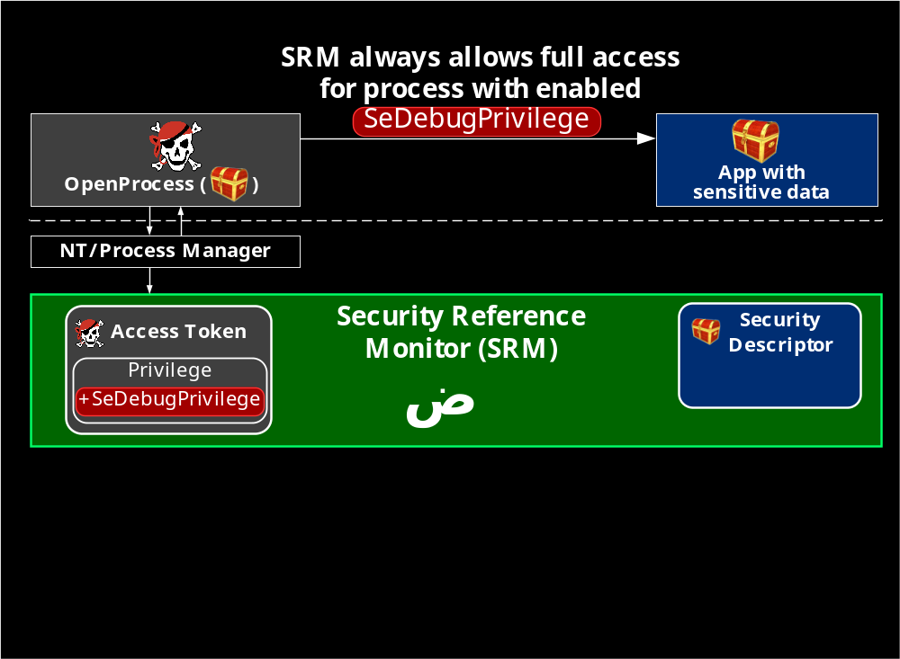
SRM allows full access for app with SeDebugPrivilege
In Windows Security Model any process with admin rights can acquire the debug privilege and access the memory of any process

Slide 26
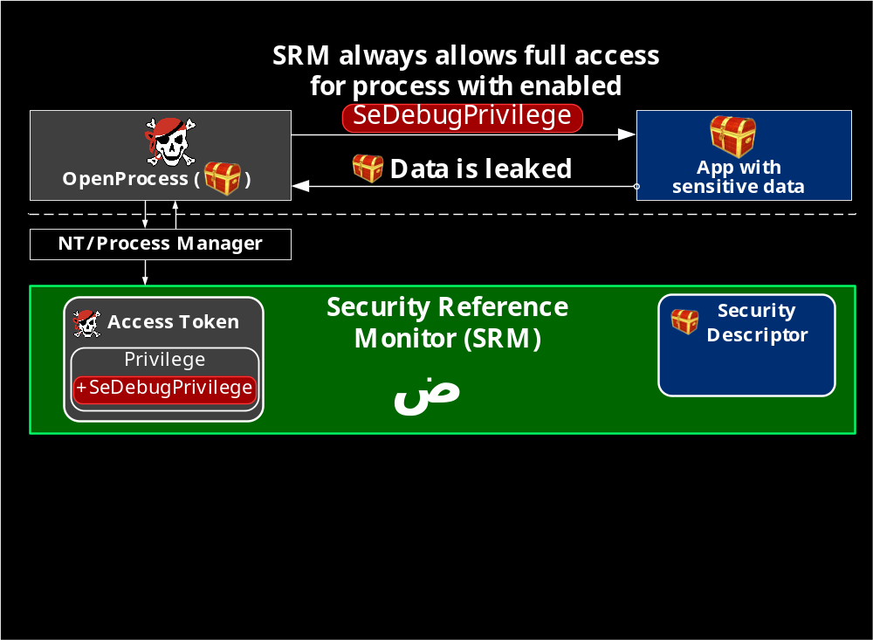
Malware with enabled debug privilege can steal sensitive data

Slide 27

How to protect data from apps running with debug privilege?
?

Slide 28

Episode 2
Protected Process Light?
What’s that?

Slide 29
Windows Features to Protect PROCESS Memory: PPL
  Security Reference Monitor (SRM)
  Protected Process Light (PPL)
  AppContainer Isolation
  Windows Resource Protection (WRP, SFC)
  Session 0 Isolation and Secure Desktop
  Windows Memory Management (Virtual Memory and Enclave API)
  Windows Integrity Control (WIC)
  Mandatory Integrity Control (MIC)
    User Interface Privilege Isolation (IUPI)
    Enhanced Protected Mode (EPM)
  Isolated User Mode (IUM) enabled by Hyper-V

Slide 30
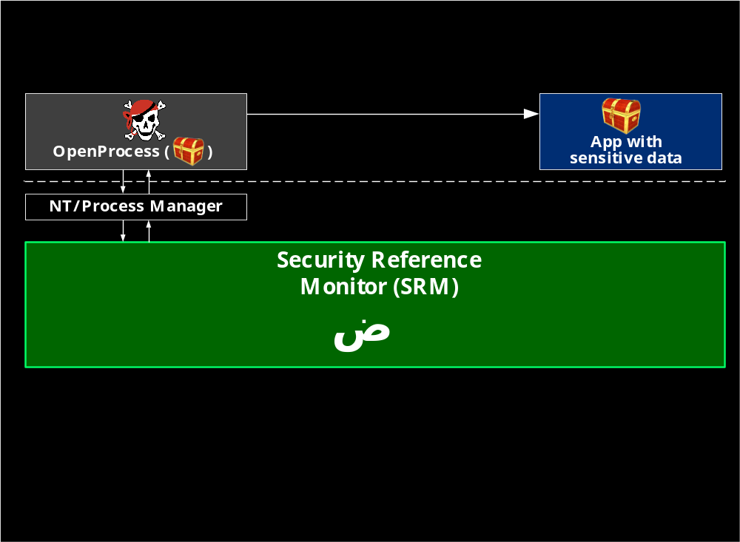
PPL restricts non-PPL apps running with debug privilege

Slide 31
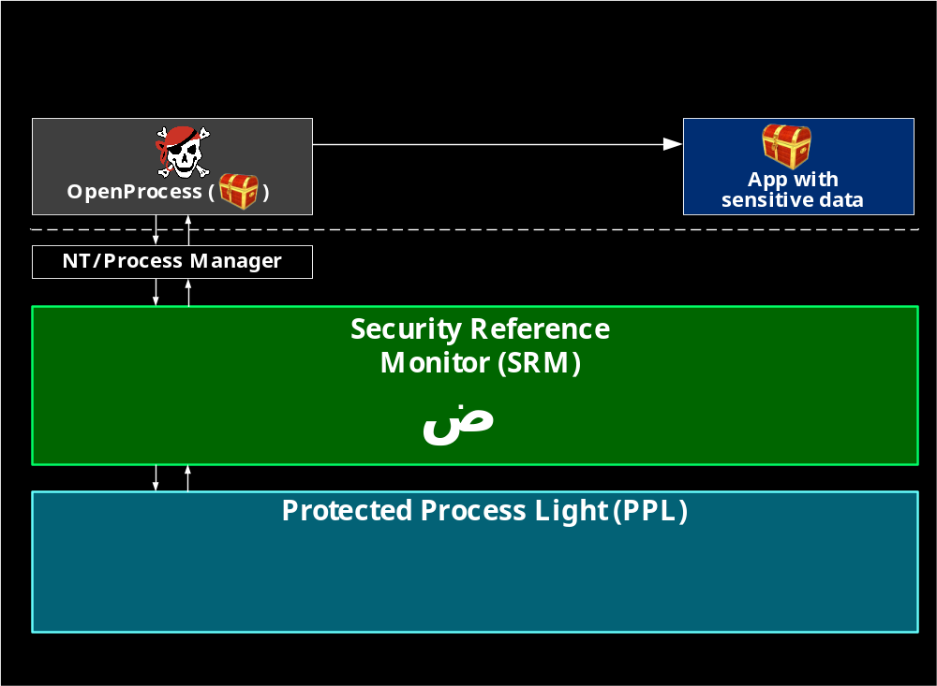
PPL restricts non-PPL apps running with debug privilege

Slide 32
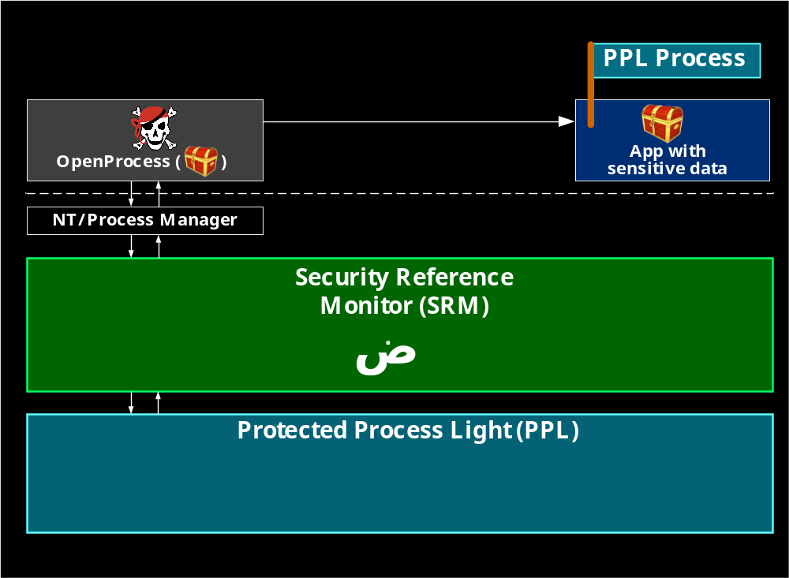
PPL restricts non-PPL apps running with debug privilege

Slide 33
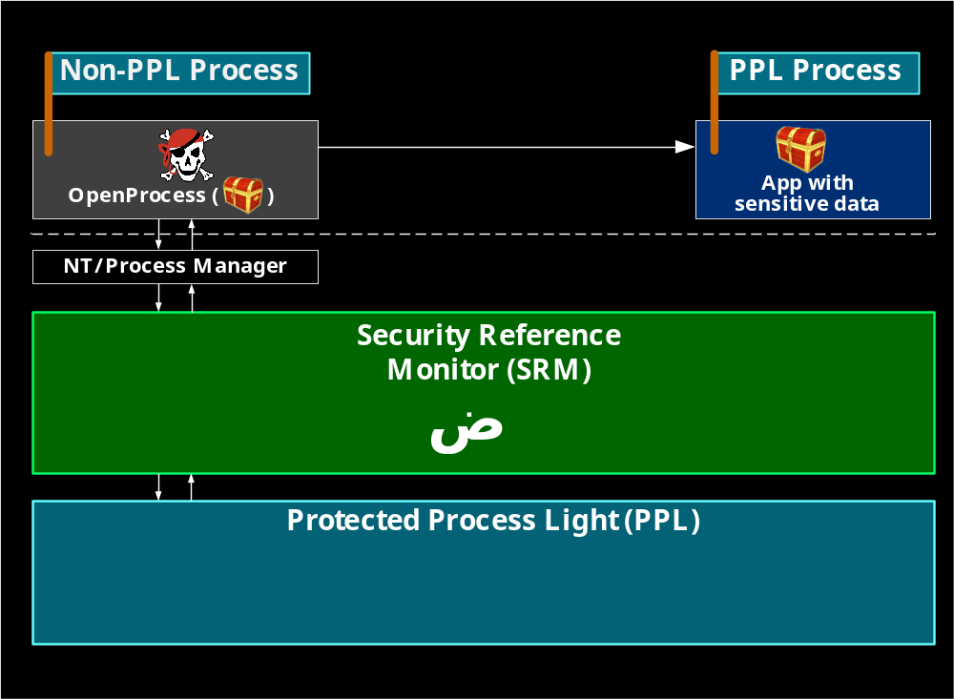
PPL restricts non-PPL apps running with debug privilege

Slide 34
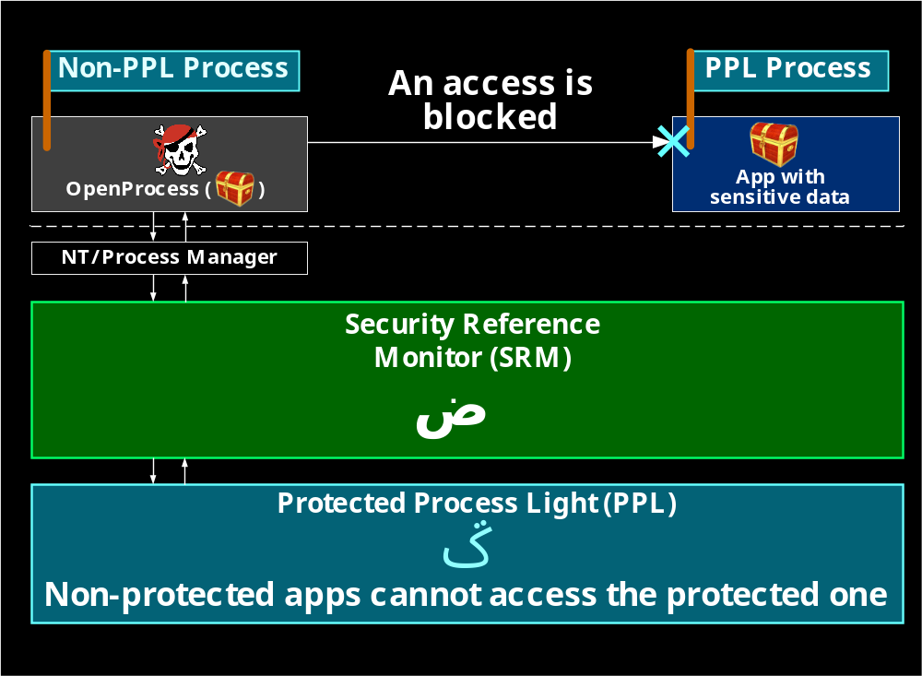
PPL restricts non-PPL apps running with debug privilege

Slide 35
PPL restricts non-PPL apps running with debug privilege

Slide 36

Episode 3
How does PPL work?

Slide 37
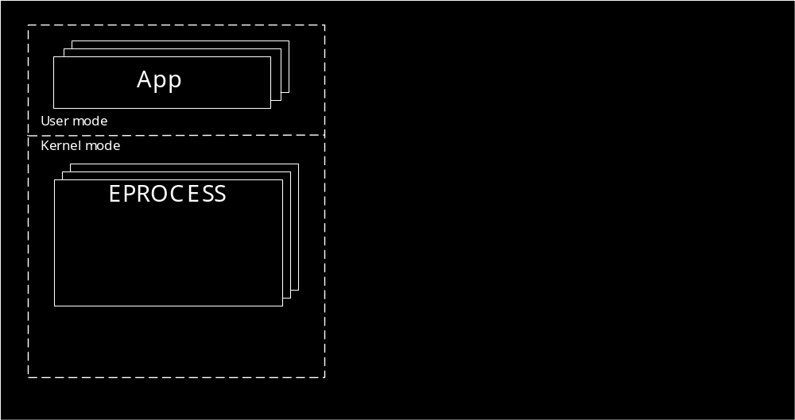
PPL: a new Protection field in EPROCESS

Slide 38
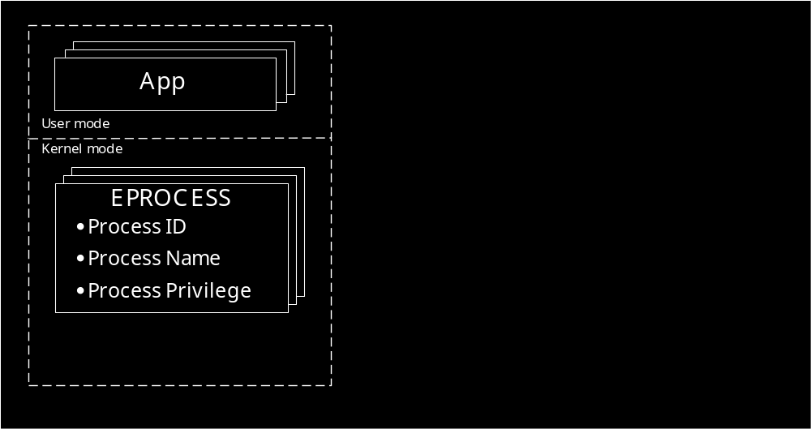
PPL: a new Protection field in EPROCESS

Slide 39
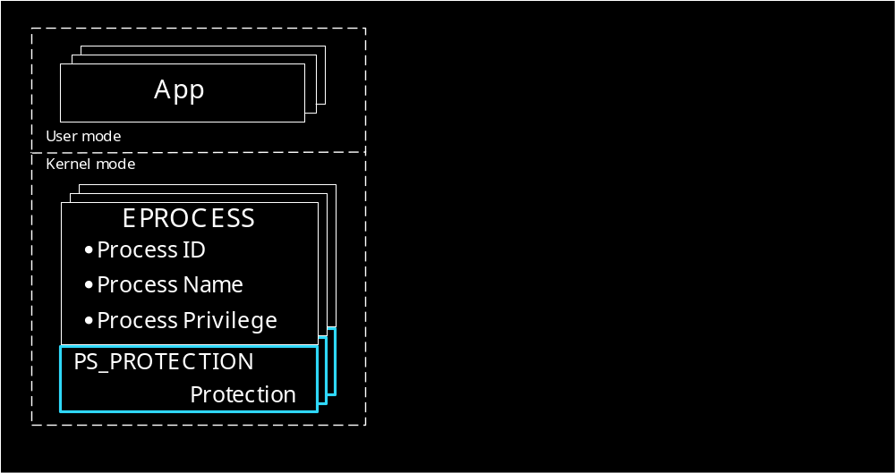
PPL: a new Protection field in EPROCESS

Slide 40
PPL: a new Protection field in EPROCESS
typedef struct _PS_PROTECTION {
union {
UCHAR Level;
struct {
UCHAR Type : 3;
UCHAR Audit : 1;//<Reserved
UCHAR Signer : 4;
};
};
} PS_PROTECTION, *PPS_PROTECTION;

Slide 41
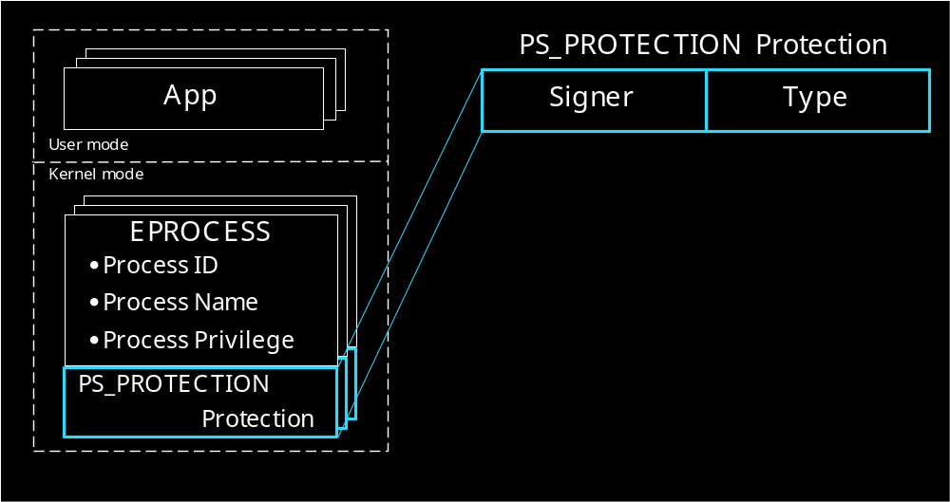
PPL: a new Protection field in EPROCESS

Slide 42
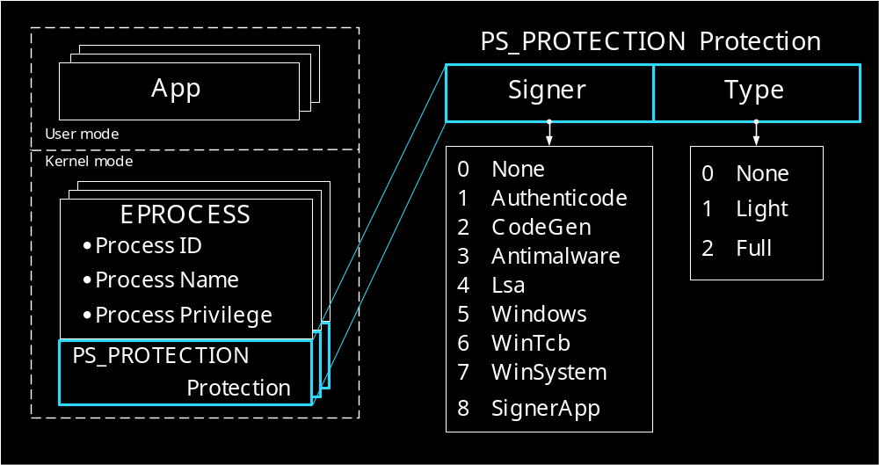
PPL: a new Protection field in EPROCESS

Slide 43
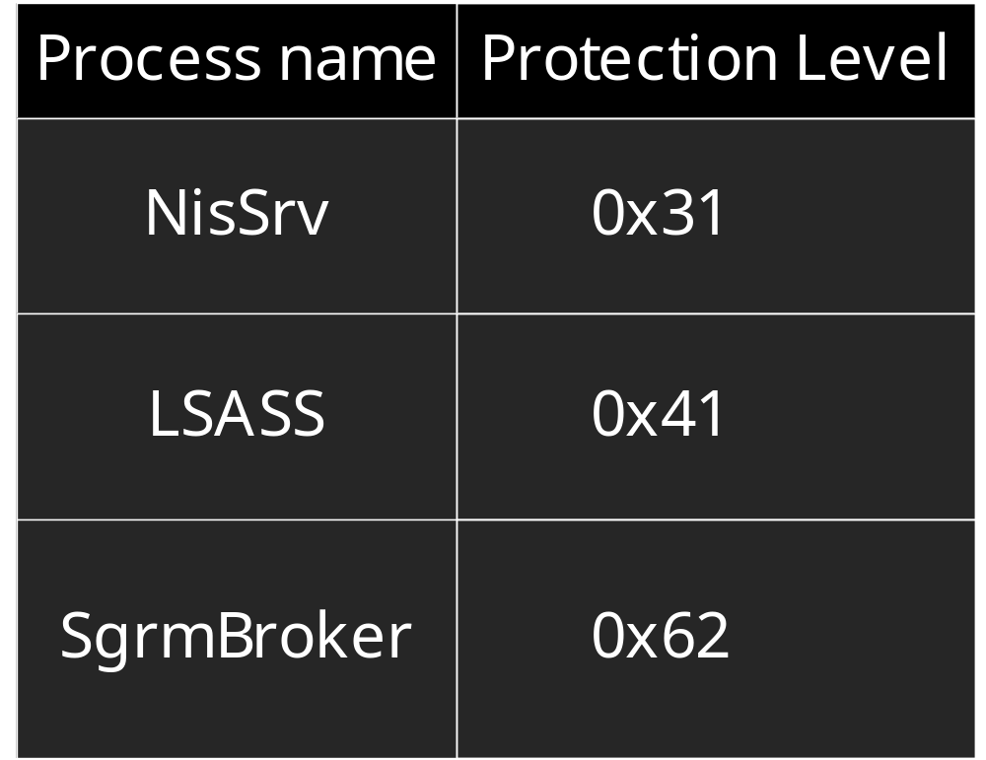
Examples of protection Level
NisSrv ‒ Microsoft Network Realtime Inspection Service.
LSASS ‒ Local Security Authority Subsystem Service.
SgrmBroker ‒ System Guard Runtime Monitor Broker.

Slide 44
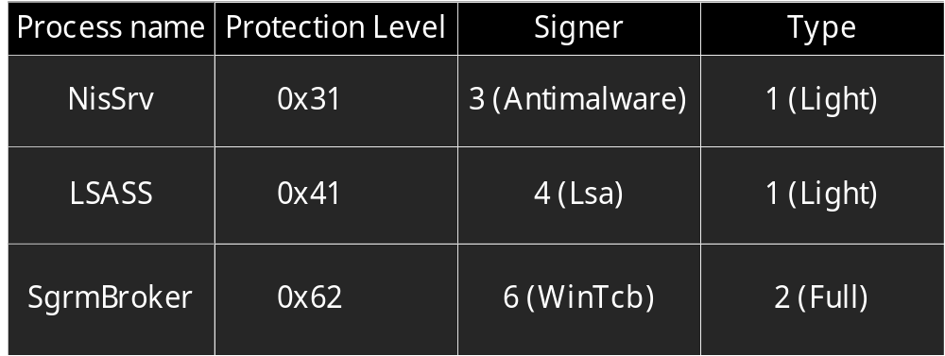
Examples of protection Level
NisSrv ‒ Microsoft Network Realtime Inspection Service.
LSASS ‒ Local Security Authority Subsystem Service.
SgrmBroker ‒ System Guard Runtime Monitor Broker.

Slide 45
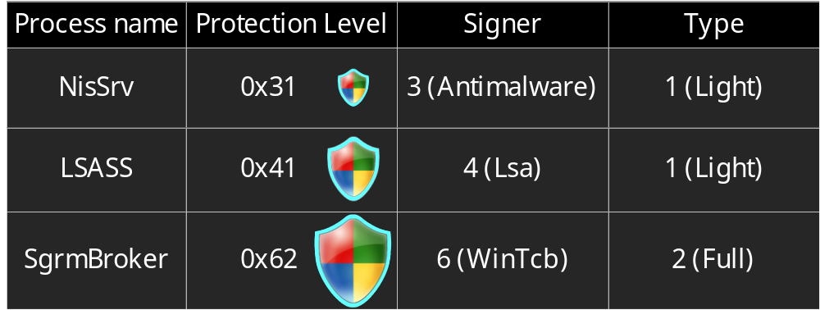
Examples of protection Level
NisSrv ‒ Microsoft Network Realtime Inspection Service.
LSASS ‒ Local Security Authority Subsystem Service.
SgrmBroker ‒ System Guard Runtime Monitor Broker.

Slide 46

Episode 4
How does Windows create
protected processes?

Slide 47
PPL: CreateProcess
“lsass.exe”
“NisSrv.exe”
“MsMpEng.exe”
“services.exe”
“System”
“MemCompression”
“Registry”
Notes:
To put it in a nutshell the MemoryRanger dispatcher is here. It processes three EPT violations and one VM exit.

Slide 48
PPL: CreateProcess
“lsass.exe”
“NisSrv.exe”
“MsMpEng.exe”
“services.exe”
“System”
“MemCompression”
“Registry”
?
?
?
?
Which OS functions are involved during
creating of Protected Processes?
Notes:
To put it in a nutshell the MemoryRanger dispatcher is here. It processes three EPT violations and one VM exit.

Slide 49
PPL: CreateProcess
“lsass.exe”
“NisSrv.exe”
“MsMpEng.exe”
“services.exe”
“System”
“MemCompression”
“Registry”
nt
ntdll
ZwCreateProcess
NtCreateUserProcess
NtCreateProcessEx
PspInitPhase0
SmFirstTimeInit
CmpInitializeRegistryProcess
Notes:
To put it in a nutshell the MemoryRanger dispatcher is here. It processes three EPT violations and one VM exit.

Slide 50
PPL: CreateProcess
“lsass.exe”
“NisSrv.exe”
“MsMpEng.exe”
“services.exe”
“System”
“MemCompression”
“Registry”
nt
ntdll
ZwCreateProcess
NtCreateUserProcess
NtCreateProcessEx
PspInitPhase0
SmFirstTimeInit
CmpInitializeRegistryProcess
PspCreateProcess
PsCreateMinimalProcess
NtCreateUserProcess
PspAllocateProcess
Notes:
To put it in a nutshell the MemoryRanger dispatcher is here. It processes three EPT violations and one VM exit.

Slide 51
PPL: CreateProcess
“lsass.exe”
“NisSrv.exe”
“MsMpEng.exe”
“services.exe”
“System”
“MemCompression”
“Registry”
nt
ntdll
ZwCreateProcess
NtCreateUserProcess
NtCreateProcessEx
PspInitPhase0
SmFirstTimeInit
CmpInitializeRegistryProcess
PspCreateProcess
PsCreateMinimalProcess
NtCreateUserProcess
PspAllocateProcess
Notes:
To put it in a nutshell the MemoryRanger dispatcher is here. It processes three EPT violations and one VM exit.

Slide 52
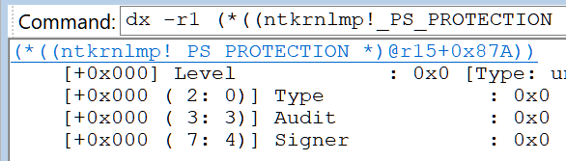
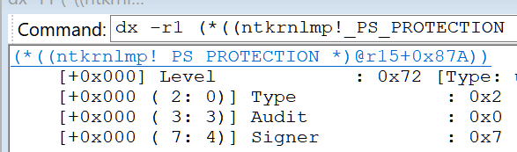
PPL: PspAllocateProcess sets Protection.Level for the process
PspAllocateProcess:
mov rdx, [nt!PsProcessType]
call nt!ObCreateObject ; allocates EPROCESS structure
..
mov r15,qword ptr [rsp+0B8h] ; r15 is address of created EPROCESS
mov byte ptr [r15+87Ah], dil ; 87Ah is offset of Protection.Level
; dil is the Protection.level
Protection = 0x0
Protection = 0x72
Notes:
To put it in a nutshell the MemoryRanger dispatcher is here. It processes three EPT violations and one VM exit.

Slide 53
PPL: PspAllocateProcess sets Protection.Level for the process
PspAllocateProcess:
mov rdx, [nt!PsProcessType]
call nt!ObCreateObject ; allocates EPROCESS structure
..
mov r15,qword ptr [rsp+0B8h] ; r15 is address of created EPROCESS
mov byte ptr [r15+87Ah], dil ; 87Ah is offset of Protection.Level
; dil is the Protection.level
Protection = 0x0
Protection = 0x72
Notes:
To put it in a nutshell the MemoryRanger dispatcher is here. It processes three EPT violations and one VM exit.

Slide 54
PPL: PspAllocateProcess sets Protection.Level for the process
PspAllocateProcess:
mov rdx, [nt!PsProcessType]
call nt!ObCreateObject ; allocates EPROCESS structure
..
mov r15,qword ptr [rsp+0B8h] ; r15 is address of created EPROCESS
mov byte ptr [r15+87Ah], dil ; 87Ah is offset of Protection.Level
; dil is the Protection.level
Protection = 0x0
Protection = 0x72
Notes:
To put it in a nutshell the MemoryRanger dispatcher is here. It processes three EPT violations and one VM exit.

Slide 55
PPL: PspAllocateProcess sets Protection.Level for the process
PspAllocateProcess:
mov rdx, [nt!PsProcessType]
call nt!ObCreateObject ; allocates EPROCESS structure
..
mov r15,qword ptr [rsp+0B8h] ; r15 is address of created EPROCESS
mov byte ptr [r15+87Ah], dil ; 87Ah is offset of Protection.Level
; dil is the Protection.level
Protection.Level = 0x0
Protection.Level = 0x72
Notes:
To put it in a nutshell the MemoryRanger dispatcher is here. It processes three EPT violations and one VM exit.

Slide 56

Episode 5
How to get access to the
protected process memory?

Slide 57
PPL: OpenProcess
“lsass.exe”
“NisSrv.exe”
“MsMpEng.exe”
OpenProcess
Some App
Notes:
To put it in a nutshell the MemoryRanger dispatcher is here. It processes three EPT violations and one VM exit.

Slide 58
PPL: OpenProcess
“lsass.exe”
“NisSrv.exe”
“MsMpEng.exe”
OpenProcess
Some App
?
Which OS functions are involved in
openning of protected processes?
Notes:
To put it in a nutshell the MemoryRanger dispatcher is here. It processes three EPT violations and one VM exit.

Slide 59
PPL: OpenProcess
“lsass.exe”
“NisSrv.exe”
“MsMpEng.exe”
handle = OpenProcess(pid)
Some App
ntdll
NtOpenProcess
            nt
ZwOpenProcess
NtOpenProcess
Notes:
To put it in a nutshell the MemoryRanger dispatcher is here. It processes three EPT violations and one VM exit.

Slide 60
PPL: OpenProcess
“lsass.exe”
“NisSrv.exe”
“MsMpEng.exe”
handle = OpenProcess(pid)
Some App
ntdll
NtOpenProcess
            nt
ZwOpenProcess
NtOpenProcess
PsOpenProcess
PspProcessOpen
PsTestProtectedProcessIncompatibility
PspCheckForInvalidAccessByProtection
RtlTestProtectedAccess
Notes:
To put it in a nutshell the MemoryRanger dispatcher is here. It processes three EPT violations and one VM exit.

Slide 61
PPL: OpenProcess → RtlTestProtectedAccess
“lsass.exe”
“NisSrv.exe”
“MsMpEng.exe”
handle = OpenProcess(pid)
Some App
ntdll
NtOpenProcess
            nt
ZwOpenProcess
NtOpenProcess
PsOpenProcess
PspProcessOpen
PsTestProtectedProcessIncompatibility
PspCheckForInvalidAccessByProtection
RtlTestProtectedAccess
Notes:
To put it in a nutshell the MemoryRanger dispatcher is here. It processes three EPT violations and one VM exit.

Slide 62
PPL: RtlTestProtectedAccess()
bool RtlTestProtectedAccess(PS_PROTECTION CallerProt, PS_PROTECTION TargetProt)
{
if (TargetProt.Type == 0)
return true;
if (CallerProt.Type < TargetProt.Type)
return false;
auto CallerDMask = RtlProtectedAccess[CallerProt.Signer].DominateMask;
auto TargetMask = (1 << TargetProt.Signer);
return (CallerDMask & TargetMask);
}
https://github.com/IgorKorkin/PPL
Notes:
To put it in a nutshell the MemoryRanger dispatcher is here. It processes three EPT violations and one VM exit.

Slide 63
PPL: RtlTestProtectedAccess()
bool RtlTestProtectedAccess(PS_PROTECTION CallerProt, PS_PROTECTION TargetProt)
{
if (TargetProt.Type == 0)
return true;
if (CallerProt.Type < TargetProt.Type)
return false;
auto CallerDMask = RtlProtectedAccess[CallerProt.Signer].DominateMask;
auto TargetMask = (1 << TargetProt.Signer);
return (CallerDMask & TargetMask);
}
https://github.com/IgorKorkin/PPL
Notes:
To put it in a nutshell the MemoryRanger dispatcher is here. It processes three EPT violations and one VM exit.

Slide 64
PPL: RtlTestProtectedAccess()
bool RtlTestProtectedAccess(PS_PROTECTION CallerProt, PS_PROTECTION TargetProt)
{
if (TargetProt.Type == 0)
return true;
if (CallerProt.Type < TargetProt.Type)
return false;
auto CallerDMask = RtlProtectedAccess[CallerProt.Signer].DominateMask;
auto TargetMask = (1 << TargetProt.Signer);
return (CallerDMask & TargetMask);
}
https://github.com/IgorKorkin/PPL
Notes:
To put it in a nutshell the MemoryRanger dispatcher is here. It processes three EPT violations and one VM exit.

Slide 65
PPL: RtlTestProtectedAccess()
bool RtlTestProtectedAccess(PS_PROTECTION CallerProt, PS_PROTECTION TargetProt)
{
if (TargetProt.Type == 0)
return true;
if (CallerProt.Type < TargetProt.Type)
return false;
auto CallerDMask = RtlProtectedAccess[CallerProt.Signer].DominateMask;
auto TargetMask = (1 << TargetProt.Signer);
return (CallerDMask & TargetMask);
}
https://github.com/IgorKorkin/PPL
Notes:
To put it in a nutshell the MemoryRanger dispatcher is here. It processes three EPT violations and one VM exit.

Slide 66
PPL: RtlTestProtectedAccess()
bool RtlTestProtectedAccess(PS_PROTECTION CallerProt, PS_PROTECTION TargetProt)
{
if (TargetProt.Type == 0)
return true;
if (CallerProt.Type < TargetProt.Type)
return false;
auto CallerDMask = RtlProtectedAccess[CallerProt.Signer].DominateMask;
auto TargetMask = (1 << TargetProt.Signer);
return (CallerDMask & TargetMask);
}
https://github.com/IgorKorkin/PPL
Notes:
To put it in a nutshell the MemoryRanger dispatcher is here. It processes three EPT violations and one VM exit.

Slide 67
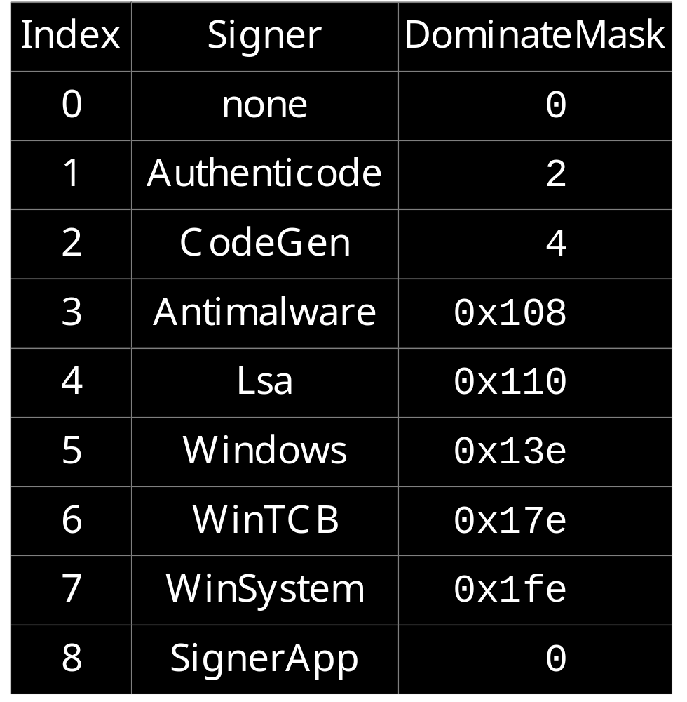
RtlProtectedAccess Array

Slide 68
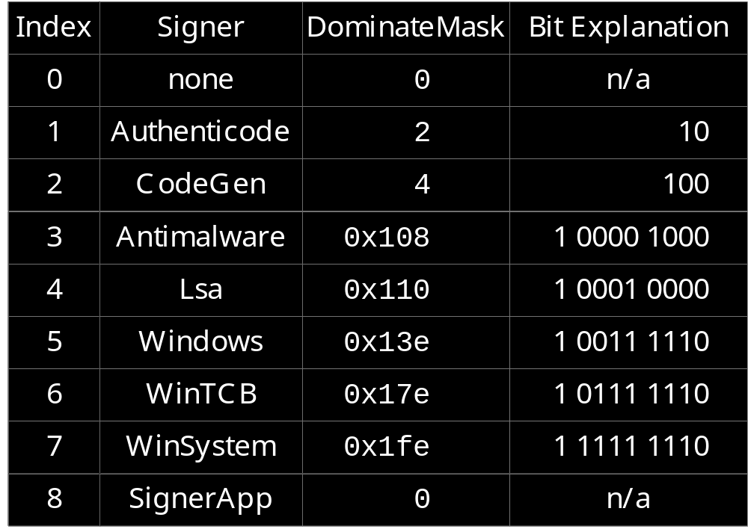
RtlProtectedAccess Array

Slide 69
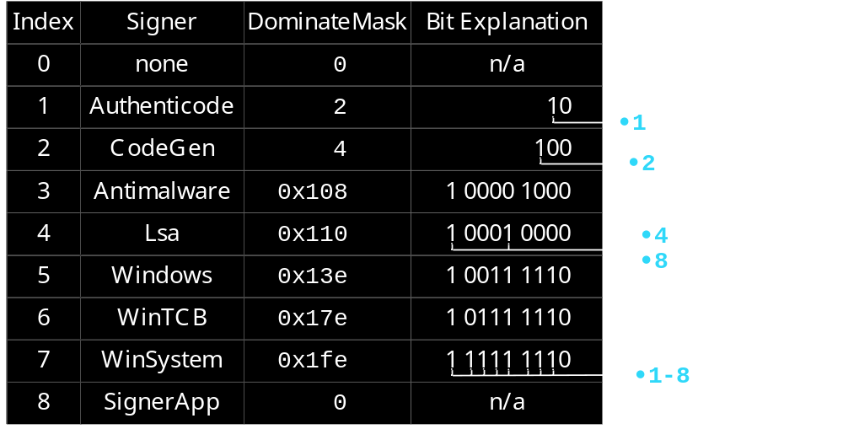
RtlProtectedAccess Array

Slide 70
RtlProtectedAccess Array
8
7
6
5
4
3
2
1
0

Slide 71
RtlProtectedAccess Array
8
7
6
5
4
3
2
1
0

Slide 72

Episode 6
Two Windows security features
SRM and PPL are playing together and losing

Slide 73
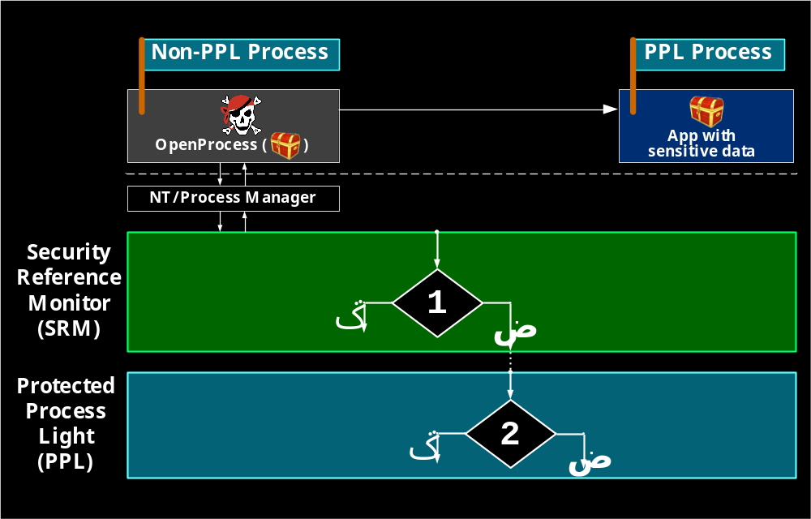
OpenProcess performs two checks: SRM and then PPL

Slide 74
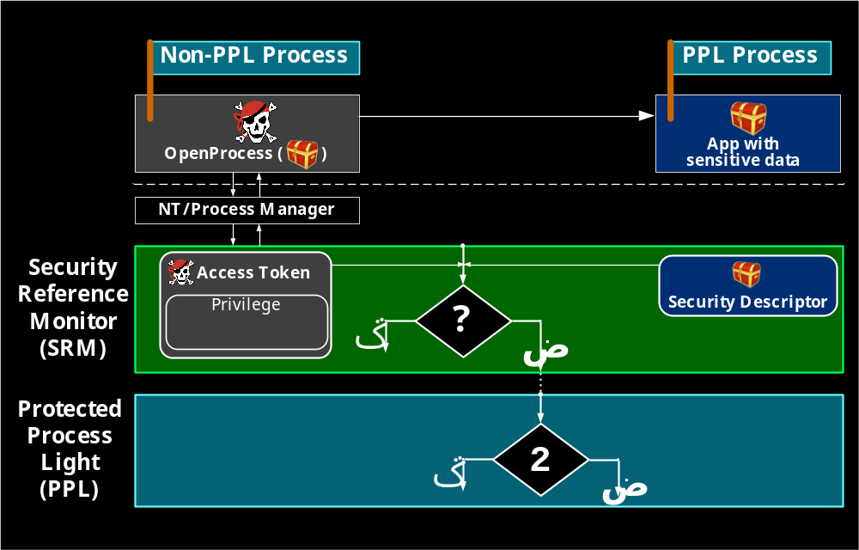
OpenProcess performs two checks: SRM and then PPL

Slide 75
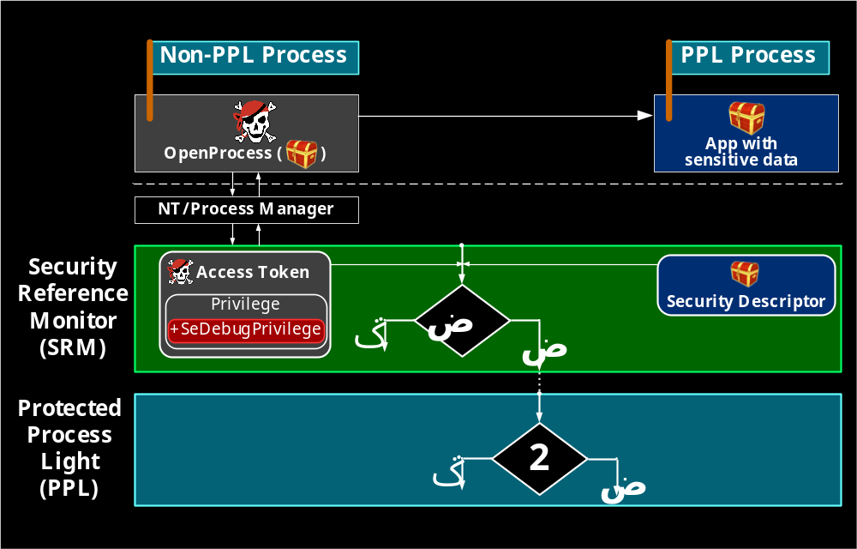
OpenProcess performs two checks: SRM and then PPL

Slide 76
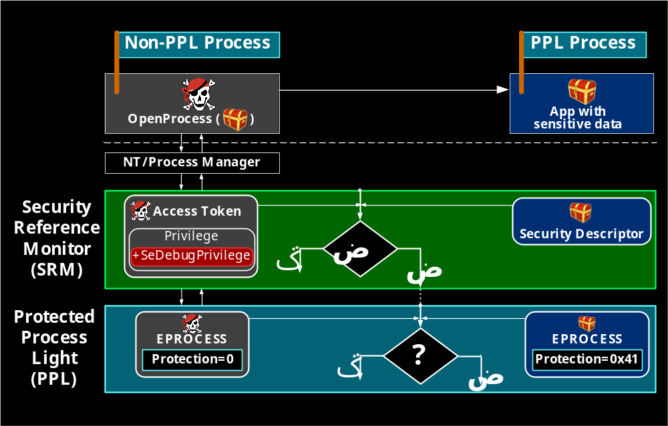
OpenProcess performs two checks: SRM and then PPL

Slide 77
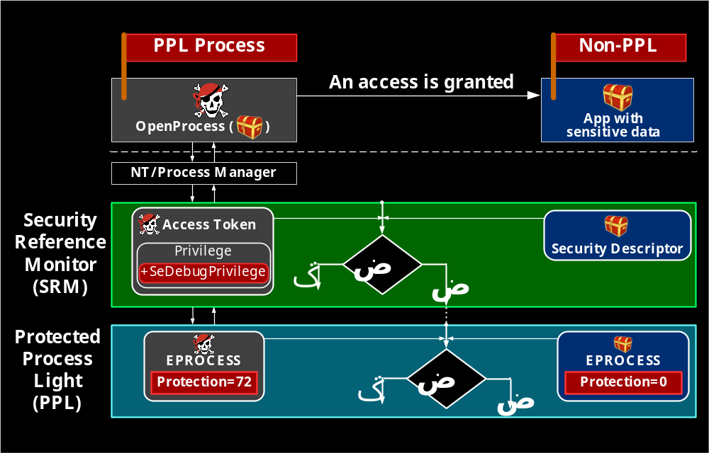
OpenProcess performs two checks: SRM and then PPL

Slide 78

Episode 7
Attacks on PPL?

Slide 79
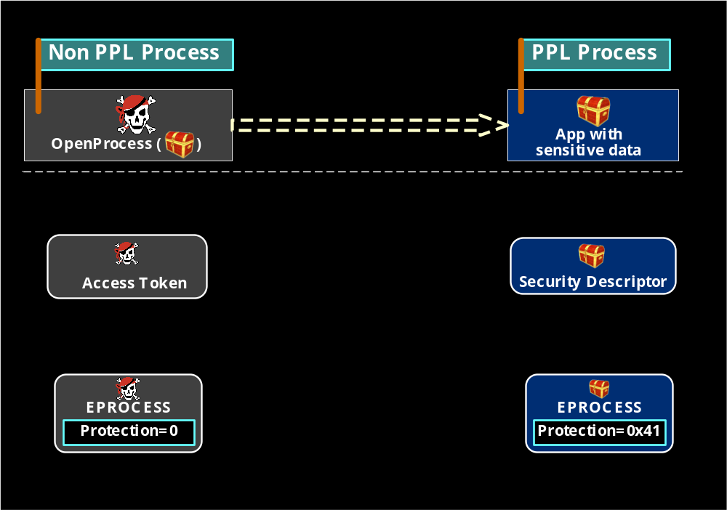
Protection LEVEL can be illegally changed by Driver

Slide 80
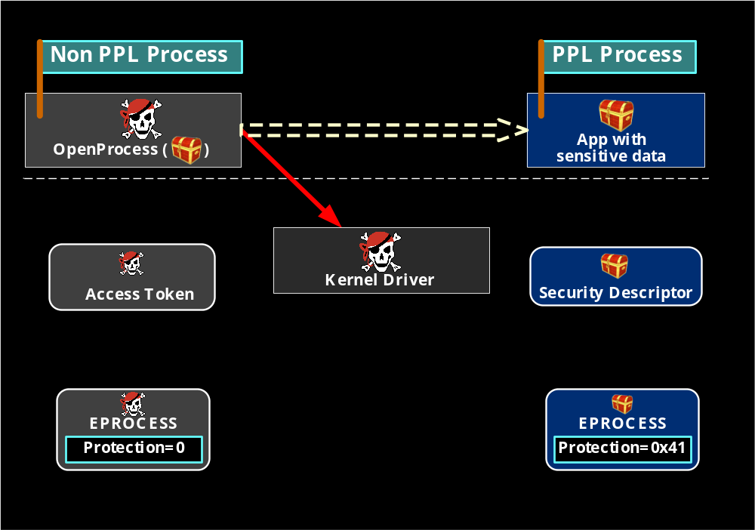
Protection LEVEL can be illegally changed by Driver

Slide 81
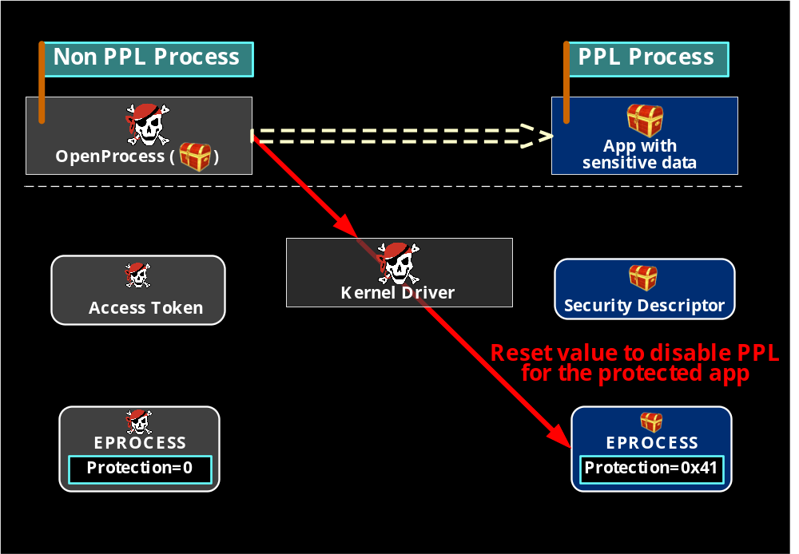
Protection LEVEL can be illegally changed by Driver

Slide 82
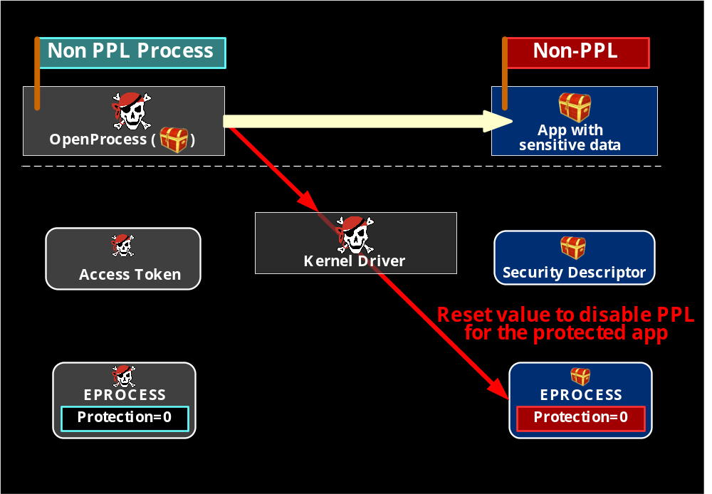
Protection LEVEL can be illegally changed by Driver

Slide 83
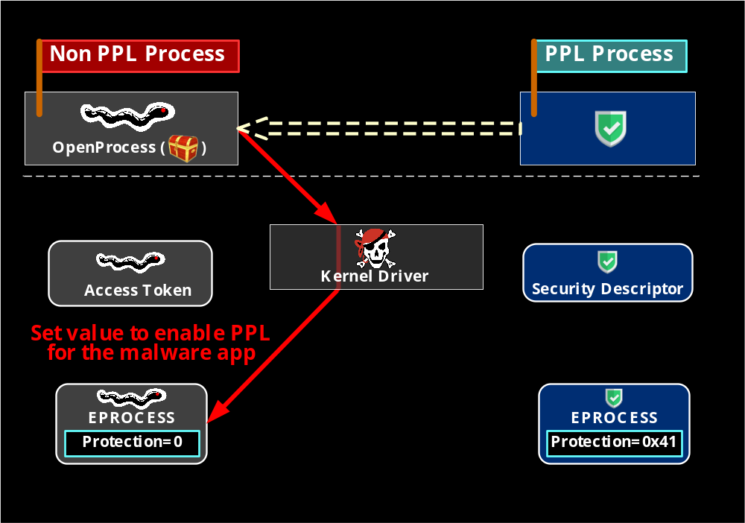
Protection LEVEL can be illegally changed by Driver

Slide 84
Protection LEVEL can be illegally changed by Driver

Slide 85
Protection LEVEL can be illegally changed by Driver

Slide 86
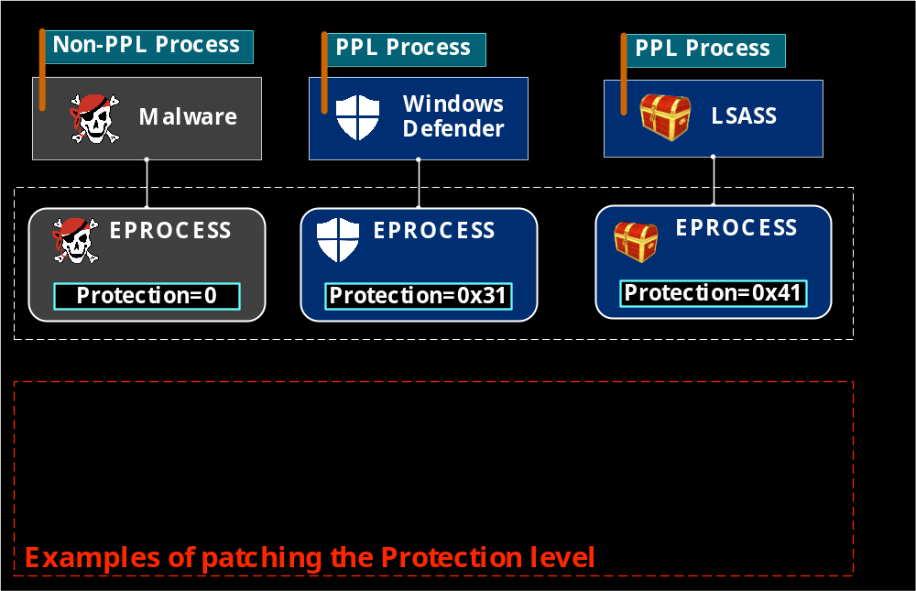
Attacks on PPL: Drivers Can Modify Protection Byte

Slide 87
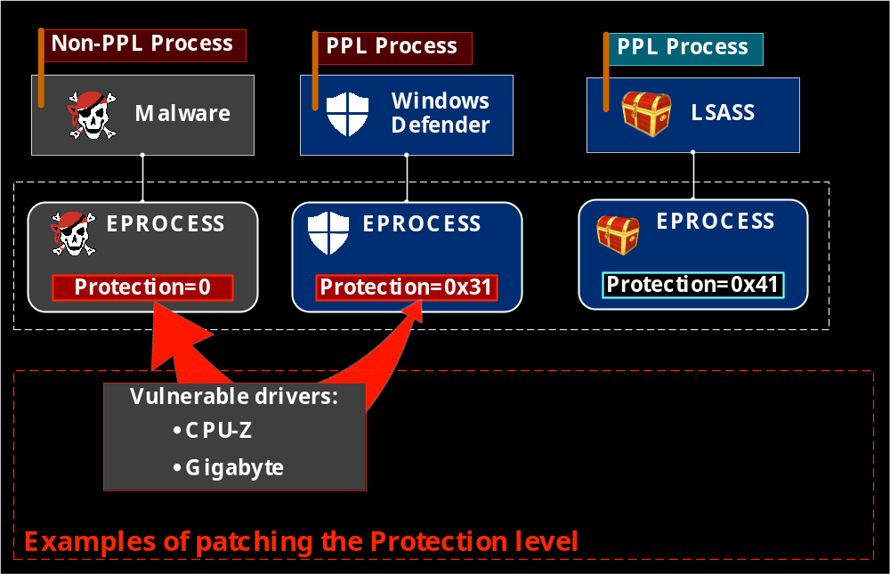
Attacks on PPL: Drivers Can Modify Protection Byte

Slide 88
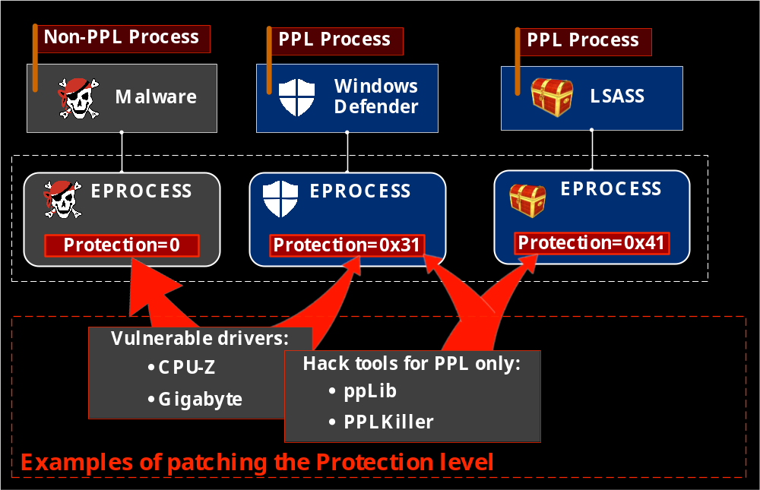
Attacks on PPL: Drivers Can Modify Protection Byte

Slide 89
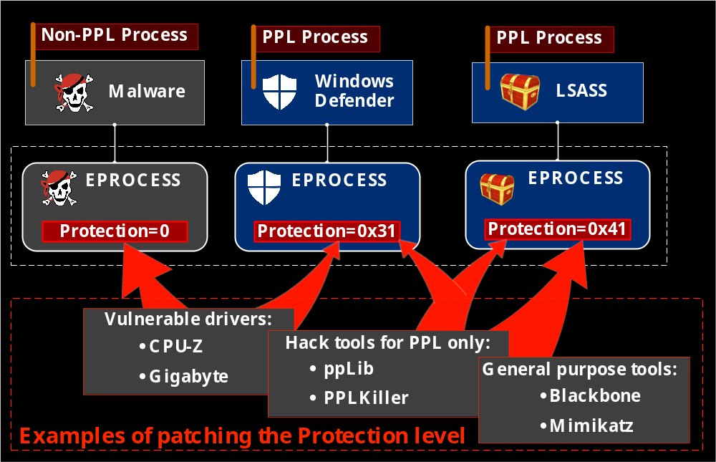
Attacks on PPL: Drivers Can Modify Protection Byte

Slide 90

Episode 8
Mimikatz can disable PPL!

Slide 91
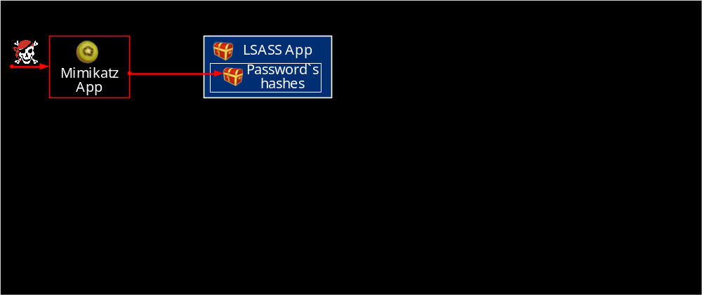
Mimikatz can gather credentials from Windows

Slide 92
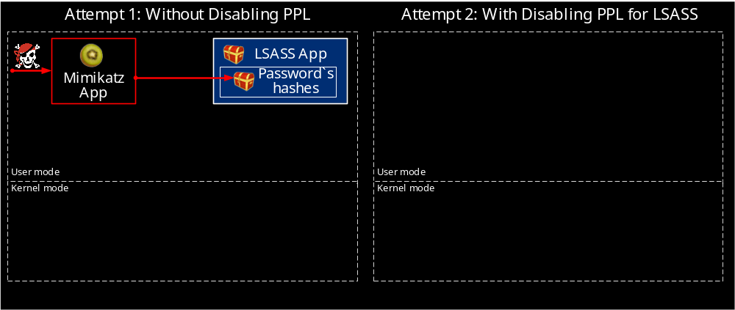
Mimikatz can gather credentials from Windows

Slide 93
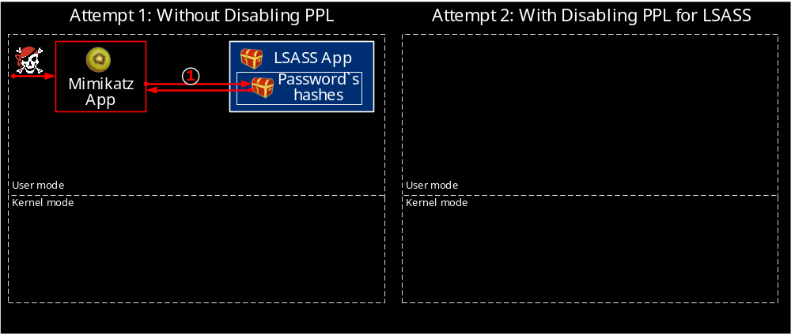
Mimikatz can gather credentials from Windows
Add debug privilege
Dump user’s hash
1

Slide 94
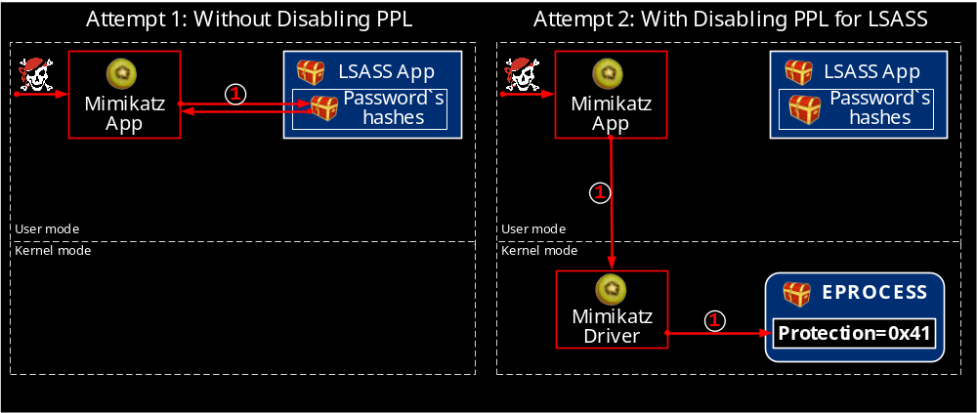
Mimikatz can gather credentials from Windows
Add debug privilege
Dump user’s hash
Load Mimikatz driver
Clear Protection byte
1
1

Slide 95
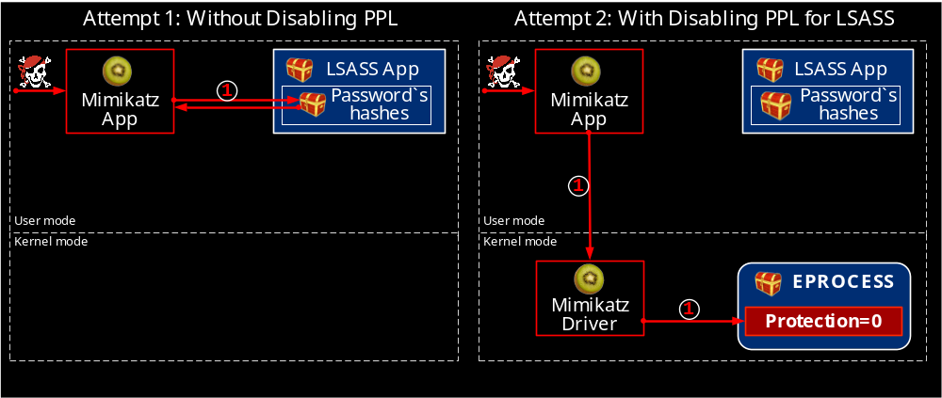
Mimikatz can gather credentials from Windows
Add debug privilege
Dump user’s hash
Load Mimikatz driver
Clear Protection byte
1
1

Slide 96
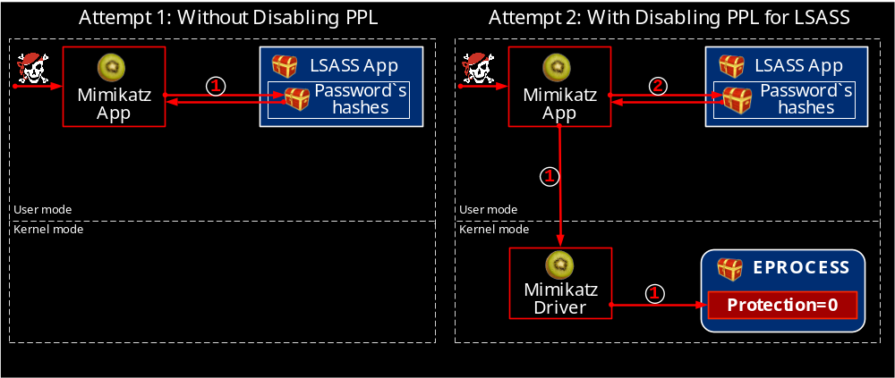
Mimikatz can gather credentials from Windows
Add debug privilege
Dump user’s hash
Load Mimikatz driver
Clear Protection byte
Add debug privilege
Dump user’s hash
1
1
2

Slide 97
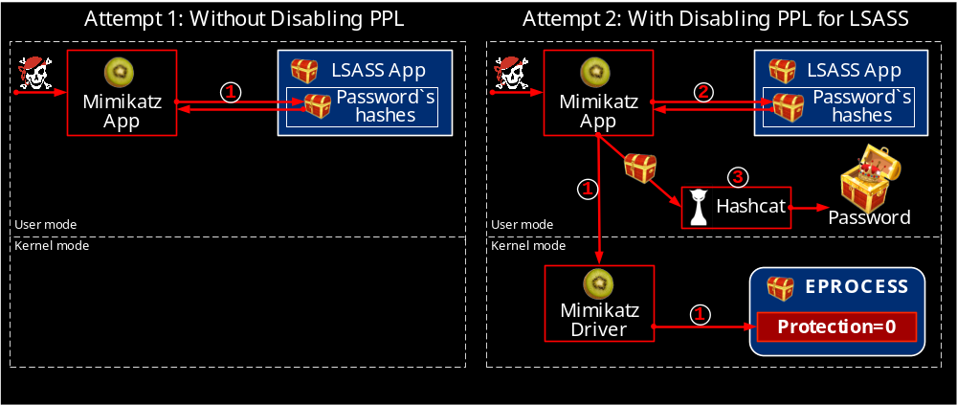
Mimikatz can gather credentials from Windows
Add debug privilege
Dump user’s hash
Load Mimikatz driver
Clear Protection byte
Add debug privilege
Dump user’s hash
1
1
2
3
Crack the hash to get password

Slide 98
Mimikatz disables PPL to dump NTLM hashes
The online version is here – https://www.youtube.com/embed/66g4PgtuD7c?vq=hd1440
Notes:
First of all, we are launching MemoryRanger console application.
It loads the hypervisor /ˈhaɪpə(r)ˌ vaɪzə(r)/ to protect kernel memory.
Then, the boss is launching his console, which loads a driver. The boss creates the budget file.
And we can see the created the file handle and the allocated FILE_OBJECT structure.
By using f_write the boss is setting up the budget.
Now, the boss is checking the budget. Done.
Now the boss receives a call and the budget file remains open.
At this moment, the attacker is getting a chance to snoop the budget.
He is launching its console. He is trying to open the budget using file system routine ZwCreateFile.
So, he fails to open the file, because Windows prevents illegal access to the budget file.
The attacker is willing to gain an access by hijacking.
He copies the address of the FILE_OBJECT. By using f_open_by_hijacking the attacker creates a file hijacker. Windows creates this file and returns the file handle and the FILE_OBJECT structure.
The attacker is trying to read the budget FILE_OBJECT, but he fails.
MemoryRanger prevents illegal memory access to the budget FILE_OBJECT.
Anyway, the attacker is still hoping to read the budget.
But instead of reading a real budget, the attacker can read only the deliberately foisted fake {pause} null data.
He fails again.
But anyway, he is trying to overwrite the budget file.
If the boss decides to check his budget he will see the originals data.
MemoryRanger prevents all illegal access attempts to the budget.
Finally, let’s compare these /ðiːz/ two files. We close the budget file and the file hijacker and both control consoles as well.
We can see that the budget file includes only the budget and all attackers input data is in his file.
The OS is protected.

Slide 99
– How to prevent PPL disabling?
– We need to restrict access to the Protection field!
?

Slide 100

Episode 9
MemoryRanger can block Mimikatz

Slide 101
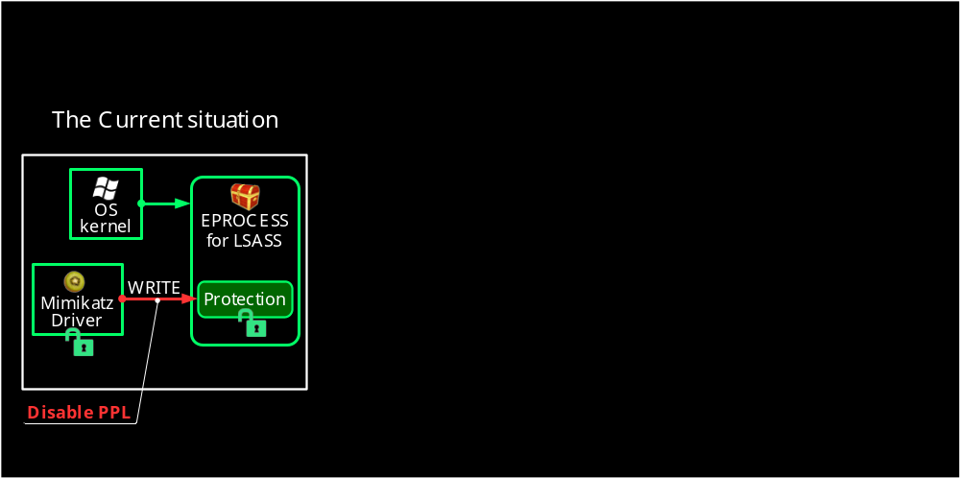
Kernel Drivers share the same memory Space

Slide 102
How to restrict access to the Protection field?

Slide 103



MemoryRanger

Slide 104
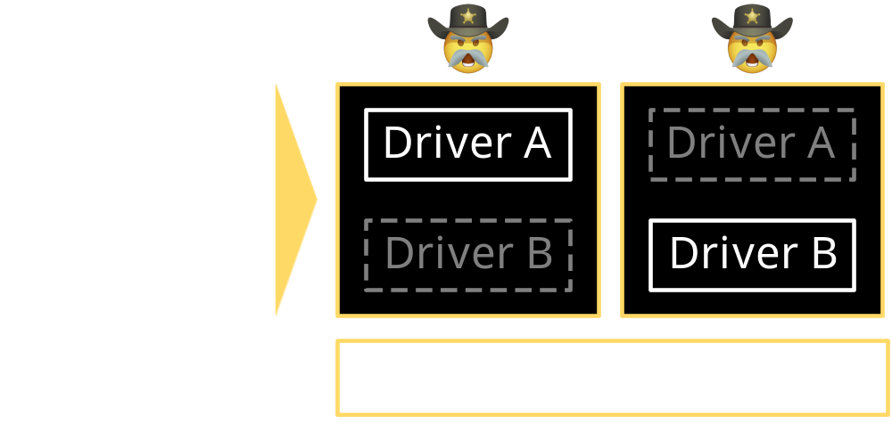
Without MemoryRanger all drivers share the same kernel memory space
MemoryRanger isolates drivers by
running them in separate kernel enclaves

Slide 105
MemoryRanger Prevents Disabling of PPL

Slide 106
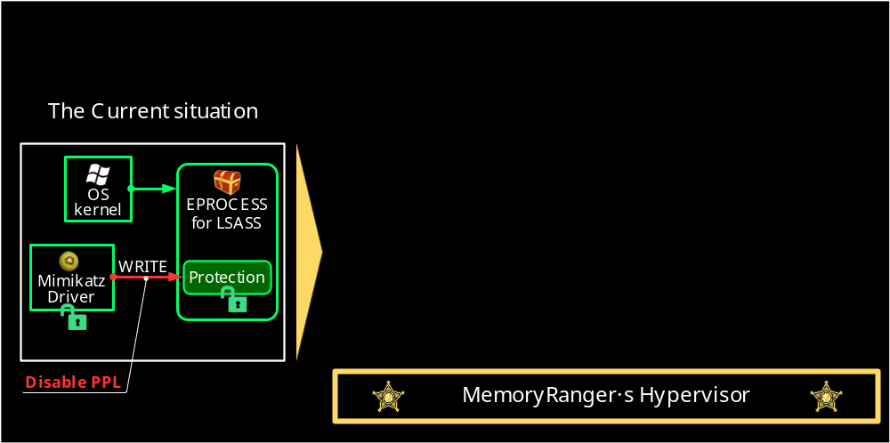
MemoryRanger Prevents Disabling of PPL

Slide 107
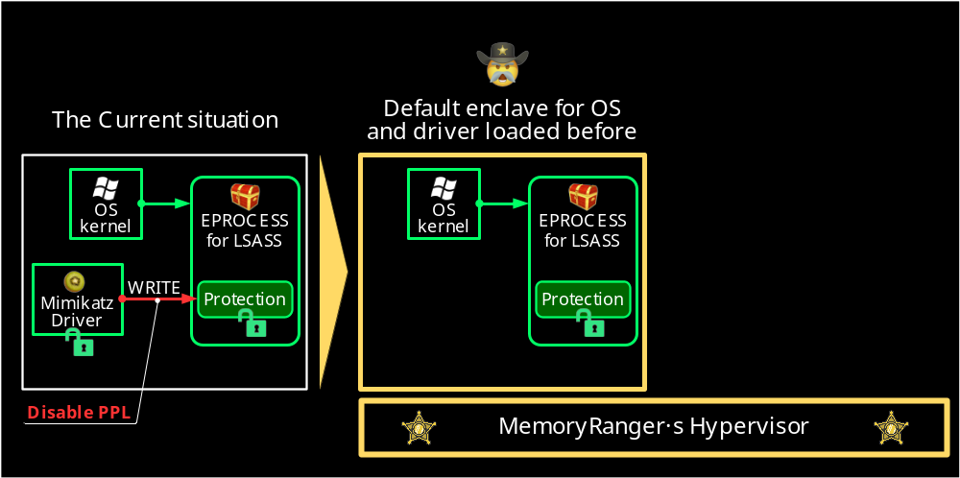
MemoryRanger Prevents Disabling of PPL

Slide 108
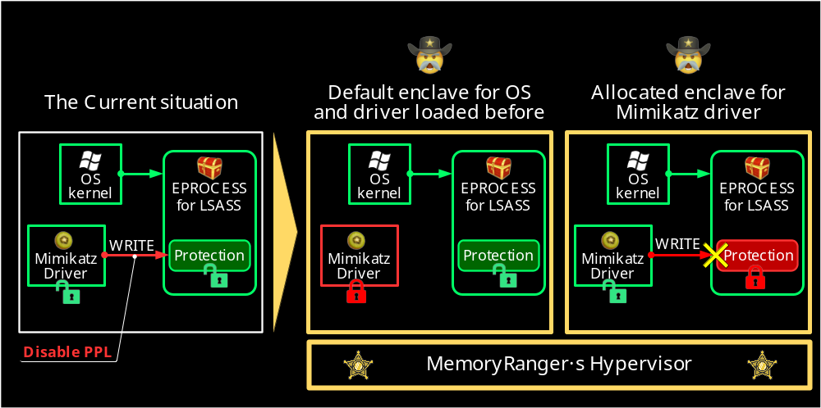
MemoryRanger Prevents Disabling of PPL

Slide 109
MemoryRanger Prevents Disabling of PPL

Slide 110
MemoryRanger Blocks Mimikatz and prevents disabling PPL
The online version is here – https://www.youtube.com/embed/66g4PgtuD7c?vq=hd1440
Notes:
First of all, we are launching MemoryRanger console application.
It loads the hypervisor /ˈhaɪpə(r)ˌ vaɪzə(r)/ to protect kernel memory.
Then, the boss is launching his console, which loads a driver. The boss creates the budget file.
And we can see the created the file handle and the allocated FILE_OBJECT structure.
By using f_write the boss is setting up the budget.
Now, the boss is checking the budget. Done.
Now the boss receives a call and the budget file remains open.
At this moment, the attacker is getting a chance to snoop the budget.
He is launching its console. He is trying to open the budget using file system routine ZwCreateFile.
So, he fails to open the file, because Windows prevents illegal access to the budget file.
The attacker is willing to gain an access by hijacking.
He copies the address of the FILE_OBJECT. By using f_open_by_hijacking the attacker creates a file hijacker. Windows creates this file and returns the file handle and the FILE_OBJECT structure.
The attacker is trying to read the budget FILE_OBJECT, but he fails.
MemoryRanger prevents illegal memory access to the budget FILE_OBJECT.
Anyway, the attacker is still hoping to read the budget.
But instead of reading a real budget, the attacker can read only the deliberately foisted fake {pause} null data.
He fails again.
But anyway, he is trying to overwrite the budget file.
If the boss decides to check his budget he will see the originals data.
MemoryRanger prevents all illegal access attempts to the budget.
Finally, let’s compare these /ðiːz/ two files. We close the budget file and the file hijacker and both control consoles as well.
We can see that the budget file includes only the budget and all attackers input data is in his file.
The OS is protected.

Slide 111
MemoryRanger Prevents Disabling of PPL for LSASS
MemoryRanger

Slide 112

Episode 10
But what if malware can escalate its own PPL?

Slide 113
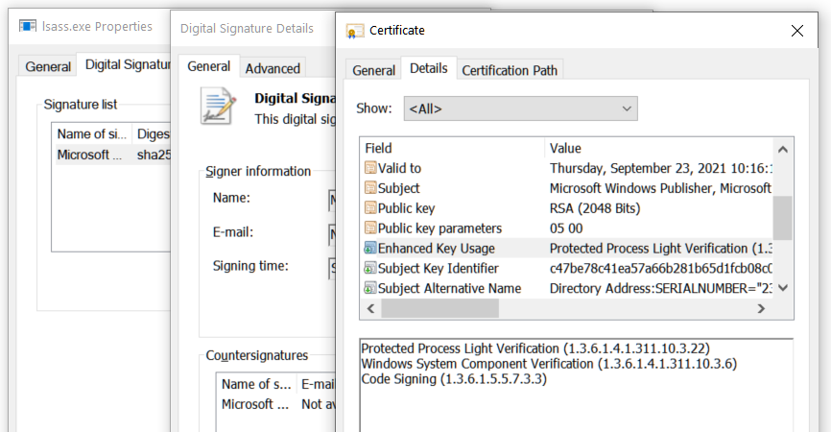
Protection.Level = 0x41

Slide 114


Code-Signing Certificate Determines the Protection Level
Malware does not have this kind of the certificate
Malware doesn’t bother about it!

Slide 115
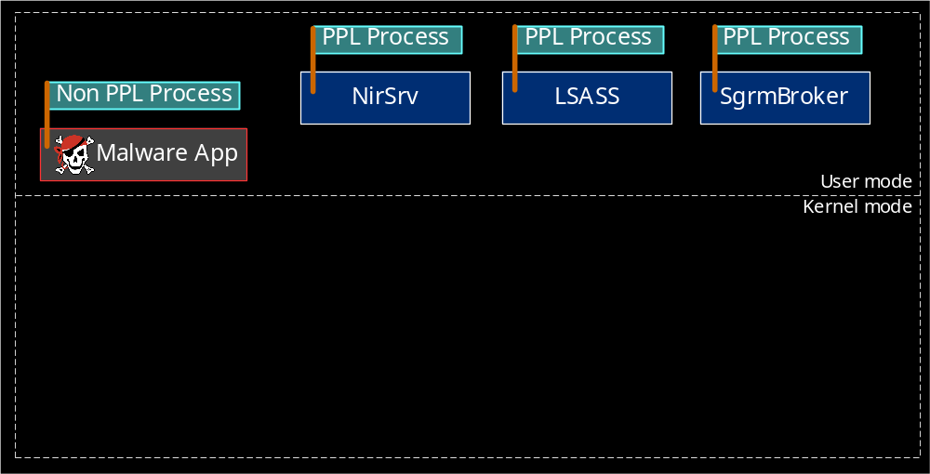
Malware can escalate its PPL to dump Protected Apps

Slide 116

Malware can escalate its PPL to dump Protected Apps

Slide 117

Malware can escalate its PPL to dump Protected Apps

Slide 118

Malware can escalate its PPL to dump Protected Apps

Slide 119
Malware escalates its PPL to dump Protected Processes
The online version is here – https://www.youtube.com/embed/IELn8mcMZ4Q?vq=hd1440
Notes:
First of all, we are launching MemoryRanger console application.
It loads the hypervisor /ˈhaɪpə(r)ˌ vaɪzə(r)/ to protect kernel memory.
Then, the boss is launching his console, which loads a driver. The boss creates the budget file.
And we can see the created the file handle and the allocated FILE_OBJECT structure.
By using f_write the boss is setting up the budget.
Now, the boss is checking the budget. Done.
Now the boss receives a call and the budget file remains open.
At this moment, the attacker is getting a chance to snoop the budget.
He is launching its console. He is trying to open the budget using file system routine ZwCreateFile.
So, he fails to open the file, because Windows prevents illegal access to the budget file.
The attacker is willing to gain an access by hijacking.
He copies the address of the FILE_OBJECT. By using f_open_by_hijacking the attacker creates a file hijacker. Windows creates this file and returns the file handle and the FILE_OBJECT structure.
The attacker is trying to read the budget FILE_OBJECT, but he fails.
MemoryRanger prevents illegal memory access to the budget FILE_OBJECT.
Anyway, the attacker is still hoping to read the budget.
But instead of reading a real budget, the attacker can read only the deliberately foisted fake {pause} null data.
He fails again.
But anyway, he is trying to overwrite the budget file.
If the boss decides to check his budget he will see the originals data.
MemoryRanger prevents all illegal access attempts to the budget.
Finally, let’s compare these /ðiːz/ two files. We close the budget file and the file hijacker and both control consoles as well.
We can see that the budget file includes only the budget and all attackers input data is in his file.
The OS is protected.

Slide 120

Malware can escalate its PPL to dump Protected Apps

Slide 121

Episode 11
MemoryRanger can block malware

Slide 122

MemoryRanger blocks modifying PPL

Slide 123

MemoryRanger blocks modifying PPL

Slide 124

MemoryRanger blocks modifying PPL

Slide 125

MemoryRanger blocks modifying PPL

Slide 126
MemoryRanger prevents escalation of PPL
The online version is here – https://www.youtube.com/embed/GEc-GOWtm8M?vq=hd1440
Notes:
First of all, we are launching MemoryRanger console application.
It loads the hypervisor /ˈhaɪpə(r)ˌ vaɪzə(r)/ to protect kernel memory.
Then, the boss is launching his console, which loads a driver. The boss creates the budget file.
And we can see the created the file handle and the allocated FILE_OBJECT structure.
By using f_write the boss is setting up the budget.
Now, the boss is checking the budget. Done.
Now the boss receives a call and the budget file remains open.
At this moment, the attacker is getting a chance to snoop the budget.
He is launching its console. He is trying to open the budget using file system routine ZwCreateFile.
So, he fails to open the file, because Windows prevents illegal access to the budget file.
The attacker is willing to gain an access by hijacking.
He copies the address of the FILE_OBJECT. By using f_open_by_hijacking the attacker creates a file hijacker. Windows creates this file and returns the file handle and the FILE_OBJECT structure.
The attacker is trying to read the budget FILE_OBJECT, but he fails.
MemoryRanger prevents illegal memory access to the budget FILE_OBJECT.
Anyway, the attacker is still hoping to read the budget.
But instead of reading a real budget, the attacker can read only the deliberately foisted fake {pause} null data.
He fails again.
But anyway, he is trying to overwrite the budget file.
If the boss decides to check his budget he will see the originals data.
MemoryRanger prevents all illegal access attempts to the budget.
Finally, let’s compare these /ðiːz/ two files. We close the budget file and the file hijacker and both control consoles as well.
We can see that the budget file includes only the budget and all attackers input data is in his file.
The OS is protected.

Slide 127

MemoryRanger blocks modifying PPL

Slide 128

Episode 12
Architecture and Customization of MemoryRanger

Slide 129

Memory Ranger architecture
Notes:
We need to process the following three events:

Slide 130

Memory Ranger architecture
Notes:
We need to process the following three events:

Slide 131

Memory Ranger architecture
Notes:
We need to process the following three events:

Slide 132

Memory Ranger architecture
Notes:
We need to process the following three events:

Slide 133

Memory Ranger architecture
Notes:
We need to process the following three events:

Slide 134

Memory Ranger architecture
(Further details in the paper)
https://github.com/IgorKorkin/MemoryRanger
Notes:
We need to process the following three events:

Slide 135

Memory Ranger architecture
(Further details in the paper)
https://github.com/IgorKorkin/MemoryRanger
Notes:
We need to process the following three events:

Slide 136
Memory Ranger architecture
(Further details in the paper)
https://github.com/IgorKorkin/MemoryRanger
Notes:
We need to process the following three events:

Slide 137
Memory Ranger architecture
(Further details in the paper)
https://github.com/IgorKorkin/MemoryRanger
Notes:
We need to process the following three events:

Slide 138

Memory Ranger architecture
(Further details in the paper)
https://github.com/IgorKorkin/MemoryRanger
Notes:
We need to process the following three events:

Slide 139

Memory Ranger architecture
(Further details in the paper)
https://github.com/IgorKorkin/MemoryRanger
Notes:
We need to process the following three events:

Slide 140







MemoryRanger: Previous Research
(2018) Divide et Impera: MemoryRanger Runs Drivers in Isolated Kernel Spaces
https://igorkorkin.blogspot.com/2018/12/divide-et-impera-memoryranger-runs.html
(2019) MemoryRanger Prevents Hijacking FILE_OBJECT Structures in Windows Kernel
https://igorkorkin.blogspot.com/2019/04/memoryranger-prevents-hijacking.html
(2020) Kernel Hijacking Is Not an Option: MemoryRanger Comes to the Rescue Again
https://conference.hitb.org/hitb-lockdown002/sessions/kernel-hijacking-is-not-an-option-memoryranger-comes-to-rescue-again/

Slide 141
MemoryRanger can Protect PPL
MR’s Driver:
  locates an address of Protection field of LSAAS EPROCESS
  traps loading of Mimikatz
MR’s Hypervisor
Any access to the restricted memory causes EPT violations
MR’s Hypervisor:
  For execute violation → switches an enclave;
  For read\write violation → blocks an access by redirecting to the fake memory page

Slide 142
MemoryRanger can Protect PPL
MR’s Driver:
  locates an address of Protection field for OS processes and newly created apps
  traps loading of Mimikatz
MR’s Hypervisor
Any access to the restricted memory causes EPT violations
MR’s Hypervisor:
  For execute violation → switches an enclave;
  For read\write violation → blocks an access by redirecting to the fake memory page

Slide 143
MemoryRanger can Protect PPL
MR’s Driver:
  locates an address of Protection field for OS processes and newly created apps
  traps loading of kernel drivers
MR’s Hypervisor
Any access to the restricted memory causes EPT violations
MR’s Hypervisor:
  For execute violation → switches an enclave;
  For read\write violation → blocks an access by redirecting to the fake memory page

Slide 144
MemoryRanger can Protect PPL
MR’s Driver:
  locates an address of Protection field for OS processes and newly created apps
  traps loading of kernel drivers
MR’s Hypervisor provides discretionary access control mechanism:
Any access to the restricted memory causes EPT violations
MR’s Hypervisor:
  For execute violation → switches an enclave;
  For read\write violation → blocks an access by redirecting to the fake memory page
 | Default enclave | Mimikatz enclave | Malware enclave
EPROCESS.Protection | Read Write | No Access | No Access
Mimikatz driver | No Access | Read Write Execute | No Access
Malware driver | No Access | No Access | Read Write Execute

Slide 145
MemoryRanger can Protect PPL
MR’s Driver:
  locates an address of Protection field for OS processes and newly created apps
  traps loading of kernel drivers
MR’s Hypervisor provides discretionary access control mechanism:
Any access to the restricted memory causes EPT violations
MR’s Hypervisor:
  For execute violation → switches an enclave;
  For read\write violation → blocks an access by redirecting to the fake memory page
 | Default enclave | Mimikatz enclave | Malware enclave
EPROCESS.Protection | Read Write | No Access | No Access
Mimikatz driver | No Access | Read Write Execute | No Access
Malware driver | No Access | No Access | Read Write Execute

Slide 146
MemoryRanger can Protect PPL
MR’s Driver:
  locates an address of Protection field for OS processes and newly created apps
  traps loading of kernel drivers
MR’s Hypervisor provides discretionary access control mechanism:
Any access to the restricted memory causes EPT violations
MR’s Hypervisor:
  For execute violation → switches an enclave;
  For read\write violation → blocks an access by redirecting to the fake page

Slide 147
Conclusion
  1. Windows Security Model does not restrict apps running with debug privilege.
  2. Protected Process Light (PPL) protects memory of OS and AV processes.
  3. Attackers can abuse PPL in the following ways:
  protect their malware by illegally enabling PPL
  steal and modify data of protected processes by illegally disabling PPL
  4. MemoryRanger blocks attacks on kernel data including attacks on PPL.

Slide 148




Thank you!
Igor Korkin igor.korkin@gmail.com
All the details are here igorkorkin.blogspot.com
Notes:
Thank you!

