Slide 1
OpenGL TEXT AND SOUND
Mark Daniel G. Dacer

Slide 2
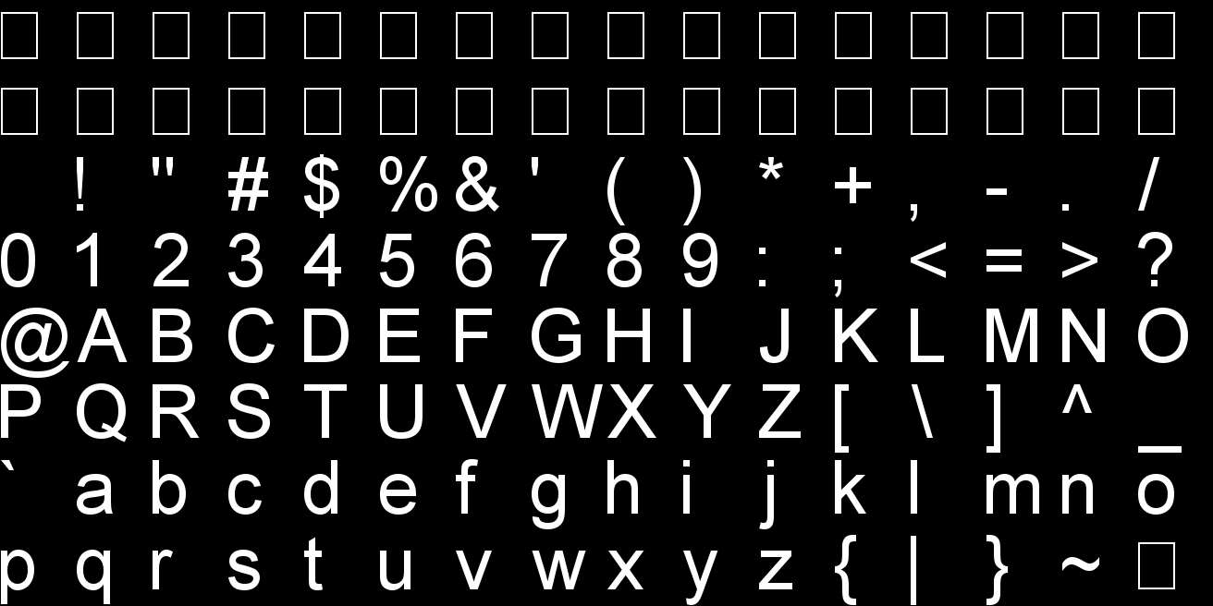
BITMAP FONTS
A bitmap font is basically a 2D font. Although we’ll place it in a 3D world, these fonts will have no thickness and can’t be rotated or scaled, only translated. Furthermore, the font will always face the viewer, like a billboard. Although this can be seen as a potential disadvantage, on the other hand we won’t have to worry about orienting the font to face the viewer

Slide 3
Syntax
void glutBitmapCharacter(void *font, int character)
Parameters:
  font – the name of the font to use (see bellow for a list of what’s available
  character – what to render, a letter, symbol, number, etc…
glutBitmapCharacter(GLUT_BITMAP_HELVETICA_18,'3');

Slide 4
FONTS AVAILABLE
GLUT_BITMAP_8_BY_13
GLUT_BITMAP_9_BY_15
GLUT_BITMAP_TIMES_ROMAN_10
GLUT_BITMAP_TIMES_ROMAN_24
GLUT_BITMAP_HELVETICA_10
GLUT_BITMAP_HELVETICA_12
GLUT_BITMAP_HELVETICA_18

Slide 5
Fonts (cont.)
One important thing to know is what is the actual raster position. The raster position can be set with the family of functions glRasterPos from the OpenGL library. The syntax of two functions from this family is presented below.
void glRasterPos2f(float x, float y);
void glRasterPos3f(float x, float y, float z);
  Parameters:
  x, y, z – local coordinates for the text to appear

Slide 6
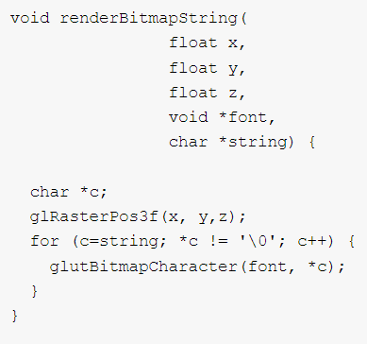
Fonts (cont.)
The function glutBitmapCharacter renders the character at the required position and advances the current raster position by the width of the character. Therefore, to render a string, successive calls to glutBitmapCharacter will suffice to achieve the desired output. The following function renders a string starting at the specified raster position:

Slide 7
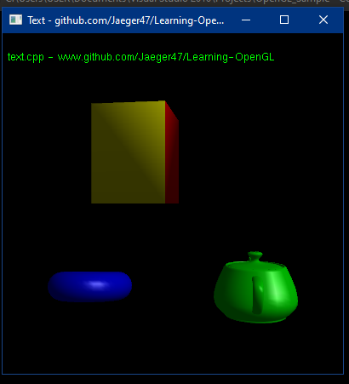
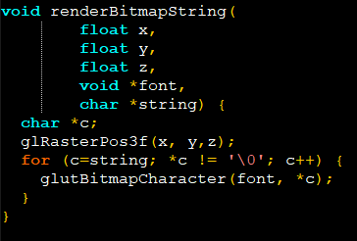
Preview

Slide 8
OPENGL Sound
OpenGL doesn't offer us any support for audio capabilities (like many other aspects of game development). We have to manually load audio files into a collection of bytes, process and convert them to an audio stream, and manage multiple audio streams appropriately for use in our game. This can get complicated pretty quick and requires some low-level knowledge of audio engineering.

Slide 9
Irrklang
IrrKlang is a high level 2D and 3D cross platform (Windows, Mac OS X, Linux) sound engine and audio library that plays WAV, MP3, OGG, and FLAC files to name a few. It also features several audio effects like reverb, delay, and distortion that can be extensively tweaked.

Slide 10
Setting up iIRKLANG
Download iirKlang on this website: https://www.ambiera.com/irrklang/downloads.html
Use 32 bit version
Extract the zip, you’ll see a bunch of files and folders
1st go to the bin\win32-visualStudio folder and copy all the .dll files to your system32 and sysWOW64

Slide 11
Setting up iIRKLANG (Cont.)
When using visual studio 2010 follow this
1st create a folder name irr on your visual studio directory\VC\include Example“: C:\Program Files\Microsoft Visual Studio 10.0\VC\include
2nd go to the irrklang folder and go to include then copy all the .h files it to the newly created irr folder.
3rd go the irrklang folder and go to the lib\Win32-visualStudio folder and copy all files to visual studio directory\VC\lib folder
Example: C:\Program Files\Microsoft Visual Studio 10.0\VC\lib

Slide 12
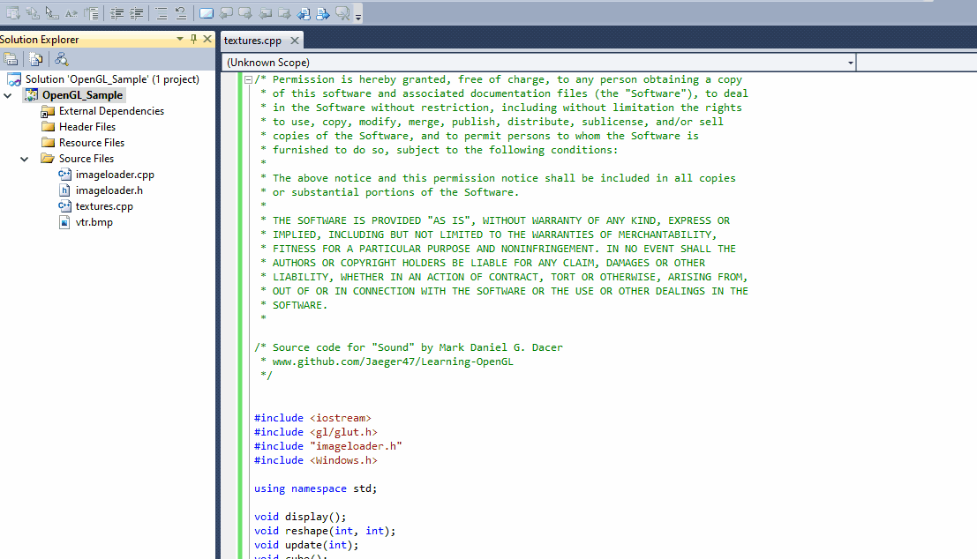
Last Step

Slide 13

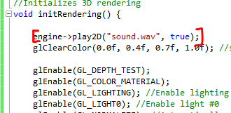
Preview
irrKlang setup
Playing audio using play2D(LOCATION, LOOPING)

Slide 14
Additional
Please read the irrKlang for more information: https://www.ambiera.com/irrklang/tutorials.html
If you cant setup or having errors setting up email, dm me or go to the faculty for clarifications.

Slide 15
EXTRA LINKS
https://learn.microsoft.com/en-us/windows/win32/opengl/fonts-and-text
https://www.ambiera.com/irrklang/index.html
https://learnopengl.com/In-Practice/2D-Game/Audio

