Slide 1


Electronic Lab Notebooks –
Support from data acquisition to publication
Carolin Leister
KIT Library | Research Services

Slide 2

Welcome to the course on Electronic Lab Notebooks
Content:
  Basics of Electronic Laboratory Notebooks (ELNs)
  Benefits of ELNs
  Assistance in selecting suitable ELNs
  Practical examples: Chemotion and Kadi4Mat
Materials will be made available one week after the course
Image by Bruno from Pixabay

Slide 3
Short introduction
Who are you and what is your field of expertise? What kind of research data do you work with?
Have you ever used a Lab Notebook?
Have you ever used an Electronic Lab Notebook?
What do you know about Electronic Lab Notebooks?
Notes:
Info: For this questions you can include a Mentimeter.

Slide 4
„Is there a reproducibility crisis?“
„More than 70% of researchers have tried and failed to reproduce another scientist’s experiments, and more than half have failed to reproduce their own experiments.”
What can help researchers to reproduce experiments?
Baker (2016): 1,500 scientists lift the lid on reproducibility. In: Nature 533 (7604), S. 452–454. DOI: https://doi.org/10.1038/533452a .
Notes:
Info: For this questions you can include a Mentimeter.

Slide 5

Good Research Practice
Read the "DFG Guidelines of Safeguarding Good Research Practice", especially
  Guideline 7: Cross-phase quality assurance
  Guideline 12: Documentation
  Guideline 13: Providing public access to research results
  Guideline 17: Archiving
What could be reasons why experiments are not reproducible? What can help researchers to guarantee the reproducibility of experiments? (5 Minutes)
How do you document your research (data)?
Deutsche Forschungsgemeinschaft (DFG) (2019): Guidelines for Safeguarding Good Research Practice. Code of Conduct. DOI: https://doi.org/10.5281/zenodo.3923601.
Notes:
Info: For this questions you can include a Mentimeter.

Slide 6
Data documentation
If research data should be reused, it must be described in a meaningful way and in as much detail as possible.
It is therefore best to document how, when and for what purpose the data was created as soon as it is created.
Data documentation can be provided in a wide variety of formats, e.g.
  in an accompanying ReadMe file
  structured as metadata
  in an internal project wiki
  in a data management plan
  within the folder structure and file naming
  in an (electronic) lab notebook
"Researchers document all information relevant to the production of a research result as clearly as is required by and is appropriate for the relevant subject area to allow the result to be reviewed and assessed.“¹
¹ Deutsche Forschungsgemeinschaft (DFG) (2019): Guidelines for Safeguarding Good Research Practice. Code of Conduct. DOI: https://doi.org/10.5281/zenodo.3923601.
This information is translated from forschungsdaten.info licensed under a CC0 license.

Slide 7


What is a laboratory notebook?
Laboratory notebooks are used to document, conduct and analyze scientific experiments and research data generated during the process¹
They are primarily used in natural sciences
Using them is part of „Good research practise“^{2,3}
“Continuous quality assurance during the research process includes
(…) the keeping of laboratory notebooks.“^{2,3}
Bild von storyset auf Freepik
¹ Biernacka et al. (2021): Train-the-Trainer-Konzept zum Thema Forschungsdatenmanagement: Zenodo. https://doi.org/10.5281/zenodo.5773203.
² Deutsche Forschungsgemeinschaft (DFG) (2019): Guidelines for Safeguarding Good Research Practice. Code of Conduct. DOI: https://doi.org/10.5281/zenodo.3923601..
³ Karlsruhe Institute of Technology (KIT) (2021): Statutes for Safeguarding Good Research Practice at Karlsruhe Institute of Technology (KIT). Online: https://www.sle.kit.edu/downloads/AmtlicheBekanntmachungen/2021_AB_061_English.pdf.

Slide 8

How is a laboratory notebook structured?
How does it look like:
  Notebook, no loose sheets of paper
  Table of content
  Numbering of pages
  Records by days
  Experimental planning and conducting
  Recording results and measured data
Important:
  Permanent ink
  Should be written during or directly following an experiment
  Stays in the lab or institute
Bild von fotografierende auf Pixabay
A laboratory notebook is a legal document to support your scientific work and serves as a defense against accusations of misconduct.

Slide 9
Disadvantages of a classic laboratory notebook
Experiments and results must be recorded manually
Tables, graphs and analysis are available in digital form, but must be in the lab notebook, so they are often printed out and pasted in
Is it readable and understandable for everyone?
You can't access your lab notebook yourself, because it is in the institute
Bild von fotografierende auf Pixabay

Slide 10
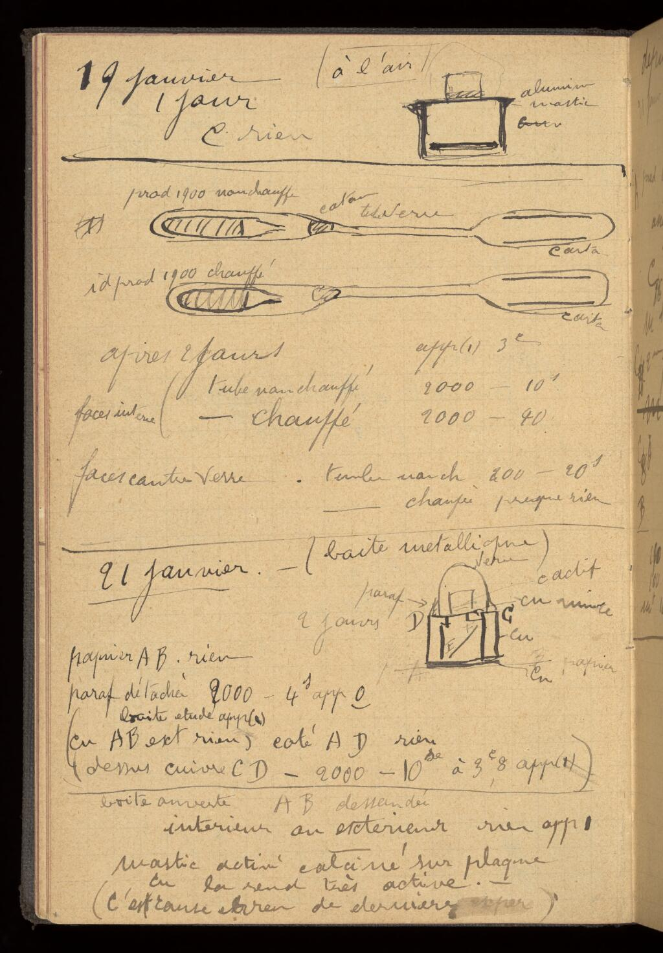
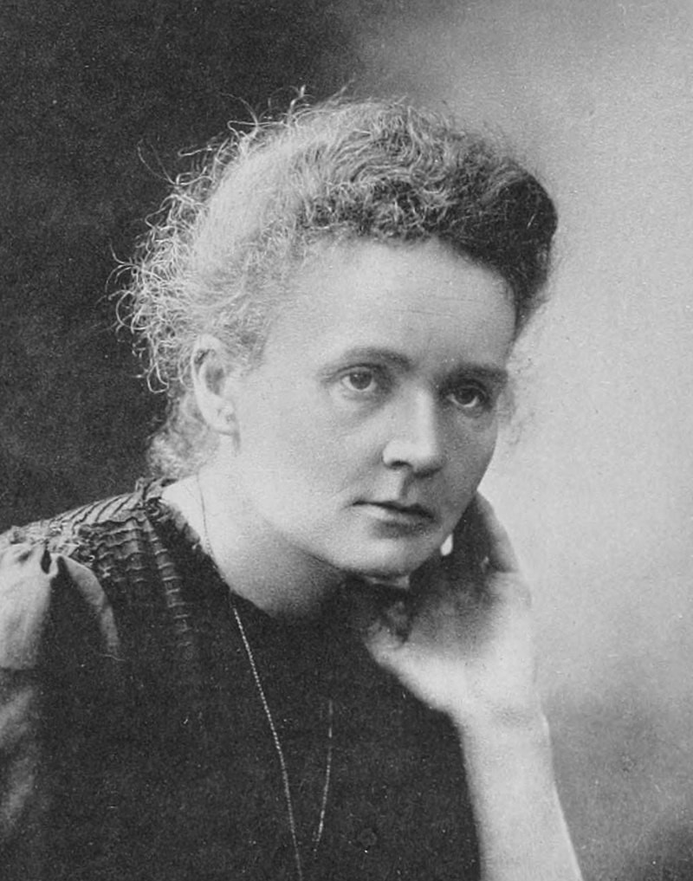
Famous negative example:
Marie Curie‘s laboratory notebook
After more than 100 years, many of Marie Curie's personal items, including her laboratory notes, are still radioactive^{1, 2}.
Curie's laboratory notes, are stored in lead-lined boxes at the French Bibliotheque National in Paris.
Radioactive half life of Radium t_{½}(²²⁶Ra) ≈ 1602 a
Marie Curie (1867-1934)
https://wellcomecollection.org/works/cywqefw4/items?canvas=82
Bryson (2003): A Short History of Nearly Everything. New York, NY: Broadway Books.
https://www.sciencealert.com/these-personal-effects-of-marie-curie-will-be-radioactive-for-another-1-500-years

Slide 11
The solution: Electronic Laboratory Notebooks
ELN Finder: An electronic lab notebook (ELN) is a specialized software for:
  the structured description of an experiment, i.e. keeping records of
    the procedure
      the used materials and instruments
      the observations made during the experiment (incl. photos)
      the metadata/description of the data generated in the experiment and, if applicable, the files (or links to them) and inferences related to it
  the long term preservation and access of all this information in compliance with long-term archival criteria
An ELN is more than just a digital copy of a paper-based lab notebook. ELNs can be fully implemented into the digital research data management system.
Higgins et al. (2022): Considerations for implementing electronic laboratory notebooks in an academic research environment. In: Nature protocols 17 (2), S. 179–189. DOI: 10.1038/s41596-021-00645-8.

Slide 12
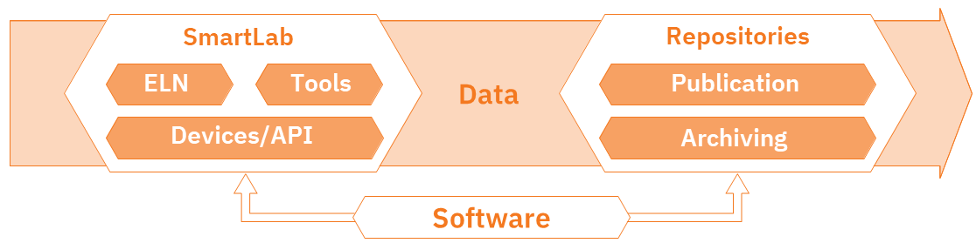
Advantages of Electronic Lab Notebooks (1/5)
Linked digital research environment
  Automatisation: Measuring devices deliver their data directly to the ELN
  Integration or linking of data that is already available in a digital format (e.g. measurements, images, tables)
  API for integration into the existing software environment
  Interfaces to other programs (e.g. ChemDraw)
  Import and export function
  Direct connection to research data repositories, data services or publication platforms
  Assign metadata
  Ability to assign persistent identifiers
Figure from NFDI4Chem Knowledge Base, licensed under a Creative Commons BY-SA 4.0 License
ZB MED - Informationszentrum Lebenswissenschaften (2021): ELN Guide. Electronic laboratory notebooks in the context of research data management and good research practice – a guide for the life sciences. DOI: https://doi.org/10.4126/FRL01-006425772.
https://www.publisso.de/en/research-data-management/rd-documenting/benefits-of-an-eln

Slide 13
Advantages of Electronic Lab Notebooks (2/5)
Collaboration with others
  Sharing of research data, process protocols, workflows, templates
  Rights and role management
  Ability to comment/write messages directly in the ELN
  Define tasks
ZB MED - Informationszentrum Lebenswissenschaften (2021): ELN Guide. Electronic laboratory notebooks in the context of research data management and good research practice – a guide for the life sciences. DOI: https://doi.org/10.4126/FRL01-006425772.
https://www.publisso.de/en/research-data-management/rd-documenting/benefits-of-an-eln
https://labfolder.com/guide/collaboration/
https://labfolder.com/guide/inventory/

Slide 14
Advantages of Electronic Lab Notebooks (3/5)
Standardization
  Create, reuse and share templates for protocols, processes and workflows
ZB MED - Informationszentrum Lebenswissenschaften (2021): ELN Guide. Electronic laboratory notebooks in the context of research data management and good research practice – a guide for the life sciences. DOI: https://doi.org/10.4126/FRL01-006425772.
https://www.publisso.de/en/research-data-management/rd-documenting/benefits-of-an-eln
https://labfolder.com/guide/protocols-and-sops/

Slide 15
Advantages of Electronic Lab Notebooks (4/5)
Evidentiary value
  Versioning
  Audit trail
  Electronic signature and time stamp
ZB MED - Informationszentrum Lebenswissenschaften (2021): ELN Guide. Electronic laboratory notebooks in the context of research data management and good research practice – a guide for the life sciences. DOI: https://doi.org/10.4126/FRL01-006425772.
https://www.publisso.de/en/research-data-management/rd-documenting/benefits-of-an-eln
https://labfolder.com/guide/data-integrity-and-security/

Slide 16
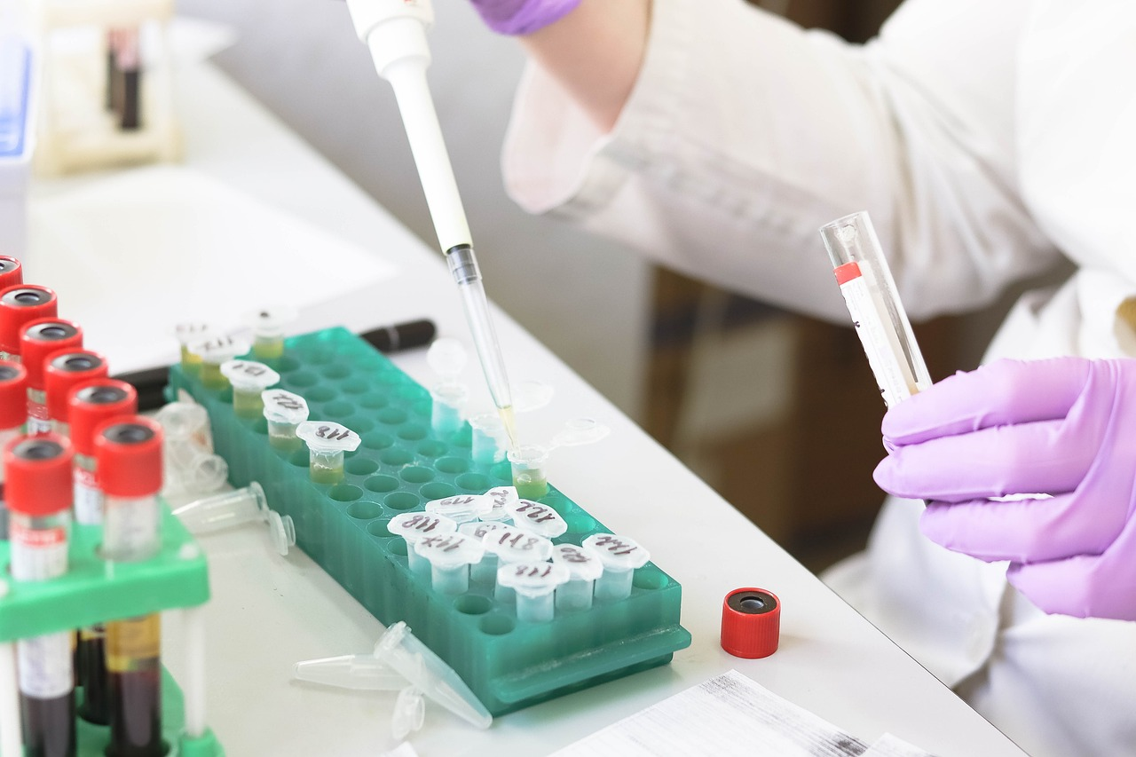
Advantages of Electronic Lab Notebooks (5/5)
Search functions and filtering options
Option to use tags
Access to the lab notebook at any time from anywhere
Structuring and visualization of processes and workflows
Easy to create backups
Managing inventories
Tracking equipment and equipment maintenance schedules
Possibility to use tablets
…
Image by Tatiana from Pixabay
Higher efficiency in daily work
Saves time and increases data quality
Avoids information loss
Make research findings traceable and verifiable
Provide a means of preparing research data for publication and digital preservation
Connected digital research environment
ZB MED - Informationszentrum Lebenswissenschaften (2021): ELN Guide. Electronic laboratory notebooks in the context of research data management and good research practice – a guide for the life sciences. DOI: https://doi.org/10.4126/FRL01-006425772.
https://www.publisso.de/en/research-data-management/rd-documenting/benefits-of-an-eln

Slide 17
Examples of ELNs:
Chemotion/LabIMotion (Open Source): https://chemotion.net
Kadi4Mat (Open Source): https://kadi.iam.kit.edu/
eLabFTW (Open Source): https://www.elabftw.net/
Labfolder (commercial): https://www.labfolder.com
openBIS (Open Source): https://openbis.ch
Rspace ELN (commercial): https://www.researchspace.com/
SciNote (Open Source): https://www.scinote.net/
Labcollector (commercial): https://labcollector.com/

Slide 18







How do I decide which ELN fits me?
Assistance is provided by the following tools:
  ELN-Guide
  ELN Finder
Image by storyset on Freepik
„There is no “one-size-fits-all” answer to the question of whether to develop a solution in-house or opt for an open-source or commercial product.“¹
¹ZB MED - Informationszentrum Lebenswissenschaften (2021): ELN Guide. Electronic laboratory notebooks in the context of research data management and good research practice – a guide for the life sciences. DOI: https://doi.org/10.4126/FRL01-006425772.

Slide 19
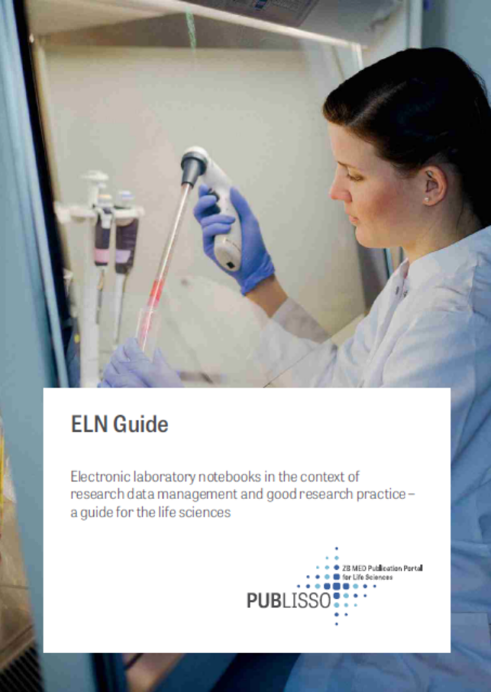
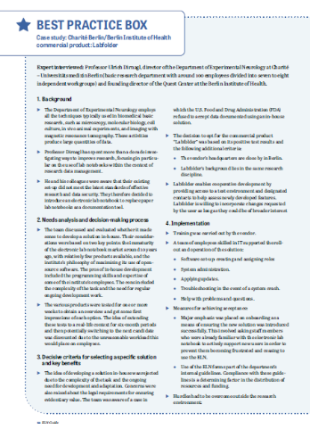
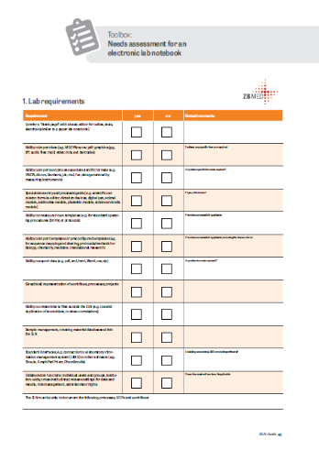
ELN-Guide
Requirements for an Electronic Lab Notebook
Procedure for the introduction of an ELN
Best-Practice-Examples
Toolboxes for needs assessment
ELN-Filter
Toolboxes also available as Table
ZB MED - Informationszentrum Lebenswissenschaften (2021): ELN Guide. Electronic laboratory notebooks in the context of research data management and good research practice – a guide for the life sciences. DOI: https://doi.org/10.4126/FRL01-006425772.

Slide 20

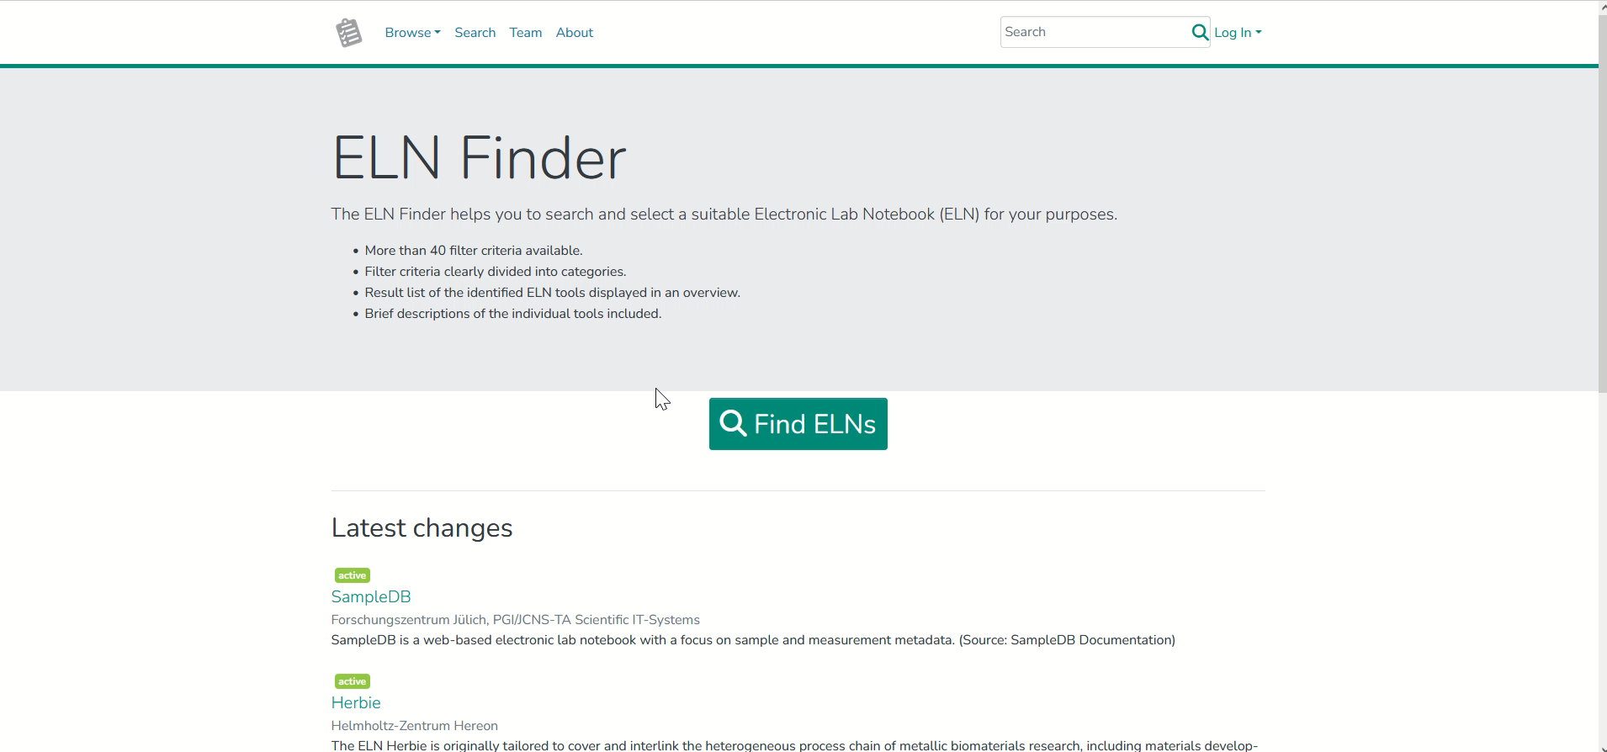
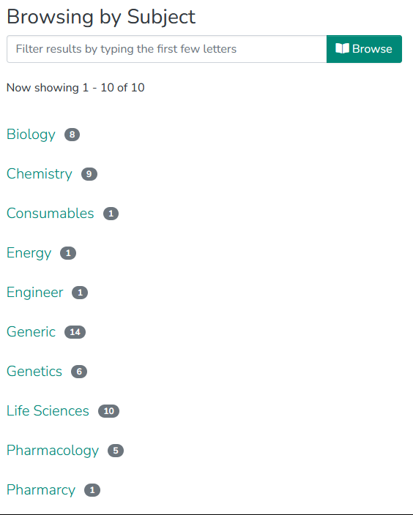
ELN Finder
Offers the possibility to search and filter electronic lab notebooks by criteria or keywords
For further information click here.
https://eln-finder.ulb.tu-darmstadt.de/

Slide 21

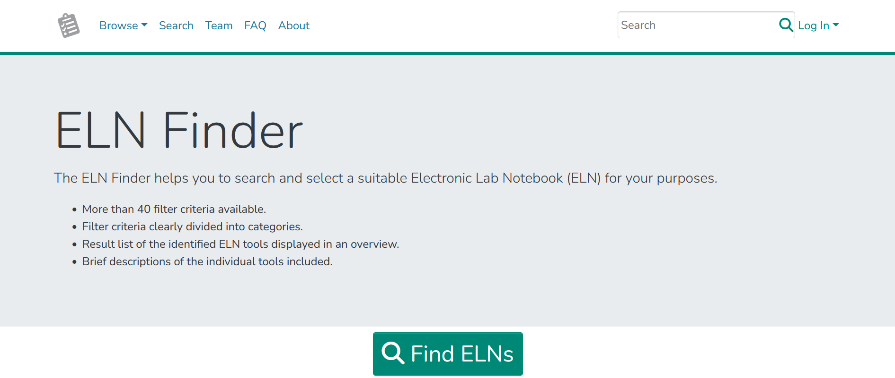
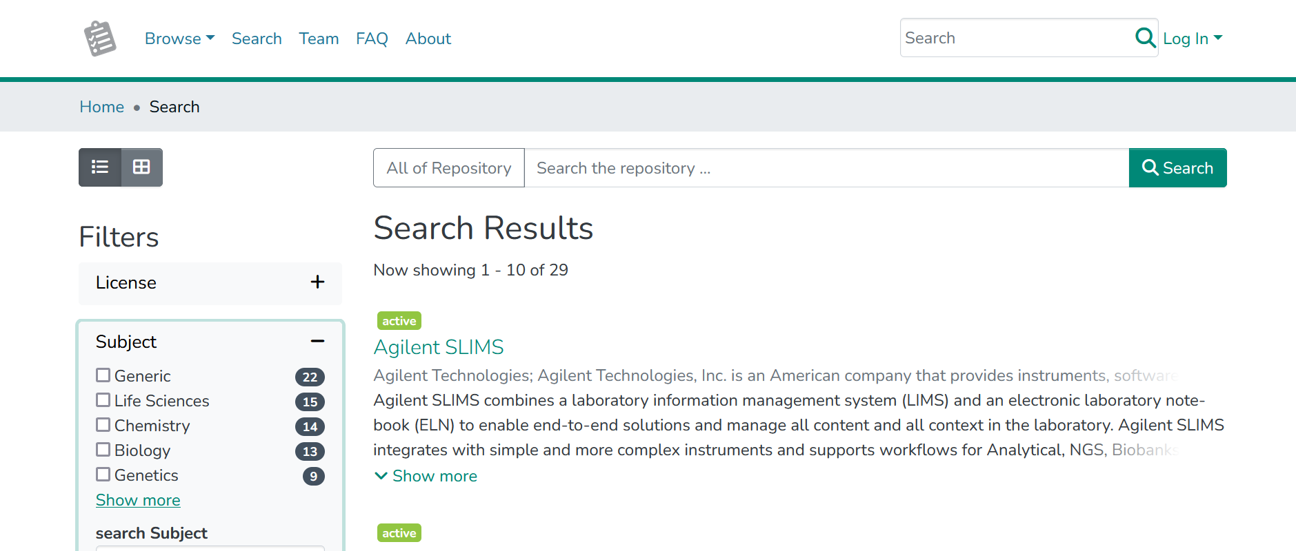
Hands on: ELN-Finder
Go to the website: https://eln-finder.ulb.tu-darmstadt.de/home
Click on „Find ELNs“ and search for an ELN that fits your needs
Notes:
Info: For this exercise you can include a Mentimeter.

Slide 22
Examples of ELNs at KIT:
Chemotion/LabIMotion (Open Source): https://chemotion.net
Kadi4Mat (Open Source): https://kadi.iam.kit.edu/
eLabFTW (Open Source): https://www.elabftw.net/
Labfolder (commercial): https://www.labfolder.com
openBIS (Open Source): https://openbis.ch
Rspace ELN (commercial): https://www.researchspace.com/
SciNote (Open Source): https://www.scinote.net/
Labcollector (commercial): https://labcollector.com/

Slide 23

Example 1: Chemotion ELN
Subject-specific ELN for Chemistry and related fields
Open Source
Developed at Institute of Organic Chemistry (IOC) / Institute of Biological and Chemical Systems – Functional Molecular Systems (IBCS-FMS)
Connected repository for publication of data
Recommended ELN of the National Research Data Infrastructure for Chemistry (NFDI4Chem)
https://www.chemotion.net/

Slide 24
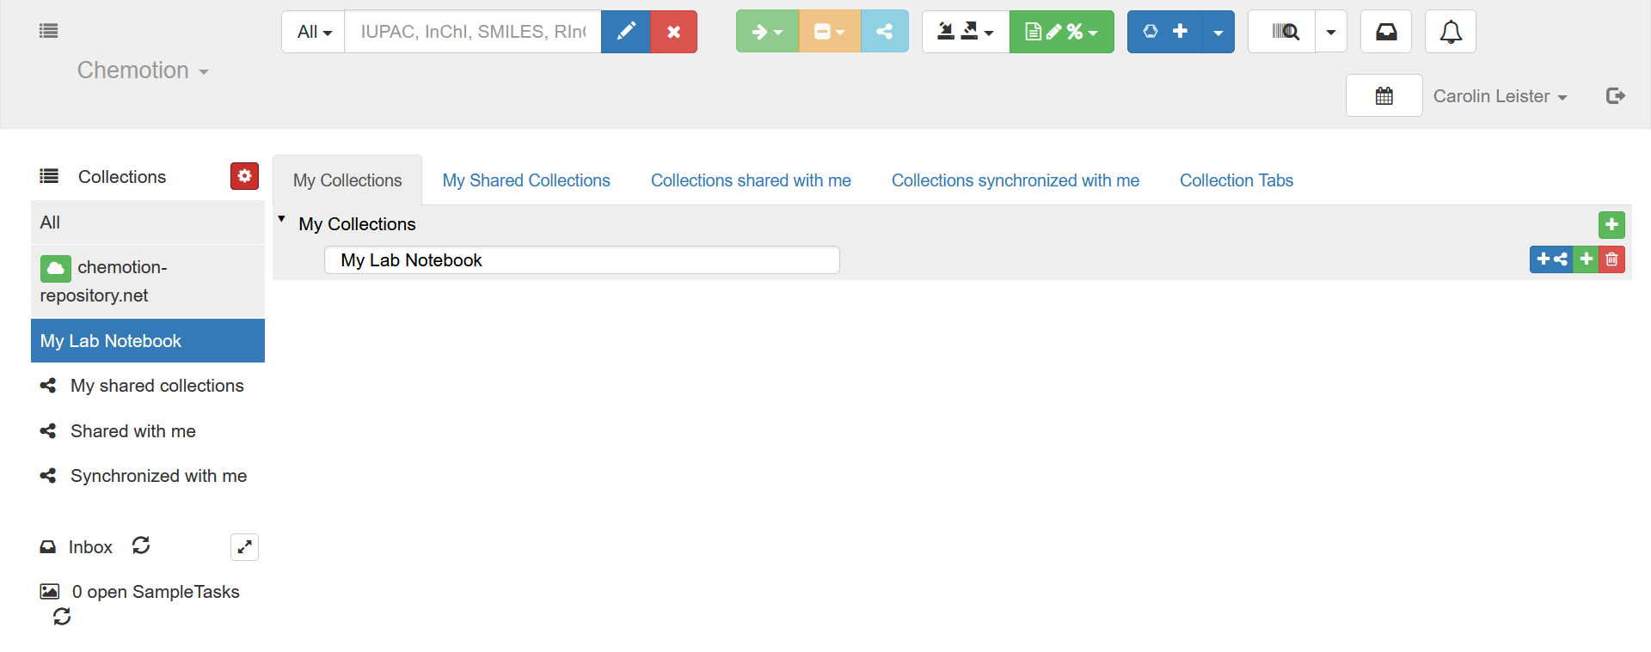
Hands-on Chemotion ELN (1/3)
Go to the Demo version of Chemotion ELN
Click on `Sign up` to create an account for the Demo version
Create a collection with your favorite name (e.g. “My Lab Notebook”)
1.
2.
3.

Slide 25
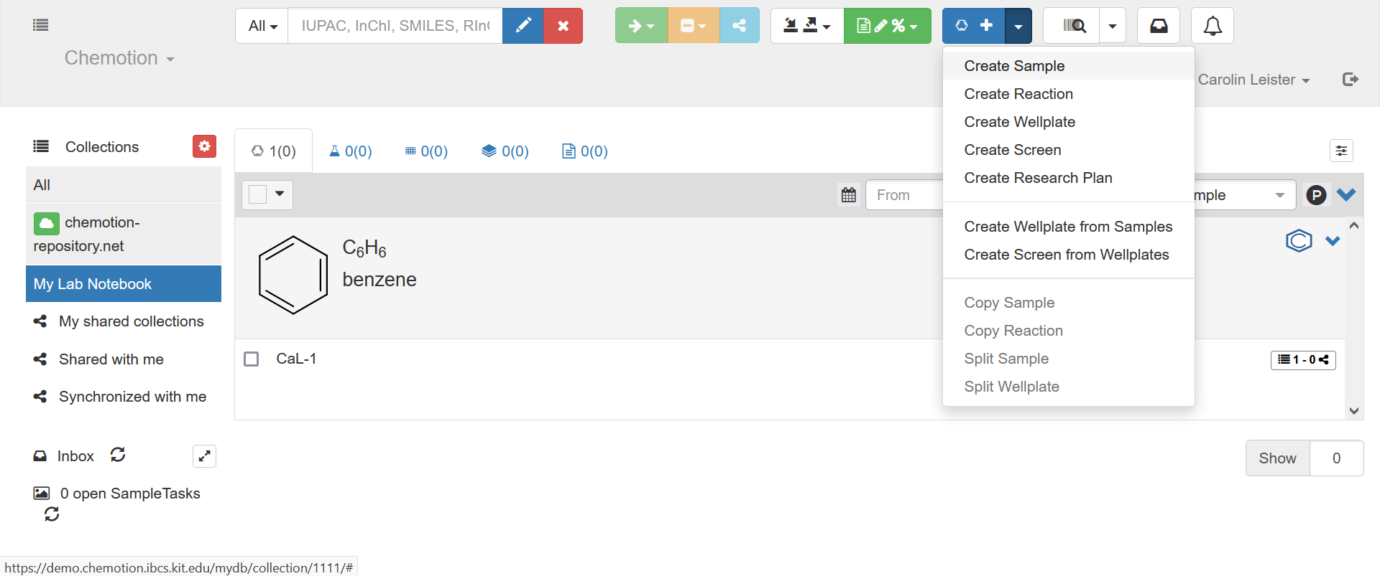
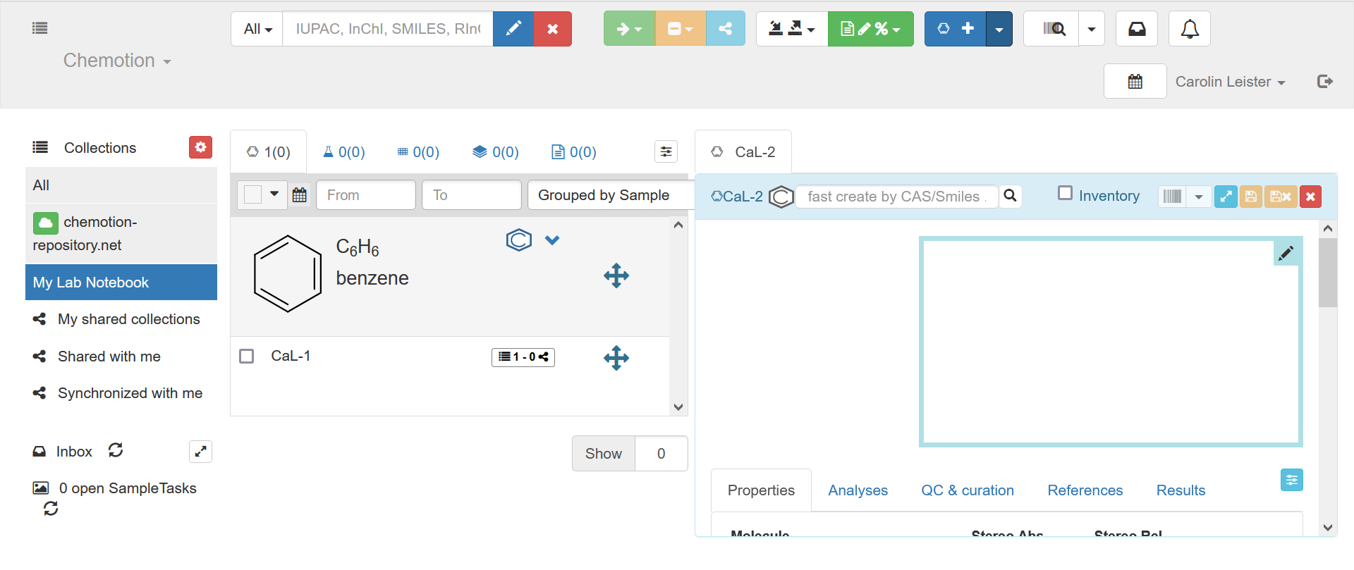
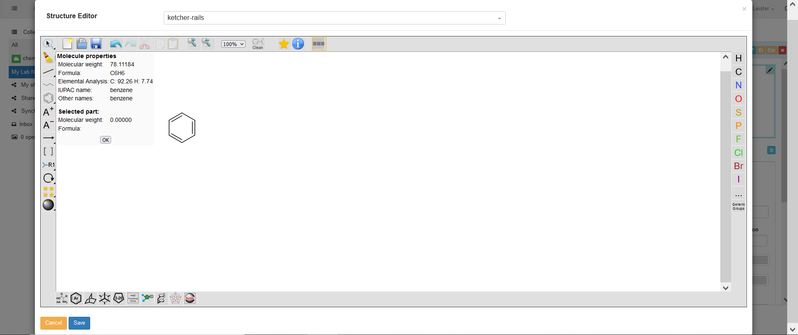
Hands-on Chemotion ELN (2/3)
Add a sample by using the molecule structure editor Ketcher

Slide 26
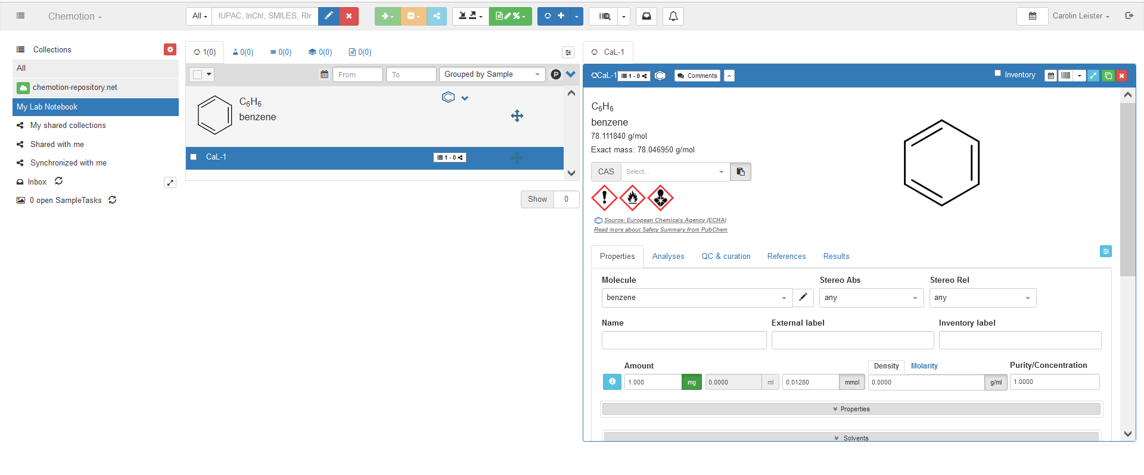
Hands-on Chemotion ELN (2/3)
Add additional informations on your molecule

Slide 27

Extension: LabIMotion
Generic extension of the established Software Chemotion-ELN
Offer solutions for the need for ELN software in other disciplines (e.g. engineering, natural sciences and materials sciences).
https://www.chemotion.net/docs/labimotion/

Slide 28
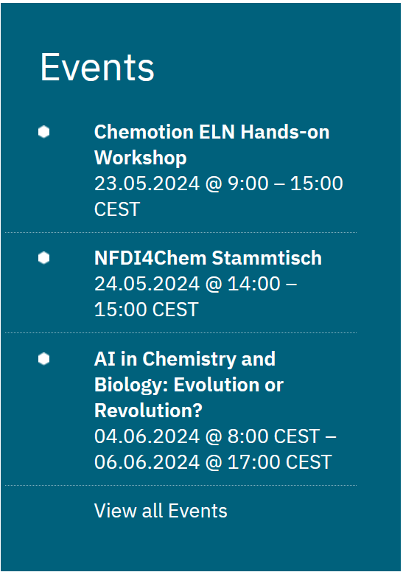
Further information?
Upcoming events on Chemotion ELN:
  Hands-on Workshop: 23.05.2024
  Q&A Session: 05.09.2024
  NFDI4Chem Stammtisch: 24.05.2024
Upcoming events on LabIMotion:
  Hands-on Workshop: 18.06.2024
More information:
  Documentation
  YouTube-Videos
  How to set up your own Chemotion ELN
You need help: Contact the helpdesk

Slide 29
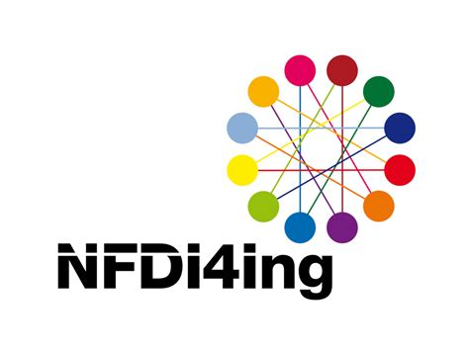

Example 2: Kadi4Mat
Karlsruhe Data Infrastructure for Materials Science (Kadi4Mat)
Open Source
Developed at the Institute for Applied Materials (IAM) at KIT
Generic ELN, originally from the field of Material Science
One of the tools of the National Research Data Infrastructure for Engineering (NFDI4Ing)
Uses a lot of interfaces to various programs
https://kadi.iam.kit.edu/

Slide 30
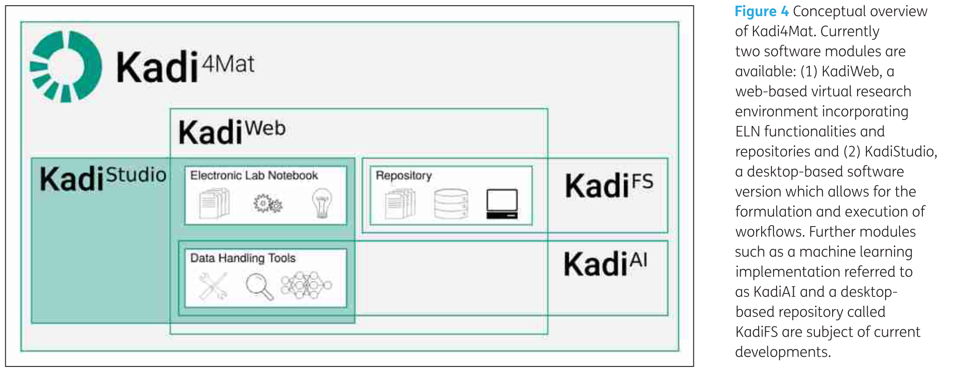
Goal of Kadi4Mat
“The goal of this project is to combine the ability to manage and exchange data, the repository, with the possibility to analyze, visualize and transform said data, the electronic lab notebook (ELN).”
https://kadi.iam.kit.edu/
Brandt et al. (2021): Kadi4Mat: A Research Data Infrastructure for Materials Science. In: Data Science Journal 20, Artikel 8. DOI: https://doi.org/10.5334/dsj-2021-008.
Griem et al. (2022): KadiStudio: FAIR Modelling of Scientific Research Processes. In: Data Science Journal 21, Artikel 16. DOI: https://doi.org/10.5334/dsj-2022-016.

Slide 31
Components of Kadi4Mat
KadiWeb: A web version of Kadi4Mat incorporating a classical ELN and a repository.
KadiStudio: Design and execute your scientific workflows with KadiStudio, a flexible workflow editor. Use a wide range of existing or customized tools to create reproducible research.
KadiAPY: A wrapper library called KadiAPY offers access to Kadi4Mat's HTTP API via Python, which follows an object oriented approach, and a Command Line Interface (CLI), as shown below. The library supports both Linux and Windows.
KadiFS: Access and edit your data directly with the filesystem integration KadiFS based on FUSE. Connect your computers and devices to directly interface with the Kadi ecosystem.
KadiAI: Integrate and implement your Artificial Intelligence (AI) and Machine Learning (ML) algorithms with KadiAI. Leverage interactive dashboards to design, train, and tune data-driven models or enhance your custom AI scripts with next-level research data management.
https://kadi.iam.kit.edu/
Griem et al. (2022): KadiStudio: FAIR Modelling of Scientific Research Processes. In: Data Science Journal 21, Artikel 16. DOI: https://doi.org/10.5334/dsj-2022-016.

Slide 32

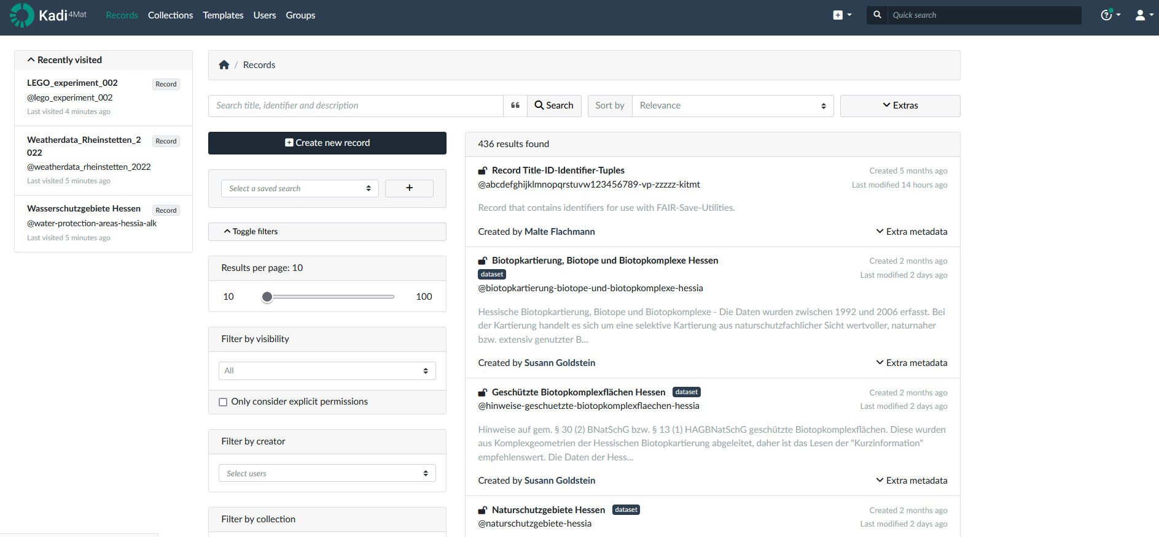
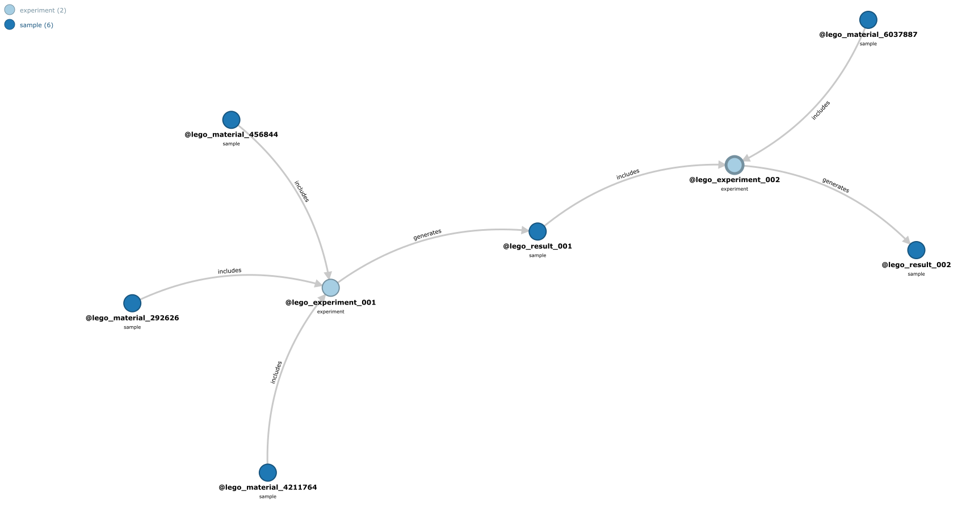

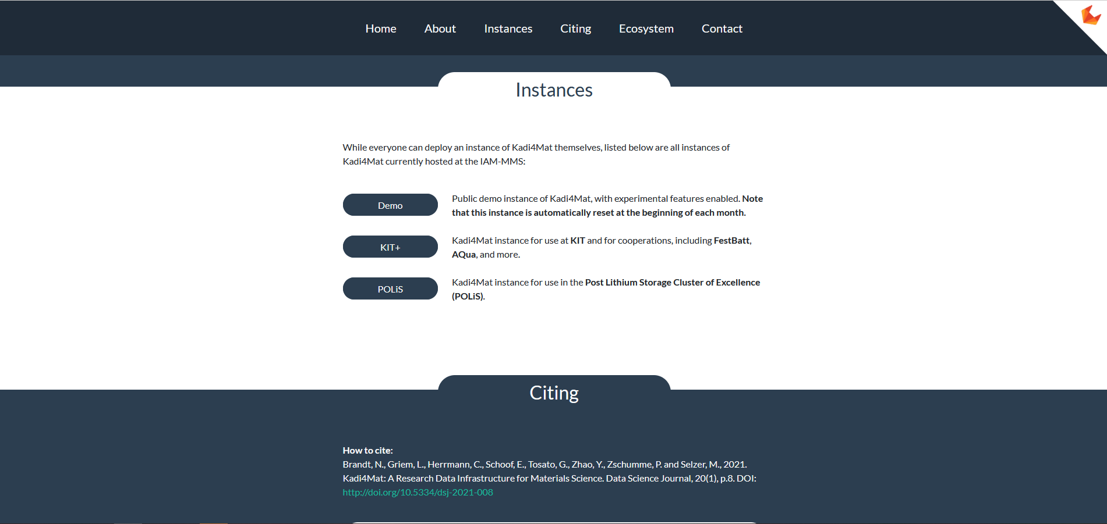
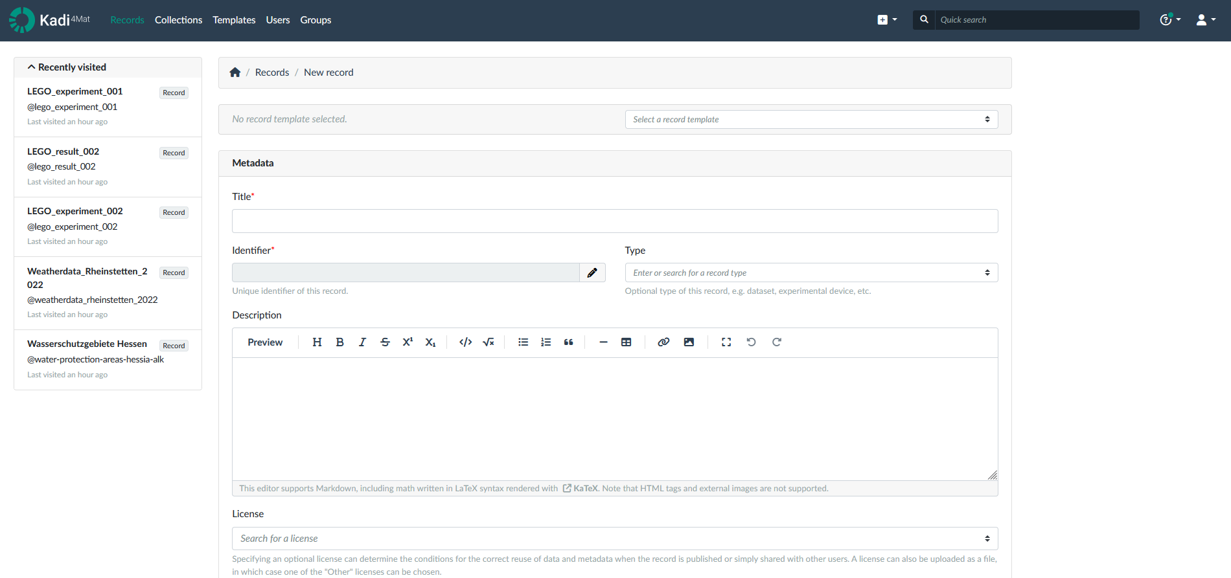


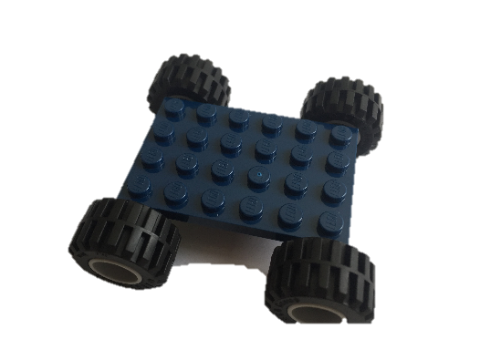

Hands-on Kadi4Mat: KadiWeb
Go to the Website and Log In: https://demo-kadi4mat.iam.kit.edu/
Create records: Click on „Records“ and than on „Create record“

Slide 33
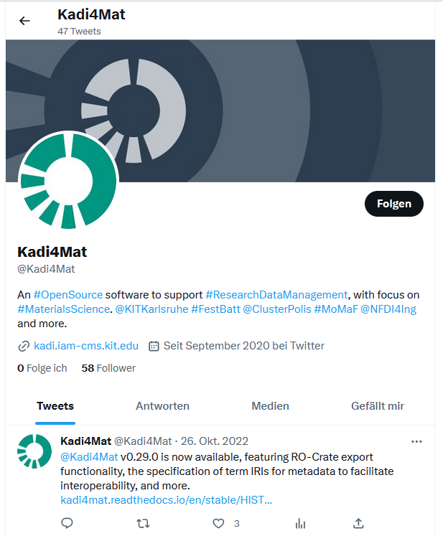

Further information?
Contact: https://kadi.iam.kit.edu/#contact
Twitter: https://twitter.com/Kadi4Mat
Want to test Kadi4Mat? Try the demo instance!
Videos: https://www.postlithiumstorage.org/en/research/rdm

Slide 34

Conclusion
Documentation of research processes and results is important
One tool for this is the electronic laboratory notebook (ELN)
ELNs have many advantages over the classic laboratory notebook, and can be fully implemented in the research data management process
There are different categories and providers of ELNs, therefore it can be helpful to use one of the presented tools to select the right ELN
At KIT two ELNs have been developed (Chemotion and Kadi4Mat), both can be used for your own research

Slide 35

Questions?
Are there further questions?
Bild von Gerd Altmann auf Pixabay

Slide 36
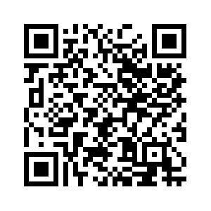

Evaluation (5 Minutes)
Deutsch:
  Bitte füllen Sie die Evaluation aus: https://www.bibliothek.kit.edu/evaluation-veranstaltung.php
  Titel der Veranstaltung: Elektronische Laborbücher - Unterstützung von der Datenerfassung bis zur Veröffentlichung
English:
  Please fill out the evaluation form: https://www.bibliothek.kit.edu/english/evaluation-event.php
  Course title: Electronic Laboratory Notebooks - Support from data acquisition to publication

Slide 37
Further information
Basic information:
  https://www.publisso.de/en/research-data-management/rd-documenting
  https://www.forschungsdaten.org/index.php/Elektronische_Laborb%C3%BCcher
Video series on ELNs (German only):
  https://www.youtube.com/playlist?app=desktop&list=PLJYlS0FDTMq17tvYMeuI2Ct5XtykRFy0K&cbrd=1
ELN-Guide:
  ZB MED - Informationszentrum Lebenswissenschaften (2021): ELN Guide. Electronic laboratory notebooks in the context of research data management and good research practice – a guide for the life sciences. DOI: https://doi.org/10.4126/FRL01-006425772.
ELN-Finder:
  https://eln-finder.ulb.tu-darmstadt.de/home
  https://www.forschungsdaten.org/images/6/6c/ZBMED_HeFDI_ELN-Finder.pdf

Slide 38
Further information on Chemotion
Website: https://chemotion.net/
Literature:
  Tremouilhac et al. (2017): Chemotion ELN: an Open Source electronic lab notebook for chemists in academia. In: Journal of cheminformatics 9 (1), S. 54. DOI: https://doi.org/10.1186/s13321-017-0240-0.
  Kotov et al. (2018): Chemotion-ELN part 2: adaption of an embedded Ketcher editor to advanced research applications. In: Journal of cheminformatics 10 (1), S. 38. DOI: https://doi.org/10.1186/s13321-018-0292-9.
Source Code: https://github.com/ComPlat/chemotion_ELN
Documentation: https://chemotion.net/docs/

Slide 39
Further information on Kadi4Mat
Website: https://kadi.iam.kit.edu/
Literature:
  Brandt et al. (2021): Kadi4Mat: A Research Data Infrastructure for Materials Science. In: Data Science Journal 20, Artikel 8. DOI: https://doi.org/10.5334/dsj-2021-008.
  Griem et al. (2022): KadiStudio: FAIR Modelling of Scientific Research Processes. In: Data Science Journal 21, Artikel 16. DOI: https://doi.org/10.5334/dsj-2022-016.
Source Code: https://gitlab.com/iam-cms/kadi
Documentation: https://kadi4mat.readthedocs.io/en/stable/

Slide 40
Thanks for your attention.
  Cite instructions on:
  https://doi.org/10.5281/zenodo.11242089

