Slide 1
Understanding Transformers
Nick

Slide 2
1. Tokenization – “convert strings into bits”
Can choose to
  Have preprocessors to break down sentences into smaller phrases/words (pre-tokenization) before further tokenization into simple words OR
  Directly tokenize the whole sentence
2 main methods:
  Byte Pair Encoding (BPE)
  Unigram Language Model (ULM)
Packages:
  Hugging Face’s “tokenizers” Python package (written in Rust)
  “sentencepiece” C++ package (written in Python)
Result:
  List of strings [“I”, “love”, “NTU”, “.”] or string IDs (e.g. OpenAI) [4421, 25, 732, 56]

Slide 3
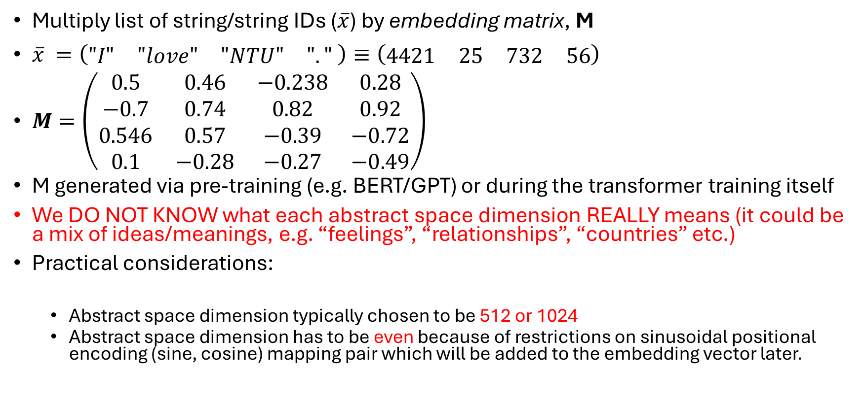
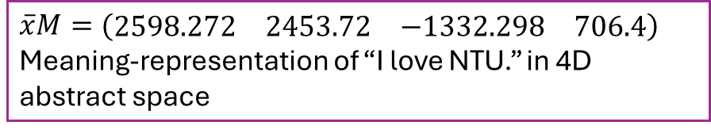
2. Embedding – “convert bits into meanings in abstract space”
Multiply list of string/string IDs ($\overline{x}$) by embedding matrix, M
$\overline{x} =\left(\begin{matrix}"I" & "love" & "NTU" & "."\end{matrix} \right)≡\left(\begin{matrix}4421 & 25 & 732 & 56\end{matrix}\right)$
$M=\left(\begin{matrix}0.5 & 0.46 & −0.238 & 0.28 \\ −0.7 & 0.74 & 0.82 & 0.92 \\ 0.546 & 0.57 & −0.39 & −0.72 \\ 0.1 & −0.28 & −0.27 & −0.49\end{matrix}\right)$
M generated via pre-training (e.g. BERT/GPT) or during the transformer training itself
We DO NOT KNOW what each abstract space dimension REALLY means (it could be a mix of ideas/meanings, e.g. “feelings”, “relationships”, “countries” etc.)
Practical considerations:
  Abstract space dimension typically chosen to be 512 or 1024
  Abstract space dimension has to be even because of restrictions on sinusoidal positional encoding (sine, cosine) mapping pair which will be added to the embedding vector later.
$$\overline{x}M=(\begin{matrix}2598.272 & 2453.72 & −1332.298 & 706.4\end{matrix})$$
Meaning-representation of “I love NTU.” in 4D abstract space
i.e. No. of columns in M

Slide 4
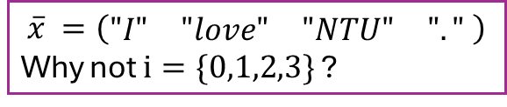
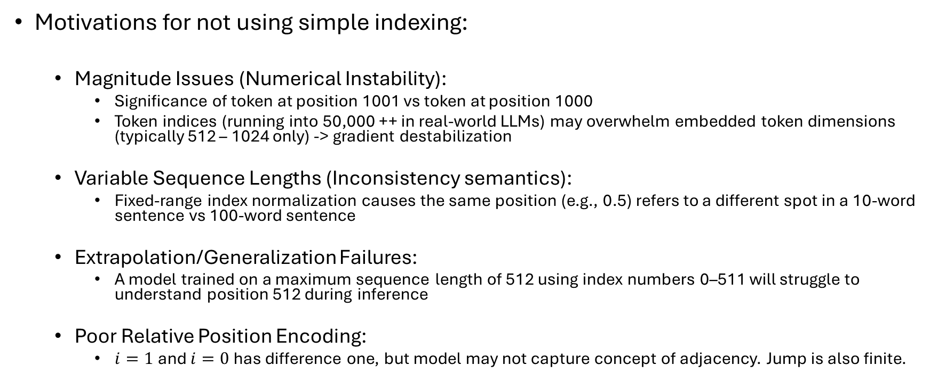
3. Positional encoding – “convert positions into bits in abstract space”
$$\overline{x} =\left(\begin{matrix}"I" & "love" & "NTU" & "."\end{matrix} \right)$$
Why not $i=\{0,1,2,3\}$ ?
Motivations for not using simple indexing:
  Magnitude Issues (Numerical Instability):
    Significance of token at position 1001 vs token at position 1000
    Token indices (running into 50,000 ++ in real-world LLMs) may overwhelm embedded token dimensions (typically 512 – 1024 only) -> gradient destabilization
  Variable Sequence Lengths (Inconsistency semantics):
    Fixed-range index normalization causes the same position (e.g., 0.5) refers to a different spot in a 10-word sentence vs 100-word sentence
  Extrapolation/Generalization Failures:
    A model trained on a maximum sequence length of 512 using index numbers 0–511 will struggle to understand position 512 during inference
  Poor Relative Position Encoding:
    $i=1$ and $i=0$ has difference one, but model may not capture concept of adjacency. Jump is also finite.

Slide 5
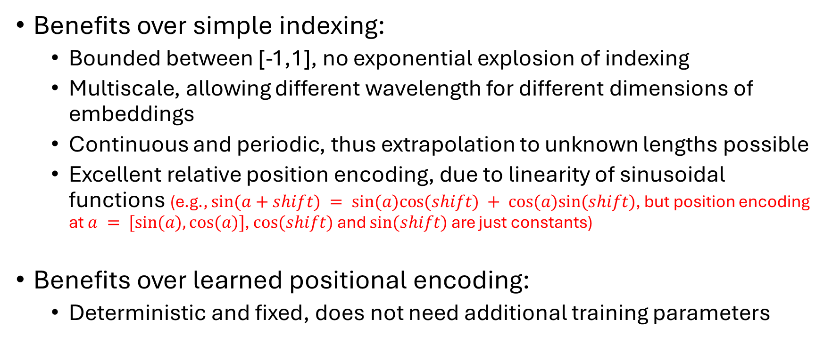
Sinusoidal encoding
Benefits over simple indexing:
  Bounded between [-1,1], no exponential explosion of indexing
  Multiscale, allowing different wavelength for different dimensions of embeddings
  Continuous and periodic, thus extrapolation to unknown lengths possible
  Excellent relative position encoding, due to linearity of sinusoidal functions (e.g., $sin⁡(a+shift) = sin⁡(a)cos⁡(shift) + cos⁡(a)sin⁡(shift)$, but position encoding at $a = [sin⁡(a), cos⁡(a)]$, $cos⁡(shift)$ and $sin⁡(shift)$ are just constants)
Benefits over learned positional encoding:
  Deterministic and fixed, does not need additional training parameters

Slide 6
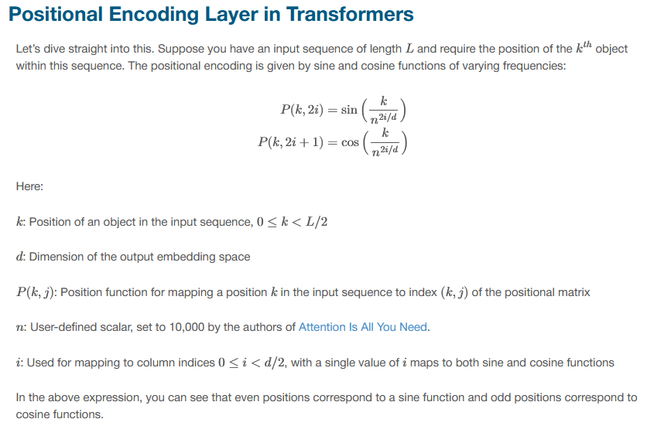

Sinusoidal encoding
The sinusoidal positional encoding must have the EXACT SAME EVEN dimension $ncol(M)$ as the input word embedding vectors

Slide 7
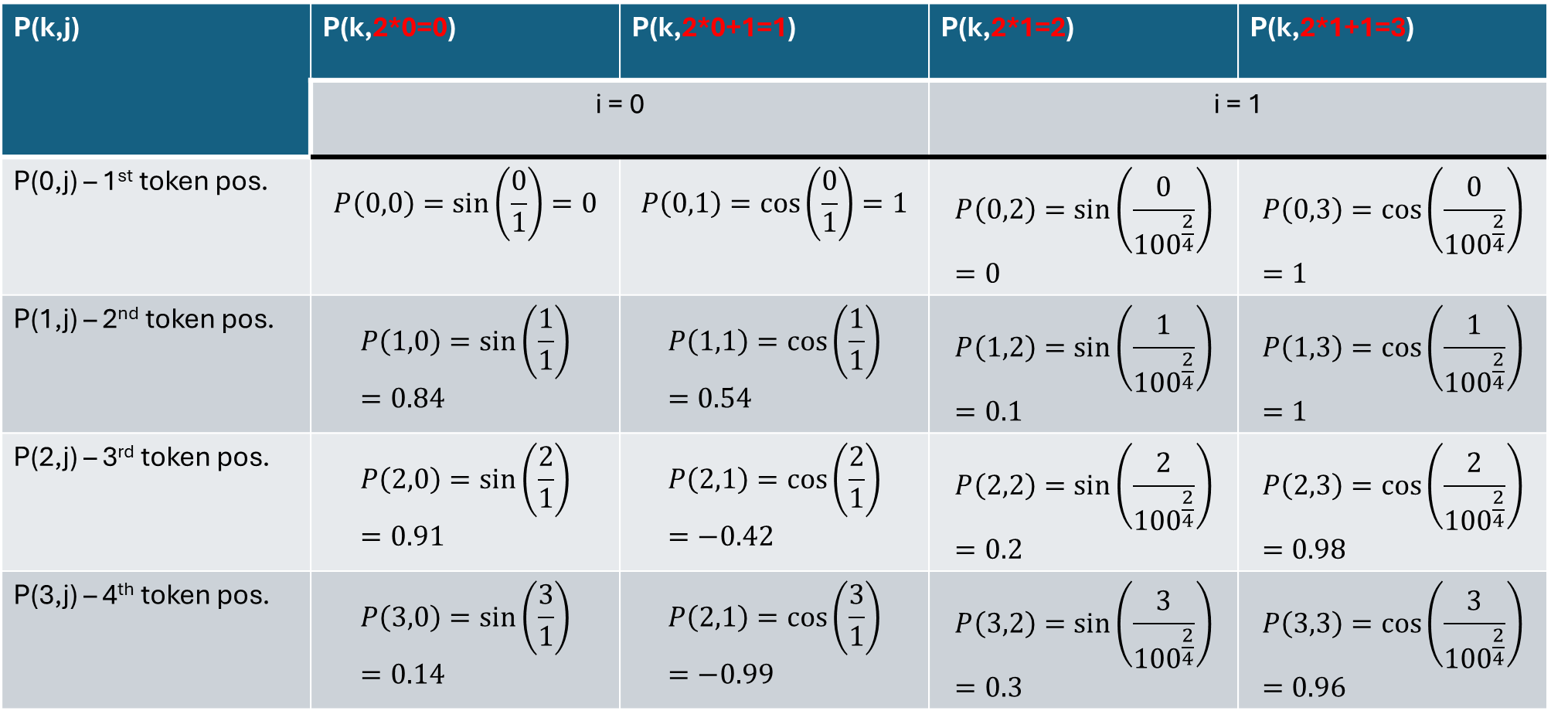
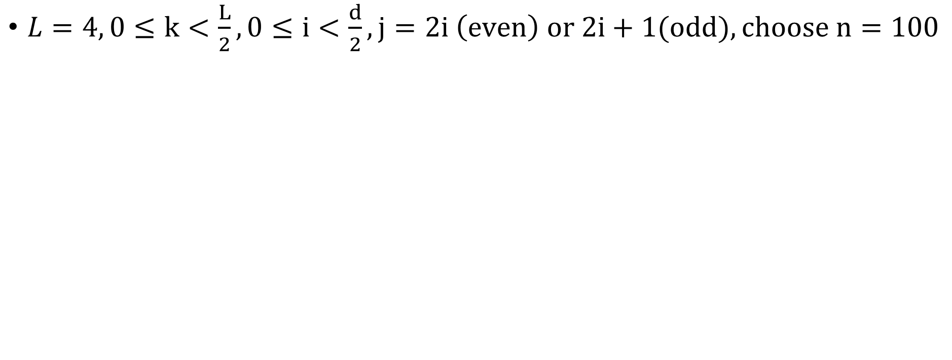
Sinusoidal encoding – example
$L=4, 0≤k<\frac{L}{2},0≤i<\frac{d}{2},j=2i \left(even\right) or 2i+1(odd), choose n=100$
P(k,j) | P(k,2*0=0) | P(k,2*0+1=1) | P(k,2*1=2) | P(k,2*1+1=3)
 | i = 0 |  | i = 1
P(0,j) – 1st token pos. | $$P\left(0,0\right)=\sin\left(\frac{0}{1}\right)=0$$ | $$P\left(0,1\right)=\cos\left(\frac{0}{1}\right)=1$$ | $$P\left(0,2\right)=\sin\left(\frac{0}{{100}^{\frac{2}{4}}}\right)=0$$ | $$P\left(0,3\right)=\cos\left(\frac{0}{{100}^{\frac{2}{4}}}\right)=1$$
P(1,j) – 2nd token pos. | $$P\left(1,0\right)=\sin\left(\frac{1}{1}\right)=0.84$$ | $$P\left(1,1\right)=\cos\left(\frac{1}{1}\right)=0.54$$ | $$P\left(1,2\right)=\sin\left(\frac{1}{{100}^{\frac{2}{4}}}\right)=0.1$$ | $$P\left(1,3\right)=\cos\left(\frac{1}{{100}^{\frac{2}{4}}}\right)=1$$
P(2,j) – 3rd token pos. | $$P\left(2,0\right)=\sin\left(\frac{2}{1}\right)=0.91$$ | $$P\left(2,1\right)=\cos\left(\frac{2}{1}\right)=−0.42$$ | $$P\left(2,2\right)=\sin\left(\frac{2}{{100}^{\frac{2}{4}}}\right)=0.2$$ | $$P\left(2,3\right)=\cos\left(\frac{2}{{100}^{\frac{2}{4}}}\right)=0.98$$
P(3,j) – 4th token pos. | $$P\left(3,0\right)=\sin\left(\frac{3}{1}\right)=0.14$$ | $$P\left(2,1\right)=\cos\left(\frac{3}{1}\right)=−0.99$$ | $$P\left(3,2\right)=\sin\left(\frac{3}{{100}^{\frac{2}{4}}}\right)=0.3$$ | $$P\left(3,3\right)=\cos\left(\frac{3}{{100}^{\frac{2}{4}}}\right)=0.96$$

Slide 8
Addition of word embedding & positional encoding
Unique representation of each token (word) at a high dimensional space
Inherits good attributes of sinusoidal positioning, e.g. relative position awareness (same word at different location -> different vectors), smooth transitions of sine/cosine
Limitations:
  Additive Interference: The additive method can distort the magnitude and direction of the original token embeddings, which may interfere with the attention scores.
  Performance at Length: simple additive sinusoidal embeddings can sometimes underperform compared to relative position methods (like RoPE) when dealing with extreme extrapolation to longer sequences

Slide 9
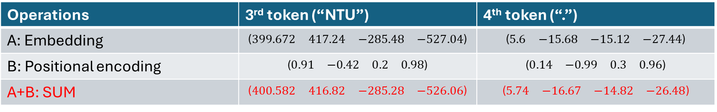
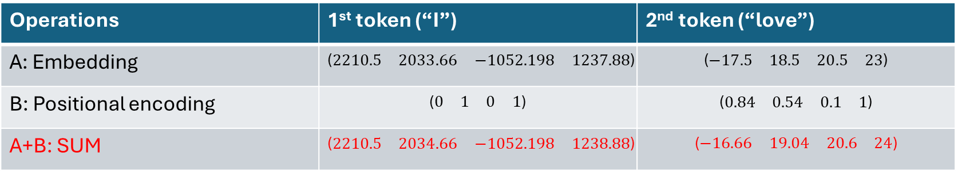
Using our example earlier – “I love NTU.”
Final input encoding:
Operations | 1st token (“I”) | 2nd token (“love”)
A: Embedding | $$\text{(}\begin{matrix}2210.5 & 2033.66 & −1052.198 & 1237.88\end{matrix}\text{)}$$ | $$\text{(}\begin{matrix}−17.5 & 18.5 & 20.5 & 23\end{matrix}\text{)}$$
B: Positional encoding | $$\text{(}\begin{matrix}0 & 1 & 0 & 1\end{matrix}\text{)}$$ | $$\text{(}\begin{matrix}0.84 & 0.54 & 0.1 & 1\end{matrix}\text{)}$$
A+B: SUM | $$\text{(}\begin{matrix}2210.5 & 2034.66 & −1052.198 & 1238.88\end{matrix}\text{)}$$ | $$\text{(}\begin{matrix}−16.66 & 19.04 & 20.6 & 24\end{matrix}\text{)}$$
Operations | 3rd token (“NTU”) | 4th token (“.”)
A: Embedding | $$\text{(}\begin{matrix}399.672 & 417.24 & −285.48 & −527.04\end{matrix}\text{)}$$ | $$\text{(}\begin{matrix}5.6 & −15.68 & −15.12 & −27.44\end{matrix}\text{)}$$
B: Positional encoding | $$\text{(}\begin{matrix}0.91 & −0.42 & 0.2 & 0.98\end{matrix}\text{)}$$ | $$\text{(}\begin{matrix}0.14 & −0.99 & 0.3 & 0.96\end{matrix}\text{)}$$
A+B: SUM | $$\text{(}\begin{matrix}400.582 & 416.82 & −285.28 & −526.06\end{matrix}\text{)}$$ | $$\text{(}\begin{matrix}5.74 & −16.67 & −14.82 & −26.48\end{matrix}\text{)}$$

Slide 10
Magnitude Concern for Sinusoidal Positional Encoding
Note the small values of B vs. A.
Design may be deliberate to prevent positional information from overriding semantic information.
No worries of positional information lost because of the linearity of sinusoidal function (slide 5).
N.B. Scaling of embedded layers remains open question. See https://datascience.stackexchange.com/questions/87906/transformer-model-why-are-word-embeddings-scaled-before-adding-positional-encod

Slide 11
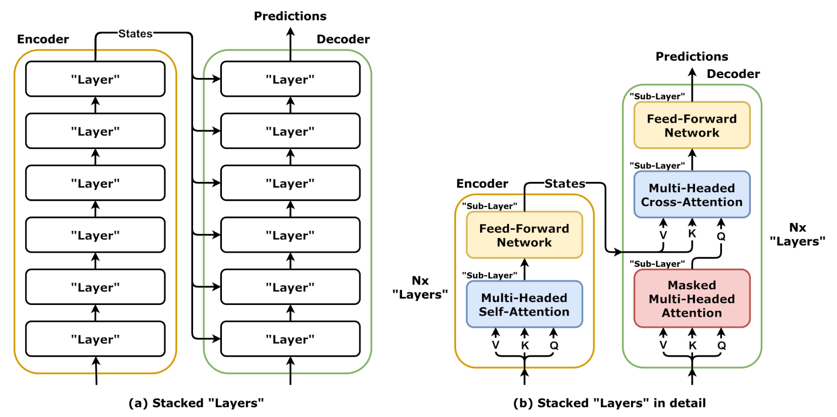
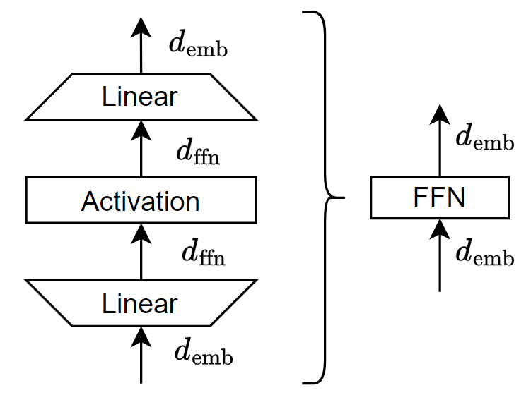

Encoder - Decoder
$$d_{ffn}≫d_{emb}(\sim 4d_{emb})$$

Slide 12
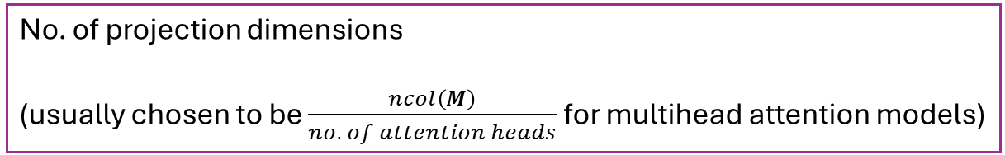
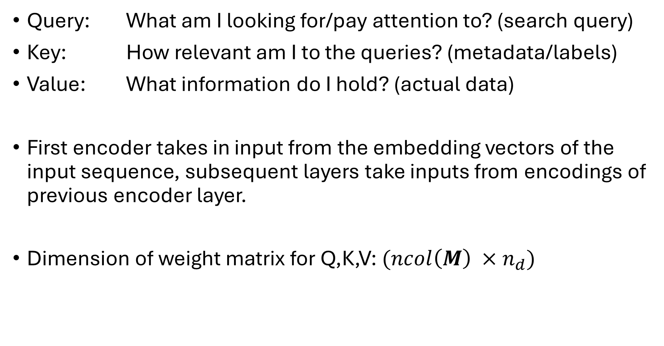
Encoder
Query: What am I looking for/pay attention to? (search query)
Key: How relevant am I to the queries? (metadata/labels)
Value: What information do I hold? (actual data)
First encoder takes in input from the embedding vectors of the input sequence, subsequent layers take inputs from encodings of previous encoder layer.
Dimension of weight matrix for Q,K,V: $(ncol\left(M\right) ×n_{d})$
No. of projection dimensions
(usually chosen to be $\frac{ncol\left(M\right)}{no. of attention heads}$ for multihead attention models)

Slide 13
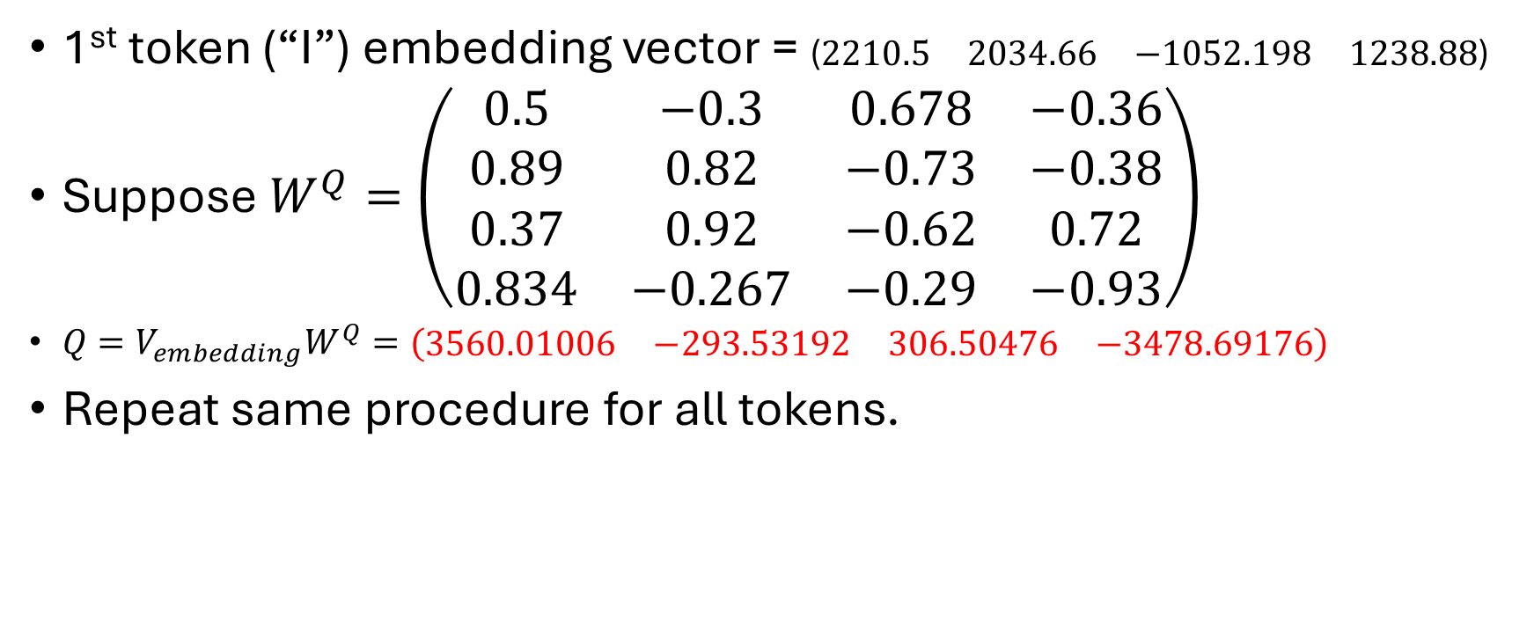
Linear projection of embedding vector
1st token (“I”) embedding vector = $\text{(}\begin{matrix}2210.5 & 2034.66 & −1052.198 & 1238.88\end{matrix}\text{)}$
Suppose $W^{Q}=\left(\begin{matrix}0.5 & −0.3 & 0.678 & −0.36 \\ 0.89 & 0.82 & −0.73 & −0.38 \\ 0.37 & 0.92 & −0.62 & 0.72 \\ 0.834 & −0.267 & −0.29 & −0.93\end{matrix}\right)$
$Q=V_{embedding}W^{Q}=(\begin{matrix}3560.01006 & −293.53192 & 306.50476 & −3478.69176\end{matrix})$
Repeat same procedure for all tokens.

Slide 14
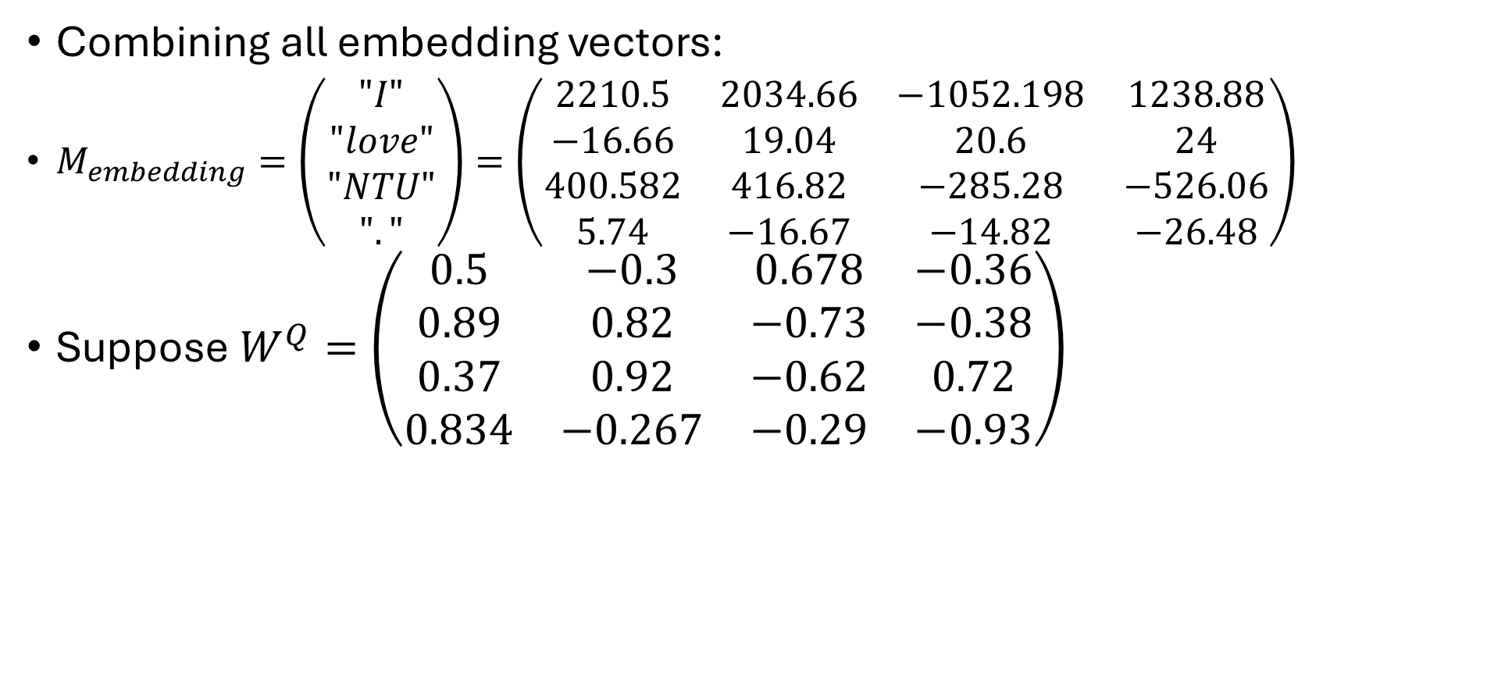
Linear projection of embedding matrix
Combining all embedding vectors:
$M_{embedding}=\left(\begin{matrix}"I" \\ "love" \\ "NTU" \\ "."\end{matrix}\right)=\left(\begin{matrix}2210.5 & 2034.66 & −1052.198 & 1238.88 \\ −16.66 & 19.04 & 20.6 & 24 \\ 400.582 & 416.82 & −285.28 & −526.06 \\ 5.74 & −16.67 & −14.82 & −26.48\end{matrix}\right)$
Suppose $W^{Q}=\left(\begin{matrix}0.5 & −0.3 & 0.678 & −0.36 \\ 0.89 & 0.82 & −0.73 & −0.38 \\ 0.37 & 0.92 & −0.62 & 0.72 \\ 0.834 & −0.267 & −0.29 & −0.93\end{matrix}\right)$

Slide 15
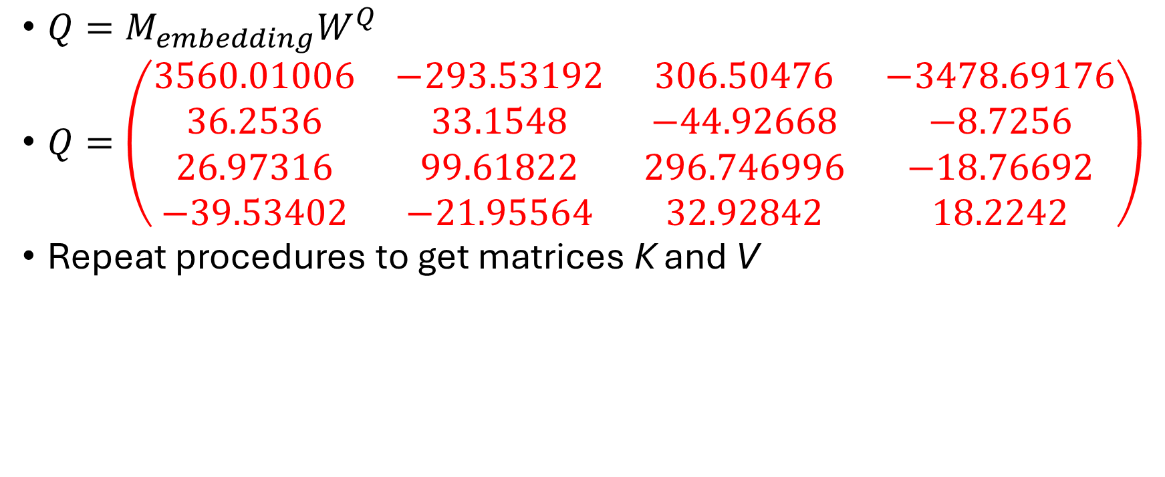
Linear projection of embedding matrix
$Q=M_{embedding}W^{Q}$
$Q=\left(\begin{matrix}3560.01006 & −293.53192 & 306.50476 & −3478.69176 \\ 36.2536 & 33.1548 & −44.92668 & −8.7256 \\ 26.97316 & 99.61822 & 296.746996 & −18.76692 \\ −39.53402 & −21.95564 & 32.92842 & 18.2242\end{matrix}\right)$
Repeat procedures to get matrices K and V

Slide 16
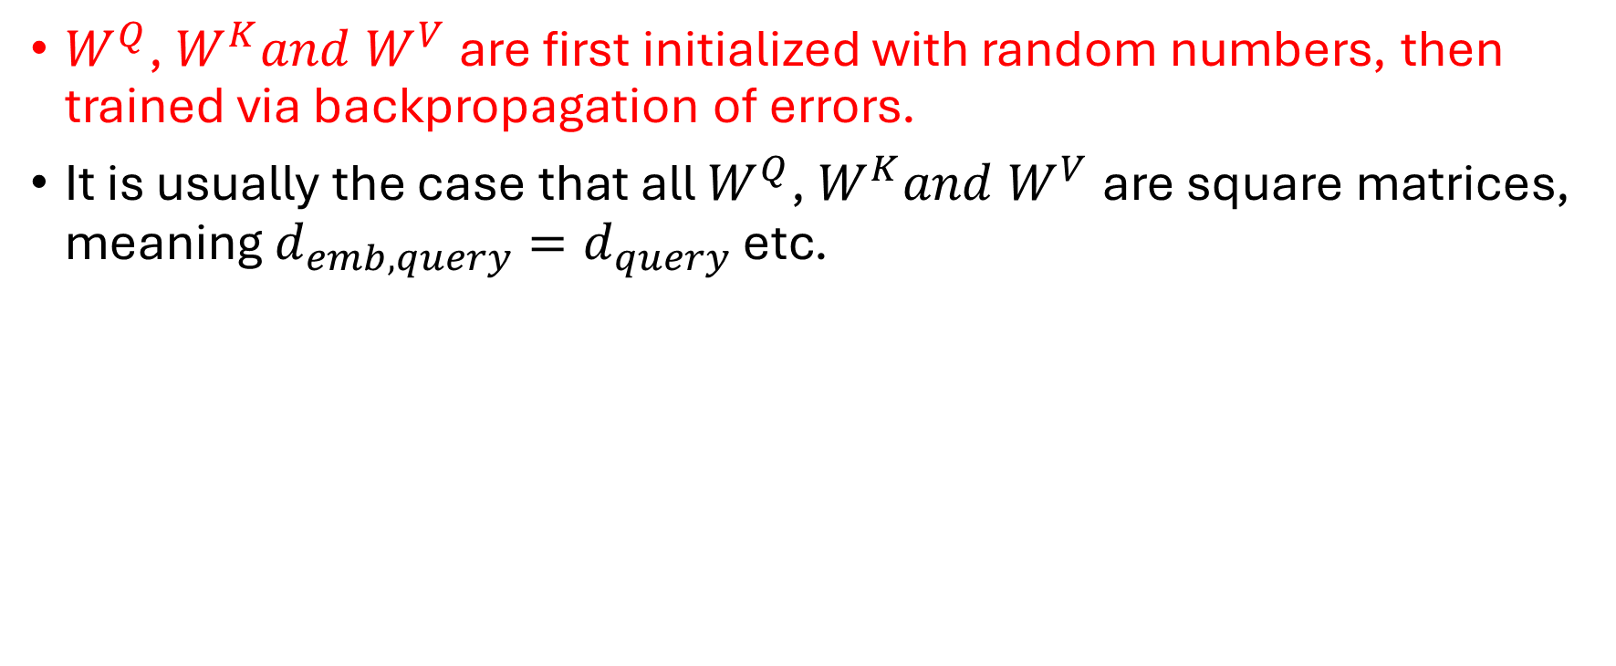
Practical considerations
$W^{Q}$, $W^{K}and W^{V}$ are first initialized with random numbers, then trained via backpropagation of errors.
It is usually the case that all $W^{Q}$, $W^{K}and W^{V}$are square matrices, meaning $d_{emb,query}=d_{query}$ etc.

Slide 17
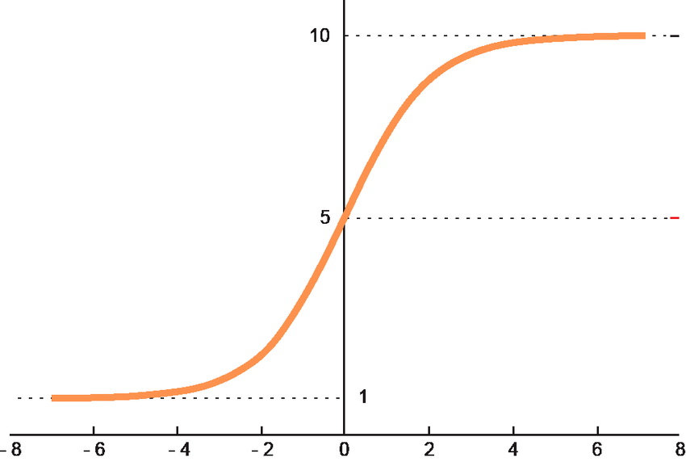
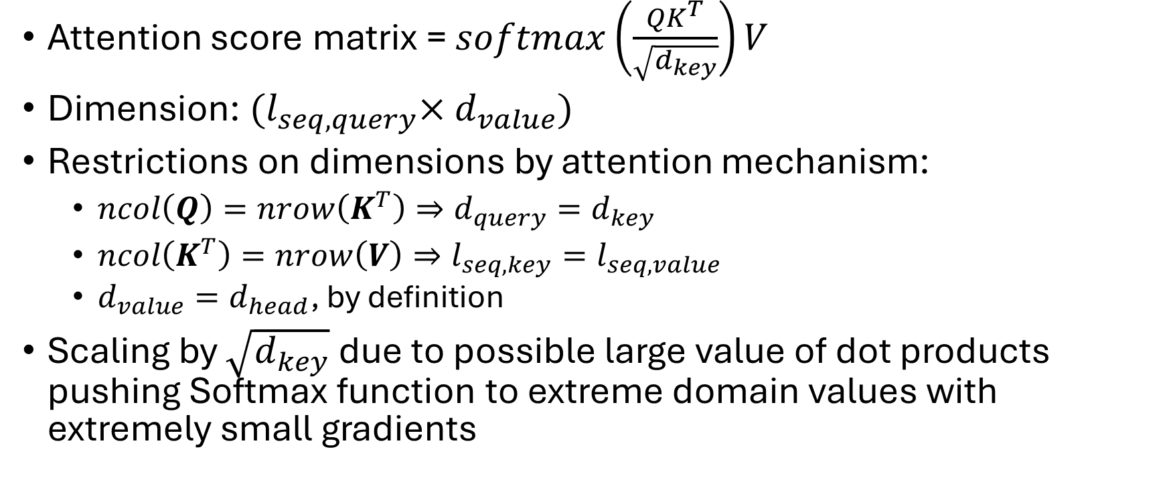
Attention score matrix
Attention score matrix = $softmax\left(\frac{QK^{T}}{\sqrt{d_{key}}}\right)V$
Dimension: ${(l}_{seq,query}×d_{value})$
Restrictions on dimensions by attention mechanism:
  $ncol\left(Q\right)=nrow\left(K^{T}\right)⇒d_{query}=d_{key}$
  $ncol\left(K^{T}\right)=nrow\left(V\right)⇒l_{seq,key}=l_{seq,value}$
  $d_{value}=d_{head}$, by definition
Scaling by $\sqrt{d_{key}}$ due to possible large value of dot products pushing Softmax function to extreme domain values with extremely small gradients

Slide 18
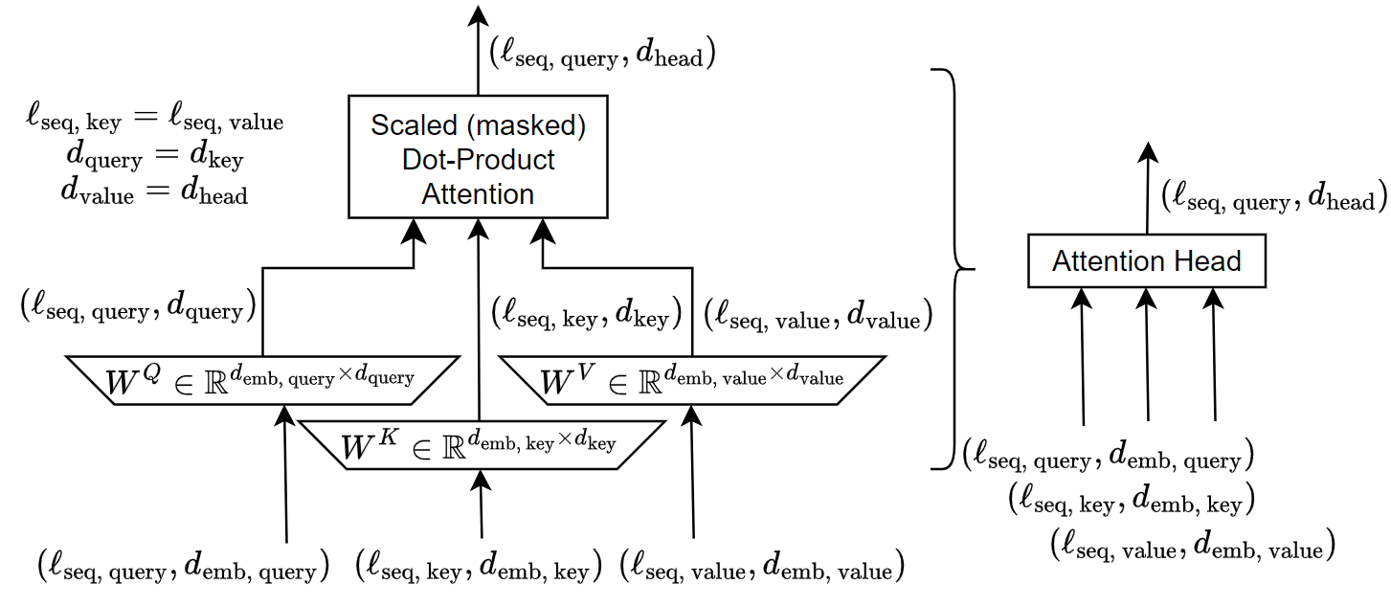
(4,4)
In previous example: (4,4)
(4,4)
(number of tokens = 4, number of abstract dimensions in embedding space = 4)

Slide 19
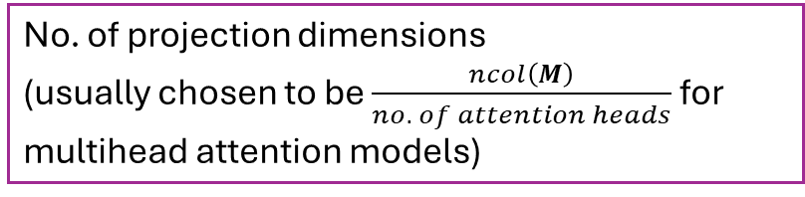
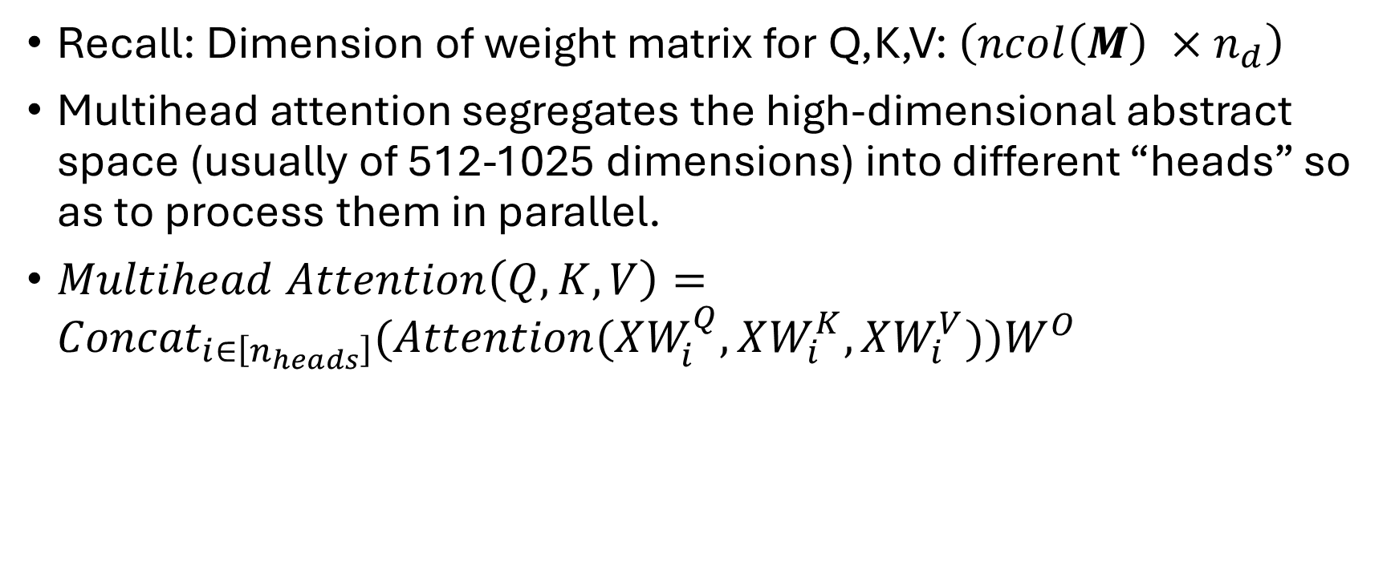
Multihead Attention Model
No. of projection dimensions
(usually chosen to be $\frac{ncol\left(M\right)}{no. of attention heads}$ for multihead attention models)
Recall: Dimension of weight matrix for Q,K,V: $\left(ncol\left(M\right) ×n_{d}\right)$
Multihead attention segregates the high-dimensional abstract space (usually of 512-1025 dimensions) into different “heads” so as to process them in parallel.
$Multihead Attention\left(Q,K,V\right)={Concat}_{i∈\left[n_{heads}\right]}(Attention(XW_{i}^{Q},XW_{i}^{K},XW_{i}^{V}))W^{O}$

Slide 20
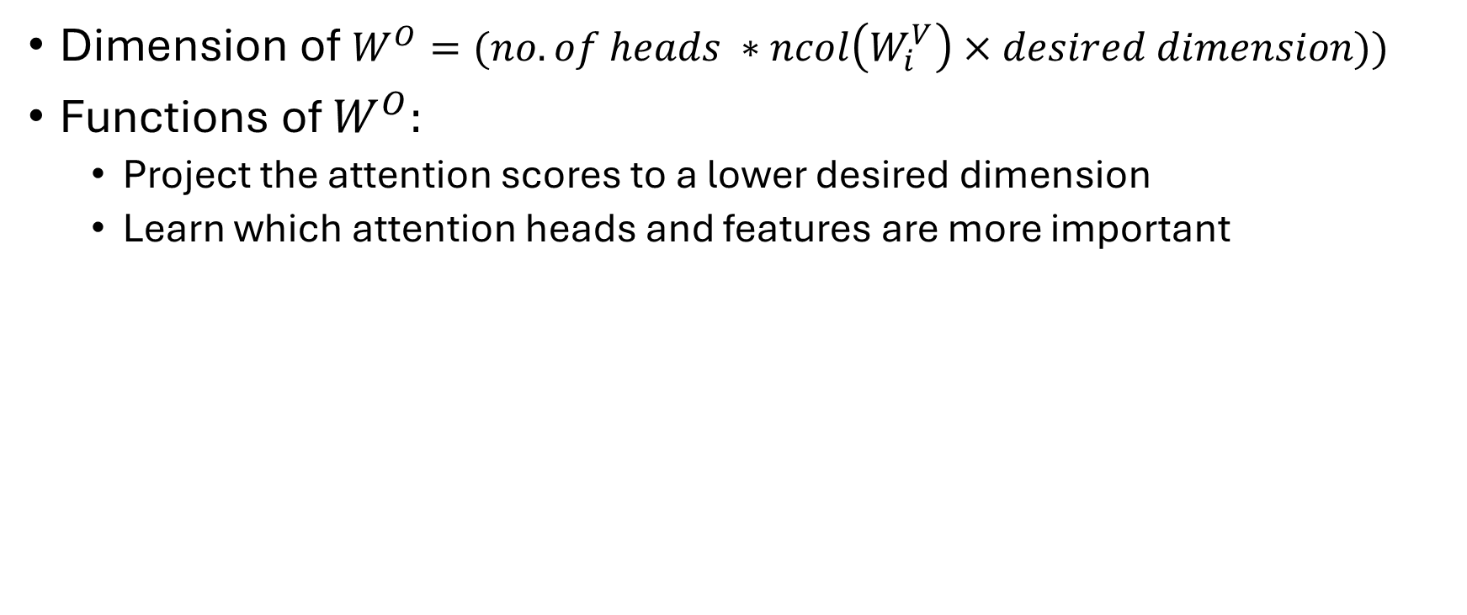
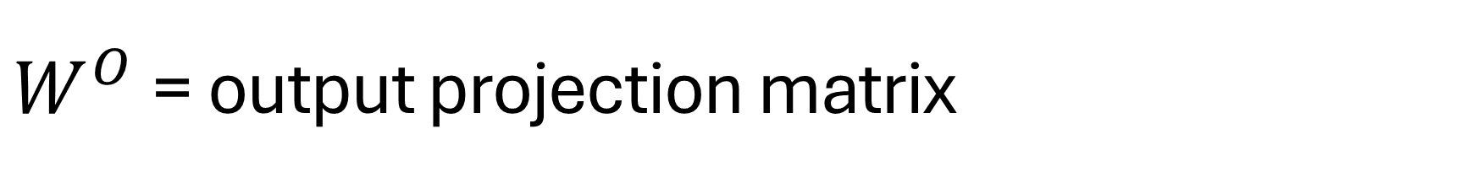


$W^{O}$= output projection matrix
Dimension of $W^{O}=(no. of heads ∗ncol\left(W_{i}^{V}\right)×desired dimension))$
Functions of $W^{O}:$
  Project the attention scores to a lower desired dimension
  Learn which attention heads and features are more important
$${=d}_{value}$$
usually = $ncol\left(M\right)$

Slide 21
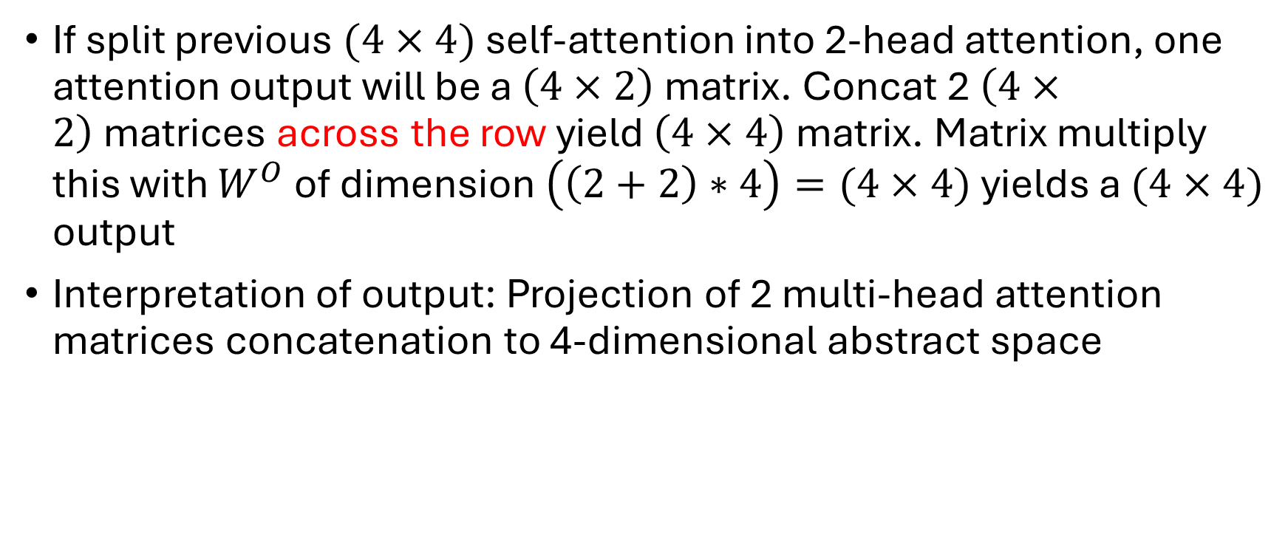
Example:
If split previous $(4×4)$ self-attention into 2-head attention, one attention output will be a $\left(4×2\right)$ matrix. Concat 2 $\left(4×2\right)$matrices across the row yield $\left(4×4\right)$ matrix. Matrix multiply this with $W^{O}$ of dimension $\left(\left(2+2\right)∗4\right)=(4×4)$ yields a $(4×4)$ output
Interpretation of output: Projection of 2 multi-head attention matrices concatenation to 4-dimensional abstract space

Slide 22
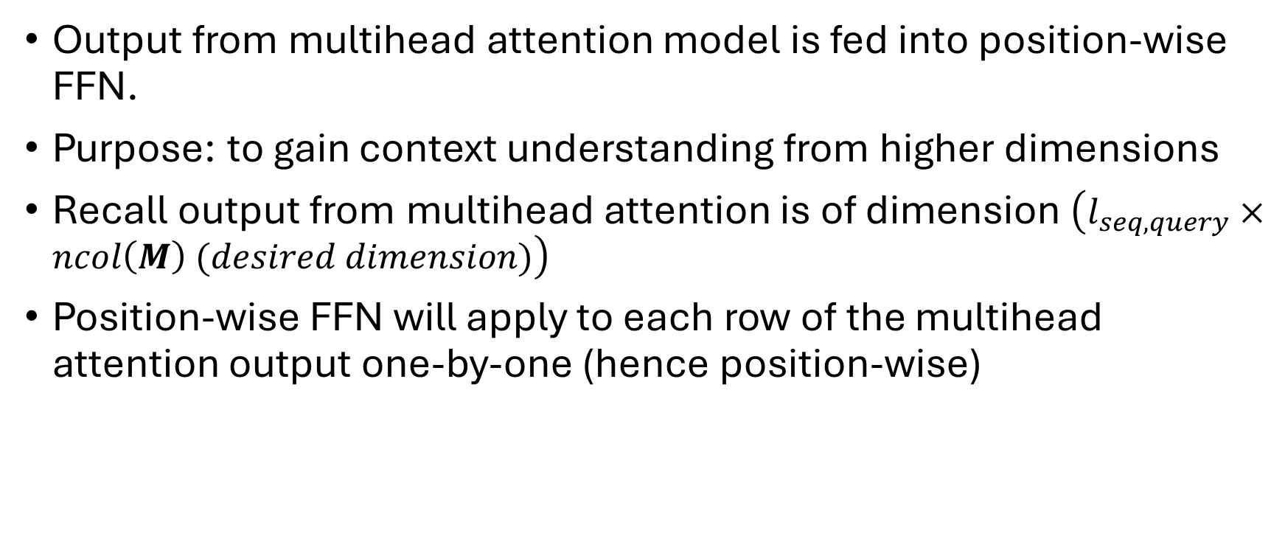
Feedforward Neural Network (for encoders)
Output from multihead attention model is fed into position-wise FFN.
Purpose: to gain context understanding from higher dimensions
Recall output from multihead attention is of dimension $\left(l_{seq,query}×ncol\left(M\right) (desired dimension)\right)$
Position-wise FFN will apply to each row of the multihead attention output one-by-one (hence position-wise)

Slide 23
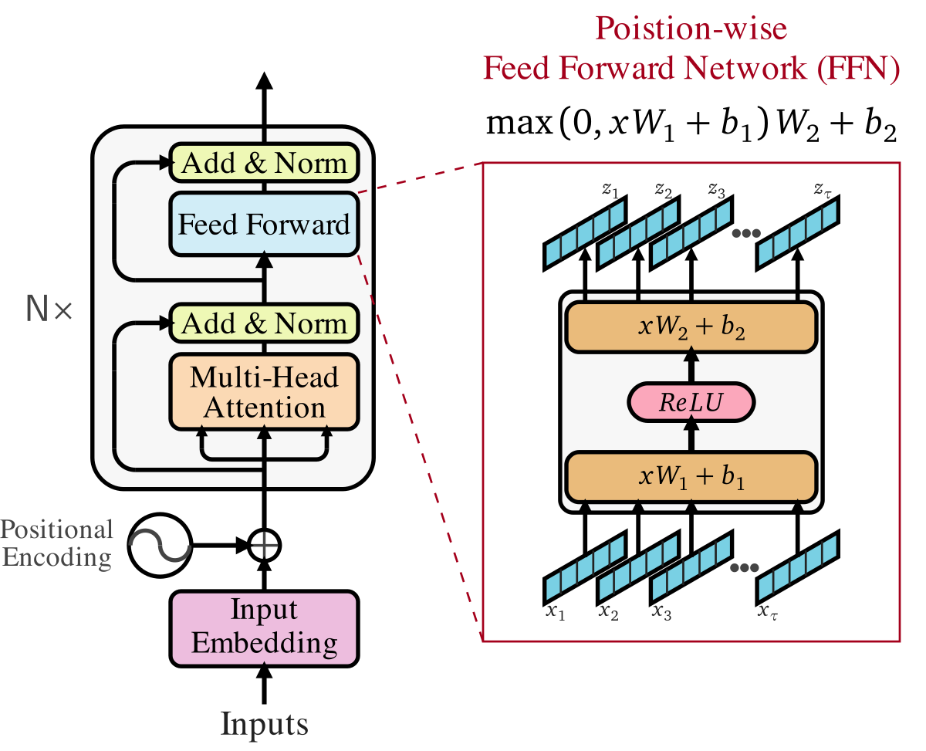
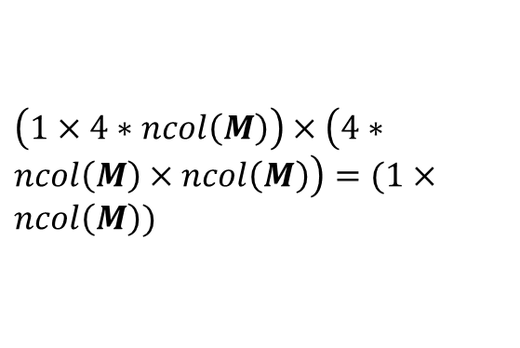
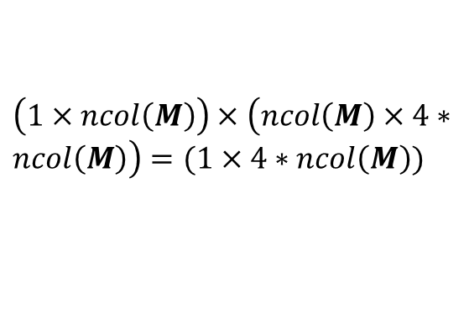
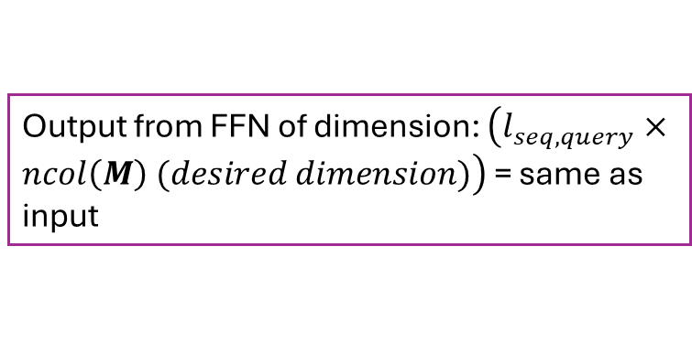

$$x_{i}=ith row of\left(l_{seq,query}×ncol\left(M\right) (desired dimension)\right)$$
$$d_{ffn}≫d_{emb}(\sim 4d_{emb})$$
$\left(1×ncol\left(M\right)\right)×\left(ncol\left(M\right)×4∗ncol\left(M\right)\right)=(1×4∗ncol\left(M\right))$
$\left(1×4∗ncol\left(M\right)\right)×\left(4∗ncol\left(M\right)×ncol\left(M\right)\right)=(1×ncol\left(M\right))$
Output from FFN of dimension: $\left(l_{seq,query}×ncol\left(M\right) (desired dimension)\right)$ = same as input

Slide 24
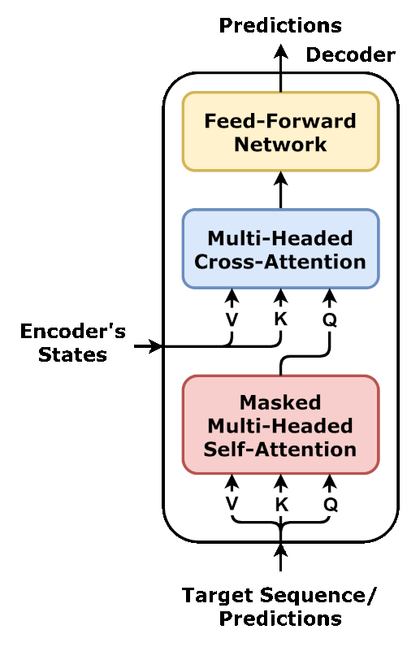
Decoders
Similar to encoders except for 2 aspects:
  2 attention sublayers within each decoder layer:
    Causal masking for self-attention mechanism
    Q and K (query and key) states come from the encoder for cross-attention

Slide 25
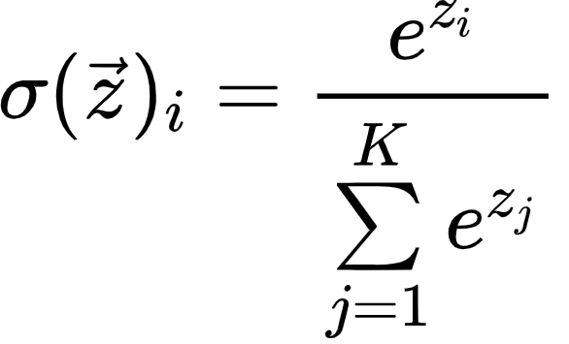
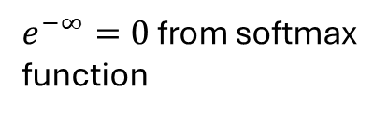
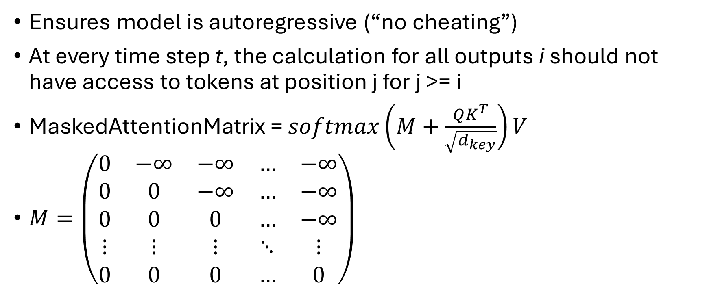
Causal masking – decoder self-attention
Ensures model is autoregressive (“no cheating”)
At every time step t, the calculation for all outputs i should not have access to tokens at position j for j >= i
MaskedAttentionMatrix = $softmax\left(M+\frac{QK^{T}}{\sqrt{d_{key}}}\right)V$
$M=\left(\begin{matrix}0 & −∞ & −∞ & … & −∞ \\ 0 & 0 & −∞ & … & −∞ \\ 0 & 0 & 0 & … & −∞ \\ ⋮ & ⋮ & ⋮ & ⋱ & ⋮ \\ 0 & 0 & 0 & … & 0\end{matrix}\right)$
$e^{−∞}=0$ from softmax function

Slide 26
No masking for encoder self-attention?
Encoder “encodes” tokens to high-dimensional abstract space
It needs to learn the sentence as a whole to build understanding
To allow bidirectional learning, no masking is needed

Slide 27
Inferencing part…
All tokens and their higher-dimensional encodings are processed simultaneously in BOTH encoder and decoder during training
BUT during inference, the encoder ONLY works once and the decoder works repeatedly, generating one token at a time.
Think about ChatGPT/Gemini, whole sentence is input.
  Encoder runs once to generate context. Encoder’s job is done, Encoder’s context output is cached to memory for reuse later.
  Decoder runs once to generate first token output, via cross-attention using context output from encoder.
  To generate next token, first token output is then fed again into input of DECODER.
  Now the context from encoder output is cached, no need to re-run encoder. Combine cached encoder context output, cross-attend to decoder (masked?) self-attention output, pass to FFN, produce output (next token).
  Repeat until End-of-sentence!

Slide 28
QK encoder outputs + V decoder inputs cross-attention
Separation of duties:
  Self-Attention: Focuses on previously generated words in the target sequence (which tokens in the output seq. are more important?)
  Cross-Attention: Focuses on the information from the source sequence (which correspondence between inputs and outputs are more important?)
Cross-attention maps high-dimensional context from output sequence to the corresponding inputs in the form of high-dimensional context. (“bridge”)

Slide 29
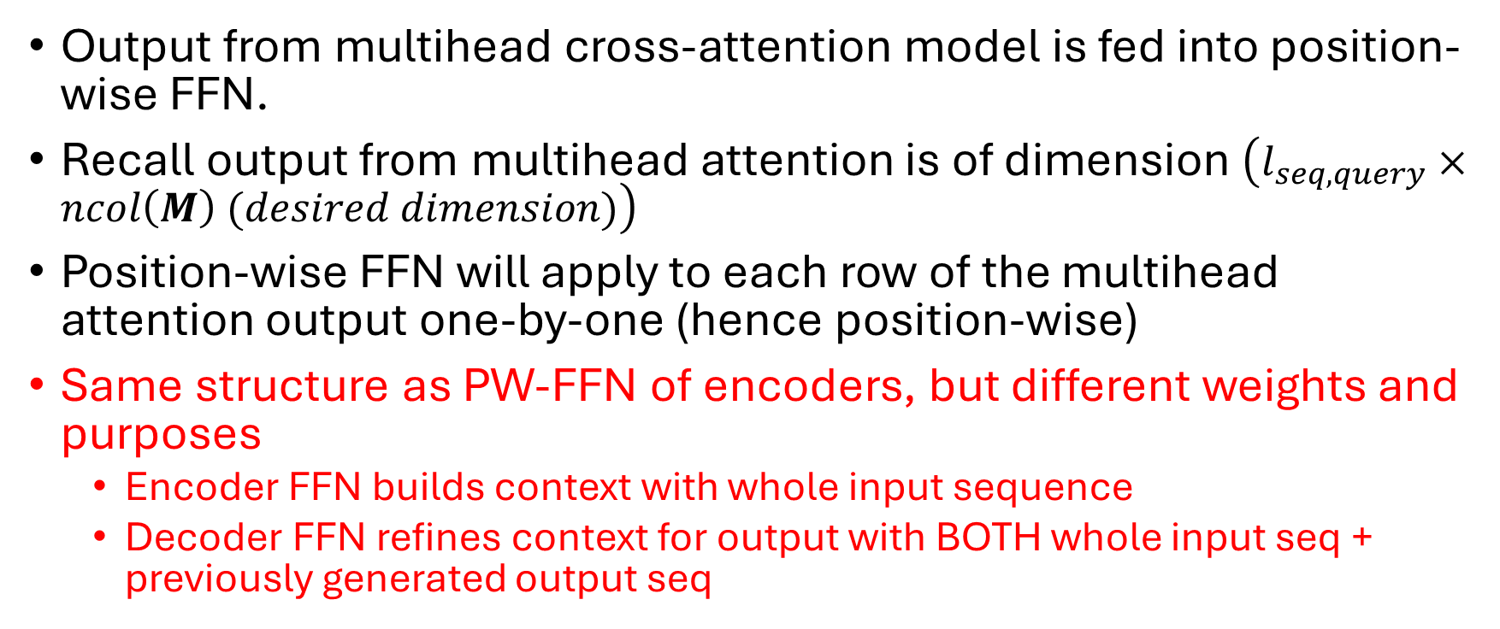
Feedforward Neural Network (for decoders)
Output from multihead cross-attention model is fed into position-wise FFN.
Recall output from multihead attention is of dimension $\left(l_{seq,query}×ncol\left(M\right) (desired dimension)\right)$
Position-wise FFN will apply to each row of the multihead attention output one-by-one (hence position-wise)
Same structure as PW-FFN of encoders, but different weights and purposes
  Encoder FFN builds context with whole input sequence
  Decoder FFN refines context for output with BOTH whole input seq + previously generated output seq

Slide 30
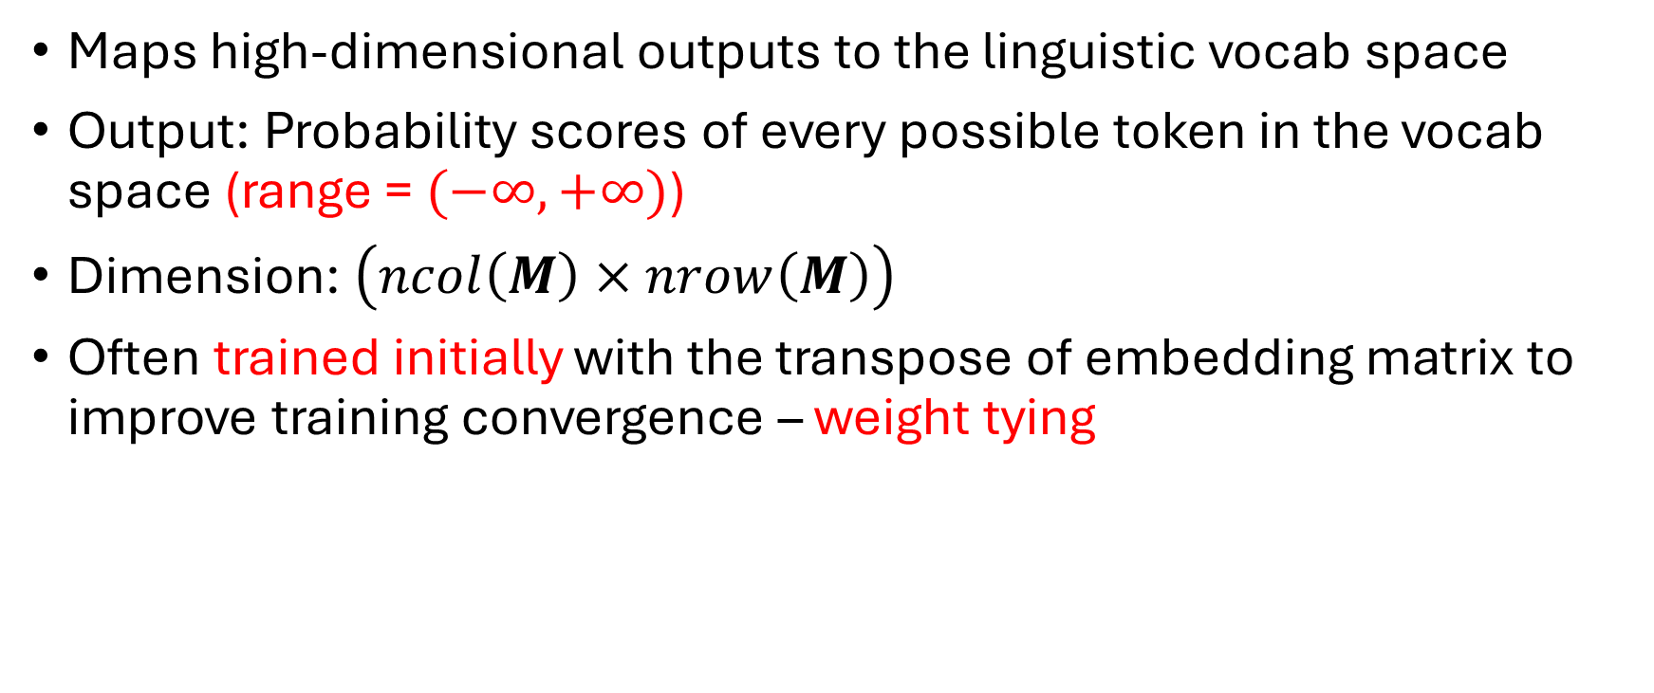
Final unembedding layer
Maps high-dimensional outputs to the linguistic vocab space
Output: Probability scores of every possible token in the vocab space (range = $(−∞,+∞)$)
Dimension: $\left(ncol\left(M\right)×nrow\left(M\right)\right)$
Often trained initially with the transpose of embedding matrix to improve training convergence – weight tying

Slide 31
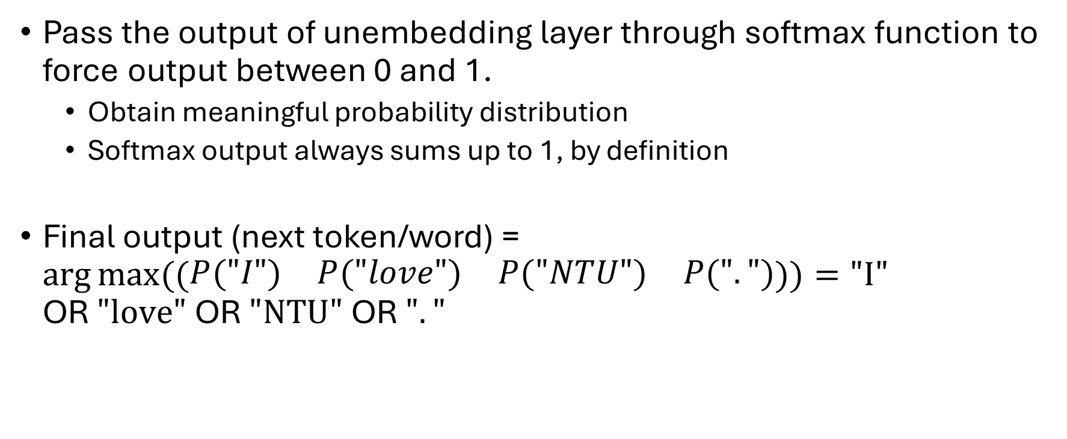
Convert scores to probability
Pass the output of unembedding layer through softmax function to force output between 0 and 1.
  Obtain meaningful probability distribution
  Softmax output always sums up to 1, by definition
Final output (next token/word) = $\arg{max⁡((\begin{matrix}P("I") & P("love") & P("NTU") & P(".")\end{matrix}))}=\text{"}\text{I}"$ OR$\text{ "}\text{love}"$ OR $"\text{NTU}\text{"}$ OR $"."$

Slide 32
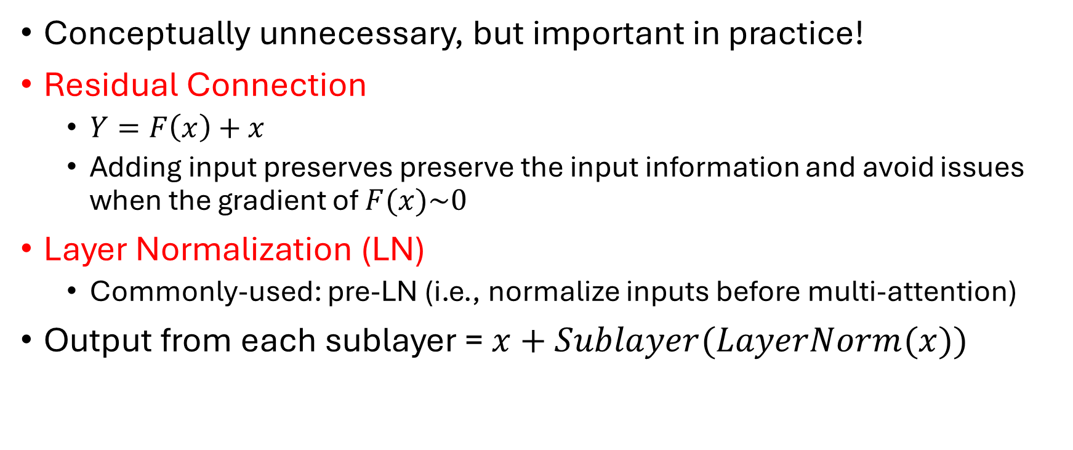
Additional improvements
Conceptually unnecessary, but important in practice!
Residual Connection
  $Y=F\left(x\right)+x$
  Adding input preserves preserve the input information and avoid issues when the gradient of $F(x)\sim 0$
Layer Normalization (LN)
  Commonly-used: pre-LN (i.e., normalize inputs before multi-attention)
Output from each sublayer = $x+Sublayer(LayerNorm(x))$

Slide 33
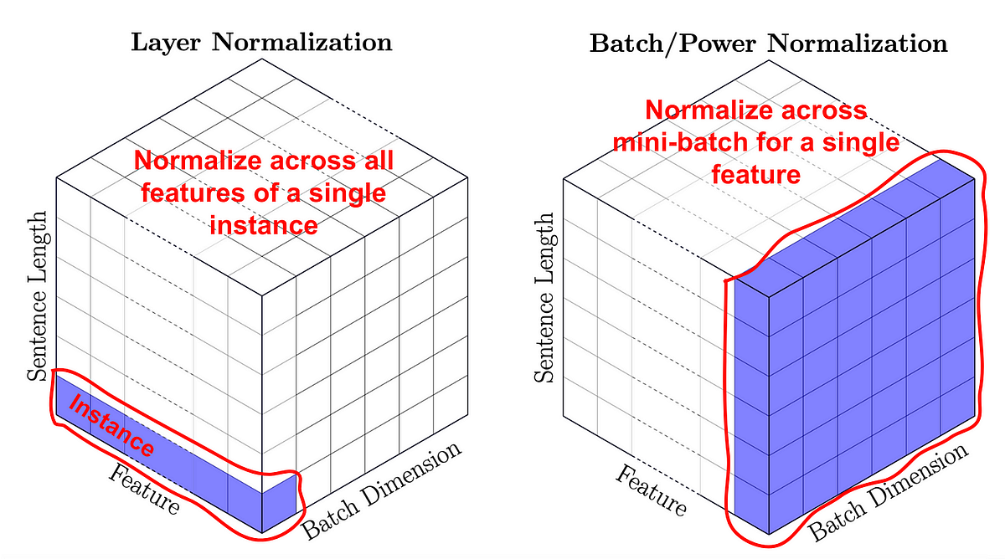

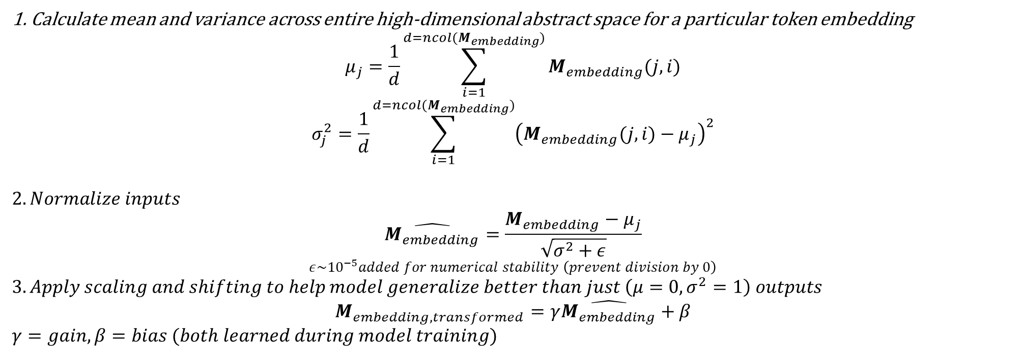
1. Calculate mean and variance across entire high-dimensional abstract space for a particular token embedding
$$μ_{j}=\frac{1}{d}\sum_{i=1}^{d=ncol(M_{embedding})}{M_{embedding}(j,i)}$$
$$σ_{j}^{2}=\frac{1}{d}\sum_{i=1}^{d=ncol(M_{embedding})}{{\left(M_{embedding}(j,i)−μ_{j}\right)}^{2}}$$
$$2. Normalize inputs$$
$$\hat{M_{embedding}}=\frac{M_{embedding}−μ_{j}}{\sqrt{σ^{2}+ε}}$$
$$ε\sim {10}^{−5}added for numerical stability \left(prevent division by 0\right)$$
$$3. Apply scaling and shifting to help model generalize better than just \left(μ=0,σ^{2}=1\right) outputs$$
$$M_{embedding, transformed}=γ\hat{M_{embedding}}+β$$
$$γ=gain, β=bias (both learned during model training)$$
j = 0 “I”
j = 1 “love”
j = 2 “NTU”
j = 3 “.”
i = 0, i = 1, i = 2 …
$$d=ncol(M_{embedding})$$

Slide 34
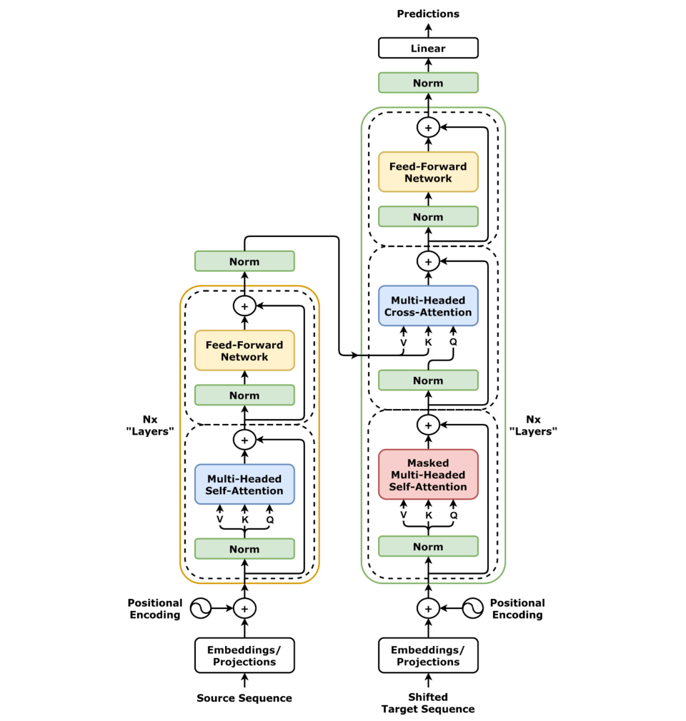
Full Transformer architecture (pre-LN)
“Pre-LN” setup modified from original setup in 2017 paper

Slide 35
Variations and Developments
Transformer architecture is modular. (“made of Lego blocks”)
  Encoder-decoder model (original model, excels at mapping one seq to another)
    Translation, summarization, instruction-following (need to read and understand contexts to produce outputs)
    E.g. Google T5, M2M100 (Facebook)
  Encoder-only (maps real-world inputs like texts to higher dimensional abstract space representations)
    To be used for downstream applications later.
    E.g. BERT (Bidirectional encoder representations from transformers)
    Rarely-used for texts, no meaningful performance enhancement vs encoder-decoder structure
  Decoder-only (very popular, produce outputs based on pre-trained architecture, excels at continuing seq, closer to everyday natural human usage)
    Absence of encoders means training is done solely on decoder.
    Self-supervised learning with causal masking self-attention.
    E.g., GPT, Gemini (1.0), DeepSeek

Slide 36
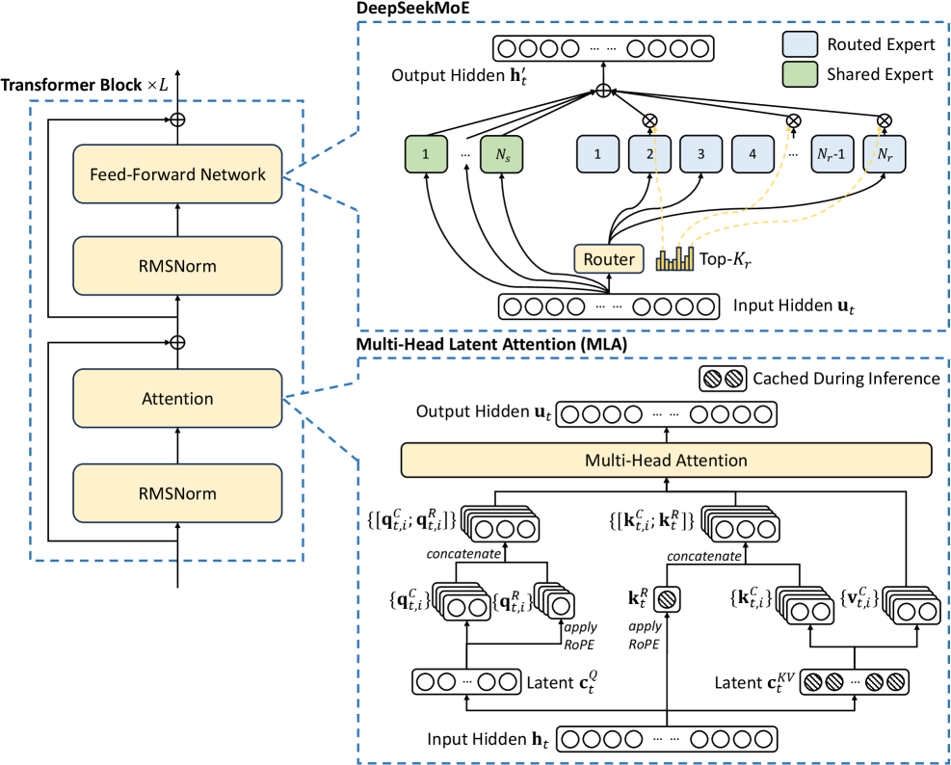
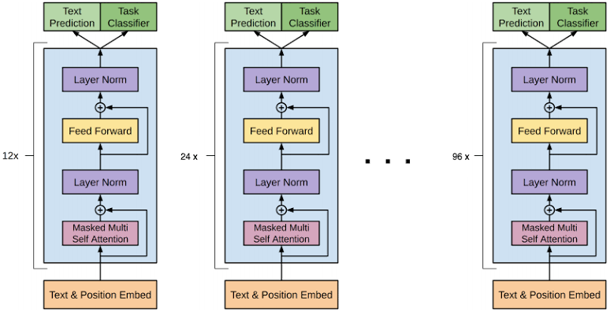
GPT 3.5 model
Latest variant
DeepSeek V3 Model
RMSNorm replacing layernorm
Norm. before attention (pre-“LN”) config.

Slide 37
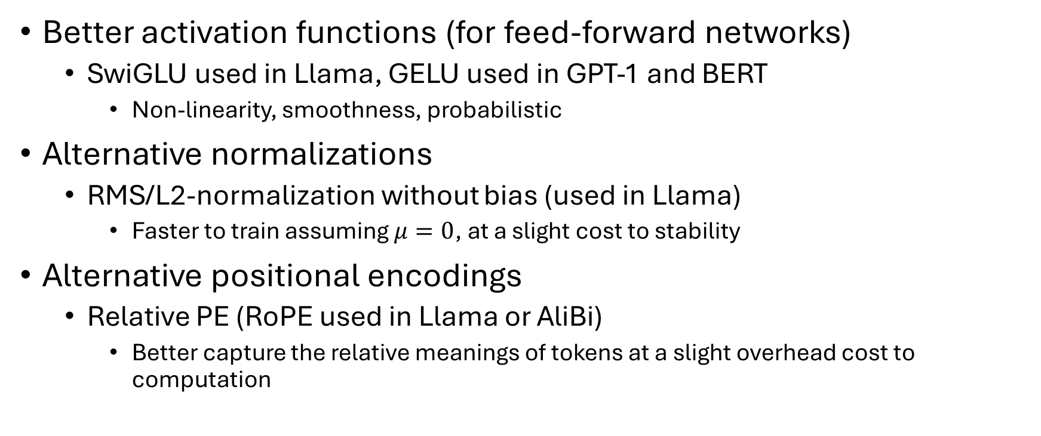
Improvements since then…
Better activation functions (for feed-forward networks)
  SwiGLU used in Llama, GELU used in GPT-1 and BERT
    Non-linearity, smoothness, probabilistic
Alternative normalizations
  RMS/L2-normalization without bias (used in Llama)
    Faster to train assuming $μ=0$, at a slight cost to stability
Alternative positional encodings
  Relative PE (RoPE used in Llama or AliBi)
    Better capture the relative meanings of tokens at a slight overhead cost to computation

Slide 38
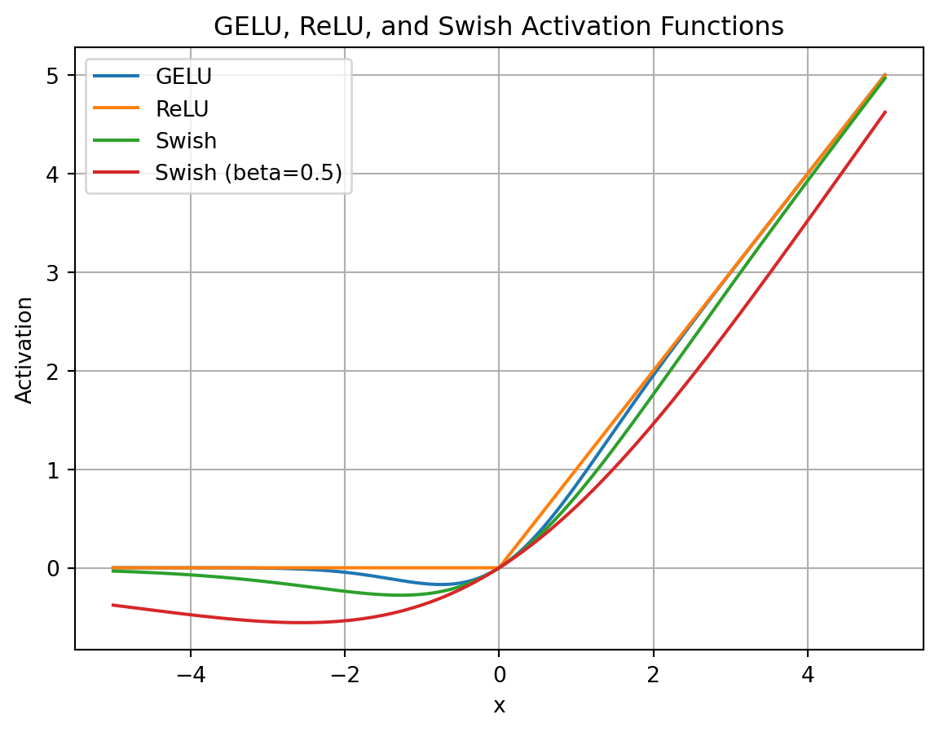
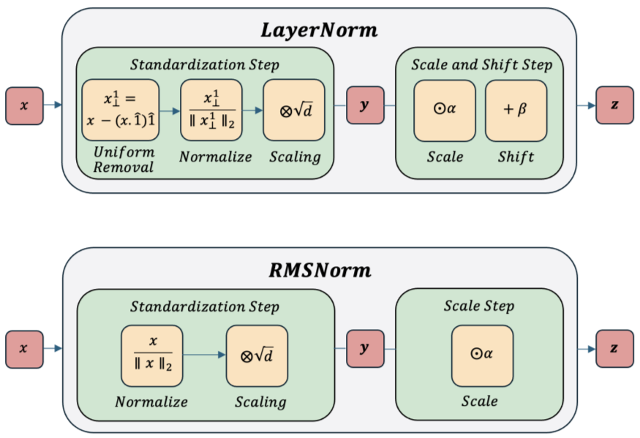
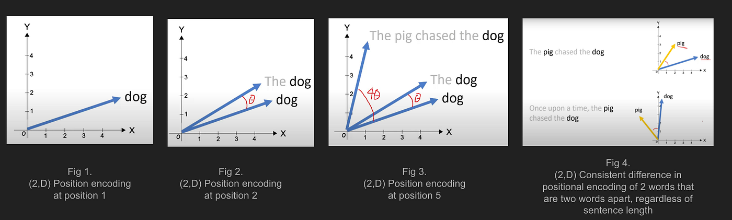

Slide 39
Efficient implementation
KV caching (during inference only) – because KV matrices are the same for a given input prompt, there is no need to regenerate them and can be cached aside for each subsequent inference (text generation). Downside – large memory needed
FlashAttention (during training and inference) – hardware acceleration by reducing HBM read-writes (slow) and move operations to faster SRAM-on-GPU/chip. (Speed up x9 vs standard attention)
Multi-Query Attention/Group-Query Attention/Multihead-Latent Attention (primarily in inference, but useful in training also) – SVD

Slide 40
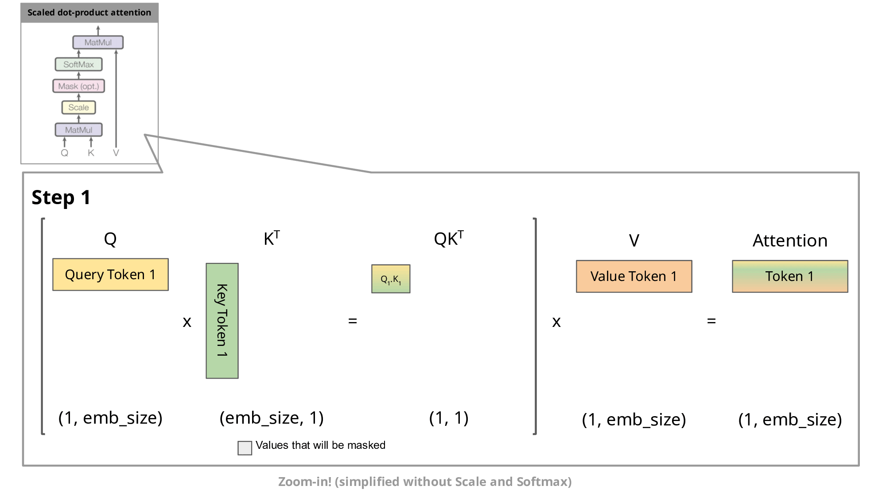
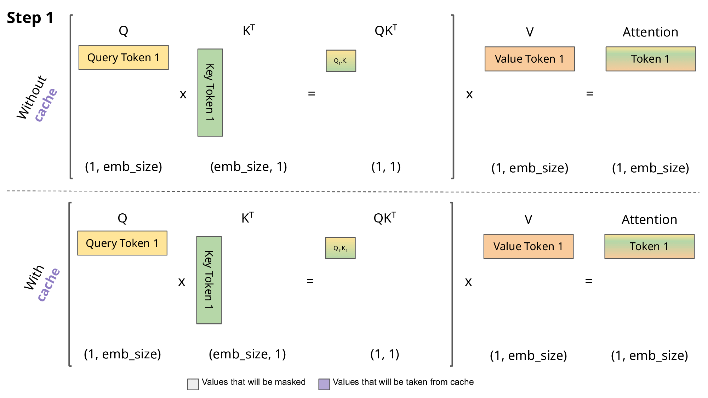


Slide 42
Efficient implementation
Speculative decoding
  Use smaller model to predict tokens.

Slide 43
Current Directions
Generative AI (GPT etc.)
Multimodal AI (process different types of data simultaneously (text/image/audio), e.g., TikTok)
Vision Transformers (computer vision: object recognition, image captioning), on par with/superior to traditional CNN

Slide 44

Special focus on ViT
ViT has the closest resemblance to our work.
  Image matrices are essentially just our filtered distance matrices
  Output is a classifier of the “images”

Slide 45
Special focus on ViT
By extension, we can predict the next “image” by adding an autoregressive decoder. Then via inferencing, sequentially generate all subsequent “distance matrices”.
  Highly susceptible to hallucinations (like in predicting stock prices via deep-learning)
Safer and direct approach is to map betti numbers output to each distance matrix. The trained via encoder-decoder model.
  Issue: not enough betti number datasets available for training. Smaller transformer taught by CNN still needs ~ 1 mil images. (Data-Efficient Image Transformers (DeiT))

Slide 46


Slide 47
Multimodal AI

Slide 48
Reducing memory usage
Mixed-precision training
  torch.amp
Memory checkpointing
  torch.utils.checkpoint
Cascaded Group Attention replacing original MHA
torch.einsum() replacing torch.matmul()
Image matrix padding to significantly reduce memory load

