Slide 1




Lego Dataset Analysis
Analysis using Clustering algorithm on Number
of parts per Lego Sets
By : Saunav Kaushik | Data Analytics Enthusiast

Slide 2


Introduction
Does LEGO's product lineup shift toward bigger sets over time, or expand across sizes at once? This project clusters 18,600+ Rebrickable sets by release year and part count to find out.

Slide 3

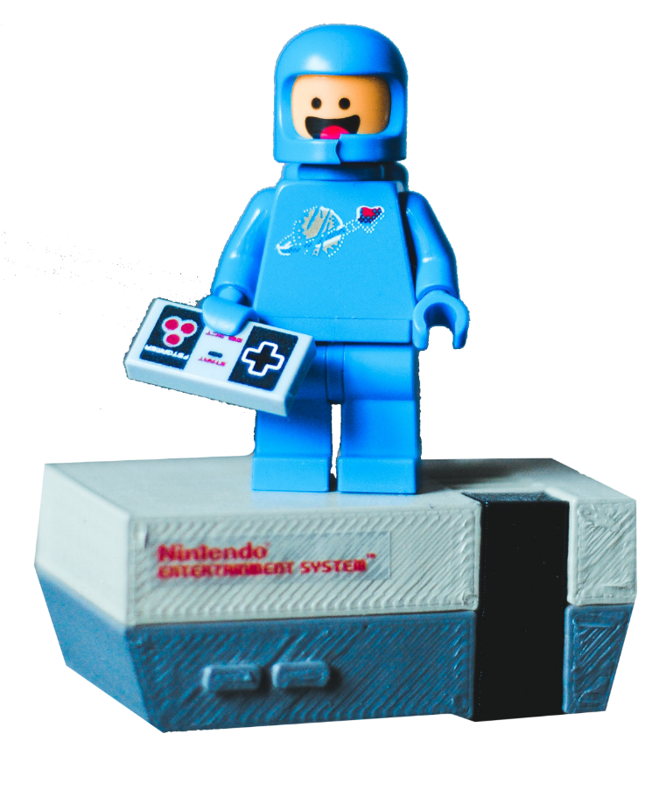
Our Approach
Cleaned and merged the Rebrickable sets and themes datasets, scaled year and part count with StandardScaler, then used the elbow method to justify k = 6 clusters before fitting K-Means.
Clean & Merge
Removed the incomplete 2022 year, checked for nulls, merged sets with themes.
Scale Features
Applied StandardScaler so year and part count contribute equally to distance.
Elbow Method
Plotted inertia across k = 1–10 to justify k = 6.

Slide 4
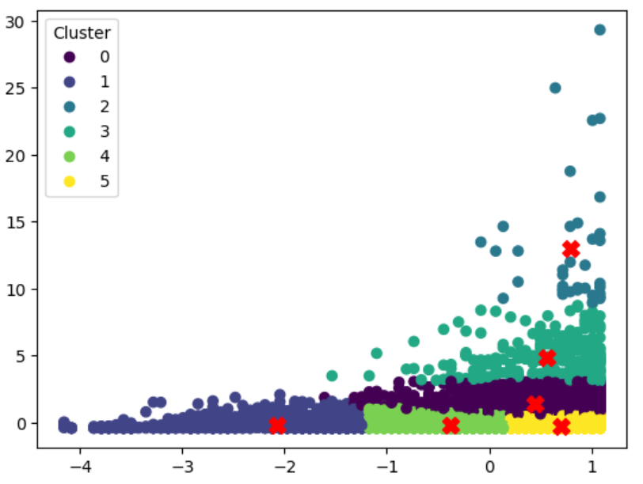
Key Finding
LEGO's growth isn't sets simply getting bigger over time. Four clusters centered on 2012–2017 range from just 65 to over 5,000 parts — small, medium, large, and mega sets released side by side. The expansion is across product tiers, not across years.
Small vs. Mega
Cluster sizes range from ~65 to 5,000+ parts.
Same Era
Most clusters center on 2012–2017, not spread across decades.
Data Caveat
~13% of sets predate 1990, limiting older-era detail.

Slide 5
References
The stunning presentation
24Slides. (n.d.). Lego blocks PowerPoint template [PowerPoint template]. https://24slides.com/templates/view/other/lego-blocks-powerpoint-template
The complete dataset
Rebrickable. (n.d.). LEGO parts/sets/colors and inventories [Data set]. https://rebrickable.com/downloads/
scikit-learn developers. (n.d.). KMeans — scikit-learn documentation. Retrieved July 19, 2026, from https://scikit-learn.org/stable/modules/generated/sklearn.cluster.KMeans.html
The insightful documentation
The plotting library
Hunter, J. D. (2007). Matplotlib: A 2D graphics environment. Computing in Science & Engineering, 9(3), 90–95. https://doi.org/10.1109/MCSE.2007.55

Slide 6

THANK
YOU
Notes:
Saunavkaushik.github.io

