Slide 1
European Data Portal
Activities in a nutshell

Slide 2

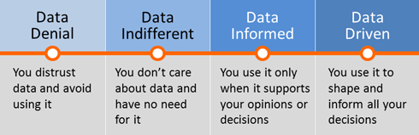
Data: What are we doing about it?
Source: http://www.analyticshero.com/wp-content/uploads/2012/12/data_adoption.png

Slide 3
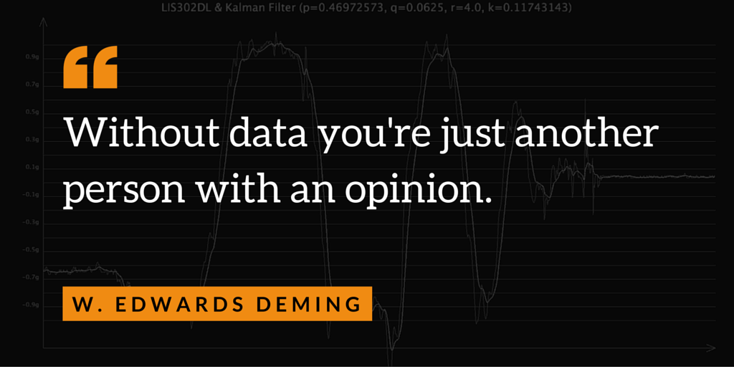

Slide 4
You Need
a
Reason
to
Believe

Slide 5


Slide 6

Show me the Money

Slide 7
€ 325 Billion
Direct Market Size
2016 - 2020

Slide 8
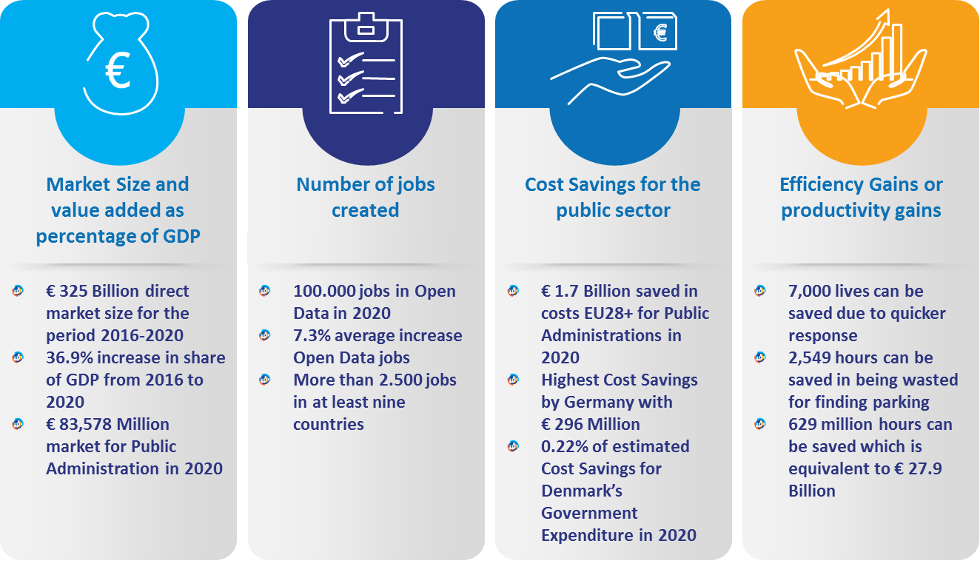
Open data can drive the economy, create jobs and generate cost savings

Slide 9
Open Data has both a direct and an indirect impact on the economy
Indirect economic benefits
Direct economic benefits
Direct benefits are monetised benefits that are
realised in market transactions in the form of
revenues and Gross Value Added (GVA),
the number of jobs involved in
producing a service or product,
and cost savings.
Indirect economic benefits are i.e. new goods and
services, time savings for users of applications
using Open Data, knowledge economy
growth, increased efficiency in public
services and growth of
related markets.
73%
27%
25,000 Jobs
created in Open
Data in 2020
2,549 hours
wasted finding parking
> € 30m of savings in Public Administration in
11 countries
16% less
energy used

Slide 10
Open Data cross-cuts through different sectors of the economy
Public administration is by far the sector that will gain the most from opening up data, confirming the public sector is the first re-user of its own data
Total estimated market size per sector 2020

Slide 11
Examples of Open Data re-use
Accessing information about your neighbourhood
Finding a parking spot in a big city
Accessing information about air pollution
Cross-cutting public data with privately owned data
Checking whether your train or bus is on time
Finding what to visit in a certain part of the city or region
Comparing schools and universities
Locating the nearest defibrillator in case of an emergency
Visualising the public sector budget
Checking if a bike is reported as stolen
Mapping the value of real estate
Finding out where it is possible to fish
Viomedo is a German business that connects patients with ongoing clinical trials. It is an easily searchable database of current clinical trials, so patients and trial volunteers can quickly find different studies to participate in.
BlindSquare uses open data from OpenStreetMap to help visually impaired people navigate to a given location by alerting users to obstacles in their environment.
Citymapper is a Transport Application working in cities all over the world. Using Open Data on public transport it helps you getting from A to B wherever you go.

Slide 12

Now imagne you can find data from anywhere, in any language

Slide 13
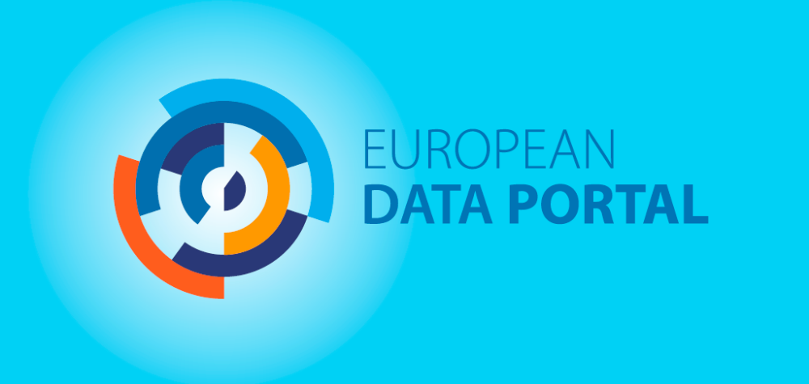

Slide 14
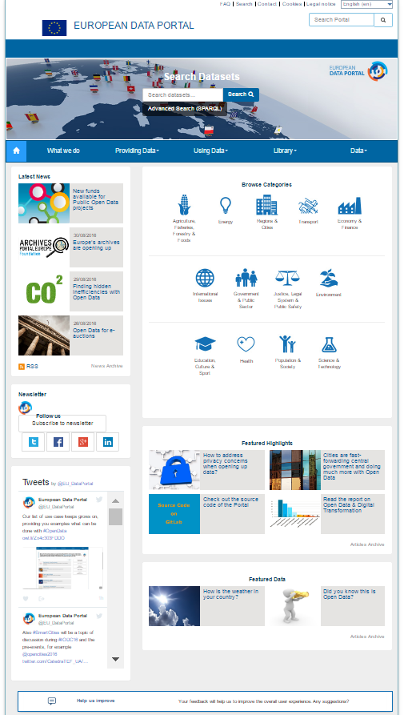

The European Data Portal - What do we do?
“We harvest open data made available by all public administrations across Europe.
Our focus is data from the Member States”
  We offer metadata in 12 languages (for now), we visualise, we offer quality checks for over 585K datasets
  We train a suite of learning experiences in the field of Open Data from publishing to the re-using Open Data
  We showcase Open Data events, Open Data news, Open Data best practices, Open Data reports, etc
  We collect by inviting stakeholders to share their stories, their feedback, their portals
  We convene: meetings, webinars, events to discuss open data best practices, challenges and next steps
  We share our source code and promote open source and re-use of components and standards
34 countries, 70 catalogues harvested, visualisations, maps, …

Slide 15
Multiple Learning experiences brought online

Slide 16

Multiple Learning experiences brought online
A Goldbook for data providers
eLearning Modules
Library
Open Data in a Nutshell
Step 1: Introduction to Open Data
Step 2: Open Data Implementation
Step 3: Technical deep dive
Step 4: Where next with Open Data?
Economic analysis
Landscaping report
Use cases
Further training material
Country specific reports
How to build an Open Data Strategy
Technical preparation & implementation
Training Companion
Putting in place an Open Data lifecycle
Practicalities to run own Open Data workshops
Ensuring and monitoring success
Online learning is complemented by tailored support to countries

Slide 17
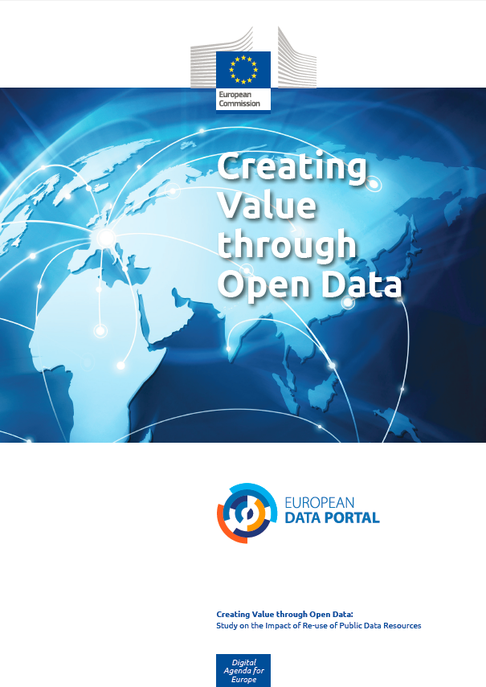
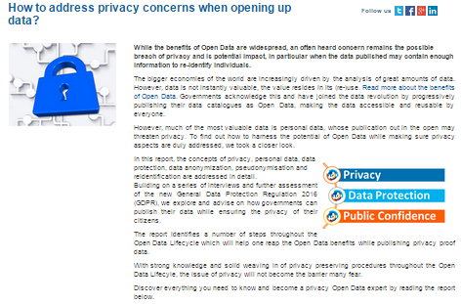
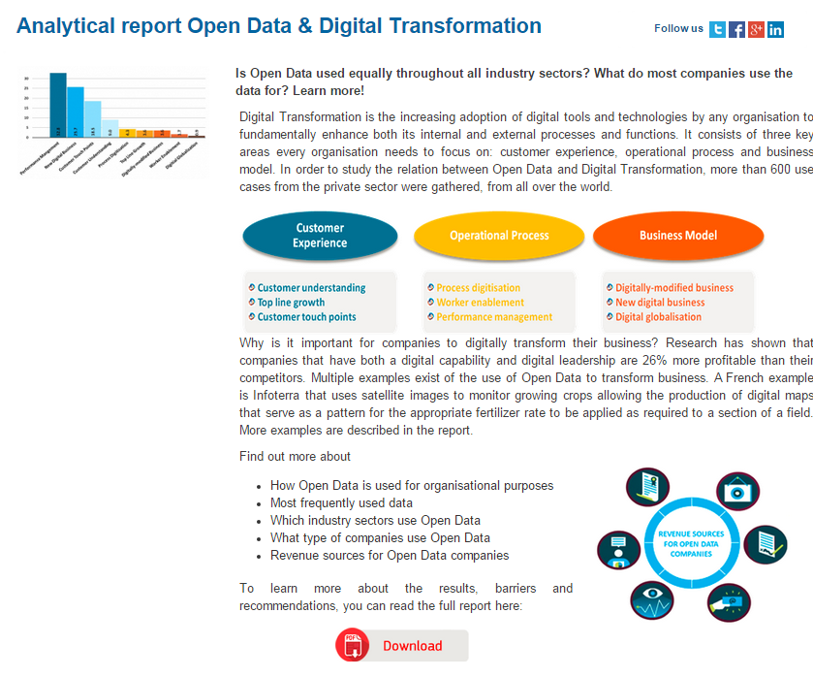
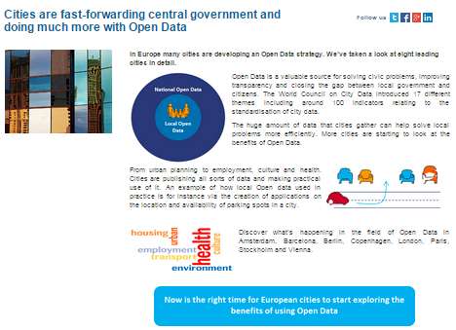
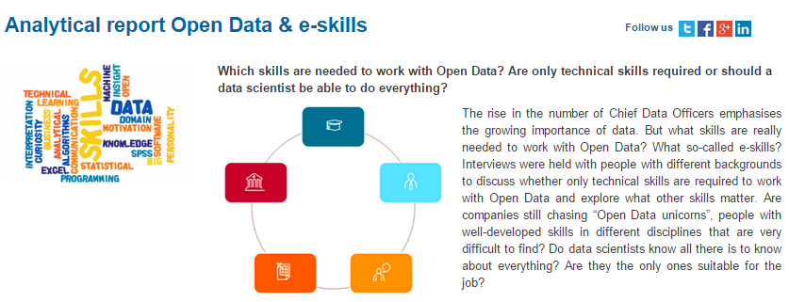
The European Data Portal also aims at fostering the reuse of public data resources
Economic Benefits of Open Data
Metrics to measure economic impact
Market Size
Jobs Created
Cost Savings
Efficiency Gains
Study published on www.europeandataportal.eu
Community Engagement
Reports to drive understanding and reuse
Topic 1: Open Data and Digital Transformation
Topic 2: Open Data and eSkills
Topic 3: Open Data and Cities
Topic 4: Open Data and Privacy
Workshops to drive understanding and reuse

Slide 18
Quick overview of the Portal

Slide 19
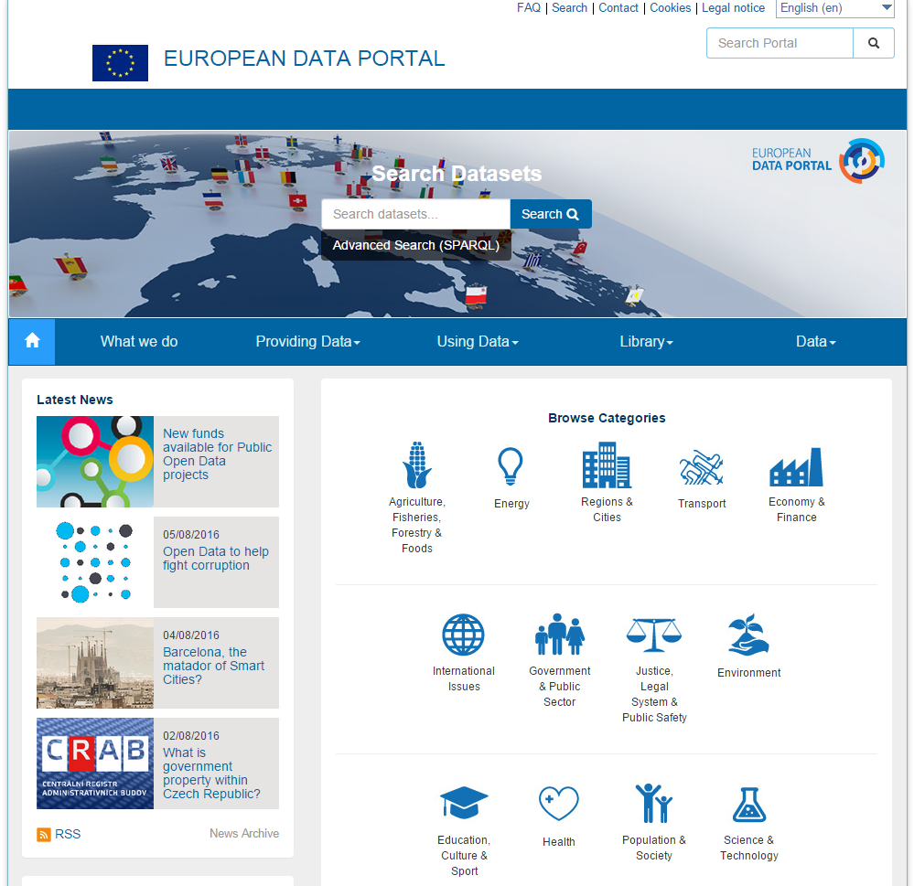

Slide 20
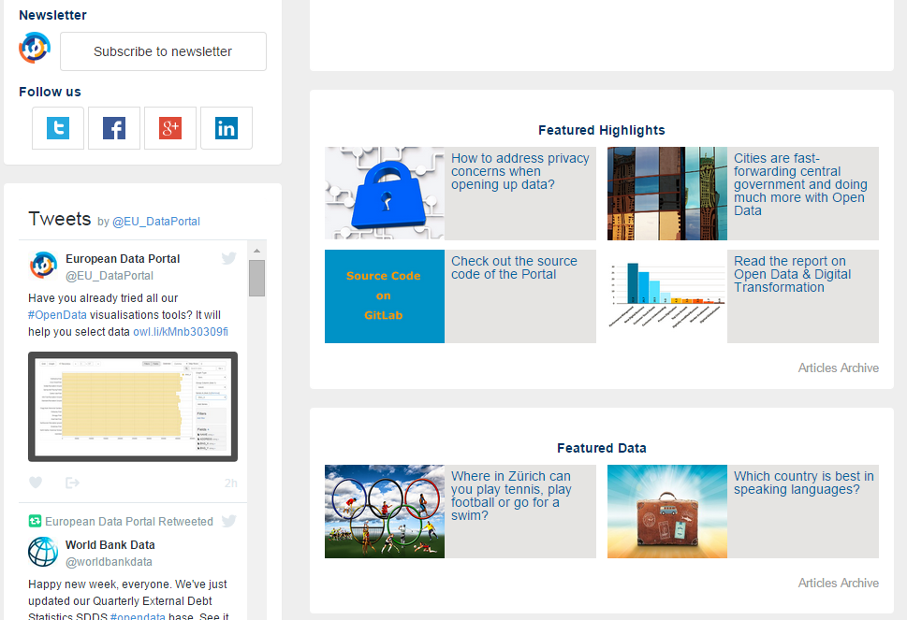

Slide 21
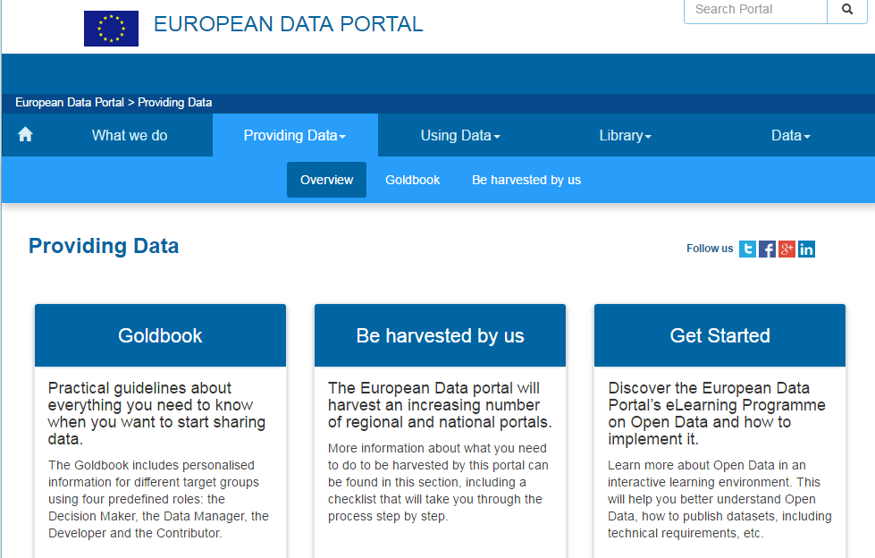
Supporting Data providers

Slide 22
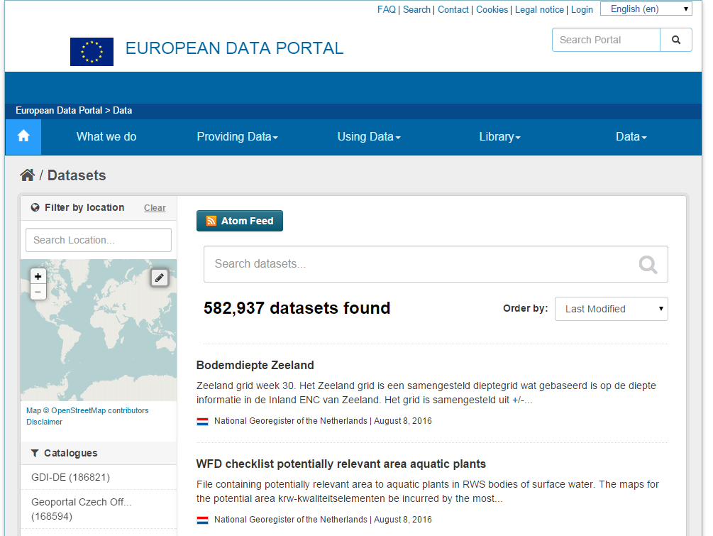
Accessing Data

Slide 23
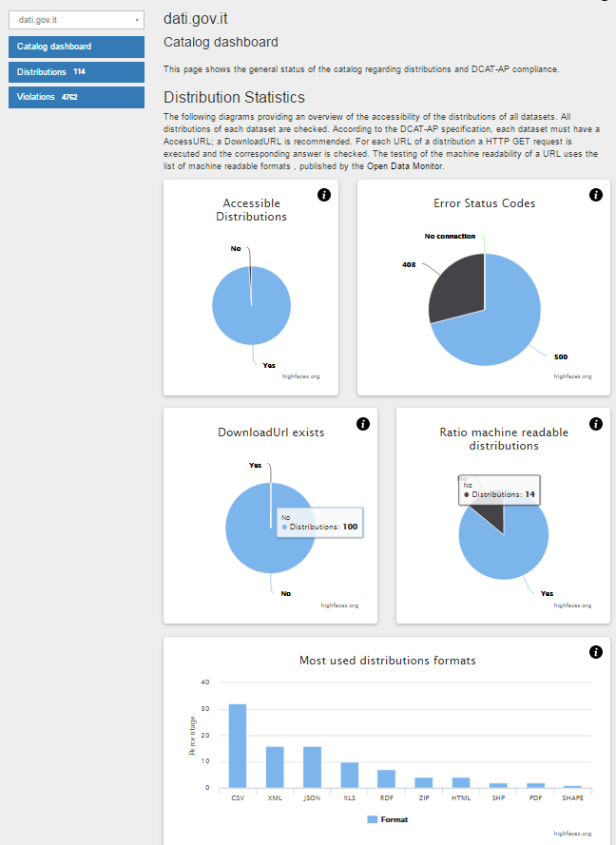
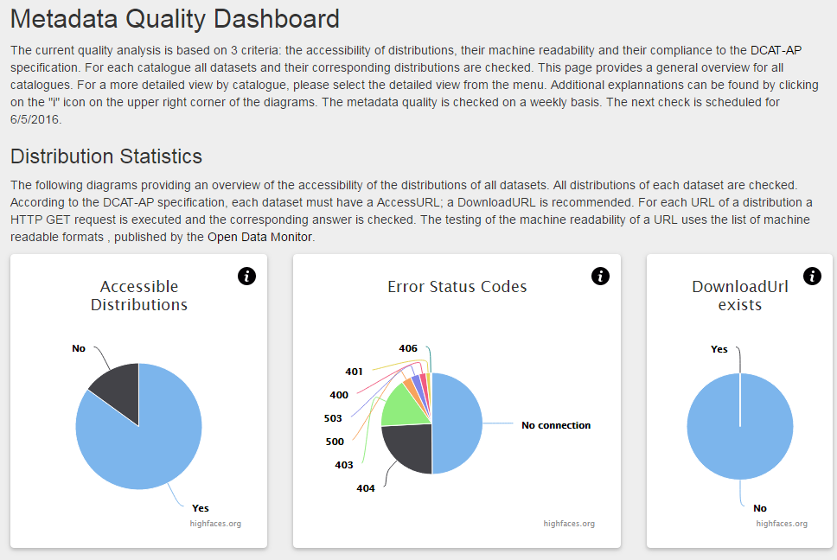







Assessing metadata quality

Slide 24
Open Data
It’s more trivial than you think

Slide 25


Recommendations to increase the value of Open Data in cities or regions
8 city examples that show the potential value of sharing more data as Open Data to develop a more effective city. But how can you do that?
1
Map the data your city currently has and check what could be published & how to go about doing that
2
Develop a city or regional portal or website to publish data on
3
Communicate about your Open Data plans and the benefits they will bring for your citizens and businesses
4
Start by sharing data that the inhabitants of your city ask for, and prioritise those
5
Raise awareness within your own city town hall
6
Organise events like hackathons to promote your data and engage with developers
7
Identify challenges your city or region is facing and share the data you have about these topics to run focused hackathons and events
8
Run a pilot project in a small area of your region to test your first Open Data Initiative
9
Monitor your success to show your citizens the value of the initiatives taken

Slide 26
To work with Open Data both soft and hard skills are required
Hard skills
Technical skill
The knowledge and abilities needed to accomplish mathematical, engineering, scientific or computer-related duties, as well as other specific tasks.
Subject matter expertise
Person who is an authority in a particular area or topic.
Maths & statistics knowledge
Knowledge of the science that deals with the collection, analysis, and interpretation of numerical data.
Communication
Two-way process of reaching mutual understanding, in which participants not only exchange information, ideas, feelings but also create and share meaning.
Collaboration
To work with another person or group in order to achieve or do something.
Problem solving
The process of working through details of a problem to reach a solution.
Soft skills
Creativity
The ability to transcend traditional ideas, rules, patterns, relationships, or the like, and to create meaningful new ideas, forms, methods, and interpretations.
Story telling
Storytelling is a method of explaining a series of events through narrative.
Curiosity
The urge felt to know more about something.

Slide 27

How to move forward?
6 key recommendations to move forward and sustain Open Data initiatives
RECOMMENDATION 1
Draft an Open Data strategy and implement it!
RECOMMENDATION 2
Adding basic (API) functionalities on a portal can stimulate re-use
RECOMMENDATION 3
Raise awareness around Open Data
RECOMMENDATION 4
Offer trainings to civil servants
RECOMMENDATION 5
Develop national guidelines
RECOMMENDATION 6
Measure your success

Slide 28

Go and try it out.
www.europeandataportal.eu

Slide 29
Overall Project Coordination & Management
Wendy CARRARA (Capgemini Consulting)
Phone: +33 (0)6 71 097 397
Email: wendy.carrara@capgemini.com
Twitter: @wcarrara
General contact
Email: info@europeandataportal.eu
Twitter: @EU_DataPortal

