Slide 1
Episodic & Semantic
Soar’s Long-Term Declarative Memory Systems
Nate Derbinsky
University of Michigan

Slide 2
Why Declarative
Long-Term Memory Systems?
Guiding Principle. Explore and evaluate new architectural mechanisms if…
  agents are missing important functionality and
  existing mechanisms cannot effectively and efficiently support this functionality

Slide 3
Soar 9

Slide 4
Autobiographic Agent History
What
Why
The ability to remember, in context, experience that wasn’t necessarily known to be important
Virtual Sensing [Nuxoll & Laird 2007]
Action Modeling [Xu & Laird 2010]
…
Arguments for a distinct mechanism
  Rule matching scales with working memory size
  Rule-based episodes would be problematic to encode and retrieve

Slide 5
Episodic Memory: Big Picture
Episodic memory is a weak learning mechanism
  Automatically captures, stores, and temporally indexes agent state
  Supports content-addressable agent interface to autobiographical prior experience

Slide 6
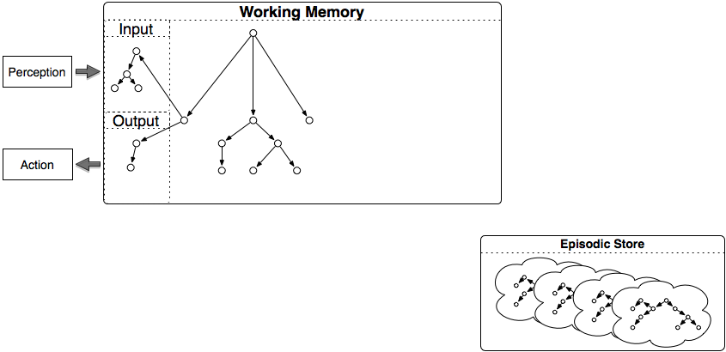
Architectural Integration

Slide 7
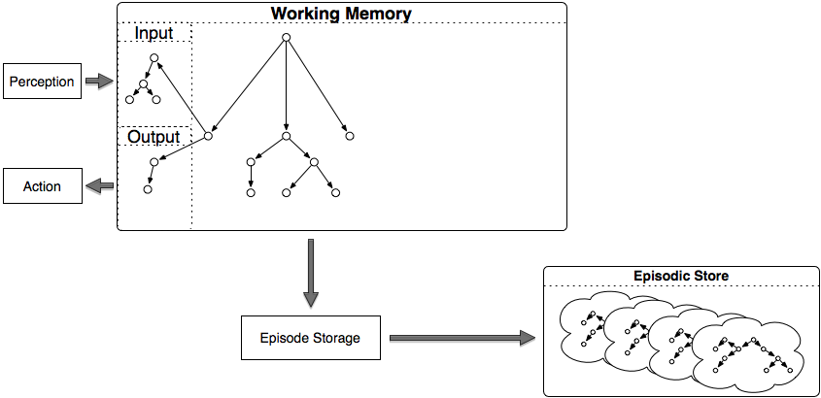
Architectural Integration

Slide 8
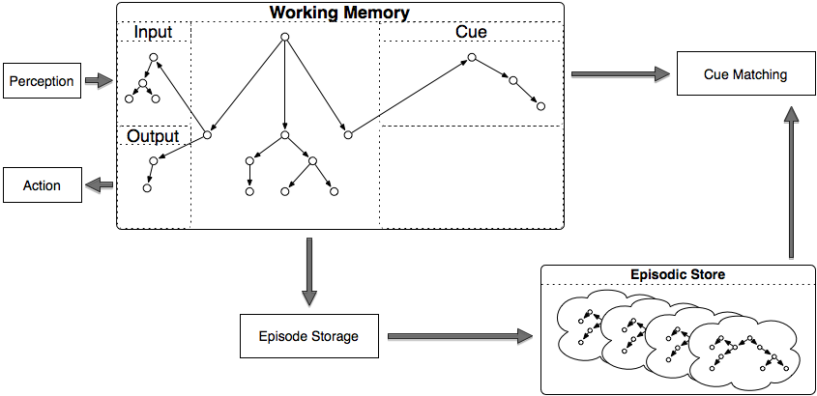
Architectural Integration

Slide 9
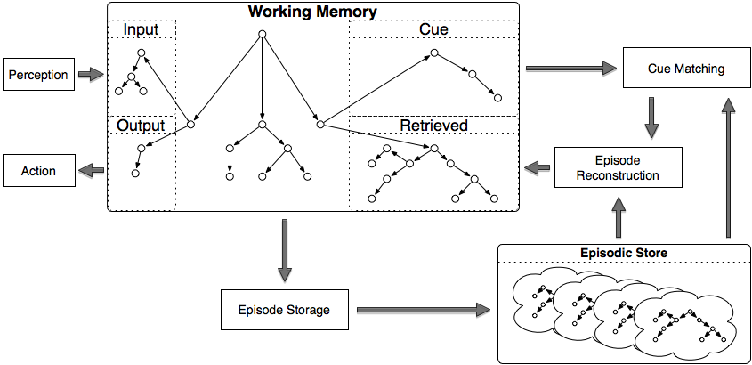
Architectural Integration
Notes:
Say output phase

Slide 10
Mechanism Detail
Encoding
  Faithful “snapshot” of top-state
Storage
  No dynamics (such as forgetting)
Retrieval
  Nearest-neighbor using structural cue matching
    Biased by recency
    Partial match

Slide 11
Select Prior Work
Architectural Integration & Agent Capabilities
  Extending Cognitive Architecture with Episodic Memory
  Andrew Nuxoll & John Laird. AAAI (2007)
Efficiency
  Efficiently Implementing Episodic Memory
  Nate Derbinsky & John Laird. ICCBR (2009)
Integrating Learning Mechanisms
  Learning to Use Episodic Memory
  Nicholas Gorski & John Laird. Cognitive Systems Research (2011)
  Using Diverse Cognitive Mechanisms for Action Modeling
  John Laird, Joseph Xu, & Sam Wintermute. ICCM (2010)

Slide 12
Soar 9

Slide 13
Declarative Knowledge Store
What
Why
The ability to store and flexibly retrieve large amounts of knowledge about the world, independent of the context in which it was originally learned
Large, diverse KBs
  Lexical (WordNet)
  Ontological (Cyc)
  …
Arguments for a distinct mechanism
  Data chunking: exponential rules, difficult to encode/change
  Working memory: rule matching grows with number of objects

Slide 14
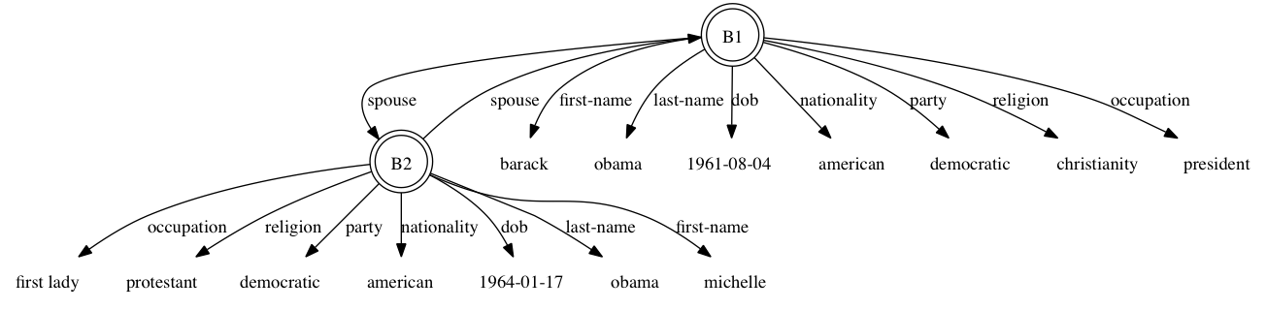
Semantic Memory: Big Picture
Supports deliberate storage and retrieval of long-term objects, features, and relations

Slide 15
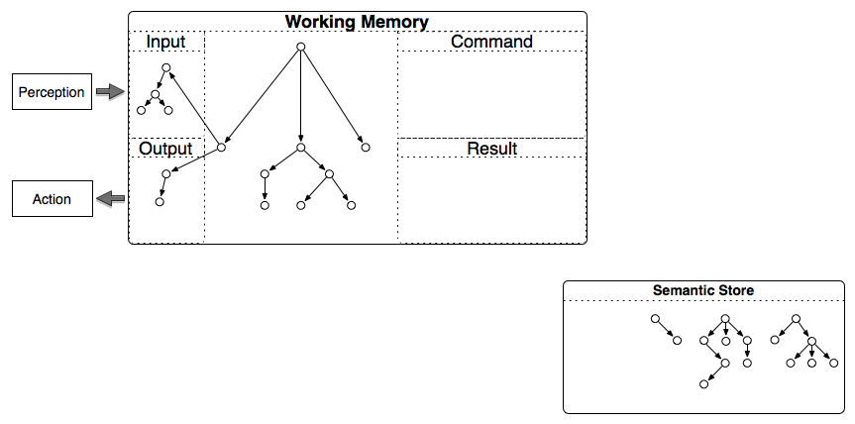
Architectural Integration

Slide 16
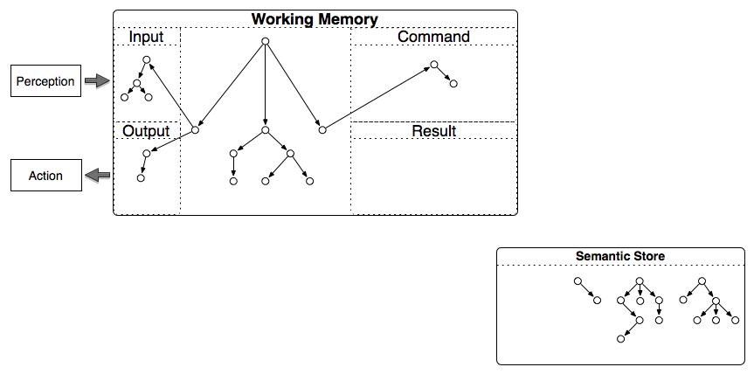
Architectural Integration
Storage

Slide 17
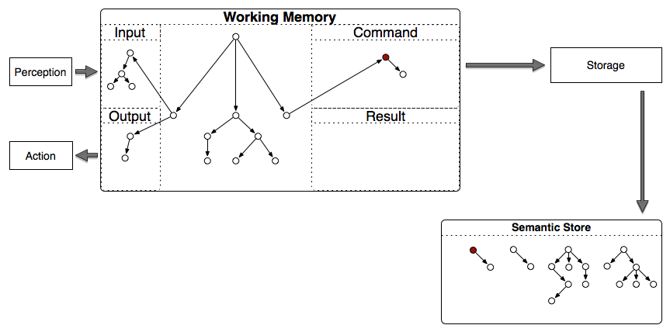
Architectural Integration
Storage

Slide 18
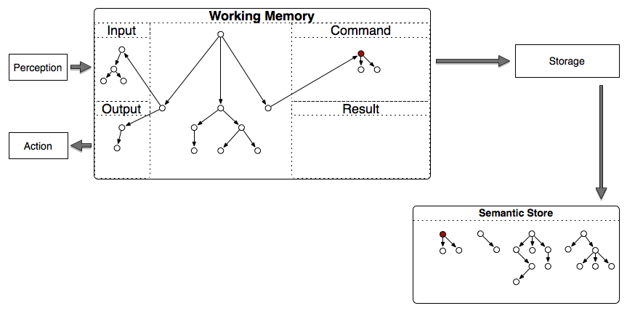
Architectural Integration
Storage

Slide 19
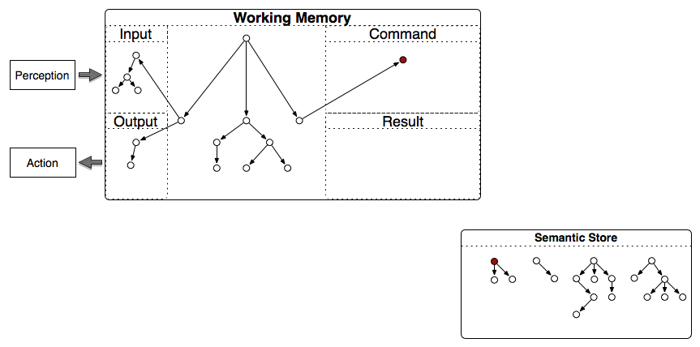
Architectural Integration
Non-Cue-Based Retrieval

Slide 20
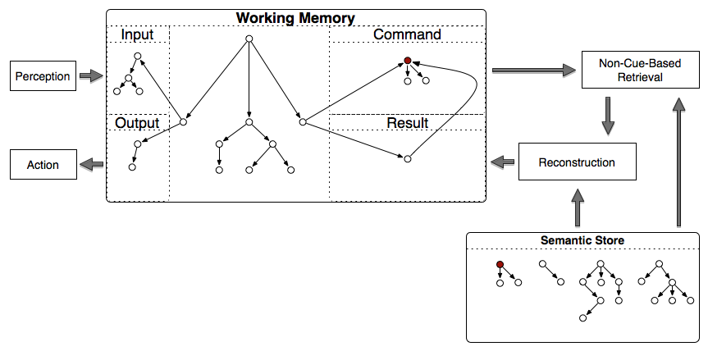
Architectural Integration
Non-Cue-Based Retrieval

Slide 21
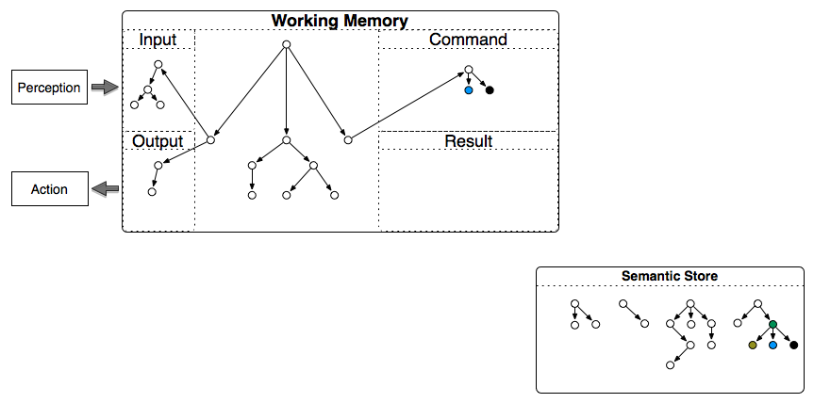
Architectural Integration
Cue-Based Retrieval

Slide 22
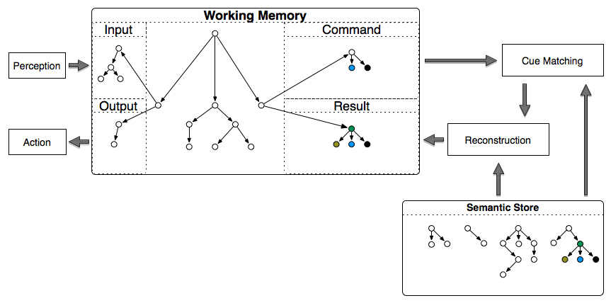
Architectural Integration
Cue-Based Retrieval

Slide 23
Mechanism Detail
Encoding
  Deliberate (via rules)
  Representation: (<long-term identifier> ^attribute value)
Storage
  Agent-modifiable over time
Retrieval
  Associative cue: given feature subset, retrieve node (parameterized biases)
  Expansion: given node, retrieve augmentations
Notes:
Representation: WM (not necessarily connected), ACT-R (dynamic slots, multi-valued attributes)

Slide 24
Memory Comparison
 | Episodic | Semantic
Encoding | Automatic Top-State | Deliberate Object+Features/Relations
Storage | No dynamics | Agent modifiable
Retrieval | Disjunctive Structural | Conjunctive Features/Relations

Slide 25
Select Prior Work
Efficiency
  Towards Efficiently Supporting Large Symbolic Declarative Memories
  Nate Derbinsky, John Laird, & Bryan Smith. ICCM (2010)
Integrating Learning Mechanisms
  Using Diverse Cognitive Mechanisms for Action Modeling
  John Laird, Joseph Xu, & Sam Wintermute. ICCM (2010)

Slide 26
Today’s Talks
EpMem | SMem | Talk
 | x | Effective and Efficient Historical Memory Retrieval Bias in Soar’s Semantic Memory Nate Derbinsky
 | x | Playing with Semantic Memory Bob Marinier
x | x | Performance Evaluation of Soar's Declarative Memories John Laird
x |  | Do's and Don't's of Episodic Memory Justin Li
x | x | Supporting Delayed Intentions with Long-Term Memories Justin Li

Slide 27
Discussion

Slide 28
Open Research Issues
Architecture
Agent/Task
Functionality
  Encoding
  Storage
  Retrieval
Efficiency
Integration
Knowledge
  Representation
  Consistency
  Sharing
  Capabilities
Evaluation
  Tasks
  Metrics
Tools

Slide 29
Encoding: Episodic
Should EpMem capture sub-goal processing?
  Space and retrieval time multiplier
Explore space saver tradeoff: stop at LTIs
  Sacrifice of fidelity (“changing” episodes)
  Added deliberation required to “reconstruct” episode contents
  Can’t search substructure

Slide 30
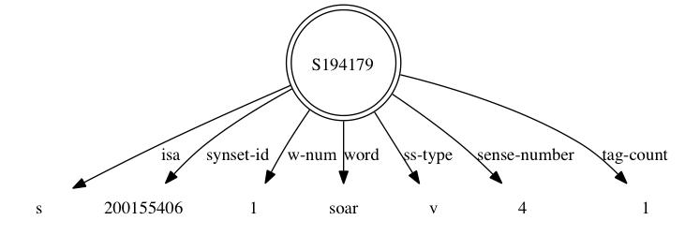
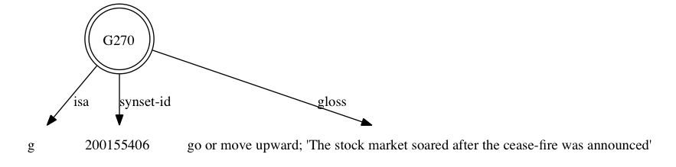
Example Semantic Knowledge: “soar”
“sense” of the word “soar”
“gloss” with the synset-id “200155406”

Slide 31
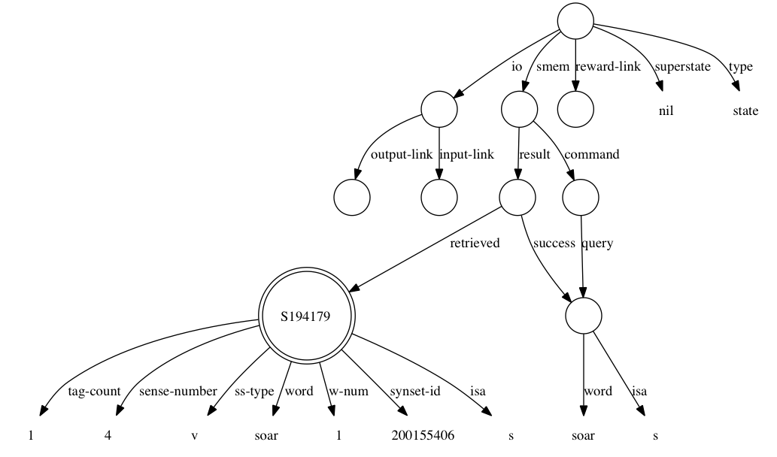
Example Episode

Slide 32
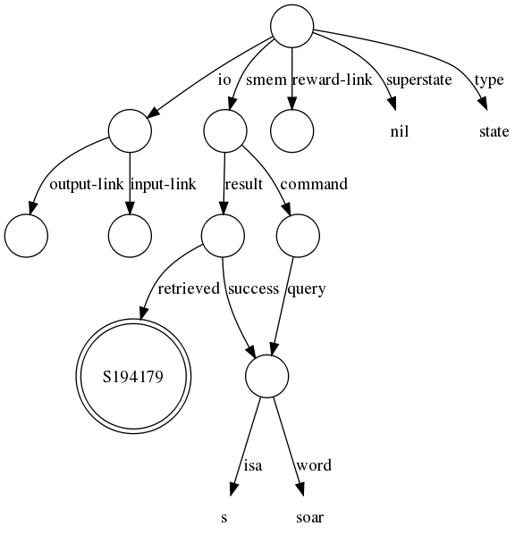
Pruned Episodic Encoding
Episodic
Semantic

Slide 33
Encoding: Semantic
Where does knowledge come from?
  Consolidating from EpMem via stability

Slide 34
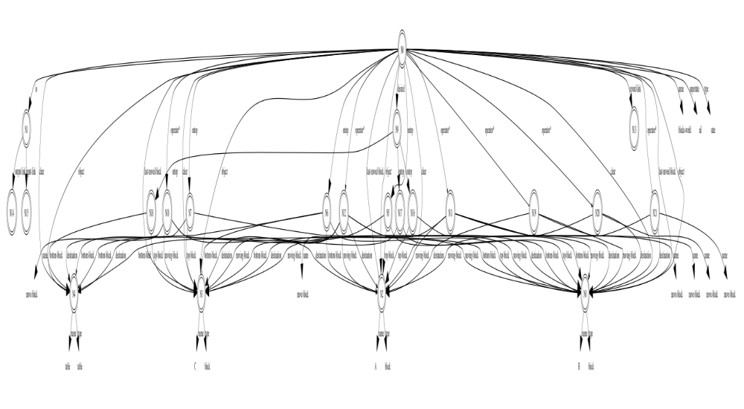
Structural Stability (1)

Slide 35
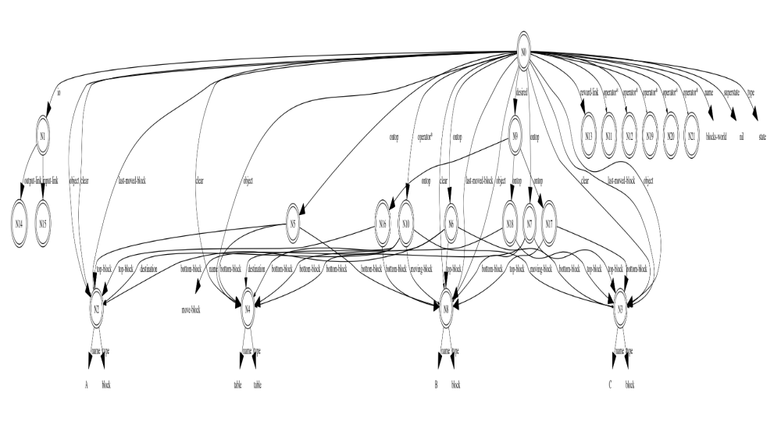
Structural Stability (2)

Slide 36
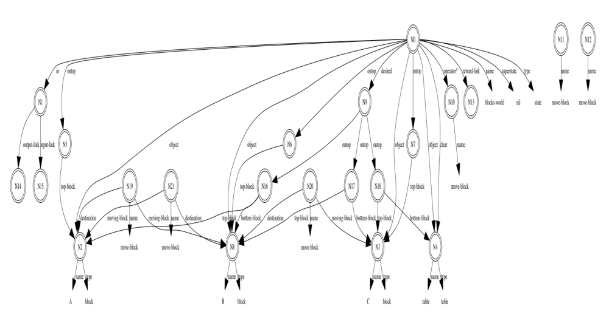
Structural Stability (3)

Slide 37
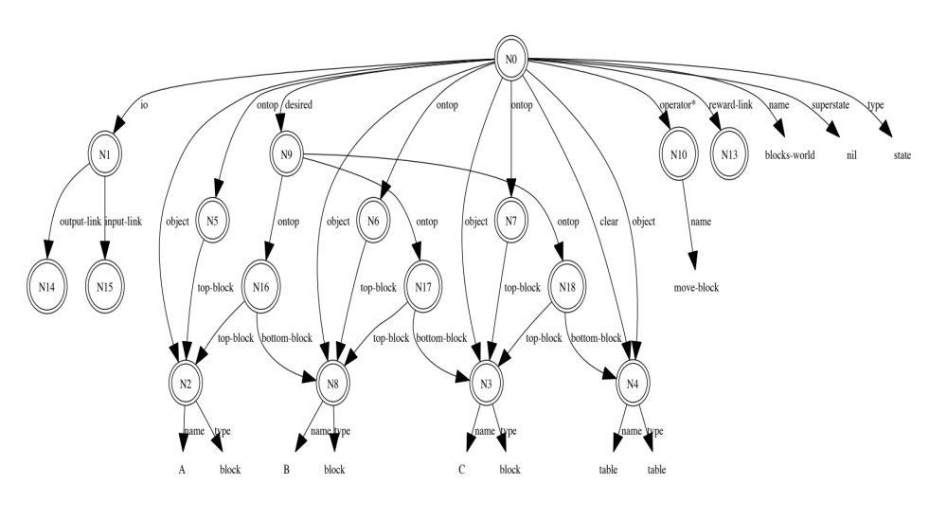
Structural Stability (4)

Slide 38
Encoding: Semantic
Where does knowledge come from?
  Consolidating from EpMem via stability
  From WM via situational focus (activation)
  Mirroring
    Hypotheticals?

Slide 39
Storage: Episodic
Memory is cheap, but not unlimited…
  Forgetting
    Recency, emotional salience
  Merging
  Can such operations occur in an incremental fashion?
  Is there a functional benefit to forgetting?

Slide 40
Storage: Semantic
Memory is cheap, but not unlimited…
  Forgetting via activation (ala ACT-R)
  Is there a functional benefit to forgetting?

Slide 41
Retrieval: Episodic
Evaluating retrieval quality
Biases for ambiguous cues
  Episode emotional appraisal
  Element activation
  How to do this efficiently!!??
More complex similarity functions
  Possibly exploit static structure of IO

Slide 42
Retrieval: Semantic
Effective & efficient biases (ala ACT-R)
  Base-level
  Spreading (more than 1-level?)
  Partial match
  Noise
  Other?

Slide 43
Efficiency
Asynchronous retrievals
  Pragmatic: max time per cycle
  Explore multiple approaches to a problem, while LTMs are searching
    Faster memory -> better task performance?

Slide 44
Integration
Learning to control LTMs
Knowledge-level learning/retrieval strategies
Symbolic vs. Perceptual LTMs
  How can symbolic LTM inform perceptual processes?

Slide 45
Knowledge
What types of representations do we need to support and learn large, diverse semantic stores?
How do we maintain consistency between the long-term memories (or at least remain robust to inconsistencies)?
To what extent can long-term knowledge be shared between agents?
How do we capture high-level capabilities as re-usable components (i.e. rule libraries)?

Slide 46
Evaluation
What is a “comprehensive” set of domains/tasks by which to measure progress of LTM development?
  Metrics?
At what time scale should we evaluate LTMs for generally intelligent agents?
  Is this feasible in real-time domains?

Slide 47
Tools
As agents persist for long periods of time and build up their own knowledge stores, how do we assess/visualize progress and debug agents?

