Slide 1
Soar-RL Discussion:
Future Directions, Open Questions, and Why You Should Use It
31st Soar Workshop

Slide 2
Soar-RL Today
Robust framework for integrated online RL
Big features:
  Hierarchical RL
  Internal actions
  Architectural constraints
    Generalization, time
Active research pushing in those directions

Slide 3
Soar-RL Tomorrow
Future research directions
  Additional architectural constraints
  Fundamental advances in RL
Increased adoption
  Usage cases
  Understanding barriers to use
Notes:
Agenda: step through these items
Interrupt and discuss points of interest
2nd half more practical than 1st half
I will be stating opinions: feel free to disagree!

Slide 4
Why You Should Use Soar-RL
Changing environment
Optimized policies over environment actions
Balanced exploration and exploitation
Why I would use Soar-RL if I were you

Slide 5
Non-stationary Environments
Dynamic environment regularities
  Adversarial opponent in a game
  Weather or seasons in a simulated world
  Variations between simulated and embodied tasks
  Limited transfer learning, or tracking
Agents that persist for long periods of time
Notes:
Gain these advantages from a learning rate

Slide 6
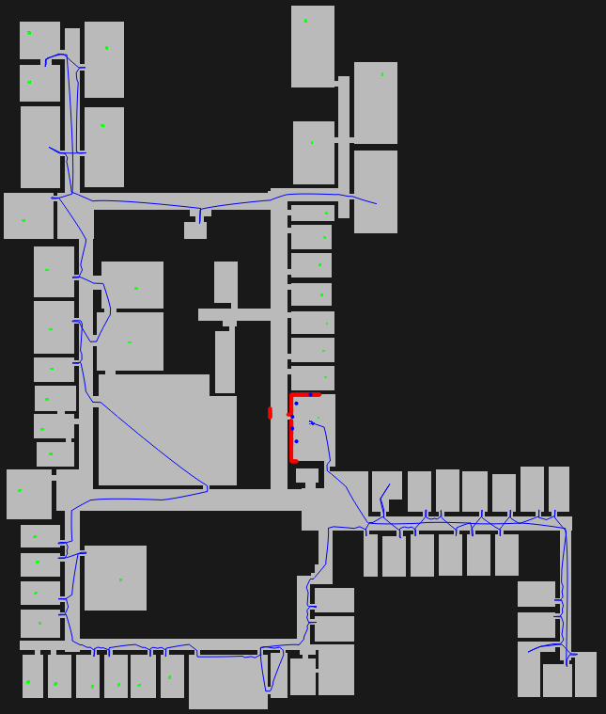
Pragmatic Soar-RL
Get-all-blocks
Go-to-room
Plan-path
Drive-to-gateway
op1
op2
op3
Turn-left
Turn-right
Go-forward

Slide 7
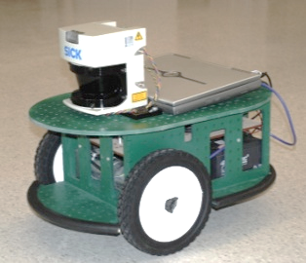
Optimizing External Actions

Slide 8
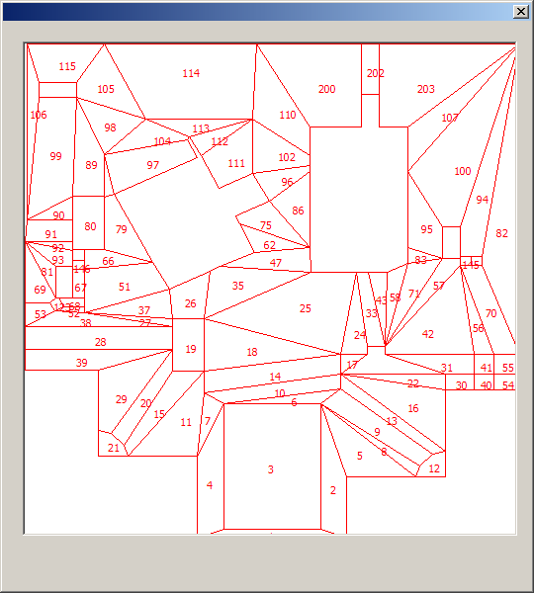
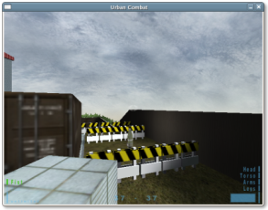
Balanced Exploration & Exploitation
Stationary, but stochastic actions

Slide 9
Practical Reasons
Programmer time is expensive
Learn in simulation, near-transfer to embodied agent
If hand-coded behavior can guarantee doctrine, then so can RL behavior
  Mix symbolic and adaptive behaviors FIX

Slide 10


Biggest Barrier to Using Soar-RL

Slide 11

Other Barriers to Adoption?

Slide 12
I Know What You’re Thinking

Slide 13
Future Directions for Soar-RL
Parameter-free framework
Issues of function approximation
Scaling to general intelligence
MDP characterization

Slide 14
Parameter-free framework
Want fewer free parameters
  Less developer time finding best settings
  Stronger architectural commitments
Parameters are set initially, and can evolve over time
Policies
Exploration
Gap handling
Learning algo.
Knobs
Learning rate
Exploration rate
Initial values
Eligibility decay
Notes:
One poke at ACT-R in the past was its reliance on parameters – different reasons, but still
An ideal architecture is parameter free
Can view function approximation, RL rules, and RL state as features

Slide 15
Soar-RL Value
Q-value: expected future reward after taking action a in state s
state
action
Q-value
<op> move-forward
-0.8
<op> move-left
-1.2
<op> move-forward
-0.1
<op> move-left
-0.3
…
<op> move-forward
0.4

Slide 16
Soar-RL Value Function Approximation
Typically agent WM has lots of knowledge
  Some knowledge irrelevant to RL state
  Generalizing over relevant knowledge can improve learning performance
Soar-RL factorization is non-trivial
  Independent rules, but dependent features
  Linear combination of rules & values
  Rules that fire for more than one operator proposal
Soar-RL is a good framework for exploration

Slide 17
Scaling to General Intelligence
Actively extending Soar to long-term agents
  Scaling long-term memories
  Long runs with chunking
Can RL contribute to long-term agents?
  Intrinsic motivation
  Origin of RL rules
  Correct factorization
    Rules, feature space, time
    What is learned with Soar-RL and what is hand coded
  Learning at the evolutionary time scale
Notes:
Odd man out – these are bigger issues
IMRL: reward that doesn’t come from the environment

Slide 18
MDP Characterization
MDP: Markov Decision Process
Interesting problems are non-Markovian
  Markovian problems are solvable
Goal: use Soar to tackle interesting problems
Are SARSA/Q-learning the right algorithms?
(The catch: basal ganglia performs temporal-difference updates)

Slide 19


