Slide 1
Action Modeling in SVS
Joseph Xu
Soar Workshop 31
June 2011

Slide 2
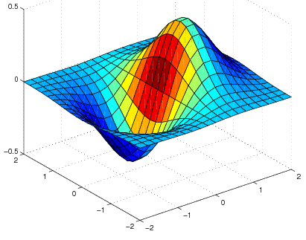
Relational State
Available Actions
Relational State
¬intersect
(robot, red_wp)
¬intersect
(robot, green_wp)
+intersect(robot, red_wp)
+intersect(robot, green_wp)
intersect
(robot, red_wp)
¬intersect
(robot, green_wp)
Relational Planner
Relational Model
Relational
Abstraction
Relational
Abstraction
Relational
Action
Continuous State
Objective Function
Continuous State
Continuous Model
Pre
out
Post
State
Update
communication
Controller
Motor
Signals
learning
Environment
usage

Slide 3
Outline
Describe continuous model learning algorithm
Show learning results in robot domain
Discuss problem with algorithm
Briefly describe relational model learning
Show results on combining relational and continuous models

Slide 4
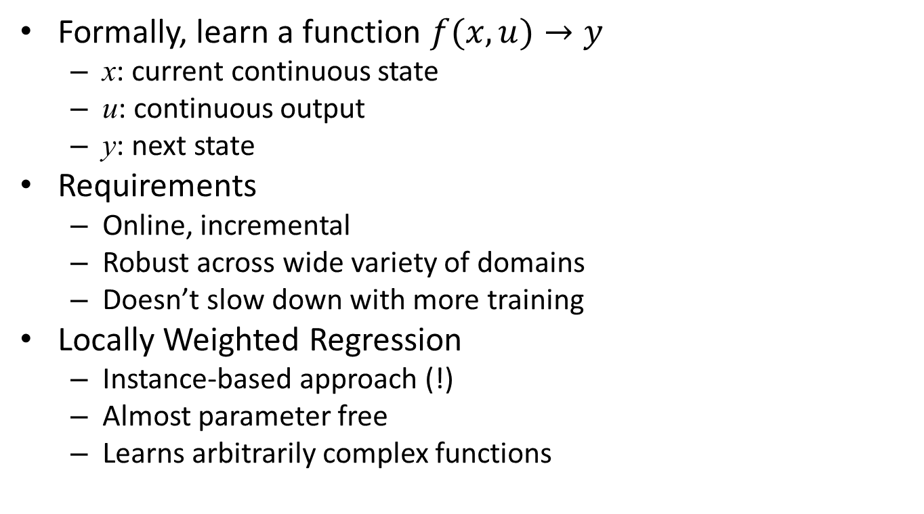
Continuous Model Learning
Formally, learn a function $f(x,u)→y$
  x: current continuous state
  u: continuous output
  y: next state
Requirements
  Online, incremental
  Robust across wide variety of domains
  Doesn’t slow down with more training
Locally Weighted Regression
  Instance-based approach (!)
  Almost parameter free
  Learns arbitrarily complex functions

Slide 5
Continuous Model Learning
Continuous
Output
Continuous
Output
Continuous
Output
left voltage: 0.2
right voltage: 0.8
Spatial Scene Graph
Spatial Scene Graph
World
World
X
U
Y
P [ 0.1, 3.4, 0.0 ]
R [ 0.0, 0.0, 0.3 ]
S [ 1.0, 1.0, 1.0 ]
P [ 0.3, 3.7, 0.0 ]
R [ 0.0, 0.0, 1.7 ]
S [ 1.0, 1.0, 1.0 ]
x
u
y
values

Slide 6
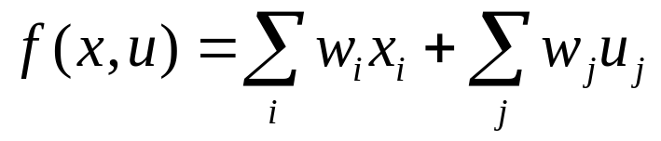

Continuous Model Prediction
Motor
Command
?
left voltage: -0.6
right voltage: 1.2
x
u
Weighted
Linear
Regression
k nearest neighbors
Notes:
Fix equation

Slide 7
Robot Domain Example
Environment input
  (x, y) position
  (x, y) velocity
  Heading angle
  Angular velocity
  Left wheel RPM
  Right wheel RPM
Agent output
  Left and right motor voltages
Using a stand-alone version
Learned model adapts
Voltage inversion
Hand-coded model fails

Slide 8
Continuous Learning Performance in Robot Domain
Notes:
Show slide of task

Slide 9
Continuous Learning Performance in Robot Domain
Notes:
Show slide of task

Slide 10
Problem: Nearest Neighbor Search
Slowest part of the prediction
Using a brute force search over all training examples leads to linear time increase
Smarter data structures such as Kd trees, ball trees, and cover trees degrade quickly as number of dimensions increase
  Number of dimensions proportional to number of objects in scene, can grow very large
Locality sensitive hashing?

Slide 11
Pruning Examples
Selectively keep new training examples:
  For each new example (x, u, y), make a prediction y’ = f(x, u) with continuous model
  If y’ ≈ y, then assume that (x, u, y) will not improve model performance, so don’t keep it

Slide 12
Table Size w/wo Pruning

Slide 13
Query Time w/wo Pruning

Slide 14
Prediction Error w/wo Pruning

Slide 15
Relational Model Learning
Learning
o1
o2
o3
S1
S2
S3
snapshot
snapshot
snapshot
Episodic Memory
e1
e2
e3
Training examples
(s1, o1, s2)
(s2, o2, s3)
Prediction
A
A
A
B
B
A
B
C
B
C
C
A
B
B
B
C
What happens if I try relational operator +on(A, C)?
Retrieve Similar Episode
C
A
Prediction
Simple Analogical Mapping
Xu, J. Z., Laird, J. E. (2010). Instance-Based Online Learning of Deterministic Relational Action Models. AAAI 2010.
Notes:
citation

Slide 16
Another Way to Make Relational Predictions
Relational State
Relational State
¬intersect
(robot, red_wp)
¬intersect
(robot, green_wp)
intersect
(robot, red_wp)
¬intersect
(robot, green_wp)
Continuous Model
Pre
out
Post
Relational
Abstraction
Relational
Action
Spatial Scene Graph
World
P [ 0.3, 3.7, 0.0 ]
R [ 0.0, 0.0, 1.7 ]
S [ 1.0, 1.0, 1.0 ]
Controller
Notes:
Another slide before to embed this in context of multiple prediction methods

Slide 17
Combining Relational and Continuous Models
Each type of model captures different information
  Relational model captures qualitative changes that can generalize across analogical situations, but doesn’t understand space
  Continuous model captures spatial configurations, but doesn’t generalize across analogical situations
Since we have both, we can combine them to offset each type’s weakness

Slide 18
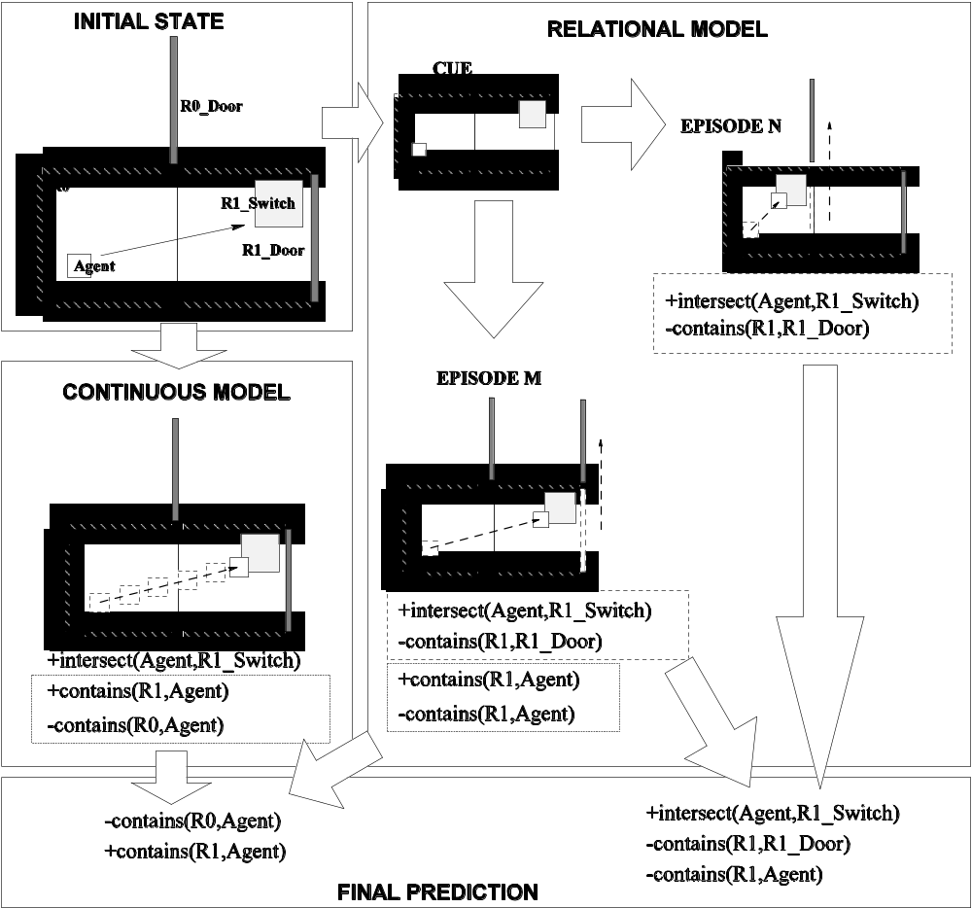
Combining Relational and Continuous Models
Rooms Domain
Series of connected rooms with doors and switches
Agent outputs (x,y) velocity to move and can open doors by stepping on switches
Relational model doesn’t capture spatial configuration of rooms
Continuous model doesn’t understand the relationship between stepping on switches and opening doors

Slide 19
Prediction Performance in
Rooms Domain
Xu, J. Z., Laird, J. E. (2011). Combining Learned Discrete and Continuous Action Models. AAAI 2011.
Notes:
reorder legend

Slide 20
Conclusion
Nuggets
Coal
Continuous model learns quickly in robot domain
Continuous model adapts online to changes in dynamics
Demonstrated a simple way to combine relational and continuous learning to improve performance
Nearest neighbor search is unbounded

Slide 21
Flattening Scene Graph
Spatial Scene Graph
World
P [ 0.1, 3.4, -12 ]
R [ 0.0, 0.0, 1.7 ]
S [ 1.0, 1.0, 1.0 ]
B
C
P [ ... ]
R [ ... ]
S [ ... ]
A
P [ ... ]
R [ ... ]
S [ ... ]
extra
properties
B
C
Flat Representation
position
rotation
scale
values
signature
B:A
C:A
A:world
P1
P2
P3
Notes:
Slide for going toward instance based, nn approach

Slide 22
Problem: Sharing Training Examples
Current implementation of continuous model learning cannot share training examples across structurally distinct states
World
World
World
splinter:world
splinter:world
disc:world
splinter:world
disc:world

