Slide 1
Competence-Preserving Retention of Learned Knowledge in Soar’s Working and Procedural Memories
Nate Derbinsky, John E. Laird
University of Michigan

Slide 2
Motivation
Goal. Agents that exhibit human-level intelligence and persist autonomously for long periods of time (days – months).
Problem. Extended tasks that involve amassing large amounts of knowledge can lead to performance degradation.

Slide 3
Common Approach
Forgetting. Selectively retain learned knowledge.
Challenge. Balance…
  agent task competence &
  computational resource growth
across a variety of tasks.

Slide 4
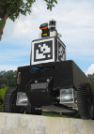

This Work
Hypothesis. Useful to forget a memory if…
  not useful (via base-level activation) &
  likely can reconstruct if necessary
Evaluation. 2 complex tasks, 2 memories in Soar
Mobile Robot Navigation
Working Memory
bounds decision time
completes task
  1 hour
Multi-Player Dice
Procedural Memory
50% memory reduction
competitive play
  days
Task Independent; Implemented in Soar v9.3.2

Slide 5
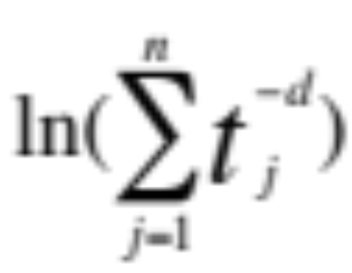
Base-Level Activation
(Anderson et al., 2004)
Predict future usage via history
  Used to bias ambiguous semantic-memory retrievals (AAAI ‘11)
θ
2-phase prediction of future decay
Novel approximation
Binary parameter search
t_{d}
Efficient & Correct
O(# memories)

Slide 6
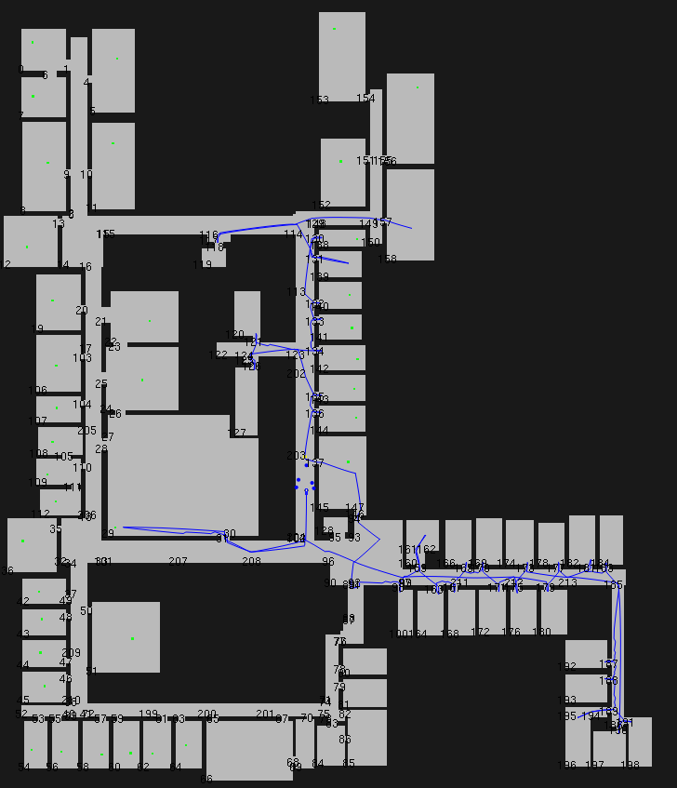
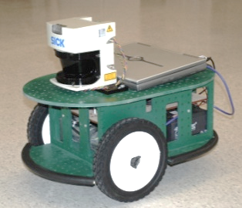
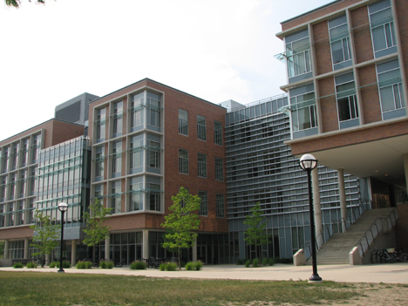
Task #1: Mobile Robotics
Simulated Exploration & Patrol
  3rd floor, BBB Building, UM
    110 rooms
    100 doorways
  Builds map in memory from experience

Slide 7
Problem: Decision Time
Issue. Large working memory
  Minor: rule matching (Forgy, 1982)
  Major: episodic reconstruction
    episode size ~ working-memory size
Forgetting Policy. Memory hierarchy
  Automatically remove from WM the o-supported augmentations of LTIs that have not been tested recently/frequently (all or nothing w.r.t. LTI)
  Agent deliberately performs retrieve commands from SMem as necessary

Slide 8
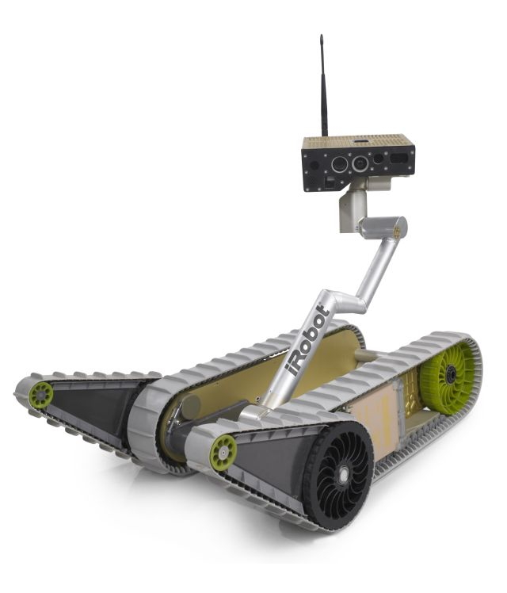
Map Knowledge
Room Features
Position, size
Walls, doorways
Objects
Waypoints
Usage
Exploration (-->SMem)
Planning/navigation (<--SMem)

Slide 9
Results: Working-Memory Size
No Forgetting
Rules
BLA: d=0.3
BLA: d=0.4
BLA: d=0.5

Slide 10
Results: Decision Time
No Forgetting
Rules
BLA: d=0.3
BLA: d=0.4
BLA: d=0.5

Slide 11
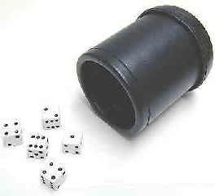
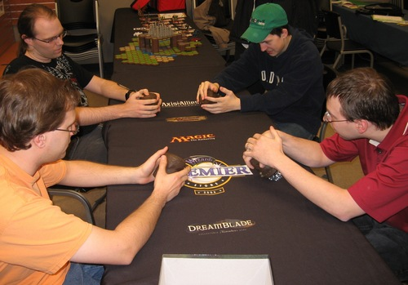
Task #2: Liar’s Dice
Complex rules, hidden state, stochasticity
  Rampant uncertainty
Agent learns via reinforcement learning (RL)
  Large state space (10⁶-10⁹ for 2-4 players)

Slide 12
Reasoning --> Action Knowledge
Bid 6 4’s
1.4
1.6
Bid 3 1’s
0.8
State
Challenge!
-0.2

Slide 13
Problem: Memory Growth
Issue. RL value-function representation: (s,a)->#
  Soar: procedural knowledge (RL rules)
  Many possible actions per turn; at most feedback for a single action -> many RL rules representing redundant knowledge
Forgetting Policy. Keep what you can’t reconstruct
  Automatically excise RL chunks that have not been updated via RL and haven’t fired recently/frequently
  New chunks are learned via reasoning as necessary

Slide 14
Forgetting Action Knowledge
Bid 6 4’s
1.6
Bid 3 1’s
0.8
0.8
…
State
Challenge!
-0.2
-0.2
…

Slide 15

Results: Memory Usage
(Kennedy & Trafton ‘07) + BLA
Max. Dec. Time = 6 msec.

Slide 16
Results: Competence
~(KT ’07)

Slide 17
Evaluation
Nuggets
Coal
Pragmatic forgetting policies for Soar: extends space and temporal extent of domains
  Implemented in Soar v9.3.2
Efficient forgetting code can be applied to any instance-based memory
Limited domain evaluation
Yet another set of parameters (d, θ) x 2
EpMem/SMem?
For more details, see two papers in proceedings of
ICCM 2012

