Slide 1
A Multi-Domain Evaluation of Scaling in Soar’s Episodic Memory
Nate Derbinsky, Justin Li, John E. Laird
University of Michigan

Slide 2
Motivation
Prior Work
Nuxoll & Laird (‘12): integration and capabilities
Derbinsky & Laird (‘09): efficient algorithms
Core Question
To what extent is Soar’s episodic memory effective and efficient for real-time agents that persist for long periods of time across a variety of tasks?

Slide 3
Approach: Multi-Domain Evaluation
Existing agents from diverse tasks (49)
  Linguistics, planning, games, robotics
Long agent runs
  Hours-days RT (10⁵ – 10⁸ episodes)
Evaluate at each X episodes
  Memory consumption
  Reactivity for >100 task relevant cues
    Maximum time for cue matching <? 50 msec.

Slide 4
Outline
Overview of Soar’s EpMem
Word Sense Disambiguation (WSD)
Planning
Video Games & Robotics

Slide 5
Episodic Memory
Problem Formulation
Representation
Episode: connected di-graph
Encoding/Storage
Automatic
Retrieval
Semantics: desired features in context
Store: temporal sequence
Cue: acyclic graph
Find the most recent episode that shares the most leaf nodes in common with the cue
No dynamics
Episodic Memory
Matching
Storage
Encoding
Working Memory
Cue

Slide 6
Episodic Memory
Algorithmic Overview
Storage
  Capture WM-changes as temporal intervals
Cue Matching (reverse walk of cue-relevant Δ’s)
  2-phase search
    Only graph-match episodes that have all cue features independently
  Only evaluate episodes that have changes relevant to cue features
  Incrementally re-score episodes

Slide 7
Episodic Memory
Storage Characterization
1 week, 8GB
1 day, 8GB

Slide 8
Episodic Memory
Retrieval Characterization
Assumptions
  Few changes per episode (temporal contiguity)
  Representational re-use (structural regularity)
  Small cue
Scaling
  Search distance (# changes to walk)
    Temporal Selectivity: how often does a WME change
    Feature Co-Occurrence: how often do WMEs co-occur within a single episode (related to search-space size)
  Episode scoring (similar to rule matching)
    Structural Selectivity: how many ways can a cue WME match an episode (i.e. multi-valued attributes)

Slide 9
Word Sense Disambiguation
Experimental Setup
Input: <“word”, POS>; Output: sense #; Result
  Corpus: SemCor (~900K eps/exposure)
Agent
  Maintain context as n-gram
  Query EpMem for context
    If success, get next episode, output result
    If failure, null
Accuracy | First | Second
2-gram | 14.57% | 92.82%
3-gram | 2.32% | 99.47%

Slide 10
Word Sense Disambiguation
Results
Storage
  Avg. 234 bytes/episode
Cue Matching
  All 1-, 2-, and 3-gram cues reactive
  0.2% of 4-grams exceed 50msec.

Slide 11
N-gram Retrieval Scaling
Retrieval Time (msec) vs. Episodes (x1000)
Feature Co-Occurrence
Temporal Selectivity

Slide 12
Planning
Experimental Setup
12 automatically converted PDDL domains
  Logistics, Blocksworld, Eight-puzzle, Grid, Gripper, Hanoi, Maze, Mine-Eater, Miconic, Mystery, Rockets, and Taxi
  44 distinct problem instances (e.g. # blocks)
Agent: randomly explore state space
  50K episodes, measure every 1K

Slide 13
Planning
Results
Storage
  Reactive: <12.04 msec./episode
  Memory: 562 – 5454 bytes/episode
Cue Matching (reactive: < 50 msec.)
  Full State: only smallest state + space size (12)
  Relational: none
  Schema: all (max = 0.08 msec.)
Notes:
9-91M eps / 48GB RAM

Slide 14
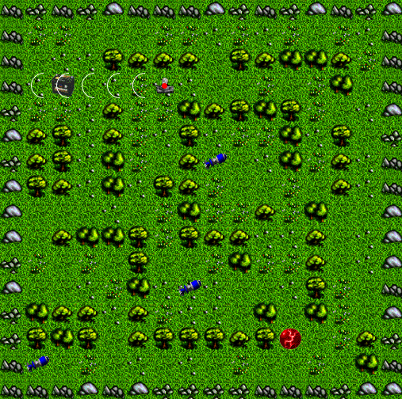
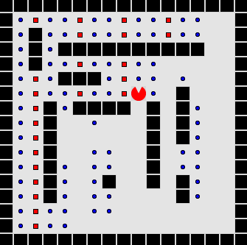
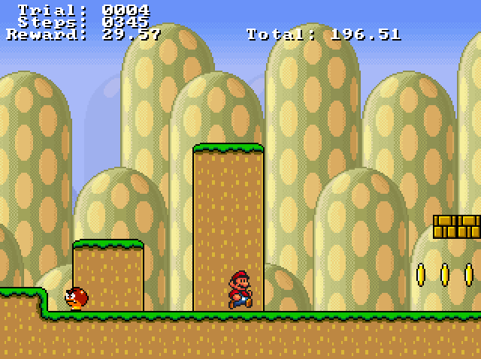
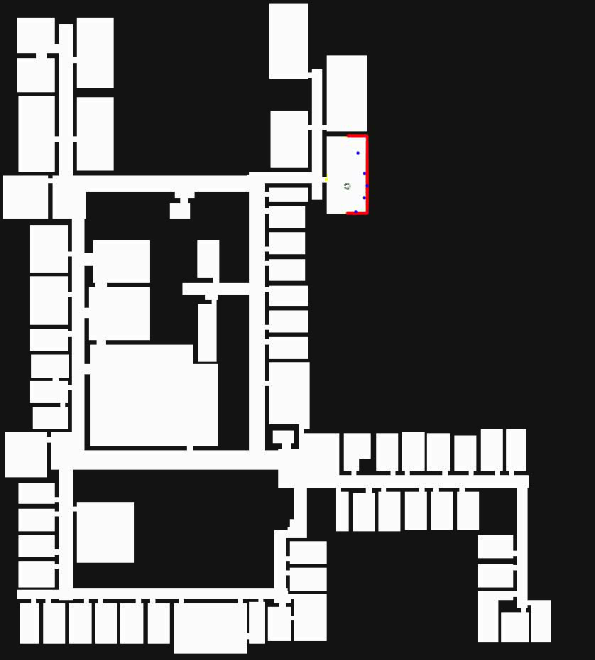
Video Games & Mobile Robotics
Experimental Setup
Hand-coded cues (per domain)
Domain | Agent | Duration | Eval. Rate
TankSoar | mapping-bot | 3.5M | 50K
Eaters | advanced-move | 3.5M | 50K
Infinite Mario | [Mohan & Laird ‘11] | 3.5M | 50K
Rooms World | [Laird, Derbinsky & Voigt ‘11] | 12 hours | 300K

Slide 15
Data: Eaters
813 bytes/episode

Slide 16
Data: Infinite Mario
Structural Selectivity
2646 bytes/episode

Slide 17
Data: TankSoar
Co-Occurrence
1035 bytes/episode

Slide 18
Data: Mobile Robotics
Temporal Selectivity
113 bytes/episode

Slide 19

Summary of Results
Generality
  Demonstrated 7 cognitive capabilities
    Virtual sensing, action modeling, long-term goal management, …
Reactivity
  <50 msec. storage time for all tasks (ex. temporal discontiguity)
  <50 msec. cue matching for many cues
Scalability
  No growth in cue matching for many cues (days!)
    Validated predictive performance models
  0.18 - 4 kb/episode (days – months)

Slide 20
Evaluation
Nuggets
Coal
Unprecedented evaluation of general episodic memory
  Breadth, temporal extent, analysis
Characterization of EpMem performance via task-independent properties
Soar’s EpMem (v9.3.2) is effective and efficient for many tasks and cues!
Domains and cues available
Still easy to construct domain/cue that makes Soar unreactive
Unbounded memory consumption (given enough time)
For more details, see paper in proceedings of
AAAI 2012

