Slide 1
Soar and StarCraft
By Alex Turner

Slide 2
What is StarCraft: Brood War?
A Real-Time Strategy (RTS) computer game released in 1998.
  A sci-fi war simulation
Continually improved upon after its release
  Improved to be very balanced
    Balanced: There are always multiple strategies to win
    Provides an ideal environment for an AI research
A player plays as one of three races
  Each has distinct advantages and disadvantages

Slide 3
What is Soar-SC?
AI has challenges with some areas of RTS games
  Soar-SC designed to help solve these challenges
Challenges
  Spatial Reasoning
    Interacting and reasoning about the world around the AI
  Large amounts of Perceptual Information
    Terrain Information
    Unit Position Information
  Imperfect and Inaccurate Information
    Fog of War
  Strategy and Tactics
    Attacking/Defending
    When and What to build

Slide 4
Soar-SC Design
Uses the Brood War Application Programming Interface (BWAPI)
  Provides an interface for software to interact with StarCraft: Brood War
  Interface is identical in functionality to what a human experiences
Heavily relies on SVS

Slide 5
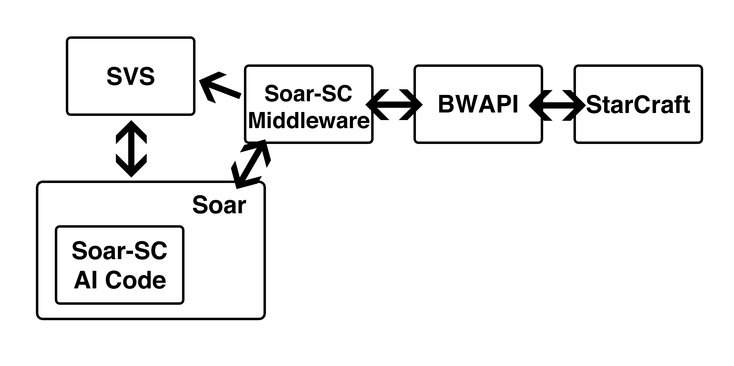
Soar-SC Overview

Slide 6
Soar-SC Design
Middleware
  Handles communication between StarCraft (BWAPI) and Soar
  Sends game information to Soar
    Unit types and counts
    Unit positions and Terrain Information to SVS
  Takes output from Soar-SC and performs actions in StarCraft
    Attack a unit
    Build a building
Agent
  Takes input from middleware and SVS
  Potentially reacts to the information
  May output an action to the middleware

Slide 7
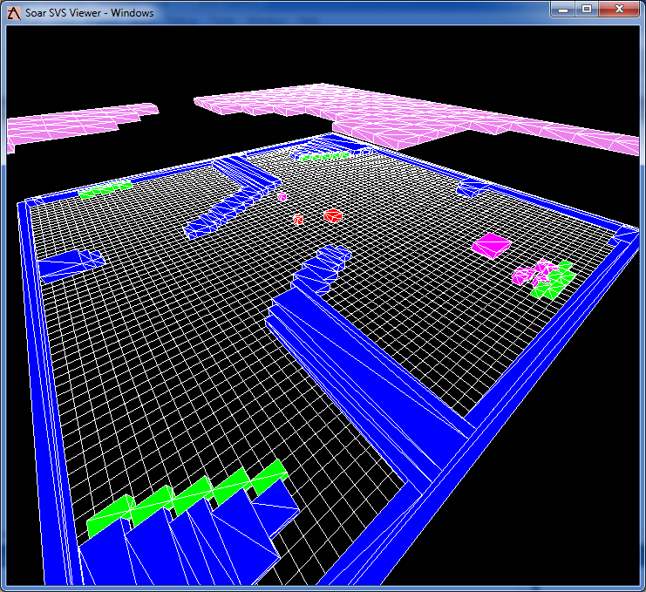
Soar-SC Design - Perception
StarCraft Environment as seen from Soar-SC
  Violet: Fog of War Tiles
  Blue: Terrain
  Green: Resources
  Magenta: Soar-SC’s units
  Red: Enemy Units

Slide 8
What can Soar-SC do?
Soar-SC can
  Parse the terrain and send it to SVS
  Gather resources
  Scout in semi-complicated ways
  Build units of arbitrary type
  Build buildings of arbitrary type at arbitrary locations
  Attack the enemy without rushing

Slide 9
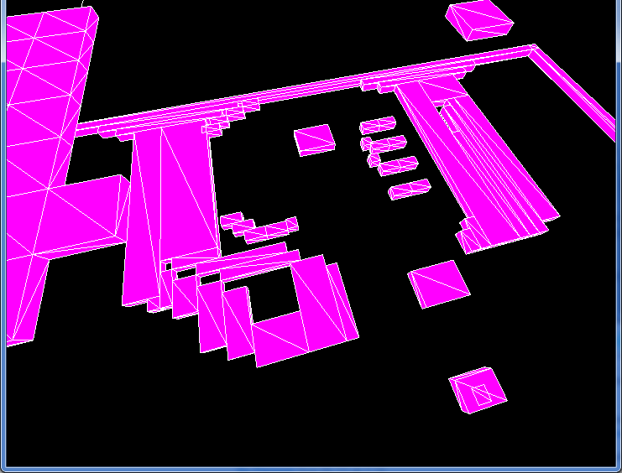
Terrain
StarCraft
  64x64 map has 256x256 “walk” tiles
    “walk” tile: Tile StarCraft uses to determine
    whether a unit can walk there
  256x256 map has 1024x1024 “walk” tiles
    Too many for SVS to handle
Algorithm
  Flood Fill
    Fills all open sections of the map with “water”
    Marks sections with no “water” as inaccessible
    Groups each filled section
    Sections with less than 5 “walk” tiles in them are marked as inaccessible
    Starting at the upper left tries to generate largest possible continuous rectangles to put into SVS.

Slide 10
Gathering Resources
Soar-SC can gather resources
  Uses SVS to do this
Method
  If Soar-SC has a worker which can gather resources and is idle
  Then it will propose an operator to gather resources with that worker
    Asks SVS to give it the closest resource to that worker
    Use the result to place the resource location on the operator
  Tell the middleware to move the worker to that resource

Slide 11
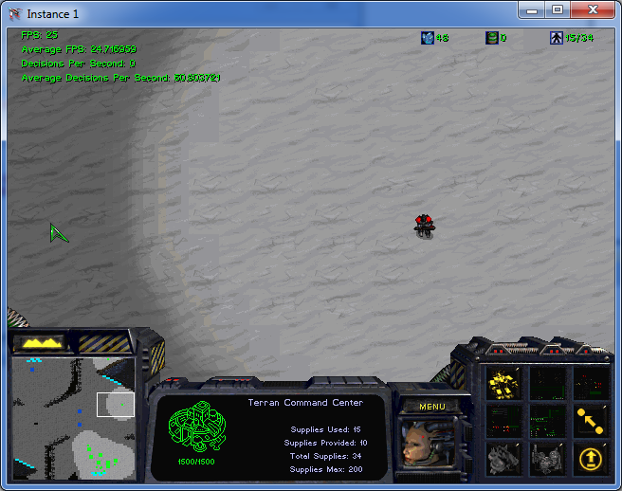
Scouting
RTS games
  Advantageous to see what your enemy is up to
  Need for scouting
Creates a scout
  Can be either a worker or a marine
    Prefers marines over workers

Slide 12
Scouting
Method – Fog of War Tiles
  If there is an idle scout and there is at least one potentially accessible fog of war tile, propose to scout a fog of war tile
    Asks SVS for which is the closest fog of war tile to the scout
    Places the tile on the scout as its location
  Tells the middleware to move the scout to the fog of war tile location

Slide 13
Scouting
Method – Key Location
  If there is an idle scout, and there are no fog of war tiles a scout can reach, and there is at least one key-location, propose to scout a key location
    Key-location: either enemy building or map corner
  Places the key-location on the scout as it’s location
  Tells the middleware to move the scout to the key-location’s location

Slide 14
Building Units
Soar-SC can build units of any type
Instead of specific rules per unit and building combination
  Uses general rules
  In order to add the building of a new type of unit, just have to add a proposal rule for that unit type
Example: Marine
  Proposes a build-unit operator with a unit type of marine and a location of a barracks
  Applies the build-unit operator
    Tells the middleware to build a unit of type marine at the barracks
    Apply rule can build any unit type at any location as long as it is capable of building that type of unit

Slide 15
Building Buildings – Virtual Objects
Soar-SC can build buildings at arbitrary locations and of arbitrary type
  Can build any type of building
  Does not use a human to predetermine locations for buildings
“Virtual Objects”
  StarCraft is the “real world” and objects Soar-SC reasons about and wants to place are “virtual” to the StarCraft world.
Similar to Building Units
  In order to build a building of a new type, all you need to do is add a proposal rule for that building
  The generic build operators will take care all of the virtual objects

Slide 16
Building Buildings – Virtual Objects
Method
  Proposes to build a building of a certain type
  No-Change Impasse
    Tells SVS to return a location for the new building
      Passes the building’s size to SVS
      Passes the building’s type to SVS
    Returns an upper-left location in (x,y)
    Puts location on the operator
    Resolves impasse
  Outputs to the middleware to build at that location

Slide 17
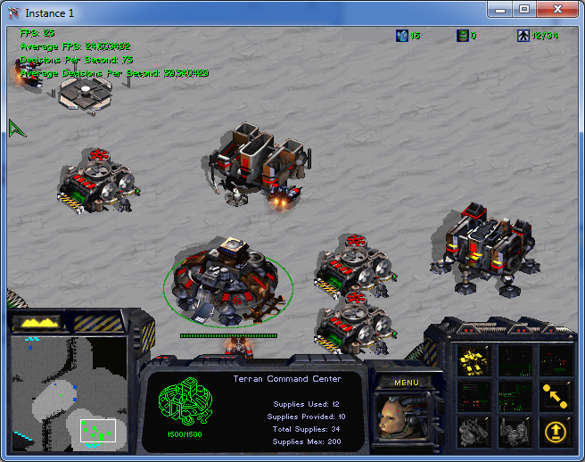
Building Buildings – Virtual Objects
Filter Algorithm
  Takes an x-size, y-size, and building type
  Gets all the buildings, resources, and terrain objects from the SVS scene graph
  Generates a grid around each building
  Eliminates all the conflicts
    Buildings
    Resources
    Path to resources from resource collectors
    Terrain
  If there is a building of the same type, eliminates all grids not within 1 build tile + the shape’s size
  From all the remaining, randomly chooses one
  Returns that grid

Slide 18
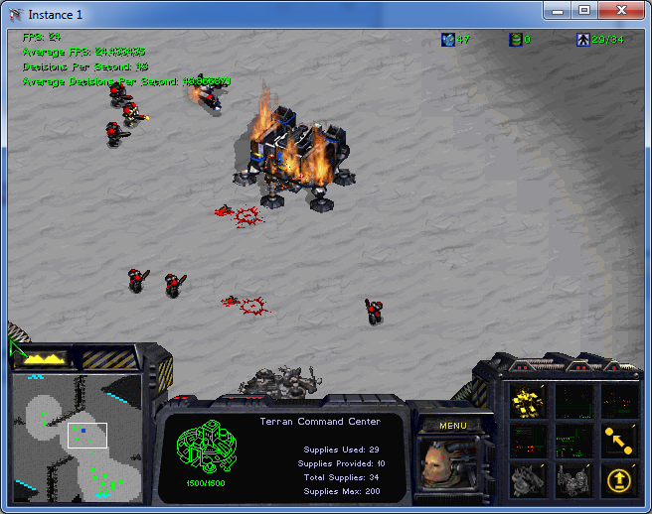
Attacking the Enemy
Soar-SC can attack an enemy
    Can Counter Attack
    Can Attack Enemy Units
    Can Attack Enemy Buildings
  Attack is generalized
    Can attack with any unit that there is a proposal rule for attacking with
    Could be more generalized to attacking with any unit which can attack

Slide 19
Attacking the Enemy
Method
  Proposes to attack a specific enemy building or unit with a specific marine
  If there is a counter attack operator, reject other types of attack
  If there is a unit attack operator, reject other types of attack
  Applies the attack
    Outputs a move command to the middleware with a specific ID to attack

Slide 20
Soar-SC
Good
  Very Flexible Platform that uses SVS
    Without SVS a lot of this would be difficult to do
    Reached some of the limits of the current version of SVS
  Middleware provides a solid base and platform
    Would allow for Agents for other races
    Would allow for Agents of many different types
  Agent can be extended
Bad
  Middleware and Agent have some speed issues
    Runs at only 60-70 decisions per second
    Occasionally drops to 20-30 decisions per second under heavy SVS load
  Middleware is not architecture independent yet
    Cannot use JSoar instead of CSoar for instance

Slide 21
Future Work
Future Work
  Better Attack Strategies
    Grouping Unit Attacks
    “Concaves”
      “Concaves” are surrounding of enemy units to attack
  Better Base Building
    More reasoning about how to plan out and build a base
  Reinforcement Learning
  Take advantage of the other memories Soar has

Slide 22
Acknowledgements
Jon Voigt
Soar Tech
Professor John Laird
Joseph Xu – SVS
Mitchel Bloch - Programming advice
University of Michigan
Department of Electrical Engineering and Computer Science

Slide 23
Questions?

