Slide 1

Role-based Cognitive Autonomy
Towards Manned-Unmanned Collaboration
Cognitive Perception and Computational Intelligence Lab
Applied Research Lab – Pennsylvania State University
Soar Workshop
Dr. John Sustersic
Office: 814-863-3015, jps263@arl.psu.edu

Slide 2
Tomorrow’s Autonomous Systems
Manned-unmanned Collaboration
  Expect same ‘rules’ as today’s manned systems.
Interact with human collaborators using (human) natural language.
  Necessary for efficiency and practicality.
  Semantics highly contextualized, often non-verbalized in normal interactions.
  Example: “Go to the store and get some milk.”
  Which store? What kind of milk? How much milk?
  What do you do if the store is out of fat-free gallons of milk you normally buy?
Latent contextual semantics and the ability to adapt semantics naturally are essential for effective autonomy

Slide 3
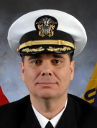
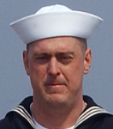
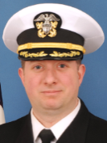
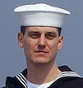
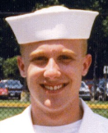
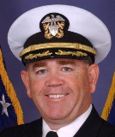
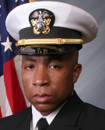
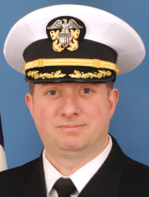
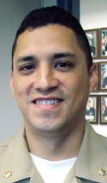
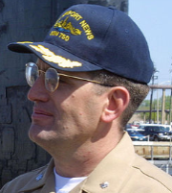
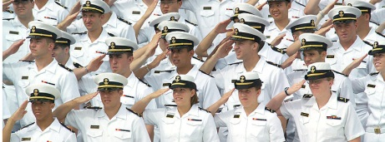
Cognitive Autonomy Metaphor
Model the Submarine Watch Standers
> Leverage 100 Years Submarine Experience
Autonomous Underwater Vehicle (AUV) Autonomy
Knowledge Base
Commanding Officer
(Mission Command)
Knowledge Elicitation
- Experience
- Training
Contact Manager
Extract
Sonar Supervisor
Watch
Standers
Weapons Officer
Encapsulate
Validate
Vehicle Control
Payloads
(sensors, weapons, other)
Payloads
(sensors, weapons, other)
Payloads
(sensors, weapons, other)
Notes:
- The holy grail is an extension of what manned crews do on manned warships
- The human watchstander model provides context for submarine operator engage SLC. (ICM – SOM – Contact Management)
- The human model provides delegated authority and inherent backup.
The human model serves as a good way to synergize SWFTSS and
This model give you “headroom” to grow – whatever you can capture as knowledge can be used
- Cognitive autonomy really is the brain function plugged into an arch compliant truck/payload nervous system much as introducing a trained and qualified crew to a manned platform.
- Evolving the brain function will take operator engagement concurrent w/truck and payload efforts
- Collaborative unmanned/manned systems – same as each other
- Currently ONR Swampworks – but no transition
- Testing and certification: Truck DOT&E – Brain (crew – ORE Operational Requirements Exam) certification

Slide 4
The Submarine Tactical Center Model
Model the AxV agents after the roles of submarine command
  Provides a well-defined and well-understood paradigm for autonomy
  Human watch stander roles directly map to artificial agents
  Decision aid systems and workstations map similarly in architecture
Leverage extensive fleet submarine operations knowledge
  Map achievement of tasks to how a crew does it – knowledge and decision making mapped directly to watch stander (crew) agents
  Submarine operations and watch stander interactions are well understood and documented … proven basis for autonomy
Abstracts well to other domains - air, land, surface vehicles
Building AxV autonomy around the metaphor of submarine operations provides a variety of benefits…

Slide 5
Role-based Autonomy
Functionality of crew of (manned) autonomous vehicles well established in all domains.
  Functionality largely independent of mission details.
  Balances cognitive loading across (human) watch standers.
Hierarchy of (human) crew member functions provide an attentional mechanism for moderating flow of information across (cognitive) levels.
  Provides a natural layering of cognitive functions.
  Enables achievement of higher cognitive levels.
    Plays to Soar’s strengths
Agent based interactions are natural language.
  Enables greater accessibility to human collaborators.
  Potential for direct training by human collaborators.
  Spoken/gesture based natural language ultimate objective.
    Beginning with text-based natural language.

Slide 6

Cognitive Autonomy Model
Commanding Officer (CO)
Autonomous Mission Commander
Mission Decisions
Safety / Stealth / Mission
Adjust constraints
Contextual Information
Charts
Weather
Environment
Mission Plans
Water Space
Navigation Plan
Contact Picture
Standing Orders
Night Orders
Knowledge
Legend
Cognition
THINKING-DECIDING
Vehicle Systems
Watch Stander
Agents
Computation
AUTOMATING
Officer of the Deck (OOD)
Ship operations
Commanders intent
Autonomy Services
Knowledge
Interaction
COMMUNICATING
Agent Model
“ENGINEERING” : Watch Agents
Materiel Failures
Navigation Solution
Power
Propulsion
Prognostics - Maintenance
Navigator (NAV)
Navigation Plan
Monitoring
Contact
Management
Communications Services
External Messages
Collaboration
Infil / Exfil
“ENGINEERING” : Watch Agents
Materiel Failures
Navigation Solution
Power
Propulsion
Prognostics - Maintenance
Engineering (ENG)
Materiel Failures
Navigation Solution
Power
Propulsion
Prognostics - Maintenance
Knowledge
Knowledge
Vehicle
Systems
Payloads
Contact Manager
Payloads
Vehicle Services
Payloads
Pilot
Planes
Ballast
Speed
Sonar Supervisor
Interfaces
Weapons
Officer
Weapons
Payloads
Payload Services
Knowledge
Knowledge

Slide 7
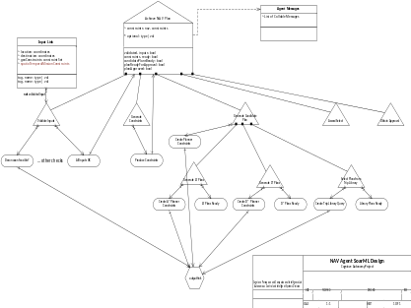
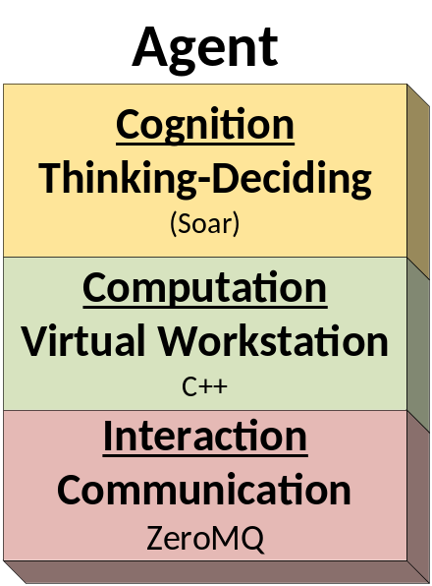
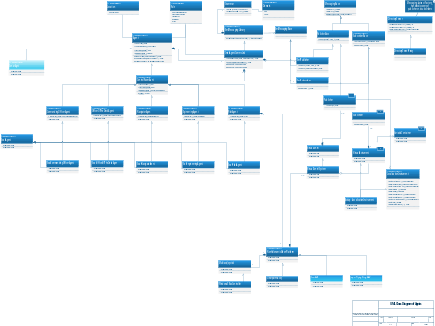

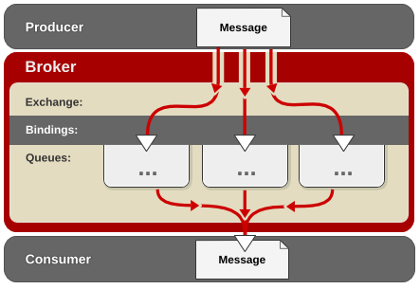
Agent Architecture
SoarML: Aspect-Oriented, goal driven behavioral modeling.
(modularity allows this layer to be ACT-R/other)
Isolating API
Example: Future ACT-R integration
UML Design
C++ 11
Leverages open source libraries e.g. Boost, Eigen, OpenCV, Xerces, etc.
(role based computation, attentional mechanisms, interface to cognitive engine and communication, etc.)
Isolating API
Example: Performed ROS to ZeroMQ Transition
Advanced Messaging Paradigms
Pub-Sub, push-pull, etc.
(platform and language agnostic network transport, well positioned for information assurance layer)
Software Assurance Best Practices - Designed for Verification and Validation from day 1

Slide 8
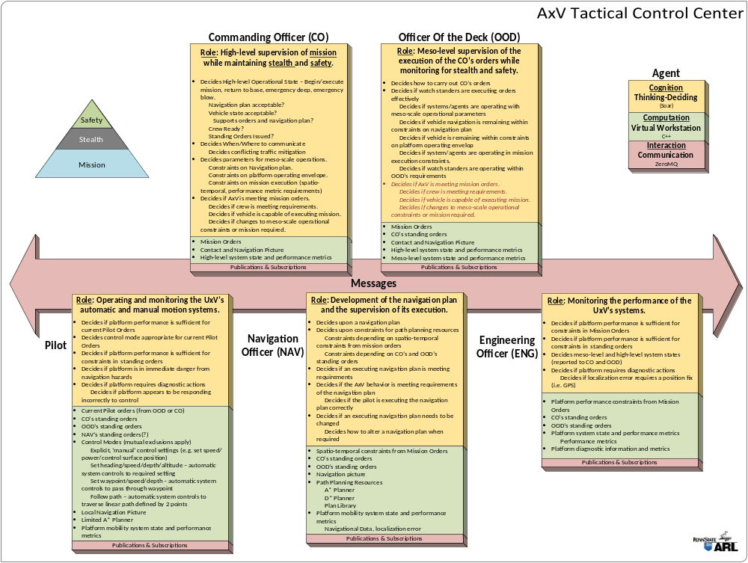

Slide 9
Project Objectives
Develop role-based autonomy capability and demonstrate feasibility on ground, air and undersea vehicles.
  Key Enablers:
    Robust localization and error estimations for sparse GPS environments.
    Web 2.0 User Interfaces for system supervision
      Web application for high-level User Interface, QT User Interface demonstrated on Windows, Linux and Android
    Platform Support
      ‘Device Drivers’ for platforms and sensors.
  Key Features:
    Natural Language inter-agent messaging
      Provides transparency and supports understanding by non-expert users and collaborators.
      Enables humans to be part of the watch team.
    Semantic mission orders and constraints (water/air/space assignments)
      Enables safety and mission caging required for autonomy.
Engender trust to all learning for robust perception and continual performance improvement with experience.

Slide 10
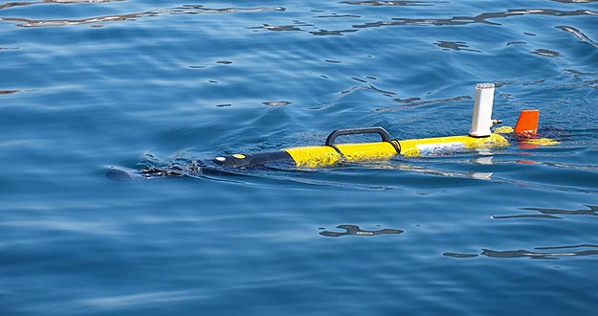
High-Level Concept of Operations
Mission Orders and Water/air/space assignments dispatched as for manned systems
AxV reports as ordered, requests instructions as needed given operational constraints
Key Objective: AxVs operate by same rules as manned systems.
Establish trust in autonomous systems in manned-unmanned teams
Enable natural language interaction and supervision of autonomous systems, teaming with non-expert human collaborators.

Slide 11
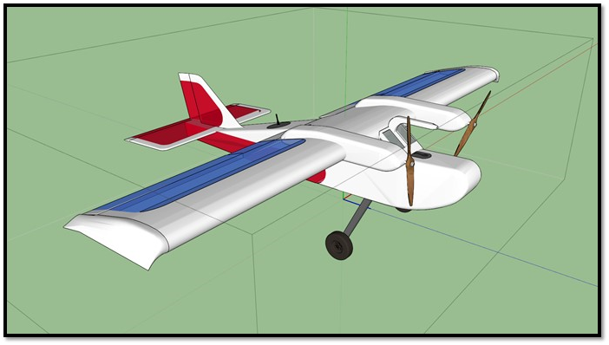
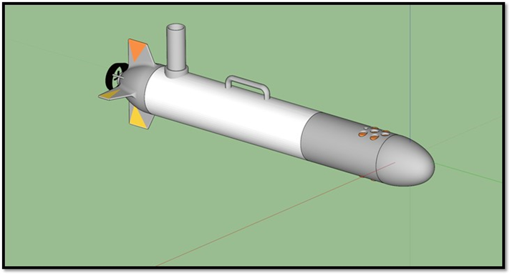
Current Status and Next Steps
Soar-based OOD and Pilot agents are collaborating to achieve safe traversal of bounded area using a Clearpath Robotics Husky AGV.
  Executes a pre-computed Navigation plan.
  Pilot avoids local simulated obstacles (e.g. potholes).
  OOD executes Navigation plan, ordering Pilot actions and ensuring the vehicle remains in authorized operating area.
  Localization indoor and outdoor using low cost COTS sensors.
    Error without GPS less than 0.5% of distance travelled.
Next Steps
Navigator manage localization error to support reasoning and decision-making regarding actions.
NAV Agent constructs Navigation plan from CO orders and constraints.
Begin to incorporate CO to team.
Demonstrate functionality on small AAV
  Gives real-world 3D environmental complexity as for AUV, but observable.
AUV system planned for FY16

Slide 12
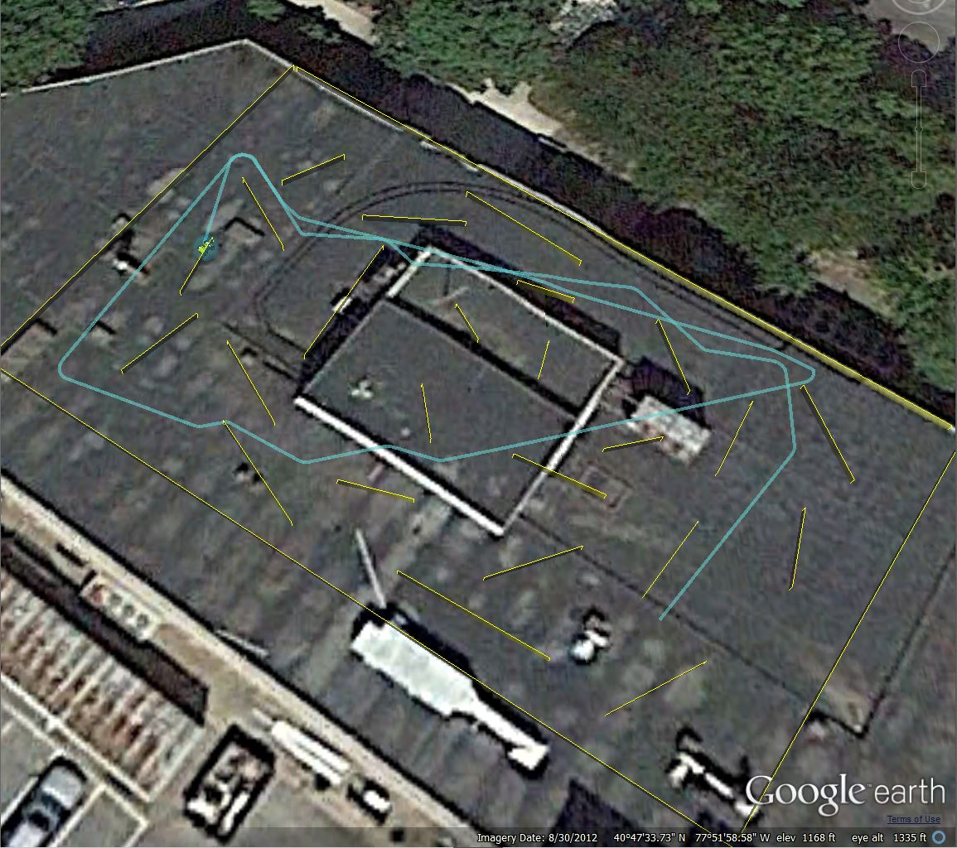

Slide 13
Questions?
Thank you!

