Slide 1

Natural Language Understanding for Rosie
John E. Laird
University of Michigan
June, 2015
Notes:
Define Autonomy

Slide 2
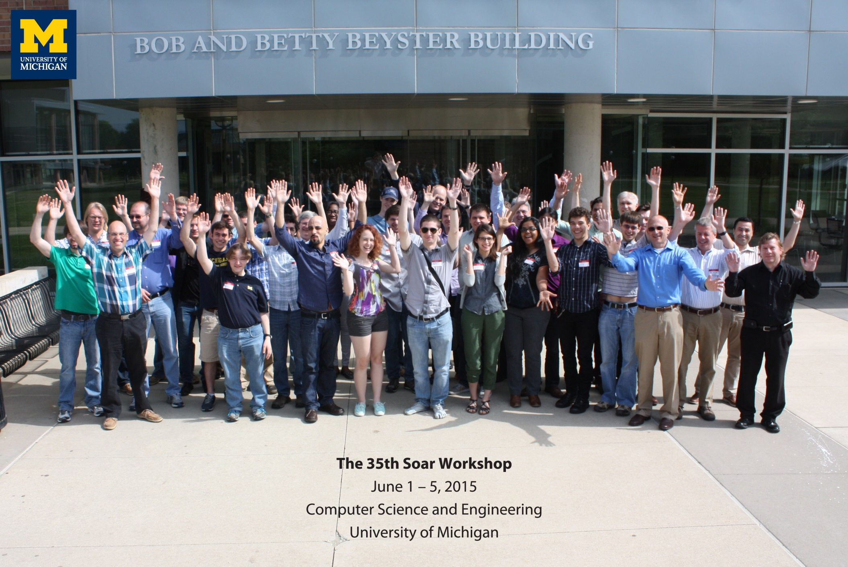

Slide 4
Interactive Task Learning
An agent that
learns new task specifications
    objects, features, relations, goals and subgoals, possible actions (physical and conceptual), situational constraints on behavior, policy for behavior, and when task is appropriate;
    using natural interaction: language, gestures, demonstrations;
    comprehends task description and uses its cognitive and physical capabilities to perform task;
    learns fast (small numbers of experiences);
    learns native representation (assimilate, fast execution).
Not
  Programmed to handle new tasks, conditions, situations
  Limited to a specific set or type of tasks
  Reliant on offline batch processing
  Using pseudocode-like language specifications
Notes:
A uniquely human ability.

Slide 5
Application Areas of ITL
Games and Puzzles (for research)
Collaborative Robots:
  Personal, commercial, military, …
Personal Assistants
  Siri, Cortana, Google Now
Constructive Agents and Virtual Humans
Cognitive Science Research

Slide 6

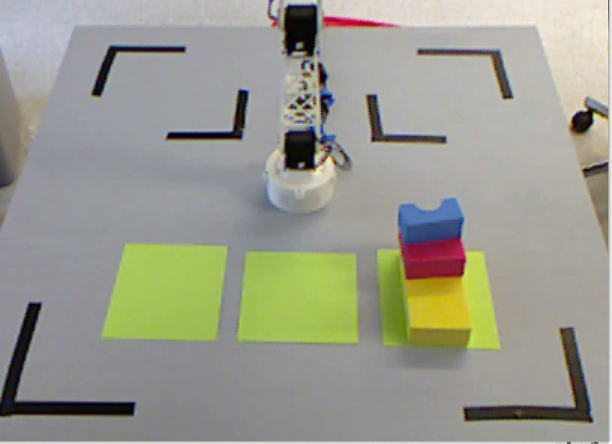
Rosie an ITL Agent
James Kirk, Shiwali Mohan, Aaron Mininger
Tabletop robot
  Robotic arm for manipulation
  Kinect sensor for vision
  Speech (Google) and recognition (CMU sphinx)
Learns through situated interactive instruction using limited natural language
Learns concepts about
  Spatial prepositions (on, right of, near)
  Object attributes (red, rectangle)
  Actions (move, store)
  Games (tic-tac-toe, tower of hanoi)

Slide 7
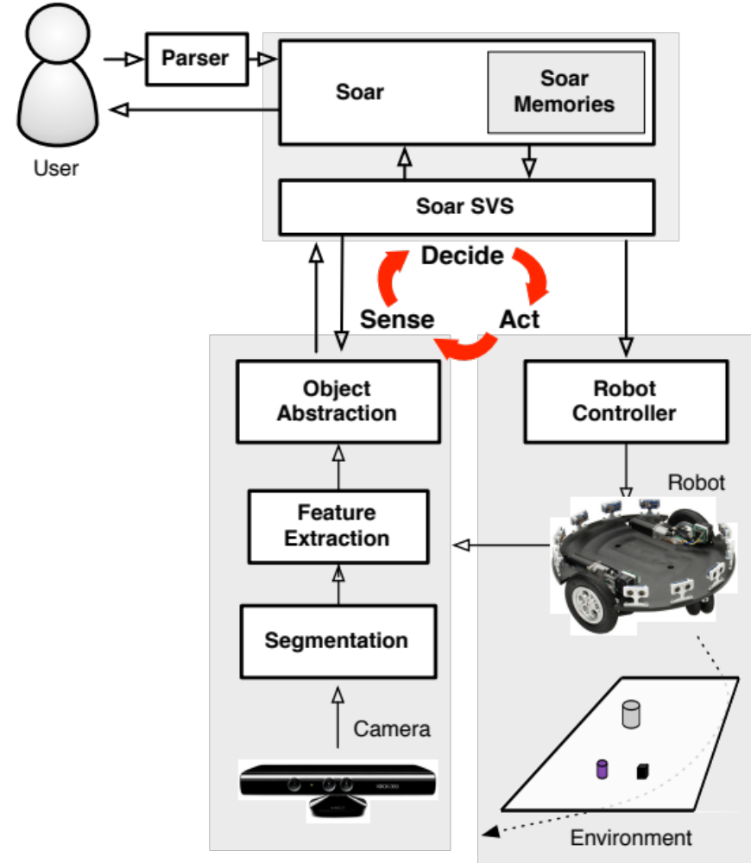
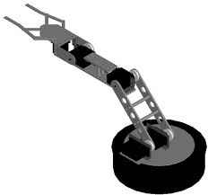
Notes:
Having text and diagram both is cluttered and hard to read
Delete text labels on the edges because we’re going to talk to it
This is an overview, not a detailed excursion
Sensing, thinking, acting
Three boxes – easier to comprehend
Giant cycle arrow in the back to show cycle
Draft architecture
How does top-down from language interact with bottom-up from sensing – research issue
Object abstraction as replacement for inference – everyone agrees!
Not nouns and adjectives – abstract object data

Slide 8
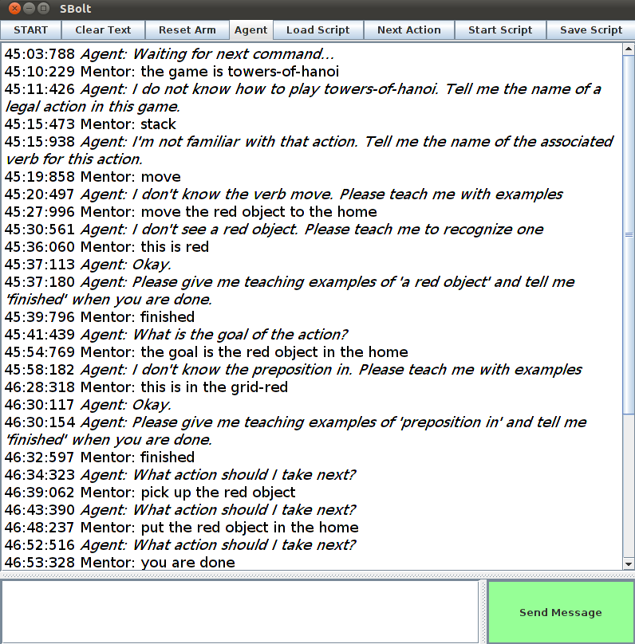
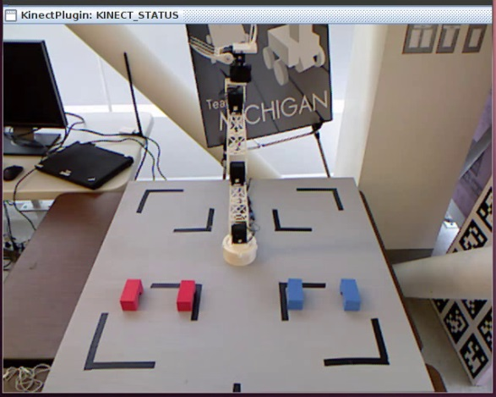
Big Picture
Acquire task description via language
Construct internal task representation
Game
Extract internal representation of objects in the world
A1
Tic-Tac-Toe
P1
place
move
C1
Reason over objects, relationships to determine available actions
block
location
C11
C12
Search for solution by internally simulating actions
Manipulate environment based on discovered solution
Notes:
Goal is not to solve natural language processing, vision,
Claim sufficient progress in each of these systems to design end to end system

Slide 9
Language Processing Goals
Flexible, extendable parser for interactive task learning
Use word by word, incremental repair-based parsing
  Inspired by NL-Soar, XNL-Soar
  Extend to constructions, word retrieval ambiguity resolution, and real-world referent grounding
  Incorporates syntax, semantics, and pragmatic processing
Use Construction Grammar
  Theory of complex language usage and connections between form (syntax) and meaning (semantics and pragmatics).
  Syntax and semantics are associated with words, phrases, constructions

Slide 10
Parsing Knowledge in Soar
Symbolic Long-Term Memories
Procedural
Parsing Knowledge
Language independent
Semantic
Words, Constructions
Syntax and Semantics
Episodic
Reinforcement
Learning
Chunking
Semantic
Learning
Episodic
Learning
Symbolic Working Memory
Decision Procedure
Spatial Visual System
Object-based continuous metric space
Perception
Action

Slide 11
Example Sentences
Red is a color.
The large one is red.
This is a big triangle.
Store the green block.
What is inside the pantry?
It is on the big green block.
Move the green block to the left of the large green block to the pantry.
Stack the red triangle, the medium block, and the large block.
Move forward until you see a doorway.

Slide 12
Basic Processing Idea
“The green block …”
For each word
Find related structure from semantic memory and retrieve into working memory
    Syntactic and semantic information about word
    Possibly expectations (assigners) for other words/structures
    Every word and structure has an S-type
      Same as word sense for words
Merge assigners with retrieved structures
    Builds up parse tree connecting structures.
  Detect end of phrases
  Build up associated semantics
THE
Spelling: the
S-type: D
Converts-to DP: …
S-type: ADJ
S-type: N
Spelling: green
S-type: ADJ
Spelling: block
S-type: N

Slide 13
How to Represent
Complex Syntactic Structures?
Standard approach is to associate syntax structure and semantics with individual words (lexical items).
  Most “structure” is in the verb.
Difficult to have contextualized structure (idioms) and associate semantics.
Constructions provide more complex structures for organizing semantics and syntax.

Slide 14
ADJ
NP
IS-V
ADV
NP
PP
U

Slide 15
Different “is” Constructions
DP-is-ADJ/DP/PP/U
  “The blue sphere is in the pantry.”
ADJ-is-DP:
  “Green is a color.”
N-is-DP:
  “Sphere is a shape.”
This-is-DP/ADJ/PP:
  “This is in the pantry.”
What-is-PP-?:
  “What is in the pantry?”
Where-is-DP-?:
  “Where is the red block?”

Slide 16
IS Construction
DP-is-ADV-ADJ/DP/PP/U
“The blue sphere is not in the pantry.”
(<x> ^structure-type CP
^current-word IS-V
^prior-word DP
^message-type object-description
^assigners <DP> <IS> <ADV> <ADJ> <DP> <PP> <U>)
(<DP> ^structure-type DP
^syntactic-structure head
^semantic-structure object
^required true)
(<IS-V> ^structure-type IS-V
^semantic-structure assignment
^required true
^referent.id soar-assignment)
(<ADV> ^structure-type ADV ...
^optional true)
(<ADJ> ^structure-type ADJ
^exclusive <DP> <PP> <U> ...)

Slide 17
Different “is” Constructions
DP-is-ADJ/DP/PP/U
  “The blue sphere is in the pantry.”
ADJ-is-DP:
  “Green is a color.”
N-is-DP:
  “Sphere is a shape.”
This-is-DP/ADJ/PP:
  “This is in the pantry.”
What-is-PP-?:
  “What is in the pantry?”
Where-is-DP-?:
  “Where is the red block?”

Slide 18
Achievements
Process sentences necessary for Rosie.
Chunking.
Connected to Rosie and extend for Mobile Rosie.
  Systematize semantics
Other stuff I don’t remember.

Slide 20
Biggest Problem with Language?
Ambiguity
  Word meaning?
  Phrase attachment?
  Anaphoric reference
  …
With Construction Grammars:
  Which construction is the best given the sentence processed so far?
  Assume constructions are data structures in semantic memory!

Slide 21
Semantic Memory
Kick the bucket
Kick the can
V NP
Kick up your heels
Jog <person>’s memory
S V O1 O2
The <Xer> the <Yer>
Notes:
The bigger the are, the harder they fall. The more you think about it, the less you understand

Slide 22
Semantic Memory
Death
bucket list
Kick <NP> off
Kick the bucket
drop in the bucket
previous-2-word
previous-word
current-word
kick
the
bucket
drop in the ocean
Kick off
kick
verb
bucket
noun
V NP
the
determiner
Working Memory
bucket
Notes:
The bigger the are, the harder they fall. The more you think about it, the less you understand

Slide 23
Semantic Memory
Death
bucket list
Kick <NP> off
Kick the bucket
drop in the bucket
previous-2-word
previous-word
current-word
kick
the
bucket
drop in the ocean
Kick off
kick
verb
bucket
noun
V NP
the
determiner
Working Memory
bucket
Notes:
The bigger the are, the harder they fall. The more you think about it, the less you understand

Slide 24
Need context to pick a construction.
Single word:
  Many constructions share the same words.
Two words:
  Still not enough: “Kick the …” or “the can/bucket.”
  “give the Devil his due”
  Not just words: Jog <someone>’s memory.
  Subject V O₁ O₂ -> Ditransitive Verb structure

Slide 25
Hypothesis
Need prior context as soft constraints when attempting retrieval on current word.
Use spreading activation to provide context to bias retrieval.

Slide 26
Semantic Memory
Death
bucket list
Kick <NP> off
Kick the bucket
drop in the bucket
previous-2-word
previous-word
current-word
kick
the
bucket
drop in the ocean
Kick off
kick
verb
bucket
noun
V NP
the
determiner
Working Memory
bucket
Notes:
The bigger the are, the harder they fall. The more you think about it, the less you understand

Slide 27
Semantic Memory
Death
bucket list
Kick <NP> off
Kick the bucket
drop in the bucket
previous-2-word
previous-word
current-word
kick
the
bucket
drop in the ocean
Kick off
kick
verb
bucket
noun
V NP
the
determiner
Working Memory
kick
Notes:
The bigger the are, the harder they fall. The more you think about it, the less you understand

Slide 28
Semantic Memory
Death
bucket list
Kick <NP> off
Kick the bucket
drop in the bucket
previous-2-word
previous-word
current-word
kick
the
bucket
drop in the ocean
Kick off
kick
verb
bucket
noun
V NP
the
determiner
Working Memory
kick
the
Notes:
The bigger the are, the harder they fall. The more you think about it, the less you understand

Slide 29
Semantic Memory
Death
bucket list
Kick <NP> off
Kick the bucket
drop in the bucket
previous-2-word
previous-word
current-word
kick
the
bucket
drop in the ocean
Kick off
kick
verb
bucket
noun
V NP
the
determiner
Working Memory
kick
the
bucket
Notes:
The bigger the are, the harder they fall. The more you think about it, the less you understand

Slide 30
More Complex Constructions?
Most constructions are not just strings of words.
Spread should move through sub-constructions.
  Kick <person> off <np>. (Kick Joe off the island.)

Slide 31
Nuggets & Coal
Nuggets
  Integrated with Rosie
  Chunking
  Ideas for selecting constructions!!
    Constituents of constructions funnel activation.
Coal
  Need more complex constructions
  Need implementation of spreading for construction selection
    Sure to be lots of devils in the details

