Slide 1
Soar Technology Company Update

Slide 2
Enhancing human performance
Intelligent
Training
Unmanned
Platforms
Decision Support

Slide 3
Technology Innovation
Autonomy
Adaptation
Human/System
Interface

Slide 4
Enhancing × Technology Innovation
Intelligent
Training
Unmanned
Platforms
Decision Support
Autonomy
Adaptation
Human/System
Interface

Slide 5
Enhancing × Technology Innovation × Domains
Intelligent
Training
Unmanned
Platforms
Decision Support
Aviation
Autonomy
Adaptation
Human/System
Interface

Slide 6
Enhancing × Technology Innovation × Domains
Intelligent
Training
Unmanned
Platforms
Decision Support
Aviation
Infantry
Autonomy
Adaptation
Human/System
Interface

Slide 7
Enhancing × Technology Innovation × Domains
Intelligent
Training
Unmanned
Platforms
Decision Support
Aviation
Infantry
Autonomy
Navy
Social, Cultural
Commercial Auto
Medical
Adaptation
Human/System
Interface

Slide 8
Enhancing × Technology Innovation × Domains
Intelligent
Training
Unmanned
Platforms
Decision Support
Aviation
Infantry
Autonomy
Navy
Social, Cultural
Commercial Auto
Medical
Cyber Security
Adaptation
Human/System
Interface

Slide 9
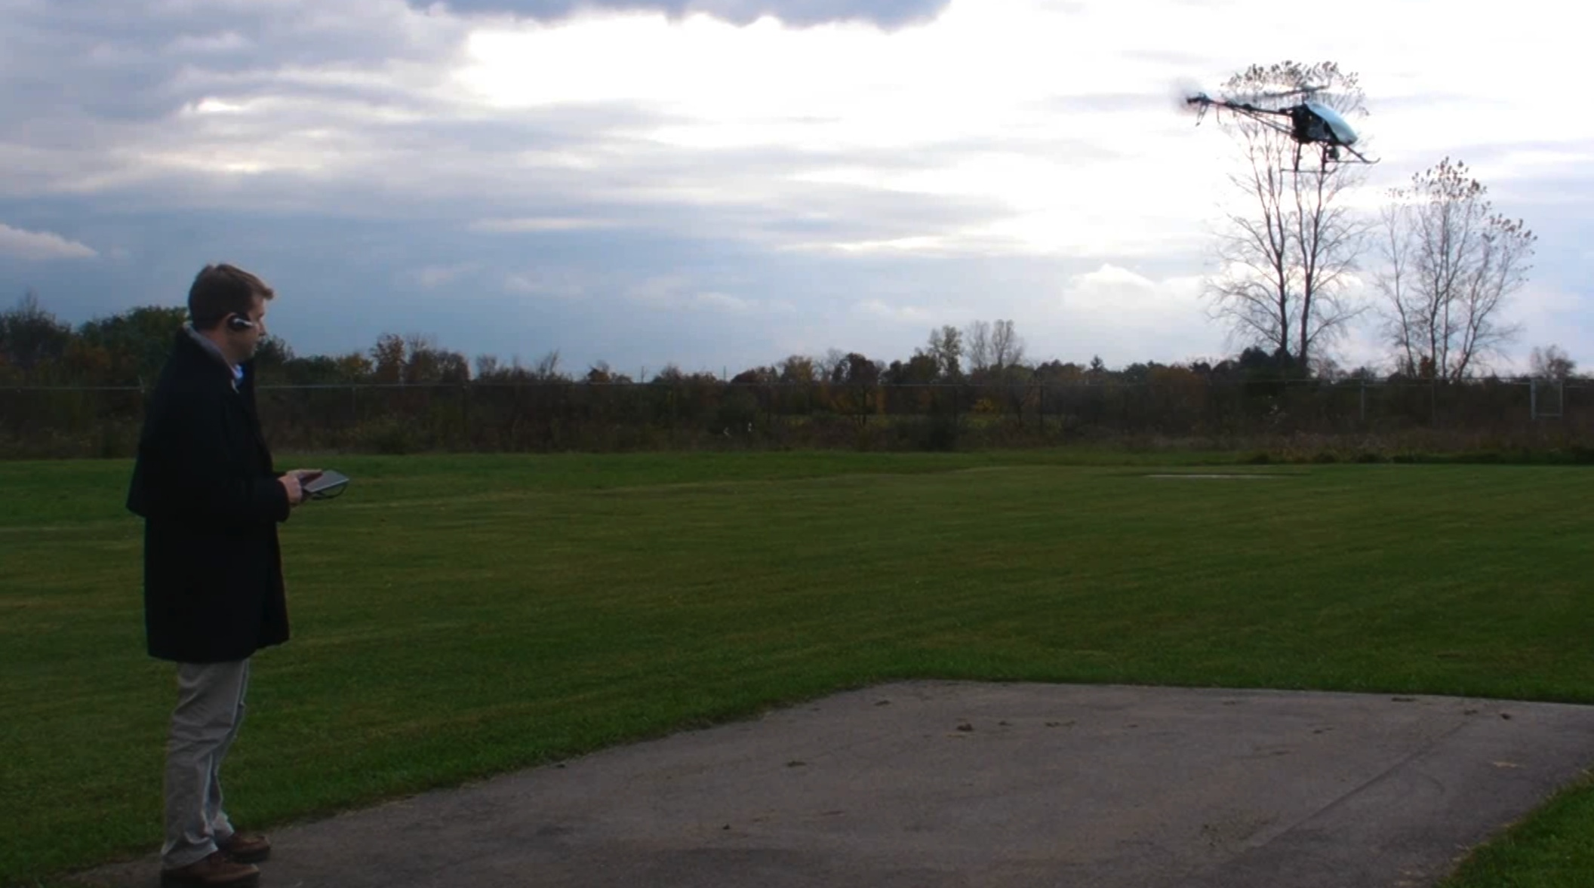
SID and STX-1 video

Slide 10
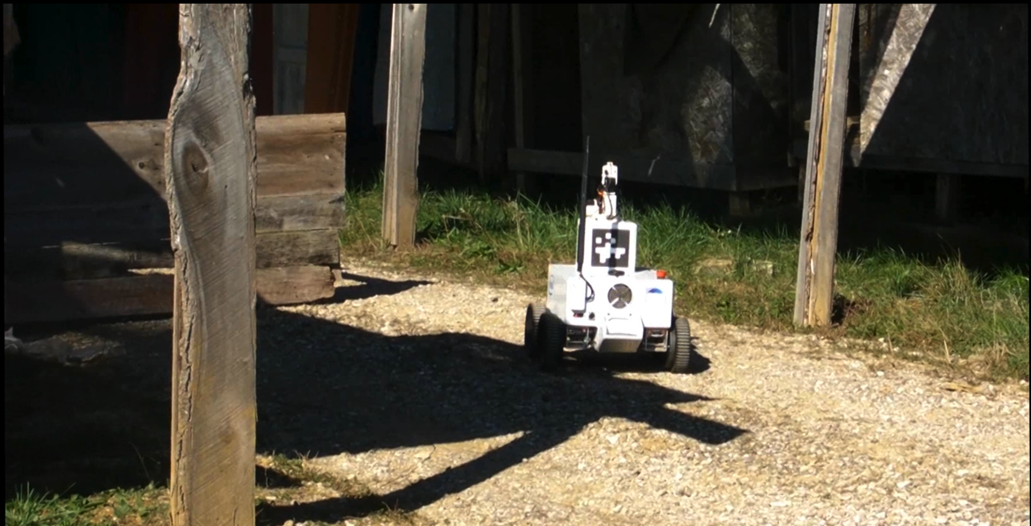
SID IROC video

Slide 11
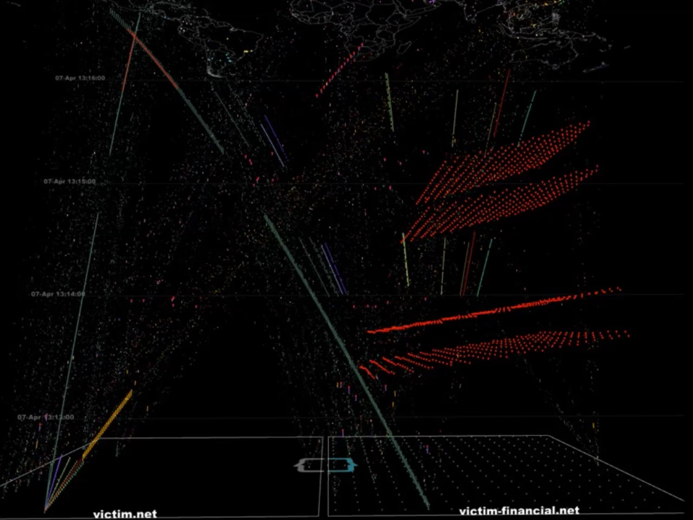
SC2RAM video

Slide 12
Contributions to the Soar community
jSoar
  jSoar 0.14.3 released this morning
  See Bob Marinier’s talk this morning
SoarIDE
  Re-engaging in supporting and extending the SoarIDE
  See Bob Marinier’s talk this morning
Soar Programmer’s Guide
  Captures lessons learned in developing Soar agents
  See Bob Marinier’s talk this morning

Slide 13
Nuggets and Coal
Nuggets
  Gaining momentum in applying Soar (and other AI technologies) to cybersecurity
  Back on a growth trajectory after weathering the storm of sequestration
  At least 7 consecutive years of profitability
  Exploring commercialization of Soar-based technologies
  Exciting new office location in Orlando
Nugget and Coal
  Emergence of competimates proposing Soar-based solutions to the DoD
Coal
  Significant competition in hiring AI researchers
  Significant competition in retaining senior software engineers

