Slide 1



Interactive Task Learning:
Language Processing for Rosie
John E. Laird and Peter Lindes
University of Michigan
Notes:
Go through all components of Soar – including Aaron’s visual stuff, and new semantic memory.
Theme of scaling and efficiency and functional capabilities.

Slide 2
Interactive Task Learning
Shiwali Mohan, James Kirk, Aaron Mininger
An agent that
learns new task specifications
    objects, features, relations, goals and subgoals, possible actions (physical and conceptual), situational constraints on behavior, policy for behavior, and when task is appropriate;
    using natural interaction:
      language, gestures, sketches, demonstrations;
    comprehends task description and uses its cognitive and physical capabilities to perform task;
    learns fast (small numbers of experiences);
    learns native representation (assimilate, fast execution).
Notes:
A uniquely human ability.

Slide 3
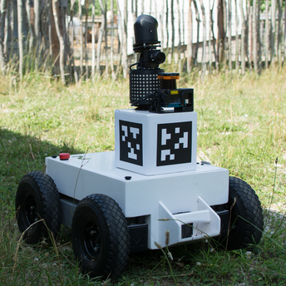
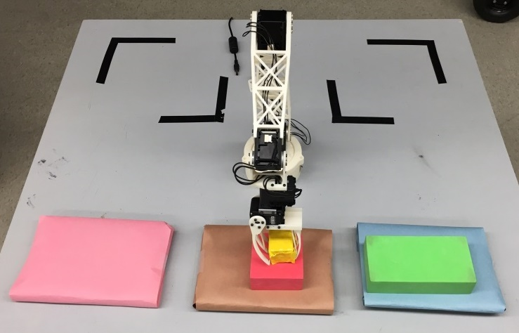
Current Research in Interactive Task Learning in Soar: Rosie
Learns novel tasks using language
(and goal demonstration)
Games and Puzzles: James Kirk
Mobile Robot tasks: Aaron Mininger

Slide 4
Processing for Task Learning
Perceive Environment
Parse Language in Context
Construct Task Representation
Interpret Task Representation
Search for Solution
Act in the World

Slide 5
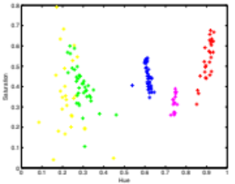

Extract internal representation of objects in the world
Perception, Semantic Memory → Working Memory
Sensor
Use learned classifiers
y1
Visual
Memory
r1
g2
p1
br2
b1
Extract relevant properties and relations
Extract learned mappings to words from semantic memory
(w1 ^object (y1 ^type block ^color yellow ^size small)
(r1 ^type block ^color red ^size medium)
...
^relation (x1 ^type on1 ^arg1 y1 ^arg2 r1)
...
^property (p1 ^name clear ^object y1))
Working
Memory
Notes:
Goal is not to solve natural language processing, vision,
Claim sufficient progress in each of these systems to design end to end system

Slide 6
Parsing Language
Perception, Working, Procedural, Semantic → Working Memory
The name of the game is tower-of-hanoi.
Ok, please teach me the actions and goals of the game.
You can move a clear block onto a clear object that is larger than the block.
I don’t know the concept clear.
If an object is not below an object, then it is clear.
Ok, I now understand the concept clear.
The goal is that a large block is on the right location and a medium block is on the large block and a small block is on the medium block.
Deliberate reasoning (Procedural Memory)
(a1 ^action move22
^modifier can
^arg1(^type block ^prop clear)
^arg2(^type object ^prop clear ^rel(larger x1))
Semantic
structure
Working
Memory
Our goal is sufficient, efficient language processing.
Notes:
Goal is not to solve natural language processing, vision,
Claim sufficient progress in each of these systems to design end to end system

Slide 7
Construct Task Representation
Working, Procedural → Working, Semantic (& Procedural)
Goal
Name
(n1 ^message object-description
^arg1(^id of ^arg1(^id name ^arg1 game))
^predicate tower-of-hanoi)
+
(g1 ^message object-description
^arg1 (^id goal)
^subclause …)
Working
Memory
Goal
Description
Deliberate reasoning (Procedural Memory)
+
Action
Description
(a1 ^action move22
^modifier can
^arg1(^type block ^prop clear)
^arg2(^type object ^prop clear ^rel(larger x1))
(w1 ^game (g1 ^name tower-of-hanoi
^struct (a1 ^goal (g1 ...)
^operator (c1 ^name stack
^arg (C11 ...)
(C12 ...))
Working Memory &
Semantic Memory
Learning (chunking) converts deliberate processing to reactive processing
Notes:
Goal is not to solve natural language processing, vision,
Claim sufficient progress in each of these systems to design end to end system

Slide 8
Interpret and Operationalize Task Representation
Working, Procedural → Working, Procedural
(w1 ^game(g1 ^name tower-of-hanoi
^struct(a1 ^goal (g1 ...)
^operator(c1 ^name stack
^arg(C11 ...)
(C12 ...))
Task
Representation
Working
Memory
+
Environment
Representation
(w1 ^object (o1 ^type block ^color yellow ^size small)
(o2 ^type block ^color red ^size medium)
...
^relation (r1 ^type on ^arg1 o1 ^arg2 o2)
...
^property (p1 ^name clear ^object o1))
Deliberate reasoning
(Procedural Memory)
(o1 ^name stack
^arg1 block1
^arg2 block3)
Chunking converts deliberate processing to reactive processing (20x speedup)
Environment
Notes:
Goal is not to solve natural language processing, vision,
Claim sufficient progress in each of these systems to design end to end system

Slide 9
Search for a Solution
Working, Procedural → Working, Procedural
Deliberate reasoning
(Procedural Memory with Working Memory)
Chunking coverts the search results to rules that implement a policy to select actions directly
If search fails, asks for instruction.
Search is hierarchical, so can succeed at the abstract level, but fail for primitive execution and ask for help.
Notes:
Goal is not to solve natural language processing, vision,
Claim sufficient progress in each of these systems to design end to end system

Slide 10
Procedural Memory
Semantic Memory
Primitive Actions
Constructions
Word – Category
Mappings
Task Learning
Innate Words
Task Structure
(Goals & Operators)
Prep Learning
Innate Mappings
Verb – Operator Mappings
Noun Learning
Verb Learning
Fixed Locations
Noun/Adjective – Perceptual Symbol Mappings
Memory Structures
Primitive Verb – Operator Mappings
Preposition – Spatial Relation Mappings
Interaction
Parsing
Episodic Memory
Action Knowledge
Agent’s Experiences
Mapping Knowledge
Working Memory
Action
Perception
Spatial Visual System
Spatial Primitives
Notes:
Denotation

Slide 11
Language Processing Goals
Flexible, extendable parser for interactive task learning
  Inspired by human-level processing
Grounds understanding in environment (when possible)
Use word by word, incremental repair-based parsing
  Inspired by NL-Soar
  Extend to constructions, word retrieval ambiguity resolution, and real-world referent grounding
  Incorporates syntax, semantics, and pragmatic processing
Use Embodied Construction Grammar (ECG)
  Theory of complex language usage and connections between form (syntax) and meaning (semantics and pragmatics).
  Syntax and semantics are associated with words, phrases, constructions

Slide 12
Two Approaches
Laird: All language specific knowledge starts in semantic memory (syntax, semantics)
  Pro: have (vague) story as to where this information could be learned by experience.
  Pro: in production – used by Rosie for all language processing
  Con: not linguistically sound (cognitive linguistics)
Lindes: All language specific knowledge starts in procedural memory (syntax, semantics)
  Pro: linguistically sound (cognitive linguistics)
  Pro: compiler from embodied construction grammar formalism into Soar rules: English and Spanish!
  Con: not a good story of how it can be learned
  Con: not yet in production

Slide 13
Parser Properties
Referring expressions grounded in environment.
Uses context for referent resolution for objects.
Move the red block behind the blue block to the right of the green block.
Creates internal hypothetical objects and supports anaphoric references.
If a location is next to a clear location but it is not diagonal with the clear location then it is adjacent to the clear location.
Adjacent

Slide 14
Example Sentences Last Year
Red is a color.
The large one is red.
This is a big triangle.
Store the green block.
What is inside the pantry?
It is on the big green block.
Move the green block to the left of the large green block to the pantry.
Stack the red triangle, the medium block, and the large block.
Move forward until you see a doorway.

Slide 15
Example Sentences this Year
If a card is on the deck and it is not below another card then it is the top card.
Put it on this.
The goal is that all the missionaries and cannibals are on the right side of the river.
You can move a person that is on the current bank and another person that is on the current bank and the boat onto the opposite bank.
If the locations between a clear location and a captured location are occupied then you can place a piece on the clear location.
The goal is that all locations are covered and the number of captured locations is more than the number of occupied locations.

Slide 16
Sentence processing in LUCIA
Translator
Infra-structure Rules
ECG Grammar Files
Grammar Rules
Action Messages
Comprehender
Rosie Operations
Pick up the green sphere on the stove.
Input Words
World Model
Soar Agent
Ontology

Slide 17
The comprehension engine
Comprehender
Words
Action messages
comprehend-word
lexical-access
match-construction
ECG-generated grammar rules
ground-x
lookup-x
Hand-coded infrastructure rules
attach-x
resolve-pronoun
comprehend-word-done

Slide 18


Pick up the green sphere.
1 Pick
2 up
3 the
4 green
5 sphere.
Comprehender
ActOnIt
action: @A1001
object: large-green-sphere1

Slide 19
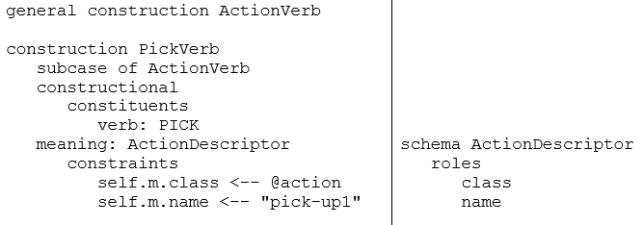
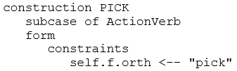
Stage 1: Pick
comprehend-word
lexical-access
match-construction
lookup-action
Action
Descriptor
@action
pick-up1
@A1001
PickVerb
PICK
Pick

Slide 20
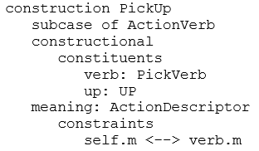
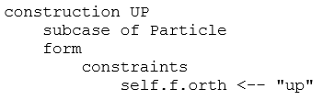
Stage 2: up
comprehend-word
lexical-access
match-construction
Compositional
Action
Descriptor
PickUp
@action
pick-up1
@A1001
PickVerb
PICK
UP
Pick
up

Slide 21
Stage 3: the
comprehend-word
lexical-access
Action
Descriptor
PickUp
@action
pick-up1
@A1001
PickVerb
PICK
UP
THE
Pick
up
the

Slide 22
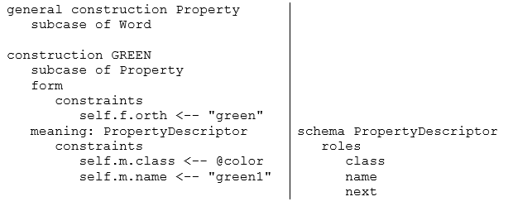
Stage 4: green
comprehend-word
lexical-access
lookup-property
Action
Descriptor
Property
Descriptor
PickUp
@action
pick-up1
@A1001
@color
green1
@P1004
PickVerb
Grounded
PICK
UP
THE
GREEN
Pick
up
the
green

Slide 23
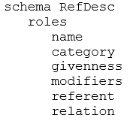
Stage 5: sphere.
comprehend-word
lexical-access
match-construction
ground-reference
ActOnIt
match-construction
large-green-sphere1
Reference
Descriptor
object
Transitive Command
Action
Descriptor
block
green1
large1
sphere1
Property
Descriptor
PickUp
RefExpr
@action
pick-up1
@A1001
@color
green1
@P1004
Entity
PickVerb
block
sphere1
PICK
UP
THE
GREEN
SPHERE
Pick
up
the
green
sphere.

Slide 24
Future Work
Continue to extend to cover syntax, …
“New” parser:
  Language knowledge in semantic memory (Laird)
  Linguistically sound – better ontology, … (Lindes)
  Compile from ECG (Lindes)
  Take advantage of spreading activation to aid retrieval in ambiguous words and constructions (S. Jones)

