Slide 1
Soar-ing Network Reticulation: early conceptualization
Alex Yahja, Marshall Scott Poole, & Steven Corman
National Center for Supercomputing Applications, U of Illinois at Urbana-Champaign, & U of Arizona

Slide 2
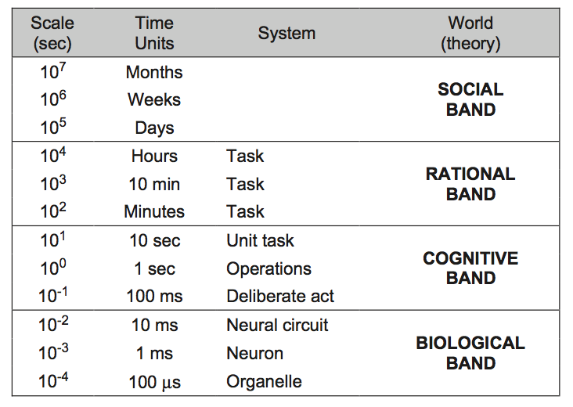
Newell’s Human Action Timescale

Slide 3
Social Band’s Networking Theories*
Self-Interest: creating ties to advance personal desires
Mutual interest & collective action: mutual advance
Contagion: ideas & beliefs spread through networks
“Cognitive” theories: meaning & perception shaping networks
Homophily & proximity: similarity & closeness
Balance: transitive ties (friending a friend of friend)
Coevolution: fitness of communities
* by Monge and Contractor (2003)

Slide 4
Some Perspectives of Groups in the Social Band*
Functional perspective: functions that groups and group members perform
Psychodynamic perspective: relationship between emotional & subconscious with rational & conscious interpersonal interaction
Social identity (Identification): a sense of belonging to groups
Conflict-power-status perspective: power, status, hierarchy, resource contention, ego & alter
Symbolic-interpretive perspective: language, symbol, interpretation
* By Poole and Hollingshead (2005)

Slide 5
Research Statement
One Social Band’s theory → Network Reticulation*:
  How human social memory, coding convention (language), communication, identity, and networking originated
  Some empirical & statistical evidence, but at Social Band
Soar in the Newell’s timescale of human action:
  Rational Band
  Cognitive Band
What underlies the Social Band’s behaviors modeled by Network Reticulation Theory (NRT)?
What Soar’s components can be adapted with the consideration of social behaviors?
* by Corman and Scott (1994)

Slide 6
Network Reticulation Theory (NRT)
Network Reticulation Theory (NRT) describes how social drivers & interactions in shared activities generate human groups/networks:
activation and activity foci
reticulation (communication & network structuration) and
enactment of events & coding conventions
>represented as multi-agents and (planned) Soar agents

Slide 7
Network Reticulation for Each Agent
Enactment for each agent: triggering events such as scheduled meetings or shared locations.
Once events are ongoing, the agent activities rise, which is part of activation.
To execute activities, agents communicate and interact with each other in the form of communication instances, which is part of reticulation.

Slide 8
Structural Manifestation of Agent Communications and Activities
Communication instances give rise to perceived network.
Activities give rise to activity foci and vice versa.
Triggering events in enactment give rise to coding conventions, in which shared symbols or meanings emerge.

Slide 9
Network Reticulation and Performance
identification
Performance
Enactment
Activation
Reticulation
Environment
systemic phenomena:
triggering
events
activities
communication
instances
action results
action effects
structural properties:
coding
conventions
activity
foci
perceived
network
reputation
network
changes
in environment

Slide 10
NRT’s and Soar’s Analogies
NRT (at the Social Band) | Soar (at the Cognitive & Rational Bands)
Activation (over people and tasks) | Spreading Activation (over rules)
Enactment | Subgoaling and operator selection
Reticulation | Symbolic Long-term Memories
Coding convention | Semantic Memory
Communications | Rule firings
Identification | Memories about Self

Slide 11
Software Factory Dataset
  Recording 79 participants (employees and clients) of a software firm over 3 years
  Participants attached a digital recorder and lapel microphone, and logged in to a server which placed a time stamp on the recording.
  Weekly staff meeting recordings
  Organizational records.
  Weekly sociometric surveys about how much they had communicated with other Software Factory participants etc.
  Bi-weekly interviews about events and activities at Software Factory and in its projects.

Slide 12
Evaluation
Nuggets:
  Melding together systems and theories from the Social, Rational and Cognitive Bands
  Greater involvement of the Social Band
Coal:
  Early research
12

Slide 13




Acknowledgment

Slide 14
Agents for Red-Blue Game
Each agent has its own goal, events, activation, and reticulation processes influenced by other agents (and commanders)
Agent type: commander, convoy, uav_patrol, elderA, elderB, bombmaker, digger, financier
3 sides: friendly (blue), enemy (red), neutral

Slide 15
Trace
Time Tick: 0
elderA: WaitforAid << enactment
elderA to commander: WhereisAid >> reticulation
elderB: WaitforAid << enactment
-------------------------------------------------------
Time Tick: 1
commander to elderA: WillGiveAid << enactment
commander to commandpatrol: PatrolAlphaRoute << enactment
commander to convoy: GotoVillageA << enactment
commander to convoy: ProvideAidtoVillageA << enactment
commander to uavpatrol: PatrolGammaRoute << enactment
convoy: GotoVillageA << activation
elderA: WaitforAid << enactment
elderB: WaitforAid << enactment
-------------------------------------------------------
Time Tick: 2
uavpatrol: PatrolGammaRoute << activation
uavpatrol to convoy: GammaRouteDangerous >> reticulation
commandpatrol: PatrolAlphaRoute << activation
elderA: WaitforAid << enactment
elderB: WaitforAid << enactment

Slide 16
Time Tick: 3
convoy: TakeAlphaRoute << activation
uavpatrol: PatrolGammaRoute << activation
uavpatrol to convoy: GammaRouteDangerous >> reticulation
commandpatrol: PatrolAlphaRoute << activation
commandpatrol to convoy: AlphaRouteClear >> reticulation
elderA: WaitforAid << enactment
elderB: WaitforAid << enactment
elderB to commander: WhereisAid >> reticulation
financier: FundBombs << enactment
-------------------------------------------------------
Time Tick: 4
convoy: TakeAlphaRoute << activation
uavpatrol: PatrolGammaRoute << activation
uavpatrol to convoy: GammaRouteDangerous >> reticulation
commandpatrol: PatrolAlphaRoute << activation
commandpatrol to convoy: AlphaRouteClear >> reticulation
elderA: WaitforAid << enactment
elderB: WaitforAid << enactment
financier to insurgentbank: GetMoney << activation
insurgentbank to financier: ProvideMoney >> reticulation
-------------------------------------------------------

Slide 17
Time Tick: 5
convoy: TakeAlphaRoute << activation
uavpatrol: PatrolGammaRoute << activation
uavpatrol to convoy: GammaRouteDangerous >> reticulation
commandpatrol: PatrolAlphaRoute << activation
commandpatrol to convoy: AlphaRouteClear >> reticulation
elderA: WaitforAid << enactment
elderB: WaitforAid << enactment
financier to smuggler: ProvideMoney << activation
financier to bombmaker: ProvideMoney << activation
-------------------------------------------------------
Time Tick: 6
convoy to elderA: AidHere >> reticulation
uavpatrol: PatrolGammaRoute << activation
uavpatrol to convoy: GammaRouteDangerous >> reticulation
elderA to smuggler: WhereisMoney >> reticulation
elderB: WaitforAid << enactment

Slide 18
Time Tick: 7
uavpatrol: PatrolGammaRoute << activation
uavpatrol to convoy: GammaRouteDangerous >> reticulation
elderB: WaitforAid << enactment
elderB to bombmaker: WhereisMoney >> reticulation
smuggler to elderA: ProvideMoney >> reticulation
smuggler to bombmaker: ProvideParts >> reticulation
bombmaker to elderB: ProvideMoney >> reticulation
bombmaker to smuggler: GetParts >> reticulation
-------------------------------------------------------
Time Tick: 8
uavpatrol: PatrolGammaRoute << activation
uavpatrol to convoy: GammaRouteDangerous >> reticulation
elderB: WaitforAid << enactment
bombmaker to digger: ProvideBomb >> reticulation
digger to bombmaker: GetBomb >> reticulation
-------------------------------------------------------

Slide 19
Time Tick: 9
uavpatrol: PatrolGammaRoute << activation
uavpatrol to convoy: GammaRouteDangerous >> reticulation
elderB: WaitforAid << enactment
digger: MovetoBetaRoute << activation
-------------------------------------------------------
Time Tick: 10
uavpatrol: PatrolGammaRoute << activation
uavpatrol to convoy: GammaRouteDangerous >> reticulation
elderB: WaitforAid << enactment
digger: PlantBomb << activation

