Slide 1




A Standard Model of the Mind
June 7, 2017
37th Soar Workshop
John E. Laird, University of Michigan
Christian Lebiere, Carnegie Mellon University
Paul S. Rosenbloom, University of Southern California
Slides originally created by Paul S. Rosenbloom
Based on Laird, J. E., Lebiere, C. & Rosenbloom, P. S. (2017). A Standard Model of the Mind: Toward a Common Computational Framework across Artificial Intelligence, Cognitive Science, Neuroscience, and Robotics. AI Magazine. In press.
Notes:
Not a machine learning talk per se, but here for timing issues
Some work that followed up on the last session of the 2013 AAAI Fall Symposium on Integrated Cognition

Slide 2
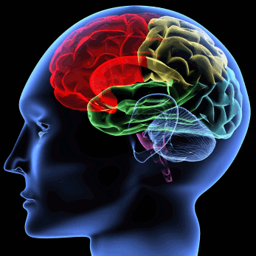
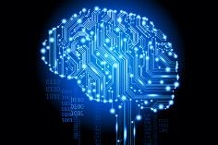
Minds
Functional entities that can think
  And thus support intelligent behavior
Humans, and many animals possess minds
  Implemented by brains
In AI, minds assumed to be computational entities
  Cognitive systems
  Implementable via a range of physical devices

Slide 3



Approaches to Understanding Minds
Artificial Intelligence (& AGI)
  Concerns building artificial minds
  Cares most for how such minds can be built
Cognitive Science
  Concerns modeling natural minds
  Cares most for understanding human cognitive processes
Neuroscience
  Concerns structure and function of brains
  Cares most for how minds arise from brains
Robotics
  Concerns building and controlling artificial bodies
  Cares most for how minds control such bodies

Slide 4
Towards a Common Understanding
Deep scientific question whether will converge on a single understanding of mind
  Must at least happen for cognitive science and neuroscience
  Naturally inspired AI/robotics may also fit if class slightly abstracted
  So also may other work that is similar for functional reasons
Call this slightly abstracted class human-like minds
  More the bounded rationality found in humans than AI optimality
  Broader than naturally inspired minds
  Narrower than human-level intelligence
Notes:
Includes natural and non-naturally-inspired but similar minds

Slide 5
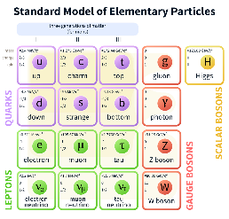
A Standard Model of Particle Physics
AN ANALOGY
Integrative model
  Combines electromagnetic, weak and strong interactions
  Classifies all of the known elementary particles
Community consensus developed over decades
  Assumed to be internally consistent but may have gaps
Yields critical functionality for field
  Cumulative reference point for progress
  Guides efforts to extend and break it

Slide 6
A Standard Model of The Mind (SMM)
Focused on human-like minds
Grew out of a summary presentation at the 2013 AAAI Fall Symposium on Integrated Cognition
  Yielded surprising consensus of those in attendance
    Organizing committee for Symposium drawn from cognitive science, cognitively and biologically inspired AI, AGI, and robotics
  Suggested a consensus has begun to emerge
Followed up with an article for AI Magazine
  Extend consensus via a dialectic among ACT-R, Soar & Sigma
  Laird, J. E., Lebiere, C. & Rosenbloom, P. S. (2017). A Standard Model of the Mind: Toward a Common Computational Framework across Artificial Intelligence, Cognitive Science, Neuroscience, and Robotics. AI Magazine. In press.

Slide 7
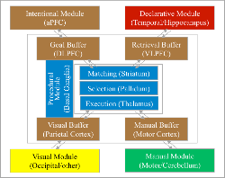
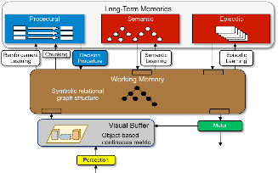
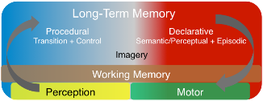
ACT-R, Soar & Sigma
ACT-R
Parallel, asynchronous modules
Central procedural memory
Only one result/module/cycle
Includes mapping to brain regions
Soar
Parallel, asynchronous modules
Central working memory
Bipartite declarative memory
Visuospatial module
Sigma
Blends CAs with graphical models
Less modular architecturally
Differing functionalities from
specialization and combination
Notes:
Original diagrams just colored to show common functionalities
ACT-R and Soar two longest and most well developed
ACT-R includes mapping to brain regions
Sigma is newer, partially based on learning from existing architectures

Slide 8
A Standard Model of The Mind (cont.)
What needs to be in a human-like cognitive architecture
  Providing an abstract community consensus
  But not itself a cognitive architecture
Yields a range of potential benefits
  Coherent baseline to facilitate shared cumulative progress
    Focus efforts to extend and break the consensus
    Framework around which evaluation data can be organized
    Interlingua for describing and comparing architectural approaches
  Guidance in
    Extending research on individual components
    Interpreting experiments and suggesting new ones
    Constructing intelligent applications
Notes:
Cognitive architecture: Working model of fixed structures that define a mind
For example, extending deep learning with memory, attention, etc.

Slide 9
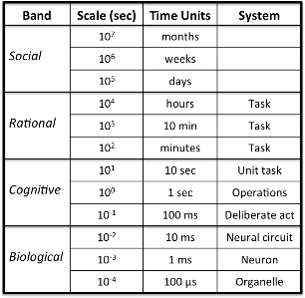
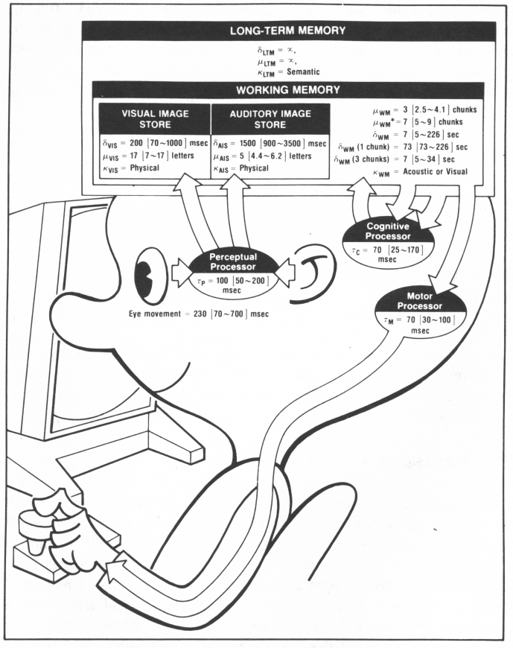
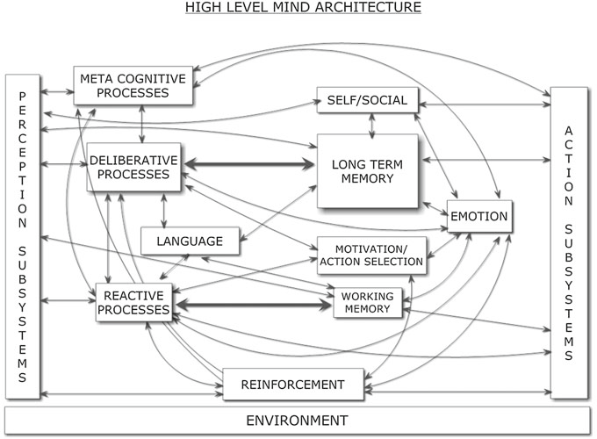
Some Precedents*
Amalgamated completeness
CogPrime, CogAff, LIDA, Psi, 4D-RCS, HTM/DeSTIN
rather than consensus
Scale Counts in Cognition
(Newell, 1990)
Model Human Processor
(Card, Moran & Newell, 1983)
Span mind
Deliberate Act up?
Very abstract
Parameters for HCI
Generic Architecture for Human-Like Cognition
(Goertzel, Pennachin & Geisweiller, 2014)*
Notes:
*Published after Symposium

Slide 10
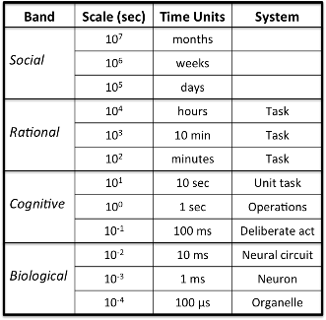
Deliberate Act Level (~100 ms)
Simple reaction time in humans (roughly)
Where cognitive architectures most commonly defined
  Although may go a bit below
Where standard model is defined
Provides a physical symbol system
  “… has the necessary and sufficient means for general intelligent action” (Newell & Simon, 1976)

Slide 11
Standard Model and Symbol Systems
Key aspect of symbols for SMM is composability
  Symbols are those things that can be combined into relations
    And support further combinations into networks of relations
  Mirrors binding problem in cognitive neuroscience
Doesn’t assume symbols must be uninterpreted labels
  Can be this and/or patterns over vectors of distributed elements
Doesn’t assume sufficiency at deliberate act level
  Logically sufficient overall, but
  Evidence shows non-symbolic needed at deliberate act level
    To represent numeric and spatial information
    To provide quantitative metadata over symbol structures
      Frequency, recency, co-occurrence, similarity, utility, activation
Notes:
Not necessarily at this point concerned with other aspects of symbols
Designation, grounding, …
Major breaks with traditional notions of cognitive architectures and symbols

Slide 12
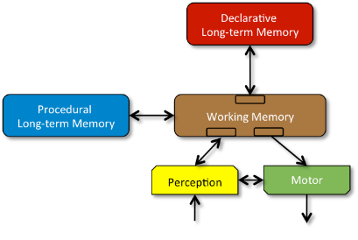
Standard Model
Our understanding of consensus from AAAI symposium fleshed out based on dialectic among three architectures
  Finding out what each actually meant and most believed
A set of communicating modules
  Each may be decomposed further
  But not just undifferentiated stuff
Global comms. through WM
  Local Perception↔︎Motor comms.
Procedural can access all of WM
  Others access only own WM buffers
At this level of detail, not too novel
  Although bipartite LTM is relatively new as a consensus

Slide 13
Standard Model (cont.)
Structure and Processing
Memory and Content
Learning
Perception and Motor

Slide 14
A. Structure and Processing
Processing yields bounded rationality, not optimality
Processing based on a few task-independent modules
There is significant parallelism in architectural processing
  Processing is parallel across modules
  Processing is parallel within modules
A cognitive cycle that runs at ~50 ms per cycle in humans drives behavior via sequential action selection
Complex behavior arises from a sequence of independent cognitive cycles that operate in their local context
Notes:
Not distinct modules for more complex behavior

Slide 15
B. Memory and Content
Declarative and procedural LTMs contain symbol* structures and associated quantitative metadata
Global communication is provided by a short-term WM
Global control is provided by procedural LTM
  Composed of rule-like conditions and actions
  Exerts control by altering contents of WM
Factual knowledge is provided by declarative LTM
Notes:
*Symbols as earlier discussed

Slide 16
C. Learning
All forms of LTM content are learnable
Learning occurs online and incrementally, as a side effect of performance and is often based on an inversion of the flow of information from performance
Procedural learning involves at least reinforcement learning and procedural composition
  Reinforcement learning yields weights over action selection
  Procedural composition yields behavioral automatization
Declarative learning involves the acquisition of facts and tuning of their metadata
More complex forms of learning involve combinations of the fixed set of simpler forms of learning

Slide 17
D. Perception and Motor
Perception yields symbol* structures with associated metadata in specific WM buffers
  There can be many different such perception modules
  Perceptual learning acquires new patterns & tunes existing ones
  Attentional bottleneck constrains information available in WM
  Perception can be influenced by top-down information from WM
Motor control converts symbol* structures in its buffers into external actions
  There can be multiple such motor modules
  Motor learning acquires new action patterns & tunes existing ones
Notes:
*Symbols as earlier discussed
Least well defined aspect of SMM

Slide 18
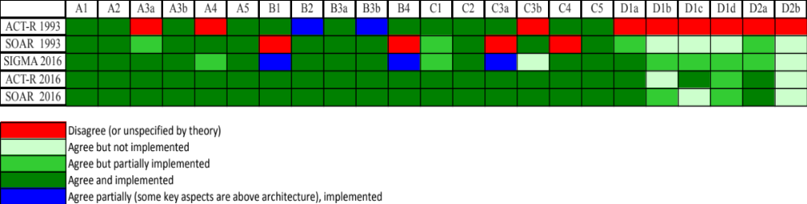
Analysis of Three Architectures
Structure and Processing
Memory and Content
Learning
Perception and Motor
ACT-R & Soar disagreed in a number of ways decades ago
  Although disagreed about different things
Now in essentially complete agreement on this consensus
  Although not all is completely implemented
Sigma differs further in placing some functionality above architecture
  And less completely implemented at this point
Notes:
ACT-R: Structure and processing, learning, P&M
Soar: Memory and content, learning
Convergence is striking for ACT-R and Soar

Slide 19
Conclusion
Standard model reflects a very real initial consensus
  Serial and parallel processing
  Symbolic and subsymbolic representations
  Procedural and declarative memories
  Pervasive learning
But it remains incomplete in a number of ways
  Metacognition, emotion, mental imagery, distinction between declarative memories, social cognition, etc.
And may still be wrong in various ways
Hope is that it yields sound beginning to build upon via more
  Consensus across architectures, researchers, data and disciplines
  Work on challenges, corrections and extensions
2017 AAAI Fall Symposium on SMM
  To “begin the process of broader community involvement”
Notes:
Hope many of you will consider participating!

