Slide 1
Turning
Level Design Concepts
into Adaptive Plans
Bob Wray, Charles Newton, Victor Hung, Norb Timpko
7 Jun 2017
Copyright © 2017 Soar Technology, Inc.

Slide 2
Challenge
Implementing a “level” in a game (or training environment) is difficult
  Tedious (lots of details that need to be specified)
  Uncertain (players will end doing things you did not expect)
  Limited expressivity for conditional events
    Initial conditions (scenario/level specification)
    Simple “scripts” for on-going management of events
How can we improve the level design and implementation process to mitigate these difficulties?

Slide 3
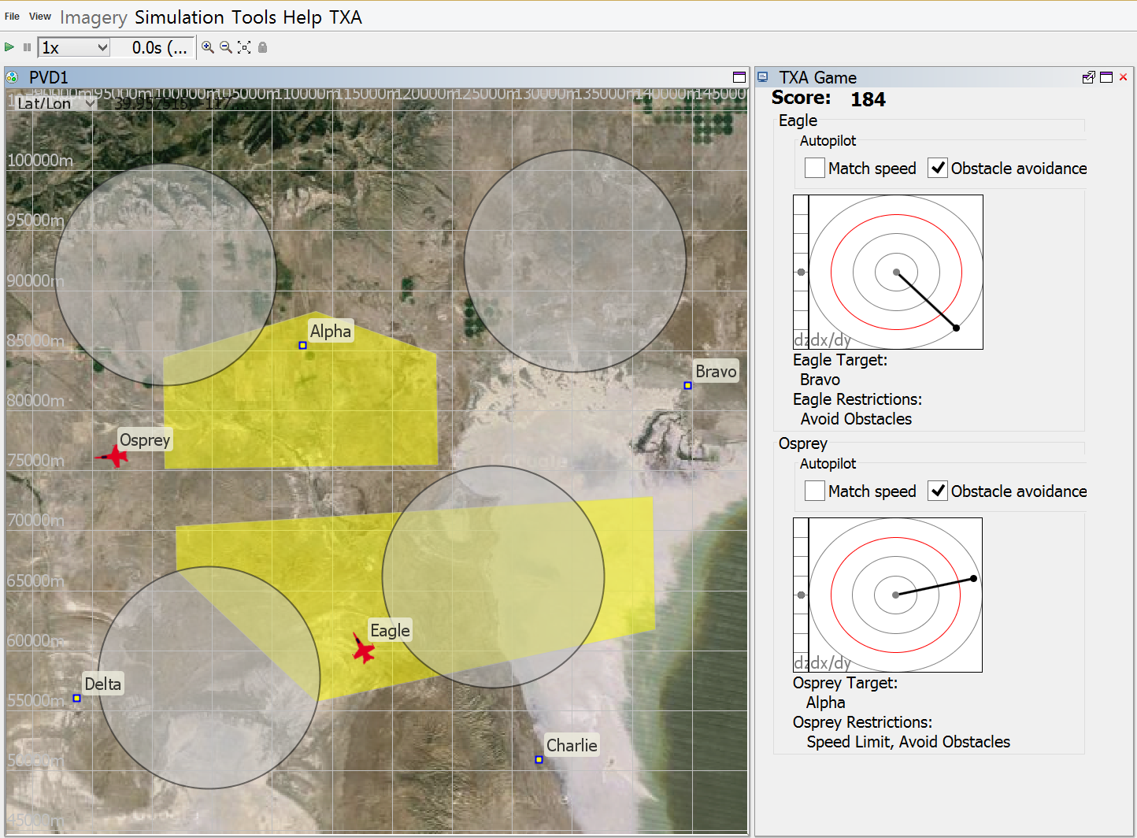
Simple Example
“Skipper” pylon-racing serious game
  Illustrates overload & aiding for supervisory control
    (Wray, Bachelor, et al 2016)

Slide 4
Simple Example
Example level/scenario (desired events)
  At least one routing that requires simultaneous speed and maneuver interventions
  Simultaneous pylon goals on one side of maneuver area
  Simultaneous pylon goals on opposite sides
  Start obstacles moving if player is >> average score after 2m
Easy to create a plan that satisfies these constraints if player is predictable
Much harder to create a plan that satisfies these constraints if player is not (altogether) predictable
Even harder when additional semi-autonomous actors can react to player actions within the scenario

Slide 5
Relevant Background
Guided (constricted) player navigation
  Restrict player choices in a seemingly unrestricted world
  “String of pearls” (limit branching)
Interactive narrative / story direction (emphasis: UX)
  Planning and plan execution that helps ensure the game constructs a compelling narrative / experience
    Riedl and Young (2004); Magerko (2007)
Scenario adaptation (emphasis: designer)
  Plan execution that adapts game events to satisfy the goals of the designer (often an instructor in simulation-based training)
    Wray & Woods (2013); Wray, Bachelor, et al (2015)
Scenario authoring
  Toolsets that allow the designer to specify scenario execution requirements
    Medler and Magerko (2006); Folsom-Kovarik et al (2016)

Slide 6
Application Requirements
Player decisions can be limited a little, but not a lot
  “Open world”
  Lax/forgiving player timeline
  Non-episodic levels: Player choices must impact later events and options within the level/scenario
Designers are not programmers (or AI developers)
  Level-design primitives need to be familiar concepts (game events)
  Must limit / encapsulate programming details
Designers will have high-level scenario requirements and low-level event requirements
  Event1 → Event2 → (Event3, Event4)
  The actors in Event2 must include at least 2 actors from Event1

Slide 7
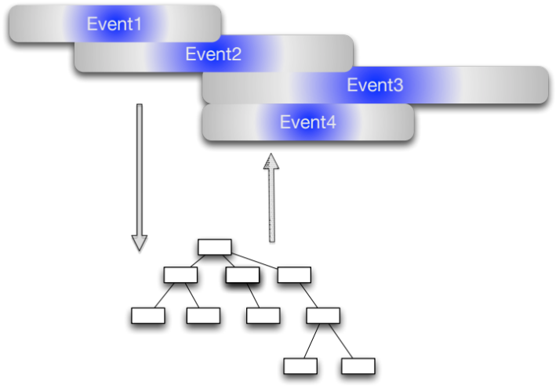
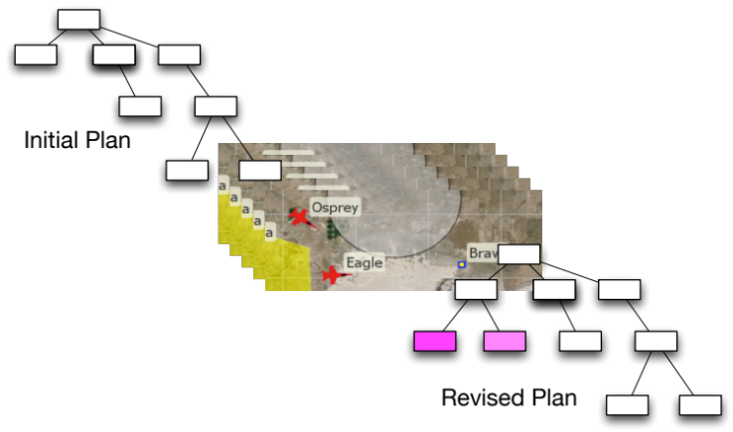
Potential Directions
Scenario Authoring Tool
  Visual representation of relationships between events, actors, and scenario goals
  Past work: Difficult to find a level of abstraction that is both expressive enough and simple enough
  Key Challenge: Representing and codifying contingencies based on individual player behavior
Mixed-initiative Scenario Planner
  “Dialog” between designer and AI agent (“planner”)
  Designer adds goals and constraints (and search control?)
  System produces scenario plans (that can be simulated and visualized)
  Key Challenge: Generalization (and communication) of player contingencies based on a few examples

Slide 8
Conclusions
Questions
  Does “listening to the architecture” inform potential approaches to the challenge?
Nuggets
  Interesting and challenging problem with potential real-world impacts
  Opportunity for integrative research (planning, plan execution, dialog, user modeling, agent/world modeling, etc.)
Coal
  Many past attempts with marginal success. What’s different now?

Slide 9
References
Folsom-Kovarik, J. T., Woods, A., & Wray, R. E. (2016). Designing an Authorable Scenario Representation for Instructor Control over Computationally Tailored Narrative in Training Proceedings of the 29th International FLAIRS Conference. Key Largo: AAAI Press.
Magerko, B. (2007). Evaluating Preemptive Story Direction in the Interactive Drama Architecture. Journal of Game Development, 3.
Medler, B., & Magerko, B. (2006). Scribe: A General Tool for Authoring Interactive Drama. Paper presented at the 3rd International Conference on Technologies for Interactive Digital Storytelling and Entertainment, Darmstadt, Germany.
Wray, R. E., & Woods, A. (2013). A Cognitive Systems Approach to Tailoring Learner Practice. In J. Laird & M. Klenk (Eds.), Proceedings of the Second Advances in Cognitive Systems Conference. Baltimore, MD.
Wray, R. E., Bachelor, B., Jones, R. M., & Newton, C. (2015). Bracketing human performance to support automation for workload reduction: A case study Lecture Notes in Computer Science: Proceedings of the Human Computer Interaction International (HCII) Conference. Los Angeles: Springer-Verlag.
Wray, R. E., Bachelor, B., Newton, C., Aron, K., & Jones, R. M. (2016). Using a Serious Game to Illustrate Supervisory Control Technology Lecture Notes in Computer Science: Proceedings of the 2016 Human Computer Interaction International (HCII) Conference. Toronto: Springer-Verlag.
Young, R. M., Riedl, M. O., Branly, M., Jhala, A., Martin, R. J., & Saretto, C. J. (2004). An architecture for integrating plan-based behavior generation with interactive game environments. Journal of Game Development, 1(1).

