Slide 1


Cognitive Language Comprehension in
Rosie
Peter Lindes
Soar Workshop
16 May 2018

Slide 2
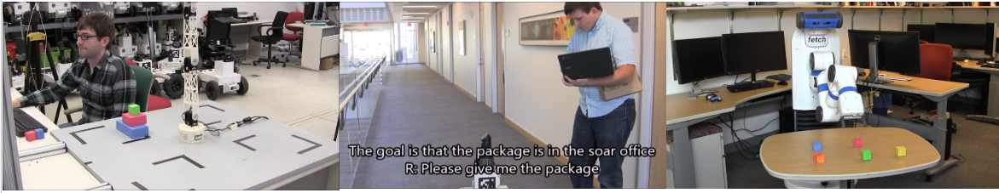
Rosie
Learn new tasks via natural language interaction in one shot
  Concept definitions
  Hierarchical goal descriptions
  Failure states
  Task constraints
  Task actions
  Heuristics
  Procedures, …
No longer depend solely on AI engineers for behavior development
Learns > 35 novel games [Kirk and Laird, ACS 2016]
Learns fetch and delivery tasks [Mininger and Laird, ACS 2016]

Slide 3
The Problem
This thesis addresses the problem of building a cognitive computational model of human language comprehension within an autonomous robotic agent for understanding instructions from a human instructor.

Slide 4



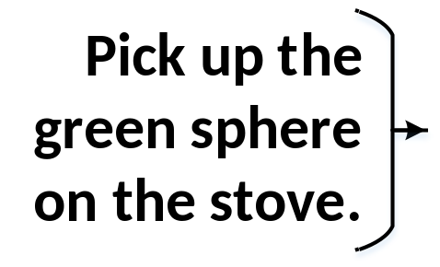
Build a human-like comprehender
within an embodied autonomous agent
Functional in context
Models human cognition
This will be what we mean by saying that it “understands.”
This will be what we mean by saying that it is “human-like.”

Slide 5
The Lucia comprehender
Representation of language form and meaning
  Construction Grammar (CxG) theory of language
  Embodied Construction Grammar (ECG) formalism
  Grammar written for the Rosie ITL domain
The process of comprehending a sentence
  Incremental, single-path with local repair (ISPLR) processing
An underlying architecture for comprehension
  Built with general cognitive abilities
  Soar cognitive architecture
Embedded in an autonomous robotic agent
  The Rosie Interactive Task Learning (ITL) agent

Slide 6
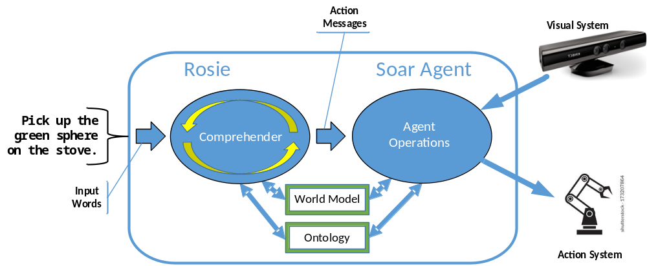
Functional in context

Slide 7
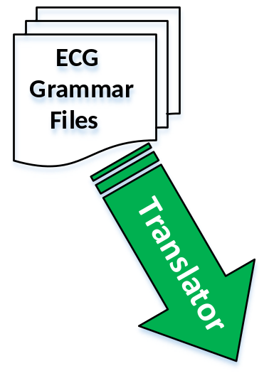
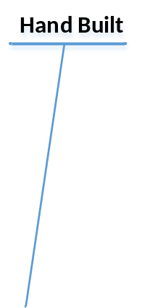
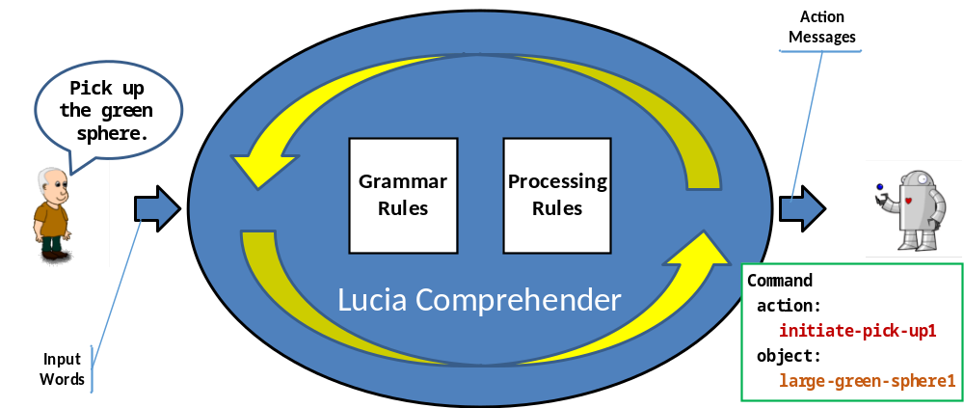
Models human comprehension

Slide 8
Construction Grammar theory
Construction: a pairing of form and meaning
Hierarchical network of constructions:
  Compositional hierarchy
  Inheritance hierarchy
Surface form
Generalizations based on cognitive processing
Usage-based
Goldberg, 2013

Slide 9
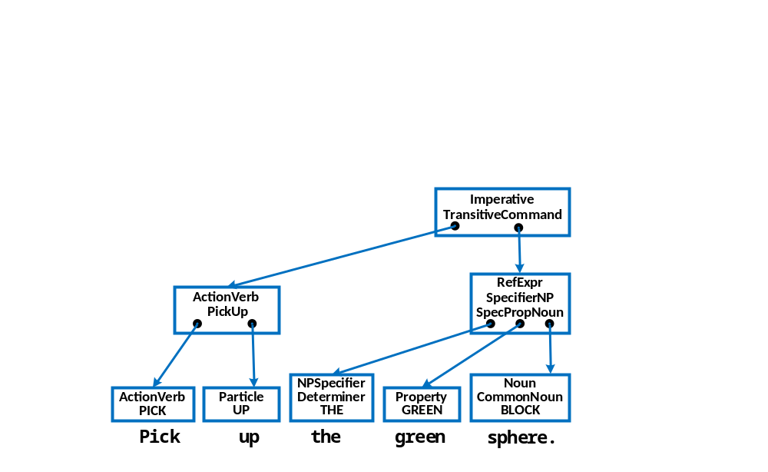

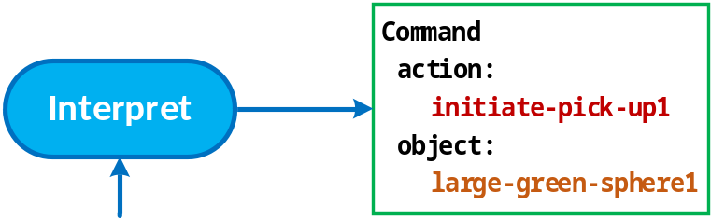


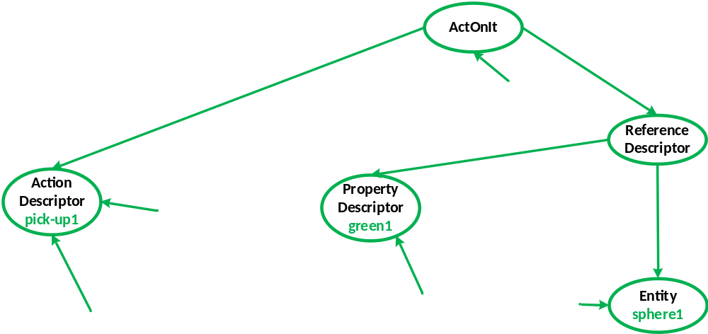

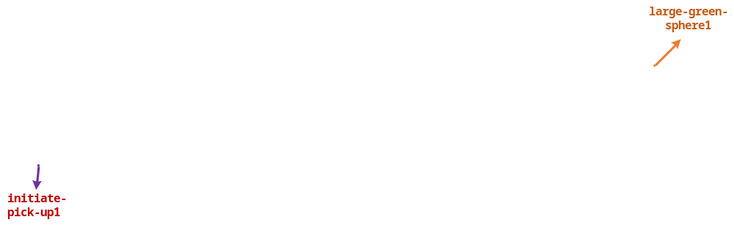
Internal representation in Lucia

Slide 10
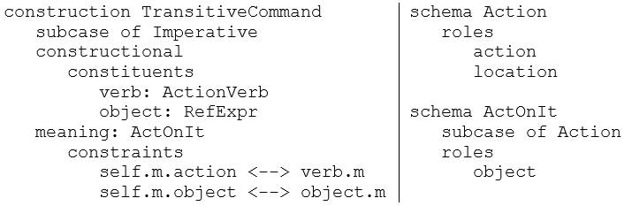
Translating ECG to Soar
Constructions:
Schemas:
Generalize
Recognize form
Evoke meaning
Unify
ActionVerb + RefExpr → TransitiveCommand
TransitiveCommand –evoke-> ActOnIt
ActOnIt –generalize-to-> Action TransitiveCommand –generalize-to-> Imperative
self.m.action ↔ verb.m self.m.object ↔ object.m

Slide 11
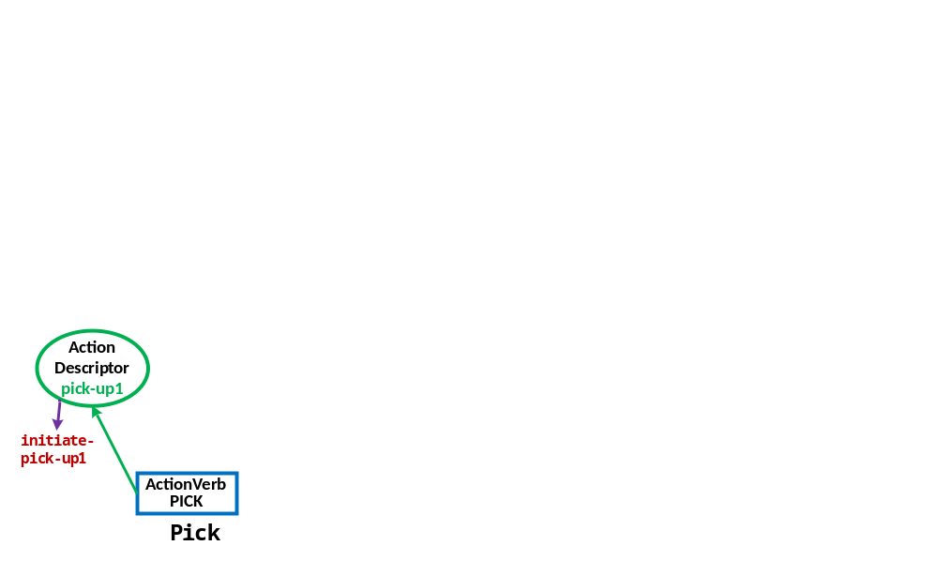

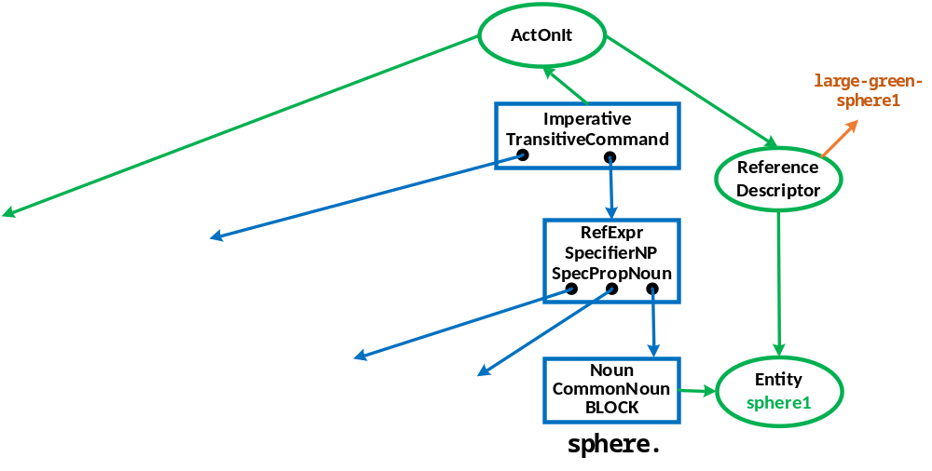
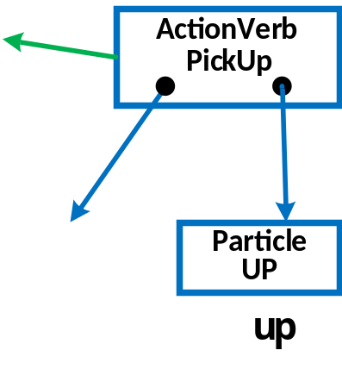
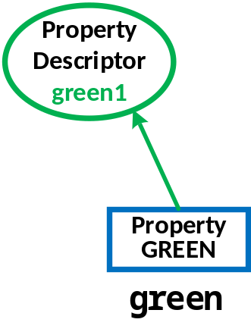

Incremental word-by-word processing

Slide 12
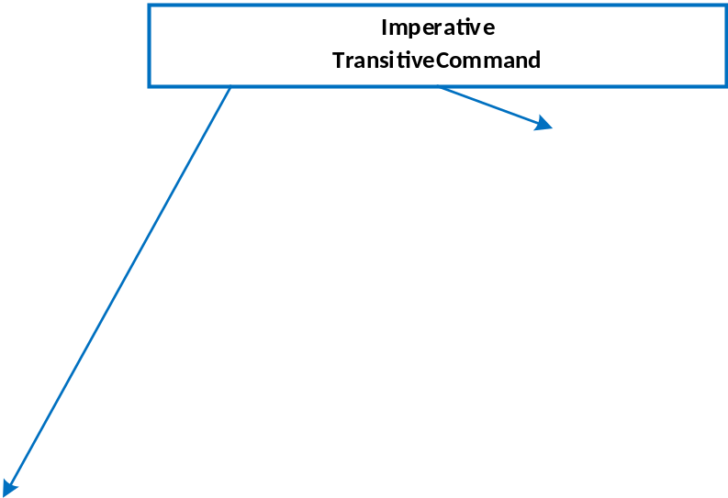
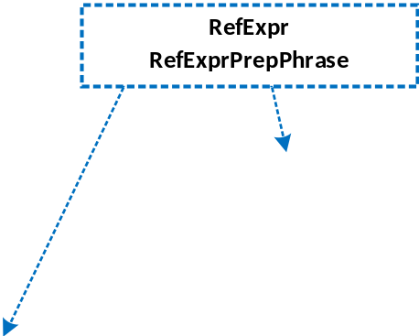
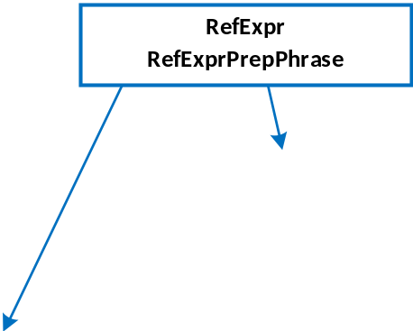

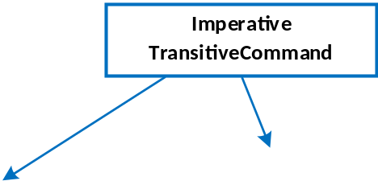
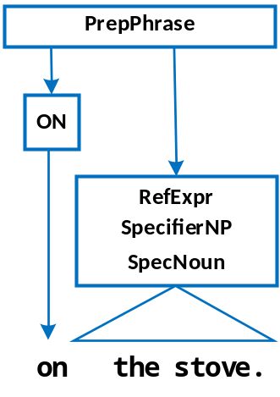
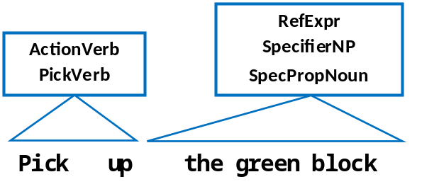
Local repair

Slide 13
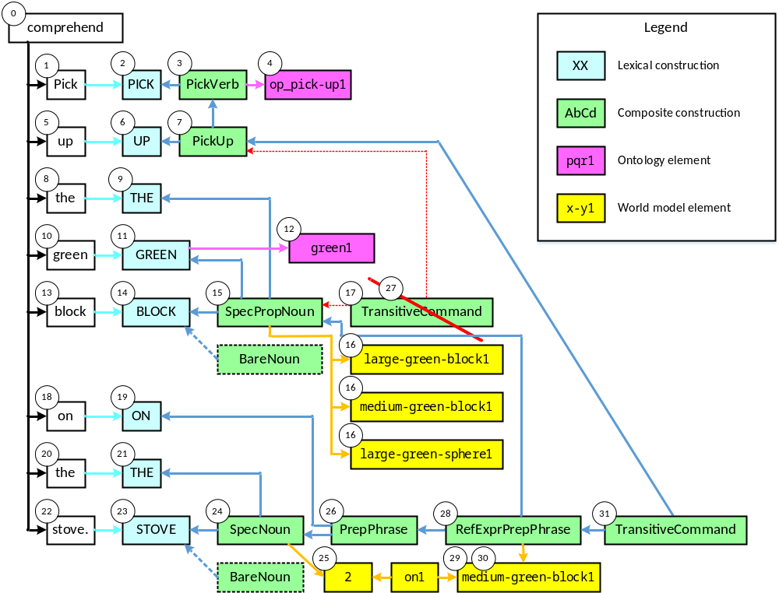
Processing

Slide 14
Theoretical implications
Inheritance gives nodes multiple identities:
  Creates grammatical flexibility
  Provides for semantic precision
Combining CxG with incremental, cognitive processing
  Patterns for grammatical structure
  A general pattern for local repairs
How do these patterns affect the structure of natural languages?
Dye et al., 2018
Widmer et al., 2017
Lewis & Phillips, 2014

Slide 15
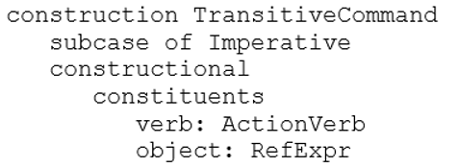
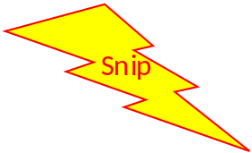



A pattern for local repairs
Recursion
Conflict

Slide 16
Method to grow the grammar
For each sentence not comprehended correctly:
  Add the sentence to the development set
  Identify its gold standard meaning
  Add additional grammar and processing items
  Test against the gold standard
  Debug as necessary
This gives a usage-based approach to acquiring new grammar incrementally from experience
This may suggest future strategies for modeling human language acquisition

Slide 17
Nuggets
Coal
It works!
Integration of:
  ECG
  Incremental processing
  Soar
  Rosie
Baseline for future work
New theory
Only 187 sentences so far
No grammar learning
Need to do smem version
Need to evaluate generality and scalability

