Slide 1
Learning the Task Definition of Games through ITL
James Kirk
Soar Workshop 2018

Slide 2
Problem Space Computational Model
  “Problem Space: A problem space consists of a set of symbolic structures (the states of the space) and a set of operators over the space…
  Problem: A problem in a problem space consists of a set of initial states, a set of goal states, and a set of path constraints. The problem is to find a path through the space that starts at any initial state, passes only along paths that satisfy the path constraints, and ends at any goal state.”
  – Allen Newell

Slide 3
Task Elements
Newell: set of initial states, final states, operators over the space, and path constraints
How can Rosie learn all the task elements used to define goal-oriented tasks from ‘scratch’
  Goals (Initial and final states)
    Learning State description
  Actions (Operators)
    Learning preconditions
  Failure conditions (Path constraints)
    Learning illegal state descriptions
  Task-specific terms
Our approach unifies learning across all types of task elements
Research focuses on learning the rules for games and puzzles

Slide 4
ITL Approach
To teach the task through natural language, the instructor provides descriptions of the task elements grounded in a shared situated example of the task, where each described task element is currently present in the external environment.
The description of a task element includes conditions that must be true for that goal, action, failure condition, or term to be applicable to the current situation.

Slide 5
Task Element Learning Process
Internal State Creation
Natural Language Processing
Recognition Structure Learning
Operation Learning
  If definition contains term that cannot be satisfied in current context, this process loops back to 2, to learn a new definition for the term
Once all task elements are learned (actions, goals, failures..) Rosie can use knowledge to solve or play.

Slide 6
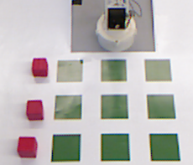
1. Internal State Creation
12
15
Primitives
7
8
9
Actions: move
Prepositions: on, linear
Attributes: color(red,blue), category(block,location)
Operations: equals, has attribute, number of (count), subset of
Objects 1-9: category=location
Objects 10-12: color=red, category=block
Objects 13-15: color=blue, category=block
On: (10,1); (11,4); (13,5); (14,6)
Linear: (1,2,3); (4,5,6); (7,8,9); (1,4,7); (2,5,8);
(3,6,9); (1,5,9); (3,5,7)
11
13
14
4
5
6
10
1
2
3
Notes:
Initial structure is stored in semantic memory

Slide 7
2. Natural Language Processing
Currently Using John’s parser (Soar)
Future plans to merge with Peter’s work
For example:
  “ The small block is on a medium block and a large block is below the medium block.”

Slide 8
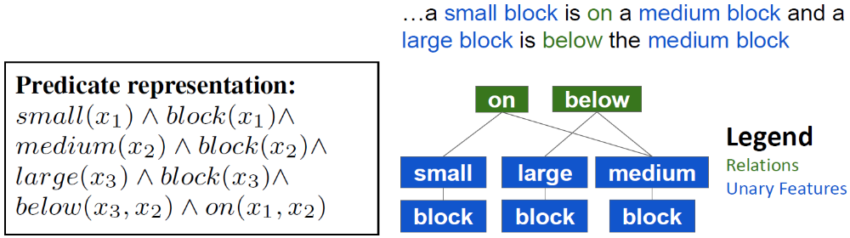
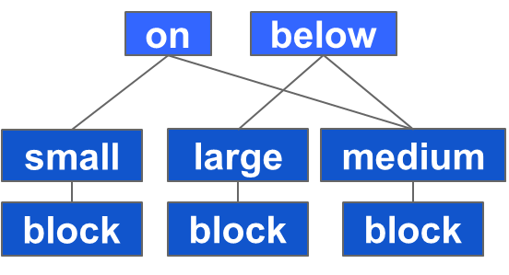
3. Recognition Structure Learning
A task element: action, goal, failure, or new task-specific term is defined by
  A linguistic term (“stacked”, “three-in-a-row”, “clear”)
  A conjunction of predicate tests (clear(X) ^ block(X) ^ ….)
From a conjunction of predicate tests a declarative tree structure is built for efficient bottom to top evaluation

Slide 9
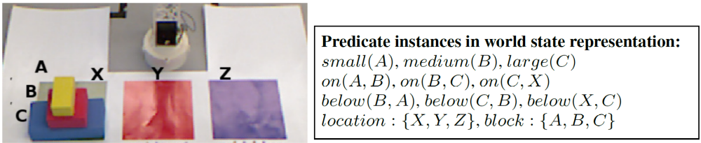
4. Operation Learning
Predicate Matching
  Evaluate individual predicates within context of world state and input arguments
Joining
  Result is the objects, sets, and values that
  satisfy all constraints
Application
  Goal: detection of goal state/winning
  Action: proposal of available actions
  Failure: detection of terminal state/losing
  New term: successful predicate match
Chunking captures this processing into
efficient procedural rules
<A,B>
<C,B>
A
C
B
A,B,C
A,B,C
A,B,C
A,B,C,X,Y,Z
Resolve Bottom Up

Slide 10
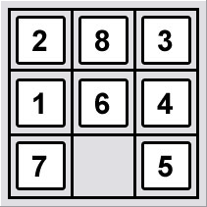
Learning new task-specific terms
“If a block is adjacent to a clear location then you can move the block onto the clear location.”
Rosie: I couldn’t satisfy adjacent. Can you define it?
“If a block is next to a location but it is not diagonal with the location then it is adjacent to the location.”
next-to
~diagonal
move
adjacent
input1
input2
block
clear
location
Legend
Verbs
Inputs
Primitive concepts
Learned concepts

Slide 11
Learning actions from compositions
You can move a free piece that is yours onto a clear location.
Rosie: I don’t know the concept clear.
A location that is not below an object is clear.
move
(10,1), (11,4), (13,5), (14,6)
12
on-to
2,3,7,8,9
on
yours
2,3,7,8,9
~below
10-15
1-9
12,15
clear
1-9
10-15
input2
input1
free
1-9
input1
block
10-15
location
piece
12
15
Legend
Verbs
Primitive concepts
Learned concepts
Input Arguments
7
8
9
Objects 1-9: category=location
Objects 10-12: color=red, category=block
Objects 13-15: color=blue, category=block
On : (10,1); (11,4); (13,5); (14,6)
Linear : (1,2,3); (1,4,9); (2,5,8); (3,6,9); (1,5,9); (3,5,7)
11
13
14
4
5
6
10
1
2
3

Slide 12
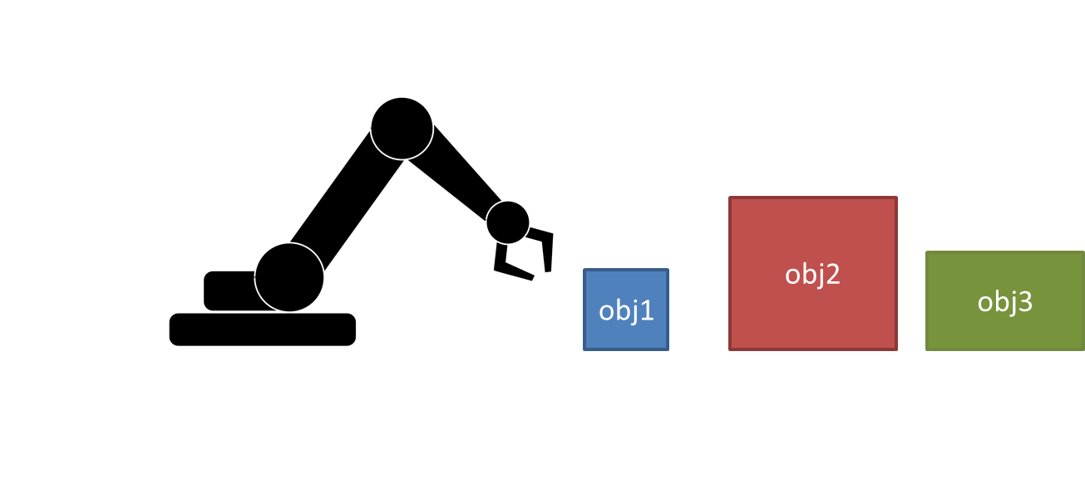
Learning heuristics
Prefer moving the smallest object.
Rosie: I don’t know the concept smallest.
If an object is not larger than any other object then it is the smallest.
Rosie: I don’t know the concept larger.
If the volume of a block is more than the volume of an object then the block is larger than the object.
Prefer (>)
move
(7.5, 5), (7.5, 3.5), (5, 3.5)
1
1
~larger
more-than
smallest
1,2,3
1,2,3
3.5, 7.5, 5
3.5, 7.5, 5
1,2,3
input1
object
volume of
volume of
object
1,2,3
1,2,3
input1
input2
Object 1: color=blue, category=object, volume = 3.5
Object 2: color=red, category=object, volume = 7.5
Object 3: color=green, category=object, volume = 5

Slide 13


Learning Problem Characteristics
Lack of Common Ground
Compositional
Many-to-many Mappings
Accumulative Learning
ruby1 cube1
red block

Slide 14
Video
Showing compositional, accumulative learning
Sudoku and KenKen
New Internal State visualizer

Slide 15
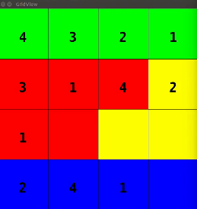
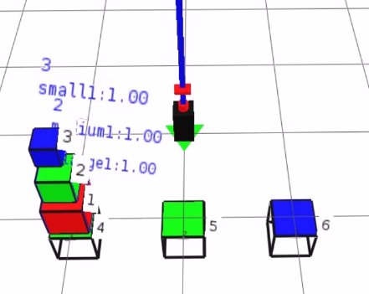
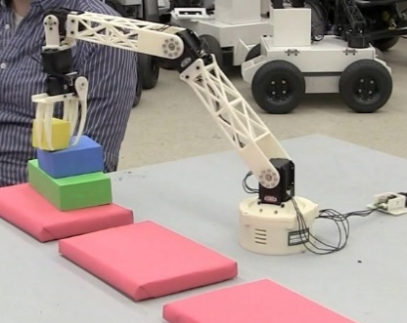
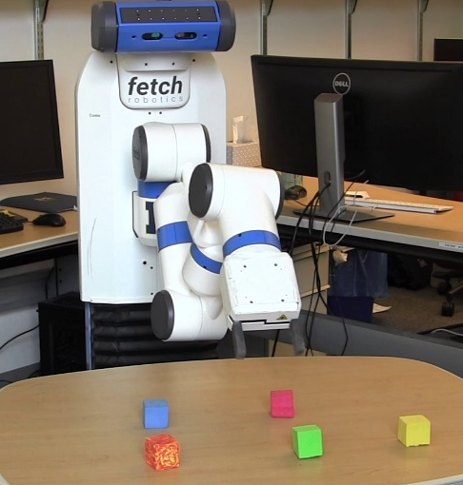
Different agent embodiments
Internal Simulated
  Entirely symbolic (New grid visualizer)
April Arm Simulator
Tabletop Robot
Card game GUI
  Java interface
  Plays against simple agents that play random legal actions
Fetch and ROS Simulator (Lizzie)

Slide 16
Nuggets and Coals
Nuggets
  Have clarified the core problem and its characteristics
  With some improvement new visualizer should be useful for large number of games
  Recent improvements have expanded the learnable tasks and concepts as well as improving the supported language (see next talk)
Coals
  Still have issues scaling to larger problem spaces i.e. 9x9 Sudoku (can learn but slow)
  No evaluation yet of learning many-to-many mappings/ handling of ambiguous learning scenarios (that could cause incorrect knowledge transfer)
  Or any recent evaluations (need to rerun old evaluations on efficiency)
  pulseaudio! ☹

Slide 17
Bonus Slides

Slide 18
Procedural knowledge for resolving “volume of”
RULE:
If:
predicate P
has name <volume> and type <attribute-of>
and input A
and A has property <volume> X
Then:
X is a result of P
3.5, 7.5, 5
more-than
volume of
volume of
input1
input2
obj1,obj2,obj3
Obj1: color=blue, category=object, volume = 3.5
Obj2: color=red, category=object, volume = 7.5
Obj3: color=green, category=object, volume = 5

Slide 19
Procedural knowledge for resolving “more than”
RULE:
(7.5, 5), (7.5, 3.5), (5, 3.5)
If:
predicate P
has name <more> and type <comparison>
and inputs A and B
and A > B
Then:
(A,B) is a result of P
3.5, 7.5, 5
more-than
3.5, 7.5, 5
volume of
volume of
input1
input2
obj1,obj2,obj3
obj1,obj2,obj3
Obj1: color=blue, category=object, volume = 3.5
Obj2: color=red, category=object, volume = 7.5
Obj3: color=green, category=object, volume = 5

Slide 20
Procedural knowledge for resolving “prefer ” action
Available proposed actions:
move(obj1), move(obj2), move(obj3)
RULE:
> move(obj1)
If:
action A proposed in state S
has name <move>
and input B
and B is smallest
Then:
Prefer(>) A in state S
Prefer (>)
move
obj1
smallest
object
obj1,obj2,obj3
Obj1: color=blue, category=object, volume = 3.5
Obj2: color=red, category=object, volume = 7.5
Obj3: color=green, category=object, volume = 5

