Slide 1

Taking Soar to the OpenAI Gym
Timothy W. Saucer, Ph.D.
May 9, 2019
Soar Technology, Inc.

Slide 2

Motivation
Comparison of reinforcement learning approaches is often difficult due to lack of benchmarks and standardized environments
Desire to demonstrate the strengths of a Soar approach by blending a priori knowledge with RL
Fun new set of environments for building agents
Rapid integration of new scenarios that keep focus on agent design
(Personal) Learn to use reinforcement learning
  Like many people, I learn best by doing

Slide 3
OpenAI
Mission:
  “OpenAI’s mission is to ensure that artificial general intelligence (AGI)—by which we mean highly autonomous systems that outperform humans at most economically valuable work—benefits all of humanity. We will attempt to directly build safe and beneficial AGI, but will also consider our mission fulfilled if our work aids others to achieve this outcome.”¹
Founded Dec 2015, converted to capped profitability company
Products:
  Gym: RL environments
  Proximal Policy Optimization: RL algorithm
  Dactyl: Robotic hand and finger manipulator code
  GPT-2: Large scale unsupervised language model

Slide 4
OpenAI Gym
Toolkit for developing and evaluating reinforcement learning algorithms
Environments with a common Python API for input, output, and reward
Input and Output are defined as “Spaces”
  Box – array of bounded floats
  Dict – dictionary of simpler spaces
  Discrete – bounded natural numbers including 0
  MultiDiscrete – array of discrete objects
  MultiBinary – array of binary objects
  Tuple – tuple of space objects
Object returned from environment (simulation)
  Observation: Environment specific data structure representing the observation of the environment after the last step.
  Reward: Float value of the reward generated from the last step.
  Done: Boolean. True if the episode has terminated.
  Info: Environment specific debugging information. Cannot be used for evaluated agents / benchmarks.

Slide 5
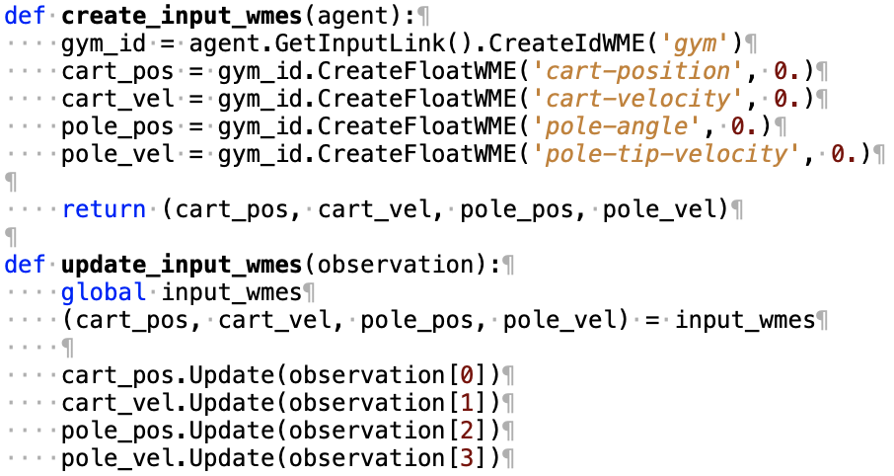
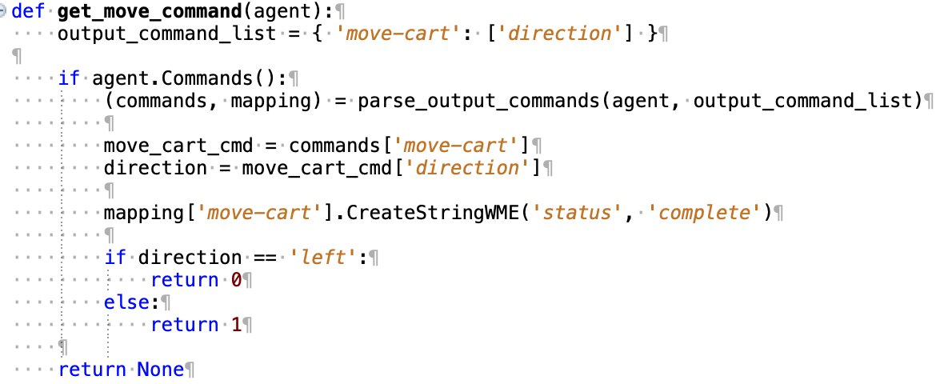
Connecting Gym to Soar
Almost trivial using the Soar Python SML Bindings.
Basic cart-pole example only 200 lines of code
Input:
Output:
Potential improvement: Introspection for automatic I/O link manipulation

Slide 6

Environment: Cart Pole
Recommended environment for all first time OpenAI Gym users
Classic 1-D control problem
A pole sits atop a movable cart connected via a revolute joint
The pole and carts each have unknown masses
Goal: Keep the pole upright (<12 degrees) for 200 time steps
Observations: cart position and velocity, pole angle and speed of its tip
Command: Push cart left or right
  Effect of the push depends on cart speed and pole orientation
Problem is considered solved when the average number of steps until episode ends is < 195 over the past 100 episodes

Slide 7
Cart Pole Live Demo

Slide 8
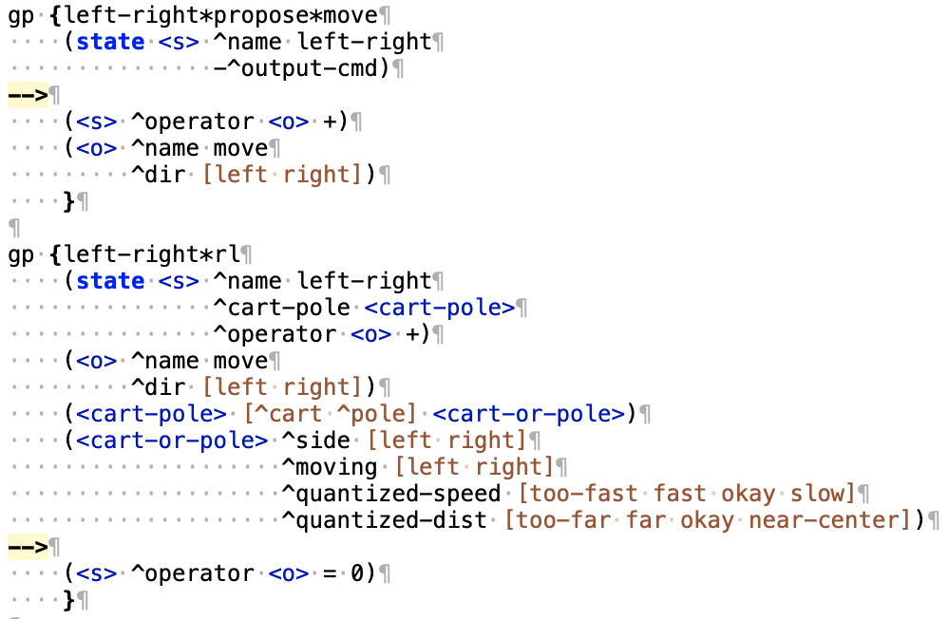
Cart Pole Soar Agent
Very similar to the left-right agent provided in the Soar tutorial RL section
Quantized the state space for the cart and the pole by direction (left/right), speed, and distance
  Static bins, not optimized
  Adds domain knowledge to agent
Create state space of 2*2*2*4*4 = 128 combinations

Slide 9
Issues encountered
Reward provided by the environment wasn’t ideal
  +1 reward every time a step didn’t end the episode, 0 if failed
  Using this reward directly gives + reward all the way up to a crash
  Solution: Implemented custom reward function
    90% pole orientation: +1 if straight up, -1 if 12 degrees
    10% cart position: +1 at center, -1 at edge
  Alternate approach: Eligibility traces?
Discretize input
  Bounds for discretizing the input were chosen arbitrarily
Documentation incorrect
  Provided example’s problem description text described the observation input using degrees, but values were actually radians
  Other environments lack proper documentation

Slide 10
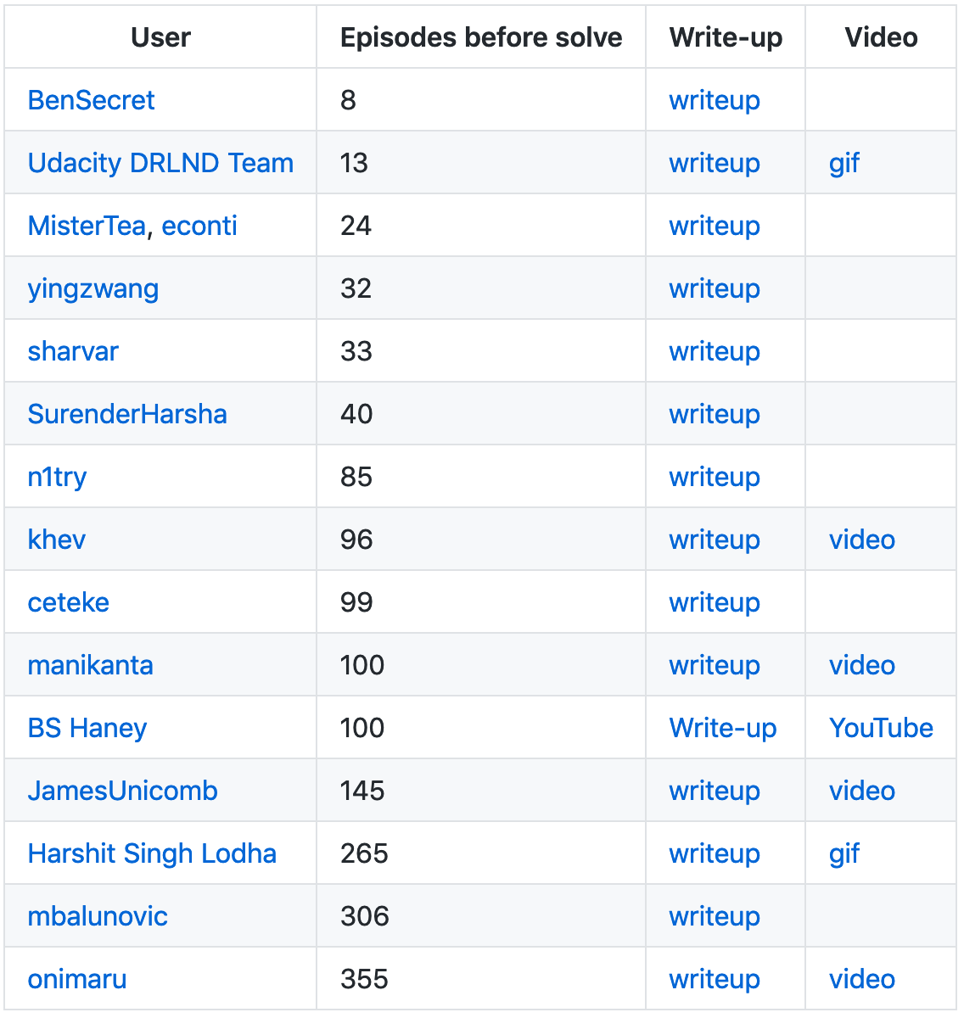
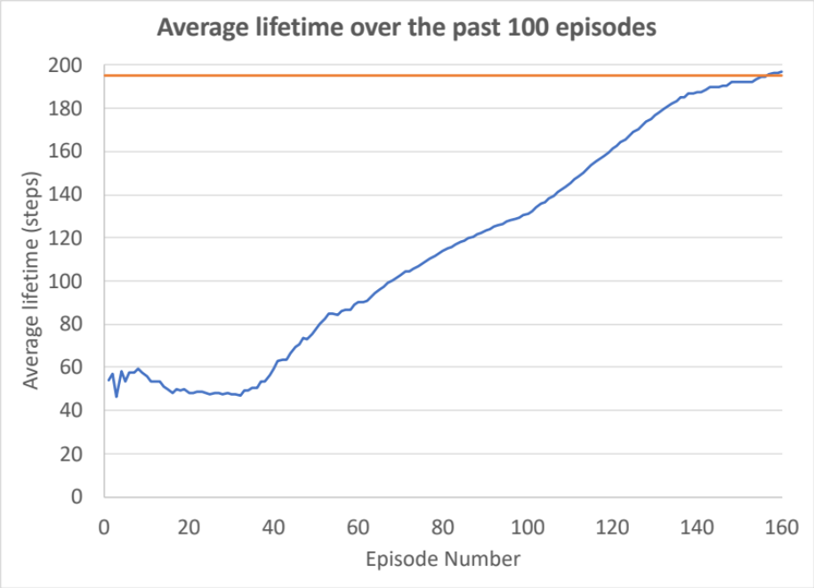
Cart Pole Soar results
Solved in 156 episodes
  Plenty of room for parameter optimization
Comparison to posted benchmarks shows early results on par with some available examples
Appears to learn two strategies
  Careful balancing
  “Running with the stick”

Slide 11
Cart Pole potential improvements
Projection algorithm
  Use domain knowledge to predict the effects (if not the magnitude) based on the current state.
  Generate a reward based on how well the prediction matched the actual response
Left/Right symmetry
  Right now the agent sometimes learns a side preference
  Problem is symmetric about x=0.
  Change from left/right to towards/away from center
  Exploits domain knowledge
Automatic space exploration
  Discretize the input (round values) and use templates

Slide 12
Check on live demo’s performance

Slide 13
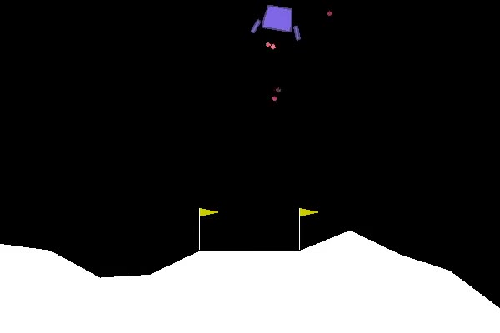
Lunar Lander Environment
Goal: Safely land craft on lunar surface
2D physics environment based on PyBox2D
Commands: Fire a thruster (main or side) or do nothing
Observations: position, velocity, angle, turn rate, if each pad has contact
Reward for landing pads making contact with surface
Thrusters
Negative
reward
Cartesian distance reward
Large reward for landing safely
Large negative if crash

Slide 14
Lunar lander naïve approach
Use RL to decide when to fire the main and side thrusters
Quantize the state space over position, angle, velocity, turn rate
Combinatorial problem quickly gets out of hand
  Quantizing into fairly course bins = 2*4*6*7*7*7*7*2*2 = 460,992
Code based on NGS-4 macros (new feature)
NGS_DefineRLExpansion lunar-lander-rl-main-thruster "
op-descriptions {
select-main-thruster-engage { $NGS_OP_ID $NGS_RL_OP_PURPOSE_CREATE \
{ <lunar-lander> fire-mains <any-main-thruster-command> } }
}
bindings {
{ $NGS_OP_ID goal:<g> }
{ <g> task }
{ <s> lunar-lander }
{ <lunar-lander> position velocity}
}
variations {
fire-mains { <g> @fire-main-thruster $NGS_RL_EXPAND_DISCRETE { $NGS_YES $NGS_NO } }
x-distance { <position> x $NGS_RL_EXPAND_STATIC_BINS { 0.03 0.08 0.13 } }
y-distance { <position> y $NGS_RL_EXPAND_STATIC_BINS { -0.08 0.0 0.03 0.08 0.13 } }
angle { <position> theta $NGS_RL_EXPAND_STATIC_BINS { -0.13 -0.08 -0.03 0.03 0.08 0.13 } }
x-velocity { <velocity> x $NGS_RL_EXPAND_STATIC_BINS { -0.13 -0.08 -0.03 0.03 0.08 0.13 } }
y-velocity { <velocity> y $NGS_RL_EXPAND_STATIC_BINS { -0.13 -0.08 -0.03 0.03 0.08 0.13 } }
turn-rate { <velocity> theta $NGS_RL_EXPAND_STATIC_BINS { -0.13 -0.08 -0.03 0.03 0.08 0.13 } }
left-contact { <lunar-lander> @left-pad-contact $NGS_RL_EXPAND_DISCRETE { $NGS_YES $NGS_NO } }
right-contact { <lunar-lander> @right-pad-contact $NGS_RL_EXPAND_DISCRETE { $NGS_YES $NGS_NO } }
}
expansions {
main-thruster-engage { select-main-thruster-engage 0.0 { fire-mains \
x-distance y-distance angle \
x-velocity y-velocity turn-rate \
left-contact right-contact } }
}
"

Slide 15
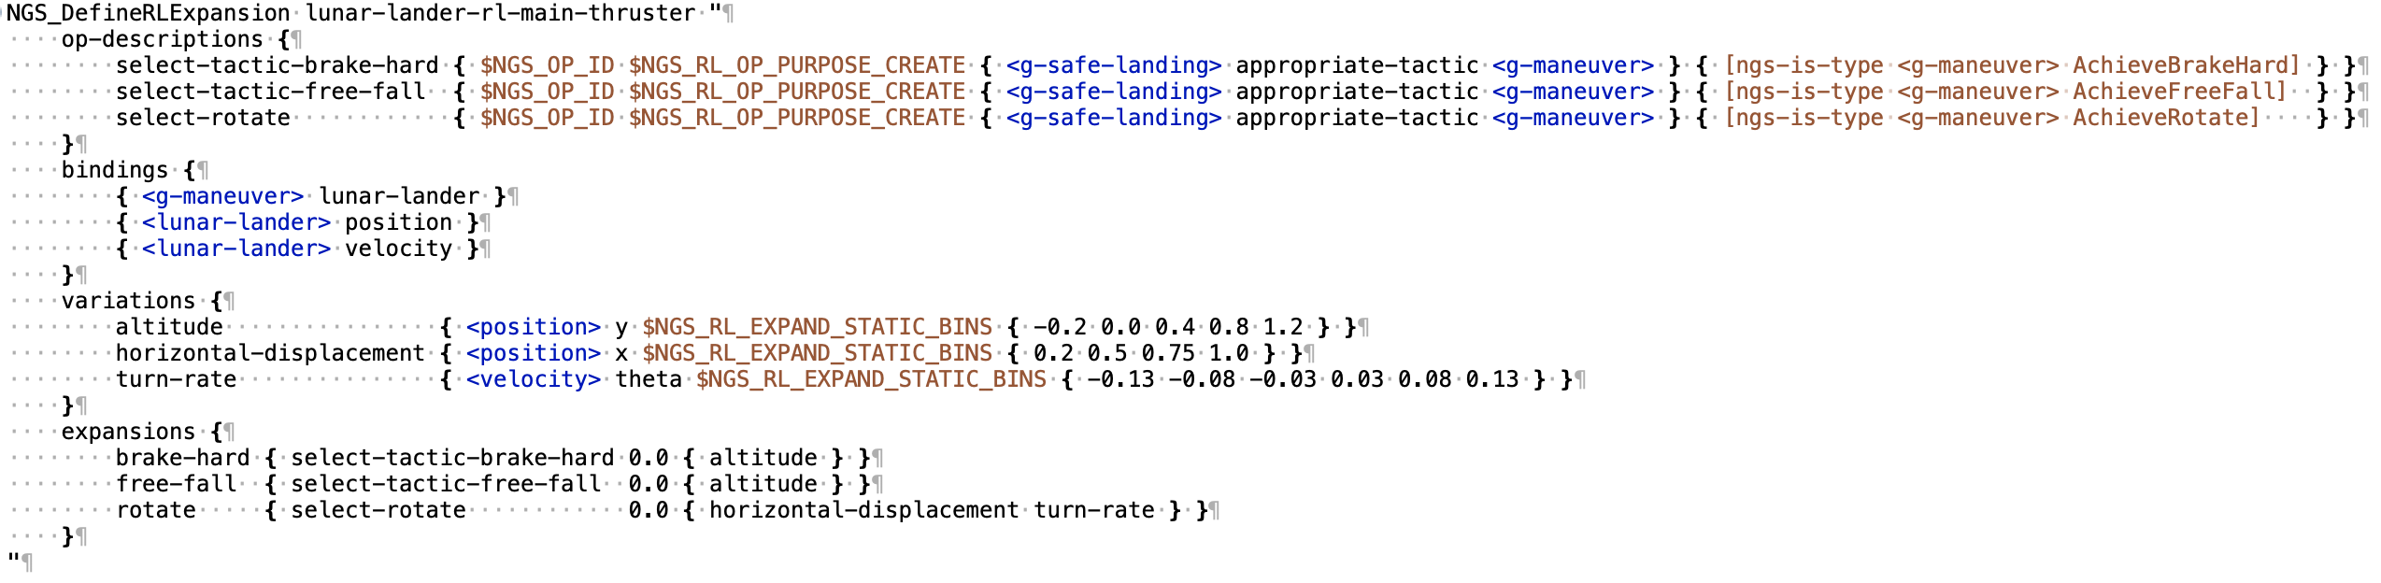
Alternate approach: learn over known tactics
Play to the strengths of the cognitive architecture by focusing on deciding when to apply different tactics
  Examples in Y direction: brake hard, slow down, rotate, free fall
Some cases we know a priori we want to only use certain tactics.
  Example: falling fast very near ground – fire main thrusters always
Advantage: Allows nuanced combinations of known approaches to working through a problem
  Somewhat alleviates the “What is it doing?” problem in explainability.
Disadvantage: Does not explore new tactics you might otherwise find
Another approach: Learn over circumstances when you would change the boundaries for applying tactics

Slide 16
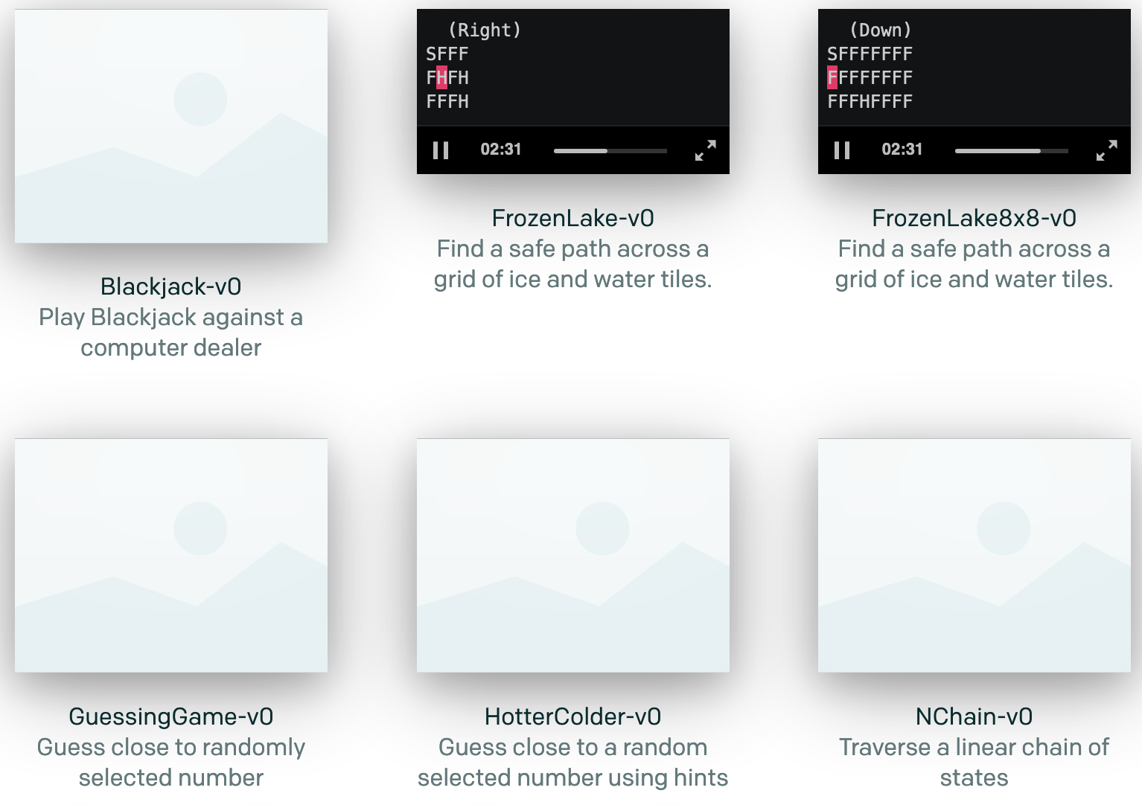
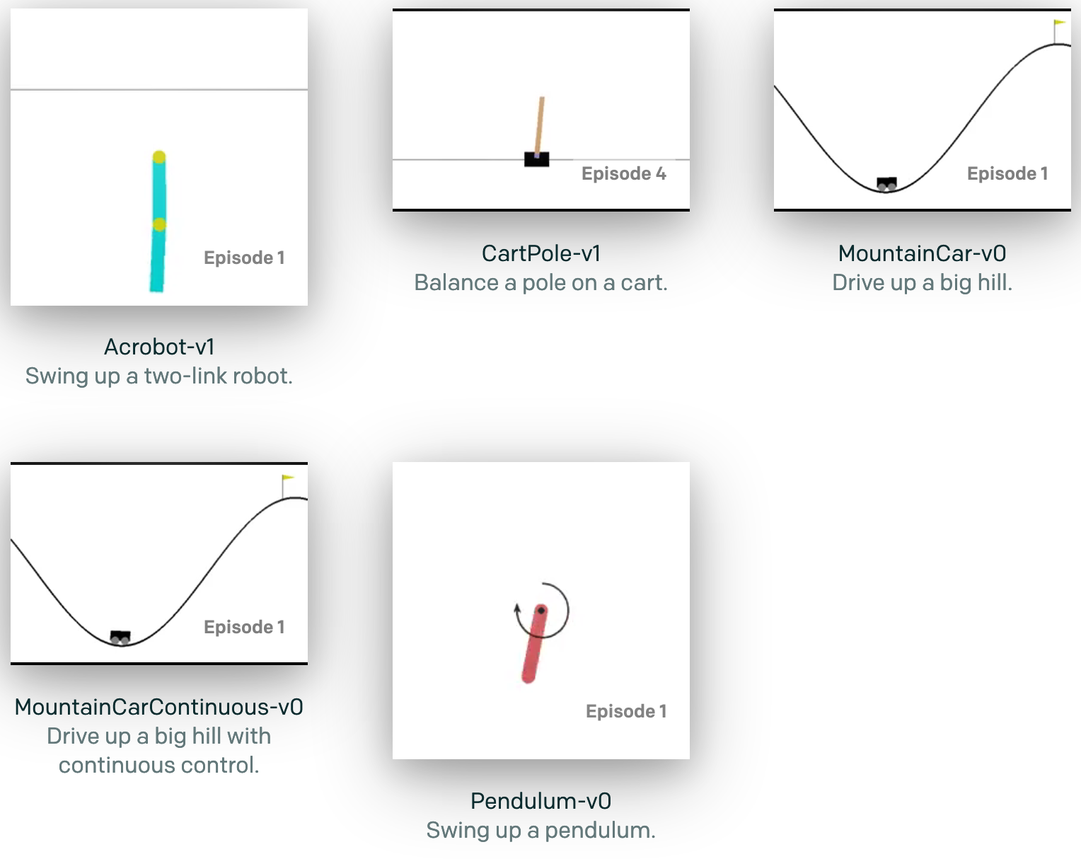
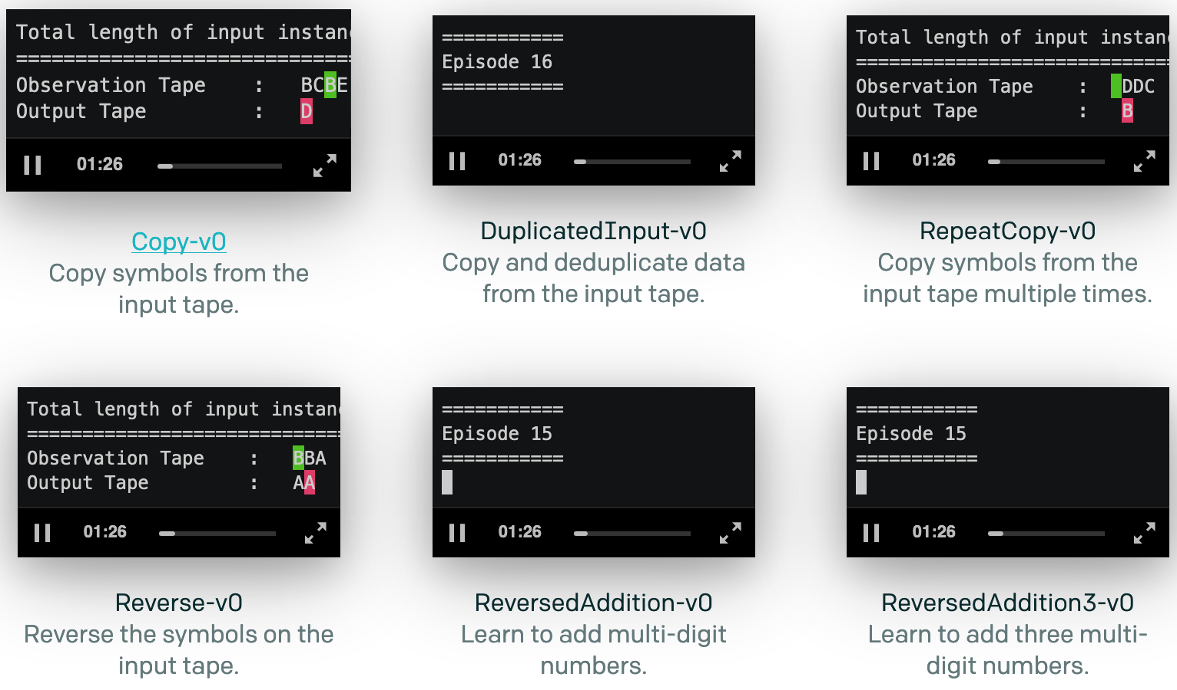
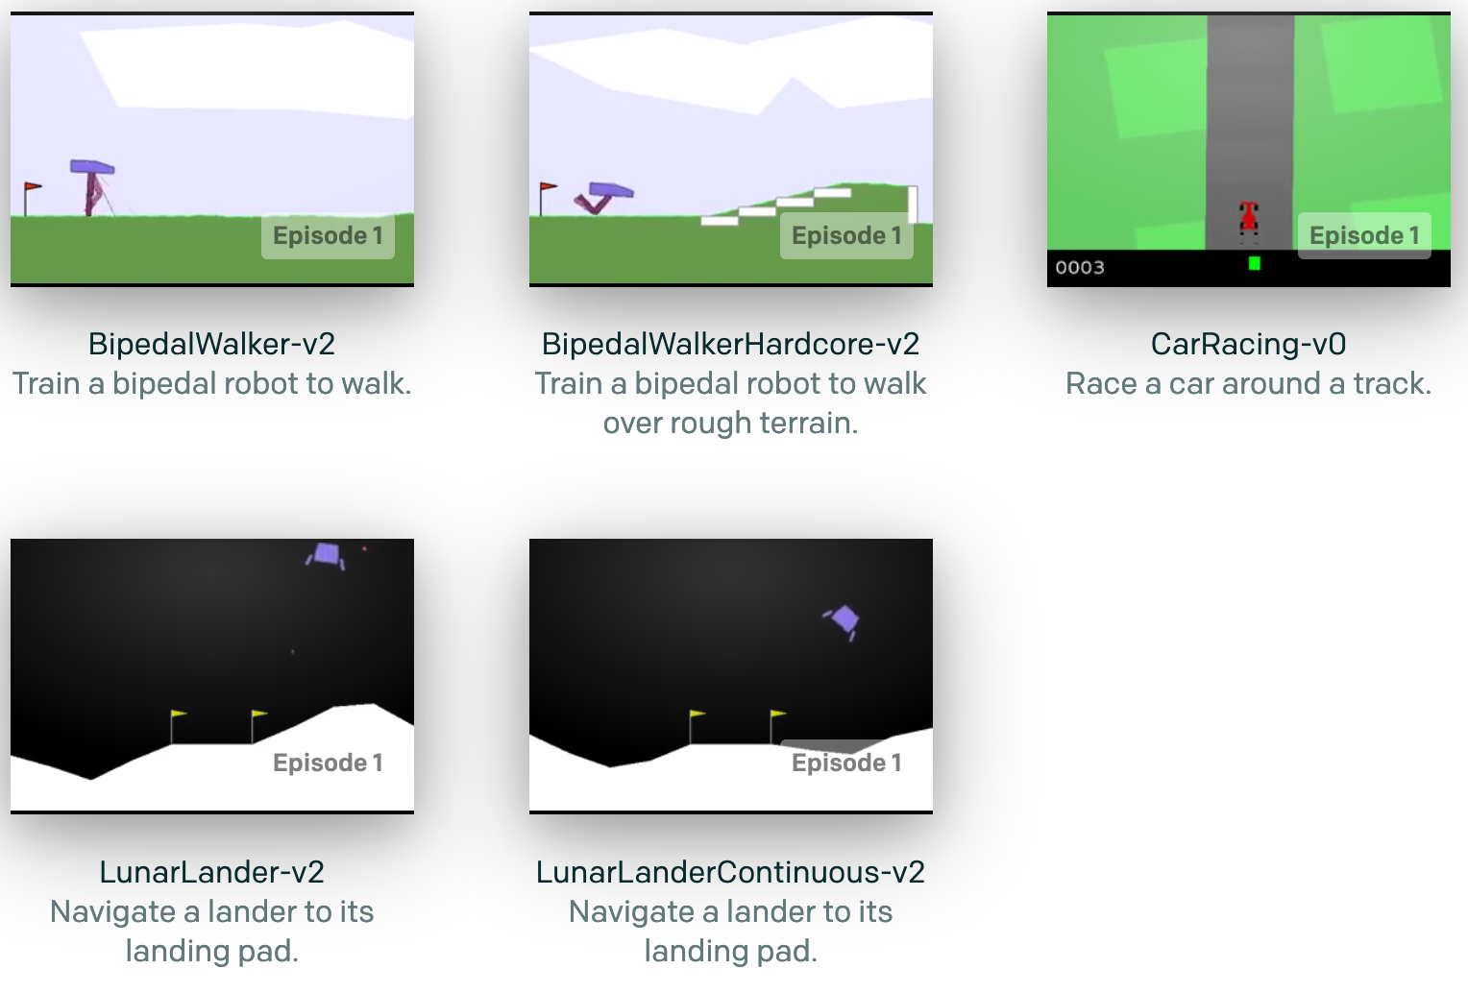
OpenAI Gym Environments
Text problems (easy)
Algorithms
Classic Control
Box2D

Slide 17
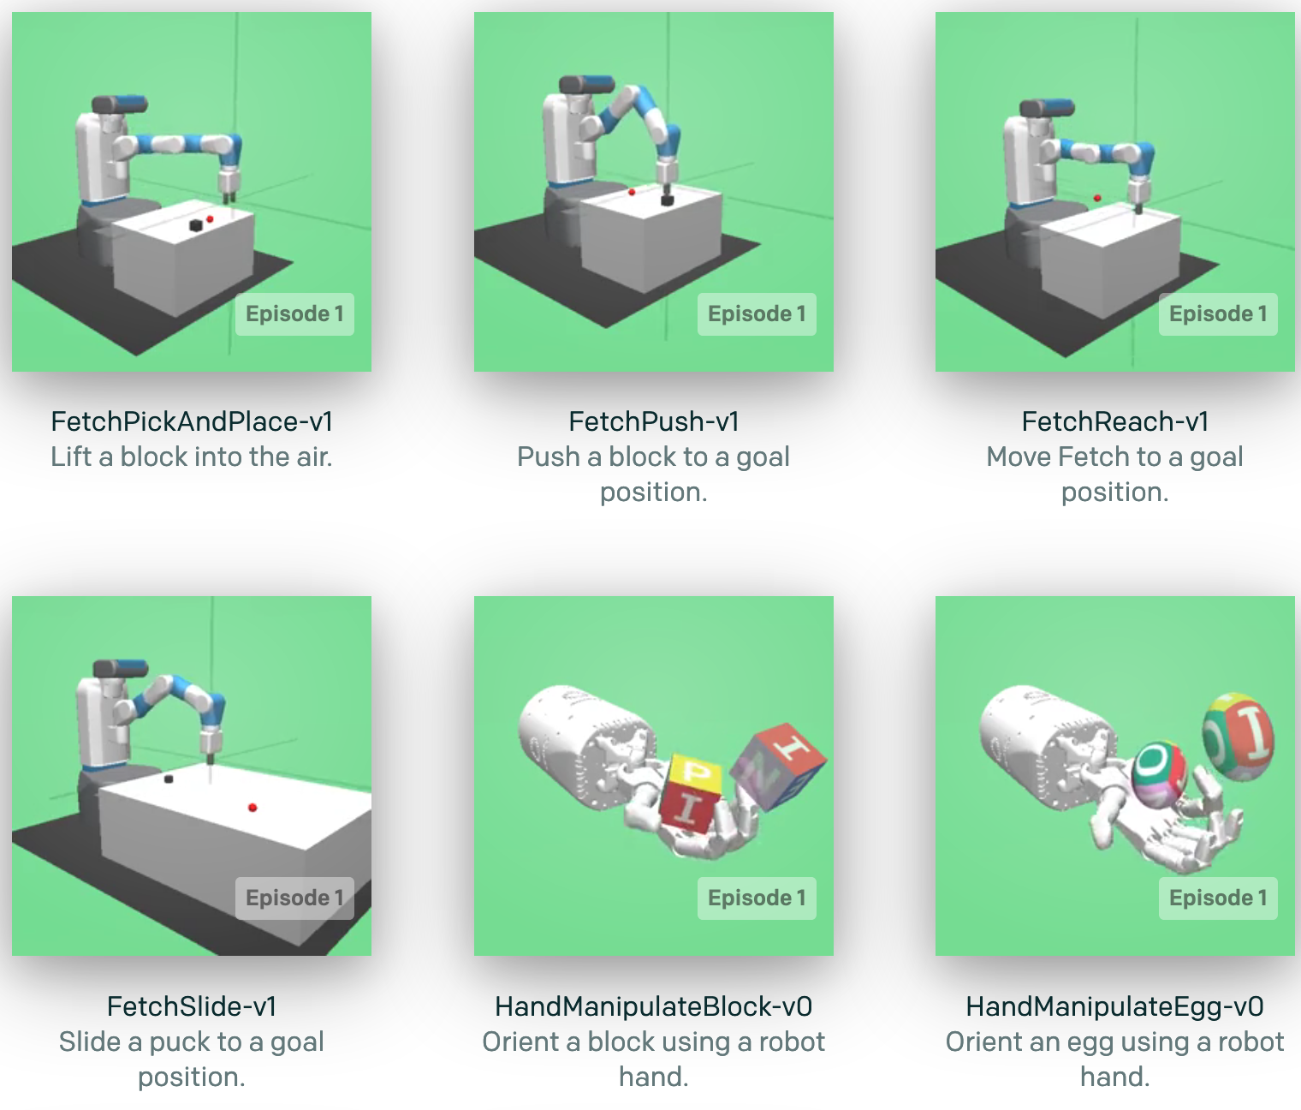
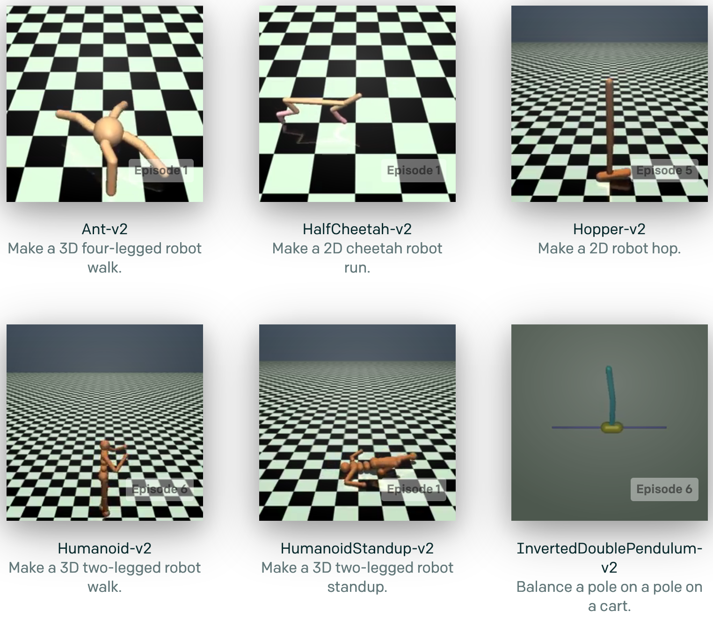
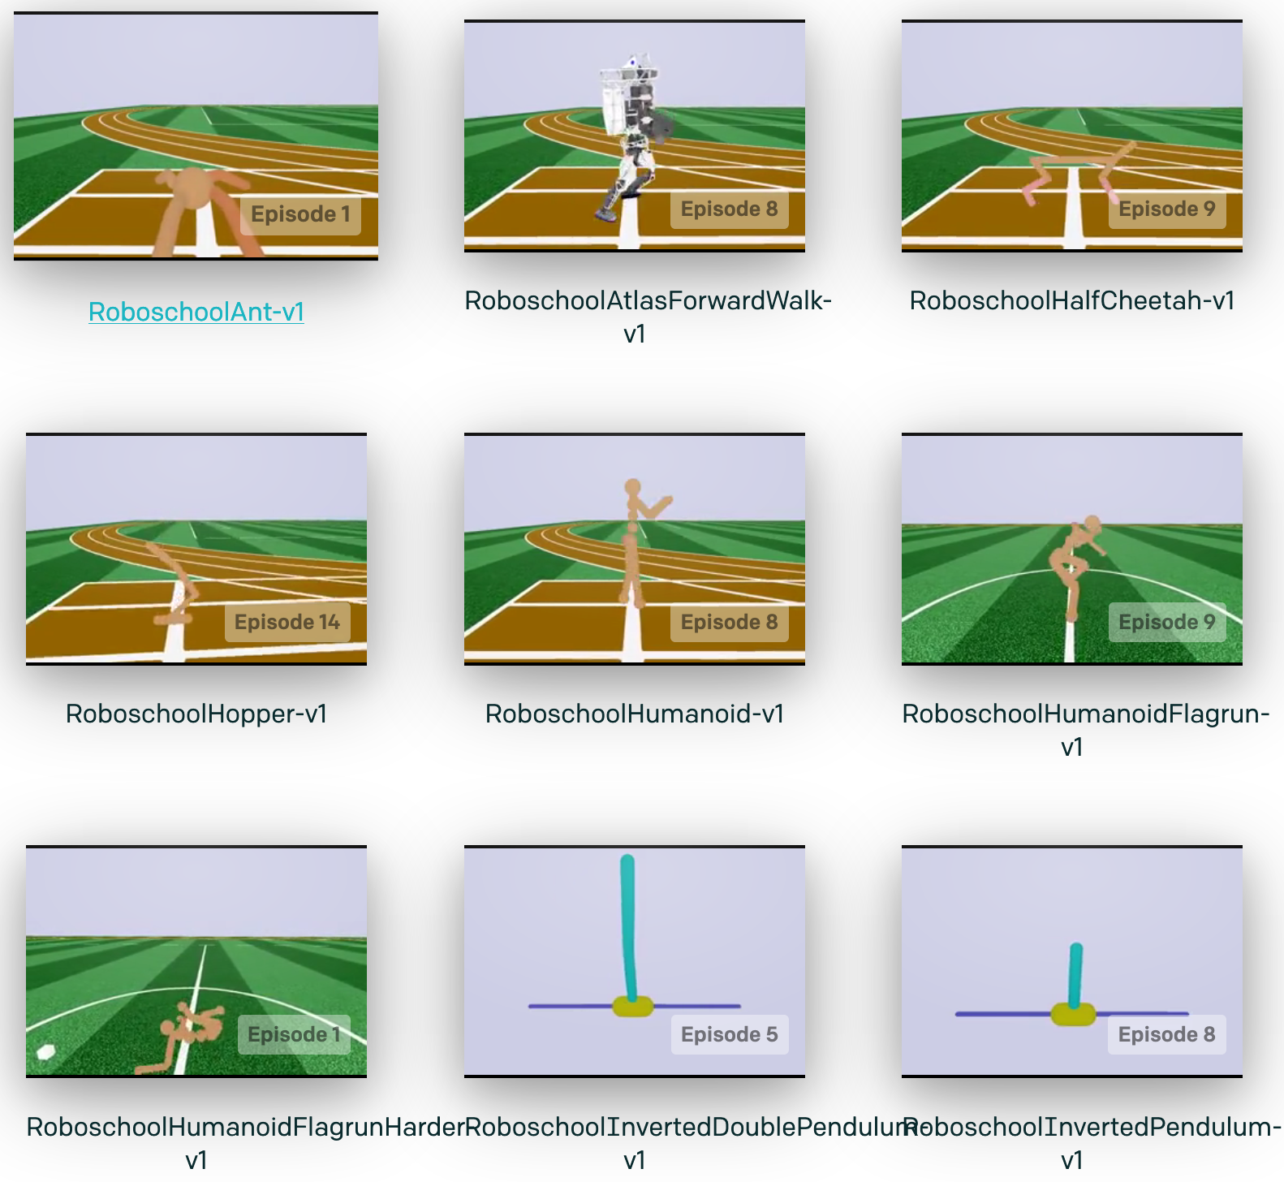
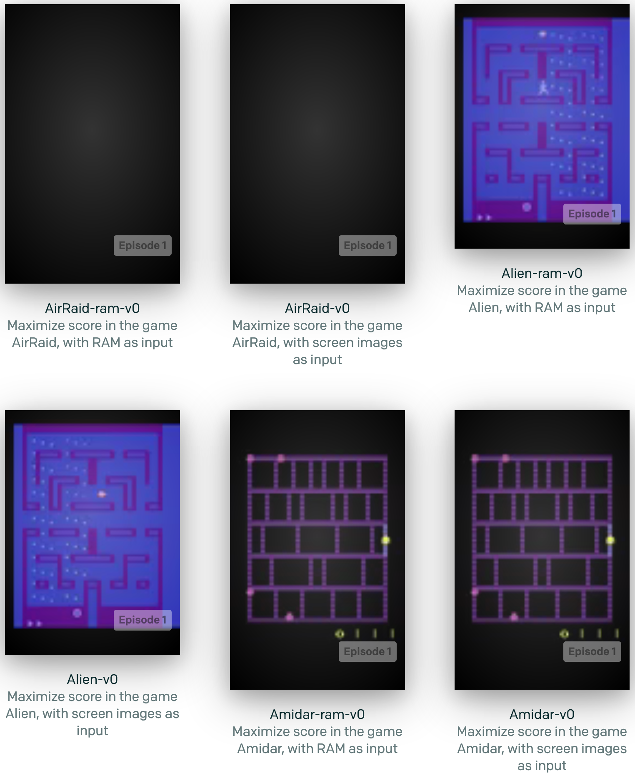
OpenAI Gym Environments
Robotics
Roboschool
MuJoCo
Atari

Slide 18
Resources
OpenAI: https://openai.com/
  ¹Charter: https://openai.com/charter/
  Gym: https://github.com/openai/gym
  Environments: https://gym.openai.com/envs
SoarTech NGS-4
  Main code: https://github.com/soartech/new-goal-system-4
  Example implementation: https://github.com/soartech/ngs4-tanksoar
  Soar Language Server for IDEs (NEW!)
    https://github.com/soartech/soar-language-server
Code demonstrated today
  https://github.com/timsaucer/SoarGym
Soar Python example:
  https://soar.eecs.umich.edu/articles/downloads/examples-and-unsupported/183-python-interface-example

Slide 19
Summary
Nuggets
Very low cost of entry
Focus on agent development instead of environment
Many scenarios with available benchmarks
Useful for Soar agent development beyond RL approaches
Coal
Some environments lack proper documentation
Reward links are not always optimal
Some environments require commercial engines

