Slide 1
20 Questions Revisited: Narrowing the Search Space for Models of Human Cognition
Bryan Stearns
University of Michigan
June 2021

Slide 2

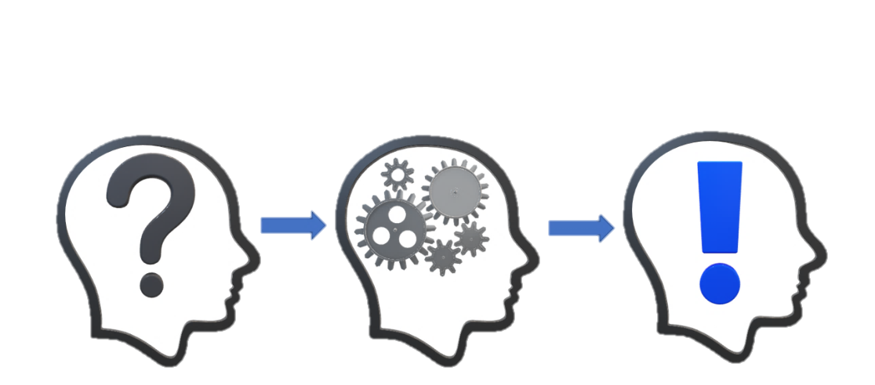
Context
Cognitive Modeling research
Just defended my dissertation
Lessons learned from PhD project

Slide 3

Dissertation Problem
My project:
  Cognitive model of human procedural learning
  Apply PRIMs theory (Taatgen, 2013) in Soar
Meta problem:
  How to know a cognitive model
  is an accurate model?
Taatgen, N. A. (2013). The nature and transfer of cognitive skills. Psychological Review, 120(3), 439–471.

Slide 4
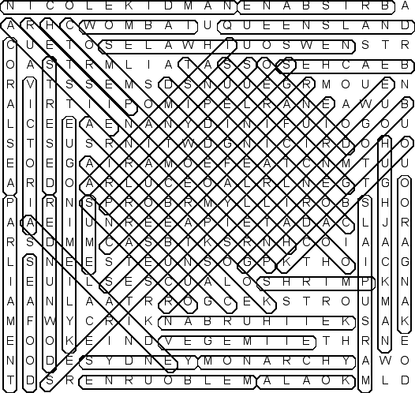
Identifiability Problems
Discovery Problem:
  Space of possible solutions is vast
  Little guidance for finding correct one
Uniqueness Problem:
  Many computational approaches produce equivalent external behavior
Anderson, J. R. (1993). Rules of the mind. L. Erlbaum Associates.

Slide 5

My Task
Compare ACT-R model of PRIMs theory
  Actransfer (Taatgen, 2013)
With my Soar model of PRIMs theory
  PROPs (Stearns & Laird, 2020)
ACT-R
Actransfer
PRIMs
PROPs
Taatgen, N. A. (2013). The nature and transfer of cognitive skills. Psychological Review, 120(3), 439–471.
Stearns, B., & Laird, J. E. (2020). Toward unifying cognitive architecture and neural task set theories.
Proceedings of the Forty-second Annual Conference of the Cognitive Science Society.

Slide 6
My Problem
Soar allows general computation
  Multiple ways to implement? (Discovery Problem)
Actransfer/PROPs both implement same high-level theory
  Expect same overall behavior (Uniqueness Problem)
  Different internal computation
How to evaluate?
ACT-R
Actransfer
>?
PRIMs
PROPs

Slide 7
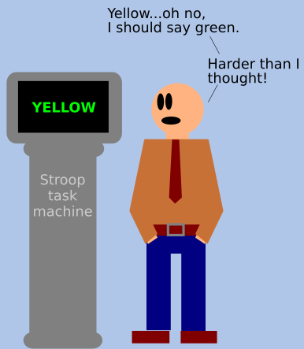
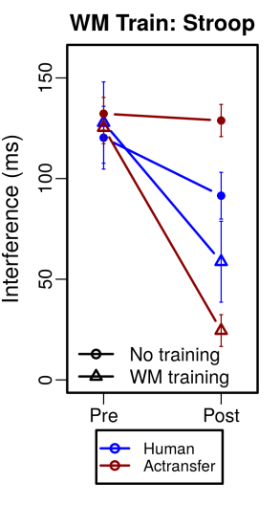
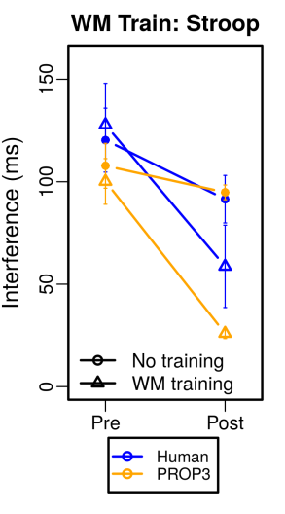
Example
Stroop task
  Answer the color of the text
Actransfer model
  Lower activation with incongruent perception
  Slower retrieval time
PROPs model
  Extra retrievals required for incongruent response
  More cycles
Which model is accurate? Either?

Slide 8
“Can’t Play 20 Questions”
Allen Newell’s (1973) “20 Questions” paper
  “You can’t play 20 questions with nature and win.”
  Too complex to look at small pieces alone
  Need better approaches for cognitive modeling
Proposed three paradigms to address problem
Newell, A. (1973). You can’t play 20 questions with nature and win: Projective comments on the papers of this symposium. Visual information processing (pp. 283–308). Elsevier Inc.

Slide 9
Newell’s Paradigms
“Construct complete processing models rather than the partial ones we now do. [...] Too much is left unspecified and unconstrained.”
“Accept a single complex task and do all of it. The current experimental style is to design specific small experiments to attempt to settle specific small questions.”
“Stay with the diverse collection of small experimental tasks, as now, but […]
construct a single system to perform them all.”
Newell, A. (1973). You can’t play 20 questions with nature and win: Projective comments on the papers of this symposium. Visual information processing (pp. 283–308). Elsevier Inc.

Slide 10
This Talk
Revisit Newell’s advice
  How I applied it for my work
  Can apply with today’s architectures in general
Reduce search space for human model
  Constraining approaches of possible models
  Increasing model complexity

Slide 11
Newell’s Paradigms
(Emphasis mine)
“Construct complete processing models rather than the partial ones we now do. [...] Too much is left unspecified and unconstrained.”
“Accept a single complex task and do all of it. The current experimental style is to design specific small experiments to attempt to settle specific small questions.”
“Stay with the diverse collection of small experimental tasks, as now, but […]
construct a single system to perform them all.”
Newell, A. (1973). You can’t play 20 questions with nature and win: Projective comments on the papers of this symposium. Visual information processing (pp. 283–308). Elsevier Inc.

Slide 12
Newell’s Paradigms
(Emphasis mine)
“Construct complete processing models rather than the partial ones we now do. [...] Too much is left unspecified and unconstrained.”
“Accept a single complex task and do all of it. The current experimental style is to design specific small experiments to attempt to settle specific small questions.”
“Stay with the diverse collection of small experimental tasks, as now, but […]
construct a single system to perform them all.”
Comprehensive
Model every part of the theory
  Include support processes
Newell, A. (1973). You can’t play 20 questions with nature and win: Projective comments on the papers of this symposium. Visual information processing (pp. 283–308). Elsevier Inc.

Slide 13
Newell’s Paradigms
(Emphasis mine)
“Construct complete processing models rather than the partial ones we now do. [...] Too much is left unspecified and unconstrained.”
“Accept a single complex task and do all of it. The current experimental style is to design specific small experiments to attempt to settle specific small questions.”
“Stay with the diverse collection of small experimental tasks, as now, but […]
construct a single system to perform them all.”
Do all of the task
  Do each kind of processing
Use each part of architecture
  Consistently with each other
  Consistent with architecture design
Consistent
Newell, A. (1973). You can’t play 20 questions with nature and win: Projective comments on the papers of this symposium. Visual information processing (pp. 283–308). Elsevier Inc.

Slide 14
Newell’s Paradigms
(Emphasis mine)
“Construct complete processing models rather than the partial ones we now do. [...] Too much is left unspecified and unconstrained.”
“Accept a single complex task and do all of it. The current experimental style is to design specific small experiments to attempt to settle specific small questions.”
“Stay with the diverse collection of small experimental tasks, as now, but […]
construct a single system to perform them all.”
Task-independent
Single system for many tasks
  No over-fitting one task
  No tailoring model for just external results
Newell, A. (1973). You can’t play 20 questions with nature and win: Projective comments on the papers of this symposium. Visual information processing (pp. 283–308). Elsevier Inc.

Slide 15
Desiderata for Models
Apply these to my PROPs model
Comprehensive
Consistent
Task-independent

Slide 16
Desiderata for Models
Comprehensive
Consistent
Task-independent

Slide 17
1. Comprehensive
Comprehensive
Consistent
Task-independent
Theory can need multiple support processes
  Decision making
  Declarative retrieval
  Planning
  Etc.
Not needed to test standalone idea
  Could just assume they work
But support processes can add constraint
  Can shape the rest of the theory
A
??
C
A
B
C

Slide 18
Constrains Theory
Comprehensive
Consistent
Task-independent
Defining support processes can constrain
  Knowledge representation
  System communication
  Processing time
Makes concrete
A
B
C

Slide 19
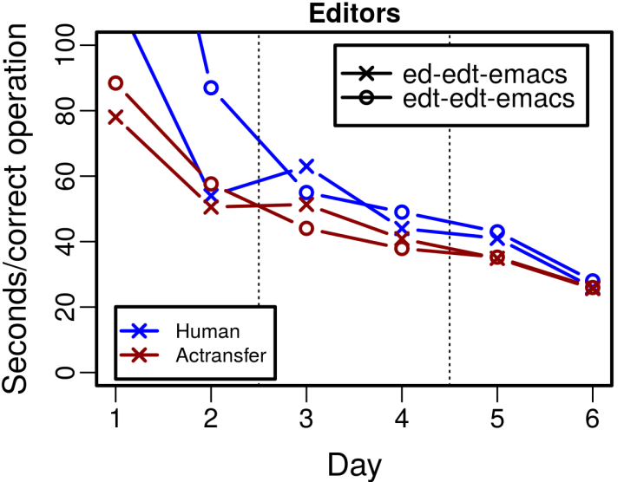
Example
Comprehensive
Consistent
Task-independent
PRIMs
Actransfer
Actransfer
  Learns rules after executing retrieved instruction
  Assumes agent retrieves correct instruction first
ACT-R
Evaluate
Init
Retrieve
Execute
Learn
Assumed

Slide 20

Example
Comprehensive
Consistent
Task-independent
PRIMs
PROPs
  Learn links to SMEM for spreading activation
  Activation leads agent to retrieve correct result
PROPs
Evaluate
Init
Retrieve
Execute
Learn
Defined

Slide 21
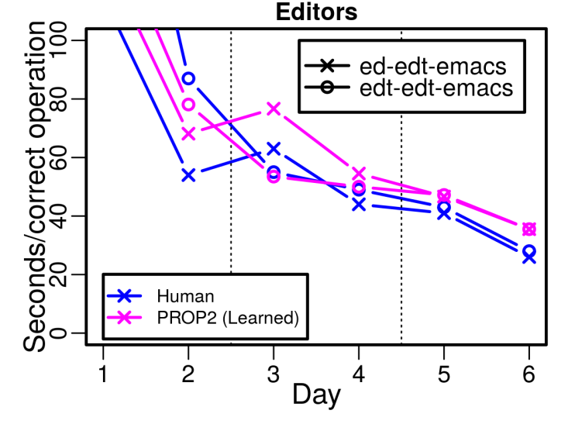
Example
Comprehensive
Consistent
Task-independent
Changes learning curve!
  Agent learns retrieval while practicing instruction
Test
Init
Retrieve
Execute
Learn
Defined

Slide 22
2. Consistent
Comprehensive
Consistent
Task-independent
Internal consistency
  “Do all of the task”
    Use all relevant architecture parts coherently
  “Listen to the architecture”
    Use parts in manner supported by prior research
External consistency
  What is known about human processing

Slide 23
Example
Comprehensive
Consistent
Task-independent
Actransfer
Actransfer
  Retrieve single most-activated instruction
  Then do instruction
Retrieval effectively replaces decision making
  Inconsistent!
Declarative Memory
Retrieve
Decision Making
Do-A
Working Memory
Do-B
Do-C
Do-B

Slide 24
Example
Comprehensive
Consistent
Task-independent
PROPs
  Retrieve multiple choices
  Let decision making select
PROPs
Declarative Memory
Retrieve
Select
Decision Making
Do-A
Working Memory
Do-B
Do-B
Do-C
Do-C

Slide 25
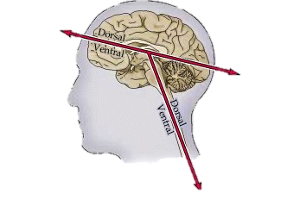
Example
Comprehensive
Consistent
Task-independent
Led to new data structure
  Soar problem spaces as declarative instruction format
Connection with Task Set theory
  (Sakai, 2008)
Declarative Memory
Retrieve
Select
Decision Making
D
B
E
Working Memory
Image from (Purves et al., 2001)
A
F
D
C
G
B
E
Cognitive
Sensory
Purves D, Augustine GJ, Fitzpatrick D, et al., editors. Neuroscience. 2nd edition. Sunderland (MA): Sinauer Associates; 2001. Some Anatomical Terminology.
Sakai, K. (2008). Task set and prefrontal cortex. Annual Review of Neuroscience, 31(1), 219-245.

Slide 26


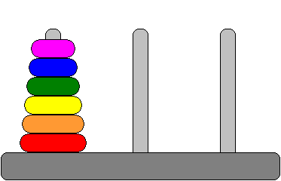

3. Task-Independent
Comprehensive
Consistent
Task-independent
BIG constraint!
Not just architecture, but main agent rules too
  Whole system
  Same model of cognition for all tasks
Vary task instructions/strategy only
  Anything learned

Slide 27
Fewer Solutions
Comprehensive
Consistent
Task-independent
Many ways to model mental arithmetic
Many ways to model Stroop task
Fewer that can do both
Even fewer can also do Towers of Hanoi
Each additional task constrains solutions

Slide 28
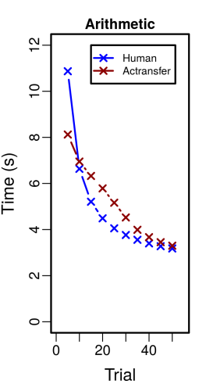

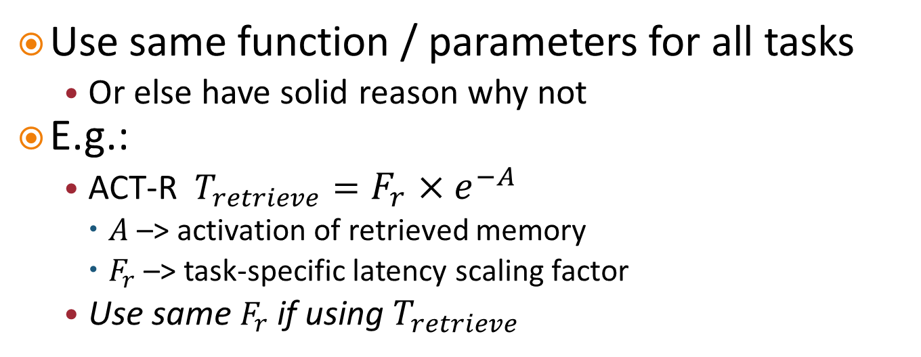


Constrains Timing
Comprehensive
Consistent
Task-independent
Use same function / parameters for all tasks
  Or else have solid reason why not
E.g.:
  ACT-R $T_{retrieve}=F_{r}×e^{−A}$
    $A$ –> activation of retrieved memory
    $F_{r}$ –> task-specific latency scaling factor
  Use same $F_{r}$ if using $T_{retrieve}$
$$F_{r}=.15$$
$$F_{r}=1.5$$

Slide 29

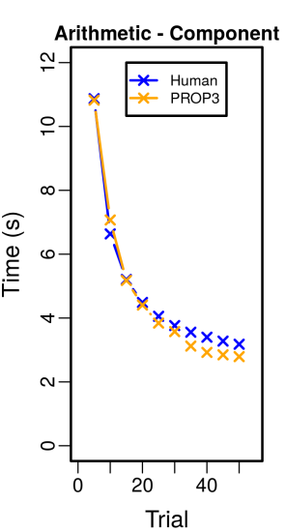
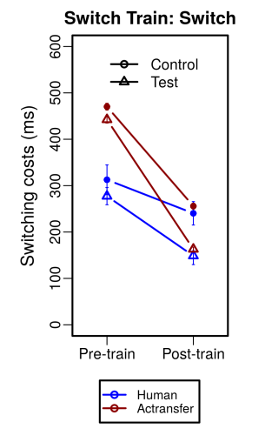
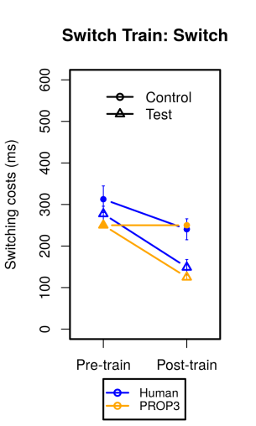
Example
Comprehensive
Consistent
Task-independent
Model of learning arithmetic task
Use same system for task-switching task
  Add constraint of same timing function
New timing model
Fewer variables
  More explanatory power

Slide 30
Summary
Smaller space of models that are:
  Comprehensive
  Consistent
  Task-independent
Increased constraint focuses model design
  Can lead to improved model!

Slide 31
Reducing Identifiability Problems
Increased complexity reduces behavior similarity
  Reduced Uniqueness Problem
+ More rigorous constraints reduce number of possible models
  Reduced Discovery Problem

Slide 32
We Need to Step Up!
More rigorous modeling
  Requires more planning
  Requires more development work
But result is powerful
  Single system can do many tasks
  Apply to AI?
I believe the field is ripe for this

Slide 33


Conclusion
Nuggets
  Specified computation Offers more precise theory comparison
  Ability to model more tasks
  Results in more constrained search for human model
Coal
  Bigger systems, more effort
  Identifiability problem still out there, even if reduced

Slide 34
20 Questions Revisited
Bryan Stearns
Thank you

