Slide 1
Goals from Partial Grounding of Constraints
Steven Jones, Robert Wray
(steven.jones@cic.iqmri.org)
Soar Workshop 2024
integratedcognition.ai
Accepted for presentation at CSCI 2023.
Notes:
This talk is about a grounding algorithm implemented in Soar that helps agents form specific goals about its situation so that it can “follow the rules”

Slide 2



“Following the Rules”
Autonomy (in the scope of real-world interaction) requires that agents (have the capacity to) “follow the rules”
“Following the Rules” is sensitive to multiple, specific contexts
  Contexts:
    Long-term goals/values, tasks, environment, culture, …
  Individual contexts introduce various constraints:
    Physical/operational constraints (safety), rules & laws, social norms, ethical and moral considerations, etc.
Long-term goal: General algorithms for “following the rules”
  In contrast to: Changing rules, limiting to pre-defined contexts, …
Notes:
To deploy agents in the world, we need them to be able to follow the rules. But there are many different contexts an AI agent can face.

Slide 3
What makes “following the rules” difficult?
Systems of rules/constraints are “messy”
Partial observability
  Cannot always “perceive” status of a constraint
Dynamic, fail-hard environments
  Unexpected dynamics can impact status of a constraint
  Discontinuities (with novel constraints)
  Known constraints also can change over time
Abstract and poorly defined constraints
  “Use caution near pedestrians”
  Human interpretations can differ; prefer agent develop its own interpretation (disintermediation)
Implicit context specification
  Agent must decide if a constraint is applicable in a situation or context
Interactions & conflicts between constraints, tasks & contexts
  Systems of rules/constraints can not be assumed to be coherent
Notes:
Why is this hard? “following the rules” doesn’t just mean solving a constraint satisfaction problem, there are many complications to face together.
We don’t necessarily deal with all of these yet, but this is what we keep in mind and represents a target for the complexities an agent has to deal with.

Slide 4
Goal: Constraint Compliance
Constraint compliance: general strategy(ies) for effectively dealing with systems of rules/constraints integrated within task performance
Constraint compliance must:
Continuously evaluate constraints & situation in dynamic environments
  Constraint compliance must be an (overall) efficient process
Satisfice
  Often not feasible to satisfy all applicable constraints all the time (over-constrained)
  Not all ambiguity in constraint specification can be resolved in the moment
Respond to new contexts, new goals & tasks, new constraints
  Preparation (instruction, pre-training, etc.) is helpful but not sufficient

Slide 5
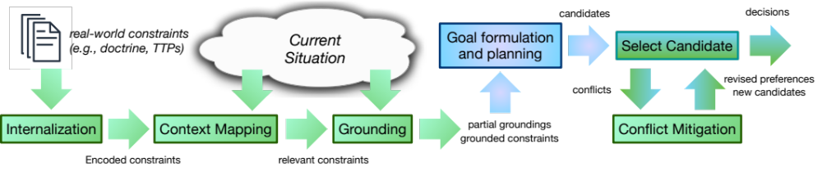
What problems would we have to solve to get a Soar agent to follow the rules?
Part of a broader computational-level analysis (in the sense of Marr) of constraint compliance: Wray, R. E., Jones, S., & Laird, J. E. (2023). Computational-level Analysis of Constraint Compliance for General Intelligence. Proceedings of the 2023 Artificial General Intelligence (AGI) Conference.

Slide 6
What problems would we have to solve to get a Soar agent to follow the rules?
Relate general constraints to the situation to make specific goals
Part of a broader computational-level analysis (in the sense of Marr) of constraint compliance: Wray, R. E., Jones, S., & Laird, J. E. (2023). Computational-level Analysis of Constraint Compliance for General Intelligence. Proceedings of the 2023 Artificial General Intelligence (AGI) Conference.
Notes:
Wanted to focus in on this one computational problem within our proposed pipeline. That’s the focus in our paper for CSCI.
Not just solving grounding of constraints, but also making sure that solution is viable in this pipeline, which means it can be used in realtime to generate constraint-relevant goals that an autonomous agent integrates with its ongoing tasks.

Slide 7
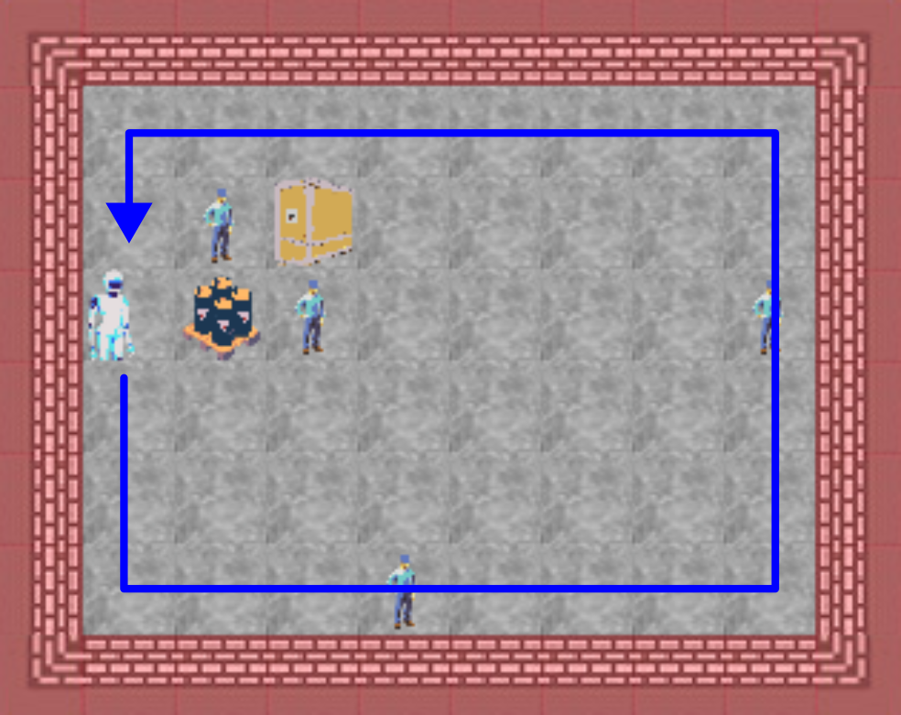
Experimental Task: Patrol
Check the perimeter of the warehouse:
achieving a minimum threshold of coverage for the wall-adjacent cells
without exceeding your resources for movement

Slide 8
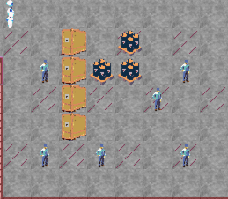
The Partial Grounding Challenge
Often not possible to fully ground a relevant constraint
  “maintain a 3s distance when following on dry payment”
  “personnel must have a valid ID in a restricted area”
  → satisfied, unsatisfied, or indeterminate (“tri-state”)
To fully ground, the agent must take some action
  Estimate distance between my vehicle and the one ahead
  Evaluate validity of some unrecognized person’s ID
Current approach:
  Compile constraint grounding analysis
  (System-2-like → System-1-like)
  Recognize when grounding action (measurement) is needed
  Incorporate measurement goals into planning
Maritime Security (MARSEC) examples:
All personnel in a restricted area must have a valid ID
Notes:
Not even just about active inference – you have to detect the extent of what you already know – active inference is to some extent what you can begin to solve after you’ve solved this. (What are the statuses of constraints I care about, given what I’ve observed?)

Slide 9
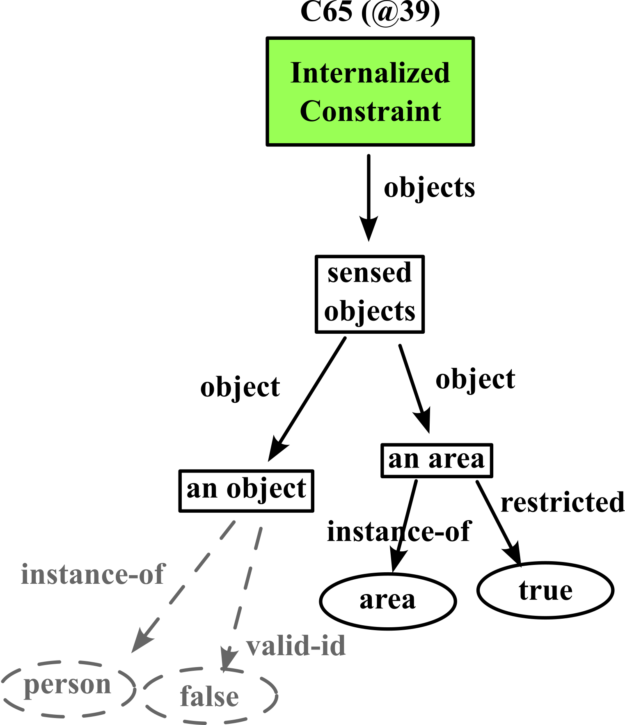
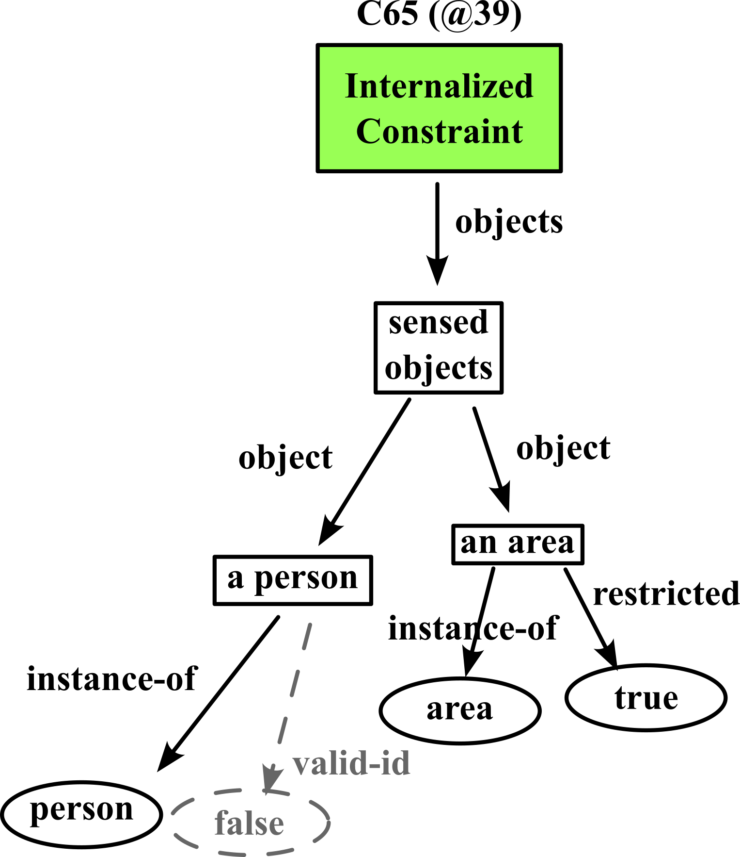
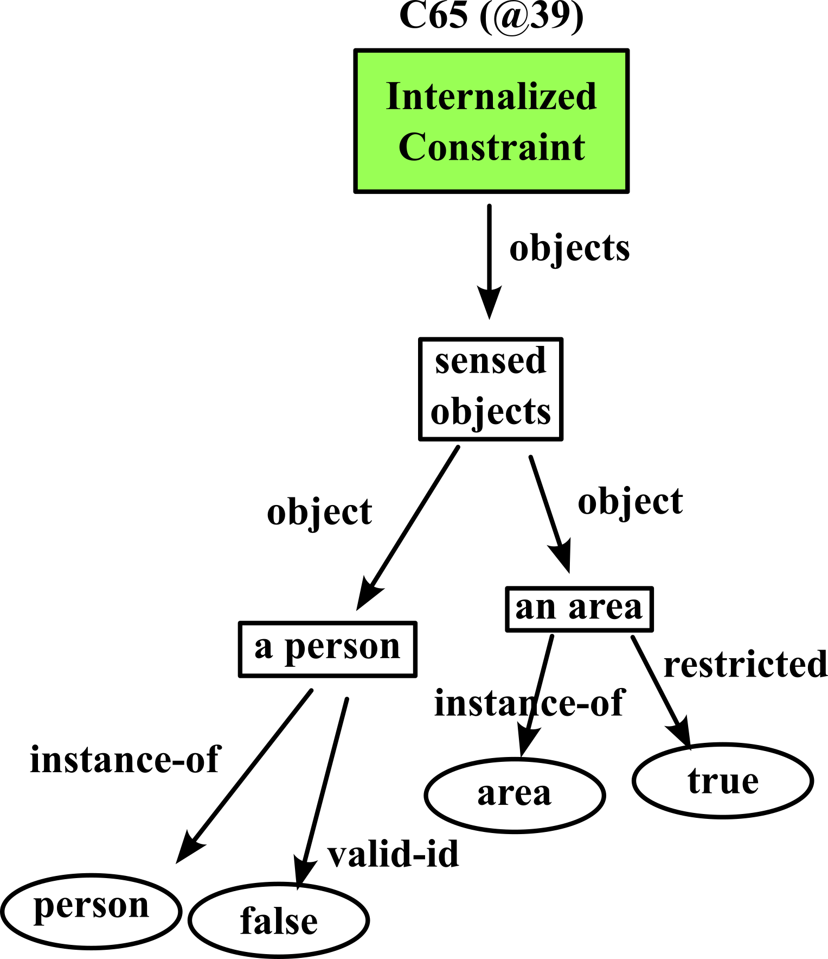
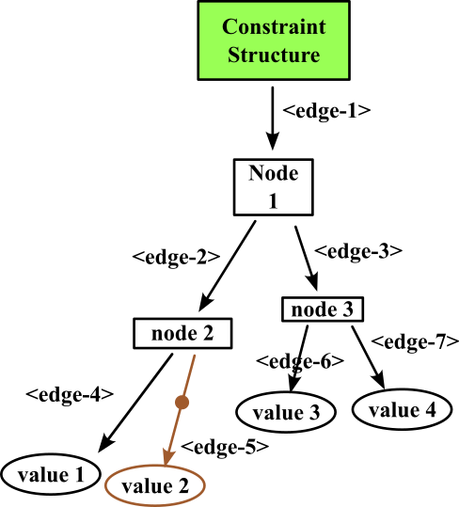
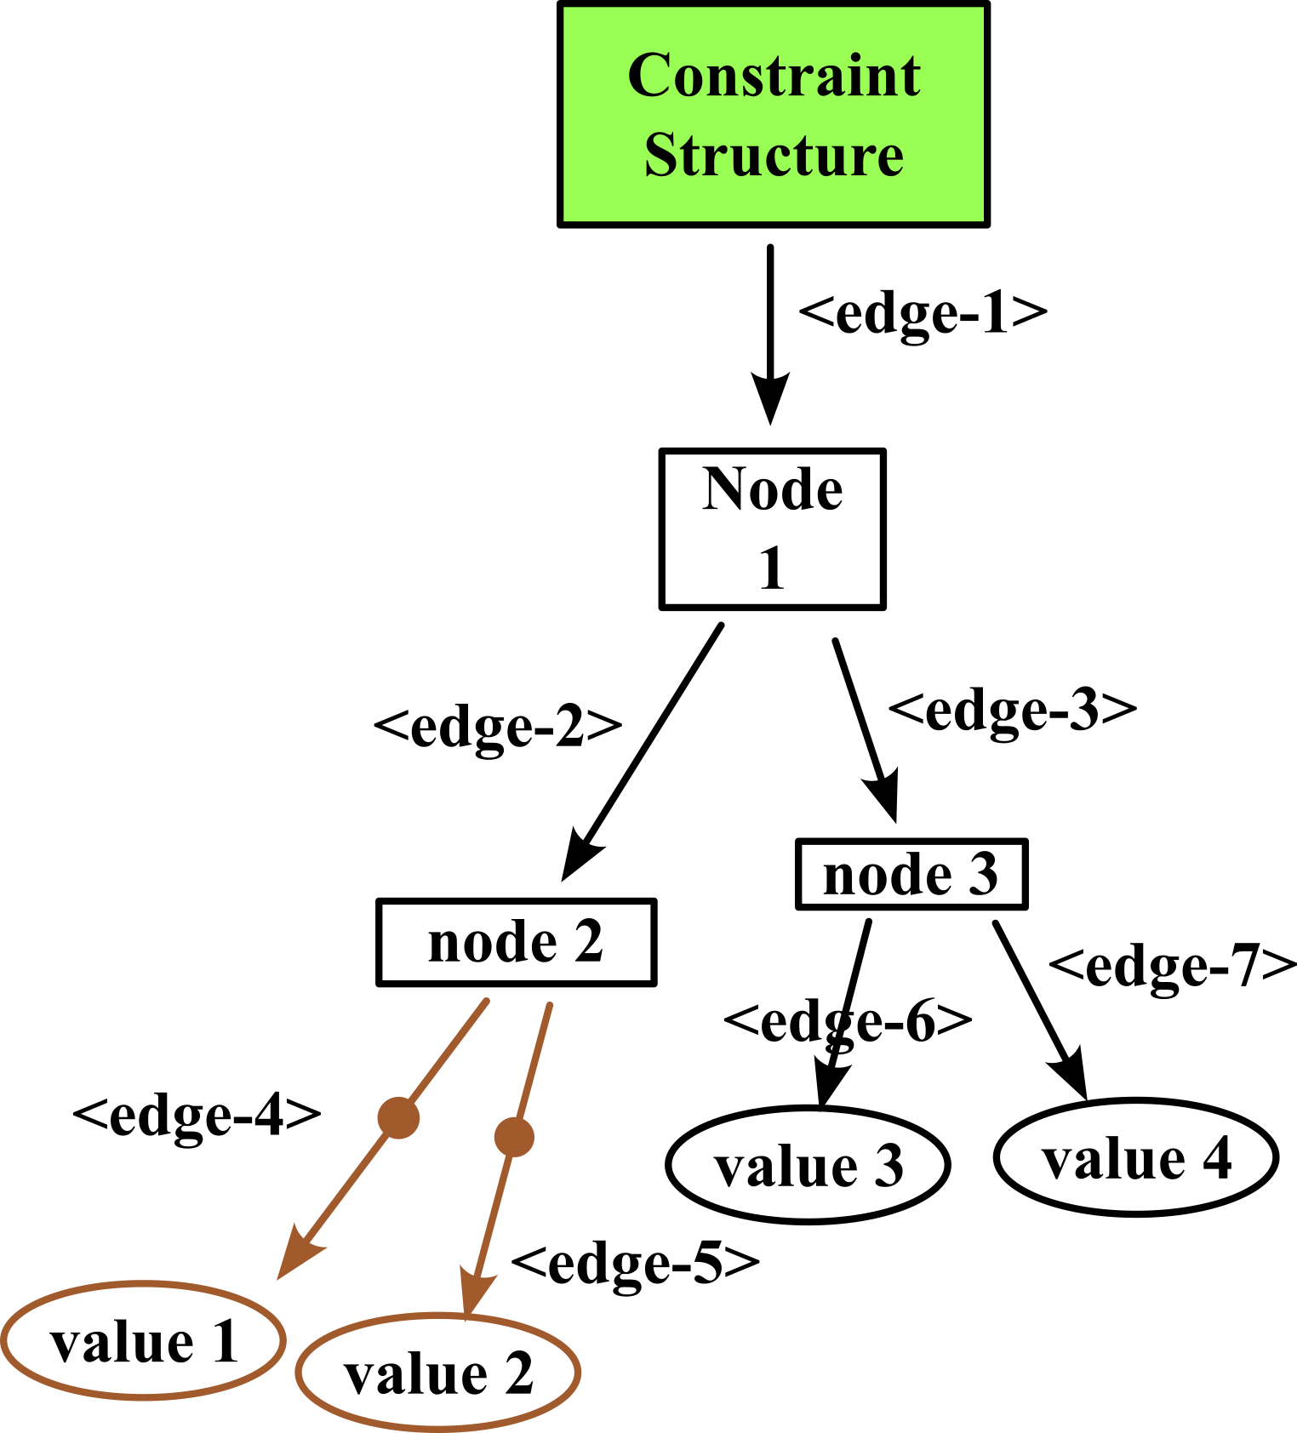
Constraint Grounding:
(Anticipatory) Structural Analysis
Structural Analysis Steps
Example:
All personnel in a restricted area must have a valid ID
Attempt to ground. If known, done.
If constraint structure unknown, exhaustively generate all possible (partial) groundings as fake states for matching
For each fake state:
  incrementally crawl state graph while incrementally matching specification graph to learn groundings
  Report resultant match: Chunking creates new abstract structure recognition knowledge that will immediately recognize situations that result in a (partial) grounding.
Notes:
Emphasize that there are two graphs in the agent

Slide 10
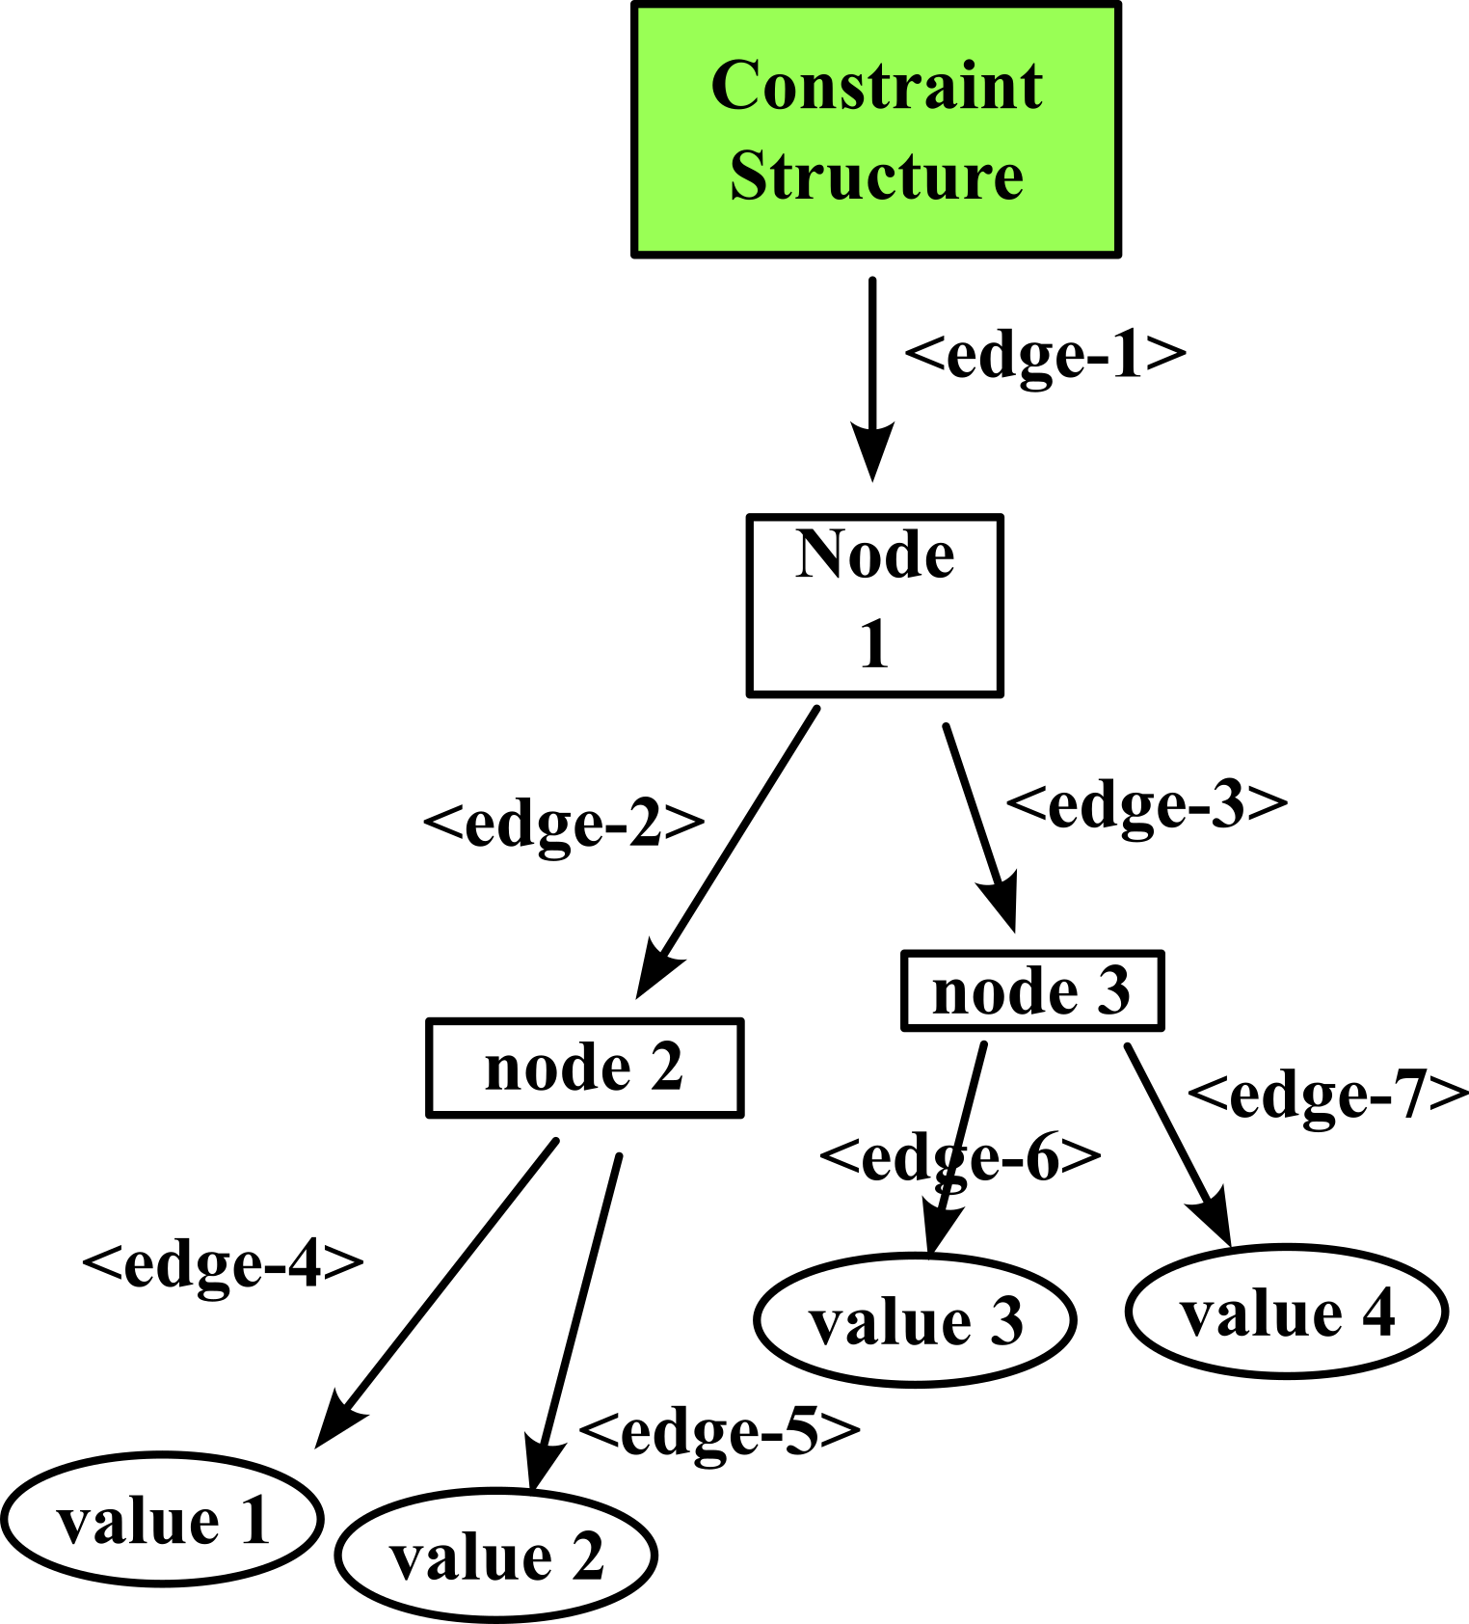
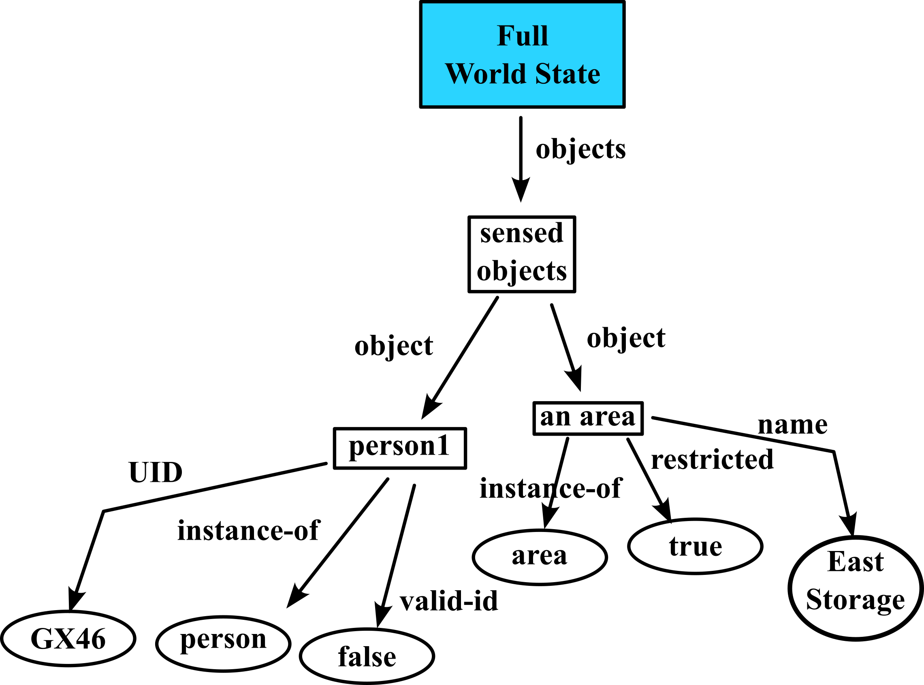
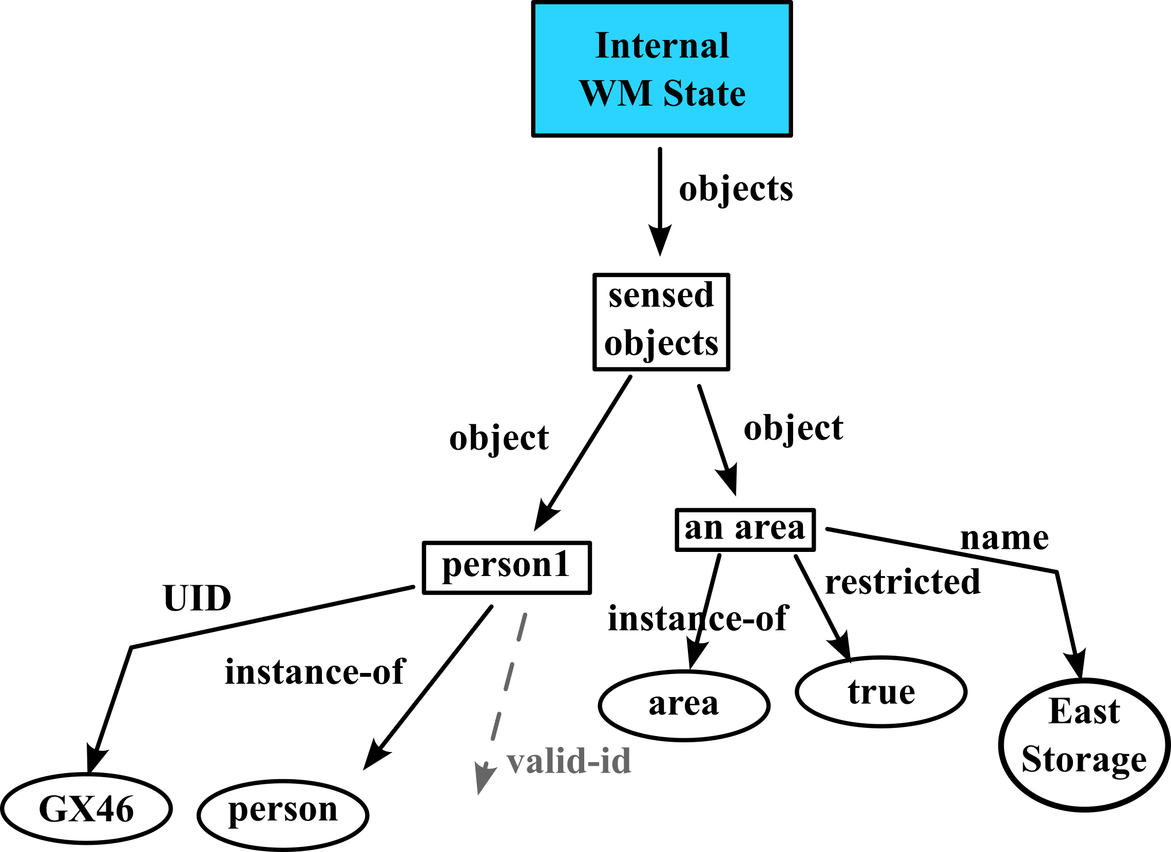
Constraint Grounding: Instantiation
Instantiation Steps
Map current situation
(real state) to constraints
  Recognize instances of grounded constraints
If partial grounding is recognized, generate
goal to resolve
(e.g., measurement)
Notes:
Emphasize now that the agent just takes the same recognition knowledge from before and just applies it to the real world instead at this point.
It’s about knowing what you don’t know to some extent.
That’s what partial grounding gives us – it’s the ability to recognize what to look for based on what you already know to determine whether a constraint is being violated

Slide 11
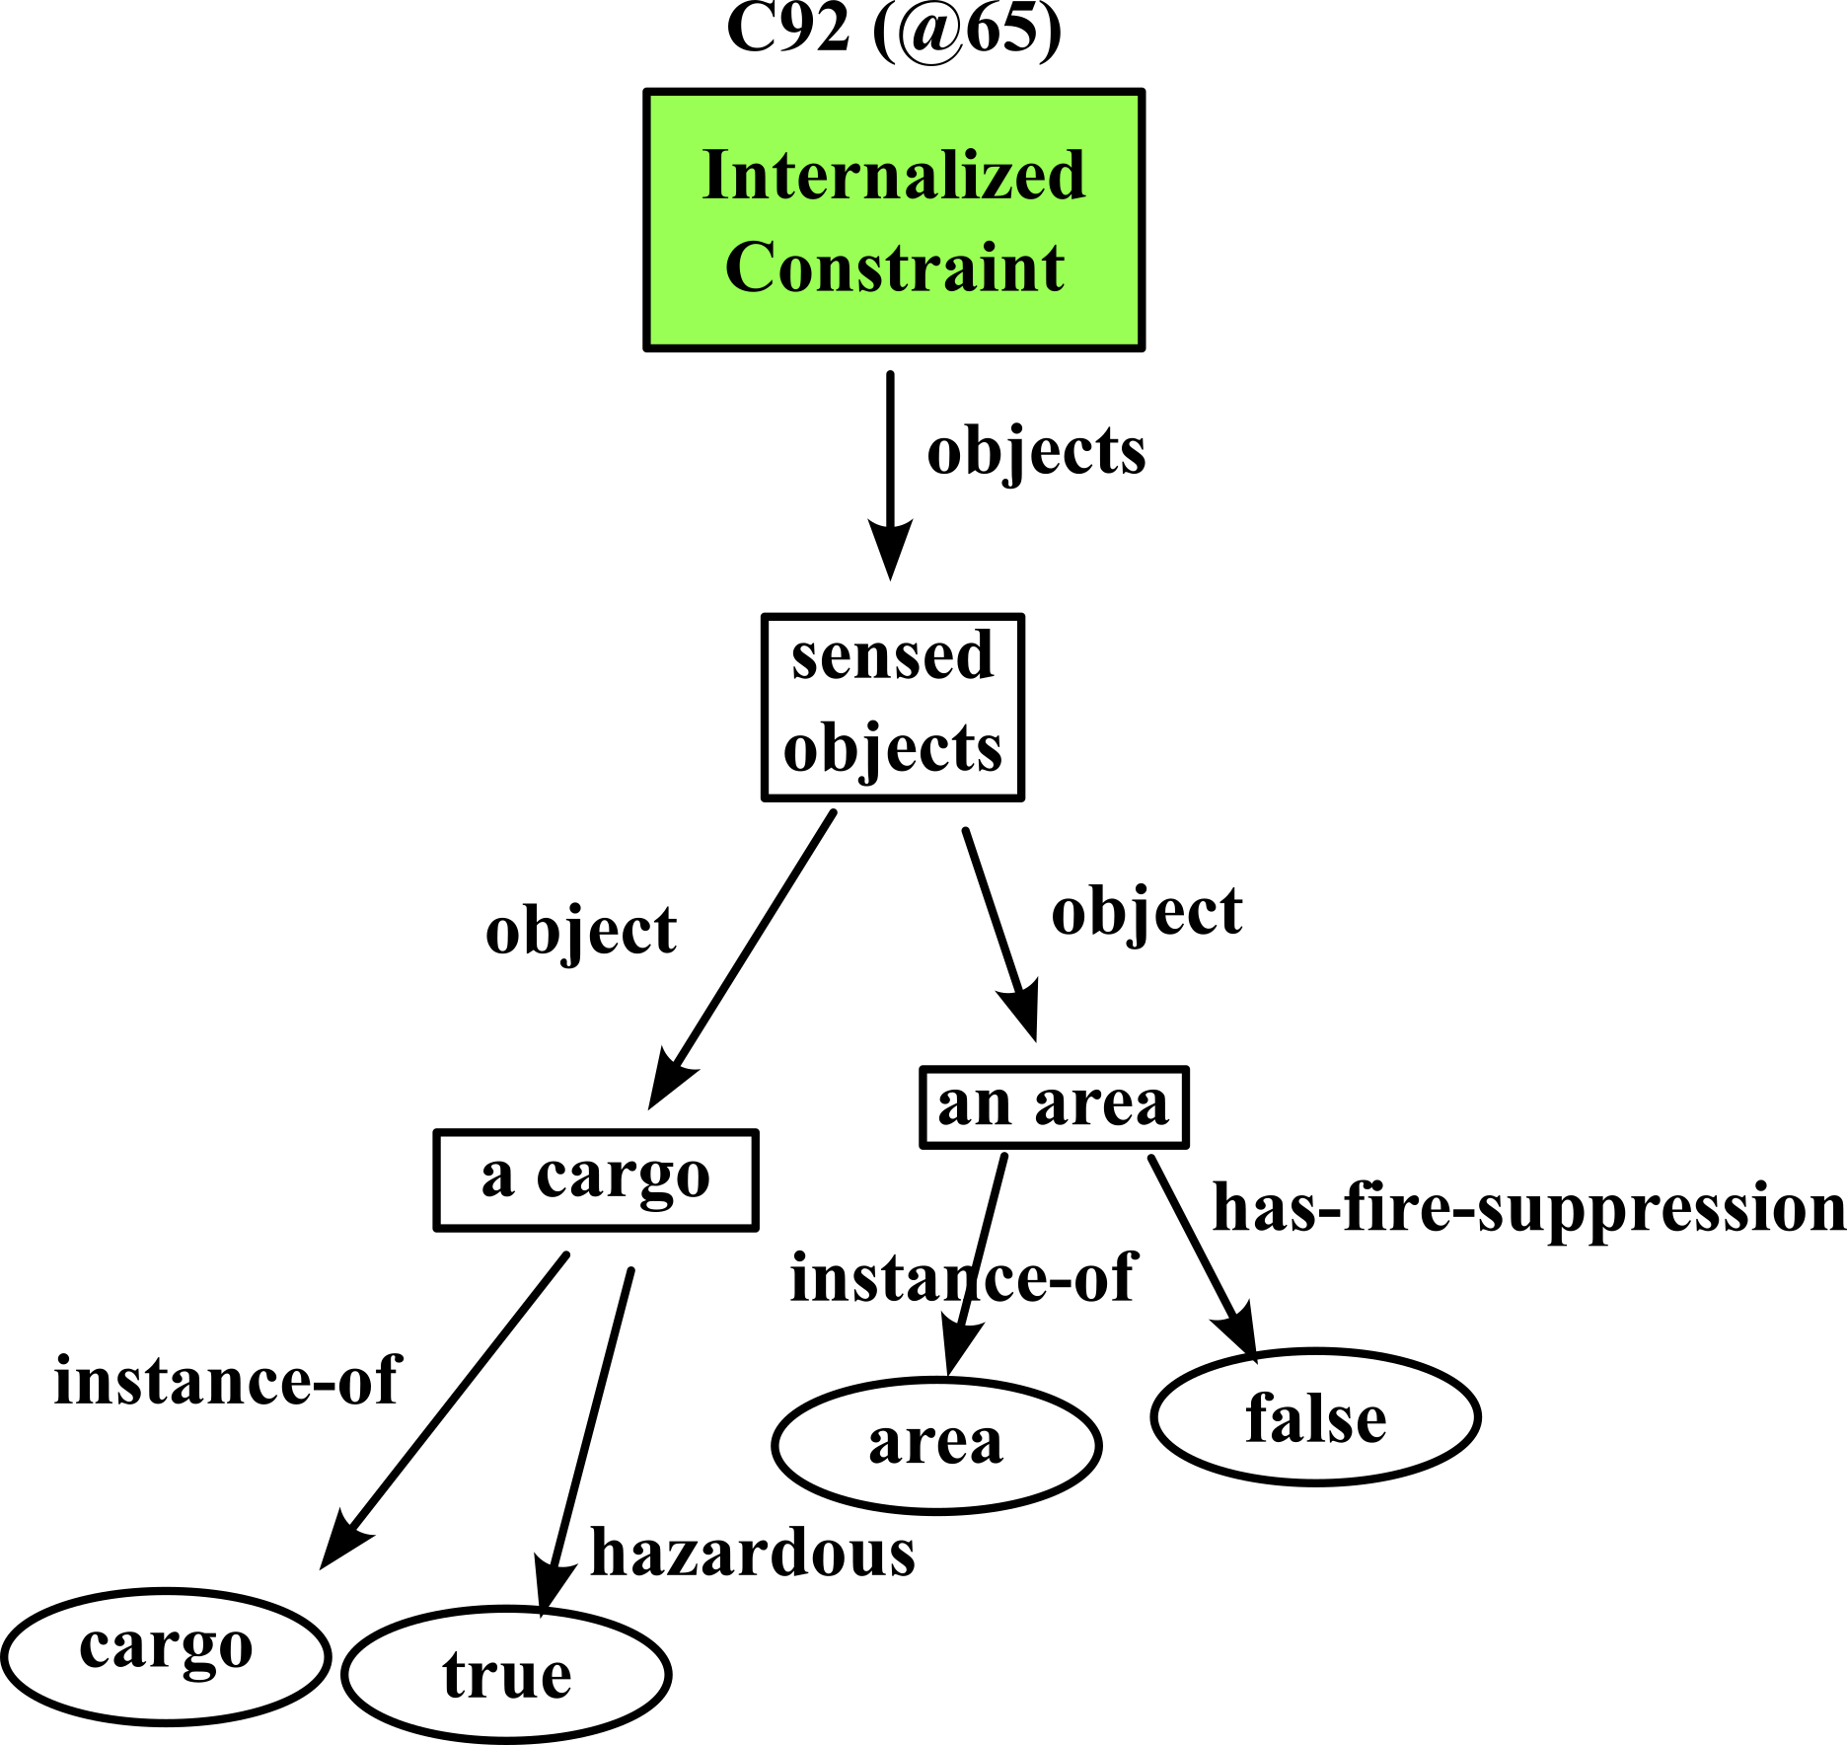
Encountering Novel Constraints
Example: No hazardous materials can be stored in an area lacking fire suppression
Incremental, structural analysis enables agent to adapt to novel constraints “on the fly” without pre-training
Known conditions: Immediate adaptation
Notes:
The learning I’ve talked about was designed to be sensitive to the structure of constraints. The idea is that when we introduce a new constraint, but with known structure like that in a previous constraint, because our system learns, it will now also be able to recognize groundings for this new constraint.

Slide 12
Encountering Novel Constraints
Example: No hazardous materials can be stored in an area lacking fire suppression
Incremental, structural analysis enables agent to adapt to novel constraints “on the fly” without pre-training
Known conditions: Immediate adaptation
Novel conditions: reason about those (but only novel conditions, not typically the whole constraint)
As the agent gains experience and sees more types of constraints, its knowledge/expertise transfers to novel constraints

Slide 13
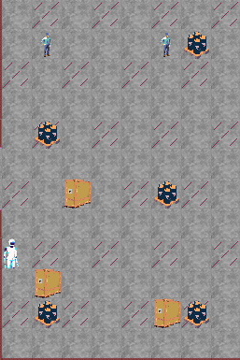
Encountering Novel Constraints
Incremental, structural analysis enables agent to adapt to novel constraints “on the fly” without pre-training
Known conditions: Immediate adaptation
Novel conditions: reason about those (but only novel conditions, not typically the whole constraint)
As the agent gains experience and sees more types of constraints, its knowledge/expertise transfers to novel constraints
Integrated fire suppression fails…
Wooden crates should not be stored next to hazardous barrels when they are stored in an area that lacks integrated fire suppression

Slide 14
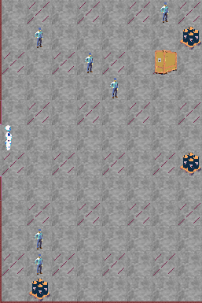
Preliminary Evaluation (Testbed)
Grounding creates measurement goals
Grounding creates “fix the violated constraint” goals
Evaluation Scenario
Regular patrol (confirm building integrity by continuously circling outer walls). 10 agent circuits constitute one “patrol shift”.
  Cannot determine “hazardous” or “valid ID” unless in same cell
Includes all constraints. Emphasis on check-ID constraint
  Scenario adds persons without IDs every circuit
  “Escort” removes offenders (not part of evaluation)
Accruing penalty for every person without a valid ID in restricted area

Slide 15
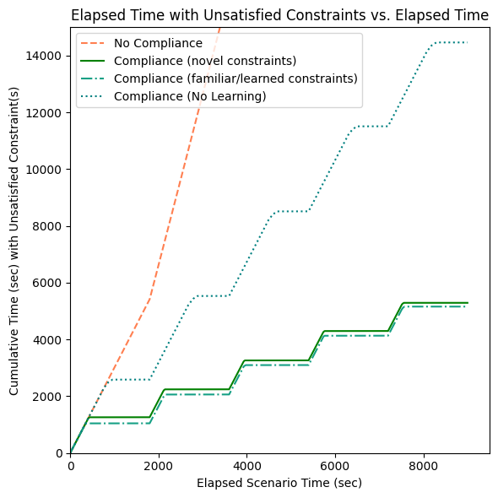
Evaluation: Costs of Partial Grounding
Notes:
If moments matter, then you care about the difference between the two bottom lines. If they don’t, the anticipatory processing is not as critical.

